Slide 1

Geometry and the Coordinate Plane
Grade 5: Unit 7
Standards addressed: 5.G.A.1, 5.G.B.3, 5.G.B.4, 5.G.A.2, 5.NBT.B.7, 5.OA.A.2, 5.OA.B.3
These slides have been created by Britnee Wright- Southeast Arkansas Education Cooperative and are not official IM materials. Images and language are taken from IM Grade 5, Unit 7 by Illustrative Mathematics.
Copyright 2020 by Illustrative Mathematics. All Rights Reserved, adapted and shared with permission.

Slide 2
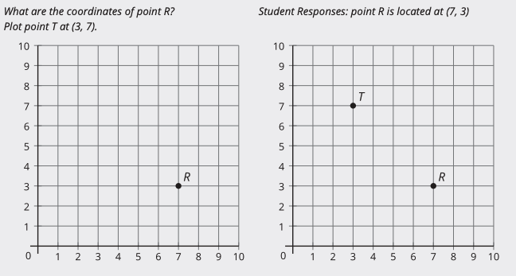
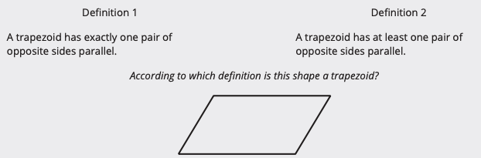
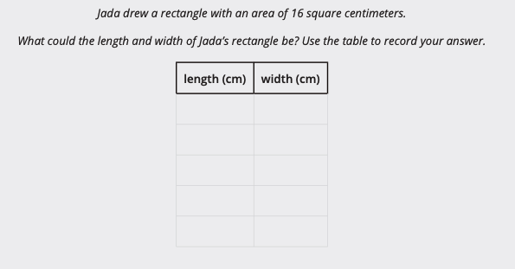
Unit 7 Progression Overview
Section A
Lessons 1-3
5.G.A.1
Section B
Lessons 4-8
5.G.B, 5.G.B.3, 5.G.B.4
Section C
Lessons 9-13
5.G.A.2, 5.NBT.B.7, 5.OA.A.2, 5.OA.B.3
Locate points on a coordinate grid.
Classify triangles and quadrilaterals in a hierarchy based on angle measurements and side lengths.
Generate, identify, and graph relationships between corresponding terms in two patterns, given a rule.
Represent and interpret real world and mathematical problems on a coordinate grid.

Slide 3



Unit 7 Quick Links
L1
L2
L3
Adapt 1
Adapt 2
Adapt 3
L4
L5
L6
L7
L8
L9
L10
L11
L12
L13

Slide 4
Explore the Coordinate Grid
1
Let’s explore the coordinate grid.
5.G.A.1

Slide 5
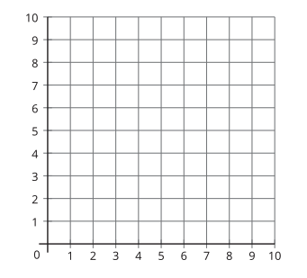
Notice and Wonder: The Grid
Warm up
What do you notice?
What do you wonder?

Slide 6

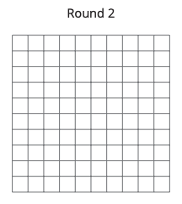
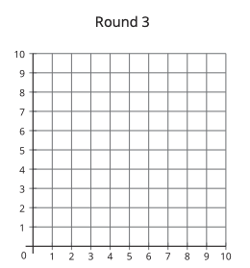
Can You Draw It:
Shapes on the Coordinate Grid
Activity #1
1. Play three rounds of Draw My Shape using the three sets of cards from your teacher.
For each round:
Partner A chooses a card—without showing the other person—and describes the shape on the card.
Partner B draws the shape as described.
Partner A reveals the card and partner B reveals the drawing.
Compare the shapes and discuss: What’s the same? What’s different?
2. Look at partner B's drawings for each round. When does partner B's drawing look most like the shape on the card? Explain why you think that is so.

Slide 7
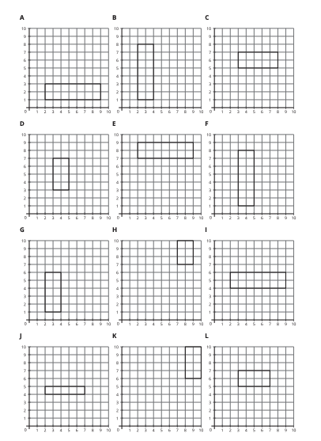

Guess Who:
Shapes on the Coordinate Grid
Activity #2
1. Play a round of Guess Which One.
Sit next to your partner and lay the shape cards out in front of both of you.
Partner A: Mentally choose a shape card without indicating which shape card you chose.
Partner B: Ask yes or no questions to determine which shape card partner A has chosen.

Slide 8
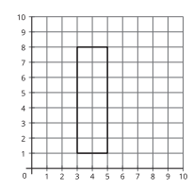
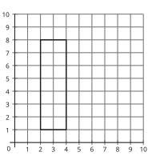
Guess Who:
Shapes on the Coordinate Grid
Activity #2
2. Switch roles and play another round of Guess Which One.
3. Diego and Kiran were playing a round of Guess Which One. These are the last two shapes. What question can Kiran ask to determine which shape is the one that Diego picked?

Slide 9
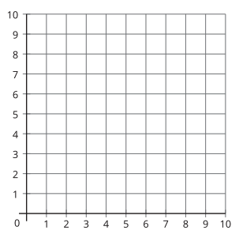

Lesson Synthesis
This was the image from our warm-up. What did we learn about it?

Slide 10
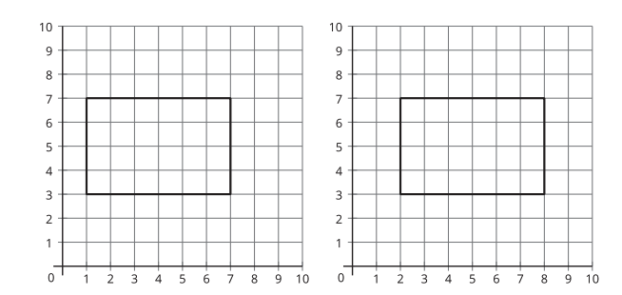
Lesson Synthesis
If you were playing the game Guess Which One and these were the last two cards, what question could you ask to determine which rectangle your partner had chosen?

Slide 11
Points on the
Coordinate Grid
2
Let’s convert units.
5.MD.A.1, 5.NBT.A.2

Slide 12
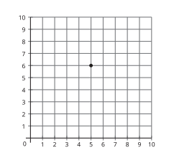
Notice and Wonder: The Grid
Warm up
What do you notice?
What do you wonder?

Slide 13
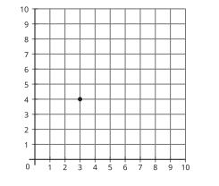
What’s the Point?
Activity #1
1. Play 2 rounds of What’s the Point so each partner gets a chance to draw.
Sit back to back with your partner.
Partner A: Choose a card. Then, describe the location of the point to your partner.
Partner B: Draw the point on the blank coordinate grid.
Compare the card with your partner’s diagram.
Discuss: What’s the same? What’s different?
2. Use words to describe the location of the point on the grid.

Slide 14

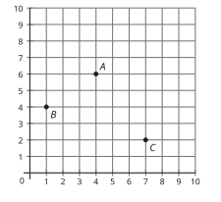

Plot and Label Points
Activity #2
1. List the coordinates for each point.
2. Plot points D, E, F on the same grid.

Slide 15
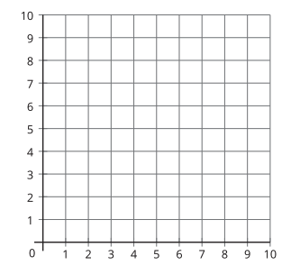
Lesson Synthesis
(4, 7) and (7, 4)
How do we plot each of these coordinate pairs?
What do we know about these points?
What information can we add to the chart about coordinate grids?

Slide 16
Plot More Points
3
Let’s locate and name points on the coordinate grid.
5.G.A.1

Slide 17
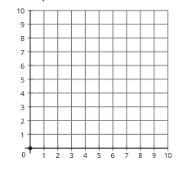
Notice and Wonder: The Origin
Warm up
What do you notice?
What do you wonder?

Slide 18
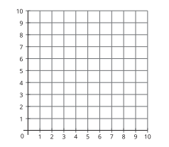
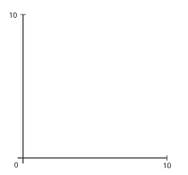
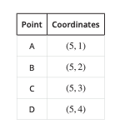
What’s the Point?
Activity #1
Partner A:
1. Estimate the location of each point.
2. Plot and label the points on the coordinate grid.
3. What do the points have in common?
4. Plot the point with coordinates (5, 0) on the coordinate grid.

Slide 19
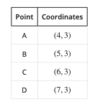
What’s the Point?
Activity #1
Partner B: :
1. Estimate the location of each point.
2. Plot and label the points on the coordinate grid.
3. What do the points have in common?
4. Plot the point with coordinates (0, 3) on the coordinate grid.

Slide 20
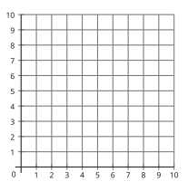
What is Missing?
Activity #2
1. Where might this point be located on the coordinate grid? ( 7, ?)
2. Where could it not be located?
3. List some numbers that might go in the blank.
( 7, __)
( 7, __)
( 7, __)
( 7, __)

Slide 21
What is Missing?
Activity #2
4. Where might this point be located on the coordinate grid? ( ? , 0)
5. List some numbers that might go in the blank
( __ , 0)
( __ , 0)
( __ , 0)
( __ , 0)

Slide 22
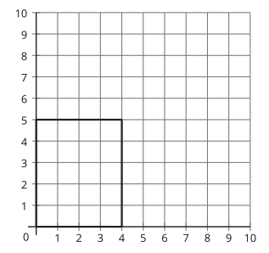
Lesson Synthesis
In the beginning of this section, we described the location of rectangles on a coordinate grid. How can we describe this rectangle?
What are the coordinates of the 4 vertices of the rectangle?
In the next section, we will be exploring rectangles and other quadrilaterals.

Slide 23
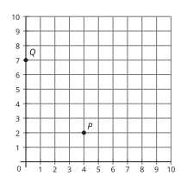
Section Summary
In this section, we plotted and described points on the coordinate grid.
The point P is 4 units from the vertical axis and 2 units from the horizontal axis. Its coordinates are ( 4, 2) . The point Q is 0 units from the vertical axis since it is on the vertical axis. It is 7 units from the horizontal axis. Its coordinates are ( 0 , 7) .
The first coordinate of a point tells us its horizontal position and the second coordinate gives its vertical position.

Slide 24
Ways of Looking at Figures
Adaptation
Lesson 1
Let’s sort two-dimensional figures.
4.G.A.2

Slide 25
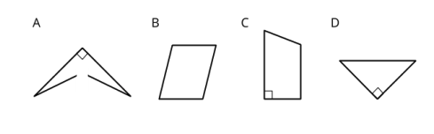
Which One Doesn’t Belong: Geometric Figures
Warm up
Which one doesn’t belong?

Slide 26
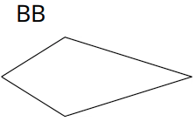
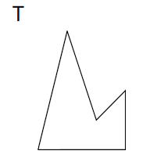
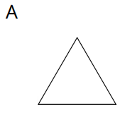
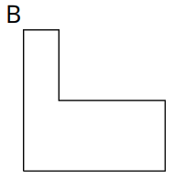
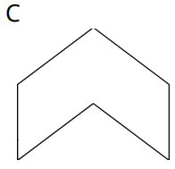
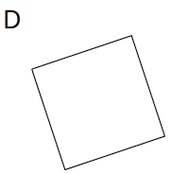
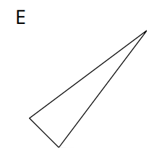
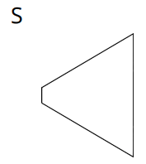
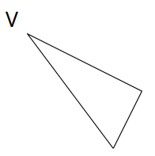
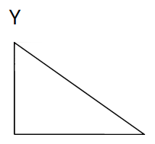
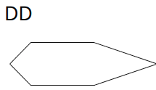
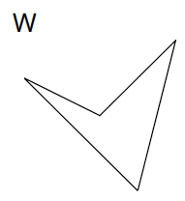
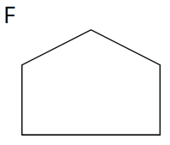
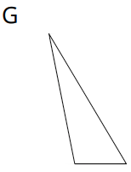
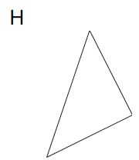
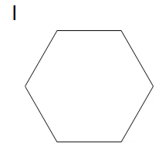
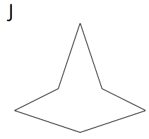
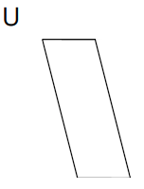
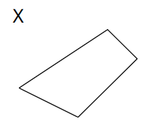
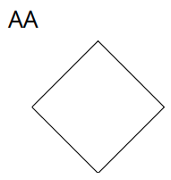
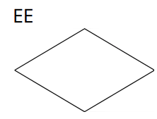
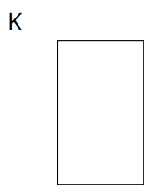
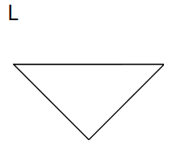
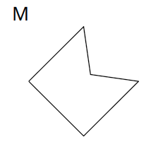
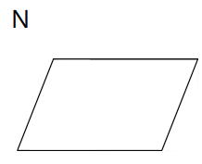
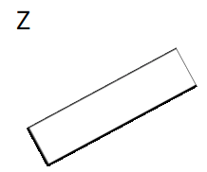










Card Sort: Grouping Figures
Activity #1
1. Sort the figures from your teacher into 3–5 categories. For each category, write a title on a sticky note.

Slide 27
Card Sort: Grouping Figures
Activity #1
2. Share your categories with another group. Take turns listening to each other’s explanations.
○ Do your categories make sense to them?
○ Do their categories make sense to you?
○ Any suggestions or corrections?
3. Cover or hide the titles of your categories. Trade places with another group—study their sorted cards while they study yours. Can you guess their categories and how they sorted the figures?

Slide 28

Guess the Category
Activity #2
Partner A:
● Write down a category from the first activity (or think of a new one). Don’t show it to your partner.
● Find 3 figures that fit the category and 3 figures that don’t. Place them in the columns of the table.
Partner B:
● Study the figures chosen by your partner.
● Pick another figure from the set. Ask: “Does this figure fit in your category?”
● Find 2 figures that fit the category and 2 figures that don’t.
● Guess the category. If your guess is off, ask more questions before guessing again.
Switch roles after the category is guessed correctly.
● Partner A’s category: __________________
● Partner B’s category: __________________

Slide 29
Lesson Synthesis
Today we sorted figures based on the different attributes or properties they have. We learned we can classify or group two-dimensional figures a variety of ways.
What are some ways to group using the sides of the figures?
Besides sides and angles, what other attributes were used to classify the figures?
Let’s continue to add new vocabulary to our word walls from the last unit. Take 1–2 minutes to add any new words from today’s lesson to your word walls.
What are some ways to group using the angles in the figures?
Notes:
We will continue to think about different attributes of two-dimensional figures and how they could help us better understand the figures.

Slide 30
Ways of Looking at Triangles
Adaptation
Lesson 2
Let’s sort and analyze triangles.
4.G.A.2

Slide 31

Warm up
Number Talk:
Sums and Products
Find the value of each expression mentally.

Slide 32

Warm up
Number Talk:
Sums and Products
Find the value of each expression mentally.

Slide 33

Warm up
Number Talk:
Sums and Products
Find the value of each expression mentally.

Slide 34

Warm up
Number Talk:
Sums and Products
Find the value of each expression mentally.

Slide 35











Activity #1
Triangle Hunt
1. From the set of triangle cards, find all the triangles that have each property.

Slide 36
Activity #1
Triangle Hunt
2. Choose one sentence to complete based on your work.
a. I noticed that some triangles . . .
b. I noticed that all triangles . . .
c. I noticed that no triangles . . .

Slide 37

The Right Kind of Triangle
Activity #2
1. Identify all figures that are right triangles. For each right triangle, mark the right angle with a small square.
2. Explain why the other figures are not right triangles.

Slide 38
Lesson Synthesis
Today we analyzed and identified triangles with different properties.
How can we tell if sides were the same length?
If we classify or group triangles based on side length, what types might we see?
If we classify or group triangles based on side length, what types might we see?
Earlier we identified some right triangles. Which of these statements do you think defines a right triangle: ‘a triangle with one right angle’ or ‘a triangle with one pair of perpendicular sides’?

Slide 39
Ways of Looking at Quadrilaterals
Adaptation
Lesson 3
Let’s sort and identify quadrilaterals.
4.G.A.1, 4.G.A.2

Slide 40

How Many Do You See: Brick Pattern
Warm up
How many bricks have 2 pair of parallel sides?

Slide 41
















Activity #1
Quadrilateral Hunt
1. Find the figures that have each of the following properties. List the letter names.

Slide 42
Activity #1
Quadrilateral Hunt
2. Choose one sentence to complete based on your work.
a. I noticed some quadrilaterals . . .
b. I noticed that all quadrilaterals . . .
c. I noticed that no quadrilaterals . . .

Slide 43




What’s True about These Quadrilaterals?
Activity #2
Here are four sets of quadrilaterals. In the space on the next page, write 4–5 statements about the sides and angles of the figures in each set. Each statement must be true for all the figures in the set.
Figures D and AA are squares.
Figures K, Z, and AA are rectangles.
Figures N, U, and Z are parallelograms.
Figures N, U, and Z are rhombuses.

Slide 44
What’s True about These Quadrilaterals?
Activity #2
Here are four sets of quadrilaterals. In the space on the next page, write 4–5 statements about the sides and angles of the figures in each set. Each statement must be true for all the figures in the set.
square | Rectangle
rhombus | Parallelogram

Slide 45

Guess Again
Activity #3
Partner A:
● Write down a property that a quadrilateral could have. Don’t show it to your partner.
● Find 3 quadrilaterals that have that property and 3 that don’t. Place them in the columns of the table.
Partner B:
● Study the quadrilaterals chosen by your partner.
● Pick another quadrilateral from the set. Ask: “Does this quadrilateral fit in your property?”
● Find at least 1 quadrilateral that fits the property and 1 that doesn’t.
● Guess the property. If your guess is off, ask more questions before guessing again.
Switch roles after the property is guessed correctly.
● Partner A’s property: _____________
● Partner B’s property: _____________

Slide 46

Lesson Synthesis
Today we looked closely at quadrilaterals and identified ones whose sides and angles have certain attributes or properties.
What properties do they not share?
What properties do these quadrilaterals share?
What can we say about parallel sides in quadrilaterals?

Slide 47
Sort Quadrilaterals
4
Let’s sort quadrilaterals.
5.G.B.3, 5.G.B.4

Slide 48

What Do You Know About….
Warm up

Slide 49

Guess Who?
Activity #1
1. Play a round of Guess Who
Partner A: Select one of the quadrilaterals. Do not reveal it to your partner.
Partner B: Ask “yes” or “no” questions to guess which shape your partner picked. Between each question, cross out or remove the quadrilaterals based on your partner’s answers.

Slide 50

Guess Who?
Activity #1
2. Han and Mai were playing the same game. These are the last two shapes.
What question can Mai ask to determine which shape is the one that Han picked?

Slide 51

















Card Sort: Quadrilaterals
Activity #2
Your teacher will give you a set of cards.
1. Sort all of the quadrilateral cards in a way that makes sense to you.
Name the categories in this sort.

Slide 52
Card Sort: Quadrilaterals
Activity #2
Your teacher will give you a set of cards.
2. Sort the quadrilateral cards in a different way and name each of the categories in this sort.

Slide 53

Today, we sorted quadrilaterals based on their properties.
Lesson Synthesis
Which of these shapes are most alike? Why?
What are some categories of shapes that fall under quadrilaterals?
Which of these shapes are most different? Why?

Slide 54
Trapezoids
5
Let’s explore trapezoids.
5.G.B.4

Slide 55

What Do You Know About….
Warm up

Slide 56


What’s a Trapezoid?
Activity #1
1. Draw a trapezoid. Label your coordinates.
2. Is it a square? Rectangle? Rhombus? Parallelogram? Explain or show using the coordinate grid.
3. Describe a trapezoid in your own words. Compare your definition with a partner.
4. Is this shape a trapezoid according to your definition? Explain your reasoning.

Slide 57


Two Definitions of a Trapezoid
Activity #2
Which statements go with the first definition?
Which statements go with the second definition?
Explain or show your reasoning.
1. All parallelograms are trapezoids.
2. No parallelograms are trapezoids.
3. All trapezoids are parallelograms.
4. Some trapezoids are parallelograms.
5. No trapezoids are parallelograms.

Slide 58


What do you know about trapezoids now?
Lesson Synthesis
Where would these shapes go in the diagram?
Turn and talk: Which of these shapes are trapezoids? Explain your reasoning

Slide 59
Hierarchy of Quadrilaterals
6
Let’s explore the hierarchy of quadrilaterals.
5.G.B.3, 5.G.B.4

Slide 60

Notice and Wonder:
Squares and Rhombuses
Warm up
What do you notice?
What do you wonder?

Slide 61


Shapes with Toothpicks
Activity #1
1. Build a square with your toothpicks. How do you know it is a square?
2. Use the same four toothpicks to build this shape. What stayed the same? What changed?
3. Build a rectangle with six toothpicks. How do you know it is a rectangle?
4. Use the same six toothpicks to build this shape. What stayed the same? What changed?

Slide 62

Three Quadrilaterals
Activity #2
1. Draw 3 different quadrilaterals on the grid, making sure at least one of them is a parallelogram.
2. For each of your quadrilaterals determine if it is a:
square
rhombus
rectangle
parallelogram
Explain or show your reasoning.
3. Draw a rhombus that is not a square. Show or explain how you know it is a rhombus but not a square.
4. Draw a rhombus that is a square. Show or explain how you know it is a rhombus and a square.
5. Diego says that it is impossible to draw a square that is not a rhombus. Do you agree with him? Show or explain your reasoning.

Slide 63

Lesson Synthesis
Turn and talk: What makes a square a rhombus?
How does this diagram show that a square is a rhombus and a parallelogram?

Slide 64
Rectangles and Squares
7
Let’s learn more about rectangles and squares.
5.G.B.3, 5.G.B.4

Slide 65

What Do You Know About….
Warm up
What do you know about this shape?

Slide 66






Quadrilateral Clues
Activity #1
Spread out your shape cards so you and your partner can see all of them.
1. Work together to find a shape that fits each clue. If you don’t think it is possible to find that shape, explain why. You can only use each shape one time.
a. Find a quadrilateral that is not a parallelogram.
b. Find a rhombus that is also a square.
c. Find a rhombus that is not a square.
d. Find a trapezoid that is not a rectangle.
e. Find a rectangle that is not a square.
f. Find a parallelogram that is not a rectangle.
2. Elena is looking for a square that is not a rectangle. Explain why this is not possible.

Slide 67
Always, Sometimes, Never
Activity #2
Make each statement true by filling in the blanks with always, sometimes, or never.
For each statement that is completed with “sometimes,” draw and describe a figure for which the statement is true and another figure for which the statement is not true.
1. A rhombus is ______________ a square.
2. A square is _____________ a rhombus.
3. A triangle is ___________a quadrilateral.
4. A square is ____________ a rectangle.
5. A rectangle __________ a parallelogram.
6. A parallelogram is ________a rhombus.
7. A trapezoid is ________ a parallelogram.

Slide 68

Lesson Synthesis
Earlier in the warm up we saw this shape.
We said this is called a square because . . .” Include statements students made earlier in the warm up. “What do you now know about this shape?
Why is a square also a rectangle?
Why is a square also a rhombus?
If a shape is a rectangle, is it also a square?

Slide 69
Sort Triangles
8
Let’s sort triangles.
5.G.B, 5.G.B.3, 5.G.B.4

Slide 70

Which One Doesn’t Belong: Triangles
Warm up
Which one doesn’t belong?

Slide 71

The Right Fit
Activity #1
1. Find a triangle card that fits in each space on the grid.
2. If you don’t think it is possible to find a triangle that fits certain criteria, explain why not.

Slide 72

All, Some, None
Activity #2
1. Use the triangle cards from activity 1.
2. For the triangles with 90 degree angles, write statements about each category.

Slide 73
Lesson Synthesis
How is classifying triangles the same as classifying quadrilaterals?
Based on what you know about triangles, how can we categorize or sort triangles?

Slide 74
Section Summary
In this section we sorted and analyzed different kinds of quadrilaterals and triangles. We described their properties. For example:
A rectangle is a quadrilateral with 4 right angles.
A rhombus is a quadrilateral with 4 equal sides.
A square is a quadrilateral with 4 right angles and 4 equal sides.
We also described how the shapes are related to each other. For example, we can see that a square is always a rhombus because it has the property of a rhombus. A square is also always a rectangle because it has the property of a rectangle. On the other hand, a rectangle does not need to be a square because its side lengths don't have to all be the same. And a rhombus does not need to be a square because its angles do not have to be right angles.

Slide 75
Generate Patterns
9
Let’s explore rules and patterns.
5.OA.B.3

Slide 76
Choral Count: Two Patterns
Warm up
What patterns do you notice?
Count by 6, starting at 0.
Record as students count.
Stop counting and recording at 60.

Slide 77

What’s the Pattern?
Activity #1
1. Jada and Priya are creating rules for patterns. Follow each rule to complete each pattern:
2. If Jada and Priya kept their patterns going, what number will be in Priya's box when Jada's box shows:
a. 40
b. 60
3. What relationship do you notice between the numbers in Priya's boxes and the numbers in Jada's boxes?
4. If Jada and Priya keep their patterns going, what number will be in Jada’s box when Priya’s box shows 192?

Slide 78

More Patterns
Activity #2
Partner A
1. Jada and Priya are creating rules for patterns. Use each rule to generate a pattern.
2. If Jada and Priya kept their patterns going:
a. What number will be in Priya’s box when Jada’s box shows 34? Explain your thinking.
b. What number will be in Jada’s box when Priya’s box shows 120? Explain your thinking.
3. What relationship do you notice between the numbers in Priya's pattern and the numbers in Jada's pattern?

Slide 79

More Patterns
Activity #2
Partner B
4. Jada and Priya are creating rules for patterns. Use each rule to generate a pattern.
5. If Jada and Priya kept their patterns going,
a. What number will be in Priya’s box when Jada’s box shows 54? Explain your thinking.
b. What number will be in Jada’s box when Priya’s box shows 198? Explain your thinking.
6. What relationship do you notice between the numbers in Priya’s pattern and the numbers in Jada’s pattern?

Slide 80

Lesson Synthesis
Today we generated patterns and recognized relationships between two different patterns.
Explain to your partner why these relationships will continue if the patterns continue.
What relationships do you notice between the patterns in each of the counts?

Slide 81
Interpret Relationships
10
Let’s find relationships between patterns.
5.OA.B.3

Slide 82

True or False:
Multiply and Divide
Warm up
Decide whether each statement is true or false.
Be prepared to explain your reasoning.

Slide 83

True or False:
Multiply and Divide
Warm up
Decide whether each statement is true or false.
Be prepared to explain your reasoning.

Slide 84

True or False:
Multiply and Divide
Warm up
Decide whether each statement is true or false.
Be prepared to explain your reasoning.

Slide 85



Mix and Match: 3 Patterns
Activity #1
1. Complete the patterns for each set of rules.
2. What are some relationships between the patterns in each set of rules? Be prepared to explain your thinking.
Set A
Set B
Set C

Slide 86



Generate Patterns
Activity #2
Partner A
Rule 1: Start with 0. Add 4.
Rule 2: Start with 0. Add 6.
2. Compare your patterns. What relationships do you notice?
3. What number will be in pattern 2 when the number in the pattern 1 box is 40?
4. What number will be in pattern 1 when the number in the pattern 2 box is 120?

Slide 87



Generate Patterns
Activity #2
Partner B
Rule 1: Start with 0. Add 2.
Rule 2: Start with 0. Add 3.
6. Compare your patterns. What relationships do you notice?
7. What number will be in pattern 2 when the number in the pattern 1 box is 30?
8. What number will be in pattern 1 when the number in the pattern 2 box is 60?

Slide 88
Lesson Synthesis
Today we noticed and explained relationships between patterns. Some of the relationships involved fractions.
Describe how you can use a relationship between two patterns to predict what numbers will be in a pattern.
What relationships did you find between the patterns we studied today?

Slide 89
Patterns and
Ordered Pairs
11
Let’s graph patterns on the coordinate grid.
5.OA.B.3

Slide 90

Notice and Wonder:
The Coordinate Grid
Warm up
What do you notice?
What do you wonder?

Slide 91


Patterns on the Coordinate Grid, Part 1
Activity #1
Partner A
Rule 1: Start at 0. Add 8.
Rule 2: Start at 0. Add 2.
1. Use the rules to complete the table.
2. Which point in the table represents the point on the coordinate grid? Label the point with the appropriate letter on the grid.
3. Plot and label the rest of the points.

Slide 92

Patterns on the Coordinate Grid, Part 1
Activity #1
Partner B
Rule 1: Start at 0. Add 10.
Rule 2: Start at 0. Add 40.
1. Use the rules to complete the table.
2. Which point on the table represents the point on the coordinate grid? Label the point with the appropriate letter on the grid.
3. Plot and label the rest of the points.

Slide 93


Patterns on the Coordinate Grid, Part 2
Activity #2
1. Use the rules to complete the table.
Rule 1: Priya starts at 0. She continues to count by 2.
Rule 2: Clare starts at 0. She continues to count by 5.
2. What patterns do you notice between the numbers in Priya’s list and Clare’s list?
3. Plot and label the points from the table.
4. What does the point C tell you about Clare’s and Priya’s counts?

Slide 94
Lesson Synthesis
Today, we plotted rules on a coordinate grid and noticed patterns.
How is looking at relationships between patterns in a table the same as looking at relationships between patterns on a coordinate grid? How is it different?

Slide 95
Represent Problems on the Coordinate Grid
12
Let’s represent problems on the coordinate grid.
5.G.A.2, 5.OA.A.2

Slide 96

True or False:
Addition and Multiplication
Warm up
Decide whether each statement is true or false.
Be prepared to explain your reasoning.

Slide 97

True or False:
Addition and Multiplication
Warm up
Decide whether each statement is true or false.
Be prepared to explain your reasoning.

Slide 98

True or False:
Addition and Multiplication
Warm up
Decide whether each statement is true or false.
Be prepared to explain your reasoning.

Slide 99

Heads or Tails
Activity #1
Han and Jada flipped a penny several times and counted how many times it came up heads and how many times it came up tails. Their overall results are plotted on the graph.
1. How many heads did Jada get? How many tails did Jada get? Show or explain how you know.
2. How many heads did Han get? How many tails did Han get? Show or explain how you know.
3. Flip the coin 10 times and record how many heads and tails you get. Plot the point in the coordinate grid representing your coin flips.
4. How many heads and tails did your partner get? Show or explain how you know.
5. Do any of the points you plotted lie on the horizontal axis? What would a point on the horizontal axis mean in this situation?
6. If time allows, toss the coin 10 more times and record your and your partner’s results in the coordinate grid.

Slide 100

Coin Values
Activity #2
The graph shows the number and value of coins some students had with them.
1. Tyler has 1 dime, 3 nickels, and 2 pennies. Plot and label a point representing Tyler on the grid.
2. Lin has 3 quarters, 1 dime, and 1 penny. Plot and label a point representing Lin on the grid.
3. Diego has 1 quarter and 1 dime. Which point represents Diego? Explain how you know.
4. Clare has 5 coins and does not have a quarter. Which point represents Clare? Which coins does Clare have?

Slide 101

Lesson Synthesis
Today we represented real world and mathematical problems by graphing points in the first quadrant of the coordinate grid and interpreted the points.
Jada says both she and Han flipped the coin 9 times. Do you agree with her? Explain your reasoning
Which point on the graph represents the most heads?
Han says point A means 6 heads and 4 tails were flipped. Do you agree with him? Explain your reasoning.

Slide 102
Perimeter and Area of Rectangles
13
Let’s explore the perimeter and area of rectangles on the coordinate grid.
5.G.A.2, 5.NBT.B.7, 5.OA.B.3

Slide 103

Estimation Exploration:
Window Washing
Warm up
What is the area of one window?
Record an estimate that is:
Too low | About right | Too high

Slide 104


Rectangle Perimeters
Activity #1
1. Jada drew a rectangle with perimeter 12 centimeters. What could the length and width of Jada’s rectangle be? Use the table to record your answer.
2. Plot the length and width of each rectangle on the coordinate grid.

Slide 105
Rectangle Perimeters
Activity #1
3. If Jada’s rectangle was 2.5 cm long, how wide was it? Plot this point on the coordinate grid.
4. If Jada’s rectangle was 3.25 cm long, how wide was it? Plot this point on the coordinate grid.
5. If Jada drew a square, how long and wide was it? 6. Tyler draws a rectangle with a perimeter of 45 cm and a width of 5 cm. What is the area of his rectangle?

Slide 106

Rectangle Areas
Activity #2
1. Jada drew a rectangle with area 16 square centimeters. What could the length and width of Jada’s rectangle be? Use the table to record your answer.
2. Plot the length and width of each rectangle on the coordinate grid.

Slide 107
Rectangle Areas
Activity #2
3. l If Jada’s rectangle was 5 cm long, how wide was it? Plot this point on the coordinate grid.
4. If Jada’s rectangle was 3 cm long, how wide was it? Plot this point on the coordinate grid.
5. If Jada drew a square, how long and wide was it? Explain how you know.
6. Tyler draws a rectangle with an area of 15 sq cm and a width of 6 cm. What is the perimeter of Tyler’s rectangle?

Slide 108

Lesson Synthesis
Today we represented real world and mathematical problems by graphing points on the coordinate grid.
This coordinate grid represents information about rectangles A–D. Based on the coordinate grid, what do we know about rectangle C?

Slide 109


Section Summary
In the beginning of the section, we used rules to generate patterns and recognized relationships between two different patterns.
Then, we plotted rules on a coordinate grid and noticed patterns.

Slide 110

Section Summary
Finally, we represented real world and mathematical problems by graphing points on the coordinate grid.

