Slide 1

Measurement Conversions and Fraction Operations
Grade 5: Unit 6
Standards addressed: 5.MD.A.1, 5.NBT.A.1, 5.NBT.A.2, 5.NF.B.6, 5.MD.B.2, 5.NF.A.1, 5.NF.A.2, 5.NF.B.5, 5.OA.A
These slides have been created by Britnee Wright- Southeast Arkansas Education Cooperative and are not official IM materials. Images and language are taken from IM Grade 5, Unit 6 by Illustrative Mathematics.
Copyright 2020 by Illustrative Mathematics. All Rights Reserved, adapted and shared with permission.

Slide 2
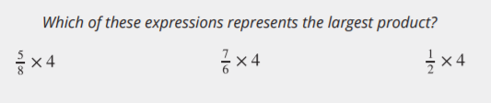
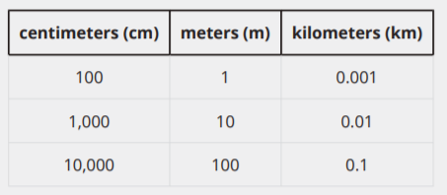
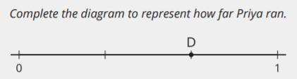
Unit 6 Progression Overview
Section A
Lessons 1-7
5.MD.A.1, 5.NBT.A.1, 5.NBT.A.2, 5.NF.B.6
Section B
Lessons 8-15
5.MD.B.2, 5.NF.A.1, 5.NF.A.2
Section C
Lessons 16-21
5.MD.B.2, 5.NF.A.2, 5.NF.B.5, 5.OA.A
Explain patterns when multiplying and dividing by powers of 10.
Solve multi-step problems involving measurement conversions.
Add and subtract fractions with unlike denominators.
Create line plots to display fractional measurement data, and use the information to solve problems.
Solve problems involving fraction operations.
Interpret multiplication as scaling (resizing).
Make generalizations about multiplying a whole number by a fraction greater than, less than and equal to 1.

Slide 3



Unit 6 Quick Links
L1
L2
L3
L4
L5
L6
L7
Adapt 1
Adapt 2
Adapt 3
L8
L9
L10
L11
L12
L13
L14
L15
L16
L17
L18
L19
L20
L21

Slide 4
Patterns of Ten
1
Let's notice patterns in measurements.
5.MD.A.1, 5.NBT.A.1, 5.NBT.A.2

Slide 5

Number Talk
Warm up
Find the value of each expression mentally.

Slide 6
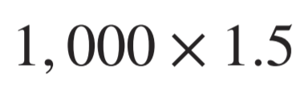
Number Talk
Warm up
Find the value of each expression mentally.

Slide 7
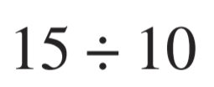
Number Talk
Warm up
Find the value of each expression mentally.

Slide 8
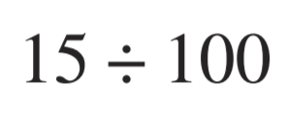
Number Talk
Warm up
Find the value of each expression mentally.

Slide 9
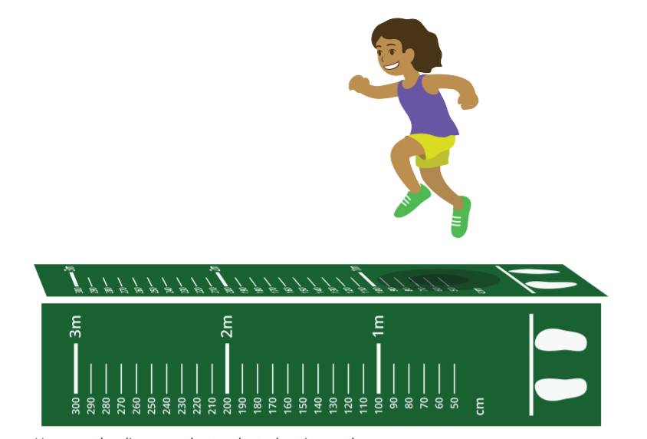
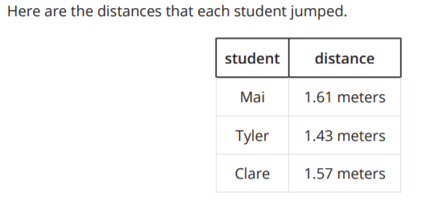
Broad Jump
Activity #1
1. The average standing broad jump distance for 5th graders is 148 centimeters. Are each of the students in the table below, at, or above the average? Explain or show your reasoning.
2. The world record for the standing broad jump is 337 centimeters. Jada says that's more than Mai and Clare jumped combined. Do you agree with Jada? Explain or show your reasoning.

Slide 10
Broad Jump
Activity #1
3. Tyler says his jump sounds more impressive if he reports it in millimeters.
a. How far is Tyler's jump in millimeters? What about Mai’s and Clare's jumps?
b. Does the order of the jumps depend on the unit they are reported in?
c. Which unit do you think is best for reporting the jumps? Explain your reasoning

Slide 11
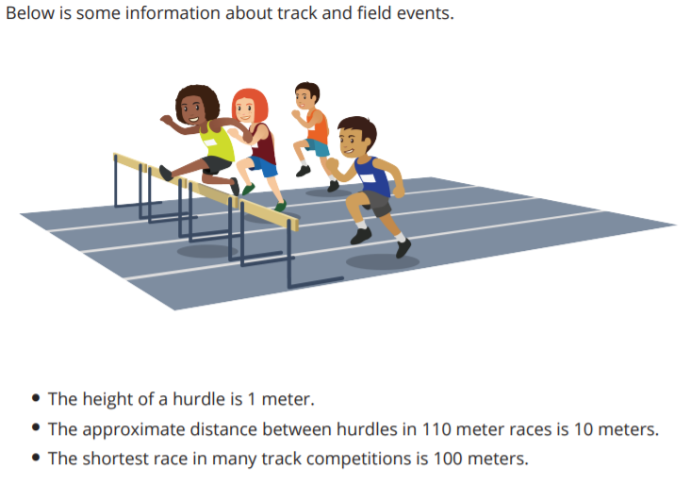
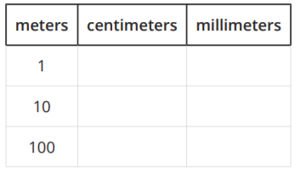
How Tall? How Long? How Far?
Activity #2
1. Complete the table.
2. What patterns do you notice in the table?

Slide 12
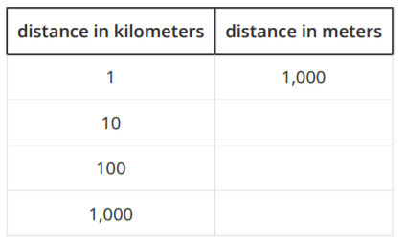
How Tall? How Long? How Far?
Activity #2
3. Three long-distance races are 10 kilometers, 100 kilometers, and 1,000 kilometers. How many meters are there in these races?
4. What patterns do you notice in the table?

Slide 13
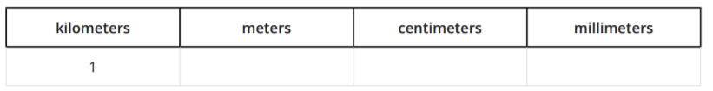

Lesson Synthesis
Today we converted between metric units to express distances related to track events in different ways.
How many centimeters is that?
Jada ran 1 kilometer. How many meters is that?
How many millimeters is that?

Slide 14
Metric Conversion and Division by Powers of 10
2
Let’s convert units.
5.MD.A.1, 5.NBT.A.2

Slide 15

True or False:
Divide by a Hundred and a Thousand
Warm up
Decide whether each statement is true or false.

Slide 16
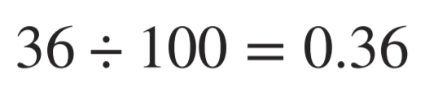
True or False:
Divide by a Hundred and a Thousand
Warm up
Decide whether each statement is true or false.

Slide 17
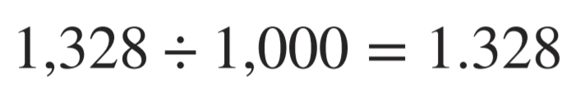
True or False:
Divide by a Hundred and a Thousand
Warm up
Decide whether each statement is true or false.

Slide 18
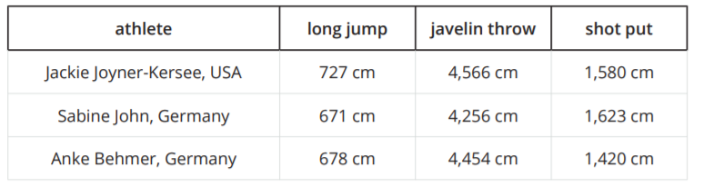
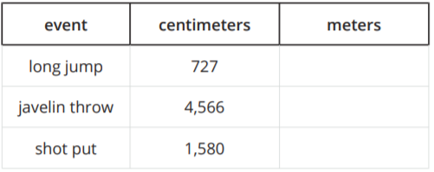
Long Jump, Javelin Throw, and Shot Put
Activity #1
1. Below are some results Jackie Joyner-Kersee recorded in different heptathlon events in 1988. Complete the table.

Slide 19
Long Jump, Javelin Throw, and Shot Put
Activity #1
2. Which unit of measure helps you picture the distance, centimeters or meters? Explain your reasoning.
3. Why do you think that the distances are measured to the nearest centimeter?

Slide 20
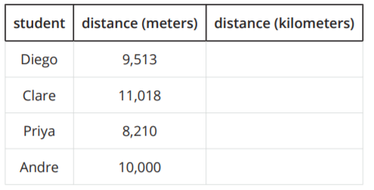
Hurdles
Activity #2
1. The table shows how many meters some students ran during a week. Complete the table to show how many kilometers each student ran
2. What patterns do you notice in the table?

Slide 21
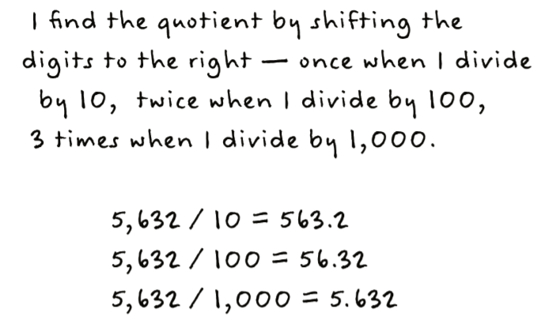
Hurdles
Activity #2
3. Below is Tyler’s strategy to divide a whole number by 10, 100, or 1,000.
Describe to your partner what Tyler means.

Slide 22
Hurdles
Activity #2
4. Why does Tyler’s strategy work? Will Tyler’s strategy always work? Show or explain your reasoning.

Slide 23
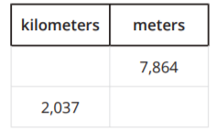
Today we converted from smaller metric measurements to larger metric measurements. We noticed and explained patterns when dividing by 10, 100, and 1,000
Lesson Synthesis
How is converting from smaller millimeters to larger meters different from converting from larger meters to smaller millimeters?
What are the missing values in the table? How do you know?

Slide 24
Write Powers of 10 with Exponents
3
Let's use exponents.
5.NBT.A.1, 5.NBT.A.2

Slide 25
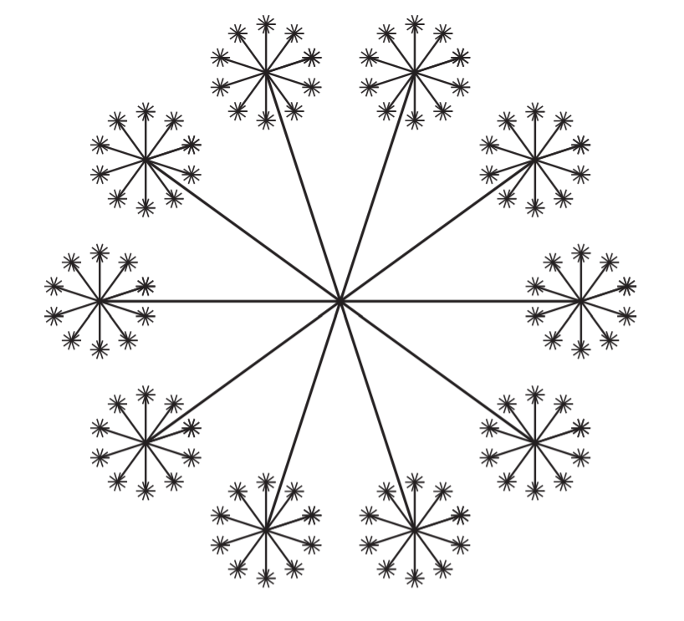
How Many Do You See:
Starburst
Warm up
How many do you see?
How do you see them?

Slide 26
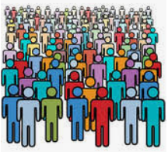
Population of Delaware and India
Activity #1
1. About 1,000,000 people live in Delaware.
a. How do you say this number?
b. How many thousands is this? Explain or show your reasoning.
c. Write the number using powers of 10.
d. How many times would you need to extend the diagram from the warm-up to get 1,000,000 tiny segments? Explain or show your reasoning

Slide 27
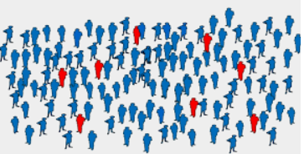
Population of Delaware and India
Activity #1
2. In 1997, the population of India was about 1,000,000,000.
a. How would you say this number?
b. How many millions is this? How many thousands is it? Explain or show your reasoning.
c. Write the number using powers of 10.
d. How many times would you need to extend the diagram from the warm-up to get 1,000,000 tiny segments? Explain or show your reasoning.

Slide 28
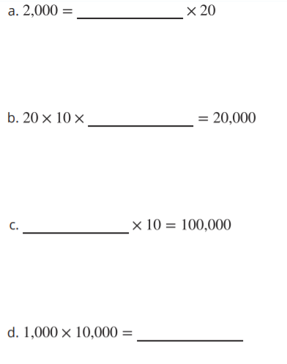

Powers of 10
Activity #2
1. Find the missing number that makes each equation true. Show your reasoning.
2. How were products of 10s useful in solving these problems?
3. Write each power of 10 as a number.

Slide 29
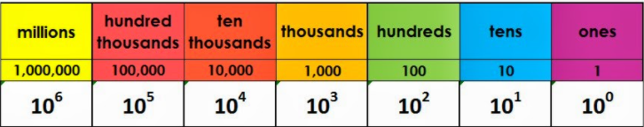
Beyond a Billion
Activity #3
1. How would you say the number 1,000,000,000,000?
2. How many billions is that? How many millions is it? Explain or show your reasoning.
3. Write the number using powers of 10.
4. Describe an example of something that there are 1,000,000,000,000 of in the world.

Slide 30
Today we looked at some really big numbers that are powers of 10 and represented them using powers of 10.
Lesson Synthesis
How many of the medium sized segments are there?
Where do we see this expression in the representation?

Slide 31


Today we looked at some really big numbers that are powers of 10 and represented them using powers of 10.
Lesson Synthesis
We can also represent this expression with a power of ten.
What power of ten can we write to make this equation true

Slide 32
Multi-step Measurement Conversion Problems
4
Let’s solve problems about metric lengths.
5.MD.A.1

Slide 33

True or False:
Powers of 10
Warm up
Decide whether each statement is true or false.

Slide 34
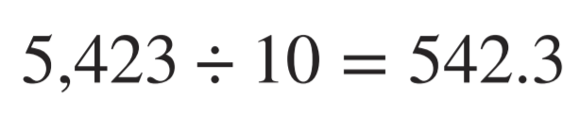
True or False:
Powers of 10
Warm up
Decide whether each statement is true or false.

Slide 35
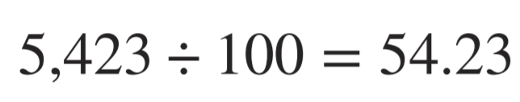
True or False:
Powers of 10
Warm up
Decide whether each statement is true or false.

Slide 36
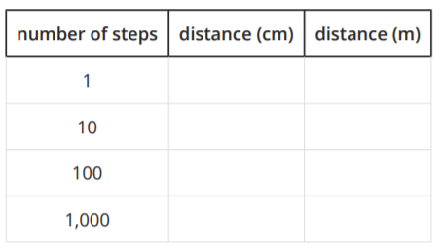
Walk All Day
Activity #1
Each of Andre’s steps is 50 cm. Use this information to fill out the table.
1. Complete the table.
2. What patterns do you notice in the table?
3. Andre lives 1.25 km from school. How many steps is that?
4. One day, Andre made a total of about 8,500 steps. How many km did Andre walk?

Slide 37
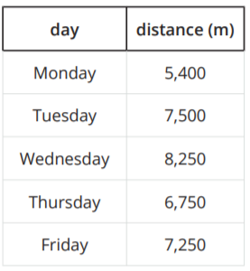
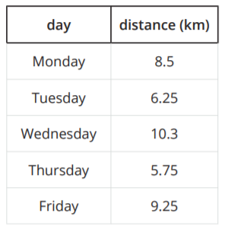
Who Ran Farther?
Activity #2
1. Use the table to find the total distance Tyler ran during the week. Show your reasoning.
2. Use the table to find the total distance Clare ran during the week. Show your reasoning.
3. Who ran farther, Clare or Tyler? How much farther? Explain or show your reasoning.

Slide 38

Today we solved problems and converted length measurements in metric units.
Lesson Synthesis
In order to determine how much farther Clare ran, would you convert Tyler’s distance to meters or Clare’s distance to kilometers? Be prepared to explain your reasoning.
Who ran farther? How do you know?

Slide 39
Convert Liquid Measurement
5
Let’s solve liquid measurement problems.
5.NBT.A.3, 5.NBT.A.3.b

Slide 40
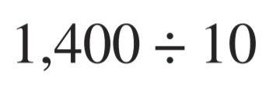
Number Talk
Warm up
Find the value of each expression mentally.

Slide 41
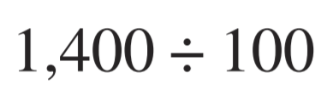
Number Talk
Warm up
Find the value of each expression mentally.

Slide 42
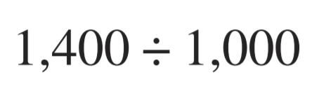
Number Talk
Warm up
Find the value of each expression mentally.

Slide 43
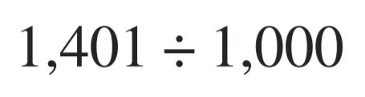
Number Talk
Warm up
Find the value of each expression mentally.

Slide 44
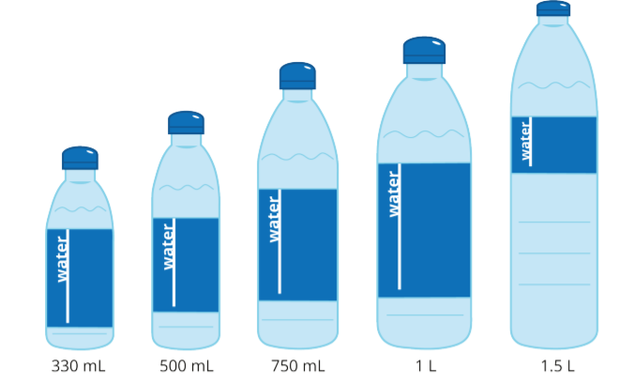
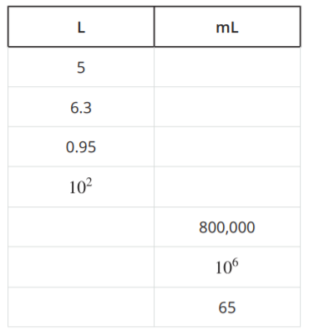
Liquid Volume Conversions
Activity #1
1. Complete the table.

Slide 45
Liquid Volume Conversions
Activity #1
2. Decide if the two measurements are equal. If not, choose which one is greater. Explain or show your reasoning.
a. 15 mL and 0.15 L
b. 2,500 mL and 2.5 L
c. 200 mL and ¼ L
d. 1 mL and 1/1,000 L
e. 15,600 mL and 15.5 L

Slide 46
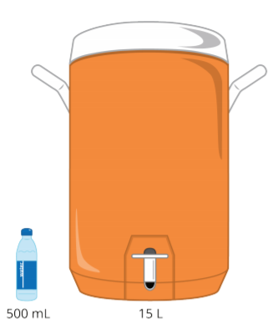
Rehydrating Dancers
Activity #2
There are 25 dancers in the performance group.
During practice, each dancer drinks 1 ½ bottles of water.
2. Each cooler holds 15 L of water. How many coolers does the team need? How much water will they have left over after practice?
1. Each bottle holds 500 mL of water. How many liters of water do the dancers drink?

Slide 47

Rehydrating Dancers
Activity #2
There are 25 dancers in the performance group.
During practice, each dancer drinks 1 ½ bottles of water.
3. The dancers can make a sports drink by mixing 30 mL of drink mix with each 500 mL of water. How many liters of drink mix does the team need for their practice?

Slide 48

Today we converted between liters and milliliters and used these conversions to solve problems.
We saw two ways to solve the water cooler problem.
Lesson Synthesis
Which method do you prefer? Why?

Slide 49
Convert Customary Length Units
6
Let’s solve more measurement problems.
5.MD.A.1

Slide 50
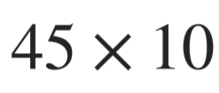
Number Talk: Multiples of 12
Warm up
Find the value of each expression mentally.

Slide 51
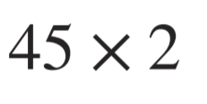
Number Talk: Multiples of 12
Warm up
Find the value of each expression mentally.

Slide 52
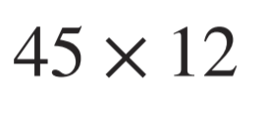
Number Talk: Multiples of 12
Warm up
Find the value of each expression mentally.

Slide 53
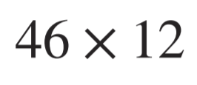
Number Talk: Multiples of 12
Warm up
Find the value of each expression mentally.

Slide 54












Card Sort: Assorted Measurements
Activity #1
1. Your teacher will give you a set of cards that show different measurements. Sort the cards into 2 categories of your choosing. Be prepared to explain the meaning of your categories.

Slide 55
Card Sort: Assorted Measurements
Activity #1
2. Match the cards with the same measurements.
Then list the measurements in increasing order.

Slide 56
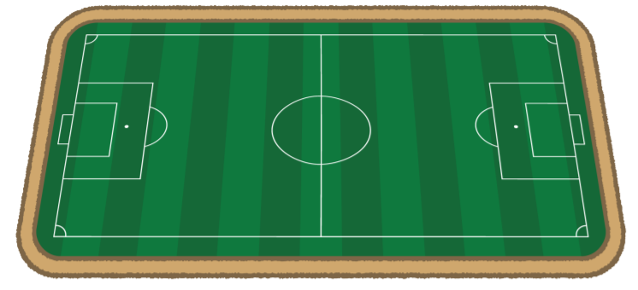
Run a Mile or Two
Activity #2
1. A rectangular field is 90 yards long and 42.25 yards wide. Priya says that 6 laps around the field is more than a mile. Do you agree with Priya? Explain your reasoning.
2. A different rectangular field is 408.5 feet long and 240.25 feet wide. How many laps around this field would Priya need to run if she wants to run at least 2 miles?

Slide 57
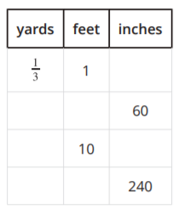
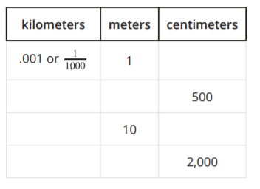
Lesson Synthesis
How are the tables different?
Converting in metric units lets us use our place value system since we multiply and divide by powers of 10. Where do we see this in the table?
Work with a partner to fill out the tables.

Slide 58
More Conversion Problems
7
Let’s solve a multi-step conversion problem.
5.MD.A.1, 5.NF.B.6

Slide 59
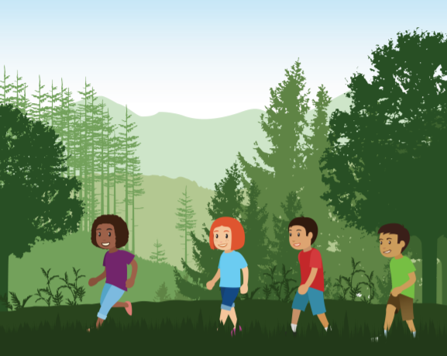
Warm up
Notice and Wonder:
Two Hikers
What do you notice?
What do you wonder?
Clare and Diego are on a hike. Clare drinks 1 ¼ cups of water each hour of a hike and Diego drinks ¾ cup of water every 30 minutes.

Slide 60

Who Drinks More Water?
Activity #1
Clare drinks 1 ¼ cups of water each hour of a hike and Diego drinks ¾ cup of water every 30 minutes.
At the end of 2 hours, who drank more water, Clare or Diego? Show or explain your reasoning.

Slide 61
Will Clare and Diego Run Out of Water?
Activity #2
Diego and Clare are going on a hike. The hike is 6 miles long and it takes them 40 minutes to hike each mile.
Clare drinks 1 ¼ cups of water each hour of the hike and Diego drinks ¾ cup of water each 30 minutes.
Clare and Diego plan to bring 3 quarts of water for the hike. Is this enough?

Slide 62
Lesson Synthesis
Today we solved a multi-step problem that involved converting different units. We converted minutes to hours and cups to quarts. What was challenging about today’s activities? What strategies did you use to work through the challenges?
What was challenging about today’s activities?
What strategies did you use to work through the challenges?

Slide 63
Fractions as Sums
Adaptation
Lesson 1
Let’s write fractions as sums.
3.NF.A.1

Slide 64
Choral Count:
Three-Fourths at a Time
Warm up
Count by ¾ , starting at 0

Slide 65
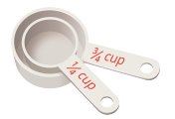
Barley Soup
Activity #1
Lin is learning to make barley soup using a family recipe. Here are some ingredients in the recipe:
¾ cup of barley
5/4 cups of chopped celery
6/4 cups of chopped carrots
1 cup of chopped onions
2 ¼ cups of vegetable broth
1. Lin has only one measuring cup that measures ¼ cup. Show how Lin could use the cup to measure the right amount of each ingredient.
Barley:
Celery:
Carrots:
Onions:
Vegetable broth:

Slide 66
Barley Soup
Activity #1
Lin is learning to make barley soup using a family recipe. Here are some ingredients in the recipe:
¾ cup of barley
5/4 cups of chopped celery
6/4 cups of chopped carrots
1 cup of chopped onions
2 ¼ cups of vegetable broth
2. Lin later found a ¾ -cup measuring cup. Show how she could use the cups to measure the right amount of each ingredient.
Barley:
Celery:
Carrots:
Onions:
Vegetable broth:

Slide 67

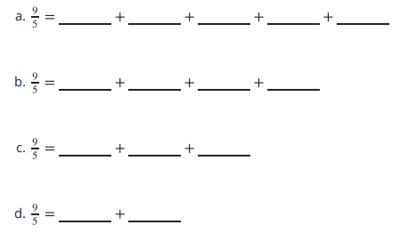

Sums in Fifths and Thirds
Activity #2
1. Use different combinations of fifths to make a sum of 9/5.
2. Write different ways to use thirds to make a sum of 4/3.
How many can you think of? Write an equation for each combination.

Slide 68

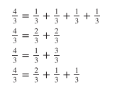
Lesson Synthesis
In earlier lessons, we saw that a fraction whose numerator is greater than 1 can be written as products. Let’s take 4/3, for example.
We can write:
Today, we saw that a fraction whose numerator is greater than 1 can also be seen as sums.
Compare these two ways of thinking about fractions. How are they alike?
How are they different

Slide 69
Addition of Fractions
Adaptation
Lesson 2
Let’s explore sums of fractions on a number line.
4.NF.B.3.a, 4.NF.B.3.b

Slide 70

Warm up
Notice and Wonder:
A Fraction on a Number Line
What do you notice?
What do you wonder?

Slide 71
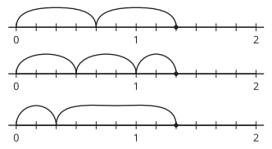

Activity #1
Sum of Jumps
1. Noah draws number lines with a series of “jumps” to show different ways to use sixths to make a sum of 8/6 . He writes 8/6 = 4/6 + 4/6 for the first diagram.
a. Write an equation for each of the other two diagrams.
b. For the following diagram,
Noah writes: 8/6 = 6/6 + 2/6 and 8/6 = 1 + 2/6. Which equation is correct? Explain your reasoning.

Slide 72
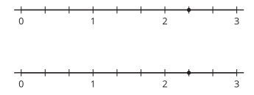
Activity #1
Sum of Jumps
2.
a. Draw "jumps" on the number lines to show two ways to use thirds to make a sum of 7/3 .
Then, represent each combination of jumps as an equation.
b. Write 7/3 as a sum of a whole number and a fraction.

Slide 73
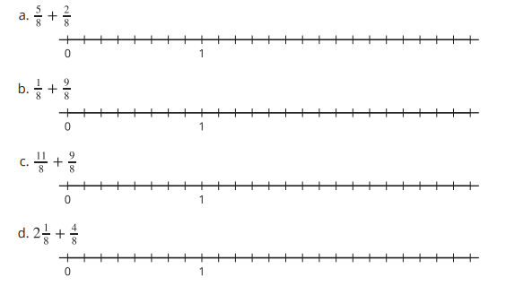

What is the Sum?
Activity #2
1. Use a number line to represent each addition expression and to find the sum.
2. Priya says the sum of 1 ⅖ and ⅘ is 1 6/5 . Kiran says the sum is 11/5 . Tyler says it is 2 ⅕ . Do you agree with any of them? Explain or show your reasoning. Use one or more number lines if you find them helpful.

Slide 74

Make Two Jumps
Activity #3
Here are four number lines,
each with a point on it.
For each number line, label the point. This is your target. Make two forward jumps to get from 0 to the target.
Pick a card from the set given to you. Use the fraction on it for your first jump. Draw the jump and label it with the fraction.
From there, draw the second jump to reach the target. What fraction do you need to add? Label the jump with the fraction.
Write an equation to represent the sum of your two fractions.

Slide 75
Lesson Synthesis
Today, we used number lines to decompose fractions into sums of smaller fractions or sums of a whole number and a fraction. We also learn that a fraction greater than 1 can be written as a mixed number.
Let’s look at some sums you found in the second activity: ⅞ ,10/8 , and 20/8 . Which ones can be written as mixed numbers and why?
How would you explain to a classmate who is absent today what a mixed number is? What examples would you give to help them understand it
What mixed number is equivalent to each of those fractions? How do you know?

Slide 76
Differences of Fractions
Adaptation
Lesson 3
Let’s explore differences of fractions on a number line.
4.NF.B.3.a, 4.NF.B.3.c

Slide 77

What Do You Know About:
Warm up

Slide 78


Activity #1
Differences of Jumps
1. To subtract different fractions from 11/6, Noah draws “jumps” on number lines.
a. The first diagram shows how he finds .
What is the difference (the result of the subtraction)?
b. Write an equation and find the difference for each of Noah’s diagrams.

Slide 79



Activity #1
Differences of Jumps
2. Here is another diagram Noah draws:
Which equations could the diagram represent? Explain your reasoning.
3. Use a number line to show how to find each difference.

Slide 80






What’s the Difference?
Activity #2
Use a number line to represent each subtraction expression and to find the difference.

Slide 81

Make Two Jumps, Subtraction Edition
Activity #3
Here are four number lines, each with a point on it.
For each number line, label the point. This is your target. Then, make two jumps to get from 0 to the target.
Pick a card from the set given to you. Use the fraction on it for your first jump. Draw the jump and label it with the fraction.
From there, draw the second jump to reach the target. What fraction do you need to subtract? Label the jump with the fraction.
Write an equation to represent the difference of your two fractions.

Slide 82



Lesson Synthesis
Today we learned to subtract a fraction from a fraction and a whole number from a fraction. We used a number line to help us.
How might we find the value of:
How might we find the value of:
How might we find the value of:

Slide 83

Section Summary
We converted between smaller metric measurements and larger metric measurements. We began with whole numbers and then worked with decimals too. We noticed and explained patterns when multiplying and dividing by 10, 100, and 1,000. We learned these numbers are called powers of 10.

Slide 84

Section Summary
For example, we noticed there are three more zeros for each distance in millimeters compared to the distance in meters. This is because we multiply by 1,000 and move the digit three places to the left so there are 3 zeroes in those places.

Slide 85
Section Summary
We also noticed that the digits shift when we multiply or divide by powers of 10. We represented really big numbers using powers of 10. We learned that means 10 multiplied by itself 7 times.
We solved problems involving metric length measurements, liquid measurements (liters and milliliters), and customary length measurements (inches, feet, and yards), time, and customary volume units (cups and quarts). We decided to convert from the smaller unit to the larger unit or the other way around.

Slide 86
Add Fractions with Unlike Denominators
8
Let’s add fractions with unlike denominators.
5.NF.A.1, 5.NF.A.2

Slide 87

True or False: Sum of 1
Warm up
Decide whether each statement is true or false.

Slide 88

True or False: Sum of 1
Warm up
Decide whether each statement is true or false.

Slide 89

True or False: Sum of 1
Warm up
Decide whether each statement is true or false.

Slide 90
Tyler’s Jog-A-Thon
Activity #1
Tyler trains for his school's Jog-A-Thon and needs to run at least 1 mile per day. In the morning, Tyler runs to his grandma's house, which is 5/8 mile away. In the afternoon, Tyler runs to his friend Jada’s house, which is ¼ mile away.
1. Estimate whether or not Tyler ran 1 mile. Explain or show your reasoning.
2. How far did Tyler run? Explain or show your thinking.

Slide 91



How Far Did Kiran Run?
Activity #2
1. Below are entries from Kiran's running log. Did he run at least 1 mile each day? Show your reasoning.
2. Each of the expressions below could be used to find the total distance Kiran ran on a given day. Match each of the expressions to one of the days entered in Kiran’s running log. Some days will have more than one match.

Slide 92

Lesson Synthesis
Today we added fractions with unlike denominators. What is challenging about adding fractions with unlike denominators?
Describe how you would add these two fractions.

Slide 93
Subtract Fractions with Unlike Denominators
9
Let’s subtract fractions with unlike denominators.
5.NF.A.1, 5.NF.A.2

Slide 94

Number Talk:
Fraction Addition and Subtraction
Warm up
Find the value of each expression mentally.

Slide 95

Number Talk:
Fraction Addition and Subtraction
Warm up
Find the value of each expression mentally.

Slide 96

Number Talk:
Fraction Addition and Subtraction
Warm up
Find the value of each expression mentally.

Slide 97

Number Talk:
Fraction Addition and Subtraction
Warm up
Find the value of each expression mentally.

Slide 98

Diego and Priya’s Race
Activity #1
1. On Monday morning, Diego ran ⅔ mile and Priya ran ⅚ mile. Here is a diagram that represents how far Diego ran. Complete the diagram to represent how far Priya ran.
2. How much farther did Priya run? Explain or show your reasoning.

Slide 99




Add and Subtract Unlike Denominators
Activity #2
Evaluate each expression. Use a diagram if it helps.

Slide 100

Grow Plants
Activity #3
1. Jada and Andre compare the growth of their plants. Jada’s plant grew 1 ⅓ inches since last week. Andre’s plant grew 8/9 inches. How much more did Jada’s plant grow? Show reasoning.
2. Diego and Clare compare the growth of their plants. Diego’s plant grew 7/4 inches since last week. Clare’s plant grew 9/8 inches. Whose plant grew more? How much more did it grow? Show your reasoning.

Slide 101

Lesson Synthesis
Today we subtracted fractions with unlike denominators.
Describe to your partner how you find the value of this expression.

Slide 102
Add and Subtract Fractions with Unlike Denominators
10
Let’s add and subtract fractions to solve problems.
5.NF.A.1, 5.NF.A.2

Slide 103

Which One Doesn’t Belong: Fraction Addition and Subtraction
Warm up
Which one doesn’t belong?

Slide 104


Select Equal Expressions
Activity #1
1. Select all the expressions that
are equal to:
2. Choose one of the expressions that is equal to ⅚ + 3/12 and explain or show how you know they are equal.
3. Choose one of the expressions that is not equal to ⅚ + 3/12 and explain or show how you know it is not equal.
4. Write at least one more expression that is equal to ⅚ + 3/12.
5. What is the value of ⅚ + 3/12?

Slide 105


Interpret Expressions
Activity #2
1. Andre picked 1 ⅔ pounds of blueberries and ½ pound of raspberries. Elena picked ¾ pound of raspberries.
Based on the situation above, write a question that represents each expression.
Partner A:
Partner B:
2. Discuss the questions you wrote with your partner. If anything is unclear, work with your partner to write revised questions. After you agree that all the questions make sense, find the value of each expression

Slide 106

Lesson Synthesis
Today we solved problems involving adding and subtraction of fractions with unlike denominators.
Which of these equations would you prefer to use to find the value of 2/8 + ¾ and why?
How do we know these equations are true?
What other equal expressions could we use to find the value of 2/8 + ¾ ?

Slide 107
All Sorts of Denominators
11
Let’s find common denominators.
5.NF.A.1, 5.NF.A.2

Slide 108

Number Talk: Double the Fun
Warm up
Find the value of each expression mentally.

Slide 109

Number Talk: Double the Fun
Warm up
Find the value of each expression mentally.

Slide 110

Number Talk: Double the Fun
Warm up
Find the value of each expression mentally.

Slide 111

Number Talk: Double the Fun
Warm up
Find the value of each expression mentally.

Slide 112

Choose Equal Expressions
Activity #1
1. Choose all the expressions that are equal to ½ + ⅔ . Be prepared to explain your thinking.
2. Choose one of the expressions that is equal to ½ + ⅔ and use it to find the value of ½ + ⅔ .

Slide 113



True and False: Fraction Addition and Subtraction
Activity #2
1. Write a number in the box to make the equations true.
2. Decide whether each equation is true or false. Show your reasoning.

Slide 114

Lesson Synthesis
Describe how you would add these two fractions.
In order to add these fractions, we need to write an equivalent expression with common denominators. What are some common denominators we can use?

Slide 115
Solve Problems
12
Let’s solve more problems by adding and subtracting fractions with unlike denominators.
5.NF.A.1, 5.NF.A.2

Slide 116

Estimation Exploration:
Large Denominators
Warm up
What is the sum?
Record an estimate that is:
Too low | About right | Too high

Slide 117

Priya’s Salad Dressing
Activity #1
1. Priya has ⅔ cup of olive oil. She is going to borrow some more from her neighbor. How much more olive oil does she need to borrow so she has enough to make the dressing?
2. 1 tablespoon is equal to 1/16 of a cup. Priya decides that 1 tablespoon of olive oil is close enough to what she needs to borrow from her neighbor. Do you agree with Priya? Explain or show your reasoning.
3. Priya says her recipe will make about 1 ½ cups of dressing. Do you agree? Explain or show your reasoning.

Slide 118

More Problems to Solve
Activity #2
1. Choose a problem to solve.
2. Discuss the problems and solutions with your partner. What is the same about your strategies and solutions? What is different?
3. Revise your work if necessary.
Problem A:
Jada is baking protein bars for a hike. She adds ½ cup of walnuts and then decides to add another ⅓ cup. How many cups of walnuts has she added altogether?
If the recipe requires 1 ⅓ cups of walnuts, how many more cups of walnuts does Jada need to add? Show your reasoning.
Problem B:
Kiran and Jada hiked ⅔ mile and took a rest. Then they hiked another4/5 mile before stopping for lunch. How many miles have they hiked so far?
If the trail they are hiking is a total of 2 ⅓ miles, how much more do they have to hike? Show your reasoning.

Slide 119

Lesson Synthesis
In the past few lessons we noticed to add and subtract fractions with unlike denominators, we can multiply the two denominators to find a common denominator.
Why are both numerators and denominators multiplied by 5 and 8, respectively?

Slide 120
Put It All Together: Add and Subtract Fractions
13
Let’s add and subtract fractions with unlike denominators.
5.NF.A.1

Slide 121

Warm up
Notice and Wonder:
Fraction Addition
What do you notice?
What do you wonder?

Slide 122

Common Denominators
Activity #1
1. Who do you agree with?
Explain or show your reasoning.
2. What is the value of 4/6 + 5/8
Tyler says: “To find the sum, I can use 18 as a common denominator.”
Han says: “To find the sum, I can use 24 as a common denominator.”
Clare says: “To find the sum, I can use 48 as a common denominator.”

Slide 123




Unlike Denominators
Activity #2
1. Evaluate each expression.

Slide 124

Lesson Synthesis
Today we added and subtracted fractions with unlike denominators. We found common denominators other than the product of the denominators.
Why would someone want to use 50 as a common denominator?
Why would someone want to use 250 as a common denominator?

Slide 125
Remember the Line Plot
14
Let’s make a line plot.
5.MD.B.2, 5.NF.A.1, 5.NF.A.2

Slide 126

Warm up
Notice and Wonder:
Line Plot
What do you notice?
What do you wonder?

Slide 127


Sums of Fractions
Activity #1
1. Play Sums of Fractions with your partner.
Take turns with your partner.
Spin the spinner twice.
Add the two fractions.
Record the sum on the line plot.
Play the game until you have 12 data points.

Slide 128
Sums of Fractions
Activity #1
2. How did you know where to plot the sums of eighths?
3. What is the difference between your highest and lowest number?
4. What do you notice about the data you collected?

Slide 129



Lots of Eggs
Activity #2
1. Use the data below to make a line plot.
2. Jada said that ¼ of the eggs weigh 1 ⅞ ounces. Do you agree? Explain or show your reasoning.
3. How much heavier is the heaviest egg than the lightest egg?

Slide 130
Lesson Synthesis
Discuss your answer with a partner.
What did you learn about line plots?
What do you still wonder about line plots?

Slide 131
Problem Solving with Line Plots
15
Let’s solve problems using the line plot.
5.MD.B.2, 5.NF.A.2

Slide 132

Number Talk: Multiply by 18
Warm up
Find the value of each expression mentally.

Slide 133

Number Talk: Multiply by 18
Warm up
Find the value of each expression mentally.

Slide 134

Number Talk: Multiply by 18
Warm up
Find the value of each expression mentally.

Slide 135

Number Talk: Multiply by 18
Warm up
Find the value of each expression mentally.

Slide 136

Info Gap: Picking Fruit
Activity #1
Your teacher will give you either a problem card or a data card. Do not show or read your card to your partner.
Pause here so your teacher can review your work. Ask your teacher for a new set of cards and repeat the activity, trading roles with your partner.

Slide 137

Mathematical Questions
Activity #2
1. What fraction of the apricots weigh less than 1 ½ ounces?
2. Write a multiplication equation that represents the total weight of the apricots that each weigh 1 ⅝ ounces.
3. Do all of Mai's apricots together weigh more or less than a pound? Explain or show your reasoning.

Slide 138
Lesson Synthesis
Today we solved problems about line plots. How do you know you accounted for all the data points in your sum?
What was the most challenging part of the Info Gap activity we did today?
What was the most challenging part of the Info Gap activity we did today?

Slide 139

Section Summary
In the beginning of this section, we reviewed what we know about using equivalent fractions to create fractions with common denominators.
Then, we used common denominators to add and subtract fractions with unlike denominators where one denominator was a multiple of the other denominator. For example, to find the difference of ⅔ - 4/9 , we can use the expression 6/9 - 4/9 because ⅔ = 4/9 so we know that ⅔ - 4/9 = 6/9 - 4/9.

Slide 140

Section Summary
Next, we learned to use common multiples to generate different common denominators in order to add and subtract fractions with unlike denominators. ⅔ + ⅗
Next, we learned to use common multiples to generate different common denominators in order to add and subtract fractions with unlike denominators.

Slide 141

Section Summary
Finally, we created line plots and used them to solve problems.
What do you know about the weights of the chicken eggs from looking at this line plot?

Slide 142
Compare Products
16
Let’s compare products.
5.NF.B.5.a

Slide 143

True or False: Compare Products
Warm up
Decide if each statement is true or false.
Be prepared to explain your reasoning.

Slide 144

True or False: Compare Products
Warm up
Decide if each statement is true or false.
Be prepared to explain your reasoning.

Slide 145

True or False: Compare Products
Warm up
Decide if each statement is true or false.
Be prepared to explain your reasoning.

Slide 146

Go the Distance
Activity #1
2. Fill in the blanks to make each statement true. Be prepared to explain your reasoning.
a. Diego ran farther than Noah, but not as far as Kiran. Diego ran ___ of a 5 mile trail.
b. Lin ran farther than Kiran, but not twice as far as Kiran. Lin ran ___ of a 5 mile trail.
c. Tyler ran farther than Noah, but not as far as Elena. Tyler ran ___ of a 5 mile trail.
1. List the students in increasing order of the distance they ran. Be prepared to explain your reasoning.

Slide 147







Compare Expressions
Activity #2
1. Use the symbols < and > to show whether each expression is greater than or less than the given number. Explain or show your reasoning.
2. Fill in each box with a number to make the equation true. Explain or show your reasoning.
3. Fill in each box with a number to make the equation true. Explain or show your reasoning.

Slide 148
Lesson Synthesis
Today we compared the value of a product to the value of one of the factors.
What patterns did you notice?
Do you think these patterns will always be true?

Slide 149
Interpret Diagrams
17
Let’s compare products without multiplying.
5.NF.B.5.a, 5.NF.B.5.b

Slide 150

Estimation Exploration:
Fraction of a Whole Number
Warm up
Record an estimate that is:
Too low | About right | Too high

Slide 151












Match the Diagram
Activity #1
1. Match the expressions and diagrams.

Slide 152


Match the Diagram
Activity #1
2. Fill in each blank with < or > to make the inequality true.

Slide 153


Who Ran Farther?
Activity #2
1. Which students ran farther than Priya?
2. Which students did not run as far as Priya?
3. List the runners in order from shortest distance run to longest. Show or explain your reasoning.
4. The point P represents how far Priya ran. Write the initial of each student in the blank that shows how far they ran
5. Label the distance for the missing student on the number line above. Explain how you knew where to place the distance for each missing student.

Slide 154

Lesson Synthesis
Today we compared products without calculating their values.
Describe to your partner how you would decide which expressions have a value that is greater than 4.

Slide 155
Compare Without Multiplying
18
Let’s compare expressions, without evaluating them.
5.NF.B.5.a

Slide 156

Notice and Wonder:
Expressions and Number Lines
Warm up
What do you notice?
What do you wonder?

Slide 157



Approximate Location
Activity #1
1. Label each expression in its approximate location on the number line.

Slide 158

Approximate Location
Activity #1
2. Fill in the blank to make the statement true.

Slide 159



An Unknown Number
Activity #2
The letter A represents a number on the number line. Label the approximate location of the value of each expression. Explain or show your reasoning.

Slide 160

An Unknown Number
Activity #2
2. Is 13/8 x 11/39 less than, greater than, or equal to 11/39? Explain or show your reasoning.
3. Is ⅔ x 17/53 less than, greater than, or equal to 17/53 ? Explain or show your reasoning.

Slide 161

Lesson Synthesis
What can we say is always true about the size of the product of a fraction and a whole number?
What numbers make these statements true

Slide 162
Compare to 1
19
Let’s explain what happens when we multiply a fraction by a fraction greater than, less than, or equal to 1.
5.NF.B.5.b

Slide 163

What Do You Know About...
Warm up

Slide 164









Compare Fraction Products on the Number Line
Activity #1
Match the expressions and number lines that show the same value.
Choose one of the expressions from each set and explain whether the value is greater than or less than the second factor.

Slide 165


True Statement
Activity #2
1. Rewrite each expression as a sum or difference of 2 products.
2. Fill in each blank < or > to make the inequality true.
3. Describe the value of the product when 4/7 is multiplied by a fraction greater than 1. Explain your reasoning.
4. Describe the resulting product when 4/7 is multiplied by a fraction less than 1. Explain your reasoning.

Slide 166

Lesson Synthesis
Today we compared the value of a product of fractions to the value of one of the factors without calculating the product.
What are some ways you can compare the value of this product with 10?

Slide 167
Will it Always Work?
20
Let’s make generalizations about multiplying a whole number by a fraction.
5.NF.B.5, 5.NF.B.5.b, 5.OA.A

Slide 168

True or False: Distributing
Warm up
Decide if each statement is true or false.
Be prepared to explain your reasoning.

Slide 169

True or False: Distributing
Warm up
Decide if each statement is true or false.
Be prepared to explain your reasoning.

Slide 170

True or False: Distributing
Warm up
Decide if each statement is true or false.
Be prepared to explain your reasoning.

Slide 171


True Statements
Activity #1
Write < , > , or = in each blank to make true statements. Choose one problem and explain or show your reasoning.

Slide 172
Andre's Rules
Activity #2
Andre says:
When you multiply any fraction by a number less than 1, the product will be less than the fraction.
When you multiply any fraction by a number greater than 1, the product will be greater than the fraction.
Each partner, choose one of the statements and describe why it is true. You may want to include details such as notes, diagrams, drawings, etc. to help others understand your thinking.

Slide 173
Lesson Synthesis
Today we generalized some rules to compare products of fractions. What is your favorite way to compare products of fractions?

Slide 174

Section Summary
In this section, we learned how to compare the value of products without multiplying. We used number lines and the meaning of multiplication to reason about the size of the factors in relation to each other and the product.
Without multiplying, determine the approximate location of the value of on the number line?

Slide 175
Weekend Investigation
21
Let’s find out about how students spend free time on the weekend.
5.MD.B.2, 5.NF.A.2

Slide 176

Data Collection
Activity #1
Imagine on the weekend you have 2 hours of free time that you can spend any way you like.
1. How would you spend it? Record your answer in fractions of an hour using multiples of ½ , ¼ , and ⅛ . Show your reasoning.
2. Record the time for each activity from your list, if there is a poster for it.

Slide 177
Data Analysis
Activity #2
Your teacher will assign a poster with a data set for one of the categories from the previous activity.
1. Create a line plot for the activity. Make sure to label the line plot.
2. Analyze the data and tell the story of your data. Choose at least 3 things. Use the following questions if they are helpful.
What is the total number of hours the class spends on this activity?
What is the difference between greatest and least time?
Is there something surprising?
How many data points are there? What does that tell you?
What fraction of your classmates spend less than an hour on this activity? More than an hour?
Be prepared to share the story with the class.

Slide 178
Lesson Synthesis
Today, we thought about how we might spend free time. We made and analyzed line plots.
Who might be interested in collecting and analyzing data like this? Why?

