Slide 1

Whole-Number Multiplication and Division
Grade 5: Unit 4
Standards addressed: 5.MD.C, 5.NBT.B, 5.OA.A.2, 5.NF.B.3, 5.OA.A.1, 5.OA.A.2, 5.NF.B.7
These slides have been created by Britnee Wright- Southeast Arkansas Education Cooperative and are not official IM materials. Images and language are taken from IM Grade 5, Unit 4 by Illustrative Mathematics.
Copyright 2020 by Illustrative Mathematics. All Rights Reserved, adapted and shared with permission.

Slide 2
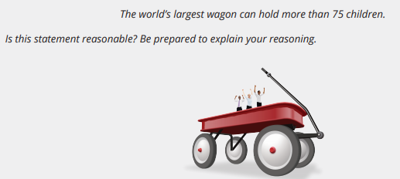
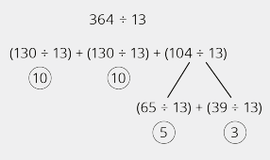
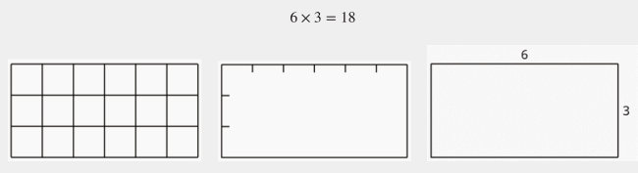
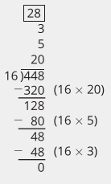
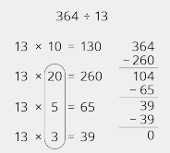
Unit 4 Progression Overview
Section A
Lessons 1-9
5.MD.C.3, 5.MD.C.5, 5.NBT.B, 5.NBT.B.5, 5.NF.B.5, 5.OA.A.2
Section B
Lessons 10-17
5.NBT.B.5, 5.NBT.B.6, 5.NF.B.3, 5.OA.A.1, 5.OA.A.2
Section C
Lessons 18-21
5.MD.C, 5.MD.C.5, 5.NBT.B.5, 5.NBT.B.6, 5.NF.B.7
Multiply multi-digit whole numbers using strategies based on place value and the properties of operations, including the standard algorithm.
Divide multi-digit whole numbers using strategies based on place value, properties of operations, and relationship between multiplication and division.
Multiply and divide to solve real-world and mathematical problems involving volume.

Slide 3



Unit 4 Quick Links
Adapt 1
Adapt 2
Adapt 3
L1
L2
L3
L4
L5
L6
L7
L8
L9
Adapt 4
Adapt 5
L10
L11
L12
L13
L14
L15
L16
L17
L18
L19
L20
L21

Slide 4
Multiply Two-Digit Numbers by One-Digit Numbers
Adaptation
Lesson 1
Let’s multiply two-digit and one-digit numbers
4.NBT.B.5

Slide 5
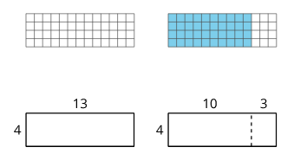
Notice and Wonder:
With and Without a Grid
Warm up
What do you notice?
What do you wonder?

Slide 6
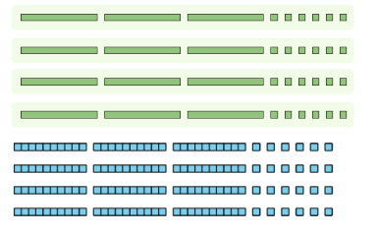
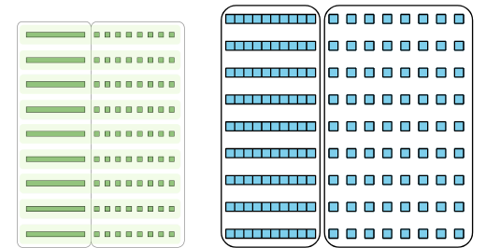
What was Tyler Thinking?
Activity #1
1. To find the value of 4 x 36, Tyler uses a base-ten diagram, as shown here.
a. Where is the 36 in Tyler’s diagram?
b. Where is the 4 in Tyler’s diagram?
c. What is the value of 4 x 36?
2. To find 9 x 18, Tyler uses 9 tens blocks and 8 ones blocks. Here is a diagram of how he arranges the blocks.
Explain or show how his arrangement helps him find the value of 9 x 18

Slide 7

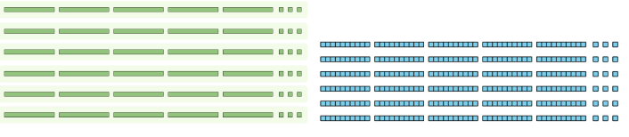
Rectangular Diagrams
Activity #2
1. Priya drew a base-ten diagram to multiply 6 x 53. She said it shows that the product can be found by adding 300 and 18.
a. Where do you see 6 and 53 in her diagram?
b. Where do you see 300 and 18 in Priya’s diagram? What do they represent?
2. Han multiplied 6 x 53 using this diagram:
Where do you see 300 and 18 in his diagram? What do they represent?

Slide 8
Rectangular Diagrams
Activity #2
5. Draw a diagram to represent each multiplication expression. Then, find the value of each product.
a. 6 x 48
b. 9 x 67
3. Which way do you prefer for multiplying 6 x 53: Han’s way or Priya’s way? Explain your reasoning.
4. Find the value of 6 x 53.

Slide 9
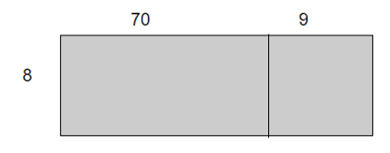
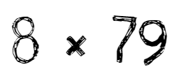

Lesson Synthesis
Today we used base-ten diagrams and rectangular diagrams to represent multiplication. We compared these representations and also used expressions to represent them.
What expression could we write to represent the diagram?
How could we use this rectangle to represent 8 x 79?
How does this diagram help us find the value of 8 x 79?

Slide 10
Multiply Three- and Four-digit Numbers by One-digit Numbers
Adaptation
Lesson 2
Let’s multiply three- and four-digit numbers by one-digit numbers
4.NBT.B.5

Slide 11

Estimation Exploration: Multiplying Teens
Warm up
What is the area of the rectangle?
Record an estimate that is:
Too low | About right | Too high

Slide 12


Larger Numbers to Multiply
Activity #1
2. Consider the expression 6 x 252.
a. Draw a diagram to represent the expression.
b. Find the value of the expression. Show your reasoning.
3. Lin drew a diagram to represent 3 x 2,135.
a. Complete Lin’s diagram.
b. Write an expression to represent the value of each part of the diagram.
c. Find the value of 3 x 2,135. Show your reasoning.
1. Clare drew this diagram.
a. What multiplication expression can be represented by the diagram?
b. Find the value of the expression. Show your reasoning.

Slide 13

Jada’s Errors
Activity #2
1. Jada used a diagram to multiply
3 x 6,489 and made a few errors.
a. Explain the errors Jada made.
b. Find the value of 3 x 6,489. Show your reasoning
2. Find the value of each expression. Show your reasoning for each.
a. 5 x 699
b. 8 x 4,973

Slide 14
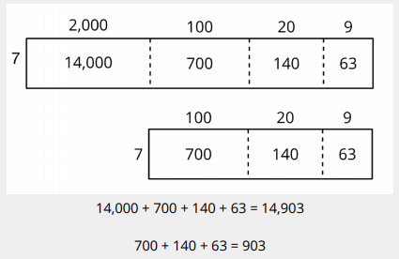

Lesson Synthesis
Today we used rectangular diagrams to multiply three- and four-digit numbers by one-digit numbers. Let’s compare the diagrams for 7 x 2,129 and 7 x 129.
How are the representations alike and how are they different?
How would you find the value of
7 x 2,039?

Slide 15
Multiply 2
Two-Digit Numbers
Adaptation
Lesson 3
Let’s multiply 2 two-digit numbers.
4.NBT.B.5

Slide 16
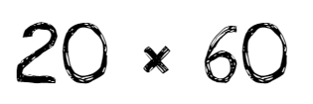
Number Talk:
Extra Groups
Warm up
Find the value of each product mentally.

Slide 17

Number Talk:
Extra Groups
Warm up
Find the value of each product mentally.

Slide 18
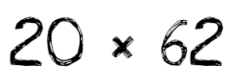
Number Talk:
Extra Groups
Warm up
Find the value of each product mentally.

Slide 19
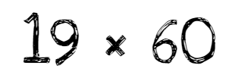
Number Talk:
Extra Groups
Warm up
Find the value of each product mentally.

Slide 20
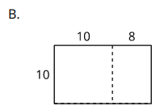
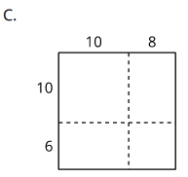
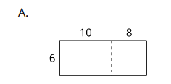
Two by Two
Activity #1
1. For each diagram, write a multiplication expression that the diagram can represent. Then, find the value of the expression. Use equations to show your reasoning.
2. How are the diagrams alike? How are they different? Discuss with your partner.

Slide 21
Two by Two
Activity #1
3. Use a diagram to find each product.
a. 13 x 21
b. 25 x 46

Slide 22
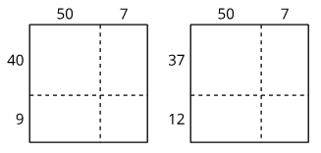
Decompose by Place Value
Activity #2
1. Why is diagram A more helpful than diagram B when finding the value of 49 x 57?
2. Use a diagram to find each product.
a. 49 x 57
b. 29 x 55
These diagrams could be used to find the value of 49 x 57.

Slide 23
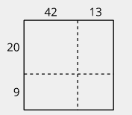
Lesson Synthesis
Today we learned how to represent the multiplication of 2 two-digit numbers using a rectangular diagram. We learned that we can decompose each factor by place value and show the tens and ones on each side of the rectangle, and that doing this can help us to multiply efficiently.
Why might it be more helpful to decompose 55 into 50 + 5 than into 42 + 13?

Slide 24
Lots of Milk
1
Let's make estimates with big numbers.
5.MD.C.5, 5.NBT.B

Slide 25
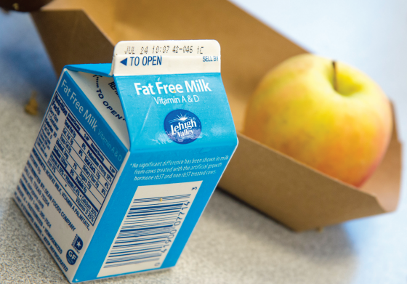
Estimation Exploration:
How Big is the Milk Carton?
Warm up
What is the volume of the milk carton in cubic inches?
Record an estimate that is:
Too low | About right | Too high

Slide 26
Milk for Everyone
Activity #1
In each situation, estimate the volume of milk, in cubic inches, that you or the group would drink in one day. Explain your reasoning.
1. you
2. your class
3. your grade
4. your school
5. 10 schools

Slide 27
How Big is 1,000,000?
Activity #2
Estimate the number of days it would take each group to drink 1,000,000 cubic inches of milk. Explain your reasoning.
1. 10 local schools
2. your school
3. your grade
4. your class
5. you

Slide 28
Lesson Synthesis
In this lesson we estimated products and quotients.
Could you also make this estimate using division?
How can you use multiplication to estimate how many days it would take your school to drink 1,000,000 ounces of milk?
Throughout this unit we will be finding products and quotients of whole numbers and learning how they are related.

Slide 29
Multiplication Estimates and Evaluation
2
Let's estimate and calculate products.
5.NBT.B

Slide 30

Number Talk:
A Multiple of 10
Warm up
Find the value of each product mentally.

Slide 31

Number Talk:
A Multiple of 10
Warm up
Find the value of each product mentally.

Slide 32

Number Talk:
A Multiple of 10
Warm up
Find the value of each product mentally.

Slide 33

Number Talk:
A Multiple of 10
Warm up
Find the value of each product mentally.

Slide 34
Reasonable Estimates
Activity #1
1. Which estimate for the product
18 × 149 is most reasonable? Be prepared to explain your reasoning to your partner.
2,000
4,000
3,000
1,500
2. Are any of the estimates unreasonable? Be prepared to explain your reasoning to your partner.
3. Do you think the actual product will be more or less than your estimate? Explain your reasoning.

Slide 35
Multiply by 18
Activity #2
Evaluate each expression. Explain your reasoning

Slide 36
Today we estimated the value of 18 × 149 and then found the exact value.
In the next lessons, we are going to continue to investigate strategies for organizing calculations for products like 18 × 149.
Lesson Synthesis
What was different about estimating and finding the exact value?
What was the same about estimating and finding the exact value?

Slide 37
Partial Products with Diagrams
3
Let's use diagrams to help find products.
5.NBT.B

Slide 38
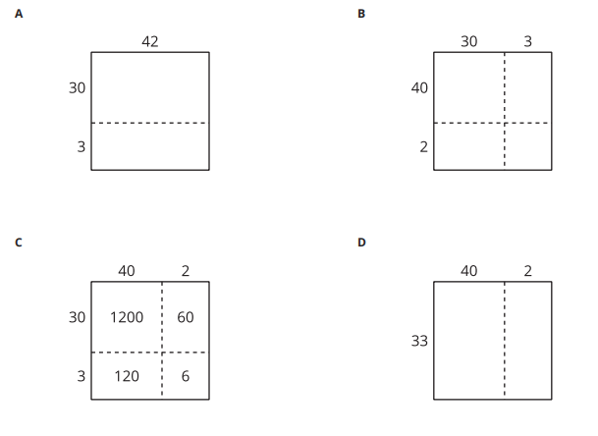
Which One Doesn't Belong: Diagrams to Find Products
Warm up

Slide 39
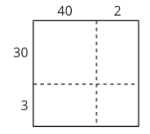
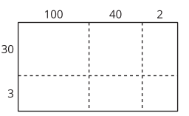
Decompose in Many Ways
Activity #1
3. This diagram represents 142 × 33.
Write the value of each product in the boxes
. 4. Find the value of 142 × 33.
1. Write the value of each product inside the rectangles.
2. Find the value of 42 × 33.

Slide 40
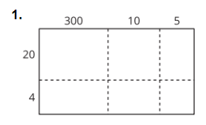
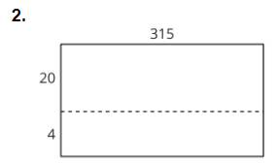
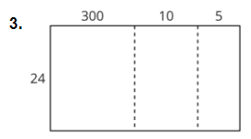
Calculating in Many Ways
Activity #2
Here are some different diagrams that represent 315 × 24 .
For each diagram, write a multiplication expression inside each rectangle to represent the product.
4. What are some advantages of each way to calculate 315 × 24 ? Explain your reasoning.
5. Use one of the diagrams to find 315 × 24.

Slide 41
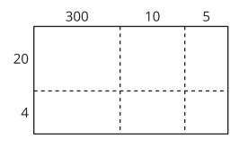
Today we multiplied numbers and represented these products with diagrams.
Lesson Synthesis
What do you need to know to find each product?
How does the diagram help visualize calculating 315 × 24?
Tomorrow we are going to work with partial products and organize them in a different way.

Slide 42
Different Methods
4
Let's organize products with expressions.
5.NBT.B, 5.NBT.B.5, 5.OA.A.2

Slide 43

Estimation Exploration:
A Large Product
Warm up
Record an estimate that is:
Too low | About right | Too high

Slide 44
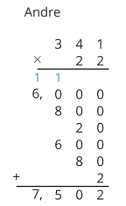
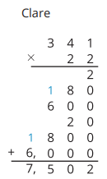
Two Ways to Multiply
Activity #1
1. How are Andre’s and Clare’s calculations the same? How are they different?
2. Create a list of expressions to match the partial products Andre and Clare found.

Slide 45
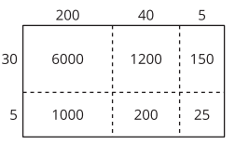
Partial Products Everywhere
Activity #2
1. Take turns picking out expressions that are equivalent to 245 × 35 when put together.
2. Explain how you know the sum of your expressions is equal to 245 × 35 .
3. What is the value of 245 × 35 ? Show or explain your reasoning.

Slide 46
Today we found products of two-digit and three-digit numbers using partial products. Sometimes we listed each partial product and sometimes we put more than one partial product together.
Lesson Synthesis
How do you know that all the different ways to find the product give the same answer?
What is helpful to remember when you are using partial products to determine a full product?
Which method did you like most?

Slide 47
The Standard Algorithm
5
Let’s learn the standard algorithm to multiply multi-digit whole numbers.
5.NBT.B.5

Slide 48

Number Talk:
Partial Product
Warm up
Find the value of each product mentally.

Slide 49

Number Talk:
Partial Product
Warm up
Find the value of each product mentally.

Slide 50

Number Talk:
Partial Product
Warm up
Find the value of each product mentally.

Slide 51

Number Talk:
Partial Product
Warm up
Find the value of each product mentally.

Slide 52
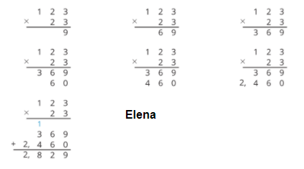
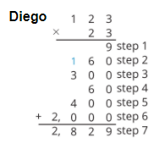
Compare Two Algorithms
Activity #1
Two algorithms for evaluating 123 × 23 are shown below.
How are Diego’s algorithm and Elena’s algorithm the same? How are they different?
Explain where you see each step from Diego’s algorithm in Elena’s algorithm.
How do the final steps in the two algorithms compare?

Slide 53

Using the Standard Algorithm
Activity #1
Calculate each product using Elena’s method.

Slide 54
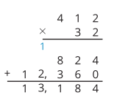
Today we learned a new algorithm to multiply whole numbers. We organized the partial products in a different way. It is called the standard algorithm for multiplication.
Lesson Synthesis
Which part of the product does the partial product 1,236 represent? How do you know?
Which part of the product does the partial product 824 represent? How do you know?

Slide 55
Compose a New Unit
6
Let’s use the standard algorithm when we have to compose a new unit.
5.NBT.B.5, 5.NF.B.5

Slide 56

Number Talk:
Partial Product
Warm up
Find the value of each product mentally.

Slide 57

Number Talk:
Partial Product
Warm up
Find the value of each product mentally.

Slide 58

Number Talk:
Partial Product
Warm up
Find the value of each product mentally.

Slide 59

Number Talk:
Partial Product
Warm up
Find the value of each product mentally.

Slide 60
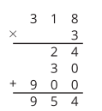

Carry on with the Standard Algorithm
Activity #1
Here is how Han calculated 318 × 3
Here is how Elena calculated 318 × 3
2. What does the 2 in Elena’s calculation represent? Show or explain your reasoning.
3. What does the 5 in Elena’s solution represent? Show or explain your reasoning.
1. Show or explain where you see these partial products in Han's diagram:
3 × 8
3 × 10
3 × 300

Slide 61

Using the Standard Algorithm with Carrying
Activity #2
2. Tyler tried to use the algorithm to multiply 261 × 4 , but he made a mistake.
a. Describe the mistake Tyler made.
b. Explain what Tyler should do to fix his mistake.
1. Find each product using the standard algorithm.
327 × 3
261 × 4

Slide 62

Lesson Synthesis
Today we learned how to multiply numbers with the standard algorithm in which we need to compose a new unit, or use carrying notation to record part of a partial product in the place value to the left.
What does the 2 over the 2 in 261 represent?
Why is there 1 thousand in the product 261 × 4 ?

Slide 63
Compose More Units
7
Let’s learn how to record more newly composed units with the standard algorithm.
5.NBT.B.5

Slide 64

Number Talk:
Three Factors
Warm up
Find the value of each product mentally.

Slide 65

Number Talk:
Three Factors
Warm up
Find the value of each product mentally.

Slide 66

Number Talk:
Three Factors
Warm up
Find the value of each product mentally.

Slide 67

Number Talk:
Three Factors
Warm up
Find the value of each product mentally.

Slide 68

Compose and Carry Again
Activity #1
1. Find the value of 286 × 4 . Here is how Tyler used the standard algorithm to calculate 286 × 4.
2. What does the 2 over the 8 represent? Explain your reasoning.
3. What does the 3 over the 2 represent? Explain your reasoning.
4. Use Tyler’s method to calculate
375 × 3

Slide 69
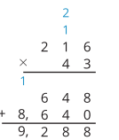
Units Upon Units
Activity #2
1. Find 216 × 3 using the standard algorithm.
2. Lin used the standard algorithm to calculate 216 × 3 . Here is her work:
a. Where do you see 216 × 3 in Lin’s work?
b. Where do you see 216 × 40 in Lin’s work?
c. What does the blue 2 represent in Lin’s calculation?
3. Use Lin’s method to calculate 128 × 24.

Slide 70
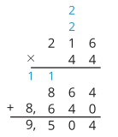
Lesson Synthesis
Today we learned how to use the standard multiplication algorithm when there are two new units composed.
Why are the digits in the second line of the calculation the same as those in the first?
Multiplying by 10 shifts each digit to the left one place because each place value is 10 times the value of the place to its right.

Slide 71
Build Multi-digit Multiplication Fluency
8
Let’s multiply multi-digit whole numbers using the standard algorithm.
5.NBT.B.5

Slide 72
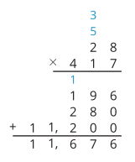
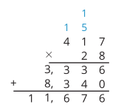
Notice and Wonder:
Same Solution
Warm up
What do you notice?
What do you wonder?

Slide 73
All the Products
Activity #1
Find each product using the standard algorithm.
647 × 9
647 × 50
647 × 59
264 × 38

Slide 74
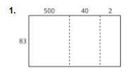
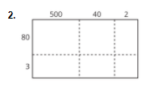
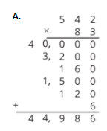
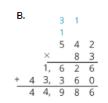
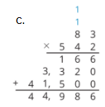

Will it Always Work?
Activity #2
Match the algorithms to the diagrams.
Diagrams and Algorithms for 542 × 83
Do you think the algorithm will work to multiply any 2 whole numbers?
Show or explain your reasoning.

Slide 75
Desperately Seeking 9 New Units
Activity #2
Tyler notices that when he uses the standard algorithm and composes a new unit, sometimes there is 1 new unit, sometimes 2, all the way up to 8. He has not seen an example with 9 of the new unit.
1. For each of these products, how many of each new unit do you compose?
256 × 5
587 × 8
809 × 9
2. Do you think it is possible to compose 9 of a new unit with the standard multiplication algorithm?

Slide 76
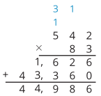
Lesson Synthesis
Today we used the standard algorithm to find products of numbers with no restriction on the number of newly composed units. We also reviewed some of the diagrams and procedures we used earlier in the unit.
Do you think the algorithm for multiplying whole numbers will work for any and all whole numbers? Why or why not? Discuss with a partner.
What do you still wonder about the standard algorithm for multiplying whole numbers?

Slide 77
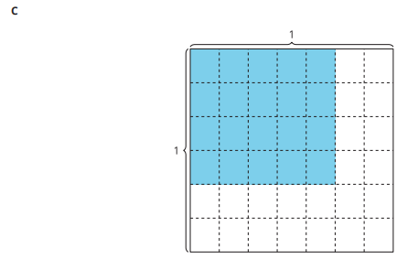


Section Summary
In diagram C, we can see that . We can multiply the numerators, 4 x 5 to find the numerator in the product. We can multiply the denominators, 6 x 7 , to find the denominator in the product. We can represent this relationship with the equation: Diagram C represents a 4 by 5 array inside a 5 by 7 array. It also represents 20 pieces that are each 1/42 of the whole square.

Slide 78
The Birds
9
Let’s solve multiplication problems.
5.MD.C.3, 5.MD.C.5, 5.NBT.B.5

Slide 79
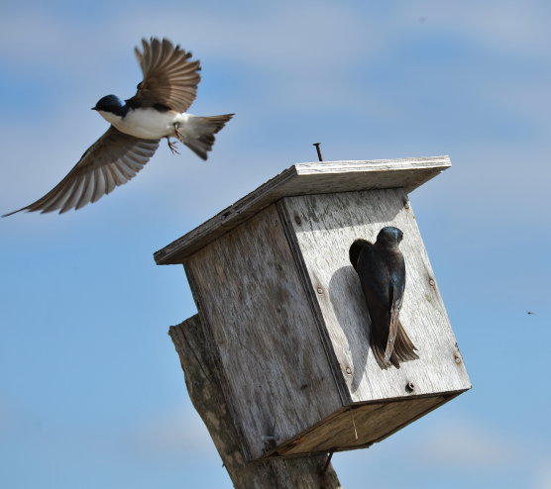
Notice and Wonder:
For the Birds
Warm up
What do you notice?
What do you wonder?

Slide 80
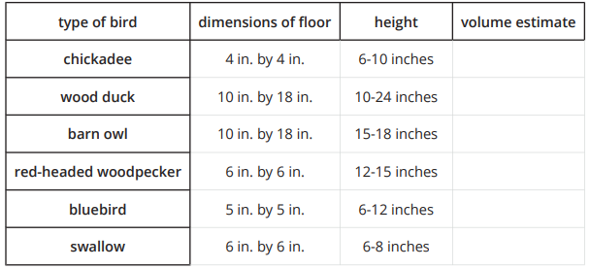
Home is Where the Bird Lives
Activity #1
Different types of birds use different types of houses. The table gives you the recommended birdhouse box sizes for various species.
Estimate a possible volume for each birdhouse.

Slide 81
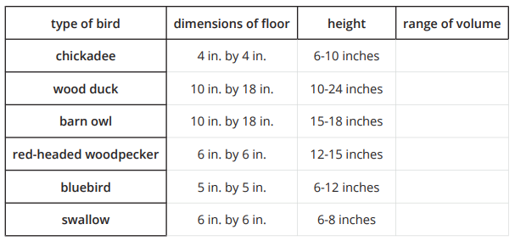
What is the Volume?
Activity #2
Use the criteria from the table to determine the possible range of volumes for each type of birdhouse.

Slide 82
Lesson Synthesis
Today we discussed when we would use the standard algorithm and when we would use other strategies
When is it most helpful to use the standard algorithm for multiplication?

Slide 83

Lesson Synthesis
Take a minute to think about which of these problems you would use the standard algorithm to solve
Different problems call for different strategies, and we each might choose a different way to solve each of these problems. We could use the algorithm to solve all these problems, but we don’t have to

Slide 84
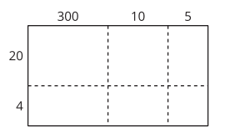
Section Summary
In this unit we multiplied multi-digit whole numbers by two-digit whole numbers. We first represented the multiplication with diagrams that help us visualize the product. This is a partial products strategy that helps us break down the multiplication by place value.
This diagram breaks up the product 315 × 24 by place value. Like we learned in previous grades, if we add up all of the products in each box, we will get the product of 315 × 24 .

Slide 85

Section Summary
Then we learned a new algorithm to multiply whole numbers—the standard algorithm for multiplication.
We can see the partial products are organized in different ways. 824 represents the partial product for 2 × 412 and 12,360 represents the partial product for 30 × 412 .
We noticed that sometimes we need to compose a new unit when we multiply, and represent that unit with carrying notation. Sometimes, we may have to compose more than one new unit.

Slide 86


Section Summary
In the first example, the 2 above the 2 in 261 represents 2 hundreds from the product 4 × 60 .
The second example shows multiple units being composed. The 1 above the 1 represents 1 ten from the product 3 × 6 and the 2 represents 2 hundreds from the product 40 × 6.

Slide 87
Section Summary
We also learned that the algorithm for multiplying whole numbers will work for any and all whole numbers, but sometimes it is more helpful to use other strategies. For example, it may be more helpful to use the standard algorithm for multiplication to evaluate the expression 143 × 67 and a mental strategy to evaluate the expression 20 × 200 .

Slide 88
Division and Area
of a Rectangle
Adaptation
Lesson 4
Let’s divide to find the side-length of a rectangle.
4.NBT.B.6, 4.MD.A.3, 4.OA.A.3

Slide 89

Estimation Exploration: Area of a Soccer Field
Warm up
What is the length of the soccer field in meters?
Record an estimate that is:
Too low | About right | Too high

Slide 90

Elena’s Mural
Activity #1
1. How many tiles long is Elena’s mural? Be prepared to explain or show how you know.
2. Write one or more equations that show how you solved this problem
Elena used 189 square tiles to create a rectangular mural for the art club. The mural is 7 tiles wide.

Slide 91
Tyler’s Mural
Activity #2
Tyler is also creating a rectangular mural for the art club. He has 197 tiles for his mural. His mural is 6 tiles wide
1. Will Tyler use all of his tiles in the mural? Explain your reasoning.
2. How many tiles long is Tyler’s mural? Show your reasoning using numbers, pictures, or words.

Slide 92
Lesson Synthesis
Today we used division to find side lengths of rectangles. For each rectangle, we knew the area and the length of one side and we used division to find the length of the other.
What is the relationship between the side lengths and the area of a rectangle?
How do we find the missing side length?

Slide 93
Area Diagrams to Represent Division
Adaptation
Lesson 5
Let’s represent division using area diagrams.
4.NBT.B.6, 4.MD.A.3

Slide 94
What Do You Know about Multiples of 9?
Warm up

Slide 95


How Long is the Pool?
Activity #1
1. A rectangular pool has an area of 252 square meters. Its width is 9 meters and its length is a whole number of meters. What is the length of the pool?
a. Write a multiplication equation and a division equation to represent the situation.
b. To find the length of the pool, Diego drew the following rectangular diagrams.
He thought, “Nine times 10 is 90. Another 9 times 10 is another 90.
Complete Diego’s reasoning. What is the length of the pool?

Slide 96

How Long is the Pool?
Activity #1
2. A rectangular patio has a width of 8 feet and an area of 376 square feet. What is its length?
a. What equations can we write to represent this situation?
b. Use an area diagram to help answer the question.

Slide 97



Which Diagram to Use?
Activity #2
Here are three diagrams that can be used to help find the value of 288 ÷ 9.
1. Where do you see the 288 in each diagram?
2. What does the 9 represent?
3. What does the value of 288 ÷ 9 represent?
4. Which diagram would you use to find the value of 288 ÷ 9? Explain your reasoning.

Slide 98

Lesson Synthesis
Today we saw that when we have the length of one side of a rectangle and its area, we could find the length of the other side. Some of us did this by using multiplication, and others used division. But all of us found the missing length in sections
Suppose a rectangle has an area of 414 square units and a width of 6 units, and we want to know its length. Which of these representations describe the question?

Slide 99

Lesson Synthesis
Here are some ways to record our strategies for finding its length.

Slide 100
World’s Record Noodle Soup
10
Let’s explore division with large numbers.
5.NBT.B.6

Slide 101

Notice and Wonder: World Record Event
Warm up
A Chinese food company holds the Guinness World Record for making the longest noodle. The noodle measured about 10,119 ft and served 400 people.
What do you notice?
What do you wonder?

Slide 102
How Many Feet in One Serving?
Activity #1
A Chinese food company cooked a single noodle measuring about 10,119 ft. It served 400 people
1. If the noodle was shared equally, about how many feet of noodle did each person eat? Explain or show your thinking.
2. Is your estimate lower or higher than the actual length of noodle each person ate? Explain your reasoning without calculating the actual length.

Slide 103
Noodle Soup
Activity #2
Partner A:
Mai made noodle soup. She made a noodle that is 155 feet long. Five people share the noodle equally.
1. Write a division expression to represent the situation.
2. How many feet of noodle does each person eat? Show or explain your thinking.
3. Compare your work with your partner’s. What is the same? What is different?
Partner B:
Han made noodle soup. He made a noodle that is 165 feet long. Five people share the noodle equally.
1. Write a division expression to represent the situation.
2. How many feet of noodle does each person eat? Show or explain your thinking.
3. Compare your work with your partner’s. What is the same? What is different?

Slide 104
Lesson Synthesis
Today, we solved problems using division. Some of us were able to solve the same problems using multiplication.
How did we use the relationship between multiplication and division today?
What do we know about the relationship between multiplication and division?

Slide 105
Fractions as Partial Quotients
11
Let’s use fractions to help us divide whole numbers.
5.NBT.B.6, 5.NF.B.3

Slide 106

What Do You Know About…..
Warm up

Slide 107

Select Expressions
Activity #1
1. Select all the expressions that are equal to the value of . Show or explain your reasoning.
2. What is the value of 78 ÷ 6?
Show or explain your thinking.

Slide 108


Choose One Expression
Activity #2
For each problem, choose one expression and use it to find the value of the division expression. Show or explain your thinking.
3. Which expressions were most helpful? Show or explain your thinking.
4. Why were some expressions more helpful than others? Show or explain your thinking.

Slide 109

Lesson Synthesis
How do we know this expression is equal to 540/18 ?
How can we use this expression to find the value of 540 ÷ 18?

Slide 110


Lesson Synthesis
How can we use this expression to help us find the value of 540 ÷ 18 ?
How do we know this expression is equal to
540 ÷ 18?
Why is this expression not as helpful as the others?

Slide 111
Interpret Division Expressions
12
Let’s interpret and evaluate division expressions.
5.NBT.B.6, 5.OA.A.1, 5.OA.A.2

Slide 112

True or False: Lucky Number 7
Warm up
Decide whether each statement is true or false.
Be prepared to explain your reasoning.

Slide 113

True or False: Lucky Number 7
Warm up
Decide whether each statement is true or false.
Be prepared to explain your reasoning.

Slide 114

True or False: Lucky Number 7
Warm up
Decide whether each statement is true or false.
Be prepared to explain your reasoning.

Slide 115

Division Expressions
Activity #1

Slide 116

Write Expressions
Activity #2
1. Fill in the blanks to write expressions that are equal to
299 ÷ 13
2. Use one of the expressions to find the value of
299 ÷ 13.
3. Explain why you chose the expression to find the value of
299 ÷ 13.

Slide 117

Lesson Synthesis
What changes in the expressions?
What stays the same in the expressions?
The number 13 is the divisor. The divisor stays the same because we divide 299 into 13 groups. The dividend changes in the expressions because it is decomposed in different ways. Why is it helpful to decompose the dividend in these ways?

Slide 118
Partial Quotients
13
Let’s use partial quotients to divide.
5.NBT.B.6

Slide 119

True or False: 192 ÷ 16
Warm up
Decide whether each statement is true or false.
Be prepared to explain your reasoning.

Slide 120

True or False: 192 ÷ 16
Warm up
Decide whether each statement is true or false.
Be prepared to explain your reasoning.

Slide 121

True or False: 192 ÷ 16
Warm up
Decide whether each statement is true or false.
Be prepared to explain your reasoning.

Slide 122


Two Different Methods
Activity #1
1. With your partner, discuss: What’s different about Jada’s and Clare’s method? What’s the same?
2. Find the value of 364 ÷ 13.

Slide 123


Two Different Methods
Activity #2
1. Jada started to find the value of 432 ÷ 12 . What could she do next?
2. Clare started to find the value of 432 ÷ 12 . What could she do next?
3. What is the value of 432 ÷ 12?

Slide 124
Lesson Synthesis
Diego said, ‘In order to solve division problems, you have to use all the operations.’ What does Diego mean? When did we use addition, subtraction, and multiplication to divide?

Slide 125
Partial Quotients Algorithm
14
Let's make sense of a partial quotient algorithm.
5.NBT.B.6

Slide 126

Notice and Wonder:
Incomplete Solution
Warm up
What do you notice?
What do you wonder?

Slide 127

Elena’s Work
Activity #1
1. Find the value of 448 ÷ 16 . Show your thinking. Organize it so it can be followed by others.
2. This is Elena’s work. Describe the steps Elena took to find the value of 448 ÷ 16.

Slide 128



Complete the Solution
Activity #2
1. Use Elena’s method to complete the following problems:

Slide 129

Lesson Synthesis
Explain to your partner how multiplication, addition, and subtraction were used to find the value of 364 ÷ 14 .

Slide 130
Divide Using Partial Quotients
15
Lets use a partial quotients algorithm to divide three-digit dividends by two-digit divisors.
5.NBT.B.6

Slide 131

Number Talk: Divide
Warm up
Find the value of each expression mentally.

Slide 132

Number Talk: Divide
Warm up
Find the value of each expression mentally.

Slide 133

Number Talk: Divide
Warm up
Find the value of each expression mentally.

Slide 134

Number Talk: Divide
Warm up
Find the value of each expression mentally.

Slide 135

Compare Solutions
Activity #1
1. Use the partial quotients algorithm to evaluate one of the problems. Be prepared to explain how you found the quotient.
2. Explain to your partner how you found the quotient in your problem.
3. Pair up with another group and compare your work.

Slide 136



Estimate and Solve
Activity #2
For each problem, make a reasonable estimate.
Then, use the partial quotients algorithm to solve.

Slide 137
Lesson Synthesis
Today we used partial quotients to divide whole numbers. What makes sense to you about this procedure? What questions do you still have about using this procedure?

Slide 138
Practice a Partial Quotients Algorithm
16
Let’s practice using a partial quotients algorithm.
5.NBT.B.6

Slide 139

Which One Doesn’t Belong:
Different Ways
Warm up

Slide 140



Find the Mistake
Activity #1
For each problem, describe where you see an error in the calculation.
Fix the error to find the whole number quotient.

Slide 141

Practice Problems
Activity #2
Evaluate. Then check in with a partner to review your work.

Slide 142
Lesson Synthesis
Today, we practiced using the partial quotients algorithm to divide multi-digit numbers.
Think about the biggest multiple of 10 and 85 that can divide into 935. So I start with 10.
Then multiply 85 x 10 and subtract the product from 935 to see how much more I have left to divide.
Keep on doing this until I get zero as a difference.
Multiply the quotient by the divisor to make sure I get back to the original dividend.
Turn and Talk: Describe how to use the partial quotients algorithm to evaluate 935 ÷ 85 .

Slide 143
Find Missing Dimensions
17
Let’s use the relationship between multiplication and division to solve problems.
5.NBT.B.5, 5.NBT.B.6

Slide 144

Estimation Exploration:
The Garden
Warm up
What is the area of one of the large rectangles in the garden?
Record an estimate that is:
Too low | About right | Too high

Slide 145

Find the Missing Dimension, Part 1
Activity #1
Complete the table.

Slide 146


Find the Missing Dimension, Part 2
Activity #2
2. Clare wants to find the height of a rectangular prism with the following measurements:
a. First, Clare divides 882 ÷ 6. What should she do next?
b. Find the missing height to finish the problem for Clare.
1. Complete the table to find the missing dimension for each rectangular prism.

Slide 147

Find the Missing Dimension, Part 2
Activity #2
3. Complete the table to find the missing dimensions for each rectangular prism.

Slide 148
Lesson Synthesis
Today we found missing dimensions of rectangles and rectangular prisms using division.
How did the partial quotients algorithm help you solve problems today?

Slide 149



Section Summary
In this section, we learned how to divide multi-digit whole numbers. We used what we know about the relationship between fractions and division expressions to make sense of partial quotients.
Then, we used the relationship between multiplication and division to make sense of partial quotients.
Finally, we learned a new strategy for dividing multi-digit whole numbers.

Slide 150
Problem Solving: World’s Largest Wagon
18
Let’s solve problems about volume.
5.MD.C.5, 5.NBT.B.5, 5.NBT.B.6

Slide 151

Notice and Wonder: Radio Flyer
Warm up
What do you notice?
What do you wonder?

Slide 152


Anatomy of an Estimate
Activity #1
1. What measurements would you take of the wagon to accurately estimate its volume?
2. What units would you use to measure the wagon? Explain your reasoning.
3. Record an estimate for the volume of the wagon that is:
4. What can you use about the picture to refine your estimate?

Slide 153

Estimating the Size of the Radio Flyer
Activity #1
Use the picture of the wagon to make a better estimate of the length, width, and height of the wagon bed.
Make sure to:
explain how you estimated each measurement
include how accurate you think each estimate is

Slide 154
Sand Wagon
Activity #3
The Radio Flyer wagon is 27 feet long 13 feet wide and 2 feet deep.
1. A 150-pound bag of sand will fill about 9 cubic feet. About how many bags of sand will it take to fill the wagon with sand?
2. A 150-pound bag of sand costs about $12. About how much will it cost to fill the wagon with sand?
3. Jada said the sand will cost approximately $120. Is Jada’s estimate reasonable? Why or why not?

Slide 155
Lesson Synthesis
Today we made and refined estimates for the volume of the world’s largest wagon.
We are going to continue to investigate the wagon tomorrow
What other question do you have about the wagon?

Slide 156
Problem Solving:
Boxes of Toys
19
Let’s solve more problems about volume.
5.MD.C.5, 5.NBT.B.5, 5.NBT.B.6, 5.NF.B.7

Slide 157

Notice and Wonder: Radio Flyer
Warm up
What do you notice?
What do you wonder?

Slide 158
How Many Boxes?
Activity #1
The Radio Flyer wagon is 27 feet long 13 feet wide and 2 feet deep
1. Each toy box is 1 foot by 1 foot by 1 foot. How many boxes will fit in the wagon?
2. If each toy box is 2 feet by 2 feet by 2 feet, how many boxes will fit in the wagon?
3. If each toy box is 3 feet by 3 feet by 3 feet, how many boxes will fit in the wagon?

Slide 159
More Boxes
Activity #2
The Radio Flyer wagon is 27 feet long 13 feet wide and 2 feet deep.
The wagon is being used to deliver 4,000 boxes that each have the dimensions 2 feet by 2 feet by 2 feet. How many trips will the wagon have to make? Be prepared to explain your reasoning.

Slide 160
Lesson Synthesis
What strategies for multiplication and division did you find most helpful today? Why were they helpful?

Slide 161
Problem Solving: More Wagon Problems
20
Let’s create and solve problems about the world’s largest wagon.
5.MD.C.5, 5.NBT.B.5, 5.NBT.B.6

Slide 162

Estimation Exploration:
Wagon People
Warm up
The Radio Flyer wagon is 27 feet long 13 feet wide and 2 feet deep.
How many people would fit in the big red wagon? Record an estimate that is:
Record an estimate that is:
Too low | About right | Too high

Slide 163
How Many Students?
Activity #1
The Radio Flyer wagon is 27 feet long 13 feet wide and 2 feet deep.
The world’s largest wagon can hold more than 75 children. Is this statement reasonable? Be prepared to explain your reasoning.

Slide 164





Wonder Wagon
Activity #2
The Radio Flyer wagon is 27 feet long 13 feet wide and 2 feet deep.
1. What else do you wonder about the wagon?
2. Write a problem about the world’s largest wagon.
3. What information would you need in order to solve your problem?

Slide 165
Lesson Synthesis
We have been learning about multiplication and division algorithms in this unit. When did we use multiplication and division while we were solving problems about the world’s largest wagon? Which problems did you use one of the algorithms to solve? Why did you use the algorithm to solve that problem?

Slide 166

Section Summary
In this section we solved problems using multiplication and division involving the world’s largest wagon.
First, we made and refined estimates for the volume of the wagon. Then, we used multiplication to figure out how many boxes fit in the wagon. We used division to figure out how many trips the wagon has to take if it has to deliver a total of 4,000 boxes. Then, we created our own problems about the world’s largest wagon.

Slide 167
Objects in the
Real World
(optional)
21
Let’s think more about area and volume in the real world.
5.MD.C, 5.MD.C.5, 5.NBT.B.5

Slide 168

Estimation Exploration: Wooden Box
Warm up
How wide is one wooden box?
Record an estimate that is:
Too low | About right | Too high

Slide 169
What Could it Be?
Activity #1
1. What object might each of the following represent? Be prepared to show or explain your reasoning.
a. Rectangle. Area: 816 sq ft
b. Rectangle. Width: 253 in
c. Rectangular prism. Volume: 375 cubic cm, base: 15 sq cm
d. Rectangular prism. Volume: 1,536 cubic ft
e. Rectangular prism. Length: 8 m, height: 9 m
2. Choose your own measurement and units. What object does this represent?

Slide 170
Who Wants to Know?
Activity #2
1. Make a sketch of your design that includes its length, width, height, and volume.
2. Describe your design.
a. What did you design?
b. What is it used for?
c. Why did you choose these measurements?
d. Why would the people in your community want this product?

Slide 171
Lesson Synthesis
Today you designed a rectangular prism that would be useful to the people in your community.
You saw another group’s design. Why would the people in your community buy their product?
How might you change the measurements to make it more useful?

