Slide 1

Fraction Multiplication
and Division
Grade 5: Unit 3
Standards addressed: 5.NF.B, 5.NF.B.4, 5.NF.B.6, 5.NF.B.7, 5.NBT.B.7
These slides have been created by Britnee Wright- Southeast Arkansas Education Cooperative and are not official IM materials. Images and language are taken from IM Grade 5, Unit 3 by Illustrative Mathematics.
Copyright 2020 by Illustrative Mathematics. All Rights Reserved, adapted and shared with permission.

Slide 2

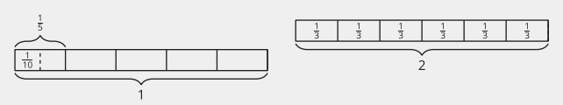
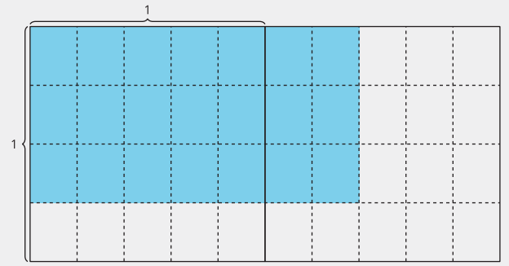
Unit 3 Progression Overview
Section A
Lessons 1-8
5.NF.B.4, 5.NF.B.4.a, 5.NF.B.4.b, 5.NF.B.6
Section B
Lessons 9-16
5.NBT.B.7, 5.NF.B.7, 5.NF.B.7.a, 5.NF.B.7.b, 5.NF.B.7.c
Section C
Lessons 17-19
5.NF.B, 5.NF.B.4, 5.NF.B.6, 5.NF.B.7
Recognize and use this generalization to multiply fractions numerically
Represent and describe multiplication of a fraction by a fraction using area concepts.
Divide a unit fraction by a whole number using whole-number division concepts.
Divide a whole number by a unit fraction using whole-number division concepts.
Solve problems involving fraction multiplication and division.

Slide 3



Unit 3 Quick Links
L1
L2
L3
L4
L5
L6
L7
L8
L9
L10
L11
L12
L13
L14
L15
L16
L17
L18
L19

Slide 4
One Piece of One Part
1
Let’s solve problems about unit fractions.
5.NF.B.4.a

Slide 5
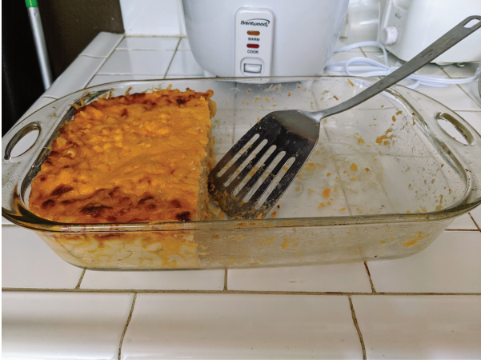
Notice and Wonder:
Baked Macaroni and Cheese
Warm up
What do you notice?
What do you wonder?

Slide 6
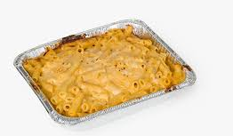
Of What?
Activity #1
At a family dinner, a pan of macaroni and cheese is ½ full. Jada eats ⅓ of the remaining macaroni and cheese in the pan.
Draw a diagram to represent the situation.
How much of the whole pan of macaroni and cheese did Jada eat? Explain or show your reasoning.

Slide 7
The Same, but Different
Activity #2
Partner A: Diego eats macaroni and cheese from a pan that is ½ full. He eats ¼ of the remaining macaroni and cheese in the pan
Draw a diagram to represent the situation.
How much of the whole pan did Diego eat?
Partner B: Kiran eats macaroni and cheese from a pan that is ⅓ full. He eats ¼ of the remaining macaroni and cheese in the pan.
1. Draw a diagram to represent the situation.
2. How much of the whole pan did Kiran eat?
Discuss your solution with your partner. What is the same about these situations? What is different?

Slide 8

Lesson Synthesis
Mai eats some macaroni and cheese from a pan that has some macaroni and cheese left in it. Draw a square, for all to see, to represent the pan of macaroni and cheese.
Mai eats macaroni and cheese from a pan that is ½ full. She eats ½ of the remaining macaroni and cheese in the pan.
What do we need to know to figure out how much of the whole pan of macaroni and cheese Mai ate?
Describe how you would draw a diagram to represent this situation. Describe how you would determine how much of the whole pan of macaroni and cheese Mai ate.

Slide 9

Lesson Synthesis
How does this expression represent how much of the pan Mai ate?

Slide 10
Represent Unit Fraction Multiplication
2
Let’s multiply unit fractions.
5.NF.B.4.a

Slide 11
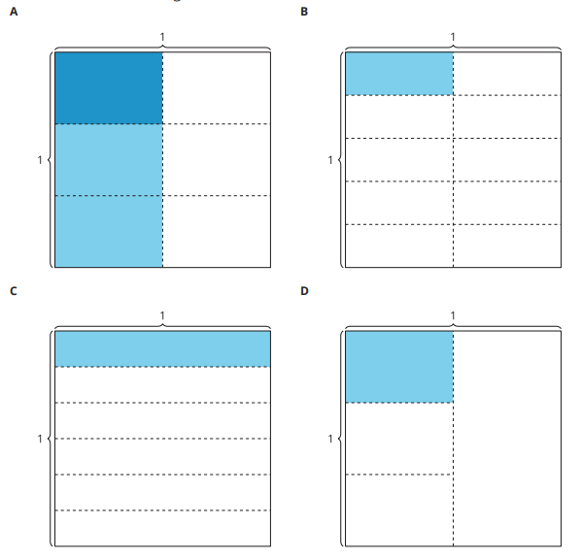
Which One Doesn’t Belong: Diagrams
Warm up

Slide 12
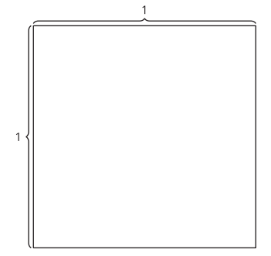
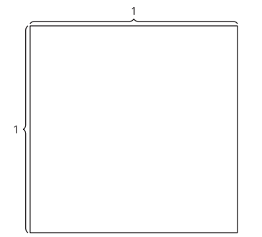


Interpret Diagrams
Activity #1

Slide 13
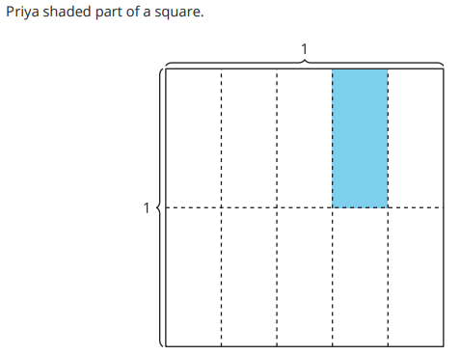

Write an Expression
Activity #2

Slide 14
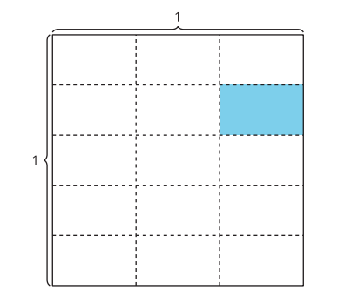

Write an Expression
Activity #2

Slide 15
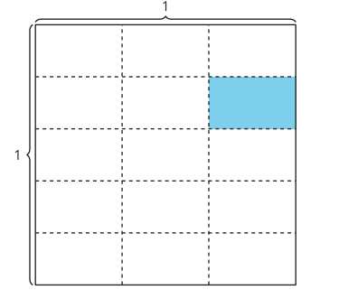

Today we wrote multiplication expressions to represent shaded rectangles. We also wrote fractions to represent the size of the shaded piece.
Lesson Synthesis
How do you know these equations are true?

Slide 16
Multiply
Unit Fractions
3
Let’s solve equations.
5.NF.B.4.a

Slide 17
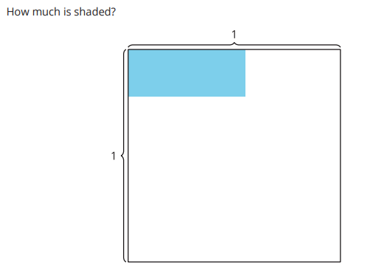
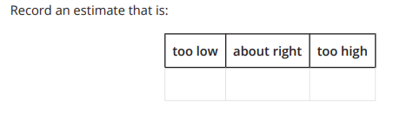
Estimation Exploration:
How Much is Shaded?
Warm up

Slide 18
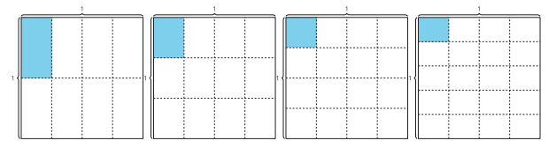

Find the Value of the Expression
Activity #1

Slide 19

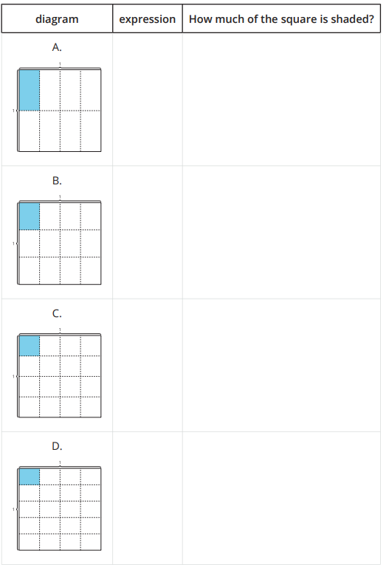

Find the Value of the Expression
Activity #1

Slide 20
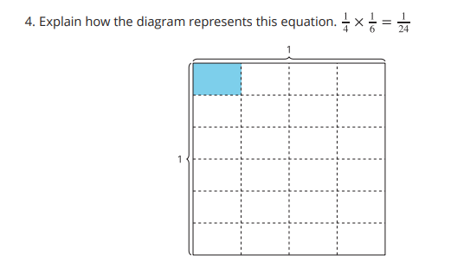
Find the Value of the Expression
Activity #1

Slide 21
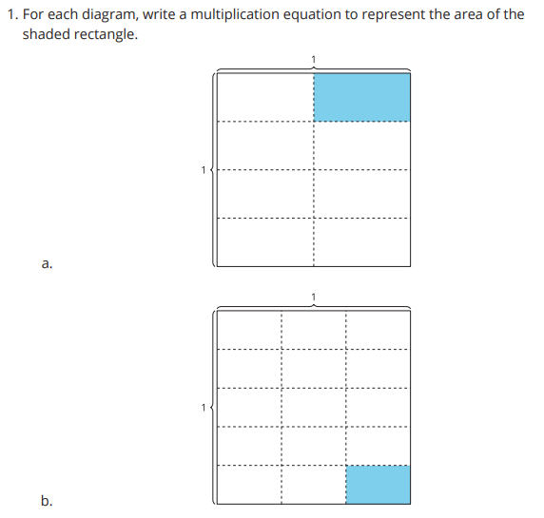
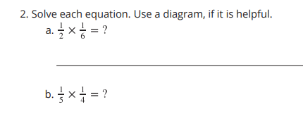
Write a Multiplication Equation
Activity #2

Slide 22
Today we represented products of unit fractions with diagrams and with equations.
Lesson Synthesis
In future lessons, we are going to multiply fractions that have a numerator greater than 1. What do you wonder about that?
How is multiplying unit fractions the same as multiplying whole numbers? How is it different

Slide 23
More Pieces of a Part and More Parts of a Piece
4
Let’s solve more problems about fraction multiplication.
5.NF.B.4.a

Slide 24

Number Talk: More Halving
Warm up
Evaluate each expression mentally.

Slide 25

Number Talk: More Halving
Warm up
Evaluate each expression mentally.

Slide 26

Number Talk: More Halving
Warm up
Evaluate each expression mentally.

Slide 27

Number Talk: More Halving
Warm up
Evaluate each expression mentally.

Slide 28
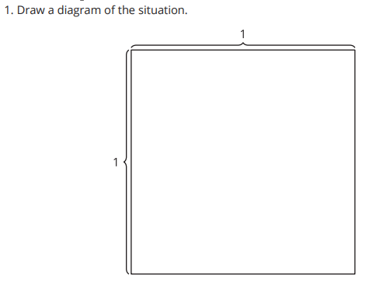
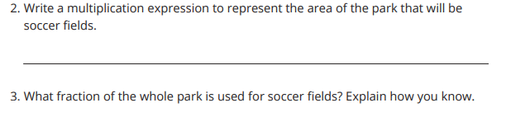
The Park
Activity #1

Slide 29
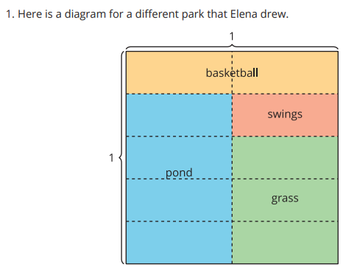
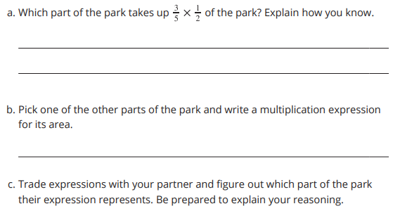
A Different Park
Activity #2

Slide 30
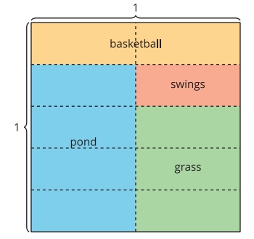
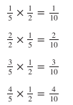
Today we represented multiplication of a unit fraction and a non-unit fraction with diagrams and expressions.
Lesson Synthesis
Each of these equations represents a part of the park. Where do we see each equation in the diagram?
What patterns do you notice in the equations?

Slide 31
Multiply a Unit Fraction
by a Non-unit Fraction
5
Let's look for more patterns when we multiply fractions.
5.NF.B.4.b

Slide 32
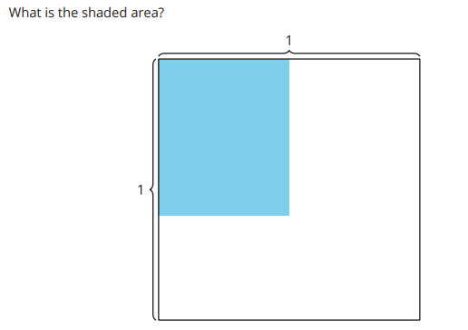
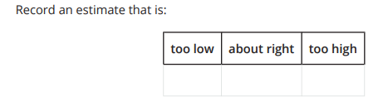
Estimation Exploration: Shaded Rectangle
Warm up

Slide 33
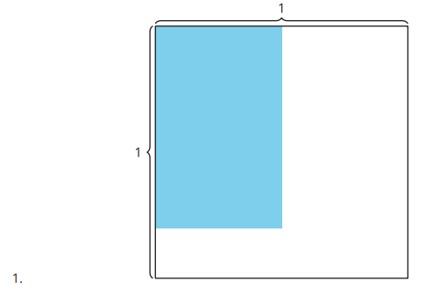
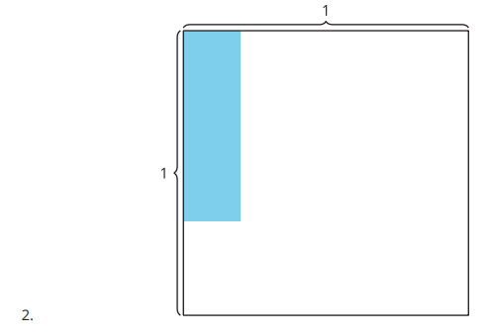
Estimate With Expressions
Activity #1
Write a multiplication expression that might represent the area of the shaded rectangle. Be prepared to explain your reasoning.

Slide 34
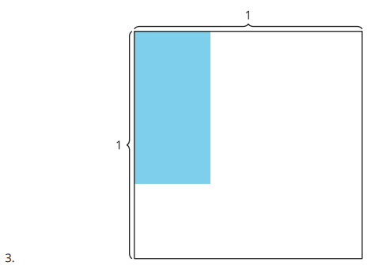
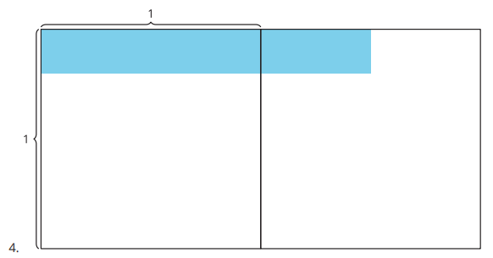
Estimate With Expressions
Activity #1
Write a multiplication expression that might represent the area of the shaded rectangle. Be prepared to explain your reasoning.

Slide 35
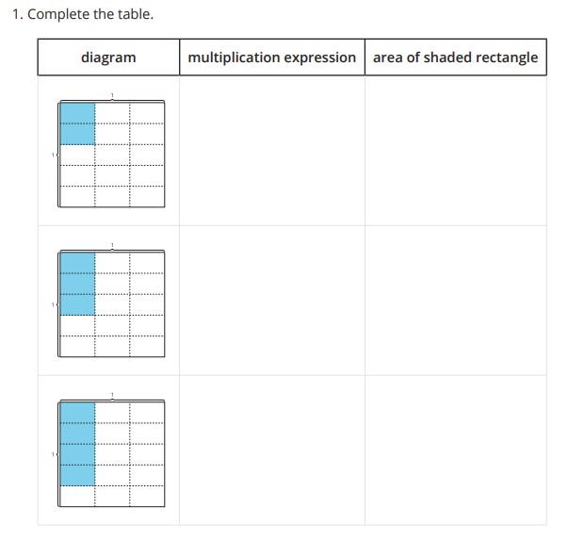
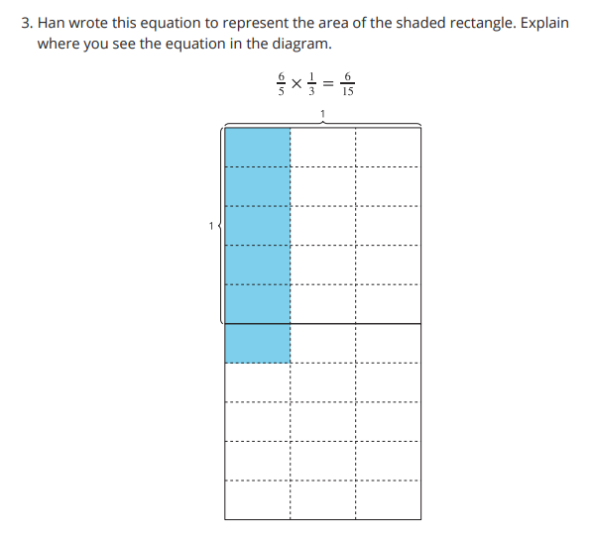

Write Equations
Activity #2

Slide 36
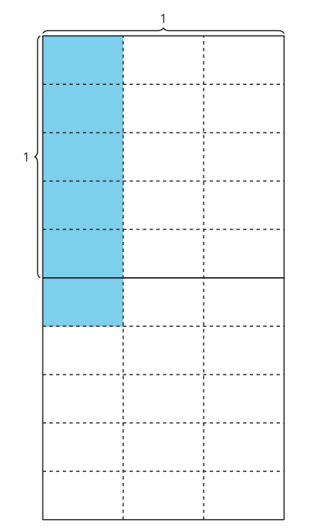
Today we multiplied a unit fraction by a non-unit fraction.
Lesson Synthesis
Kiran wrote this explanation: I think the area of the shaded rectangle is 6/30 because 6/10 of ⅓ of the whole thing is shaded.
What do you think Kiran means?
What mistake did Kiran make?

Slide 37
Multiply Fractions
6
Let’s multiply two non-unit fractions using diagrams and expressions.
5.NF.B.4, 5.NF.B.4.b

Slide 38
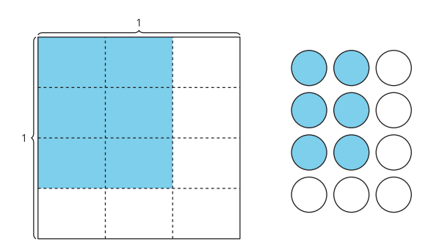
Notice and Wonder: Area and Arrays
Warm up
What do you notice?
What do you wonder?

Slide 39
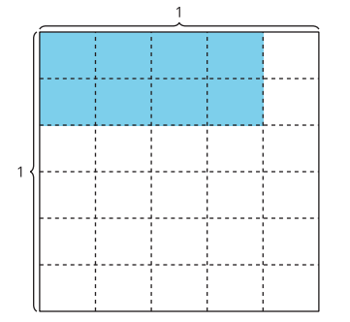
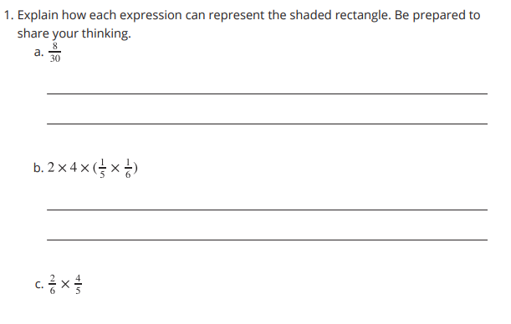
Many Expressions
Activity #1

Slide 40
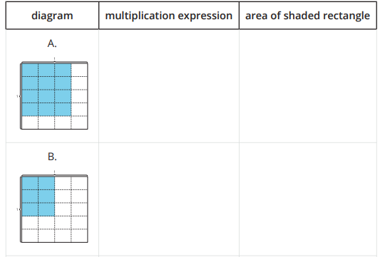
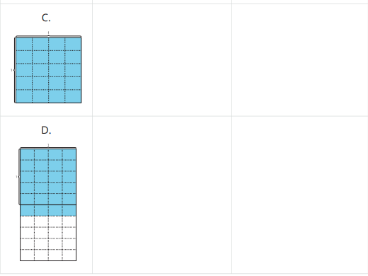
More Patterns
Activity #2
1. Complete the table.

Slide 41
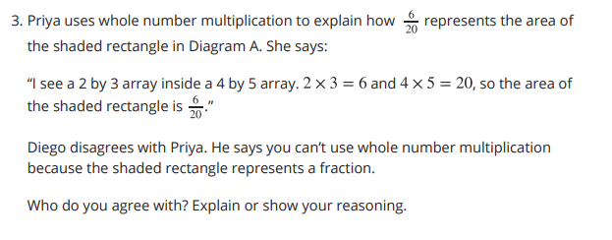
More Patterns
Activity #2

Slide 42
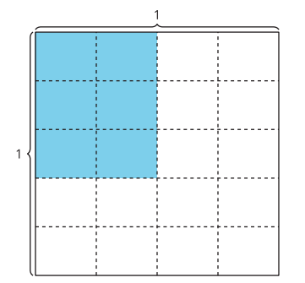


Lesson Synthesis
What does the 6 represent in the diagram?
What does the 20 represent in the diagram?
How does this expression represent the area of the shaded rectangle in Diagram A?
Discuss with a partner where you see this expression in the diagram.

Slide 43
Will It Always Work?
7
Let’s multiply fractions.
5.NF.B.4, 5.NF.B.4.a

Slide 44

Number Talk: Multiply ¾
Warm up
Evaluate each expression mentally.

Slide 45

Number Talk: Multiply ¾
Warm up
Evaluate each expression mentally.

Slide 46

Number Talk: Multiply ¾
Warm up
Evaluate each expression mentally.

Slide 47

Number Talk: Multiply ¾
Warm up
Evaluate each expression mentally.

Slide 48
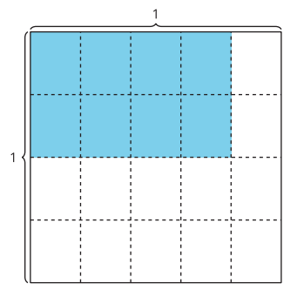
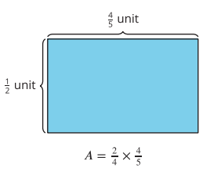
Equations and Area
Activity #1
Look at the two shaded rectangles. What do you notice? What do you wonder?

Slide 49
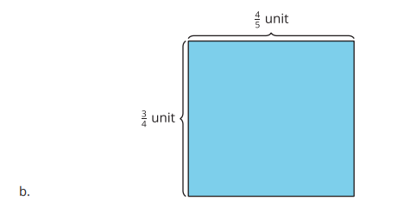
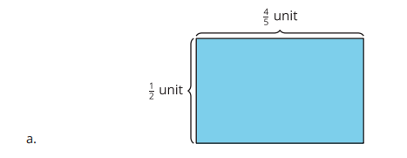
Equations and Area
Activity #1
1. Write a multiplication equation to represent the area of each diagram. Use a letter to represent the unknown value. Then, find the area.

Slide 50
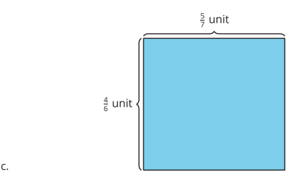
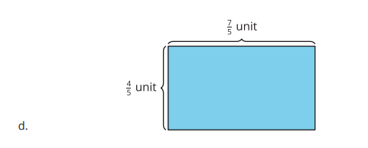
Equations and Area
Activity #1
1. Write a multiplication equation to represent the area of each diagram. Use a letter to represent the unknown value. Then, find the area.

Slide 51
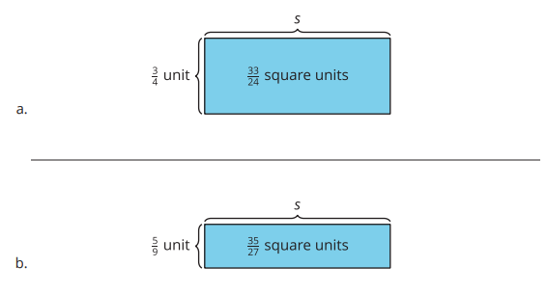
Equations and Area
Activity #1
2. Write a multiplication equation to represent the area of each diagram. Use a letter to represent the unknown value. Then, find the unknown value.

Slide 52
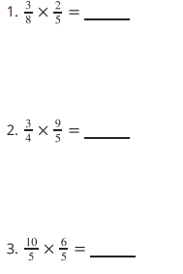
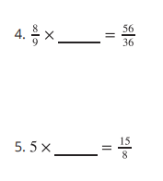
Multiply Fractions
Activity #2
Complete each equation. Draw a diagram, if it is helpful.

Slide 53
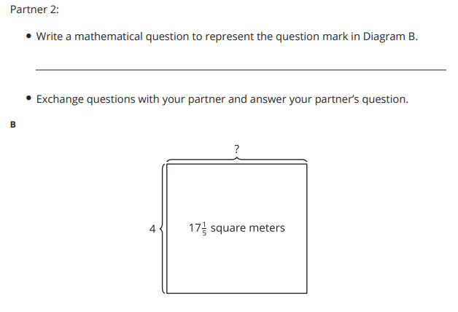
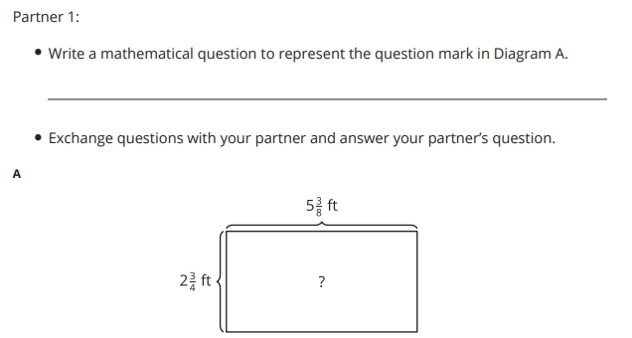
Any Questions? (Optional)
Activity #3

Slide 54
Lesson Synthesis
What do you know about multiplying fractions?

Slide 55
Solve Problems with Fraction Multiplication
8
Let’s solve problems about flags.
5.NF.B.4.a, 5.NF.B.6

Slide 56

Number Talk: ( 13/5)
Warm up
Evaluate each expression mentally.

Slide 57

Number Talk: ( 13/5)
Warm up
Evaluate each expression mentally.

Slide 58

Number Talk: ( 13/5)
Warm up
Evaluate each expression mentally.

Slide 59

Number Talk: ( 13/5)
Warm up
Evaluate each expression mentally.

Slide 60


Flags
Activity #1
Jada has a small replica of a flag of Thailand.
It is 5 inches wide and 7 ½ inches long

Slide 61


More Flags
Activity #2
Han has a replica of the flag of Columbia. It is 3 ½ inches wide and 5 ¼ inches long. The yellow stripe is ½ of the width of the flag and the blue and red stripes are each ¼ of the width.

Slide 62


Today we solved problems using measurements of flags.
Lesson Synthesis
What might Kiran mean?
Kiran says the area of the red, white, and blue sections are equal. Do you agree?
What information in the problem confirms what Kiran said.

Slide 63



Section Summary
In this unit, we learned to multiply fractions. First we learned to multiply unit fractions. For example, we learned that . Another way to show this relationship is with a diagram.
In diagram A, we can see that ⅓ of ¼ of a square is the same size as 1/12 of the whole square. Next, we learned to multiply unit fractions by non-unit fractions. For example, we learned that .

Slide 64

Section Summary
In diagram B, we can see that ⅖ of ⅓ of a square is the same size as 2/15 of the whole square. Next, we learned how to multiply any fraction by a fraction

Slide 65



Section Summary
In diagram C, we can see that . We can multiply the numerators, 4 x 5 to find the numerator in the product. We can multiply the denominators, 6 x 7 , to find the denominator in the product. We can represent this relationship with the equation: Diagram C represents a 4 by 5 array inside a 5 by 7 array. It also represents 20 pieces that are each 1/42 of the whole square.

Slide 66
Whole Number Division
9
Let’s think about quotients
5.NBT.B.7, 5.NF.B.7

Slide 67
Number Talk: Same Dividend, Different Divisor
Warm up
Find the value of each expression mentally.

Slide 68
Number Talk: Same Dividend, Different Divisor
Warm up
Find the value of each expression mentally.

Slide 69
Number Talk: Same Dividend, Different Divisor
Warm up
Find the value of each expression mentally.

Slide 70
Number Talk: Same Dividend, Different Divisor
Warm up
Find the value of each expression mentally.

Slide 71


Share Pretzels
Activity #1
Order the situations from greatest to least based on the number of pretzels each student will get. Be prepared to explain your reasoning.

Slide 72


Division Patterns
Activity #2

Slide 73
Lesson Synthesis
Today we noticed patterns while dividing whole numbers.
What do we know about division?
What do you still wonder about division?

Slide 74
Divide a Unit Fraction by a Whole Number
10
Let’s divide a unit fraction by a whole number.
5.NF.B.7.a, 5.NF.B.7.b

Slide 75
Number Talk:
Double the Divisor
Warm up
Find the value of each expression mentally.

Slide 76
Number Talk:
Double the Divisor
Warm up
Find the value of each expression mentally.

Slide 77
Number Talk:
Double the Divisor
Warm up
Find the value of each expression mentally.

Slide 78
Number Talk:
Double the Divisor
Warm up
Find the value of each expression mentally.

Slide 79

More Macaroni and Cheese
Activity #1
Jada and her 2 sisters equally share ½ a pan of macaroni and cheese.
1. Draw a diagram to represent the situation.
2. Explain how this expression represents the situation:
3. How much of the whole pan of macaroni and cheese will each person get?

Slide 80


More People Share
Activity #2
1.
4 people equally share ½ a pan of macaroni and cheese.
a. Draw a diagram to represent the situation.
b. Explain where you see .
c. How much macaroni and cheese did each person get? Be prepared to explain your reasoning
2.
5 people equally share ½ a pan of macaroni and cheese.
a. Draw a diagram to represent the situation.
b. Explain where you see .
c. How much macaroni and cheese did each person get? Be prepared to explain your reasoning.
d. How are the problems the same? How are they different?

Slide 81
Lesson Synthesis
What can we add to our poster to show what we learned about division today?

Slide 82
Patterns with Division of a Unit Fraction by a Whole Number
11
Let’s make sense of the division of a unit fraction by a whole number.
5.NF.B.7.b

Slide 83


Estimation Exploration:
How Much is Shaded?
Warm up

Slide 84


Diagrams, Equations, Situations
Activity #1

Slide 85

Diagrams, Equations, Situations
Activity #1

Slide 86

Reason About Revisions
Activity #2

Slide 87


Look for Patterns
Activity #3

Slide 88

Lesson Synthesis
What are some numbers we can write in the blanks to make the equation true?
Explain to your partner why the number in the blanks on each side of the equation is the same

Slide 89
Dividing a Whole Number by a
Unit Fraction
12
Let’s divide whole numbers by unit fractions.
5.NF.B.7.b

Slide 90

Notice and Wonder: Quilts
Warm up
What do you notice?
What do you wonder?

Slide 91



My Way Quilt
Activity #1
Below are diagrams that show strips of different colored paper. Each strip is 2 feet long.
The paper strips will be cut into different sized pieces
4. Describe what was the same about the problems you solved. Describe what was different.

Slide 92

More Quilt Strips
Activity #2
Kiran has a yellow strip of paper that is 2 feet long.
He wants to cut the strip into foot pieces.
1. How many pieces will Kiran have? Show or explain your reasoning.
2. Write a division equation to represent the situation.
3. How would the number of pieces change if Kiran had a strip of paper that is 3 feet long?
4. Describe how this equation represents a strip of paper that is 3 feet long being cut into equal sized pieces

Slide 93

Today, we solved problems about cutting strips of paper into small pieces. We wrote equations to represent dividing a whole number by a unit fraction
Lesson Synthesis
Here is another equation we discussed. In this equation, the size of the piece is the same as the equation above it. Why is the quotient larger than the dividend?
These are some of the equations we discussed today. Why is the quotient getting larger in each equation?
We are going to learn more about the relationships between the numbers in division equations with unit fractions in the next lesson.

Slide 94
More Division of Whole Numbers by Unit Fractions
13
Let’s use equations to represent division of a whole number by a unit fraction.
5.NF.B.7.b

Slide 95
Number Talk:
Increasing Quotients
Warm up
Find the value of each expression mentally.

Slide 96

Number Talk:
Increasing Quotients
Warm up
Find the value of each expression mentally.

Slide 97

Number Talk:
Increasing Quotients
Warm up
Find the value of each expression mentally.

Slide 98

Number Talk:
Increasing Quotients
Warm up
Find the value of each expression mentally.

Slide 99


Notice Patterns
Activity #1

Slide 100



Match the Situation to the Equation
Activity #2

Slide 101
Today we used equations to represent and solve problems involving the division of a whole number by a unit fraction
Lesson Synthesis
Jada says when you divide a whole number by a unit fraction, the answer will always be a whole number
Do you agree with Jada? Be prepared to explain your thinking
Discuss your thinking with your partner.

Slide 102
Make Connections
14
Let’s connect what we know about multiplication and division.
5.NF.B.7, 5.NF.B.7.b

Slide 103

Estimation Exploration:
How Many One Fifths?
Warm up

Slide 104


Greater Than or Less Than 1
Activity #1

Slide 105


Solve Equations
Activity #2
Solve the equations.

Slide 106
Lesson Synthesis
What is the same and different about the explanations?

Slide 107
Match, Solve, and Write
15
Let’s solve division problems involving whole numbers and unit fractions.
5.NF.B.7, 5.NF.B.7.c

Slide 108
Number Talk
Warm up

Slide 109
Number Talk
Warm up

Slide 110

Number Talk
Warm up

Slide 111

Number Talk
Warm up

Slide 112

Card Sort: Fraction Division Problem Sort
Activity #1

Slide 113

Division Story Problems
Activity #2

Slide 114
Lesson Synthesis
What can we add to our chart to show what we learned about division in this section?

Slide 115
How Much in One?
16
Let’s solve “How much in one?” problems.
5.NF.B.7.b

Slide 116


Estimation Exploration:
What Number Goes in the Blank?
Warm up

Slide 117



Different Equations
Activity #1

Slide 118


How Big is the Class?
Activity #2

Slide 119

How many in One Group? (Optional)
Activity #3

Slide 120

Section Summary
In this unit, we learned to divide with whole numbers and unit fractions. We used diagrams to solve problems involving division of unit fractions by whole numbers.

Slide 121

Section Summary

Slide 122

Section Summary

Slide 123
Fraction Multiplication and Division
17
Let’s multiply and divide fractions.
5.NF.B.4, 5.NF.B.6, 5.NF.B.7

Slide 124

Number Talk:
Multiply and Divide
Warm up
Find the value of each expression mentally.

Slide 125

Number Talk:
Multiply and Divide
Warm up
Find the value of each expression mentally.

Slide 126

Number Talk:
Multiply and Divide
Warm up
Find the value of each expression mentally.

Slide 127

Number Talk:
Multiply and Divide
Warm up
Find the value of each expression mentally.

Slide 128

Info Gap: Tiles
Activity #1

Slide 129

Info Gap: Tiles
Activity #1

Slide 130

Multiplication or Division (Optional)
Activity #2
Solve each problem. Show or explain your reasoning.

Slide 131

Lesson Synthesis
Describe one relationship to your partner
What relationships do you see in these problems?
What do we know about the relationship between multiplication and division?

Slide 132
Multiplication and Division 1
18
Let’s solve problems involving multiplication and division with fractions.
5.NF.B.4, 5.NF.B.6, 5.NF.B.7

Slide 133


Estimation Exploration: Multiply Fractions
Warm up

Slide 134


To Multiply or Divide? Part 1
Activity #1
Some of the problems below can be solved using multiplication or division. Other problems need a different operation.

Slide 135

To Multiply or Divide? Part 1
Activity #1
Some of the problems below can be solved using multiplication or division. Other problems need a different operation.

Slide 136

To Multiply or Divide? Part 2
Activity #2

Slide 137

Lesson Synthesis
Today we looked at different situations and analyzed those that could be solved using either multiplication or division.
Andre has ⅓ of a bottle of juice. He has 10 ounces in his bottle. How much juice does the bottle hold when it is completely full?
How do we see both of these equations in this situation?

Slide 138
Multiplication and Division 2
19
Let’s solve real world multiplication and division problems.
5.NF.B, 5.NF.B.4, 5.NF.B.6, 5.NF.B.7

Slide 139

Number Talk:
Three and a Tenth
Warm up

Slide 140

Number Talk:
Three and a Tenth
Warm up

Slide 141

Number Talk:
Three and a Tenth
Warm up

Slide 142

Number Talk:
Three and a Tenth
Warm up

Slide 143

Putting it All Together:
Multiplication and Division
Activity #1
1. Draw a diagram to represent the situation.
2. Write a division equation to represent the situation.
3. Write a multiplication to represent the situation

Slide 144

Putting it All Together:
Multiplication and Division
Activity #1
1. Draw a diagram to represent the situation.
2. Write a division equation to represent the situation.
3. Write a multiplication to represent the situation

Slide 145

Multiplication or Division?
Activity #2

Slide 146

Multiplication or Division?
Activity #2

Slide 147

Multiplication or Division?
Activity #2

Slide 148
Lesson Synthesis
What do we know about the relationship between multiplication and division?”

Slide 149

Section Summary

Slide 150

Section Summary
We also wrote multiplication and division equations to represent the same diagram. For example:

Slide 151
Section Summary

