Slide 1

Fractions as Quotients and Fraction Multiplication
Grade 5: Unit 2
Standards addressed: 5.NF.B.3, 5.NF.B.4, 5.NF.B.7
These slides have been created by Britnee Wright- Southeast Arkansas Education Cooperative and are not official IM materials. Images and language are taken from IM Grade 5, Unit 2 by Illustrative Mathematics.
Copyright 2020 by Illustrative Mathematics. All Rights Reserved, adapted and shared with permission.

Slide 2


Unit 2 Progression Overview
Section A
Lessons 1-5
5.NF.B.3
Section B
Lessons 6-8
5.NF.B.4
Section C
Lessons 9-17
5.NF.B.4, 5.NF.B.7
Represent and explain the relationship between division and fractions.
Solve problems involving division of whole numbers leading to answers that are fractions.
Extend understanding of the relationship between multiplication and division to fractions.
Represent and solve problems involving multiplication of a whole number by a fraction.
Write and interpret numerical expressions using the relationship between multiplication and division.
Find the area of a rectangle when one side length is a whole number and the other side length is a fraction or mixed number.
Represent and solve problems involving the multiplication of a whole number by a fraction or mixed number.
Write, interpret and evaluate numerical expressions that represent multiplication of a whole number by a fraction or mixed number.

Slide 3



Unit 2 Quick Links
Adapt 1
Adapt 2
L1
L2
L3
L4
L5
L6
L7
L8
L9
L10
L11
L12
L13
L14
L15
L16

Slide 4
Finding All Kinds of Quotients
Adaptation
Lesson 1
Let’s solve problems involving division.
OA.B.4
Notes:
The purpose of this lesson is for students to represent and solve contextual problems that involve dividing a whole number of up to four digits by a single-digit divisor, resulting in a number with or without a remainder. Students also interpret the result and remainder in context.

Slide 5




True or False: Multiples
Warm up
Is each statement true or false? Be prepared to explain your reasoning.
Notes:
10 minutes
The purpose of this warm-up is to elicit strategies and understandings students have for identifying multiples of small numbers, primarily by looking for and making use of structure (MP7). These understandings will be helpful later when students solve division problems that involve distinguishing quotients with and without a remainder.
Give me a signal when you know whether the equation is true and can explain how you know.
Synthesis
● How can you use the second and third statements to help you reason about the fourth statement? (Because 105 is a multiple of 3 and 5, it is also a multiple of 15.)
● How do you know if a number is a multiple of a different number? (When you divide a multiple by that number, it will result in a whole-number quotient without a remainder.)

Slide 6
Muffins & Seats
Activity #1
Two bakers at a bakery made 378 muffins. The muffins are put in boxes of 4.
○ The first baker says they will need 94 boxes for all the muffins.
○ The second baker says 95 boxes are needed.
Who do you agree with? Explain or show your reasoning.
An auditorium seats 258 people. The seats are arranged in rows of 9, but there is one short row with fewer than 9 seats.
How many regular rows are there? How many seats are in the shorter row?
Notes:
15 minutes
This activity encourages students to interpret the quantities in situations, represent them mathematically, use their models to find solutions, and then interpret their solutions in context. The dividends here are limited to three-digit numbers.
Launch: Groups of 2
● 5–6 minutes: quiet work time
● 2–3 minutes: partner discussion
● Monitor for the strategies students use to divide the numbers and the different ways they interpret the remainder in each question.
Synthesis:
Invite students to share their responses and reasoning.
● For the first question, highlight that both 94 and 95 boxes are plausible if they could be defended and the assumptions are made clear. (For example, Students might say that the bakers could have two leftover muffins rather than trying to sell them in boxes, so 94 boxes are enough.)
● For the second question, ask: “What equation could we write to describe the relationship between the number of rows and the number of seats?” (One possible equation: (68 x 9) + 6 = 258.)

Slide 7
Save for a Garden
Activity #2
A school needs $1,270 to build a garden. After saving the same amount each month for 8 months, the school is still short by $6.
How much did they save each month? Explain or show your reasoning.
Choose one of the following division expressions.
711 ÷ 3 3,128 ÷ 8
Write a situation to represent the expression.
Find the quotient. Show your reasoning.
Explain what the value means in the situation you invented.
Notes:
20 minutes
In this activity, students continue to solve contextual problems that involve division. Here, the dividends extend to four-digit numbers and the problems demand a greater lift, prompting students to persevere in making sense of them (MP1). In the second half of the activity, students are asked to reason in the opposite direction: given a division expression, they are to invent a situation that it can represent and interpret the value of the expression in context.
Launch:
3–4 minutes: quiet work time for the first question ● Invite students to share responses and reasoning. ● “What equation(s) can we write to represent the relationship between the monthly saving, the number of months of saving, and the amount needed for the garden?” (One possible equation: (8 x 158) + 6 = 1,270) ● 5–7 minutes: quiet work time for the second question ● Give access to tools for creating a visual display for the second question
Synthesis:
Students find a partner who chose a different expression and take turns presenting their display. The person listening should consider whether the response makes sense and check if the quotient is correct. ● If time permits, find another partner to present their display.

Slide 8

Let’s Put it All Together
Lesson Synthesis
What strategies did you find yourself using to divide numbers?
Notes:
Use partial products
Use partial quotients
Draw diagrams
Divide by place value
Write a series of equations
Estimate first
Use other ways

Slide 9
Representations of Fractions (Part 1)
Adaptation
Lesson 2
Let’s name some fractions and represent them visually
OA.B.4
Notes:
The purpose of this lesson is for students to make sense of unit fractions with denominators 2, 3, 4, 5, 6, 8, 10, and 12, using physical and visual representations.

Slide 10
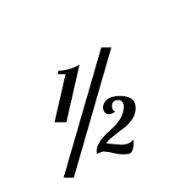
What Do you Know About ½ ?
Warm up
What do you know about this number?
Notes:
10 minutes
The purpose of this warm-up is to invite students to share what they know about the number ½ and elicit ways in which it can be represented. It gives the teacher the opportunity to hear students’ understandings about and experiences with fractions, ½ in particular. The fraction ½ is familiar to students and will be central in the first activity.
Launch:
Groups of 2 ● Display the number . 2 1 ● “What do you know about this number?” ● 1 minute: quiet think time
Synthesis:
“What different ways can we represent ?” (Cut an object, a rectangle, a shape 2 1 into two equal pieces, mark the middle point between 0 and 1 on a number line.)

Slide 11
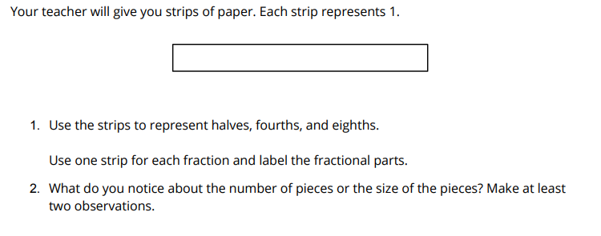
Fraction Strips
Activity #1
Notes:
20 minutes
The purpose of this activity is for students to use fraction strips to represent halves, fourths, and eighths. The denominators in this activity are familiar from grade 3. The goal is to remind students of the relationships between fractional parts in which one denominator is a multiple of another. Students should notice that each time the unit fractions on a strip are folded in half, there are twice as many equal-size parts on the strip and that each part is half as large. In the discussion, use the phrases “number of parts” and “size of the parts” to reinforce the meaning of a fraction.
Launch:
Groups of 2 ● 4 paper strips and a straightedge for each group ● Hold up one strip for all to see. ● “For this activity, each strip represents 1.” ● Label that strip with the number 1 and tell students to do the same on one of their strips. ● “Take a new strip. How would you fold it to show halves?” ● 30 seconds: partner think time ● Share responses “Think about how you would show fourths on the third strip and eighths on the last strip.”
Activity:
● “Work with your partner to complete the task.” ● 10 minutes: partner work time ● Monitor for students who notice that each denominator is twice of the next smaller denominator.
Synthesis:
● Select a group to share their paper strips and how they identified those fractional parts. Ask if others in the class also found them the same way.

Slide 12
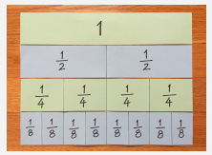
Fraction Strips
Synthesis
What do you notice about the number and size of the parts on the strips?
Notes:
20 minutes
The purpose of this activity is for students to use fraction strips to represent halves, fourths, and eighths. The denominators in this activity are familiar from grade 3. The goal is to remind students of the relationships between fractional parts in which one denominator is a multiple of another. Students should notice that each time the unit fractions on a strip are folded in half, there are twice as many equal-size parts on the strip and that each part is half as large. In the discussion, use the phrases “number of parts” and “size of the parts” to reinforce the meaning of a fraction.
Launch:
Groups of 2 ● 4 paper strips and a straightedge for each group ● Hold up one strip for all to see. ● “For this activity, each strip represents 1.” ● Label that strip with the number 1 and tell students to do the same on one of their strips. ● “Take a new strip. How would you fold it to show halves?” ● 30 seconds: partner think time ● Share responses “Think about how you would show fourths on the third strip and eighths on the last strip.”
Activity:
● “Work with your partner to complete the task.” ● 10 minutes: partner work time ● Monitor for students who notice that each denominator is twice of the next smaller denominator.
Synthesis:
● Select a group to share their paper strips and how they identified those fractional parts. Ask if others in the class also found them the same way.
If the terms “numerator” and “denominator” did not arise during discussion, ask students about them. ● Remind students that the denominator, the number at the bottom of a fraction, tells us the number of equal-size parts in 1 whole, and the numerator, the number at the top of a fraction, refers to how many of those parts are being described. Consider displaying these terms and their meanings for students to reference. ● Ask students to save the fraction strips for a future lesson

Slide 13
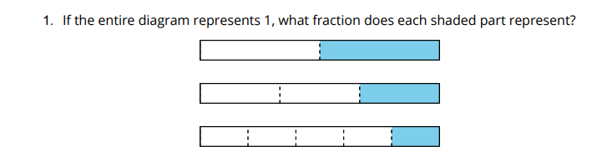
Fractions, Represented
Activity #2
Notes:
20 minutes
Previously, students revisited some benchmark fractions (halves, fourths, and eighths) and recalled the meaning of numerators and denominators. The purpose of this activity is for students to revisit the meaning of unit fractions with some other denominators (3, 5, 6, 10, and 12) and be reminded of how to name and represent them. As they draw diagrams to represent these fractions, students have opportunities to look for structure and make use of the relationships between the denominators of the fractions (MP7). To support students in drawing straight lines on the tape diagrams, provide access to a straightedge or ruler. Students should not, however, use rulers to measure the location of a fraction on any diagram. This activity uses MLR1 Stronger and Clearer Each Time. Advances: reading, writing
Launch:
● Groups of 2 ● Straightedge for each student ● “Let’s look at some other fractions and draw diagrams to represent them. Consider using a straightedge when you draw.”
Activity:
● 7–8 minutes: independent work time ● “Discuss your responses with your partner. Be sure to talk about how you created diagrams for , , and .” 6 1 1 10 1 12 ● 2–3 minutes: partner discussion ● Monitor for students who: ○ notice the relationship of thirds, sixths, and twelfths, and of fifths and tenths ○ use the given tape diagrams to help partition the other diagrams

Slide 14
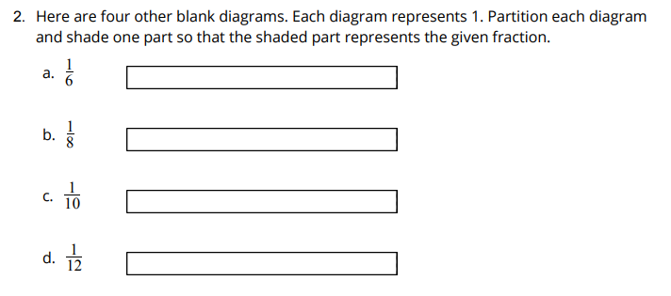
Fractions, Represented
Activity #2
Notes:
20 minutes
Previously, students revisited some benchmark fractions (halves, fourths, and eighths) and recalled the meaning of numerators and denominators. The purpose of this activity is for students to revisit the meaning of unit fractions with some other denominators (3, 5, 6, 10, and 12) and be reminded of how to name and represent them. As they draw diagrams to represent these fractions, students have opportunities to look for structure and make use of the relationships between the denominators of the fractions (MP7). To support students in drawing straight lines on the tape diagrams, provide access to a straightedge or ruler. Students should not, however, use rulers to measure the location of a fraction on any diagram. This activity uses MLR1 Stronger and Clearer Each Time. Advances: reading, writing
Launch:
● Groups of 2 ● Straightedge for each student ● “Let’s look at some other fractions and draw diagrams to represent them. Consider using a straightedge when you draw.”
Activity:
● 7–8 minutes: independent work time ● “Discuss your responses with your partner. Be sure to talk about how you created diagrams for , , and .” 6 1 1 10 1 12 ● 2–3 minutes: partner discussion ● Monitor for students who: ○ notice the relationship of thirds, sixths, and twelfths, and of fifths and tenths ○ use the given tape diagrams to help partition the other diagrams
“How did you know how to partition the diagrams in the second question?”

Slide 15
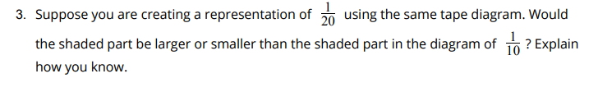
Fractions, Represented
Activity #2
Notes:
20 minutes
Previously, students revisited some benchmark fractions (halves, fourths, and eighths) and recalled the meaning of numerators and denominators. The purpose of this activity is for students to revisit the meaning of unit fractions with some other denominators (3, 5, 6, 10, and 12) and be reminded of how to name and represent them. As they draw diagrams to represent these fractions, students have opportunities to look for structure and make use of the relationships between the denominators of the fractions (MP7). To support students in drawing straight lines on the tape diagrams, provide access to a straightedge or ruler. Students should not, however, use rulers to measure the location of a fraction on any diagram. This activity uses MLR1 Stronger and Clearer Each Time. Advances: reading, writing
Launch:
● Groups of 2 ● Straightedge for each student ● “Let’s look at some other fractions and draw diagrams to represent them. Consider using a straightedge when you draw.”
Activity:
● 7–8 minutes: independent work time ● “Discuss your responses with your partner. Be sure to talk about how you created diagrams for , , and .” 6 1 1 10 1 12 ● 2–3 minutes: partner discussion ● Monitor for students who: ○ notice the relationship of thirds, sixths, and twelfths, and of fifths and tenths ○ use the given tape diagrams to help partition the other diagrams

Slide 16
Fractions, Represented
Synthesis
What relationships do you see between the fractions in this activity?”
Notes:
“What relationships do you see between the fractions in this activity?” Sample responses: ○ As the denominator gets larger, each fractional part gets smaller. ○ Halves, fourths, and eighths are related in that twice 2 is 4 and twice 4 is 8. ○ Thirds, sixths, and twelfths are related in that a third is 2 sixths and a sixth is 2 twelfths. Fifths and tenths are related in the same way
“Share your response to the last question with your partner. Take turns being the speaker and the listener. If you are the speaker, share your response. If you are the listener, ask questions and give feedback to help your partner improve their work.”

Slide 17
Let’s Put it All Together
Lesson Synthesis
In general, what does the denominator in a fraction represent?
What does the fraction ⅕ tell us?
What did you notice about the size of a fraction as the denominator gets larger?
What relationships did we see between the fractions that we studied today?
Notes:
“Today we refreshed our memory about fractions like , , , , and so on. We used fraction strips 2 1 3 1 4 1 5 1 and diagrams to represent these fractions.”

Slide 18
Today, we named fractions and represented them visually.
Next, let’s learn more about fractions and tape diagrams.

Slide 19
Representations of Fractions (Part 2)
Adaptation
Lesson 2
Let’s name some other fractions and represent them with tape diagrams.
OA.B.4
Notes:
The purpose of this lesson is for students to make sense of non-unit fractions (including those greater than 1) that have denominators 2, 3, 4, 5, 6, 8, 10, and 12, using tape diagrams to do so.

Slide 20
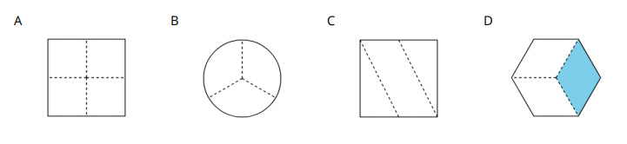
Which One Doesn’t Belong: All Cut Up
Warm up
Notes:
10 minutes
This warm-up prompts students to carefully analyze and compare the features of four shapes that are each partitioned. It enables the teacher to hear the terminologies students know and how they talk about fractions and fractional parts. In making comparisons, students have a reason to use language precisely (MP6).
Launch:
Groups of 2 ● Display the image.“Pick one that doesn’t belong. Be ready to share why it doesn’t belong.” ● 1 minute: quiet think time
Synthesis:
“What does the shaded part in D represent?” ( or one-third of the shape) 3 1 ● Shade one part of B and C. ● “Is each shaded part one-third of the shape as well?” (Yes for B, no for C.) ● “Why is the shaded part not one-third of the square in C?” (The parts aren’t equal in size.) ● Shade one part of A. “Is it a third of the square?” (No, it is or one-fourth)

Slide 21
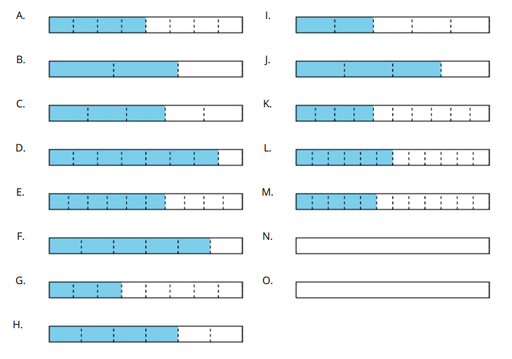
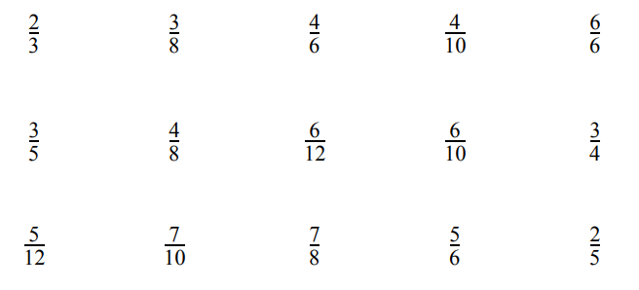
Matching: A Diagram for Each Fraction
Activity #1
Match each fraction with a tape diagram that represents it. Two of the fractions are not represented. Create a representation for each of them.
Notes:
20 minutes
The purpose of this activity is to activate what students know about the meaning and size of non-unit fractions. Students match a set of fractions with tape diagrams that represent them. In doing so, they recall that a non-unit fraction can be understood as a parts of a unit fraction . They also recall b a b 1 that fractions with different numerators and denominators can have the same representation. The reasoning they do and the representations they use here echo their work on equivalence from grade 3.
Launch:
Groups of 2 ● Straightedge for each student ● Record and display the fraction for all 4 1 to see. ● “Describe to your partner what the fraction strip would look like for this fraction.” ● 30 seconds: partner discussion Record and display the fraction for all 4 2 to see. ● “Describe what the fraction strip would look like for this fraction.” ● 30 seconds: partner discussion ● Share responses. ● “In an earlier lesson, we looked at fractions with 1 for the numerator. Now let’s look at fractions with other numbers for the numerator.” ● Draw students’ attention to the list of fractions in the task. As a class, read aloud the word name of each fraction
Activity:
“Take a minute to think quietly about how you might match each fraction with a diagram that represents it.” ● 1 minute: quiet think time ● “Work with a partner to match each fraction with a diagram. Two of the fractions have no matching diagrams. Use the blank tapes to create representations for them.” ● 10 minutes: group work time
Synthesis:
To add movement to the activity, students can check their matches with other groups in the room before the synthesis. ● Invite students to share how they went about making the matches. ● Highlight explanations that emphasize the meaning of numerator and denominator in a fraction. ● Ask students if they noticed that some diagrams have the same amount shaded but the fractions they represent have different numbers. “Which diagrams show this?” (A and L, B and H, C and E, I and J) ● “What does it mean that the diagrams representing those fractions are the same?” (The fractions are the same size. The term “equivalent” may or may not come up at this point.)

Slide 22
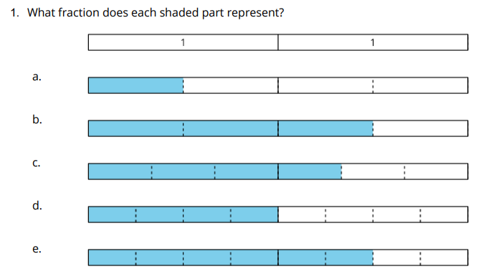
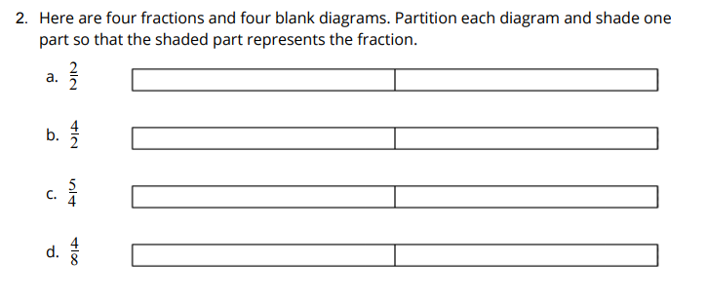
Diagrams for Some Other Fractions
Activity #2
Notes:
15 minutes
The purpose of this activity is to extend students’ reasoning about the meaning of numerator and denominator and the size of non-unit fractions to include fractions greater than 1. Students are prompted to reason both ways: to match fractions to tape diagrams that represent them, and to create tape diagrams that represent fractions. Some students may benefit from having physical manipulatives to help them conceptualize fractions that are greater than 1. Consider using fraction strips to support them—for instance, by asking them to fold as many strips as needed to represent, say, 4 halves or 5 fourths. As in the previous lesson, rulers can be provided to help students draw, extend, or align partition lines, but should not be used to measure the location of a fraction on any diagram.
Launch:
Groups of 2 ● Ask students to retrieve the fraction strips they created in a previous lesson. ● “How can you show with a fraction 4 3 strip?” (Find the strip showing fourths, highlight 3 parts of fourths.) ● “How can you show ?” 4 8 ● 30 seconds: partner discussion ● If students say that they don’t have enough strips that show fourths, ask them to work with another group and combine their strips. ● Ask groups to share how they used strips to represent . Students may think of 4 8 different ways (including using fourths and halves, or fourths and eighths). ● Highlight one thing all representations share: to show , two strips are used. 4 8 ● Display two strips that show fourths side by side, as shown. ● ● Count the fourths: “ , , . . . , .” 4 1 4 2 4 8 ● “How many fourths did we count?” (8) “How many wholes was that?” (2) ● Straightedge for each student
Activity:
“Take a couple of quiet minutes to work on the first question. Afterward, discuss your responses with your partner.” ● “Both you and your partner should be prepared to explain how you know what fractions the diagrams represent.” ● 2–3 minutes: independent work time on the first question ● 2 minutes: partner discussion ● Monitor for students who reference the length of 1 whole on the tape diagram (rather than the entire length, which is 2) to determine the size of the fractional parts. ● Pause for a discussion. Invite students to share their responses and reasoning for the first question. ● “How did you determine the fractions the diagrams represent?” (Count the number of parts in 1, and then count the number of shaded pieces.) ● Display students’ work, or display and annotate the tape diagrams as they explain. ● Consider labeling each fractional part with the corresponding unit fraction and counting each shaded part aloud (“1 half, 2 halves, 3 halves,” “1 third, 2 thirds, 3 thirds, 4 thirds,” and so on) before writing the value of the shaded parts as or .Ask students to work with their partner to create the diagrams in the second question. ● “You may use a straightedge to help you draw your diagrams.” ● 5–7 minutes: partner work time
Synthesis:
● Select students to share their completed diagrams. ● “How did you know how many pieces to partition each diagram and how many parts to shade?“ (Cut each 1 whole portion into as many equal parts as the number in the denominator. Shade as many parts as the number in the numerator.) ● “How did you partition a diagram into 4 equal parts?” (Split each 1 whole into 2 parts, and then split each half into 2 parts again.) ● “How did you partition a diagram into 8 equal parts?” (Split each fourth into 2 parts.)

Slide 23
Let’s Put it All Together
Lesson Synthesis
Did you notice anything interesting about the last two diagrams you created and the fractions they represent?
Notes:
The shaded parts are the same size. They have the same amount of shading. ● The numerator and denominator in one fraction are twice the numerator and denominator in the other. ● The fractions are equivalent.)

Slide 24
Representing Equal Groups of Unit Fractions
Adaptation
Lesson 3
Let’s identify equal groups of fractions.
Notes:
The mathematical purpose of this lesson is to represent situations involving equal groups of unit fractions and understand the product is a multiple of that unit fraction.

Slide 25

How Many Do You See: Oranges
Warm up
How many do you see?
How many do you see them?
Notes:
10 minutes
The purpose of this How Many Do You See is for students to use grouping strategies to describe the images they see. The image is designed to elicit ideas about equal groups of fractions of objects. This will be useful when students work with equal groups of fractions in this lesson. While students may notice and wonder many things about these situations, ideas around describing the groups as equal and having fractional parts are the important discussion points. Students may notice the halves of oranges and describe them with whole numbers. If this happens, consider asking: “How might we describe the amount of fruit using fractions?” Students explain their reasoning as they describe the way they see the image. They also make sense of the approaches of others and identify connections between different approaches (MP1).
Launch:
Groups of 2 ● “How many do you see? How do you see them?” ● Display the image. ● 1 minute: quiet think time
Activity:
“Discuss your thinking with your partner.” ● 1 minute: partner discussion ● Record responses. ● Repeat for each image.
Synthesis:
“How might you describe this image to a friend?” (There are three plates with 2 1 an orange on each plate.) ● “How many groups do you see?” (I see 3 plates or 3 groups.) ● Describe any groups you see and how you see them. (3 groups of orange slices, 3 groups of )

Slide 26
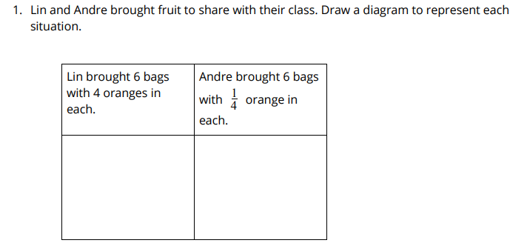
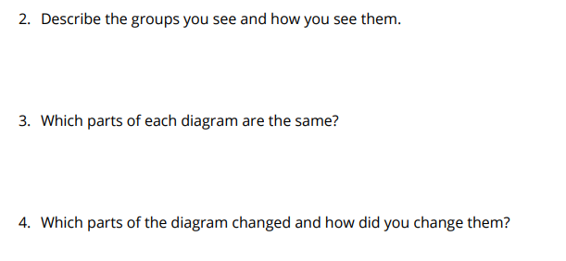
Equal Groups of Fractions
Activity #1
Notes:
20 minutes
The purpose of this activity is for students to interpret and represent situations involving equal groups of a fractional amount, and to connect such situations to multiplication of a whole number by a fraction. Students create diagrams and expressions to describe how they show “groups of” situations and then compare them. Encourage students to use any representation that makes sense to them. In grade 3, students used equal-groups diagrams when they learned multiplication. This lesson provides an opportunity for the teacher to see with which representations students are already familiar. Focus the lesson synthesis on connecting equal-groups situations with fractions and those with whole numbers. Students notice that both situations involve equal groups and describe how they know the groups are equal and also use expressions to represent equal-groups situations.
Launch:
Groups of 2 ● 1 minute: share responses ● “If you could bring fruit to share with the class, what fruit would you bring?” ● Collect student responses. Allow students to describe fruits that may be unfamiliar to the class. ● “Let’s look at what Lin and Andre brought to class.”
Activity:
Students complete problems 1–5. ● 5 minutes: independent work time ● 2 minutes: partner discussion ● Monitor for students who use the same type of representation for equal groups of whole numbers and fractions. ● Select 1–2 students to share responses to problems 3 and 4. ● 2 minutes: group discussion ● Discuss problem 5. “What expression would we use to represent Lin’s oranges? Why?” (6 x 4, because there are 6 groups of 4 oranges.) ● “What expressions would we use to represent Andre’s oranges? Why?” (6 x , 4 1 because there are 6 groups of of an 4 1 orange. We can use the same thinking as we used for whole groups.) Students complete problem 6. ● Monitor for students who have equal-groups drawings with expressions to match.
Synthesis:
Select previously identified students to describe the equal groups in the diagrams they created. ● “What expression could we use to represent the fruit Noah brought to class? Why?” (7 x , because seven groups of would be written as 7 x ). 3 1 3 1 ● “Let’s continue to think about these diagrams as we work on the next activity.”

Slide 27
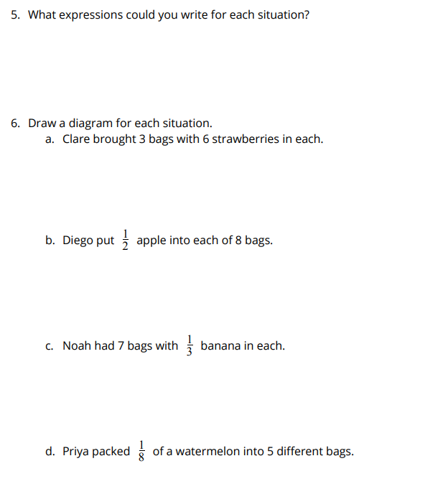
Equal Groups of Fractions
Activity #1
Notes:
20 minutes
The purpose of this activity is for students to interpret and represent situations involving equal groups of a fractional amount, and to connect such situations to multiplication of a whole number by a fraction. Students create diagrams and expressions to describe how they show “groups of” situations and then compare them. Encourage students to use any representation that makes sense to them. In grade 3, students used equal-groups diagrams when they learned multiplication. This lesson provides an opportunity for the teacher to see with which representations students are already familiar. Focus the lesson synthesis on connecting equal-groups situations with fractions and those with whole numbers. Students notice that both situations involve equal groups and describe how they know the groups are equal and also use expressions to represent equal-groups situations.
Launch:
Groups of 2 ● 1 minute: share responses ● “If you could bring fruit to share with the class, what fruit would you bring?” ● Collect student responses. Allow students to describe fruits that may be unfamiliar to the class. ● “Let’s look at what Lin and Andre brought to class.”
Activity:
Students complete problems 1–5. ● 5 minutes: independent work time ● 2 minutes: partner discussion ● Monitor for students who use the same type of representation for equal groups of whole numbers and fractions. ● Select 1–2 students to share responses to problems 3 and 4. ● 2 minutes: group discussion ● Discuss problem 5. “What expression would we use to represent Lin’s oranges? Why?” (6 x 4, because there are 6 groups of 4 oranges.) ● “What expressions would we use to represent Andre’s oranges? Why?” (6 x , 4 1 because there are 6 groups of of an 4 1 orange. We can use the same thinking as we used for whole groups.) Students complete problem 6. ● Monitor for students who have equal-groups drawings with expressions to match.
Synthesis:
Select previously identified students to describe the equal groups in the diagrams they created. ● “What expression could we use to represent the fruit Noah brought to class? Why?” (7 x , because seven groups of would be written as 7 x ). 3 1 3 1 ● “Let’s continue to think about these diagrams as we work on the next activity.”

Slide 28
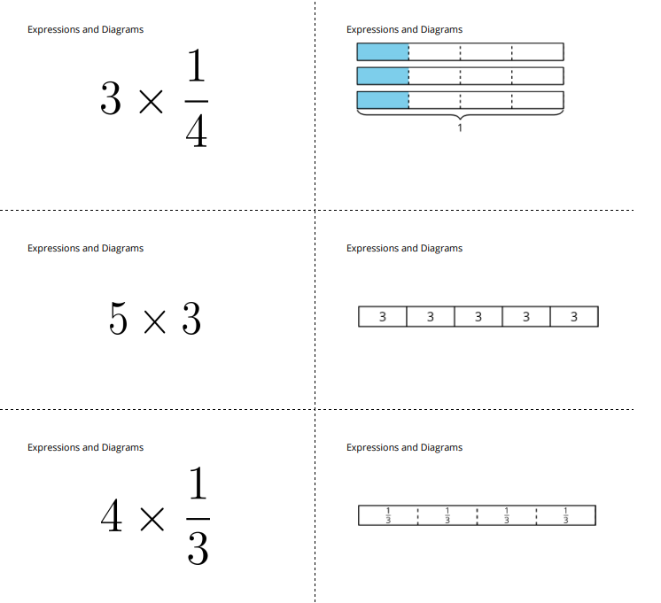
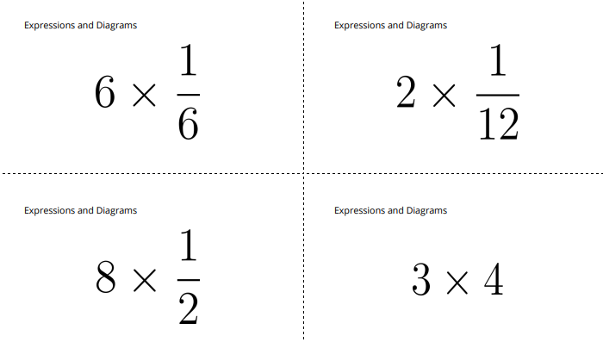
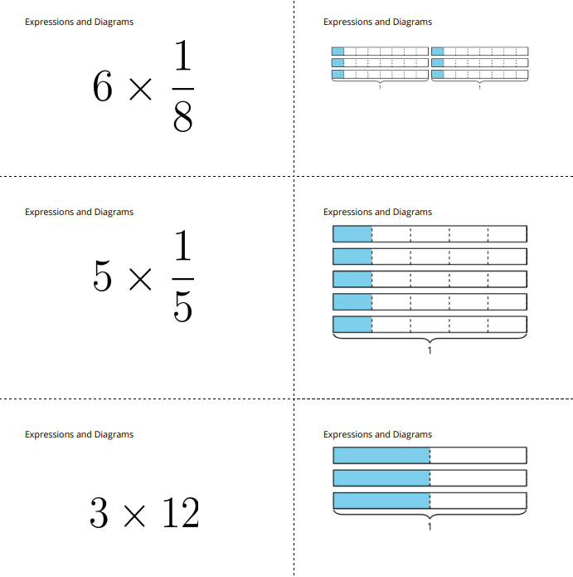
Expressions and Diagrams
Activity #2
Notes:
15 minutes
The purpose of this activity is for students to interpret multiplication expressions and diagrams as the number of groups and amount in each group. After students have matched the expressions and diagrams in problem 1, pause for a whole-class discussion for students to explain how they decided on the matches before they move to problems 2 and 3.
Launch:
Groups of 2 ● Review directions to the task.
Activity:
5 minutes: partner work time ● Monitor for students who reason about the number of groups and amount in each group as they match or draw.
Synthesis:
Select 2–3 students to describe the groups they see and how they see them. ● Consider asking different students to echo reasoning by asking: ○ “Who can say that differently?” ○ “Who can restate what _____ just said?”

Slide 29
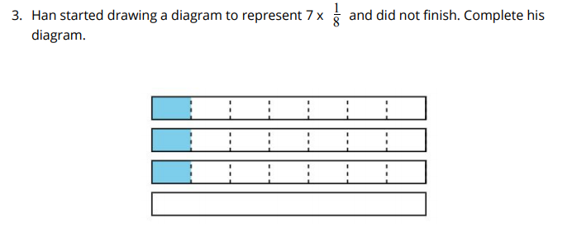
Expressions and Diagrams
Activity #2
Notes:
15 minutes
The purpose of this activity is for students to interpret multiplication expressions and diagrams as the number of groups and amount in each group. After students have matched the expressions and diagrams in problem 1, pause for a whole-class discussion for students to explain how they decided on the matches before they move to problems 2 and 3.
Launch:
Groups of 2 ● Review directions to the task.
Activity:
5 minutes: partner work time ● Monitor for students who reason about the number of groups and amount in each group as they match or draw.
Synthesis:
Select 2–3 students to describe the groups they see and how they see them. ● Consider asking different students to echo reasoning by asking: ○ “Who can say that differently?” ○ “Who can restate what _____ just said?”

Slide 30
Let’s Put it All Together
Lesson Synthesis
If the expression was for 7 groups of ⅓ instead of ⅛ , how would Han’s diagram change?
What was missing from Han’s diagram?
How do you know?
Notes:
Today we matched diagrams for multiplication expressions and drew diagrams of equal-group situations

Slide 31
Name That Expression
Adaptation
Lesson 3
Let’s write multiplication expressions from diagrams and situations.
Notes:
The mathematical purpose of this lesson is to represent situations involving equal groups of unit fractions and understand the product is a multiple of that unit fraction.

Slide 32


Choral Count
Warm up
Notes:
10 minutes
The purpose of this Choral Count is to invite students to practice counting by a unit fraction and notice patterns in the count. These understandings help students develop fluency and will be helpful later in this lesson when students are to recognize that every fraction can be written as the product of a whole number and unit fraction. When students describe the number of groups of and , they are noticing repeated structure and 4 1 4 2 making use of this structure to determine the next number in the counting sequence (MP7).
Launch:
Count by ¼ starting at 0
Activity:
Record as students count. ● Stop counting and recording at .11/4 Repeat with 2/4 .
Synthesis:
“What patterns do you notice?” (The numerators go up by 1 and 2, and denominators stay the same.) ● “How many groups of do we have?” 4 1 (11) ● “Where do you see them?” (Each count represents a new group of .) 4 1 ● “How might we represent with an 4 9 expression?” (9 groups of is 9 x .)
“Who can restate the pattern in different words?” ● “Does anyone want to add an observation as to why that pattern is happening here?” ● “Do you agree or disagree? Why?”

Slide 33
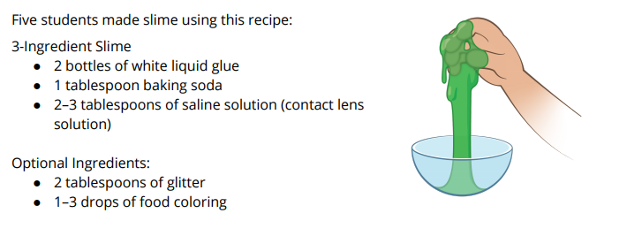
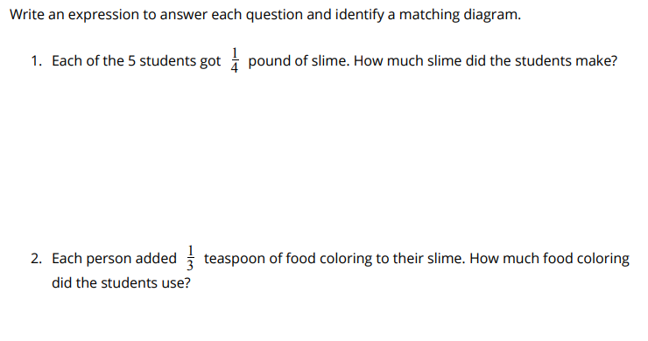
Writing Expressions
Activity #1
Notes:
20 minutes
In this activity, students use expressions to represent “groups of” unit fractions. Allow students to write both x n ( of n) and n x (n groups of ). For upcoming work with fractions in this grade and b 1 b 1 b 1 b 1 grade 5, it will be helpful for them to interpret an expression n x (b not equal to zero) as n groups b 1 with objects in each group. This can be addressed in the synthesis if needed. b 1 The synthesis asks students to describe equal groups of unit fractions in diagrams and use expressions to describe these equal groups in terms of the problem situations.
Launch:
Groups of 2 ● “Think of something your family likes to make for breakfast, dinner, or a snack.” ● “Share the recipe or describe to a partner the ingredients in the dish.” ● 1 minute: partner discussion ● “Sometimes we make recipes for things we don’t eat.” ● “The students in Mai’s class are working together to make slime.” ● “Take a look at this recipe for slime.” ● “Review each problem or diagram in the set you have been assigned and write an expression for each one.
Activity:
2 minutes: quiet think time ● 3–5 minutes: partner work time ● Monitor for students who describe the equal groups in situations, diagrams, and expressions.
Synthesis:
Select 1–2 students to describe the equal groups in their expressions, situations, and diagrams. ● “Let’s look at problem 3. Which diagram matches this problem?” (The one with 5 groups of .) 2 1 ● “What part of the diagram represents the students in the group?” (There are 5 rows that are the same. Each row represents a student because there are 5 students.) ● “What part of the diagram represents the tablespoons of glitter?” (The shaded portion of each row is of the row. Each 2 1 shaded region represents tablespoon 2 1 of glitter.) ● “What expression should we write to represent 5 groups of ? Why?” 5 x 2 1 2 1 because there are 5 groups of .) 2 1 ● If some students write expressions with the factors switched, take time to explain that while the product is the same, we will be reading the expressions as “_____ groups of _____” in this activity, and the fraction is the second factor.

Slide 34
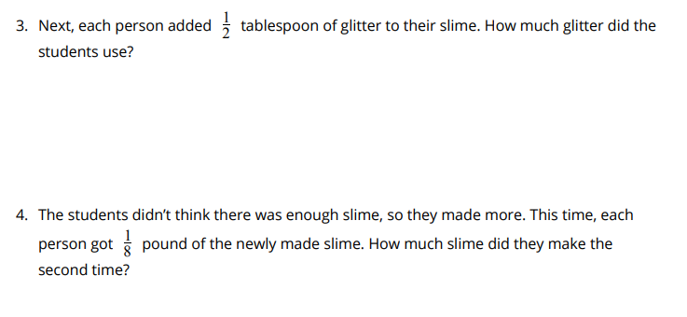
Writing Expressions
Activity #1
Notes:
20 minutes
In this activity, students use expressions to represent “groups of” unit fractions. Allow students to write both x n ( of n) and n x (n groups of ). For upcoming work with fractions in this grade and b 1 b 1 b 1 b 1 grade 5, it will be helpful for them to interpret an expression n x (b not equal to zero) as n groups b 1 with objects in each group. This can be addressed in the synthesis if needed. b 1 The synthesis asks students to describe equal groups of unit fractions in diagrams and use expressions to describe these equal groups in terms of the problem situations.
Launch:
Groups of 2 ● “Think of something your family likes to make for breakfast, dinner, or a snack.” ● “Share the recipe or describe to a partner the ingredients in the dish.” ● 1 minute: partner discussion ● “Sometimes we make recipes for things we don’t eat.” ● “The students in Mai’s class are working together to make slime.” ● “Take a look at this recipe for slime.” ● “Review each problem or diagram in the set you have been assigned and write an expression for each one.
Activity:
2 minutes: quiet think time ● 3–5 minutes: partner work time ● Monitor for students who describe the equal groups in situations, diagrams, and expressions.
Synthesis:
Select 1–2 students to describe the equal groups in their expressions, situations, and diagrams. ● “Let’s look at problem 3. Which diagram matches this problem?” (The one with 5 groups of .) 2 1 ● “What part of the diagram represents the students in the group?” (There are 5 rows that are the same. Each row represents a student because there are 5 students.) ● “What part of the diagram represents the tablespoons of glitter?” (The shaded portion of each row is of the row. Each 2 1 shaded region represents tablespoon 2 1 of glitter.) ● “What expression should we write to represent 5 groups of ? Why?” 5 x 2 1 2 1 because there are 5 groups of .) 2 1 ● If some students write expressions with the factors switched, take time to explain that while the product is the same, we will be reading the expressions as “_____ groups of _____” in this activity, and the fraction is the second factor.

Slide 35
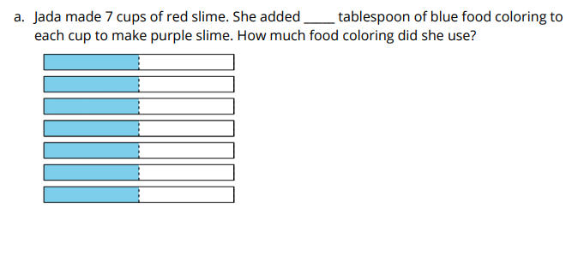
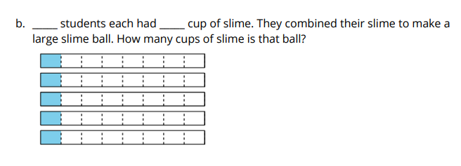
Complete the Story
Activity #2
Notes:
15 minutes
The purpose of this activity is for students to notice and describe the number of groups and the size of each group in situations involving the multiplication of a fraction by a whole number. Students generate situations, diagrams, and write expressions.
Launch:
Groups of 2 ● 5 minutes: independent work time
Activity:
“Compare the expressions, diagrams, and situations with a partner.” ● 5 minutes: partner discussion ● “Discuss any expressions that are not the same.”
Synthesis:
● Select 2–3 students to share their responses for problem 1. ● “How did you decide which numbers to place in the blank for each situation?” (In part a, the diagram shows groups of , 2 1 and in part b, the diagram shows 5 groups of .) 8 1 ● Discuss problem 3 during the lesson synthesis.

Slide 36
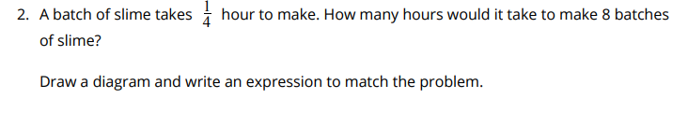
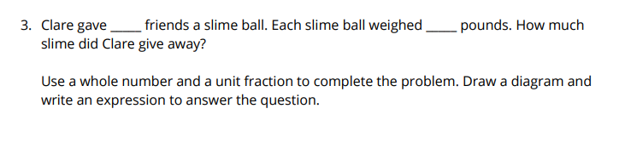
Complete the Story
Activity #2
Notes:
15 minutes
The purpose of this activity is for students to notice and describe the number of groups and the size of each group in situations involving the multiplication of a fraction by a whole number. Students generate situations, diagrams, and write expressions.
Launch:
Groups of 2 ● 5 minutes: independent work time
Activity:
“Compare the expressions, diagrams, and situations with a partner.” ● 5 minutes: partner discussion ● “Discuss any expressions that are not the same.”
Synthesis:
● Select 2–3 students to share their responses for problem 1. ● “How did you decide which numbers to place in the blank for each situation?” (In part a, the diagram shows groups of , 2 1 and in part b, the diagram shows 5 groups of .) 8 1 ● Discuss problem 3 during the lesson synthesis.

Slide 37
Let’s Put it All Together
Lesson Synthesis
Describe how you see the groups represented in each student’s diagram.
Notes:
“Today we wrote expressions to represent diagrams and problems.”

Slide 38
Multiplication Patterns
Adaptation
Lesson 3
Let’s look at patterns in multiplication of a fraction by a whole number.
Notes:
The purpose of this lesson is to evaluate multiplication expressions of a unit fraction by a whole number and for students to understand that every fraction can be written as the product of a whole number and unit fraction

Slide 39

Choral Count
Warm up
Notes:
10 minutes
The purpose of this Choral Count is to invite students to practice counting by a unit fraction and notice patterns in the count. These understandings help students develop fluency and will be helpful later in this lesson when students are to recognize that every fraction can be written as the product of a whole number and unit fraction. When students describe the number of groups of , they notice repeated structure and use this 8 1 structure to determine the next number in the counting sequence (MP7).
Launch:
“Count by _____ , starting at _____.”
Activity:
Record as students count. ● Stop counting and recording at _____.
Synthesis:
“How would our count change if we counted by ?” (Each numerator would be a multiple of 3.) Consider asking: ● “Who can restate the pattern in different words?” ● “Does anyone want to add an observation as to why that pattern is happening here?” ● “Do you agree or disagree? Why?”

Slide 40
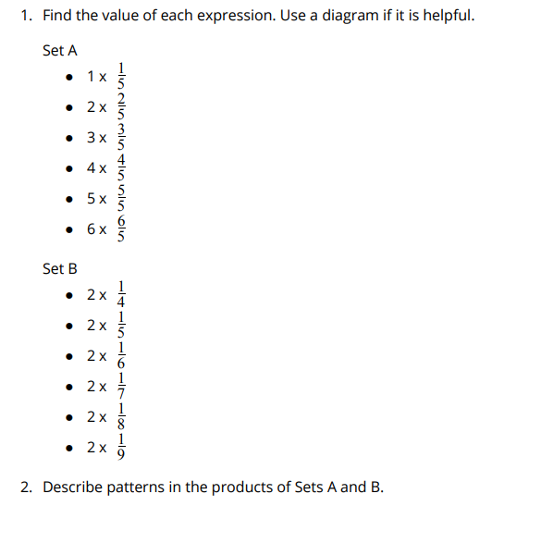
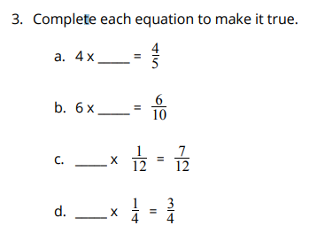
Describe the Pattern
Activity #1
Notes:
10 minutes
The purpose of this task is for students to notice that the product of a whole number and unit fraction has a numerator that is the same as the whole-number factor. Students may use diagrams to support their reasoning.
Launch:
Groups of 2 ● “You and your partner will each solve a different set of problems and then look for patterns when you compare your work.
Activity:
5 minutes: partner work time ● Monitor for the language students use to explain patterns: ○ The whole number in each expression is only being multiplied by the numerator of each fraction. ○ Language describing patterns in the denominator of the product (The denominator in the product is the same as the unit fraction each time.) ○ “Groups of” language to justify or explain patterns (The number of groups of each unit fraction is going up each time because it is one more group.)
Synthesis:
Select 1–2 students to share patterns. ● “How did you use what you noticed in Sets A and B to reason about the expression in problem 2?” (I knew that each blank was a whole number and a fraction and the whole number should be the same as the numerator of the product.) ● Write on the board. 4 3 ● “Can you write any fraction as a multiplication expression using its unit fraction?” (Yes, because the numerator is the number of groups and the denominator represents the size of each unit.) ● “What would it look like to write as a 4 3 multiplication expression using a whole number and a unit fraction?” ( = 3 x )

Slide 41
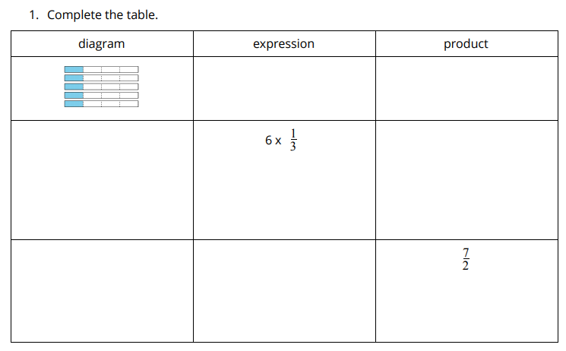
Write, Solve, and Draw
Activity #2
Notes:
25 minutes
The purpose of this activity is to use the pattern noticed in the previous activity to solve problems. In the previous task, students noticed regularity between the numerator and the whole number being multiplied in each expression. This activity uses a “carousel” structure in which students complete a rotation of tasks. In this task, they use this generalized understanding to evaluate expressions without using patterns and use this to describe in general terms what happens when a fraction number is multiplied by a whole number. This activity uses MLR7 Compare and Connect. Advances: representing, conversing
Launch:
Groups of 2 ● “Turn to a partner and explain what you are supposed to do to complete problem 1.” ● Ask students to complete problem 1 independently. ● 5 minutes: independent work time
Activity:
1–2 minutes: whole-class discussion ● “How did you complete the last row of the table?” (The whole number was the same as the number in the numerator and the fraction has the same denominator as the product.) ● “Let’s explore the pattern we are noticing and try to explain what is happening.” ● Combine two groups of 2 to form groups of 4. ● Demonstrate the 5 steps of the carousel using from problem 1 for the first 2 7 step. ● Read each step aloud and complete a practice round as a class. “What questions do you have about the task before you begin?” ● 5–7 minutes: group work time
Synthesis:
Use lesson synthesis to summarize the ideas from this activity.

Slide 42
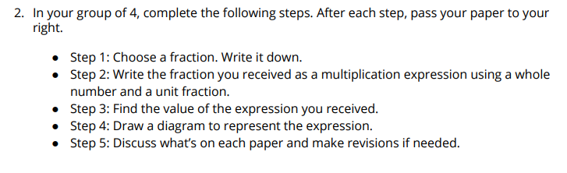
Write, Solve, and Draw
Activity #2
Notes:
25 minutes
The purpose of this activity is to use the pattern noticed in the previous activity to solve problems. In the previous task, students noticed regularity between the numerator and the whole number being multiplied in each expression. This activity uses a “carousel” structure in which students complete a rotation of tasks. In this task, they use this generalized understanding to evaluate expressions without using patterns and use this to describe in general terms what happens when a fraction number is multiplied by a whole number. This activity uses MLR7 Compare and Connect. Advances: representing, conversing
Launch:
Groups of 2 ● “Turn to a partner and explain what you are supposed to do to complete problem 1.” ● Ask students to complete problem 1 independently. ● 5 minutes: independent work time
Activity:
1–2 minutes: whole-class discussion ● “How did you complete the last row of the table?” (The whole number was the same as the number in the numerator and the fraction has the same denominator as the product.) ● “Let’s explore the pattern we are noticing and try to explain what is happening.” ● Combine two groups of 2 to form groups of 4. ● Demonstrate the 5 steps of the carousel using from problem 1 for the first 2 7 step. ● Read each step aloud and complete a practice round as a class. “What questions do you have about the task before you begin?” ● 5–7 minutes: group work time
Synthesis:
Use lesson synthesis to summarize the ideas from this activity.

Slide 43
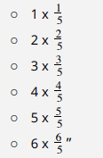

Let’s Put it All Together
Lesson Synthesis
Today we looked at multiplication expressions in two different ways. In the first activity, the number of groups changed while the unit fraction stayed the same like this:
Then we looked at a situation in which the unit fraction changed and the number of groups stayed the same, like this:
How could we write 7/3 as a product of a whole number 3 7 and a fraction?

Slide 44
Groups with More Things
Adaptation
Lesson 3
Let’s multiply any fraction by a whole number.
Notes:
The purpose of this lesson is to apply understandings from previous lessons to multiply a non-unit fraction by a whole number. Students generalize a method for multiplying any fraction by a whole number and use what they have learned about multiplication situations, representations, and equations to explain why their method works

Slide 45

Notice and Wonder: Thirds
Warm up
What do you notice?
What do you wonder?
Notes:
10 minutes
The purpose of this warm-up is for students to compare multiplication situations that involve a unit and non-unit fraction. The understandings elicited in this Notice and Wonder allow students to discuss the relationship between the product of a whole number and a unit fraction and the product of a whole number and a non-unit fraction with the same denominator.
Launch:
Groups of 2 ● Display the image
Activity:
“What do you notice? What do you wonder?” ● 1 minute: quiet think time ● 1 minute: partner discussion ● Share and record responses.
Synthesis:
● If no students notice or wonder about equal groups, ask, “What groups do you see and how do you see them?” (4 groups with tapes in each, each tape has 3 2 shaded) ● “How many thirds do you see?” (8 thirds) ● “We have been using diagrams to show groups of unit fractions. Today, we will think about how diagrams can show groups of fractions that are not unit fractions.”

Slide 46
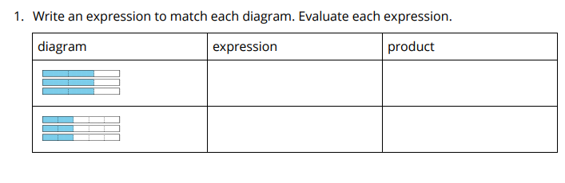
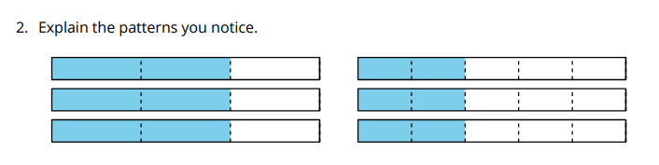
Diagrams for Groups of Many Fractions
Activity #1
Notes:
15 minutes
The purpose of this activity is for students to generate and evaluate expressions to match diagrams that represent a fraction multiplied by a whole number. Students also begin to describe the regularity in the expressions and products when the number of groups changes as the size of the group remains the same. They use the regularity they notice to evaluate expressions that follow this same pattern (MP8).
Launch:
Groups of 2 ● “Read the directions for your task and explain to a neighbor what the task is asking you to do.”
Activity:
5 minutes: independent work time ● “Describe to a partner the pattern you see in the first set of expressions.” (The numerators are both 6 because there are 3 groups with 2 in each. In one, they are groups of two thirds and in the other, they are two fifths.) ● 2 minutes: partner discussion ● “Describe to a partner how the two sets of diagrams are different.” (One pair shows 3 groups of 2 different fractions resulting in the same numerator and different denominators. The next pair of diagrams shows 4 and 5 groups of the same fraction, resulting in the same denominator and different numerators.) ● 2 minutes: partner discussion ● “Let’s see if we can use the patterns we noticed to complete the rest of the task.” ● 5–7 minutes: partner work
Synthesis:
Ask students to share the pattern they used to evaluate the second set of expressions. ● “Why does it make sense to multiply the numerator by the whole number to get the product?" (because that's the size of each group) ● “Why does the denominator stay the same?” (because the size of the unit piece or the unit fraction does not change)

Slide 47
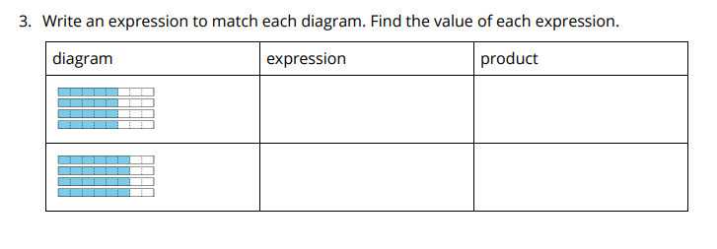
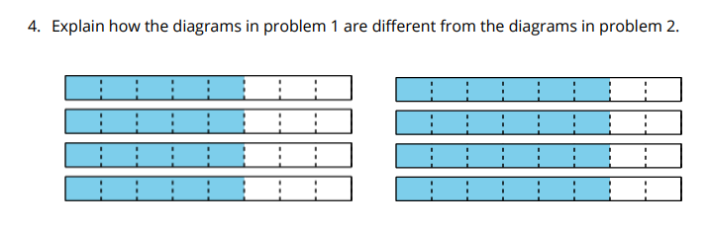
Diagrams for Groups of Many Fractions
Activity #1
Notes:
15 minutes
The purpose of this activity is for students to generate and evaluate expressions to match diagrams that represent a fraction multiplied by a whole number. Students also begin to describe the regularity in the expressions and products when the number of groups changes as the size of the group remains the same. They use the regularity they notice to evaluate expressions that follow this same pattern (MP8).
Launch:
Groups of 2 ● “Read the directions for your task and explain to a neighbor what the task is asking you to do.”
Activity:
5 minutes: independent work time ● “Describe to a partner the pattern you see in the first set of expressions.” (The numerators are both 6 because there are 3 groups with 2 in each. In one, they are groups of two thirds and in the other, they are two fifths.) ● 2 minutes: partner discussion ● “Describe to a partner how the two sets of diagrams are different.” (One pair shows 3 groups of 2 different fractions resulting in the same numerator and different denominators. The next pair of diagrams shows 4 and 5 groups of the same fraction, resulting in the same denominator and different numerators.) ● 2 minutes: partner discussion ● “Let’s see if we can use the patterns we noticed to complete the rest of the task.” ● 5–7 minutes: partner work
Synthesis:
Ask students to share the pattern they used to evaluate the second set of expressions. ● “Why does it make sense to multiply the numerator by the whole number to get the product?" (because that's the size of each group) ● “Why does the denominator stay the same?” (because the size of the unit piece or the unit fraction does not change)

Slide 48
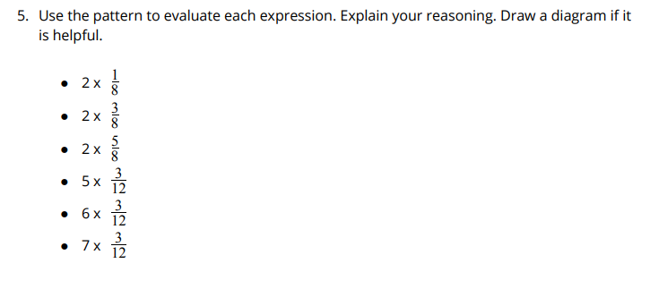
Diagrams for Groups of Many Fractions
Activity #1
Notes:
15 minutes
The purpose of this activity is for students to generate and evaluate expressions to match diagrams that represent a fraction multiplied by a whole number. Students also begin to describe the regularity in the expressions and products when the number of groups changes as the size of the group remains the same. They use the regularity they notice to evaluate expressions that follow this same pattern (MP8).
Launch:
Groups of 2 ● “Read the directions for your task and explain to a neighbor what the task is asking you to do.”
Activity:
5 minutes: independent work time ● “Describe to a partner the pattern you see in the first set of expressions.” (The numerators are both 6 because there are 3 groups with 2 in each. In one, they are groups of two thirds and in the other, they are two fifths.) ● 2 minutes: partner discussion ● “Describe to a partner how the two sets of diagrams are different.” (One pair shows 3 groups of 2 different fractions resulting in the same numerator and different denominators. The next pair of diagrams shows 4 and 5 groups of the same fraction, resulting in the same denominator and different numerators.) ● 2 minutes: partner discussion ● “Let’s see if we can use the patterns we noticed to complete the rest of the task.” ● 5–7 minutes: partner work
Synthesis:
Ask students to share the pattern they used to evaluate the second set of expressions. ● “Why does it make sense to multiply the numerator by the whole number to get the product?" (because that's the size of each group) ● “Why does the denominator stay the same?” (because the size of the unit piece or the unit fraction does not change)

Slide 49
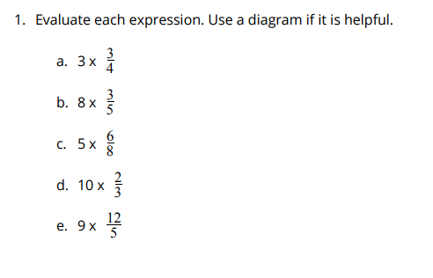
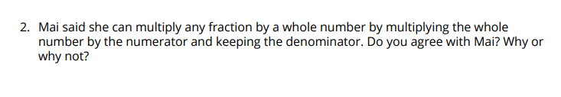
Mai’s Big Discovery
Activity #2
Notes:
20 minutes
This is a 5 Practices activity. The purpose of this activity is for students to evaluate multiplication expressions and begin to articulate the general idea behind multiplying any fraction by a whole number. As students work, monitor and select students who: ○ attempt to draw tape diagrams for all problems. These students may or may not recognize that there could be a more efficient approach. ○ draw tape diagrams for only some of the expressions, and for others use a numerical approach (multiply the numerator by the whole number, and keep the denominator the same) to get the product ○ use a numerical approach for each expression Sequence student explanations in the order provided in the synthesis. The synthesis offers questions that will be used to connect the ideas of each student as they share. Before each student begins, consider clearly stating the idea and part of the student work to be shared with the class.
Launch:
Groups of 2 ● 5–7 minutes: independent work
Activity:
As students work, consider asking questions that assess how they are making sense of the problems and invite them to think more deeply about their process: ○ For students using diagrams as the only strategy for solving: “How might you solve these without a diagram?○ For students using diagrams for some expressions and multiplication to solve others: “How do you choose which expressions to use multiplication for?” ○ For students using multiplication to solve: “How can you be sure that your answer is correct?”
Synthesis:
Select a student who chose to draw diagrams for each expression. ● “Where is the answer in your diagram? How do you know?” (There are 3 groups of , so there are 9 fourths shaded, and 4 3 3 x = .) 4 3 4 9 ● Select a student who drew a diagram for some expressions, and used a numerical approach for others. ● “Why did you choose to draw a diagram for some expressions and to do something else for others?” (Sample response: After drawing some diagrams, I realized that I would have to draw a lot of groups or partitions for some of the expressions. I multiplied the numbers in each expression together when the groups got too big.) ● Select the student who chose to use a numerical approach to evaluate each expression. ● “I noticed that you did not use diagrams at all. What strategy did you use to evaluate the expressions?” (I noticed that when we multiply fractions by whole numbers, we can multiply the whole number and the numerator of the fraction and keep the denominator the same to get the product.) ● If no students articulate the idea that when multiplying a whole number and a fraction, we multiply the whole number and the fraction and the denominator stays the same, use Mai’s thinking in problem two to investigate the idea as a whole class.

Slide 50

Let’s Put it All Together
Lesson Synthesis
Let’s discuss Mai’s reasoning using the expression 4 x ⅔ and the diagram from today’s warm-up.
Why can we multiply 4 x 2 to get the numerator of the product?
Why is the denominator of the product the same as the fraction in the expression?
Notes:
“Today we multiplied fractions by whole numbers. Mai said she can multiply any fraction by a whole number by multiplying the whole number by the numerator and keeping the denominator.”

Slide 51
Relate Multiplication Expressions
Adaptation
Lesson 3
Let's write multiplication expressions in different ways.
Notes:
The purpose of this lesson is for students to extend patterns for multiplying a unit fraction by a whole number to multiply any fraction by a whole number.

Slide 52

How Many Do You See?
Warm up
How many thirds do you see?
How do you see them?
Notes:
10 minutes
The purpose of this How Many Do You See is for students to use grouping strategies to describe the images they see. Students’ descriptions are recorded using equations and expressions to support the goal of creating equivalent expressions. The synthesis encourages students to think about why two expressions can represent the same amount.
Launch:
Groups of 2 ● “How many thirds do you see? How do you see them?”
Activity:
Display the image. ● 1 minute: quiet think time
Synthesis:
For each way that students see thirds, ask: “What expression should we use to represent the groups of thirds that _____ saw?” ● If students do not suggest it, ask, “How might someone see 4 groups of in the 3 2 diagram?” (By combining 2 of the thirds from each strip, we can make 4 groups of .) 3 2 ● Write 8 x = 4 x , and ask students if 3 1 3 2 they agree or disagree with the statement. ● “We are going to revisit this question at the end of our lesson today. Let’s see if our thinking changes in any way.” Consider asking: ● “Who can restate the way _____ saw the image in different words?” ● “Did anyone see the dots the same way but would explain it differently?” ● “Does anyone want to add an observation to the way _____ saw the image?”

Slide 53
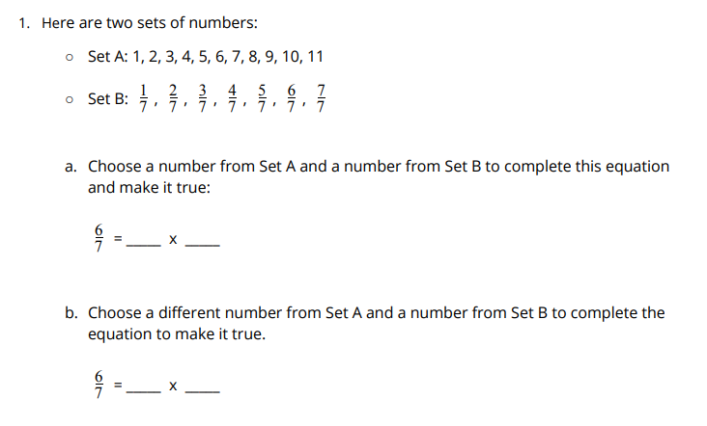
Complete the Equation
Activity #1
Notes:
15 minutes
The purpose of this activity is for students to think of different ways of using multiplication expressions to represent a product. Students informally use the associative property as they work toward generalizing that n x = = n x a .
Launch:
Groups of 2 ● 3 minutes: independent work time on the first set of problems
Activity:
4 minutes: partner discussion ● “Did you choose the same numbers as your partner? If not, are both equations correct?” ● 7 minutes: independent work time ● Monitor for students who use the factors of 12 to complete the equations in the second problem, and factors of 8 in the last problem
Synthesis:
Select 2–3 partners to share the following equations from the first problem:“Why are these all true equations?” (To get to , we can multiply the whole 7 6 number by the numerator and then keep the denominator the same for each equation. When we multiply the whole number and the numerator, it equals 6 each time. There are different ways to multiply to get 6 as a numerator: 6 x 1, 3 x 2, 2 x 3, and 1 x 6.) ● “How did you know what fractions to use to complete each equation in the second problem?” (We looked for the numbers to multiply to get or . The 5 12 9 8 denominators stay the same, so we find out what is going to be the whole number and numerator by knowing the factor pairs of 12 or 8.)

Slide 54
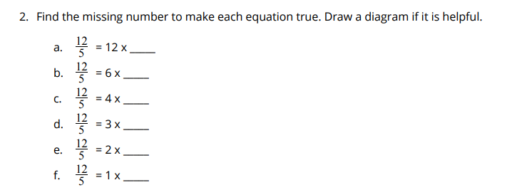
Complete the Equation
Activity #1
Notes:
15 minutes
The purpose of this activity is for students to think of different ways of using multiplication expressions to represent a product. Students informally use the associative property as they work toward generalizing that n x = = n x a .
Launch:
Groups of 2 ● 3 minutes: independent work time on the first set of problems
Activity:
4 minutes: partner discussion ● “Did you choose the same numbers as your partner? If not, are both equations correct?” ● 7 minutes: independent work time ● Monitor for students who use the factors of 12 to complete the equations in the second problem, and factors of 8 in the last problem
Synthesis:
Select 2–3 partners to share the following equations from the first problem:“Why are these all true equations?” (To get to , we can multiply the whole 7 6 number by the numerator and then keep the denominator the same for each equation. When we multiply the whole number and the numerator, it equals 6 each time. There are different ways to multiply to get 6 as a numerator: 6 x 1, 3 x 2, 2 x 3, and 1 x 6.) ● “How did you know what fractions to use to complete each equation in the second problem?” (We looked for the numbers to multiply to get or . The 5 12 9 8 denominators stay the same, so we find out what is going to be the whole number and numerator by knowing the factor pairs of 12 or 8.)

Slide 55
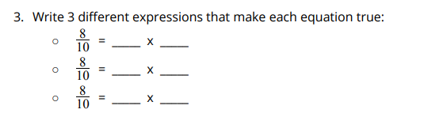
Complete the Equation
Activity #1
Notes:
15 minutes
The purpose of this activity is for students to think of different ways of using multiplication expressions to represent a product. Students informally use the associative property as they work toward generalizing that n x = = n x a .
Launch:
Groups of 2 ● 3 minutes: independent work time on the first set of problems
Activity:
4 minutes: partner discussion ● “Did you choose the same numbers as your partner? If not, are both equations correct?” ● 7 minutes: independent work time ● Monitor for students who use the factors of 12 to complete the equations in the second problem, and factors of 8 in the last problem
Synthesis:
Select 2–3 partners to share the following equations from the first problem:“Why are these all true equations?” (To get to , we can multiply the whole 7 6 number by the numerator and then keep the denominator the same for each equation. When we multiply the whole number and the numerator, it equals 6 each time. There are different ways to multiply to get 6 as a numerator: 6 x 1, 3 x 2, 2 x 3, and 1 x 6.) ● “How did you know what fractions to use to complete each equation in the second problem?” (We looked for the numbers to multiply to get or . The 5 12 9 8 denominators stay the same, so we find out what is going to be the whole number and numerator by knowing the factor pairs of 12 or 8.)

Slide 56
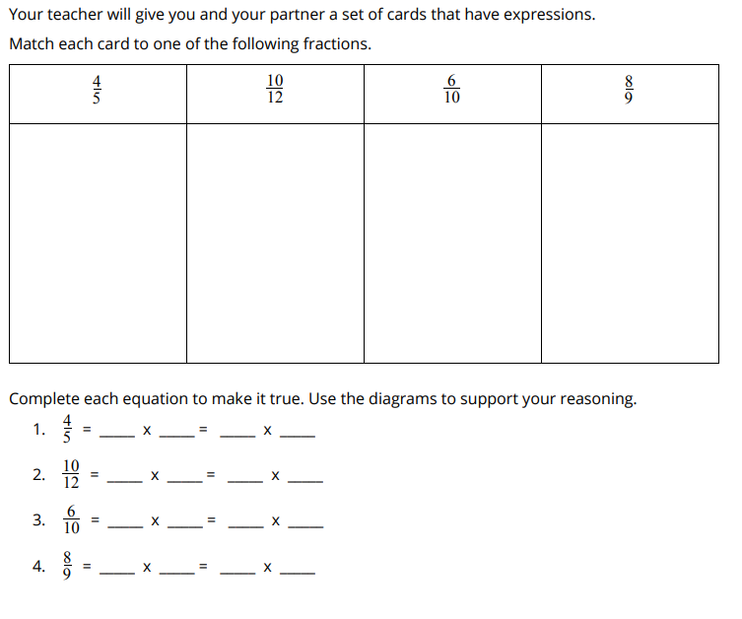
Equivalent Expressions
Activity #2
Notes:
20 minutes
The purpose of this activity is for students to write equivalent expressions that match different representations of the same amount. Students will use the results of a card sort to reason about equivalent expressions. Each fraction may not have the same number of matching cards.
Launch:
Groups of 2 ● Fraction Cards
Activity:
“Match cards that represent the same fraction. Each fraction may not have the same number of matching cards.” ● “When you are done matching, write equivalent expressions for each fraction.” ● As students work, monitor for students who describe the non-unit fractions as multiples of the unit fraction in their reasoning for problems 1–4.
Synthesis:
Ask selected students to share different expressions for problem 2. ● “How can we explain why these expressions are equivalent?” ● Display the solution to the final problem: =

Slide 57
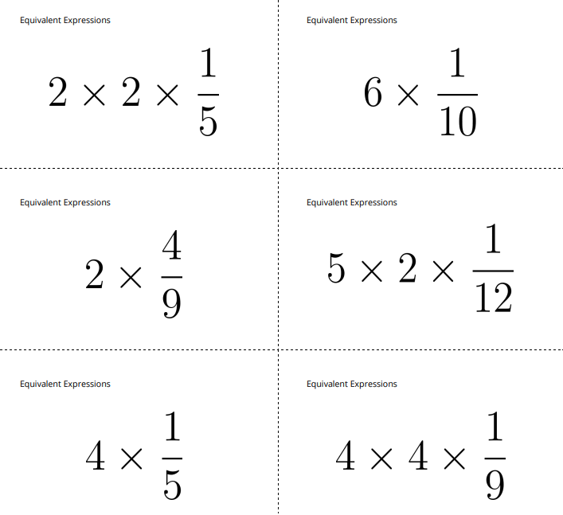
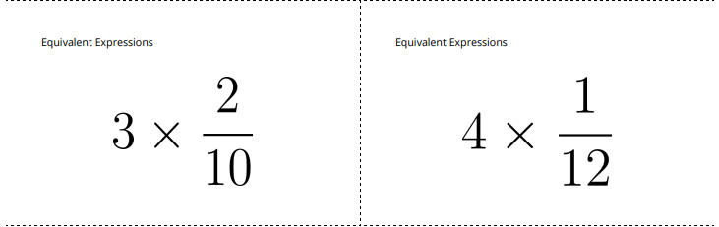
Equivalent Expressions
Activity #2
Notes:
20 minutes
The purpose of this activity is for students to write equivalent expressions that match different representations of the same amount. Students will use the results of a card sort to reason about equivalent expressions. Each fraction may not have the same number of matching cards.
Launch:
Groups of 2 ● Fraction Cards
Activity:
“Match cards that represent the same fraction. Each fraction may not have the same number of matching cards.” ● “When you are done matching, write equivalent expressions for each fraction.” ● As students work, monitor for students who describe the non-unit fractions as multiples of the unit fraction in their reasoning for problems 1–4.
Synthesis:
Ask selected students to share different expressions for problem 2. ● “How can we explain why these expressions are equivalent?” ● Display the solution to the final problem: =

Slide 58
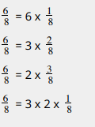
Let’s Put it All Together
Lesson Synthesis
How does the first equation relate to the second equation, and how does that one relate to the third equation?
Notes:
“Today we looked at different expressions to represent the same fraction.”

Slide 59
Share Bread
1
Let’s share one thing.
5.NF.B.3

Slide 60
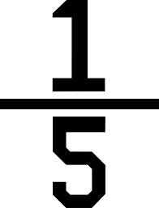
What Do You Know About ⅕ ?
Warm up

Slide 61
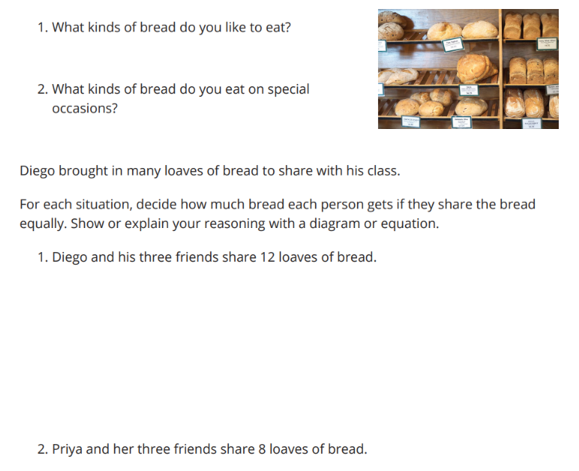
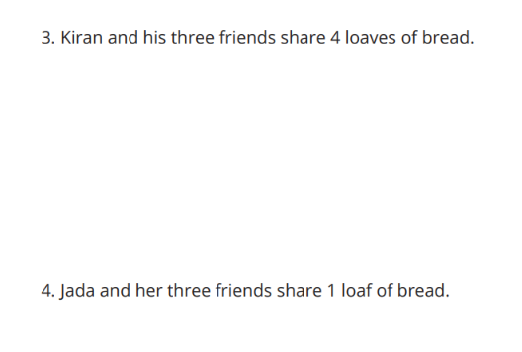
Equal Shares of Bread
Activity #1

Slide 62
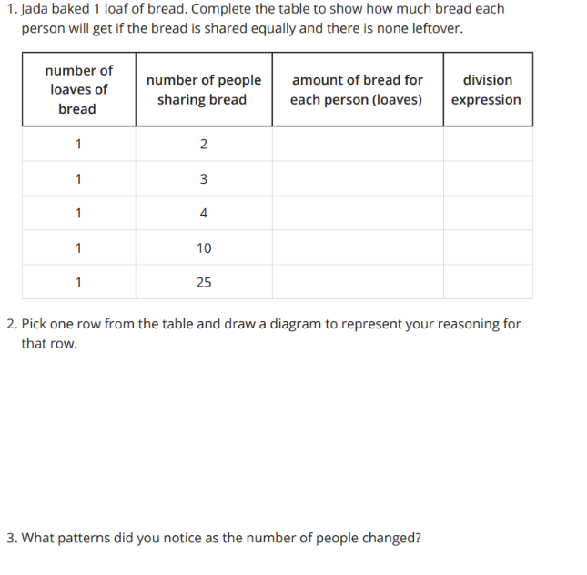
One Loaf
Activity #2

Slide 63
Let’s Put it All Together
Lesson Synthesis
What does the expression mean in terms of the problems we were solving about people sharing a loaf of bread?
How much of the loaf of bread will each person get?

Slide 64
Share More
2
Let’s share things equally.
5.NF.B.3

Slide 65
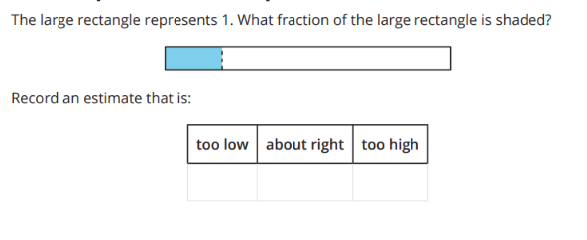
Estimation Exploration:
Name that Fraction
Warm up

Slide 66
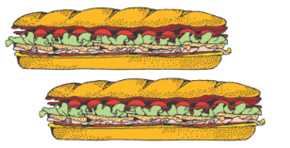

Share Sandwiches
Activity #1

Slide 67


Share More Sandwiches
Activity #2
Match each diagram with a situation. Be prepared to explain your reasoning.

Slide 68
Share More Sandwiches
Activity #2
2. Work with your partner to write a division expression to represent each matched pair.

Slide 69
Let’s Put it All Together
“Today we thought about situations where a group of people shares different numbers of things equally. We noticed some patterns in the amount each person gets and in diagrams and expressions to represent the situations.”
Lesson Synthesis
If 3 people equally share 2 sandwiches, how much sandwich does each person get?
Describe how you would figure out the amount of sandwich each person gets if 3 people share any amount of sandwiches?

Slide 70
Interpret Equations
3
Let’s share more things equally.
5.NF.B.3

Slide 71
What Do You Know About?
Warm up

Slide 72



Dehydrated Dancers
Activity #1

Slide 73

Interpret Expressions
Activity #2

Slide 74

Let’s Put it All Together
Lesson Synthesis
If 6 dancers share 5 liters of water, how much water does each get?
What can we add to our answers from the warm-up question based on what we learned today?

Slide 75
Situation, Diagrams, and Equations
4
Let’s solve and represent division situations.
5.NF.B.3

Slide 76

Number Talk
Warm up
Find the value of each expression mentally.

Slide 77
Number Talk
Warm up
Find the value of each expression mentally.

Slide 78

Number Talk
Warm up
Find the value of each expression mentally.

Slide 79

Number Talk
Warm up
Find the value of each expression mentally.

Slide 80












Card Sort: Division Mix and Match
Activity #1
1. Match each diagram, situation, and equation.
2. Solve each division equation.

Slide 81



Creating Division Situations
Activity #2
1. Complete the missing parts of the table. Be prepared to explain your thinking.
2. Discuss both your solutions with your group. What is the same? What is different?

Slide 82





Pan for Gold
Activity #3

Slide 83

Let’s Put it All Together
Lesson Synthesis
What division situation might this equation represent?
What number or numbers make this equation true? How do you know?

Slide 84
The Relationship Between Division and Fractions
5
Let’s explain why fractions can be represented as division expressions.
5.NF.B.3

Slide 85

True or False:
Warm up
Is the statement true or false? Be prepared to explain your reasoning.

Slide 86

True or False:
Warm up
Is the statement true or false? Be prepared to explain your reasoning.

Slide 87

True or False:
Warm up
Is the statement true or false? Be prepared to explain your reasoning.

Slide 88


Fill in the Blank
Activity #1
Fill in the blank to make the equations true:

Slide 89


Why does it work?
Activity #2

Slide 90
Let’s Put it All Together
Lesson Synthesis
What do you know about the relationship between division and fractions?
How can we represent the relationship between division and fractions?

Slide 91

Section Summary

Slide 92
So far we have:
learned how to represent the relationship between division and unit fractions and division and non-unit fractions in a way that makes sense to you.
learned how to represent the relationship between multiplication and division and fractions with equations.
figured out how to solve problems involving division of whole numbers leading to answers in the form of mixed numbers and fractions.
are able to explain the relationship between division and fractions.

Slide 93
Divide and Multiply
6
Let’s explore the relationship between multiplication and division.
5.NF.B.4, 5.NF.B.4.a

Slide 94

Number Talk:
Multiply & Divide
Warm up
Find the value of each expression mentally.

Slide 95

Number Talk:
Multiply & Divide
Warm up
Find the value of each expression mentally.

Slide 96

Number Talk:
Multiply & Divide
Warm up
Find the value of each expression mentally.

Slide 97

Number Talk:
Multiply & Divide
Warm up
Find the value of each expression mentally.

Slide 98





Where Do You See It?
Activity #1

Slide 99



The Race
Activity #2

Slide 100
Let’s Put it All Together
Lesson Synthesis
When did we use division today?
What did we learn about the relationship between multiplication and division?
When did we use multiplication today?
What do you still wonder about the relationship between multiplication and division?

Slide 101
Find a Fraction of a Whole Number
7
Let’s solve problems about multiplying whole numbers by unit fractions.
5.NF.B.4

Slide 102

Estimation Exploration: Number Line
Warm up

Slide 103

How Far Did They Run?
Activity #1
Solve each problem. Draw a diagram if it is helpful

Slide 104













Match the Situation
Activity #2

Slide 105
Let’s Put it All Together
Lesson Synthesis
What expressions can you write to represent ¼ of 10?
What does it mean to run ¼ of a 10 mile road?
Which expression helps you calculate how far ¼ of 10 miles is?

Slide 106
More Diagrams and Expression
8
Let’s solve problems about multiplying whole numbers by fractions.
5.NF.B.4

Slide 107

True or False:
A Fraction by a Whole Number
Warm up
Is each statement true or false? Be prepared to explain your reasoning.

Slide 108


Find the Value
Activity #1
Find the value of each expression. Draw a diagram if it is helpful.

Slide 109

Expressions and Diagrams
Activity #2

Slide 110

Expressions and Diagrams
Activity #2

Slide 111
Let’s Put it All Together
Lesson Synthesis
What would you add to or revise about the relationship between multiplication and division?

Slide 112

Section Summary

Slide 113
In the past few lessons, we’ve:
explored the relationships between multiplication and division.
represented and solved problems involving multiplication of a whole number by a unit fraction.
represented and solved problems involving multiplication of a whole number by a non unit fraction.

Slide 114
Area With Unit Fraction Side Lengths
9
Let’s find the area of rectangles with unit fraction side lengths.
5.NF.B.4.b

Slide 115

Which One Doesn’t Belong: Area
Warm up

Slide 116

Find the Area
Activity #1
Find the area of the shaded region. Explain your reasoning.

Slide 117

Find the Area
Activity #1
Find the area of the shaded region. Explain your reasoning.

Slide 118

Find the Area
Activity #1
Find the area of the shaded region. Explain your reasoning.

Slide 119

Find the Area
Activity #1
Find the area of the shaded region. Explain your reasoning.

Slide 120


Draw Rectangles
Activity #2

Slide 121

Let’s Put it All Together
Lesson Synthesis
“What do you know about area?”
What information do you need to find the shaded area of this rectangle?
Once you know how long it is, how would you find the shaded area?

Slide 122

Let’s Put it All Together
Lesson Synthesis
What is the shaded area?
How do you know?

Slide 123
Represent Volume with Expressions
10
Let’s find the area of rectangles with fractional side lengths.
5.NF.B.4

Slide 124


Estimation Exploration: What is the Area?
Warm up

Slide 125

Rectangle With a Fractional Side Length
Activity #1
Write a multiplication expression to represent the area of each shaded region.
Then find the area.

Slide 126

Rectangle With a Fractional Side Length
Activity #1
Write a multiplication expression to represent the area of each shaded region.
Then find the area.

Slide 127

Rectangle With a Fractional Side Length
Activity #1
Write a multiplication expression to represent the area of each shaded region.
Then find the area.

Slide 128

What Are the Side Lengths?
Activity #2

Slide 129


What Are the Side Lengths?
Activity #2

Slide 130
Let’s Put it All Together
Lesson Synthesis
How is finding the area of these rectangles the same as finding the area of rectangles with 2 whole number side lengths?
How is it different?

Slide 131
Fractional Side Lengths Greater Than 1
11
Let’s find the area of more rectangles.
5.NF.B.4.b

Slide 132

True or False: Thirds
Warm up
Decide if each statement is true or false. Be prepared to explain your reasoning

Slide 133


Greater Than One
Activity #1

Slide 134

Lin's Desk and Garden
Activity #2

Slide 135

Lin's Desk and Garden
Activity #2

Slide 136


Let’s Put it All Together
Lesson Synthesis
Where do you see the expression in the diagram?

Slide 137

Let’s Put it All Together
Lesson Synthesis
Where do you see the expression in the diagram?

Slide 138
Let’s Put it All Together
Lesson Synthesis
Where do you see the expression in the diagram?

Slide 139
Decompose Rectangles
12
Let's decompose rectangles to find their area
5.NF.B.4, 5.NF.B.4.b

Slide 140
Number Talk: Partial Products
Warm up
Find the value of each product mentally.

Slide 141
Number Talk: Partial Products
Warm up
Find the value of each product mentally.

Slide 142
Number Talk: Partial Products
Warm up
Find the value of each product mentally.

Slide 143

Number Talk: Partial Products
Warm up
Find the value of each product mentally.

Slide 144


Which Garden Is Larger?
Activity #1

Slide 145


Represent Area With Sums and Differences
Activity #2

Slide 146
Let’s Put it All Together
Lesson Synthesis
How can we describe the strategies we used today?

Slide 147
Diagrams and Expressions
13
Let’s write expressions to represent the area of rectangles.
5.NF.B.4, 5.NF.B.4.b

Slide 148
Number Talk: Parentheses
Warm up
Find the value of each expression mentally

Slide 149
Number Talk: Partial Products
Warm up
Find the value of each expression mentally

Slide 150

Number Talk: Partial Products
Warm up
Find the value of each expression mentally

Slide 151

Number Talk: Partial Products
Warm up
Find the value of each expression mentally

Slide 152

Card Sort: Diagrams and Expressions
Activity #1

Slide 153















Card Sort: Diagrams and Expressions
Activity #1

Slide 154


Write Expressions
Activity #2
Write as many expressions as you can to match the shaded area in each diagram.

Slide 155


Let’s Put it All Together
Lesson Synthesis
How do we know these expressions are all equivalent?
Where can we see each of these expressions in the diagram?

Slide 156
Reason About Fraction Multiplication
14
Let’s use the properties of operations to multiply fractions.
5.NF.B.4, 5.NF.B.4.b

Slide 157

True or False: Decompose Numbers
Warm up
Is each statement true or false? Be prepared to explain your reasoning.

Slide 158

True or False: Decompose Numbers
Warm up
Is each statement true or false? Be prepared to explain your reasoning.

Slide 159

True or False: Decompose Numbers
Warm up
Is each statement true or false? Be prepared to explain your reasoning.

Slide 160


Priya’s Garden
Activity #1

Slide 161


Find the Area
Activity #2
Find the area that each set of dimensions represents.

Slide 162

Let’s Put it All Together
Lesson Synthesis
What is a reasonable estimate for the value of this expression?

Slide 163

Let’s Put it All Together
Lesson Synthesis
How do we know this equation is true?

Slide 164
Problem Solve
15
Let’s apply what we’ve learned about fraction multiplication.
5.NF.B.4, 5.NF.B.4.b

Slide 165
Number Talk: Multiply Fractions
Warm up
Evaluate each expression. Be prepared to explain your reasoning.

Slide 166

Number Talk: Multiply Fractions
Warm up
Evaluate each expression. Be prepared to explain your reasoning.

Slide 167

Number Talk: Multiply Fractions
Warm up
Evaluate each expression. Be prepared to explain your reasoning.

Slide 168

Number Talk: Multiply Fractions
Warm up
Evaluate each expression. Be prepared to explain your reasoning.

Slide 169

Info Gap: Area
Activity #1

Slide 170

Info Gap: Area
Activity #1

Slide 171


Fill in the Blank
Activity #2
Fill in the blanks to make each equation true. Be prepared to explain your reasoning.

Slide 172
Let’s Put it All Together
Lesson Synthesis
We multiplied whole numbers by fractions that were written as a sum of a whole number and a fraction and we multiplied whole numbers by fractions greater than 1.
Which way do you prefer and why?

Slide 173
Multiply More Fractions
16
Let’s multiply mixed numbers.
5.NF.B.4.b

Slide 174

Number Talk: Multiply Mixed Numbers
Warm up
Find the value of each product mentally.

Slide 175

Number Talk: Multiply Mixed Numbers
Warm up
Find the value of each product mentally.

Slide 176

Number Talk: Multiply Mixed Numbers
Warm up
Find the value of each product mentally.

Slide 177

Number Talk: Multiply Mixed Numbers
Warm up
Find the value of each product mentally.

Slide 178


Multiply Your Way
Activity #1
Write numbers from the list in the blank spaces so the situations make sense. Each number will be used only one time. Be prepared to explain your thinking.

Slide 179

Equivalent Expressions
Activity #2
Fill in the missing parts of the table so that each row shows equivalent expressions

Slide 180

Let’s Put it All Together
Lesson Synthesis
Tell me everything you know about this expression.

Slide 181

Section Summary

Slide 182

Section Summary

Slide 183
In the past few lessons, we’ve:
understood that multiplying the side lengths of a rectangle to find the area still works when the one of the side lengths is a unit fraction.
found the area of a rectangle with one fractional side length in a way that makes sense to you.
found the area of a rectangle with one fractional side length greater than one in a way that makes sense to you.
represented the area with a multiplication expression.
decomposed a rectangle to find its area.
represented the decomposition of a rectangle with diagrams and expressions.
solved problems involving multiplication of a whole number by a fraction, including fractions greater than 1.

