Slide 1

Measuring
Length, Time, Liquid Volume, and Weight
Grade 3: Unit 6
Standards addressed: 3.MD.B.4, 3.NF.A.3, 3.OA.C.7, 3.MD.A.2, 3.MD.A.1, 3.MD.A.2, 3.MD.B.4, 3.NBT.A.2, 3.OA.A.3
These slides have been created by Britnee Wright Southeast Arkansas Education Cooperative and are not official IM materials. Images and language are taken from IM Grade 3, Unit 6 by Illustrative Mathematics.
Copyright 2020 by Illustrative Mathematics. All Rights Reserved, adapted and shared with permission.

Slide 2
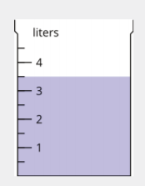
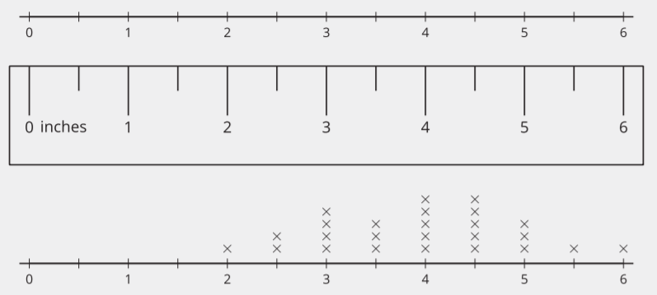

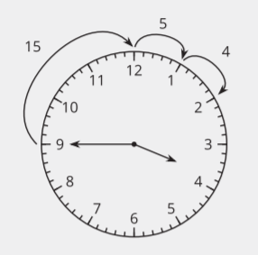
Unit 6 Progression Overview
Measuring Length, Time, Liquid Volume, and Weight
Section A
Lessons 1-5
3.MD.B.4, 3.NF.A.3.c, 3.OA.C.7
Section B
Lessons 6-8
3.MD.A.2, 3.NF.A, 3.OA.C.7
Section C
Lessons 9-11
3.MD.A.1
Section D
Lessons 12-16
3.MD.A.1, 3.MD.A.2, 3.MD.B.4, 3.NBT.A.2, 3.OA.A.3, 3.OA.C.7
Measure lengths using rulers marked with halves and fourths of an inch to generate data for making a line plot.
Measure and estimate liquid volumes and weights of objects.
Solve problems involving addition and subtraction of time intervals in minutes.
Tell time to the minute.
Solve problems involving the four operations and measurement contexts.

Slide 3



Unit 6 Quick Links
Adapt 1
Adapt 2
Adapt 3
L1
L2
L3
L4
L5
L6
L7
L8
Adapt 4
L9
L10
L11
L12
L13
L14
L15
L16

Slide 4
What is an Inch?
Adaptation
Lesson 1
Let’s measure in inches.
2.MD.A.1, 2.MD.A.3

Slide 5
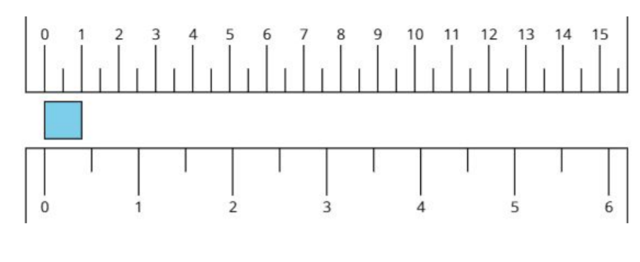
Notice and Wonder:
Inches and Centimeters
Warm up
What do you notice?
What do you wonder?

Slide 6
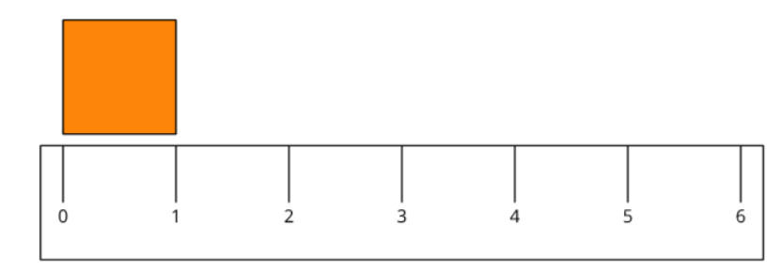
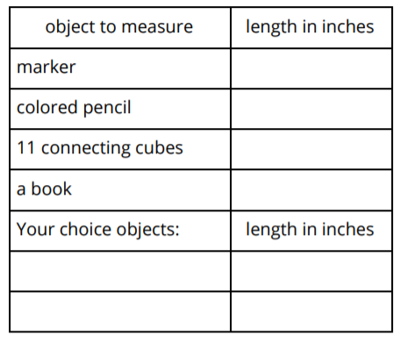
What is an Inch?
Activity
#1
Measure the length of each object.
1. Find 2 items that are about an inch.
a. ________________________
b. ________________________

Slide 7


Measure Shapes
Activity
#2
2. How long is a side of the square in inches?
Estimate: _________
Measure the long side of the square.
Actual length: _________
1. How long is the long side of the rectangle in inches?
Estimate: _________
Measure the long side of the rectangle.
Actual length: _________

Slide 8
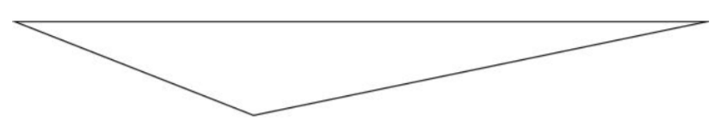
Measure Shapes
Activity
#2
3. How long is the longest side of the triangle in inches?
Estimate: _________
Measure the longest side of the triangle.
Actual length: _________

Slide 9

Lesson Synthesis
Today, we measured shapes and objects with inch tiles and rulers.
How would you measure the length of a bookshelf or whiteboard in inches?
About how long do you estimate the bookshelf will be in inches?

Slide 10
What is a Line Plot?
Adaptation
Lesson 2
Let’s learn a new way to represent data.
2.MD.A.1

Slide 11
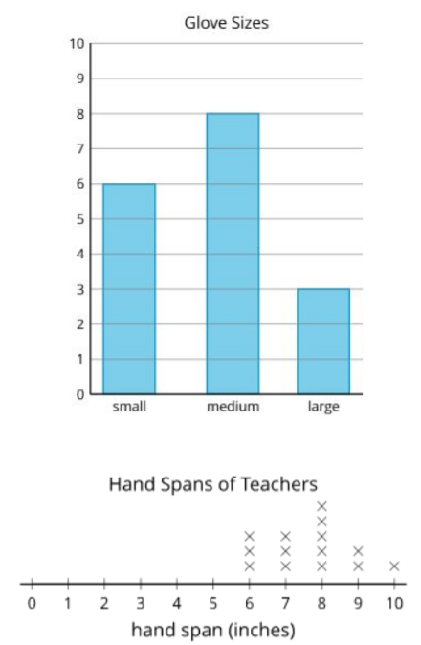
Notice and Wonder: Glove Sizes
Warm up
What do you notice?
What do you wonder?

Slide 12

Measuring Our Hand Spans
Activity
#1
1. Trace your hand. (Spread your fingers wide.)
2. Draw a line from your thumb to your pinky.
Measure the length of the line in inches.
My hand span is _____ inches.

Slide 13

Interpreting Our Numerical Data
Activity
#2
1. What was the longest hand span?
2. What was the shortest hand span?
3. Write another statement about our class’s hand spans based on the line plot.

Slide 14
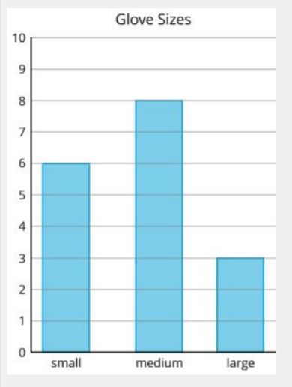
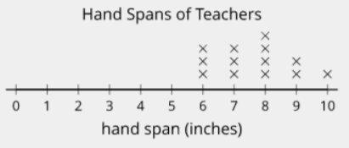
Lesson Synthesis
Today we learned a new way to display data—a line plot.
What is the same and different about the bar graphs and line plots?
What do the numbers tell us in each graph?

Slide 15
Creating Line Plots
Adaptation
Lesson 3
Let’s represent data in line plots
2.MD.D.9

Slide 16
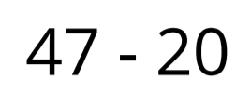
Number Talk: Subtraction within 50
Warm up
Find the value of each difference mentally.

Slide 17
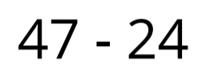
Number Talk: Subtraction within 50
Warm up
Find the value of each difference mentally.

Slide 18
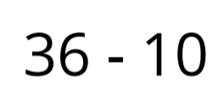
Number Talk: Subtraction within 50
Warm up
Find the value of each difference mentally.

Slide 19
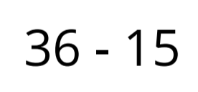
Number Talk: Subtraction within 50
Warm up
Find the value of each difference mentally.

Slide 20
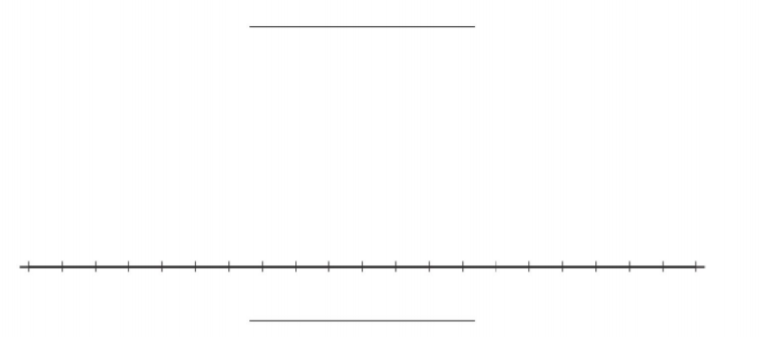
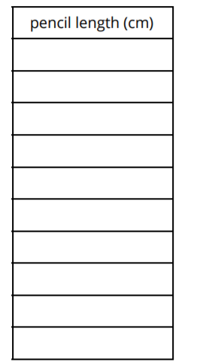
Measure and Plot Pencil Lengths
Activity
#1
1. Measure the pencils in centimeters.
Work with a partner and check each other’s measurements.
Record each measurement in the table.
2. Create a line plot to represent the lengths of all the pencils in your group.

Slide 21
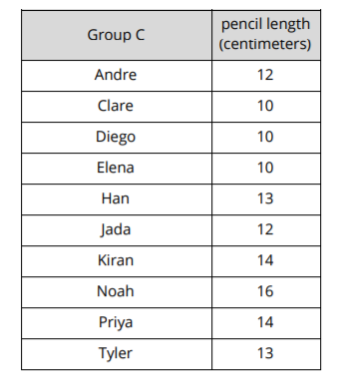
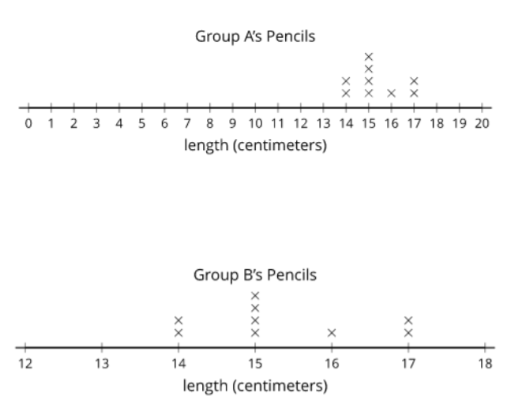
Plot Pencil Lengths
Activity
#2
Use this data to create a line plot.

Slide 22
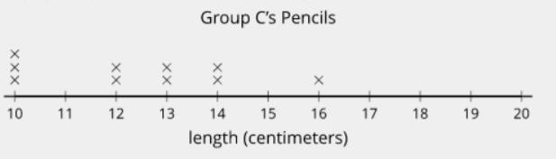
Lesson Synthesis
_____ said that the most pencils were 10 cm. _____ said the longest pencil was 16 cm. Are they both correct?
What do you know about the lengths of the pencils based on the line plot?
How can I find out how many pencils were measured based on this line plot?

Slide 23
Measure in Fractions
of an Inch
1
Let’s measure the length of objects around the room.
3.MD.B.4

Slide 24

What Do You Know About….
Warm up

Slide 25
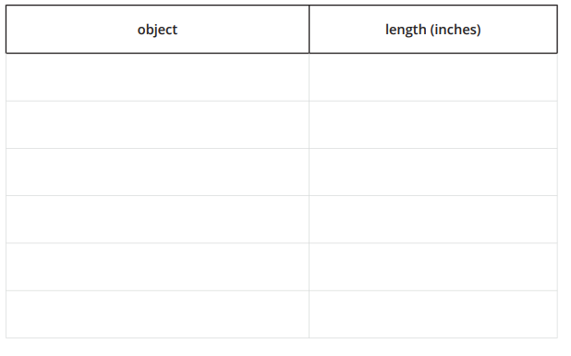
Measure Around the Room
Activity 1
Use the ruler your teacher gives you to measure the length of objects in the room. Be prepared to discuss your reasoning.

Slide 26
Partition Inches into Halves
Activity 2
1. Work with your partner to partition one ruler from the previous activity to show halves of an inch.
2. Use the ruler marked with halves of an inch to measure some lengths around the room.

Slide 27

Lesson
Synthesis
Today we used a ruler to measure length in inches.
How is a ruler like a number line?
When we record the length in fractions that are greater than 1, we can record it a fraction like , or we can use a number that combines a whole number with a fraction like . Numbers like this that use whole numbers and fractions are called mixed numbers.

Slide 28
Measure in Halves or
Fourths of an Inch
2
Let’s measure length in halves or quarters of an inch.
3.MD.B.4

Slide 29
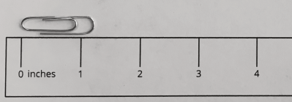
Estimation Exploration: Measure in Inches
Warm up
What is the length of the paperclip?
Record an estimate that is:
Too low | About right | Too high

Slide 30
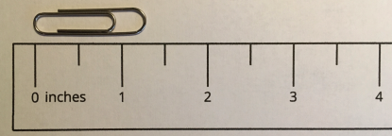
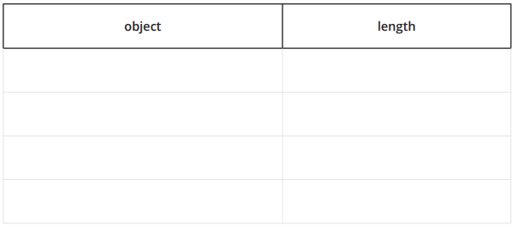
Partition Inches into Fourths
Activity 1
2. Take turns with your partner using this ruler to measure the length of 4 objects around the room.
1. With your partner, partition one of your rulers from the previous lesson to show fourths of an inch.
Notes:
(15 minutes total slides 14-17) See page 38 of teacher’s edition of facilitation notes.

Slide 31
Partition Inches into Fourths
Activity 2
With your partner, measure some objects around the room.
For each object use your ruler that is marked with half inches or your ruler marked with quarter inches.
Practice saying each measurement with your partner.
Notes:
(15 minutes total slides 14-17) See page 38 of teacher’s edition of facilitation notes.

Slide 32

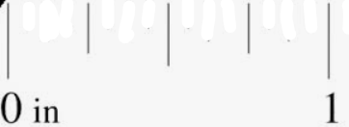
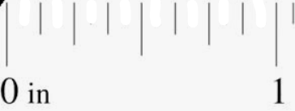
Lesson
Synthesis
Which ruler would you use if we want to measure and get a length that is as close as possible to the actual length of the object?

Slide 33
Measure with Fractions
of Inches
3
Let’s measure lengths in halves of an inch and quarters of an inch.
3.MD.B.4, 3.NF.A.3.c

Slide 34
Notice and Wonder: Rulers
Warm up
What do you notice?
Look at the rulers you have been using to measure and the ruler your teacher gave you.
What do you wonder?
Notes:
(10 minutes total slides 24 and 25) See page 46 of teacher’s edition of facilitation notes. Give students 1 minutes of quiet think time and then discuss their thinking with their neighbor. Record students noticing and wonderings after they have shared with a partner.

Slide 35
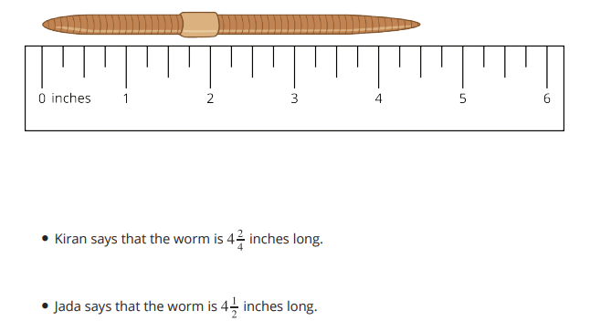
Write and Read Fractions
Activity 1
Use the ruler to explain how both of their measurements are correct.
Notes:
(15 minutes total slides 24 and 25) See page 47-49 of teacher’s edition of facilitation notes. Tell students that you will complete the 2nd row of the table together. Remind them that this is just like the rectangle we looked at in the warm up. The number represented is already in the table.” How many parts are shaded? What is the size of each part?

Slide 36
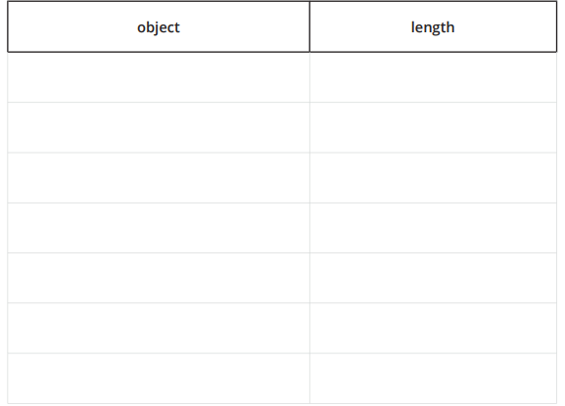
Measure with a Ruler Marked with Halves and Fourths
Activity 2
1. Use the ruler that you received during the warm-up to measure some objects around the room.
Notes:
(15 minutes total slides 24 and 25) See page 47-49 of teacher’s edition of facilitation notes. Tell students that you will complete the 2nd row of the table together. Remind them that this is just like the rectangle we looked at in the warm up. The number represented is already in the table.” How many parts are shaded? What is the size of each part?

Slide 37
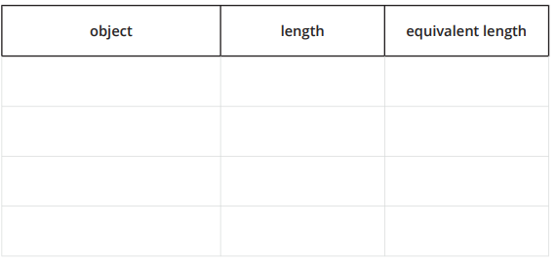
Measure with a Ruler Marked with Halves and Fourths
Activity 2
2. Trade lists with another group. Find a length that could be written a different way.
Notes:
(15 minutes total slides 24 and 25) See page 47-49 of teacher’s edition of facilitation notes. Tell students that you will complete the 2nd row of the table together. Remind them that this is just like the rectangle we looked at in the warm up. The number represented is already in the table.” How many parts are shaded? What is the size of each part?

Slide 38
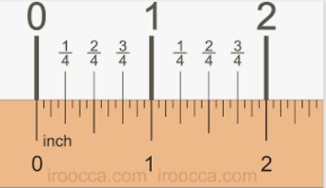
Lesson
Synthesis
Today we measured lengths using a ruler marked with halves of an inch and quarters of an inch. What are some important things to remember when you measure with a ruler marked with half inches and fourth inches?

Slide 39
Interpret Line Plots
4
Let’s make sense of line plots with lengths in half inches and quarter inches.
3.MD.B.4

Slide 40
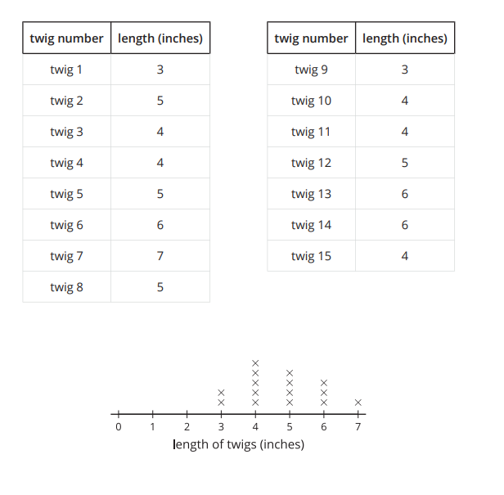
Notice and Wonder:
Line Plot
Warm up
What do you notice?
What do you wonder?
Notes:
(10 minutes total slide 39) See page 54 for facilitation notes. Ask students to take about 1 minute to record an estimate that is too low, too high, and about right. Dan Meyers talks about brave estimates. So, 0 would be too low, but not very brave. After they have estimated have them turn and share with a partner.

Slide 41
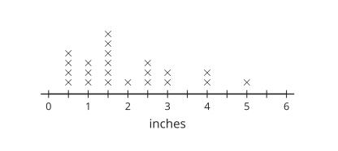
Analyze a Line Plot
Activity 1
What could the data in this line plot represent?
Notes:
(20 minutes total slide ) See page 55 and 56 for facilitation notes. You can print out game boards and cards for students OR play on playingcards.io

Slide 42
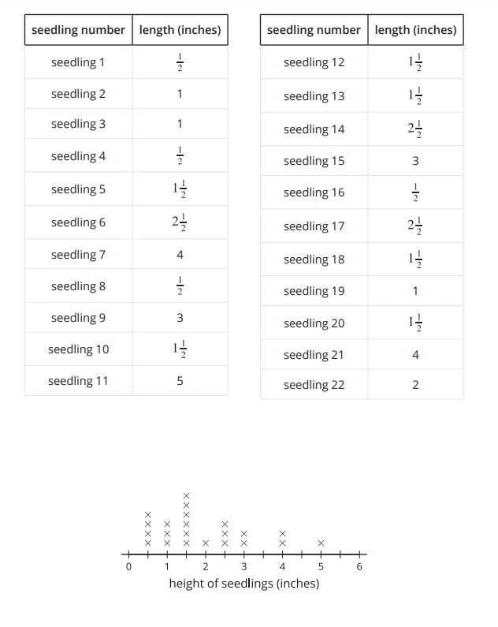
Analyze a Line Plot
Activity 1
1. Write 3 statements that we could make about the measurements represented in the line plot.
2. Write some questions that could be answered more easily with the line plot than the table.
Notes:
(20 minutes total slide ) See page 55 and 56 for facilitation notes. You can print out game boards and cards for students OR play on playingcards.io

Slide 43
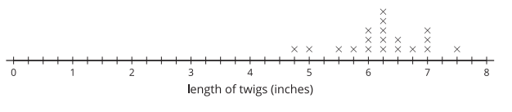
Answering Questions About a Line Plot
Activity 2
1. How many twigs’ lengths are represented on the line plot?
2. How many of the twigs were 6 ½ inches long?
3. How many of the twigs were less than 6 inches long?
4. How many of the twigs were more than 6 inches long?
5. What is the length of the shortest twig?
6. What is the length of the longest twig?
7. What was the most common length of twig?
8. Add an “x” to the line plot that would represent a twig with a length between 3 and 4 inches.
9. What is the length of the twig you added to the line plot?
Notes:
(15 minutes total slides 42-43 ) See page 57 for facilitation notes. “Give students between 5-7 minutes to work on these representations independently. If some students don’t finish in that amount of time that is fine! Then ask students to pick one of their representations to draw on their whiteboard. Share that with their neighbor. After students have shared, ask students, “What part of each diagram would represent where the object was hidden?”

Slide 44
Lesson Synthesis
Today we asked and answered questions about measurements shown in a line plot.
What were some big ideas to keep in mind as you answered questions about the measurements that were shown in a line plot?

Slide 45
Measure and Represent Data on Line Plots
5
Let’s collect data and represent it in a line plot.
3.MD.B.4, 3.OA.C.7

Slide 46

Number Talk: Multiply Teen Numbers
Warm up
Find the value of each expression mentally.

Slide 47
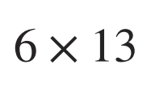
Number Talk: Multiply Teen Numbers
Warm up
Find the value of each expression mentally.

Slide 48
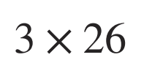
Number Talk: Multiply Teen Numbers
Warm up
Find the value of each expression mentally.

Slide 49

Number Talk: Multiply Teen Numbers
Warm up
Find the value of each expression mentally.

Slide 50
Go for a Measurement Walk
Activity #1
Today we are going to take a walk around the school
(the playground/the classroom) to measure the length of some objects in nature.
Talk with your group about some objects we could measure on our walk.
Decide what your group will measure on our walk.
  Your group will make a poster with a line plot with these measurements once we are done with the walk.

Slide 51
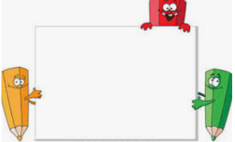
Line Plot Poster Gallery Walk
Activity #2
Make a poster with a line plot that represents your data from the last activity.

Slide 52
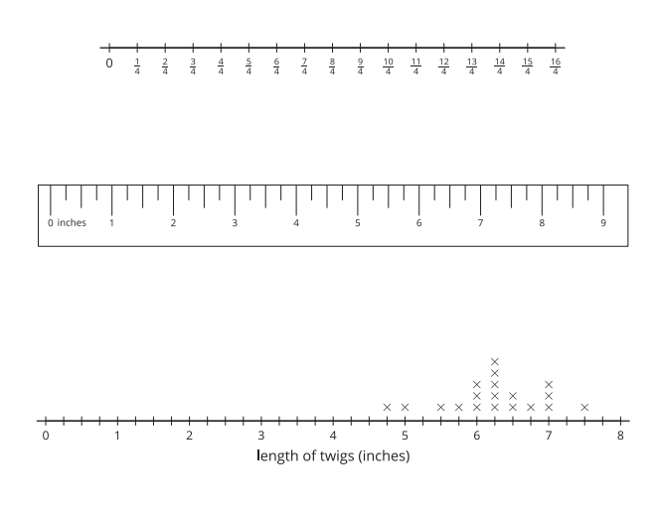
Lesson Synthesis
Think about what we’ve learned about line plots over the last few lessons. What are some of the most important things you’ve learned about line plots?
How are line plots like rulers and number lines? How are they different?

Slide 53

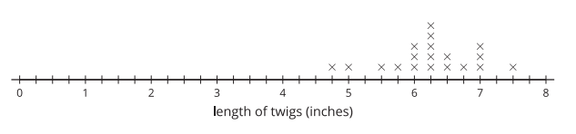
Section Summary
In this section we learned how to measure lengths using rulers marked with halves and quarters of an inch.
We learned how to make line plots to show measurements in half inches or quarter inches.

Slide 54
Estimate and
Measure Weight
6
Let’s measure and estimate weight.
3.MD.A.2

Slide 55
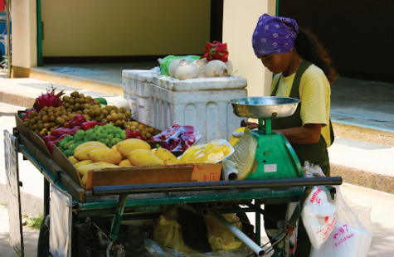
Notice and Wonder:
Produce Stand
Warm up
What do you notice?
What do you wonder?
Notes:
(10 minutes total slide 39) See page 54 for facilitation notes. Ask students to take about 1 minute to record an estimate that is too low, too high, and about right. Dan Meyers talks about brave estimates. So, 0 would be too low, but not very brave. After they have estimated have them turn and share with a partner.

Slide 56
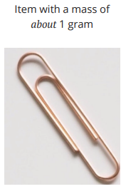
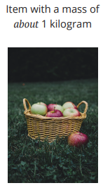
Measure Weight
Activity #1
1. For each weight measurement, list an example of something you think has about the same weight.
a. 1 gram
Example:
b. 10 grams
Example:
c. 100 grams
Example:
d. 1 kilogram
Example:
e. 2 kilograms
Example:

Slide 57
Measure Weight
Activity #1
2. Find some objects around the room that weigh:
a. less than a gram
b. between 1 and 10 grams
c. between 10 grams and 100 grams
d. between 100 grams and 1 kilogram
e. between 1 kilogram and 2 kilograms
f. more than 2 kilograms

Slide 58
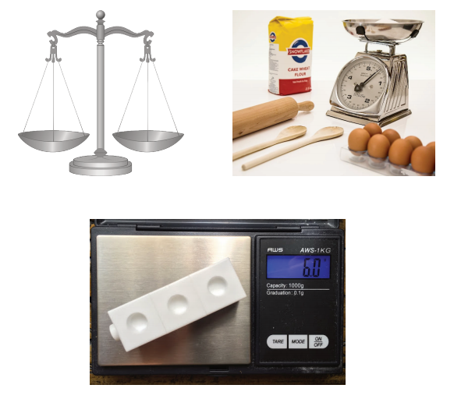
Measure in Grams or Kilograms
Activity 2
What do you notice?
What do you wonder?
Notes:
(10 minutes total slide 39) See page 54 for facilitation notes. Ask students to take about 1 minute to record an estimate that is too low, too high, and about right. Dan Meyers talks about brave estimates. So, 0 would be too low, but not very brave. After they have estimated have them turn and share with a partner.

Slide 59
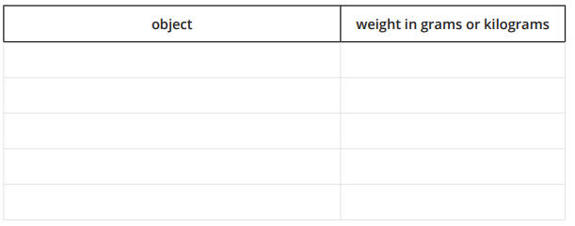
Measure in Grams or Kilograms
Activity #2
Have each person from your group use a balance or a scale to measure the weight of one object from around the room.

Slide 60
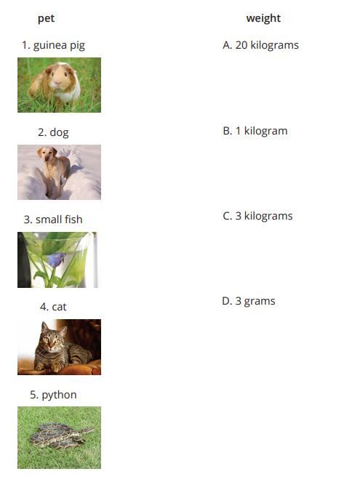
The Weight of Pets
Activity #3
Match the pet to the amount that could be its weight.
Explain your reasoning.

Slide 61
Lesson Synthesis
Today we learned how to measure and estimate weight.
What advice would you give to someone who was measuring weight for the first time?

Slide 62
Introduction to
Liquid Volume
7
Let’s learn about liquid volume.
3.MD.A.2

Slide 63
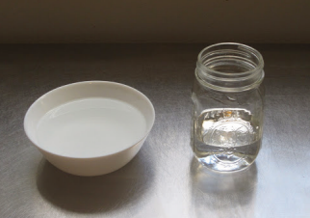
Notice and Wonder:
The Bowl and the Jar
Warm up
What do you notice?
What do you wonder?
Notes:
(10 minutes total slide 39) See page 54 for facilitation notes. Ask students to take about 1 minute to record an estimate that is too low, too high, and about right. Dan Meyers talks about brave estimates. So, 0 would be too low, but not very brave. After they have estimated have them turn and share with a partner.

Slide 64

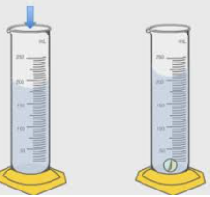
Volume Estimation Exploration
Activity #1
1. How many units do you think container A will hold?
Record an estimate that is:
2. How many units do you think container B will hold?
Record an estimate that is:
3. Use the unit container to compare the liquid volume that containers A and B hold.
Which container holds the greater volume?
How do you know?

Slide 65
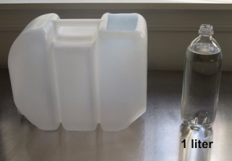
Liquid Volume in Liters
Activity #2
How many liters of water will fit in the large container?
Record an estimate that is:
Too low | About right | Too high

Slide 66
Lesson Synthesis
Today, we learned what liquid volume is.
How would you describe liquid volume to someone who didn’t know what it is

Slide 67
Measure and Estimate Liquid Volume
8
Let’s measure and estimate liquid volume.
3.MD.A.2, 3.NF.A, 3.OA.C.7

Slide 68

Number Talk: Divide by 3
Warm up
Find the value of each expression mentally.

Slide 69

Number Talk: Divide by 3
Warm up
Find the value of each expression mentally.

Slide 70
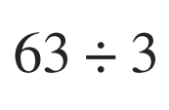
Number Talk: Divide by 3
Warm up
Find the value of each expression mentally.

Slide 71
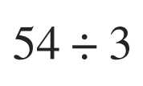
Number Talk: Divide by 3
Warm up
Find the value of each expression mentally.

Slide 72
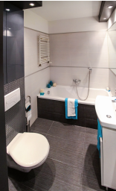
Estimate Volume
Activity #1
Who do you agree with?
Explain or show your reasoning.
Clare says the bathtub holds about 2 liters.
Jada says the bathtub holds about 20 liters.
Kiran says the bathtub holds about 200 liters

Slide 73


Estimate Volume
Activity #1
1. Would the bucket and the bottle hold 2 liters, 20 liters, or 200 liters?
Explain how you know.

Slide 74








Estimate Volume
Activity #1
2. Match the containers to the number of liters they could hold.
Be ready to explain your reasoning.

Slide 75

Measure Volume
Activity 2
What do you notice?
What do you wonder?
Notes:
(10 minutes total slide 39) See page 54 for facilitation notes. Ask students to take about 1 minute to record an estimate that is too low, too high, and about right. Dan Meyers talks about brave estimates. So, 0 would be too low, but not very brave. After they have estimated have them turn and share with a partner.

Slide 76


Measure Volume
Activity #2
1. Use the images of liquid in containers marked in liters to find the volume of the liquid.

Slide 77


Measure Volume
Activity #2
1. Use the images of liquid in containers marked in liters to find the volume of the liquid.

Slide 78


Measure Volume
Activity #2
1. Use the images of liquid in containers marked in liters to find the volume of the liquid.

Slide 79


Measure Volume
Activity #2
1. Use the images of liquid in containers marked in liters to find the volume of the liquid.

Slide 80


Measure Volume
Activity #2
2. Shade the images of the empty containers to show the liquid volume.

Slide 81


Measure Volume
Activity #2
2. Shade the images of the empty containers to show the liquid volume.

Slide 82

Measure Volume
Activity #2
2. Shade the images of the empty containers to show the liquid volume.

Slide 83
Lesson Synthesis
Today we measured and estimated liquid volume in liters. How was this like measuring length and weight? How was it different?
What are some tips you would give someone as they use containers marked in liters to measure liquid volume?

Slide 84

Section Summary
In this section we learned how to measure and estimate weight in grams and kilograms.

Slide 85

Section Summary
We also learned how to measure and estimate liquid volume in liters.

Slide 86
Count by 5 to Tell Time
Adaptation
Lesson 4
Let’s tell time.
2.MD.C.7, 2.NBT.A.2

Slide 87

Notice and Wonder:
Number Line and Clock
Warm up
What do you notice?
What do you wonder?

Slide 88


Count by 5 on the Clock
Activity
#1
1. Discuss 2 ways to read the time on this clock.
2. What time does this clock show?

Slide 89








Count by 5 on the Clock
Activity
#1
3. Cut apart the clock cards. Read the time on each clock card with your partner.
Put the clocks in order based on the times they show.

Slide 90



Write the Time
Activity
#2
Write the time shown on each clock.

Slide 91



Write the Time
Activity
#2
Write the time shown on each clock.

Slide 92

Lesson Synthesis
Today we learned that each time the minute hand moves between numbers, 5 minutes have passed. This is why counting by 5 can help us tell time.
Tell your partner what time is shown on the clock and how you know.

Slide 93
Time to the
Nearest Minute
9
Let’s tell and write time to the nearest minute.
3.MD.A.1

Slide 94

Estimation Exploration: Ticking Away
Warm up
This clock only has an hour hand. What time could it be?
Record an estimate that is:
Too low | About right | Too high

Slide 95





Just a Clock on the Wall
Activity #1
1. Lin says the time shown on the clock is 1:37 p.m. Diego says the time is 1:35 p.m.
Who do you agree with?
Explain or show your reasoning.
2. What time is shown on each clock?
a.
b.
c.
d.

Slide 96

On the One Hand...
Activity #2
1. Show the time given on each clock.
2:36 p.m.
3:18 p.m.
12:17 p.m.
9:02 a.m.
2. Draw a time on this clock.
Trade with a partner and determine what time is shown on their clock.

Slide 97

Lesson Synthesis
How was telling time different today than how you have told time in the past?
If you were going to explain to a friend how to tell time to the nearest minute, what would be the most important ideas you would want to share with them

Slide 98
Solve Problems Involving Time (Part 1)
10
Let’s solve problems involving time.
3.MD.A.1

Slide 99

Choral Count: Fifteens
Warm up
What patterns do you see?
Count by 15 minutes, starting at 12:00
Stop counting and recording at 3:00
How much time has passed at the end of each row?

Slide 100

Time Marches On
Activity #1
Elena arrived at the bus stop at 3:45 p.m. as shown on this clock.
She waited 24 minutes for the bus to arrive.
What time did the bus arrive?
Show your thinking. Organize it so it can be followed by others.

Slide 101

Thinking About Time
Activity #2
In the future which representations do you want to try when you solve problems involving time?
Explain your reasoning

Slide 102
Lesson Synthesis
Let’s share some of our reflections about which representations you want to try when you solve problems involving time in the future. We’ll record our ideas to remember when we solve problems involving time.

Slide 103
Solve Problems Involving Time (Part 2)
11
Let’s solve more problems involving time.
3.MD.A.1

Slide 104


Notice and Wonder:
Band Practice
Warm up
What do you notice?
Han ate his dinner before he caught the bus. When he got off the bus, he had to hurry to get to band practice on time.
What do you wonder?
Notes:
(10 minutes total slide 39) See page 54 for facilitation notes. Ask students to take about 1 minute to record an estimate that is too low, too high, and about right. Dan Meyers talks about brave estimates. So, 0 would be too low, but not very brave. After they have estimated have them turn and share with a partner.

Slide 105


On the Bus Again
Activity #1
1.
Han got on the bus Han got off the bus
How long was Han on the bus?
Explain or show your reasoning.
2.
Draw the minute hand to show that Elena waited for the bus for 32 minutes.

Slide 106

11.2: Math Libs Time
Activity #2
For each problem, fill in a name and an activity.
Then, solve each problem.
Show your thinking. Organize it so it can be followed by others.

Slide 107

11.2: Math Libs Time
Activity #2
For each problem, fill in a name and an activity.
Then, solve each problem.
Show your thinking. Organize it so it can be followed by others.

Slide 108

11.2: Math Libs Time
Activity #2
For each problem, fill in a name and an activity.
Then, solve each problem.
Show your thinking. Organize it so it can be followed by others.

Slide 109

11.2: Math Libs Time
Activity #2
For each problem, fill in a name and an activity.
Then, solve each problem.
Show your thinking. Organize it so it can be followed by others.

Slide 110
Lesson Synthesis
We learned how to tell time to the nearest minute and solved problems involving time. What are the most important things to remember about this?

Slide 111

Section Summary
In this section we learned to tell and write time to the nearest minute. We solved addition and subtraction problems about time.
I counted up 3 minutes from 5:42 to 5:45 and then I did 15 minutes to 6:00, 30 minutes to 6:30, and then 7 minutes to 6:37. 15 + 30 = 45 and then 3 + 7 is 10 more.

Slide 112
Giant Pumpkins at the Fair
12
Let’s make sense of and solve problems about giant pumpkins at the fair.
3.MD.A.2

Slide 113

Notice and Wonder: The Fair
Warm up
What do you notice?
What do you wonder?

Slide 114

Giant Pumpkin Event
Activity #1
1. Write a list of mathematical questions that could be asked about this image.
2. Work with your partner to solve the problem you were given by your teacher and show your thinking on a poster. Be sure to write down the problem you are solving on your poster.

Slide 115










Card Sort: Giant Pumpkins
Activity #2
Your teacher will give you a set of cards. Match each situation with a diagram.

Slide 116
Lesson Synthesis
Today we made sense of and solved problems about weight and liquid volume that relate to the giant pumpkin weigh-off at the fair. What helps you make sense of problems that involve weight or liquid volume?

Slide 117
Pigs at the Fair
13
Let’s solve problems about pigs at the fair.
3.MD.A.2

Slide 118

Estimation Exploration:
Baby Pigs
Warm up
How much does one baby pig weigh in grams or kilograms?
Record an estimate that is:
Too low | About right | Too high

Slide 119

Info Gap: Pig Weigh-Off, Part 1
Activity #1
Your teacher will give you either a problem card or a data card.
Do not show or read your card to your partner.

Slide 120
Info Gap: Pig Weigh-Off, Part 2
Activity #2
Your teacher will give you either a problem card or a data card.
Do not show or read your card to your partner.

Slide 121
Lesson Synthesis
We’ve been focusing on problem solving for the last two lessons. How would you describe your general approach to solving math problems to a friend? What are some important ideas you’d want to make sure to share with them?

Slide 122
Carnival at the Fair
14
Let’s solve problems about the carnival at the fair.
3.MD.A.1, 3.MD.A.2, 3.NBT.A.2

Slide 123

Number Talk: Carnival
Warm up
Find the value of each expression mentally.

Slide 124

Number Talk: Carnival
Warm up
Find the value of each expression mentally.

Slide 125

Number Talk: Carnival
Warm up
Find the value of each expression mentally.

Slide 126

Number Talk: Carnival
Warm up
Find the value of each expression mentally.

Slide 127

Carnival Time Number Choice
Activity #1
1. Make up your own numbers that make sense for the situation you were assigned.
a. Clare waited for Tyler to ride the Ferris wheel. Tyler left at __ and got back at __ . How long did Clare wait for Tyler?
b. When Tyler got back, he and Clare got in line to ride the roller coaster. They waited__ minutes. At __, they got on the ride. What time did they get in line?
c. Clare and Tyler got to the carnival at__ . After __ minutes, they took a break to buy lemonade. What time did they take their lemonade break?
2. Have each member of your group share the numbers they choose and why those numbers make sense.
3. Work with our group to solve each problem. Be prepared to explain your reasoning.

Slide 128

Lemonade Break
Activity 2
What do you notice?
What do you wonder?

Slide 129


Lemonade Break
Activity #2
Use the information about the lemonade stand to write a question that could be answered with the mathematical work shown.

Slide 130
Lesson Synthesis
Today we solved a variety of problems that came up at the carnival or lemonade stand at the fair. Work with your partner to write a situation that represents this image and involves multiplication or division.

Slide 131
Your Day at the Fair
15
Let’s imagine spending a day at the fair.
3.MD.A.1, 3.MD.A.2, 3.OA.A.3, 3.OA.C.7

Slide 132

Number Talk: Divide by 8
Warm up
Find the value of each expression mentally.

Slide 133

Number Talk: Divide by 8
Warm up
Find the value of each expression mentally.

Slide 134

Number Talk: Divide by 8
Warm up
Find the value of each expression mentally.

Slide 135

Number Talk: Divide by 8
Warm up
Find the value of each expression mentally.

Slide 136
Day at the Fair Posters
Activity #1
You are spending the day at the fair. Solve each problem that comes up. At certain points you can choose which problem to solve.
Then create a poster that shows your day at the fair and your mathematical reasoning for each problem.
2. Choose 1 of these 2 problems to solve:
a. You started your day at the giant pumpkin weigh-off. You arrived at 11:12 a.m. You left when the event ended at 12:25 p.m. How long were you there?
b. You started your day at the carnival. You spent 48 minutes at the carnival with one of your friends. You left the carnival at 12:10 p.m. What time did you get to the carnival?
1. Admission to the fair is $9 per person. You went there with 6 other people. How much money did you need all together to get in?

Slide 137
Day at the Fair Posters
Activity #1
You are spending the day at the fair. Solve each problem that comes up. At certain points you can choose which problem to solve.
Then create a poster that shows your day at the fair and your mathematical reasoning for each problem.
3. Choose 1 of these 2 problems to solve:
a. Next, you walked through the sheep barn. A farmer told you that his sheep drink 91 liters of water per day. The farmer had 7 sheep and they each drink about the same amount. How much water does each sheep drink per day?
b. Next, you stopped to look at a life-size sculpture of a dairy cow made out of butter. You read that the butter cow weighs 273 kilograms. That is 277 kilograms less that the actual cow. How much does the actual cow weigh?
4. Finally, you stopped to pick up some grilled corn on the cob. On the grill, you saw 9 equal rows of corn on the cob. How many pieces of corn on the cob were in each row if there were 54 pieces of corn on the cob all together?

Slide 138

Day at the Fair Gallery Walk
Activity #2
As you visit the posters with your partner, answer these questions:
1. Describe a solution strategy you saw that was different than yours for one of the problems.
2. What are three things you saw on posters that made the math used clear for you?

Slide 139
Lesson Synthesis
What were some aspects of the posters you saw that helped make the math your classmates used clear for you?
What are some strategies or representations you saw that you might use in your own problem solving in the future?

Slide 140

Section Summary
In this section, we saw examples of how mathematical ideas come up in real life, at the fair. We solved problems about equal groups, time, weight, and liquid volume using all four operations.

Slide 141
Carnival Games
16
Let’s make some carnival games.
3.MD.B.4

Slide 142

Notice and Wonder:
Carnival Games
Warm up
What do you notice?
What do you wonder?

Slide 143

Carnival Games
Activity #1
Your teacher will give you a game card.
1. Use the card to set up the game with the available materials.
2. Play the game at least once with all players of the team.

Slide 144

Play and Record
Activity #2
1. Play your game twice. Record the measurements of each group member for your game.
2. Use the measurements to create a line plot.

Slide 145
Lesson Synthesis
Today, we made games, made line plots, and analyzed the results.
Based on the results of your game, how might you change the materials or the way the game is played to make it harder or easier?

