Slide 1

Relating Multiplication to Division
Grade 3: Unit 4
Standards addressed: 3.NBT.A., 3.OA.A., 3.MD.C.7, 3.OA.B, 3.OA.C.7, 3.OA.D
These slides have been created by Britnee Wright Southeast Arkansas Education Cooperative and are not official IM materials. Images and language are taken from IM Grade 3, Unit 4 by Illustrative Mathematics.
Copyright 2020 by Illustrative Mathematics. All Rights Reserved, adapted and shared with permission.

Slide 2
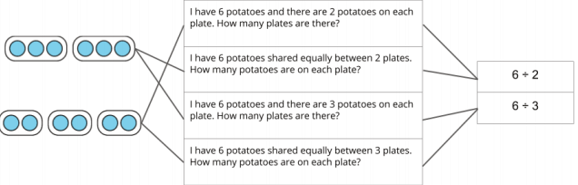





Unit 4 Progression Overview
Relating Multiplication to Division
Section A
Lessons 1-5
3.NBT.A.2, 3.OA.A.2, 3.OA.A.3
Section B
Lessons 6-11
3.MD.C.7.c, 3.NBT.A.3, 3.OA.A.2, 3.OA.A.3, 3.OA.B.5,
3.OA.B.6, 3.OA.C.7, 3.OA.D.9
Section C
Lessons 12-17
3.MD.C.7.c, 3.NBT.A.3, 3.OA.A.3, 3.OA.B.5, 3.OA.D.8
Section D
Lessons 18-23
3.MD.C.7, 3.NBT.A.3, 3.OA.A.2, 3.OA.A.3, 3.OA.A.4,
3.OA.B.5, 3.OA.C.7, 3.OA.D.8
Represent and solve “How many groups?” and “How many in each group?” problems.
Understand division as a missing factor problem.
Use properties of operations to develop fluency with single-digit multiplication facts, and their related division facts.
Use properties of operations and place value understanding to develop strategies to multiply within 100.
Use properties of operations, place value understanding and the relationship between multiplication and division to develop strategies to divide within 100.

Slide 3



Unit 4 Quick Links
L1
L2
L3
L4
L5
L6
L7
L8
L9
L10
L11
L12
L13
L14
L15
L16
L17
L18
L19
L20
L21
L22
L23

Slide 4
How Many Groups?
1
Let’s represent and solve problems.
3.OA.A.2, 3.OA.A.3

Slide 5
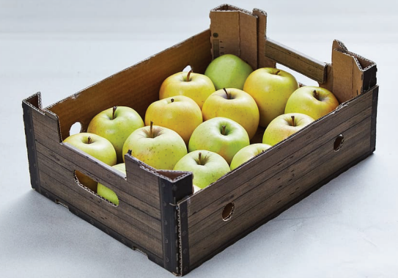
How Many Do You See: Apples
Warm up
How many do you see?
How do you see them?

Slide 6
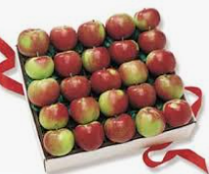
How Many Apples?
Activity #1
Solve each problem. Show your thinking using a drawing or a diagram.
1. If 24 apples are put into boxes with 8 apples in each box, how many boxes are there?
2. If 42 apples are put into boxes with 6 apples in each box, how many boxes are there?
3. If 32 apples are put into boxes with 4 apples in each box, how many boxes are there?

Slide 7

Gallery Walk
Activity #2
1. As you visit the posters with your partner, discuss what is the same and what is different about the thinking shown on each poster.
2. Now reflect on what you saw. Write down one thing that was the same and one thing that was different about the thinking shown on each poster.

Slide 8

Lesson Synthesis
Today we solved problems about putting apples into boxes. How were these problems the same as multiplication? How were they different?
The problems we solved today are division problems. How would you define division based on the problems we saw today?

Slide 9
How Many in Each Group?
2
Let’s represent and solve more problems.
3.OA.A.2, 3.OA.A.3

Slide 10
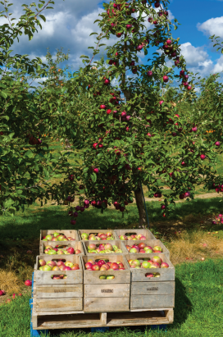
Notice and Wonder:
More Apples
Warm up
What do you notice?
What do you wonder?

Slide 11
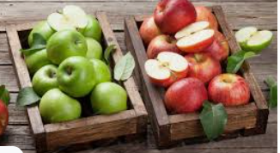
How Many Apples?
Activity #1
Solve each problem. Show your thinking using a drawing or a diagram.
1. If 20 apples are packed into 4 boxes with each box having the same number of apples, how many apples are in each box?
2. If 36 apples are packed into 6 boxes with each box having the same number of apples, how many apples are in each box?
3. If 45 apples are packed into 9 boxes with each box having the same number of apples, how many apples are in each box?

Slide 12
Gallery Walk
Activity #2
As you visit the posters with your partner, discuss what is the same and what is different about the thinking shown on each poster.

Slide 13

All the Apples
Activity #3
If 24 apples are put into boxes with 8 apples in each box, how many boxes are there?
If 20 apples are packed into 4 boxes with each box having the same number of apples, how many apples are in each box?
Discuss with your partner, what was the same and what was different about these problems and how students represented them.

Slide 14
Yesterday, we solved problems that asked about how many groups we could make. Today we solved problems that asked about how many things are in each group. Both of these ideas are division. Division is finding the number in each group or finding the size of each group when we share into groups of equal size.
Lesson Synthesis

Slide 15
Division Situation Drawings
3
Let’s represent division situations with drawings.
3.NBT.A.2, 3.OA.A.2

Slide 16

Number Talk:
The More Things Change...
Warm up
Find the value of each expression mentally.

Slide 17
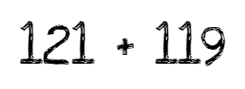
Number Talk:
Place Value Practice
Warm up
Find the value of each expression mentally.

Slide 18

Number Talk:
Place Value Practice
Warm up
Find the value of each expression mentally.

Slide 19

Number Talk:
Place Value Practice
Warm up
Find the value of each expression mentally.

Slide 20

Groups of Students
Activity #1
1. What did you notice about how the students put themselves into groups of 2?
2. What did you notice about how the students put themselves into 2 groups?

Slide 21

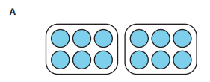
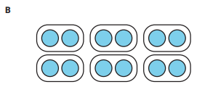
Elena’s Colored Pencils
Activity #2
Elena has 12 colored pencils. She has 2 boxes and wants to put the same number of colored pencils in each box. How many colored pencils will go in each box?
Which drawing matches the situation? Explain your reasoning.

Slide 22






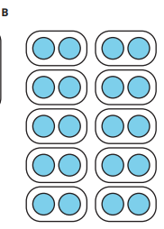
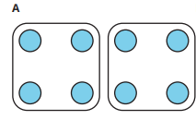
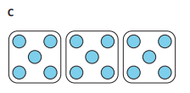
Which Drawing Matches?
Activity #2
Match each situation to a drawing. Be prepared to explain your reasoning.

Slide 23


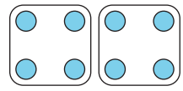
Lesson Synthesis
Today we matched drawings to division situations. There are two types of division situations and we saw today that the same drawing can match both types of situations.”
Now that we are dividing, we need a new symbol to write division expressions. If we wanted to represent “8 divided into groups of 4” we would write: 8÷4 .
What is the same and what is different about these division situations?
In the first situation we need to figure out how many groups there are. We know there are 4 muffins in each box, but we don’t know how many boxes there will be. In the second situation we need to figure out how many in each group. We know there are 2 bags, but we don’t know how many shells will be in each bag
What expression could we write to represent “8 divided into 2 groups”?

Slide 24
Interpret Division Expressions
4
Let’s make sense of division expressions.
3.NBT.A.2, 3.OA.A.2

Slide 25

Number Talk:
More or Less?
Warm up
Find the value of each expression mentally.

Slide 26

Number Talk:
Hundreds, Tens, and Ones
Warm up
Find the value of each expression mentally.

Slide 27

Number Talk:
Hundreds, Tens, and Ones
Warm up
Find the value of each expression mentally.

Slide 28

Number Talk:
Hundreds, Tens, and Ones
Warm up
Find the value of each expression mentally.

Slide 29










Expression Match
Activity #1
Match each situation to a division expression. Be prepared to explain your reasoning.

Slide 30
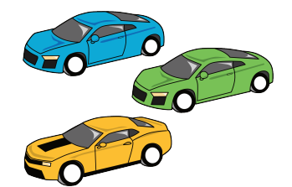
Which Situation?
Activity #2
Consider these 2 situations.
A. Han has 21 toy cars. He puts the same number of cars in 3 boxes. How many cars will be in each box?
B. Han has 21 toy cars. He wants to put 3 cars in each box. How many boxes will he need?
Which situation does the expression 21 ÷ 3 match? Explain your reasoning.

Slide 31








Ways to Represent Division
Activity #3
Match each situation to a drawing and an equation. Be prepared to explain your reasoning.

Slide 32

Lesson Synthesis
Division expressions can be interpreted two ways and you can’t really tell what type of division situation is being represented unless you have a situation or a drawing that goes with the expression.
Is there any way to tell the expressions that represent a 'how many groups?' problem from the expressions that represent a 'how many in each group?' problem?

Slide 33
Write Division Expressions
5
Let’s write division expressions and solve “how many groups?” and "how many in each group?" problems.
3.NBT.A.2, 3.OA.A.2, 3.OA.A.3

Slide 34

Number Talk:
Hundreds, Tens, and Ones
Warm up
Find the value of each expression mentally.

Slide 35

Number Talk:
Hundreds, Tens, and Ones
Warm up
Find the value of each expression mentally.

Slide 36

Number Talk:
Hundreds, Tens, and Ones
Warm up
Find the value of each expression mentally.

Slide 37
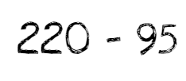
Number Talk:
Hundreds, Tens, and Ones
Warm up
Find the value of each expression mentally.

Slide 38






All Kinds of Problems
Activity #1
1. Your teacher will give you a set of cards that show situations. Sort the cards into 2 categories of your choosing. Be prepared to explain the meaning of your categories.
2. Write a division expression to represent each situation. Be ready to explain your reasoning.

Slide 39

Solving Our Problems
Activity #2
Create a visual display that shows your thinking about the problem you were assigned by your teacher.

Slide 40
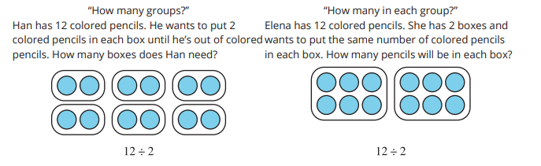
Lesson Synthesis
Over the last few lessons we have been learning about division. We represented and solved two kinds of division problems. Let’s summarize what we know about division together.
What are some of the big ideas we have learned about division?

Slide 41
Section Summary
In this section, we learned that division is finding the number in each group or finding the size of each group when we share into groups of equal size. We represented division situations with drawings and expressions, and solved division problems.

Slide 42
Division as an
Unknown Factor
6
Let’s connect division equations to multiplication equations
3.NBT.A.2, 3.OA.B.5

Slide 43
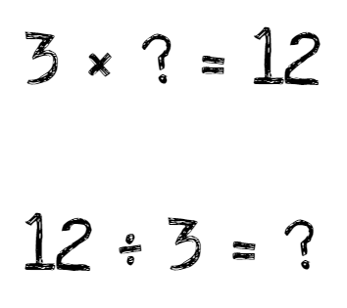
Notice and Wonder:
Missing Numbers
Warm up
What do you notice?
What do you wonder?

Slide 44

Multiplication or Division?
Activity #1
Kiran had 14 melons that he shared equally into 2 boxes. How many melons are in each box?
Whose equation do you agree with? Be ready to explain your reasoning.

Slide 45
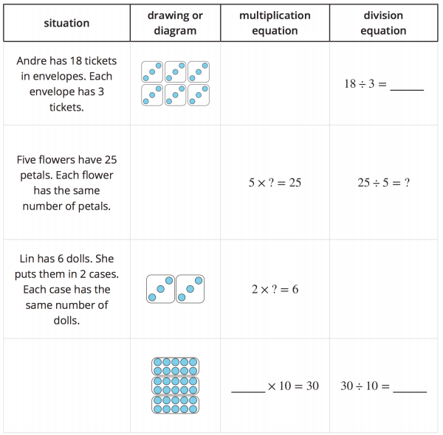
Equal Groups Fill In
Activity #2
Complete each row. Be prepared to explain your reasoning.

Slide 46
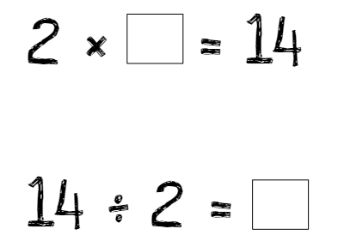

Lesson Synthesis
Today we focused on connecting multiplication and division equations. Why does the unknown move locations when you write a multiplication equation and a division equation for the same situation?
We call the result in a division equation the quotient. For example, in 14 ÷ 2 = ? , the result is unknown, so we are finding the value of the quotient. In the completed equation 14 ÷ 2 = 7 , we see that the value of the quotient is 7

Slide 47
Relating Multiplication to Division
7
Let’s make more connections between multiplication and division.
3.NBT.A.3, 3.OA.A.2, 3.OA.A.3, 3.OA.B.6

Slide 48

How Many Do You See: Tens
Warm up
How many do you see?
How do you see them?

Slide 49
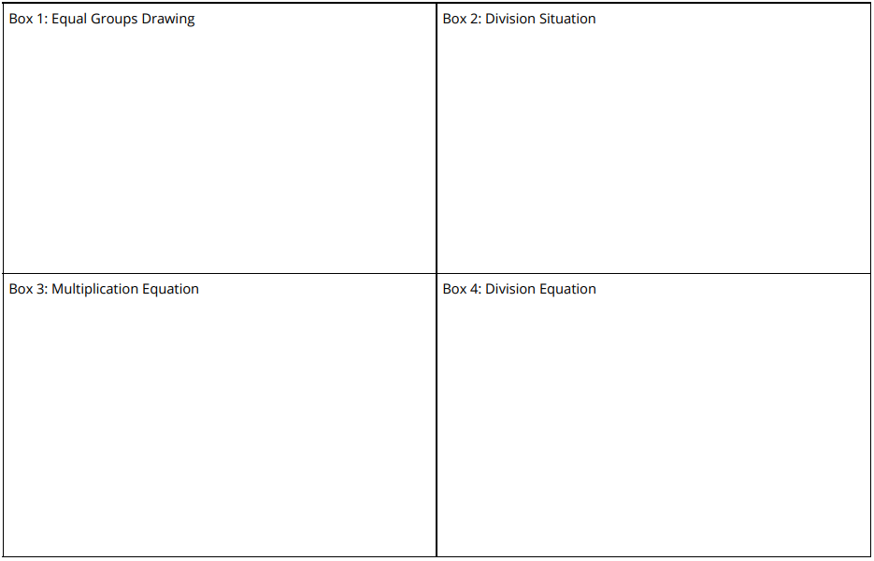
Division Round Table
Activity #1
1. Draw equal groups in Box 1 on your recording sheet. (wait for teacher instructions)
2. In Box 2, write a division situation that matches the drawing you were just passed. (wait for teacher instructions)
3. In Box 3, write a multiplication equation with a symbol for the unknown quantity that matches the drawing and division situation you were just passed. (wait for teacher instructions)
4. In Box 4, write a division equation with a symbol for the unknown quantity that matches the drawing, division situation, and multiplication equation you were just passed.

Slide 50




Represent and Solve Problems With Equal Groups
Activity #2
For each problem:
a. Write an equation with a symbol for the unknown quantity.
b. Solve the problem and determine the unknown number in each equation. Be prepared to explain your reasoning.

Slide 51


Lesson Synthesis
What would be the related division equation and how are they related?
What would be the related multiplication equation and how are they related?

Slide 52
Relating Quotients to Products You Know
8
Let’s consider the products and quotients we know right away or can find quickly
3.OA.B.6, 3.OA.C.7

Slide 53

Number Talk:
Multiplication and Division
Warm up
Find the value of each expression mentally.

Slide 54
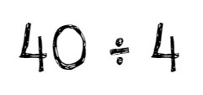
Number Talk:
Subtract Two-Digit Numbers
Warm up
Find the value of each expression mentally.

Slide 55
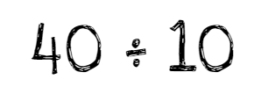
Number Talk:
Subtract Two-Digit Numbers
Warm up
Find the value of each expression mentally.

Slide 56

Number Talk:
Subtract Two-Digit Numbers
Warm up
Find the value of each expression mentally.

Slide 57
Multiplication Card Sort
Activity #1
Part 1
Quiz your partner on their multiplication facts and sort your partner’s facts into one of these columns:
1. know it right away
2. can find it quickly
3. don’t know it yet
Part 2
Multiplication expressions I’m going to practice:
1.
2.
3.
4.
5.

Slide 58


If I Know, Then I Know
Activity #2

Slide 59
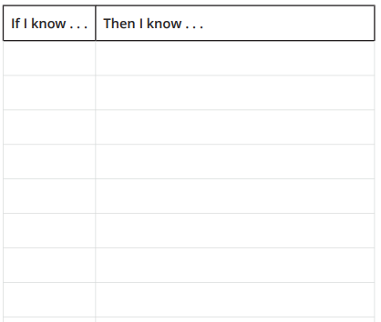
If I Know, Then I Know
Activity #2
Activity
1. Set the multiplication fact cards in a stack face down.
2. Take turns drawing a multiplication fact card. 3. For each card, use a multiplication fact to record a multiplication equation in the “If I know . . .” column.
4. Then, record a related division equation in the “Then I know . . .” column.

Slide 60
Lesson Synthesis
Today we thought about multiplication facts that we know and worked on some that we don’t know yet. How did this help you with finding division facts?

Slide 61
Strategies and the Multiplication Table
9
Let’s use patterns in the multiplication table to think about strategies for multiplying.
3.OA.C.7, 3.OA.D.9

Slide 62
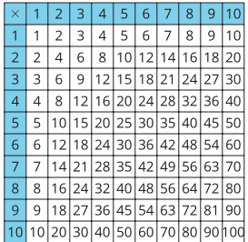
Notice and Wonder:
Squares
Warm up
What do you notice?
What do you wonder?

Slide 63

Guess the Product
Activity #1
Part 1
Solve these “Who am I?” riddles. Be ready to explain your reasoning
1. I’m an even number. One of my factors is 5. If you divide me by 2, you get an odd number.
2. I’m an odd number. One of my factors is 3. If you add 3, then I have 10 as a factor.
3. I’m an odd number. I only have one factor, but I can be a factor of any number.
Part 2
Work with a partner to create your own “Who am I?” riddle.

Slide 64
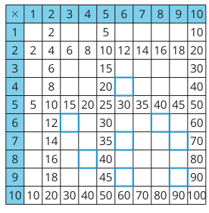
The Missing Products
Activity #2
Use some of the products that are already in the table to find some of the products that go in the highlighted boxes.

Slide 65
Lesson Synthesis
Today we considered patterns in the multiplication chart and thought about how we could use a multiplication fact that we know to find a multiplication fact we don’t know.
How could today's lesson help us move from not knowing a product yet to finding the same product quickly?

Slide 66
Show Strategies
with Area
10
Let’s use area to show strategies.
3.MD.C.7.c, 3.OA.B.5, 3.OA.C.7

Slide 67
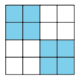
How Many Do You See: Squares
Warm up
How many do you see?
How do you see them?

Slide 68
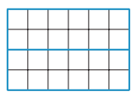
How Many Do You See: Squares
Warm up
How many do you see?
How do you see them?

Slide 69
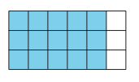
How Many Do You See: Squares
Warm up
How many do you see?
How do you see them?

Slide 70
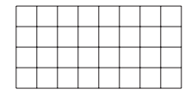
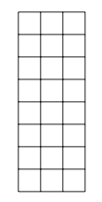
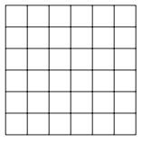
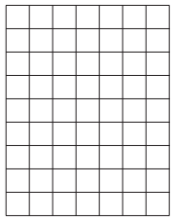

Finding Area in Parts
Activity #1
For each rectangle:
a. Highlight parts of each diagram to show how you could find the total number of squares.
b. Write multiplication expressions to represent how you found the total number of squares
1.
3.
4.
5.
2.

Slide 71

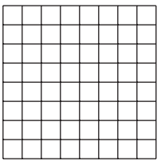
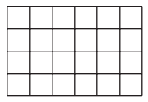
Represent the Strategy
Activity #2
Highlight part of each rectangle below to show how each student saw the area.
Be prepared to explain your reasoning.
1. Noah says the expression (5 × 3) + (2 × 3) shows how he saw the area of the rectangle.
3. Tyler says the expression (5 × 8) + (3 × 8) shows how he saw the area of the rectangle.
2. Priya says the expression 2 (2 × 3) shows how she saw the area of the rectangle.

Slide 72
Lesson Synthesis
Today, we used diagrams to show different multiplication strategies.
How did using diagrams make it easier to see the strategies that were being used to multiply?

Slide 73
Number Talks Bonanza
11
Let’s think about strategies we can use to multiply and divide.
3.OA.C.7

Slide 74

Number Talk:
Multiplication and Division
Warm up
Find the value of each expression mentally.

Slide 75

Number Talk:
Multiplication and Division
Warm up
Find the value of each expression mentally.

Slide 76
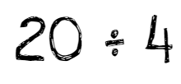
Number Talk:
Multiplication and Division
Warm up
Find the value of each expression mentally.

Slide 77
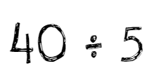
Number Talk:
Multiplication and Division
Warm up
Find the value of each expression mentally.

Slide 78
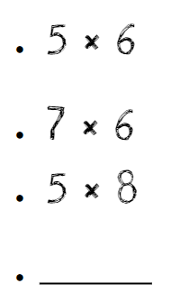
One Missing Expression
Activity #1
Write an expression to complete the Number Talk.

Slide 79
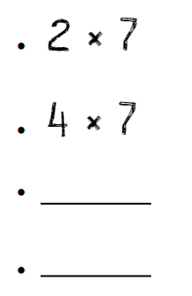
Two Missing Expressions
Activity #2
Write two expressions to complete the Number Talk.

Slide 80
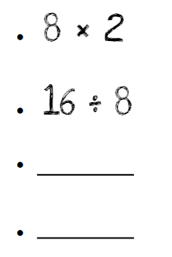
Another Two Missing Expressions
Activity #3
Write two expressions to complete the Number Talk.

Slide 81
Lesson Synthesis
Think about how the multiplication facts you know have changed over the last few lessons. What are some strategies that you’ve learned that have been helpful?

Slide 82

Section Summary
In this section we learned how multiplication and division are related. We used strategies to multiply and divide and worked towards fluent multiplication and division within 100.

Slide 83
Solve Problems With
Equal Groups
12
Let’s multiply some teen numbers.
3.OA.A.3, 3.OA.B.5

Slide 84
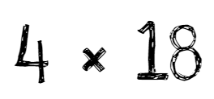
Estimation Exploration: Multiplying Teens
Warm up
Record an estimate that is:
Too low | About right | Too high

Slide 85

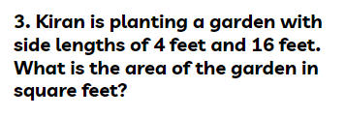

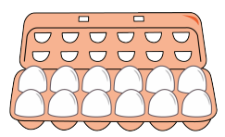
Teen Problems
Activity #1
Solve each problem. Show your thinking using objects, a drawing, or a diagram

Slide 86
Gallery Walk
Activity #2
As you visit the posters with your partner, discuss what is the same and what is different about the thinking shown on each poster.

Slide 87
Lesson Synthesis
Today we solved some problems that involved multiplying teen numbers. What were some strategies or representations you saw today that you’d like to try in the future?
How did your work multiplying smaller numbers help you multiply teen numbers?

Slide 88
Ways to Represent Multiplication of Teen Numbers
13
Let’s make sense of some ways to represent the multiplication of teen numbers.
3.OA.B.5

Slide 89
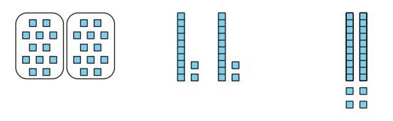
Notice and Wonder:
Seeing Groups
Warm up
What do you notice?
What do you wonder?

Slide 90
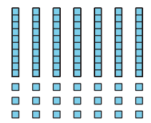
A Factor Greater than Ten
Activity #1
Part 1
Tyler says he can use base-ten blocks to find the value of 7 × 13 because he knows 7 × 10 and 7 × 3 and says the place-value diagram proves his thinking. Do you agree or disagree? Explain your reasoning
Part 2
Use Tyler’s method to find the value of the product 3 × 14 . Explain or show your reasoning.

Slide 91
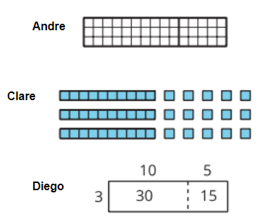
Ways to Represent
Activity #2
Andre, Clare, and Diego represented the same expression. Their representations are shown below.
1. How do you see the factors in each diagram?
2. How do you see the product in each diagram?

Slide 92
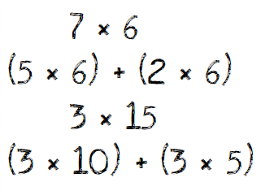
Lesson Synthesis
Today we saw some different ways to represent strategies we can use to multiply teen numbers. How are the strategies we use to multiply teen numbers like the strategies we used to multiply smaller numbers in past lessons?

Slide 93
Equal Groups, Larger Numbers
14
Let’s solve some problems with equal groups that have larger numbers.
3.MD.C.7.c, 3.OA.A.3, 3.OA.B.5

Slide 94
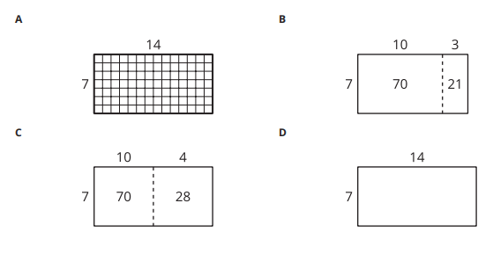
Which One Doesn’t Belong:
Area Diagrams
Warm-
up

Slide 95

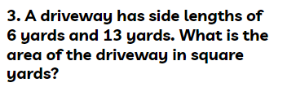
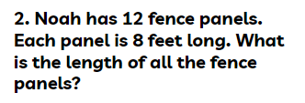
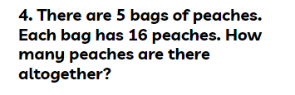
Equal Groups, Larger Numbers
Activity #1
Solve each problem. Show or explain your reasoning.

Slide 96
Gallery Walk
Activity #2
As you visit the posters with your partner, discuss what is the same and what is different about the thinking shown on each poster.

Slide 97
Lesson Synthesis
Today we solved problems that involved the multiplication of a teen number. What would be the advantages and disadvantages of using each of these diagrams?

Slide 98
Multiply Multiples of Ten
15
Let’s multiply one-digit numbers times multiples of 10.
3.NBT.A.3

Slide 99
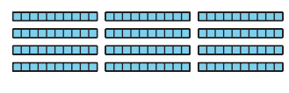
Notice and Wonder:
Tens
Warm up
What do you notice?
What do you wonder?

Slide 100

Field Trip Money
Activity #1
1. Elena was helping count the money for a field trip. There were eighteen envelopes and each envelope had a ten dollar bill in it. How much money was there all together?
2. All the money for the field trip is in ten dollar bills. Find different ways the money could be organized into envelopes where each envelope has the same amount.

Slide 101

Two Strategies
Activity #2

Slide 102

Two Strategies
Activity #2
2. Find the value of each expression. Show or explain your reasoning.

Slide 103
Lesson Synthesis
Today we multiplied one-digit whole numbers by multiples of 10. How did thinking about tens help us find the value of products that were larger than we had found before?
What were some strategies that were helpful as you multiplied one-digit whole numbers by multiples of 10?

Slide 104
Multiplying Numbers
Larger than 20
16
Let’s multiply numbers that are larger than 20.
3.OA.B.5

Slide 105

Estimation Exploration: Multiplying Twenties
Warm up
Record an estimate that is:
Too low | About right | Too high

Slide 106
Analyze and Try
Activity #1
1. Andre is multiplying 2 × 37. His first step is shown. What would he do next to find the product? Show or explain your reasoning.
2 × 30 = 60
2. Use Andre’s method to find the value of the expressions. Show or explain your reasoning.
2 × 43
4 × 22
3 × 28

Slide 107


Play Close to 100, Multiplication
Activity #2
Play Close to 100, Multiplication with a partner.
1. Place the cards face down.
2. Each player draws 4 cards.
3. Each player chooses 2 cards to complete the expression to make a value as close to 100 as possible. Write the 2 digits and the product.
4. Player closest to 100 wins.
5. Play 5 rounds. Player who wins the most rounds wins.

Slide 108
Lesson Synthesis
Today we finished with a game where you were able to use strategies you’ve learned to multiply larger numbers. How have the strategies you use to multiply changed over the last few lessons?

Slide 109
Use the Four Operations to Solve Problems
17
Let’s use the four operations to solve problems.
3.OA.B.5, 3.OA.D.8

Slide 110

True or False: Multiply by 10
Warm up
Decide whether each statement is true or false.
Be prepared to explain your reasoning.

Slide 111

True or False: Multiply by 10
Warm up
Decide whether each statement is true or false.
Be prepared to explain your reasoning.

Slide 112

True or False: Multiply by 10
Warm up
Decide whether each statement is true or false.
Be prepared to explain your reasoning.

Slide 113

True or False: Multiply by 10
Warm up
Decide whether each statement is true or false.
Be prepared to explain your reasoning.

Slide 114

Questions about a Situation
Warm up
What questions could you ask about this situation?
There are 142 guests at a party. All the guests are in 2 rooms. Room A has 94 guests. Room B has 6 tables that each have the same number of guests. There are 4 pieces of silverware and 1 plate for each guest.

Slide 115



Party Problems
Activity #1
For each problem:
a. Write an equation with a letter for the unknown quantity to represent the situation.
b. Solve the problem. Show or explain your reasoning

Slide 116
Lesson Synthesis
Today we used multiplication, division, addition, and subtraction to solve two-step problems.
What were some strategies that were helpful as you solved these types of problems?

Slide 117

Section Summary
In this section we used strategies to multiply teen numbers. We learned to multiply single-digit numbers by multiples of ten, then used strategies to multiply numbers greater than 20.

Slide 118
Solve Division Problems
with Larger Quotients
18
Let’s divide with larger numbers.
3.OA.A.3

Slide 119

What Do You Know About Division?
Warm up

Slide 120

Solve, Your Way
Activity #1
There are 48 students going on a field trip to the aquarium. They are put into groups of 4 students. How many groups will there be?
Show your thinking using diagrams, symbols, or other representations.

Slide 121


Division Reflection
Activity #2
Another strategy I could have used to solve the problem today is…

Slide 122
Lesson Synthesis
Today we found the value of quotients with larger numbers than we have worked with before. What ideas about division or multiplication that we learned in this unit did you find helpful as you worked?
What idea did you see today that you want to try as we continue to divide with larger numbers?

Slide 123
Represent Division, Part 1
19
Let’s make sense of representations of division.
3.NBT.A.3, 3.OA.B.5, 3.OA.C.7

Slide 124

True or False: Multiply by 10
Warm up
Decide whether each statement is true or false.
Be prepared to explain your reasoning.

Slide 125

True or False: Multiply by 10
Warm up
Decide whether each statement is true or false.
Be prepared to explain your reasoning.

Slide 126

True or False: Multiply by 10
Warm up
Decide whether each statement is true or false.
Be prepared to explain your reasoning.

Slide 127

True or False: Multiply by 10
Warm up
Decide whether each statement is true or false.
Be prepared to explain your reasoning.

Slide 128

Use Base-Ten Blocks to Divide
Activity #1
Write an equation to show the value of each quotient. You can use base-ten blocks to represent the quotients if you’d like.

Slide 129
Teen Number Divisors
Activity #2
1. Find the value of each quotient. Explain or show your reasoning.
36 ÷ 3
70 ÷ 14
2. Find the value of each quotient. Explain or show your reasoning.
72 ÷ 18
57 ÷ 3
90 ÷ 15
96 ÷ 8

Slide 130

Lesson Synthesis
Today we solved division problems. We applied what we knew about place value and that we can think of the divisor as the number of groups in a division situation or the size of each group.
Turn and talk with your partner. One partner tells a situation that could match this expression that uses 8 as the number of groups and the other partner tells a situation that could match this expression that uses 8 as the size of each group

Slide 131
Represent Division, Part 2
20
Let’s make sense of representations of division.
3.OA.B.5, 3.OA.C.7

Slide 132

Number Talk:
Multiplication and Division
Warm up
Find the value of each expression mentally.

Slide 133

Number Talk:
More Groups, Less Groups
Warm up
Find the value of each expression mentally.

Slide 134

Number Talk:
More Groups, Less Groups
Warm up
Find the value of each expression mentally.

Slide 135

Number Talk:
More Groups, Less Groups
Warm up
Find the value of each expression mentally.

Slide 136

Multiply to Divide
Activity #1
1. Mai and Kiran wanted to use multiplication to find
52 ÷ 4. They wrote these equations.
4 × 10 = 40
4 × 3 = 12
10 + 3 = 13
Then, Kiran used base-ten blocks to represent the ideas and Mai used a diagram.
2. Try Mai and Kiran’s strategy to find:
48 ÷ 3
How did Mai and Kiran use multiplication to find the quotient?

Slide 137

How Would You Divide?
Activity #2
Find the value of each quotient. Show your thinking.
Organize it so it can be followed by others.

Slide 138



Lesson Synthesis
Today we used the relationship between multiplication and division to divide. How could these products help us find the quotient of 96 ÷ 6?
We have used a variety of strategies and representations to find the value of quotients, including using the relationship between multiplication and division. How do you like to divide with larger numbers? Why?
In the last few lessons, we noticed that we can multiply or divide to find the value of the quotient, we can use place value to help us think about how to divide, and we also discovered that it’s sometimes helpful to think about the divisor as the number of groups or the group size

Slide 139
Divide with Larger Numbers
21
Let’s divide with even larger numbers.
3.OA.B.5, 3.OA.C.7

Slide 140

Estimation Exploration: Division
Warm up
Record an estimate that is:
Too low | About right | Too high

Slide 141



So Many Ways to Divide
Warm up
1. Lin, Priya, and Tyler found 78 ÷ 3 . Their work is shown. Make sense of their work.

Slide 142
So Many Ways to Divide
Warm up
2. In your group, have each member explain one student’s work. After you each share, see if your group has any questions or ideas to add about the student’s work.
3. Work with your group to find the value of each quotient. Explain or show your reasoning.
96 ÷ 4
63 ÷ 3
100 ÷ 25

Slide 143

Play Compare Expressions, Stage 3
Activity #2

Slide 144
Lesson Synthesis
Today we divided when the quotient was more than 20. Share with your partner the way you solved a problem in class today that you are proud of. Then we will share as a whole class.

Slide 145
Solve Problems Using the Four Operations
22
Let’s represent and solve problems using all four operations.
3.OA.D.8

Slide 146
Notice and Wonder:
Tens
Warm up
What do you notice?
What do you wonder?
A farmer picked some apples. Some of the apples are packed into boxes and some are not.

Slide 147

Apple Adventure
Warm up
A farmer picked some apples. Some of the apples are packed into boxes and some are not.
Choose 4 numbers from those provided that would make sense together in this situation. Write your choices in the table below. Be ready to explain how your numbers make sense together.
Total number of apples | Number of apples not in boxes | Number of boxes | Number of apples in each box

Slide 148
Apple Days
Warm up
1. There is an event at the apple orchard. The orchard had 200 tickets available for the event. They sold 184 tickets, then shared the leftover tickets equally between 4 people who work at the orchard. How many tickets did each person get?
a. Write an equation with a letter for the unknown quantity to represent this situation.
b. Solve the problem. Show or explain your reasoning.
2. Tyler is stacking apples to sell at the event. There are 85 apples for his display. He has already made 5 rows of 10 apples. How many apples are left?
a. Write an equation with a letter for the unknown quantity to represent this situation.
b. Solve the problem. Show or explain your reasoning.

Slide 149
Apple Days
Warm up
3. Clare is helping sell baked goods at the event. They have some money in the cash box. A customer buys 8 brownies that cost $3 each. Clare adds that money to the cash box and now they have $125. How much money was in the cash box before that purchase?
a. Write an equation with a letter for the unknown quantity to represent this situation.
b. Solve the problem. Show or explain your reasoning.

Slide 150
Lesson Synthesis
What did you find most challenging about solving these problems?
What ideas can you share that helped you overcome those challenges?

Slide 151

Section Summary
In this section, we learned In this section, we divided with larger numbers. We represented division with base-ten blocks, diagrams, and equations. We used what we know about place value and multiplication to divide. We also solved problems using all four operations. rounding is a formal way to decide what multiple of 10 or 100 a number is closest to.

Slide 152
School Community Garden
23
Let’s plan a school garden.
3.MD.C.7, 3.OA.A.2, 3.OA.A.3, 3.OA.A.4, 3.OA.D.8

Slide 153

Notice and Wonder:
Garden
Warm up
What do you notice?
What do you wonder?

Slide 154



Produce
Activity #1
For each situation draw a diagram and write an equation or expression.
1. A strawberry patch has 7 rows with 8 strawberry plants in each row.
a. How many strawberry plants are in the patch?
b. To grow strawberries in the best way, the rows should be 4 ft apart. Each plant in the row should be 2 ft apart. How long and wide is the strawberry patch?
c. You can harvest 12 strawberries per plant. How many strawberries will grow in each row?
2. Peas grow in pods. A pod typically has 6 peas. You have 84 peas. How many pods are there?
3. With your partner, take turns explaining where you see the numbers in the expression or equation you wrote in your diagram.

Slide 155
Plan the Garden
Activity #2
1. Circle 2 plants to grow and then read the information about them on the next page:
a. Strawberries
b. Carrots
c. Zucchini
d. Peas
e. Pinto beans
f. Potatoes
2. Plan your garden. Both of your plants should harvest between 50–100 fruits or vegetables.
a. How many of each plant will you grow?
b. Predict how many fruits or vegetables you will harvest. Show or explain your reasoning.
3. Make a diagram that shows how the plants are arranged and how much space is needed.

Slide 156






Plan the Garden
Activity #2

Slide 157
Lesson Synthesis
Today, we planned a community garden. Many of you used multiplication and division to arrange your plants and find out how much you could harvest. Arranging plants and the harvest are just a few things to think about when we have a garden.
What other information would we have to think about if we want to have a community garden?

