Slide 1

Wrapping Up 1,000
Grade 3: Unit 3
Standards addressed: 2.NBT.A.3, 3.NBT.A.2, 3.OA.D.9, 3.NBT.A.2, 3.OA.B.5, 2.NBT.B.7, 3.NBT.A.2, 3.OA.B.5,2.NBT.B.8, 3.NBT.A.1, 3.NBT.A.2, 3.OA.B.5, 3.OA.C.7, 3.OA.D.8
These slides have been created by Britnee Wright Southeast Arkansas Education Cooperative and are not official IM materials. Images and language are taken from IM Grade 3, Unit 3 by Illustrative Mathematics.
Copyright 2020 by Illustrative Mathematics. All Rights Reserved, adapted and shared with permission.

Slide 2
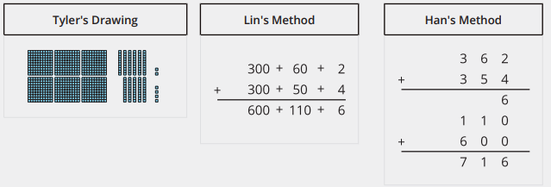

Unit 3 Progression Overview
Wrapping Up 1,000
Section A
Lessons 1-3
2.NBT.A.3, 3.NBT.A.2, 3.OA.D.9
Section B
Lessons 4-7
3.NBT.A.2, 3.OA.B.5
Section C
Lessons 8-13
2.NBT.B.7, 3.NBT.A.2, 3.OA.B.5
Section D
Lessons 14-21
2.NBT.B.8, 3.NBT.A.1, 3.NBT.A.2, 3.OA.B.5, 3.OA.C.7, 3.OA.D.8
Identify arithmetic patterns and explain them using properties of operations.
Use place value understanding to compose and decompose numbers.
Fluently add within 1,000 using algorithms based on place value and properties of operations.
Fluently subtract within 1,000 using algorithms based on place value, properties of operations and the relationship between addition and subtraction.
Assess the reasonableness of answers.
Round whole numbers to the nearest multiple of 10 and 100.
Solve two-step word problems using addition, subtraction, and multiplication.

Slide 3



Unit 3 Quick Links
Adapt 1
Adapt 2
Adapt 3
Adapt 4
Adapt 5
L1
L2
L3
Adapt 6
Adapt 7
L4
L5
L6
L7
L8
L9
L10
L11
L12
L13
Adapt 8
L14
L15
L16
L17
L18
L19
L20
L21

Slide 4
Making Multiples of 100
Adaptation
Lesson 1
Let’s compose hundreds using tens
2.NBT.A.1.A. 2.NBT.A.1.B, 2.NBT.A.2

Slide 5
True or False: Less Than or Equal to 100
Warm up
Is each statement true or false?
Be prepared to explain your reasoning.

Slide 6
True or False: Less Than or Equal to 100
Warm up
Is each statement true or false?
Be prepared to explain your reasoning.

Slide 7
True or False: Less Than or Equal to 100
Warm up
Is each statement true or false?
Be prepared to explain your reasoning.

Slide 8
True or False: Less Than or Equal to 100
Warm up
Is each statement true or false?
Be prepared to explain your reasoning.

Slide 9
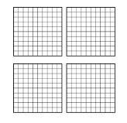

Making Hundreds Using Tens
Activity
#1
1. Use your base-ten blocks to show this number.
a. How many tens? _______
b. How many hundreds? _____
c. Write it as a three-digit number. ____
2. Use your base-ten blocks to show this number.
a. How many tens? _______
b. How many hundreds? _____
c. Write it as a three-digit number. ____

Slide 10
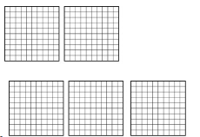

Making Hundreds Using Tens
Activity
#1
4. Use your base-ten blocks to show this number.
a. How many tens? _______
b. How many hundreds? _____
c. Write it as a three-digit number. ____
4. Use your base-ten blocks to show this number.
a. How many tens? _______
b. How many hundreds? _____
c. Write it as a three-digit number. ____

Slide 11
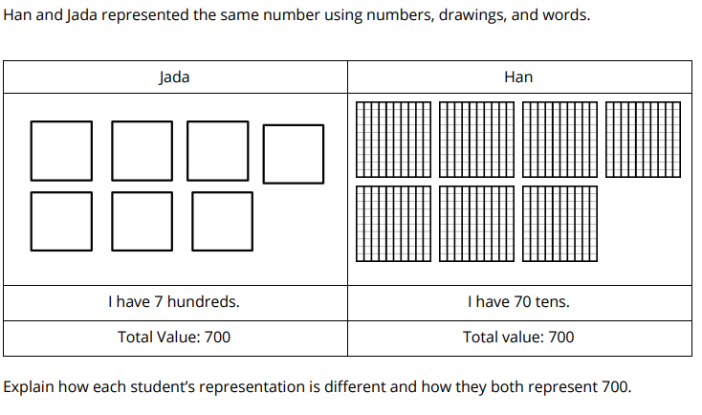
How Many Hundreds?
Activity
#2

Slide 12
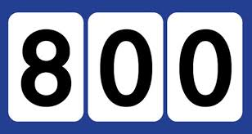
What Do You Know About:
Activity
#3

Slide 13

Lesson Synthesis
Today we learned that we can count by hundreds, tens, or ones to find total values. If Mai has 200 ones, what other ways could we describe this number?

Slide 14
Representing Three-Digit Numbers
Adaptation
Lesson 2
Let’s represent three-digit numbers in different ways.
2.NBT.A.1, 2.NBT.A.3

Slide 15
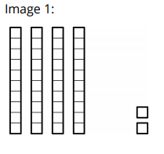
How Many Do You See? Building Three-Digit Numbers
Warm up
How many do you see?
How do you see them?

Slide 16
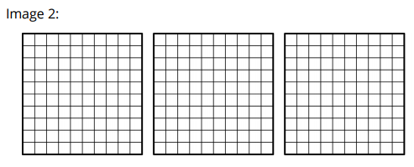
How Many Do You See? Building Three-Digit Numbers
Warm up
How many do you see?
How do you see them?

Slide 17
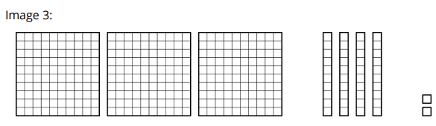
How Many Do You See? Building Three-Digit Numbers
Warm up
How many do you see?
How do you see them?

Slide 18
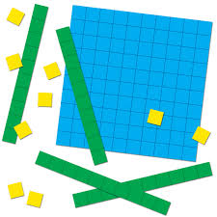
Representing 35 Tens
Activity
#1
How many base-ten blocks do you have?
Represent the value with numbers or words.

Slide 19

Writing Expressions and Three-Digit Numbers
Activity
#2

Slide 20
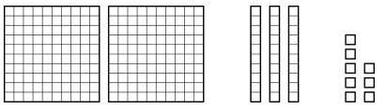

Writing Expressions and Three-Digit Numbers
Activity
#2
Write each number as an expression of hundreds, tens, and ones, and a three-digit number.
2.
Sum of hundreds, tens, and ones:
Three-digit number:
3.
Sum of hundreds, tens, and ones:
Three-digit number:

Slide 21

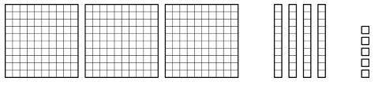
Writing Expressions and Three-Digit Numbers
Activity
#2
Write each number as an expression of hundreds, tens, and ones, and a three-digit number.
4.
Sum of hundreds, tens, and ones:
Three-digit number:
5.
Sum of hundreds, tens, and ones:
Three-digit number:

Slide 22
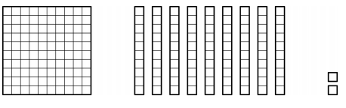
Writing Expressions and Three-Digit Numbers
Activity
#2
Write each number as an expression of hundreds, tens, and ones, and a three-digit number.
6.
Sum of hundreds, tens, and ones:
Three-digit number:

Slide 23
Lesson Synthesis
Today we represented numbers as expressions and written numbers.
426 400 + 20 + 6
How could we represent 547 as the sum of hundreds, tens, and ones?
Explain how you know these represent the same value.

Slide 24
Identifying and Writing Three-Digit Numbers
Adaptation
Lesson 3
Let’s identify and write three-digit numbers.
2.NBT.A.1, 2.NBT.A.3

Slide 25
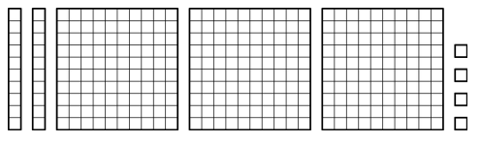
How Many Do You See:
Base-Ten Blocks
Warm up
How many do you see?
How do you see them?

Slide 26
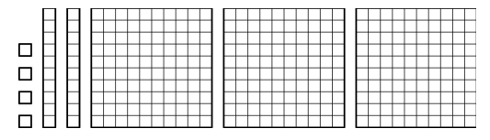
How Many Do You See:
Base-Ten Blocks
Warm up
How many do you see?
How do you see them?

Slide 27
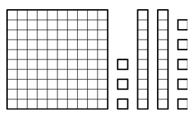
How Many Do You See:
Base-Ten Blocks
Warm up
How many do you see?
How do you see them?

Slide 28
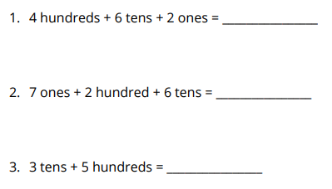
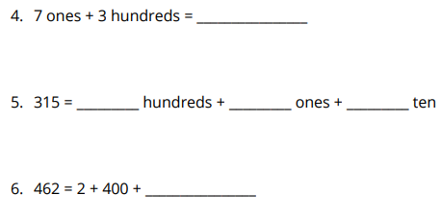
Base-Ten Equations
Activity
#1
Write the numbers that make the equation true. Use base-ten blocks or diagrams if they help.

Slide 29
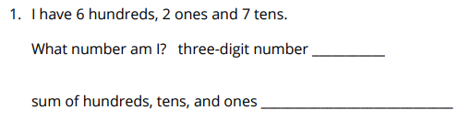
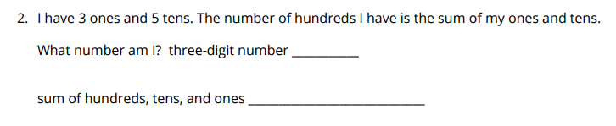
Base-Ten Riddles
Activity
#2
Solve each riddle. Write the number as a three-digit number and the sum of hundreds, tens, and ones.

Slide 30
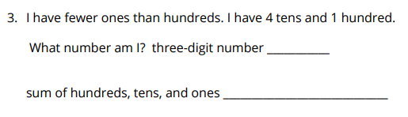
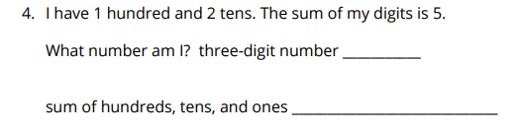
Base-Ten Riddles
Activity
#2
Solve each riddle. Write the number as a three-digit number and the sum of hundreds, tens, and ones.

Slide 31
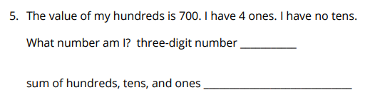
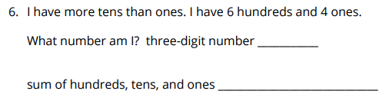
Base-Ten Riddles
Activity
#2
Solve each riddle. Write the number as a three-digit number and the sum of hundreds, tens, and ones.

Slide 32
Lesson Synthesis
Today we learned that three-digit numbers can be represented with their hundreds, tens and ones out of order. We learned that it is very important to put those digits in the correct place when representing the quantity with a three-digit number.
Han says 5 tens + 4 ones + 7 hundreds = 547. What would you say to Han about his thinking?

Slide 33
Composing and Decomposing Three-Digit Numbers
Adaptation
Lesson 4
Let’s make and break apart numbers in different way.
2.NBT.A.1, 2.NBT.A.2

Slide 34
True or False: Value of Digits
Warm up
Is it statement true or false?
Be prepared to explain your reasoning.

Slide 35

True or False: Value of Digits
Warm up
Is it statement true or false?
Be prepared to explain your reasoning.

Slide 36

True or False: Value of Digits
Warm up
Is it statement true or false?
Be prepared to explain your reasoning.

Slide 37

True or False: Value of Digits
Warm up
Is it statement true or false?
Be prepared to explain your reasoning.

Slide 38
Breaking Apart 214
Activity
#1
Break apart 214 in more than 1 way using hundreds, tens, and ones.
Show your thinking using drawings, numbers or words.

Slide 39
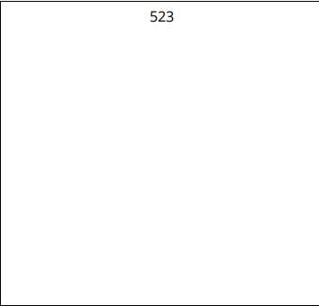
Different Ways to Make 523
Activity
#2
Find different ways to make 523. Show your thinking using drawings, numbers, or words.

Slide 40

Lesson Synthesis
Today we represented numbers with different amounts of hundreds, tens, and ones.
Han says this represents 350 but Tylers says that can’t be right because there are only 2 hundreds. What do you think?

Slide 41
Representing Numbers in Different Ways with Hundreds, Tens and Ones
Adaptation
Lesson 5
Let’s represent more numbers with hundreds, tens and ones.
2.NBT.A.1, 2.NBT.A.2, 2.NBT.A.3

Slide 42
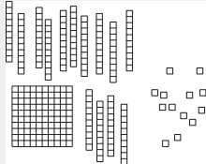
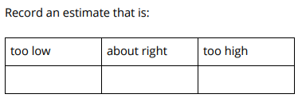
Estimation Exploration: How Many Ones?
Warm up
What is the value of the blocks?

Slide 43
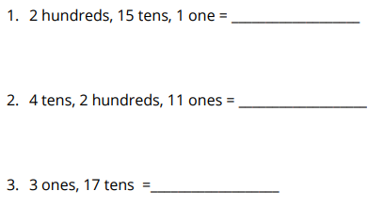
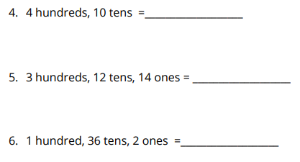
What’s the Number?
Activity
#1
Write the three-digit number. Use base-ten blocks or drawings if they help.
.

Slide 44
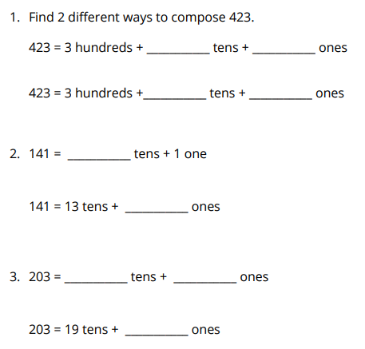
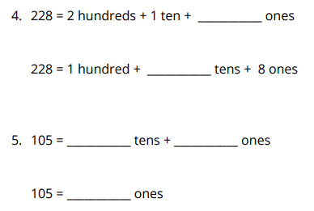
Finding Missing Parts
Activity
#2

Slide 45
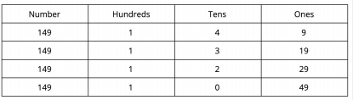
Lesson Synthesis
There are lots of ways we can compose numbers using hundreds, tens and ones. We know we can use 1 hundred or 10 tens to make the same number. We can also use 1 ten or ten ones.
Explain the pattern you see and why it happens?

Slide 46
Find and Explain Patterns
1
Let’s find and explain patterns
3.OA.D.9

Slide 47
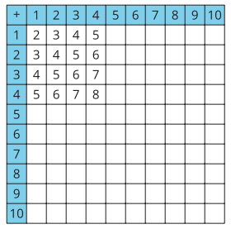
Notice and Wonder:
The Addition Table
Warm up
What do you notice?
What do you wonder?

Slide 48
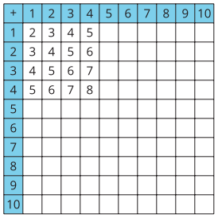
Patterns in the Addition Table
Activity #1
1. Fill in the rest of the addition table.
2. List some patterns you see in the addition table.
3. Choose one of the patterns you found in the addition table and explain why it works.

Slide 49
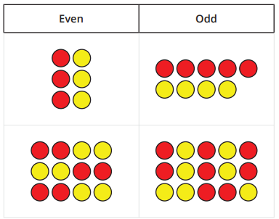
Even and Odd
Activity #2
Choose one of the statements. Tell whether the statement is always true, sometimes true, or never true. Explain your reasoning. Use your completed addition table if it’s helpful. If you finish early, choose another statement to explain.
1. When you add two even numbers the sum is an even number.
2. When you add two odd numbers, the sum is an odd number.
3. When you add an even number and an odd number, the sum is an odd number.

Slide 50

Lesson Synthesis
How did looking for patterns help you know that your statement about even and odd numbers would always be true?

Slide 51
Represent Numbers in Different Ways
2
Let’s represent numbers in different ways.
2.NBT.A.3, 3.NBT.A.2

Slide 52
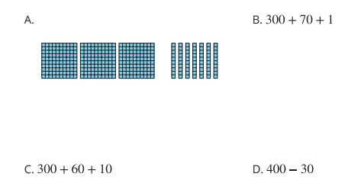
Which One Doesn’t Belong: Numbers within 1,000
Warm up

Slide 53
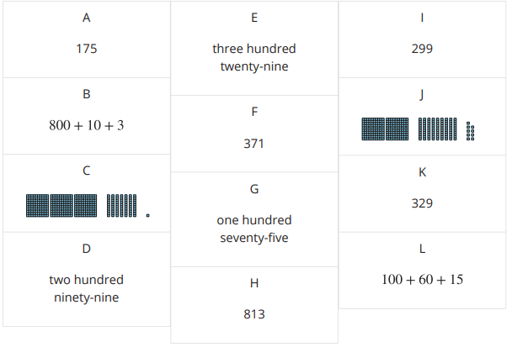
Card Sort: Numbers in Their Different Forms
Activity #1
Your teacher will give you a set of cards that show numbers in different forms. Find the cards that match. Be ready to explain your reasoning.

Slide 54
Numbers in Different Forms Round Table
Activity #2
Part 1
1. Write a three-digit number in Box 1 on your recording sheet. (wait for teacher instructions)
2. In Box 2, show a way that the number could be decomposed. (wait for teacher instructions)
3. In Box 3, show a way that the number could be decomposed that’s different from Box 2. (wait for teacher instructions)
4. In Box 4, show a way that the number could be decomposed that’s different from Boxes 2 and 3.

Slide 55
Numbers in Different Forms Round Table
Activity #2
Part 2
1. Look at what was filled in to represent your number. Write down any connections you notice between the different ways the number was decomposed.
2. Look at all of the recording sheets for your group. What patterns do you notice across the sheets that show how place value can be used to decompose numbers in different ways?

Slide 56
Today we decomposed numbers in lots of different ways.
Lesson Synthesis
If you were adding 253 and 134, which way of decomposing the numbers do you think would be most helpful and why?

Slide 57
Addition and Subtraction Situations
3
Let’s solve problems involving addition and subtraction.
3.NBT.A.2

Slide 58

Number Talk:
Place Value Practice
Warm up
Find the value of each expression mentally.

Slide 59

Number Talk:
Place Value Practice
Warm up
Find the value of each expression mentally.

Slide 60

Number Talk:
Place Value Practice
Warm up
Find the value of each expression mentally.

Slide 61

Number Talk:
Place Value Practice
Warm up
Find the value of each expression mentally.

Slide 62
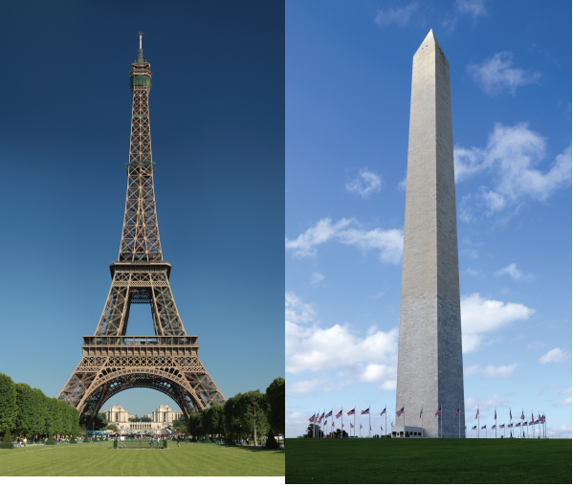

You Know I Got Problems
Activity #1
We are going to solve some problems about some famous places.
What are some famous landmarks that you know about?

Slide 63
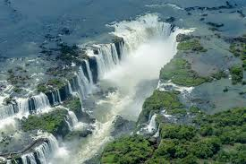
You Know I Got Problems
Activity #1
Solve each problem. Explain or show your reasoning
1. Iguazu Falls in South America marks the border between Paraguay, Brazil, and Argentina. It is the largest waterfall in the world. The waterfall falls in two parts. The waterfalls 115 feet in the first part and 131 feet in the second part. How far does the waterfall go altogether?
2. In Washington DC, there are many monuments to famous people in American history. The Lincoln Memorial is 99 feet tall. The Washington Monument is 555 feet tall. How much taller is the Washington Monument than the Lincoln Memorial?
3. The Eiffel Tower in Paris, France has 674 steps that go from the ground to the second floor. There are 328 steps from the ground to the first floor. How many steps are there from the first floor to the second floor?

Slide 64

Journal About Connections
Activity #2
What math did you do today that connected to something you did in an earlier grade?
or
Describe something you really understand well after today’s lesson or describe something that was confusing, challenging, or that you’d like to learn more about.

Slide 65
Lesson Synthesis
Today we used strategies to solve problems that involve addition and subtraction within 1,000 and heard some of the strategies that our classmates used.
What is a strategy you like to use for addition or subtraction and why?
What is a strategy for addition or subtraction that you would like to learn more about?

Slide 66
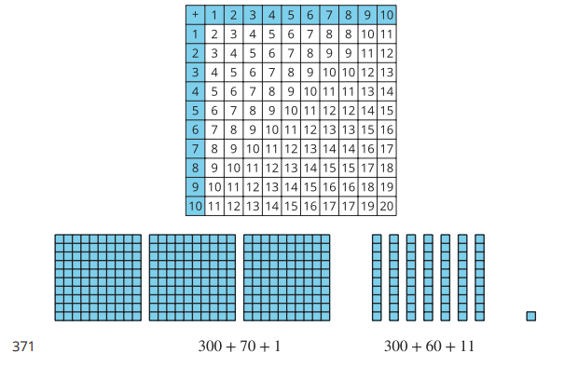
Section Summary
In this section we learned about patterns and reviewed different ways we can represent numbers, including different ways we can decompose numbers. Also, we solved problems involving addition and subtraction.

Slide 67
Decomposing to Subtract
Adaptation
Lesson 6
Let’s subtract.
2.NBT.B.7

Slide 68

Notice and Wonder: Equations
Warm up
What do you notice?
What do you wonder?

Slide 69

Decomposing to Subtract
Activity
#1
Write an equation that shows the difference.
Write an equation that shows the difference.

Slide 70
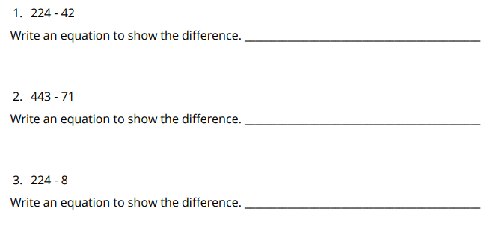
Decomposing with Base-Ten Blocks
Activity
#2
Use base-ten blocks to find the difference.

Slide 71
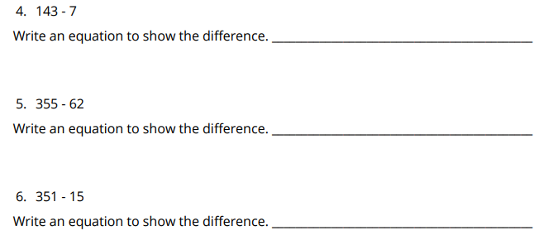
Decomposing with Base-Ten Blocks
Activity
#2
Use base-ten blocks to find the difference.

Slide 72
Lesson Synthesis
Today we saw that sometimes we need to decompose a hundred or a ten to subtract. How is decomposing a hundred like decomposing a ten?

Slide 73
Planning for Decompositions
Adaptation
Lesson 7
Let’s think about decomposing before subtracting
2.NBT.B.7

Slide 74
Choral Count
Warm up
Count by 10, starting at 350

Slide 75
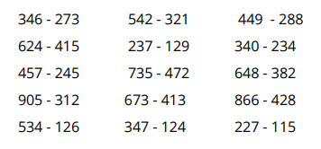
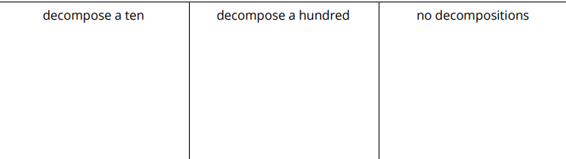
Subtraction Sort
Activity
#1
Sort the expressions into 3 categories:

Slide 76
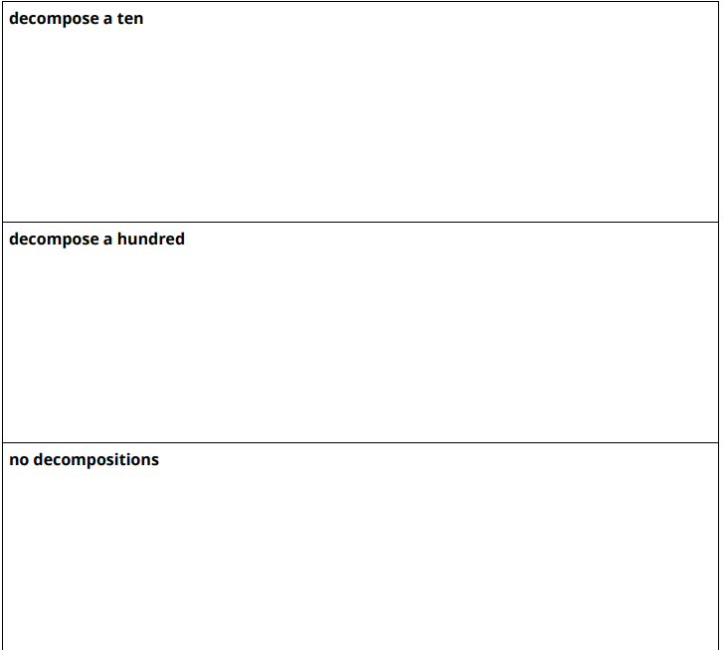
Subtraction Sort
Activity
#1
Choose 1 expression from each category and find the difference.
Show your thinking using drawings, symbols, or other representations.

Slide 77
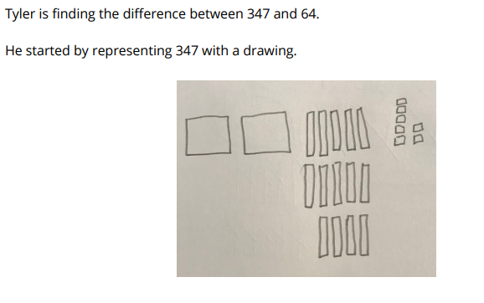
Tyler’s Representations
Activity
#2
Why did Tyler represent 347 like this? How will it help him subtract?
Choose one expression from the sort in activity 1 and show how Tyler might represent the number with a drawing.

Slide 78
Lesson Synthesis
Today we looked at expressions and figured out what decompositions were needed before subtracting. Why is it helpful to think about the decompositions that are needed before beginning to find the difference?

Slide 79
Add Your Way
4
Let’s add within 1,000.
3.NBT.A.2

Slide 80

Number Talk:
Hundreds, Tens, and Ones
Warm up
Find the value of each expression mentally.

Slide 81

Number Talk:
Hundreds, Tens, and Ones
Warm up
Find the value of each expression mentally.

Slide 82

Number Talk:
Hundreds, Tens, and Ones
Warm up
Find the value of each expression mentally.

Slide 83

Number Talk:
Hundreds, Tens, and Ones
Warm up
Find the value of each expression mentally.

Slide 84
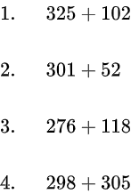
Strategies to Add
Activity #1
Find the value of each sum in any way that makes sense to you. Explain or show your reasoning.

Slide 85
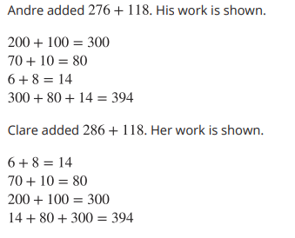
Two Ways to Add
Activity #2
With your partner, discuss:
What’s different about Clare and Andre’s work?
What’s the same?

Slide 86
Lesson Synthesis
Today we added numbers using many different strategies and representations. What is your favorite representation to use when you add numbers?
Does the way you add numbers or the representation you use change based on the numbers in the problem?
Keep all these strategies we have shared today in mind as we learn new ways to show your reasoning for adding in the upcoming lessons.
Notes:
“Take 5 minutes to respond to one or more of these prompts: Describe area in your own words. How can we measure area? What lingering questions do you have about area?” (Area is the amount of space that a shape covers. We can count squares to find the area of a shape in square units. How do you find the area of a triangle?)

Slide 87
Introduction to Addition Algorithms
5
Let’s learn new ways to add.
3.NBT.A.2

Slide 88
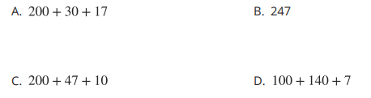
Which One Doesn’t Belong: 247
Warm up

Slide 89
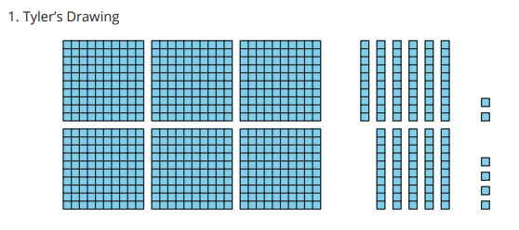
What is an Algorithm?
Activity #1
Three students added 362 + 354 as shown. Explain how each method works.

Slide 90
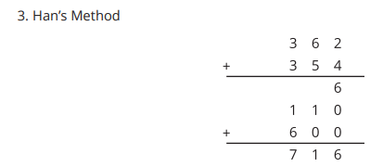


What is an Algorithm?
Activity #1
Three students added 362 + 354 as shown. Explain how each method works.

Slide 91
Try an Algorithm
Activity #2
Try an algorithm to find the value of each sum.
Show your thinking. Organize it so it can be followed by others.

Slide 92
Lesson Synthesis
Today we learned about two different algorithms since there were two different sets of steps to carry them out. How are the 2 algorithms the same? How are they different?

Slide 93
Another Addition Algorithm
6
Let’s learn another algorithm to add.
3.NBT.A.2, 3.OA.B.5

Slide 94

How Many Do You See?
Products of 4 and 6
Warm up
How many do you see?
How do you see them?

Slide 95

How Many Do You See?
Products of 4 and 6
Warm up
How many do you see?
How do you see them?

Slide 96

How Many Do You See?
Products of 4 and 6
Warm up
How many do you see?
How do you see them?

Slide 97

A New Addition Algorithm
Activity #1
Discuss with your partner:
1. How is Elena’s algorithm different from Han’s algorithm?
2. Why do both algorithms work?

Slide 98

Compose New Units
Activity #2
Two algorithms for adding 365 + 182 are shown.
1. How do the algorithms show the 14 tens differently?

Slide 99


Compose New Units
Activity #2
2. Try Elena’s algorithm to find the value of each sum.

Slide 100
Lesson Synthesis
In this lesson, we have been adding from right to left, starting with the ones place. Let’s look at this problem again. Let’s consider what would happen if we started adding from the left with hundreds place.
What would happen next? Can we add from left to right?

Slide 101
Use Strategies and Algorithms to Add Within 1,000
7
Let’s consider when to use algorithms and when to use strategies to add.
3.NBT.A.2

Slide 102
Number Talk:
Little More, Little Less
Warm up
Find the value of each expression mentally.

Slide 103
Number Talk:
Little More, Little Less
Warm up
Find the value of each expression mentally.

Slide 104
Number Talk:
Little More, Little Less
Warm up
Find the value of each expression mentally.

Slide 105
Number Talk:
Little More, Little Less
Warm up
Find the value of each expression mentally.

Slide 106

Just Ones
Activity #1
1. How is the newly composed ten and hundred recorded differently in each example?

Slide 107


Just Ones
Activity #1
2. Try the second way of recording to add these numbers:

Slide 108


How Would You Add?
Activity #2
Use a strategy or algorithm of your choice to find the value of each sum. Show your thinking. Organize it so it can be followed by others.

Slide 109
Lesson Synthesis
Today we saw how we can use strategies or algorithms to add.
After hearing what other students chose to use, what are your thoughts about choosing when to use a strategy or an algorithm?

Slide 110

Section Summary
In this section, we learned that an algorithm is a set of steps that works every time as long as the steps are carried out correctly. Then we learned algorithms to add numbers within 1,000. We also learned that we can choose to add with a strategy that may not work for every sum or an algorithm based on the numbers.

Slide 111
Subtract Your Way
8
Let’s subtract within 1,000.
3.NBT.A.2

Slide 112
Number Talk:
Subtract Two-Digit Numbers
Warm up
Find the value of each expression mentally.

Slide 113
Number Talk:
Subtract Two-Digit Numbers
Warm up
Find the value of each expression mentally.

Slide 114
Number Talk:
Subtract Two-Digit Numbers
Warm up
Find the value of each expression mentally.

Slide 115
Number Talk:
Subtract Two-Digit Numbers
Warm up
Find the value of each expression mentally.

Slide 116
Strategies to Subtract
Activity #1
Find the value of each difference in any way that makes sense to you.
Explain or show your reasoning.

Slide 117

Base-ten Drawings
Activity #2
Han used base-ten blocks to subtract 262 - 135.
A drawing of his work is shown.
Explain how Han used the blocks.

Slide 118


Base-ten Drawings
Activity #2
Write each expression next to the matching diagram, then find the difference.

Slide 119
Lesson Synthesis
Today we subtracted numbers using many different strategies. What is your favorite representation to use to subtract numbers?
Does the way you subtract numbers or the representation you use change based on the numbers in the problem?
Keep all these strategies we have shared today in mind as we learn new ways to show your reasoning around subtraction in the upcoming lessons.
What is your favorite representation to use to subtract numbers?

Slide 120
Introduction to Subtraction Algorithms (Part 1)
9
Let’s learn a new way to subtract.
3.NBT.A.2

Slide 121
Number Talk: Subtraction Strategies
Warm-Up
Find the value of each expression mentally.

Slide 122
Number Talk: Subtraction Strategies
Warm-Up
Find the value of each expression mentally.

Slide 123
Number Talk: Subtraction Strategies
Warm-Up
Find the value of each expression mentally.

Slide 124
Number Talk: Subtraction Strategies
Warm-Up
Find the value of each expression mentally.

Slide 125

From Drawings to an Algorithm
Activity #1
1. Explain how Kiran’s algorithm starts.
2. Explain how Kiran recorded the decomposition of the ten into more ones.
3. Finish Kiran’s work.

Slide 126

Card Sort: Diagrams and Algorithms
Activity #2
Your teacher will give you a set of cards. Match each diagram with an algorithm.

Slide 127

Lesson Synthesis
Today we learned an algorithm for subtraction. How is this algorithm similar to the algorithm we used for addition? How is it different?

Slide 128
Introduction to Subtraction Algorithms (Part 2)
10
Let’s learn more about our first subtraction algorithm.
2.NBT.B.7, 3.NBT.A.2

Slide 129
True or False: Does It Commute?
Warm up
Is it statement true or false?
Be prepared to explain your reasoning.

Slide 130
True or False: Does It Commute?
Warm up
Is it statement true or false?
Be prepared to explain your reasoning.

Slide 131
True or False: Does It Commute?
Warm up
Is it statement true or false?
Be prepared to explain your reasoning.

Slide 132

Revise Subtraction Work
Activity #1
1. What did Lin do?
2. What would you tell or show Lin so she can revise her work?

Slide 133


Try the Algorithm
Activity #2
Try Kiran’s algorithm to find the value of each difference.
Show your thinking. Organize it so it can be followed by others.

Slide 134

Lesson Synthesis
We’ve been learning about an algorithm for subtraction. Noah says the problem above has been changed into a completely different problem because the 832 has been crossed out. How would you explain the crossed out numbers to Noah?

Slide 135
A Second Subtraction Algorithm
11
Let’s learn another algorithm to subtract.
3.NBT.A.2

Slide 136

Notice and Wonder: Disappearing Digits
Warm up
What do you notice?
What do you wonder?

Slide 137


A New Subtraction Algorithm
Activity #1
Andre and Clare subtracted 528 - 271. This is how they started their work.
1. Complete both problems to find the difference.
2. How did the different ways of getting started change the steps used to subtract the numbers?

Slide 138


Try Clare’s Algorithm
Activity #2
Use Clare’s algorithm to find the value of each difference.
Clare’s Algorithm

Slide 139
Lesson Synthesis
How did place value allow us to use fewer digits in the second method?

Slide 140
Subtraction Specifics
12
Let’s think about subtraction algorithms in more detail.
3.NBT.A.2

Slide 141
Number Talk:
Subtract within 1,000
Warm up
Find the value of each expression mentally.

Slide 142
Number Talk:
Subtract within 1,000
Warm up
Find the value of each expression mentally.

Slide 143
Number Talk:
Subtract within 1,000
Warm up
Find the value of each expression mentally.

Slide 144
Number Talk:
Subtract within 1,000
Warm up
Find the value of each expression mentally.

Slide 145

Use an Algorithm?
Activity #1
Noah wanted to subtract 301 - 167 and set it up like this:
Elena says you can’t subtract this way because you need more ones, but there’s a zero in the tens place.
1. Do you agree or disagree with Elena’s reasoning? Explain your reasoning.
2. How could we build on Elena’s thinking to complete the problem? Explain or show your reasoning.

Slide 146

Compare Two Subtraction Algorithms
Activity #2
1. The first steps of two algorithms are shown.
How are the steps different?
2. Use each algorithm to subtract:
824 - 541

Slide 147
Lesson Synthesis
Now that we’ve learned different algorithms for subtracting, which subtraction algorithm is your favorite and why?

Slide 148
Use Strategies and Algorithms to Subtract within 1,000
13
Let’s consider when to use algorithms and when to use strategies to subtract.
3.NBT.A.2, 3.OA.B.5

Slide 149
Number Talk: Threes
Warm up
Find the value of each expression mentally.

Slide 150
Number Talk: Threes
Warm up
Find the value of each expression mentally.

Slide 151
Number Talk: Threes
Warm up
Find the value of each expression mentally.

Slide 152
Number Talk: Threes
Warm up
Find the value of each expression mentally.

Slide 153


How Would You Subtract?
Activity #1
Use a strategy or algorithm of your choice to find the value of each difference. Show your thinking. Organize it so it can be followed by others.

Slide 154


Greatest Difference, Smallest Difference
Activity #2
1. Decide with your partner whether you will try to make the greatest difference or least difference.
2. Take turns spinning and recording a digit in the hundreds, tens, or ones place. Continue until your numbers are complete.
3. Find the difference.
4. Compare your values.
5. Write a comparison using >, <, or =.
6. Play again

Slide 155
Lesson Synthesis
Today we saw how we can use strategies or algorithms to subtract.
How did you decide when to use a strategy and when to use an algorithm?

Slide 156


Section Summary
In this section, we learned algorithms to subtract numbers within 1,000. We also learned that we can choose to subtract with a strategy that may not work for every difference, or an algorithm based on the numbers.

Slide 157
Numbers on the Number Line
Adaptation
Lesson 8
Let’s create and analyze number lines.
2.MD.B.6, 2.NBT.A.2

Slide 158

True or False:
Making Tens to Add
Warm up
Is each statement true or false?
Be prepared to explain your reasoning.

Slide 159

True or False:
Making Tens to Add
Warm up
Is each statement true or false?
Be prepared to explain your reasoning.

Slide 160

True or False:
Making Tens to Add
Warm up
Is each statement true or false?
Be prepared to explain your reasoning.

Slide 161
Building a Human Number Line
Activity
#1
Today, you are going to create a human number line.
As I call out numbers, find your place on the number line.

Slide 162




Analyzing Number Lines
Activity
#1

Slide 163
Lesson Synthesis
Today we created our own human number line and analyzed number line. What do we need to think about when creating number line?

Slide 164
Introduction to Rounding
14
Let’s learn about rounding.
3.NBT.A.1

Slide 165

What Do You Know About?
Warm-
up

Slide 166

What is Close To?
Activity #1
1. What is an amount that is close to the amount the student is describing, but not exactly that amount? You can use the number line to show your reasoning.
a. Noah is wrapping gifts and says he needs about 100 feet of ribbon for all the gifts.
b. Mai says about 35 people came to her last soccer game.
c. Priya has about 75 stuffed animals in her bedroom.
2. Why don’t we need an exact amount in these situations?
3. What is a situation in which you’d want to make sure you got the exact amount?

Slide 167

What Am I Rounding To?
Activity #2
What do you notice? What do you wonder?

Slide 168



What Am I Rounding To?
Activity #2
Did Diego round to the nearest multiple of 10 or the nearest multiple of 100? Explain your reasoning.

Slide 169
Lesson Synthesis
How would you describe rounding to a friend?
How do you know whether you are rounding to the nearest multiple of 10 or the nearest multiple of 100?

Slide 170
Round to the Nearest Ten or Hundred within 1,000
15
Let’s round numbers to the nearest multiple of 10 and 100.
2.NBT.B.8, 3.NBT.A.1

Slide 171


Choral Count: Tens and Hundreds
Warm-
up
Count by 10, starting at 0
Count by 100, starting at 0
What patterns do you see?

Slide 172



Round to the Nearest Multiple of 10 or 100
Activity #1

Slide 173

Where Am I Rounding To?
Activity #2

Slide 174

Where Am I Rounding To?
Activity #2
Complete the table.
Be prepared to explain your reasoning.

Slide 175
Lesson Synthesis
Today we rounded numbers to the nearest multiple of 10 and 100. We also learned what to do when a number is halfway between two multiples of 10.
If you were going to round 75 to nearest 10, what number would it round to?
How could you use how you rounded 75 to the nearest ten to round 175 to the nearest 10?

Slide 176
Round and Round Again
16
Let’s use what we’ve learned about rounding.
3.NBT.A.1, 3.OA.B.5

Slide 177
Number Talk: Products of 4 and 6
Warm up
Find the value of each expression mentally.

Slide 178
Number Talk: Products of 4 and 6
Warm up
Find the value of each expression mentally.

Slide 179
Number Talk: Products of 4 and 6
Warm up
Find the value of each expression mentally.

Slide 180
Number Talk: Products of 4 and 6
Warm up
Find the value of each expression mentally.

Slide 181




All the Numbers
Activity #1

Slide 182


What’s My Mystery Number?
Activity #2

Slide 183
Lesson Synthesis
In the last few lessons we learned about rounding to the nearest multiple of 10 and 100.
What are some important things you have found helpful to remember when you are rounding?

Slide 184
Does It Make Sense?
17
Let’s decide if our answers make sense.
3.OA.D.8

Slide 185


Estimation Exploration: Jars of Beads
Warm up
How many beads are in the second jar?
Record an estimate that is:

Slide 186

Quick Estimate
Activity #1
1. There are 212 beads in a plastic bag. Then, 98 beads are used to make a necklace. Finally, 308 beads are dumped in the bag. Priya makes an estimate that there are about 400 beads in the bag now. Do you agree with Priya? Explain your reasoning.
2. Use Priya’s rounding strategy to estimate the answer for each of these problems.
a. Clare was counting her steps walking from home to the bus stop. She walked 252 steps, then backtracked 92 steps to pick up something she dropped, then walked another 203 steps to arrive at the bus stop. How many steps is it from Clare’s house to the bus stop?
b. Han picked 558 blueberries and put them in a bucket. His little sister poured 302 blueberries from her basket into the bucket. They used about 250 blueberries to make a pie. How many blueberries do they have left?

Slide 187

Solve and Reason
Activity #2
1. Solve one of the problems. Show or explain your reasoning.
a. Mai’s backyard is 326 square feet. An area of 32 square feet is covered with flowers. There is a patio with an area of 84 square feet. The rest of her backyard is grass. What is the area of the part of her backyard that is grass?
b. A house has an area of 624 square feet. A bedroom with an area of 132 square feet and a bathroom with an area of 48 square feet are added to the house. What is the area of the house now?
2. Trade work with a partner. Decide whether your partner’s answer for their problem makes sense. Explain your reasoning

Slide 188
Lesson Synthesis
Today we talked about what it means for answers to make sense.
What are some ways you would know that an answer does not make sense? Give an example if it is helpful
How would you describe what it means for an answer to make sense to a friend?

Slide 189
Word Problems,
Different Ways
18
Let’s connect situations to diagrams and equations.
3.OA.D.8

Slide 190

Notice and Wonder: Diagrams
Warm up
What do you notice?
What do you wonder?

Slide 191




Card Sort:
Situations, Equations, and Diagrams
Activity #1
Your teacher will give you a set of cards that shows situations, equations, and diagrams. Find the cards that match. Be ready to explain your reasoning

Slide 192

Makes Sense to Me Gallery Walk
Activity #2

Slide 193

Lesson Synthesis
How does the diagram or equation help you illustrate or clarify your understanding of the situation?

Slide 194
Situations and Equations
19
Let’s represent and solve problems.
3.OA.D.8

Slide 195

Notice and Wonder: The Unknown
Warm up
What do you notice?
What do you wonder?

Slide 196


Mai’s Beads
Activity #1
Part 1
Match each diagram with a situation. Be ready to explain your reasoning.

Slide 197

Mai’s Beads
Activity #1
Part 2
Match each equation with a letter for the unknown quantity to a situation in Part 1

Slide 198

Represent, Solve, Explain
Activity #2
Peanut butter is on sale at the grocery store. There were 104 jars of peanut butter. Then, 9 customers each bought 2 jars of peanut butter. How many jars of peanut butter are there now?
1. Write an equation with a letter for the unknown quantity to represent the situation.
2. Solve the problem. Show or explain your reasoning.
3. Explain how you know your answer makes sense.

Slide 199
Lesson Synthesis
During the last few lessons we have been representing situations with equations that have a symbol or letter for an unknown quantity and using diagrams to help us solve problems.
What do you have to think about to represent and solve problems?

Slide 200
More Practice to
Represent and Solve
20
Let’s represent and solve more problems.
3.OA.C.7, 3.OA.D.8

Slide 201
Number Talk:
More Groups, Less Groups
Warm up
Find the value of each expression mentally.

Slide 202
Number Talk:
More Groups, Less Groups
Warm up
Find the value of each expression mentally.

Slide 203
Number Talk:
More Groups, Less Groups
Warm up
Find the value of each expression mentally.

Slide 204
Number Talk:
More Groups, Less Groups
Warm up
Find the value of each expression mentally.

Slide 205

Info Gap: Introduction
Activity #1

Slide 206

Info Gap: Bake Sale
Activity #2
Your teacher will give you either a problem card or a data card.
Do not show or read your card to your partner.
Pause here so your teacher can review your work. Ask your teacher for a new set of cards and repeat the activity, trading roles with your partner.

Slide 207
Lesson Synthesis
Today we learn the Information Gap routine. How did this routine help you make sense of the problems you solved?

Slide 208

Section Summary
In this section, we learned that rounding is a formal way to decide what multiple of 10 or 100 a number is closest to.
Then we applied our rounding understanding to estimate answers to problems. This helped us decide if our answers to problems made sense based on the situation and the numbers in the situation. We also wrote equations with an unknown and used diagrams to solve for the exact answer in problems.

Slide 209
Classroom Supplies
21
Let’s make a wish list for class supplies.
3.NBT.A.1, 3.NBT.A.2

Slide 210


School Supplies List
Warm up
What do you notice? What do you wonder?

Slide 211



Make a Wish List
Activity #1
Imagine our class received $1,000 to spend on school supplies from the given list. How would you spend the money to benefit our classroom the most?
1. Make a plan on how to spend the money. You may purchase more than one of the same item. Use rounding as you make your selections.

Slide 212
Make a Wish List
Activity #1
2. For your wish-list, find the actual total for each category:
a. Supplies
b. Books and maps
c. Puzzles and games
d. Special items
3. What was the total cost of all your choices?
a. Did you have any money left over? If so, how much?
b. Did you spend too much money? If so, how much?

Slide 213
A Proposal
Activity #2
1. Share your wishlist with a partner group. Take turns to explain how you made your choices and listen to the choices of your partner group.
2. How much more or less did you choose to spend on each category than your partner group? How much more or less did you choose to spend in total than your partner group?

Slide 214
Lesson Synthesis
There wasn’t enough money to buy everything on the list
What else would you get if we had more money?
Which item on the list has the greatest benefit for the class?
What are some other things you would buy for the class that isn’t on the list?

