Slide 1

Area and Multiplication
Grade 3: Unit 2
Standards addressed: 3.MD.C.5, 3.MD.C.5.a, 3.MD.C.5.b, 3.MD.C.6, 3.OA.A.1,3., 3.MD.C.7.b, 3.OA.B.5, 3.OA.D.9, 2.NBT.B.5, 3.MD.C.7.d, 3.NBT.A.2
These slides have been created by Britnee Wright Southeast Arkansas Education Cooperative and are not official IM materials. Images and language are taken from IM Grade K, Unit 2 by Illustrative Mathematics.
Copyright 2020 by Illustrative Mathematics. All Rights Reserved, adapted and shared with permission.

Slide 2
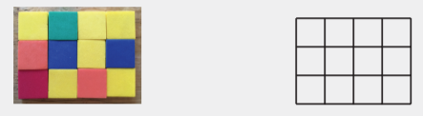
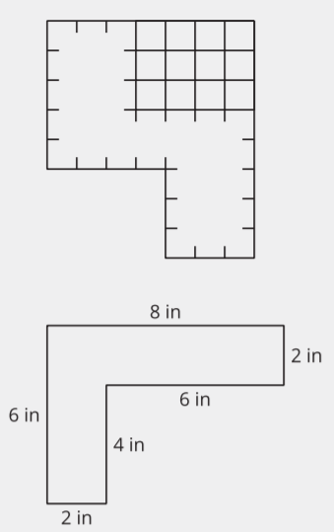
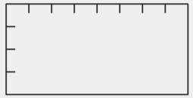
Unit 1 Progression Overview
Introducing Multiplication
Section A
Lessons 1-4
3.MD.C.5, 3.MD.C.5.a, 3.MD.C.5.b, 3.MD.C.6, 3.OA.A.1
Section B
Lessons 5-11
3.MD.C.6, 3.MD.C.7.b, 3.OA.B.5, 3.OA.D.9
Section C
Lessons 12-15
2.NBT.B.5, 3.MD.C.5, 3.MD.C.6, 3.MD.C.7.b, 3.MD.C.7.d, 3.NBT.A.2
Reasoning about area as an attribute of two-dimensional shapes.
Develop a sense of area as the amount of space covered by a shape.
Solve one- and two-step story problems using addition and subtraction.
Represent whole-number products as rectangular areas as they see equal groups in the rows and columns of rectangular areas filled with squares.
Introduced to standard square units, such as inches, centimeters, feet, and meters and make sense of when different square units might be used.
Understand that area is additive as they find the area of figures composed of rectangles by decomposing them into non-overlapping rectangles.
Find missing side lengths in figures composed of rectangles.

Slide 3



Unit 2 Quick Links
Adapt 1
Adapt 2
Adapt 3
L1
L2
L3
L4
L5
L6
L7
L8
L9
L10
L11
L12
L13
L14
L15

Slide 4
Arrays and Rectangles
Adaptation
Lesson 1
Let’s make arrays and rectangles using tiles.
2.OA.C.4, 2.G.A.2

Slide 5
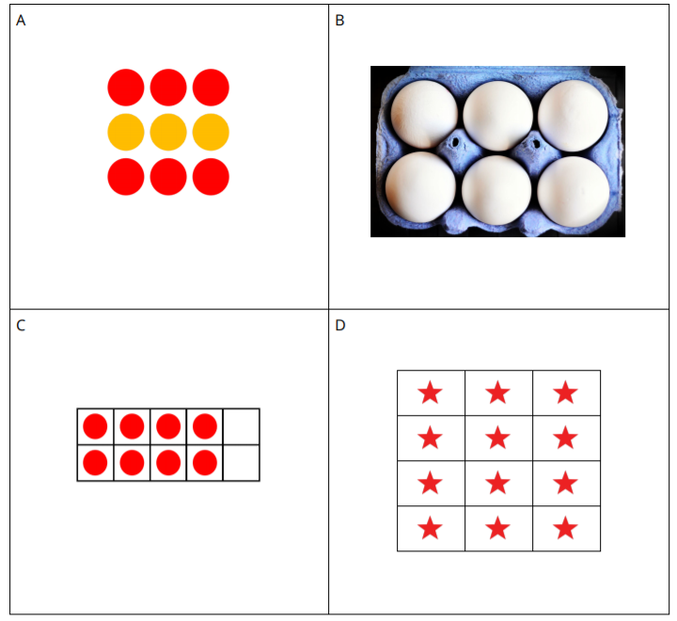
Which One Doesn’t Belong:
All Kinds of Arrays
Warm up

Slide 6
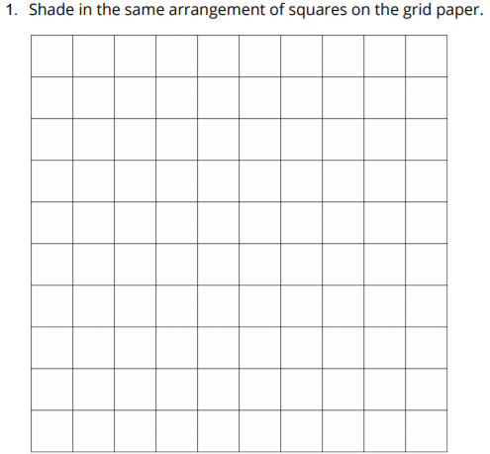
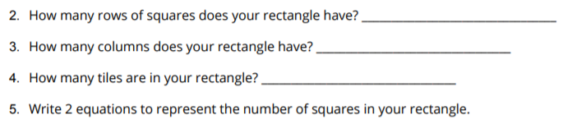
Using Tiles to Make Arrays
Activity
#1
Choose a number of tiles.
12 15 16 18 20
Arrange all the tiles in an array.
Then push them together to make a rectangle.

Slide 7
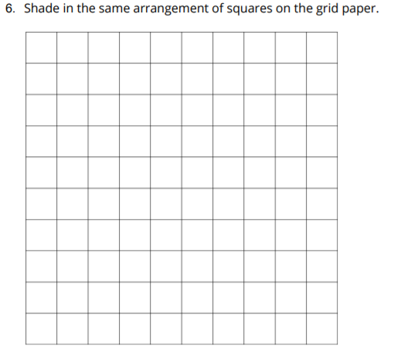
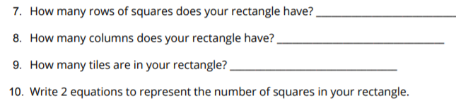
Using Tiles to Make Arrays
Activity
#1
Choose a number of tiles.
12 15 16 18 20
Arrange all the tiles in an array.
Then push them together to make a rectangle.

Slide 8
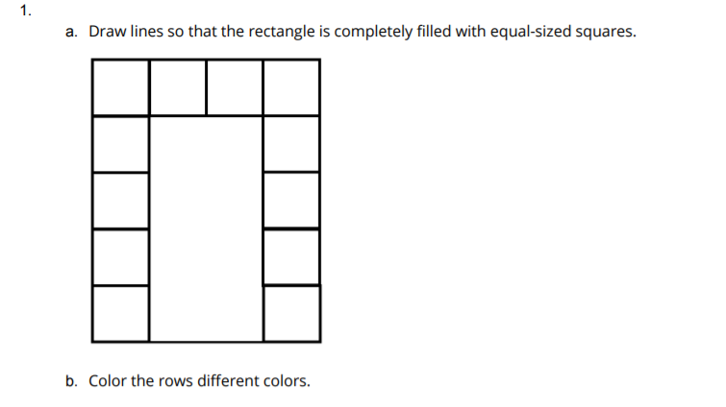
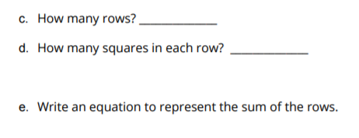
Partitioning Rectangles to Make Equal-Sized Squares
Activity
#2

Slide 9
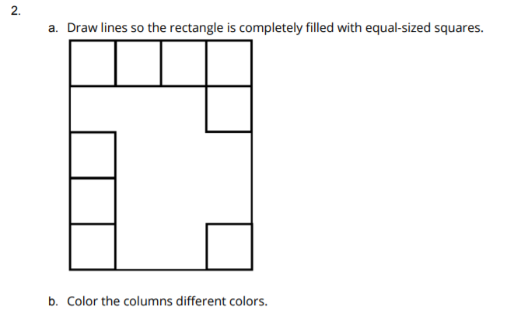
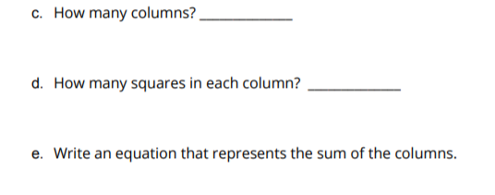
Partitioning Rectangles to Make Equal-Sized Squares
Activity
#2

Slide 10
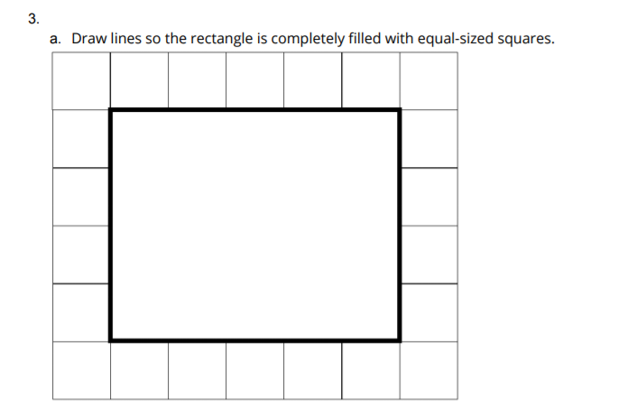
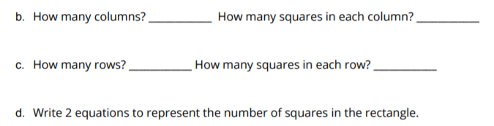
Partitioning Rectangles to Make Equal-Sized Squares
Activity
#2

Slide 11
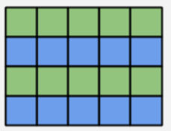

Let’s Put it All Together
Lesson Synthesis
Today you learned that we can partition a rectangle into equal-sized squares
How would you describe this rectangle?
What is the total number of equal-sized squares inside the rectangle?

Slide 12
Partitioning Rectangles
into Squares
Adaptation
Lesson 2
Let’s partition rectangles into squares.
2.OA.C.4, 2.G.A.2

Slide 13
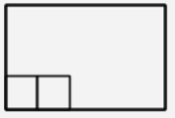
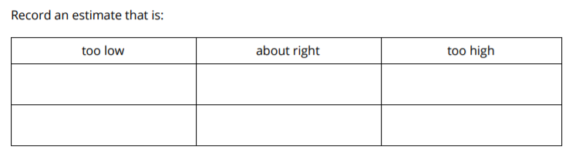
Estimation Exploration: Fill It Up
Warm up
How many little squares would fill the rectangle?

Slide 14
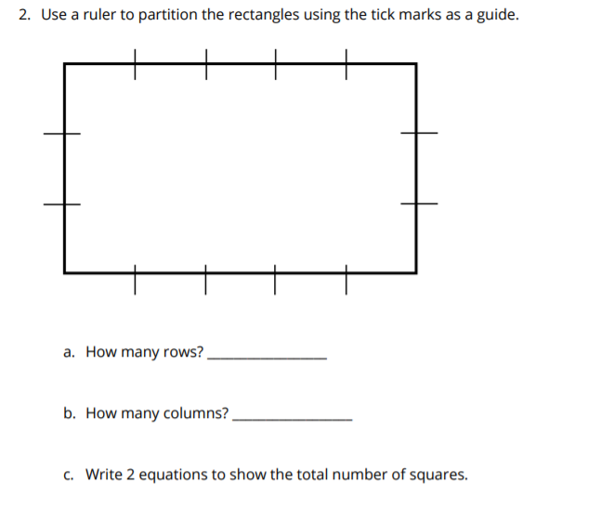
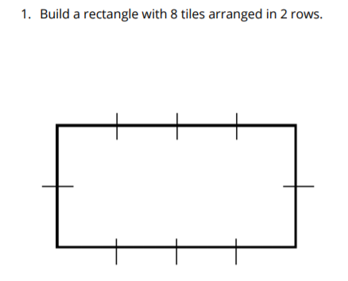
How Many Squares?
Activity
#1

Slide 15
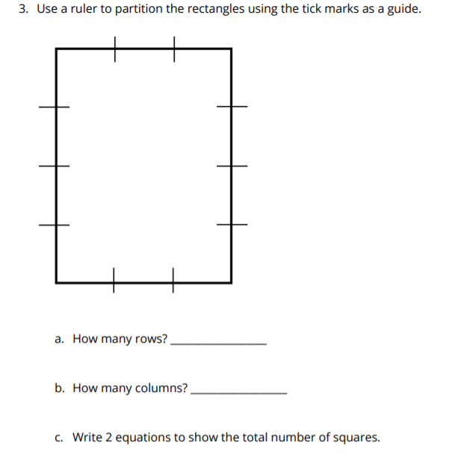
How Many Squares?
Activity
#1

Slide 16


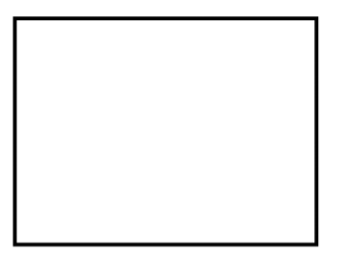

Partitioning Rectangles
Activity
#2

Slide 17
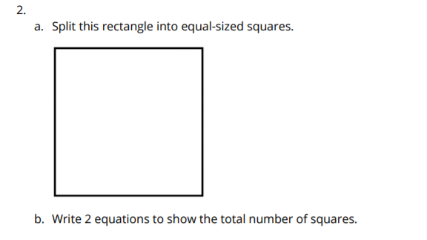
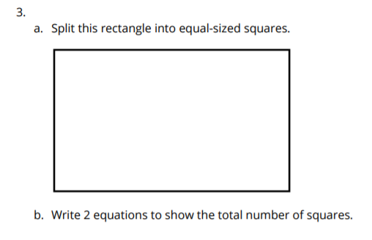
Partitioning Rectangles
Activity
#2

Slide 18
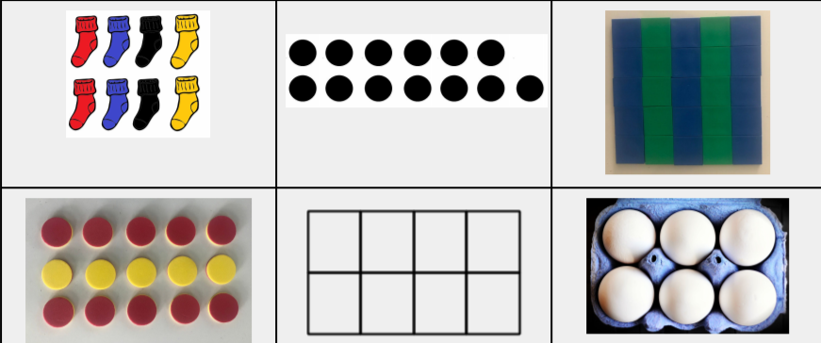
Let’s Put it All Together
Lesson Synthesis
In this unit you learned about even and odd numbers and different types of arrays. Looking at these images, think about 1 thing you could say about each one.
What are some things that are the same or different?

Slide 19
Make Your Own Number Talk
Adaptation
Lesson 3
Let’s create a Number Talk.
2.NBT.B.5, 2.NBT.B.9

Slide 20
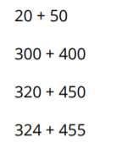
Number Talk: Addition
Warm up
Find the value of each sum mentally.

Slide 21
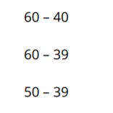
Design 1
Activity
#1
Write an expression to complete the number talk.

Slide 22
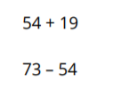
Design 2
Activity
#2
Write expressions to complete the number talk.

Slide 23

Design 3
Activity
#3
Write expressions to complete the number talk.

Slide 24
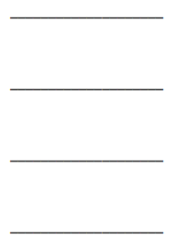
Design 4
Activity
#4
Write expressions to complete the number talk.

Slide 25
Let’s Put it All Together
Lesson Synthesis
Share your work from the cool down.

Slide 26
What is Area?
1
Let’s compare the size of shapes.
3.MD.C.5, 3.OA.A.1

Slide 27

How Many Do You See: Arrays
Warm up
How many do you see?
How do you see them?

Slide 28

How Many Do You See: Arrays
Warm up
How many do you see?
How do you see them?

Slide 29

How Many Do You See: Arrays
Warm up
How many do you see?
How do you see them?

Slide 30
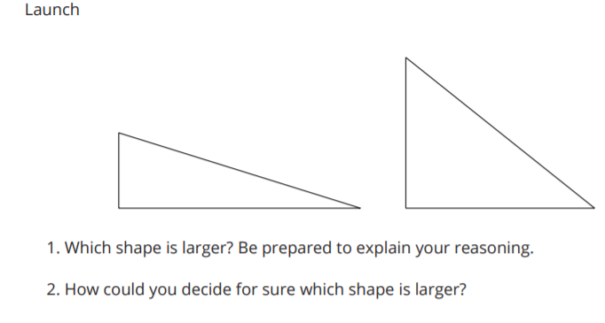
Compare Shapes
Activity #1

Slide 31
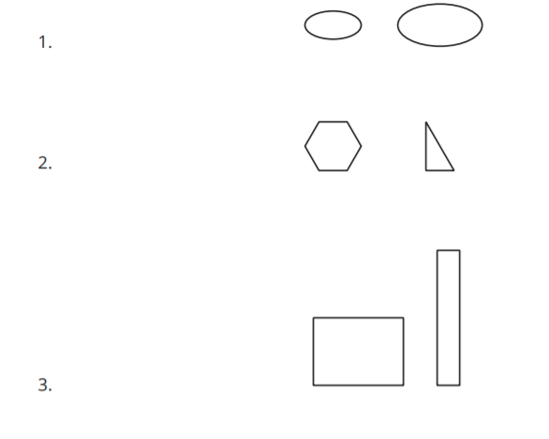
Compare Shapes
Activity #1
Consider each pair of shapes.
Which shape is larger?
Be ready to explain your reasoning.

Slide 32
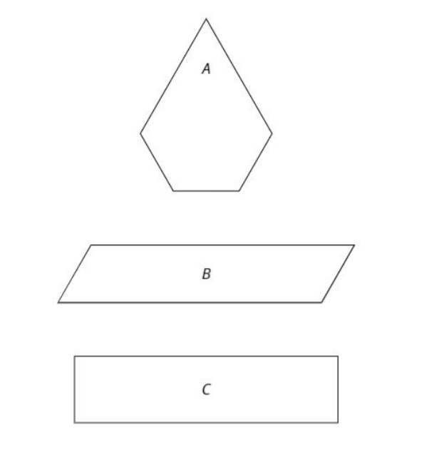
Pattern Blocks to Compare Shapes
Activity #2
Use pattern blocks to decide which shape covers the most space.
Be ready to explain your reasoning.

Slide 33

Lesson Synthesis
Within each pair, which of these shapes has the greater area? How do you know?

Slide 34
How Do We Measure Area?
2
Let’s use square tiles to measure area.
3.MD.C.5, 3.MD.C.5.a, 3.MD.C.5.b

Slide 35
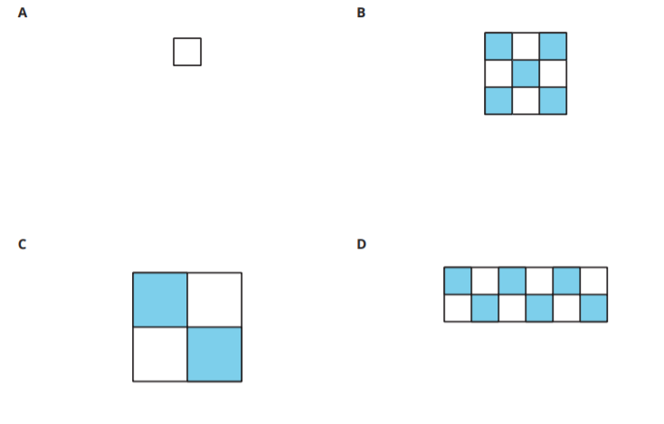
Which One Doesn’t Belong: Compare Size
Warm up

Slide 36
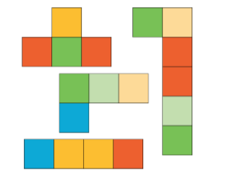
Create and Compare
Activity #1
1. Take a handful of square tiles.
2. Create a shape from the tiles.
3. As a group, order the shapes from smallest to largest.

Slide 37
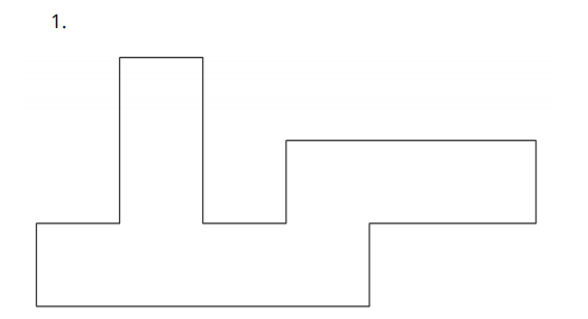
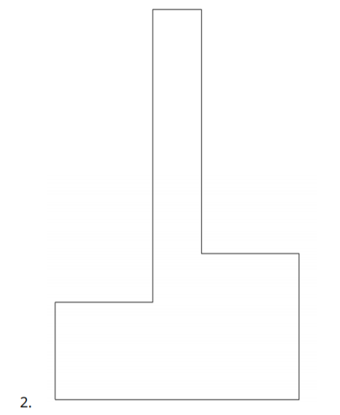
Use Square Tiles to Measure Area
Activity #2
Now that we know we can count square tiles to find area, we can think about filling shapes with tiles to find their area.
We call this tiling.
In this activity you will tile each shape with square tiles to find the area.

Slide 38
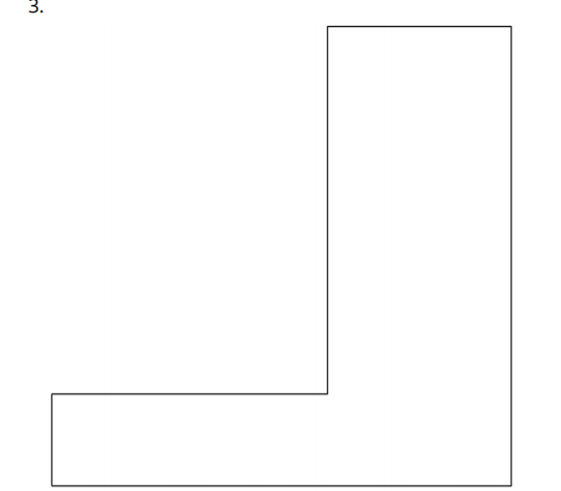

Use Square Tiles to Measure Area
Activity #2
Now that we know we can count square tiles to find area, we can think about filling shapes with tiles to find their area.
We call this tiling.
In this activity you will tile each shape with square tiles to find the area.

Slide 39
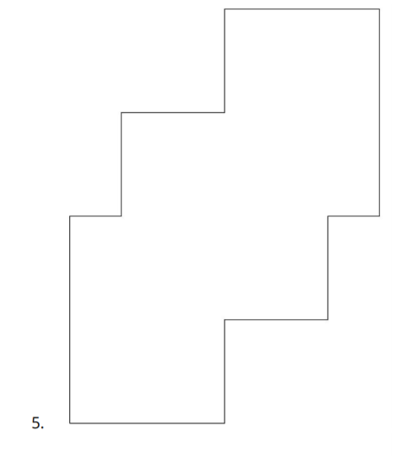
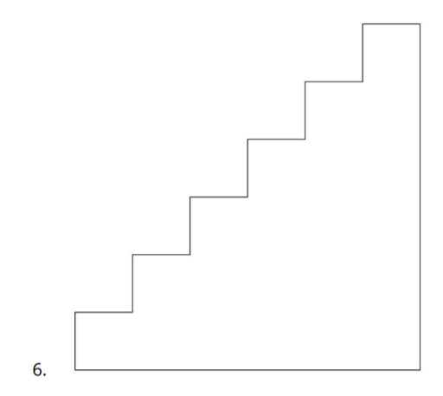
Use Square Tiles to Measure Area
Activity #2
Now that we know we can count square tiles to find area, we can think about filling shapes with tiles to find their area.
We call this tiling.
In this activity you will tile each shape with square tiles to find the area.

Slide 40
Today we used square tiles to find area.
Lesson Synthesis
What were some things you needed to think about as you used the square tiles to find area?

Slide 41
Count the Squares
3
Let’s count square tiles.
3.MD.C.5.b, 3.MD.C.6

Slide 42
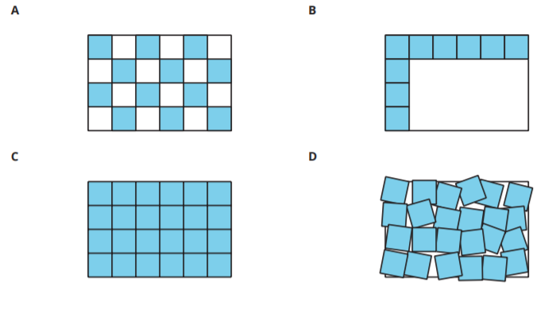
Which One Doesn’t Belong: Tiling
Warm up

Slide 43
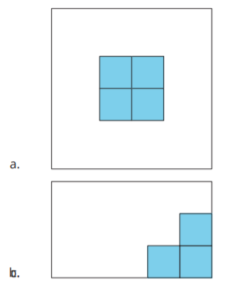
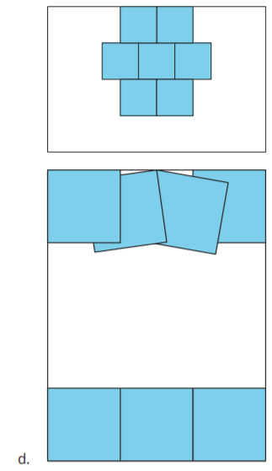
Time to Tile
Activity #1
1. Describe how to use square tiles to finish measuring the area of each rectangle. You can move the square tiles already placed if needed.
2. Describe how to use square tiles to find the area of any rectangle

Slide 44
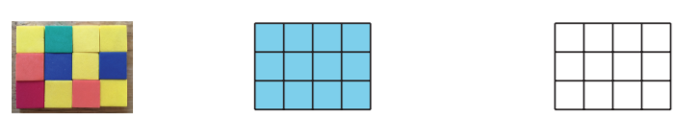
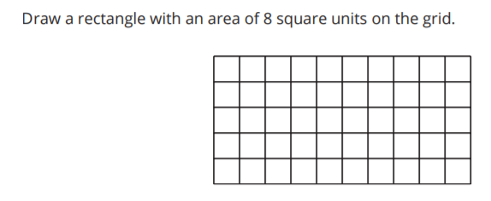
Launch
Activity #2
What do you notice?
What do you wonder?

Slide 45
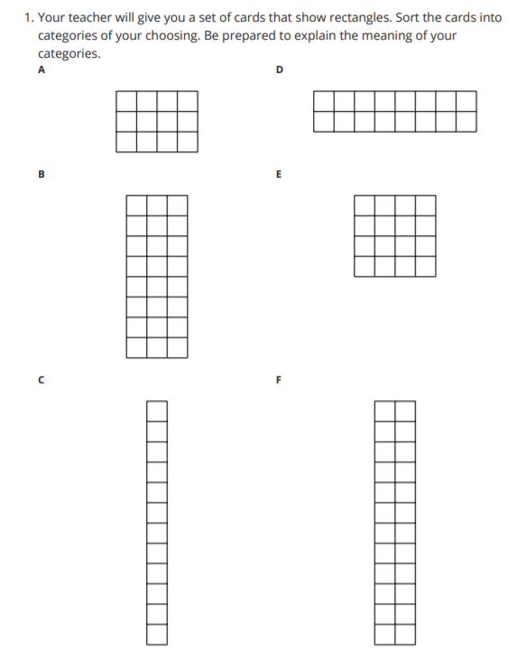
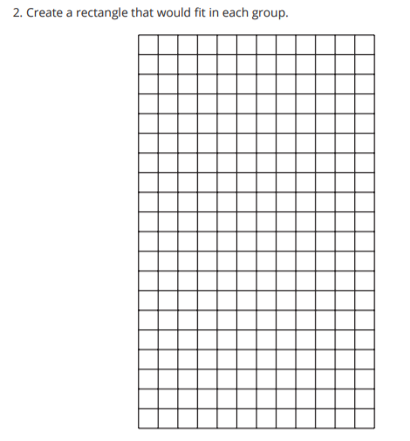
Card Sort: Rectangles
Activity #2

Slide 46
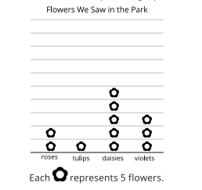
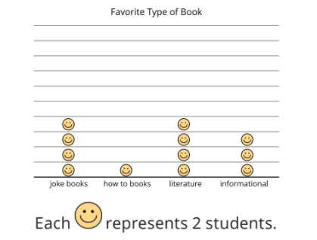

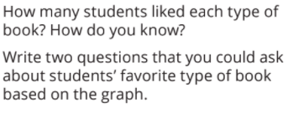

Questions about Scaled Picture Graphs
Activity #2

Slide 47
Lesson Synthesis
Today we learned we can draw squares in rectangles to represent tiling. We can count the squares to find the area of a rectangle just like we would count tiles
What helpful features do rectangles have that help us find their area?

Slide 48
Area of Rectangles
4
Let’s find the area of more rectangles.
3.MD.C.6

Slide 49
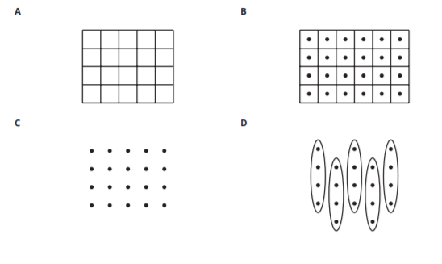
Which One Doesn’t Belong: Area and Arrays
Warm up

Slide 50
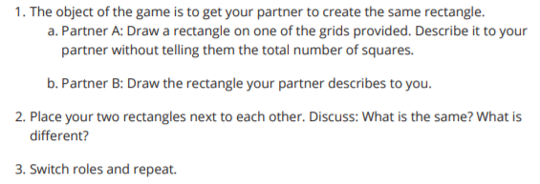

What Did I Create?
Activity #1

Slide 51




Find the Area
Activity #2
Find the area of each rectangle. Include the units in your answer. Explain or show your reasoning.

Slide 52


Lesson Synthesis
In the last few lessons we learned about area. We learned that area is the amount of space covered by a shape. Then we learned that we could find the area of two-dimensional shapes by counting how many squares cover the shape
We also revisited arrays today during our warm-up. Here is an array next to a rectangular area. How is area different from an array?
How do you see equal groups in these representations?
Notes:
“Take 5 minutes to respond to one or more of these prompts: Describe area in your own words. How can we measure area? What lingering questions do you have about area?” (Area is the amount of space that a shape covers. We can count squares to find the area of a shape in square units. How do you find the area of a triangle?)

Slide 53

Section Summary
In this section we learned that area is the amount of space covered by a shape. We learned that we can count squares to measure the area of a shape. We need to make sure that the squares are covering the shape with no gaps or overlaps

Slide 54
Represent Products
as Areas
5
Let’s connect multiplication expressions to area.
3.MD.C.7.b, 3.OA.B.5

Slide 55

How Many Do You See:
One More
Warm up
How many do you see?
How do you see them?

Slide 56

How Many Do You See:
One More
Warm up
How many do you see?
How do you see them?

Slide 57

How Many Do You See:
One More
Warm up
How many do you see?
How do you see them?

Slide 58

Match Expressions and Areas
Activity #1
What is one way you could describe this rectangle?

Slide 59









Match Expressions and Areas
Activity #1
Match the expressions with their rectangular areas. Be ready to explain your reasoning.

Slide 60


Create Areas from Expressions
Activity #2

Slide 61

Lesson Synthesis
How are rectangular areas similar to other ways we’ve shown multiplication?
How could you figure out the total number of square inches in this rectangle?
How are rectangular areas different from other ways we’ve shown multiplication?

Slide 62
Different Square Units (Part 1)
6
Let’s learn about different units we can use to measure area.
3.MD.C.6

Slide 63

Notice and Wonder:
Squares, Squares
Warm up

Slide 64

Same Rectangle, Different Units
Activity #1

Slide 65

What’s the Area?
Activity #2

Slide 66

What’s the Area?
Activity #2

Slide 67

Lesson Synthesis
Why is it useful to have different types of unit squares to use when measuring area?

Slide 68
Different Square Units (Part 2)
7
Let’s learn about larger square units.
3.MD.C.6

Slide 69

Notice and Wonder: A Bigger Square
Warm up

Slide 70


Square Feet and Square Meters
Activity #1

Slide 71



Which Unit Square?
Activity #2

Slide 72

Area Scavenger Hunt
Activity #3
Find some things that you would measure with square inches, square centimeters, square feet, and square yards.

Slide 73
Lesson Synthesis
Now, we’ve worked with different types of unit squares. Why is it important to have many different options rather than just square centimeters and square inches?

Slide 74
Disappearing Squares
8
Let’s solve area problems without a grid.
3.MD.C.7.b, 3.OA.B.5

Slide 75

How Many Do You See:
One More, One Less
Warm up
How many do you see?
How do you see them?

Slide 76

How Many Do You See:
One More, One Less
Warm up
How many do you see?
How do you see them?

Slide 77

How Many Do You See:
One More, One Less
Warm up
How many do you see?
How do you see them?

Slide 78

Partially Tiled
Activity #1
What do you notice?
What do you wonder?

Slide 79

Partially Tiled
Activity #1
After learning about azulejos in Portugal, Elena is making her own tile artwork. This rectangle shows the project Elena is tiling. Each tile has a side length of 1 inch.

Slide 80


No More Squares
Activity #2

Slide 81
Lesson Synthesis
What do you need to know to find the area of any rectangle?
What did you need to think about to find the area of rectangles where only some of the squares were visible or none of the squares were visible?

Slide 82
Measure to Find the Area
9
Let’s measure and multiply to find the area.
3.MD.C.7.b, 3.OA.B.5

Slide 83

Notice and Wonder: Groups and Arrays
Warm-Up
What do you notice?
What do you wonder?

Slide 84

Notice and Wonder: Groups and Arrays
Warm-Up
What do you notice?
What do you wonder?

Slide 85

Measure to Find Area
Activity #1
How could we use a ruler to find the area of the rectangle without marks on the sides?
We are going to measure some rectangles in centimeters to help us calculate the area. First, look at all of them and predict which one has the greatest area.
Circle the number of the rectangle that you think has the greatest area

Slide 86




Measure to Find Area
Activity #1

Slide 87

Create a Rectangle
Activity #2

Slide 88
Lesson Synthesis
Over the last few lessons we’ve solved area problems where the square units are less and less visible, and in this lesson you couldn’t see them at all. How has the way you solve area problems changed as the grid has gone away?

Slide 89
Solve Area Problems
10
Let’s solve area problems.
3.MD.C.7.b, 3.OA.B.5

Slide 90

Number Talk: One More Group
Warm up
Find the value of each expression mentally.

Slide 91



Paint a Wall
Activity #1

Slide 92

Create a Garden
Activity #2
What could we count or measure in this garden?

Slide 93

Create a Garden
Activity #2

Slide 94


Create a Garden
Activity #2

Slide 95
Lesson Synthesis
What are some ideas or representations you saw that you might use as you solve area problems in the future?

Slide 96

Section Summary
In this section we learned how area is related to multiplication. We multiplied the side lengths of a rectangle to find its area. We also learned how different square units are useful for measuring area in different situations and solved problems involving area.

Slide 97
Area and the Multiplication Table (optional)
11
Let’s explore area and the multiplication table
3.MD.C.7.b, 3.OA.B.5, 3.OA.D.9

Slide 98

How Many Do You See: Growing Rectangle
Warm up
How many do you see?
How do you see them?

Slide 99

How Many Do You See: Growing Rectangle
Warm up
How many do you see?
How do you see them?

Slide 100

How Many Do You See: Growing Rectangle
Warm up
How many do you see?
How do you see them?

Slide 101

Area and the Multiplication Table
Activity #1
What do you notice?
What do you wonder?

Slide 102


Area and the Multiplication Table
Activity #1
1. For this table, start from the top left corner and create your own rectangle. Record the product in the table that represents the rectangle. Be prepared to explain your reasoning.
2. For this table start from the top left corner and create a rectangle with an area of 24 square units. Record the product in the table that represents the rectangle. Be prepared to explain your reasoning.

Slide 103

Products in the Multiplication Table
Activity #2
We can represent more than just one product at a time in the multiplication table.
What do you notice?
What do you wonder?

Slide 104

Products in the Multiplication Table
Activity #2

Slide 105
Lesson Synthesis
What did you learn about the multiplication table?

Slide 106
Area and Addition
12
Let's find the area of figures made up of rectangles.
2.NBT.B.5, 3.MD.C.7.d

Slide 107


Number Talk: So Close
Warm up
Find the value of each expression mentally.

Slide 108

Rectangles in Rectangles
Activity #1

Slide 109

Find the Rectangles
Activity #2
What do you notice?
What do you wonder?

Slide 110
Find the Rectangles
Activity #2
There are many ways to find the area of this figure.
1. Find the area of this figure.
Explain or show your reasoning.
Organize it so it can be followed by others

Slide 111
Lesson Synthesis
Why does it make sense that we can decompose figures in many different ways, but still get the same area for the figure?

Slide 112
Find the Area of Figures
13
Let’s find the area of figures.
3.MD.C.7.d, 3.NBT.A.2

Slide 113


Number Talk: Extend Make a Ten
Warm up
Find the value of each expression mentally.

Slide 114

Bye-Bye Squares
Activity #1
What do you notice?
What do you wonder?

Slide 115


Bye-Bye Squares
Activity #1
Find the area of each figure. Explain or show your reasoning.

Slide 116

How Many Tiles Do We Need?
Activity #2
1. How many 1 square foot tiles will Noah need to cover the whole floor?
2. What is the area of the floor? Explain or show your reasoning

Slide 117

Lesson Synthesis
What did you need to think about when finding the area of a figure with just side length measurements?

Slide 118
Find the Area of Figures with Missing Sides
14
Let’s find the area of figures with missing side lengths.
3.MD.C.7.d

Slide 119

Notice and Wonder:
What’s Missing?
Warm-
up
What do you notice?
What do you wonder?

Slide 120

The Missing Side
Activity #1
Tyler says that the missing side length is 5 meters because it looks longer than the 4 meter sides.
Do you agree or disagree?
Be prepared to explain your reasoning.

Slide 121


Practice with Missing Sides
Activity #2
Find the area of each figure. Show or explain your reasoning

Slide 122
Lesson Synthesis
What is it about the structure of these figures we have been working with that helps you find missing side lengths?
How do you like to find the area of these figures after you know the side lengths?

Slide 123

Section Summary
In this section we found the area of figures. We decomposed a figure into rectangles. Then we added the area of each rectangle to find the area of the entire figure. We also found missing side lengths.

Slide 124
Mystery Rectangles Jigsaw
15
Let’s make a mystery rectangles jigsaw.
3.MD.C.5, 3.MD.C.6, 3.MD.C.7.b

Slide 125

How Many Do You See? Funky Figure
Warm-
up
How many do you see?
How do you see them?

Slide 126


Mystery Rectangles Jigsaw, Part 1
Activity #1

Slide 127


Mystery Rectangles Jigsaw, Part 2
Activity #2

Slide 128
Lesson Synthesis
Were there specific words that you used more by the end of the game?
What did you notice about how your own descriptions changed?

Slide 129
Today, we solved multiplication problems using any strategy or representation that we wanted. We used our understanding of equal groups to create drawings, diagrams, expressions and equations to find the unknown factor or product.
Next, let’s make some arrays.

Slide 130

Section Summary
In the past few lessons we have:
learned about equal groups.
created drawings, diagrams, expressions and equations to match situations.
written expressions and equations to match drawings, diagrams and situations.
solved problems by finding an unknown factor or product.

Slide 131
Arrange Objects into Arrays
16
Let’s make some arrays
OA.A.1

Slide 132

Notice & Wonder
Warm up

Slide 133


Compare Equal Groups and Arrays
Activity #1

Slide 134
Arrange into Arrays
Activity #2
Use cubes to make 6 groups of 5.
  Arrange them into an array.
  Explain or show how the array is related to equal groups.
Count out 20 cubes.
  Arrange them into as many arrays as you can.
  Explain or show how each array is related to equal groups.
Count out 24 cubes.
  Arrange them into as many arrays as you can.
  Explain or show how each array is relate to equal groups.

Slide 135
Let’s Put it All Together
Lesson Synthesis
What did you think about when you arranged cubes into arrays?

Slide 136
Today, we arranged objects into arrays and described how arrays are related to equal groups. We also created more than one array for a given number of objects. Arrays are made up of rows and columns.
Next, let’s match arrays to equal groups and draw arrays.

Slide 137
Match and Draw Arrays
17
Let’s match arrays to equal groups and draw arrays.
OA.A.1

Slide 138

Which One Doesn’t Belong?
Warm up

Slide 139

Card Sort: Arrays Sort
Activity #1

Slide 140


Draw Arrays
Activity #2

Slide 141
Let’s Put it All Together
Lesson Synthesis
What do you need to think about when you draw an array?

Slide 142
Today, we matched equal group drawings to arrays. We also made drawings that showed how groups of dots could be rearranged into arrays. Arrays are organized into rows and columns.
Next, let’s represent situations with arrays and expressions.

Slide 143
Represent Arrays with Expressions
18
Let’s represent situations with arrays and expressions.
OA.A.1

Slide 144

How Many Do You See?
Warm up

Slide 145

Represent Array Situations
Activity #1

Slide 146

Connect Arrays to Expressions
Activity #2

Slide 147
Let’s Put it All Together
Lesson Synthesis
How did your knowledge of equal groups help you create arrays and write expressions for multiplication situations?

Slide 148
Today, we learned that multiplication is how we express the total number of objects in equal groups. We learned that the number of groups tells us how many rows or columns there are.
We also represented multiplication situations and expressions using arrays.
Next, let’s solve problems involving arrays.

Slide 149
Solve Problems
Involving Arrays
19
Let’s solve problems involving arrays
OA.A.3

Slide 150
Number Talk
10 x 2
Warm up

Slide 151
Number Talk
9 x 2
Warm up

Slide 152
Number Talk
8 x 2
Warm up

Slide 153
Number Talk
7 x 2
Warm up

Slide 154
Array of Colors
Activity #1
There are 7 rows.

Slide 155
Array of Colors
Activity #1
There are 7 rows.
Each row has 5 crayons.
How many crayons are there?

Slide 156

Tyler’s Tree
Activity #2

Slide 157

Let’s Put it All Together
Lesson Synthesis
How do each of these equations represent the array situation?
What does the question mark in the first equation represent in the situation?
What does the 45 in the second equation represent in this situation?

Slide 158
Today, we asked questions about array situations. We solved problems by representing the situation with an array and an equation and we wrote equations using a symbol for the unknown number.
Next, let’s learn about the commutative property.

Slide 159
The Commutative Property
20
Let’s learn about the commutative property.
OA.B.5

Slide 160
Number Talk
70 - 10
Warm up

Slide 161
Number Talk
68 - 10
Warm up

Slide 162
Number Talk
70 - 12
Warm up

Slide 163
Number Talk
68 - 12
Warm up

Slide 164



Learn More About Multiplication
Activity #1

Slide 165

Revisit Arrays
Activity #2

Slide 166

Let’s Put it All Together
Lesson Synthesis
What did we learn from thinking about arrays and seeing pairs of equations like this today?
3 x 4 = 12
4 x 3 = 12

Slide 167

Today, we learned how equal groups connect to arrays. We also learned that you can multiply numbers in any order and get the same product.
The idea that we can multiply two numbers in any order and get the same product is called the commutative property.

