Slide 1

Introducing Multiplication
Grade 3: Unit 1
Standards addressed: MD.B.3, OA.A.1, OA.A.3, OA.A.4, OA.B.5
These slides have been created by Plainville Community Schools and are not official IM materials. Images and language are taken from IM Grade 3, Unit 1 by Illustrative Mathematics.
Copyright 2020 by Illustrative Mathematics. All Rights Reserved, adapted and shared with permission.

Slide 2
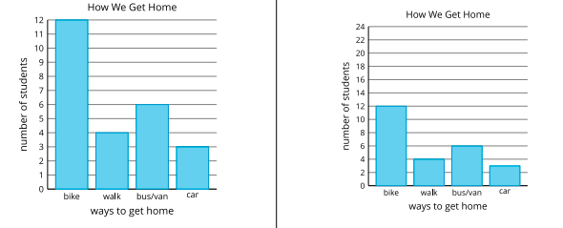

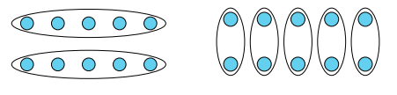

Unit 1 Progression Overview
Introducing Multiplication
Section A
Lessons 1-8
MD.B.3
Section B
Lessons 9-15
OA.A.1, OA.A.3, OA.A.4,
Section C
Lessons 16-21
OA.A.1, OA.A.3, OA.OA.B.5
Interpret scaled picture and bar graphs.
Represent data using scaled picture and bar graphs.
Solve one- and two-step story problems using addition and subtraction.
Represent and solve multiplication problems involving equal groups.
Understand multiplication in terms of equal groups.
Represent and solve multiplication problems involving arrays.

Slide 3

Unit 1 Quick Links
Adapt 1
Adapt 2
L1
L2
L3
L4
L5
L6
L7
L8
Adapt 3
Adapt 4
L9
L10
L11
L12
L13
L14
L15
L16
L17
L18
L19
L20
L21

Slide 4
Interpreting Picture Graphs
Adaptation
Lesson 1
Let’s answer questions based on picture graphs.
MD.D.10

Slide 5
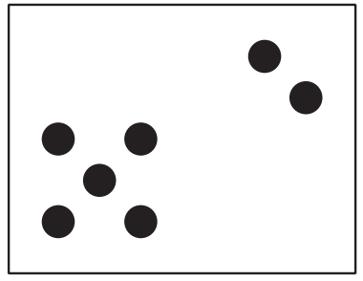
How Many Do You See?
Warm up
How many do you see? How do you see them?

Slide 6
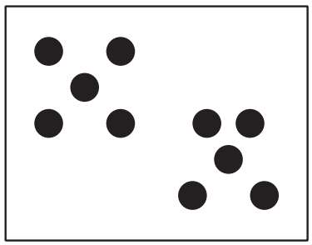
How Many Do You See?
Warm up
How many do you see? How do you see them?

Slide 7
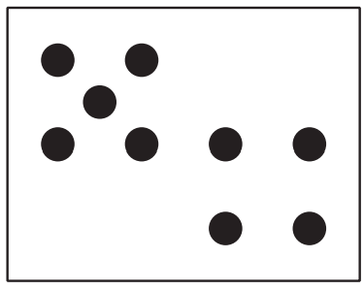
How Many Do You See?
Warm up
How many do you see? How do you see them?
How did your method stay the same or change in each image?

Slide 8
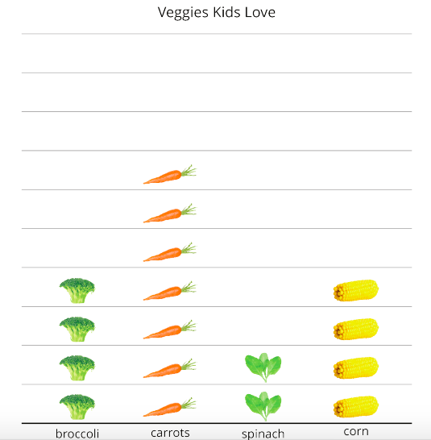
Veggies People Love
Activity
#1
Clare asked a group of kids, “What veggies do you love?” Their responses are shown in this picture graph.
What can you learn about veggies kids love from Clare’s picture graph?

Slide 9
Veggies People Love
Activity
#1
What is the total number of kids who loved spinach or corn?

Slide 10
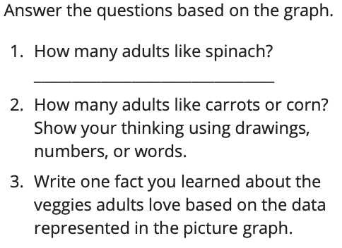
Veggies People Love
Activity
#1
Clare asked a group of adults, “What veggies do you love?” Their responses are shown in this picture graph.
How many more adults like carrots than spinach? Explain how you know.

Slide 11
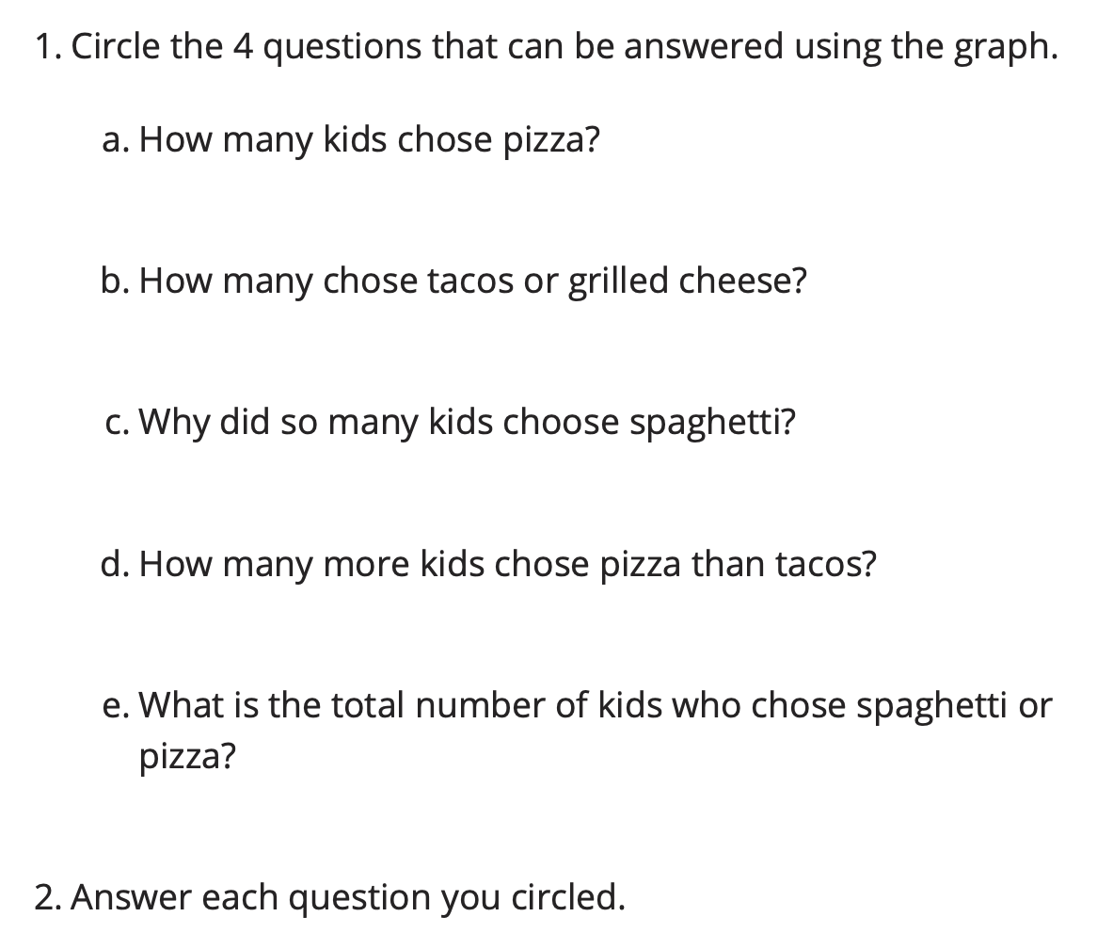
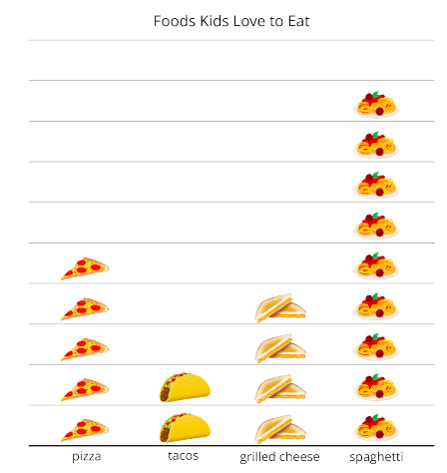
Answer Questions
Activity
#2
Which questions did you decide couldn’t be answered? Explain.

Slide 12

Let’s Put it All Together
Lesson Synthesis
Today, you learned about picture graphs, which is one way of representing data.
What did you learn about how picture graphs can help with answering questions about data?

Slide 13
Representing Data using Picture Graphs and
Bar Graphs
Adaptation
Lesson 2
Let’s make our own picture graphs and bar graphs.
MD.D.10

Slide 14
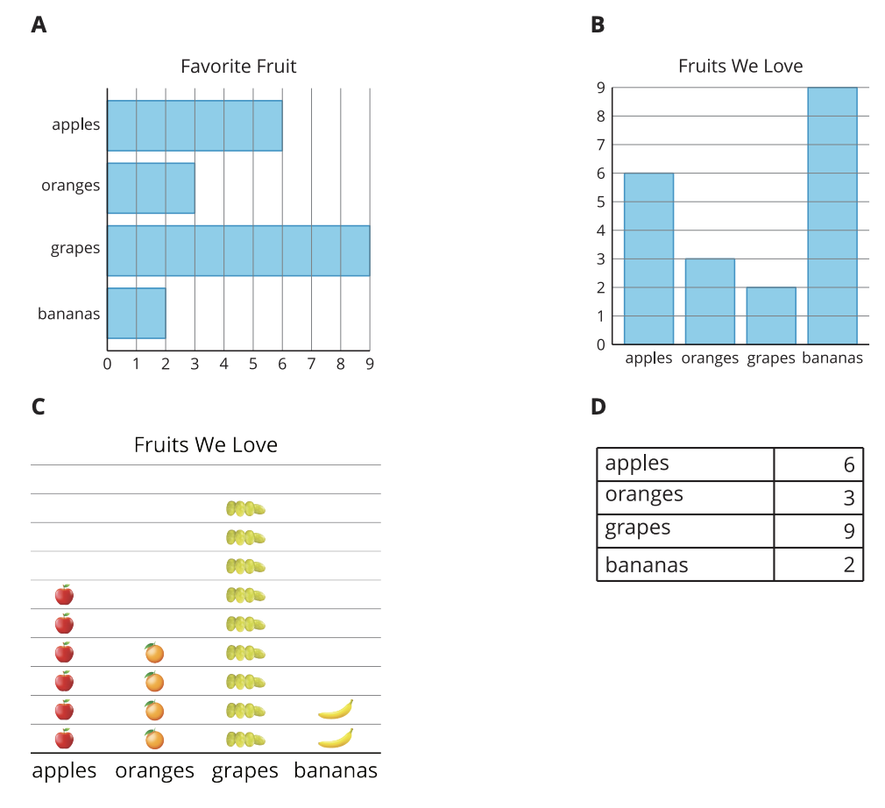
Which One Doesn’t Belong?
Warm up
How is graph A different from the other graphs? How is it the same?

Slide 15
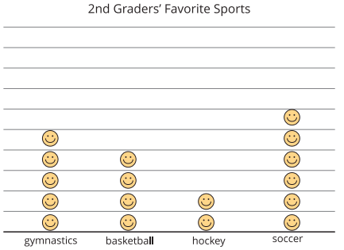
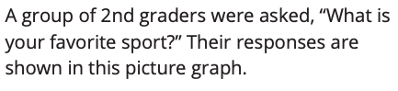
Draw Picture Graphs
Activity
#1
What can you learned about 2nd graders’ favorite sport from this graph?
What are some features of this graph that help us understand the data?

Slide 16
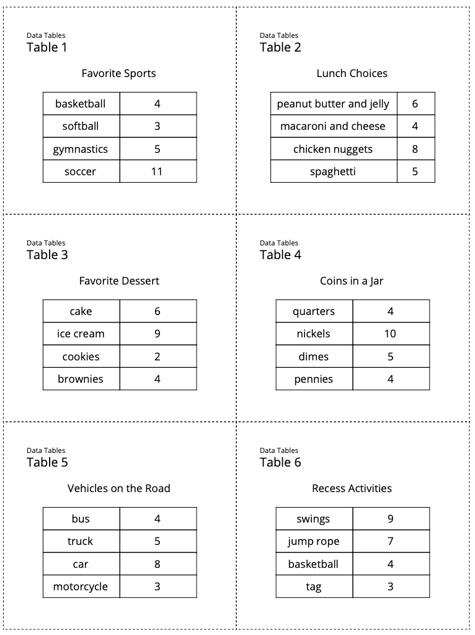

Draw Picture Graphs
Activity
#1
Now you are going to create your own picture graph.
What did you choose as your symbol? Why?
What other features did you add to your graph to help others’ understand it?

Slide 17
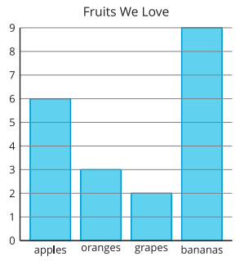
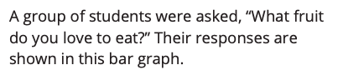

Draw Bar Graphs
Activity
#2

Slide 18
Draw Bar Graphs
Activity
#2
Trade data tables with a partner. This time draw a bar graph.
How did you know how high to make each bar in your graph?
How was drawing a bar graph like drawing a picture graph? How was it different?

Slide 19
Let’s Put it All Together
Lesson Synthesis
Today you made picture graphs and bar graphs to represent data.
How did you revise your thinking while creating your graphs?
What is something new you learned today?

Slide 20
Got Data?
1
Let’s read and ask questions about data.
MD.B.3

Slide 21
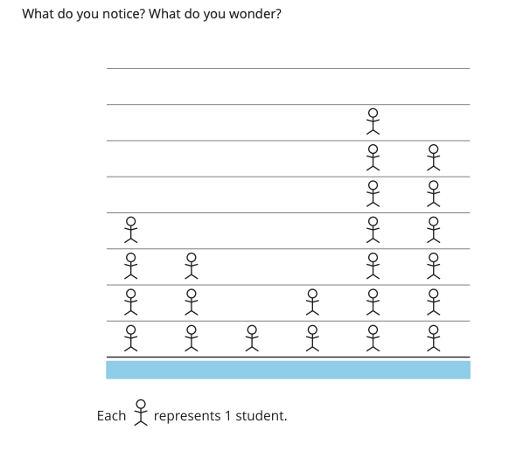
Notice & Wonder
Warm up
“What situations could the graph represent?”

Slide 22
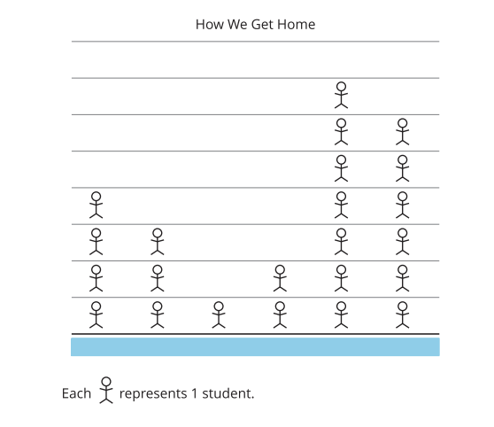
Picture Time
Activity #1
“What could the categories be for this picture graph?”
“How many categories will there be for this graph? How can you tell?

Slide 23
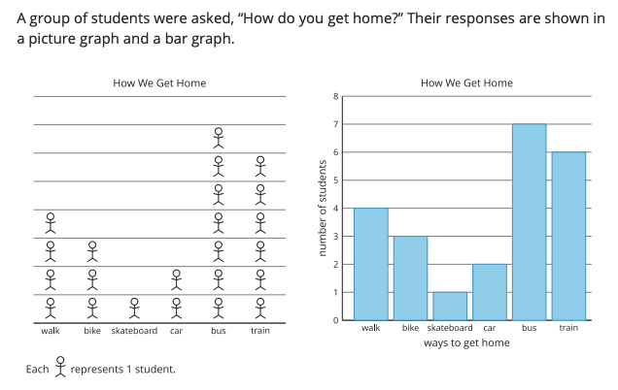
Picture Graphs and Bar Graphs
Activity #2
1. “How are they the same? How are they different?”

Slide 24
Picture Graphs and Bar Graphs
Activity #2
2. What have we learned about how students get home based on the graphs?
3. Write two questions you could ask about how students get home based on the graphs.

Slide 25

Let’s Put it All Together
Lesson Synthesis
What parts of graphs help us communicate the information in
the graph with others?
How are picture graphs and bar graphs the same? How are they different?

Slide 26
Today, we looked at picture graphs and bar graphs. We now know that in a picture graph, the picture represents an object or person. In a bar graph, the scale tells us how many objects or people.
Next, let’s create graphs and answer questions.

Slide 27
Represent Data and Solve Problems
2
Let’s create graphs and answer questions.
MD.B.3

Slide 28
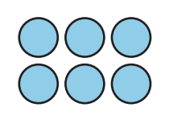
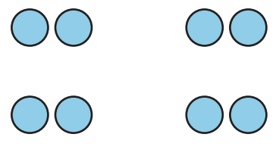
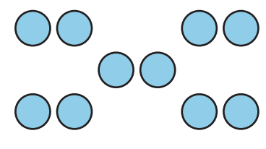
How Many Do You See?
How many do you see? How do you see them?
Warm up
How many more dots were in the 3rd image than the 2nd image? What equation matches your thinking?

Slide 29
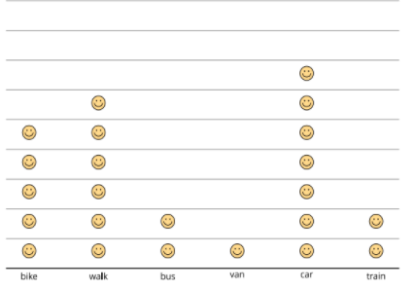
How We Get Home
Activity #1
Follow your teacher’s instructions to organize and represent the class data in a picture graph.

Slide 30

How We Get Home
Activity #1
2. Represent the same data that shows how our class gets home on a bar graph.
How are our picture graph and bar graph alike? How are they different?

Slide 31
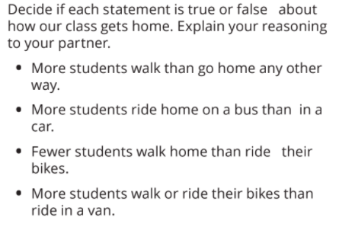
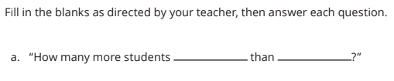
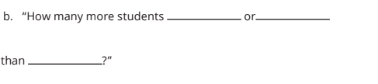
Questions About a Bar Graph
Activity #2
What equation matches your thinking from each question?

Slide 32
Let’s Put it All Together
Let’s look at the graphs we created.
Lesson Synthesis
Do you have any lingering questions about how to answer these questions from the bar graph?
Let’s remember to ask questions that answer how many more or how many fewer?

Slide 33
Today, we created a picture graph and then used that information to create bar graphs. We made sure that our picture graphs had a key and that our bar graphs had a scale. We added other features to our graphs including a title, and labels for the side axis and bottom axis.
We also used our graphs to answer “how many more?” and “how many fewer?” questions
Next, let’s explore scaled picture graphs.

Slide 34
Scaled Picture Graphs
3
Let’s explore scaled picture graphs.
MD.B.3

Slide 35
Number Talk
50 + 10
Warm up
“Give me a thumbs up when you have an answer and can explain how you got it.”

Slide 36
Number Talk
50 + 12
Warm up
“Give me a thumbs up when you have an answer and can explain how you got it.”

Slide 37
Number Talk
60 + 13
Warm up
“Give me a thumbs up when you have an answer and can explain how you got it.”

Slide 38
Number Talk
65 + 13
Warm up
How was place value helpful as you added these numbers?

Slide 39
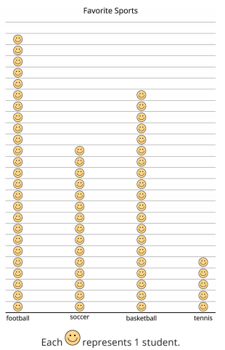


So Many Responses
Activity #1
What do you notice?
What do you wonder?
How many students are represented in the graph?
How could we count the total number of students in this graph?

Slide 40
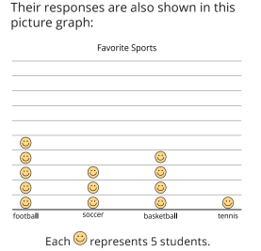
So Many Responses
Activity #1
How is counting the total number of students in this graph different from counting the total number of students in the first graph?
How could we count the total number of students in this graph?

Slide 41
So Many Responses
Activity #1
“In a graph where there’s a lot of data we can adjust the scale so each picture represents more than 1 object. When each picture represents something other than 1, we say that it’s a scaled picture graph. The key tells us that in this graph, each smiley face represents 5 students.”

Slide 42
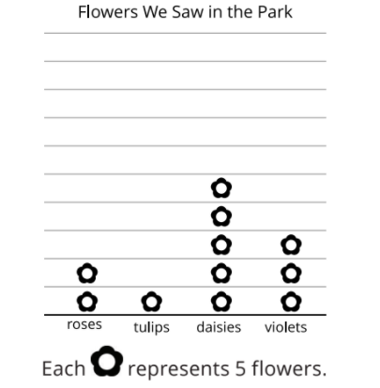
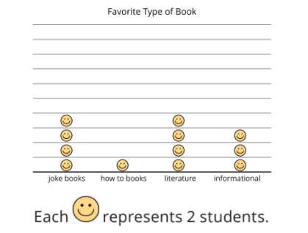

Questions about Scaled Picture Graphs
Activity #2

Slide 43
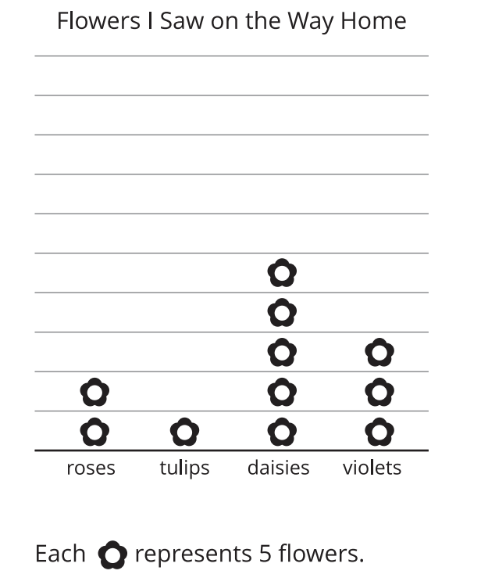
Questions about Scaled Picture Graphs
Activity #2
How many of each type of flower did Andre see on his way home?
Roses: _______
Tulips: _______
Daisies: _______
Violets: _______
Write 2 questions that you could ask about the flowers Andre saw on his way home.

Slide 44
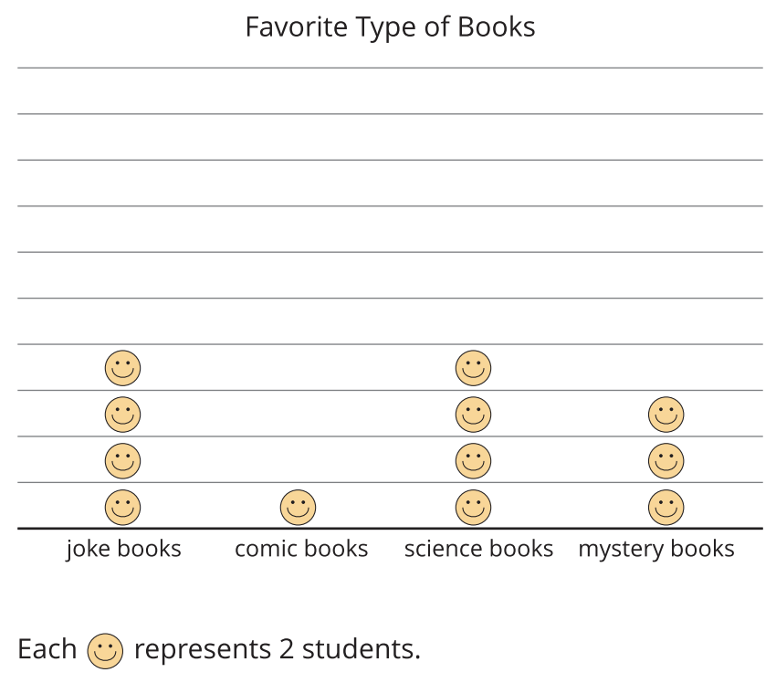
Questions about Scaled Picture Graphs
Activity #2
How many student liked each type of book? How do you know?
Write 2 questions that you could ask about the students’ favorite types of books based on the graph.
How did you use the scale to answer the questions?

Slide 45
Let’s Put it All Together
Lesson Synthesis
Why would we use a scaled picture graph to represent data?
How is reading scaled picture graphs different from reading graphs that have a
scale of 1?

Slide 46
Why would we make a scaled picture graph?
How is reading scaled picture graphs different from reading graphs that have a scale of 1?

Slide 47
Today, we learned about scaled picture graphs. We noticed that the key to a graph is not always 1. Based on the key, we skip-counted by 2’s or 5’s to answer questions about the data in the graph.
Next, let’s make a scaled picture graph.

Slide 48
Create Scaled Picture Graphs
4
Let’s make a scaled picture graph
MD.B.3

Slide 49
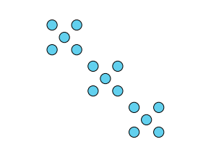
How Many Do You See?
Warm up
How many do you see? How do you see them?

Slide 50
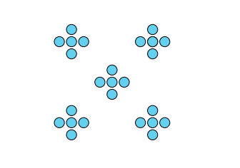
How Many Do You See?
Warm up
How many do you see? How do you see them?
What patterns did you see first and how did this help you figure out the total?

Slide 51
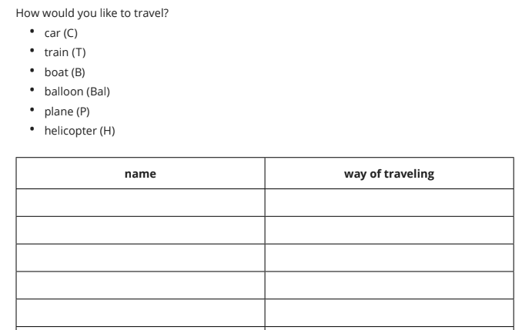
Ways to Travel
Activity #1
What is helpful about having this data in the form of a list?
What is not helpful?

Slide 52
Create a Scaled Picture Graph
Activity #2
How can we create a picture graph about our survey data without having to draw a picture for each student in our class?
Represent the data that you collected in your own scaled picture graph, where each picture represents 2 students.
How do you represent an odd number?

Slide 53
Let’s Put it All Together
Lesson Synthesis
What if 2 more
students chose to
travel by balloon?
What if 1 more
student chose to
travel by car?

Slide 54
Today, we created a scaled picture graph based on data collected from our class. We gave our graph a title, labels and a key. We used a scale of 2, so each of our pictures represented two students.
We also answered questions based on our graph.
Next, let’s make a scaled bar graph.

Slide 55
Represent Data in Scaled
Bar Graphs
5
Represent data using scaled bar graphs.
MD.B.3

Slide 56
Number Talk
2 + 2 + 2 + 2
Warm up

Slide 57
Number Talk
2 + 2 + 2 + 2 + 2 + 2 + 2 + 2
Warm up

Slide 58
Number Talk
5 + 5 + 5 + 5
Warm up

Slide 59
Number Talk
5 + 5 + 5 + 5 + 5 + 5 + 5 + 5
Warm up
How did the first two expressions help you solve the 3rd and 4th expressions?

Slide 60
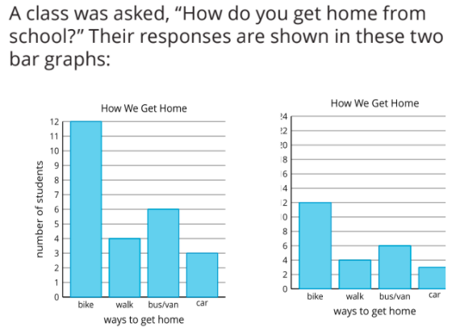
Compare Bar Graphs
Activity #1
When each jump on the scale is some number other than 1, we say it’s a scaled bar graph.
Why would it be helpful to make a scaled bar graph?
How are the two graphs alike?
How are they different?

Slide 61
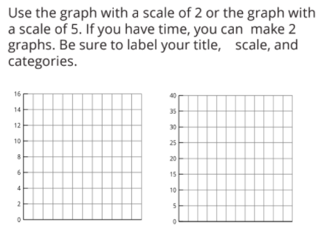
Create a Scaled Bar Graph
Activity #2
Represent the data we collected earlier in a scaled bar graph.
How did you represent the way of travel that did not land right on the number in the scale?
What differences do you notice when the graph is with a scale of 2 and when the graph is with a scale of 5?

Slide 62
Let’s Put it All Together
Lesson Synthesis
If you were going to help a friend create a scaled bar graph, what advice would you give them?
Why might you choose a scale of 2?
Why might you choose a scale of 5?

Slide 63
Today, we learned how to create a scaled bar graph. We talked about when and why we might choose to use a scale of 2 and when and why we might choose to use a scale of 5.
Next, let’s choose a scale for our bar graph.

Slide 64
Choose a Scale
6
Let’s choose a scale for our bar graph.
MD.B.3

Slide 65
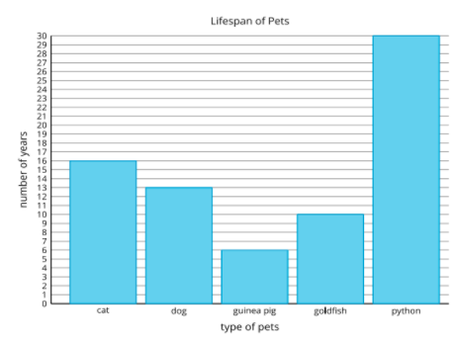
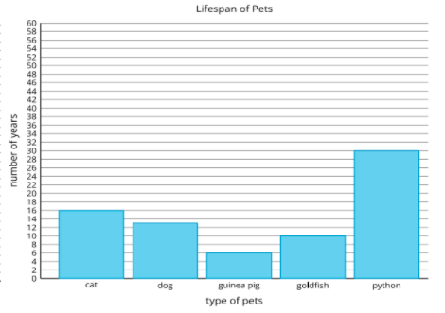
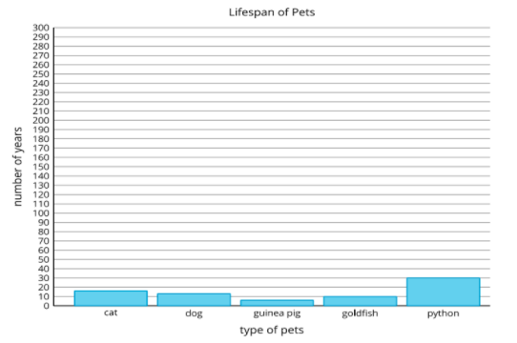
Notice & Wonder
Warm up
What do you notice? What do you wonder?
How are the three graphs different?

Slide 66
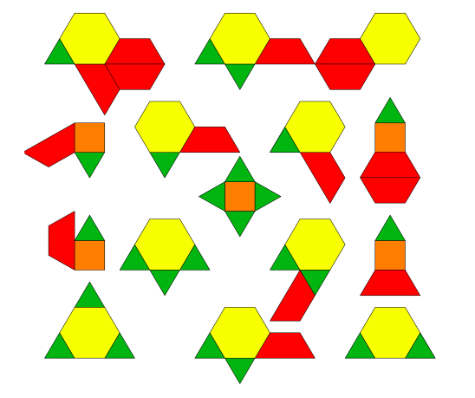
Represent Pattern Blocks
Activity #1

Slide 67
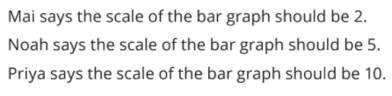


Represent Pattern Blocks
Activity #1
Mai, Noah, and Priya want to make a bar graph to represent the number of triangles, squares, trapezoids, and hexagons in a collection.
What scale did you use for your bar graph? Why did you choose that scale?

Slide 68
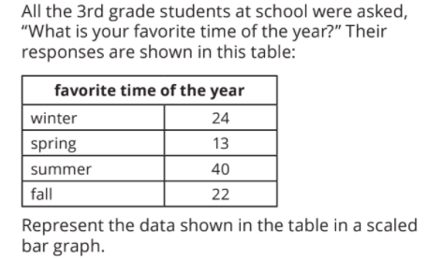
Represent More Data in a Scaled Bar Graph
Activity #2
How did the scale you chose for your graph affect how your graph looked in the end?

Slide 69
Let’s Put it All Together
Lesson Synthesis
What did you learn today that will help you make decisions about how to create scaled graphs in
the future?

Slide 70
Today, we learned how to use information from images and tables to create a scaled bar graph.
We also made a decision to use a scale of 2, 5 or 10 based on the data we had.
Next, let’s solve problems based on information represented in bar graphs.

Slide 71
Answer Questions about Scaled Bar Graphs
7
Let’s solve problems based on information represented in bar graphs.
MD.B.3

Slide 72

How Many Do You See?
Warm up
How many do you see? How do you see them?

Slide 73
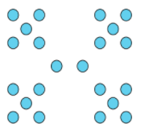
How Many Do You See?
Warm up
How many do you see? How do you see them?
How did thinking about groups help you find the total number of dots?

Slide 74

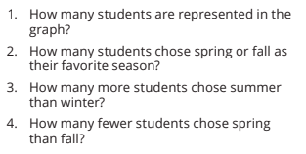
Questions about Favorite Time of Year
Activity #1
How are questions 3 and 4 the same? How are they different?

Slide 75
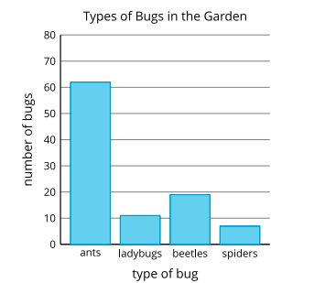
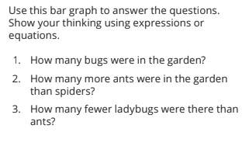
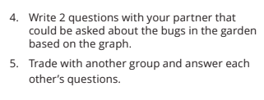
Questions about Bugs in the Garden
Activity #2
What is one thing you notice?

Slide 76
Let’s Put it All Together
Lesson Synthesis
What were some strategies that were helpful as you answered questions about information represented in the bar graph?

Slide 77
Today, we answered one-step questions that asked us “how many more?” and “how many less?" using the information represented in bar graphs.
Next, let’s solve problems based on information represented in bar graphs.

Slide 78
More Questions about
Scaled Bar Graphs
8
Let’s solve problems based on information represented in bar graphs.
MD.B.3

Slide 79
Number Talk
2 + 2 + 2 + 2 + 2
Warm up

Slide 80
Number Talk
2 + 2 + 2 + 2 + 2 + 2
Warm up

Slide 81
Number Talk
5 + 5 + 5 + 5 + 5 + 5
Warm up

Slide 82
Number Talk
5 + 5 + 5 + 5 + 5 + 5 + 5
Warm up
What is a strategy that you hadn’t used before you that might use in the future?

Slide 83
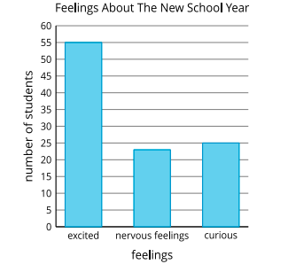

New School Year
Activity #1
A group of students were asked, “How are you feeling about the new school year?” Their responses were show in this bar graph:
How did reading the problem three times help you make sense of the problem?

Slide 84
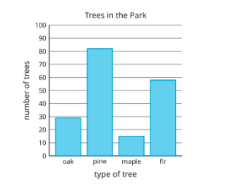
Use Bar Graphs to Solve Problems
Activity #2
This bar graph shows how many of each type of tree Clare saw on the way home. Use the graph to answer the questions. Show your thinking using expressions or equations.
How many more pine trees did Clare see than fir trees?
How many more pine trees did Clare see than oak or maple trees?
How many fewer oak trees did Clare see than pine trees?
How many fewer maple trees did Clare see than fir trees?
How are the methods used to solve 1 and 4 the same? How are they different?

Slide 85
Let’s Put it All Together
Lesson Synthesis
In the future, could you use the Three Reads strategy without a partner?
How did you use what you know about tens and ones to solve the problems?

Slide 86
Today, we learned about the Three Reads strategy help us make sense of the information in a graph.
We used the information represented in the bar graph to solve one-step and two-step problems that asked “how many more?” and “how many fewer?”
Next, let’s work with equal groups of things.

Slide 87
Section Summary
So far we have:
learned what a picture graph is and what a bar graph is. We also learned about the similarities and differences between the two types of graphs.
figured out what a scale is and why we might use a scale other than 1.
identified situations where it would make sense to use a scale of 2, 5, or 10.
created our own picture graphs and bar graphs from data.
solved one-step and two-step problems asking “how many more?” and “how many less?” by using the data represented in picture graphs and bar graphs.

Slide 88
What is an Array?
Adaptation
Lesson 3
Let’s learn about arrays.
2.OA.C.4

Slide 89
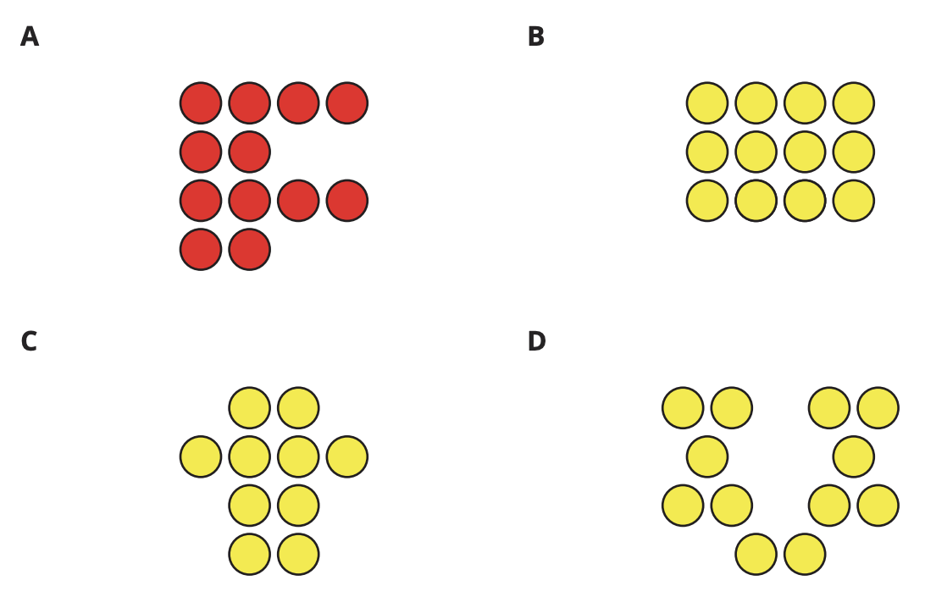
Which One Doesn’t Belong?
Warm up
How are the circles in B arranged differently than in the other groups?
We call objects arranged in equal rows an array.

Slide 90

What is An Array?
Activity
#1
1. How many counters? _____
Show how you arranged them using words, drawings, or numbers.
2. How many counters? _____
Show how you arranged them using words, drawings, or numbers.
3. How many counters? _____
Show how you arranged them using words, drawings, or numbers.
Arrange each set of counters into an array. Your arrays should have the same number of counters in each row with no extra counters. Be prepared to explain how you made an array out of each set.

Slide 91

What is An Array?
Activity
#1
How can we describe this array of counters?
7 and 9 are both odd numbers. What did you notice about the arrays you could make with them?

Slide 92


Rows of Counters
Activity
#2
Which of these images shows 10 counters in an array? How do you know?
How many rows are in the array?
How many counters are in each row?

Slide 93


Rows of Counters
Activity
#2

Slide 94

Let’s Put it All Together
Lesson Synthesis
Today you learned that an array is an arrangement of objects with equal number of objects in each row.
How could you use the rows to find the total number of counters?”

Slide 95
A Sum of Equal Addends
Adaptation
Lesson 4
Let’s match expressions to arrays.
2.OA.C3, 2.OA.C.4

Slide 96


Estimation Exploration
Warm up
How many waffles?
Record an estimate that is:

Slide 97

Estimation Exploration
Warm up
How many waffles?
Would you like to revise your thinking?
Even though we can’t see the whole tray, some students are very confident about their estimates. Why do you think that is?

Slide 98

Sums of Rows and Sums of
Columns
Activity
#1
How can both expressions represent the array?
Which expression represents the sum of the number in each row?
Mai’s expression is 6 + 6. What are the different ways Mai may see 6 + 6 in this array?

Slide 99



Card Sort: Arrays and Expressions
Activity
#2
Sort the cards into 8 groups.
Each group should have an array, 2 expressions and a total number.
Each group has 4 cards, but one will have 3

Slide 100


Card Sort: Arrays and Expressions
Activity
#2
How is it possible that these two arrays have the same expression?
What was different about this array?

Slide 101


Add It All Up
Activity
#3

Slide 102

Let’s Put it All Together
Lesson Synthesis
Today you learned that the number of objects in an array can be represented using expressions that show the sum of the number of objects in each row or the sum of the number of objects in each column.
What can you tell me about this array?

Slide 103
Multiplication as Equal Groups
9
Let’s work with equal groups of things.
OA.A.1

Slide 104
Number Talk
40 + 35
Warm up

Slide 105
Number Talk
45 + 35
Warm up

Slide 106
Number Talk
45 + 36
Warm up

Slide 107
Number Talk
34 + 58
Warm up
How did you compose new tens as you solved these problems?

Slide 108


From Scaled Graphs to Equal Groups
Activity #1
This drawing shows equal groups. How does this drawing help you represent data in the picture graph?

Slide 109
Equal Group Situations
Activity #2
Represent each situation.
There are 4 people wearing shoes. Each person is wearing 2 shoes.
There are 2 boxes of markers. Each box has 10 markers.
There are 3 basketball teams. Each team has 5 players.
How do the representations help you picture the situation?

Slide 110

Let’s Put it All Together
Lesson Synthesis
The situations we looked at today were all multiplication. Multiplication is how we represent the total number of object when you have a certain number of equal groups. For example, in this picture we would say 5 groups of 2.
Describe a situation with equal groups that you could represent with multiplication?

Slide 111
Today, we made connections between equal groups and the information that is shown on a scaled picture graph.
We also learned that multiplication is how we represent the total number of objects in equal groups.
Next, let’s represent equal groups.

Slide 112
Drawings, Situations, and Diagrams, Oh My!
10
Let’s represent equal groups.
OA.A.1

Slide 113

Notice and Wonder: Socks
Warm up
What do you notice? What do you wonder?
How does this problem relate to what we know about multiplication?

Slide 114

Scaled Picture Graph to Diagram
Activity #1
What do you notice? What do you wonder?
How does the diagram show the speed limit signs that Elena saw on the way home?
Represent the data from another category in the graph with your own drawing or diagram.
2 | 2 | 2 | 2 | 2
Which category does this tape diagram represent? How do you know?
How is the diagram the same as the scaled picture graph? How is the diagram different than the scaled picture graph?

Slide 115












Card Sort: Equal Groups
Activity #2

Slide 116

Card Sort: Equal Groups
Activity #2
What do our representations have in common?
Where are the 4 bags and 2 strawberries in each drawing or diagram?
Where are the 4 hands and the 5 fingers in each drawing or diagram?

Slide 117

Let’s Put it All Together
Lesson Synthesis
4 groups of 5 in each group
4 x 5
What is the
symbol for
multiplication?
What does the multiplication expression 4 x 5 mean?
How can a diagram show multiplication?

Slide 118
Today, represented math situations with drawings, images and tape diagrams.
We learned that a multiplication expression is how we represent the number of equal groups and the amount in each group. We also learned that the multiplication symbol comes in the middle of an expression.
Next, let’s write multiplication expressions.

Slide 119
Multiplication Expressions
11
Let’s write multiplication expressions.
OA.A.1

Slide 120
Choral Count
Warm up
0
0
What patterns do you see?
What patterns do you see?
How could some of the patterns help you with counting by 5?
How could some of the patterns help you with counting by 2?

Slide 121
Expression Match
Activity #1
Match the card to one of the expressions posted around the room. Be prepared to share your reasoning.

Slide 122

Expressions to Drawings & Diagrams
Activity #2
Multiplication is how we express equal groups.
We use multiplication symbols to create an expression like 5 x 10 which represents the total number of objects in 5 groups of 10 or 5 tens.
How is our work for 3 x 4 the same? How is it different?

Slide 123

Write Multiplication Expressions
Activity #3
Why does each representation show multiplication?

Slide 124
Let’s Put it All Together
Lesson Synthesis
What are some different ways you can represent multiplication?
Share something you learned about multiplication today.

Slide 125
Today, we matched multiplication expressions to drawings, tape diagrams and multiplication situations.
We also created expressions to represent equal groups, drawings, tape diagrams and multiplication situations.
Next, let’s represent and solve problems involving equal groups.

Slide 126
Represent & Solve Multiplication Problems
12
Let’s represent and solve problems involving equal groups.
OA.A.3

Slide 127

How Many Do You See: Lots of Dots
Warm up
How many do you see? How do you see them?

Slide 128
How Many Do You See: Lots of Dots
Warm up
How many do you see? How do you see them?
What pattern was helpful for finding the total number of dots?

Slide 129
Tyler’s Boxes
Activity #1
Tyler has 3 boxes.

Slide 130

Tyler’s Boxes
Activity #1
Tyler has 3 boxes.
He has 5 baseballs in each box.
How many baseballs does he have altogether? Show your thinking using diagrams, symbols or other representations.
How does each representation help us see what’s happening in the problem?

Slide 131

Solve Equal Group Problems
Activity #2
How does this representation help us see what’s happening in the problem?
How could each representation help us solve the problem?

Slide 132
Let’s Put it All Together
Lesson Synthesis
Which representation did you find most helpful today? Why?

Slide 133
Today, we solved problems using equal groups drawings, tape diagrams and multiplication symbols and expressions.
Next, let’s learn about multiplication equations.

Slide 134
Multiplication Equations
13
Let’s learn about multiplication equations.
OA.A.3

Slide 135

Which One Doesn’t Belong
Warm up
How is C different from the other ways we’ve represented equal groups before?

Slide 136
Which One Doesn’t Belong
Warm up
“C is a multiplication equation because it contains a multiplication symbol and the equal sign.”
“There are words that help us talk about different parts of the multiplication equation. The factors are the numbers being multiplied. The product is the result of multiplying some numbers. In the equation in C, the numbers 2 and 5 are the factors. The product is 10. Keep these words in mind today as we work with other multiplication equations.”

Slide 137

Multiplication Equation Match
Activity #1
3 x 5 = 15
4 x 2 = 8
4 x 10 = 40
16 = 8 x 2
2 x 10 = 20
4 x 5 = 20
10 = 5 x 2
50 = 5 x 10
30 = 6 x 5
How does the equation represent the situation or diagram?

Slide 138


Write Multiplication Equations
Activity #2
Write an equation that represents each situation, drawing, or diagram.
Be prepared to explain your reasoning.
What part of the situation, drawing, or diagram were especially helpful as you wrote the equation?

Slide 139
Let’s Put it All Together
Lesson Synthesis
Expression: 3 x 5
Equation: 3 x 5 = 15
How are multiplication expressions and equations different?
How are multiplication expressions and equations alike?
When would each be helpful?

Slide 140
Today, we learned about equations and how we can use them to represent multiplication. We matched equations to diagrams, drawings and situations. We wrote equations to represent situations, drawings and diagrams.
We also learned that in the equation 3 x 5 = 15, 3 and 5 are the factors and 15 is the product.
Next, let’s work with equations with unknown numbers.

Slide 141
Write and Solve Equations with Unknown Numbers
14
Let’s work with equations with unknown numbers
OA.A.3, OA.A.4

Slide 142
Number Talk
1 x 5
Warm up

Slide 143
Number Talk
2 x 5
Warm up

Slide 144
Number Talk
3 x 5
Warm up

Slide 145
Number Talk
4 x 5
Warm up
What pattern do you see as you look at all the problems? Why is that happening?

Slide 146

Card Sort: Unknown Numbers
Activity #1
4 x 5 = ?
What might this equation mean?
What does each number in the equation represent?
What does each question mark, blank, or box represent?
How can we figure out which number goes in the blank to make the equation true?
Different symbols can be used to represent the unknown number in a equation:
?
____

Slide 147

Write Equations with an Unknown Number
Activity #2
What strategies did you use to find the unknown number, or product in the equations?
How did each equation change as you found the total for each set of equal groups?

Slide 148
Let’s Put it All Together
Lesson Synthesis
How was finding an unknown factor different from finding an unknown product?
6 x 5 = ?
6 x ? = 30
? x 5 = 30

Slide 149
Today, we found missing numbers in multiplication equations. We matched and wrote equations that had an unknown number. These equations had either a missing factor or a missing product.
Next, let’s solve more multiplication problems.

Slide 150
More Factors,
More Problems
15
Let’s solve more multiplication problems.
OA.A.3, OA.A.4

Slide 151
Number Talk
1 x 10
Warm up

Slide 152
Number Talk
2 x 10
Warm up

Slide 153
Number Talk
3 x 10
Warm up

Slide 154
Number Talk
4 x 10
Warm up
What pattern do we see as we look at all the problems? Why is that happening?

Slide 155

Represent Situations with Equations
Activity #1
For each problem:
Write an equation with a symbol for the unknown to represent the situation.
Find the number that makes the equation true. Show your reasoning.
How did you use the factors in each equation to find the product?

Slide 156

Multiplication Mashup
Activity #2

Slide 157
Let’s Put it All Together
Lesson Synthesis
What are the most important things to remember when you are solving multiplication problems?
What strategy or representation do you find most helpful when you are solving these types of problems? Why?

Slide 158
Today, we solved multiplication problems using any strategy or representation that we wanted. We used our understanding of equal groups to create drawings, diagrams, expressions and equations to find the unknown factor or product.
Next, let’s make some arrays.

Slide 159

Section Summary
In the past few lessons we have:
learned about equal groups.
created drawings, diagrams, expressions and equations to match situations.
written expressions and equations to match drawings, diagrams and situations.
solved problems by finding an unknown factor or product.

Slide 160
Arrange Objects into Arrays
16
Let’s make some arrays
OA.A.1

Slide 161

Notice & Wonder
Warm up
What do you notice? What do you wonder?
An array is an arrangement of objects in rows and columns. Each column must contain the same number of objects as the other columns, and each row must have the same number of objects as the other rows.”
“The eggs are arranged in an array.
How does having the eggs in a carton help you see equal groups?

Slide 162


Compare Equal Groups and Arrays
Activity #1
How are arrays related to equal groups?

Slide 163
Arrange into Arrays
Activity #2
Use cubes to make 6 groups of 5.
  Arrange them into an array.
  Explain or show how the array is related to equal groups.
Count out 20 cubes.
  Arrange them into as many arrays as you can.
  Explain or show how each array is related to equal groups.
Count out 24 cubes.
  Arrange them into as many arrays as you can.
  Explain or show how each array is relate to equal groups.
Why were you able to create different arrays with 24 objects?

Slide 164
Let’s Put it All Together
Lesson Synthesis
What did you think about when you arranged cubes into arrays?

Slide 165
Today, we arranged objects into arrays and described how arrays are related to equal groups. We also created more than one array for a given number of objects. Arrays are made up of rows and columns.
Next, let’s match arrays to equal groups and draw arrays.

Slide 166
Match and Draw Arrays
17
Let’s match arrays to equal groups and draw arrays.
OA.A.1

Slide 167

Which One Doesn’t Belong?
Warm up
Why is B not an array?

Slide 168

Card Sort: Arrays Sort
Activity #1
What did you look for to decide if the two cards were matches?

Slide 169





Draw Arrays
Activity #2
What kinds of equal groups did you make from 16 dots? How can you see the equal groups in the arrays you made?

Slide 170
Let’s Put it All Together
Lesson Synthesis
What do you need to think about when you draw an array?

Slide 171
Today, we matched equal group drawings to arrays. We also made drawings that showed how groups of dots could be rearranged into arrays. Arrays are organized into rows and columns.
Next, let’s represent situations with arrays and expressions.

Slide 172
Represent Arrays with Expressions
18
Let’s represent situations with arrays and expressions.
OA.A.1

Slide 173

How Many Do You See?
Warm up
How many do you see? How do you see them?
How did seeing equal groups help you know how many triangles there were in the array?

Slide 174

Represent Array Situations
Activity #1
How did you use equal groups to write your multiplication expression?

Slide 175

Connect Arrays to Expressions
Activity #2
4 X 6
Work together as a class to use your bodies to create an array for this multiplication expression.
What connections did you and your partner see between the multiplication expression and arrays?

Slide 176
Let’s Put it All Together
Lesson Synthesis
How did your knowledge of equal groups help you create arrays and write expressions for multiplication situations?

Slide 177
Today, we learned that multiplication is how we express the total number of objects in equal groups. We learned that the number of groups tells us how many rows or columns there are.
We also represented multiplication situations and expressions using arrays.
Next, let’s solve problems involving arrays.

Slide 178
Solve Problems
Involving Arrays
19
Let’s solve problems involving arrays
OA.A.3

Slide 179
Number Talk
10 x 2
Warm up

Slide 180
Number Talk
9 x 2
Warm up

Slide 181
Number Talk
8 x 2
Warm up

Slide 182
Number Talk
7 x 2
Warm up
What did you notice about the product as we worked through this series of problems?
Why does the product decrease by 2 each time?

Slide 183
Array of Colors
Activity #1
There are 7 rows.

Slide 184
Array of Colors
Activity #1
There are 7 rows.
Each row has 5 crayons.
How many crayons are there?
What equation did you write?
How does each part of the equation connect to the situation?

Slide 185

Tyler’s Tree
Activity #2
For each problem:
Write an equation with a symbol for the unknown to represent the situation.
Solve the problem. Show your reasoning.
A field of coconut trees in Mexico has 5 rows of trees. Each row has 9 trees. How many trees are there?
After learning about growing coconuts in Mexico, Tyler wants to plant coconut trees in his backyard in Florida. His mom will only allow him to plant 2 rows of 4 trees in his backyard. How many trees will Tyler plant?
What questions do you still have about solving array problems or writing an equation with a symbol for the unknown?

Slide 186
Let’s Put it All Together
Lesson Synthesis
How do each of these equations represent the array situation?
What does the question mark in the first equation represent in the situation?
What does the 45 in the second equation represent in this situation?

Slide 187
Today, we asked questions about array situations. We solved problems by representing the situation with an array and an equation and we wrote equations using a symbol for the unknown number.
Next, let’s learn about the commutative property.

Slide 188
The Commutative Property
20
Let’s learn about the commutative property.
OA.B.5

Slide 189
Number Talk
70 - 10
Warm up

Slide 190
Number Talk
68 - 10
Warm up

Slide 191
Number Talk
70 - 12
Warm up

Slide 192
Number Talk
68 - 12
Warm up
How was place value helpful as you found the difference in these problems?

Slide 193


Learn More About Multiplication
Activity #1
2 x 5 = 10
5 x 2 = 10
How do each of the numbers in the equations connect to the situation you wrote?
What do you notice?
What do you wonder?
A
B

Slide 194

Revisit Arrays
Activity #2
3 x 6 = 18
6 x 3 = 18
Stronger Clear Each Time:
Write down why both equations can represent the array.
Share with partner.
Share with another partner.
Revise your initial draft based on the feedback from your partners.

Slide 195

Let’s Put it All Together
Lesson Synthesis
3 x 4 = 12
4 x 3 = 12
What did we learn from thinking about arrays and seeing pairs of equations like this today?
3 x 4 = 4 x 3
The idea that we can multiply two numbers in any order to get the same product is called the commutative property.

Slide 196

Today, we learned how equal groups connect to arrays. We also learned that you can multiply numbers in any order and get the same product.
The idea that we can multiply two numbers in any order and get the same product is called the commutative property.

Slide 197
Game Night Seating Plan
21
Let’s plan a game night.
MD.B.3, OA.A., OA.A.3

Slide 198

Notice & Wonder
Warm up
What do you notice? What do you wonder?
Somebody drew the diagram to illustrate a real work situation. What could that situation be?
The image shows table arrangements for a game night.
If you were in charge of planning the seating arrangement for a game night what questions would you need to ask to have enough information to plan?

Slide 199

Game Night
Activity #1
What does the arrangement tell us about the situation?
What multiplication expression represents the number of people that can play Game A? B? C? D?
Make a seating plan that shows the table arrangement so that each guest can play one of the games.
Make a poster that includes:
  A seating chart
  An explanation about how you decided on your seating plan
  How many people can play games in the room with your seating plan.

Slide 200


Game Night Graph
Activity #2
How did choosing different scales affect the graph?
What information does this bar graph give us about the situation?

Slide 201
Let’s Put it All Together
Lesson Synthesis
Which decisions affected your arrangement?
Were there any decisions that did not affect your arrangement?

Slide 202
Today, we made seating arrangements based on information and other things we decided.

