Slide 1

Equal Groups
Grade 2: Unit 8
Standards addressed: 2.NBT.B.7, 2.NBT.B.9, 2.OA.B.2, 2.OA.C, 2.OA.C.3, 2.G.A.2, 2.NBT.A.2, 2.OA.C.4
These slides have been created by Britnee Wright Southeast Arkansas Education Cooperative and are not official IM materials. Images and language are taken from IM Grade 2, Unit 8 by Illustrative Mathematics.
Copyright 2020 by Illustrative Mathematics. All Rights Reserved, adapted and shared with permission.

Slide 2
Unit 8 Progression Overview
Equal Groups
Section A
Lessons 1-6
2.NBT.B.7, 2.NBT.B.9, 2.OA.B.2, 2.OA.C, 2.OA.C.3
Section B
Lessons 7-13
2.G.A.2, 2.NBT.A.2, 2.OA.B.2, 2.OA.C.3, 2.OA.C.4
Determine whether a group of objects (up to 20) has an odd or even number of members.
Write an equation to express an even number as a sum of two equal addends.
Find the total number of objects arranged in rectangular arrays with up to 5 rows and up to 5 columns using addition.
Partition rectangles into rows and columns of equal-size squares, and count to find the total number of squares.
Represent the total number of objects in an array as a sum of equal addends.

Slide 3



Unit 8 Quick Link Page
L1
L2
L3
L4
L5
L6
L7
L8
L9
L10
L11
L12
L13

Slide 4
Can You Share?
1
Let’s share groups of objects equally with a partner.
2.OA.C

Slide 5
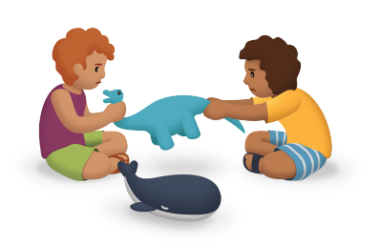
Notice and Wonder:
Sharing is Caring
Warm up
What do you notice?
What do you wonder?

Slide 6
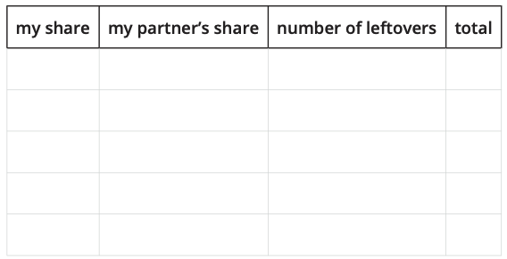
My Fair Share
Activity #1
Choose a container of counters.
Share the counters equally with your partner.
Then complete the table to show how many you each received and the total number of objects.

Slide 7

Share the Marbles
Activity #2
Andre has a collection of 17 marbles. He wants to play a game with his sister. They both need to start with the same number of marbles and they want to use as many as they can.
1. How many marbles would Andre and his sister get? Would there be any marbles left out of the game? Show your thinking.
2. What if Andre had 18 marbles? How many would each person get? Would there be any marbles left out? Show your thinking.
3. What if Andre had 20 marbles? How many would each person get? Would there be any marbles left out?

Slide 8
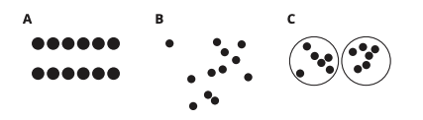

Lesson Synthesis
Which representations help you see if 12 blocks could be split into two equal groups?

Slide 9
Partners Make Pairs
2
Let’s make pairs with groups of objects.
2.OA.C, 2.OA.C.3

Slide 10
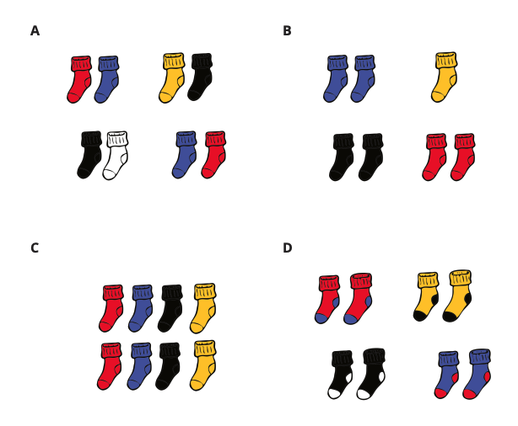
Which One Doesn’t Belong: Laundry Day
Warm up
Which one doesn’t belong?

Slide 11
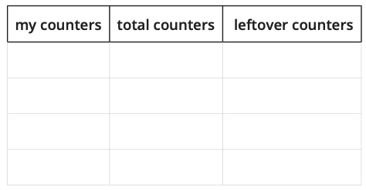
Pair Up
Activity #1
Make pairs with 1 yellow counter and 1 red counter.

Slide 12
Are You Feeling Left Out?
Activity #2
Show your thinking using diagrams, symbols, or other representations.
Use counters if it helps.
1. There are 18 students in Clare’s class today. They will work in pairs.
Will everyone be in a group of 2?
2. There are 20 students in Priya’s class. Will everyone be in a group of 2?
3. There are 19 students in Noah’s class. Will everyone be in a group of 2?

Slide 13
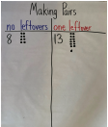
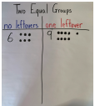
Lesson Synthesis
When the number of objects can be split into two equal groups or made into pairs without any objects left over, we say the number is even.
Numbers that are not even are called odd. When we try to make two equal groups of objects but there’s one left over, there is an odd number of objects. If we try to put objects into pairs but we have one left over, there is an odd number of objects.
What do you notice about the numbers in each chart? What do you wonder?

Slide 14
Is it Odd or Even?
3
Let’s explain why the number of objects in a group is even or odd.
2.OA.C.3

Slide 15



Choral Count: Skip Count by 2
Warm up
Count by 2, starting at 2.
Stop counting and recording at 40.

Slide 16
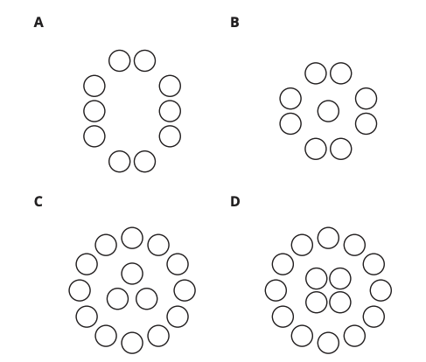
Color by Number
Activity #1
Han wants to color a design with the same number of yellow and blue shapes.
1. Which designs could Han choose? Show your thinking using diagrams, symbols, or other representations. Use counters if it helps.
2. Draw a circle design that would work for Han and a circle design that would not work.
3. Priya drew a design that has 6 circles, 3 triangles, and 3 squares. Would Han be able to color it the way he wants? Show your thinking using diagrams, symbols, or other representations. Use counters if it helps.

Slide 17

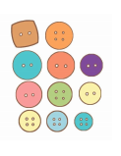
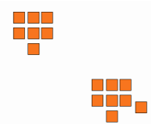
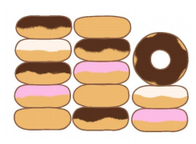
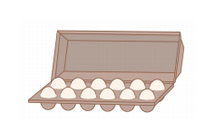
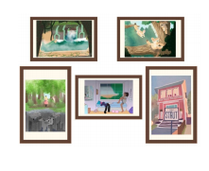










Card Sort: Even or Odd
Activity #2
1. Sort your cards into 2 piles. For each card, decide whether it shows an even or odd number. Explain your thinking to your partner.

Slide 18
Card Sort: Even or Odd
Activity #2
2. Find 3 cards that show the same number. Explain to your partner how each card shows whether the number is even or odd in a different way.

Slide 19
Lesson Synthesis
Today we practiced identifying whether different representations of groups of objects showed an even or odd number of members.
Think of at least two different ways you explained how a representation showed an even or odd number of objects. Then you will share your ideas with your partner.

Slide 20
Decompose Even and Odd Numbers
4
Let’s look for patterns with even and odd numbers.
2.OA.B.2, 2.OA.C.3

Slide 21

Number Talk:
Doubles and Near Doubles
Warm up
Find the value of each expression mentally.
Be prepared to explain your reasoning.

Slide 22

Number Talk:
Doubles and Near Doubles
Warm up
Find the value of each expression mentally.
Be prepared to explain your reasoning.

Slide 23

Number Talk:
Doubles and Near Doubles
Warm up
Find the value of each expression mentally.
Be prepared to explain your reasoning.

Slide 24

Number Talk:
Doubles and Near Doubles
Warm up
Find the value of each expression mentally.
Be prepared to explain your reasoning.

Slide 25
Share in Different Ways
Activity #1
1. Kiran baked 12 cookies. He wants to put them in two gift bags.
Which ways can he share the cookies?
a. Can both bags have the same amount of cookies?
12 = ___+ ___
b. Can both bags have an even number of cookies?
12 = ___+ ___
c. Can both bags have an odd number of cookies?
12 = ___+ ___
d. Can one bag have an even number of cookies and the other have an odd number of cookies?
12 = ___+ ___

Slide 26
Share in Different Ways
Activity #1
2. Lin baked 14 cookies. She wants to put them in two gift bags.
Which ways can he share the cookies?
a. Can both bags have the same amount of cookies?
14 = ___+ ___
b. Can both bags have an even number of cookies?
14= ___+ ___
c. Can both bags have an odd number of cookies?
14 = ___+ ___
d. Can one bag have an even number of cookies and the other have an odd number of cookies?
14 = ___+ ___

Slide 27
Share in Different Ways
Activity #1
3. Noah baked 15 cookies. He wants to put them in two gift bags.
Which ways can he share the cookies?
a. Can both bags have the same amount of cookies?
15 = ___+ ___
b. Can both bags have an even number of cookies?
15= ___+ ___
c. Can both bags have an odd number of cookies?
15 = ___+ ___
d. Can one bag have an even number of cookies and the other have an odd number of cookies?
15 = ___+ ___

Slide 28
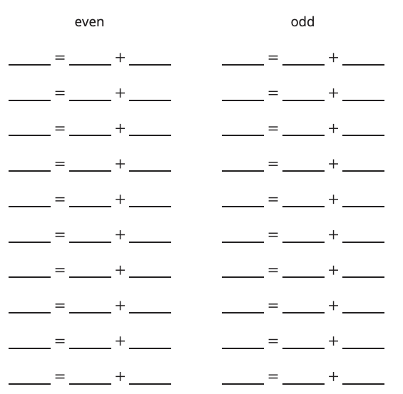
Representing Numbers with Two Addends
Activity #2
1. Pick a number between 0 and 20.
2. Decide with your partner whether the number is even or odd.
3. Complete the equation to show your number as the sum of two equal addends. If you cannot use two equal addends, use two addends that are as close as possible.

Slide 29

Lesson Synthesis
Is there an even or odd number of dots? Explain.
What is an equation that would show that the number of dots is even?

Slide 30
Patterns with Even and Odd Numbers
5
Let’s look for patterns with even and odd numbers.
2.NBT.B.9, 2.OA.B.2, 2.OA.C.3

Slide 31

How Many Do You See:
Even or Odd
Warm up
How many do you see?
How do you see them?

Slide 32

How Many Do You See:
Even or Odd
Warm up
How many do you see?
How do you see them?

Slide 33

How Many Do You See:
Even or Odd
Warm up
How many do you see?
How do you see them?

Slide 34
Even and Odd Round-About
Activity #1
We are going to count together by 1. The first person to count will say 0 and stay standing.
The next person will say their number and sit down. The next person will say their number and stay standing.
We will keep counting until everyone has said a number.
What do you notice?
What do you wonder?

Slide 35
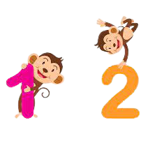
Presto Chango
Activity #2
1. On your recording sheet, circle even or odd based on the number of each student's counters.
2. Complete the gray column. Does adding 1 change whether the number of counters is even or odd? Explain.
3. Complete the last column. Does adding 2 change whether the number of counters is even or odd? Explain.

Slide 36
Lesson Synthesis
Han has an odd number of objects.
Lin has 2 more than Han.
Does Lin have an odd or even number of objects? Explain.

Slide 37
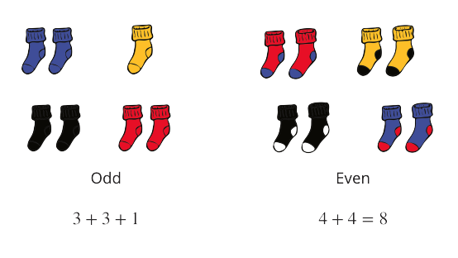
Section Summary
In this section, we learned that groups of objects have either an even or odd number of members. We learned that an even number of objects can be split into 2 equal groups or into groups of 2 with no objects left over. We learned that an odd number of objects always has one object left over when you make 2 equal groups of groups of 2. We also learned that even numbers can be represented as an equation with 2 equal addends.

Slide 38
Center Day 1
6
Let’s prove whether a group of objects shows an even or odd number.
2.NBT.B.7, 2.OA.B.2, 2.OA.C.3

Slide 39
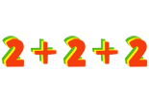
Number Talk: Two More
Warm up
Find the value of each expression mentally.
Be prepared to explain your thinking.

Slide 40
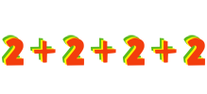
Number Talk: Two More
Warm up
Find the value of each expression mentally.
Be prepared to explain your thinking.

Slide 41
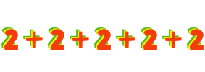
Number Talk: Two More
Warm up
Find the value of each expression mentally.
Be prepared to explain your thinking.

Slide 42
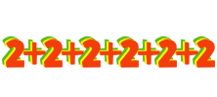
Number Talk: Two More
Warm up
Find the value of each expression mentally.
Be prepared to explain your thinking.

Slide 43
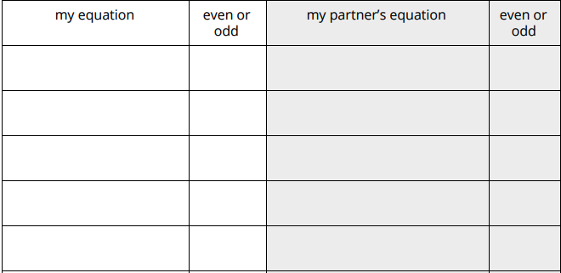
Centers:
Introduce Even or Odd, Even or Odd with Equations
Activity #1
Directions:
Spin both spinners.
Write an equation to represent your number of objects.
Share your equation with your partner.
You get 1 point if your number matches the word you spun.
The player that gets 6 points first wins.

Slide 44

Centers Choice Time
Activity #2
Even or Odd
Compare
5 in a Row

Slide 45
Lesson Synthesis
Jada wants to write an equation so that her partner can quickly tell whether the number is even or odd. Which equation do you think she should pick? Explain.

Slide 46
What is an Array?
7
Let’s learn about arrays.
2.OA.B.2, 2.OA.C.3, 2.OA.C.4

Slide 47
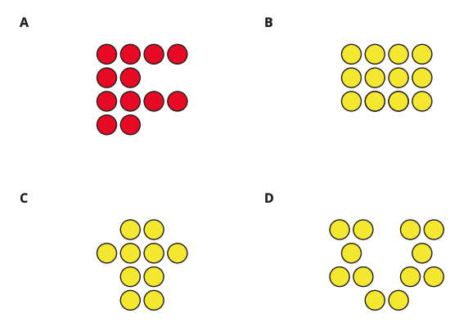
Which One Doesn’t Belong: Counter Collections
Warm up
Which one doesn’t belong?

Slide 48
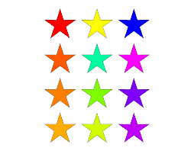
What is An Array?
Activity #1
Arrange each set of counters into equal rows with no extra counters.
1. How many counters? _____
Show how you arranged them using words, drawings, or numbers.
2. How many counters? _____
Show how you arranged them using words, drawings, or numbers.
3. How many counters? _____
Show how you arranged them using words, drawings, or numbers.

Slide 49


Counter Collections
Activity #2
1.
a. How many rows are in this array?
b. How many counters are in each row?
c. How many counters are there in all?
2.
a. How many rows are in this array?
b. How many counters are in each row?
c. How many counters are there in all?

Slide 50
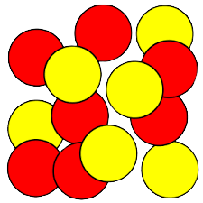
Counter Collections
Activity #2
3. Use 6 counters to make 2 rows with the same number in each row.
How many counters in each row?
4. Use 20 counters to make 4 rows with the same number in each row.
How many counters are in each row?

Slide 51
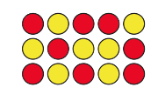
Lesson Synthesis
Today you learned that an array is an arrangement of objects in rows with an equal number of objects in each row.
How could you use the rows to find the total number of counters?

Slide 52
Count Columns and Objects in Columns
8
Let’s learn about columns in arrays.
2.OA.B.2, 2.OA.C.3, 2.OA.C.4

Slide 53
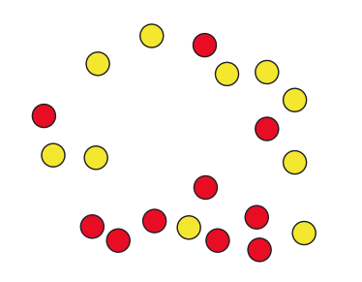
Estimation Exploration: Rearrange the Dots
Warm up
How many counters do you see?
Record an estimate that is:
Too low | About right | Too high

Slide 54
Estimation Exploration: Rearrange the Dots
Warm up
How many counters do you see?
Record an estimate that is:
Too low | About right | Too high

Slide 55


Count by Columns
Activity #1
1.
a. How many rows are in this array?
b. How many counters are in each row?
c. How many counters are there in all?
2.
a. How many rows are in this array?
b. How many counters are in each row?
c. How many counters are there in all?

Slide 56
Count by Columns
Activity #2
3. Use 10 counters to make 2 columns with the same number in each column.
a. How many counters are in each column?
b. How many rows are in the array?
c. How could you count these counters without counting by ones?
4. Use 15 counters to make 3 columns with the same number in each column.
a. How many counters are in each column?
b. How many rows are in the array?
c. How many counters are in each row?
d. How could you count these counters without counting by ones?

Slide 57
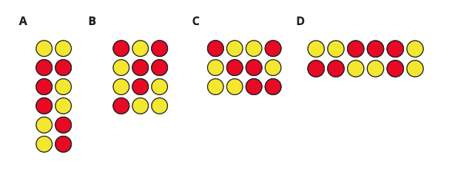
Guess My Array
Activity #2
Four students talked about their arrays.
Han said, “My array has an even number of counters. It has 2 rows with 6 counters in each row.”
Priya said, “My array has more than 10 counters. It has 4 rows with 3 counters in each row.”
Elena said, “My array is very tall. It has 6 counters in each column.”
Kiran said, “My array has more columns than rows. It has 3 rows.”
1. Which array belongs to which student? Write the name of each student below their array.

Slide 58
Guess My Array
Activity #2
Four students talked about their arrays.
Han said, “My array has an even number of counters. It has 2 rows with 6 counters in each row.”
Priya said, “My array has more than 10 counters. It has 4 rows with 3 counters in each row.”
Elena said, “My array is very tall. It has 6 counters in each column.”
Kiran said, “My array has more columns than rows. It has 3 rows.”
2. Each student used _____ counters to make an array.
3. Make an array using up to 20 counters, but don’t let your partner see.
Give your partner clues about your array, so they can try to make it.
Compare to see if your partner made the same array. Be prepared to explain how you knew the total number of counters.

Slide 59
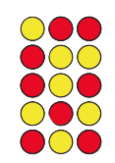
Lesson Synthesis
Today you learned that when arranging counters in an array, the counters in each row should line up with the counters in the other rows. The counters in an array also line up in columns that go up and down. The columns in an array always have the same number of counters in them. Arrays can help us organize objects, so we can find total amounts in an efficient way.
How would you describe this array using rows or columns?

Slide 60
Find Sums
Using Arrays
9
Let’s match expressions with arrays.
2.OA.B.2, 2.OA.C.3, 2.OA.C.4

Slide 61
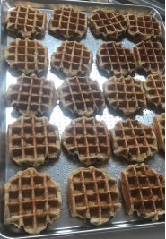
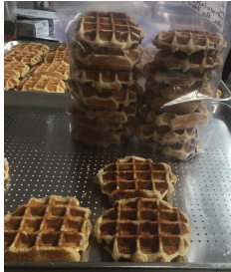
Estimation Exploration:
How Many Waffles?
Warm up
How many waffles are on the tray?
Record an estimate that is:
Too low | About right | Too high

Slide 62
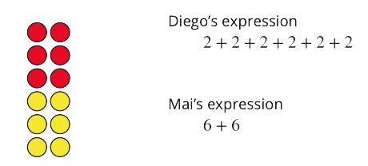
Sums of Rows and Sums of Columns
Activity #1
Mai and Diego represented the same array with different expressions.
Who do you agree with?
Show your thinking using diagrams, symbols, or other representations.

Slide 63
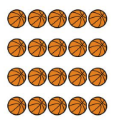
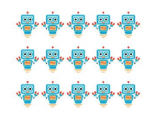

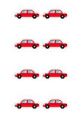

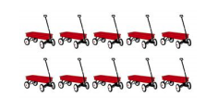




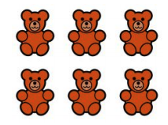



















Match Arrays to Expressions
Activity #2
Sort the cards into 8 piles.
Each pile will have 4 cards, except for one pile, which will only have 3.
Each pile should have an array, 2 expressions, and a total number.

Slide 64


Add It All Up
Activity
#3
1.
a. How many counters are there in all?
b. Explain how you found the total number of counters.
c. Circle 2 expressions that represent the array.
3 + 3 + 3 + 3
3 + 3 + 3
4 + 3
4 + 4 + 4
4 + 4 + 4 + 4
2.
a. How many counters are there in all?
b. Explain how you found the total number of counters.
c. Circle 2 expressions that represent the array.
2 + 2 + 2 + 2 + 2 + 2 + 2
6 + 6
7 + 7
2 + 2 + 2 + 2 + 2

Slide 65
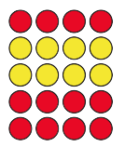
Lesson Synthesis
Today you learned that the number of objects in an array can be represented using expressions that show the sum of the number of objects in the rows or number of objects in the columns.
What can you tell me about this array?

Slide 66
Write Expressions and Equations to Represent Arrays
10
Let’s write equations to represent arrays.
2.NBT.A.2, 2.OA.B.2, 2.OA.C.3, 2.OA.C.4

Slide 67
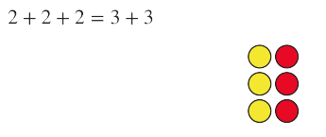
True or False:
Expressions that Represent Arrays
Warm up
Decide if each statement is true or false.
Be prepared to explain your reasoning.

Slide 68
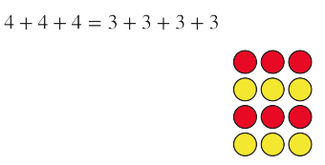
True or False:
Expressions that Represent Arrays
Warm up
Decide if each statement is true or false.
Be prepared to explain your reasoning.

Slide 69

True or False:
Expressions that Represent Arrays
Warm up
Decide if each statement is true or false.
Be prepared to explain your reasoning.

Slide 70
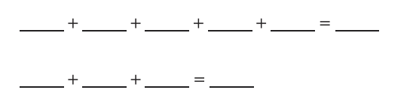
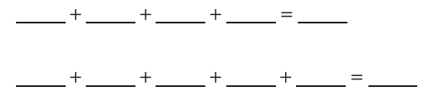
Build Arrays and Write Equations
Activity #1
1. Use 20 counters to make an array with 4 rows.
a. How many columns?
b. Fill in the blanks to create equations with equal addends that represent the array.
2. Use 15 counters to make an array with 3 columns.
a. How many rows?
b. Fill in the blanks to create equations with equal addends that represent the array.

Slide 71
Build Arrays and Write Equations
Activity #1
3. Choose an even number of counters between 6 and 24. Make an array.
a. How many rows?
b. How many columns?
c. Write equal addends equations that represent the array

Slide 72
Arrange Veggies to Make Arrays
Activity #2
3. Make an array that shows how to plant 15 potatoes.
Draw it. Write an equal addend equation to represent your array
4. Make an array that shows how to plant 12 carrot seeds.
Draw it. Write an equal addend equation to represent your array..
1. Make an array that shows how to plant 9 potatoes.
Draw it. Write an equal addend equation to represent your array.
2. Make an array that shows how to plant 16 carrot seeds.
Draw it. Write an equal addend equation to represent your array.

Slide 73
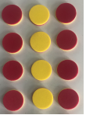
Lesson Synthesis
Today you learned that you can write equations to show the sum of the number of objects in rows or columns of arrays.
Elena wrote 6 + 6 = 12 as an equation to represent the number of objects in this array. Do you agree? Explain.

Slide 74
Arrays and Rectangles
11
Let’s make arrays and rectangles using tiles.
2.G.A.2, 2.OA.C.4

Slide 75
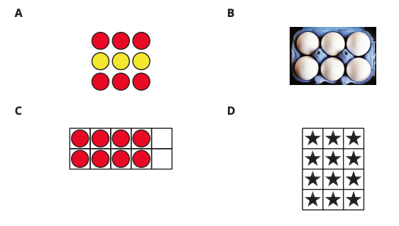
Which One Doesn’t Belong:
All Kinds of Arrays
Warm up
Which one doesn’t belong?

Slide 76
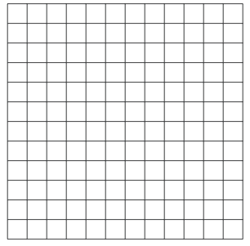
Use Tiles to Make Arrays
Activity
#1
Choose a number of tiles.
12 15 16 18 20
Arrange all the tiles in an array. Then push them together to make a rectangle.
1. Shade in the same arrangement of squares on the grid paper.
2. How many rows of squares does your rectangle have?
3. How many columns does your rectangle have?
4. How many tiles are in your rectangle?
5. Write 2 equations to represent the number of squares in your rectangle.

Slide 77
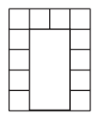
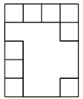
Partition Rectangles to
Make Equal-Sized Squares
Activity
#2
1. a. Draw lines so that the rectangle is completely filled with equal-sized squares.
b. Color the rows different colors.
c. How many rows?
d. How many squares in each row?
e. Write an equation to represent the sum of the rows.
2. a. Draw lines so that the rectangle is completely filled with equal-sized squares.
b. Color the columns different colors.
c. How many columns?
d. How many squares in each column?
e. Write an equation that represents the sum of the columns.

Slide 78
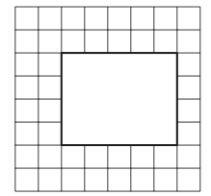
Partition Rectangles to
Make Equal-Sized Squares
Activity
#2
3. a. Draw lines so that the rectangle is completely filled with equal-sized squares.
b. How many columns? How many squares in each column?
c. How many rows? How many squares in each row?
d. Write 2 equations to represent the number of squares in the rectangle.

Slide 79
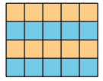
Lesson Synthesis
Today you learned that we can partition a rectangle into equal-sized squares.
How would you describe this rectangle?
What is the total number of equal-sized squares inside the rectangle?

Slide 80
Partition Rectangles
into Squares
12
Let’s partition rectangles into squares.
2.G.A.2, 2.OA.C.4

Slide 81

Estimation Exploration:
Fill it Up
Warm up
How many little squares would fill the rectangle?
Record an estimate that is:
Too low | About right | Too high

Slide 82



How Many Squares?
Activity
#1
1. Build a rectangle with 8 tiles arranged in 2 rows. Use a ruler to partition the rectangle to match the rectangle you made.
2. Use a ruler to partition the rectangle using the tick marks as a guide.
a. How many rows?
b. How many columns?
c. Write 2 equations to represent the total number of squares.
3. Use a ruler to partition the rectangle using the tick marks as a guide.
a. How many rows?
b. How many columns?
c. Write 2 equations to represent the total number of squares.

Slide 83
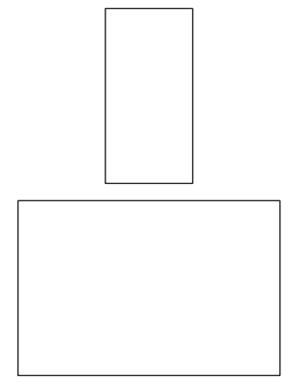
Partition Rectangles
Activity
#2
1. Use 12 tiles to make a rectangle. Split one of the rectangles into equal-sized squares to match your rectangle made of tiles.
a. Write 2 equations to represent the total number of squares.

Slide 84


Partition Rectangles
Activity
#2
2. Split this rectangle into equal-sized squares.
a. Write 2 equations to represent the total number of squares.
3. Split this rectangle into equal-sized squares.
a. Write 2 equations to represent the total number of squares.

Slide 85



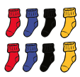


Lesson Synthesis
In this unit you learned about even and odd numbers and different types of arrays. Looking at these images, think about 1 thing you could say about each one. What are some things that are the same or different?

Slide 86

Section Summary
In this section, we learned that arrays are groups of objects that are organized into rows and columns. Arrays have the same number of objects in each row and the same number of objects in each column. We practiced different ways to count the objects in an array and used expressions with equal addends to show that you can find the total objects in an array by adding the sums of each row or the sums of each column. We also learned that rectangles can be composed of an array of equal-sized squares. We practiced partitioning rectangles into rows and columns of equal-sized squares.

Slide 87
Center Day 2
13
Let’s match arrays to expressions with equal addends.
2.OA.B.2, 2.OA.C.4

Slide 88

True or False:
Two or False
Warm up
Decide if each statement is true or false.
Be prepared to explain your reasoning.

Slide 89

True or False:
Two or False
Warm up
Decide if each statement is true or false.
Be prepared to explain your reasoning.

Slide 90

True or False:
Two or False
Warm up
Decide if each statement is true or false.
Be prepared to explain your reasoning.

Slide 91

Centers:
Introduce, Equal Groups Concentration, Partitioned Rectangles to Expressions
Activity #1
Directions:
Shuffle the cards and place them upside down in 3 rows with 4 cards in each row.
Choose two cards. If they match, explain to your partner how they match. If the cards are not a match, put them back where they were.
After you get a match, find the sum. If your partner agrees, keep the pair of cards and go again. You can do this up to 2 times in a row.
The player with the most pairs of cards at the end wins.

Slide 92
Centers Choice Time
Activity #2
Equal Groups Concentration
The Least and Greatest of Them All
Compare

Slide 93

Lesson Synthesis
Diego and Priya are playing Equal Groups Concentration. Diego just turned over these two cards.
What do you know about the two face-down cards? Explain how you know.

