Slide 1

Add and Subtract within 1,000
Grade 2: Unit 7
Standards addressed: 2.NBT.A.2, 2.NBT.B.5, 2.NBT.B.7, 2.NBT.B.8, 2.NBT.B.9, 2.NBT.A.4, 2.NBT.B.6, 2.MD.D.10, 2.NBT.A.1, 2.NBT.A.3
These slides have been created by Britnee Wright Southeast Arkansas Education Cooperative and are not official IM materials. Images and language are taken from IM Grade 2, Unit 7 by Illustrative Mathematics.
Copyright 2020 by Illustrative Mathematics. All Rights Reserved, adapted and shared with permission.

Slide 2
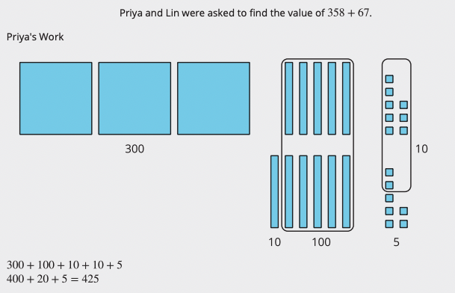
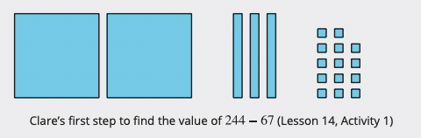
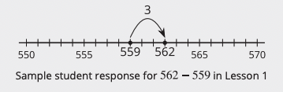
Unit 7 Progression Overview
Add and Subtract within 1,000
Section A
Lessons 1-5
2.NBT.A.2, 2.NBT.B.5, 2.NBT.B.7, 2.NBT.B.8, 2.NBT.B.9
Section B
Lessons 6-11
2.NBT.A.4, 2.NBT.B.5, 2.NBT.B.6, 2.NBT.B.7, 2.NBT.B.8, 2.NBT.B.9
Section C
Lessons 12-18
2.MD.D.10, 2.NBT.A.1, 2.NBT.A.2, 2.NBT.A.3,
2.NBT.B.7, 2.NBT.B.8, 2.NBT.B.9
Add and subtract numbers within 1,000 without composition or decomposition, and use strategies based on the relationship between addition and subtraction and the properties of operations.
Add numbers within 1,000 using strategies based on place value understanding, including composing a ten or hundred.
Subtract numbers within 1,000 using strategies based on place value understanding, including decomposing a ten or hundred.

Slide 3



Unit 7 Quick Link Page
L1
L2
L3
L4
L5
L6
L7
L8
L9
L10
L11
L12
L13
L14
L15
L16
L17
L18

Slide 4
Compare, Count on, and Count Back
1
Let’s compare numbers and add or subtract.
2.NBT.A.2, 2.NBT.B.7, 2.NBT.B.8

Slide 5
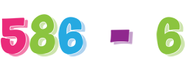
Number Talk: Count Back
Warm up
Find the value of each difference mentally.
Be prepared to explain your reasoning.

Slide 6
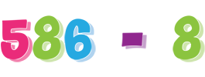
Number Talk: Count Back
Warm up
Find the value of each difference mentally.
Be prepared to explain your reasoning.

Slide 7
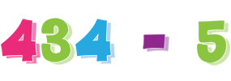
Number Talk: Count Back
Warm up
Find the value of each difference mentally.
Be prepared to explain your reasoning.

Slide 8
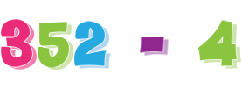
Number Talk: Count Back
Warm up
Find the value of each difference mentally.
Be prepared to explain your reasoning.

Slide 9
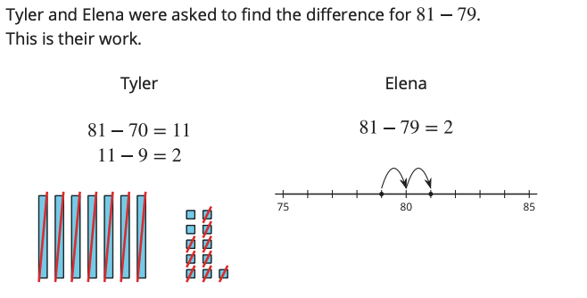
Notice the Difference on the Number Line
Activity #1
What do you notice?
What do you wonder?

Slide 10
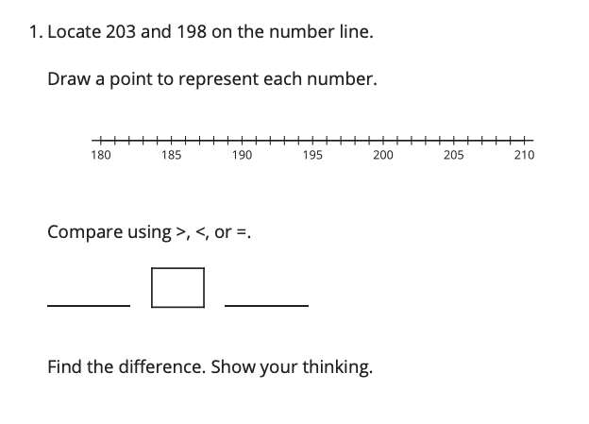
Notice the Difference on the Number Line
Activity #1

Slide 11
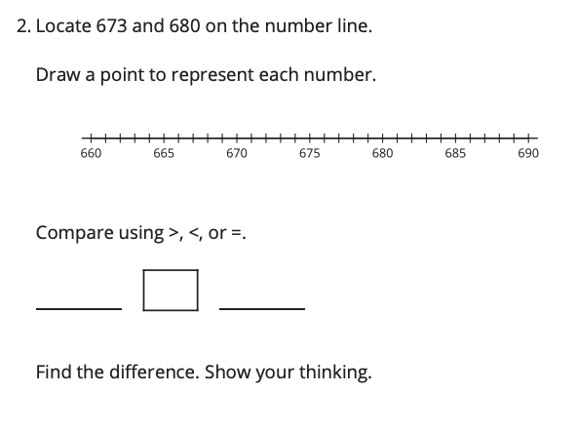
Notice the Difference on the Number Line
Activity #1

Slide 12
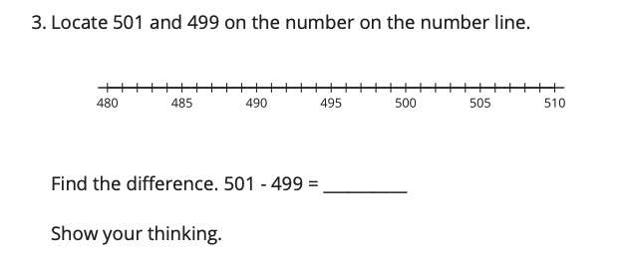
Notice the Difference on the Number Line
Activity #1

Slide 13
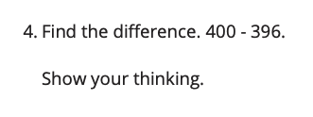
Notice the Difference on the Number Line
Activity #1

Slide 14

What’s the Big Difference?
Activity #2
On this number line there are 5 tick marks, but only 3 are labeled.
What are the missing numbers and how do you know?

Slide 15


What’s the Big Difference?
Activity #2
For each of the problems, use what you know about counting, representing numbers on the number line, and place value to find the missing numbers.
1. Fill in the missing numbers
Does this number line show counting by 10 or counting by 100?
2. Fill in the missing numbers
Does this number line show counting by 10 or counting by 100?

Slide 16


What’s the Big Difference?
Activity #2
For each of the problems, use what you know about counting, representing numbers on the number line, and place value to find the missing numbers.
3. Fill in the missing numbers
Does this number line show counting by 10 or counting by 100?
4. Fill in the missing numbers
Explain how you can tell your numbers show counting on by 10 and not counting on by 100.

Slide 17

Lesson Synthesis
Today you compared three-digit numbers and found the difference between them.
You also made sense of counting on and counting back by 10 or 100 on the number line.
How can this help you think about
234 + 200?

Slide 18
Add and Subtract with Multiples of 10 and 100
2
Let’s add and subtract tens or hundreds.
2.G.A.1

Slide 19
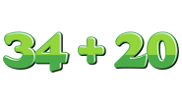
Number Talk:
Add Multiples of 10
Warm up
Find the value of each sum mentally.
Be prepared to explain your reasoning.

Slide 20
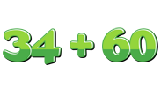
Number Talk:
Add Multiples of 10
Warm up
Find the value of each sum mentally.
Be prepared to explain your reasoning.

Slide 21
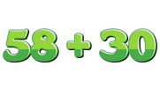
Number Talk:
Add Multiples of 10
Warm up
Find the value of each sum mentally.
Be prepared to explain your reasoning.

Slide 22
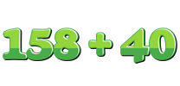
Number Talk:
Add Multiples of 10
Warm up
Find the value of each sum mentally.
Be prepared to explain your reasoning.

Slide 23
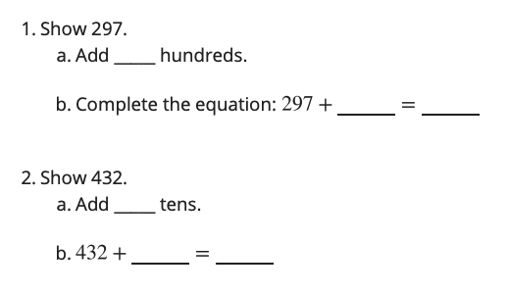
Show It with Base-ten Blocks
Activity #1
Use your base-ten blocks to show each number.
Then, roll a number cube to see how many tens or hundreds to add or subtract.

Slide 24
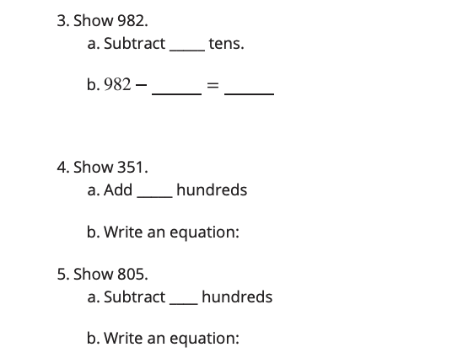
Show It with Base-ten Blocks
Activity #1
Use your base-ten blocks to show each number.
Then, roll a number cube to see how many tens or hundreds to add or subtract.

Slide 25
How Many with Base-ten Blocks and Equations
Activity #2
1.
Mai has 2 hundreds, 2 tens, and 3 ones. Lin has 4 hundreds.
Represent their values with base-ten blocks or diagrams.
What is the value of their blocks all together?
Show your thinking.
2.
Andre has 4 hundreds, 2 tens and 8 ones.
Represent his value with base-ten blocks or diagrams.
Andre gives 2 hundreds to Clare.
What is the value of his blocks now?
Show your thinking.

Slide 26
How Many with Base-ten Blocks and Equations
Activity #2
3.
Diego has 6 tens. Tyler has 8 hundreds, 3 tens, and 6 ones.
What is the value of their blocks together?
Show your thinking.
4.
Elena has 5 hundreds, 7 tens, and 2 ones. She gives 2 tens to Kiran.
What is the value of her blocks now?
Show your thinking.

Slide 27
How Many with Base-ten Blocks and Equations
Activity #2
5.
Priya has 6 hundreds, 5 tens, and 8 ones. Han gives her 3 hundreds.
What is the value of her blocks now?
Show your thinking.
6.
Jada has 4 hundreds, 8 tens, and 2 ones. She gives 3 hundreds to Noah.
What is the value of her blocks now?
Show your thinking.

Slide 28
Lesson Synthesis
Today you added and subtracted hundreds or tens to three-digit numbers.
How is the representation of Jada’s blocks different from the representation for Priya’s blocks?

Slide 29
Count on or Count Back to Subtract
3
Let’s find the difference between numbers.
2.NBT.B.7

Slide 30
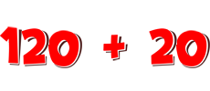
Number Talk:
Tens and Hundreds
Warm up
Find the value of each sum mentally.
Be prepared to explain your reasoning.

Slide 31

Number Talk:
Tens and Hundreds
Warm up
Find the value of each sum mentally.
Be prepared to explain your reasoning.

Slide 32
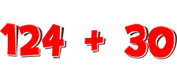
Number Talk:
Tens and Hundreds
Warm up
Find the value of each sum mentally.
Be prepared to explain your reasoning.

Slide 33

Number Talk:
Tens and Hundreds
Warm up
Find the value of each sum mentally.
Be prepared to explain your reasoning.

Slide 34
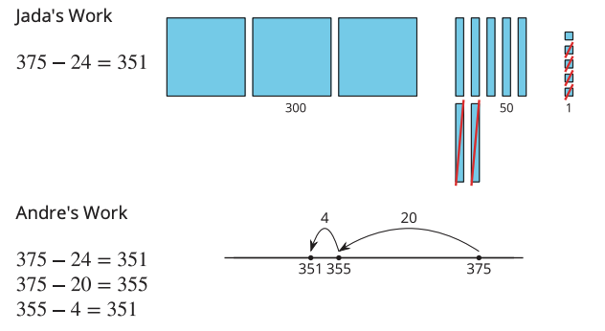
Jump Back, Back, Back
Activity #1
Jada and Andre found the value of
375 - 24.
Here is their work.
What do you notice? What do you wonder?

Slide 35
Jump Back, Back, Back
Activity #1
1.
Try Andre’s way to find the value of 189 - 73 .
Show your thinking. Use a number line if it helps.
2.
Find the value of 647 - 46 in your own way.
Show your thinking. Use a number line if it helps.

Slide 36
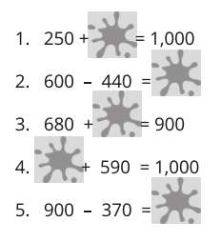

Who Spilled Paint?
Activity #2
Oh no! Diego spilled paint on his paper and now he can’t see all of the numbers. Find the number hidden by the paint.
Find the number that makes each equation true.

Slide 37
Lesson Synthesis
Today you used the relationship between addition and subtraction to find the value of differences and numbers that make equations true.
Think about all of the ways you saw used to find the value of differences and unknown addends. Tell your partner about one that you feel really confident about using and why

Slide 38
Add and Subtract Three-digit Numbers in Different Ways
4
Let’s add and subtract three-digit numbers.
2.NBT.B.7, 2.NBT.B.9

Slide 39
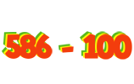
Number Talk:
Count Back by Place
Warm up
Find the value of each expression mentally.
Be prepared to explain your reasoning.

Slide 40
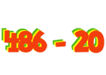
Number Talk:
Count Back by Place
Warm up
Find the value of each expression mentally.
Be prepared to explain your reasoning.

Slide 41
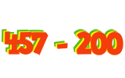
Number Talk:
Count Back by Place
Warm up
Find the value of each expression mentally.
Be prepared to explain your reasoning.

Slide 42
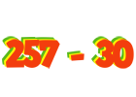
Number Talk:
Count Back by Place
Warm up
Find the value of each expression mentally.
Be prepared to explain your reasoning.

Slide 43
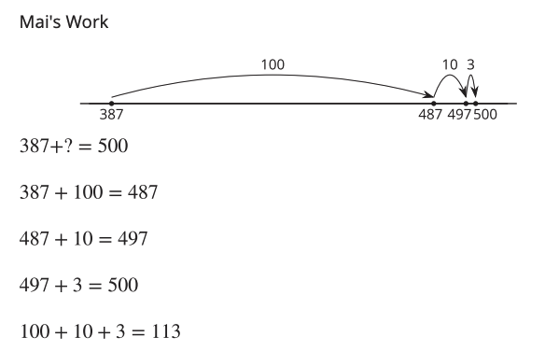
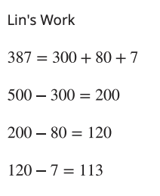
Zero Tens and Zero Ones
Activity #1
Mai and Lin were asked to find the value of . Here is their work.

Slide 44
Zero Tens and Zero Ones
Activity #1
Find the value of each difference. Show your thinking.
1. Try Mai’s way to find the value of 600 -476.
2. Try Lin’s way to find the value of 400 - 134.

Slide 45
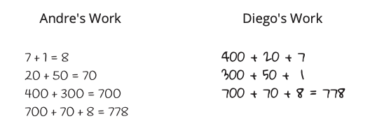
Add or Subtract with Expanded Form
Activity #2
1. Andre and Diego showed their thinking with symbols to find the value of 427 + 351
What is the same or different about their work? Discuss with your partner.

Slide 46
Add or Subtract with Expanded Form
Activity #2
2. Try Andre’s way to find the value of 725 + 243
3. Try Diego’s way to find the value of 863 - 432
4. Choose your own way to find the value of 163 + 326 . Show your thinking.
5. Choose your own way to find the value of 692 - 571 . Show your thinking.

Slide 47
Lesson Synthesis
Today you shared different ways to represent adding and subtracting numbers. You also talked about how thinking about place value and expanded form can help you find the value of expressions.
What was most helpful to you when finding the difference?
What is something that you learned from comparing with a partner when adding or subtracting three-digit numbers by place value?

Slide 48
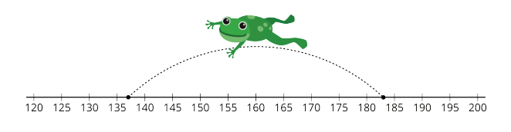
Section Summary
In this section of the unit, we compared three-digit numbers and looked at how addition can be used to find the difference, especially when numbers are close together. We added and subtracted multiples of 10 and multiples of 100 and counted on or back by place. We also used expanded form to think about adding or subtracting using place value based strategies.

Slide 49
Center Day 1
5
Let’s add numbers within 1,000.
2.NBT.B.7

Slide 50
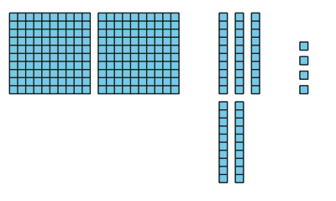
How Many Do You See: Hundreds, Tens, and Ones
Warm up
How many do you see?
How do you see them?

Slide 51
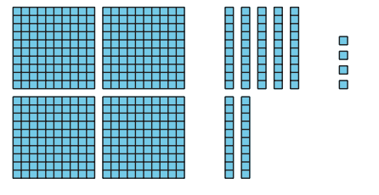
How Many Do You See: Hundreds, Tens, and Ones
Warm up
How many do you see?
How do you see them?

Slide 52
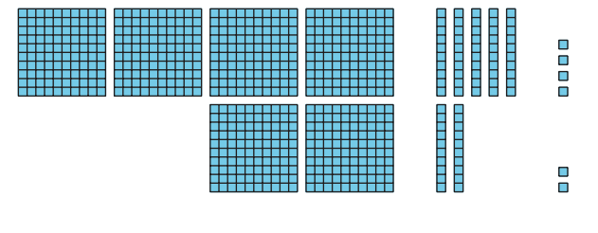
How Many Do You See: Hundreds, Tens, and Ones
Warm up
How many do you see?
How do you see them?

Slide 53
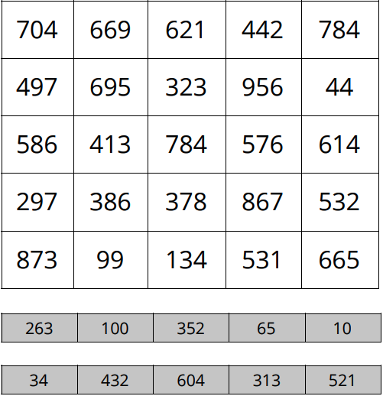
Centers:
Introduce 5 in a Row, Add Three-digit numbers, without Composing
Activity #1
Directions:
Player 1 puts a paper clip on 2 numbers in the grey boxes they will add.
Player 1 puts a counter on the sum.
Player 2 moves 1 of the paper clips, adds the numbers, and puts a counter on the sum.
Continue taking turns until someone gets 5 in a row.

Slide 54
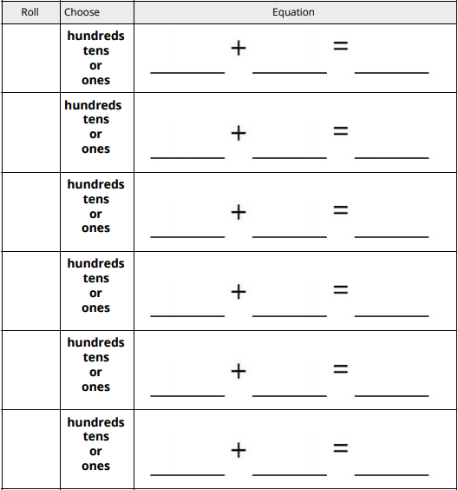
Centers:
Introduce Get to 1,000
Activity #2
Directions:
Start at 111.
Roll the number cube. Choose whether to add that number of tens or ones and add it to your starting number.
Write an equation.
The sum becomes the starting number in the next equation.
The player to get a sum closest to 1,000 in 6 rounds wins

Slide 55
Lesson Synthesis
Today we added numbers within 1,000. Tell your partner one thing you know about adding numbers.

Slide 56
Use a Ten to Add Within 1,000
6
Let’s add three-digit numbers by composing a ten.
2.NBT.B.5, 2.NBT.B.7

Slide 57
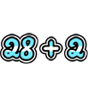
Number Talk:
Sums that Make 10
Warm up
Find the value of each sum mentally.
Be prepared to explain your reasoning.

Slide 58
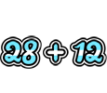
Number Talk:
Sums that Make 10
Warm up
Find the value of each sum mentally.
Be prepared to explain your reasoning.

Slide 59

Number Talk:
Sums that Make 10
Warm up
Find the value of each sum mentally.
Be prepared to explain your reasoning.

Slide 60
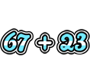
Number Talk:
Sums that Make 10
Warm up
Find the value of each sum mentally.
Be prepared to explain your reasoning.

Slide 61
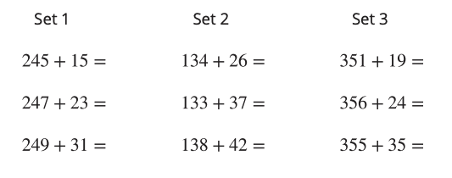
Add Two-Digit and Three-Digit Numbers
Warm up
1. Find the sum of each expression.
2. What patterns did you notice?

Slide 62
















Perfect 10
Activity #2
1. Work with your group to match the cards.
Check to see if each pair will make a perfect 10 with the ones.

Slide 63
Perfect 10
Activity #2
2. Pick 1 pair to find the sum.
a. Write an equation to show the sum. Show your thinking

Slide 64
Perfect 10
Activity #2
2. Pick 1 pair to find the sum.
b. Write an equation to show the sum. Show your thinking

Slide 65
Lesson Synthesis
Today you learned that when you add a two-digit number to a three-digit number, knowing sums of 10 can help you see if you need to make a new ten.
How did you find the sum of your pair?

Slide 66
Make New Tens, Make New Hundreds
7
Let’s add three-digit numbers and compose new tens or hundreds.
2.NBT.B.5, 2.NBT.B.7, 2.NBT.B.8

Slide 67
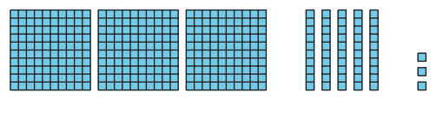
How Many Do You See:
Are They the Same?
Warm up
How many do you see?
How do you see them?

Slide 68
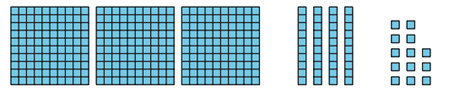
How Many Do You See:
Are They the Same?
Warm up
How many do you see?
How do you see them?

Slide 69
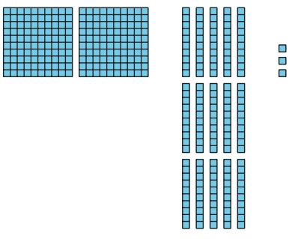
How Many Do You See:
Are They the Same?
Warm up
How many do you see?
How do you see them?

Slide 70

Compose a Ten or a Hundred
Activity #1
1. Find the value of each sum.
Show your thinking. Use base-ten blocks if it helps you.
2. Compare your thinking with your partner.

Slide 71
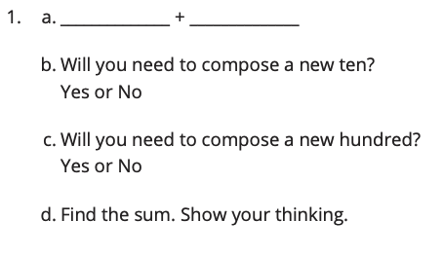
Walk About and Add
Activity #2
Directions:
Find a partner and record your numbers to make an expression.
Discuss if you would need to make a new ten or new hundred to find the sum of your numbers.
Find the sum. Show your thinking.

Slide 72
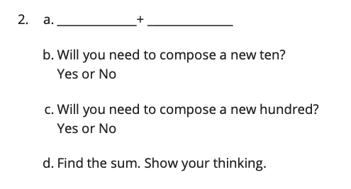
Walk About and Add
Activity #2
Directions:
Find a partner and record your numbers to make an expression.
Discuss if you would need to make a new ten or new hundred to find the sum of your numbers.
Find the sum. Show your thinking.

Slide 73
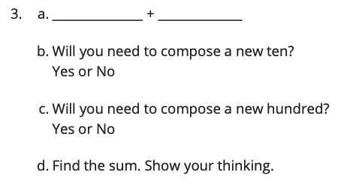
Walk About and Add
Activity #2
Directions:
Find a partner and record your numbers to make an expression.
Discuss if you would need to make a new ten or new hundred to find the sum of your numbers.
Find the sum. Show your thinking.

Slide 74
Lesson Synthesis
Today we learned that when you add numbers, sometimes you need to compose a new unit. You found sums and composed a new ten or hundred.
Clare is wondering if she will make a new ten or hundred when finding the sum for 428 + 42. How can you tell without a diagram?

Slide 75
Make New Tens and Hundreds to Add
8
Let’s make new tens and hundreds to add.
2.NBT.B.7, 2.NBT.B.9

Slide 76
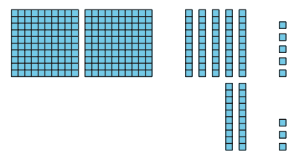
How Many Do You See:
Too Many Tens, Too Many Hundreds
Warm up
How many do you see?
How do you see them?

Slide 77
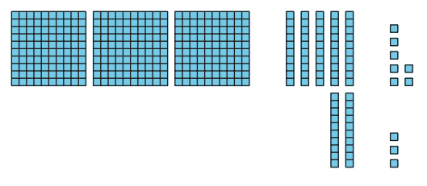
How Many Do You See:
Too Many Tens, Too Many Hundreds
Warm up
How many do you see?
How do you see them?

Slide 78
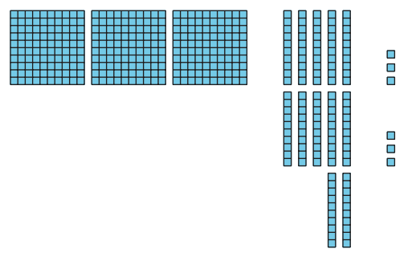
How Many Do You See:
Too Many Tens, Too Many Hundreds
Warm up
How many do you see?
How do you see them?

Slide 79


Make New Units
Activity #1
Find the value of each sum. Show your thinking. Use base-ten blocks if it helps.
4. What was the same and different about the sums?

Slide 80
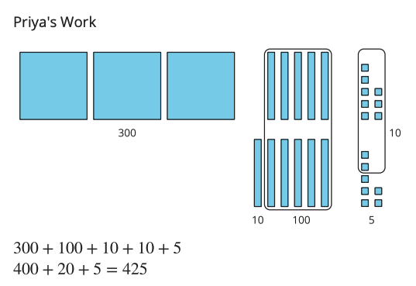
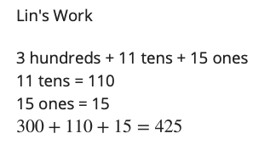
Different Ways to Show Your Thinking
Activity #2
1. Priya and Lin were asked to find the value of 358 + 67.
What do you notice about their work? What is the same and different about their representations? Be prepared to explain your thinking.

Slide 81
Different Ways to Show Your Thinking
Activity #2
1. Priya and Lin were asked to find the value of 358 + 67.
What do you notice about their work? What is the same and different about their representations? Be prepared to explain your thinking.
2. Find the value of 546 + 86.
Show your thinking.
You may use base-ten blocks if it helps you.

Slide 82
Lesson Synthesis
Today you learned that sometimes you will make a new ten and a new hundred when finding sums. There are different ways to represent our thinking.
Which representations do you find most helpful to show your thinking? Why?

Slide 83
Find Sums and Compose New Units
9
Let’s practice finding sums within 1,000.
2.NBT.B.7, 2.NBT.B.9

Slide 84

Number Talk:
Make a Ten and Some More
Warm up
Find the value of each sum mentally.

Slide 85

Number Talk:
Make a Ten and Some More
Warm up
Find the value of each sum mentally.

Slide 86

Number Talk:
Make a Ten and Some More
Warm up
Find the value of each sum mentally.

Slide 87

Number Talk:
Make a Ten and Some More
Warm up
Find the value of each sum mentally.

Slide 88


Find Some Sums
Activity #1
Find the value of each sum. Show your thinking.

Slide 89


Find Some Sums
Activity #1
Find the value of each sum. Show your thinking.

Slide 90


Analyze and Add
Activity
#2
Noah and Kiran showed how they found the value of 267 + 338
1. How is Noah and Kiran’s work the same?
How is it different?
2. Which way did not work?
Explain. Show your thinking.

Slide 91
Lesson Synthesis
Today we found sums of two three-digit numbers and looked at different methods and representations.
Which method do you prefer? Which would you like to practice more?
How are the different methods and representations you saw today the same? How are they different?

Slide 92
Find Sums within 1,000
10
Let’s find sums within 1,000 and explain our strategies.
2.NBT.B.7, 2.NBT.B.9

Slide 93

Number Talk:
Use Sums of 10 and 100 to Find Sums
Warm up
Find the value of each sum mentally.

Slide 94

Number Talk:
Use Sums of 10 and 100 to Find Sums
Warm up
Find the value of each sum mentally.

Slide 95

Number Talk:
Use Sums of 10 and 100 to Find Sums
Warm up
Find the value of each sum mentally.

Slide 96

Number Talk:
Use Sums of 10 and 100 to Find Sums
Warm up
Find the value of each sum mentally.

Slide 97










How Did You Do That?
Activity #1
1. Sort the cards into 2 piles with your partner. Make 1 group of expressions that you agree the value is less challenging to find. Make another group of expressions that you agree the value is more challenging to find. Keep any expressions together that you and your partner disagree on.
3. Choose an expression that you feel is more challenging.
Find the value of the sum.
Show your thinking using diagrams, symbols, or other representations.
2. Choose an expression that you feel is less challenging.
Find the value of the sum.
Show your thinking.

Slide 98
How Did You Do That?
Activity #1
4. Discuss one card you and your partner disagreed on. If you felt the expression was more challenging, explain why. If you felt the expression was less challenging, explain how you would find the value. Show your thinking.

Slide 99



Find the Missing Digit
Activity #2
Oh no! Diego spilled paint on his paper and now he can’t see one of the digits in each of his equations.
1. What digit makes the equation true? Show your thinking using diagrams, symbols, or other representations.
2. What digit makes the equation true? Show your thinking using diagrams, symbols, or other representations.

Slide 100

Lesson Synthesis
Today you found the sums of expressions using strategies that made sense to you. You shared ways to think about the addends in an expression to choose a method for finding the value of a sum.
Which of these expressions would be less challenging to find? Which might be more challenging? Why?

Slide 101

Section Summary
In this section of the unit, we learned many different ways to add three-digit numbers using what we know about place value. We used base-ten blocks, diagrams, and equations to show adding hundreds to hundreds, tens to tens, and ones to ones. We learned that when you add by place, you may need to compose a new ten, a new hundred, or both.

Slide 102
Center Day 2
11
Let’s add numbers within 1,000.
2.NBT.A.4, 2.NBT.B.6, 2.NBT.B.7

Slide 103

Number Talk:
Use Sums of 10 and 100 to Find Sums
Warm up
Find the value of each sum mentally.

Slide 104

Number Talk:
Use Sums of 10 and 100 to Find Sums
Warm up
Find the value of each sum mentally.

Slide 105

Number Talk:
Use Sums of 10 and 100 to Find Sums
Warm up
Find the value of each sum mentally.

Slide 106

Number Talk:
Use Sums of 10 and 100 to Find Sums
Warm up
Find the value of each sum mentally.

Slide 107

Centers:
Introduce Get to 1,000 and The Least and Greatest of Them All
Activity #1
Directions:
Start at 111.
Roll 3 number cubes and use them to make a 3-digit number.
Add it to your starting number and record it with an equation.
The sum becomes the starting number in the next equation.
The player to get a sum closest to 1,000 in 6 rounds wins.

Slide 108

Centers Choice Time
Activity #2
Get to 1,000: Add Multiples of 100, 10, or 1, Add Three-digit, Two-digit, and One-digit Numbers
5 in a Row: Add Three-digit Numbers, without Composing
The Least and Greatest of Them All: Add within 1,000

Slide 109
Lesson Synthesis
When might you need to add numbers like the ones you worked with in these centers?

Slide 110
Decompose to Subtract
12
Let’s subtract within 1,000.
2.NBT.A.1, 2.NBT.A.3, 2.NBT.B.7

Slide 111

What Do You Know About 354?
Warm-up
What do you know about 354?
How could we represent the number 354?

Slide 112


Decompose to Subtract
Activity
#1
Find the value of each difference in any way that makes sense to you.
Explain or show your reasoning.

Slide 113
Decompose with Base-ten Blocks
Activity
#2
Work with your partner to find the value of each difference.
Partner A: Read the expression and represent the larger number using blocks.
Partner B: Decide if you need to decompose and explain. Then subtract.
Discuss and write the difference.
Switch roles.
264 - 38
274 - 41
336 - 115
343 - 127
485 - 266
451 - 315

Slide 114
Lesson Synthesis
Today we saw that we can subtract by place with larger numbers, but sometimes we need to decompose a ten to subtract.
How did you know when you needed to decompose a ten when you subtracted three-digit numbers?
How was this the same as when you subtracted two-digit numbers? How was it different?

Slide 115
Decompose Tens or Hundreds
13
Let’s decompose a ten or hundred to subtract.
2.NBT.B.7, 2.NBT.B.9

Slide 116

Which One Doesn’t Belong: Blocks and Blocks
Warm up
Which one doesn’t belong?

Slide 117

Difference with Base-ten Diagrams
Activity
#1
Mai used base-ten blocks to find the value of 336 - 52. Then, she made a diagram to show her work.
Explain what Mai did in Step 2. Show what Mai should do next to find the difference.

Slide 118



Difference with Base-ten Diagrams
Activity
#1
1. Write each expression next to the matching diagram. Then find the value of each difference.
244 - 28
256 - 64
244 - 64

Slide 119
Decompose a Ten or Hundred
Activity
#2
Find the value of each difference.
Show your thinking. Try Mai's way for one expression.
245 - 28
352 - 71
364 - 182
293 - 147
5. Share how you found the value of one of the expressions to your partner. Use the sentence frames to help explain:
“First, I . . .”
“Next, I . . .”
“Then, I . . .”
“Last , I . . .”

Slide 120

Lesson Synthesis
Today we decomposed hundreds or tens to subtract by place.
Kiran wanted to take away by place and use a base-ten diagram to keep track of his thinking. First, Kiran drew 534 as 5 hundreds, 3 tens, and 4 ones.
What could Kiran do next? Explain.

Slide 121
Think Before You Subtract
14
Let’s think about decomposing before we subtract.
2.NBT.A.1, 2.NBT.B.7

Slide 122

Which One Doesn’t Belong: Blocks and Blocks and Blocks
Warm up
Which one doesn’t belong?

Slide 123

Agree to Disagree
Activity #1
Tyler and Clare are subtracting by place to find the value of 244 - 67 . Tyler says he knows they need to decompose first. Clare says she agrees.
The diagrams show each student’s first step.
1. What is the same about Tyler and Clare’s diagrams? What is different?
2. Work together to complete Tyler’s way and Clare’s way to find the value of 244 - 67 .
3. What do Tyler and Clare’s diagram look like after the last step? What is the same about these diagrams? What is different?

Slide 124


Sort and Subtract
Activity #2
Andre wants to use diagrams and subtract by place to find the value of 341 - 68. He says he needs to decompose a ten and a hundred to subtract. Why do you think he said that?
1. Andre only wants to use a diagram to subtract by place if he needs to decompose. Help Andre sort the expressions into groups. If you are not sure, use base-ten blocks or a diagram to help.
Decompose 2 units | Decompose 1 unit | Do not decompose
2. Choose 1 expression from each group and find the difference. Show your thinking.

Slide 125
Lesson Synthesis
Today we looked at expressions and thought about how we could decompose numbers to subtract by place. When you subtract by place, why is it helpful to think about where you may need to decompose a unit before beginning to find the difference?

Slide 126
Decompose a Ten and a Hundred to Find the Difference
15
Let’s subtract within 1,000.
2.NBT.A.2, 2.NBT.B.7, 2.NBT.B.9

Slide 127


Choral Count: Hundreds and Tens
Warm-up
Count back by 10, starting at 590.
Stop counting and recording at 390.

Slide 128

Elena’s Thinking
Activity
#1
Elena’s thinking:
1. Use base-ten blocks or a base-ten diagram to show Elena’s steps.
2. Finish Elena’s work to find the value of 726 - 568.
3. What is another way you could use numbers or equations to show subtracting by place to find the value of 726 - 568?

Slide 129

Walk About and Subtract
Activity
#2
Find someone with a different number than you.
Find the difference between your numbers. Show your thinking.
Trade cards and find a new partner.

Slide 130
Lesson Synthesis
How are these representations the same? How are they different?
Which methods did you try today? Which methods do you prefer?

Slide 131
Find Differences
Within 1,000
16
Let’s subtract in a way that makes sense.
2.NBT.A.1, 2.NBT.B.7, 2.NBT.B.9

Slide 132
True or False:
Equations Based on Place Value
Warm up
Decide if each statement is true or false.
Be prepared to explain your reasoning.

Slide 133
True or False:
Equations Based on Place Value
Warm up
Decide if each statement is true or false.
Be prepared to explain your reasoning.

Slide 134
True or False:
Equations Based on Place Value
Warm up
Decide if each statement is true or false.
Be prepared to explain your reasoning.

Slide 135



Jada’s Thinking
Activity
#1
Lin’s Diagram:
Jada’s Equations:
1.
a. Discuss how Jada’s equations match Lin’s diagram.
b. Finish Jada’s work to find the the value of 582 - 145.
2. Jada is thinking about how to find 402 - 298.
a. Jada says she noticed a way to count on to find the difference. She showed her thinking using a number line.
Explain Jada’s thinking.
b. Jada says you can’t decompose to find 402 - 298 because there aren’t any tens.
Do you agree with Jada? Use base-ten blocks, diagrams, or other representations to show your thinking.

Slide 136


Find It Your Way
Activity
#2
Find the value of each difference in the way that makes sense to you.
Show your thinking. Organize it so it can be followed by others.

Slide 137
Lesson Synthesis
In this unit, you added and subtracted within 1,000, composing and decomposing units when necessary. What are you most proud of learning? What do you still need to work on?

Slide 138

Section Summary
In this section of the unit, we learned many different ways to subtract three-digit numbers using what we know about place value. We used base-ten blocks, diagrams, and equations to show subtracting hundreds from hundreds, tens from tens, and ones from ones. We learned that when you subtract by place, you may need to decompose a hundred, a ten, or both. We learned that it is helpful to look closely at the numbers in an expression to plan how to decompose or to choose a strategy that helps us use friendly numbers or the relationship between addition and subtraction.

Slide 139
Center Day 3
17
Let’s add 3-digit numbers and find differences within 1,000.
2.NBT.B.7

Slide 140

Number Talk:
Use Simpler Computations
Warm up
Find the value of each difference mentally.

Slide 141

Number Talk:
Use Simpler Computations
Warm up
Find the value of each difference mentally.

Slide 142

Number Talk:
Use Simpler Computations
Warm up
Find the value of each difference mentally.

Slide 143

Number Talk:
Use Simpler Computations
Warm up
Find the value of each difference mentally.

Slide 144

Centers:
Introduce Compare, Three-Digit Subtraction
Activity #1
Let’s learn a new center called Compare.
Directions
Both partners flip over a card and find the difference.
  The partner whose card has the greater difference takes both cards
The game is over when each partner runs out of cards to flip over.
The partner with the most cards wins.

Slide 145
Centers Choice Time
Activity #2
Compare
The Least and Greatest of them All
5 in a Row

Slide 146
Lesson Synthesis
How did you and your partner work together during centers? What went well? What can we continue to work on?

Slide 147
Paint Splattered
Bar Graph
18
Let’s solve problems involving a bar graph and addition and subtraction.
2.MD.D.10, 2.NBT.B.7, 2.NBT.B.8, 2.NBT.B.9

Slide 148

Number Talk:
Subtract within 1,000
Warm up
Find the value of each expression mentally.

Slide 149

Number Talk:
Subtract within 1,000
Warm up
Find the value of each expression mentally.

Slide 150

Number Talk:
Subtract within 1,000
Warm up
Find the value of each expression mentally.

Slide 151

Number Talk:
Subtract within 1,000
Warm up
Find the value of each expression mentally.

Slide 152

Student Population
Activity #1
Oh no! Paint fell on the poster of the bar graph Clare and Priya created.
Answer the questions that you can with the graph. If a question cannot be answered, explain how you know.
1. What is the total number of students in grades 3 and 4?
2. How many more students are in grade 2 than in grade 1?
3. How many more students are in grade 3 than grade 2?
4. Write at least 2 mathematical questions that can be answered using the bar graph.

Slide 153

Asked and Answered
Activity #2
For each round:
1. Each pair, trade one question you came up with in the last activity.
2. Answer the question. Show or explain your reasoning.
3. If you have time, trade another question.

Slide 154
Lesson Synthesis
Today, we analyzed a bar graph and answered questions using the information from the graph.
How did you know when you can answer a question by adding or subtracting?

