Slide 1

Geometry, Time,
and Money
Grade 2: Unit 6
Standards addressed: 2.G.A.1, 2.MD.A.1, 2.NBT.A.3, 2.NBT.A.4, 2.NBT.B.5, 2.G.A.1, 2.G.A.3, 2.NBT.A.1, 2.NBT.A.2, 2.MD.A.3, 2.MD.C.7, 2.NBT.B.6, 2.MD.C.8, 2.NBT.B.8, 2.OA.A.1
These slides have been created by Britnee Wright Southeast Arkansas Education Cooperative and are not official IM materials. Images and language are taken from IM Grade 2, Unit 6 by Illustrative Mathematics.
Copyright 2020 by Illustrative Mathematics. All Rights Reserved, adapted and shared with permission.

Slide 2
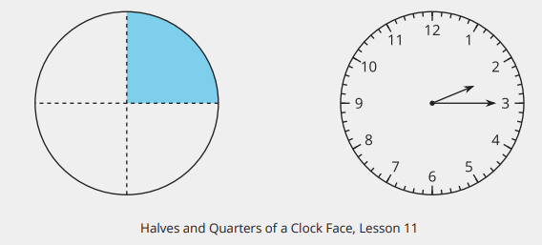
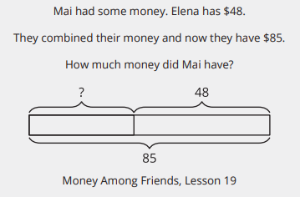
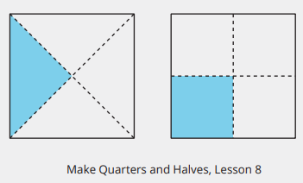
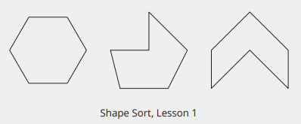
Unit 6 Progression Overview
Geometry, Time and Money
Section A
Lessons 1-5
2.G.A.1, 2.MD.A.1, 2.NBT.A.3, 2.NBT.A.4, 2.NBT.B.5
Section B
Lessons 6-10
2.G.A.1, 2.G.A.3, 2.NBT.A.1, 2.NBT.A.2
Section C
Lessons 11-14
2.G.A.1, 2.MD.A.1, 2.MD.A.3, 2.MD.C.7, 2.NBT.A.2,
2.NBT.B.5, 2.NBT.B.6
Section D
Lessons 15-21
2.G.A.1, 2.MD.A.1, 2.MD.A.3, 2.MD.C.8, 2.NBT.A,
2.NBT.A.2, 2.NBT.B.5, 2.NBT.B.6, 2.NBT.B.8, 2.OA.A.1
Identify triangles, quadrilaterals, pentagons, hexagons, and cubes.
Recognize and draw shapes having specified attributes, such as a given number of angles or a given number of equal faces.
Partition rectangles and circles into halves, thirds, and fourths and name the shares.
Recognize 2 halves, 3 thirds, and 4 fourths as one whole.
Understand that equal shares do not need to be the same shape.
Tell and write time from analog and digital clocks to the nearest five minutes, using a.m. and p.m.
Find the value of a group of bills and coins.
Use addition and subtraction within 100 to solve one- and two-step word problems.

Slide 3



Unit 6 Quick Link Page
L1
L2
L3
L4
L5
L6
L7
L8
L9
L10
L11
L12
L13
L14
L15
L16
L17
L18
L19
L20
L21

Slide 4
Identify and Sort Shapes
1
Let’s sort and name shapes based on their sides and corners.
2.G.A.1

Slide 5
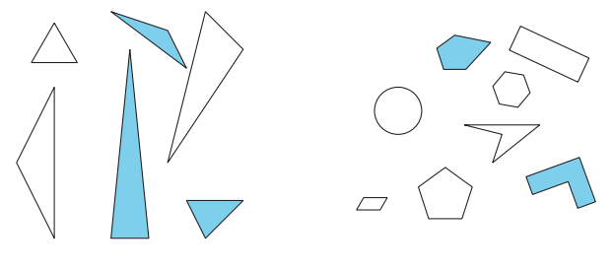
Notice and Wonder:
Groups of Shapes
Warm-up
What do you notice?
What do you wonder?

Slide 6
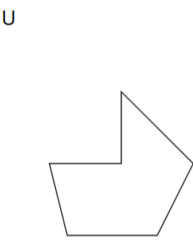
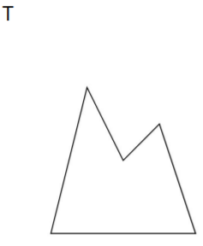
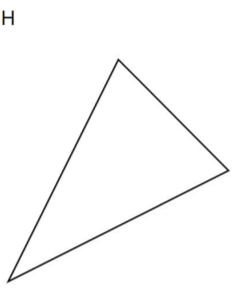
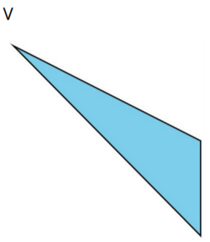
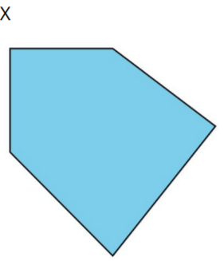
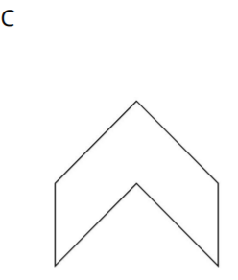
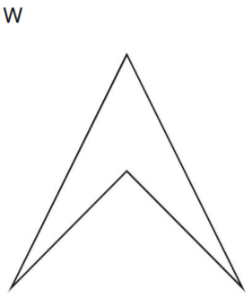
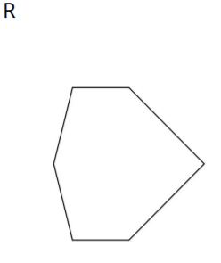
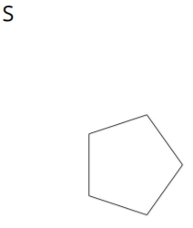
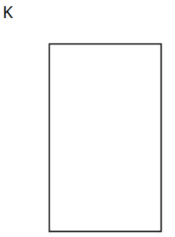
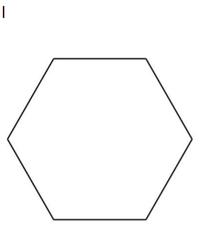
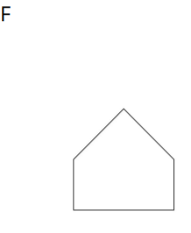
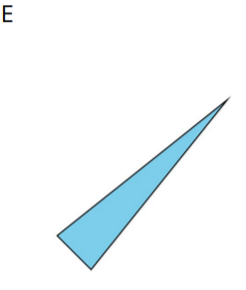
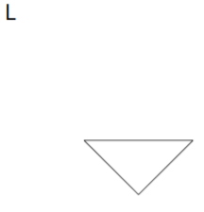
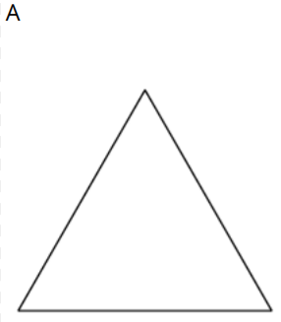
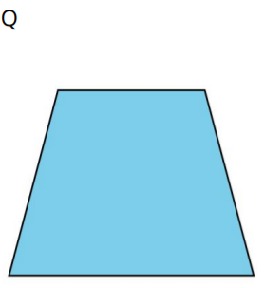
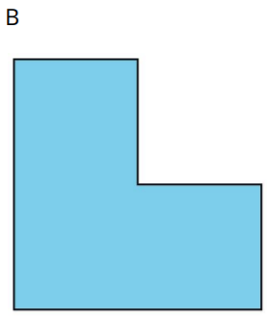
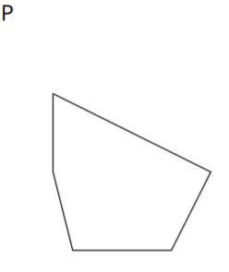
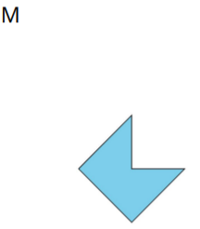
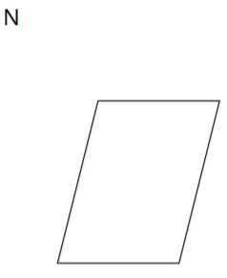
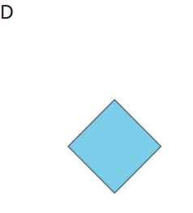
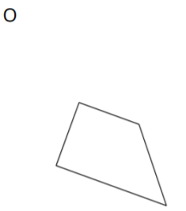
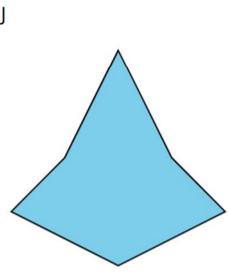
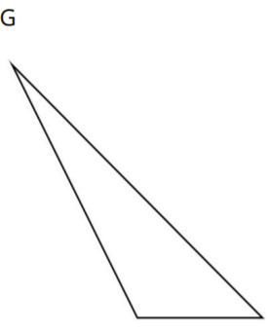
Sort the Shapes
Activity #1
Sort the shapes into categories in a way that makes sense to you. Be prepared to explain how you sorted the shapes.

Slide 7
Penta-what?
Activity #2
1. Ask the teacher whether a shape card belongs with one of these categories.
Use this question frame:
Is Shape _______ a _____________________?
2. Use the clues you gathered to make a true statement.
Shape _______ is a _____________________ because it has:_________________________
Gather clues to find out what kind of shapes belong in each of these categories.
triangle
pentagon
hexagon
quadrilateral

Slide 8
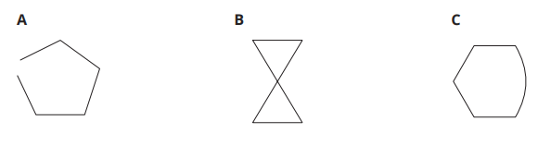
Penta-what?
Activity #2
Gather clues to find out what kind of shapes belong in each of these categories.
triangle
pentagon
hexagon
quadrilateral
3. Would these shapes belong to any of these categories? Explain.

Slide 9
Compare Shapes
Activity #3
Pick 1 shape card. Be prepared to name and describe your shape to a partner.

Slide 10
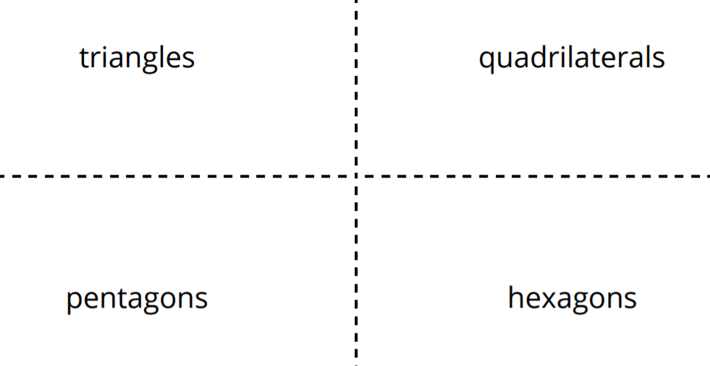
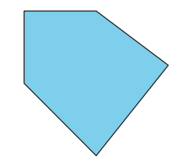

Lesson Synthesis
Today we learned we can name shapes based on the number of sides and corners they have.
Diego told his partner that this shape was a hexagon because it has 5 sides.
Do you agree or disagree? Explain.

Slide 11
Draw Shapes
2
Let’s recognize and draw triangles, quadrilaterals, pentagons, and hexagons.
2.G.A.1

Slide 12
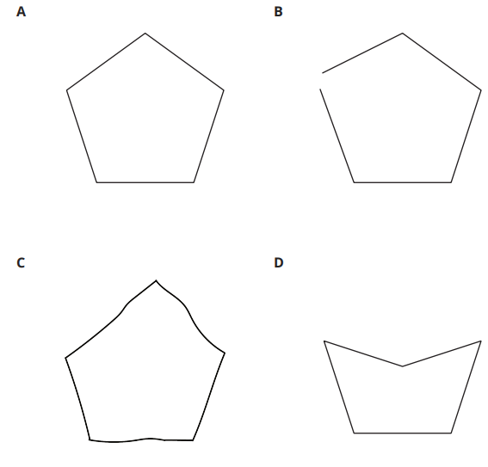
Which One Doesn’t Belong:
Five-Sided Shapes
Warm up
Which one doesn’t belong?

Slide 13
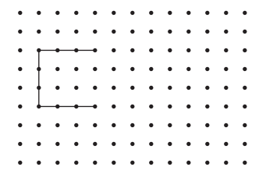
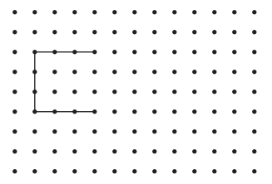
Draw Shapes
Activity #1
1. Complete the shape to make a quadrilateral. Then draw a different four-sided shape.
2. Complete the shape to make a pentagon. Then draw a different five-sided shape.

Slide 14
Draw Shapes
Activity #1
3. Complete the shape to make a hexagon. Then draw a different six-sided shape.
4. Compare your shapes with your partner’s shapes.
Find one way your shapes are the same and one way they are different.

Slide 15
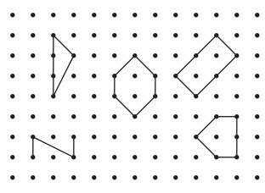

What Shape Could It Be
Activity #2
1. Clare drew a shape that has fewer than 5 sides. Circle shapes that could be Clare’s shape.
2. Draw a different shape that could be Clare’s shape.

Slide 16
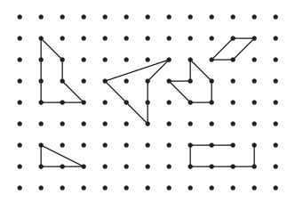
What Shape Could It Be
Activity #2
3. Andre drew a shape that has 4 corners. Circle shapes that could be Andre’s shape.
4. Draw a different shape that could be Andre’s shape.

Slide 17
What Shape Could It Be
Activity #2
5. Han drew a shape that has more corners than Andre’s shape.
Draw two shapes that could be Han’s shape.

Slide 18
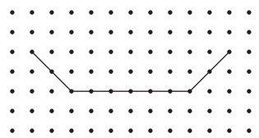
Lesson Synthesis
Today you practiced drawing shapes based on the number of sides or corners. Mai started drawing a shape like this.
Could she make a triangle from her drawing?
Could she make a hexagon from her drawing?

Slide 19
Draw All Kinds of Shapes
3
Let’s find and draw shapes with specific side lengths.
2.G.A.1, 2.MD.A.1

Slide 20
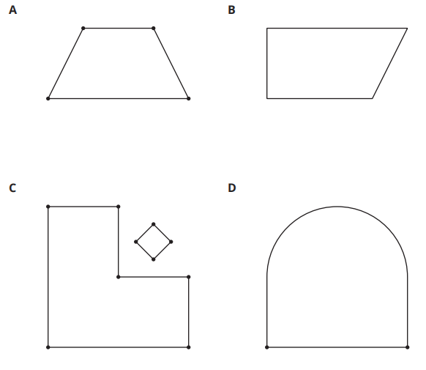
Which One Doesn’t Belong:
Different Shapes
Warm up
Which one doesn’t belong?

Slide 21
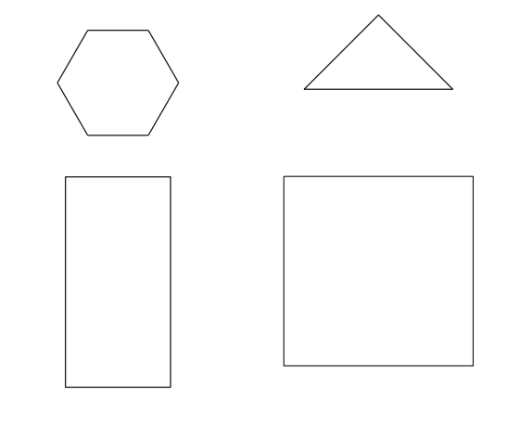
Measure Twice, Draw Once
Activity #1
1. Diego drew a shape that has fewer than 5 sides. Two sides are 3 centimeters long.
Circle shapes that could be Diego’s shape.
2. Tyler drew a shape that has 4 sides. Each side is 2 inches long.
a. Circle shapes that could be Tyler’s shape.
b. Draw another shape that could be Tyler’s shape.

Slide 22

Measure Twice, Draw Once
Activity #1
3. Priya drew a shape that has more sides than Tyler’s shape.
Only one side of her shape is 2 inches long.
Draw two shapes that could be Priya’s shape.

Slide 23
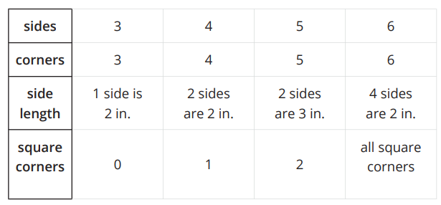
Build a Shape
Activity #2
Choose your own attributes.
Circle an attribute from each row.
Draw and name a shape with the attributes you chose. If you cannot draw the shape, explain why.
Shape:____________
Name:____________

Slide 24
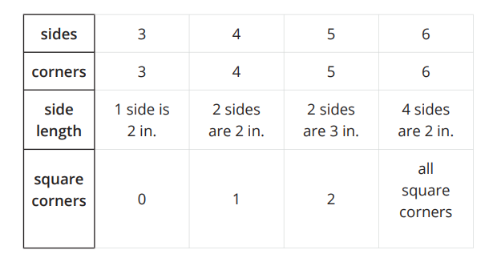
Build a Shape
Activity #2
Choose your own attributes.
Circle an attribute from each row.
Draw and name a shape with the attributes you chose. If you cannot draw the shape, explain why.
2. Shape:____________
Name:____________

Slide 25
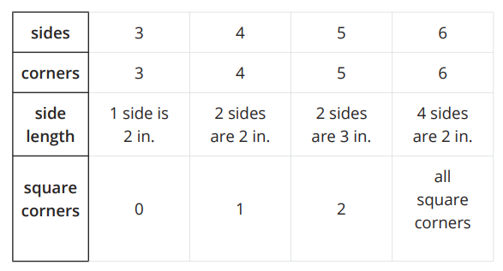
Build a Shape
Activity #2
Choose your own attributes.
Circle an attribute from each row.
Draw and name a shape with the attributes you chose. If you cannot draw the shape, explain why.
3. Shape:____________
Name:____________

Slide 26
Build a Shape
Activity #2
4. Cover your attribute table and trade papers with your partner. Guess which attributes they used to draw their shape.
5. If you have time: Are there any attributes that are impossible to put together to make a shape? Show or explain.

Slide 27

Lesson Synthesis
Today, we used length measurements to identify and draw shapes.
Clare drew a shape that has these attributes. Which shape did Clare draw? Describe to your partner what the shape would look like.

Slide 28

Lesson Synthesis
Today, we used length measurements to identify and draw shapes.
Diego wanted to draw a shape with these attributes. Is it possible? Explain.

Slide 29
Solid Shapes
4
Let’s identify and describe solid shapes.
2.G.A.1

Slide 30
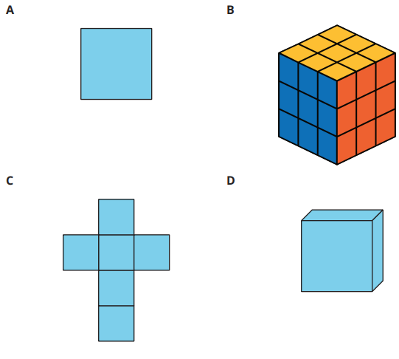
Notice and Wonder:
What is That Shape?
Warm-up
What do you notice?
What do you wonder?

Slide 31

What is the Missing Shape?
Activity #1
Make a poster to describe your solid shape.
Use words, numbers, and drawings to help other groups name your shape.

Slide 32
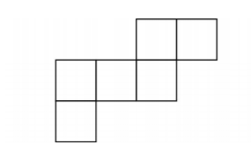
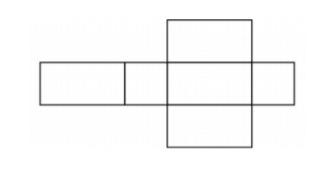
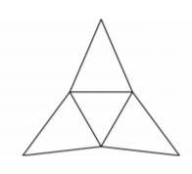
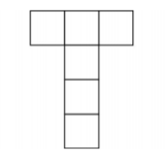
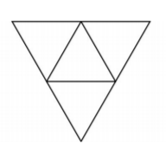
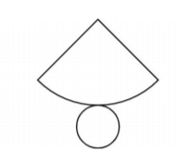


Sort and Build Solid Shapes
Activity #2
1. Sort your shape design cards into groups. Be prepared to describe how you sort the cards.

Slide 33
Sort and Build Solid Shapes
Activity #2
2. Match one of your cards to a solid shape. Explain your match.

Slide 34
Sort and Build Solid Shapes
Activity #2
3. Which shape designs could be folded to make cubes? Explain.

Slide 35
Sort and Build Solid Shapes
Activity #2
4. Your teacher will give you 2 shape designs.
Fold the shape designs to make cubes.
Compare your cube with your partner’s cube.

Slide 36
Lesson Synthesis
In earlier lessons, we identified and drew shapes based on their sides and corners. Today we described solid shapes based on their faces. We also used the shapes we know to help us describe solid shapes.
In the first activity, you made posters that helped identify solid shapes. What would you put on a poster to identify a cube? What would you draw? What words would you use?

Slide 37

Section Summary
In this section, we named and drew shapes based on their number of sides and corners. We drew shapes with different side lengths and corners. We described solid shapes based on the number and shape of their faces.

Slide 38
Center Day 1
5
Let’s work with shapes and place value.
2.G.A.1, 2.NBT.A, 2.NBT.A.3, 2.NBT.A.4, 2.NBT.B.5

Slide 39

Number Talk: Add 5
Warm up
Find the value of each sum mentally.
Be prepared to explain your reasoning.

Slide 40

True or False:
Value of Digits
Warm up
Is each statement true or false?
Be prepared to explain your reasoning.

Slide 41

True or False:
Value of Digits
Warm up
Is each statement true or false?
Be prepared to explain your reasoning.

Slide 42

True or False:
Value of Digits
Warm up
Is each statement true or false?
Be prepared to explain your reasoning.

Slide 43

Centers:
Introduce Guess My Shape, Draw and Name
Activity #1
Directions:
1. Partner 1, choose a card and describe the shape to your partner.
2. Partner 2, draw the shape and write the name of the shape.
3. Check to see if the shapes match. If not, discuss how the shapes are different, and whether or not both shapes match the description.

Slide 44



Centers Choice Time
Activity #2
Guess My Shape, Draw and Name
Number Riddles,
Make the Greatest Number, Three-digit Numbers

Slide 45
Lesson Synthesis
Today we learned a new way to play Guess My Shape, in which we described each shape so our partner could draw and name it. Tell your partner one thing you have to know about a shape in order to draw it correctly.

Slide 46
Compose and Decompose Shapes
6
Let’s make shapes with equal-sized smaller shapes.
2.G.A.1

Slide 47

Notice and Wonder:
Painting Pictures with Shapes
Warm-up
What do you notice?
What do you wonder?

Slide 48

Many Ways to Compose Shapes
Warm up
Mai used pattern blocks to make this design.
Work with a partner to make the same design without using any yellow hexagons.

Slide 49

Compose Shapes with Equal Parts
Activity #2
What is the same?
What is different?

Slide 50

Compose Shapes with Equal Parts
Activity #2
1. I used ___________________ to compose a _______________.
2. I used ___________________ to compose a _______________.
3.I used___________________ to compose a _______________.

Slide 51
Lesson Synthesis
Today we thought about how shapes could be made using equal-sized smaller shapes.
Tell your partner 2 different shapes you used to compose other shapes.

Slide 52
Make Halves, Thirds, and Fourths
7
Let’s make halves, thirds, and fourths or quarters.
2.G.A.3

Slide 53

Which One Doesn’t Belong:
Compare Equal Parts
Warm up
Which one doesn’t belong?

Slide 54

Fold Equal Parts
Activity #1
1. Fold the rectangle to make 2 equal parts and cut them out.
Each part is called a ____________________.
Compare with your partner. Tell how you know the parts are equal.
2. Fold the rectangle to make 4 equal parts and cut them out.
Each part is called a ____________________.
Compare with your partner. Tell how you know the parts are equal.
3. Fold the rectangle to make 3 equal parts and cut them out.
Each part is called a ____________________.
Compare with your partner. Tell how you know the parts are equal.

Slide 55

That’s Not It
Activity #2
1. Noah is looking for examples of circles that have been decomposed into halves, thirds, or fourths.
Put an X on the 2 circles in each row that are not examples.

Slide 56
That’s Not It
Activity #2
2. Explain why each of the shapes you marked is not an example of halves, fourths, or thirds.

Slide 57

That’s Not It
Activity #2
3. Partition this circle into thirds.

Slide 58
Lesson Synthesis
Today you learned about making and identifying examples of shapes that were decomposed, or partitioned, into halves, thirds, and fourths.
What is something you did to try to make the parts equal when you decomposed shapes by cutting?
What is something you did to try to make the parts equal when you partitioned shapes by drawing lines?

Slide 59
Are all Parts
Created Equal?
8
Let’s make halves, thirds, and fourths in different ways.
2.G.A.3, 2.NBT.A.2

Slide 60

Number Talk:
Subtracting Multiples of 5 from Multiples of 5
Warm up
Find the value of each difference mentally.

Slide 61

Number Talk:
Subtracting Multiples of 5 from Multiples of 5
Warm up
Find the value of each difference mentally.

Slide 62

Number Talk:
Subtracting Multiples of 5 from Multiples of 5
Warm up
Find the value of each difference mentally.

Slide 63

Number Talk:
Subtracting Multiples of 5 from Multiples of 5
Warm up
Find the value of each difference mentally.

Slide 64


Make Quarters and Halves
Activity #1
1. Which of these shows fourths or quarters?
Explain and share with your partner.
2. Name the shaded part.
3. Is the same amount shaded in each square? Explain your thinking.

Slide 65


Make Quarters and Halves
Activity #1
4. Show 2 different ways to split the rectangle into quarters or fourths.
Shade in one fourth of each rectangle.
5. Show 2 different ways to split the square into halves. Shade in one half of each square.

Slide 66



Make Equal Shares
Activity #2
1. Lin, Mai, and Andre were asked to shade in one third of a shape.
Do all their shapes show one third shaded? Explain and share with a partner.
2. Split the rectangle into thirds and shade a third of the shape.
3. Diego’s dad made 2 square pans of cornbread and sliced them up for the family.
Diego’s little brother was upset because he thought his piece of cornbread was smaller than Diego’s. What would you tell him?

Slide 67


Lesson Synthesis
Today you learned that if a shape is split into the same number of parts, but in different ways, the parts of the shapes will have the same name, even though they look different.
Diego's brother was upset about his piece of cornbread. How could we help Diego’s little brother?
Since both pans are the same size, we know that both brothers got one quarter even though it looks different.

Slide 68
You Ate the
Whole Thing
9
Let’s talk about the whole.
2.G.A.3, 2.NBT.A.2

Slide 69

Number Talk:
Add Multiples of 5 to Multiples of 5
Warm up
Find the value of each sum mentally.

Slide 70

Number Talk:
Add Multiples of 5 to Multiples of 5
Warm up
Find the value of each sum mentally.

Slide 71

Number Talk:
Add Multiples of 5 to Multiples of 5
Warm up
Find the value of each sum mentally.

Slide 72

Number Talk:
Add Multiples of 5 to Multiples of 5
Warm up
Find the value of each sum mentally.

Slide 73

Pizza to Share
Warm up
Clare’s friends were going to share a pizza.
The images show how they cut and shared the pizza.
1. Clare ate 3 slices and her friends got upset with her.
a. Why are her friends upset?
b. How many thirds did Clare eat?
c. How much of the pizza was left?

Slide 74

Pizza to Share
Warm up
Clare’s friends were going to share a pizza.
The images show how they cut and shared the pizza.
a. Priya will eat _________ of the pizza?
b. Together they will eat _______ of the pizza?

Slide 75

Pizza to Share
Warm up
Clare’s friends were going to share a pizza.
The images show how they cut and shared the pizza.
a. Each girl will eat ___________ of the pizza.
b. Together they will eat _______ of the pizza?

Slide 76

Pizza to Share
Warm up
Clare’s friends were going to share a pizza.
The images show how they cut and shared the pizza.
a. How much pizza will each child eat?
b. How much pizza will they eat in all?

Slide 77

Equal Shares of the Pie
Activity
#2
1. Noah ate most of the pie. He left a quarter of the pie for Diego.
2. Lin gave away half of her pie and kept half of the pie for herself.
3. Tyler cut a pie into four equal parts. He ate a quarter of the pie.
4. Mai sliced the pie to share it equally with Clare and Priya.
a. What part of the pie will they each get?
b. How much of the pie will they eat in all?
Write the letter of each image next to the matching story.

Slide 78

Equal Shares of the Pie
Activity
#2
5. Now you try.
Partition the circle into four equal parts.
Shade in a quarter of the circle red.
Shade in the rest of the circle blue.
How much of the circle is shaded?

Slide 79
Equal Shares of the Pie
Activity
#2
6.
Partition the circle into 2 equal parts.
Shade one half of the circle blue.
Color the other part green.
What part of the circle is green?
How much of the circle is shaded?

Slide 80

Lesson Synthesis
We have learned a lot about composing and decomposing shapes. Sometimes different-sized parts can make up a whole. Sometimes the whole is made up of equal-sized parts. We learned that these equal-sized parts of a whole have special names.
Each of these shapes has parts shaded. How would you name each one? Are there any parts that you are not sure how to name? Explain.

Slide 81

Section Summary
We have learned a lot about composing and decomposing shapes. Sometimes the parts make up a whole, but all of the parts are not equal. Sometimes the whole is partitioned into equal parts and they have special names.

Slide 82
Center Day 2
10
Let’s split shapes.
2.G.A.3, 2.NBT.A.1

Slide 83

How Many Do You See?: Base-Ten Blocks
Activity #2
How many do you see?
How do you see them?

Slide 84

How Many Do You See?: Base-Ten Blocks
Activity #2
How many do you see?
How do you see them?

Slide 85

How Many Do You See?: Base-Ten Blocks
Activity #2
How many do you see?
How do you see them?

Slide 86

How Many Do You See?: Base-Ten Blocks
Activity #2
How many do you see?
How do you see them?

Slide 87


Centers:
Introduce Split the Shapes, Equal or Unequal
Activity #1
Directions:
Spin and split your shape.
Compare your shapes.
If you made equal parts, name the parts using halves, thirds, or fourths.

Slide 88

Centers Choice Time
Activity #2
Guess My Shape, Draw and Name
Split the Shape, Two Ways
Make the Greatest Number, Three-digit Numbers

Slide 89
Lesson Synthesis
Today we split shapes in lots of different ways. Sometimes we used the words halves, thirds, and fourths and sometimes we didn’t. How do you know when to use the words halves, thirds, and fourths?

Slide 90
Tell Time with Halves and Quarters
11
Let’s tell time with halves and quarters.
2.MD.C.7

Slide 91

What Do You Know About Ways to Tell Time?
Warm up
What do you know about ways to tell time?
What words do you use to talk about time?

Slide 92


Tell Time to the Hour and Half-Hour
Activity
#1
1. Circle the clock that shows 4 o’clock.
Why doesn’t the other clock show 4 o’clock?
2. Circle the clock that shows half past 7.
Why doesn’t the other clock show half past 7?

Slide 93

Tell Time to the Hour and Half-Hour
Activity
#1
3. Draw the hands on the clock to show 10:00.
4. Draw the hands on the clock to show 1:30

Slide 94












Halves and Quarters of a Clock Face
Activity
#2
1. Find matching sets of cards. Each set should have 3 cards.
Be prepared to explain why they match.

Slide 95


Halves and Quarters of a Clock Face
Activity
#2
2. Write the time shown on each clock using the words half past, quarter past, or quarter till.

Slide 96



Halves and Quarters of a Clock Face
Activity
#2
2. Write the time shown on each clock using the words half past, quarter past, or quarter till.

Slide 97

Lesson Synthesis
Today we practiced reading analog clocks and using phrases to tell the time.
Are there any new words or phrases that are important to include on our display?
Describe how you can tell if a clock shows a quarter past or a quarter till. Use your shape cards to help explain if it helps.

Slide 98
Count by 5 to Tell Time
12
Let’s tell time.
2.MD.C.7, 2.NBT.A.2

Slide 99

Notice and Wonder:
Number Line and Clock
Warm-up
What do you notice?
What do you wonder?

Slide 100


Count by 5 on the Clock
Activity
#1
1. Discuss 2 ways to read the time on this clock.
2. What time does this clock show?

Slide 101








Count by 5 on the Clock
Activity
#1
3. Read the time on each clock card with your partner.
Put the clocks in order based on the times they show.

Slide 102


Write the Time
Activity
#2
Write the time shown on each clock.

Slide 103


Write the Time
Activity
#2
Write the time shown on each clock.

Slide 104


Write the Time
Activity
#2
Write the time shown on each clock.

Slide 105

Lesson Synthesis
Today we learned that each time the minute hand moves between numbers, 5 minutes have passed. This is why counting by 5 can help us tell time.
Tell your partner what time is shown on the clock and how you know.

Slide 106
What Time Is It?
13
Let’s read and write times using a.m. or p.m.
2.MD.C.7

Slide 107
Choral Count:
Count Around the Clock
Warm up
What patterns do you see?
Count on by 5 minutes, starting at 3:45.
Stop counting and recording at 5:00.
Where do you see a change in the pattern of counting by 5?

Slide 108

What is the Time of Day?
Activity
#1
1. Use the materials your teacher gives you to create your own representation for the hours in a day.
Circle and label when you eat breakfast, lunch, and dinner on the diagram.
Shade in when you might be sleeping.

Slide 109

What is the Time of Day?
Activity
#1
2.
Fill in the blank with a.m. or p.m. to show the time of day for each activity.
Explain your thinking to your partner.

Slide 110


Tell the Time with a.m. and p.m.
Activity
#2
Label each activity with a.m. or p.m.
Draw a line to the time when the activity could take place and to one of the clocks.
Draw the hands on the clock to show the time.

Slide 111

Lesson Synthesis
Today we learned that the hours in a day are split into 2 groups called a.m. and p.m. We learned that a.m. is usually thought of as morning and p.m. is thought of as afternoon and night.
Tell your partner what time you might do each of these activities. Include a.m. or p.m. with the time.

Slide 112

Section Summary
In this section, we learned to read clocks to tell and write time to the nearest 5 minutes. We learned how to count by 5 on the clock to tell the time in minutes. We learned how to think about the position of the hour hand depending on how many minutes had passed. We also learned how to use what we know about morning, afternoon, and night to use a.m. and p.m. when we tell and write time.

Slide 113
Center Day 3
14
Let’s estimate and measure length.
2.G.A.1, 2.MD.A.1, 2.MD.A.3, 2.NBT.B.5, 2.NBT.B.6

Slide 114

Number Talk:
Adding Up to 4 Two-Digit Numbers
Warm up
Find the value of each sum mentally.

Slide 115

Number Talk:
Adding Up to 4 Two-Digit Numbers
Warm up
Find the value of each sum mentally.

Slide 116

Number Talk:
Adding Up to 4 Two-Digit Numbers
Warm up
Find the value of each sum mentally.

Slide 117

Number Talk:
Adding Up to 4 Two-Digit Numbers
Warm up
Find the value of each sum mentally.

Slide 118


Centers:
Introduce Estimate and Measure, Line Segments
Activity #1
Directions:
Choose a line segment.
Record your estimate including the unit.
Measure and record the actual measurement.
Find the difference.

Slide 119
Centers Choice Time
Activity #2
Guess My Shape, Draw and Name
Split the Shape, Two Ways
Estimate and Measure

Slide 120
Lesson Synthesis
Today we estimated and measured the length of line segments. What other things can you estimate and measure the length of?

Slide 121
Identify Pennies, Nickels, and Dimes
15
Let’s learn about coins and their values.
2.MD.C.8, 2.NBT.A.2, 2.NBT.B.5, 2.NBT.B.6, 2.NBT.B.8

Slide 122



What Do You Know About ...
Warm up

Slide 123


Show Me the Money
Activity
#1
Name the coins in each group and find the value in cents.
Show your thinking using numbers, words, drawings, or equations.
1. Andre’s coins:
a. Circle the name of the coins in this collection:
dimes nickels pennies
b. What is the value of the coins?
2. Clare’s coins:
a. Circle the name of the coins in this collection:
dimes nickels pennies
b. What is the value of the coins?

Slide 124

Show Me the Money
Activity
#1
Name the coins in each group and find the value in cents.
Show your thinking using numbers, words, drawings, or equations.
3. Han’s coins:
a. Circle the name of the coins in this collection:
dimes nickels pennies
b. What is the value of the coins?
4. Show 2 different ways to make 10¢ using numbers, words, or drawings.

Slide 125


Compare Coins
Activity
#2
Name the coins in each group and find the value in cents.
Show your thinking using numbers, words, drawings, or equations.
1. Mai’s coins:
a. Circle the name of the coins in this collection:
dimes nickels pennies
b. What is the value of the coins?
2. Andre’s coins:
a. Circle the name of the coins in this collection:
dimes nickels pennies
b. What is the value of the coins?

Slide 126


Compare Coins
Activity
#2
Name the coins in each group and find the value in cents.
Show your thinking using numbers, words, drawings, or equations.
3. Clare’s coins:
a. Circle the name of the coins in this collection:
dimes nickels pennies
b. What is the value of the coins?
4. Priya’s coins:
a. Circle the name of the coins in this collection:
dimes nickels pennies
b. What is the value of the coins?

Slide 127

Compare Coins
Activity
#2
5. Compare your coin names and how you found the values with your partner.
6. Whose group of coins has the least value?
7. Who has the most coins? Does this group of coins have the greatest value? Explain.

Slide 128

Lesson Synthesis
Today we found the value of sets of coins and used the cent sign to show the unit. Just like when we added within 100, there are different strategies we can use to find the total.
Priya has the most coins, but her coins were not worth the most. How is that possible?

Slide 129
There’s a New Coin in Town
16
Let’s learn about quarters and find the value of different sets of coins.
2.MD.C.8, 2.NBT.A.2, 2.NBT.B.5

Slide 130
Choral Count:
Counting on by 5
Warm up
What patterns do you see?
Count by 5, starting at 15.
Stop counting and recording at 85.
Count by 5, starting at 40.
Stop counting and recording at 100.
Who can restate the pattern in different words?

Slide 131

How Much is a Quarter Worth?
Activity
#1
Write the names and values of the coins you know.

Slide 132

How Much is a Quarter Worth?
Activity
#1
1. Complete the table so each row shows a value in cents and two different groups of coins that have that value.

Slide 133




More Coins to Compare
Activity
#2
1. Elena's Coins
How many cents? Show your thinking.
2. Tyler's Coins
How many cents? Show your thinking.

Slide 134
More Coins to Compare
Activity
#2
3. Make your own set of coins with a value of 97¢.
I used:
quarters
dimes
nickels
pennies
4. Make your own set of coins with a value of 66¢. Use the fewest number of coins possible.
I used:
quarters
dimes
nickels
pennies

Slide 135
Lesson Synthesis
Today you found the value of sets of coins and used the cent sign to show the unit. Just like when we composed numbers in different ways with different numbers of hundreds, tens, and ones, we can use different combinations of coins to make the same value in cents.
There were different ways to make 97¢. What is the same or different about how _____ showed it and _____ showed it?

Slide 136
Let’s Make a Dollar
17
Let’s make a dollar.
2.MD.C.8, 2.NBT.B.5, 2.NBT.B.6

Slide 137

Number Talk:
Add 25
Warm up
Find the value of each sum mentally.

Slide 138

Number Talk:
Add 25
Warm up
Find the value of each sum mentally.

Slide 139

Number Talk:
Add 25
Warm up
Find the value of each sum mentally.

Slide 140

Number Talk:
Add 25
Warm up
Find the value of each sum mentally.

Slide 141

Many Many Cents
Activity
#1
What do you notice?
What do you wonder?

Slide 142

Many Many Cents
Activity
#1
Circle the coins in this collection.
quarters
dimes
nickels
pennies
How many coins? __________
What is the value in cents? Show your thinking.

Slide 143

Many Many Cents
Activity
#1
Circle the coins in this collection.
quarters
dimes
nickels
pennies
How many coins? __________
What is the value in cents? Show your thinking.

Slide 144

Many Many Cents
Activity
#1
Circle the coins in this collection.
quarters
dimes
nickels
pennies
How many coins? __________
What is the value in cents? Show your thinking.

Slide 145

Dollar Bills Y’all
Activity
#2
2. How much money does he have?
Show your thinking.

Slide 146

Dollar Bills Y’all
Activity
#2
1. How much money does he have?
Show your thinking.

Slide 147

Dollar Bills Y’all
Activity
#2
3. Priya has $1 and 18¢ in her pocket.
What coins could she have in her pocket?
Represent Priya’s coins: S
how Priya’s money using dollars and cents.

Slide 148

Lesson Synthesis
Today we learned that 100¢ is the same value as $1, and sometimes we have $1 with cents left over.
Can you think of different ways to represent the same value with more coins or fewer coins?

Slide 149
Money Problems
18
Let’s solve problems with money.
2.MD.C.8, 2.NBT.B.5, 2.OA.A.1

Slide 150

How Many Do You See: Groups of Coins
Activity #2
How many coins do you see?
How do you see them?

Slide 151

How Many Do You See: Groups of Coins
Activity #2
How many coins do you see?
How do you see them?

Slide 152

How Many Do You See: Groups of Coins
Activity #2
How many coins do you see?
How do you see them?

Slide 153
Many Many Cents
Activity
#1
What do you notice?
What do you wonder?

Slide 154


Shop for School Supplies
Activity
#1
1. Lin has these coins:
a. How much money does Lin have for supplies?
b. If Lin buys an eraser, how much money will she have left? Show your thinking

Slide 155

Shop for School Supplies
Activity
#1
2. Diego has these coins:
a. How much money does Diego have for supplies?
b. If Diego buys a pack of pencils, how much money will he have left? Show your thinking.

Slide 156

Shop with a Dollar
Activity
#2
1. Clare wants to buy a pencil box and colored pencils.
a. How much money will it cost?
b. Clare has $1. How much will she have left?

Slide 157
Shop with a Dollar
Activity
#2
2. Tyler needs a notebook and a pencil box.
a. How much money does he need?
b. He has $1. How much will he have left?

Slide 158
Shop with a Dollar
Activity
#2
3. Andre has $1. He needs a glue stick.
a. What other 2 items could he buy?
b. How much will he spend?
c. How much will he have left?

Slide 159
Lesson Synthesis
Today you solved story problems using addition and subtraction. In the second activity, each student had $1.
How did you think about a dollar to solve the problems?

Slide 160
More Money Problems
19
Let’s solve money problems with lots of dollars.
2.MD.C.8, 2.NBT.B.5, 2.OA.A.1

Slide 161

Number Talk:
Use Ten to Add Within 100
Warm up
Find the value of each sum mentally.

Slide 162

Number Talk:
Use Ten to Add Within 100
Warm up
Find the value of each sum mentally.

Slide 163

Number Talk:
Use Ten to Add Within 100
Warm up
Find the value of each sum mentally.

Slide 164

Number Talk:
Use Ten to Add Within 100
Warm up
Find the value of each sum mentally.

Slide 165

Shop for School Supplies
Activity
#1
1. A pair of shoes costs $39. After buying the shoes Elena’s mom has $29.
How much money did she have at first? _____
2. Jada is saving to buy a gift for her dad. The gift costs $68. So far she has $39.
How much more does she need? _____

Slide 166
Shop for School Supplies
Activity
#1
3. Clare’s aunt had $68. After she bought a dress for Clare, she had $29.
How much did the dress cost? _____
4. Andre had $39. His mom gave him some money for his birthday. Now he has $68.
How much money did he get for his birthday? _____

Slide 167

Money Among Friends
Activity
#2
For each problem, show your thinking.
Write your final answer using the $. Use a diagram if it helps
1. Mai has some money. Elena has $48. They combined their money and now they have $85. How much money did Mai have?
2. Tyler has $95. He has $36 more than Andre. How much money does Andre have?
3. Noah has $54. Noah has $18 less than Kiran. How much money does Kiran have?

Slide 168

Lesson Synthesis
Today we solved all different types of story problems and used diagrams to help make sense of them.
Tell your partner a story about money that this diagram could represent.

Slide 169

Section Summary
In this section we learned to recognize quarters, dimes, nickels, and pennies and know their values. We added and subtracted to find the values of mixed sets of coins. We learned that 100¢ is the same value as $1 and combined coins to make $1. We also solved story problems in the context of money.

Slide 170
Center Day 4
20
Let’s compare coin collections.
2.G.A.1, 2.MD.A.1, 2.MD.A.3, 2.MD.C.8, 2.NBT.A, 2.NBT.B.5, 2.NBT.B.6, 2.NBT.B.8

Slide 171

Number Talk:
Coin Counting Connections
Warm up
Find the value of each sum mentally.

Slide 172

Number Talk:
Coin Counting Connections
Warm up
Find the value of each sum mentally.

Slide 173

Number Talk:
Coin Counting Connections
Warm up
Find the value of each sum mentally.

Slide 174

Number Talk:
Coin Counting Connections
Warm up
Find the value of each sum mentally.

Slide 175

Centers:
Introduce Compare, Coin Collections
Activity #1
Directions:
Both partners choose a card and find the value of the coin collection.
The partner whose collection has the greater value takes both cards.
Play until all the cards have been used. The person with more cards at the end of the game wins.

Slide 176
Centers Choice Time
Activity #2
Compare, Coin Collections
Number Riddles
Estimate and Measure

Slide 177




Lesson Synthesis
Today we compared the value of coin collections. How can you compare these collections without finding the value of each?

Slide 178
Pattern Block Puzzles
21
Let’s make pattern block puzzles.
2.G.A.1, 2.MD.C.8, 2.NBT.B.5, 2.OA.A.1

Slide 179

Notice and Wonder:
Pattern Block Bees
Warm-up
What do you notice?
What do you wonder?

Slide 180

Pattern Block Puzzles
Activity #1
1. Make a puzzle using 4 pattern blocks. Use at least 1 hexagon.
2. Trace each pattern block on the blank puzzle paper.
3. Trade the puzzle paper with another person in your group.
4. Use the pattern blocks to show two different ways to make your partner’s puzzle. Sketch the two ways.

Slide 181

Pattern Block Puzzles
Activity #1
1. Make a puzzle using 4 pattern blocks. Use at least 1 hexagon.
2. Trace each pattern block on the blank puzzle paper.
3. Trade the puzzle paper with another person in your group.
4. Use the pattern blocks to show two different ways to make your partner’s puzzle. Sketch the two ways.
5. Share one thing you notice about the puzzles.

Slide 182

Pattern Block Puzzles
Activity #2
How much would the two puzzles you sketched cost at the Pattern Block Store?

Slide 183
Today we made Pattern Block Puzzles and solved addition problems with money based on our Pattern Block Store.
Lesson Synthesis
How did the number of pieces and the shapes you used affect the price of the design?

