Slide 1

Numbers to 1,000
Grade 2: Unit 5
Standards addressed: 2.MD.B.6, 2.NBT.A.1, 2.NBT.A.2, 2.NBT.A.3, 2.NBT.A.4, 2.NBT.B.5, 2.NBT.B.8
These slides have been created by Britnee Wright Southeast Arkansas Education Cooperative and are not official IM materials. Images and language are taken from IM Grade 2, Unit 5 by Illustrative Mathematics.
Copyright 2020 by Illustrative Mathematics. All Rights Reserved, adapted and shared with permission.

Slide 2
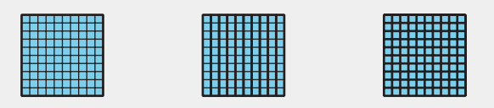

Unit 5 Progression Overview
Numbers to 1,000
Section A
Lessons 1-7
2.MD.B.6, 2.NBT.A.1, 2.NBT.A.2, 2.NBT.A.3
Section B
Lessons 8-14
2.MD.B.6, 2.NBT.A.1, 2.NBT.A.2, 2.NBT.A.3, 2.NBT.A.4, 2.NBT.B.5, 2.NBT.B.8
Read, write, and represent three-digit numbers using base-ten numerals and expanded form.
Use place value understanding to compose and decompose three-digit numbers.
Compare and order three-digit numbers using place value understanding and the relative position of numbers on a number line.
Represent whole numbers up to 1,000 as lengths from 0 on a number line.

Slide 3



Unit 5 Quick Link Page
L1
L2
L3
L4
L5
L6
L7
L8
L9
L10
L11
L12
L13
L14

Slide 4
How Do We Compose a Hundred?
1
Let’s compose a hundred.
2.NBT.A.1, 2.NBT.A.1.a, 2.NBT.A.2

Slide 5
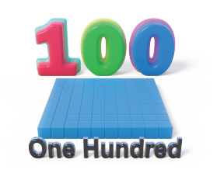
Choral Count: Count Beyond 100
Warm up
Count by 1, starting at 90.
Stop counting and recording at 120.

Slide 6
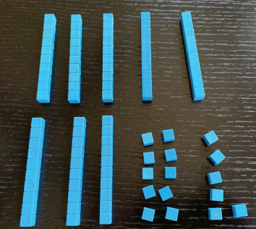
How Do We Make a Hundred?
Activity #1
How many do you see?
How do you see them?

Slide 7
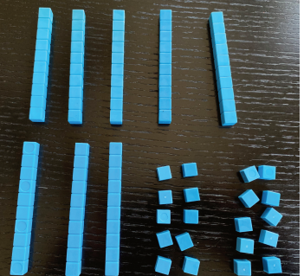
How Do We Make a Hundred?
Activity #1
2. Andre added more blocks.
a. What is the value of Andre’s blocks now?
b. How many tens and ones are in this number?
3. Andre made the same number with the fewest amount of blocks possible. Draw a base-ten diagram to show what Andre’s number looks like now. Use your base-ten blocks to help.

Slide 8
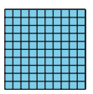
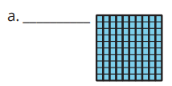

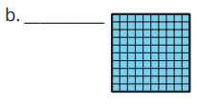

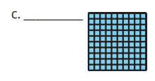

1.2: Different Ways to See 100
Activity #2
Three students were looking at 100 small squares arranged like this:
1. Match the diagrams to the statements.
Label each diagram with the students’ names.
Be prepared to explain your matches.

Slide 9
1.2: Different Ways to See 100
Activity #2
2. Represent 100 + 11 with blocks or a diagram

Slide 10


Lesson Synthesis
Today we learned about a new unit called a hundred. Kiran, Lin, and Priya described 100 in different ways.
Complete the following statements with your partner.

Slide 11
Make Multiples
of 100
2
Let’s represent hundreds in different ways.
2.NBT.A.1.a, 2.NBT.A.1.b, 2.NBT.A.2

Slide 12
Choral Count: Count by 10 to 300
Warm up
What do you
notice?
Count by 10, starting at 0.
Stop counting and recording at 300.
What patterns do you see?

Slide 13
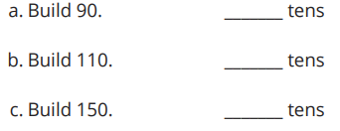


Make Hundreds Using Tens
Activity #1
1. Build each number using base-ten blocks. Record how many tens blocks you use.
2. How many tens blocks would you need to build 200?
3. How many tens blocks would you need to build 300?
4. How many tens would you need to build 300 if you could use 1 hundreds block?

Slide 14


Make Hundreds Using Tens
Activity #1
5. How many tens would you need to build 300 if you could use 2 hundreds blocks?
6. How many tens would you need to build 300 if you could use only hundreds blocks?

Slide 15
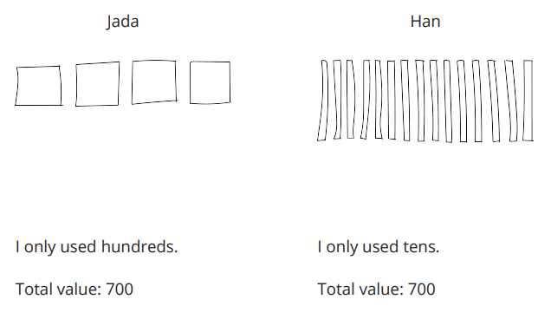
How Many Hundreds?
Activity #2
Han and Jada represented the same number using base-ten blocks. They started base-ten drawings, but ran out of time to finish them.
1. Represent each student's work with base-ten blocks in your group.
2. Explain how you know both ways of using base-ten blocks show 700.
3. Complete Jada’s base-ten diagram.
4. Explain why you think Han ran out of time to finish his diagram.

Slide 16
Lesson Synthesis
Today we used base-ten blocks and diagrams to represent numbers that are much greater than 100.
Which way do you think was easier to represent 700? Jada’s way or Han’s way. Explain.
Han’s way used 70 total blocks. How could you represent 700 with the greatest amount of blocks?

Slide 17
How Do We Compose Three-Digit Numbers?
3
Let’s compose three-digit numbers.
2.NBT.A.1.a, 2.NBT.A.1.b, 2.NBT.A.2, 2.NBT.B.5

Slide 18
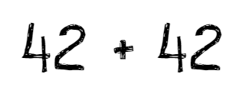
Number Talk: Add Tens and Ones
Warm up
Find the value of each sum mentally.

Slide 19
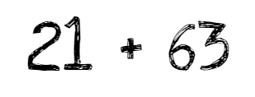
Number Talk: Add Tens and Ones
Warm up
Find the value of each sum mentally.

Slide 20
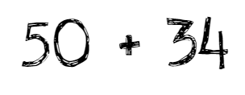
Number Talk: Add Tens and Ones
Warm up
Find the value of each sum mentally.

Slide 21
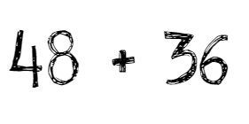
Number Talk: Add Tens and Ones
Warm up
Find the value of each sum mentally.

Slide 22
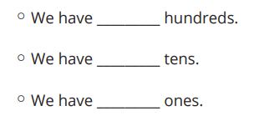
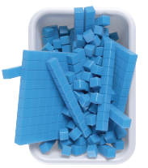
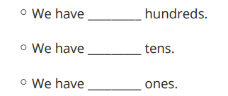
Sort Blocks by Place Value
Activity #1
1. Sort the blocks.
2. Represent the same value with the fewest number of blocks possible.
3. Represent the value of your blocks using base-ten diagrams, words, or numbers

Slide 23
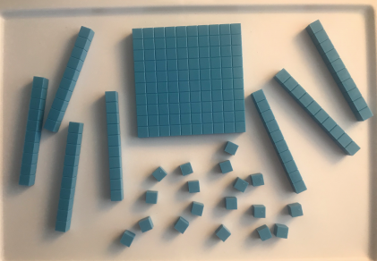
Show the Same Values in Different Ways
Activity #2
Mai’s Blocks
1. Mai has ______ hundreds _____ tens _____ ones
2. Draw base-ten diagrams to represent the same total value with the fewest number of blocks.
3. What is the value of Mai’s blocks?

Slide 24
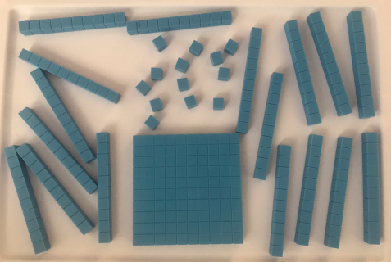
Show the Same Values in Different Ways
Activity #2
Diego’s Blocks
4. Diego has ______ hundreds _____ tens _____ ones
5. Draw base-ten diagrams to represent the same total value with the fewest number of blocks.
6. What is the value of Diego’s blocks?

Slide 25
Lesson Synthesis
Today you represented numbers that were greater than 100 using base-ten diagrams, numbers, or words.
How many of each block would we use to represent 324?

Slide 26
Represent Three-Digit Numbers
4
Let’s represent three-digit numbers using base-ten numerals.
2.NBT.A.1, 2.NBT.A.3

Slide 27
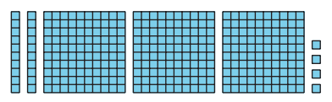
How Many Do You See: Base-Ten Blocks and Three-Digit Numbers
Warm up
How many do you see?
How do you see them?

Slide 28
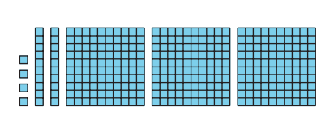
How Many Do You See: Base-Ten Blocks and Three-Digit Numbers
Warm up
How many do you see?
How do you see them?

Slide 29
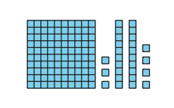
How Many Do You See: Base-Ten Blocks and Three-Digit Numbers
Warm up
How many do you see?
How do you see them?

Slide 30
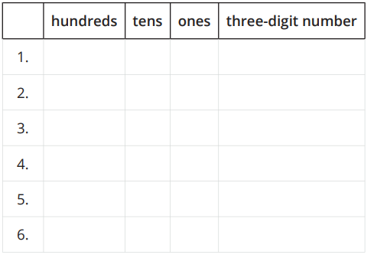
Place Value Riddles
Activity #1
Solve each riddle and write the three-digit number. Use the table to help you organize the digits.
1. I have 2 ones, 7 tens, and 6 hundreds.
2. I have 3 ones, 5 tens, and 2 hundreds.
3. I have 7 hundreds, 5 ones, and 3 tens.
4. I have 5 hundreds, no tens, and 9 ones.
5. I have 4 ones, 6 tens, and 3 hundreds.
6. I have 8 tens, 1 hundred, and no ones.

Slide 31
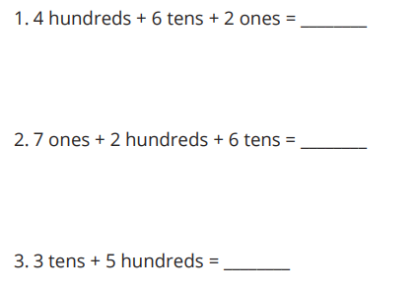
Mixed Up Digits Make Numbers
Activity #2
Write the number that makes the equation true. Use base-ten blocks or diagrams if they help.

Slide 32
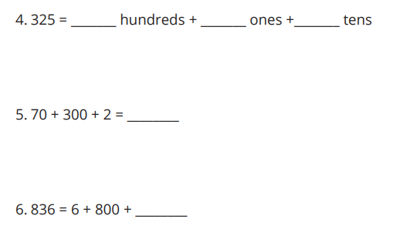
Mixed Up Digits Make Numbers
Activity #2
Write the number that makes the equation true. Use base-ten blocks or diagrams if they help.

Slide 33
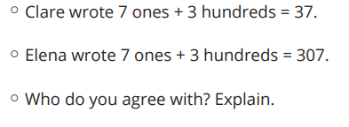
Mixed Up Digits Make Numbers
Activity #2
7. Clare and Elena solved the same problem, but have different answers.

Slide 34
Lesson Synthesis
Today we learned that three-digit numbers can be represented with their hundreds, tens, and ones out of order with blocks or diagrams or even in equations. We learned that it is very important to put those digits in the correct place when representing the quantity as a three-digit number.
Han says:
5 tens + 4 ones + 7 hundreds = 547.
What would you say to Han about his thinking?

Slide 35
Expanded Form of Numbers
5
Let’s represent three-digit numbers as a sum of the digits.
2.NBT.A.1, 2.NBT.A.3

Slide 36
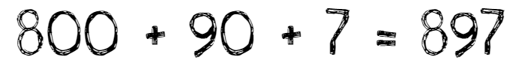
True or False:
Value of Digits
Warm up
Is each statement true or false?
Be prepared to explain your reasoning.

Slide 37

True or False:
Value of Digits
Warm up
Is each statement true or false?
Be prepared to explain your reasoning.

Slide 38

True or False:
Value of Digits
Warm up
Is each statement true or false?
Be prepared to explain your reasoning.

Slide 39
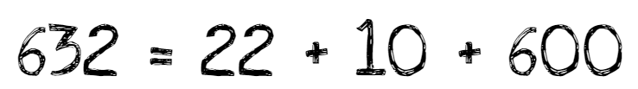
True or False:
Value of Digits
Warm up
Is each statement true or false?
Be prepared to explain your reasoning.

Slide 40
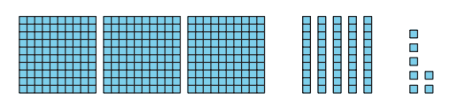
Writing Expressions and Three-Digit Numbers
Activity #1
1. Andre has 3 hundreds. Tyler has 5 tens. Mai has 6 ones. They want to represent the amount they have using an equation.
Write an expression to represent the sum of their values.
__________ + __________ + __________
Write the total value as a three-digit number: __________________

Slide 41
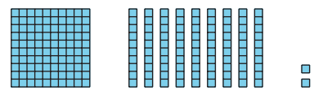
Writing Expressions and Three-Digit Numbers
Activity #1
Write each number as the sum of hundreds, tens, and ones, and as a three-digit number.
2. Expanded form: __________________________
Three-digit number: _______________________

Slide 42
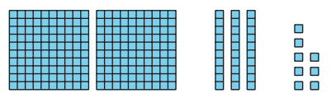
Writing Expressions and Three-Digit Numbers
Activity #1
Write each number as the sum of hundreds, tens, and ones, and as a three-digit number.
3. Expanded form: __________________________
Three-digit number: _______________________

Slide 43
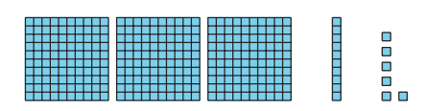
Writing Expressions and Three-Digit Numbers
Activity #1
Write each number as the sum of hundreds, tens, and ones, and as a three-digit number.
4. Expanded form: __________________________
Three-digit number: _______________________

Slide 44
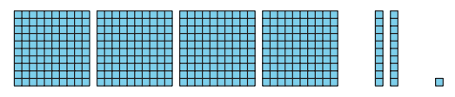
Writing Expressions and Three-Digit Numbers
Activity #1
Write each number as the sum of hundreds, tens, and ones, and as a three-digit number.
5. Expanded form: __________________________
Three-digit number: _______________________

Slide 45
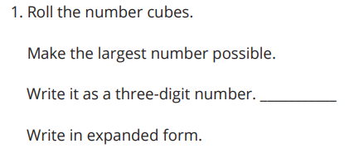
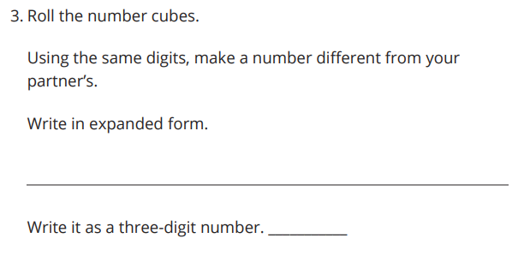
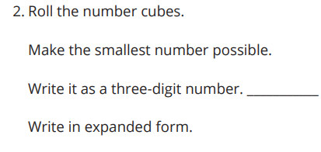
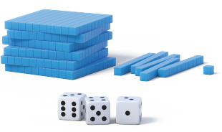
Expanded Form, Unit Form, and Three-Digit Numbers
Activity #2

Slide 46
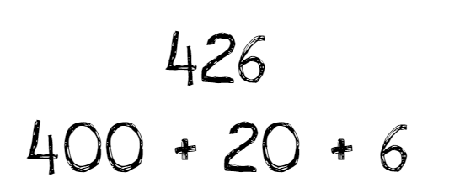
Lesson Synthesis
Today you represented numbers in expanded form and as three-digit numbers.
Explain how you know these represent the same value.

Slide 47
Represent Numbers in Different Ways
6
Let’s work with numbers represented in different ways.
2.NBT.A.3

Slide 48
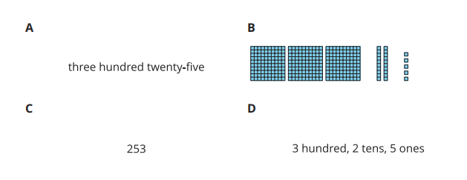
Which One Doesn’t Belong: Representing Numbers in Different Ways
Warm up

Slide 49
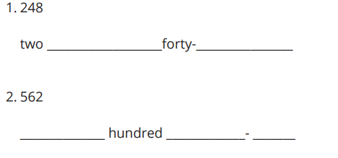
Number Names
Activity #1
Fill in the blanks to complete the number names.

Slide 50
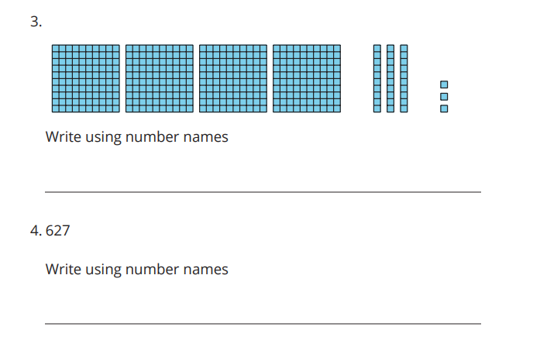
Number Names
Activity #1
Fill in the blanks to complete the number names.

Slide 51
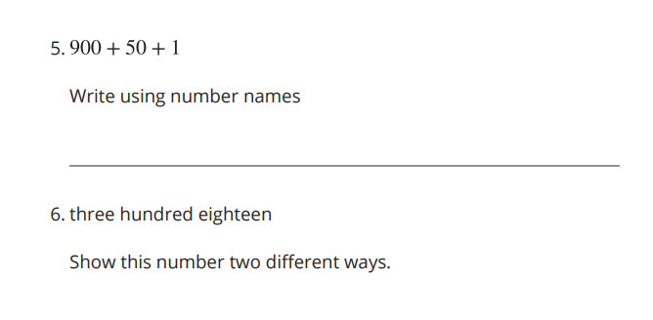
Number Names
Activity #1
Fill in the blanks to complete the number names.

Slide 52
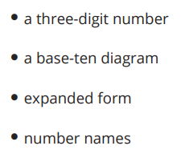

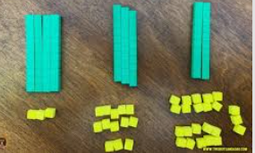
Represent Numbers in Different Ways
Activity #2
Represent the number on your poster.
Be sure to represent the number using:
If you have time:

Slide 53
Lesson Synthesis
Today you had the chance to represent numbers in different ways and make connections across representations
While you walked around, what representation did you look at first to help you identify the number? Why?
What questions do you have about three-digit numbers or any of the representations you saw today?

Slide 54
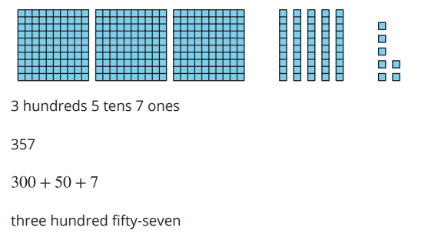
Section Summary
In this section of the unit, we learned different ways to represent numbers that are greater than 99. We represented hundreds with base-ten blocks and diagrams. We represented numbers by describing the number of hundreds, tens, and ones that make up the number. We learned to read and write numbers as three-digit numbers, as a sum of the value of each of the digits, and using number names.

Slide 55
Center Day
7
Let’s play Number Riddles.
2.MD.B.6, 2.NBT.A, 2.NBT.A.1

Slide 56
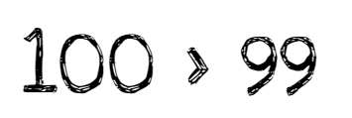
True or False:
Value of Digits
Warm up
Is each statement true or false?
Be prepared to explain your reasoning.

Slide 57
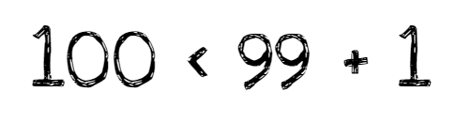
True or False:
Value of Digits
Warm up
Is each statement true or false?
Be prepared to explain your reasoning.

Slide 58
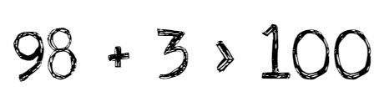
True or False:
Value of Digits
Warm up
Is each statement true or false?
Be prepared to explain your reasoning.

Slide 59
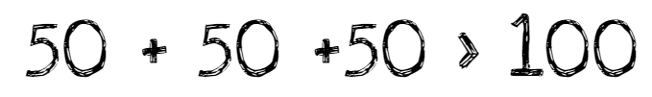
True or False:
Value of Digits
Warm up
Is each statement true or false?
Be prepared to explain your reasoning.

Slide 60
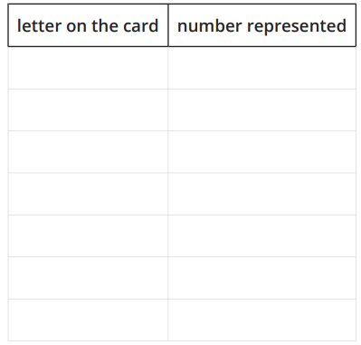

Centers: Introduce Number Riddles, Solve
Activity #1
1. Choose a card.
2. Work with your partner to solve the riddle and write the number.

Slide 61

Centers: Introduce Number Riddles, Write
Activity #2

Slide 62


Centers Choice Time
Activity #2
Playing on the Number Line
Number Riddles, Write

Slide 63
Lesson Synthesis
Today we worked with number riddles. Tell your partner what you need to know about place value to write and solve a number riddle.

Slide 64
Locate and Represent Three-digit Numbers on the Number Line
8
Let’s locate and represent three-digit numbers on the number line.
2.MD.B.6, 2.NBT.A.1, 2.NBT.A.2

Slide 65

Choral Count: Count by 10 and 100
Warm up
What do you
notice?
Count by 10, starting at 0.
Stop counting and recording at 100.
Count by 10, starting at 0.
Stop counting and recording at 1,000.
What patterns do you see?

Slide 66

Locate Three-digit Numbers on the Number Line
Activity #1
1. What do you notice?
What do you wonder?
2. Locate 30, 300, and 3 on a number line. Represent each number with a point and label it.

Slide 67

Locate Three-digit Numbers on the Number Line
Activity #1
Label the number located at each point.

Slide 68

Locate Three-digit Numbers on the Number Line
Activity #1
Label the number located at each point.

Slide 69

Represent Three-digit Numbers on a Number Line
Activity #2
Label the tick marks on each number line.
Represent each number with a point on the number line and label it with the number.

Slide 70

Represent Three-digit Numbers on a Number Line
Activity #2
Label the tick marks on each number line.
Represent each number with a point on the number line and label it with the number.

Slide 71
Lesson Synthesis
Today you represented three-digit numbers on number lines.
How can you use the starting and ending numbers to help you find the unit that works in this number line?
Why did you use _____ (ones, tens, hundreds) to locate this number?

Slide 72
Compare Numbers on the Number Line
9
Let’s compare numbers on the number line.
2.MD.B.6, 2.NBT.A.1, 2.NBT.A.4

Slide 73


Estimation Exploration: Estimating Hundreds
Warm up
What number could this be?
1. Record an estimate that is:
2. Record an estimate that is:

Slide 74





Compare Methods for Three-digit Numbers Comparisons
Activity
#1
Each student compared 371 and 317, but represented their thinking in different ways.
Diego
Jada
Clare

Slide 75
Compare Methods for Three-digit Numbers Comparisons
Activity
#1
1. What is the same and different about these students’ representations? Discuss with a partner.
2. Try Jada’s way. Locate 483 and 443 on the number line. Draw a point and label each number.
3. Use >, =, or < to compare 483 and 443.

Slide 76

Different Ways to Compare
Activity
#2
1. Locate 420 and 590. Draw a point and label each number.
Use <, >, and = to compare 420 and 590.
2. Locate 378 and 387 on the number line.
Use <, >, and = to compare 378 and 387.

Slide 77

Different Ways to Compare
Activity
#2
3. Use <, >, and = to compare the quantities shown.
.
4. Which representation was most helpful to compare the numbers? Why?

Slide 78

Lesson Synthesis
Today you learned that a number line can be used to compare numbers and decide which number is less than or greater than the other.
If I wanted to compare 543 and 345, how would the number line help me see which is less and which is greater? Explain.

Slide 79
Place Value Comparisons (Part 1)
10
Let’s use place value to compare three-digit numbers.
2.NBT.A.4, 2.NBT.B.8

Slide 80

Number Talk: Add a Multiple of 10
Warm up
Find the value of each sum mentally.

Slide 81

Number Talk: Add a Multiple of 10
Warm up
Find the value of each sum mentally.

Slide 82

Number Talk: Add a Multiple of 10
Warm up
Find the value of each sum mentally.

Slide 83

Number Talk: Add a Multiple of 10
Warm up
Find the value of each sum mentally.

Slide 84

Compare Three-digit Numbers by Place
Activity
#1
Who has more?
How do you know?

Slide 85

Compare Three-digit Numbers by Place
Activity
#1
1. Compare the base-ten diagrams.
Write each value as a three-digit number.
Use the symbols >, =, or < to compare the numbers.

Slide 86

Compare Three-digit Numbers by Place
Activity
#1
1. Compare the base-ten diagrams.
Write each value as a three-digit number.
Use the symbols >, =, or < to compare the numbers.

Slide 87

Compare Three-digit Numbers by Place
Activity
#1
1. Compare the base-ten diagrams.
Write each value as a three-digit number.
Use the symbols >, =, or < to compare the numbers.

Slide 88

Compare Hundreds, Tens, and Ones
Activity
#2
Compare the values represented in the diagrams.
Write each value as a three-digit number.
Use the symbols >, =, or < to compare the numbers.

Slide 89

Compare Hundreds, Tens, and Ones
Activity
#2
Compare the values represented in the diagrams.
Write each value as a three-digit number.
Use the symbols >, =, or < to compare the numbers.

Slide 90

Compare Hundreds, Tens, and Ones
Activity
#2
Compare the values represented in the diagrams.
Write each value as a three-digit number.
Use the symbols >, =, or < to compare the numbers.

Slide 91

Compare Hundreds, Tens, and Ones
Activity
#2
Compare the values represented in the diagrams.
Write each value as a three-digit number.
Use the symbols >, =, or < to compare the numbers.
5. In problem 4, how do you know which value was greater?

Slide 92


Today, we compared three-digit numbers with the help of base-ten diagrams.
Lesson Synthesis
Mai thinks it is better to start with the hundreds. Who do you agree with? Explain your thinking to your partner.
Tyler believes it is always better to compare numbers by starting with the ones, then tens, and then hundreds.

Slide 93
Place Value Comparisons (Part 2)
11
Let’s compare three-digit numbers using place value.
2.NBT.A.1, 2.NBT.A.3, 2.NBT.A.4

Slide 94

True or False:
Greater Than or Less Than
Warm up
Is each statement true or false?
Be prepared to explain your reasoning.

Slide 95

True or False:
Greater Than or Less Than
Warm up
Is each statement true or false?
Be prepared to explain your reasoning.

Slide 96

True or False:
Greater Than or Less Than
Warm up
Is each statement true or false?
Be prepared to explain your reasoning.

Slide 97

True or False:
Greater Than or Less Than
Warm up
Is each statement true or false?
Be prepared to explain your reasoning.

Slide 98

Represent and Compare
Activity
#1
Compare the numbers.

Slide 99

Represent and Compare
Activity
#1
Compare the numbers.

Slide 100






Represent and Compare
Activity
#1
3. Place the numbers in the blanks to make each comparison true. Use each number only once. Use a number line if it helps.

Slide 101

Make the Greater Number
Activity
#2
Take turns spinning with your partner:
Each partner spins 3 times to make a three-digit number.
Choose where to place each digit, hundreds, tens, or ones.
Record your partner’s number.
Compare the numbers using <, >, or =.

Slide 102

Lesson Synthesis
Today we compared numbers by looking at the digits and thought about how to use digits to make the greatest number possible.
Using these digits, what is the greatest number you can make?
Using these digits, what is the smallest three-digit number you can make?

Slide 103
Ordering Numbers
12
Let’s put numbers in order
2.NBT.A.1, 2.NBT.A.4, 2.NBT.B.8

Slide 104

Number Talk:
Subtract a Multiple of 10
Warm up
Find the difference mentally.

Slide 105

Number Talk:
Subtract a Multiple of 10
Warm up
Find the difference mentally.

Slide 106

Number Talk:
Subtract a Multiple of 10
Warm up
Find the difference mentally.

Slide 107

Number Talk:
Subtract a Multiple of 10
Warm up
Find the difference mentally.

Slide 108

Who is Out of Order?
Activity
#1
Who do you agree with? Why?
Be prepared to explain your thinking. Use the number line to justify your reasoning.

Slide 109

Order Numbers on the Number Line
Activity
#2

Slide 110

Order Numbers on the Number Line
Activity
#2

Slide 111

Order Numbers on the Number Line
Activity
#2

Slide 112

Order Numbers on the Number Line
Activity
#2

Slide 113
Lesson Synthesis
During this unit we have used a variety of representations to help us think about numbers. Think about all the work we did with numbers up to 1,000.
Which representations help you make sense of large numbers and compare them to one another? Using a base-ten diagram, looking at the digits, or using a number line?
I noticed some students prefer one representation for place value, but a different one when comparing or ordering numbers. It is good to know what works best for you and when to use it.

Slide 114

Section Summary
In this unit, we learned how to compare three-digit numbers. We used base-ten diagrams, number lines, expanded form, and the digits in base-ten numerals to help us think about the value of the digits. Diagrams are helpful when comparing numbers because you can see and compare hundreds to hundreds, tens to tens, and ones to ones. We learned that you can do this with the digits, too. The number line shows the numbers in order, so we can see which number is the largest based on its location. We also wrote expressions using the >, <, and = symbols.

Slide 115
Center Day
13
Let’s make the greatest three-digit number possible.
2.NBT.A.1, 2.NBT.A.4, 2.NBT.B.5

Slide 116

How Many Do You See:
Place Value
Warm up
How many do you see?
How do you see them?

Slide 117

How Many Do You See:
Place Value
Warm up
How many do you see?
How do you see them?

Slide 118

How Many Do You See:
Place Value
Warm up
How many do you see?
How do you see them?

Slide 119

Center: Introduce Make the Greatest Number, Three-digit Numbers
Activity
#1
Player A chooses a number card and writes the number in one of the blanks for round 1.
Player B does the same.
Repeat until each player has a three-digit number.
Write a comparison using > or <.
The player with the greater number wins the round.

Slide 120




Centers Choice Time
Activity #2
Make the Greatest Number, Three-digit Numbers
How Close, Close to 100
Less than 10, Start with 99

Slide 121
Lesson Synthesis
Today we worked on different center activities. Tell your partner one thing you were working on during center time today.
How did the activity you chose help you work on it?

Slide 122
Hundreds of Objects
14
Let’s use place value to count real world objects.
2.NBT.A.1, 2.NBT.A.2, 2.NBT.A.4

Slide 123

Notice and Wonder: Jar of Beans
Warm up
What do you
notice?
What do you wonder?

Slide 124




Cup of Beans Strategies
Activity
#1
Jada’s counting strategy:
Claire’s counting strategy:
Noah’s counting strategy:
Claire, Noah, and Jada counted a cup of dried beans. They each came up with 529 beans. The following pictures show how each of them counted.
1. What do you notice about each of their strategies?
2. What is helpful about each strategy
3. What is challenging about each strategy?

Slide 125

Lots of Beans
Activity
#2
Organize and count your beans. Use the space to record your thinking.

Slide 126
Lesson Synthesis
Today, we used strategies we have been studying about numbers between 100-999 to count a large amount of beans.
What are important things to remember when you count a large number? What is important when you represent your strategy so that it is clear to others?

