Slide 1

Addition and Subtraction on the Number Line
Grade 2: Unit 4
Standards addressed: 2.MD.B.6, 2.NBT.A.2, 2.NBT.B.5,2.MD.B.5, 2.MD.B.6, 2.OA.A.1
These slides have been created by Britnee Wright Southeast Arkansas Education Cooperative and are not official IM materials. Images and language are taken from IM Grade 2, Unit 4 by Illustrative Mathematics.
Copyright 2020 by Illustrative Mathematics. All Rights Reserved, adapted and shared with permission.

Slide 2
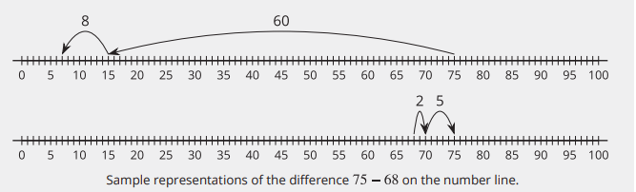
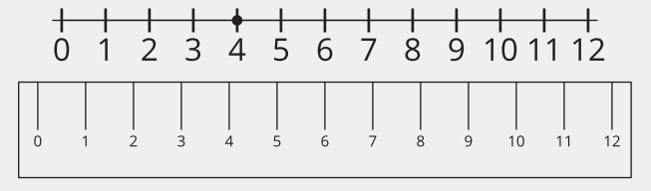
Unit 4 Progression Overview
Addition and Subtraction on the Number Line
Section A
Lessons 1-6
2.MD.B.6, 2.NBT.A.2, 2.NBT.B.5
Section B
Lessons 7-15
2.MD.B.5, 2.MD.B.6, 2.NBT.A.2, 2.NBT.B.5, 2.OA.A.1
Represent whole numbers within 100 as lengths from 0 on a number line.
Understand the structure of the number line.
Represent sums and differences on a number line.

Slide 3



Unit 4 Quick Link Page
L1
L2
L3
L4
L5
L6
L7
L8
L9
L10
L11
L12
L13
L14
L15

Slide 4
Whole Numbers on the Number Line
1
Let’s represent numbers on a number line.
2.MD.B.6

Slide 5
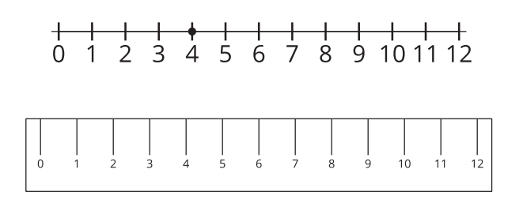
Notice and Wonder: Rulers and Number Lines
Warm up
What do you
notice?
What do you wonder?

Slide 6
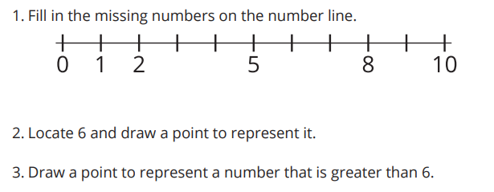
What is a Number Line?
Activity #1

Slide 7
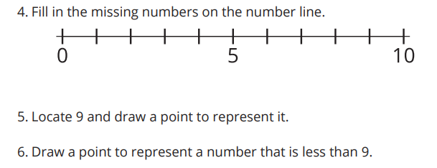
What is a Number Line?
Activity #1

Slide 8

Make Your Own Number Line
Activity #2
1. Make a number line that goes from 0 to 20.
2. Locate 13 on your number line and draw a point to represent it.
3. Locate 3 on your number line and draw a point to represent it.
4. Compare your number line with your partner’s.

Slide 9
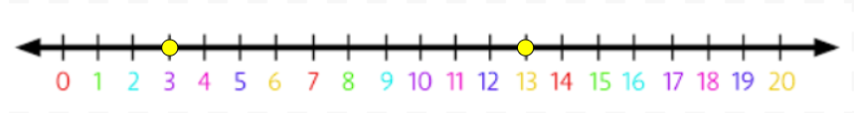

Lesson Synthesis
Today we learned about the number line, which is a visual representation of numbers. We learned that, just like with rulers and line plots, numbers can be represented by tick marks to show their length from 0. We also learned that points can be drawn to help show specific numbers on a number line
How can the points on each number line represent the same number?

Slide 10
Numbers on a Number Line
2
Let’s explore the features of a number line.
2.MD.B.6, 2.NBT.A.2

Slide 11
Choral Count: Count by 5
Warm up
What do you
notice?
Count by 5, starting at 0.
What patterns do you see?

Slide 12
Class Number Line
Activity #1
Today, you are going to create a class number line to represent the numbers from 0 to 30.
When I call you, place your number card on the number line.
  How did you decide where to place your number on the number line?
  What revisions do we need to make to the number line? Why?

Slide 13
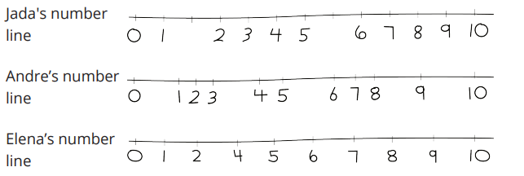

Analyze Number Lines
Activity #2
1. How should Jada revise her number line?
2. How should Andre revise his number line?
3. How should Elena revise her number line?
4. Fill in the numbers to create your own number line.

Slide 14
Lesson Synthesis
Today we created our own class number line and analyzed number lines. What do we need to think about when creating a number line to represent numbers?

Slide 15
What’s Missing?
3
Let’s locate numbers on the number line.
2.MD.B.6, 2.NBT.A.2

Slide 16
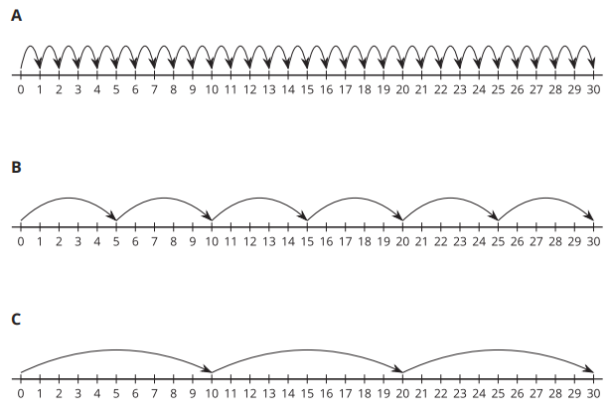
Notice and Wonder: Count from 0 to 20
Warm up
What do you
notice?
What do you wonder?

Slide 17
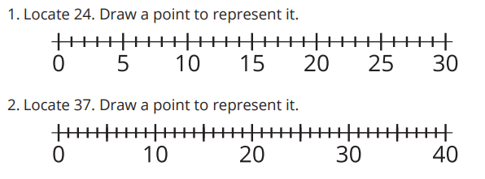
Locate Numbers on the Number Line
Activity #1

Slide 18
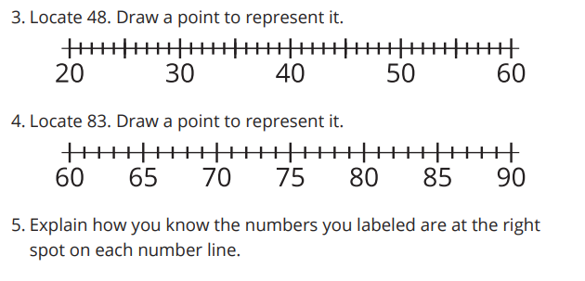
Locate Numbers on the Number Line
Activity #1

Slide 19
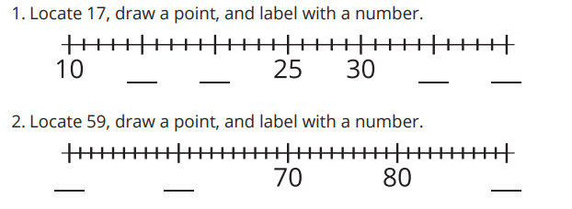
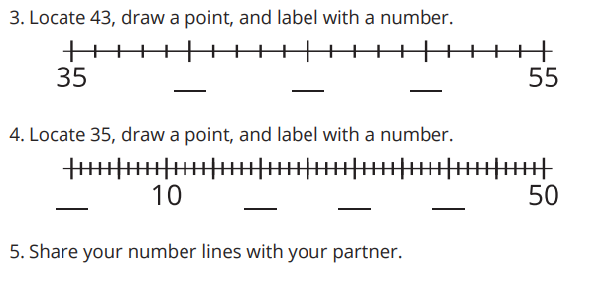
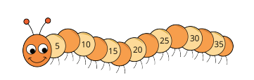
Are You Missing Something?
Activity #2
Complete each number line by filling in the missing labels.
Then, locate and label the numbers

Slide 20

Lesson Synthesis
Today we made sense of number lines that do not label each number and number lines that do not start with 0
What other tick marks could we label on this number line to make it easier to find other numbers?
Why might someone want to label on the tick marks that show the numbers you say when you skipcount by 10? Why not always label every tick mark?

Slide 21
Compare Numbers on a Number Line
4
Let’s use the number line to compare numbers.
2.MD.B.6, 2.NBT.B.5

Slide 22

Number Talk: Subtract Multiples of 5
Warm up
Find the value of each expression mentally.

Slide 23

Number Talk: Subtract Multiples of 5
Warm up
Find the value of each expression mentally.

Slide 24

Number Talk: Subtract Multiples of 5
Warm up
Find the value of each expression mentally.

Slide 25

Number Talk: Subtract Multiples of 5
Warm up
Find the value of each expression mentally.

Slide 26
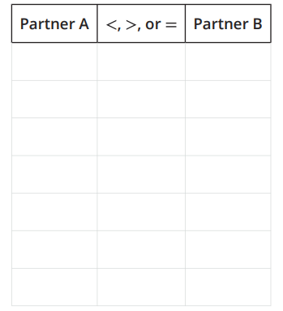
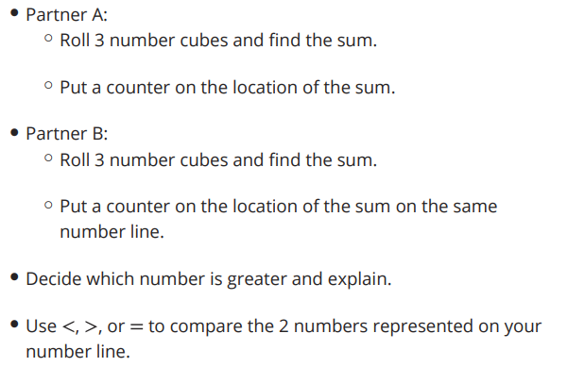
Compare Numbers on the Number Line
Activity #1

Slide 27
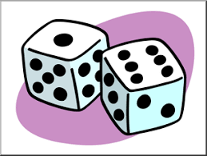
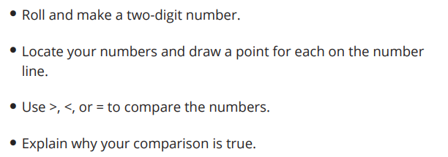
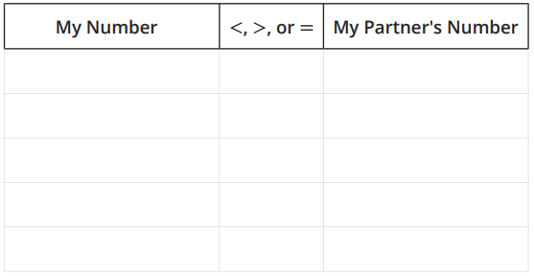
Represent and Compare Numbers
on the Number Line
Activity #2

Slide 28

Lesson Synthesis
Today, we used number lines to compare numbers and thought about how close or far away they are from zero and each other. We also used position words like to the left or right to talk about which number was less or more Draw:
If A and B are points that represent numbers on this number line, which number is less? How do you know?

Slide 29
Estimation on a Number Line
5
Let’s estimate numbers on a number line.
2.MD.B.6

Slide 30

Estimation Exploration:
What Number Could this Be?
Warm up
What could this number be?
Record an estimate that is:
Too low | About right | Too high

Slide 31

Estimation Exploration:
What Number Could this Be?
Warm up
Based on this new information, do you want to revise, or change, your estimates?
Record an estimate that is:
Too low | About right | Too high

Slide 32




Estimate Numbers on a Number Line
Activity #1
1. What number could this be? _____
2. What number could this be? _____
3. What number could this be? _____
4. What number could this be? _____
5. Which estimate are you most confident in? Why?
6. Which estimate are you least confident in? Why?

Slide 33
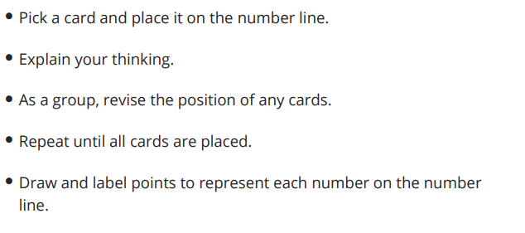

Order Numbers on the Number Line
Activity #2

Slide 34
Lesson Synthesis
How did you use what you know about a number line to estimate today?

Slide 35
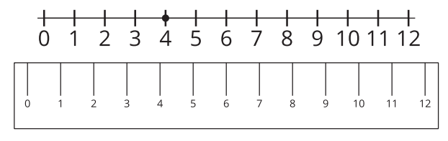
Section Summary
In this section, we learned about the number line. It is like a ruler, but not used to measure objects. A number line can be used to represent numbers and see their distance from 0 and each other. Numbers can be represented by tick marks and points on the number line and increase in value when moving to the right. We used tick marks to help us locate numbers and counted by 5 and 10 to help us fill in missing numbers. We also estimated numbers by thinking about how close they were to zero and other numbers.

Slide 36
Center Day Lesson
6
Let’s put numbers on a number line.
2.MD.B.6, 2.NBT.B.5

Slide 37

Number Talk:
Decompose and Subtract
Warm up
Find the value of each difference mentally.

Slide 38

Number Talk:
Decompose and Subtract
Warm up
Find the value of each difference mentally.

Slide 39

Number Talk:
Decompose and Subtract
Warm up
Find the value of each difference mentally.

Slide 40

Number Talk:
Decompose and Subtract
Warm up
Find the value of each difference mentally.

Slide 41
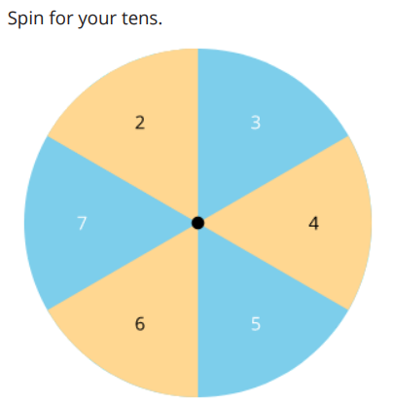
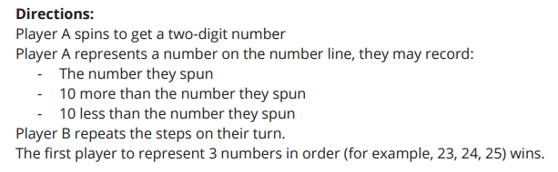
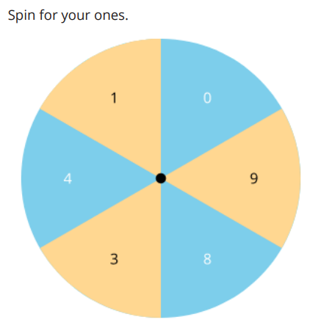
Introduce Playing on the Number Line, Fill It
Activity #1

Slide 42
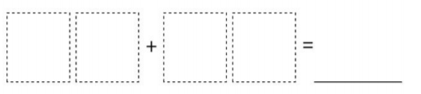
Centers Choice Time
Activity #2
Playing on the
Number Line, Fill It
Number Puzzles,
Up to 100

Slide 43
Lesson Synthesis
Today our center activities required us to add and subtract. What strategy did you use to help you add and subtract?

Slide 44
Addition and Subtraction on the Number Line
7
Let’s match equations to number line representations.
2.MD.B.6

Slide 45
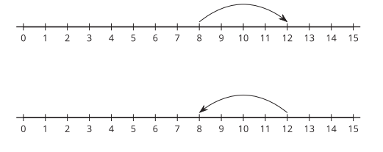
Notice and Wonder: Jumps on the Number Line
Warm up
What do you
notice?
What do you wonder?

Slide 46
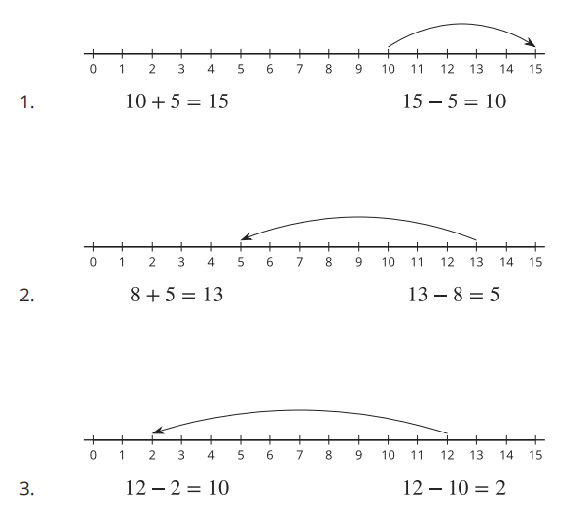
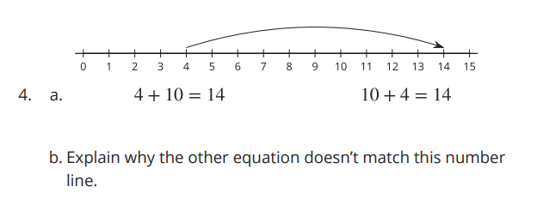
Addition and Subtraction on the Number Line
Activity #1
Circle the equation represented on the number line.

Slide 47














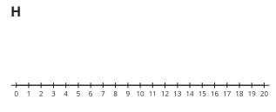
Number Lines and Equations
Activity #2
1. Cut out the equations.
2. Paste each equation next to the number line that represents it.
3. Paste the equation that didn’t have a match and represent it on a number line.

Slide 48
Lesson Synthesis
Today we saw addition and subtraction represented on number lines. What do the arrows on the number lines tell us?
We need to remember the direction of the arrow helps us to see if we are adding or subtracting and the jump shows the difference between the starting and ending numbers.
What do the arrows on the number lines tell us?

Slide 49
Equations on a Number Line
8
Let’s write equations and represent them on a number line.
2.MD.B.6, 2.NBT.A.2

Slide 50
Choral Count: Counting back by 10 from any number
Warm up
What do you
notice?
Count back by 10, starting at 99.
Stop counting and recording at 49.
Count back by 10, starting at 98.
Stop counting and recording at 48
Count back by 10, starting at 95.
Stop counting and recording at 45.
What patterns do you see?

Slide 51
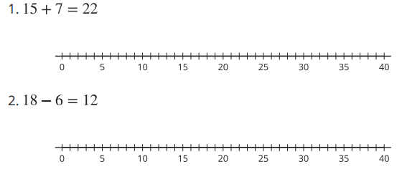
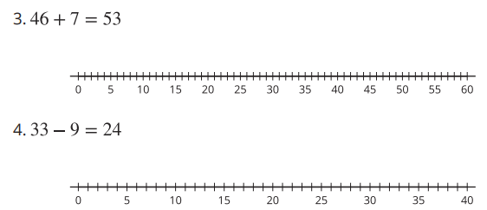
Represent Equations on the Number Line
Activity
#1
Represent each equation on the number line.

Slide 52




How Long is the Jump?
Activity
#2
For each number line, write an equation that matches the diagram.
5. Compare your equations with your partner.
6. Pick the 2 number lines you think are most alike. Explain your choice to your partner.
1. Equation for the number line below:____
2. Equation for the number line below:____
3. Equation for the number line below:____
4. Equation for the number line below:____

Slide 53
Lesson Synthesis
Today we worked with equations and number line representations.
How could you explain to a friend how they could use the number line to show addition and subtraction?

Slide 54
The Difference Between Numbers
9
Let’s represent ways to subtract on the number line.
2.MD.B.6, 2.NBT.B.5

Slide 55

Number Talk:
Add to Find the Difference
Warm up
Find the value of each difference mentally.

Slide 56
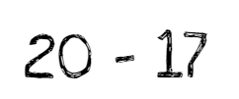
Number Talk:
Add to Find the Difference
Warm up
Find the value of each difference mentally.

Slide 57

Number Talk:
Add to Find the Difference
Warm up
Find the value of each difference mentally.

Slide 58

Number Talk:
Add to Find the Difference
Warm up
Find the value of each difference mentally.

Slide 59
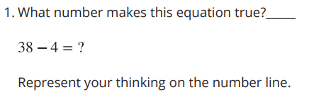
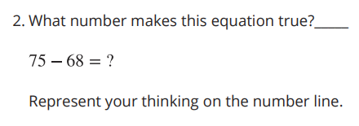
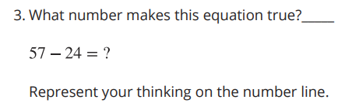
Add or Subtract to Find the Difference
Activity
#1

Slide 60
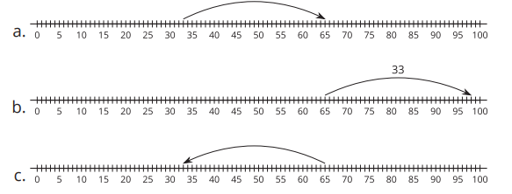
Different Ways to Find the Difference
Activity
#2
1. Elena had a length of string that was much too long for her project. The string was 65 inches long. Elena cut off 33 inches. How long is the string now?
Choose 2 number lines that show a way to find the length of Elena’s string.
2. Han had 87 inches of string. He cut off 85 inches of it. How much string does he have left?
a. Write an equation to represent the problem with a ? for the unknown.
b. Solve the problem.
c. Represent your thinking on the number line.
3. Find someone who used a different strategy.
Show their strategy on the number line.

Slide 61
Today we saw different ways to solve subtraction problems represented on the number line. You can think about subtraction as taking away or as finding a missing addend. We learned that either way, we are finding the difference between the 2 numbers.
Lesson Synthesis
Which representation do you prefer for
35 - 3=? Why?
Describe to your partner the different ways you can represent and think about 35 - 3.

Slide 62
Place Value Strategies and the Number Line
10
Let’s compare strategies using the number line
2.MD.B.6, 2.NBT.B.5

Slide 63

Notice and Wonder:
Base-ten and the Number Line
Warm up
What do you
notice?
What do you wonder?

Slide 64
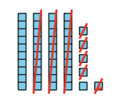

Compare Representations to
Show Subtraction
Activity
#1
1. Write an equation to represent Clare’s subtraction problem.
2. Represent Clare’s thinking on the number line.
Clare solved a subtraction problem and represented it with base-ten blocks.

Slide 65
Compare Representations to
Show Subtraction
Activity
#1
3. Find the difference: 58 - 24
Show your thinking using base-ten diagrams.
4. Represent how you found the difference of 58 - 24 on the number line.
Clare solved a subtraction problem and represented it with base-ten blocks.

Slide 66
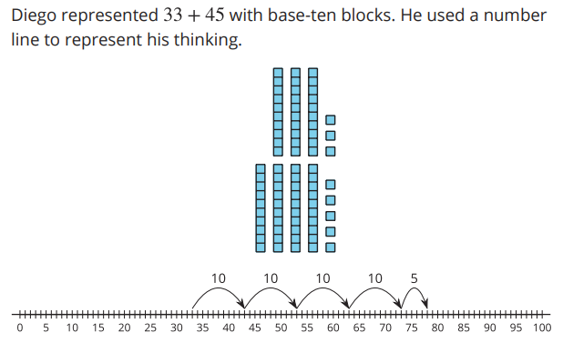
Add and Subtract on the Number Line
Activity
#2
1. Write an equation to show the sum for Diego’s work. ____________
2. Find the sum 23 + 24
Represent your thinking on the number line.
Write an equation. _______

Slide 67
Add and Subtract on the Number Line
Activity
#2
3. Find the difference 50 - 32
Represent your thinking on the number line.
Write an equation. _______
4. Find the difference 40 - 26
Represent your thinking on the number line.
Write an equation. _______

Slide 68
Lesson Synthesis
Today we learned that the strategies we use to add or subtract can be represented on the number line. We saw you can add the tens first and then the ones or the ones first and then the tens. This works for both addition and subtraction.
Did you prefer showing your thinking with base-ten diagrams or the number line? Was it the same for addition and subtraction? Explain

Slide 69
Different Strategies to Add and Subtract
11
Let’s add and subtract by using a ten.
2.MD.B.6, 2.NBT.B.5

Slide 70

Number Talk:
Using Multiples of Ten
Warm up
Find the difference mentally.

Slide 71

Number Talk:
Using Multiples of Ten
Warm up
Find the difference mentally.

Slide 72

Number Talk:
Using Multiples of Ten
Warm up
Find the difference mentally.

Slide 73

Number Talk:
Using Multiples of Ten
Warm up
Find the difference mentally.

Slide 74
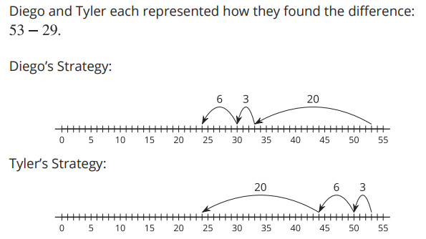


Compare Base-ten Strategies
Activity
#1
1. Use Diego’s strategy to find the difference.
2. Use Tyler’s strategy to find the difference.

Slide 75
More Strategies on the Number Line
Activity
#2
Partner A:
1. Find the sum.
59 + 27
Represent your thinking on the number line.
2. Find the difference.
65 - 18
Represent your thinking on the number line.
Partner B:
1. Find the difference.
68 - 39
Represent your thinking on the number line.
2. Find the sum.
22 + 49
Represent your thinking on the number line.

Slide 76
Lesson Synthesis
When we are adding and subtracting within 100, we may use different strategies based on the numbers in the problem we’re working on. The number line can be helpful to show our thinking

Slide 77
Equations with Unknowns on the Number Line
12
Let’s represent equations with a ? for the unknown.
2.MD.B.6, 2.NBT.B.5

Slide 78

True or False:
Making Tens to Add
Warm up
Is each statement true or false?
Be prepared to explain your reasoning.

Slide 79

True or False:
Making Tens to Add
Warm up
Is each statement true or false?
Be prepared to explain your reasoning.

Slide 80

True or False:
Making Tens to Add
Warm up
Is each statement true or false?
Be prepared to explain your reasoning.

Slide 81
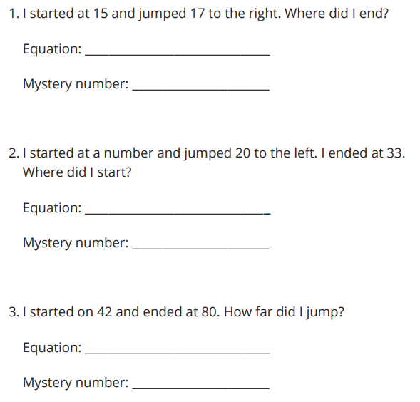
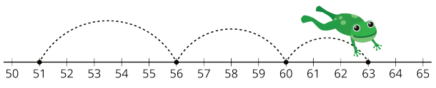
Number Line Riddles
Activity
#1
Solve riddles to find the mystery number.
For each riddle:
Write an equation that represents the riddle and write a ? for the unknown.
Write the mystery number. Represent the equation on the number line.

Slide 82
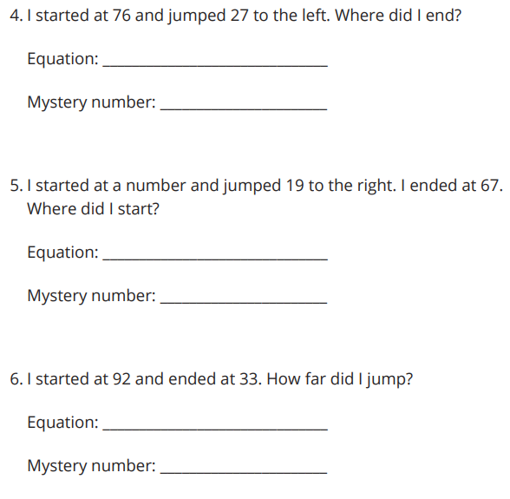
Number Line Riddles
Activity
#1
Solve riddles to find the mystery number.
For each riddle:
Write an equation that represents the riddle and write a ? for the unknown.
Write the mystery number. Represent the equation on the number line.

Slide 83
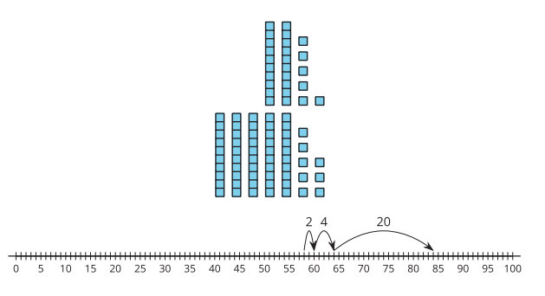
Find the Missing Value
Activity
#2
What is the same?
What is different?

Slide 84
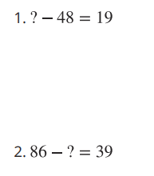
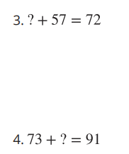
Find the Missing Value
Activity
#2
Find the missing values.
Show your thinking on the number line.
Use base-ten diagrams or blocks if it helps.

Slide 85
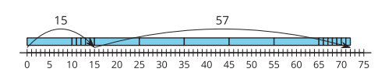
Find the Missing Value
Activity
#2
How does this representation show us what we see on the number line?

Slide 86

Lesson Synthesis
Today you solved all different types of problems with the unknown in all different positions by using addition and subtraction
If I wanted to find the missing value in either of these equations, what are some strategies I could use to find the start?
How did the number line help with these types of problems?

Slide 87
Story Problems and Representations
13
Let’s compare representations and solve problems.
2.MD.B.5, 2.MD.B.6, 2.NBT.B.5, 2.OA.A.1

Slide 88
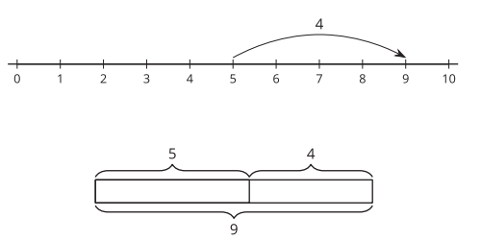
Notice and Wonder:
Compare Representations
Warm up
What do you
notice?
What do you wonder?

Slide 89







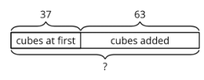







Different Ways to Represent and Solve Story Problems
Activity
#1
Today we are going to think about how we can use diagrams to make sense of stories and use number lines to show our thinking.
You will be looking for matches with stories, diagrams, number lines, and equations

Slide 90
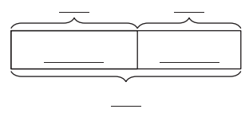
All Kinds of Representations
Activity
#2
Solve. Show your thinking. Use a number line or diagram if it helps.
1. Clare’s train was made using 42 cubes. 24 were green and the rest were yellow. How many cubes were yellow?
2. Andre had 37 cubes. Then he added 39 more to make the train longer. How many cubes did Andre use?

Slide 91
All Kinds of Representations
Activity
#2
Solve. Show your thinking. Use a number line or diagram if it helps.
3. Mai wanted her train to be 55 cubes long. So far she has 47.
How many more cubes does Mai need?

Slide 92
Lesson Synthesis
Today you solved problems and compared representations. You have learned how you can use diagrams to make sense of story problems and how number lines can help you show your thinking
We've spent a lot of time looking at addition and subtraction on the number line during this unit. Tell a partner 1 way the number line helped you understand a strategy or someone else’s thinking?

Slide 93
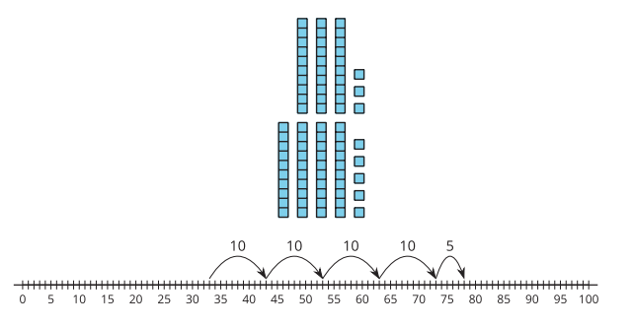
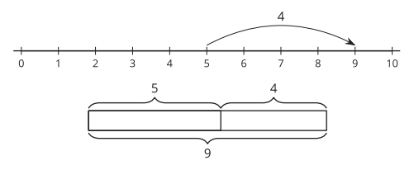
Section Summary
In this unit, we have solved all types of problems and represented them in different ways. We represented addition and subtraction on the number line and made connections to equations and strategies. When adding and subtracting within 100, we can use diagrams, base-ten blocks, number lines, and equations to make sense of stories and situations and to show our thinking. They are all connected.

Slide 94
Center Day 2
14
Let’s put numbers on a number line and practice adding and subtracting.
2.MD.A.1, 2.MD.D.9

Slide 95

True or False:
Is This 50?
Warm up
Is each statement true or false?
Be prepared to explain your reasoning.

Slide 96

True or False:
Is This 50?
Warm up
Is each statement true or false?
Be prepared to explain your reasoning.

Slide 97

True or False:
Is This 50?
Warm up
Is each statement true or false?
Be prepared to explain your reasoning.

Slide 98



Centers: Introduce Playing on the Number Line, Get to 100
Activity
#1

Slide 99

Centers Choice Time
Activity #2
Playing on the
Number Line, Get to 100
How Close, Close to 100

Slide 100
Lesson Synthesis
How did you and your partner work together during centers?
What went well? What can we continue to work on?

Slide 101
Riddles
15
Let’s use what we know about adding and subtracting to solve and write riddles about people’s ages.
2.MD.B.6, 2.NBT.B.5

Slide 102

Notice and Wonder:
Birthday Candles
Warm up
What do you
notice?
What do you wonder?

Slide 103
Kiran’s Age Riddles
Activity
#1
Solve Kiran’s age riddles. Show your thinking. Use a number line if it helps.
1. I’m 7. My sister is 5 years older than I am. How old is she? __________ years old
2. If you add 27 years to my sister’s age, you get my mom’s age. How old is my mom? __________ years old
3. My brother is 24 years younger than my mom. How old is my brother? __________ years old
4. My grandma is 53 years older than my brother. How old is my grandma? __________ years old
5. My uncle is 21 years younger than my grandma. How old is my uncle? __________ years old
6. My uncle is 33 years older than my cousin. How old is my cousin? __________ years old
7. There is a 50 year difference between my grandpa’s age and my cousin’s age. How old is my grandpa?

Slide 104

Write Riddles
Activity
#2
1. Complete the table by writing down 4 people you know with different ages.
2. Come up with 3 mathematical questions to ask your partner.
Question 1:
Question 2:
Question 3:
3. Solve your partner's riddles. Show your thinking using a number line or equation.

Slide 105
Lesson Synthesis
Today we worked to represent and solve real world problems about ages.
How would you suggest they solve them?
How could you explain to a friend how they could take some ages and make up their own addition and subtraction problems?

