Slide 1

Measuring Length
Grade 2: Unit 3
Standards addressed: 2.MD.A, 2.MD. B, 2.MD. D, 2.OA.A, 2.OA.B
These slides have been created by Britnee Wright Southeast Arkansas Education Cooperative and are not official IM materials. Images and language are taken from IM Grade 2, Unit 3 by Illustrative Mathematics.
Copyright 2020 by Illustrative Mathematics. All Rights Reserved, adapted and shared with permission.

Slide 2
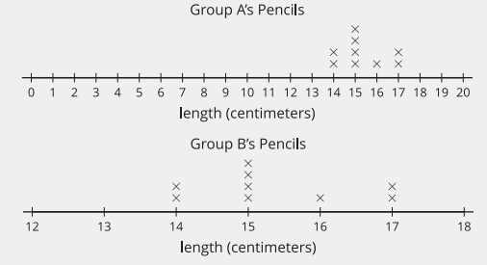

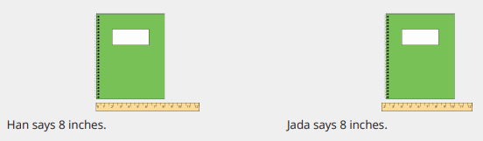
Unit 3 Progression Overview
Measuring Length
Section A
Lessons 1-7
2.MD.A.1, 2.MD.A.2, 2.MD.A.3, 2.MD.A.4, 2.MD.B.5, 2.NBT.A.2, 2.NBT.B.5, 2.OA.A.1, 2.OA.B.2
Section B
Lessons 8-13
2.MD.A.1, 2.MD.A.2, 2.MD.A.3, 2.MD.B.5, 2.NBT.B.5, 2.OA.A, 2.OA.B.2
Section C
Lessons 14-18
2.MD.A.1, 2.MD.A.3, 2.MD.A.4, 2.MD.B.5, 2.MD.D.9, 2.NBT.B.5, 2.OA.A.1, 2.OA.B.2
Measure length in centimeters and meters.
Represent and solve one-step story problems within 100.
Measure length in feet and inches.
Represent and solve one- and two-step story problems within 100
Represent numerical data on a line plot

Slide 3


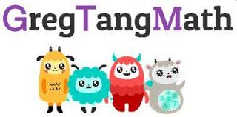
Unit 3 Quick Link Page
ADAPT 1
ADAPT 2
ADAPT 3
L1
L2
L3
L4
L5
L6
L7
L8
L9
L10
L11
L12
L13
L14
L15
L16
L17
L18

Slide 4
Connecting Cube Towers to Determine Length
Adaptation
Lesson 1
Let’s use connecting cube towers to measure the length of objects
1.MD.A.2

Slide 5
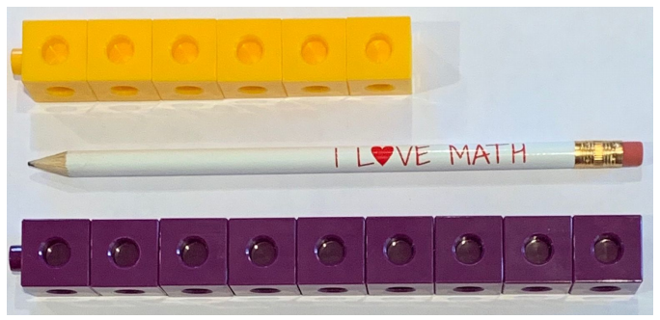
Notice and Wonder:
Measuring a Pencil
Warm up
What do you
notice?
What do you
wonder?

Slide 6
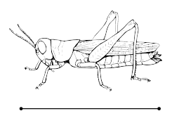
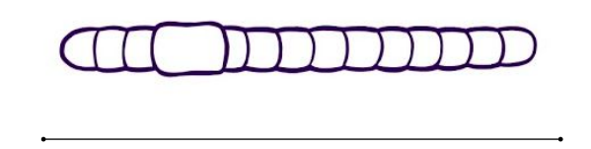
Creepy Crawly Things
Activity #1
1. The grasshopper is the same length as a tower of ___ connecting cubes.
2. The earthworm is the same length as a tower of ___ connecting cubes.

Slide 7
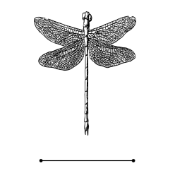
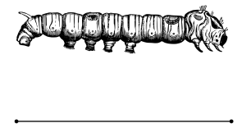
Creepy Crawly Things
Activity #1
3. The dragonfly is the same length as a tower of ___ connecting cubes.
4. The caterpillar is the same length as a tower of ___ connecting cubes.

Slide 8
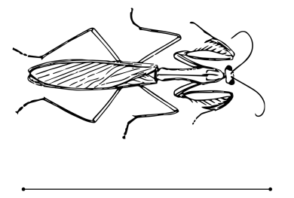
Creepy Crawly Things
Activity #1
5. The praying mantis is the same length as a tower of ___ connecting cubes.

Slide 9
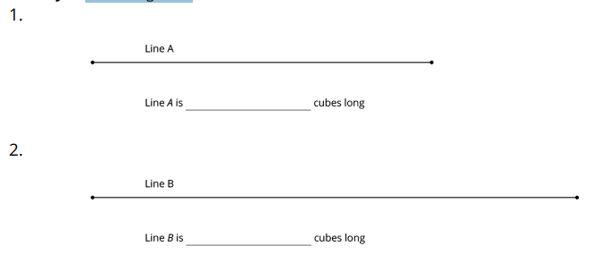
Measuring Lines
Activity #2

Slide 10
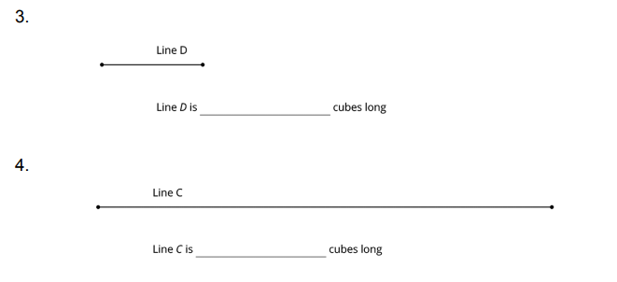
Measuring Lines
Activity #2

Slide 11
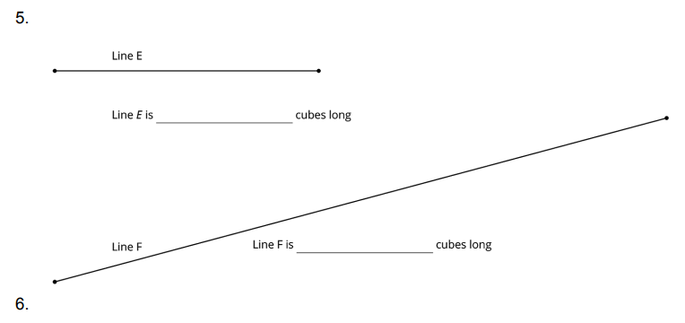
Measuring Lines
Activity #2

Slide 12
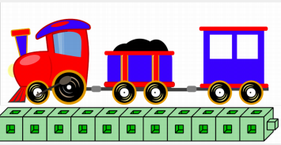

Lesson Synthesis
We compared the length of objects to the length of connecting cube towers. We can count the number of cubes in the tower to say how many cubes long the tower is. When a tower and a line have the same length, the number of cubes in the tower is also the length of the line in connecting cube units
Share your statement with your partner. Work together to agree on the statement.
How many cubes long is this toy train?
When we use connecting cube towers to measure things, that means the length of a cube is the unit we are measuring with. We will see later that we can measure lengths with different units

Slide 13
Measuring by Using Math Tools
Adaptation
Lesson 2
Let’s measure length precisely.
1.MD.A.2

Slide 14
Number Talk:
Using a Ten to Add
Warm up
Find the value of each sum mentally.

Slide 15
Number Talk:
Using a Ten to Add
Warm up
Find the value of each sum mentally.

Slide 16
Number Talk:
Using a Ten to Add
Warm up
Find the value of each sum mentally.

Slide 17
Number Talk:
Using a Ten to Add
Warm up
Find the value of each sum mentally.

Slide 18
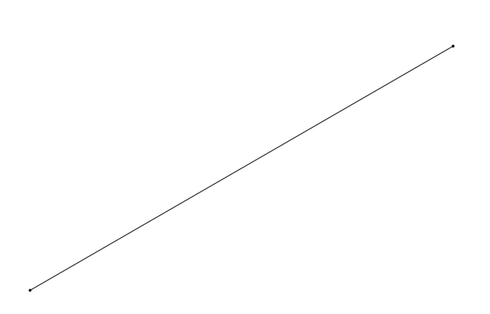
Measuring with Paper Clips BLM
Activity #1
Use paper clips to measure.
How long is the line?

Slide 19
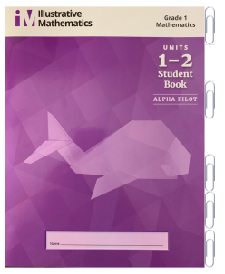
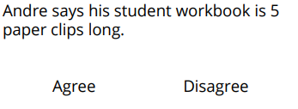
Measuring Our Workbook
Activity #2
Circle whether you agree or disagree with each student.
Explain why you agree or disagree?

Slide 20

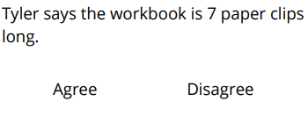
Measuring Our Workbook
Activity #2
Circle whether you agree or disagree with each student.
Explain why you agree or disagree?

Slide 21
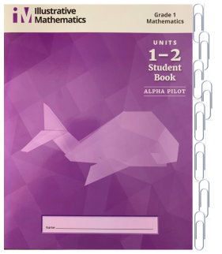
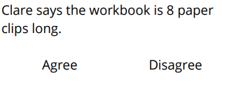
Measuring Our Workbook
Activity #2
Circle whether you agree or disagree with each student.
Explain why you agree or disagree?

Slide 22
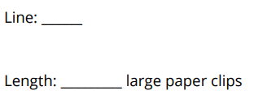
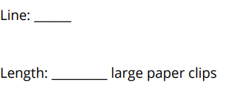
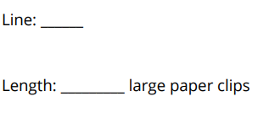
Measuring Lengths of Lines
Activity #3
Use large paper clips to measure each line

Slide 23
Lesson Synthesis
I’m going to measure this line using little strips of paper.
What advice would you give to someone who has never measured before?
What do you think about this measuring? What could I do to improve?
Tell your partner the advice.

Slide 24
Measuring Length with Different Units
Adaptation
Lesson 3
Let’s measure the same object using different length units.
1.MD.A.2

Slide 25
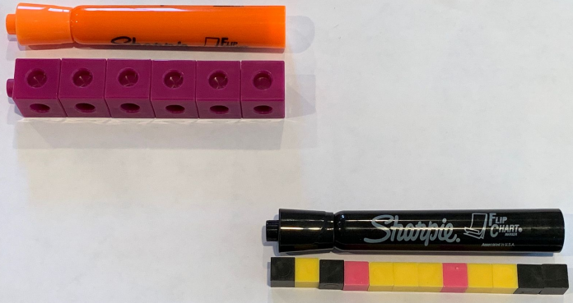
Notice and Wonder: Large Cubes and Small Cubes
Warm up
What do you
notice?
What do you wonder?

Slide 26


Measure with Different Length Units
Activity #1
Measure the lines.
Our measurement:
Our partner’s measurement:
What do you notice?
Our measurement:
Our partner’s measurement:
What do you notice?

Slide 27

Measure with Different Length Units
Activity #1
Measure the lines.
Our measurement:
Our partner’s measurement:
What do you notice?

Slide 28
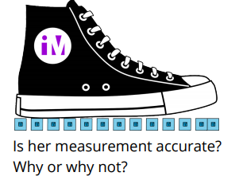
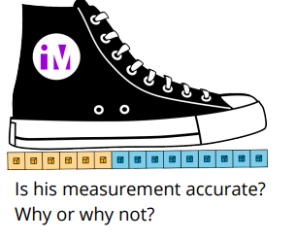
Measuring Mr. Green’s Shoe
Activity #2
1. Andre measured Mr. Green’s shoe and said it was 15 connecting cubes long.
2. Jada measured Mr. Green’s shoe and said it was 12 connecting cubes long.

Slide 29
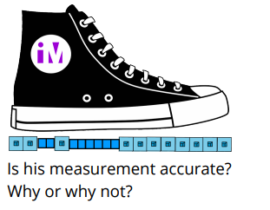
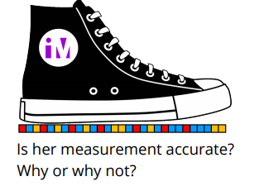
Measuring Mr. Green’s Shoe
Activity #2
3. Clare measured Mr. Green’s shoe and said it was 30 small cubes long.
4. Kiran measured Mr. Green’s shoe and said it was 19 long.

Slide 30
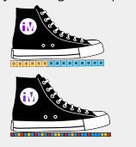
Lesson Synthesis
You said Clare and Andre both had accurate measurements. How could they have different answers?

Slide 31
Standard Units of Measure
1
Let’s measure length.
2.MD.D.10, 2.NBT.B.5, 2.OA.A.1

Slide 32
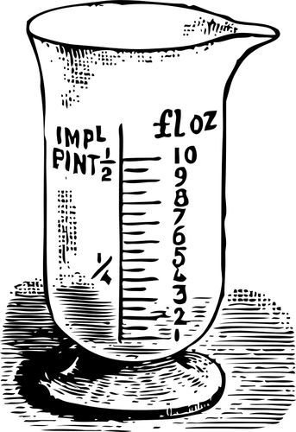
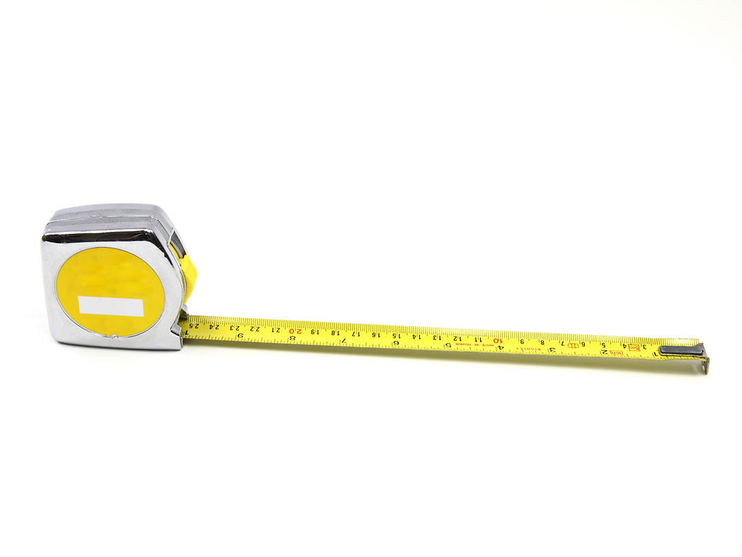
What Does it Mean to Measure?
Warm up

Slide 33
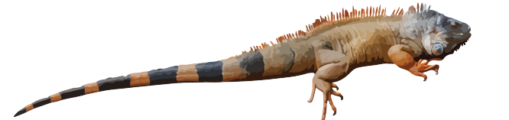
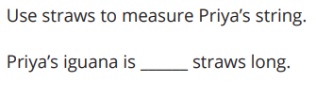
Priya’s Pet
Activity #1

Slide 34
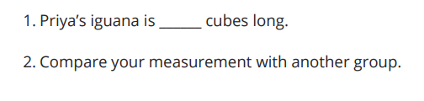
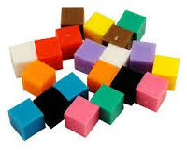
Use a Standard Unit
Activity #2
Use the cubes to measure Priya’s string.

Slide 35

Lesson Synthesis
Today, we measured a length of string using different units. We used straws and cubes.
The cubes we used today can be called centimeter cubes because the edge of each cube is 1 centimeter long.
A centimeter is a standard unit of length that people use to measure all around the world.

Slide 36
Lesson Synthesis
Priya’s iguana is 40 cubes long.
Priya’s iguana is 40 centimeter cubes long
Which sentence best describes the length of Priya’s iguana? Explain.

Slide 37
Measure with Centimeters
2
Let’s measure with centimeters.
2.MD.A.1, 2.MD.A.4

Slide 38
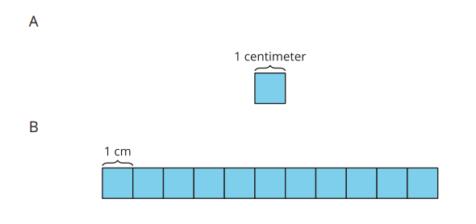
Notice and Wonder: Centimeters
Warm up
What do you
notice?
What do you wonder?

Slide 39
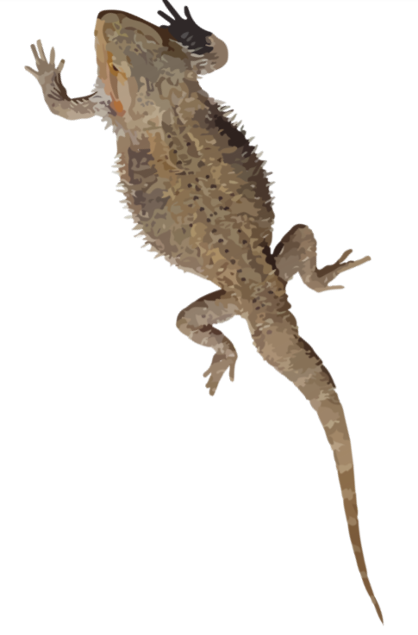
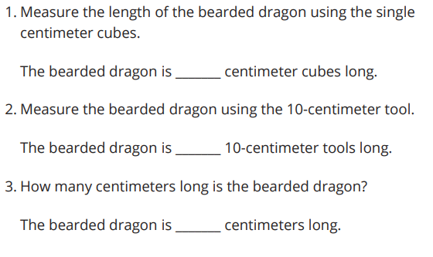
Length in Centimeters
Activity #1

Slide 40
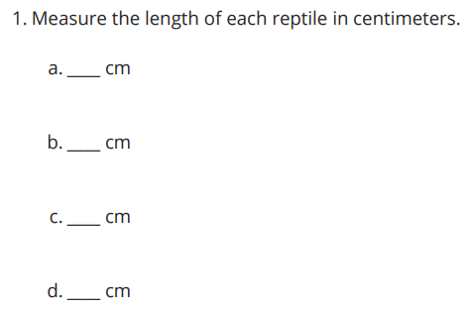

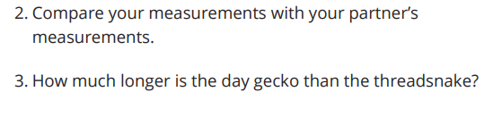
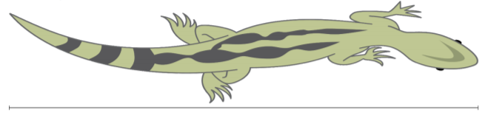
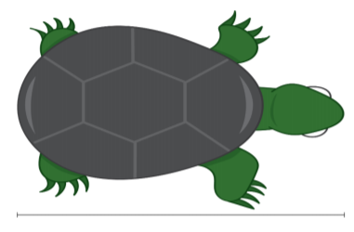
Measure with 10-centimeter Tools
Activity #2

Slide 41
Lesson Synthesis
Today, we measured different reptiles using the length-unit of centimeters, which is a pretty small unit. We saw that we can use the centimeter cubes or the 10-centimeter blocks as tools to measure centimeters.
How could you use a 10-centimeter tool to show someone how long 1 centimeter is?
What if you wanted to show someone how long 5 centimeters is? What would you use?
How could you use a centimeter cube to show someone how long 1 centimeter is?
What if you wanted to show someone how long 50 centimeters is? What would you use?

Slide 42
Create and Use a Ruler
3
Let’s create rulers and use them to measure and compare lengths in centimeters.
2.MD.A.1, 2.MD.A.4, 2.NBT.B.5

Slide 43
Number Talk:
Subtract Two Digits
Warm up
Find the value of each expression mentally.

Slide 44
Number Talk:
Subtract Two Digits
Warm up
Find the value of each expression mentally.

Slide 45
Number Talk:
Subtract Two Digits
Warm up
Find the value of each expression mentally.

Slide 46
Number Talk:
Subtract Two Digits
Warm up
Find the value of each expression mentally.

Slide 47
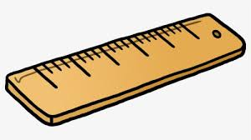
Create a Ruler
Activity #1
1. Use your tools to make a ruler that shows lengths in centimeters.
2. Compare your ruler with your partner’s ruler

Slide 48
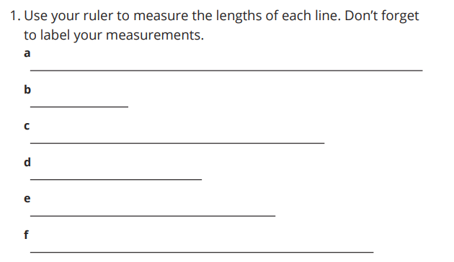
Measure and Compare Lengths
with Our Rulers
Activity #2
2. How many more centimeters longer is line a than line b?
3. How many more centimeters longer is line f than line d?
4. Which two lines are the longest? How long would the line be if you joined them together?

Slide 49
Lesson Synthesis
Today, we created a ruler so we didn’t have to line up centimeter cubes or 10-centimeter tools to measure.
How did you use a ruler to find how many more centimeters longer one line was than another?
How is measuring with a ruler the same as measuring with centimeter cubes or a 10-centimeter tool? How is it different

Slide 50
Measure and Estimate in Centimeters
4
Let’s estimate and measure in centimeters.
2.MD.A.1, 2.MD.A.3

Slide 51
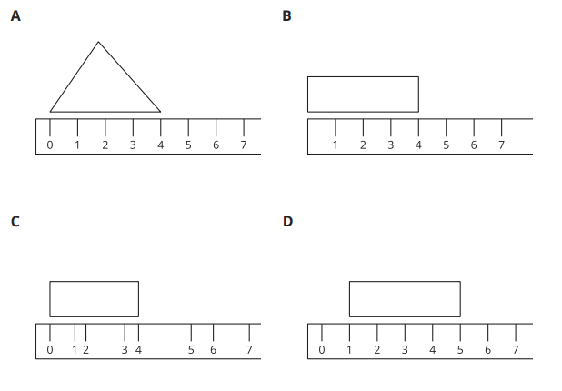
Which One Doesn’t Belong: Measurements of Length
Warm up

Slide 52
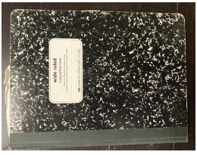
Estimate Length in Centimeters
Activity #1
Andre wanted to measure the length of his notebook, but he didn’t have any tools to measure it. He made a guess that he thought would be close.
Look at the notebook and think about how long you think it is in centimeters.
What is an estimate that’s too high? Too low? About right?

Slide 53
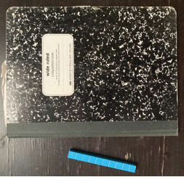
Estimate Length in Centimeters
Activity #1
Based on the second image,
Do you want to revise, or change, your estimates?
How did your estimation change?

Slide 54
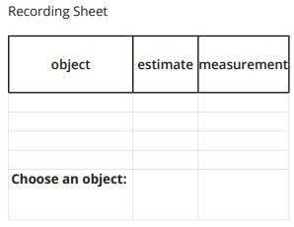
Estimate Length in Centimeters
Activity #1
1. Record an estimate that is:
too low, about right, too high
2. Record an estimate that is:
too low, about right, too high
3. Record an estimate for each object on the recording sheet.
4. Tell your partner why you think your estimates are “about right.

Slide 55
Measure and Compare
Activity #2
1. Measure each object on your recording sheet. Record each length in centimeters.
2. Compare your measurements to your estimates.

Slide 56
Lesson Synthesis
Today we practiced estimating length and we used rulers to measure the length of objects in centimeters.
What did you think about when you were making your estimates? How could you use the length of a ruler to make estimates?
How was measuring with the rulers like measuring with other tools? How was it different?

Slide 57
Measure with Meters
5
Let’s measure length in meters.
2.MD.A.1, 2.MD.A.2, 2.MD.A.3, 2.NBT.A.2

Slide 58

Choral Count:
Counting by Ones Beyond 100
Warm up
Count by 1, starting at 20.

Slide 59
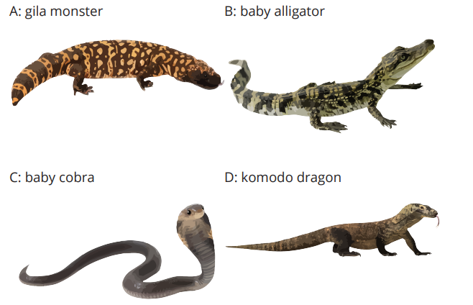
Reptiles to Measure
Activity #1
Each line on the floor represents the length of a reptile.
1. Measure to find the length of each reptile. Don’t forget the unit.
a. What is the length of a gila monster?
b. What is the length of a baby gator?
c. What is the length of a baby cobra?
d. What is the length of a komodo dragon?

Slide 60
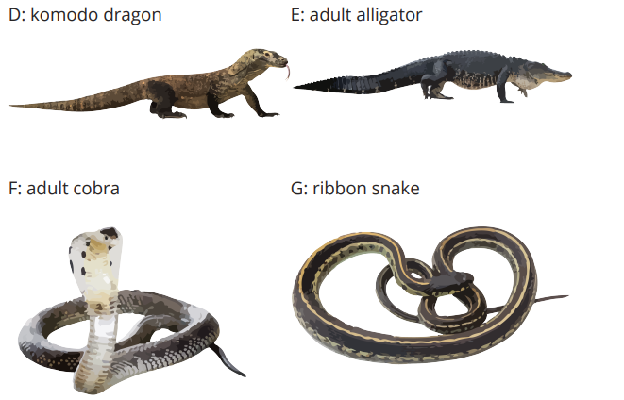
Measuring with a Meter Stick
Activity #2
1. Measure the length of the komodo dragon in meters and centimeters.
2. What is the same or different about your measurements for the Komodo Dragon from Activity 1 and Activity 2?
3. Measure each reptile in centimeters or meters. Don’t forget the units.
a. How long is an adult alligator?
b. How long is an adult cobra?
c. How long is a ribbon snake?

Slide 61
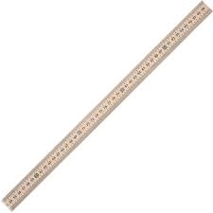
Lesson Synthesis
Today, we learned about another standard unit of length—the meter. We used meter sticks to make measuring longer lengths a lot easier. We learned that a meter is equivalent to 100 centimeters.
What are some things you could measure using a meter stick?
What are some things in our classroom that are about 1 meter long?

Slide 62
Compare Reptile Lengths in Story Problems
6
Let’s solve story problems about reptile lengths.
2.MD.B.5, 2.NBT.B.5, 2.OA.A.1, 2.OA.B.2

Slide 63
Number Talk: Fives and Tens
Warm up
Find the value of each sum mentally.

Slide 64
Number Talk: Fives and Tens
Warm up
Find the value of each sum mentally.

Slide 65
Number Talk: Fives and Tens
Warm up
Find the value of each sum mentally.

Slide 66
Number Talk: Fives and Tens
Warm up
Find the value of each sum mentally.

Slide 67




Whose Pet is Longer?
Activity #1
1. Lin's pet lizard is 62 cm long. It is 19 cm shorter than Jada's. How long is Jada's pet lizard?
a. Whose pet is longer?
b. Circle the diagram that matches the story.
c. Solve. Show your thinking.
Jada’s pet lizard is_________ cm long.
2. Diego and Mai have pet snakes. Mai’s snake is 17 cm longer than Diego’s. Mai’s snake is 71 cm. How long is Diego’s pet snake?
a. Whose pet is longer?
b. Circle the diagram that matches the story.
c. Solve. Show your thinking.
Diego’s pet snake is _________ cm long.

Slide 68










Guess My Reptiles
Activity #2

Slide 69

Guess My Reptiles
Activity #2

Slide 70
Lesson Synthesis
Today, you solved story problems by comparing lengths. You used diagrams to help you think about which reptile was longer or shorter and to help you think about finding the difference.
How did the diagram help you decide if you would add or subtract?
How did the diagram help you think about which animal was longer?

Slide 71


Section Summary
In this section, we measured the length of objects using different length-units. We learned that the centimeter is a standard length-unit and we used measured lengths in centimeters using base-ten blocks, rulers, and meter sticks. We learned that rulers represent length-units using tick marks and that labeled tick marks show a length from 0.
We also learned that when you need to measure a longer length you may need to use larger tools or a larger length-unit. We learned that a meter is a standard length-unit that is much longer than a centimeter. We practiced estimating the length of objects using what we know about the length of a centimeter and a meter.

Slide 72
Center Day 1 (Optional)
7
Let’s estimate the length of an object and then measure it.
2.MD.A.1, 2.MD.A.3, 2.NBT.B.5, 2.OA.A.1

Slide 73

Number Talk:
Subtracting from 37
Warm up
Find the value of each expression mentally.

Slide 74

Number Talk:
Subtracting from 37
Warm up
Find the value of each expression mentally.

Slide 75

Number Talk:
Subtracting from 37
Warm up
Find the value of each expression mentally.

Slide 76

Number Talk:
Subtracting from 37
Warm up
Find the value of each expression mentally.

Slide 77


Centers: Introduce Estimate and Measure, Length
Activity #1

Slide 78


Centers Choice Time
Activity #2
Estimate and Measure
Math Stories

Slide 79
Visual Representation of Data
Activity #2
Let’s organize and represent the data about how our class gets to school.
Make a list
Write numbers in a table
car | bus | walk | train
car
bus
walk
train

Slide 80
Lesson Synthesis
Today we estimated and measured the length of objects.
What strategy did you use to help you make an estimate that was close to the actual measurement?

Slide 81
What is an Inch?
8
Let’s measure in inches.
2.MD.A.1, 2.MD.A.3

Slide 82

Notice and Wonder:
Inches and Centimeters
Warm up
What do you
notice?
What do you wonder?

Slide 83

What is an inch?
Activity
#1
1. Find 2 items that are about an inch.
__________
__________

Slide 84

What is an inch?
Activity
#1
Measure the length of each object.

Slide 85


Measure Shapes
Activity
#2
1. How long is the long side of the rectangle in inches?
Estimate: _________
Measure the long side of the rectangle.
Actual length: _________
2. How long is a side of the square in inches?
Estimate: _________
Measure the long side of the square.
Actual length: _________

Slide 86

Measure Shapes
Activity
#2
3. How long is the longest side of the triangle in inches?
Estimate: _________
Measure the long side of the triangle.
Actual length: _________

Slide 87
Lesson Synthesis
Today, we measured shapes and objects with inch tiles and rulers.
How would you measure the length of a bookshelf or whiteboard in inches?
About how long do you estimate the bookshelf will be in inches

Slide 88
From Feet to Inches
9
Let’s measure longer lengths with customary units.
2.MD.A.1, 2.MD.A.2, 2.MD.A.3

Slide 89


Estimation Exploration:
Small Fry Catches a Big Fish
Warm up
How long is this Cobia fish in inches?

Slide 90




Let’s Measure the Creatures of the Sea
Activity
#1
1. Work with your group to measure the tape strips around the classroom in inches and feet.
2. What did you notice about the number of feet compared to the number of inches when you measured the tape strips?

Slide 91


Inches or Feet? That is the Question
Activity
#2
1. Estimate the length of objects around the room. Say if you will measure in inches or feet.
2. Choose the best tool to measure each object. Complete the table to record your actual measurements.

Slide 92
Today, you practiced measuring in inches and feet.
Lesson Synthesis
Do you think it will always be true that it takes more smaller units than larger units to measure length?
What did you notice about the number of feet in comparison to the number of inches when you measured the tape strips?

Slide 93
Measuring with a Torn Tape
10
Let’s measure with a torn tape measure.
2.MD.B.5, 2.OA.B.2

Slide 94
True or False:
Constant Difference
Warm up
Is it statement true or false?
Be prepared to explain your reasoning.

Slide 95

True or False:
Constant Difference
Warm up
Is it statement true or false?
Be prepared to explain your reasoning.

Slide 96

True or False:
Constant Difference
Warm up
Is it statement true or false?
Be prepared to explain your reasoning.

Slide 97

True or False:
Constant Difference
Warm up
Is it statement true or false?
Be prepared to explain your reasoning.

Slide 98

The Notebook Problem
Activity
#1
1. How did Han and Jada get the same measurement?
2. Write an equation that could show Jada’s thinking.

Slide 99
The Notebook Problem
Activity
#1
3. Measure an object using Jada’s method.
I measured a__________________.
I started with the number _____.
I ended with the number _____.
Equation: ___________________.
The length of my object is _____.
4. What do you notice about you and your partner’s measurements?

Slide 100

A Desktop to Measure
Activity
#2
1. What is the length of the long side of the desktop? Show your thinking using drawings, numbers, or words.
Equation:_______________
The long side of the desktop is _____.

Slide 101

A Desktop to Measure
Activity
#2
2. What is the length of the short side of the desktop? Show your thinking using drawings, numbers, or words.
Equation:_______________
The short side of the desktop is _____.

Slide 102
Lesson Synthesis
Today, you learned you can still measure the length of objects using measuring tools without starting at zero by counting the number of units. We also agreed that you could use addition or subtraction to find the difference when measuring without starting at zero.
What was your preferred method? Why?

Slide 103
Stories of Saree Silk: Making Necklaces and Bracelets
11
Let’s solve story problems about length.
2.MD.B.5, 2.NBT.B.5, 2.OA.A

Slide 104

Notice and Wonder: Take From
Warm up
What do you
notice?
What do you wonder?

Slide 105

Making Saree Silk Ribbon Necklaces
Activity
#1
Priya had a ribbon that was 44 in. long. She cut off 18 in. How long is Priya’s ribbon now?
Andre drew this diagram to help him think about the problem.
1. What does the “?” represent in the story?
2. Why do you think there is a dotted line between the parts?
3. Find the missing value. Show your thinking.
4. Priya’s ribbon is _____ long.

Slide 106



Saree Silk Ribbon Projects
Activity
#2
Label the diagram. Find the missing value.
Show your thinking and don’t forget the units.

Slide 107
Lesson Synthesis
Today, you solved story problems about ribbon lengths and used diagrams to help you think about how to find the missing values.
How did the diagram help you decide if you would add or subtract?

Slide 108
Stories of Saree Silk Ribbon: Making Friendship Bracelets
12
Let’s solve two-step story problems about length.
2.MD.B.5, 2.NBT.B.5

Slide 109

True or False:
Place Value Comparisons
Warm up
Is each statement true or false?
Be prepared to explain your reasoning.

Slide 110

True or False:
Place Value Comparisons
Warm up
Is each statement true or false?
Be prepared to explain your reasoning.

Slide 111

True or False:
Place Value Comparisons
Warm up
Is each statement true or false?
Be prepared to explain your reasoning.

Slide 112

True or False:
Place Value Comparisons
Warm up
Is each statement true or false?
Be prepared to explain your reasoning.

Slide 113

Sharing Ribbon with Friends
Activity
#1
1. Solve. Show your thinking. Use a diagram if it helps. Don’t forget the units.
a. Lin found a piece of ribbon that is 92 cm long. She cut a piece for Noah that is 35 cm. How much ribbon does Lin have left?
b. Then, Lin cut off 28 cm of ribbon for Jada. How much ribbon does Lin have left now?

Slide 114

Friendship Bracelets and Gifts
Activity
#2
1. Solve. Show your thinking. Don’t forget the units. Use a diagram if it helps.
a. Han has 82 inches of ribbon. He only needs 48 inches. How much should he cut off?
b. Han gives the ribbon he doesn’t need to Clare. Clare uses it to make her ribbon longer. Her ribbon was 27 inches. How long is Clare’s ribbon now?

Slide 115
Friendship Bracelets and Gifts
Activity
#2
2. Solve. Show your thinking. Don’t forget the units. Use a diagram if it helps.
a. Andre’s ribbon is too short. He has 28 inches of ribbon, but he needs it to be 50 inches long. How much more ribbon does he need?
b. Andre got the ribbon he needed from Mai. Mai now has 49 inches of ribbon left. How much ribbon did Mai start with?

Slide 116
Lesson Synthesis
Today you solved different kinds of story problems and some of the stories had 2 parts.
What did you find helpful for keeping track of your calculations and representing your thinking?
What ideas for solving story problems have you learned from others

Slide 117

Section Summary
In this section of the unit, we learned more about standard units of measure. We measured using the U.S. Customary System of measurement, which is what we use in the United States. We learned to measure using inches and feet. We also solved two-step story problems about measurement and learned a new way to represent subtraction using diagrams.

Slide 118
Center Day 2 (Optional)
13
Let’s use place value to build numbers and complete equations.
1.NBT.B.3, 2.NBT.B.5, 2.OA.B.2

Slide 119

Number Talk: Use Ten to Add
Warm up
Find the value of each expression mentally.

Slide 120

Number Talk: Use Ten to Add
Warm up
Find the value of each expression mentally.

Slide 121

Number Talk: Use Ten to Add
Warm up
Find the value of each expression mentally.

Slide 122

Number Talk: Use Ten to Add
Warm up
Find the value of each expression mentally.

Slide 123


Centers: Introduce Make the Greatest Number, Two-digit Numbers
Activity
#1

Slide 124



Centers Choice Time
Activity
#2
Make the Greatest Number, Two-digit Numbers
Number Puzzles

Slide 125
Lesson Synthesis
Today we made the greatest two-digit numbers possible with our number cards.
Which digit, the tens or the ones, was more helpful in making the greatest number?
Why was this digit more helpful?

Slide 126
What is a Line Plot?
14
Let’s learn a new way to represent data.
2.MD.A.1, 2.MD.D.9

Slide 127


Notice and Wonder:
“Handy” Graphs
Warm up
What do you
notice?
What do you wonder?

Slide 128


Measuring Our Hand Spans
Activity
#1

Slide 129


Interpreting Our Numerical Data
Activity
#2

Slide 130


Today we learned a new way to display data—a line plot.
Lesson Synthesis
What is the same and different about the bar graphs and line plots?
What do the numbers tell us in each graph?

Slide 131
Creating Line Plots
15
Let’s represent data in line plots.
2.MD.D.9, 2.NBT.B.5

Slide 132
Number Talk:
Subtraction within 50
Warm up
Find the value of each difference mentally.

Slide 133

Number Talk:
Subtraction within 50
Warm up
Find the value of each difference mentally.

Slide 134

Number Talk:
Subtraction within 50
Warm up
Find the value of each difference mentally.

Slide 135

Number Talk:
Subtraction within 50
Warm up
Find the value of each difference mentally.

Slide 136


Measure and Plot Pencil Lengths
Activity
#1
1. Measure the pencils in centimeters. Work with a partner and check each other’s measurements. Record each measurement in the table.
2. Create a line plot to represent the lengths of all the pencils in your group.

Slide 137



Plot Pencil Lengths
Activity
#2

Slide 138

Plot Pencil Lengths
Activity
#2
Use this data to create a line plot.

Slide 139

Lesson Synthesis
____ said that the most pencils were 10 cm. ____ said the longest pencil was 16 cm. Are they both correct?
What do you know about the lengths of the pencils based on the line plot?
How can I find out how many pencils were measured based on this line plot?

Slide 140
Interpret Measurement Data
16
Let’s represent measurement data in line plots.
2.MD.D.9, 2.NBT.B.5

Slide 141

Number Talk:
Addition within 50
Warm up
Find the value of each sum mentally.

Slide 142

Number Talk:
Addition within 50
Warm up
Find the value of each sum mentally.

Slide 143

Number Talk:
Addition within 50
Warm up
Find the value of each sum mentally.

Slide 144

Number Talk:
Addition within 50
Warm up
Find the value of each sum mentally.

Slide 145

The Plant Project
Activity
#1
Use this table to create a line plot.

Slide 146

Interpret Measurement Data on a Line Plot
Activity
#2
The Plant Project
Answer the questions based on your line plot.
1. What was the shortest plant height?
2. What was the tallest plant height?
3. What is the difference between the height of the tallest plant and the shortest plant? Write an equation to show how you know.

Slide 147

Interpret Measurement Data on a Line Plot
Activity
#2
Answer the questions based on Han’s line plot.
4. Han looked at this line plot and said that the tallest plant was 29 centimeters. Do you agree with him? Why or why not?
5. How many plants were measured in all?
6. Write a statement based on Han’s line plot

Slide 148

Today you created line plots to represent measurement data about plant heights, answered questions about the data, and shared statements based on what you learned from the line plots.
Lesson Synthesis
What are some statements you came up with based on Han’s line plot?

Slide 149

Section Summary
In this section of the unit, we learned about a new kind of graph. A line plot is a graph used to represent measurement data. The line and the numbers on it represent the units you used to measure. The line should look like the numbers on the tool you use to measure.
This line plot tells us that 4 teachers have a hand span of 8 inches because there are 4 Xs over the 8. We learned how to make line plots and how to answer questions based on a line plot.

Slide 150
Center Day 3 (Optional)
17
Let’s work in centers.
1.NBT.B.3, 2.MD.A.1, 2.MD.A.3, 2.NBT.B.5, 2.OA.B.2

Slide 151

Number Talk:
Subtract from a Multiple of 10
Warm up
Find the value of each expression mentally.

Slide 152

Number Talk:
Subtract from a Multiple of 10
Warm up
Find the value of each expression mentally.

Slide 153

Number Talk:
Subtract from a Multiple of 10
Warm up
Find the value of each expression mentally.

Slide 154

Number Talk:
Subtract from a Multiple of 10
Warm up
Find the value of each expression mentally.

Slide 155

Centers:
Introduce How Close, Close to 100
Activity
#1

Slide 156



Centers:
Choose a center.
Activity
#1
How Close, Close to 100
Less than 10, Start with 99

Slide 157
Centers Choice Time
Activity
#2
Number Puzzles
Make the Greatest Number, Two-digit Numbers
Estimate and Measure

Slide 158
Lesson Synthesis
Today we had a chance to work on many different center activities. Tell your partner one thing they did really well during your work together today.

Slide 159
Make a Yard Stick
18
Let’s make a yardstick.
2.MD.A.1, 2.MD.A.4, 2.MD.B.5, 2.MD.D.9, 2.OA.A.1

Slide 160

Number Talk:
3s and 5s
Warm up
Find the value of each expression mentally.

Slide 161

Number Talk:
3s and 5s
Warm up
Find the value of each expression mentally.

Slide 162

Number Talk:
3s and 5s
Warm up
Find the value of each expression mentally.

Slide 163

Number Talk:
3s and 5s
Warm up
Find the value of each expression mentally.

Slide 164


Make a Yardstick
Activity
#1

Slide 165

Compare Yardsticks
Activity
#2
Measure the height of your desk using your yardstick.
Write your measurement on a sticky note and add it to the class line plot.
Use the completed line plot to answer the following:
1. What do you notice? What do you wonder?
2. What is the tallest measurement for the desks in the room?
3. What is the shortest measurement?
4. Find the difference between the tallest and the shortest measurements. Write an equation to show your reasoning.

Slide 166
Measure Your Arms
Activity
#3
1. Measure the lengths of your hand from the wrist to the top of your middle finger.
a. hand length partner A: _____
b. hand length partner B: _____
2. Measure the lengths of your forearm from the outside of your elbow to your wrist.
a. forearm length partner A: _____
b. forearm length partner B: _____
3. Write two equations using the measurements in your group and write two statements describing what the equations tell you.
a. Equation 1: ____________________
Statement 1:____________________
b. Equation 2: _____________________
Statement 2:____________________

Slide 167
Lesson Synthesis
Today we made a measuring tool and used it to measure some objects around us. What are some important things we learned about how measuring tools are made?

