Slide 1

Adding and Subtracting with Data
Grade 2: Unit 2
Standards addressed: MD.D.10, OA.A.1, OA.B.2
These slides have been created by Britnee Wright Southeast Arkansas Education Cooperative and are not official IM materials. Images and language are taken from IM Grade K, Unit 2 by Illustrative Mathematics.
Copyright 2020 by Illustrative Mathematics. All Rights Reserved, adapted and shared with permission.

Slide 2
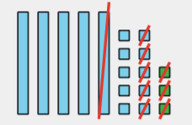
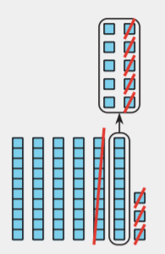
Unit 1 Progression Overview
Adding and Subtracting with Data
Section A
Lessons 1-4
2.MD.D.10, 2.NBT.A.2, 2.NBT.B.5, 2.NBT.B.9, 2.OA.A.1, 2.OA.B.2
Section B
Lessons 5-10
2.NBT.B.5, 2.NBT.B.6, 2.NBT.B.8, 2.NBT.B.9, 2.OA.B.2
Section C
Lessons 11-16
2.NBT.B.5, 2.NBT.B.6, 2.NBT.B.8, 2.NBT.B.9, 2.OA.A.1, 2.OA.B.2
Add and subtract within 100 using strategies based on place value and the relationship between addition and subtraction
Subtract within 100 using strategies based on place value, including decomposing a ten, and the properties of operations.
Represent and solve one- and two-step problems involving addition and subtraction within 100, including different problem types with unknowns in all positions.

Slide 3



Unit 2 Quick Link Page
ADAPT 1
ADAPT 2
ADAPT 3
ADAPT 4
ADAPT 5
L1
L2
L3
L4
L5
L6
L7
L8
L9
L10
ADAPT 6
ADAPT 7
ADAPT 8
L11
L12
L13
L14
L15
L16

Slide 4
How Many Groups of 10?
Adaptation
Lesson 1
Let’s find groups of ten.
1.NBT.B.2.C

Slide 5
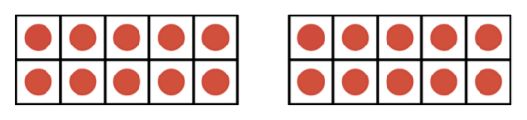
How Many Do You See:
Multiples of 10
Warm up
How many do you see?
How do you see them?

Slide 6
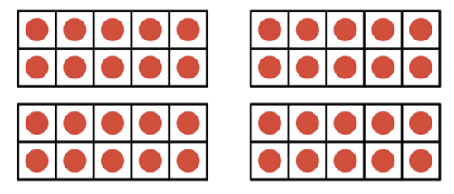
How Many Do You See:
Multiples of 10
Warm up
How many do you see?
How do you see them?

Slide 7
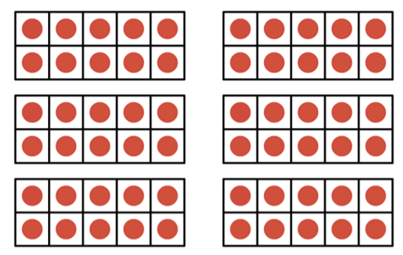
How Many Do You See:
Multiples of 10
Warm up
How many do you see?
How do you see them?

Slide 8

Matching Numbers: Groups of Ten and Written Numbers
Activity #1
For this activity you and your partner are going to match 3 cards together so the sets are complete.

Slide 9
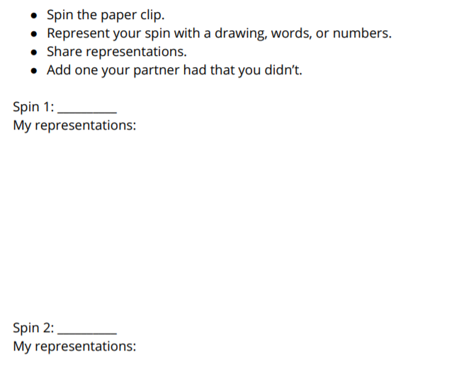
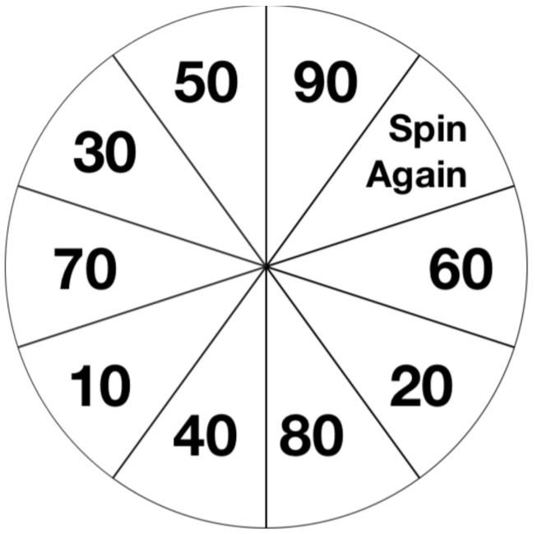
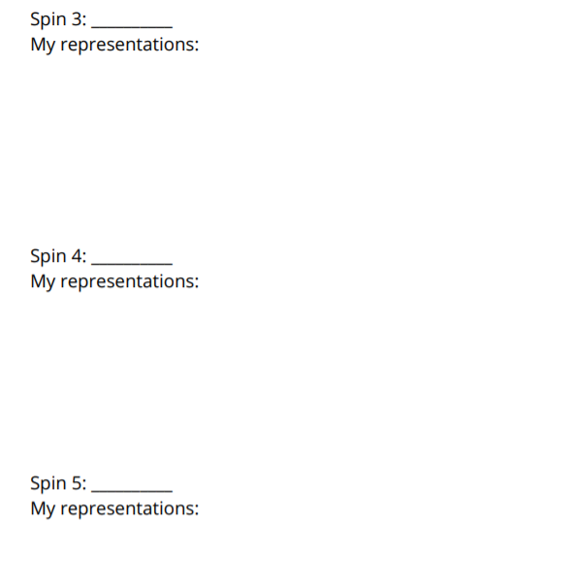
How Many Tens? Spin and Represent
Activity #2

Slide 10
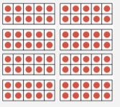

Lesson Synthesis
We’ve talked about how many groups of 10 we see in the numbers we’ve
been working with.
How did you find the answer?
How many dots are there?
We can say that 80 is made up of 8 tens or 80 ones.

Slide 11
Counting Tens and Ones
Adaptation
Lesson 2
Let’s figure out how many tens and ones are in a collection.
1.NBT.B.2

Slide 12
Choral Counting
Warm up
Count by 1, starting at 50
What patterns do you see?

Slide 13
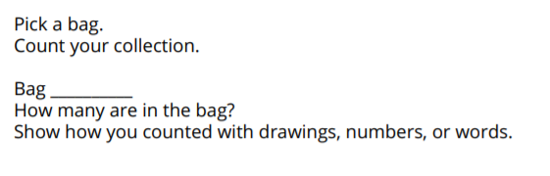
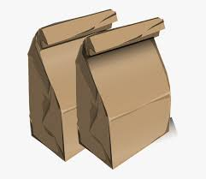
Counting Collections: Tens and Some More
Activity #1

Slide 14

Concentration: Quantities with Tens and Ones
Activity #2
Today you will be playing a game in which you try to find matches for cards. For example, look at these 3 cards. Which 2 match?
To play this game, you put all the cards face down.
One partner turns over 2 cards. If they match, they keep them. If they don’t match, they turn them back over.
Then the other partner turns over 2 cards. If they match, they keep them, and if they don’t, they turn them back over.
It is important to try and remember where different cards are. The goal is to get all the cards matched.
What parts of the card did you look at to make sure they matched?

Slide 15
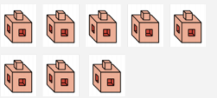
Lesson Synthesis
How many tens does this card show?
How is this image different than the ones we used in the activity today?
We say that numbers with one digit have 0 tens. What other numbers do you think have 0 tens? Why do you think that?

Slide 16
Expressions with Tens and Ones
Adaptation
Lesson 3
Let’s write expressions to match base-ten representations
1.NBT.C

Slide 17
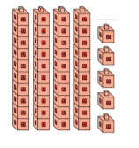
How Many Do You See: Towers of 10 and Ones
Warm up
How many do you see?
How do you see them?

Slide 18
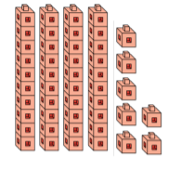
How Many Do You See: Towers of 10 and Ones
Warm up
How many do you see?
How do you see them?

Slide 19
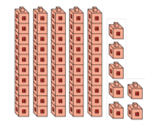
How Many Do You See: Towers of 10 and Ones
Warm up
How many do you see?
How do you see them?

Slide 20
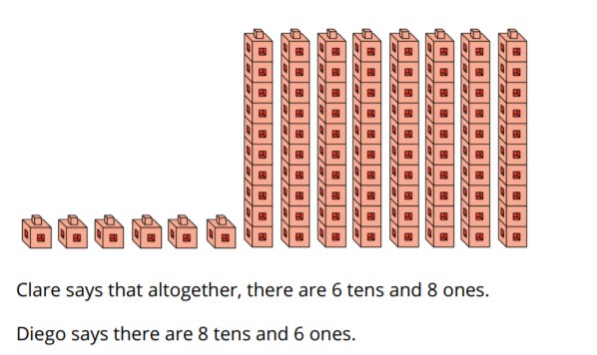
Who Do You Agree With?
Activity #1
1. Who do you agree with?
Explain using drawings, words, and numbers.
2. What number is represented?

Slide 21
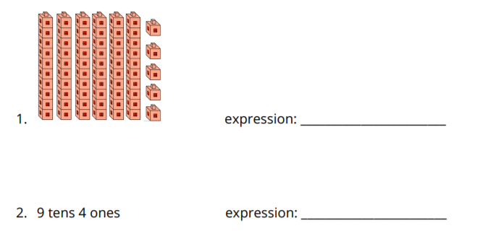
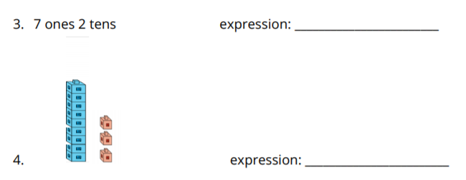
Writing Expressions
Activity #2
Write the expression that matches each representation.

Slide 22
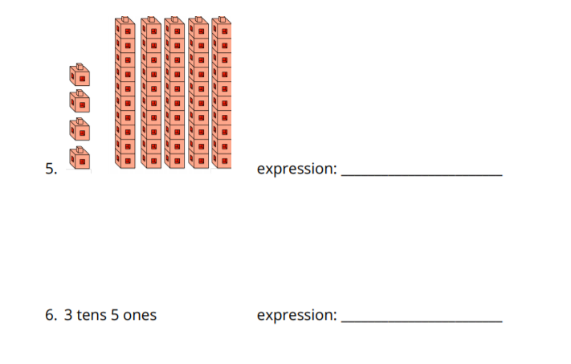
Writing Expressions
Activity #2
Write the expression that matches each representation.

Slide 23
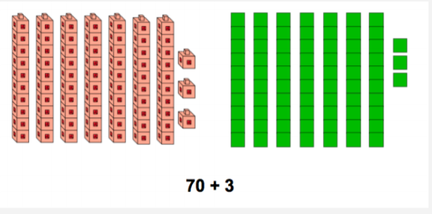

Lesson Synthesis
What do you notice about these representations?
What do you notice about this number? How is it the same as the other representations? How is it different?

Slide 24
Writing Numbers as Tens and Ones
Adaptation
Lesson 4
Let’s represent a number using different base-ten representations
1.NBT.A.2

Slide 25
What do you know?
Warm up
What Do You Know About 75?

Slide 26
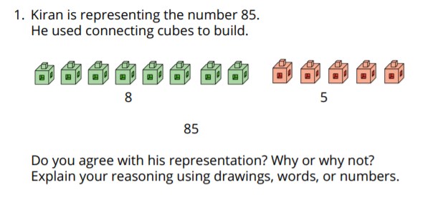

Kiran Represents 85
Activity #1

Slide 27
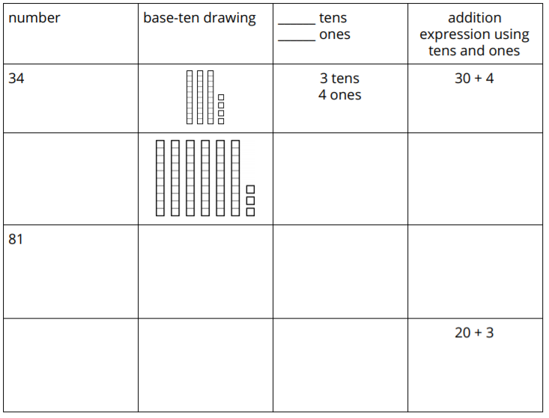
Base-Ten Representations
Activity #2
Fill in the missing parts on the table.

Slide 28
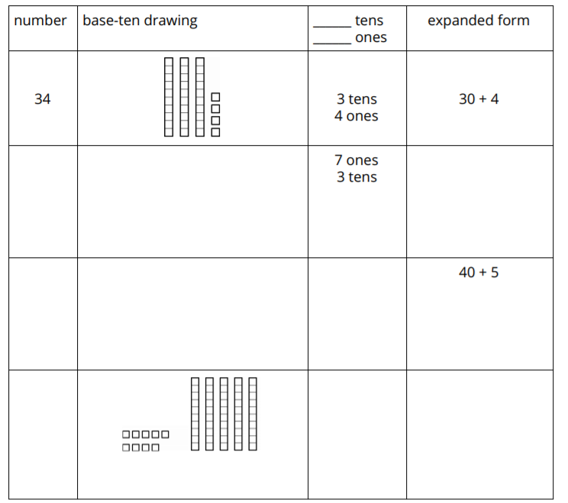
Base-Ten Representations
Activity #2
Fill in the missing parts on the table.

Slide 29
Lesson Synthesis
What do you notice about these representations?
What do you notice about this number? How is it the same as the other representations? How is it different?

Slide 30
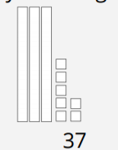
Lesson Synthesis
This is a base-ten drawing of 37 I saw during class today. What do you notice about how the student drew it?
Now that we are counting larger quantities, this is a new type of base-ten drawing that we can use. It is a short-cut method that can make your base-ten drawings more efficient.

Slide 31
Breaking Apart Two-Digit Numbers in Different Ways
Adaptation
Lesson 5
Let’s put together and break apart two-digit numbers in different ways
1.NBT.A.1

Slide 32
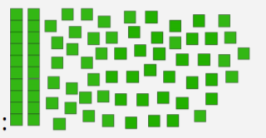
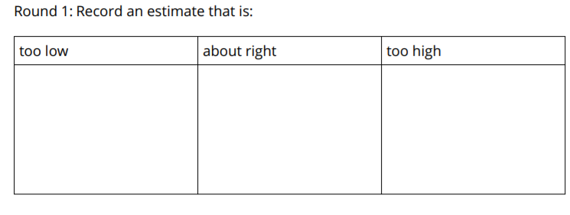
Estimation Exploration: Tens and Ones
Warm up

Slide 33
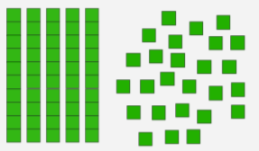
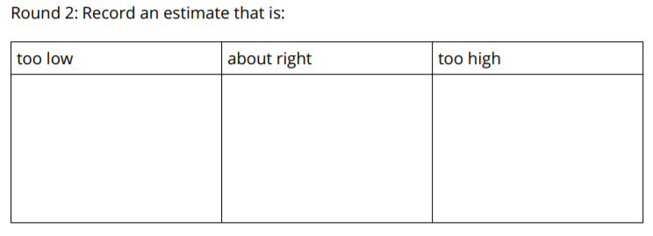
Estimation Exploration: Tens and Ones
Warm up

Slide 34
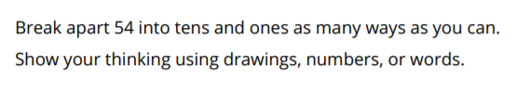
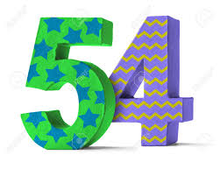
All the Ways to Make 54
Activity #1

Slide 35

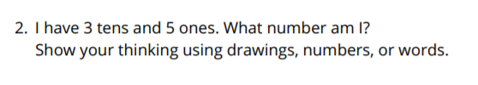
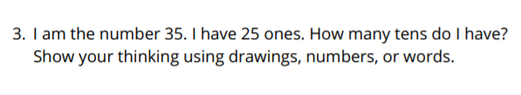

What Number Am I? Base-Ten Riddles
Activity #2

Slide 36

20 + 34 and 30 + 5
Lesson Synthesis
When we look at the two expressions, which one has a greater value? How do you know?

Slide 37
Add and Subtract to Compare
1
Let’s solve Compare problems with larger numbers.
2.MD.D.10, 2.NBT.B.5, 2.OA.A.1

Slide 38
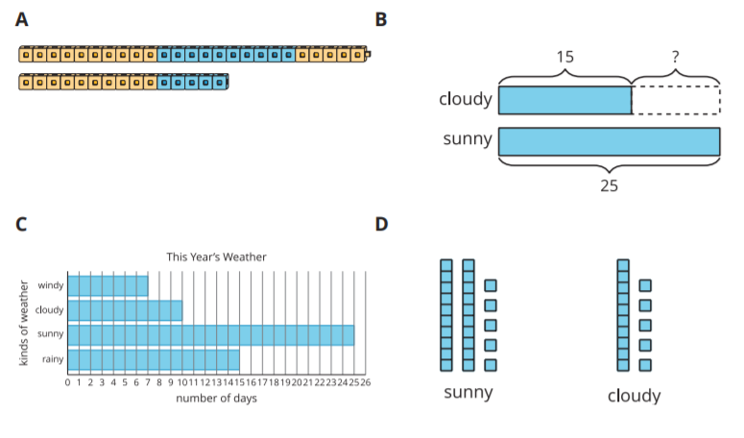
Which One Doesn’t Belong: Compare Representations
Warm up

Slide 39
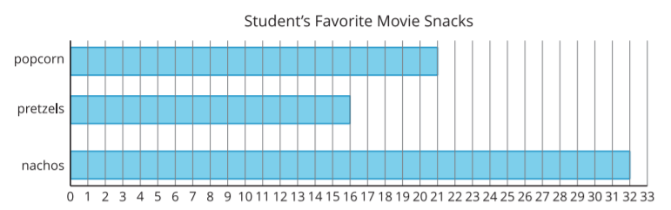

Movie Snacks
Activity #1
Use the bar graph to answer the questions.
1. How many students chose popcorn or pretzels? Show your thinking.
2. How many more students chose nachos than chose popcorn? Show your thinking.

Slide 40
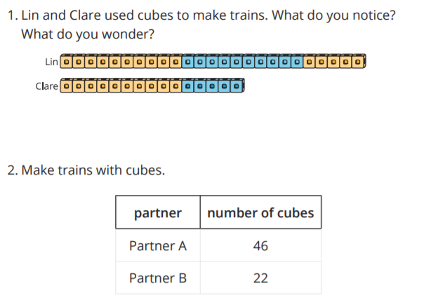
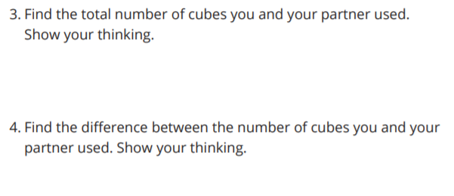
Build and Compare
Activity #2

Slide 41

Lesson Synthesis
This equation shows one way to represent the difference between your blocks.
What are the different ways we found the difference?
Why can we use methods that show taking away and use methods that add to find the difference?

Slide 42
Find the Value of Unknown Addends
2
Let's find values that make the equations true.
2.NBT.A.2, 2.NBT.B.5, 2.NBT.B.9

Slide 43
Choral Count
Warm up
Count Back by 10

Slide 44
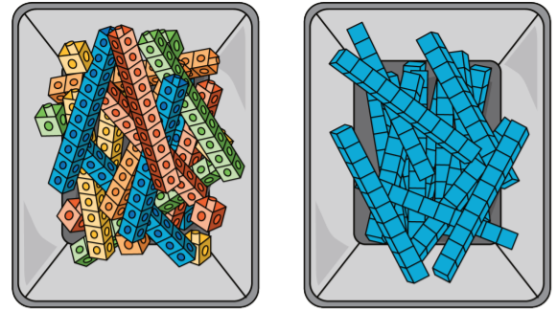
Add or Subtract to Make the Equations True
Activity #1
1. What is the same and what is different between these tools?
2. Find the value that makes the equation true. Show your thinking using the cubes, blocks, or drawings.
41+_____=84

Slide 45
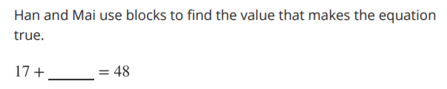
You Go This Way, I’ll Go That Way
Activity #2
1. Han starts by using blocks to show 17. Show how he could find the value that makes the equation true.
2. Mai starts by using blocks to show 48. Show how she could find the value that makes the equation true.
3. Try this one on your own. Choose who will start with 21 and who will start with 96.
21+____=96
4. Show your partner how you found the value that makes the equation true.

Slide 46

Lesson Synthesis
How are these equations the same? How are they different?
What tool would you use to find the value that makes each equation true? Explain how you would use it

Slide 47
A Day at the Zoo
3
Let's solve story problems
2.NBT.B.5, 2.OA.A.1

Slide 48
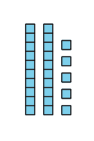
How Many Do You See?: Base-ten Diagram
Warm up
How many do you see?
How do you see them?

Slide 49
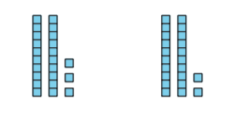
How Many Do You See?: Base-ten Diagram
Warm up
How many do you see?
How do you see them?

Slide 50
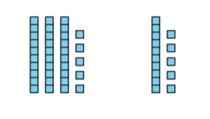
How Many Do You See?: Base-ten Diagram
Warm up
How many do you see?
How do you see them?

Slide 51
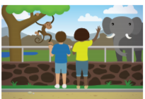
Fun at the Zoo
Activity #1
1. Some students were on the bus to go to the zoo. Then 34 more students got on. Now there are 55 students on the bus. How many students were on the bus at first?

Slide 52
More Fun at the Zoo
Activity #2
Solve each story problem. Show your thinking.
1. There were 65 students in the Monkey House. 23 left to see the hippos. How many are still in the Monkey House?
2. 58 students went to see the monkeys. 27 students went to see the lions. How many more students went to see the monkeys than the lions?
3. Some birds were in the cages outside. 34 were inside the Bird House. In all, there were 88 birds. How many were in the cages outside?

Slide 53
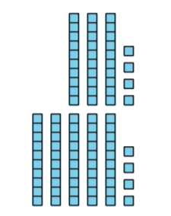
Lesson Synthesis
Let’s come up with equations we could write to match how _____ used their diagram.

Slide 54
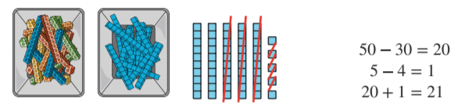
Section Summary
In this section of Unit 2, we used addition and subtraction to compare and to find unknown values. We used different tools to show how to add and subtract two-digit numbers.
We learned that when you subtract 2 two-digit numbers you can think about subtracting tens from tens and ones from ones.

Slide 55
Center Day 1 (Optional)
4
Let’s play games to practice adding and subtracting.
2.NBT.B.5, 2.OA.B.2

Slide 56

Number Talk: Subtract 2 Digits
Warm up
Find the value of each expression mentally.

Slide 57

Number Talk: Subtract 2 Digits
Warm up
Find the value of each expression mentally.

Slide 58

Number Talk: Subtract 2 Digits
Warm up
Find the value of each expression mentally.

Slide 59

Number Talk: Subtract 2 Digits
Warm up
Find the value of each expression mentally.

Slide 60
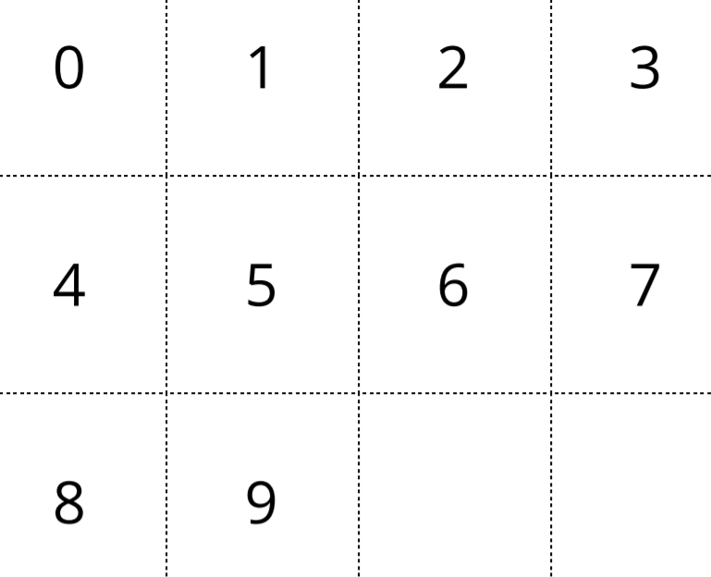
Number Puzzles, Up to 20
Activity #1
Work with your partner to use your digit cards to make each equation true. You can only use each digit one time

Slide 61
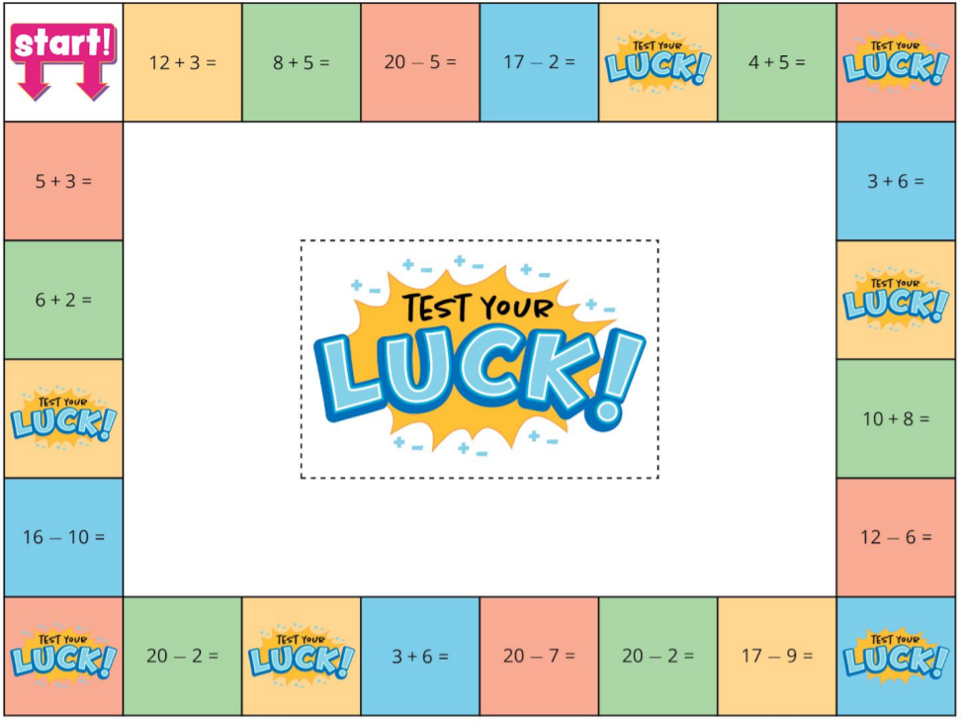
Board Game, Add and Subtract within 20
Activity #2
We are going to play a board game to practice adding and subtracting.
When it’s your turn, roll a die and move that many spaces clockwise around the gameboard.
Solve the addition or subtraction expression on the space correctly to receive a point.
If you land on a challenge space, pick up a challenge card and answer the problem correctly to score a point.
If you land on a chance space, pick up a chance card for a surprise.
The first player to reach 50 points wins.

Slide 62
Lesson Synthesis
Today, we played games that helped us practice adding and subtracting
How did you and your partner work together during centers? What went well? What can we continue to work on?

Slide 63
Different Ways to Find the Difference
5
Let’s subtract one-digit numbers from two digit numbers.
2.NBT.B.5, 2.OA.B.2

Slide 64

Number Talk: Subtract a Little More
Warm up
Find the value of each expression mentally.

Slide 65

Number Talk: Subtract a Little More
Warm up
Find the value of each expression mentally.

Slide 66

Number Talk: Subtract a Little More
Warm up
Find the value of each expression mentally.

Slide 67

Number Talk: Subtract a Little More
Warm up
Find the value of each expression mentally.

Slide 68
How Do You Find the Difference?
Activity #1
Find the difference for 82 - 9 .
Show your thinking using drawings, numbers, or words.
Be prepared to share your thinking.

Slide 69
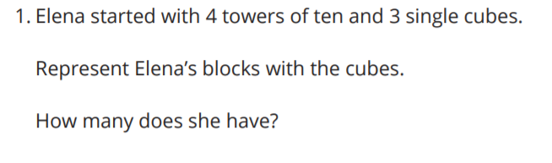
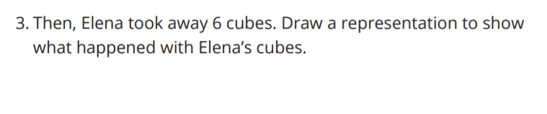
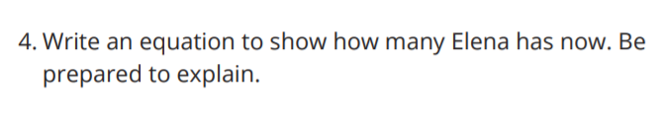
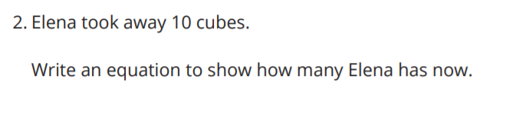
Subtracting with Towers of Ten
Activity #2

Slide 70





Subtracting with Base-ten Blocks
Activity #3

Slide 71



Lesson Synthesis
In this lesson, we learned that sometimes we can decompose a ten into 10 ones to subtract. We used towers of ten and base-ten blocks and drew base-ten diagrams to represent decomposition in subtraction problems.
How could representing 35 the second way help us find the difference?

Slide 72
Comparing Methods for Finding the Difference
6
Let’s compare subtraction methods.
2.NBT.B.5

Slide 73

True or False: How many Tens?
How many Ones?
Warm up
Is each statement true or false? Be prepared to explain your reasoning.

Slide 74

True or False: How many Tens?
How many Ones?
Warm up
Is each statement true or false? Be prepared to explain your reasoning.

Slide 75

True or False: How many Tens?
How many Ones?
Warm up
Is each statement true or false? Be prepared to explain your reasoning.

Slide 76



Different Ways to Decompose
Activity #1
1. Compare Elena’s work to Diego’s.
a. What is the same?
b. What is different?

Slide 77
Different Ways to Decompose
Activity #1
2. Compare Diego’s work to Tyler’s.
a. What is the same?
b. What is different?

Slide 78

Less Than 10
Activity #2
Spin to get a number to subtract from your starting number.
Take turns spinning and finding the difference
The first person to get less than 10 wins!

Slide 79
Lesson Synthesis
In this lesson, we learned that sometimes we can decompose a ten into 10 ones to subtract. We used towers of ten and base-ten blocks and drew base-ten diagrams to represent decomposition in subtraction problems.
How could representing 35 the second way help us find the difference?

Slide 80
Double Digits, Double the Fun
7
Let’s find the difference with two-digit numbers.
2.NBT.B.5, 2.NBT.B.6, 2.NBT.B.8, 2.NBT.B.9

Slide 81

How Many Do You See: Composing Ten
Warm up
How many do you see?
How do you see them?

Slide 82

How Many Do You See: Composing Ten
Warm up
How many do you see?
How do you see them?

Slide 83

How Many Do You See: Composing Ten
Warm up
How many do you see?
How do you see them?

Slide 84

How Many Do You See: Composing Ten
Warm up
How many do you see?
How do you see them?

Slide 85



What's the Difference?
Activity #1

Slide 86


Using Blocks to Take Away
Activity #2

Slide 87
Visual Representation of Data
Activity #2
Let’s organize and represent the data about how our class gets to school.
Make a list
Write numbers in a table
car | bus | walk | train
car
bus
walk
train

Slide 88
Lesson Synthesis
Today you used different methods to find the difference between 2 two-digit numbers. You solved in ways that make sense to you and you used base-ten blocks to take away different amounts
After finding the difference in your group activity, you found the sum of your numbers. In the end, how many do Lin, Han, Diego, and Jada have in all? Explain.
Activity 2 required you all to work together. What are some ways your group worked together?

Slide 89
Comparing Methods to Find the Difference
8
Let’s decompose to subtract.
2.NBT.B.5, 2.NBT.B.8, 2.NBT.B.9

Slide 90

Number Talk: Add and Subtract Multiples of 10
Warm up
Find the value of each expression mentally.

Slide 91

Number Talk: Add and Subtract Multiples of 10
Warm up
Find the value of each expression mentally.

Slide 92

Number Talk: Add and Subtract Multiples of 10
Warm up
Find the value of each expression mentally.

Slide 93

Number Talk: Add and Subtract Multiples of 10
Warm up
Find the value of each expression mentally.

Slide 94

Clare’s Method for Finding the Difference
Activity
#1
Part 1
1. Represent Clare’s work with base-ten blocks.
2. Equation:
34 - 18 =________
3. Talk to your group about how Clare’s work shows her thinking.

Slide 95
Clare’s Method for Finding the Difference
Activity
#1
Part 2
1. Try Clare’s method to find the value of :
73 - 26
Show your thinking using base-ten diagrams. Use the blocks if it helps.
2. Equation:
73 - 26 =________

Slide 96

Lin’s Method for Finding the Difference
Activity
#2
Part 1
1. Represent Lin’s work with base-ten blocks.
2. Find the missing value.
71 - 53 =_____
3. Talk to your group about Lin’s work

Slide 97
Lin’s Method for Finding the Difference
Activity
#2
Part 2
1. Try Lin’s method to find the value of :
82 - 37 = _______
Represent 82 with base-ten blocks using only 7 tens.
How many ones do you have? _________
2. Complete the equation.
82 - 37 = _______

Slide 98
Lesson Synthesis
Today you compared 2 methods for finding the difference.
What was different about their methods? And, what was the same?
Tell your partner which of these methods made sense to you. Explain.

Slide 99
Solve it Your Way
9
Let’s find the difference in our own way.
2.NBT.B.5

Slide 100

Which One Doesn’t Belong?:
Tens and Ones
Warm up

Slide 101



Sort and Solve
Activity
#1

Slide 102




Add or Subtract to Find the Value
Activity
#2
Find the value of each expression.
Show your thinking. Use blocks if it helps.

Slide 103
In this unit, you added and subtracted within 100 using different strategies, tools, and representations.
Lesson Synthesis
What is something new you’ve learned about addition or subtraction?
What is something you’ve learned from another classmate?

Slide 104

Section Summary
In this section we learned about subtracting within 100 when a ten is decomposed. We were introduced to a new math tool, base-ten blocks, that can be used to represent numbers and help us with composing and decomposing when we add or subtract.

Slide 105
Center Day 2 (Optional)
10
Let’s play games to practice adding and subtracting.
2.NBT.B.5, 2.NBT.B.9

Slide 106

Notice and Wonder:
Compare the Representations
Warm up
What do you notice?
What do you wonder?

Slide 107

Centers: Introducing Less than 10, Start with 99
Activity
#1

Slide 108


Centers Choice Time
Activity
#2
Number Puzzles
Board Game

Slide 109
Lesson Synthesis
Today we chose activities to work on and worked with a partner during center time.

Slide 110
Sort Story Problems
Adaptation
Lesson 6
Let’s solve story problems and write equations.
1.OA.C.6, 1.OA.D.6

Slide 111

Which one doesn’t belong?
Warm up

Slide 112

Comparing Recess Stories
Activity #1
How are these problems alike?
How are they different?
Be prepared to share your thinking.

Slide 113

Comparing Recess Stories
Activity #1
How are these problems alike?
How are they different?
Be prepared to share your thinking.

Slide 114


Solve a Recess Story Problem
Activity
#2

Slide 115


Solve a Recess Story Problem
Activity
#2

Slide 116


Solve a Recess Story Problem
Activity
#2

Slide 117


Solve a Recess Story Problem
Activity
#2

Slide 118

Lesson Synthesis
How do each of these equations represent the problem?

Slide 119
Introduce Equations with Unknowns
Adaptation
Lesson 7
Let’s make sense of equations with boxes.
1.OA.A.1, 1.OA.D.8

Slide 120

Notice and Wonder
Warm up
What do you notice?
What do you wonder?

Slide 121









Card Sort
Activity #1

Slide 122

Which Equation
Activity
#2

Slide 123
Lesson Synthesis
Today, we saw that for some story problems, there are addition and subtraction equations that can represent the problem
Which kind of equation do you prefer to write? Why?

Slide 124
Story Problems and Equations
Adaptation
Lesson 8
Let’s write more than 1 equation to match story problems.
1.OA.A.1

Slide 125

Which one doesn’t belong?
Warm up

Slide 126


Write More Than 1 Equation
Activity #1

Slide 127


Write More Than 1 Equation
Activity #1

Slide 128


Questionless Word Problems
Activity
#2

Slide 129


Questionless Word Problems
Activity
#2

Slide 130
Lesson Synthesis
3 + 7 and 3 = 10 and + 3 + ___ = 10
How is the first equation the same as the second equation? How is it different?

Slide 131
How Do You Solve Story Problems?
11
Let’s solve story problems.
2.NBT.B.5, 2.OA.A.1

Slide 132
What Do You Know About ____?
Warm up
What do you know about story problems?

Slide 133

How Many Seeds?
Activity
#1
1. Diego gathered 42 orange seeds. Jada gathered 16 apple seeds.
How many more seeds did Diego gather than Jada?
Show your thinking

Slide 134



The Seeds of Greatness
Activity
#2
Solve each story problem. Show your thinking

Slide 135
Lesson Synthesis
How are these diagrams and drawings the same? How are they different?
Which diagrams do you find most helpful when you are trying to understand a story? Which do you use when you find the value?

Slide 136
Connect Story Problems and Diagrams
12
Let’s make sense of diagrams and solve story problems.
2.NBT.B.5, 2.OA.A.1

Slide 137

Notice and Wonder: Mancala
Warm up
What do you notice?
What do you wonder?

Slide 138


Interpret the Diagram
Activity
#1
Circle the diagrams that match each story. Then explain your match to your partner.

Slide 139


Interpret the Diagram
Activity
#1
Circle the diagrams that match each story. Then explain your match to your partner.

Slide 140



Diagrams for Different Types of Story Problems
Activity
#2

Slide 141

Lesson Synthesis
Today we read many different kinds of story problems and matched them with diagrams.
How are these diagrams the same? How are they different?
Think of a story that could match Card N

Slide 142
Connect Story Problems and Equations
13
Let’s make sense of equations and solve story problems.
2.NBT.B.5, 2.OA.A.1

Slide 143


Which One Doesn’t Belong: Diagrams
Warm up
D.

Slide 144
Equations for Different Types of Word Problems
Activity
#1
1. Match each story problem to an equation.
-Explain why the cards match.
2. Choose 2 story problems and solve them.
-Show your thinking.

Slide 145

Represent and Solve Story Problems
Activity
#2

Slide 146

Represent and Solve Story Problems
Activity
#2

Slide 147

Represent and Solve Story Problems
Activity
#2

Slide 148

Represent and Solve Story Problems
Activity
#2

Slide 149


Lesson Synthesis
Do both equations match the story and the diagram? Explain.
Which helps you make sense of a story – a diagram, an equation, or both?

Slide 150
Solve More Story Problems Your Own Way
14
Let’s solve story problems and share our thinking with others.
2.NBT.B.5, 2.NBT.B.8, 2.OA.A.1

Slide 151

Number Talk: Multiple Addends
Warm up
Find the value of each expression mentally.

Slide 152

Number Talk: Multiple Addends
Warm up
Find the value of each expression mentally.

Slide 153

Number Talk: Multiple Addends
Warm up
Find the value of each expression mentally.

Slide 154

Number Talk: Multiple Addends
Warm up
Find the value of each expression mentally.

Slide 155

Put It All Together
Activity
#1
1. Andre gathered seeds. He has 25 sunflower seeds and 17 squash seeds.
How many seeds does he have? Show your thinking.
2. Andre gathered more seeds. He has 35 cucumber seeds.
How many seeds does Andre have altogether? Show your thinking.
3. Compare your thinking with your partner.

Slide 156



Select, Solve, and Share
Activity
#2

Slide 157
Lesson Synthesis
In this unit, we practiced making sense of and solving different kinds of story problems and using what we know about adding and subtracting two-digit numbers.
What do you do to make sense of and solve story problems?
What ideas for solving story problems have you learned from others?

Slide 158

Section Summary
In this section of Unit 2, we solved many different kinds of story problems. We used diagrams and equations to make sense of problems.
We shared how we make sense of story problems and how we solve them and learned from each other.

Slide 159
Center Day 3 (Optional)
15
Let’s use diagrams to make our own story problems and solve them.
2.NBT.B.5, 2.OA.B.2

Slide 160

Number Talk:
Subtracting Multiples of 10
Warm up
Find the value of each expression mentally.

Slide 161

Number Talk:
Subtracting Multiples of 10
Warm up
Find the value of each expression mentally.

Slide 162

Number Talk:
Subtracting Multiples of 10
Warm up
Find the value of each expression mentally.

Slide 163

Number Talk:
Subtracting Multiples of 10
Warm up
Find the value of each expression mentally.

Slide 164


Centers: Math Stories
Activity
#1

Slide 165

Centers Choice Time
Activity
#2
Less than 10
Board Game

Slide 166
Lesson Synthesis
Today we used diagrams to tell our own stories and practiced adding and subtracting.
Would you rather create a story problem or solve a story problem? Explain.

Slide 167
Our Market’s Inventory
16
2.NBT.B.5, 2.NBT.B.6, 2.NBT.B.9, 2.OA.A.1, 2.OA.B.2

Slide 168

Notice and Wonder: The Shopping Cart
Warm up
What do you notice?
What do you wonder?

Slide 169


100 Items
Activity
#1
1. Complete the first two rows of the table.
2. Share your store set-up with your partner pair. Discuss:
a. the amount you have for each item
b. how you know that you have a total of 100 items at your store

Slide 170


Buyers and Sellers
Activity
#2

Slide 171

Sales Reports
Activity
#3

Slide 172
Lesson Synthesis
We’ve been learning about adding and subtracting within 100.
How does today’s lesson connect to what we learned?

Slide 173


Section Summary
We learned how to represent and solve Compare problems.
First, we used bar graphs to find the difference between two categories.
We learned about a new representation called a diagram. It helps us make sense of story problems. We can use diagrams to show which part of a comparison we need to find.
Jada read 47 pages of the book. Noah read 20 pages of the book. How many fewer pages did Noah read?

