Slide 1

Adding and Subtracting with Data
Grade 2: Unit 1
Standards addressed: MD.D.10, OA.A.1, OA.B.2
These slides have been created by Plainville Community Schools and are not official IM materials. Images and language are taken from IM Grade 2, Unit 1 by Illustrative Mathematics.
Copyright 2020 by Illustrative Mathematics. All Rights Reserved, adapted and shared with permission.

Slide 2
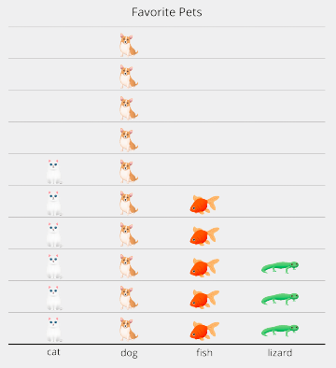
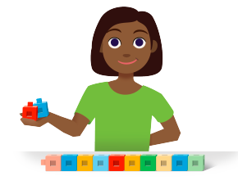
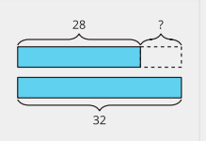
Unit 1 Progression Overview
Adding and Subtracting with Data
Section A
Lessons 1-6
OA.B.2, NBT.A.1
Section B
Lessons 7 - 12
MD.D.10, OA.A.1, OA.B.2
Section C
Lessons 13 - 17
MD.D.10, OA.A.1, OA.B.2, NBT.B.5
Build toward fluency with adding within 100
Build toward fluency with subtracting within 20.
Interpret picture and bar graphs
Represent data using picture and bar graphs
Solve one and two-step problems using addition and subtraction within 20
Make sense of and interpret tape diagrams
Represent and solve compare problems with unknowns in all positions within 100

Slide 3

Unit 1 Quick Link Page
ADAPT 1
ADAPT 2
ADAPT 3
ADAPT 4
L1
L2
L3
L4
L5
L6
ADAPT 5
L7
L8
L9
L10
L11
L12
ADAPT 6
ADAPT 7
ADAPT 8
L13
L14
L15
L16
L17
L18

Slide 4
Solve Story Problems with 3 Numbers
Adaptation
Lesson 1
Let’s solve story problems with 3 numbers.
1.OA.A.2, 1.OA.B.3, 1.OA.C.5, 1.OA.C.6

Slide 5
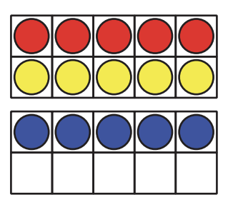
How Many Do You See?
Warm up
How many do you see? How do you see them?

Slide 6
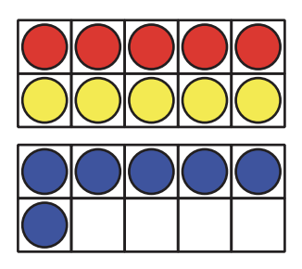
How Many Do You See?
Warm up
How many do you see? How do you see them?

Slide 7
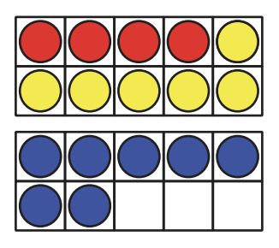
How Many Do You See?
Warm up
How many do you see? How do you see them?

Slide 8
How Many Do You See?
Warm up
What equation could I write for each image?
How can I write an equation that shows the number of each color of counters?

Slide 9
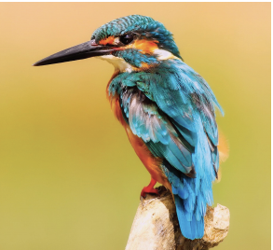
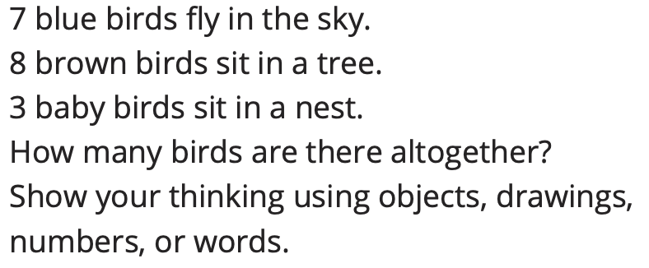
5 Practices: Louis Agassiz Fuertes’s Birds
Activity #1
Is there a method that is different than yours, that you would like to try?

Slide 10
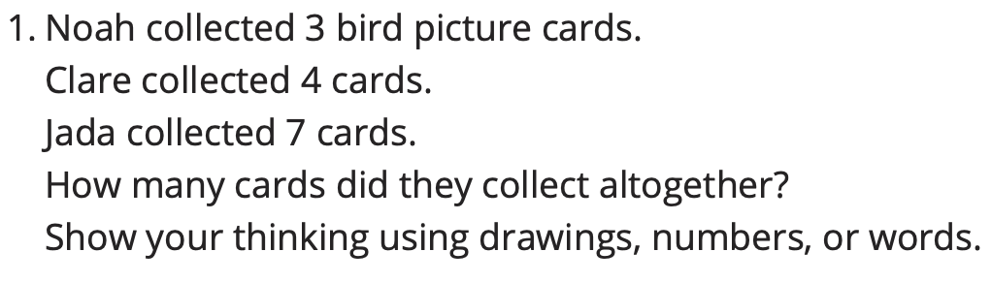
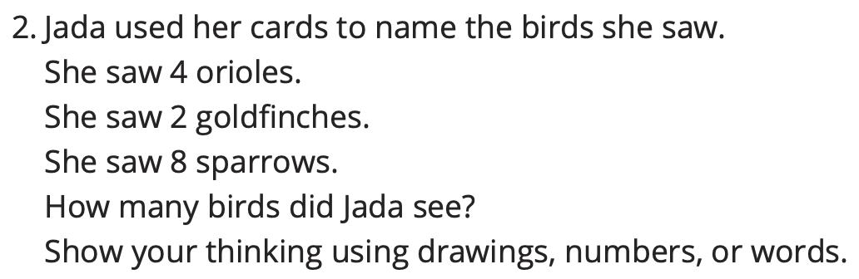
Fuertes’s Bird Cards
Activity #2

Slide 11
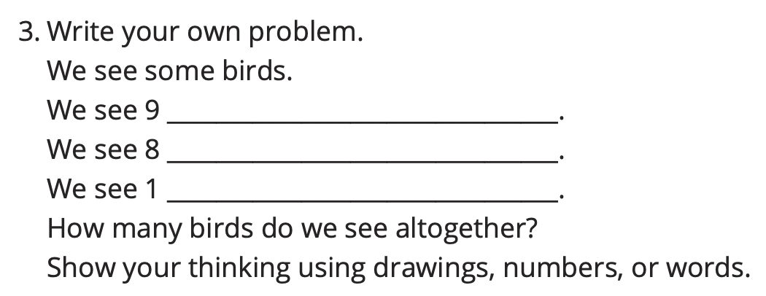
Fuertes’s Bird Cards
Activity #2

Slide 12
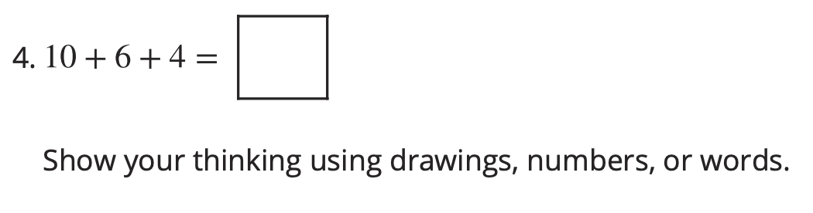
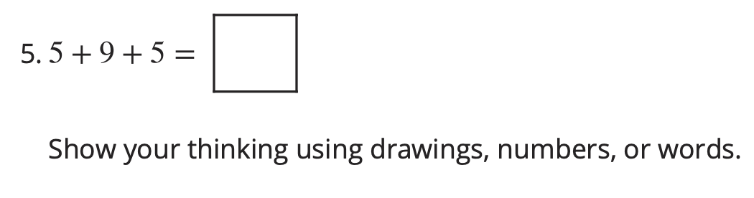
Fuertes’s Bird Cards
Activity #2
What connections do you see between the different methods?

Slide 13

Let’s Put it All Together
Lesson Synthesis
Today, we learned about a man who was a very good painter. He wanted to paint birds while they were alive so he learned how to paint quickly. We also found the sum of three numbers.
What did each of you do today that helped you solve a problem with three numbers?

Slide 14
Add Three Numbers
Adaptation
Lesson 2
Let’s add 3 numbers.
1.OA.A.2, 1.OA.B.3, 1.OA.C.5, 1.OA.C.6

Slide 15
Number Talk
Warm up
7 + 10

Slide 16
Number Talk
Warm up
7 + 2 + 8

Slide 17
Number Talk
Warm up
10 + 9

Slide 18
Number Talk
Warm up
4 + 9 + 6
Why did some of the expressions have the same value?

Slide 19
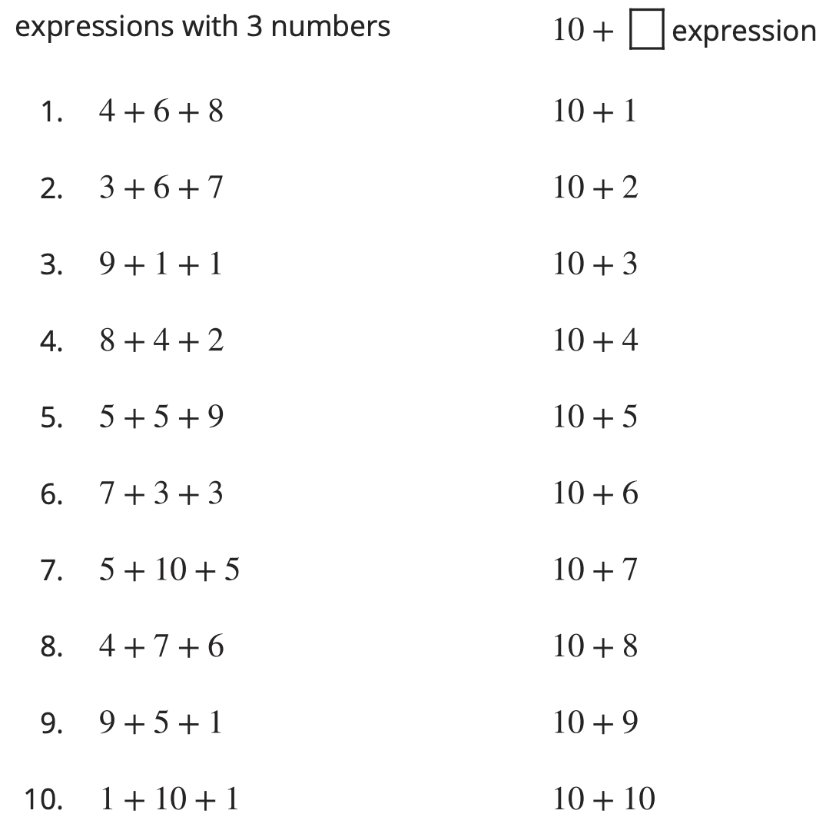
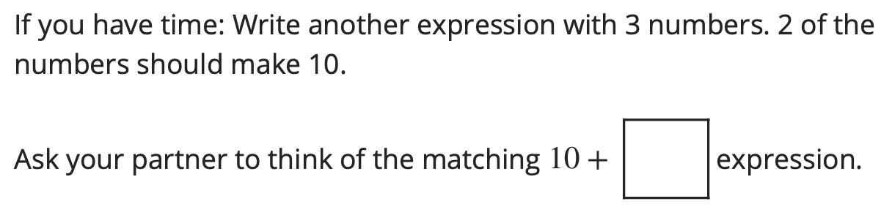
Match Expressions
Activity #1
Draw a line to match each expression to one that has the same sum.
How did you know which expressions have the same value?

Slide 20
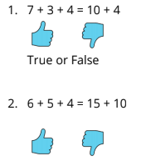
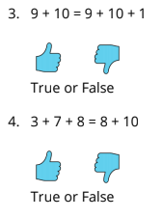
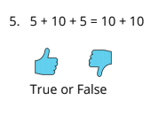
Is the Equation True?
Activity #2
Determine whether each equation is true or false.
Be ready to explain your reasoning in a way that others can understand.
Does their reasoning prove whether the equation is true? Why or why not?

Slide 21
Write Expressions
Activity #3
Write the related 10 + _____ expression and find the sum.
1. 5 + 7 + 5
2. 3 + 7 + 6
3. 1 + 9 + 9
4. 4 + 8 + 6
5. 8 + 10 + 2
Write as many expressions as you can with 3 addends that are equal to 10 + 5.
10 + n
In order to make adding three numbers easier, we can rewrite each expression as an expression.

Slide 22
Let’s Put it All Together
Lesson Synthesis
Today we worked with expression with three numbers and expressions with 10.
2 + 6 + 8 = 7 + 3 + 6.
Did anyone determine whether it is true or false without adding all the numbers?
Is this problem true or false? How do you know?

Slide 23
Use a Ten to Subtract
Adaptation
Lesson 3
Let’s use 10 to help us subtract.
1.OA.C.6, 1.OA.D.8

Slide 24
Number Talk
Warm up
17 - 7

Slide 25
Number Talk
Warm up
17 - 7 - 1

Slide 26
Number Talk
Warm up
17 - 8

Slide 27
Number Talk
Warm up
17 - 9
Did anyone approach the problem in a different way?

Slide 28
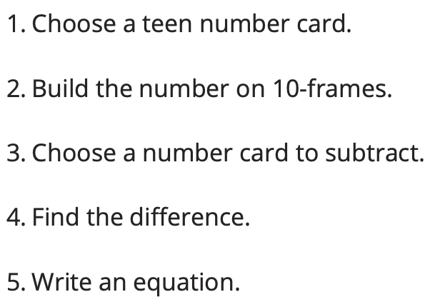
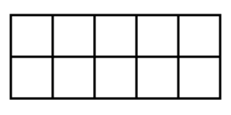
Number Card Subtraction with 10-Frames
Activity #1
Pick your favorite equation.
Show how you found the difference using drawings,
words, or numbers.
Did the double 10-frames help? Why?

Slide 29


Diego and Andre Find the Difference
Activity #2
Diego is playing Number Card Subtraction. He started with 15 and then picked an 8. He started out by doing this:
What could Diego do next to find the difference?
What is the difference?

Slide 30
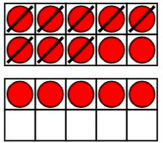
Diego and Andre Find the Difference
Activity #2
Andre was also trying to find 1 5- 8. He started out by doing this:
What could Andre do next to find the difference?
What is the difference?

Slide 31
Diego and Andre Find the Difference
Activity #2
Find the difference using Diego’s way or Andre’s way.
1. 14 - 5 Show your thinking using drawings, numbers, or words.
2. 13 - 6 Show your thinking using drawings, numbers,or words.
Did anyone solve it a different way? Why?

Slide 32
Let’s Put it All Together
Lesson Synthesis
Today we used a ten to subtract from teen numbers.
14 - 7
How can we use 10 to help us find the value of the difference?

Slide 33
Relating Counting to Addition and Subtraction
Adaptation
Lesson 4
Let’s subtract by counting on or taking away.
1.NBT.A.1,.1.OA.B.4, 1.OA.C.5, 1.OA.C.6

Slide 34
Choral Count
Warm up
Count backwards by 1,
starting at 50.
Who can restate the pattern in different words?

Slide 35
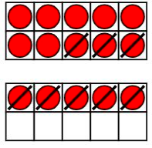


Different Ways to Subtract
Activity #1
Yesterday, we saw Diego’s strategy for finding 15 - 8.
Diego’s way:
Tyler’s way:

Slide 36
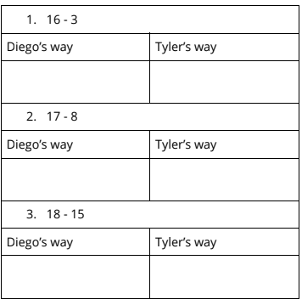


Different Ways to Subtract
Activity #1
For each problem, find the difference using Diego’s way, then using Tyler’s way.
How does this equation match Deigo’s method?
How does this equation match Tyler’s method?

Slide 37
Find the Value That Makes Equations True
Activity #2
Find the value that makes each equation true. Be sure you can explain your thinking in a way that others will understand.
Set B:
6. 5 + __ = 18
7. 13 = __ + 6
8. 20 = 15 + ___
Set A:
1. 12 – 7 = __
2. 18 - 5 = __
3. __ = 14 - 6
4. 15 - 12 = __
5. 13 - 4 = ___
How is this equations difference from all of the others?

Slide 38
Let’s Put it All Together
Lesson Synthesis
Today we used different methods for subtracting.
What method do you like best for subtracting?
Why?

Slide 39
Add and Subtract
within 10
1
Let’s add and subtract within 10.
OA.B.2

Slide 40

What Do You Know About Math?
Warm up

Slide 41
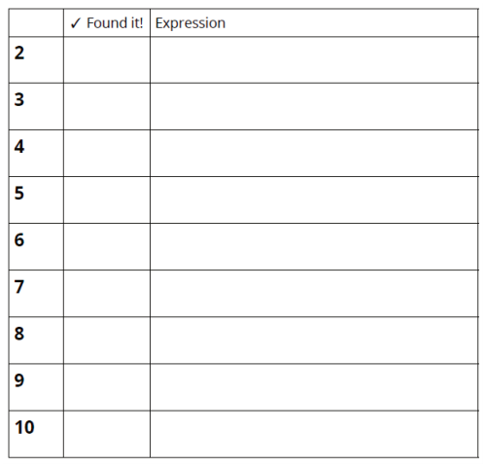
Introduce Check It Off; Add or Subtract within 10
Activity #1
I’m going to pick two cards. I have to decide whether I want to add or subtract.
Now I find the value.
Now I check off the value. What expression represents the value of the numbers?
I record the expression on my recording sheet next to the value. Now it’s my partner’s turn.
Did you write any expressions that matched the same value? What number was it? What were the expressions?
Were there any values that you and your partner did not find? What are some expressions that could match these numbers?

Slide 42
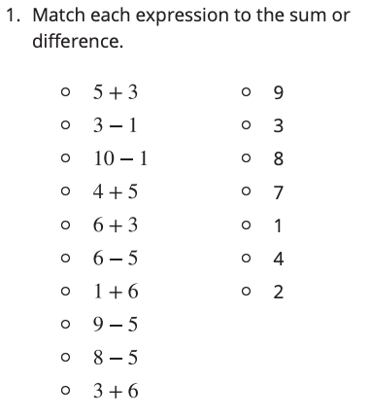
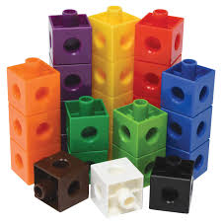
What’s the Value?
Activity #2

Slide 43
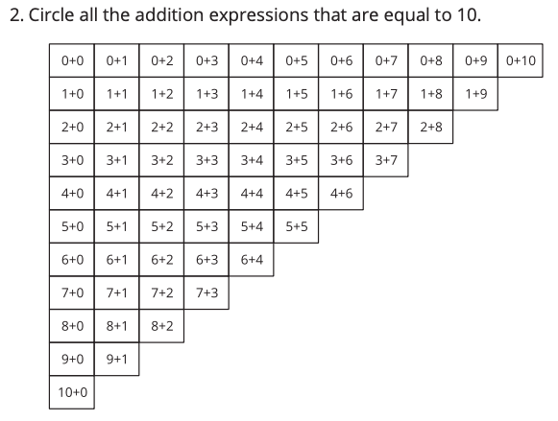
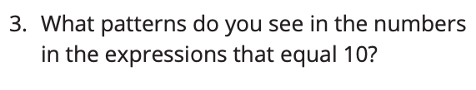
What’s the Sum? What’s the Difference?
Activity #2

Slide 44
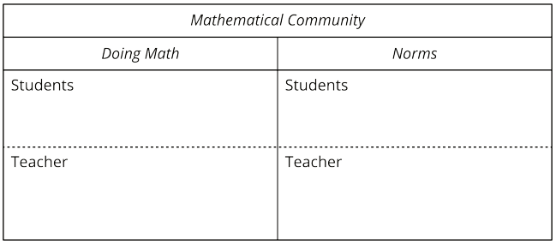

Today, you played a math game and added and subtracted within 10. We are going to make a chart to describe what you do and I do in our mathematical community.
Lesson
Synthesis
What does it look like and sound like to do math together?

Slide 45
Relate Addition & Subtraction within 10
2
Let’s think about the relationship between addition and subtraction.
MD.C.3, MD.C.4

Slide 46
What Do You Know About 10?
Warm up
How could we represent 10?

Slide 47

Revisit What’s Behind My Back; 10 Cubes
Activity #1
We are going to play a game called What’s Behind My Back. Let’s play the first round together to make sure we all remember how to play.
How many cubes are behind my back? How do you know?
Switch roles.
How does this expression represent the game?
2 + _____ = 10
How can we represent the game with a subtraction equation?

Slide 48
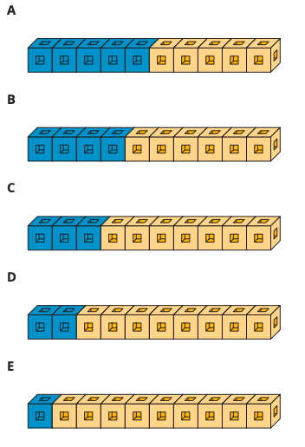
Sums of 10
Activity #2
Write as many equation as you can to represent the tower.
Continue writing as many equations for each cube tower. You can write addition and subtraction equations.

Slide 49
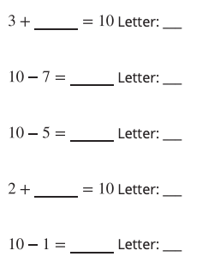
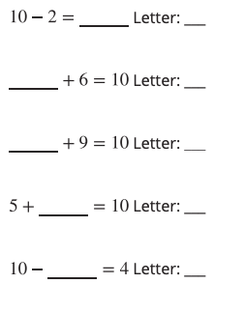
Activity #2
Find the number that makes each equation true. Then write the letter of the cube tower that represents the equation.
10 - 7
Which cube tower does this represent?
Where do you see each part of the equation in the tower?
How can the tower help us find the unknown number?

Slide 50
Let’s revisit our Math Commnity Chart
Lesson
Synthesis
Based on what we did today, what can we add to doing math?

Slide 51
Relate Addition and Subtraction within 20
3
Let’s find the number that makes the equations with 20.
OA.B.2

Slide 52
Number Talk
7 + 3
Warm up

Slide 53
Number Talk
10 - 7
Warm up

Slide 54
Number Talk
10 - 2
Warm up

Slide 55
Number Talk
10 - 4
Warm up
How did thinking about addiction help you subtract?

Slide 56
What’s Behind My Back; 20 Cubes
Activity #1
We are going to play What’s Behind My Back this time with 20 cubes.
How did you figure out how many connecting cubes were behind your partners back last time?
Let’s try.
This time when you play, you are going to record an addition equation with a blank to represent the missing cubes, before you figure out how many are behind your partner’s back. What equation should we record?
What’s behind my back? How do you know?

Slide 57
What’s Behind My Back: 20 Cubes
Activity #1
What’s an addition equation I can write to represent the number of cubes you know and the number of cubes you need to figure out?
Tell your partner how you can figure out how many cubes are missing.

Slide 58









Make the Equation True
Activity #2
How did thinking about a ten help them find their answer?

Slide 59
Let’s Put it All Together
Lesson Synthesis
Today, we found the unknown number in equations that makes them true.
We are going to make a list of norms for how we do math together.

Slide 60
Add and Subtract Your Way
4
Let’s add and subtract within 20
OA.C.6

Slide 61
Number Talk
Warm up
8 + 2

Slide 62
Number Talk
Warm up
8 + 3

Slide 63
Number Talk
Warm up
8 + 5

Slide 64
Number Talk
Warm up
7 + 6
How does making 10 help in finding the value of the sums?

Slide 65
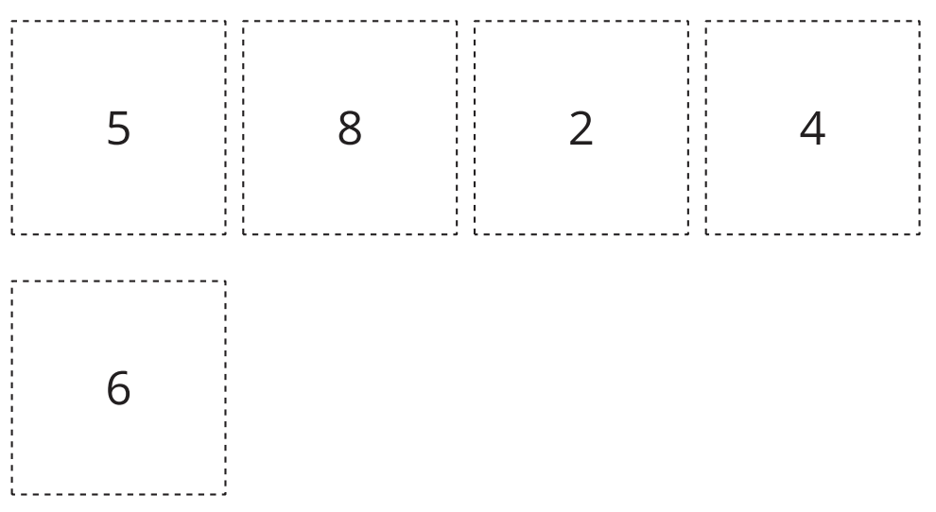
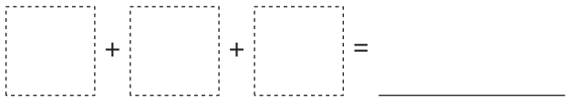
Revisit How Close? Close to 20
Activity #1
Look at the 5 cards. Think about which 3 cards you would choose to add together to get close to 20.
After you choose your 3 cards, you will write an equation showing the sum.
When you have your equation written, compare it with your partner’s to see who found a sum closer to 20.
What methods did you use to find a sum close to 20?

Slide 66
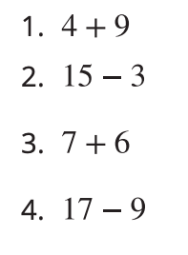
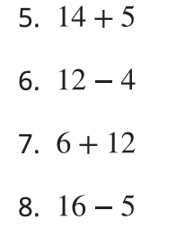
Add and Subtract Within 20
Activity #2
Find the sum or difference.
Show your thinking using drawings, numbers, or words.

Slide 67
Let’s Put it All Together
Lesson Synthesis
Today, we worked with a partner to play a game about adding and subtracting within 20.
Do our community norms need any additions or revisions?

Slide 68
Add Within 50
5
Let’s add within 50
NBT.C.4

Slide 69
Number Talk
Warm up
16 + 3

Slide 70
Number Talk
Warm up
16 + 5

Slide 71
Number Talk
Warm up
26 + 5

Slide 72
Number Talk
Warm up
38 + 6
How does looking for ways to make 10 help to find the value of the sum with larger numbers?

Slide 73
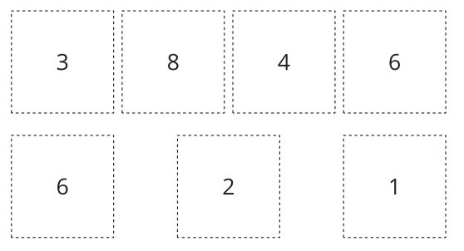

How Close? Close to 50
Activity #1
Look at the 7 cards. Think about cards you would choose to make 2 two-digit numbers that have a sum close to 50.
After you choose your two-digit numbers, you will write an equation showing the sum.
When you have your equation written, compare it with your partner’s to see who found a sum closer to 50.

Slide 74
How Close? Close to 50
Activity #1
Diego made the number 38. What number could Diego make next to get close to 50?

Slide 75
Add Within 50
Activity #2
Find the sum.
Show your thinking using drawings, numbers, or words.
37 + 8 4. 39 + 11
24 + 23 5. 27 + 15
16 + 30

Slide 76
Let’s Put it All Together
Lesson Synthesis
Today, we played another game with a partner. We also worked through some problems independently before sharing our thinking with others. Let’s add to our chart from yesterday.
What norms would you like to add?

Slide 77
Centers:
Choice Time
6
Let’s add and subtract in center activities.
OA.C.6, NBT.C.4

Slide 78
Number Talk
Warm up
14 + 22

Slide 79
Number Talk
Warm up
19 + 22

Slide 80
Number Talk
Warm up
15 + 25

Slide 81
Number Talk
Warm up
17 + 25

Slide 82
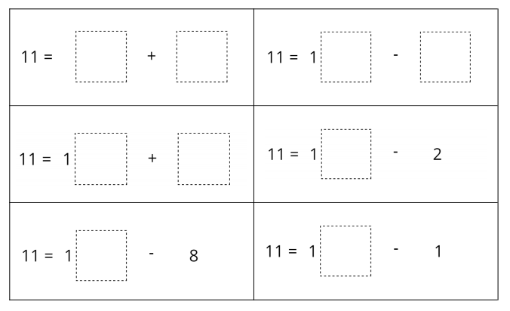
Revisit Number Puzzles, Within 20
Activity #1
In this game, you use digit cards to make each equation true.
You can only use each digit card once on the game board.
Which equation would you start with? Why would you start there?

Slide 83
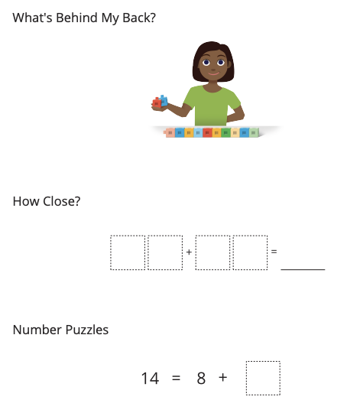
Choice Time
Activity #2
What is one thing you learned or got better at by working on the activity you chose?

Slide 84
Let’s Put it All Together
Lesson Synthesis
Today we chose activities to work on and worked with a partner during center time.
What went well? What can we continue to work on?

Slide 85
Questions About Data?
Adaptation
Lesson 5
Let’s ask and answer questions about data.
1.MD.A.4, 1.OA.C.6

Slide 86
Number Talk
7 + 1
Warm up

Slide 87
Number Talk
7 + 2
Warm up

Slide 88
Number Talk
9 - 1
Warm up

Slide 89
Number Talk
9 - 2
Warm up
How can we add or subtract 1 or 2 quickly?

Slide 90
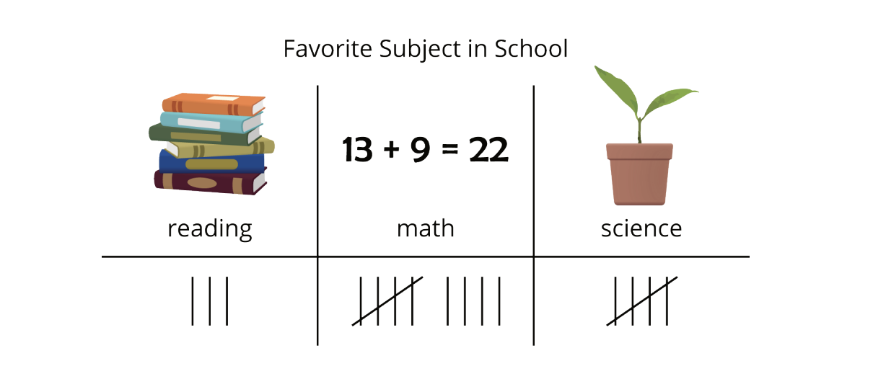
Can You Answer It?
Activity #1
Elena asked her classmates, “What is your favorite subject in school?” She showed their responses below.

Slide 91
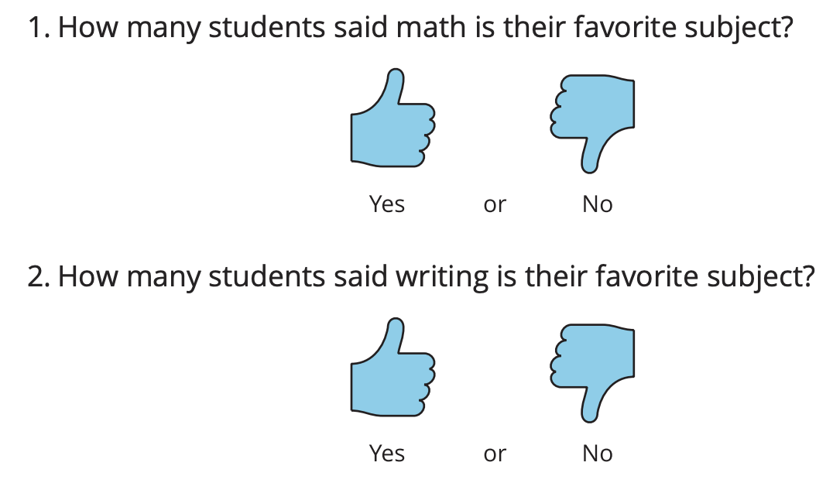
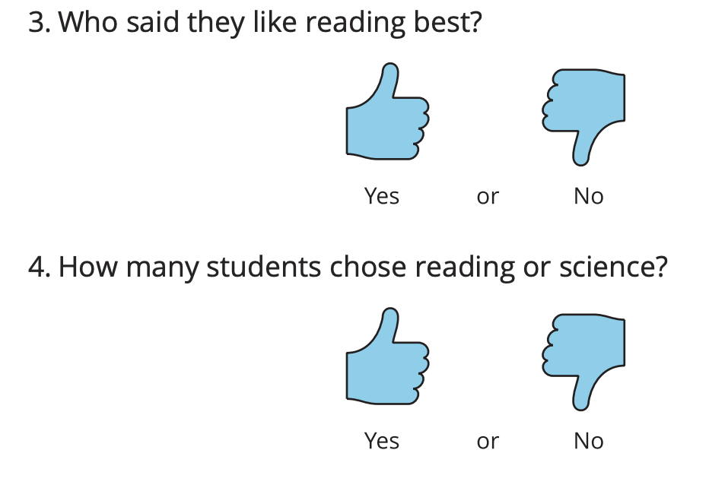
Can You Answer It?
Activity #1
Han wrote questions about Elena's data. Decide whether each question can be answered using the data representation. Be ready to explain why.
What question did you find cannot be answered? Why can’t it be answered?
How can we change the question so that it can be answered using this representation?

Slide 92
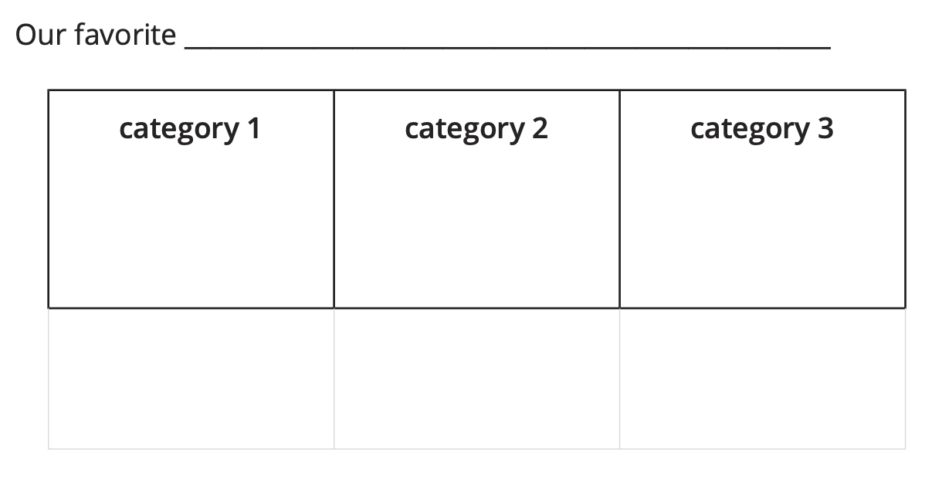
Ask Questions
Activity #2
Group A
Group B

Slide 93
Answer Questions
Activity #3
Now you will take turns asking and answering questions about your data.
The person who goes first shows their data representation to their partner and asks a question about the data. Their partner answers the question and explains how they found the answer.
Repeat with another question, then switch roles.
If your partner asks you a question that can’t be answered using the data representation, explain why it can’t be answered.
Why do we have two different answers to the questions?

Slide 94
Today we asked questions about our data.
Lesson Synthesis
What do you need to think about when asking questions, to be sure they can be answered using your data representation?

Slide 95
Collect and Represent Data
7
Section B: Different Ways to Represent Data
Let’s organize data and share with others.
MD.D.10

Slide 96
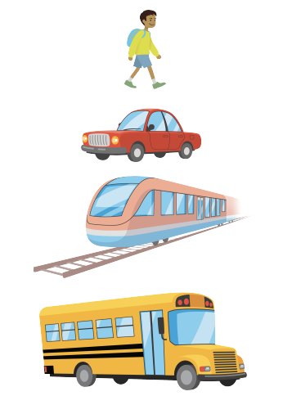
Notice & Wonder
Warm up
What do you notice? What do you wonder?

Slide 97
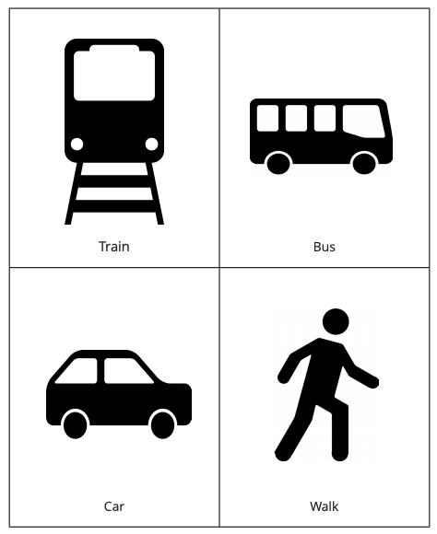

How Do We Get To School?
Activity #1
What are some of the different ways people get to our school? What are other ways people may get to school in other places?
How could we find out how many students in our class took the bus to school today?
What other questions could we ask about how we got to school today based on our chart?
Is it easy to answer these questions from our chart just by looking at it? Why or why not?

Slide 98
Visual Representation of Data
Activity #2
Organize and represent the data we collected in a visual display.
Data is information about the things or people in a group.
Think about how you can represent the data in a way that will make sense to other people.
What is the same and what is different between our representations?
What suggestions do you have for _____ to make their representation more clear?

Slide 99
Let’s Put it All Together
Lesson Synthesis
Today we saw that there are different ways to represent data in an organized way.
How does each representation help you see how many students took the bus?
What makes a data display organized and clear to read?

Slide 100
Interpret Picture Graphs
8
Let’s answer questions based on picture graphs.
MD.D.10

Slide 101
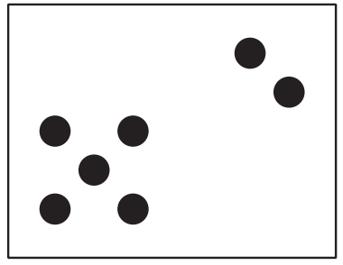
How Many Do You See?
Warm up
How many do you see? How do you see them?

Slide 102
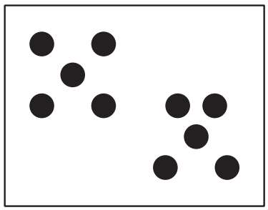
How Many Do You See?
Warm up
How many do you see? How do you see them?

Slide 103
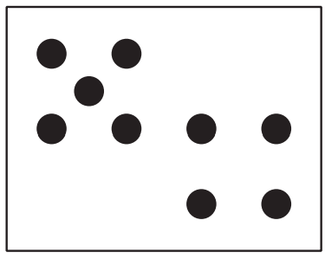
How Many Do You See?
Warm up
How many do you see? How do you see them?
How did your method stay the same or change in each image?

Slide 104
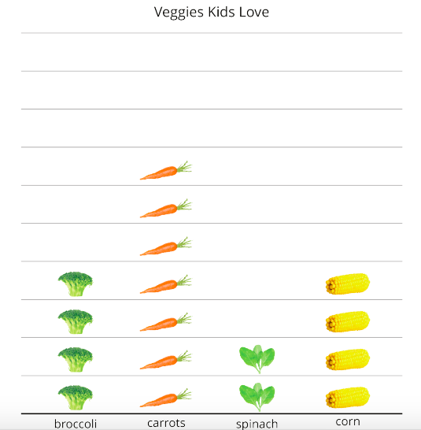
Veggies People Love
Activity
#1
Clare made this picture graph to share data she collected.
What could this graph represent?

Slide 105
Veggies People Love
Activity
#1
Clare asked the kids in her class which vegetable they loved.
She made a picture graph to show their responses.
A picture graph is a way to show how many in each group or category using pictures of the objects or symbols.
What can you learn about the veggies kids love from her picture graph?

Slide 106
Veggies People Love
Activity
#1
What is the total number of kids who love spinach or corn?

Slide 107
Veggies People Love
Activity
#1
What is the total number of kids who love spinach or corn?

Slide 108
Veggies People Love
Activity
#1
Clare asked a group of kids, “What veggies do you love?” Their responses are shown in this picture graph.
What can you learn about the veggies kids love from Clare’s picture graph?

Slide 109
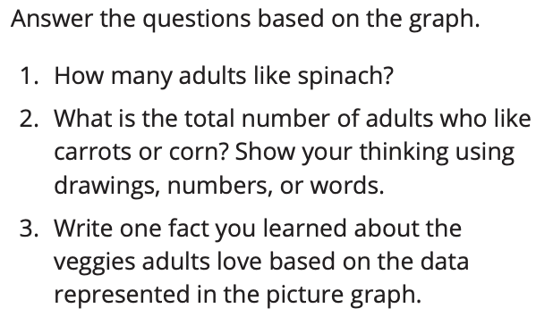
Veggies People Love
Activity
#1
Clare asked a group of adults, “What veggies do you love?” Their responses are shown in this picture graph.
How many more adults like carrots than spinach? Explain how you know.”

Slide 110


Answer Questions
Activity
#2
A group of kids were asked “What foods do you love to eat?”. Their responses are shown in the picture graph.
Which question did you decide couldn’t be answered? Explain.

Slide 111
Let’s Put it All Together
Lesson Synthesis
Today, you learned about picture graphs, which is one way of representing data.
What did you learn about how picture graphs can help with answering questions about data?

Slide 112
Interpret Bar Graphs
9
Let’s interpret data in bar graphs.
MD.10

Slide 113

Notice and Wonder
Warm up
What do you notice? What do you wonder?
The graph on the right is called a bar graph.
A bar graph is a way to show how many in each group or category using the length of rectangles
How is the data represented differently in the bar graph compared to the picture graph?

Slide 114

Field Trip Choices
Activity
#1

Slide 115



Field Trip Choices
Activity
#1

Slide 116

Field Trip Choices
Activity
#1
25 students voted
Which graph did this group interpret? How do you know?

Slide 117

Our Favorite Seasons
Activity
#2

Slide 118

Our Favorite Seasons
Activity
#2

Slide 119
Let’s Put it All Together
Lesson Synthesis
Today, we interpreted data in a bar graph. Using a bar graph is a little different than using a picture graph to answer questions.
How are the ways you used a bar graph to answer questions different than how you used picture graphs?
How are they
the same?

Slide 120
Represent Data using Picture Graphs and Bar Graphs
10
Let’s make our own picture graphs and bar graphs.
MD.D.10

Slide 121

Which One Doesn’t Belong?
Warm up
How is graph A different from other graphs we have seen? How is it the same?

Slide 122

Draw Picture Graphs
Activity
#1
What can you learn about 2nd graders’ favorite sports from this graph?
What are some features of this graph that help us understand the data?

Slide 123


Draw Picture Graphs
Activity
#1
Write the number of the data table on your page.
Tell your partner 1 thing you think they did really well and 1 thing you still have a question about.

Slide 124

Drawing Bar Graphs
Activity
#2
What do you think the labels are on the bottom? Why?
What are some features of this graph that help us understand the data?

Slide 125
Draw Bar Graphs
Activity
#1
Trade tables with a partner.
Write the number of the data table on your page.
How did you know how high to make each bar in your graph?

Slide 126
Let’s Put it All Together
Lesson Synthesis
Today you made picture graphs and bar graphs to represent data.
What is something new about graphs you learned today?
How did you revise your graph today to make it easier for someone else to understand the data?
Tomorrow you will use your graphs to write questions for your classmates to answer and have the chance to answer their questions based on the graphs.

Slide 127
Questions about Data
11
Let’s answer questions using picture graphs and bar graphs.
MD.10

Slide 128
Number Talk
Warm up
3 + 7

Slide 129
Number Talk
Warm up
3 + 7 + 2

Slide 130
Number Talk
Warm up
5 + 7

Slide 131
Number Talk
Warm up
2 + 4 + 8
How does looking for ways to make a ten make it easier to find the values of these expressions?

Slide 132
Write Questions Based on Graphs
Activity
#1
Write 2 questions for each graph, but don’t put them all in order.
Your classmates will have to think about which graph to use to answer your questions.
Write at least 1 question that requires someone to combine or compare two categories.
How do you know these questions will require someone to combine or compare the totals of two or more categories?

Slide 133
Answer Questions Using Graphs
Activity
#2
Answer your partner’s questions from Activity 1 using the graphs.

Slide 134
Let’s Put it All Together
Lesson Synthesis
Today you asked and answered questions based on data represented in picture graphs and bar graphs.
What kinds of questions were easier to answer? Which kinds of questions were more difficult to answer?
Where did you look on each graph to find the answers to questions?

Slide 135
Center Day
12
Let’s sort a collection and make graphs to represent it.
MD.10

Slide 136
Number Talk
Warm up
17 - 7

Slide 137
Number Talk
Warm up
17 - 9

Slide 138
Number Talk
Warm up
15 - 5

Slide 139
Number Talk
Warm up
15 - 8
How can we use the first expression to find the value of the second one?”

Slide 140

Revisit Sort and Display
Activity
#1
Choose a collection to sort. Sort into 3 categories. Represent the data in a graph that shows how many are in each category.
After you’ve made your representation, you and a partner should ask each other questions about the data in your graph
What questions can we ask about the representation of how they sorted?

Slide 141


Choice Time
Which activity did you choose? What did you like about the activity you chose?

Slide 142
Using Data to Answer Compare Questions
Adaptation
Lesson 6
Let’s answer compare problems, with the difference unknown, based on data representations.
1.MD.C.4, 1.OA.A.1

Slide 143
Number Talk
Warm up
20 - 19

Slide 144
Number Talk
Warm up
20 - 15

Slide 145
Number Talk
Warm up
20 - 3

Slide 146
Number Talk
Warm up
20 - 9

Slide 147

Favorite Drinks at Lunch
Activity #1
This display shows what students like for their lunch drink.
1. How many more students like chocolate milk than regular milk?
2. How many kids like milk or juice?
3. What other observations can you make about the data?

Slide 148


Excited to See Animals at the Zoo
Activity
#2

Slide 149
Let’s Put it All Together
Lesson Synthesis
Priya says that this picture also shows how many people were excited about seeing tigers and
monkeys. Where are the tigers? Where are the monkeys?
What does the whole drawing represent?

Slide 150
Compare Questions with Unknowns in All Positions
Adaptation
Lesson 7
Let’s solve compare problems with the unknowns in all
positions, using language that suggests the correct operation.
1.OA.A.1

Slide 151
Notice and Wonder
Warm up
Lin has some fish. Priya has more fish than Lin.

Slide 152
​3 Reads: Lin’s and Priya’s Fish
Read 2
Activity #1
Priya has some fish. Priya has 2
more fish than Lin.

Slide 153
​3 Reads: Lin’s and Priya’s Fish
Read 2
Activity #1
Priya has 8 fish.
Priya has 2 more fish than Lin.
Show your thinking using drawings, connecting
cubes, numbers, or words.

Slide 154

Clare and Kiran Have Stickers
Activity
#2
Show your thinking using drawings, connecting cubes, numbers, or words. Use the diagram if it helps you.
1. Clare has 5 stickers. Kiran has 2 more stickers than Clare. How many stickers does Kiran have?
2. Clare has 5 stickers. Kiran has 7 stickers. How many more stickers does Kiran have than Clare?
3. Kiran has 2 more stickers than Clare. Kiran has 7 stickers. How many stickers does Clare have?

Slide 155
Let’s Put it All Together
Lesson Synthesis
How can these diagrams help us solve problems?

Slide 156
Understanding
Compare Problems
Adaptation
Lesson 8
Let’s reason about compare problems, with unknowns in all
positions.
1.OA.A.1

Slide 157
Notice and Wonder
Warm up
Lin and Andre have apples.
Lin has fewer apples than Andre.

Slide 158
Lin’s Apples and Andre’s Apples
Activity #1
Use pictures, connecting cubes, numbers, or words to explain your thinking.
1. Lin has 3 fewer apples than Andre. Andre has 5 apples. Who has more apples?
2. Lin has 6 apples. She has 3 more than Andre. Who has fewer apples?
3. Lin has 3 fewer apples than Andre. Lin has 2 apples. Who has more apples?
4. Andre has 4 fewer apples than Lin. Lin has 5 apples. Who has more?

Slide 159

Analyze Two Strategies
Activity
#2
Priya and Lin both drew a diagram for this situation:
Lin has 6 apples.
She has 3 more than Andre.
Who do you agree with? Why?
Use pictures, connecting cubes, numbers, or words to
explain your thinking.

Slide 160
Let’s Put it All Together
Lesson Synthesis
What equation would we write to go with the situation?

Slide 161
Use Bar Graphs to Compare
Section C: Diagrams to Compare
13
Let’s use bar graphs to solve compare problems.
MD.D.10

Slide 162
True or False
Warm up
9 + 4 = 9 + 1 + 3

Slide 163
True or False
Warm up
9 + 4 = 10 + 3

Slide 164
True or False
Warm up
9 + 5 = 10 + 6
How can you justify your answer without adding?

Slide 165

What’s the Difference?
Activity
#1
A group of third grade students were asked,
‘What pets do you have?’ Their responses are shown in the bar graph.
What do you notice about the data in the graph?
What do you wonder?

Slide 166

What’s the Difference?
Activity
#1
How many more students have cats than have rabbits?
Show two ways to find the difference.
Can you show us on the bar graph how you could count on (or count back) to find how many more?

Slide 167

Dogs in the Park
Activity
#2
What statement can you make that compares the number of huskies to the number of bulldogs?

Slide 168

Dogs in the Park
Activity
#2
Kiran and Lin counted the types of dogs they saw in a park. Their data is shown in the bar graph.
What other equations could we write to show how many fewer for _____’s statement? What does each number represent in the equation?

Slide 169
Let’s Put it All Together
Lesson Synthesis
Today, we learned that there are different ways we can talk about comparisons and write equations to represent them.
14 + 6 = 20
6 is the answer.
What is the question?
8 - 2 = 6
2 is the answer.
What is the question?

Slide 170
Use Diagrams to Compare
14
Let’s use bar graphs and diagrams to solve compare problems
MD.D.10

Slide 171

Notice and Wonder
What Kind of Graph is This?
Warm up
What do you notice? What do you wonder?
The 2 images at the bottom are called diagrams.
What do you think the 15 and 8 represent in the diagrams at the bottom?
What does the question mark in the diagram represent?

Slide 172

Party Time
Activity
#1
What can we learn from this graph?
Cut out each of the bars in the graph and put the strips next to each other. What comparison statements can you make about the bars?
What comparison statements did you make about the data? Did anyone get confused about what each bar represented? Did anyone get confused about how many are in each bar?

Slide 173
Party Time
Activity
#1
Glue down the two bars that compare the number of students who picked hot dogs to the number who picked burgers.
Write two statements that compare the number of students who picked hot dogs to the number who picked burgers.
How does your diagram make it easy to see which food received the most votes?
What do you need to add to the bars to answer questions like ‘How many more students chose hot dogs than burgers?

Slide 174

Party Time: Part 2
Activity
#2
Use the data from the bar graph to complete the diagram.
How many more students chose pizza than chose burgers? Write an equation to show how you found the difference.

Slide 175

Party Time: Part 2
Activity
#2
3. Use the data from the bar graph to complete the diagram.
4. Write a statement that compares the student votes in the diagram.
.
How did you figure out what food was being compared to pizza?
What does the question mark represent in the diagram?
What equation could we write to represent this difference?
How do you see each number represented in the diagram?

Slide 176

Let’s Put it All Together
Lesson Synthesis
Today, we learned about diagrams that can represent
problems in which we compare two amounts.
Tell your partner a story that is represented by this diagram.

Slide 177
Diagrams with All Kinds of Compare Problems
15
Let’s connect compare problems to diagrams.
OA.A.1

Slide 178
Number Talk
Warm up
4 + 8 + 2

Slide 179
Number Talk
Warm up
4 + 5 + 3 + 2

Slide 180
Number Talk
Warm up
9 + 3 + 1

Slide 181
Number Talk
Warm up
9 + 5
How did making a ten help when finding the sums?

Slide 182


Shell Collections
Activity
#1
Diego has some shells. Lin has fewer shells.
Talk to your partner about how many shells Diego could have and how many shells Lin could have.
Diago has 55 shells. Lin has 20 fewer shells than Diago.
Write an equation to show how you could find the unknown number of shells.
Use a question mark to represent the unknown.
How did you use the diagram to write your equation?

Slide 183
Card Sort: At the Beach
Activity
#2
Lin and Diego want to compare other things they collected and did at the beach.
Find one diagram and one equation that match a story problem. There may be more than one equation that matches each story problem.
Take turns reading a story problem. After one partner reads, work together to find other cards that match. When you think you have found a match, explain to your partner why the cards match.
If it helps, you may label the diagrams to explain your matches.
Notes:
Teachers, you may want to omit/ different

Slide 184

Let’s Put it All Together
Lesson Synthesis
Today, we worked more with diagrams to represent compare story problems. Diagrams can help show if we need to find the bigger number, the smaller number, or the difference.
Which diagram shows that you are looking for the bigger number? How do you know?
Which diagram shows that you are looking for the smaller number? How do you know?

Slide 185
Solve All Kinds of Compare Problems
16
Let’s solve compare problems
OA.A.1

Slide 186
True or False: Multiples of 10
Warm up
18 + 5 = 18 + 2 +3

Slide 187
True or False: Multiples of 10
Warm up
28 + 5 = 30 + 3

Slide 188
True or False: Multiples of 10
Warm up
38 + 4 = 40 + 3
How could you change 28 + 5 to be 30 + 3?"

Slide 189


A Trip to the Library
Activity
#1
Priya and Andre returned books to the library. Prya returned 29 books. Andre returned 8 more books than Priya.
Who returned more books?
Use the story problem to complete the diagram.
How many books did Andre return?

Slide 190

A Trip to the Library
Activity
#1
Andre read 45 pages of his book last night. Priya read 20 fewer pages of her book than Andre.
Who read more pages?
Complete the diagram to match the story problem.
How many pages did Priya read?
How did you know where to put the numbers and the question mark in this problem?

Slide 191
Solving Compare Problems
Activity
#2
Jada read 10 fewer pages than Noah. Noah read 27 pages.
How many pages did Jada read?

Slide 192

Solving Compare Problems
Activity
#2
What’s the same about their representations? What’s different?
How did your representation help you decide whether to add or subtract?

Slide 193
Let’s Put it All Together
Lesson Synthesis
Today we made sense of and solved many compare problems.
What did you do to figure out how to solve these problems?

Slide 194
Center Day
17
Let’s count large groups of objects and play games to practice adding and creating graphs.
NBT.B.5

Slide 195
Number Talk
Warm up
27 + 10

Slide 196
Number Talk
Warm up
27 + 10 + 10

Slide 197
Number Talk
Warm up
27 + 30

Slide 198
Number Talk
Warm up
37 + 30
How did you use what you know about place value to find the sums?

Slide 199

Revisit Counting Collections
You and your partner will get a collection of objects.
Your job is to figure out how many objects are in your collection and show how you counted.
How did you keep track as you counted?

Slide 200

Center Choice Time
Which activity did you choose? What did you like about the activity you chose?

Slide 201
Let’s Put it All Together
Lesson Synthesis
Today we chose activities to work on and worked with a partner during center time.
What went well? What can we continue to work on?

Slide 202
Class Surveys
(Optional)
18
Let’s create our own surveys to get to know our classmates better.
NBT.B.5

Slide 203
What do you know about?
Warm up
What do you know about bar graphs?
What is an example of how we might use a bar graph?
What are other ways you can represent data?

Slide 204

Classroom Survey and Graph
Activity #1
How we get to school
Favorite sport
Favorite season
Field trip choice
Recess activity
Favorite pet
Food for a party
Fruits we love
Veggies we love
What choices did these mathematicians make with their graphs?

Slide 205

I Ask, then You Ask
Activity #2
Where do we see the equations in their graph? What does the equation mean?
What’s the difference between answering the questions from a bar graph and answering them from a picture graph?

Slide 206


Analyzing Data with Diagrams
Activity #2
You and your partner are going to draw a diagram. Your diagram should compare two facts you learned from your survey.
Decide with your partner which 2 facts you want to share with the class and how you will compare the two facts.
What information does this diagram or equation tell us about our classmates?
Where do you see this equation in the diagram?

Slide 207
Let’s Put it All Together
Lesson Synthesis
Today we had a chance to learn more about each other by collecting data and representing it in multiple ways.
What information can we see in the picture/bar graph that we don’t see in the diagram?
How are these representations the same?
What information can we see in the diagram that we don’t see in the picture/bar graph?

