Slide 1

Numbers within 20
Kindergarten : Unit 6
Standards addressed: K.CC.A.1, K.CC.A.2, K.CC.A.3, K.CC.B.4, K.CC.B.5, K.OA.A.1, K.OA.A.2,
K.OA.A.3, K.OA.A.4, K.NBT.A.1
These slides have been created by Britnee Wright Southeast Arkansas Education Cooperative and are not official IM materials. Images and language are taken from IM Grade K, Unit 6 by Illustrative Mathematics.
Copyright 2020 by Illustrative Mathematics. All Rights Reserved, adapted and shared with permission.

Slide 2
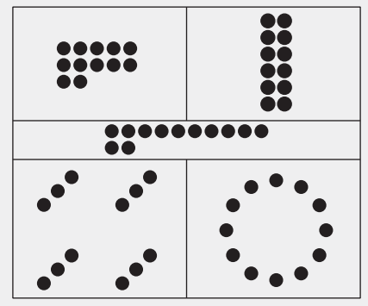
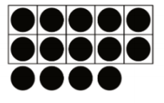
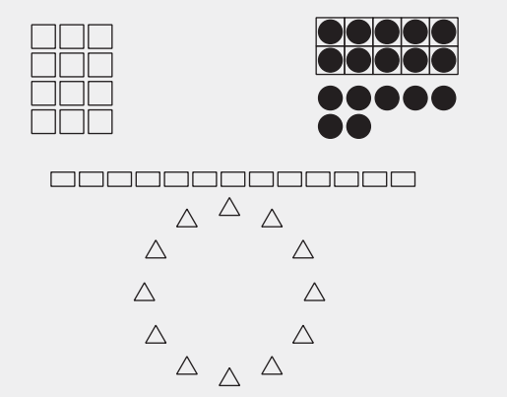
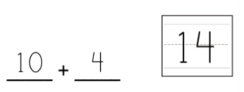
Unit 6 Progression Overview
Numbers within 20
Section A
Lessons 1-4
K.CC.A.1, K.CC.A.2, K.CC.A.3, K.CC.B.4, K.CC.B.5, K.OA.A.1, K.OA.A.2, K.OA.A.3, K.OA.A.4
Section B
Lessons 5-10
K.CC.A.1, K.CC.A.3, K.CC.B.5, K.NBT.A.1, K.OA.A.1
Section C
Lessons 11-13
K.CC.A.1, K.CC.A.2, K.CC.A.3, K.CC.B.4, K.CC.B.4.b, K.CC.B.5, K.NBT.A.1, K.OA.A.1, K.OA.A.4
Count groups of images up to 20.
Represent quantities up to 20 with a written number.
Count groups of up to 20 objects.
Understand numbers 11-19 as 10 ones and some more ones.

Slide 3



Unit 6 Quick Links
L1
L2
L3
L4
L5
L6
L7
L8
L9
L10
L11
L12
L13

Slide 4
Count Larger
Collections of Objects
1
Let’s figure out how many objects are in our collections.
K.CC.A.1, K.CC.A.2, K.CC.A.3, K.CC.B, K.CC.B.4, K.CC.B.5, K.OA.A.1, K.OA.A.3, K.OA.A.4

Slide 5

Choral Count:
Count to 80 and Count On
Warm up
Let’s count to 80

Slide 6

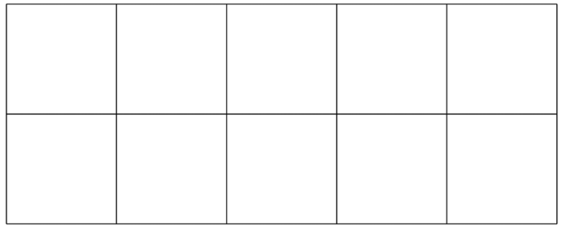
Counting Collections
Activity
#1
How many objects are in your collection?

Slide 7

How We Count
Activity
#2
How many cubes are there? How do you know?

Slide 8
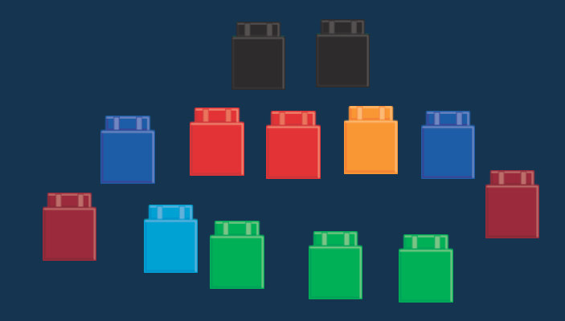
How We Count
Activity
#2
How many cubes are there?
What can we do to figure out how many cubes there are?

Slide 9

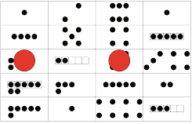
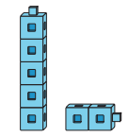

Centers: Choice Time
Activity
#3
Number Race, Trace 11–20
Snap the Cubes, How Many Are Missing?
Make or Break Apart Numbers, Dots
Subtraction Towers, Objects

Slide 10

Today we talked about lots of different ways to count larger collections of objects.
Lesson
Synthesis
How is counting larger groups of objects like counting smaller groups of objects? How is it different?

Slide 11
Keep Track of Objects
2
Let’s figure out how many objects are in our collections.
K.CC.A.3, K.CC.B, K.CC.B.4, K.CC.B.4.a, K.CC.B.5, K.OA.A.1, K.OA.A.2, K.OA.A.3, K.OA.A.4

Slide 12

Number Talk:
Add and Subtract 0 and 1
Warm up
Add or subtract.

Slide 13
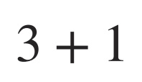
Number Talk:
Add and Subtract 0 and 1
Warm up
Add or subtract.

Slide 14
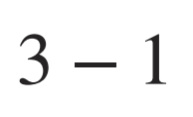
Number Talk:
Add and Subtract 0 and 1
Warm up
Add or subtract.

Slide 15
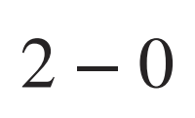
Number Talk:
Add and Subtract 0 and 1
Warm up
Add or subtract.

Slide 16
Counting Collections
Activity
#1
How many objects are in your collection?
Tell your partner how many objects are in your collection.

Slide 17
Different Ways to Keep Track
Activity
#2
How can you use the counting mat to help you figure out how many objects are in your collection?
How can you use the 10-frame to help you figure out how many objects there are in your collection?
Choose either the 10-frame or the counting mat to help you figure out how many objects are in your collection.

Slide 18
Centers: Choice Time
Activity
#3
Number Race, Trace 11–20
Snap the Cubes, How Many Are Missing?
Make or Break Apart Numbers, Dots
Subtraction Towers, Objects

Slide 19
We have seen different ways to count our collections and make sure that we count each object one time.
Lesson
Synthesis
Tell your partner how you keep track of the objects when you count.

Slide 20
Count Carefully
3
Let’s see if we get the same number as our partner when we count the same group of objects.
K.CC.A.3, K.CC.B, K.CC.B.4, K.CC.B.4.b, K.CC.B.5, K.OA.A.1, K.OA.A.3, K.OA.A.4

Slide 21
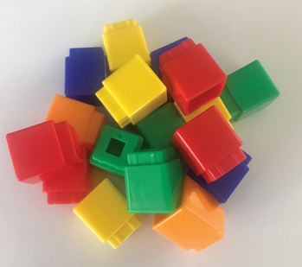
Notice and Wonder:
18 Connecting Cubes
Warm up
What do you notice?
What do you wonder?

Slide 22
Counting Collections
Activity
#1
How many objects are in your collection?
Tell your partner how many objects are in your collection.
Switch collections with your partner.
Do you agree with your partner about how many objects are in the collection?

Slide 23
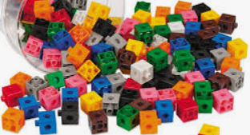
Count Carefully with Friends
Activity #2
Clare, Andre, and Noah all counted these cubes.
Clare says there are 15 cubes.
Andre says there are 16 cubes.
Noah says there are 17 cubes.
Can they all be right?

Slide 24
Centers: Choice Time
Activity
#3
Number Race, Trace 11–20
Snap the Cubes, How Many Are Missing?
Make or Break Apart Numbers, Dots
Subtraction Towers, Objects

Slide 25
Lesson
Synthesis
There are 18 cubes.
Elena counted this pile of cubes and said that there are 19 cubes. What should she do next?

Slide 26
Does the Number Change?
4
Let’s figure out how many objects there are when the objects are moved around.
K.CC.A.3, K.CC.B, K.CC.B.4, K.CC.B.4.b, K.CC.B.5, K.OA.A.1, K.OA.A.3, K.OA.A.4

Slide 27
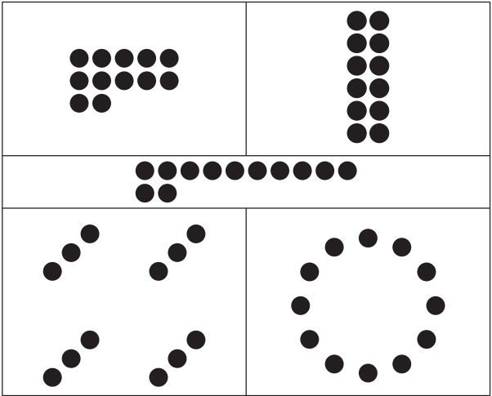
Notice and Wonder:
Lots of Dots
Warm up
What do you notice?
What do you wonder?

Slide 28
Counting Collections
Activity
#1
How many objects are in your collection?
Tell your partner how many objects are in your collection.
Switch collections with your partner.
Do you agree with your partner about how many objects are in the collection?

Slide 29
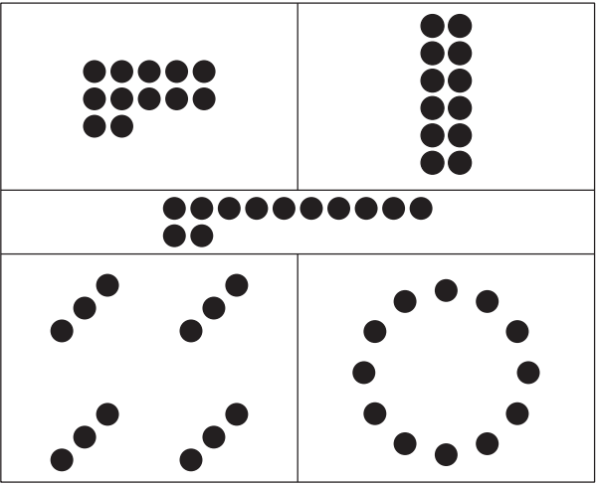
Count, Rearrange, Recount
Activity #2
We just saw different ways that we can arrange, or organize, dots. You can use this picture for ideas about how to rearrange the objects in your collection.
Choose who will count first. Figure out how many objects are in the collection. If your partner is counting, watch your partner to make sure that they count each object one time.
Once your partner has counted, rearrange the objects. You can use the picture for ideas.
Figure out how many objects are in your collection now.
Trade collections with another group. Then take turns figuring out how many objects there are and rearranging them.

Slide 30
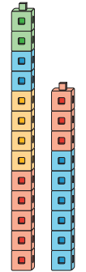
Centers: Choice Time
Activity
#3
Number Race, Trace 11–20
Tower Build, Count and Build to 20
Make or Break Apart Numbers, Dots
Subtraction Towers, Objects
Snap the Cubes, How Many Are Missing?

Slide 31

Lesson Synthesis
There are 20 objects in a line. If I move all of the objects into a circle, how many objects will I have?

Slide 32
How Many Fingers? How Many Dots?
5
Let’s count pictures.
K.CC.A.3, K.CC.B.5

Slide 33
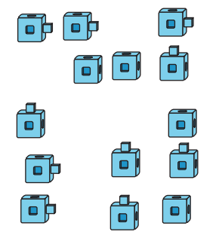
Estimation Exploration: Connecting Cubes
Warm up
How many cubes are there?
Record an estimate that is:
Too low | About right | Too high

Slide 34
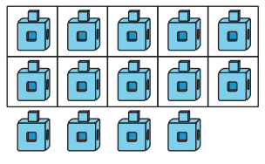
Estimation Exploration: Connecting Cubes
Warm up
How many cubes are there?
Record an estimate that is:
Too low | About right | Too high

Slide 35
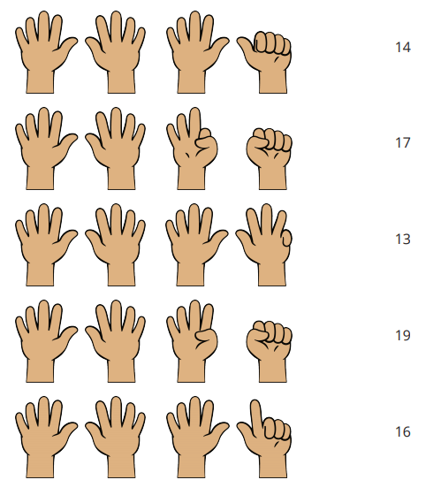
How Many Fingers?
Activity #1
Let’s practice reading numbers
Now, figure out how many fingers there are in each image.
Draw a line from the fingers to the number that shows how many there are.

Slide 36
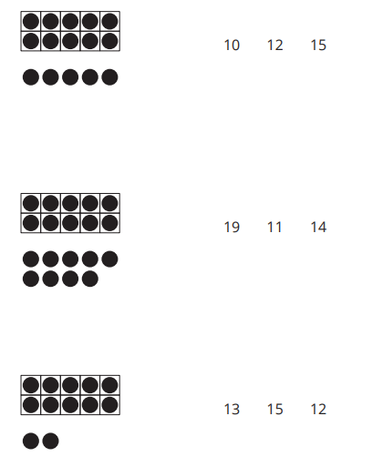
How Many Dots in 10-frames?
Activity #2
Let’s practice reading numbers again.
Now, figure out how many dots there are in each image.
Circle the number that shows how many dots there are.

Slide 37
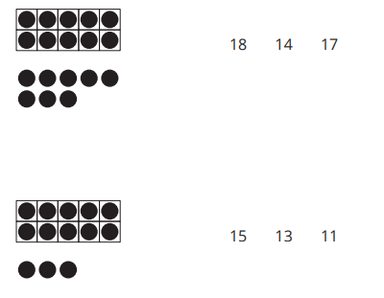
How Many Dots in 10-frames?
Activity #2
Let’s practice reading numbers again.
Now, figure out how many dots there are in each image.
Circle the number that shows how many dots there are.

Slide 38
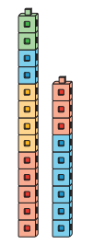
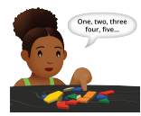

Centers: Choice Time
Activity
#3
Grab and Count, Guess then Count
Number Race, Trace 11–20
Tower Build, Count and Build to 20

Slide 39

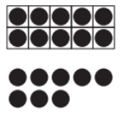
Lesson Synthesis
How are the images different?
How are the images the same?

Slide 40
Fingers and 10-Frames
6
Let’s show numbers on our fingers and 10-frames.
K.CC, K.CC.A.3, K.CC.B.5, K.NBT.A.1

Slide 41

How Many Do You See: 5 Fingers and Some More Fingers
Warm up
How many do you see?
How do you see them?

Slide 42

How Many Do You See: 5 Fingers and Some More Fingers
Warm up
How many do you see?
How do you see them?

Slide 43

How Many Do You See: 5 Fingers and Some More Fingers
Warm up
How many do you see?
How do you see them?

Slide 44

How Many Do You See: 5 Fingers and Some More Fingers
Warm up
How many do you see?
How do you see them?

Slide 45
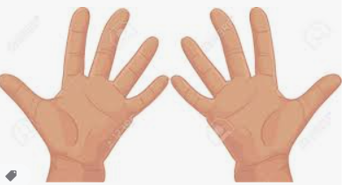
Lots of Fingers
Activity #1
Show 5 with your fingers
How do you know that you are holding up 5 fingers?
Show 6 with your fingers. Did you and your partner show 6 the same way?
Show 10 with your fingers.
How do you know that you’re holding up 10 fingers?
Show 13 with your fingers.
Work with a partner to show 13 with your fingers.
Repeat with numbers 15, 18, and 20.

Slide 46

Fingers to 10-Frames
Activity #2
One partner figures out how many fingers are displayed in the image. The other partner displays the same number of counters on a 10-frame. Switch roles for each problem.

Slide 47

Fingers to 10-Frames
Activity #2
One partner figures out how many fingers are displayed in the image. The other partner displays the same number of counters on a 10-frame. Switch roles for each problem.

Slide 48

Fingers to 10-Frames
Activity #2
One partner figures out how many fingers are displayed in the image. The other partner displays the same number of counters on a 10-frame. Switch roles for each problem.

Slide 49

Fingers to 10-Frames
Activity #2
One partner figures out how many fingers are displayed in the image. The other partner displays the same number of counters on a 10-frame. Switch roles for each problem.

Slide 50
Centers: Choice Time
Activity
#3
Grab and Count, Guess then Count
Number Race, Trace 11–20
Tower Build, Count and Build to 20

Slide 51
Lesson Synthesis
Today we showed numbers on fingers and 10-frames.
If you were working alone and had to show the number 15, would you use fingers or a 10-frame to show the number?
Why would you choose to show 15 this way?

Slide 52
Make Numbers with 10 and Some More: Part 1
7
Let’s make numbers with full 10-frames and some more dots.
K.CC.A.3, K.CC.B.4.a, K.CC.B.5, K.NBT.A.1

Slide 53
Choral Count: Two Groups
Warm up
Group 1- Count as a group from 1 until I tell you to stop.
Group 2- Count on from where the group 1 stops.
What number always comes after 10?

Slide 54
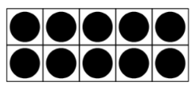

Put Together Numbers 11–19
Activity #1
Walk around and find a partner.
If you have a 10-frame on your card, find a partner who does not have a 10-frame on their card.
If you do not have a 10-frame on your card, find a partner who does have a 10-frame
Tell your partner how many dots you have on your card. Then work together to figure out how many dots you both have altogether.

Slide 55
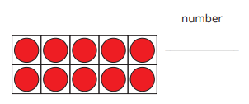
Add More Counters
Activity #2
Flip over one card.
Add that many dots to your 10-frame.
Write a number to show how many dots there are now.
Work with your partner to finish the rest of the problems.

Slide 56
Centers: Choice Time
Activity
#3
Grab and Count, Guess then Count
Number Race, Trace 11–20
Tower Build, Count and Build to 20

Slide 57

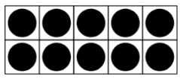

Lesson Synthesis
Today we put groups together to make numbers from 11 to 19. Which two images can we put together to make 12? How do you know?
12 dots is 10 dots plus 2 dots. Another way we could write that is 12 is 10 + 2

Slide 58
Make Numbers with 10 and Some More: Part 2
8
Let’s show numbers with 10-frames and dots or counters.
K.CC.B.5, K.NBT.A.1

Slide 59

How Many Do You See: Teen Numbers on a 10-Frame
Warm up
How many do you see?
How do you see them?

Slide 60
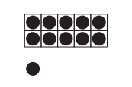
How Many Do You See: Teen Numbers on a 10-Frame
Warm up
How many do you see?
How do you see them?

Slide 61
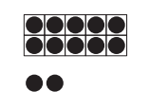
How Many Do You See: Teen Numbers on a 10-Frame
Warm up
How many do you see?
How do you see them?

Slide 62
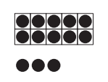
How Many Do You See: Teen Numbers on a 10-Frame
Warm up
How many do you see?
How do you see them?

Slide 63
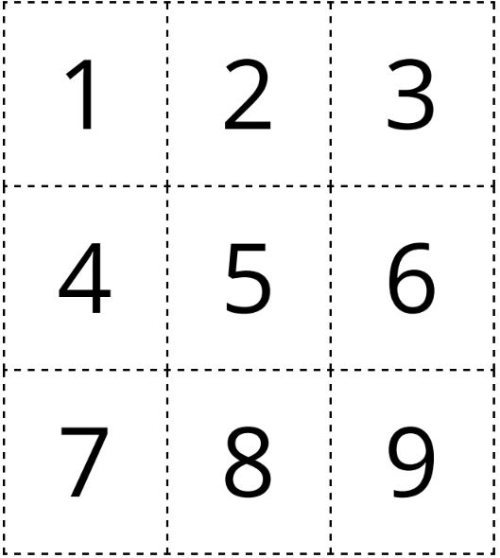
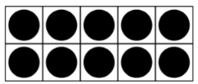

Make Number Cards
Activity #1
Make each number.
You can cut out the 10-frames and the dots to help you make each number.
When you’re finished, trace each number.

Slide 64
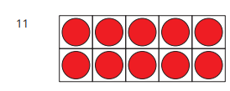
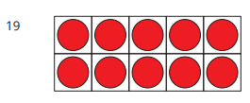
Make Each Number
Activity #2
Draw more dots to finish the representation of each number.

Slide 65

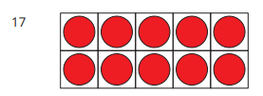
Make Each Number
Activity #2
Draw more dots to finish the representation of each number.

Slide 66
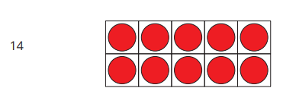
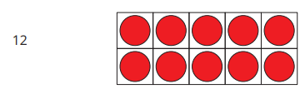
Make Each Number
Activity #2
Draw more dots to finish the representation of each number.

Slide 67
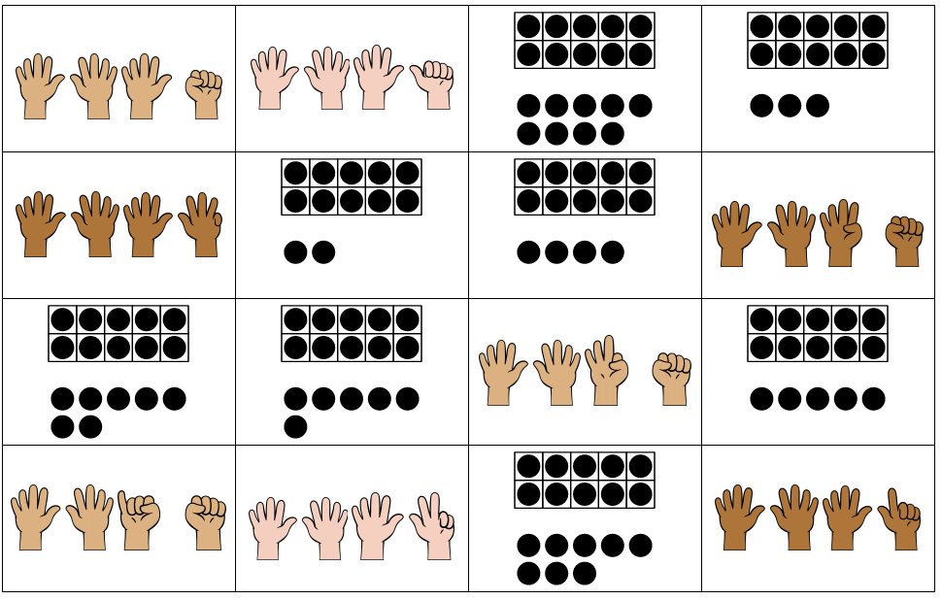
Centers: Introduce Cover Up, Numbers 11–19
Activity
#3
One student chooses a card with a number from 11–19 and all students in the group can place a counter on their gameboard over a group that has that number of images.
Students play until someone has 4 counters in a row.

Slide 68
Lesson Synthesis
Today we made numbers 11–19.
How many counters do we need to add to make 16? How do you know?

Slide 69
Expressions and Equations
9
Let’s show numbers 11–19 in different ways.
K.CC.A.1, K.CC.A.3, K.CC.B.4.a, K.CC.B.5, K.NBT.A.1

Slide 70
Choral Count: Recording to 19
Warm up
Count by ones, starting at 0.
Stop counting and recording at 19.
What patterns do you see?

Slide 71
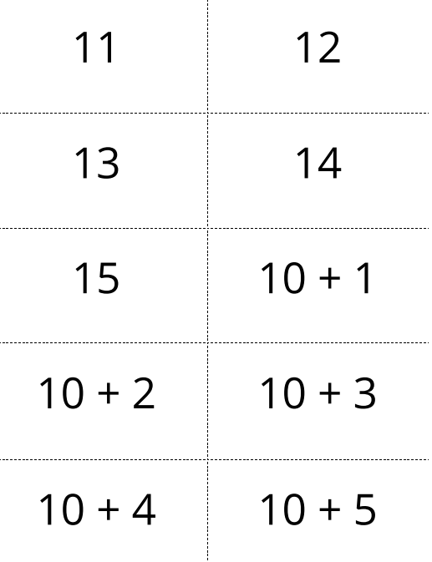
Organize Expressions and Numbers
Activity #1
Work with your group to organize the cards in a way that makes sense to you

Slide 72
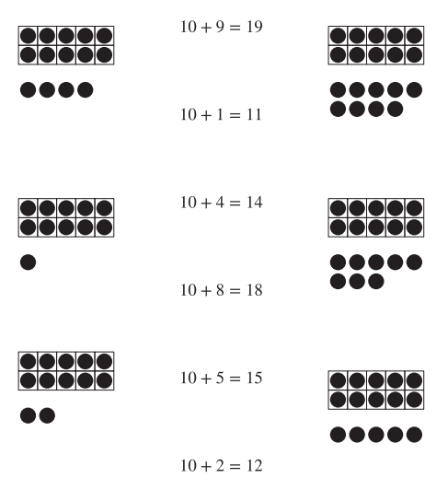
Equations and 10-frames
Activity #2
Draw a line from each equation to the image it matches.

Slide 73
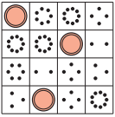
Centers: Choice Time
Activity
#3
Grab and Count, Guess then Count
Number Race, Trace 11–20
Cover Up, Numbers 11–19

Slide 74

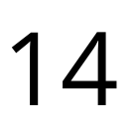
Lesson Synthesis
Which of these matches the image? How do you know?

Slide 75
Fill It In
10
Let’s work with numbers 11–19 and write their equations
K.CC.A.3, K.CC.B.5, K.NBT.A.1, K.OA.A.1

Slide 76

What do you know about 15?
Warm up

Slide 77
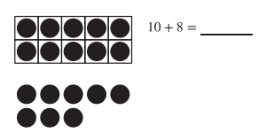
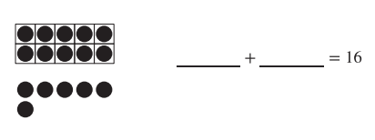
What Is Missing?
Activity #1
How did you figure out what was missing?
How did you figure out what was missing?

Slide 78
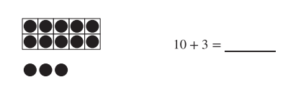
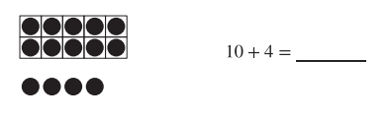
What Is Missing?
Activity #1
How did you figure out what was missing?
How did you figure out what was missing?

Slide 79
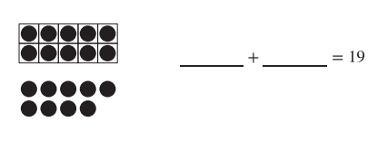
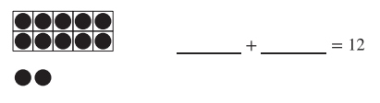
What Is Missing?
Activity #1
How did you figure out what was missing?
How did you figure out what was missing?

Slide 80
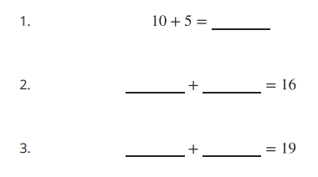

Fill In Equations
Activity #2
Fill in the missing numbers. You can use objects, drawings, or 10-frames to help you.

Slide 81
Centers: Choice Time
Activity
#3
Grab and Count, Guess then Count
Number Race, Trace 11–20
Cover Up, Numbers 11–19

Slide 82
Lesson Synthesis
Find a way to show that 10 + 9 is 19

Slide 83


We saw and made numbers 11–19 on fingers and 10-frames.
We saw these numbers written as 10 and some more in different ways.
We practiced writing numbers 11–20.
Section Summary

Slide 84
Count Images (Part 1)
11
Let’s find 10 shapes and figure out how many shapes there are.
K.CC, K.CC.A.1, K.CC.A.2, K.CC.B.5, K.NBT.A.1

Slide 85

Choral Count:
Count to 90 and Count On
Warm up
Let’s count to 90.
Now, start at the number 12 and count to 20.

Slide 86

Find 10 Ones to Count
Activity #1
What do you notice?
What do you wonder?

Slide 87

Find 10 Ones to Count
Activity #1
Circle a group of 10 squares in the first problem.
Share with your partner. Did you both circle the same 10 squares?
How many squares are there? How do you know?
Figure out how many shapes there are. You may circle a group of 10 if it can help you figure out how many there are. Write a number to show how many shapes there are.

Slide 88

Find 10 Ones to Count
Activity #1
Circle a group of 10 rectangles in the first problem.
Share with your partner. Did you both circle the same 10 squares?
How many squares are there? How do you know?
Figure out how many shapes there are. You may circle a group of 10 if it can help you figure out how many there are. Write a number to show how many shapes there are.

Slide 89

Find 10 Ones to Count
Activity #1
How many dots are there? How do you know?
Figure out how many shapes there are. You may circle a group of 10 if it can help you figure out how many there are. Write a number to show how many shapes there are.

Slide 90

Find 10 Ones to Count
Activity #1
How many hexagons are there? How do you know?
Figure out how many shapes there are. You may circle a group of 10 if it can help you figure out how many there are. Write a number to show how many shapes there are.

Slide 91

Find 10 Ones to Count
Activity #1
How many dots are there? How do you know?
Figure out how many shapes there are. You may circle a group of 10 if it can help you figure out how many there are. Write a number to show how many shapes there are.

Slide 92

Find 10 Ones to Count
Activity #1
How many dots are there? How do you know?
Figure out how many shapes there are. You may circle a group of 10 if it can help you figure out how many there are. Write a number to show how many shapes there are.

Slide 93

Color to Match Expressions
Activity #2
Color the shapes to show each expression.
Then fill in an equation to show how many shapes there are altogether.

Slide 94

Color to Match Expressions
Activity #2
Color the shapes to show each expression.
Then fill in an equation to show how many shapes there are altogether.

Slide 95

Color to Match Expressions
Activity #2
Color the shapes to show each expression.
Then fill in an equation to show how many shapes there are altogether.

Slide 96

Color to Match Expressions
Activity #2
Color the shapes to show each expression.
Then fill in an equation to show how many shapes there are altogether.

Slide 97


Centers: Choice Time
Activity
#3
Math Fingers, Make 10
Shake and Spill, Cover

Slide 98
Lesson Synthesis
In this unit, we have been working with the numbers 11–20.
What is one thing you have learned about these numbers?

Slide 99
Count Images (Part 2)
12
Let’s figure out how many shapes there are
K.CC.B.4.a, K.CC.B.4.b, K.CC.B.5, K.OA.A.4

Slide 100

Which One Doesn’t Belong:
Tons of Tens
Warm up

Slide 101

Count Images in Organized Arrangements
Activity #1
Figure out how many shapes there are.
Write a number to show how many shapes there are.

Slide 102

Count Images in Organized Arrangements
Activity #1
Figure out how many shapes there are.
Write a number to show how many shapes there are.

Slide 103

Count Images in Organized Arrangements
Activity #1
Figure out how many shapes there are.
Write a number to show how many shapes there are.

Slide 104

Count Images in Organized Arrangements
Activity #1
Figure out how many shapes there are.
Write a number to show how many shapes there are.

Slide 105

Count Images in Organized Arrangements
Activity #1
Figure out how many shapes there are.
Write a number to show how many shapes there are.

Slide 106

Count Images in Organized Arrangements
Activity #1
Figure out how many shapes there are.
Write a number to show how many shapes there are.

Slide 107

Count in Circles
Activity #2
Work with your partner to figure out how many triangles there are in the first problem.
Write a number to show how many triangles there are.
Pair up with another group. Did you count the triangles the same way?
Figure out how many shapes there are. Write a number to show how many shapes there are.

Slide 108

Count in Circles
Activity #2
Work with your partner to figure out how many triangles there are in the first problem.
Write a number to show how many triangles there are.
Pair up with another group. Did you count the triangles the same way?
Figure out how many shapes there are. Write a number to show how many shapes there are.

Slide 109

Count in Circles
Activity #2
Work with your partner to figure out how many triangles there are in the first problem.
Write a number to show how many triangles there are.
Pair up with another group. Did you count the triangles the same way?
Figure out how many shapes there are. Write a number to show how many shapes there are.

Slide 110

Count in Circles
Activity #2
Work with your partner to figure out how many triangles there are in the first problem.
Write a number to show how many triangles there are.
Pair up with another group. Did you count the triangles the same way?
Figure out how many shapes there are. Write a number to show how many shapes there are.

Slide 111

Count in Circles
Activity #2
Work with your partner to figure out how many triangles there are in the first problem.
Write a number to show how many triangles there are.
Pair up with another group. Did you count the triangles the same way?
Figure out how many shapes there are. Write a number to show how many shapes there are.

Slide 112

Count in Circles
Activity #2
Work with your partner to figure out how many triangles there are in the first problem.
Write a number to show how many triangles there are.
Pair up with another group. Did you count the triangles the same way?
Figure out how many shapes there are. Write a number to show how many shapes there are.

Slide 113



Centers: Choice Time
Activity
#3
Shake and Spill
Math Fingers,
Make 10
Find the Pair,
Make 10

Slide 114

Lesson Synthesis
What can I do to make sure that I count each triangle one time and that I don’t forget to count any triangles?
Did I count correctly? Why or why not?

Slide 115


In this section, we counted groups of up to 20 things.
We counted things in lines, arrays, circles, and on 10-frames.
Section Summary
We wrote numbers to show how many images there are.

Slide 116
Fingerprint Animals
13
Let’s make a fingerprint animal book.
K.CC.A.2, K.CC.A.3, K.CC.B.4, K.NBT.A.1, K.OA.A.1

Slide 117

How Many Do You See:
Fingerprints or Animals?
Warm up
How many do you see?
How do you see them?

Slide 118


Fingerprint Zoo Book Pages
Activity #1

Slide 119
Order Our Pages
Activity #2
Now we will play a game to help us put our numbers in order. The person with 11 starts the game. Say ‘I have 11.’ and put your fingerprint page upside down in the middle of your group.
The person with 12 goes next. Say, ‘I have 12.’ and put your fingerprint page upside down on top of the other page.
Continue the game until all the pages are put in the middle.
At the end, check the stack to make sure the pages are in order. Then read your book together

Slide 120
Today, we all made counting books for numbers 11–19.
Lesson Synthesis
Where do you see the equation _____ in the 10-frames?

