Slide 1

Compose and Decompose Numbers to 10
Kindergarten : Unit 5
Standards addressed: K.CC.A, K.CC.B, K.CC.C, K.OA.A
These slides have been created by Britnee Wright Southeast Arkansas Education Cooperative and are not official IM materials. Images and language are taken from IM Grade K, Unit 5 by Illustrative Mathematics.
Copyright 2020 by Illustrative Mathematics. All Rights Reserved, adapted and shared with permission.

Slide 2
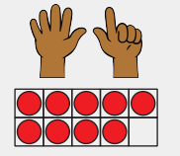
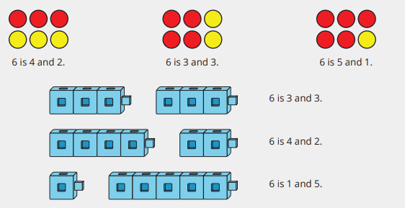
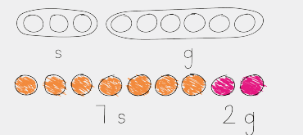
Unit 5 Progression Overview
Compose and Decompose Numbers to 10
Section A
Lessons 1-6
K.CC.A., K.CC.B., K.OA.A.
Section B
Lessons 7-11
K.CC.A, K.CC.C, K.CC., K.OA.A.
Section C
Lessons 12-17
K.CC.A, K.CC.B, K.CC.C., K.OA.A
For any number from 1 to 9, find the number that makes 10 when added to the given number.
Compose and decompose numbers up to 9 in more than 1 way.
Write expressions to represent decompositions.
Solve Put Together, Total Unknown, Put Together/Take Apart, Both Addends Unknown, and Add To/Take From, Result Unknown story problems

Slide 3



Unit 5 Quick Links
L1
L2
L3
L4
L5
L6
L7
L8
L9
L10
L11
L12
L13
L14
L15
L16
L17

Slide 4
Make 2 Parts
1
Let’s break numbers up into parts.
K.CC.A.3, K.CC.B.5, K.OA.A.1, K.OA.A.2, K.OA.A.3, K.OA.A.5

Slide 5

Notice and Wonder: 2 Pictures
Warm up
What do you notice?
What do you wonder?

Slide 6

Five Connecting Cubes
Activity
#1
You have 5 cubes. Put some of the cubes in your hands and some on your desk.
Tell your partner how many cubes are in your hands. Show them the cubes.
Tell your partner how many cubes are on your desk. Show them the cubes.
Tell your partner how many cubes you have altogether.

Slide 7
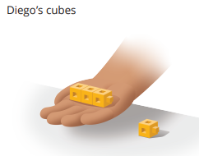
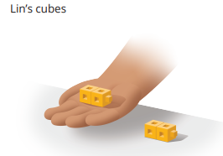
Diego’s and Lin’s Connecting Cubes
Activity
#2
Diego and Lin also put some cubes in their hands and some on their desks. Diego has 3 in his hand and 1 on his desk. He says he has 4 cubes total. Lin has 2 in her hand and 2 on her desk. She also says she has 4 cubes total. Can they both have 4 cubes total?

Slide 8
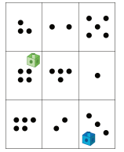
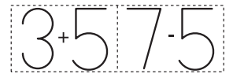

Centers: Choice Time
Activity
#3
Find the Value of Expressions, Color the Total or Difference
Roll and Add, Addition Expressions
Math Fingers,
Add 2 Hands

Slide 9


Today we learned that you can break numbers into two parts in different ways.
Lesson
Synthesis
Tell your partner how you can break apart the 5 cubes into two parts.

Slide 10
Break Apart
Numbers Within 5
2
Let’s break apart numbers and record the parts with an expression.
K.CC.A.3, K.CC.B.5, K.OA.A.1, K.OA.A.2, K.OA.A.3, K.OA.A.5

Slide 11
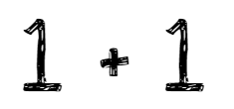
Number Talk + 1
Warm up

Slide 12
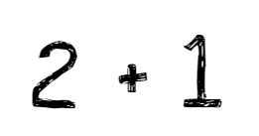
Number Talk + 1
Warm up

Slide 13
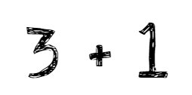
Number Talk + 1
Warm up

Slide 14
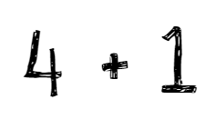
Number Talk + 1
Warm up

Slide 15
Break Apart 5 With Counters
Activity
#1
Today we are going to do an activity that is like the center activity Shake and Spill.
We will play with 5 counters.
Each time we spill out the counters, we will draw a picture of the counters.
Then draw a line to the expression that represents the 2 parts.
The parts are the red counters and the yellow counters.

Slide 16
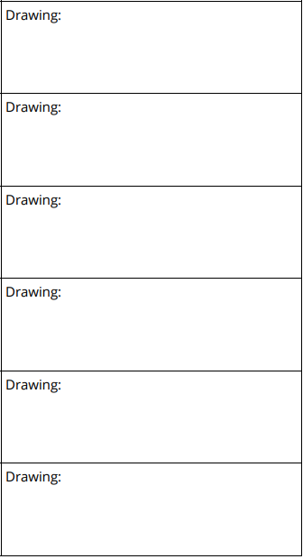

Break Apart 5 With Counters
Activity
#1

Slide 17
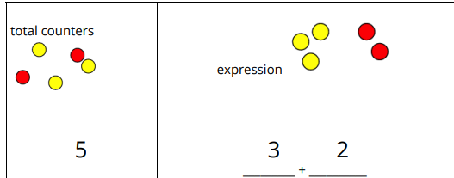
Introduce Shake and Spill, Cover
Activity
#2
Now we are going to learn another way to play Shake and Spill. This game is called Shake and Spill, Cover. Let’s play a round together.

Slide 18
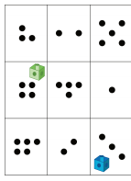
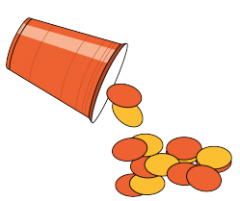


Centers: Choice Time
Activity
#3
Roll and Add, Addition Expressions
Shake and Spill,
Cover
Find the Value of Expressions, Color the Total or Difference
Math Fingers, Add 2 Hands

Slide 19
Today we learned that expressions can tell us the 2 parts that make up a number.
Lesson
Synthesis
What are the 2 parts in this expression? Work with your partner to represent the parts with cubes.

Slide 20
Represent Parts of Totals with Expressions
3
Let’s break apart numbers and show the 2 parts with an expression.
K.CC.A.1, K.CC.A.3, K.CC.B.5, K.G.A.1, K.G.B.6

Slide 21

How Many Do You See? Counters
Warm up
How many do you see?
How do you see them?

Slide 22

How Many Do You See? Counters
Warm up
How many do you see?
How do you see them?

Slide 23

How Many Do You See? Counters
Warm up
How many do you see?
How do you see them?

Slide 24
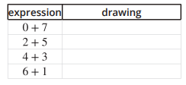
Represent Expressions
Activity #1
Andre and Lin played Shake and Spill with 7 counters. They wrote these expressions to show what happened when they spilled the counters.
Draw a group of counters that could go with each expression

Slide 25

Write Expressions
Activity #2
We are going to play Shake and Spill. This time we will write an expression to represent the red and yellow counters in each round. Let’s play 1 round together.
We will all start with 8 counters.
How many counters are red? How many are yellow? What expression can we write to represent the red and yellow parts?
Now you will work with your partner with 8 cubes. Take turns shaking and spilling the counters

Slide 26
Centers: Choice Time
Activity
#3
Roll and Add, Addition Expressions
Shake and Spill,
Cover
Find the Value of Expressions, Color the Total or Difference
Math Fingers, Add 2 Hands

Slide 27

Lesson
Synthesis
Today we worked with expressions that represent different ways to break numbers into parts.
Tell your partner what expression you would write to show how you made 8 with fingers.

Slide 28
Break Apart Pattern Block Designs
4
Let’s make and break apart pattern block designs.
K.CC.A.3, K.CC.B.5, K.OA.A.1, K.OA.A.2, K.OA.A.3

Slide 29
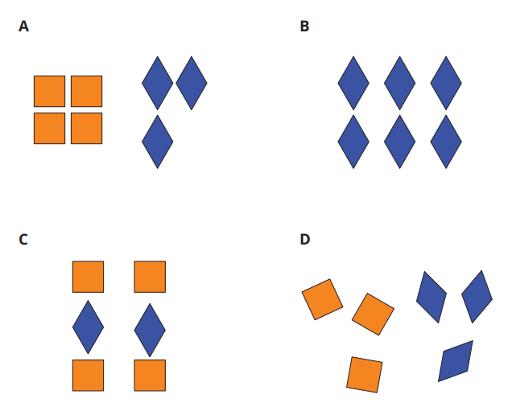
Which One Doesn’t Belong: Pattern Block Designs
Warm up

Slide 30

Create Pattern Blocks Designs
Activity #1
Create a design with 7 pattern blocks.
Use only green triangles and orange squares.
Draw a picture of your design and write an expression to represent the parts inside your 7 blocks.

Slide 31
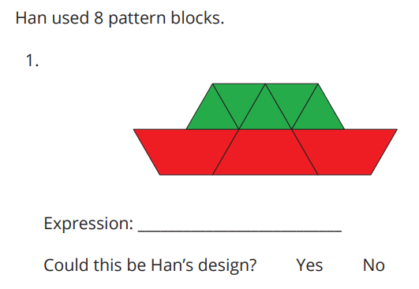
Han’s Pattern Block Design
Activity
#2
Here are some pattern block designs made with 8 pattern blocks.
Write an expression to represent the 2 parts in each design.

Slide 32
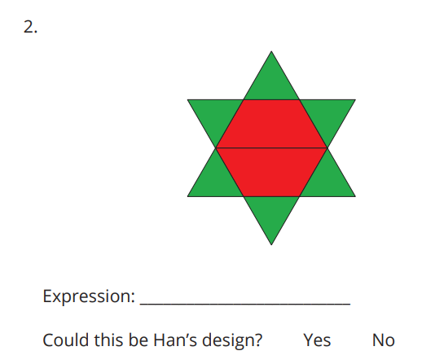
Han’s Pattern Block Design
Activity
#2
Here are some pattern block designs made with 8 pattern blocks.
Write an expression to represent the 2 parts in each design.

Slide 33
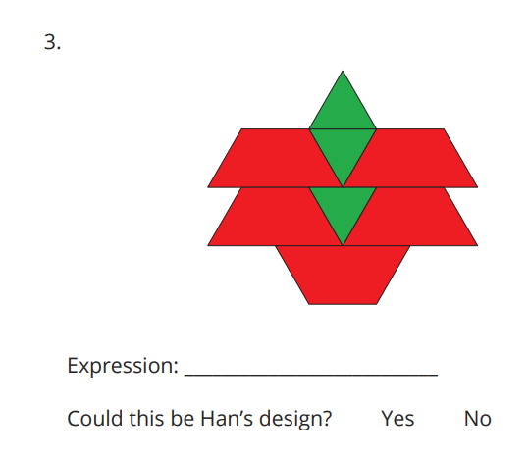
Han’s Pattern Block Design
Activity
#2
Here are some pattern block designs made with 8 pattern blocks.
Write an expression to represent the 2 parts in each design.

Slide 34
Centers: Choice Time
Activity
#3
Roll and Add, Addition Expressions
Shake and Spill,
Cover
Find the Value of Expressions, Color the Total or Difference
Math Fingers, Add 2 Hands

Slide 35
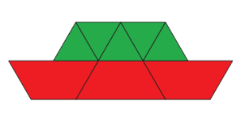
Lesson Synthesis
Today we wrote expressions to represent the 2 parts in pattern block designs.
Elena wrote 5 + 3 to represent the parts in this design.
Is there another expression we could write?

Slide 36
Snap the Cubes
5
Let’s snap towers into 2 parts, record the parts, and look for patterns.
K.CC.A.3, K.CC.B.5, K.OA.A.1, K.OA.A.2, K.OA.A.3

Slide 37
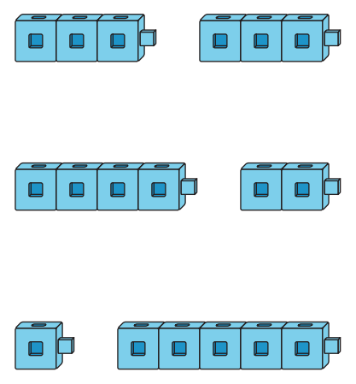
Notice and Wonder:
Connecting Cube Towers
Warm up
What do you notice?
What do you wonder?

Slide 38

Introduce Snap the Cubes,
Show 2 Parts
Activity #1
Today we’re going to learn a game called Snap the Cubes.
Let’s play 1 round together
Start with a tower of 8 cubes. One partner breaks the cube into 2 parts.
The other partner describes what happened to the tower. Tell your partner what happened to my tower.
Both partners record the two parts with a drawing and an expression.
Then put your tower back together, and play again. Take turns snapping the tower.

Slide 39
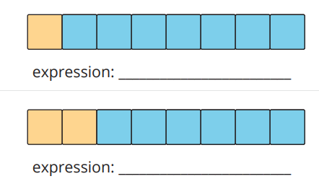
Patterns in Decompositions
Activity #2
Andre and Priya played snap with 8 cubes. They used 2 different colors to show how they broke their tower.
Write an expression to represent the 2 parts in each drawing.

Slide 40
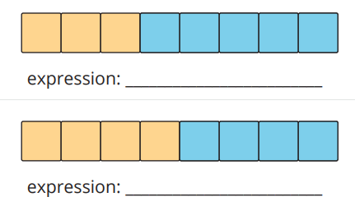
Patterns in Decompositions
Activity #2
Andre and Priya played snap with 8 cubes. They used 2 different colors to show how they broke their tower.
Write an expression to represent the 2 parts in each drawing.

Slide 41
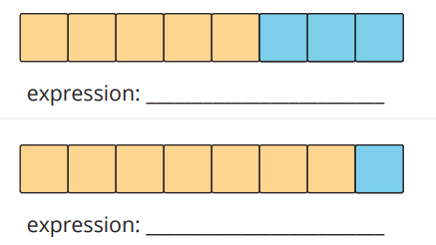
Patterns in Decompositions
Activity #2
Andre and Priya played snap with 8 cubes. They used 2 different colors to show how they broke their tower.
Write an expression to represent the 2 parts in each drawing.

Slide 42
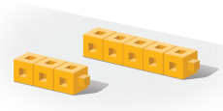
Centers: Choice Time
Activity
#3
Roll and Add, Addition Expressions
Shake and Spill,
Cover
Snap the Cubes, Show 2 Parts
Math Fingers, Add 2 Hands

Slide 43
Today we recognized patterns when we broke numbers into 2 parts.
Lesson Synthesis
Tell your partner what pattern you noticed.

Slide 44
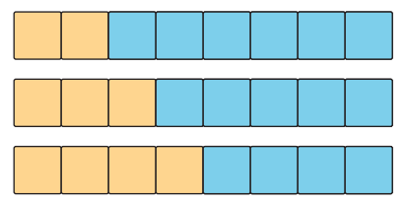
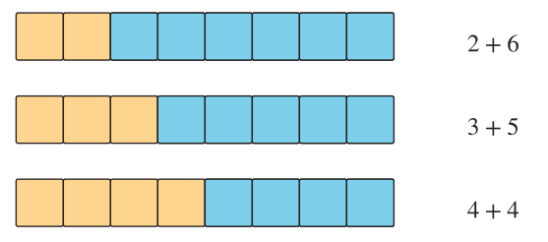
We broke numbers apart in different ways.
We wrote expressions to represent the 2 parts a number was broken into.
Section Summary

Slide 45
Find All the Ways
6
Let’s find all the ways to break apart a number.
K.CC.A.1, K.CC.A.2, K.CC.A.3, K.CC.B.5, K.OA.A.1, K.OA.A.2, K.OA.A.3

Slide 46

Choral Count: Count On
Warm up
Let’s count to 60.

Slide 47
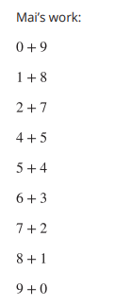
Did She Find All the Ways?
Activity #1
Mai has 9 cubes. She is looking for all of the different ways she can break 9 into 2 parts.
She recorded each way with an expression.
Do you think Mai found all the ways? Why or why not?

Slide 48

Find All the Ways
Activity #2
Find all the different ways you can break apart 7 into 2 parts.
Show each way with cubes or counters and an expression.

Slide 49
Centers: Choice Time
Activity
#3
Roll and Add, Addition Expressions
Shake and Spill,
Cover
Snap the Cubes, Show 2 Parts
Math Fingers, Add 2 Hands

Slide 50

Lesson Synthesis
Today we used patterns to help us find all the ways to make 7.
What expression do you think comes next in the pattern?

Slide 51
Put Together
7
Let’s show what happens in a story problem and solve it.
K.CC.A.3, K.CC.C.7, K.OA.A.1, K.OA.A.2, K.OA.A.3

Slide 52
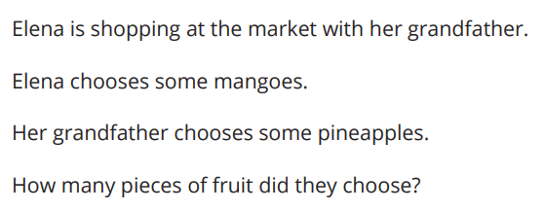
Notice and Wonder:
Numberless Put Together Story Problem
Warm up
What do you notice?
What do you wonder?

Slide 53
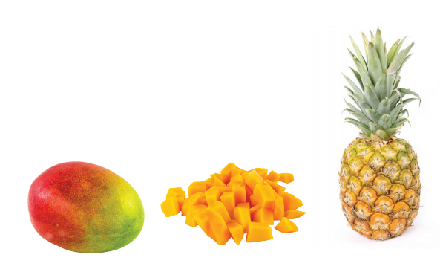
Fruit at the Market
Activity #1
Elena is shopping at the market with her grandfather.
Elena chooses 4 mangoes.
Her grandfather chooses 2 pineapples.
How many pieces of fruit did they choose?

Slide 54
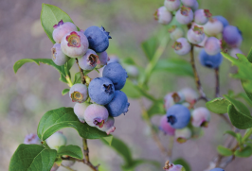
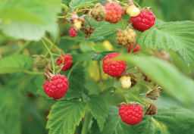
A Bear with Berries
Activity #2
A bear was searching for berries to eat in the forest.
He ate 3 blueberries.
He ate 6 raspberries.
How many berries did the bear eat?

Slide 55
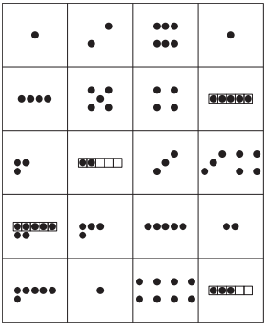
Centers: Introduce Make or Break Apart Numbers, Dots
Activity #3
We are going to learn a new center called Make or Break Apart Numbers.
I’m going to roll a cube onto the number mat to find which number I have to make.
We rolled the number 5. My partner and I have to find 2 groups of dots that go together to make 5. Which groups of dots go together to make 5?
I’m going to put a counter on this group of 3 dots and a counter on this group of 2 dots. 3 dots and 2 dots is 5 dots. What expression should I write on my recording sheet.
Now that my partner and I have written our expression, we can look to see if there are 2 more groups of dots that go together to make 5 dots. If we can’t find any more ways to make 5, then we roll and make another number.

Slide 56
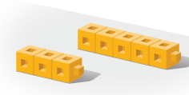
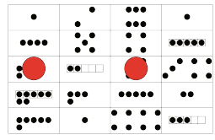
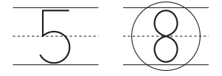
Centers: Choice Time
Activity
#3
Roll and Record,
Which is Less?
Snap the Cubes, Show 2 Parts
Make or Break Apart Numbers, Dots

Slide 57
Lesson Synthesis
Today we read and solved story problems.
A bear was searching for berries to eat in the forest.
He ate 3 blueberries.
He ate 6 raspberries.
How many berries did the bear eat?
What can you add to or change about your work to show what is happening in the story?

Slide 58
Red and Yellow Apples
8
Let’s solve story problems.
K.CC.A.3, K.CC.C.7, K.OA.A.1, K.OA.A.2, K.OA.A.3

Slide 59
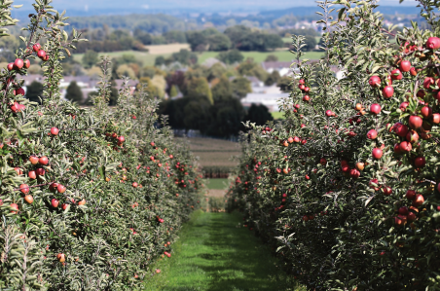
Act It Out: All About Apples
Warm up
Mai was picking apples at the orchard.
Mai picked 5 yellow apples and 2 red apples.
How many apples did she pick?

Slide 60
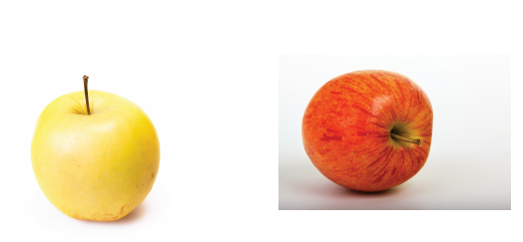
Two Problems about Apples
Activity #1
1. Mai was picking apples at the orchard.
Mai picked 5 yellow apples and 2 red apples.
How many apples did she pick?
2. Lin picked 8 apples at the orchard.
Some of the apples were yellow.
The rest of the apples were red.

Slide 61
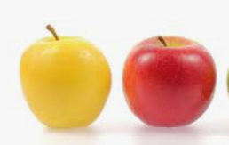
Yellow Apples and Red Apples
Activity #2
Lin picked 8 apples at the orchard.
Some of the apples were yellow.
The rest of the apples were red.

Slide 62
Centers: Choice Time
Activity
#3
Roll and Record,
Which is Less?
Snap the Cubes, Show 2 Parts
Make or Break Apart Numbers, Dots

Slide 63
Lesson Synthesis
What is the same about all of their work?

Slide 64
Solve Both
Addends Unknown
9
Let’s solve story problems.
K.CC.A.3, K.CC.C.7, K.OA.A.1, K.OA.A.2, K.OA.A.3

Slide 65
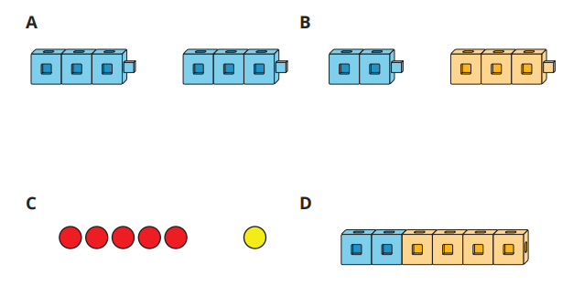
Which One Doesn’t Belong: Decompose with Math Tools
Warm up

Slide 66
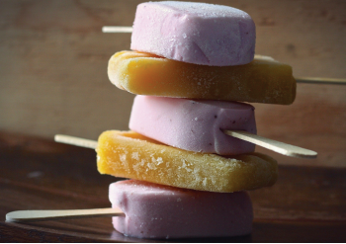
Fruit for Paletas
Activity #1
Jada made 6 paletas with her brother.
They made two flavors, lime and coconut.
How many of the paletas were lime?
Then how many of the paletas were coconut?

Slide 67
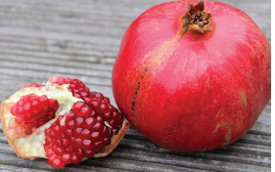
Pomegranates
Activity #2
Kiran had 7 pomegranates in his bag.
He put some of the pomegranates on the shelf.
He put the rest of the pomegranates in a basket.
How many of the pomegranates were on the shelf?
Then how many of the pomegranates were in the basket?

Slide 68
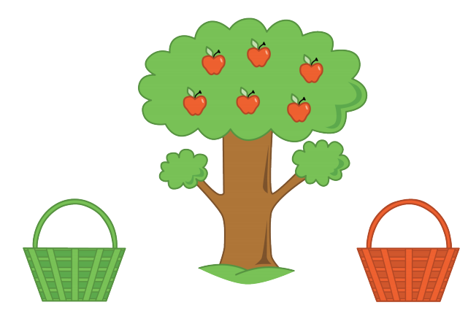
Centers: Introduce Math Stories, Both Addends Unknown
Activity #3
We are going to learn a new way to play our Math Stories center.
Priya picked all the apples from the apple tree. One partner will tell a story about which apples Priya put in the green basket and which apples she put in the red basket.
Think of a story you can tell your partner.
Now I need to use objects or drawings to show what happened in my partner’s story. How can I show what happened in my partner’s story?
Once I finish using objects or drawings to show what happened in my partner’s story, I need to tell my partner a different story about the apples and the baskets.

Slide 69
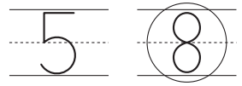
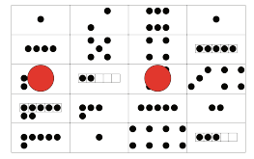
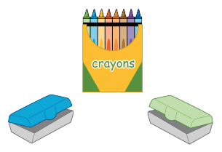
Centers: Choice Time
Activity
#3
Roll and Record,
Which is Less?
Make or Break Apart Numbers, Dots
Snap the Cubes, Show 2 Parts
Math Stories, Both Addends Unknown

Slide 70

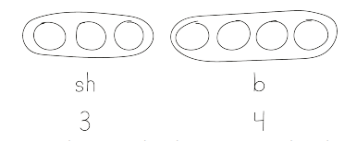
Lesson Synthesis
Priya wants to show that 5 of the pomegranates are on the shelf and 2 of the pomegranates are in the basket. What can she change or add to the drawing to show this?
We can use labels, colors, and numbers to help us show what is happening in the story.
Tyler drew this picture.
Does Tyler’s picture show the story?

Slide 71
More Than One Way
10
Let’s find more than one way to solve a problem.
K.CC.A.3, K.CC.C.7, K.OA.A.1, K.OA.A.2, K.OA.A.3

Slide 72
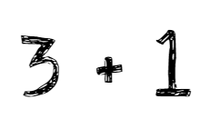
Number Talk: Expressions
Warm up
Add or Subtract

Slide 73
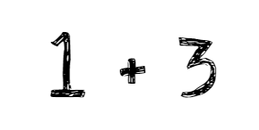
Number Talk: Expressions
Warm up
Add or Subtract

Slide 74

Number Talk: Expressions
Warm up
Add or Subtract

Slide 75

Number Talk: Expressions
Warm up
Add or Subtract

Slide 76

Citrus Juice
Activity #1
Han squeezed 9 pieces of fruit to make juice.
Some of the fruits were satsumas.
The rest of the fruits were grapefruits.
How many of the fruits were satsumas?
Then how many of the fruits were grapefruits?
Which drawing represents the story?

Slide 77


Dates to Stuff
Activity #1
Andre and his older brother have 8 dates.
They stuff some of the dates with cheese.
They stuff the rest of the dates with almonds.
How many of the dates did they stuff with cheese?
Then how many of the dates did they stuff with almonds?
Tell your partner what happened in the story.
What are we trying to figure out?
Show your thinking using drawings, numbers, words or objects.

Slide 78
Centers: Choice Time
Activity
#3
Roll and Record,
Which is Less?
Make or Break Apart Numbers, Dots
Snap the Cubes, Show 2 Parts
Math Stories, Both Addends Unknown

Slide 79


Lesson Synthesis
Andre and his older brother have 8 dates.
They stuff some of the dates with cheese.
They stuff the rest of the dates with almonds.
How many of the dates did they stuff with cheese?
Then how many of the dates did they stuff with almonds
Diego
Diego and Priya drew these pictures to show what happened in the story. Priya says that they found the same answer to the story problem. What do you think?
Priya
8 = 3 + 5

Slide 80
All of the Story Problems
11
Let’s solve story problems.
K.CC.A.1, K.CC.A.2, K.CC.A.3, K.CC.C.7, K.OA.A.1, K.OA.A.2, K.OA.A.3

Slide 81

Choral Count:
Count to 70 and Count On
Warm up
Let’s count to 70.
Now, start at the number 7 and count to 30.

Slide 82

All the Story Problems
Activity #1
Mai grew 7 tomatoes in her garden.
She picked 5 of the tomatoes to make salsa.
How many tomatoes are still in the garden?
Tell your partner what happened in the story.
What are we trying to figure out?
Show your thinking using drawings, numbers, words, or objects.

Slide 83
All the Story Problems
Activity #1
There are 9 tomatoes in Mai’s garden.
Some of the tomatoes are yellow.
The rest of the tomatoes are red.
How many of the tomatoes are yellow?
Then how many of the tomatoes are red?
Tell your partner what happened in the story.
What are we trying to figure out?
Show your thinking using drawings, numbers, words, or objects.

Slide 84
Make and Match Story Problems
Activity #2
You are going to think of a different story problem about fruits or vegetables in a garden. Remember that your story problem should have a question at the end. You can write words or draw pictures to help you remember the story problem that you create.
Tell your partner your story problem.
Solve the story problem your partner told you.
Show your thinking using objects, drawings, numbers, or words

Slide 85
Centers: Choice Time
Activity
#3
Roll and Record,
Which is Less?
Make or Break Apart Numbers, Dots
Snap the Cubes, Show 2 Parts
Math Stories, Both Addends Unknown

Slide 86
Lesson Synthesis
Today we solved many different story problems about tomatoes in a garden.
1. Mai grew 7 tomatoes in her garden. She picked 5 of the tomatoes to make salsa. How many tomatoes are still in the garden?
2. There are 9 tomatoes in Mai’s garden. Some of the tomatoes are yellow. The rest of the tomatoes are red. How many of the tomatoes are yellow? Then how many of the tomatoes are red?
Why did we all get the same answer to the first story problem? Why did we get different answers for the second story problem?

Slide 87

In this section, we solved story problems with more than one solution.
Kiran had 7 pomegranates in his bag.
He put some of the pomegranates on the shelf.
He put the rest of the pomegranates in a basket.
How many of the pomegranates were on the shelf?
Then how many of the pomegranates were in the basket?
Section Summary
We used objects and drawings to solve story problems.

Slide 88
Introduce the 10-frame
12
Let’s make and use 10-frames.
K.CC.A.3, K.CC.B, K.CC.B.4.b, K.CC.B.5, K.CC.C.6, K.OA.A.1, K.OA.A.2, K.OA.A.4

Slide 89

Notice and Wonder:
Fingers and Two 5-frames
Warm up
What do you notice?
What do you wonder?

Slide 90





Introduce 10-frames
Activity #1
Cut out and glue the 5-frames to make each number.

Slide 91

Numbers on Fingers and 10-frames
Activity #2
Figure out how many fingers are held up in each picture.
Then use your counters to show that number on the 10-frame.

Slide 92

Numbers on Fingers and 10-frames
Activity #2
Figure out how many fingers are held up in each picture.
Then use your counters to show that number on the 10-frame.

Slide 93

Numbers on Fingers and 10-frames
Activity #2
Figure out how many fingers are held up in each picture.
Then use your counters to show that number on the 10-frame.

Slide 94

Numbers on Fingers and 10-frames
Activity #2
Figure out how many fingers are held up in each picture.
Then use your counters to show that number on the 10-frame.

Slide 95

Numbers on Fingers and 10-frames
Activity #2
Figure out how many fingers are held up in each picture.
Then use your counters to show that number on the 10-frame.

Slide 96

Numbers on Fingers and 10-frames
Activity #2
Figure out how many fingers are held up in each picture.
Then use your counters to show that number on the 10-frame.

Slide 97



Centers: Choice Time
Activity
#3
Shake and Spill
Math Libs, Draw 1-10
Math Stories, Both Addends Unknown

Slide 98

Today we used a new tool called a 10-frame to organize and show numbers
Lesson Synthesis
Use your fingers to show how many counters are on the 10-frame.
Tell your partner what you know about this 10-frame

Slide 99
Equations that Show
Compositions and Decompositions of 10
13
Let’s match equations to 10-frames and fingers.
K.CC.A.3, K.CC.B.4.b, K.CC.B.5, K.CC.C.6, K.OA.A.1, K.OA.A.2, K.OA.A.4

Slide 100

Notice and Wonder:
Expressions for 10
Warm-Up
What do you notice?
What do you wonder?

Slide 101


Match Equations and 10-frames
Activity #1

Slide 102

Represent Equations with Fingers
Activity #2
Color the fingers to represent each equation.

Slide 103

Represent Equations with Fingers
Activity #2
Color the fingers to represent each equation.

Slide 104

Represent Equations with Fingers
Activity #2
Color the fingers to represent each equation.

Slide 105

Represent Equations with Fingers
Activity #2
Color the fingers to represent each equation.

Slide 106

Represent Equations with Fingers
Activity #2
Color the fingers to represent each equation.

Slide 107

Represent Equations with Fingers
Activity #2
Color the fingers to represent each equation.

Slide 108
Centers: Choice Time
Activity
#3
Shake and Spill
Math Libs, Draw 1-10
Math Stories, Both Addends Unknown

Slide 109



Today we used equations to show many different ways to make 10.
Lesson Synthesis
Where do you see 9? Where do you see 1?
Where do you see 10 on the 10-frame and on the fingers?

Slide 110
How Many Are Missing?
14
Let’s fill 10-frames in different ways.
K.CC.A.3, K.CC.B.4.b, K.CC.B.5, K.CC.C.6, K.OA.A.1, K.OA.A.2, K.OA.A.3, K.OA.A.4

Slide 111

Which One Doesn’t Belong: 10-frames
Warm up

Slide 112


Shake, Spill, and Arrange with 10
Activity #1
Take turns shaking and spilling all 10 counters.
Arrange the counters in the 10-frame at the top of your page.
Then color in the equation that shows the red and yellow counters.
If you get the same equation again, put a check in the box.

Slide 113

How Many to Fill the 10-frame?
Activity #2
Figure out how many counters are needed to fill the 10-frame. Write a number to show many counters are needed to fill the 10-frame.
Circle the equation that shows the number of counters in the 10-frame and the number of counters needed to fill the 10-frame.

Slide 114

How Many to Fill the 10-frame?
Activity #2
Figure out how many counters are needed to fill the 10-frame. Write a number to show many counters are needed to fill the 10-frame.
Circle the equation that shows the number of counters in the 10-frame and the number of counters needed to fill the 10-frame.

Slide 115

How Many to Fill the 10-frame?
Activity #2
Figure out how many counters are needed to fill the 10-frame. Write a number to show many counters are needed to fill the 10-frame.
Circle the equation that shows the number of counters in the 10-frame and the number of counters needed to fill the 10-frame.

Slide 116

How Many to Fill the 10-frame?
Activity #2
Figure out how many counters are needed to fill the 10-frame. Write a number to show many counters are needed to fill the 10-frame.
Circle the equation that shows the number of counters in the 10-frame and the number of counters needed to fill the 10-frame.

Slide 117

How Many to Fill the 10-frame?
Activity #2
Figure out how many counters are needed to fill the 10-frame. Write a number to show many counters are needed to fill the 10-frame.
Circle the equation that shows the number of counters in the 10-frame and the number of counters needed to fill the 10-frame.

Slide 118

How Many to Fill the 10-frame?
Activity #2
Figure out how many counters are needed to fill the 10-frame. Write a number to show many counters are needed to fill the 10-frame.
Circle the equation that shows the number of counters in the 10-frame and the number of counters needed to fill the 10-frame.

Slide 119
Centers: Choice Time
Activity
#3
Shake and Spill
Math Libs, Draw 1-10
Math Stories, Both Addends Unknown

Slide 120


Lesson Synthesis
Jada spilled 10 counters. Here are the red counters Jada got when she was playing Shake and Spill.
What equation can we use to show Jada’s counters?
How many yellow counters did Jada get? How do you know?

Slide 121
Make 10
15
Let’s make 10.
K.CC, K.CC.A.3, K.CC.B.4.b, K.CC.B.5, K.CC.C.6, K.OA.A.1, K.OA.A.2, K.OA.A.4

Slide 122

How Many Do You See:
Fingers Up and Down
Warm up
How many do you see?
How do you see them?

Slide 123

How Many Do You See:
Fingers Up and Down
Warm up
How many do you see?
How do you see them?

Slide 124

How Many Do You See:
Fingers Up and Down
Warm up
How many do you see?
How do you see them?

Slide 125
Introduce Math Fingers, Make 10
Activity #1
Now we are going to learn another way to play Math Fingers.
This game is called Math Fingers, Make 10. Let’s play a round together.
I rolled 7, so I am going to hold up 7 fingers.
Now my partner needs to figure out how many more fingers I need to put up to show 10 fingers. How many more fingers do I need to hold up to make 10?
Now we need to fill in an equation to show how many fingers are up and how many more fingers are needed to make 10. How should I fill in an equation?
Take turns with your partner rolling to find a number and showing that number with your fingers. Your partner figures out how many more fingers are needed to make 10. You both fill in an equation to show how many fingers are up and how many more fingers are needed to make 10.

Slide 126

Make 10
Activity #2
Work with your partner to figure out which number you need to make 10 with each number.
Once you both agree, write a number on the line.
Then fill in an equation to show 1 way to make 10.

Slide 127

Centers: Choice Time
Activity
#3
Shake and Spill
Math Libs,
Draw 1-10
Math Stories, Both Addends Unknown
Math Fingers,
Make 10

Slide 128


Lesson Synthesis
Show your partner how you can use your fingers to figure out what number goes with 3 to make 10.
Why are our fingers a helpful tool if we want to find different ways to make 10?
10 is 3 plus 7. 3 and 7 are 2 parts that go together to make 10.

Slide 129
Towers of 10
16
Let’s figure out how many cubes are hidden.
K.CC.A.3, K.CC.B.4.b, K.CC.B.5, K.CC.C.6, K.OA.A.1, K.OA.A.2, K.OA.A.4

Slide 130
What Do You Know About ?
Warm up
10

Slide 131
Introduce Snap the Cubes,
How Many Are Missing?
Activity #1
Make a tower with 10 connecting cubes.
Now we are going to learn another way to play Snap the Cubes . This game is called Snap the Cubes, How Many Are Missing? Let’s play a round together.
Choose who will go first. Snap the tower into two parts and hide one of the parts behind your back. Show your partner the other part.
Figure out how many cubes are hidden behind your partner’s back.
Draw or color the connecting cube tower to show the two parts that the tower snapped into. Work together to fill in an equation to show the total number of connecting cubes in the tower and the two parts that the tower snapped into.
Take turns snapping the tower of 10 cubes and hiding one part.

Slide 132


How Many Cubes Are Hidden?
Activity #2
Han has a tower of 10 cubes.
He snaps it into 2 parts and hides 1 part behind his back.
He shows his partner 4 cubes.
How many cubes is Han hiding?

Slide 133





Centers: Choice Time
Activity #3
Snap the Cubes, How Many Are Missing?
Shake and Spill
Math Fingers, Make 10
Math Libs, Draw 1-10
Math Stories, Both Addends Unknown

Slide 134




Lesson Synthesis
We have looked at lots of ways to make 10: 10-frames, fingers, expressions and equations, and towers of connecting cubes.
What is your favorite way to make 10? Why is it your favorite?

Slide 135


Section Summary
In this section, we found many different ways to make 10.
We used a 10-frame and our fingers to show numbers and figure out how many more are needed to make 10.
We used equations to show different ways to make 10.

Slide 136
Lots of Fruit
17
Let’s make up story problems and solve them.
K.OA.A.1, K.OA.A.2, K.OA.A.3

Slide 137

Notice and Wonder: Fruit Stand
Warm up
What do you notice?
What do you wonder?

Slide 138

Fruit Story Problems
Activity #1
I will roll the cube onto the fruit mat. This tells me which fruit to tell a story about.
I will roll the cube onto the number mat. This tells me how many pieces of fruit I have altogether.
You will tell a story problem about the fruit and the number that you roll. Remember that your story problem should have two questions at the end. You can write words or draw pictures to help you remember the story problem that you create.

Slide 139
All the Solutions
Activity #2
Tell your new partner your story problem.
What are you trying to figure out?
Work with your partner to show as many possible solutions for the story problem.
Show your thinking using drawings, numbers, words, or objects.

Slide 140
Lesson Synthesis
In the story problems, we saw that there were a lot of different solutions.
How can we organize our work to show that we have all the solutions?

