Slide 1

Numbers 1–10
Kindergarten : Unit 2
Standards addressed: K.CC, K.CC.A.1, K.CC.A.3, K.CC.B.4, K.CC.B.4.b, K.CC.B.5, K.CC.C.6, K.G.B
These slides have been created by Britnee Wright Southeast Arkansas Education Cooperative and are not official IM materials. Images and language are taken from IM Grade K, Unit 2 by Illustrative Mathematics.
Copyright 2020 by Illustrative Mathematics. All Rights Reserved, adapted and shared with permission.

Slide 2
Unit 2 Progression Overview
Math In Our World
Section A
Lessons 1-6
K.CC, K.G.B
Section B
Lessons 7-11
K.CC
Section C
Lessons 12-16
K.CC
Section D
Lessons 17-22
Connect quantities with spoken number words.
Count and compare up to 10 objects and know the number remains the same regardless of the arrangement of the objects.
Connect quantities with spoken number words.
Count and compare up to 10 images in organized arrangements and know the number remains the same regardless of the order in which the images are counted.
Connect quantities with spoken number words and written numbers.
Understand the relationship between number and quantity.
Compare written numbers 1–10.

Slide 3



Unit 2 Quick Links
L1
L2
L3
L4
L5
L6
L7
L8
L9
L10
L11
L12
L13
L14
L15
L16
L17
L18
L19
L20
L21
L22

Slide 4
Fingers as a Math Tool
1
Let’s show numbers with our fingers.
K.CC, K.CC.A.1, K.G.B

Slide 5
Choral Count: Fingers and Counting
Warm up
Let’s count to 10.

Slide 6

How Many Fingers?
Activity
#1
How many fingers am I holding up?
One partner holds up some fingers. The other partner has to figure out how many fingers they are holding up. Take turns playing with your partner

Slide 7


Show Some Fingers
Activity
#2
When I say a number, hold up that many fingers. Then check with your partner to see if you are holding up the same number of fingers.

Slide 8

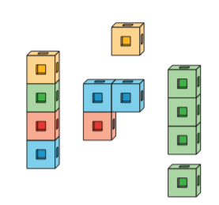
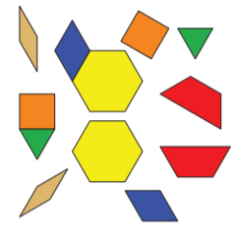
Centers: Introducing Math Fingers: Show and Say, Stage 1
Activity
#3
Math Fingers
Connecting Cubes
Pattern Blocks

Slide 9

Today we used our fingers as math tools to show numbers. Tell your partner which number was your favorite to show using your fingers and why it was your favorite.
Lesson
Synthesis

Slide 10
Count and Arrange
2
Let’s figure out how many counters we have
K.CC, K.CC.A.1, K.CC.B.4, K.CC.B.4.b, K.CC.B.5

Slide 11
Choral Count: Fingers and Numbers
Warm up
As I count to 10, put up 1 finger as I say each number.
Now let’s count to 10 with our fingers. Each time you say a number, put up 1 finger.

Slide 12
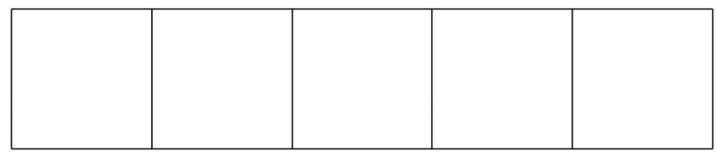
Grab and Count
Activity
#1
We are going to play a game called Grab and Count.
One person will grab a handful of pattern blocks, count them, and tell their partner how many there are.
Then the other person will rearrange the pattern blocks using the 5-frame, count them, and tell their partner how many there are.
Then switch roles.

Slide 13
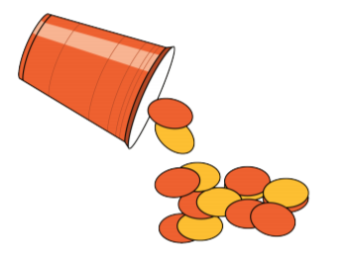
Introducing Shake and Spill: Count, Stage 1
Activity
#2
We’re learning a new game called Shake and Spill. Let’s play a round together
Start with all the counters in the cup. Partner A shakes the cup and spills the counters out on the table and figures out how many there are.
How could we figure out how many counters are here?
Their partner should also count the counters to see if they agree. When both partners agree, Partner B puts the counters back in the cup, shakes them, and spills them out on the table. Partner B figures out how many counters are there and Partner A checks
After both partners have had a chance to shake and spill the counters, play again but take some counters away so you are playing with a different number of counters.

Slide 14
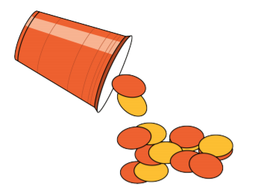

Centers: Choice Time
Activity
#3
Shake and Spill
Picture Books
Math Fingers

Slide 15
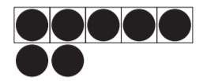
Lesson
Synthesis
How many objects are there?
How many objects are there?

Slide 16
Groups that Look Very Different
3
Let’s figure out if there are more green triangles or more orange squares.
K.CC, K.CC.A.1, K.CC.A.3, K.CC.B.4, K.CC.B.4.b, K.CC.B.5, K.CC.C.6

Slide 17
Choral Count: Represent with Fingers and Numbers
Warm up
Count to 10 with your fingers. Each time you say a number, put up 1 finger.
As you count and put up your fingers, I will write the numbers.

Slide 18


More or Fewer Pattern Blocks
Activity #1
What do you notice?
What do you wonder?

Slide 19
More or Fewer Pattern Blocks
Activity #1
Take the pattern blocks out of your bag.
Are there more orange squares or more green triangles?
How do you know which has more?
Count your orange squares. Count your green triangles.
Switch your bag of objects with another group. Are there more orange squares or more green triangles?

Slide 20
Creating Groups with More and Fewer
Activity #2
Make a group of counters that has more than the green triangles.
Count your counters and triangles and tell your partner how many of each you have.
Make a group of counters that has fewer counters than orange squares.
Count your counters and squares and tell your partner how many of each you have.

Slide 21
Creating Groups with More and Fewer
Activity #2
Make a group of counters that has more than the green triangles.
Count your counters and triangles and tell your partner how many of each you have.
Make a group of counters that has fewer counters than orange squares.
Count your counters and squares and tell your partner how many of each you have.

Slide 22

Centers: Introducing Number Race: Trace It, Stage 1
Activity
#3
Shake and Spill
Number Race
Math Fingers

Slide 23
Lesson Synthesis
We can just see that there are a lot of red counters and only a few yellow counters. There are fewer yellow counters than red counters. There are more red counters than yellow counters
Are there fewer yellow counters or red counters? How do you know?

Slide 24
Groups that Look Alike
4
Let’s find groups that have more, fewer, or the same number.
K.CC, K.CC.A.3, K.CC.C.6

Slide 25



How Many Do You See?
Warm up
How many do you see? How do you see them?

Slide 26
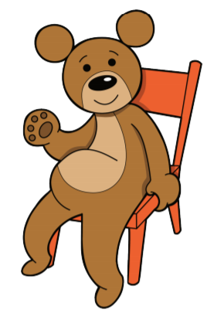
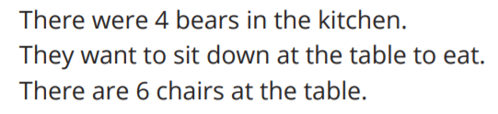
Which Has More?
Activity #1

Slide 27
Introducing Shake and Spill: Count, Stage 2
Activity
#2
We are going to play a new Shake and Spill game.
First we shake the counters in the cup and spill them out onto the table. Then we find out which color there are more of and which there are fewer of. It might be helpful to see if they are the same first. If not you can see which color has more.
Do we have more red or more yellow counters? How do you know?
Repeat after me. ‘There are more red counters than yellow counters
Repeat after me. ‘There are fewer yellow counters than red counters.
Now you will play with your partner. Take turns shaking and spilling the counters. Then work together to say which color there are more of which there are fewer of.

Slide 28
Centers: Choice Time
Activity
#3
Shake and Spill
Number Race
Math Fingers

Slide 29
Lesson Synthesis
Today we saw that sometimes you can compare 2 groups just by looking at them, but sometimes you need to match or count the objects. Tell your partner why you might need to match or count the objects in order to compare groups.

Slide 30
Make Groups of More, Fewer, or the Same
5
Let’s make groups of objects that have more, fewer, or the same number of objects as another group.
K.CC.B

Slide 31



How Many Do You See?
Warm up
How many do you see? How do you see them?

Slide 32
Introducing Less, Same, More: Groups of Objects, Stage 1
Activity #1
Choose a group of objects and place them in the box at the top of the mat.
Use cubes to make a new group of objects for each box below. Make a group that has fewer objects, a group that has the same number of objects, and a group that has more objects.
Discuss with your partner how you know each group has more, fewer or the same number of objects.

Slide 33
1 More and 1 Fewer
Activity #2
You are going to work with your partner to make 2 groups of objects.
First, Partner A makes a group of objects in the box at the top of the mat.
Then, Partner B makes a group that has 1 more and a group that has 1 fewer object than Partner A’s group. Partner B also says a sentence using “more” or “fewer” to describe each group and explains how they know it is 1 more or 1 fewer. You do not have to make anything in the middle box.
When both partners agree, switch roles and continue playing.

Slide 34
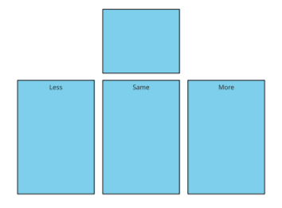
Choice Time
Activity #3
Less, Same, More Math Fingers Shake and Spill

Slide 35
Today we made groups that had more, fewer, or the same number of objects as a given group. We made groups with just 1 more or 1 fewer than a given group.
Lesson Synthesis
Now show a group of fingers that is 1 more than the group I am showing
Show a group of fingers that is more than the group I am showing
There are lots of numbers that are more than 4, but there is only 1 number that is 1 more than 4.

Slide 36
Use More, Fewer, or the Same to Describe Groups
6
Let’s use “more”, “fewer” and “the same as” to describe groups.
K.CC, K.CC.A.3, K.CC.C.6

Slide 37

How Many Do You See: Fingers 1–10
Warm up
How many do you see? How do you see them?

Slide 38

How Many Do You See: Fingers 1–10
Warm up
How many do you see? How do you see them?

Slide 39

How Many Do You See: Fingers 1–10
Warm up
How many do you see? How do you see them?

Slide 40
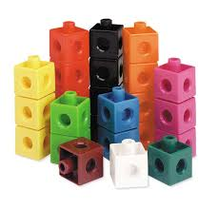
Match Bags to Comparison Statements
Activity #1
Each group will be given 3 bags of cubes.
I am going to read a statement to you about the cubes. Your job is to find the bag of cubes that matches the statement.
In this bag, there are more red cubes than blue cubes.
How did you know that bag matched the statement?
Let’s all say, ‘There are more red cubes than blue cubes.
There are fewer red cubes than blue cubes.
There are the same number of red cubes and blue cubes.

Slide 41
Cube Tower Walk and Talk
Activity #2
Take a handful of cubes and put them together into a tower.
You are going to walk around the room with your cube tower. When you hear the signal, find a partner.
Figure out whose tower has more cubes and whose tower has fewer cubes.
We will repeat these steps so you can work with a few different towers.

Slide 42

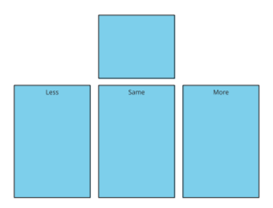

Introducing Math Fingers:
Fewer or More, Stage 2
Activity #3
Math Fingers Less, Same, More Number Race

Slide 43


Lesson Synthesis
How can we use “more,” “fewer,” or “the same as” to describe the number of students in these groups?

Slide 44

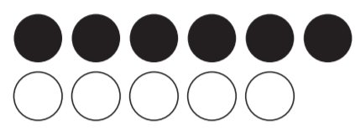
Section Summary
In this section, we found groups that had fewer, the same, or more objects than another group. Sometimes we could tell just by looking.
There are more black dots than white dots
If you can’t tell by looking, you can match up objects. There are more black dots than white dots.
We used the words “more,” “fewer,” and “the same” in sentences to describe objects in different groups.

Slide 45
Count Images in Different Arrangements
7
Let’s figure out how many images there are.
K.CC.A.3, K.CC.B, K.CC.B.4, K.CC.B.4.b, K.CC.B.5

Slide 46

Questions About Us: Dogs or Cats? (Part 1)
Warm up
Which animal do you like better: dogs or cats?”
Stand up if you like dogs better.
Stand up if you like cats better.

Slide 47



Images in Stations
Activity #1
At each station, there is a card with images on it.
Take turns figuring out how many images are on the card.
Show your group how you figured out how many images are on the card.
When I give the signal, move to the next station.

Slide 48
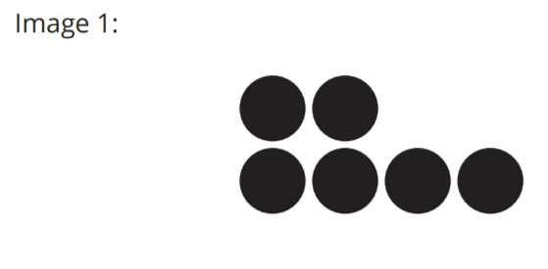

Counting Images (optional)
Activity #2
What do you notice
What do you wonder?
How many dots are there? You can use the counters to help you.

Slide 49
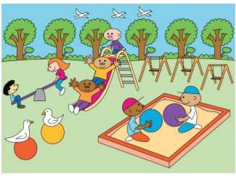
Centers: Introducing Math Stories: How Many, Stage 1
Activity #3
Math Stories Less, Same, More Number Race

Slide 50

Lesson Synthesis
How would you figure out how many dots there are? Which dot would you count first? Which dot would you count next?

Slide 51
Comparing Matching Images
8
Let’s figure out what we have more and fewer of.
K.CC.A.3, K.CC.B, K.CC.B.5, K.CC.C.6

Slide 52
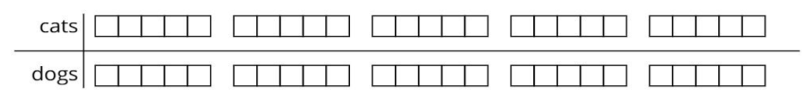
Questions About Us: Dogs or Cats? (Part 2)
Warm up
Which animal do you like better: dogs or cats?

Slide 53
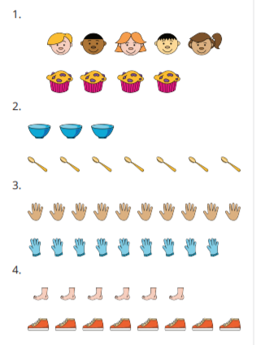
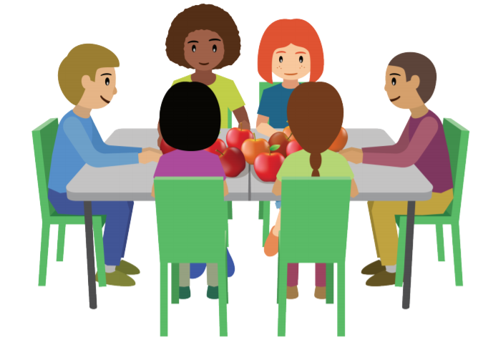
Are There Enough?
Activity #1
What do you notice? What do you wonder?

Slide 54
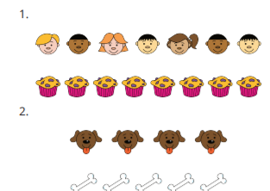
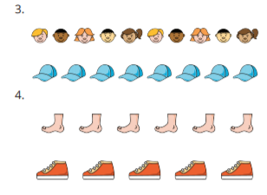
Comparing Images That Aren’t Matched
Activity #2
How are these images different from the ones we worked with in Activity 1?

Slide 55

Centers: Introducing Math Stories: How Many, Stage 1
Activity #3
Math Stories Less, Same, More Math Fingers

Slide 56
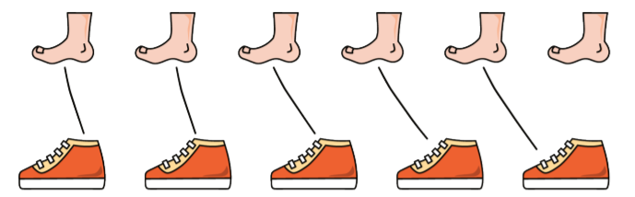
Lesson Synthesis
Tell your partner about the feet and shoes using ‘more
Tell your partner about the feet and shoes using ‘fewer’.

Slide 57
More, Fewer, or the Same
9
Let’s figure out if there are more, fewer, or the same number of images.
K.CC.B, K.CC.B.5, K.CC.C.6

Slide 58
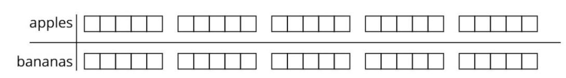

Questions About Us: Apples or Bananas? (Part 1)
Warm up
Which fruit do you like better: apples or bananas?

Slide 59
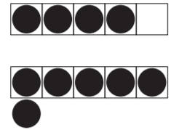
Compare 5-frame Cards
Activity #1
What do you notice? What do you wonder?

Slide 60
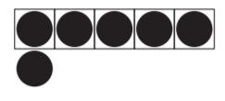
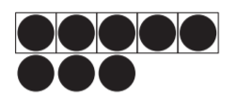
Compare 5-frame Cards
Activity #1
Which card has more dots?

Slide 61
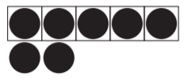
More and Fewer with 5-frames and Fingers
Activity #2
We are going to use our fingers to show more and fewer than the dots.
Use your fingers to show more.
Use your fingers to show fewer
Take turns flipping over a card.
Figure out how many dots there are and show more on your fingers.
Then your partner shows fewer on their fingers.
Show how many dots there are on this card on your fingers.

Slide 62
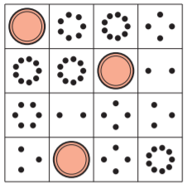
Centers: Introducing Cover Up: Images Stage 1
Activity #3
Math Stories Less, Same, More Cover Up

Slide 63
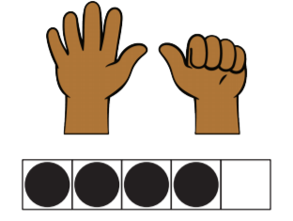
Diego and Lin flipped over these cards while they were playing. Diego said, ‘There are more fingers than dots.’ Lin said, ‘There are fewer dots than fingers.’ Who do you agree with? Why?
Lesson Synthesis

Slide 64
Find More or Fewer
10
Let’s compare groups of images using the words “more,” “fewer,” or “the same.”
K.CC.A.3, K.CC.B, K.CC.B.5, K.CC.C.6

Slide 65
Questions About Us: Apples or Bananas? (Part 2)
Warm up
What do the circles represent?
How can we figure out how many students like apples better?
How many students like apples better?
How can we figure out how many students like bananas better?

Slide 66

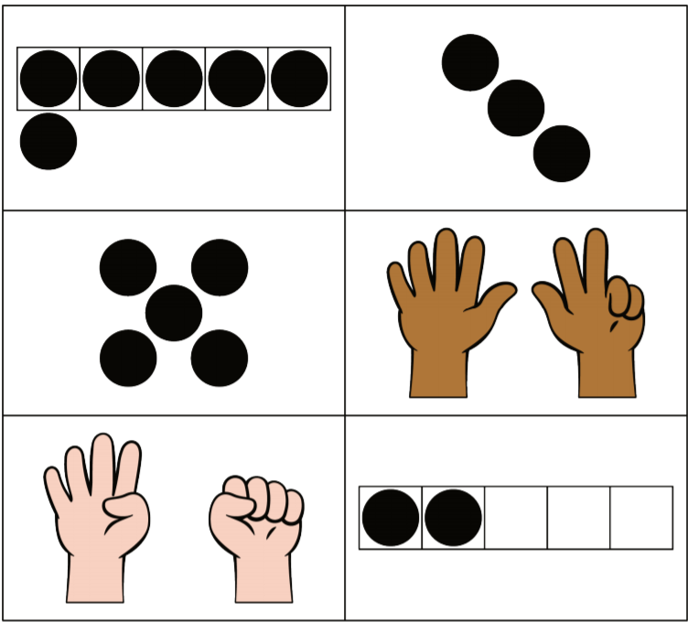
Circle More, Circle Fewer
Activity #1
How many dots are there?
Look at the images below.
Circle the 3 images that show more than 4.
For each image, tell your partner a statement

Slide 67
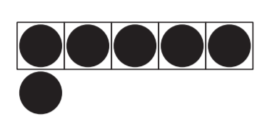
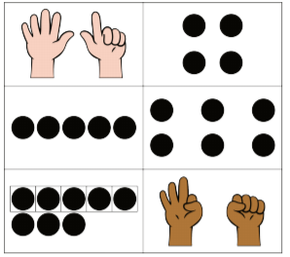
Circle More, Circle Fewer
Activity #1
How many dots are there?
Look at the images below.
Circle the 3 images that show more than 4.
For each image, tell your partner a statement

Slide 68
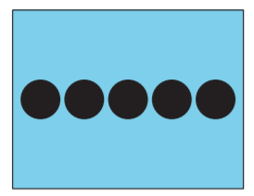
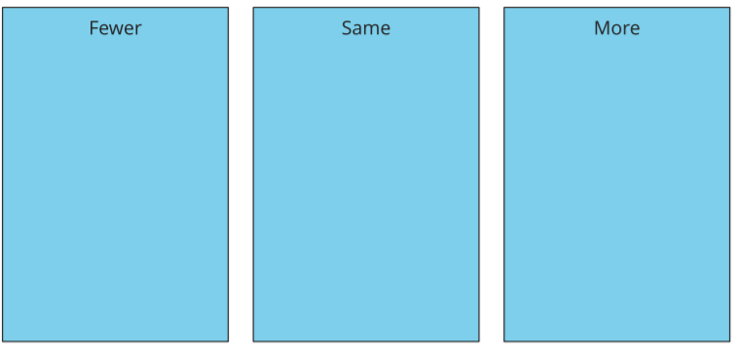
Introducing Less, Same, More: Images, Stage 2
Activity #2

Slide 69
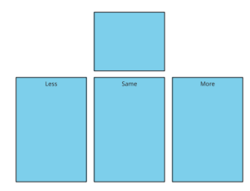
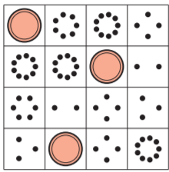
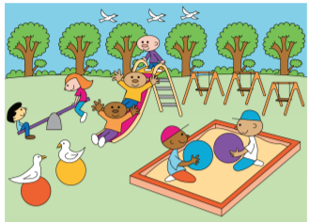

Centers: Choice Time
Activity #3
Less, Same, More Cover Up Math Stories Number Race

Slide 70

Lesson Synthesis
“Today we counted and compared groups of images.”
How does this picture help you see that 7 is more than 4?

Slide 71
Create Groups of Images
11
Let’s make groups that have more, fewer, or the same number of images.
K.CC.A.3, K.CC.B, K.CC.B.5, K.CC.C.6

Slide 72
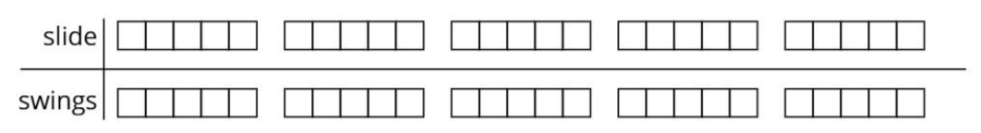
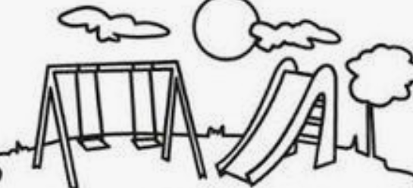
Questions About Us:
Slide or Swings?
Warm up
Would you rather play on the slide or on the swings?

Slide 73
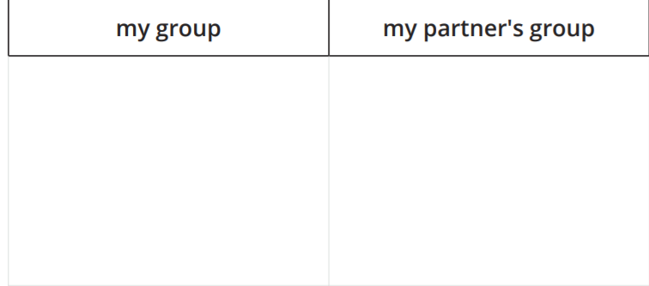
Drawing Groups of Images
Activity #1
You are going to draw a group of things.
Then show your group to your partner and say one of the sentences.
  Draw a group that has more things than my group.
  Draw a group that has fewer things than my group.
  Draw a group that has the same number of things as my group.
Your partner will draw a group next to yours, tell you how many things are in the group, and say a sentence comparing the groups using ‘more’, ‘fewer’, or ‘the same as’.”
Switch roles and repeat.

Slide 74
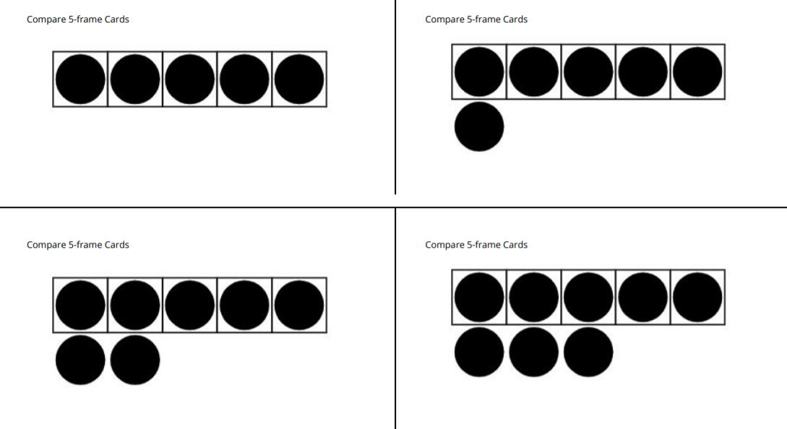
Introducing Less, Same, More: Drawings, Stage 3
Activity #1
We are going to work on a new stage of the Less, Same, More center.
First, draw a card and place it at the top of the mat. Figure out how many things are on the card.
Draw 3 groups below. Draw one that has fewer things, one that has the same number of things, and one that has more things.
Switch mats with your partner. Check to be sure you agree with the groups your partner made.”
Choose 1 of your groups to describe with a sentence using ‘more’, ‘fewer’, or ‘the same’.”

Slide 75
Centers: Choice Time
Activity #3
Less, Same, More Cover Up Math Stories Number Race

Slide 76


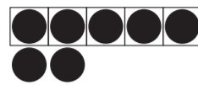
Today we made groups with more, fewer, or the same number of images as another group. We have also been counting and comparing given groups of images
Lesson Synthesis
Tell your partner how you would compare these groups of images. Describe your comparison using ‘more’, ‘fewer’, or ‘the same’.
Tell your partner how many images you would draw to make a group that has fewer images.

Slide 77

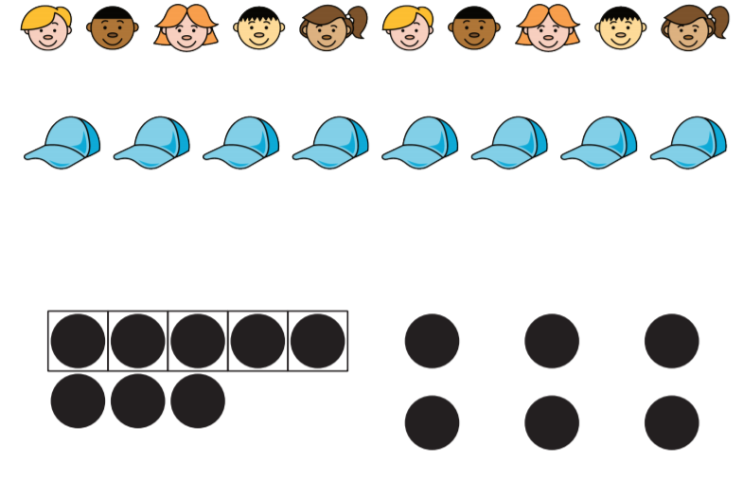
Section Summary
In this section we counted images. We also compared images using “more”, “fewer”, and “the same”.
When images are lined up, it can be easy to compare just by looking.
Sometimes they aren’t lined up and matched, and we need to compare a different way.

Slide 78
Connect Quantities and Numbers
12
Let’s figure out which groups of objects go with which numbers.
K.CC, K.CC.A.3, K.CC.B, K.CC.B.4, K.CC.B.5

Slide 79

How Many Do You See?
Warm up
How many do you see?
How do you see them?

Slide 80

How Many Do You See?
Warm up
How many do you see?
How do you see them?

Slide 81

How Many Do You See?
Warm up
How many do you see?
How do you see them?

Slide 82

Which Bag?
Activity #1
Find the bag with the number of objects that is said.

Slide 83
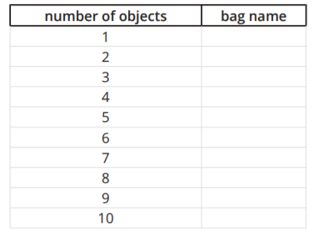
Counting Stations
Activity #2

Slide 84

Centers: Introducing Number Race: Write It, Stage 2
Activity #3
Number Race Math Fingers Shake and Spill

Slide 85

“Tell your partner about these pattern blocks.”
Lesson Synthesis

Slide 86
Numbers in Many Ways
13
Let’s figure out how many things there are.
K.CC, K.CC.A.3, K.CC.B.4, K.CC.B.5, K.CC.C.6

Slide 87

How Many Do You See?
Warm up
How many do you see?
How do you see them?

Slide 88
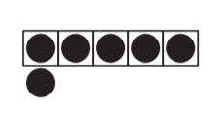
How Many Do You See?
Warm up
How many do you see?
How do you see them?

Slide 89

How Many Do You See?
Warm up
How many do you see?
How do you see them?

Slide 90
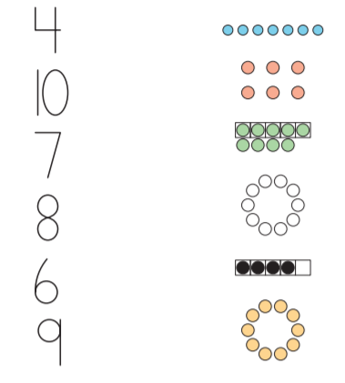
Matching Groups of Images and Numbers
Activity #1
What numbers do you see on this page?
Let’s say each number together.
Point to and say each written number on the student page.
Draw a line from each number to the group of dots that it matches.

Slide 91
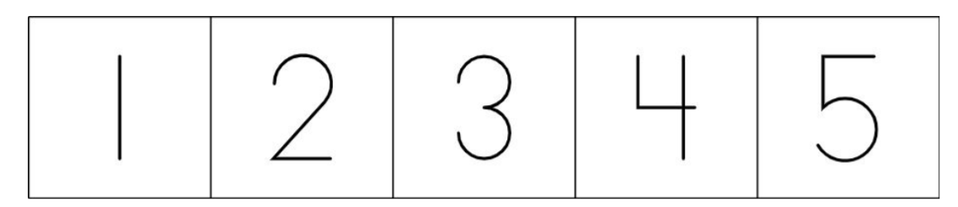

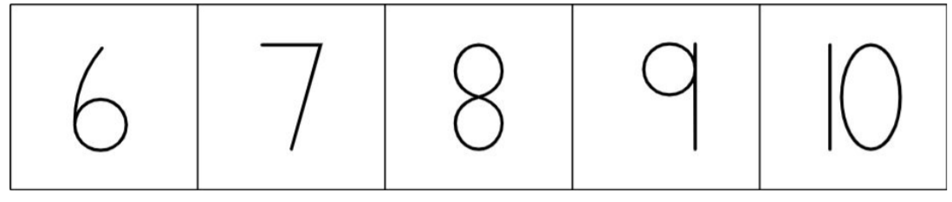
Different Arrangements, Same Number
Activity #2
What do you notice?
What do you wonder?
Where do you think I should place this card? Why do you think that?

Slide 92
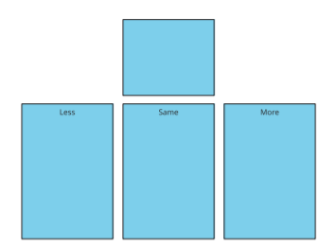

Centers: Choice Time
Activity #3
Less, Same, More Number Race Shake and Spill

Slide 93

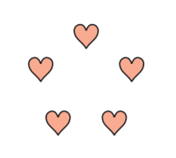

Activity #2
“Mai matched the dots in the 5-frame and the hearts to the number 5. Diego says that the hearts and dots can’t both show 5 because the hearts are in a circle and the dots are in a line in a 5-frame.
What do you think?”

Slide 94
Count Out Objects
14
Let’s figure out how many toppings we need to put on our pizza.
K.CC.A.1, K.CC.B.5, K.CC.C.6

Slide 95
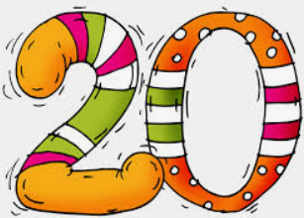
Choral Count:
Extending the Count Sequence
Let’s count to 20.
Warm up

Slide 96

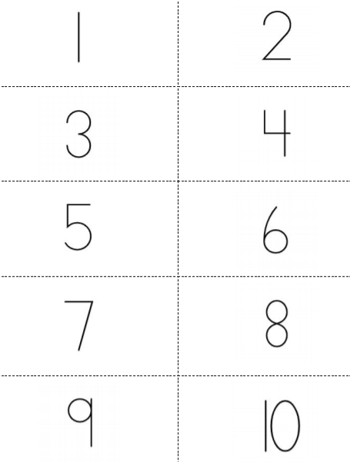
Toppings on Pizza
Activity #1
What is your favorite pizza topping?
If my partner showed me this card, how many pizza toppings should I add to my pizza?
Pick a card and show it to your partner. Your partner puts that many pizza toppings on the pizza. Check to make sure your partner put the right number of toppings on the pizza. Take turns until you use all of the cards.

Slide 97

Number Posters with Objects
Activity #2
You are going to make a poster with your group. Use things from our classroom to make groups of objects to show the number on your poster.
Walk around and look at the posters that other groups made. What do you notice? How are the other posters the same as your poster? How are they different?

Slide 98
Centers: Choice Time
Activity #3
Math Stories Math Fingers Shake and Spill

Slide 99
Today we found 1 less and 1 more than a given number. ”
Lesson Synthesis
What other things could we do to show the number 9?

Slide 100
Draw Images
15
Let’s figure out how many things to draw.
K.CC.A.1, K.CC.A.3, K.CC.B.5, K.CC.C.6

Slide 101
Choral Count: Count 1-20
Let’s count to 20.
Warm up

Slide 102
Number Posters with Drawings
Activity #1
You are going to make a poster with your group. Draw as many groups as you can to show the number on your poster.
Walk around and look at the posters that other groups made. What do you notice? How are the other posters the same as your poster? How are they different?

Slide 103

Introducing Math Libs:
Draw 1-10, Stage 1
Activity #2
Take turns playing with your partner.
Roll the cube and tell your partner the number.
Then they choose where to write the number and draw that many things in their picture.

Slide 104


Centers: Choice Time
Activity #3
Cover Up Math Libs Number Race

Slide 105


Lesson Synthesis
Han wrote down the number 8 for his picture. Which picture did Han draw?

Slide 106
Write Numbers to Represent Quantities
16
Let’s write numbers to show how many there are.
K.CC, K.CC.A.3, K.CC.B.5, K.CC.C.6

Slide 107

What Do You Know?
What do you know about the number 5?
Warm up

Slide 108

Math Stories: Write the Number
Activity #1
Think of 1 ‘how many’ question that you can ask your partner about this picture.
Take turns with your partner asking ‘how many’ questions about the picture.
When your partner asks you a ‘how many’ question, make a representation to show how many there are.
Show your thinking using drawings, numbers, and words.”

Slide 109

Labeling Mystery Bags
Activity #2
Today we’re going to play a game called ‘Mystery Bags’.
There are some objects inside each bag but we can’t see how many.
We need to figure out how many objects are in the bag
Then put a label on the bag so that the next group knows how many objects are inside.

Slide 110
Centers: Choice Time
Activity #3
Less, Same, More Cover Up Math Stories

Slide 111
Lesson Synthesis
Why are numbers helpful?

Slide 112



Section Summary
In this section, we matched numbers with groups of objects and images.
We also counted out objects and drew pictures to represent numbers.
We wrote numbers to show how many things there are.

Slide 113
Order Towers and Numbers
17
Let’s put numbers and cube towers in order from 1–10.
K.CC.A.3, K.CC.B.4, K.CC.B.4.c, K.CC.B.5, K.CC.C.6

Slide 114

Act It Out: Flowers in the Garden
Clare found eight flowers in the garden.
How can she represent the flowers?
Warm up

Slide 115

Cube Towers
Activity #1
We are going to make cube towers.
First, choose a number card.
Then build a cube tower with that number of cubes.
When both partners agree that the tower has the correct number of cubes, choose another number card and build the next tower.

Slide 116
Order Towers and Numbers
Activity #2
Put your cube towers and your numbers in order from 1–10.

Slide 117
Centers: Choice Time
Activity #3
Less, Same, More Math Libs Number Race

Slide 118

Today we made cube towers to match each number. We put the towers and numbers in order.
Lesson Synthesis
What do you notice about the towers and the numbers?

Slide 119
1 More or 1 Less with Towers and Numbers
18
Let’s find 1 more or 1 less than a number.
K.CC, K.CC.A.3, K.CC.B.4, K.CC.B.4.c, K.CC.B.5, K.CC.C.6

Slide 120

Act It Out: Flowers and Butterflies
There are 9 butterflies and 7 flowers.
Are there enough flowers for each butterfly to land on one?
How can you act out this story?
Warm up

Slide 121
What’s Missing?
Activity #1
Put your towers and numbers in order from 1–10.
Put the number under each tower.
Now one person will close their eyes and their partner will remove one tower

Slide 122

One Less, One More
Activity #2
You will work with your partner to find 1 less and 1 more.
First, one person builds a tower with the cubes and writes down a number to show how many cubes are in the tower.
Then, their partner makes a new tower with either 1 fewer or 1 more cube than this tower.

Slide 123
Centers: Choice Time
Activity #3
Less, Same, More Math Libs Number Race

Slide 124
Today we found 1 less and 1 more than a given number.
Lesson Synthesis
Tell your partner how you can figure out what number is 1 less than 9.

Slide 125
Compare Numbers and Images
19
Let’s compare images and numbers.
K.CC, K.CC.A.3, K.CC.B.4, K.CC.B.4.c, K.CC.B.5, K.CC.C.6

Slide 126

Act It Out: Picking Flowers From the Garden
Diego picked 6 flowers from the garden.
How many flowers will Diego have if he picks 1 more flower?
How can you act out this story?
Warm up

Slide 127


Which Has More?
Activity #1
Figure out how many images there are in each group.
Write the number.
Then circle the group that has more.

Slide 128

Introducing Less, Same, More: Numbers and Images, Stage 4
Activity #2
We are going to work on a new stage of the Less, Same, More center.
First, draw a card and place it at the top of the mat.
Then, for each of the other cards, decide if they show less than, the same, or more than the card in the middle.
Place each card in the appropriate box on the bottom of the mat.
After you place each card, say a sentence using the words ‘less than’, ‘the same as’, or ‘more than’ to compare the card to the card in the middle

Slide 129
Centers: Choice Time
Activity #3
Less, Same, More Math Libs Cover Up

Slide 130

Lesson Synthesis
How can we figure out which is more?

Slide 131
Represent and Compare Numbers
20
Let’s represent and compare numbers.
K.CC.A.3, K.CC.B.5, K.CC.C.6, K.CC.C.7

Slide 132

Act It Out: Who Picked More Flowers?
Lin picked 8 flowers from the garden. Tyler collected 6 flowers from the garden.
Did Lin or Tyler collect more flowers?
How can you act out this story?
Warm up

Slide 133
Representing Numbers
Activity #1
Figure out how many images there are in each group.
Write the number.
Then circle the group that has more.

Slide 134
Introducing Less, Same, More: Numbers and Images, Stage 4
Activity #2
We are going to work on a new stage of the Less, Same, More center.
First, draw a card and place it at the top of the mat.
Then, for each of the other cards, decide if they show less than, the same, or more than the card in the middle.
Place each card in the appropriate box on the bottom of the mat.
After you place each card, say a sentence using the words ‘less than’, ‘the same as’, or ‘more than’ to compare the card to the card in the middle

Slide 135

Centers: Choice Time
Activity #3
Less, Same, More Number Race Cover Up

Slide 136
Lesson Synthesis
During the gallery walk today, did you compare the images or the numbers on the charts? Why?

Slide 137
Compare Numbers
21
Let’s compare numbers.
K.CC.A.3, K.CC.B.5, K.CC.C.6, K.CC.C.7

Slide 138

Act It Out: Colorful Butterflies
There are 9 yellow butterflies and 5 orange butterflies in the air.
Are there fewer yellow or orange butterflies?
How can you act out this story?
Warm up

Slide 139

Which is More?
Activity #1
Work with your partner to figure out which number is more.
Circle the number that is more.

Slide 140

Introducing Roll and Record:
Which Is Less, Stage 1
Activity #2
We’re going to play a game called ‘Roll and Record’.”
First we each roll a cube onto the number mat.
Next we write the numbers we landed on in the boxes.

Slide 141

Centers: Choice Time
Activity #3
Less, Same, More Number Race Roll and Record

Slide 142
Lesson Synthesis
Diego doesn’t know if 7 is more or less than 4. How could you help Diego understand that 7 is more than 4?

Slide 143

Section Summary
In this section we compared numbers. We used objects and images to help us compare numbers.
We also learned that we can use the count sequence to compare numbers. 1, 2, 3, 4, 5, 6, 7, 8, 9, 10

Slide 144
The Pizzeria
22
Let’s count pizza toppings.
K.CC.A.3, K.CC.B.5, K.CC.C.6, K.CC.C.7

Slide 145

Notice and Wonder: Pizza Toppings
Warm up
What do you notice?
What do you wonder?

Slide 146


Class Pizza Order
Activity #1
When you call a pizza shop to order pizzas, they usually have lots of toppings on their menu to choose from. The person who answers the phone has to tell the chef exactly what kind of toppings to put on the pizza and how many of each.
We will create a class order for just one pizza. Our topping choices are pepperoni, sausage, olive, bell pepper, and pineapple. We can have up to 10 of any topping.

Slide 147
More Pizza Orders
Activity #2
Take orders from your group. You can order a pizza with up to 3 kinds of toppings. You can have up to 10 of those toppings.
Each person will take turns as an order giver and taker. Everyone will listen to the order, write down the number, and then make the pizza.

Slide 148
Lesson Synthesis
Today we said, wrote, read, and compared numbers while we made pizzas by counting out and drawing different toppings for our pizzas.

