Slide 1

Math In Our World
Kindergarten : Unit 1
Standards addressed: CC.A.1, CC.B, CC.B.4, CC.B.4A, CC.C.6
These slides have been created by Plainville Community Schools and are not official IM materials. Images and language are taken from IM Grade K, Unit 1 by Illustrative Mathematics.
Copyright 2020 by Illustrative Mathematics. All Rights Reserved, adapted and shared with permission.

Slide 2
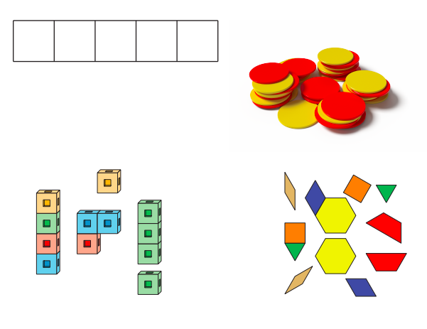

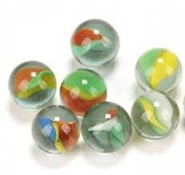
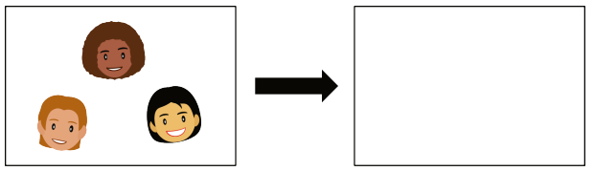
Unit 1 Progression Overview
Math In Our World
Section A
Lessons 1-5
CC, G, G.B
Section B
Lessons 6-9
CC, CC.B.4
Section C
Lessons 10 - 11
CC.
Section D
Lessons 12-17
CC, CC.A.1, CC.B, CC.B.4, G.B
Explore and use math tools
Share mathematical ideas with a partner
Recognize and name groups of up to 4 objects and images without counting
Answer “are there enough” questions
Count groups of up to 10 objects

Slide 3

Unit 1 Quick Links
L1
L2
L3
L4
L5
L6
L7
L8
L9
L10
L11
L12
L13
L14
L15
L16
L17

Slide 4
Explore Connecting Cubes
1
Let’s explore connecting cubes
MD, MD.B.3, CC.B, G.B

Slide 5
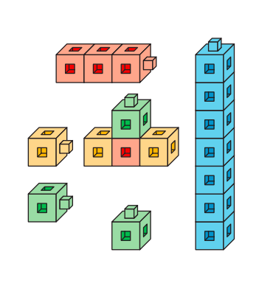
Notice and Wonder
Warm up
What do you notice? What do you wonder?
These are called connecting cubes.
What is one thing you could do or make with the connecting cubes?

Slide 6
Introduce Connecting Cubes; Explore
Activity #1
Share with your partner or class one thing you made with your connecting cubes.
Who heard something you might want to try next time with the connecting cubes?

Slide 7

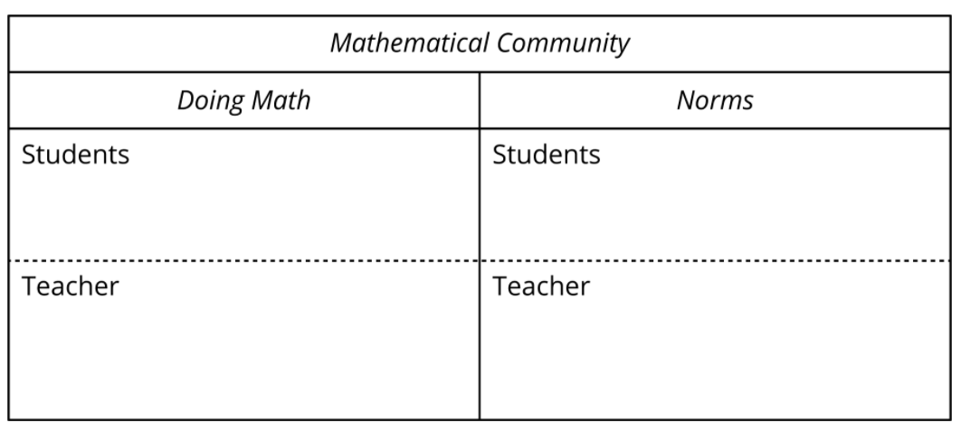
Today we explored connecting cubes and you explained to your partner what you were doing with the cubes.
Lesson
Synthesis
Let’s make a chart about what you did and what I did while we were doing math today.

Slide 8
Explore Pattern Blocks
2
Let’s explore pattern blocks
K.G, K.MD.B.3, K.CC.B

Slide 9
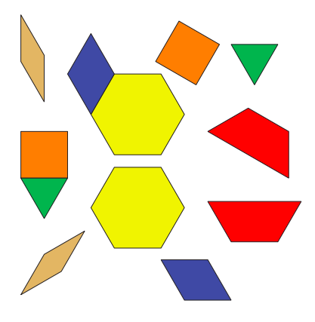
Notice and Wonder
Warm up
What do you notice? What do you wonder?
These are called pattern blocks.
What is one thing you could do or make with the pattern blocks?

Slide 10
Introduce Pattern Blocks; Explore
Activity 1
Some of us used the pattern blocks to make designs and pictures.
What kinds of tools can you use at home to make designs or pictures?
Share with your partner or class one thing you did or made with your pattern blocks.

Slide 11
Today, we explored pattern blocks and you explained to your partner what you were doing with the blocks.
Lesson
Synthesis
Let’s add to our chart from yesterday about what doing math together looks like.

Slide 12
Exploring Two- Color Counters and 5-Frames
3
Let’s explore two-color counters and 5-Frames
CC.B, MD.B.3

Slide 13
Notice and Wonder
Warm up
What do you notice? What do you wonder?
These are called two-color counters.
How are these math tools the same? How are they different?

Slide 14
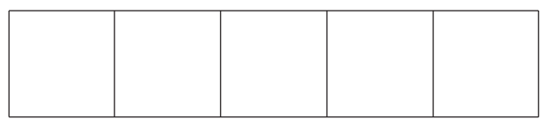
Explore Counters and
5 - Frames
Activity #1
Share one thing you did or made with the two-color counters and 5-frames?

Slide 15
We’ve learned about tools that can help us do math - connecting cubes, pattern blocks, counters, and 5-frames.
Lesson Synthesis
Let’s practice counting to 10.
Which tools can you use to make shapes? Why?
Which tools can you use to count? Why?

Slide 16
Explore Geoblocks
4
Let’s explore blocks
K.MD, MD.B.3, CC.B,, K.G

Slide 17
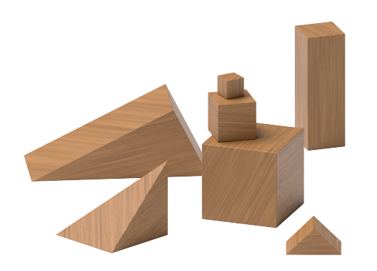
Notice and Wonder
Warm up
What do you notice? What do you wonder?
These are called geoblocks.
What is one thing you could do or make with the geoblocks?

Slide 18
Introduce Geoblocks; Explore
Activity #1
Share with your partner or class one thing you did or made with geoblocks.
One thing that we did with the geoblocks was build.
What kinds of tools can you use at home to build things?

Slide 19
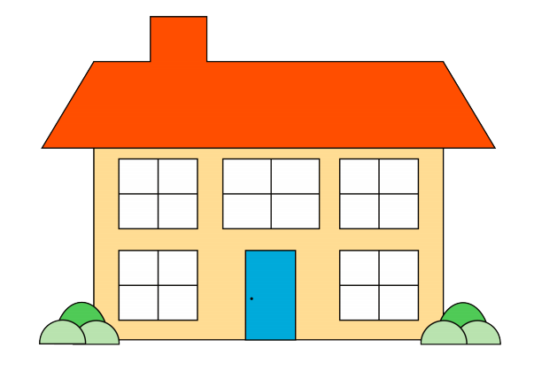
Introduce Geoblocks; Build
Activity #2
What do you notice? What do you wonder?
Use blocks to build a house.
What new ideas did you hear your partner talk about today when they used the geoblocks?
What did you see your partner do with their geoblocks?

Slide 20
Today we explored geoblocks.
Lesson Synthesis
What was your favorite thing you did or made with geoblocks?
Which of these did you do today?
How did they help the class?
Is there anything we should add to our poster?
Let’s practice counting to 10.

Slide 21
Explore Math Tools
5
Let’s explore our math tools
K.CC.B, K.G, K.MD.B.3

Slide 22
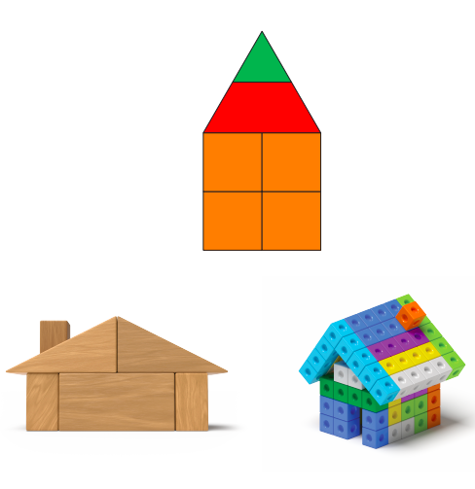
Notice & Wonder
Warm up
What do you notice? What do you wonder?
Can someone tell me what their partner said?

Slide 23
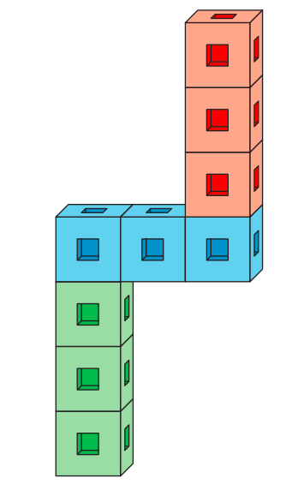
Introduce Connecting Cubes, Build To Match
Activity #1
Use your connecting cubes to build this object.
Show your partner and describe it to them.

Slide 24
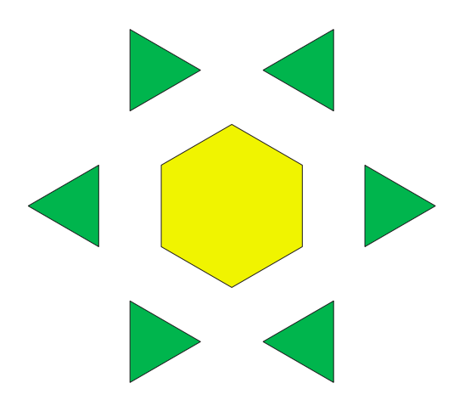
Introduce Pattern Blocks, Puzzles
Activity #2
Use your pattern blocks to fill in the puzzle.
Which puzzle was your favorite?

Slide 25
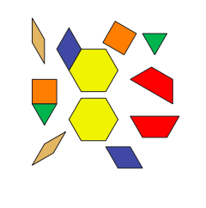
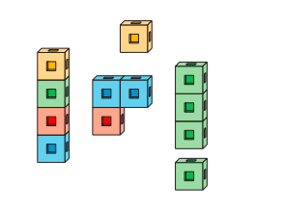
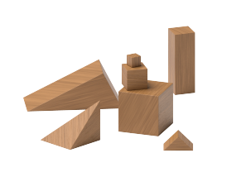
Center Choice Time
Activity #3
Pattern Blocks Connecting Cubes Geoblocks

Slide 26
Today, we got to choose a math tool to work with. We also listened carefully to other students so we could repeat their math ideas.
Lesson Synthesis
Norms are expectations that help everyone in the room feel safe, comfortable, and productive doing math together.
Let’s make a list of norms for how we do math together.
One example of a norm is ‘Listen as others share their ideas.’ What other norms should we set for our class?
Let’s practice counting to 10.

Slide 27
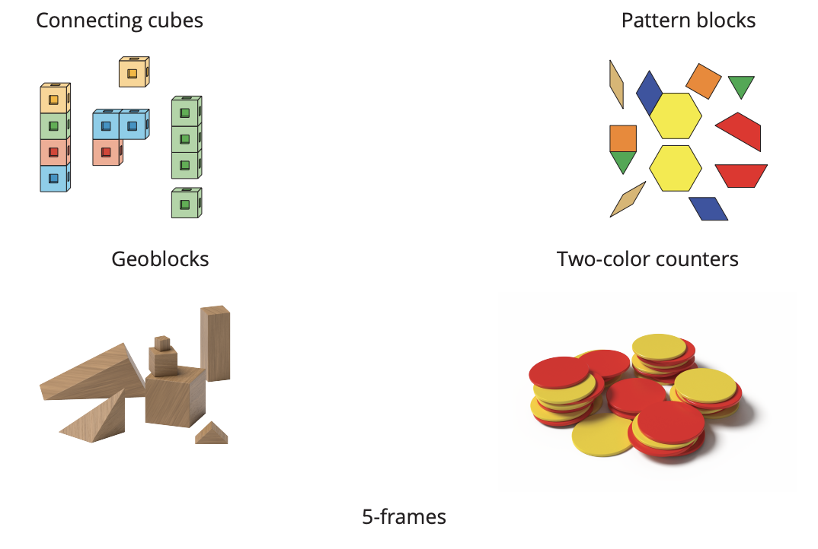
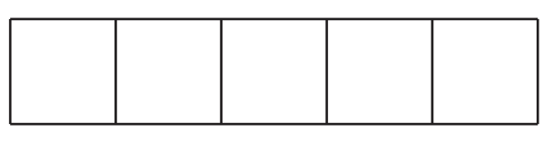
Section Summary
We explored many math tools.

Slide 28
Look for Small Groups
6
Let’s look for small groups of objects
K.CC, K.CC.B.4

Slide 29
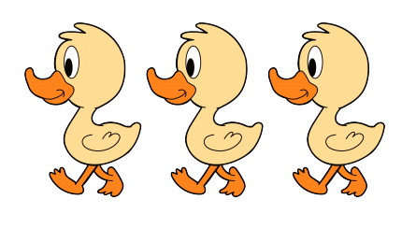
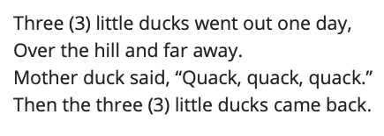
Act It Out
Warm up
We will come back to this story tomorrow and think about what happens in the story.

Slide 30

How Many Do You See?
Activity #1
How many do you see? How do you see them?
There are three dots.

Slide 31
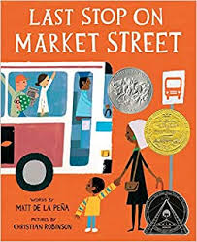



Exploring Picture Books
Activity #2
Look for groups of things in your book. Use your fingers to show your partner and tell your partner how many things there are in the groups you find.
What groups of things did you find in your book? How many things are in the group?

Slide 32

Choice Time
Activity #3
Pattern Blocks Connecting Cubes Geoblocks Picture Books

Slide 33
Today, we worked with partners and shared our ideas as we looked for groups of things in books. What went well? What can we continue to work on?
Lesson Synthesis
Let’s practice counting to 10.

Slide 34
Classroom Scavenger Hunt
7
Let’s look for groups of objects in the classroom.
K.CC, K.CC.B.4

Slide 35
Act It Out
Warm up
Let’s act it out.

Slide 36

How Many Do You See?
Activity #1
How many do you see? How do you see them?

Slide 37

How Many Do You See?
Activity #1
How many do you see? How do you see them?
We used our fingers to show how many dots there are.
Use your fingers to show how many teachers are in our classroom.

Slide 38
Classroom Scavenger Hunt
Activity #2
Walk around the room with your partner and find groups of objects. When you find a group, tell your partner how many objects are in the group and how you know.
Where do you see a group of 3 objects in our classroom?
What groups of objects did you find in our classroom?
How did you know how many objects were in the group?

Slide 39
Choice Time
Activity #3
Pattern Blocks Connecting Cubes Geoblocks Picture Books

Slide 40
Today, we found groups of objects in the classroom. Tell your partner how you knew how many objects were in each group you found.
Lesson Synthesis

Slide 41
Different Group, Same Quantity
8
Let’s find groups that have the same number of things.
K.CC.B.4, K.CC, K.CC.C.6

Slide 42
Act It Out
Warm up
Let’s act it out a different way.

Slide 43

How Many Do You See?
Activity #1
How many do you see? How do you see them?

Slide 44

How Many Do You See?
Activity #1
How many do you see? How do you see them?

Slide 45

How Many Do You See?
Activity #1
How many do you see? How do you see them?
We’re going to play a game called “Is it 3?” When I show you fingers or dots, think about if it is 3. If it is 3, give a thumbs up. If it is not 3, touch your shoes.

Slide 46
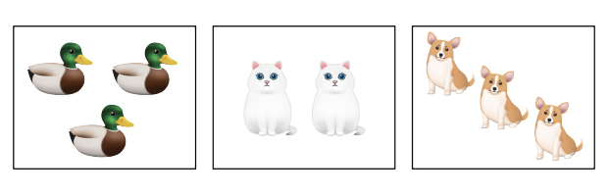
Different Groups, Same Quantity
Activity #2
Work with your partner to match the cards that have the same number of things. Explain to your partner how you know.
Which groups have the same number of things? How do you know?

Slide 47
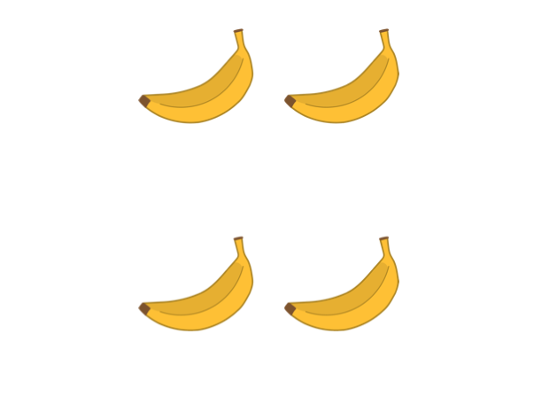
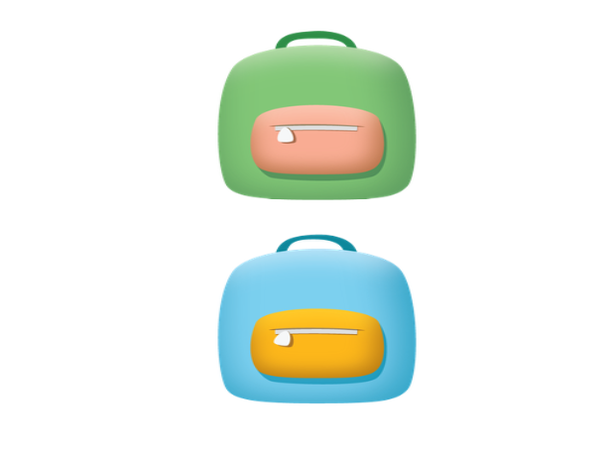
Different Groups, Same Quantity
Activity #2
What’s the same about these cards? What is different?

Slide 48
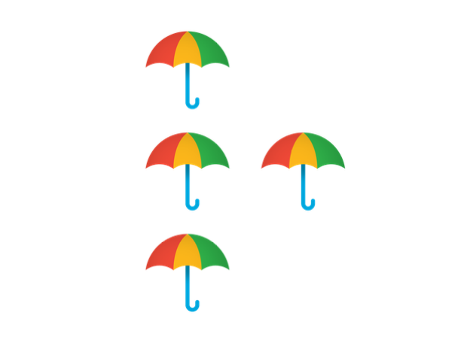
Different Groups, Same Quantity
Activity #2
What’s the same about these cards? What is different?
These cards both have the same number of things.
They both have 4.

Slide 49
Choice Time
Activity #3
Pattern Blocks Connecting Cubes Geoblocks Picture Books

Slide 50
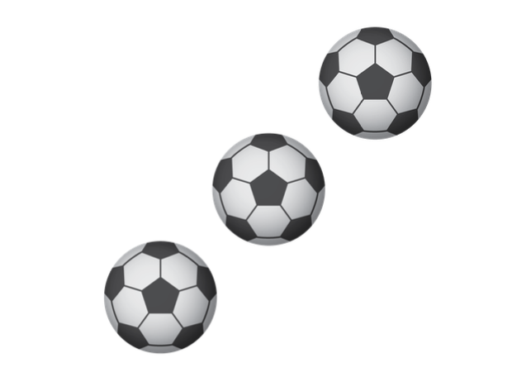
Today, we matched groups that had the same number of things.
Lesson Synthesis
Show or tell your partner how many things are on this card.
What are some groups of things in our classroom that have 3 things?

Slide 51
Picture Book Creation
9
Let’s make picture books about our classroom.
K.CC.B.4

Slide 52
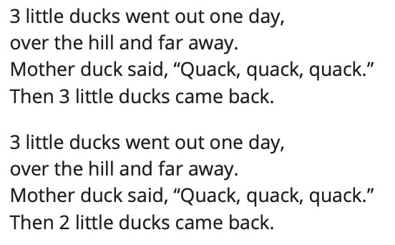
Act It Out
Warm up
What will be different about how we act out the story this time?

Slide 53
How Many Do You See?
Activity #1
How many do you see? How do you see them?

Slide 54

How Many Do You See?
Activity #1
How many do you see? How do you see them?
What did you notice about the group of dots?

Slide 55
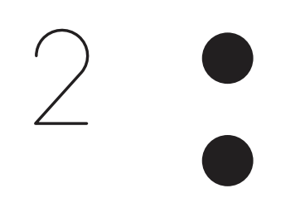
Introduce Picture Books, Create
Activity #2
What do you notice? What do you wonder?
Make a page for a picture book.
There are two dots at the top of the page, so on this page you should draw things that there are two of in our classroom.
What is the same about all of these groups of things?

Slide 56
Choice Time
Activity #3
Pattern Blocks Connecting Cubes Geoblocks Picture Books

Slide 57
Today, we made a page in our picture books with different groups of things from around our classroom.
Lesson Synthesis
What are some groups of 2 we saw?
Let’s count to 10.

Slide 58

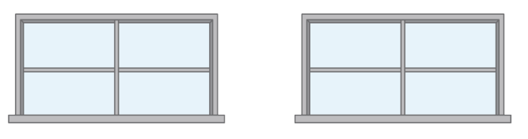
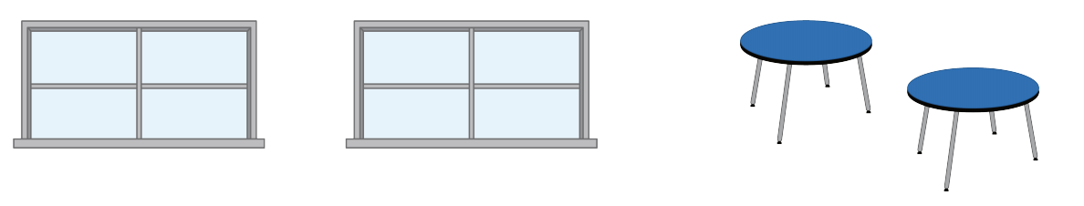
Section Summary
In this section, we noticed math in our world. We found groups of things in our classroom and in books. We used our fingers and said numbers to tell how many things there are.
We found groups that have the same number of things.
There are 2 windows and 2 tables.

Slide 59

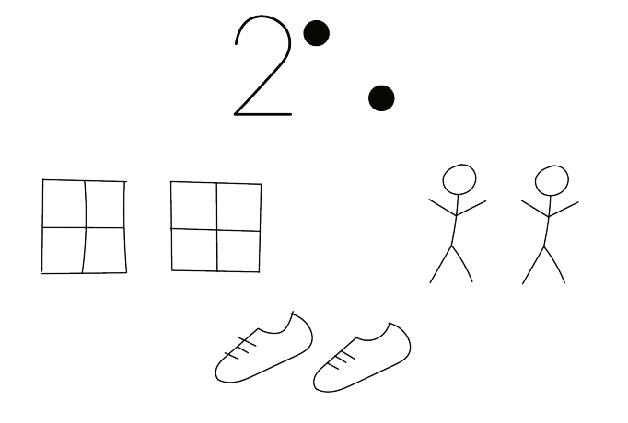
Section Summary
There are 3 stars and 3 soccer balls. They look different but they are both 3.
We created our own books to show groups that have the same number of things in our classroom.

Slide 60
Are There Enough?
10
Let’s figure out if there are enough supplies for everyone.
K.CC.B.4, K.CC.C.6

Slide 61

How Many Do You See?
Warm up
How many do you see? How do you see them?

Slide 62

How Many Do You See?
Warm up
How many do you see? How do you see them?
Did any see the dots the same way but would explain it differently?

Slide 63
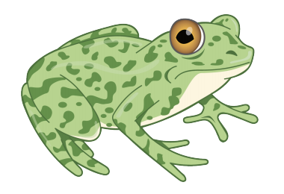
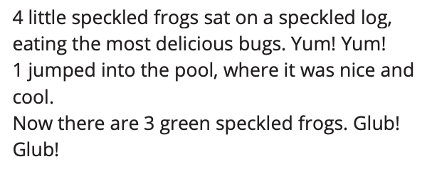
Act It Out
Activity #1
We will come back to this story tomorrow and think about what happens in the story and act it out.

Slide 64
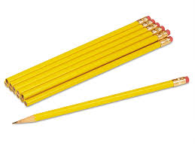
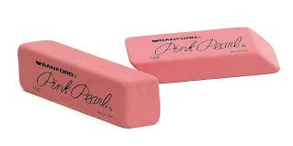
Are There Enough?
Activity #2
Are there enough pencils at your table for each student to get one?
How did you find out if there were enough erasers?

Slide 65
Choice Time
Activity #3
Pattern Blocks Connecting Cubes Geoblocks Picture Books

Slide 66
Today, we decided if we had enough pencils and erasers for everyone in our group. Now we are going to see if there are enough markers for everyone in this group.
Lesson Synthesis
Are there enough markers for everyone in the group? How do you know?

Slide 67
Get Enough
11
Let’s get enough pencils for everyone.
K.CC.B.4, K.CC.C.6

Slide 68

How Many Do You See?
Warm up
How many do you see? How do you see them?

Slide 69

How Many Do You See?
Warm up
How many do you see? How do you see them?
How could you tell how many dots there were when I flashed the dots so quickly?

Slide 70
Act It Out
Activity #1
Act it out.

Slide 71
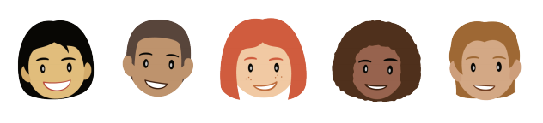
Get Enough
Activity #2
Work together with your group to get enough pencils so that everyone in your group has one pencil.
Work with your group to get enough pencils so that each student pictured gets one.
I need to get enough pencils so that each student has one. What should I do?

Slide 72
Choice Time
Activity #3
Pattern Blocks Connecting Cubes Geoblocks Picture Books

Slide 73
If this group of students is working with geoblocks during center time, how many blocks do we need so that each student can have one? How do you know?
Lesson Synthesis
Let’s count to 10.

Slide 74
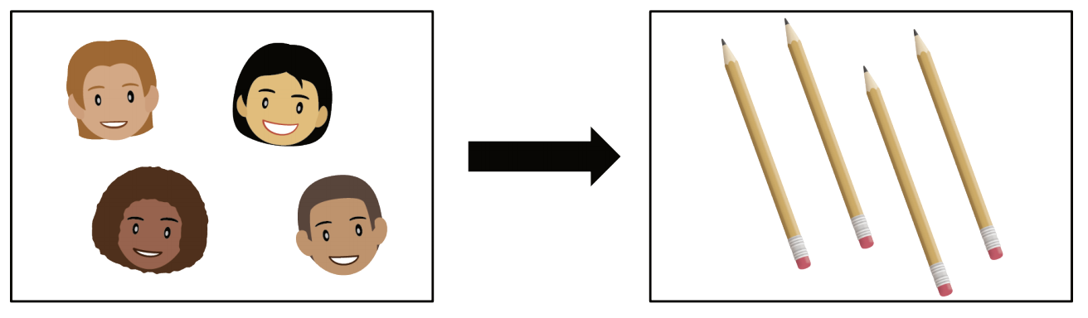
Section Summary
In this section, we figured out if there were enough pencils for everyone in our group
We matched each pencil with one person. We also got enough pencils so that each person could have one

Slide 75
How Many Are There? (Part 1)
12
Let’s count collections of objects.
K.CC., K.CC.B.4, K.CC.A.1, K.G.B, K.CC.C.6

Slide 76
Questions About Us
How can we figure out how many of us are there?
How many of us are here today?
_______
Warm up
Did I count the students correctly?

Slide 77
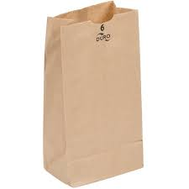
Counting Collections
Activity #1
Figure out how many objects are in your collection. Use the tools if they are helpful.
What did you notice about how ______ counted?

Slide 78
Counting to 10
Activity #2
Take turns counting to 10 with your partner.
You can clap your hands or touch the table when you say each number.
You can also think of your own movement for each number.
Let’s practice counting to 10.

Slide 79
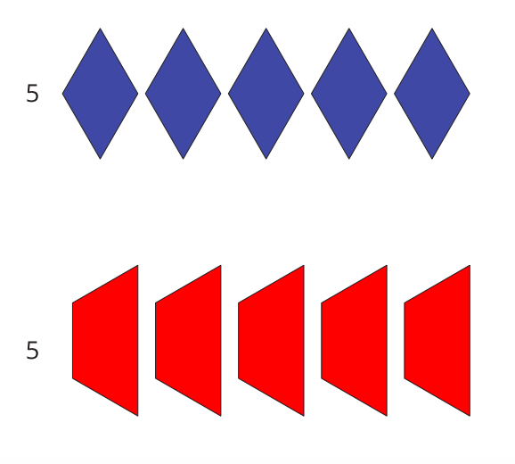
Introduce Pattern Blocks, Get and Build
Activity #3
What do you notice? What do you wonder?
This shows you which pattern blocks you need. Work with your partner to take out all of the pattern blocks that you need.
Now you can use your pattern blocks to create whatever you’d like. You can make a robot or a design or something else.
How did you figure out how many pattern blocks you needed?

Slide 80
Choice Time
Activity #3
Pattern Blocks Connecting Cubes Geoblocks Picture Books

Slide 81
Today we counted collections of objects.
Lesson Synthesis
Where do you see people count?

Slide 82
How Many Are There? (Part 2)
13
Let’s count collections of objects.
K.CC..A.1, K.CC.B.4, K.CC.C.6

Slide 83
Questions About Us
We need to figure out how many of us are here. How can we make sure that we count each person 1 time?
How many of us are here today?
_______
Warm up
Did we count everyone one time? How do you know?

Slide 84
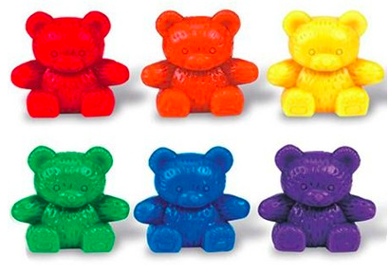
Counting Collections
Activity #1
Figure out how many objects are in your collection.
What did you notice about how ______ counted?

Slide 85
Pairing Objects and Numbers
Activity #2
Move the objects in your collection into the bucket one at a time. Say a number each time you put an object in the bucket.”
Let’s practice counting to 10.
Why do we say one number as we move each object?

Slide 86
Choice Time
Activity #3
Pattern Blocks Connecting Cubes Geoblocks Picture Books

Slide 87
Today we counted collections of objects.
Lesson Synthesis
What is something you can count at home?

Slide 88
Answer “How Many” Questions
14
Let’s count to figure out how many objects are in our collections.
K.CC., K.CC.B.4, K.CC.A.1, K.CC.C.6

Slide 89
Questions About Us
How can we show how many of us are here today?
How can we figure out how many of us are here?
How many of us are here today?
_______
Warm up
What did we do to show each student in our class?

Slide 90
Counting Collections: How Many?
Activity #1
Figure out how many objects are in your collection.
How many objects are in ________’s collection? How do you know?

Slide 91
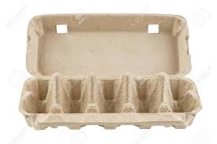
Egg Carton Counting
Activity #2
Use the egg carton to figure out how many objects are in your collection.
Take turns counting your collection with your partner. As you place each object in the egg carton, your partner says one number.

Slide 92
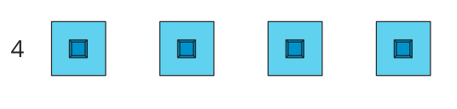
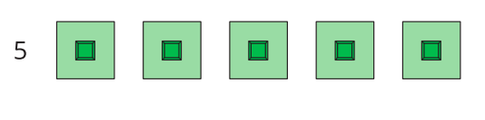
Introduce Connecting Cubes, Get and Build
Activity #3
What do you notice? What do you wonder?
This shows you which connecting cubes you need. Work with your partner to take out all of the connecting cubes that you need.
Now you can use your connecting cubes to create whatever you’d like. You can make an animal or tower or something else.

Slide 93
Choice Time
Activity #3
Pattern Blocks Connecting Cubes Geoblocks Picture Books

Slide 94
Today we counted collections of objects to figure out how many objects there were..
Lesson Synthesis
Ask your partner a question about the classroom that starts with “How many…”

Slide 95
Explain How You Counted
15
Let’s count collections of objects and tell our partners how we counted.
K.CC., K.CC.B, K.CC.A.1

Slide 96
Questions About Us
How can we show how many of us are here today?
How can we figure out how many of us are here?
How many of us are here today?
_______
Warm up
What did we do to show each student in our class?

Slide 97
Counting Collections: Share How You Counted
Activity #1
Figure out how many objects are in your collection.
How did the 5-frame (or counting mat) help you count your collection of objects?

Slide 98


Using a Counting Mat to Keep Track
Activity #2
Use the counting mat to figure out how many objects are in your collection.
Which objects do I still need to count? Which objects did I already count? How do you know?

Slide 99
Choice Time
Activity #3
Pattern Blocks Connecting Cubes Geoblocks Picture Books

Slide 100
Today we counted collections of objects.
Lesson Synthesis
Did you use any math tools to help you count? How did they help you count?

Slide 101
Represent Our Collections
16
Let’s count collections of objects and show how we counted.
K.CC.A.1, K.CC.B

Slide 102
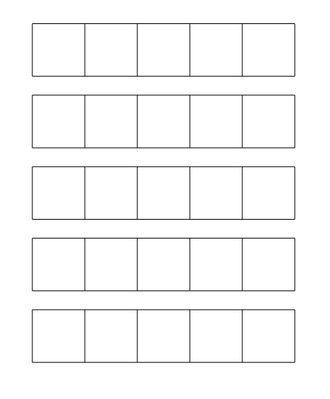
Questions About Us
How can we figure out how many of us are here?
How many of us are here today?
_______
Warm up
What do you notice?

Slide 103
Counting Collections: Show How Many
Activity #1
Figure out how many objects are in your collection.
Show how you counted your collection. Show your thinking using objects, drawings, numbers, or words.
What is the same about how _______ and _______ showed their collections?
What’s different about how they showed their collections?

Slide 104
Answering How Many Questions
Activity #2
Figure out how many objects are in your collection.
How many objects are in your collection? Tell your partner how many objects are in your collection without counting the objects again.

Slide 105

Answering How Many Questions
Activity #2
How many are in the collection?

Slide 106
Choice Time
Activity #3
Pattern Blocks Connecting Cubes Geoblocks Picture Books

Slide 107
Today we counted collections to figure out how many objects there are.
Lesson Synthesis
Ask your partner a question about our classroom that starts with “how many”.

Slide 108
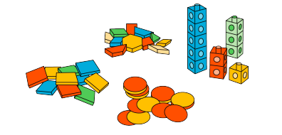
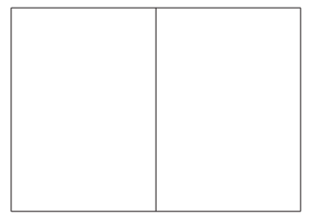
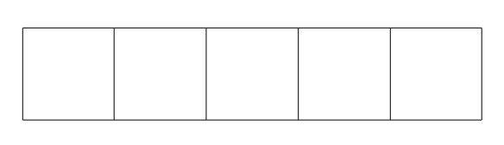
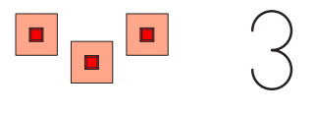
Section Summary
In this section, we counted collections of objects.
We counted each object and kept track of which object we’ve counted.
We said a number to tell how many objects there are.

Slide 109
Connecting Cubes Sculptures
(Optional)
17
Let’s build with connecting cubes and figure out how many we have.
K.CC.B.4

Slide 110
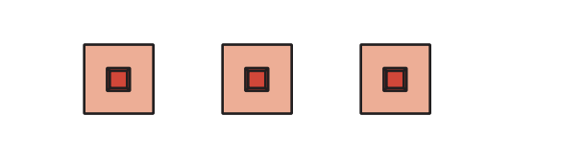
How Many Do You See?
Warm up
How many do you see? How do you see them?

Slide 111
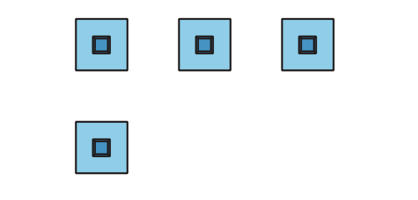
How Many Do You See?
Warm up
How many do you see? How do you see them?

Slide 112
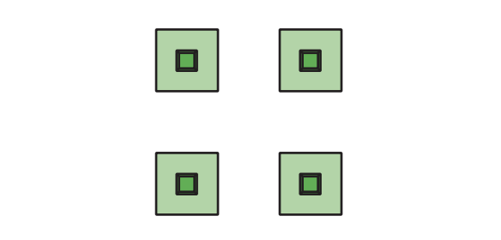
How Many Do You See?
Warm up
How many do you see? How do you see them?

Slide 113
How Many Do You See?
Warm up
How many do you see? How do you see them?
What is the same about these groups of connecting cubes? What is different?

Slide 114
Count Cubes
Activity #1
Figure out how many cubes are in your collection.
Show how you counted your collection. Show your thinking using objects, drawings, numbers, or words.
How many cubes are in _________’s collection? How do you know?

Slide 115
Connecting Cube Creations
Activity #2
Use all your connecting cubes to create whatever you’d like.
Tell your group what you made and how many cubes you used without counting them again.

Slide 116
Lesson Synthesis
What are some questions we can ask about what your classmates made?

