Slide 1

Properties of Two-dimensional Shapes
Standards addressed: 4.G.A.1, 4.G.A.2, 4.G.A.3, 4.NBT.B.5, 4.MD.A.2, 4.MD.A.3, 4.MD.C.7, 4.NF.B.3, 4.NF.B.4,
These slides have been created by Britnee Wright- Southeast Arkansas Education Cooperative and are not official IM materials. Images and language are taken from IM Grade 4 Unit 8 by Illustrative Mathematics.
Copyright 2020 by Illustrative Mathematics. All Rights Reserved, adapted and shared with permission.

Slide 2
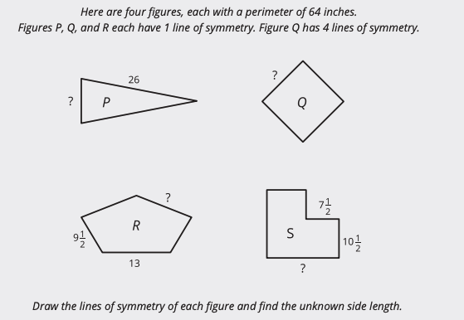
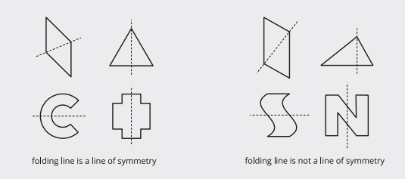
Unit 8 Progression Overview
Properties of Two-Dimensional Shapes
Section A
Lessons 1-6
4.G.A.1, 4.G.A.2, 4.G.A.3, 4.NBT.B.5
Section B
Lessons 7-10
4.G.A.1, 4.G.A.2, 4.G.A.3, 4.MD.A, 4.MD.A.2, 4.MD.A.3, 4.MD.C.7, 4.NF.B.3.c, 4.NF.B.4, 4.NF.B.4.b
Classify triangles (including right triangles), parallelograms, rectangles, rhombuses, and squares based on the properties of their side lengths and angles.
Identify and draw lines of symmetry in two-dimensional figures.
Solve problems using the known properties and attributes of two-dimensional shapes including angle measurement, side lengths, symmetry, perimeter and area.

Slide 3



Unit 8 Quick Links
L1
L2
L3
L4
L5
L6
L7
L8
L9
L10

Slide 4
Ways of Looking at Figures
1
Let’s sort two-dimensional figures.
4.G.A.2

Slide 5
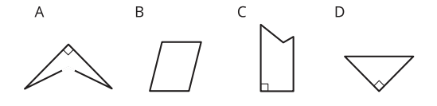
Which One Doesn’t Belong: Geometric Figures
Warm up
Which one doesn’t belong?

Slide 6
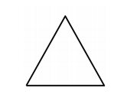
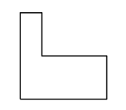
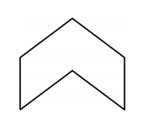
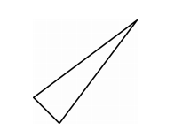
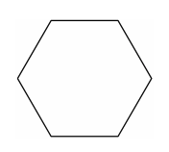

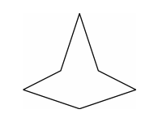
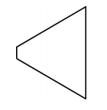
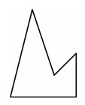
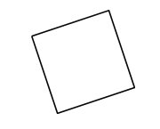
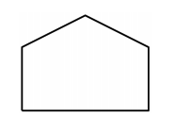
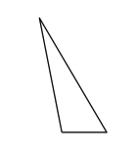
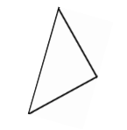
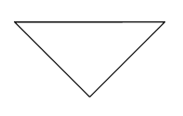
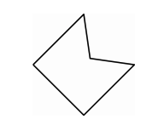
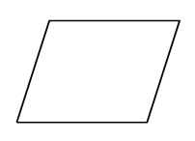
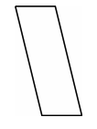
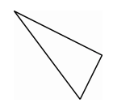
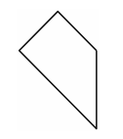
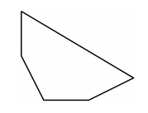
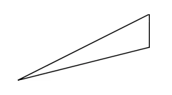
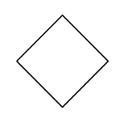
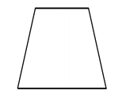

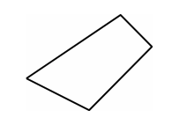
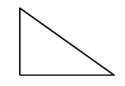
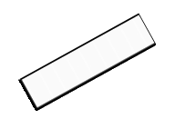
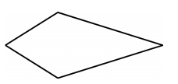
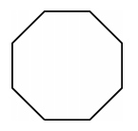
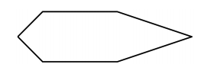
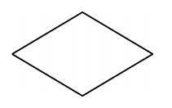
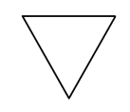
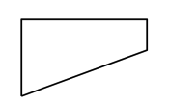

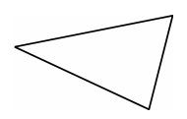
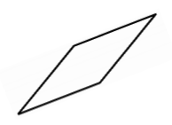
Card Sort: Grouping Figures
Activity #1
1. Sort the figures from your teacher into 3–5 categories. For each category, write a title on a sticky note.

Slide 7
Card Sort: Grouping Figures
Activity #1
2. Share your categories with another group. Take turns listening to each other’s explanations. Do your categories make sense to them? Do their categories make sense to you? Any suggestions or corrections?

Slide 8
Card Sort: Grouping Figures
Activity #1
3. Cover or hide the titles of your categories. Trade places with another group. Study their sorted cards while they study yours. Can you guess their categories and how they sorted the figures?

Slide 9

Guess the Category
Activity #3
Partner A:
Write down a category from the first activity (or think of a new one). Don’t show it to your partner.
Find 3 figures that fit the category and 3 figures that don’t. Place them in the columns of the table.
Partner B:
Study the figures chosen by your partner.
Pick another figure from the set. Ask: “Does this figure fit in your category?”
Find 2 figures that fit the category and 2 figures that don’t.
Guess the category. If your guess is off, ask more questions before guessing again.
Switch roles after the attribute is guessed correctly.

Slide 10

Lesson Synthesis
Today we sorted figures based on the different attributes they have. We learned we can classify or group two-dimensional figures a variety of ways.
Let’s look at an image from the first activity.
Besides sides and angles, what other attributes were used to classify the figures?
What are some ways to group using the angles in the figures
Let’s continue to add new vocabulary to our word walls from the last unit. Take 1–2 minutes to add any new words from today’s lesson to your word walls.
What are some ways to group using the sides of the figures?
Notes:
We will continue to think about different attributes of two-dimensional figures and how they could help us better understand the figures.

Slide 11
Ways of Looking at Triangles
2
Let’s sort and analyze triangles.
4.G.A.2

Slide 12

Number Talk: Sums and Products
Warm up
Find the value of each expression mentally.
Is each statement true or false?

Slide 13

Number Talk: Sums and Products
Warm up
Find the value of each expression mentally.
Is each statement true or false?

Slide 14

Number Talk: Sums and Products
Warm up
Find the value of each expression mentally.
Is each statement true or false?

Slide 15

Number Talk: Sums and Products
Warm up
Find the value of each expression mentally.
Is each statement true or false?

Slide 16
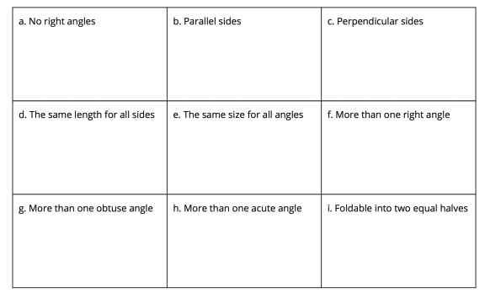
Triangle Hunt
Activity #1
1. From the set of triangle cards, find all the triangles that have each attribute.
Record their letter names here.
2. Choose one sentence to complete based on your work.
a. I noticed that some triangles . . .
b. I noticed that all triangles . . .
c. I noticed that no triangles . . .

Slide 17
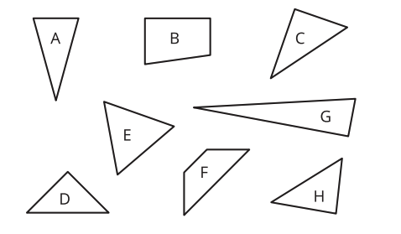
The Right Kind of Triangle
Activity #2
1. Identify all shapes that are right triangles. For each right triangle, mark the right angle with a small square.
2. Explain why the other shapes are not right triangles.

Slide 18
Lesson Synthesis
Today we analyzed and identified triangles with different attributes.
If we classify or group triangles based on angle, what types might we see?
How can we tell if sides were the same length?
Earlier we identified some right triangles. Which of these statements do you think defines a right triangle: ‘a triangle with one right angle’ or ‘a triangle with one pair of perpendicular sides’?
If we classify or group triangles based on side length, what types might we see?
Notes:
Tell students that, in the next lesson, they will explore some of the same attributes in four-sided figures.

Slide 19
Ways of Looking at Quadrilaterals
3
Let’s sort and identify quadrilaterals.
4.G.A.1, 4.G.A.2

Slide 20
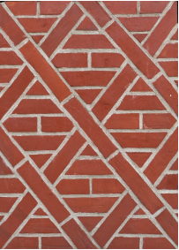
How Many Do You See:
Brick Pattern
Warm up
How many bricks have 2 pairs of parallel sides?

Slide 21
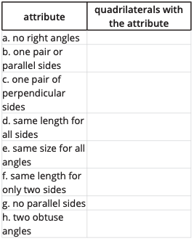
Quadrilateral Hunt
Activity #1
1. Find the quadrilaterals that have each of the following attributes. Record their letter names here.
2. Choose one sentence to complete based on your work.
a. I noticed some quadrilaterals . . .
b. I noticed that all quadrilaterals . . .
c. I noticed that no quadrilaterals . . .
Do you think it is possible for a quadrilateral to have:
1. More than 2 acute angles?
2. More than 2 obtuse angles?
3. Exactly 3 right angles?

Slide 22

What’s True about These Quadrilaterals?
Activity #2
Here are four sets of quadrilaterals. Write 4–5 statements about the sides and angles of the quadrilaterals in each set.
Each statement must be true for all the shapes in the set.
Quadrilaterals D and AA are squares.

Slide 23

What’s True about These Quadrilaterals?
Activity #2
Here are four sets of quadrilaterals. Write 4–5 statements about the sides and angles of the quadrilaterals in each set.
Each statement must be true for all the shapes in the set.
Quadrilaterals K, Z, and AA are rectangles.

Slide 24

What’s True about These Quadrilaterals?
Activity #2
Here are four sets of quadrilaterals. Write 4–5 statements about the sides and angles of the quadrilaterals in each set.
Each statement must be true for all the shapes in the set.
Quadrilaterals N, U, and Z are parallelograms.

Slide 25

What’s True about These Quadrilaterals?
Activity #2
Here are four sets of quadrilaterals. Write 4–5 statements about the sides and angles of the quadrilaterals in each set.
Each statement must be true for all the shapes in the set.
Quadrilaterals N, U, and Z are rhombuses.

Slide 26
Guess Again
Activity #3
Partner A:
Write down an attribute that a quadrilateral could have. Don’t show it to your partner.
Find 3 quadrilaterals that have that attribute and 3 that don’t. Place them in the columns of the table.
Partner B:
Study the quadrilaterals chosen by your partner.
Pick another quadrilateral from the set. Ask: “Does this quadrilateral have the attribute?”
Find at least 1 quadrilateral that has the attribute and 1 that doesn’t.
Guess the attribute. If your guess is off, ask more questions before guessing again.
Switch roles after the attribute is guessed correctly.

Slide 27
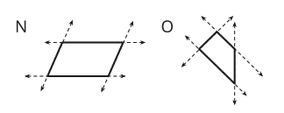
Lesson Synthesis
Today we looked closely at quadrilaterals and their attributes.
What attributes do these quadrilaterals share?
What attributes are different?
What can we say about parallel sides in quadrilaterals?

Slide 28
Symmetry in Figures
(Part 1)
4
Let’s use symmetry to identify two-dimensional figures.
4.G.A.2, 4.G.A.3

Slide 29
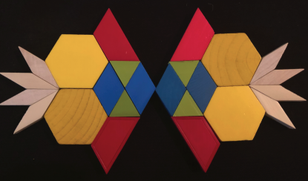
Notice and Wonder: Seeing Double
Warm up
What do you notice?
What do you wonder?

Slide 30
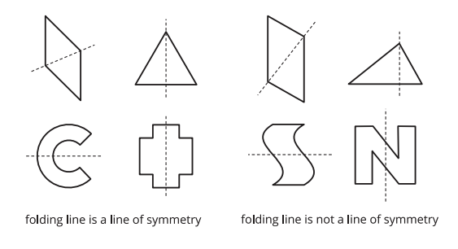
Perfect Matches
Activity #1
1. Lin has pieces of paper in different figures. She folds each figure once, creating two smaller figures. She then sorts the figures into two categories based on the folding lines.
Study the figures in each category.
What do you think a line of symmetry means?
Complete this sentence: A line of symmetry is . . .

Slide 31
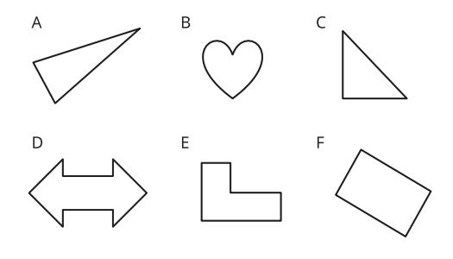
Perfect Matches
Activity #1
2. Do the following figures have a line of symmetry? If so, draw the line.
If not, explain how you know.
3. Are there any figures with more than one line of symmetry?
If you think so, draw all the lines of symmetry.

Slide 32
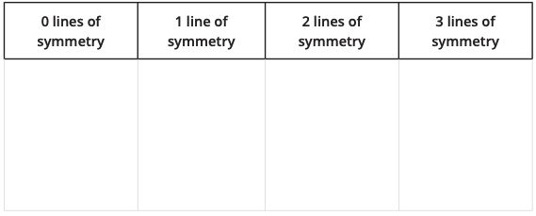
In Search of Symmetry
Activity #2
Your teacher will give your group a set of cards.
1. Sort the figures on the cards by the number of lines of symmetry they have.

Slide 33
In Search of Symmetry
Activity #2
Your teacher will give your group a set of cards.
2. Find another group that has the same set of cards.
Compare your sorting decisions to theirs.
Did you agree with how their figures are sorted? If not, discuss any disagreement.

Slide 34
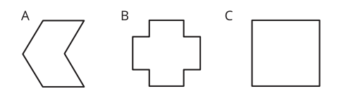
Just Keep Folding
Activity #3
Priya is folding paper of different shapes along their lines of symmetry. She keeps folding each one until the folded shape has no more lines of symmetry.
1. How many times can she fold each shape before she can no longer continue?
2. What do you notice about each folded shape when it can no longer be folded?

Slide 35
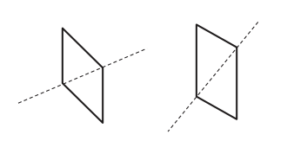
Lesson Synthesis
Today we found lines of symmetry in two-dimensional figures.” Display the two parallelograms from the first activity.
Not all lines that divide a figure into two identical halves are lines of symmetry
In both figures, there’s a line that creates two identical triangles. Why does the first figure have line symmetry but the other doesn’t?

Slide 36
Symmetry in Figures
(Part 2)
5
Let’s draw some figures that have lines of symmetry.
4.G.A.2, 4.G.A.3, 4.NBT.B.5

Slide 37

Number Talk: Keeping Track
Warm up
Find the value of each sum mentally.
Be prepared to to explain your reasoning.

Slide 38

Number Talk: Keeping Track
Warm up
Find the value of each sum mentally.
Be prepared to to explain your reasoning.

Slide 39

Number Talk: Keeping Track
Warm up
Find the value of each sum mentally.
Be prepared to to explain your reasoning.

Slide 40

Number Talk: Keeping Track
Warm up
Find the value of each sum mentally.
Be prepared to to explain your reasoning.

Slide 41
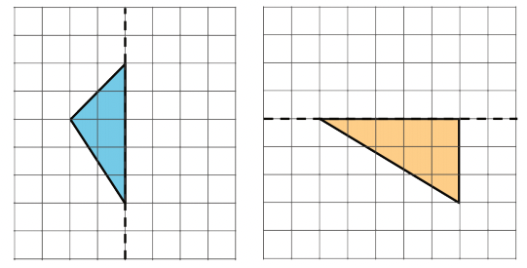
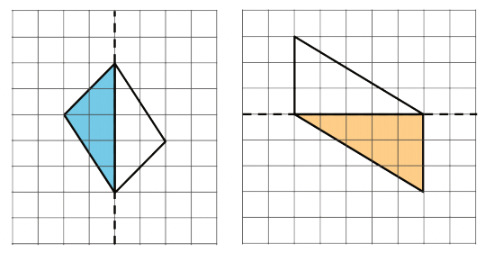
Half-Drawn Figures
Activity #1
Each shaded triangle is half of a whole figure that has a line of symmetry shown by the dashed line.
Clare drew in some segments to show the missing half of each figure.
Explain why each of Clare’s drawings doesn’t show the correct whole figure. Then, complete each missing half correctly.

Slide 42
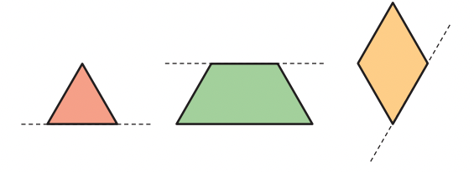
What’s the Whole Picture?
Activity #2
1. Here are three figures.
Each figure is half of a whole figure.
The dashed line is a line symmetry of that figure.
Use patty paper to help you draw the whole figure.

Slide 43

What’s the Whole Picture?
Activity #2
2. Each figure on the grid is half of a whole figure that has a line of symmetry. The dashed line shows the line of symmetry
Use the grid to help you draw the whole figure. Be as precise as possible.

Slide 44

What’s the Whole Picture?
Activity #2
3. Here is another figure that is half of a whole figure with a vertical line of symmetry. Draw the whole figure. Be as precise as possible.

Slide 45
What Could the Whole Figure Be?
Activity #3
Trace a triangle cutout from your teacher.
If the triangle is half of a whole figure that has line symmetry, what could the whole figure look like?
Can you show two possibilities?
Three possibilities?

Slide 46

Lesson Synthesis
Today we saw that, if given half of a figure and a line of symmetry, we can draw a full figure. If we wanted to, we can do that quite precisely.
How would you know if your drawing is correctly drawn?
Here’s half of a figure you saw earlier. What are some ways to find the other half so that the whole figure has line symmetry?

Slide 47
All Kinds of Attributes
6
Let’s use what we know about attributes of figures to create drawings.
4.G.A.1, 4.G.A.2, 4.G.A.3

Slide 48

How Many Do You See: Dot after Dot
Warm up
How many do you see?
How do you see them?

Slide 49



You’re Gonna Draw It: It’s Symmetric!
Activity #1
1. Here is a pair of parallel segments that have the same length.
Add one or more segments to create a figure with only 1 line of symmetry.
2. Here are two more pairs of parallel segments. Add more segments to make:
a. a figure with 2 lines of symmetry
b. a figure with no lines of symmetry

Slide 50

You’re Gonna Draw It: It’s Symmetric!
Activity #1
If You Have Time Here are some other pairs of parallel lines.
Add more segments to create a figure with 1 line of symmetry.

Slide 51

Hidden Shapes
Activity #2
Can you connect the dots to create each of the following shapes? If so, draw the shapes. If not, be prepared to explain your reasoning.
1. A triangle with only one line of symmetry
2. A quadrilateral with only one line of symmetry
3. A quadrilateral with two pairs of parallel sides
4. A quadrilateral with one pair of perpendicular sides
5. A rectangle
6. A six-sided figure with only one line of symmetry
Here is a field of dots.

Slide 52

Lesson Synthesis
Today we used our understanding of the attributes of figures to draw figures with varying lines of symmetry and varying numbers of parallel or perpendicular sides.
How might we use grids to see if:
two segments have the same length?
two segments are parallel?
two segments are perpendicular?
a figure has line symmetry?
When figures are shown on a line grid or dotted grid, we can often learn a lot about their attributes. Here are two figures, one on a square grid and the other on a dotted triangular grid.

Slide 53

Section Summary
In this section, we looked at different attributes of shapes, such as the number and length of sides, the measurements of sides and angles, and whether the shapes had parallel and perpendicular sides.
We then used these attributes to classify quadrilaterals and triangles.
Triangles with a right angle are right triangles.

Slide 54




Section Summary
Quadrilaterals with two pairs of parallel sides are parallelograms.
Quadrilaterals with four equal sides are rhombuses.
Quadrilaterals with two pairs of parallel sides and four right angles are rectangles.
Quadrilaterals with four equal sides and four right angles are squares.

Slide 55

Section Summary
We also learned about lines of symmetry.
A figure that has a line of symmetry can be folded along that line to create two halves that match up exactly.

Slide 56
Ways of Finding Length (Part 1)
7
Let’s find the perimeter of different figures.
4.G.A.3, 4.MD.A.2, 4.MD.A.3, 4.NF.B.3.c, 4.NF.B.4, 4.NF.B.4.b

Slide 57

Number Talk: Multiplying by Thirds
Warm up
Find the value of each product mentally.
Be prepared to to explain your reasoning.

Slide 58

Number Talk: Multiplying by Thirds
Warm up
Find the value of each product mentally.
Be prepared to to explain your reasoning.

Slide 59

Number Talk: Multiplying by Thirds
Warm up
Find the value of each product mentally.
Be prepared to to explain your reasoning.

Slide 60

Number Talk: Multiplying by Thirds
Warm up
Find the value of each product mentally.
Be prepared to to explain your reasoning.

Slide 61

All the Way Around
Activity #1
1. Find the perimeter of each shape.
Write an expression that shows how you find the perimeter.
2. Compare strategies for solving with your partners’ expressions. Make 1–2 observations.
3. Diego is finding the perimeter of a quadrilateral with two side lengths that are are 43 and 71 units. He saw that he could write (2 x 43) + (2 x 71) to represent the perimeter. Which quadrilateral could it be?
A. a square
B. a rectangle
C. a quadrilateral with no lines of symmetry
D. a quadrilateral with 1 or more lines of symmetry E. a quadrilateral with only 1 line of symmetry

Slide 62

Pondering Perimeter
Activity #2
Here are four shapes and what we know about them:
A, B, and C have no lines of symmetry.
A has no parallel sides.
B has 1 pair of parallel sides.
C has 2 pairs of parallel sides.
D has 1 pair of parallel sides and 1 line of symmetry.
Mai says, “We can’t find the perimeter of any quadrilateral because each one is missing one or more side lengths.”
Andre disagrees. He says, “We can find the perimeters for C and D but not for A and B.”
1. Do you agree with either one of them?
Explain or show your reasoning.
2. Find the perimeters that could be found, if any.

Slide 63


Perimeter Expressions
Activity #3
Here are five shapes and what we know about them.
Not all the sides are labeled.
The lines of symmetry are shown.
Only the triangle has no parallel sides.
1. For which shapes is it possible to find the perimeter? For which shapes is it not possible? Be prepared to explain how you know.
2. Here are four expressions. Each one represents the perimeter of one shape. The 6 ½ and 3 ¼ in each represent side lengths. Can you tell which expression represents which shape?

Slide 64
Lesson Synthesis
Today we found the perimeter of various two-dimensional figures. Sometimes the sides were labeled with their lengths. Other times they were not.
Do you agree with the following statements? Find an image from today’s lesson that supports your answer.
If a figure has line symmetry, we can sometimes tell the lengths of the segments even when not all segments are labeled.
If a figure shows no line symmetry, we can’t tell the lengths of unlabeled segments.

Slide 65
Ways of Finding Length (Part 2)
8
Let’s use some tools to measure angles.
4.MD.C.5.a, 4.MD.C.5.b, 4.MD.C.6, 4.MD.C.7, 4.NBT.B.5

Slide 66

True or False: Equations with Fractions
Warm up
Is each statement true or false?
Is each statement true or false?

Slide 67

True or False: Equations with Fractions
Warm up
Is each statement true or false?
Is each statement true or false?

Slide 68

True or False: Equations with Fractions
Warm up
Is each statement true or false?
Is each statement true or false?

Slide 69

True or False: Equations with Fractions
Warm up
Is each statement true or false?
Is each statement true or false?

Slide 70

Missing Lengths
Activity #1
Here are four shapes.
Each shape has a perimeter of 64 inches.
P, Q, and R each have 1 line of symmetry.
Q has 4 lines of symmetry.
1. Draw the lines of symmetry of each shape.
2. Find the unknown side length in each shape. Show your reasoning.

Slide 71

Lin’s Design
Activity #2
Lin is using 145 inches of fancy tape for the outline of a design with line symmetry.
Here is half of the design. The dashed line is the line of symmetry.
1. Sketch Lin’s entire design.
2. Does she have enough tape for the entire outline? Show your reasoning
If You Have Time:
Lin has a sheet of fancy paper that she can cut up to cover the inside of the design. The paper is a rectangle that is 30 inches by 18 inches.
If the angles in the design are right angles, does Lin have enough paper cover the inside of the design? Show your reasoning.

Slide 72

Lesson Synthesis
Today we used attributes of figures to reason about their side lengths and perimeter.
“Here are two shapes. Suppose we know the perimeter of each shape is 48 units. Shape A has a line of symmetry and B has none.”
Shape B has no line of symmetry. Can we figure out the missing lengths?
How can knowing the line of symmetry in A help us find the missing side lengths?
Suppose we know that B is a parallelogram. Would that help us find those lengths? Why or why not?

Slide 73
Section Summary
In this section, we used the attributes such as side lengths, angles, lines of symmetry, and parallel sides to solve problems about perimeter of shapes.
We learned that, if a shape has certain attributes, we can use them to find its perimeter, even if we don't have all of its side lengths. Or, if we know the perimeter of a shape, we can find its side lengths if there is enough information about their attributes.

Slide 74

Section Summary
For example, here are two shapes:
If we know the perimeter of each shape is 48 units and the dashed line through shape A is a line of symmetry, we can find the missing side lengths.
Shape B doesn't have a line of symmetry, but if we were told that its opposite sides have equal lengths, then we can also reason about the three missing side lengths.

Slide 75
Symmetry in Action
9
Let’s investigate symmetry in folded figures.
4.G.A.1, 4.G.A.2, 4.G.A.3, 4.MD.C.7, 4.NF.B.3.c, 4.NF.B.4

Slide 76

Which One Doesn’t Belong:
Figures
Warm up
Which one doesn’t belong?

Slide 77




Activity #1
Before and After
1. Mai has a piece of paper. She can get two different shapes by folding the paper along a line of symmetry. What is the shape of the paper before it was folded?
2. Diego folded a piece of paper once along a line of symmetry and got this right triangle.
Which shapes could the paper have before it was folded? Explain or show how you know.

Slide 78

Activity #2
Before and After, Perimeter Edition
1. Jada folded a piece of paper along a line of symmetry and got this rectangle.
a. What could the paper look like before being folded? Draw one or more sketches.
b. Write an expression for the perimeter of the unfolded paper.

Slide 79

Activity #2
Before and After, Perimeter Edition
2. Kiran folded a piece of paper twice—each time along a line of symmetry—and got the same rectangle as Jada did.
Show that each expression could represent the perimeter of the paper Kiran folded.

Slide 80

Lesson Synthesis
Today we practiced visualizing shapes that have been folded along a line of symmetry and reasoning about the perimeter of the original shapes.
To find the perimeter of the original shape, could we just double the perimeter of the folded shape? Why or why not?
Suppose this right triangle is a result of folding once along a line of symmetry. What strategies could we use to determine the possible shapes before they were folded?
What could be the perimeters of the original shapes that fold into this triangle?

Slide 81
Ways of Finding Angles
10
Let’s find angle measurements in figures with line symmetry.
4.G.A.3, 4.MD.C.7

Slide 82

How Many Do You See:
Symmetry in a Star
Warm up
How many lines of symmetry do you see?
How do you see them?

Slide 83

Activity #1
Before and After, Angle Edition
Noah, Clare, Andre, and Elena each have a sheet of paper with one line of symmetry. When they folded their paper along the line of symmetry, they all produced the same shape. The dashed line represents the folding line.
1. Draw the shape of the unfolded paper that each student received. Be as precise as possible.
2. Without measuring, find the measurement of all angles within the shape (of the unfolded paper) that you drew.

Slide 84

Activity #2
Angular Fish
Here is a diagram of an origami fish, which has one line of symmetry.
1. Draw the line of symmetry.
2. Without measuring, find the measurement of angles labeled a – f . Be prepared to explain your reasoning.

Slide 85

Lesson Synthesis
Today we saw that lines of symmetry can be handy for finding unknown angle measurements.
Can you find the size of each angle marked with a question mark? Why or why not?
How would you find the angle measurements in the first figure?
Here are two V-shaped figures—one has line symmetry and the other does not. In each diagram, one angle measurement is known.
What do we know about the two angles in the second figure?

