Slide 1

Angles and
Angle Measurement
Standards addressed: 4.G.A.1, 4.MD.C.5, 4.NBT.B.4, 4.NBT.B.5, 4.MD.C.6, 4.MD.C.7, 4.NBT.B.6, 4.G.A.2
These slides have been created by Britnee Wright- Southeast Arkansas Education Cooperative and are not official IM materials. Images and language are taken from IM Grade 4 Unit 7 by Illustrative Mathematics.
Copyright 2020 by Illustrative Mathematics. All Rights Reserved, adapted and shared with permission.

Slide 2
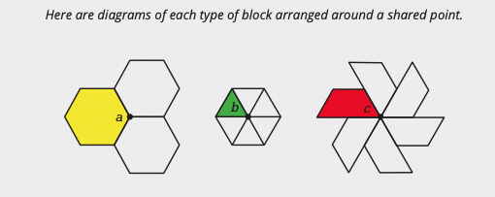
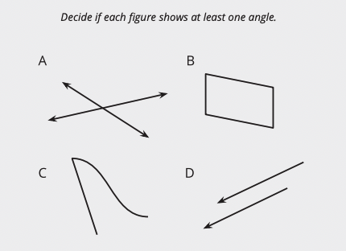
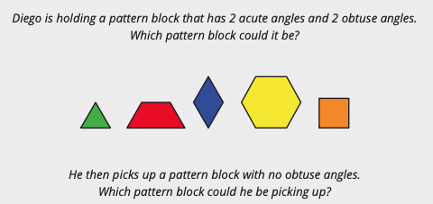
Unit 7 Progression Overview
Angles and Angle Measurement
Section A
Lessons 1-5
4.G.A.1, 4.MD.C.5, 4.NBT.B.4, 4.NBT.B.5
Section B
Lessons 6-10
4.G.A.1, 4.MD.C.5, 4.MD.C.5., 4.MD.C.6, 4.MD.C.7,
4.NBT.B.5, 4.NBT.B.6
Section C
Lessons 11-14
4.G.A.1, 4.G.A.2, 4.MD.C.6, 4.MD.C.7
Draw and identify points, lines, rays, segments, and parallel and intersecting lines in geometric figures.
Recognize that angles are formed wherever two rays share a common endpoint and identify angles in two-dimensional figures.
Recognize that angles can be measured in degrees, and can be found using addition and subtraction.
Use a protractor to measure and draw angles, and recognize that perpendicular lines meet or cross at a right angle.
Draw and identify acute, obtuse, right, and straight angles in two-dimensional figures.
Write equations to represent angle relationships and reason about and find unknown measurements.

Slide 3



Unit 7 Quick Links
L1
L2
L3
L4
L5
L6
L7
L8
L9
L10
L11
L12
L13
L14

Slide 4
How Would You Describe These Figures?
1
Let’s draw and describe geometric figures.
4.G.A.1

Slide 5
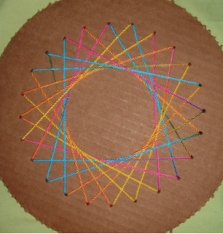
Notice and Wonder:
String Art
Warm up
What do you notice?
What do you wonder?

Slide 6
Do You See What I See?
Activity #1
Work with a partner in this activity. Sit back to back or use a divider to block each other’s view.
Partner A:
Your teacher will give you a card. Don’t show it to your partner.
Describe the image on the card—as clearly and precisely as possible—so that your partner can draw it on a blank card.
Partner B:
Your teacher will give you a blank card.
Your partner will describe an image. Listen carefully to the descriptions. On your card, create a drawing as described.
1. When done, compare the given image and the drawn image. Discuss:
Which parts were accurate? Which were off?
How could the descriptions be improved so the drawing could be more accurate?
Which words or descriptions are useful?
2. Try again with a second card from your teacher. When done, compare and discuss the images again.
3. Switch roles and repeat the exercise. Your teacher will give you 2 new cards (1 for each round).

Slide 7

A Field of Dots
Activity #2
Here is a field of dots.
1. Draw 5 lines, each one connecting at least 2 dots and extending as far as possible.
2. Did your lines make some familiar shapes—perhaps a triangle, quadrilateral, a letter, or a number?
Identify at least one familiar shape in your drawing. Trace the shape with a heavier mark or use a color pencil to make it obvious.
3. Share your drawing with your group members. Discuss:
How are the drawings alike? What do all the shapes have in common?
How are the drawings different?

Slide 8
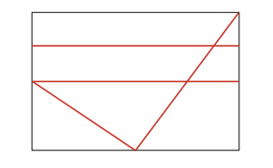
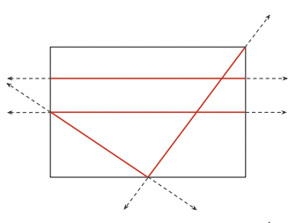

Lesson Synthesis
Today we described some drawings and created some drawings based on descriptions. We noticed how points, lines, and segments are present in the drawings, and that those terms were handy for describing what we were seeing.
Let’s look at an image from the first activity.
Let’s assume that the lines that reach the edge of the card actually go on if the card was larger.
How many lines do you see?

Slide 9
Lesson Synthesis
Today we described some drawings and created some drawings based on descriptions. We noticed how points, lines, and segments are present in the drawings, and that those terms were handy for describing what we were seeing.
Let’s look at an image from the first activity.
We can use points to talk about locations. This drawing contains many points. Which points might be significant?
Where are the line segments in this image?
How many segments do you see on this card?

Slide 10
Points, Lines, Rays, and Segments
2
Let’s draw lines, segments, and rays.
4.G.A.1, 4.NBT.B.4, 4.NBT.B.5

Slide 11

Number Talks:
Finding Differences
Warm up
Find the value of each expression mentally.

Slide 12

Number Talks:
Finding Differences
Warm up
Find the value of each expression mentally.

Slide 13

Number Talks:
Finding Differences
Warm up
Find the value of each expression mentally.

Slide 14

Number Talks:
Finding Differences
Warm up
Find the value of each expression mentally.

Slide 15



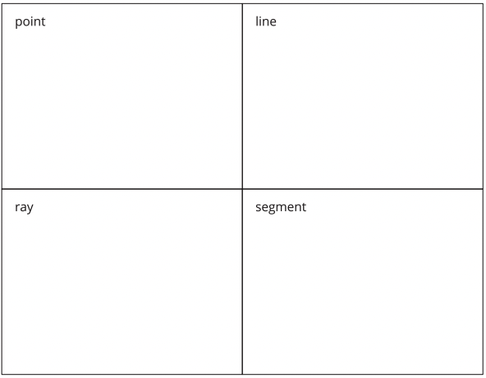













Card Sort: Who Am I?
Activity #1
Your teacher will give you a set of cards that describe or illustrate points, lines, rays, and segments.
Sort the cards into 4 groups. Each group should represent the characteristics of one of the geometric figures.
Pause for directions from your teacher before completing the graphic organizer.

Slide 16
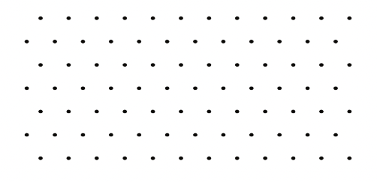
Make Some Shapes
Activity #2
1. Here is a field of dots. Each dot represents a point.
Draw some segments to create:
a. a triangle
b. a rhombus
c. a trapezoid
d. a hexagon
e. a pentagon
f. a rectangle

Slide 17
Make Some Shapes
Activity #2
2. Here is another field of dots.
Draw a combination of rays and segments to create:
a. an uppercase letter
b. a numeral
c. a lowercase letter

Slide 18
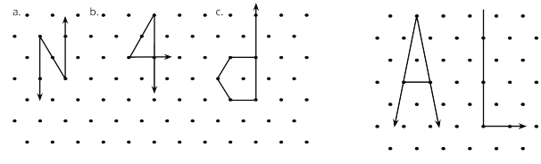
Lesson Synthesis
Today we learned the meanings of points, lines, segments, and rays, and we used those geometric parts to create drawings.
Are the dots on the paper the only points that could be in the drawing? The tip of the letter A and the ends of the horizontal segment don’t stop at any dots. Can we call them points?
How might we explain to a new student how lines, rays, and line segments are different?

Slide 19
Lesson Synthesis
Today we learned the meanings of points, lines, segments, and rays, and we used those geometric parts to create drawings.
Take 1–2 minutes to add any new words from today's lesson to your word walls. Share your new entries with a neighbor and add any new ideas you learn from conversation.
Is the bottom left corner of the letter L also a point? Why or why not?

Slide 20
Two or More Lines
3
Let’s look at lines that cross and lines that don’t.
4.G.A.1

Slide 21
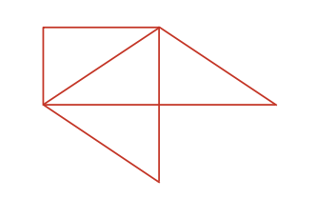
How Many Do You See?
A Curious Figure
Warm up
How many line segments do you see?
How do you see them?

Slide 22
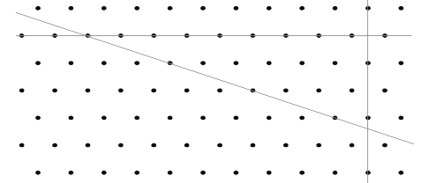
Four Lines
Activity #1
1. Three lines on a field of dots intersect (cross), forming a triangle.
Can you add a fourth line so that the four lines form a quadrilateral?
Use the drawing to show your reasoning, or explain why it cannot be done.

Slide 23
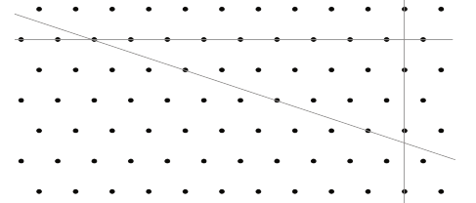
Four Lines
Activity #1
2. Here is a copy of the same drawing.
Can you add a fourth line to form a rectangle?
Use the drawing to show your reasoning, or explain why it cannot be done.

Slide 24

Four Lines
Activity #1
3. Discuss your drawings with your group.
Check if they agree with your conclusions on both questions.

Slide 25


To Cross or Not to Cross
Activity #2
1. Draw a line through at least 2 points. Label it line h .
2. Draw another line that goes through 2 points and intersects your first line. Label it line g..
3. Can you draw a new line that you think would never intersect:
a. Line h?
b. Lineg ?
If so, draw the line. Be prepared to explain or show how you know the lines would never cross. If not, explain why it can’t be done.
4. Here is a trapezoid. Do you think its top and bottom sides are parallel? What about its left and right sides? Explain or show how you know.
Here is another field of dots. Each dot represents a point.

Slide 26
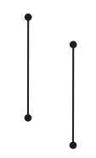
Lesson Synthesis
Today we learned about lines that cross—intersecting lines—and lines that never do—parallel lines.
Are these two line segments parallel?
How do we know for sure?

Slide 27

Lesson Synthesis
Today we learned about lines that cross—intersecting lines—and lines that never do—parallel lines.
Are these lines parallel?
How might we check to see if the lines are parallel or intersecting?

Slide 28

Lesson Synthesis
Today we learned about lines that cross—intersecting lines—and lines that never do—parallel lines.
You are learning many new mathematical terms in this unit. To help you visualize and remember these words, let’s create a personal illustrated word wall.
Add the new vocabulary words from the past two lessons to your word wall—one box for each word. Write the definition of each term in your own words, and add a sketch to illustrate its meaning..
Take a few minutes to do so now.

Slide 29
Points and Lines
All Around
4
Let’s find parallel and intersecting lines all around us.
4.G.A.1

Slide 30
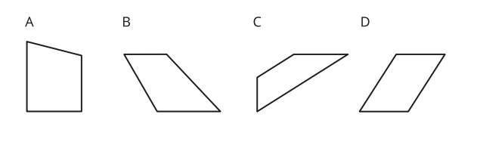
Which One Doesn’t Belong: Four-Sided Shapes
Warm up

Slide 31
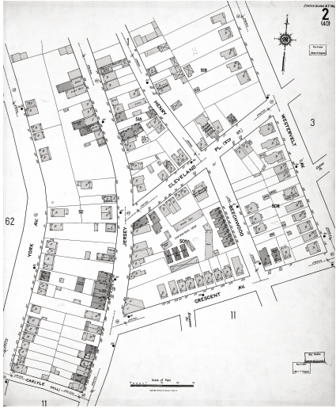
Spotting Lines and Segments
Activity #1
1. Here is a map of a neighborhood in Staten Island, New York.
On the map, find and label the following items:
4 line segments of different lengths
3 pairs of parallel lines
2 pairs of lines that are not parallel
(Consider using different colors for the different types of lines.)

Slide 32

Spotting Lines and Segments
Activity #1
In the words WHALE and JOY, which letter has:
a. No parallel segments? __________________
b. Exactly one pair of parallel segments? ________
c. More than one pair of parallel segments? ______
d. Only one segment? ____________________

Slide 33
Drawing and Designing with Lines
Activity #2
1. Draw a sketch of a part of our classroom and be sure to include:
a. at least 3 pairs of parallel lines
b. intersecting lines that make square corners
c. intersecting lines that don’t make square corners
Trade sketches with a partner and find the specified lines in each other’s sketches.

Slide 34

Drawing and Designing with Lines
Activity #2
2. Here are some symbols and logos that you may recognize. All of them have intersecting and parallel segments.
Design a logo with at least 8 parallel segments and 8 intersecting segments.
Use a ruler for any straight parts of your logo.

Slide 35
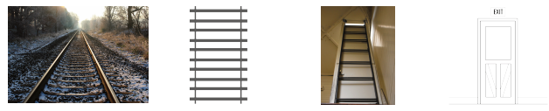
Lesson Synthesis
Today we saw various examples of parallel lines and intersecting lines and segments in life.
Does it matter if the left and right sides of a ladder are not parallel?
Where do you see parallel lines in the images?
Does it matter that the two sides of a track are always parallel? Why or why not?

Slide 36
Lesson Synthesis
Today we saw various examples of parallel lines and intersecting lines and segments in life.
When you were creating your sketch or logo today, how did you make sure that the segments that need to be parallel are actually parallel?
Take 1–2 minutes to add any new words from today's lesson to your word wall. Share your new entries with a neighbor and add any new ideas you learn from your conversation.

Slide 37
What is an Angle?
5
Let’s look for angles and find out what they are about.
4.G.A.1, 4.MD.C.5

Slide 38
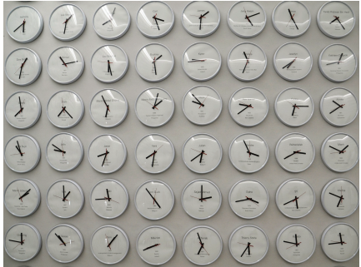
Notice and Wonder:
A Wall of Clocks
Warm up
What do you notice?
What do you wonder?

Slide 39
Tricky Figures
Activity #1
Work with a partner in this activity. Choose a role: A or B. Sit back to back, or use a divider to keep one person from seeing the other person’s work.
Partner A:
Your teacher will give you a card. Don’t show it to your partner.
Describe both images on the card—as clearly and precisely as possible—so that your partner can draw the same images.
Partner B:
Your partner will describe two images. Listen carefully to the descriptions.
Create the drawings as described. Follow the instructions as closely as possible.
1. When done, compare the drawings to the original images. Discuss:
Which parts were accurate?
Which were off?
How could the descriptions be improved so the drawing could be more accurate?
2. Switch roles and repeat the exercise. Compare the drawings to the original images afterwards.

Slide 40
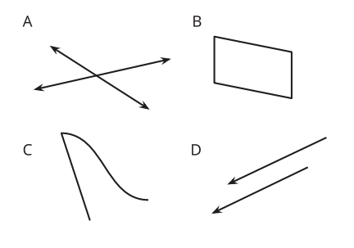
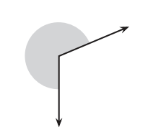
Angles or Not Angles?
Activity #2
1. Decide if each figure shows at least one angle and write your reasoning for each.
2. Clare and Kiran are looking at this diagram. Clare sees one angle, but Kiran sees two angles.
Do you agree with either of them? How many angles do you see?

Slide 41


Discovering Angles
Activity #3
Here are two figures.
1. Find 2–3 angles in each figure. Draw pairs of rays to show the angles.
2. Sketch a part of your classroom that has 2–3 angles. Draw pairs of rays to show the angles.

Slide 42
Lesson Synthesis
Today we learned that an angle is the space between two rays sharing the same endpoint, and that the shared point is the vertex of the angle.
Intersecting lines form angles.
Parallel lines can form angles.
Angles can be formed by curves.
Use the words ‘sometimes’, ‘always’, or ‘never’ to respond to each statement about angles and lines:

Slide 43
Lesson Synthesis
Today we learned that an angle is the space between two rays sharing the same endpoint, and that the shared point is the vertex of the angle.
Take 1–2 minutes to add the new words from today's lesson to your word wall.
Share your new entries with a neighbor and add any new ideas you learn from your conversation.
In the next section of our unit we are going to learn a little more about that space between rays and how we might measure it.

Slide 44
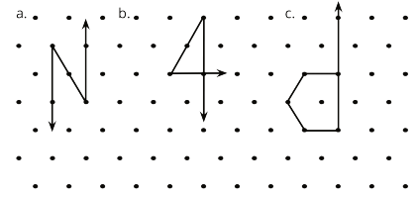
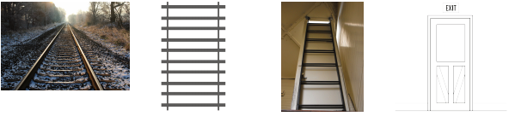
Section Summary
In this section, we learned the meanings of points, lines, segments, and rays. We used these terms to describe figures and used these geometric parts to create drawings.
We learned about lines that cross—intersecting lines—and lines that never do—parallel lines, and we looked for examples of parallel lines and intersecting lines and segments in life.

Slide 45
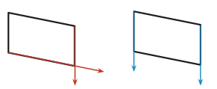
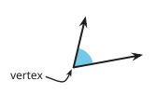
Section Summary
Rays that form sides of a shape can be extended to determine if the sides are parallel or intersecting.
Finally we learned that an angle is the space between two rays sharing the same endpoint, and that the shared point is the vertex of the angle.

Slide 46
How Can We
Measure Angles?
6
Let’s think about the size of angles.
4.MD.C.5, 4.MD.C.5.a, 4.MD.C.7

Slide 47

What Do You Know about…..
Warm up

Slide 48
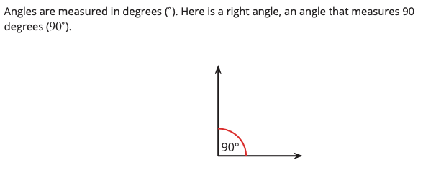
Right Angles All the Way Around
Activity #1
Your teacher will give you a rectangular sheet of paper.
1. Tear off all of the square corners. Fit one square corner in the angle. What do you notice?
2. Place a second square corner next to the first to make a larger angle with the same vertex. Leave no gaps or overlaps between the square corners. Sketch the angle. How many degrees is this angle?
3. Place a third square corner to make an even larger angle with the same vertex. Sketch the angle. How many degrees is it?
4. Repeat with the fourth square corner. Sketch the angle. How many degrees is it?
5. Can we make larger angles than the last one by adding more square corners? Explain your reasoning.

Slide 49
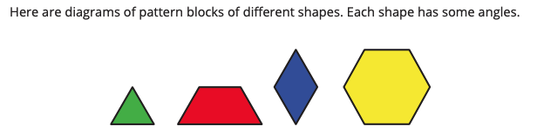
How Many Angles? How Many Degrees?
Activity #2
1. How many angles do you see inside each shape?
a. A triangle
b. A trapezoid
c. A rhombus
d. A hexagon

Slide 50
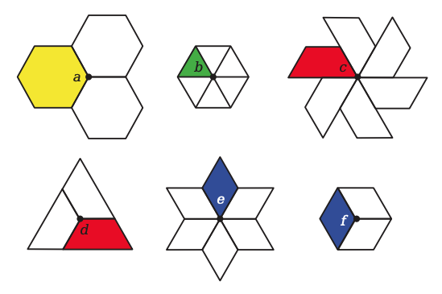
How Many Angles? How Many Degrees?
Activity #2
2. Here are diagrams of each type of blocks arranged around a shared point.
Use what you know about angle measurement to find the sizes of angles a–f.
Show your reasoning.

Slide 51

Lesson Synthesis
Today we learned that angles can be measured in degrees. We also looked at different ways to reason about the measurement.
The measurements and came up often in the lesson.
What’s special about those angles?
Here is an angle. What are some ways to describe how big this angle is?

Slide 52

Lesson Synthesis
Today we learned that angles can be measured in degrees. We also looked at different ways to reason about the measurement.
How many blocks do you see? How many angles are in each?
How can we find the size of angle labeled k?
Take 1-2 minutes to add any new words from today’s lesson to your word walls.

Slide 53
Find Angle Measurements
7
Let’s compose and decompose angles to find their measurements.
4.MD.C.5, 4.MD.C.5.a, 4.MD.C.7

Slide 54
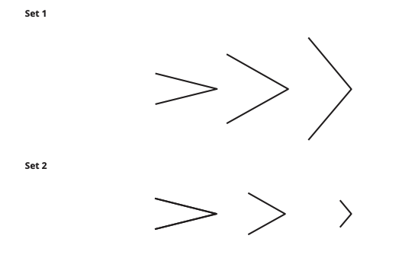
Notice and Wonder:
Two Sets of Angles
Warm up
What do you notice?
What do you wonder?

Slide 55
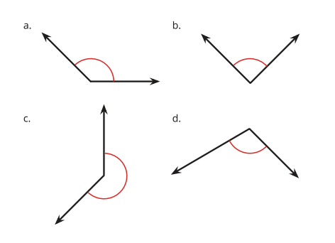
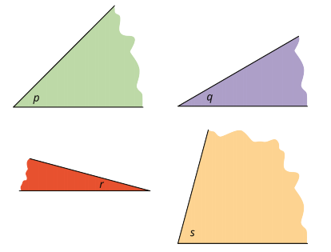
How Big Are These Angles?
Activity #1
Your teacher will give you materials that can help you find angle measurements.
1. Use the materials and what you know about right angle to find the size of angles , p, q, r and s . Be prepared to explain or show your reasoning.
2. Next, use the measurements of angles p, q, r and s to find the measurements of the following angles.

Slide 56
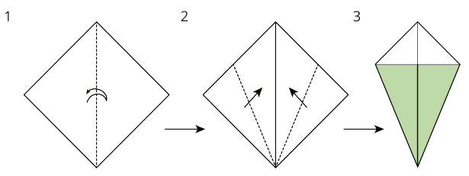
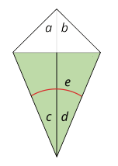
Angles in a Kite
Activity #2
Your teacher will give you a square sheet of paper. Follow the steps to fold the paper into a kite. Fold as precisely as possible.
Can you find the measurement of each labeled angle on the kite? If so, show your reasoning. If not, explain why not.

Slide 57
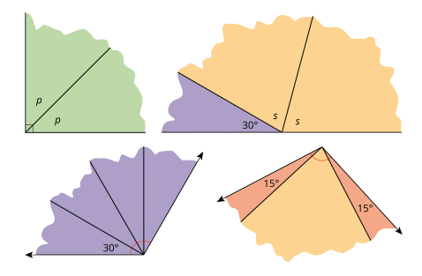
Lesson Synthesis
Today we used different operations to find the measurement of different angles.
Which of these angles can we find by using division?
Which unknown angle can we find by multiplication?
Which unknown angle can we find by subtracting one angle from another?
Which unknown angle can we find by adding known angles?
Here are some angles whose measurements we tried to find: angle p, angle s, and some angles composed of smaller angles. We used different operations to find the unknown measurements.

Slide 58
Use a Protractor to Measure Angles
8
Let’s use some tools to measure angles.
4.MD.C.5.a, 4.MD.C.5.b, 4.MD.C.6, 4.MD.C.7, 4.NBT.B.5

Slide 59

True or False: Something about 45
Warm up
Is each statement true or false?
Is each statement true or false?

Slide 60

True or False: Something about 45
Warm up
Is each statement true or false?
Is each statement true or false?

Slide 61

True or False: Something about 45
Warm up
Is each statement true or false?
Is each statement true or false?

Slide 62

True or False: Something about 45
Warm up
Is each statement true or false?
Is each statement true or false?

Slide 63
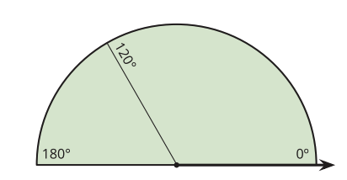

Activity #1
Making a Measuring Tool
Your teacher will give you a sheet of paper in the shape of half a circle. It shows a 120 degree angle and a 180 degree angle from the ray on the bottom right.
On the half-a-circle paper:
1. Draw a line to show a 90 degree angle from the same ray. Label it with the measurement. Be as precise as possible.
2. Draw lines to show the following angles (measured from the same ray). Label each line with the measurement.
3. Can you find a 1 degree angle from that same ray? Explain or show how you might do it.

Slide 64
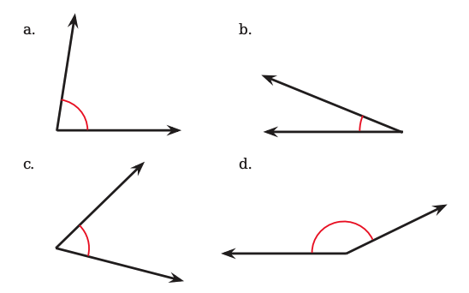
Activity #1
Making a Measuring Tool
Your teacher will give you a sheet of paper in the shape of half a circle. It shows a 120 degree angle and a 180 degree angle from the ray on the bottom right.
4. You just made a measuring tool!
How can it be used to estimate the size of an angle? Discuss your ideas with your group. Then, use your tool to estimate the sizes of at least two angles.

Slide 65


Activity #2
How Large is a 1 degree Angle?
1. A ray that turns all the way around its endpoint and back to its starting place has made a full turn or has turned 360 degrees.
What fraction of a full turn is each of the following angle measurements?
2. Your teacher will give you a protractor, a tool for measuring the number of degrees in an angle.
a. How is 1 degree shown on the protractor?
b. How many 1 degree measurements do you see?

Slide 66
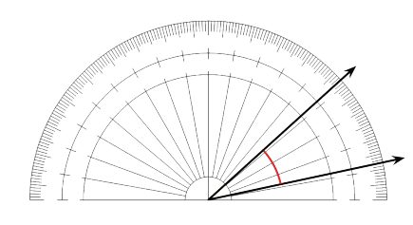
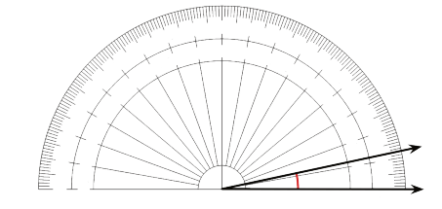
Activity #2
How Large is a 1 degree Angle?
3. A protractor with no numbers has been placed over an angle.
The center of the protractor is lined up with the vertex of the angle.
The straight edge of the protractor is lined up with a ray of the angle.
How many degrees is this angle? Explain how you know.
4. An angle contains thirty 1 degree angles, as shown. How many degrees is this angle?

Slide 67
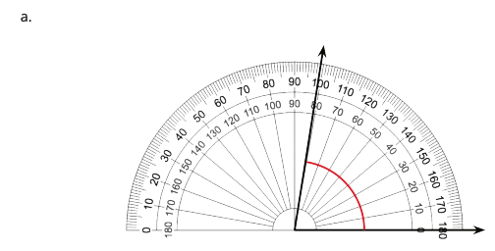
Activity #2
Using a Protractor
1. Here are four angles whose sizes you may have estimated earlier.
A protractor has been placed over each angle. What are their measurements?

Slide 68
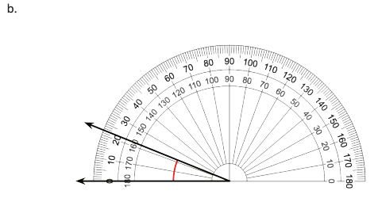
Activity #2
Using a Protractor
1. Here are four angles whose sizes you may have estimated earlier.
A protractor has been placed over each angle. What are their measurements?

Slide 69
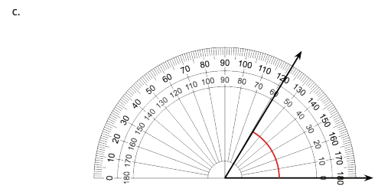
Activity #2
Using a Protractor
1. Here are four angles whose sizes you may have estimated earlier.
A protractor has been placed over each angle. What are their measurements?

Slide 70
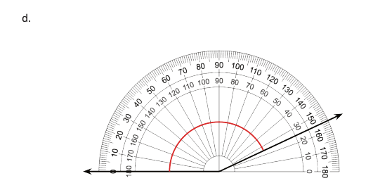
Activity #2
Using a Protractor
1. Here are four angles whose sizes you may have estimated earlier.
A protractor has been placed over each angle. What are their measurements?

Slide 71
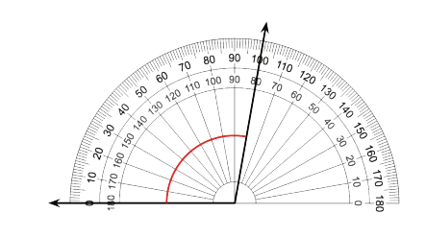
Activity #2
Using a Protractor
2. Elena and Kiran are measuring an angle with a protractor. Elena says the angle is 80 degrees . Kiran says it shows 100 degrees.
Why might they end up with different measurements? Which one is correct?
Explain your reasoning.

Slide 72
Lesson Synthesis
Today we learned that angles can be measured in degrees. We also looked at different ways to reason about the measurement.
In earlier lessons, we used pattern blocks and paper cutouts to help us find angle measurements. We also used familiar angles like 60, 90, and 180 degrees as references to find the size of other angles. Today, we used 1 degree angles, a much smaller reference.
How can 1 degree angles tell us the size of other angles?
What do you know about a 1 degree angle?
How would we know how many 1 degree angles are in another angle?

Slide 73
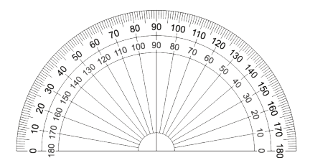
Lesson Synthesis
We saw that a protractor has two sets of numbers. How do you know which set of numbers to use when measuring an angle?
Take 1-2 minutes to add any new words from today's lesson to your word wall. Share your new entries with a neighbor and add any new ideas you learn from your conversation.

Slide 74
Angle Measurement and Perpendicular Lines
9
Let’s measure all kinds of angles.
4.G.A.1, 4.MD.C.5.b, 4.MD.C.6, 4.NBT.B.6

Slide 75

Number Talks:
Quotients
Warm up
Find the value of each expression mentally.

Slide 76

Number Talks:
Quotients
Warm up
Find the value of each expression mentally.

Slide 77

Number Talks:
Quotients
Warm up
Find the value of each expression mentally.

Slide 78
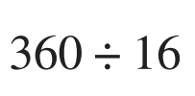
Number Talks:
Quotients
Warm up
Find the value of each expression mentally.

Slide 79
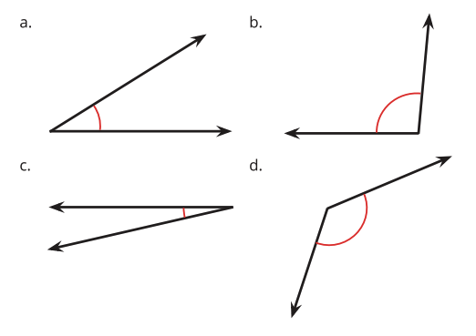
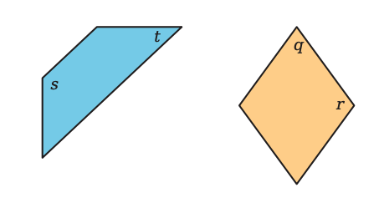
Activity #1
Angles Here, There, Everywhere
1. Use a protractor to measure each marked angle.
2. Use a protractor to measure the labeled angles in each figure.

Slide 80
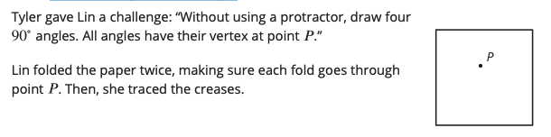
Activity #2
A Folding Challenge
1. Your teacher will give you a sheet of paper. Draw a point on it. Then, show how Lin met the challenge.
2. When Lin folded the paper, the creases formed a pair of perpendicular lines. What do you think “perpendicular lines” mean?

Slide 81
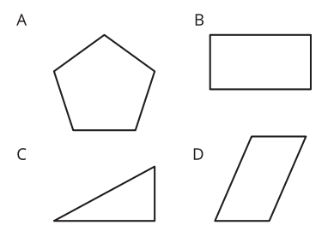
Activity #2
A Folding Challenge
3. Use Lin’s method to create a new pair of perpendicular lines through the same point and label them.
4. Which shapes have sides that are perpendicular to one another?
Mark the perpendicular sides. Be prepared to explain how you know the sides are perpendicular.

Slide 82
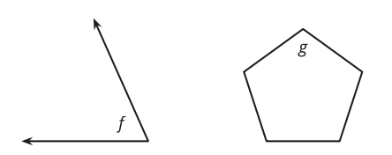
Lesson Synthesis
Today you used a protractor to measure different angles. Suppose you are to show a classmate who is absent today how to measure the angles labeled f and g.
Would your description for measuring angle g be different from that for angle f ?
How would you describe the process of measuring the angles so that it is clear to them?
Are there any perpendicular lines in either of the diagrams? How can we tell?

Slide 83
Use a Protractor to
Draw Angles
10
Let’s draw some angles.
4.G.A.1, 4.MD.C.5.a, 4.MD.C.6, 4.MD.C.7

Slide 84

Estimation Exploration:
Long Hand and Short Hand
Warm up
How many degrees is the angle formed by the long hand and the short hand of the clock?
Record an estimate that is:
Too low | About right | Too high

Slide 85

Activity #1
Draw These Angles!
1. Draw a line that is neither vertical nor horizontal. Put a point somewhere on that line. Use your protractor to draw a perpendicular line through that point. Be as precise as possible. (No folding this time!)
2. Here is a ray that starts at point M.
a. A ray starting at point M to create a 40 degree angle.
b. Another ray starting at point M to create a 20 degree angle.
c. One more ray starting at point M to create a 95 degree angle. Label each angle with its measurement.

Slide 86

Activity #1
Draw These Angles!
3. In your drawing, there should be one angle that is not labeled with a measurement.
How many degrees is this angle?
Be prepared to explain how you know

Slide 87
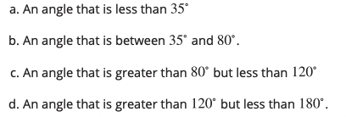
Angles Made to Order
Activity #2
Your teacher will give you some blank cards. Label them a–d.
1. On each card, draw an angle that meets one requirement. Use a ruler and a protractor
2. Trade cards with your partner.
a. Measure and record each angle your partner drew. Check to make sure each angle meets the requirement.
b. If a requirement is not met, return it to your partner so it can be corrected. Save the cards for the next lesson.

Slide 88
Lesson Synthesis
Today we used protractors to draw angles of different sizes and to check one another’s drawings.
In the last activity, you drew a bunch of angles, some smaller, some larger. Did you find some sizes of angles easier to draw than others? Why or why not?
What were some challenges in drawing angles precisely?
How would you describe the process of drawing an angle to a classmate who is absent today? If you were to give step-by-step instructions for creating a 70 degree angle, what would the steps be?

Slide 89
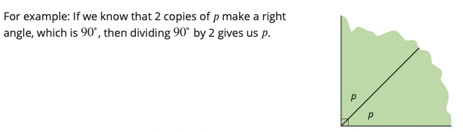

Section Summary
In this unit, we learned that angles can be measured and that we can use different operations to find the unknown measurements of angles.
We used pattern blocks and paper cutouts to help us find angle measurements. We also used familiar angles like 60, 90 , and 180 degrees to find the size of other angles.

Slide 90

Section Summary
Finally, we learned that a protractor is a tool used to measure angles and can also be used to create angles of a certain measure.
A protractor has two sets of numbers and that either set of numbers could be used, but it is efficient to use the set that counts up from 0 rather than count down from 180. We used a protractor to measure and draw different angles.

Slide 91
Types of Angles
11
Let’s look at different types of angles.
4.G.A.1

Slide 92

Number Talks:
Fractions of 360
Warm up
Find the value of each expression mentally.

Slide 93

Number Talks:
Fractions of 360
Warm up
Find the value of each expression mentally.

Slide 94

Number Talks:
Fractions of 360
Warm up
Find the value of each expression mentally.

Slide 95

Number Talks:
Fractions of 360
Warm up
Find the value of each expression mentally.

Slide 96

Activity #1
Sorting Angles
In an earlier lesson, you and your partner drew some angles on cards.
Put the cards together and sort the angles into two groups. Be prepared to explain why you sort them the way you do.

Slide 97


Activity #2
What is It, Really?
1. Mai and Jada are looking at this drawing. Jada says it is just a line. Mai says it is an angle.
Who do you agree with? Explain your reasoning.
2. Tyler and Andre were measuring an angle in a letter Y.
Andre said the angle he measured is obtuse. Tyler said the angle is acute.
Explain why they could both be right.

Slide 98

Activity #3
Small Angles, Large Angles
1. Identify each angle as acute, right, obtuse, or straight.

Slide 99

Activity #3
Small Angles, Large Angles
2. Here is a drawing of the structure of a roof.
Find as many acute and obtuse angles as you can in the drawing. Use an “A” to label acute angles, a square (◻) for right angles, and an “O” for obtuse angles.

Slide 100

Activity #3
Small Angles, Large Angles
a. Diego is holding a pattern block that has 2 acute angles and 2 obtuse angles. Which pattern block could it be?
b. He then picks up a pattern block with no obtuse angles.
Which pattern block could he be picking up?
Explain your reasoning

Slide 101

Lesson Synthesis
Earlier in this unit, we categorized lines by their features or characteristics. Today, we categorized angles by their size. Let’s recall the types of lines and the types of angles we’ve come across so far.

Slide 102
Reasoning about Angles (Part 1)
12
Let’s find the size of angles on the clock.
4.MD.C.6, 4.MD.C.7

Slide 103

Which One Doesn’t Belong:
Time After Time
Warm up
Which one doesn’t belong?

Slide 104

Activity #1
Draw a Clock
Kiran is drawing a clock. He draws a pair of perpendicular lines to find the placement of the numbers 3, 6, 9, and 12 around the circle.
1. How many degrees is each angle he has drawn so far? Explain how you know.
2. Help Kiran find the exact placement of the numbers “1” and “2” on the clock.
a. How many new lines does he need to draw?
b. What angles should be formed between the two lines he has already drawn and the new ones?
c. Draw the lines precisely and place the numbers “1” and “2” on the drawing.
3. Measure and draw as many lines as needed to complete the clock drawing so that all the numbers are precisely placed where they should be.

Slide 105

Activity #1
Tick Tock
1. What angles are formed by the hour and minute hands of the clock at these times?
a. 6 o’clock
b. 8 o’clock
c. 9 o’clock
d. 11 o’clock
e. 12 o’clock
2. How many degrees has the minute hand turned when it moves from 2:00 to 2:05? What about from 2:05 to 2:30? Explain how you know.
3. The minute hand of the clock is vertical at 7 p.m. Sometime later, it makes an angle that is 120 degree from where it was at 7 p.m. What time could it be?
4. How many degrees does the minute hand turn in:
a. 10 minutes?
b. 1 minute?
c. 4 minutes?

Slide 106
Lesson Synthesis
Today we learned about angle measurements on a clock. We looked at the angles formed by the two hands, and we also thought about the number of degrees that a minute hand turns over time.
Which is more useful for finding the size of angles on a clock: thinking in terms of number of minutes, the number of 5 minutes, or the numbers 1–12?

Slide 107

Lesson Synthesis
Does the minute hand on a square clock or an oval clock turn the same number of degrees every minute as it does on a round clock? Explain or show you how you know

Slide 108
Reasoning About Angles (Part 2)
13
Let’s figure out a bunch of missing angle measurements.
4.G.A.1, 4.MD.C.7

Slide 109

How Many Do You See:
Obtuse Angles
Warm up
How many obtuse angles do you see in the folded paper heart?

Slide 110

Activity #1
Shaded and Unshaded Angles
Find the measurement of each shaded angle. Show how you know.

Slide 111

Activity #2
A Whole Bunch of Angles
Your teacher will give you either a problem card or a data card. Do not show or read your card to your partner.
Pause here so your teacher can review your work. Ask your teacher for a new set of cards and repeat the activity, trading roles with your partner.

Slide 112

Lesson Synthesis
Today we solved some angle problems that required multiple steps, all without measuring the angles with a protractor.
Earlier in the unit, we relied on the number of degrees in a full turn, , to find other angle measurements. Did you still rely on when solving these problems? Why or why not?
What equations can we write to help us find the value of p ? What about d?

Slide 113

Section Summary
Earlier in the unit, we learned that a right angle measures exactly 90 degrees . In this section, we learned other ways to name angles based on their measurements.

Slide 114



Section Summary
We also solved problems about angles. For example, if two angles make a right angle or a straight angle, we can use the size of one angle to find the other.
Another example: Knowing that a full turn measures 360 degrees , we reasoned that the long hand of a clock makes:

Slide 115
Guess the Figure
14
Let’s draw and identify all kinds of two-dimensional figures.
4.G.A.1, 4.G.A.2

Slide 116

Notice and Wonder: Two Figures
Warm up
What do you notice?
What do you wonder?

Slide 117




Make a Change
Activity #1
Your teacher will give you a set of cards. Each partner picks one of the cards.
1. Draw the figure you selected, but make at least one change.
2. Look at your partner’s card and drawing. What change did your partner make?

Slide 118

Guess my Figure
Activity #2
1. Create a two-dimensional shape that has at least 3 of the following:
a. ray
b. line segment
c. right angle
d. acute angle
e. obtuse angle
f. perpendicular lines
g. parallel lines
2. Without showing your partner, describe the figure so that your partner is able to draw it as best as possible.
3. Switch roles, and draw your partner’s shape based on their description.

Slide 119
Lesson Synthesis
Today, we described and drew two-dimensional figures.
In this unit, we learned about different geometric features and measurement of two-dimensional figures. What are the most important things to remember about what we learned?

