Slide 1

Whole-number Multiplication and Division
Standards addressed: 4.NBT.A.1, 4.NBT.B.4, 4.OA.B.4, 4.MD.A.2, 4.NBT.B.5, 4.OA.A.3, 4.MD.A.3, 4.NBT.B.6, 4.OA.A.2, 4.OA.C.5
These slides have been created by Britnee Wright- Southeast Arkansas Education Cooperative and are not official IM materials. Images and language are taken from IM Grade 4 Unit 6 by Illustrative Mathematics.
Copyright 2020 by Illustrative Mathematics. All Rights Reserved, adapted and shared with permission.

Slide 2
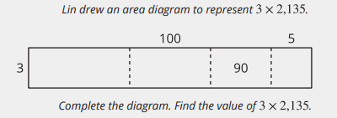
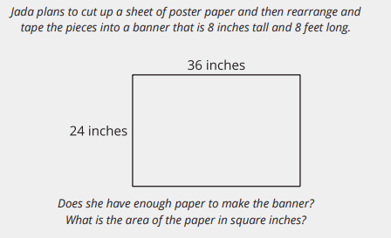
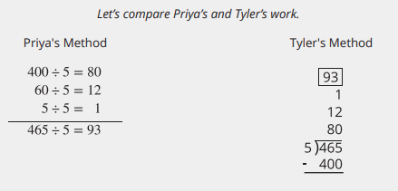
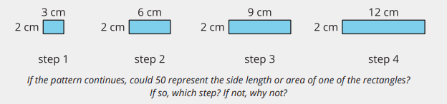
Unit 6 Progression Overview
Whole-number Multiplication and Division
Section A
Lessons 1-4
4.OA.C.5
Section B
Lessons 5-12
4.MD.A.2, 4.NBT.B.4, 4.NBT.B.5, 4.OA.A.3
Section C
Lessons 13-20
4.MD.A.3, 4.NBT.B.6, 4.OA.A.3, 4.OA.B.4
Section D
Lessons 21-25
4.MD.A.2, 4.MD.A.3, 4.NBT.B.4, 4.NBT.B.5, 4.NBT.B.6,
4.OA.A.2, 4.OA.A.3, 4.OA.C.5
Generate a number or shape pattern that follows a given rule.
Identify apparent features of a number pattern that were not explicit in the rule itself.
Multiply a whole number of up to four digits by a one-digit whole number, and 2 two-digit numbers using strategies based on place value and the properties of operations.
Use a partial quotients algorithm to divide multi-digit numbers of up to four digits by one-digit divisors, resulting in numbers with or without a remainder.
Use the four operations to solve problems that involve multi-digit whole numbers and assess the reasonableness of answers.

Slide 3



Unit 6 Quick Links
L1
L2
L3
L4
Adapt 1
Adapt 2
L5
L6
L7
L8
L9
L10
L11
L12
Adapt 3
Adapt 4
L13
L14
L15
L16
L17
L18
L19
L20
L21
L22
L23
L24
L25

Slide 4
Patterns in Shapes
that Grow
1
Let’s look at designs that grow and think about how they might keep growing.
4.OA.C.5

Slide 5
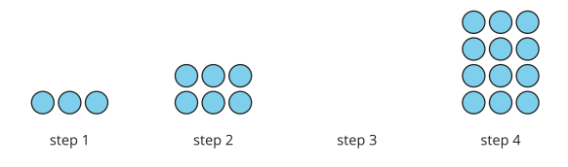
Notice and Wonder:
Growing Sets of Circles
Warm up
What do you notice?
What do you wonder?

Slide 6
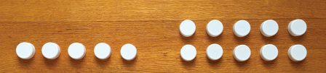
Growing Sets of Bottle Caps
Activity #1
1.
a. What might be the pattern that Han has in mind? How do you think the design would continue?
b. Describe or draw the next two steps.
2. Is there another possible pattern? Can you think of another way that Han’s design could continue? If you think so, describe or draw the next two steps.
3. For each pattern that you noticed, write a list of numbers that represent the number of caps in step 1 through step 6.
Han is designing a pattern using bottle caps. Here are the first two steps of the design.

Slide 7
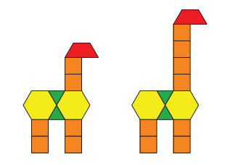
Taller and Taller
Activity #2
Jada used pattern blocks to make giraffes. Here are the first two giraffes. She continued to add 2 square blocks for each giraffe that follows.
Partner A:
1. List the number of square blocks in each of the first five giraffes. Make two observations about the numbers.
2. Without drawing the giraffe, predict how many square blocks the tenth giraffe will have? Explain your reasoning.
3. Will a giraffe ever have 25 square blocks? Show or explain how you know.

Slide 8
Taller and Taller
Activity #2
Jada used pattern blocks to make giraffes. Here are the first two giraffes. She continued to add 2 square blocks for each giraffe that follows.
Partner B::
1. List the total number of blocks in each of the first five giraffes. Make two observations about the numbers.
2. Predict how many total blocks the tenth giraffes will have. Explain your reasoning.
3. Will the giraffe ever have a total of 25 blocks? Show or explain how you know.

Slide 9

Lesson Synthesis
Today we looked at several visual designs. Each of them shows sets of items that change according to a rule, which then created a pattern.
Here is a list of numbers that describe a possible pattern for Han’s bottle cap design in the first activity:
5, 10, 15, 20, 25, 30
What are some ways we used to describe and extend the patterns we saw?
How might we find the number for the eighth step?
Could 72 be a number of bottle caps in this pattern? Why or why not?

Slide 10
Patterns in Shapes that Repeat
2
Let’s look at shapes that repeat by a rule and make some predictions about the patterns they create.
4.OA.C.5

Slide 11
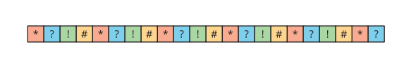
How Many Do You See:
Colorful Tiles
Warm up
How many do you see?
How do you see them?

Slide 12

A Design with a Rule
Activity #1
1. Here is a design made by arranging shapes.
a. Look for as many patterns as you can and describe them to your partner.
b. What rule might have been used to create this design?
c. Use the rule to extend the design so that each pattern repeats one more time.
2. Create a new design that uses only a circle and one other shape, and that follows a new rule for repetition.
a. Trade your design with your partner. Look for as many patterns as you can in their design and describe them.
b. What rule might your partner have used to arrange the shapes in their design?
c. Use the rule to extend their design so that each pattern repeats one more time.

Slide 13

A Design with a Rule
Activity #2
1. Number the shapes 1 to 12.
2. Your teacher will assign you a shape. Write it in every blank space and answer the questions.
a. What numbers were placed on the ____________________s?
b. If you extend the design, what numbers will be placed on the next two _____________________s?
c. What number will the tenth ____________________ have? Explain or show how you know.
d. Will the 30th shape be a ____________________? Explain or show your reasoning

Slide 14
Clare’s Design
Activity #3
Clare made a design using 3 shapes—a triangle, a circle, and a square—that repeat in that order.
1. Draw the first 10 shapes in Clare’s design.
2. Clare numbered her shapes. What numbers are the first five squares?
3. Describe the pattern you see in these numbers.
4. What is the 31st shape in Clare’s design? Explain or show how you know.
5. Clare wants to use 40 shapes in her design and the last shape to be a square. Is this possible? How do you know?

Slide 15

Lesson Synthesis
Today we explored patterns created by shapes that repeat according to a rule. When we numbered the shapes, we have lists of numbers that also have a pattern in them.
Here are some lists or sequences of numbers we saw in this lesson. How would you find the 50th number in each sequence, without listing all 50 numbers?

Slide 16
Patterns in Rectangles
3
Let’s look at patterns in rectangles that grow according to a rule.
4.OA.C.5

Slide 17

Number Talks:
Patterns in Multiplication
Warm up
Find the value of each product mentally.

Slide 18

Number Talks:
Patterns in Multiplication
Warm up
Find the value of each product mentally.

Slide 19

Number Talks:
Patterns in Multiplication
Warm up
Find the value of each product mentally.

Slide 20

Number Talks:
Patterns in Multiplication
Warm up
Find the value of each product mentally.

Slide 21
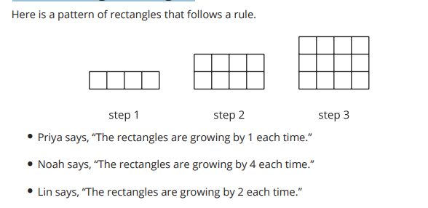
Growing Rectangles
Activity #1
1. Can you think of possible reasons that all of them could be correct even though they describe the patterns differently?
2. Revise the statement made by each student so that what they mean is clearer and more precise.
3. Priya writes the number list 1, 2, 3, 4, 5, 6 to represent the first six steps of the pattern she sees. Write a list of numbers to represent the first six steps of the pattern that Noah and Lin see.
4. Predict what number Priya, Noah, and Lin will write for step 20 if the pattern of rectangles continue. Explain or show your reasoning.

Slide 22
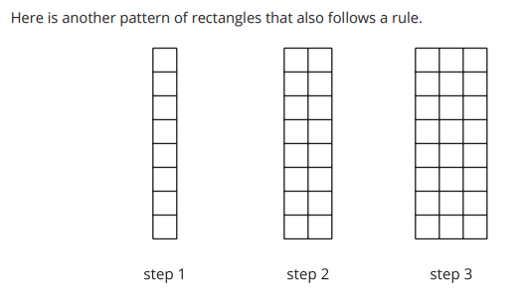
More Growing Rectangles
Activity #2
1. The number list 1, 2, 3, _____, _____, _____ represents the number of vertical columns in the first six steps of the pattern. Complete the number list.
2. Find another feature of the rectangles that can be represented with a number list and would show a pattern. Write at least one list of numbers for the first six steps of that feature.
Feature: _______________________________ Number list: ____, ____, ____, ____, ____, ____
3. Without writing out all the numbers, predict the 30th number in your list. Explain your reasoning by completing this sentence frame: I know that the 30th number is _____ because . . .

Slide 23
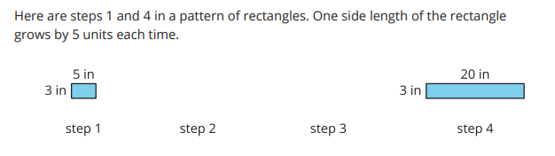
More Growing Rectangles
Activity #3
1. Sketch the missing rectangles in steps 2 and 3. Label the sides with their lengths.
2. Write two lists of numbers that each represent a feature of the rectangles, from step 1 to step 6.
a. Feature: ________________________________________
Number list: _____, _____, _____, _____, _____, _____
b. Feature: ________________________________________
Number list: _____, _____, _____, _____, _____, ____

Slide 24
More Growing Rectangles
Activity #3
3. For each of the following questions, if you answer yes, show how you know and state the step number. If you answer no, explain or show why not. If the pattern continues:
a. Could 82 inches be a side length of a rectangle?
b. Could 300 square inches be the area of a rectangle in the pattern?
c. Could 100 inches be the perimeter of a rectangle in the pattern?

Slide 25

Lesson Synthesis
Today we looked at rectangles that grow according to a rule. We saw that the rule doesn’t only create a pattern in the size or the number of one feature, but it also creates patterns in other features of the rectangles.

Slide 26
Patterns in Numbers
4
Let’s investigate some counting patterns.
4.OA.C.5

Slide 27
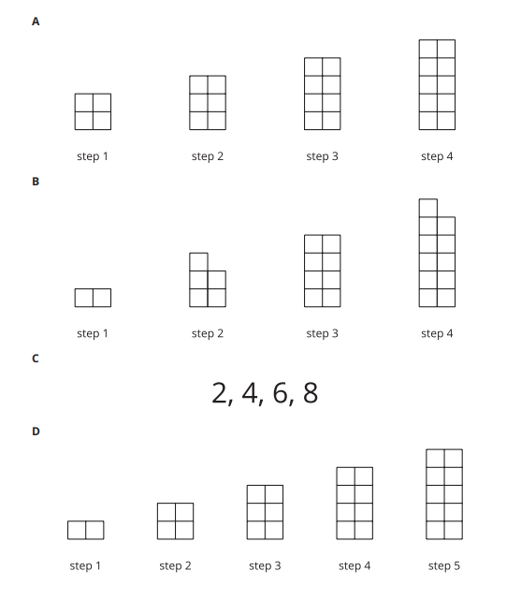
Which One Doesn’t Belong: Stacked Squares
Warm up

Slide 28
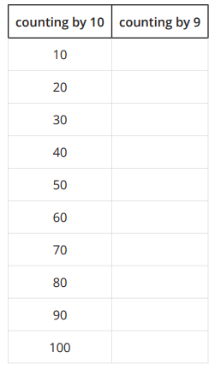
Counting by 10 and by 9
Activity #1
Andre’s class is choral counting by 10 and then by 9.
The left column shows the numbers they call out when counting by 10.
1. Complete the right column with the first ten numbers the class should call out when counting by 9.
What patterns do you see in each column? Make at least two observations about each list of numbers.

Slide 29
Counting by 10 and by 9
Activity #1
Andre’s class is choral counting by 10 and then by 9.
The left column shows the numbers they call out when counting by 10.
2. For the numbers in the “counting by 10” column, why do you think:
a. the digits in the tens place change the way they do?
b. the digits in the ones place are the way they are? Explain your reasoning.
3. For the numbers in the “counting by 9” column, why do you think the digits in the ones place change the way they do? Explain your reasoning.

Slide 30
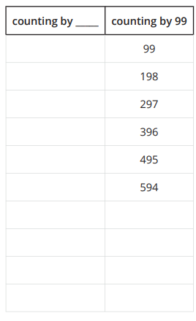
Counting by 99
Activity #2
Andre’s class did a choral count by 99. Here are the first six numbers they counted.
1. Study the list of numbers.
What patterns do you see?
Make at least three observations.

Slide 31
Counting by 99
Activity #2
Andre’s class did a choral count by 99. Here are the first six numbers they counted.
2. Extend the list with the next four multiples of 99. Be prepared to discuss how you know what numbers to write.
3. Why do you think the digits in the numbers change the way they do? If you get stuck, try counting by 100 and recording the numbers in the empty column.

Slide 32

Counting by 15
Activity #3
1. Write the next four numbers she’d count if she kept going.
2. What patterns do you see? Describe as many as you can.
3. Choose one pattern that you noticed and explain why you think the digits or numbers behave that way.
4. Could 250 be a number that Elena calls out if she continued to count by 15? Explain or show your reasoning.

Slide 33
Lesson Synthesis
Today we saw different patterns in the numbers that we get when counting by 9, 10, 99, 100 (and 15, if students completed the optional activity). We saw that the digits in the ones, tens, and hundreds place behave in particular ways and we tried to make sense of those patterns.
Suppose a classmate who is absent today doesn’t quite see patterns in these numbers. What would you suggest that they pay attention to?
Choose a pattern and think about how you would explain it to them.

Slide 34
Equal Groups,
Larger Numbers
Adaptation
Lesson 1
Let’s solve some problems with equal groups that have larger numbers.
3.MD.C.7.c, 3.OA.A.3, 3.OA.B.5

Slide 35
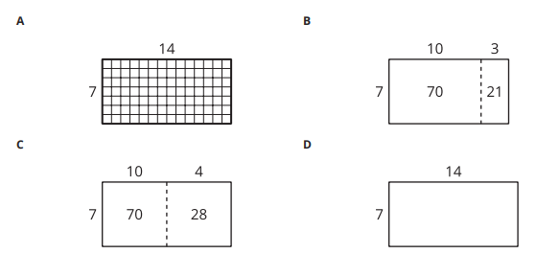
Which One Doesn’t Belong:
Area Diagrams
Warm-
up

Slide 36

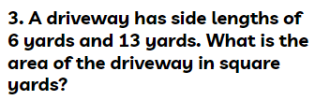
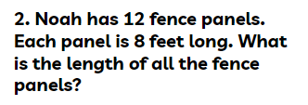
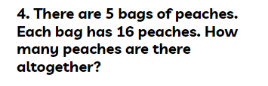
Equal Groups, Larger Numbers
Activity #1
Solve each problem. Show or explain your reasoning.

Slide 37

Gallery Walk
Activity #2
As you visit the posters with your partner, discuss what is the same and what is different about the thinking shown on each poster.

Slide 38
Lesson Synthesis
Today we solved problems that involved the multiplication of a teen number. What would be the advantages and disadvantages of using each of these diagrams?

Slide 39
Multiply Multiples of Ten
Adaptation
Lesson 2
Let’s multiply one-digit numbers times multiples of 10.
3.NBT.A.3

Slide 40
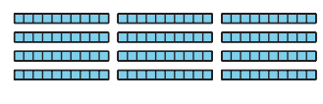
Notice and Wonder:
Tens
Warm up
What do you notice?
What do you wonder?

Slide 41

Field Trip Money
Activity #1
1. Elena was helping count the money for a field trip. There were eighteen envelopes and each envelope had a ten dollar bill in it. How much money was there all together?
2. All the money for the field trip is in ten dollar bills. Find different ways the money could be organized into envelopes where each envelope has the same amount.

Slide 42
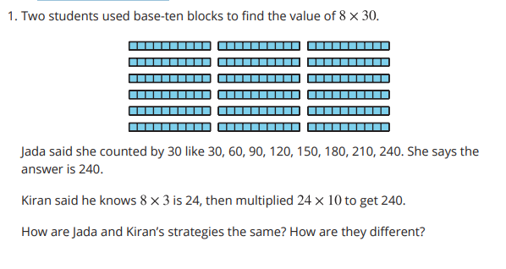
Two Strategies
Activity #2

Slide 43
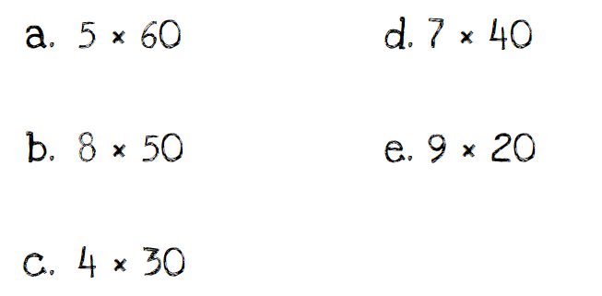
Two Strategies
Activity #2
2. Find the value of each expression. Show or explain your reasoning.

Slide 44
Lesson Synthesis
Today we multiplied one-digit whole numbers by multiples of 10. How did thinking about tens help us find the value of products that were larger than we had found before?
What were some strategies that were helpful as you multiplied one-digit whole numbers by multiples of 10?

Slide 45
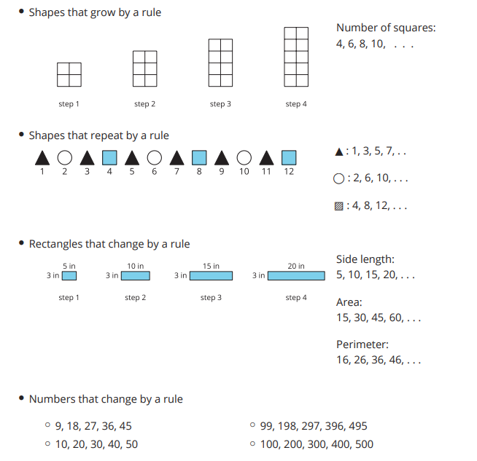
Section Summary
In this section, we looked at different patterns of shapes and patterns of numbers. We saw shapes that grew or repeated by certain rules, and we used numbers to help us see how the shapes changed. Here are some examples of the patterns:
We learned to extend the patterns by first finding their rule. Sometimes we can use addition and multiplication to represent a rule and then extend the pattern. Other times we can see how the digits in the numbers change to make predictions.

Slide 46
Products Beyond 100
5
Let’s find products beyond 100.
4.NBT.B.5

Slide 47

Number Talk:
A Number Times Some Multiple of 10
Warm up
Find the value of each product mentally.

Slide 48

Number Talk:
A Number Times Some Multiple of 10
Warm up
Find the value of each product mentally.

Slide 49

Number Talk:
A Number Times Some Multiple of 10
Warm up
Find the value of each product mentally.

Slide 50

Number Talk:
A Number Times Some Multiple of 10
Warm up
Find the value of each product mentally.

Slide 51
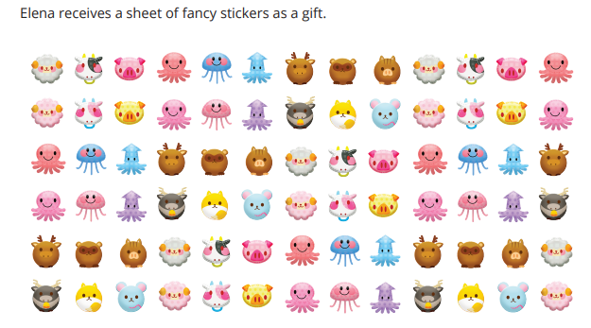
The Book Fair
Activity #1
How many stickers are there?
Show how you would find out without counting every sticker.

Slide 52

More and More Stickers
Activity #2
1. Elena has another sheet of stickers that has 9 rows and 21 stickers in each row. How many stickers does Elena have?
Show your reasoning.
2. Noah’s sticker sheet has 3 rows with 48 stickers in each row. Andre’s sticker sheet has 7 rows with 23 stickers in each row. Who has more stickers? Show your reasoning.

Slide 53
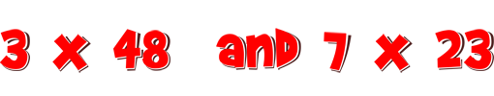
Lesson Synthesis
Today we used different strategies to multiply a two-digit whole number by one-digit whole number.
To find 3 x 48, some of you started by finding 3 x 40 —with or without drawing diagrams—and others started by finding 3 x 50 . If you started with 3 x 40 , what did you do next?
To find 7 x 23 , some of you found 7 x 20 first and then 7 x 3 . Why did you decide to decompose the 23 into 20 and 3

Slide 54
Multiply Two-digit Numbers by One-digit Numbers
6
Let’s multiply two-digit and one-digit numbers.
4.NBT.B.5

Slide 55
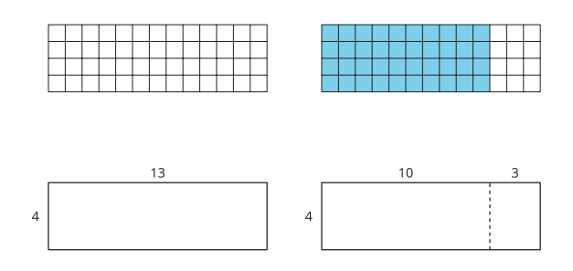
Notice and Wonder:
With and Without a Grid
Warm up
What do you notice?
What do you wonder?

Slide 56
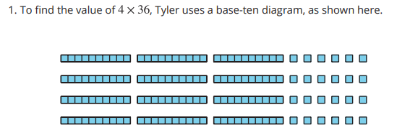
What was Tyler Thinking?
Activity #1
a. Where is the 36 in Tyler’s diagram?
b. Where is the 4 in Tyler’s diagram?
c. What is the value of 4 x 36 ?

Slide 57
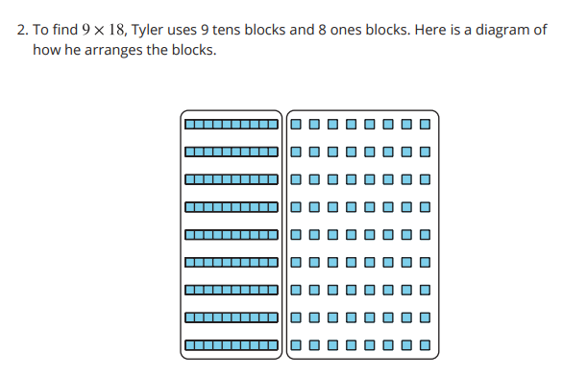
What was Tyler Thinking?
Activity #1
Explain or show how his arrangement helps him find the value of 9 x 18.

Slide 58
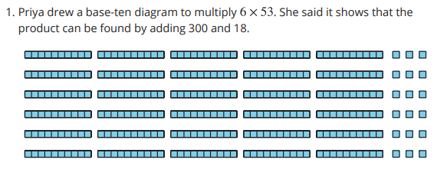
Rectangular Diagrams
Activity #2
a. Where do you see 6 and 53 in her diagram?
b. Where do you see 300 and 18 in Priya’s diagram? What do they represent?

Slide 59
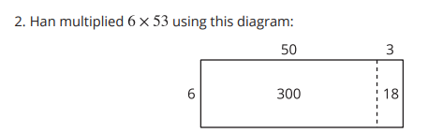
Rectangular Diagrams
Activity #2
Where do you see 300 and 18 in his diagram? What do they represent?

Slide 60

Rectangular Diagrams
Activity #2
3. Which way do you prefer for multiplying 6 x 53:
Han’s way or Priya’s way? Explain your reasoning.
4. Find the value of6 x 53
5. Draw a diagram to represent each multiplication expression.
Then, find the value of each product.
6 x 48
9 x 67

Slide 61

Lesson Synthesis
Today we used base-ten diagrams and rectangular diagrams to represent multiplication. We compared these representations and also used expressions to represent them.
8 x 79
What expression could we write to represent the diagram?
What is the value of the product
How could we use this rectangle to represent 8 x 79?

Slide 62
Multiply Three- and Four-digit Numbers by One-digit Numbers
7
Let’s multiply three- and four-digit numbers by one-digit numbers.
4.NBT.B.5

Slide 63
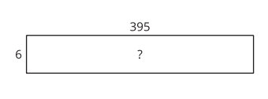
Estimation Exploration:
Mysterious Area
Warm up
What is the area of the rectangle?
Record an estimate that is:
Too low | About right | Too high

Slide 64


Larger Numbers to Multiply
Activity #1
1. Clare drew this diagram.
a. What multiplication expression can be represented by the diagram?
b. Find the value of the expression.
Show your reasoning.
2. Consider the expression 6 x 252 .
a. Draw a diagram to represent the expression.
b. Find the value of the expression. Show your reasoning.
3. Lin drew a diagram to represent 3 x 2,135.
a. Complete Lin’s diagram.
b. Write an expression to represent the value of each part of the diagram.
c. Find the value of . Show your reasoning.

Slide 65


Jada’s Errors
Activity #2
1. Jada used a diagram to multiply and made a few errors.
a. Explain the errors Jada made.
b. Find the value of . Show your reasoning.
2. Find the value of 5 x 699 .
Show your reasoning.
3. Find the value of 8 x 4,973 .
Show your reasoning.

Slide 66
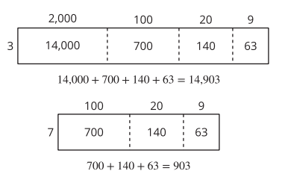
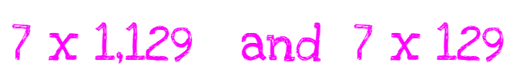
Lesson Synthesis
Today we used rectangular diagrams to multiply three- and four-digit numbers by one-digit numbers.
How are the representations alike and how are they different?
How would you find the value of 7 x 2,039 ?

Slide 67
Multiply 2 Two-digit Numbers
8
Let’s multiply 2 two-digit numbers.
4.NBT.B.4, 4.NBT.B.5

Slide 68

Number Talk: Extra Groups
Warm up
Find the value of each product mentally.

Slide 69
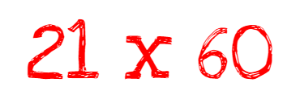
Number Talk: Extra Groups
Warm up
Find the value of each product mentally.

Slide 70

Number Talk: Extra Groups
Warm up
Find the value of each product mentally.

Slide 71

Number Talk: Extra Groups
Warm up
Find the value of each product mentally.

Slide 72
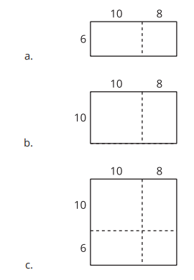
Two by Two
Activity #1
1. For each diagram, write a multiplication expression that the diagram can represent. Then, find the value of the expression. Use equations to show your reasoning.
2. How are the diagrams alike? How are they different?
Discuss with your partner.
3. Use a diagram to find each product.
13 x 21
25 x 46

Slide 73
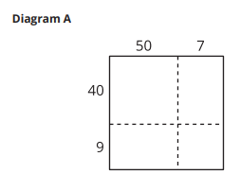
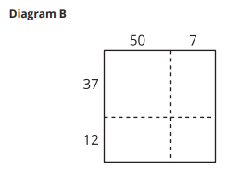
Activity #2
Decompose by Place Value
These diagrams could be used to find the value of
49 x 57
1. Why is Diagram A more helpful than Diagram B when finding the value of 49 x 57 ?
2. Use a diagram to find each product.
49 x 57
29 x 55

Slide 74
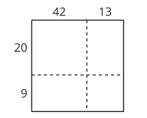
Lesson Synthesis
Today we learned how to represent the multiplication of 2 two-digit numbers using a rectangular diagram. We learned that we can decompose each factor by place value and show the tens and ones on each side of the rectangle, and that doing this can help us to multiply efficiently.
Why might it be more helpful to decompose 55 into 50 + 5 than into 42 + 13 ?

Slide 75
Multiply Using a Partial-products Algorithm
9
Let’s analyze and try a partial-products algorithm.
4.NBT.B.5

Slide 76
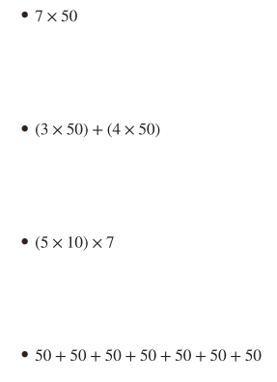
Which One Doesn’t Belong: Expressions Galore
Warm-
up

Slide 77
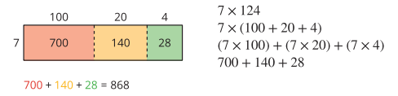
Activity #1
An Algorithm for Noah
1. Noah drew a diagram and wrote expressions to show his thinking as he multiplied two numbers.
How does each expression represent Noah’s diagram?
Be prepared to share your thinking with a partner.

Slide 78
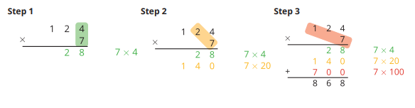
Activity #1
An Algorithm for Noah
2. Later, Noah learned another way to record the multiplication, as shown here.

Slide 79
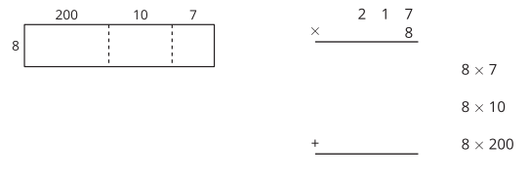
Activity #1
An Algorithm for Noah
3. Complete the diagram to find the value of 217 x 8 .
Use Noah’s recording method to check your work

Slide 80
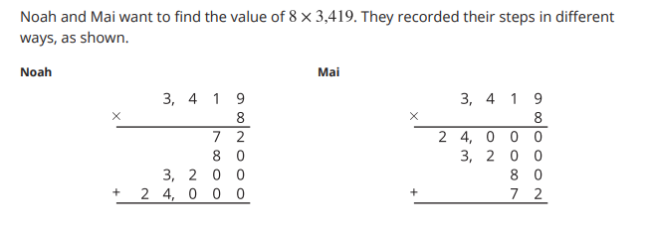
Activity #2
Liters and Milliliters
1. How are Mai’s and Noah’s notation alike? How are they different?
2. Use a rectangular diagram to show what each of the partial products 72, 80, 3,200 and 24,000 represent. Then, find the value of 8 x 3,419 .

Slide 81
Activity #2
Liters and Milliliters
3. Find the value of each expression. For at least one expression, use the partial-products algorithm that Noah used. Show your reasoning.
4 x 5,342
7 x 983

Slide 82
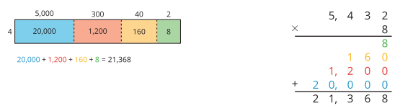
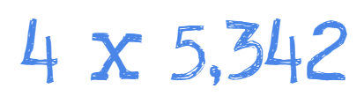
Lesson Synthesis
Today we learned different ways of recording partial products to multiply four-digit by one-digit numbers using partial products. We made connections between calculations done using a diagram and using partial-products algorithms.
Which method do you prefer? Why

Slide 83
Lesson Synthesis
Each number in the smaller rectangles in the diagram is a partial product—a result of multiplying a part of one factor by the second factor.
When we use a diagram, we can find the partial products for different smaller rectangles and add the pieces together in any order. The product stays the same no matter how we decompose the diagram.
When we use the partial-products algorithm, we multiply the ones, tens, hundreds, then thousands, and record the partial products vertically. Changing the order of multiplying doesn’t change the final product.

Slide 84
Multiply by Two-digit Numbers Using a Partial-products Algorithm
10
Let’s try multiplying two-digit numbers with a partial-products algorithm.
4.NBT.B.5

Slide 85
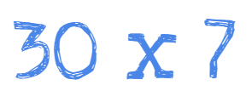
Number Talk: Products
Warm up
Find each product mentally.

Slide 86

Number Talk: Products
Warm up
Find each product mentally.

Slide 87

Number Talk: Products
Warm up
Find each product mentally.

Slide 88
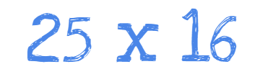
Number Talk: Products
Warm up
Find each product mentally.

Slide 89
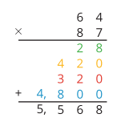
Activity #1
Partial Products, Recorded
1. Tyler used a partial-products algorithm to find 64 x 87
How do you think he arrived at the last five numbers? Record your thinking.
Be prepared to explain it to a partner.
2. Use Tyler’s method to find 31 x 15 . Then, draw a diagram to check your answer.

Slide 90
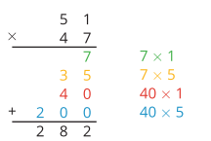



Han’s Multiplication Mishap
Activity #2
1. Find the value of each product.
Show your reasoning.
2. Here is Han’s computation of 51 x 47
a. What error or errors did Han make?
b. Show the correct computation for finding 51 x 47.

Slide 91
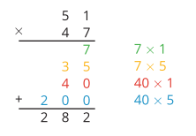
Lesson Synthesis
Today we used a partial-products algorithm to multiply pairs of two-digit numbers. We wrote expressions and equations to help us find and keep track of the partial products as we were multiplying.
Before we analyze his steps closely, can you tell whether his answer of 282 could be correct or seem reasonable? Why or why not?

Slide 92
Partial Products and the Standard Algorithm
11
Let’s compare multiplication algorithms.
4.NBT.B.5

Slide 93
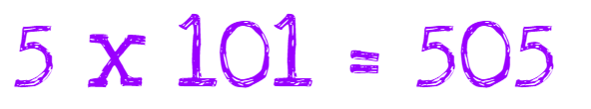
True or False:
The Value of the Digits
Warm up
Decide whether each statement is true or false.
Be prepared to explain your reasoning.

Slide 94

True or False:
The Value of the Digits
Warm up
Decide whether each statement is true or false.
Be prepared to explain your reasoning.

Slide 95

True or False:
The Value of the Digits
Warm up
Decide whether each statement is true or false.
Be prepared to explain your reasoning.

Slide 96

True or False:
The Value of the Digits
Warm up
Decide whether each statement is true or false.
Be prepared to explain your reasoning.

Slide 97

Activity #1
Two Algorithms to Multiply
1. Here are two algorithms for finding the value of 3 x 713.
Discuss with your partner:
a. How are Kiran’s algorithm and Diego’s algorithm alike? How are they different?
b. How do you think Kiran found the product 2,139?

Slide 98


Activity #1
Two Algorithms to Multiply
2. Find the value of each product.

Slide 99


Activity #2
Algorithm Comparison
1. Analyze the two algorithms used to multiply 4 x 223.
a. How are methods A and B alike?
b. How are methods A and B different?
c. Where is the 12 in Method A?
2.
a. Try using Method A to multiply 512 x 3 .
b. Check your work using a different method.

Slide 100

Lesson Synthesis
Today we compared the standard algorithm for multiplication to the partial-products algorithm. Let’s see how we’d find 3 x 512 using the standard algorithm.
How should we begin?
What should we do next?
Where did you write the 3? Why there?
Where did you write the 6? Why there?
Why might someone choose the standard algorithm to multiply instead of the partial-products algorithm?

Slide 101
Solve Problems Involving Multiplication
12
Let’s solve problems using what we learned about multiplication of whole numbers.
4.MD.A.2, 4.NBT.B.5, 4.OA.A.3

Slide 102

What Do You Know About 1 Year?
Warm up

Slide 103

Activity #1
Time Flies When We Leap Years
1. A baby elephant was born exactly 48 weeks ago. How many days old is she?
2. A leap year has 366 days. A non-leap year (or a common year) has 365 days. How many days are in 3 leap years?
3. In our calendar system, some months are 31 days long, some are 30 days long, and one month (February) is either 28 or 29 days long.
What if the calendar system changed so that each month has 31 days? How many more days would there be in a year?

Slide 104

Activity #2
Coin Collection
1. Lin’s family has collected 2,074 nickels over the years. How many pennies are worth the same amount?
2. If Lin’s family saved 2,074 nickels each year for 4 years, how many nickels would her family have?
3. Create a situation that involves a problem that can be solved by finding 8 x 1,049 .
Solve the problem and show your reasoning.

Slide 105
Lesson Synthesis
Today we used what we have learned about multiplication to solve problems involving measurement.
How would you know if your solutions were correct?
When you had to multiply numbers, which method did you rely on the most? What made you choose that method?

Slide 106

Section Summary
In this section, we learned to multiply factors whose products are greater than 100, using different representations and strategies to do so.
When working with multi-digit factors, it helps to decompose them by place value before multiplying. For example, to find 4 X 5,342, we can decompose the 5,342 into its expanded form, 5,000 + 300 + 40 + 2, and then use a diagram or an algorithm to help us multiply.

Slide 107

Section Summary
In both the diagram and the algorithm, the 20,000, 1,200, 160, and 8 are called the partial products. They are the result of multiplying each decomposed part of 5,342 by 4. An algorithm that shows partial products is called a partial-products algorithm.
We can do the same to multiply a two-digit number by another two-digit number. For example, here are two ways to find 31 X 15. The 31 is decomposed into 30 + 1 and 15 is decomposed into10 + 5 .

Slide 108
Solve Division Problems
with Larger Quotients
Adaptation
Lesson 3
Let’s divide with larger numbers.
3.OA.A.3

Slide 109

What Do You Know About Division?
Warm up

Slide 110

Solve, Your Way
Activity #1
There are 48 students going on a field trip to the aquarium. They are put into groups of 4 students. How many groups will there be?
Show your thinking using diagrams, symbols, or other representations.

Slide 111


Division Reflection
Activity #2
Another strategy I could have used to solve the problem today is…

Slide 112
Lesson Synthesis
Today we found the value of quotients with larger numbers than we have worked with before. What ideas about division or multiplication that we learned in this unit did you find helpful as you worked?
What idea did you see today that you want to try as we continue to divide with larger numbers?

Slide 113
Represent Division, Part 1
Adaptation
Lesson 4
Let’s make sense of representations of division.
3.NBT.A.3, 3.OA.B.5, 3.OA.C.7

Slide 114

True or False: Multiply by 10
Warm up
Decide whether each statement is true or false.
Be prepared to explain your reasoning.

Slide 115

True or False: Multiply by 10
Warm up
Decide whether each statement is true or false.
Be prepared to explain your reasoning.

Slide 116

True or False: Multiply by 10
Warm up
Decide whether each statement is true or false.
Be prepared to explain your reasoning.

Slide 117

True or False: Multiply by 10
Warm up
Decide whether each statement is true or false.
Be prepared to explain your reasoning.

Slide 118

Use Base-Ten Blocks to Divide
Activity #1
Write an equation to show the value of each quotient. You can use base-ten blocks to represent the quotients if you’d like.

Slide 119
Teen Number Divisors
Activity #2
1. Find the value of each quotient. Explain or show your reasoning.
36 ÷ 3
70 ÷ 14
2. Find the value of each quotient. Explain or show your reasoning.
72 ÷ 18
57 ÷ 3
90 ÷ 15
96 ÷ 8

Slide 120

Lesson Synthesis
Today we solved division problems. We applied what we knew about place value and that we can think of the divisor as the number of groups in a division situation or the size of each group.
Turn and talk with your partner. One partner tells a situation that could match this expression that uses 8 as the number of groups and the other partner tells a situation that could match this expression that uses 8 as the size of each group

Slide 121
Division Situations
Within 100
13
Let’s interpret and solve division problems.
4.NBT.B.6

Slide 122

Estimation Exploration:
Colored Pencils
Warm up
How many colored pencils are in the set?
Record an estimate that is:
Too low | About right | Too high

Slide 123

Activity #1
Popsicles for a Party
Diego’s aunt is buying popsicles for a class party. At the supermarket, popsicles come in different flavors. She buys the same number of popsicles of each flavor
1. What mathematical questions can we ask about this situation?
2. Here is an equation: 84 ÷ 7 = ?
In the situation about the class party, what questions could the equation represent?
3. Find the answer to one of the questions you wrote. Show your reasoning.

Slide 124

Activity #2
Crayons and Notebooks
1. Andre is passing out 85 crayons to his classmates.
Each student will get 5 crayons.
a. Estimate how many students would get 5 crayons. Explain your reasoning.
b. Write one or more equations to represent the situation.
c. How many students will get 5 crayons?
d. While Andre is passing them out, 6 crayons break. He still has to give 5 crayons to each student. How many students will get 5 crayons now?

Slide 125


Activity #2
Crayons and Notebooks
a. Estimate the number of notebooks in each stack. Show or explain your reasoning.
b. Here are four equations. Explain to a partner why each equation can represent this situation.
c. What is the value of ? Show how you know.
2. Han’s class receives a donation of 108 notebooks. Han is sorting them into 3 equal stacks, with n notebooks in each stack.

Slide 126
Lesson Synthesis
Today we solved problems involving division of whole numbers. We estimated the solutions and wrote equations with a symbol for the unknown. We also thought about the kinds of division problems we were solving—whether we were trying to find the number of groups or the amount in each group.
What does the value of 96 ÷ 8 mean?
In this situation, what questions could the equation represent
What are some ways to find the value of 96 ÷ 8 ?

Slide 127
Division Situations
Beyond 100
14
Let’s interpret and solve division problems beyond 100.
4.MD.B.4

Slide 128

Number Talk: Dividing by 7
Warm up
Find each quotient mentally.

Slide 129

Number Talk: Dividing by 7
Warm up
Find each quotient mentally.

Slide 130

Number Talk: Dividing by 7
Warm up
Find each quotient mentally.

Slide 131

Number Talk: Dividing by 7
Warm up
Find each quotient mentally.

Slide 132

Write Multiples
Activity #1
1. Han starts writing multiples of a number. When he reaches 104, he has written 8 numbers.
For each of the following questions, show your reasoning.
a. What number is Han writing multiples of?
b. What is the 15th multiple of this number?
c. Han gets to 286. How many numbers has he written at that point?
2. Kiran wants to know how many multiples of 7 are between 0 and 150.
a. He thinks he can use division to find out. Do you agree? Explain your reasoning.
b. How many multiples will he find? Show your reasoning.
c. Is 150 a multiple of 7? Show how you know.

Slide 133
Jada’s Mystery Number
Activity #2
Jada is writing multiples of a mystery number. After writing a bunch of numbers, she writes out 126.
Mai says 6 is the mystery number.
Priya says 8 is the mystery number.
Andre says 9 could be the mystery number.
1. Which student do you agree with? Show your reasoning and include equations.
2. Jada gives one more clue: “If I keep writing multiples, I’ll get to 153.” What is the mystery number? Explain or show your reasoning.

Slide 134
Lesson Synthesis
Today we tried to find out if a number is a multiple or a factor of another number. For instance: “Is 267 a multiple of 8?
One way to answer the question is by using familiar multiplication facts or by finding partial products. How would you start?
Is this question a division problem? Why?
Why might it be helpful to start with multiples of 10?
Can we use division to answer the question?

Slide 135
Organize and Analyze Data on Line Plots
15
Let’s organize data on line plots and analyze the data.
4.MD.B.4, 4.NF.B.3, 4.NF.B.4

Slide 136

Estimation Exploration:
Area of a Soccer Field
Warm up
What is the length of the soccer field in meters?
Record an estimate that is:
Too low | About right | Too high

Slide 137

Activity #1
Elena’s Mural
Elena used 189 square tiles to create a rectangular mural for the art club. The mural is 7 tiles wide.
1. How many tiles long is Elena’s mural? Be prepared to explain or show how you know.
2. Write one or more equations that show how you solved this problem.

Slide 138
Activity #2
Tyler’s Mural
Tyler is also creating a rectangular mural for the art club. He has 197 tiles for his mural. His mural is 6 tiles wide.
1. Will Tyler use all of his tiles in the mural? Explain your reasoning.
2. How many tiles long is Tyler’s mural? Show your reasoning using numbers, pictures, or words.

Slide 139
Lesson Synthesis
Today we used division to find side lengths of rectangles. For each rectangle, we knew the area and the length of one side and we used division to find the length of the other.
What is the relationship between the side lengths and the area of a rectangle?
How do we find the missing side length?

Slide 140
Area Diagrams to
Represent Division
16
Let’s represent division using area diagrams.
4.MD.A.3, 4.NBT.B.6, 4.OA.A.3

Slide 141


What Do You Know about Multiples of 9?
Warm up

Slide 142


Activity #1
How Long is the Pool?
2. A rectangular patio has a width of 8 feet and an area of 376 square feet. What is its length?
a. What equations can we write to represent this situation?
b. Use an area diagram to help answer the question.
1. A rectangular pool has an area of 252 square meters. Its width is 9 meters and its length is a whole number of meters. What is the length of the pool?
a. Write a multiplication equation and a division equation to represent the situation.
b. To find the length of the pool, Diego drew the following rectangular diagrams.

Slide 143

Activity #1
Which Diagram to Use?
Here are three diagrams that can be used to help find the value of 288 ÷ 9.
1. Where do you see the 288 in each diagram?
2. What does the 9 represent?
3. What does the value of 288 ÷ 9 represent?
4. Which diagram would you use to find the value of 288 ÷ 9 ? Explain your reasoning.

Slide 144


Lesson Synthesis
Today we saw that when we have the length of one side of a rectangle and its area, we could find the length of the other side.Some of us did this by using multiplication, and others used division. But all of us found the missing length in sections.
Suppose a rectangle has an area of 414 square units and a width of 6 units, and we want to know its length. Which of these representations describe the question?
Here are some ways to record our strategies for finding its length
What is happening in each strategy? How do we find the answer to the question?
How are the strategies alike? How are they different?

Slide 145
Base-ten Diagrams to Represent Division
17
Let’s divide using base-ten blocks or diagrams.
4.NBT.B.6

Slide 146

Which One Doesn’t Belong: Base-Ten Diagrams
Warm-
up

Slide 147


Activity #1
Divide with Diagrams or Blocks
1. Priya draws a base-ten diagram to find the value of 64 ÷ 4. A rectangle represents 10. A small square represents 1.
Use the diagram (or actual blocks) to help Priya complete the division. Explain or show your reasoning.
2. Use this base-ten diagram (or actual blocks) to find the value of 81 ÷ 3 .

Slide 148

Activity #2
Help Noah Get Unstuck
2. Find the value of 432 ÷ 6.
Show your reasoning. Use base-ten diagrams or blocks if you find them helpful.

Slide 149


Lesson Synthesis
Today we solved problems by converting one unit to another unit—first from gallons to quarts or cups (or the other way around) and then from pounds to ounces (or the other way around). By converting some measurements, we were able to make comparisons, find total amounts, and more.
If someone claimed that 3 quarts is greater than 2 gallons because 3 is greater than 2, how would you explain that this is not true? What correction would you offer?
If someone claimed that 24 ounces is 8 times as much as 3 pounds, would you agree? Why or why not?

Slide 150
Divide Using a Partial-quotients Algorithm
18
Let’s analyze and use a partial-quotients algorithm.
4.NBT.B.6, 4.OA.A.3

Slide 151

Number Talk: Dividing by 3
Warm up
Find each quotient mentally.

Slide 152

Number Talk: Dividing by 3
Warm up
Find each quotient mentally.

Slide 153

Number Talk: Dividing by 3
Warm up
Find each quotient mentally.

Slide 154

Number Talk: Dividing by 3
Warm up
Find each quotient mentally.

Slide 155

Activity #1
Decompose Dividends
2. Here’s how Priya finds 465 ÷ 5 .
a. What has Priya done? Describe her steps.
b. How is Priya’s method similar to your method?
c. Use Priya’s method to find the value of 428 ÷ 4 .
1. Find the value of 465 ÷ 5 .
Show your reasoning. You may use base-blocks if you find them helpful.

Slide 156


Activity #2
Tyler’s Method
Tyler uses a different method to find 465 ÷ 5
Let’s compare Priya’s and Tyler’s work.
1. How are Priya and Tyler’s methods alike? How are they different?
a. List as many similarities and differences as you can find.
b. Why do you think Tyler uses subtraction in his method?
c. Is Tyler finished with his process? How do you know?
2. Show how Tyler might record the process of finding 428 ÷ 4 .

Slide 157
Lesson Synthesis
Today we learned to use a partial-quotients algorithm to divide numbers.
Suppose we’d like to find the value of 738 ÷ 9 and know we could decompose the 738 into parts. How would we know what numbers to choose?
How would you explain “partial quotients” to a classmate who might be absent today?

Slide 158
Division With and Without Remainders
19
Let’s find quotients and remainders using a partial-quotients algorithm.
4.NBT.B.6, 4.OA.A.3, 4.OA.B.4

Slide 159

Notice and Wonder:
Equations with Hundreds
Warm up
What do you notice?
What do you wonder?

Slide 160

Activity #1
A Stack of Partial Quotients
1.
a. Look at the three numbers above 389. What do they represent?
b. Look at the three subtractions below 389. What do they represent?
c. What is another way you can decompose 389 to divide by 7?
2. Is 389 a multiple of 7? Explain your reasoning.
3. Use a partial-quotients algorithm to find out how many groups of 3 are in 702
4. Is 702 a multiple of 3? Explain your reasoning.

Slide 161


Activity #2
Andre and Elena’s Work
Andre and Elena are dividing 2,316 by 5.
Before they begin, Andre says, “I can already tell that there will be a remainder.”
1. Without doing any calculations, decide if you agree with Andre. Explain your reasoning.
2. Here is Andre and Elena’s work. Each student made one or more errors. Identify the errors each student made. Then, show a correct computation.

Slide 162




Activity #3
Incomplete Calculations
Here are four calculations to find the value of , but each one is unfinished.
Complete at least two of the unfinished calculations. Be prepared to explain why you chose them.

Slide 163
Lesson Synthesis
Today we looked at different ways to divide multi-digit numbers by one-digit divisors. Some divisions result in a number with a remainder and others result in no remainders
Some ways to divide are pretty lengthy. What are some ways to divide efficiently?
Can we always tell if there will be a remainder?
How can we sometimes tell that there will be a remainder?
How can we check the result of our division to make sure it’s not off?

Slide 164
Interpret Remainders in Division Situations
20
Let’s solve problems involving division and interpret remainders.
4.NBT.B.6, 4.OA.A.3

Slide 165
Choral Count by 2, 3 and 5
Warm up
What patterns do you notice?
Count by 2’s starting at 90.
Stop counting at 112.

Slide 166
Choral Count by 2, 3 and 5
Warm up
What patterns do you notice?
Count by 3’s starting at 90.
Stop counting at 112.

Slide 167
Choral Count by 2, 3 and 5
Warm up
What patterns do you notice in each of the recorded counts?
Count by 5’s starting at 90.
Stop counting at 112.

Slide 168


Activity #1
Muffins and Seats
1. Two bakers at a bakery made 378 muffins. The muffins are put in boxes of 4.
The first baker says they will need 94 boxes for all the muffins.
The second baker says 95 boxes are needed.
Who do you agree with? Explain or show your reasoning.
2. An auditorium seats 258 people. The seats are arranged in rows of 9, but there is one short row with fewer than 9 seats.
How many rows of 9 seats are there? How many seats are in the shorter row?

Slide 169



Activity #2
Save for a Garden
1. A school needs $1,270 to build a garden. After saving the same amount each month for 8 months, the school is still short by $6.
How much did they save each month? Explain or show your reasoning.
2. Choose one of the following division expressions.
a. Write a situation to represent the expression.
b. Find the quotient. Show your reasoning.
c. What does the quotient represent in your situation?

Slide 170
Lesson Synthesis
Today we solved problems that involved division. What strategies did you find yourself using to divide numbers?
Did you:
use partial products?
use partial quotients?
draw diagrams?
divide by place value (thousands, hundreds, tens, and ones)?
write a series of equations? estimate first?

Slide 171
Section Summary
In this section, we solved different problems that involve dividing whole numbers.
We are reminded of two ways of thinking about division. For example, suppose 274 ÷ 8 represents a situation where 274 markers are put into equal groups.
The value of 274 ÷ 8 can tell us:
how many markers are in each group if there were 8 groups, or
how many groups can be made if there were 8 markers in each group.

Slide 172

Section Summary
There are many ways to find the value of a quotient. For 274 ÷ 8:
We can think about whether one number is a multiple or factor of another number. For example, “Is 274 a multiple of 8?” or “Is 8 a factor of 274?”
We can divide by place value and think about putting 2 hundred, 7 tens, and 4 ones into 8 equal groups.
We can also use a partial-quotients algorithm, in which we divide a number in parts. For example, to find 274 ÷ 8, we can first find 160 ÷ 8 (which is 20), and then 80 ÷ 8 (which is 10), and then 32 ÷ 8 (which is 4). Here’s one way to record it:

Slide 173
Section Summary
Sometimes the division results in a leftover that can’t be put into equal groups or is not enough to make a new group.
We call the leftover a remainder.
Dividing 274 by 8 gives 34 and a remainder of 2.

Slide 174
Different Ways to Solve Problems
21
Let’s reason about and solve multi-step problems.
4.NBT.B.5, 4.NBT.B.6, 4.OA.A.3

Slide 175

Which One Doesn’t Belong:
Expressions with 5 or 90
Warm up
Which one doesn’t belong?

Slide 176

Activity #1
Going on a Field Trip
1. Forty-five students are going on a field trip to a museum. Tickets for the museum are $18 each. Teachers have $900 to cover tickets for the trip. Will this be enough to cover tickets for every student?
If yes, will there be any leftover money and how much?
If no, how much more money is needed?

Slide 177

Activity #1
Going on a Field Trip
2. Your teacher will show five strategies for answering the previous question. Analyze the strategies.
a. Which strategy is closest to yours? With a partner, take turns explaining how your strategies are close to the poster you chose.
b. Discuss a different strategy with your partner. Try using this strategy to multiply 14 x 35 .

Slide 178

Activity #2
A Trip to the Movies
Movie tickets are $9 each. The theater sold the same number of tickets two days in a row.
The theater made $3,132 from ticket sales on the first day.
1. Record and answer one question of your choice from the list the class generated. Discuss your strategy with your partner.
2. Use the given information about movie tickets to complete the following statement: __________ tickets were sold on the first and second days.
3. A medium drink is $7 and small popcorn is $5. If each ticket holder purchases popcorn and a drink, how much money will the theater collect from the sales of popcorn and drink?

Slide 179
Lesson Synthesis
Today we encountered problems that can each be solved using different strategies. For instance, we saw at least five ways to think about the product of 45 and 18. Some of the strategies involve using multiplication and division equations, or multiplying and dividing mentally.
Look back at your work today. Can you find an example in which you solved a problem by:
drawing diagrams?
using more than one operation (multiplication, division, addition, or subtraction)?
writing one or more equations?

Slide 180
Problems About
Perimeter and Area
22
Let’s solve situations involving perimeter and area.
4.MD.A.2, 4.MD.A.3, 4.NBT.B.5, 4.OA.A.3

Slide 181

How Many Do You See:
Shaded Squares
Warm up
How many shaded squares do you see?
How do you see them?

Slide 182

Activity #1
Creating a Class Banner
Jada’s teacher bought a poster paper that measures 36 inches by 24 inches. Her plan is to cut it up and rearrange and tape the pieces into a welcome banner that is 8 inches tall and 8 feet long.
1. Does she have enough paper to make the banner? Show your reasoning.
2. How many square inches is the poster paper?

Slide 183

Activity #2
Replacing Classroom Carpet
A classroom is getting new carpet and baseboards. Tyler and a couple of friends are helping to take measurements.
Here is a sketch of the classroom and the measurements they recorded.
For each question, show your reasoning.
1. How many feet of baseboard will they need to replace in the classroom? How many inches is that?
2. 1,200 inches of baseboard material was delivered. Is that enough?
3. How many square feet of carpet will be needed to cover the floor area?

Slide 184
Lesson Synthesis
Today we used all kinds of operations on large numbers to solve problems about measurements.
Can you find examples where it was helpful or necessary to multiply, divide, add, or subtract multi-digit numbers?
What were some challenges you came across when solving the problems? When multiplying or dividing?

Slide 185
Solve Problems with
Many Operations
23
Let’s solve multi-step problems involving the four operations.
4.MD.A.2, 4.NBT.B.4, 4.NBT.B.5, 4.NBT.B.6

Slide 186

Notice and Wonder:
Native American Languages
Warm up
What do you notice?
What do you wonder?

Slide 187
Activity #1
Do You Speak Navajo?
2. Navajo, Apache, and Cherokee languages have been used during wartime to help the U.S. military keep its communications secure and incomprehensible to their enemies.
a. Based on the data here, how many people might have been able to understand the communications? Show your reasoning.
b. How do you know that your answer is reasonable?
3. Are there more Navajo speakers than the speakers of all the other nine languages combined? Explain or show how you know.
1. In the list of the ten most widely spoken Native American languages in the U.S., Navajo takes first place and Yupik takes second place.
a. How many more Navajo speakers are there than Yupik speakers? Show your reasoning.
b. About how many times as many Navajo speakers as there are Yupik speakers? Show your reasoning.

Slide 188

Activity #2
Languages in Philadelphia and Chicago
Philadelphia, the birthplace of the United States, is a diverse city and home to people of different backgrounds. The table shows 2017 data on the types of languages spoken in Philadelphia and the numbers of people that speak them.
1. Are there more Philadelphians who only speak English or more who speak a language other than English? Show how you know.
2. What is the difference between the number of people who speak only English and those who speak another language? Show how you know.

Slide 189

Activity #2
Languages in Philadelphia and Chicago
Philadelphia, the birthplace of the United States, is a diverse city and home to people of different backgrounds. The table shows 2017 data on the types of languages spoken in Philadelphia and the numbers of people that speak them.
3. Chicago is a city with a similar population to Philadelphia. This table shows the types of languages for different populations of Chicago.
a. How many more speakers of Spanish and other Indo-European languages are in Chicago than in Philadelphia? Show your reasoning.
b. How do you know your answer is reasonable?

Slide 190
Lesson Synthesis
Today we performed addition and subtraction on very large numbers. Even though most of us used the standard algorithm, we didn’t all add or subtract the numbers the same way.
In the second activity, you had to add a series of numbers in a table. Which numbers did you add (or subtract) first? Does it matter?
When the numbers being added or subtracted have many digits, it is easy to make an error, to regroup or carry incorrectly, or to get the digits mixed up. What are some ways we could check our answers? What are some common errors, and how can we avoid them?

Slide 191
Assess the Reasonableness of Solutions
24
Let’s solve problems and assess the reasonableness of solutions.
4.NBT.B.4, 4.OA.A.2, 4.OA.A.3

Slide 192

True or False: Differences
Warm up
Decide whether each statement is true or false.
Be prepared to explain your reasoning.

Slide 193

True or False: Differences
Warm up
Decide whether each statement is true or false.
Be prepared to explain your reasoning.

Slide 194

True or False: Differences
Warm up
Decide whether each statement is true or false.
Be prepared to explain your reasoning.

Slide 195

True or False: Differences
Warm up
Decide whether each statement is true or false.
Be prepared to explain your reasoning.

Slide 196

Activity #1
Back and Forth
1. How far does Mai’s cousin travel each round trip—from her homeroom to the four classes and back? Write one or more expressions or equations to show your reasoning.
2. Each week, Mai’s cousin makes 3 round trips from her homeroom to her music class. The total distance traveled on those 3 round trips is 2,364 feet. How far away is the music room from her homeroom? Show your reasoning.
3. Mai thinks her cousin travels 2 miles each week just going between classes. Do you agree? Show your reasoning.
Mai’s cousin is in middle school. She travels from her homeroom to math, then English, history, and science. When she finishes her science class, she takes the same path back to her homeroom. Mai’s cousin makes the same trip 5 times each week. The distances between the classes are shown.

Slide 197


Activity #2
Fitness Challenge
1. Han walked 32,550 steps in the first week. He walked the same number of steps every day. How many steps did Han walk each day? Show your reasoning.
2. The table shows the total number steps Han took each week for the first three weeks. How much did the number of steps drop from the first week to the second week?
To encourage students to exercise, Han’s school is holding a fitness challenge with prizes.

Slide 198
Activity #2
Fitness Challenge
To encourage students to exercise, Han’s school is holding a fitness challenge with prizes.
3. What is the fewest number of steps that Han needs to take in week 4 to meet the fitness challenge? Show your reasoning.
4. How do you know your answer to problem 3 is reasonable?

Slide 199
Lesson Synthesis
Today we solved problems that involved numbers with four or more digits. Some of those problems could be interpreted in more than one way.
In the fitness challenge activity, how did you think about finding Han’s steps per day? Did you think of it in terms of multiplication (what number times 7 is 32,550?) or in terms of division (what is 32,550 divided by 7?)? Is one way of thinking more convenient? Why or why not?
How did you think about finding Han’s step in week 4? Did you think in terms of addition (what number must be added to 96,897 to make 120,000?) or subtraction (what is the difference between 120,000 and 96,897?

Slide 200
Section Summary
In this section, we encountered problems that involve large numbers from different contexts and that could be solved with different strategies.
In the first lesson, we saw at least five ways to find the product of 45 and 18: by multiplying and dividing in parts, using a series of equations, drawing diagrams, and more.
Later, we explored problems about measurements, with numbers up to four digits. We found that, often, the same problem could be solved using different operations.
For example, in the fitness challenge activity, Han took 32,550 steps in 7 days. We can find the number of steps he took per day by thinking in terms of multiplication (what number times 7 is 32,550?) or in terms of division (what is 32,550 divided by 7?).

Slide 201


Section Summary
We can also write different equations.
To find out how many steps Han had to take to reach a goal of 120,000 steps if he had 96,897 steps, we can think in terms of addition (what number must be added to 96,897 to make 120,000?) or subtraction (what is the difference between 120,000 and 96,897?)

Slide 202
Paper Flower Decorations
25
Let’s make patterns with paper flowers.
4.NBT.B.4, 4.OA.A.2, 4.OA.A.3

Slide 203

How Many Do You See:
Paper Flowers
Warm up
How many do you see?
How do you see them?

Slide 204


Activity #1
Paper Flower Construction
1. Follow these steps to make paper flowers:
Place 6 pieces of tissue paper on top of each other.
Starting at one side, fold over about 1 inch, then fold in the opposite direction. Repeat with this accordion fold (like a paper fan) until you have a strip that is 1 inch wide and the length of the original paper.
Tie a rubber band around the middle of the folded paper strip. Then, open up the folds.
Carefully, one layer at a time, fold the layers up into the middle to make the petals.
2. Use all the flowers in your group to make a garland that follows a pattern. Describe the rule for your pattern.

Slide 205
Activity #2
Quinceañera Decorations
Priya and Jada are making paper flower garlands for their friend’s quinceañera.
Each garland uses 12 flowers.
1. Priya wants 2 big flowers, followed by 2 small flowers. Jada wants 1 big flower, followed by 2 small flowers. Use their patterns to draw the garlands.
2. Priya and Jada make 25 garlands of each type. How many large and small flowers will they need altogether?
3. Diego and Kiran also made flowers. They made a total of 155 flowers for garlands that require 16 flowers each. How many garlands can they make?
4. It takes 1 minute to cut the strips for a flower and 2 minutes to finish it. How long did it take Diego and Kiran to make the 155 flowers, if they each make about the same number of flowers?

Slide 206
Activity #3
Make Your Own Problems
1. Write a multi-step problem about making paper flowers.
2. Exchange the problem with your partner and solve each other’s problems.

Slide 207
Lesson Synthesis
Today, we solved many different problems about paper flowers and created flowers and problems of our own.
What are some ways making the flowers help you write your own math problems?

