Slide 1

Multiplicative Comparison and Measurement
Standards addressed: 4.NBT.B.5, 4.OA.A.1, 4.OA.A.2, 4.OA.A.3, 4.MD.A.1, 4.MD.A.2, 4.MD.B.4, 4.NF.B.3, 4.NF.B.4, 4.MD.A.3
These slides have been created by Britnee Wright- Southeast Arkansas Education Cooperative and are not official IM materials. Images and language are taken from IM Grade 4 Unit 5 by Illustrative Mathematics.
Copyright 2020 by Illustrative Mathematics. All Rights Reserved, adapted and shared with permission.

Slide 2
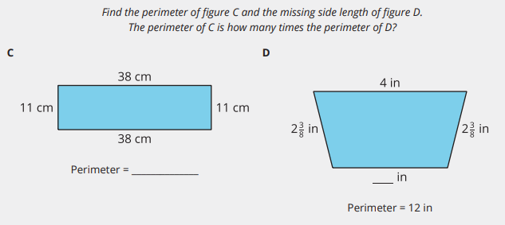
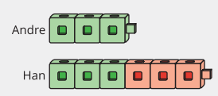
Unit 5 Progression Overview
Multiplicative Comparison and Measurement
Section A
Lessons 1-6
4.NBT.B.5, 4.OA.A.1, 4.OA.A.2, 4.OA.A.3
Section B
Lessons 7-13
4.MD.A.1, 4.MD.A.2, 4.OA.A.2, 4.OA.A.3
Section C
Lessons 14-16
4.MD.B.4, 4.NF.B.3, 4.NF.B.4
Section D
Lessons 17-21
4.MD.A.1, 4.MD.A.2, 4.MD.A.3, 4.NBT.B, 4.OA.A.2
Analyze, describe, and represent multiplicative comparison situations.
Multiply or divide to solve one-step and two-step problems involving multiplicative comparison.
Convert from larger units to smaller units within a given system of measurement.
Solve problems involving multiplicative comparison and measurement.
Understand the relative sizes of kilometers, meters and centimeters, liters and milliliters, kilograms and grams, and pounds and ounces.
Create and analyze line plots that display measurement data in fractions of a unit (⅛ ,¼ , ½ ). Solve problems involving addition and subtraction of fractions and mixed numbers using measurement data presented in line plots.
Solve multi-step problems involving multiplicative comparison and measurement.

Slide 3



Unit 5 Quick Links
L1
L2
L3
L4
L5
L6
Adapt 1
Adapt 2
L7
L8
L9
L10
L11
L12
L13
Adapt 3
Adapt 4
L14
L15
L16
L17
L18
L19
L20
L21

Slide 4
Estimating and Measuring Weight
Adaptation
Lesson 1
Let’s measure and estimate weight.
3.MD.A.2

Slide 5
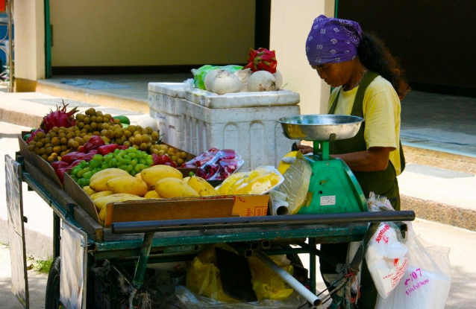
Notice and Wonder:
Produce Stand
Warm up
What do you notice?
What do you wonder?

Slide 6


Measuring Weight
Activity #1
1. For each weight measurement, list an example of something you think has about the same weight.
Item with a mass of about 1 gram | Item with a mass of about 1 kilogram
A paper clip | A basket of apples

Slide 7
Measuring Weight
Activity #1
2. Find some objects around the room that weigh:
a. less than a gram
b. between 1 and 10 grams
c. between 10 grams and 100 grams
d. between 100 grams and 1 kilogram
e. between 1 kilogram and 2 kilograms
f. more than 2 kilograms

Slide 8
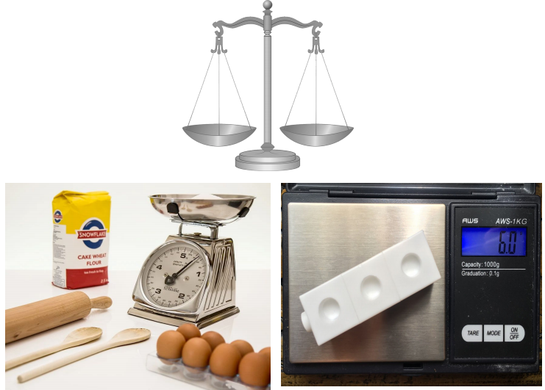
Measuring in Grams or Kilograms
Activity #2
What do you notice?
What do you wonder?

Slide 9
Measuring in Grams or Kilograms
Activity #2
Have each person from your group use a balance or a scale to measure the weight of one object from around the room.
object | Weight in grams or kilograms

Slide 10
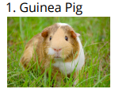
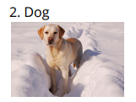
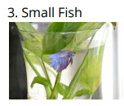


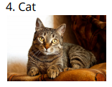
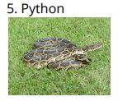


The Weight of Pets
Activity #3
Part 1: Match the pet to the amount that could be its weight. Explain your reasoning.

Slide 11

Lesson Synthesis
Today we learned how to measure and estimate weight. What advice would you give to someone who was measuring weight for the first time?

Slide 12
Introduction to Liquid Volume
Adaptation
Lesson 2
Let’s learn about liquid volume.
3.MD.A.2

Slide 13
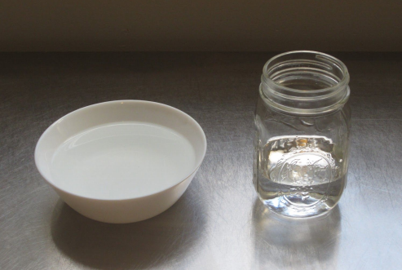
Notice and Wonder:
Comparing Cubes
Warm up
What do you notice?
What do you wonder?

Slide 14
Volume Estimation Exploration
Activity #1
1. How many units do you think container A will hold? Record an estimate that is:
2. How many units do you think container B will hold? Record an estimate that is:
3. Use the unit container to compare the liquid volume that containers A and B hold. Which container holds the greater volume? How do you know?
Too low | About right | Too high
Too low | About right | Too high

Slide 15
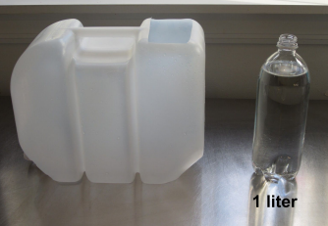
Liquid Volume in Liters
Activity #2
How many liters of water will fit in the large container?
Record an estimate that is:
Too low | About right | Too high

Slide 16
Lesson Synthesis
Today, we learned what liquid volume is.
How would you describe liquid volume to someone who didn’t know what it is?

Slide 17
Multiplicative Comparison Situations
1
Let’s represent situations that involve “_____ times as many.”
4.OA.A.1, 4.OA.A.2

Slide 18
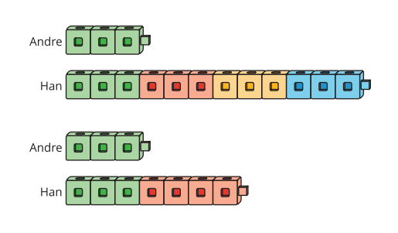
Notice and Wonder:
Comparing Cubes
Warm up
What do you notice?
What do you wonder?

Slide 19
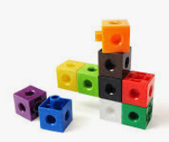
Twice as Many
Activity #1
Andre has some cubes. Han has twice as many cubes as Andre.
Use cubes, pictures, or other diagrams to show how many cubes Andre could have and how many cubes Han could have.
Be prepared to explain how your representation shows that Han has twice as many cubes.

Slide 20
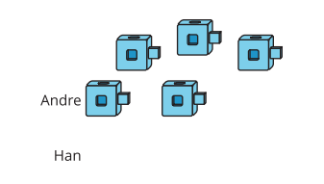
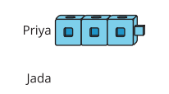
Times as Many
Activity #2
Draw a picture to show the number of cubes the students have in each situation.
Be prepared to explain your reasoning.
1. Andre has the following cubes and Han has 4 times as many.
2. Priya has the following cubes and Jada has 6 times as many.

Slide 21
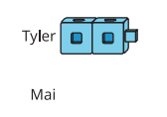
Times as Many
Activity #2
Draw a picture to show the number of cubes the students have in each situation.
Be prepared to explain your reasoning.
3. Tyler has the following cubes and Mai has 8 times as many.
4. What number represents “8 times as many as 2”?
Show your reasoning.

Slide 22
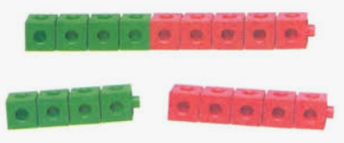
Make n Times as Many
Activity #3
Work with a partner on this activity.
1. Partner A: Create a set of connecting cubes between 2–6 and show
Partner B. Partner B: Roll a number cube. Let’s call the number rolled .
2. Partner A: Use the connecting cubes or a diagram to show times as many
as the original set of cubes. Show your reasoning.
Partner B: Check your partner’s work and discuss any disagreements.
3. Switch roles and repeat.

Slide 23
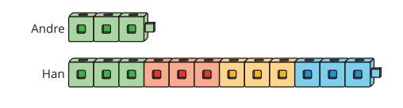
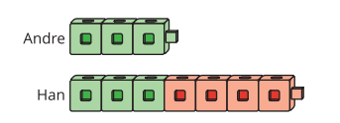
Lesson Synthesis
Today, we created representations to show 4, 6, and 8 times as many.
With your partner, describe what the cubes would look like if it was 6 times as many or 8 times as many.
Which of these pictures shows 4 times as many?
How do you know?

Slide 24
Diagrams and Equations Representing Multiplicative Comparison
2
Let’s compare quantities where one quantity is some number of times as many as another.
4.OA.A.1, 4.OA.A.2

Slide 25

How Many Do You See:
Times as Many
Warm up
How many do you see?
How do you see them?

Slide 26

How Many Do You See:
Times as Many
Warm up
How many do you see?
How do you see them?

Slide 27

How Many Do You See:
Times as Many
Warm up
How many do you see?
How do you see them?

Slide 28
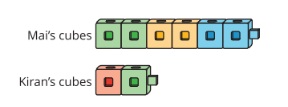
Analyze and Represent “_____ Times as Many”
Activity #1
1. Jada has 4 times as many cubes as Kiran. Draw a diagram to represent the situation.
2. Diego has 5 times as many cubes as Kiran. Draw a diagram to represent the situation.
3. Lin has 6 times as many cubes as Kiran. How many cubes does Lin have?

Slide 29












Diagrams to Solve Multiplicative Comparison Problems
Activity #2
Here are four sets of descriptions, diagrams, and equations that compare pairs of quantities.
Match each description to a diagram and an equation that describe the same situation.
Be prepared to explain your reasoning.

Slide 30
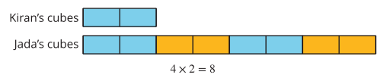
Lesson Synthesis
Today we looked at a new way to use multiplication equations. Multiplication equations can describe equal groups, but they also represent multiplicative comparison.
How is multiplicative comparison different from comparing how many more one amount is than another?
Explain how you see 4 x 2 = 8 in this diagram.
In this case, the value of the product is 8. How is one of the factors being compared to 8 in this diagram?

Slide 31
How Many Times as Many?
3
Let’s solve multiplicative comparison problems.
4.OA.A.1, 4.OA.A.2

Slide 32
Number Talk:
Find the Missing Factor
Warm up
Find the value of each unknown mentally.

Slide 33
Number Talk:
Find the Missing Factor
Warm up
Find the value of each unknown mentally.

Slide 34
Number Talk:
Find the Missing Factor
Warm up
Find the value of each unknown mentally.

Slide 35
Number Talk:
Find the Missing Factor
Warm up
Find the value of each unknown mentally.

Slide 36
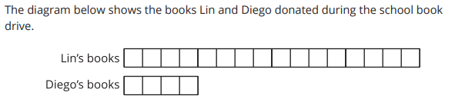

A Book Drive
Activity #1
1. Lin donated 16 books. Diego donated 4 books. How many times as many books did Lin donate as Diego did? Show or explain your reasoning. Use the diagram if it is helpful.
2. Priya donated 3 books. Noah donated 21 books. How many times as many books did Noah donate as Priya did? Draw a diagram to show your reasoning
3. Mai stacked 27 donated books on a desk. Tyler made his own stack of 3 books. How many times as many books did Mai stack as Tyler did? Show your reasoning.

Slide 37
Represent a Missing Amount
Activity #2
2. Han says he can figure out the number of books Andre has donated using division.
Tyler says we have to use multiplication because it says “times as many”.
a. Do you agree with Han or Tyler? Explain your reasoning.
b. Write an equation to represent Tyler’s thinking.
c. Write an equation to represent Han’s thinking
1. Clare donates 48 books. Clare donates 6 times as many books as Andre.
a. Draw a diagram to represent the situation.
b. How many books does Andre donate? Explain your reasoning

Slide 38

Represent a Missing Amount
Activity #2
3. Elena donates 9 times as many books as Diego. Elena donates 81 books.
Use multiplication and division to find the number of books Diego donates.

Slide 39

Lesson Synthesis
In today’s lesson you had to solve multiplicative comparison problems in which different pieces of information were missing
How would you complete the equations and comparison statements to make them true? Explain how you know.

Slide 40
Multiplicative Comparison of Large Numbers
4
Let’s represent and solve multiplicative comparison problems with larger numbers
4.OA.A.1, 4.OA.A.2

Slide 41
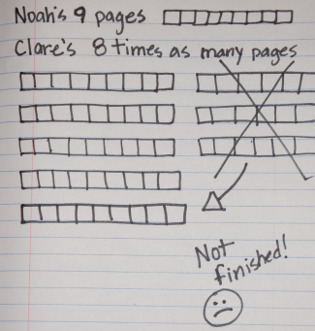
Notice and Wonder:
Too Many Times More?
Warm up
What do you notice?
What do you wonder?

Slide 42
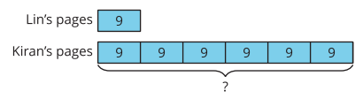
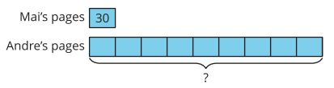
Multiplication Equations
Activity #1
2. The diagram shows the pages Lin and Kiran read on one day of the reading competition.
a. Complete the statement and explain how you know. Kiran read _____ times as many pages as Lin.
b. Write a multiplication equation that compares the pages read by Lin and Kiran.
c. How many total pages did Kiran read?
1. Mai and Andre compare the number of pages they read on the first day of the reading competition.
What would be a good estimate for the number of pages Andre read?

Slide 43
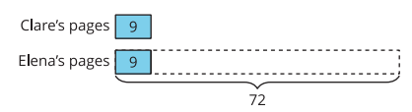
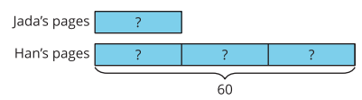
Multiplication Equations
Activity #1
3. Jada read some pages. Han read 60 pages altogether
a. How many times as many pages did Han read? Explain how you know.
b. Write a multiplication equation to compare the pages read by Han and Jada. Use a symbol to represent the unknown.
c. How many pages did Jada read? Explain how you know.
4. Elena read 72 pages. Clare read 9 pages.
a. How is this diagram different from the earlier diagrams?
b. Write a multiplication equation to compare the pages read by Elena and Clare. Use a symbol to represent the unknown.
c. How many times as many pages does Elena read as Clare?

Slide 44
Who Read More?
Activity #2
1. Diego read 8 times as many books as Lin read. Lin read 7 books.
a. Equation:
b. Diagram:
c. How many books did Diego read?
2. Tyler has some books. Clare has 72 books, which is 12 times as many books as Tyler has.
a. Equation:
b. Diagram:
c. How many books does Tyler have?
For each situation:
Write an equation to represent the situation. Use a symbol to represent the unknown.
Draw a diagram to show the comparison.
Answer the question about the situation.

Slide 45
Who Read More?
Activity #2
3. Noah read 13 books. Elena read 130 books.
a. Equation:
b. Diagram:
c. Complete the statement: _______________ read _____ times as many books as _______________ read.
For each situation:
Write an equation to represent the situation. Use a symbol to represent the unknown.
Draw a diagram to show the comparison.
Answer the question about the situation.

Slide 46
Lesson Synthesis
Today we used diagrams to compare two large quantities.
Why might we represent the diagram with a number instead of drawing all the parts out?
What do you notice about the different diagrams we used to represent this
_ x 12 = 72?
Diagrams that use numbers to show the quantities are a helpful tool for showing “_____ times as many” situations because they can represent any amount

Slide 47
Solve Problems with Multiplicative Comparison
5
Let’s solve multiplicative comparison word problems.
4.OA.A.1, 4.OA.A.2, 4.OA.A.3

Slide 48
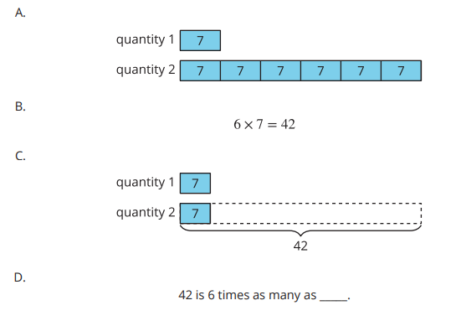
Which One Doesn’t Belong: What’s Missing?
Warm up
Which one doesn’t belong?

Slide 49

The Book Fair
Activity #1
For this year’s book fair, a school ordered 16 science experiment books and 6 times as many picture books.
Last year, the school ordered 4 times as many picture books and 4 times as many science experiment books than they did this year.
1. How many picture books were ordered this year?
2. How many picture books were ordered last year?
3. How many more science experiment books were ordered last year than this year?

Slide 50

More Book Fair Purchases
Activity #2
1. The book fair collected $23 Tuesday morning and 8 times as much of that in the afternoon.
How much money did the book fair collect on Tuesday?
2. Mai purchased a biography for $16 and a comic book for $3 on Thursday. The book fair sales that day were 9 times as much as Mai spent.
How much money did the book fair collect on Thursday?

Slide 51
Lesson Synthesis
Today we solved multiplicative comparison problems that involved more than one step.

Slide 52
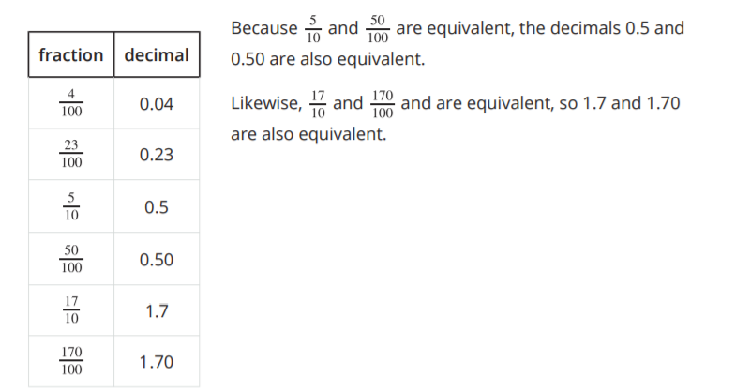
Section Summary
In this section, we learned to express tenths and hundredths as decimals, locate them on a number line, and compare them.
We learned that the decimal form for the fraction 1/10 is 0.1, and that this number is also read "1 tenth." The decimal form for 1/100 is 0.01 and is read "1 hundredth."
Here are some more examples of tenths and hundredths in their decimal form:

Slide 53
Ten Times as Much
6
Let’s represent “ten times as many.”
4.NBT.B.5, 4.OA.A.1, 4.OA.A.2, 4.OA.A.3

Slide 54
Choral Count: 12, 15 and 24
Warm up
What do you notice about the 10th multiple?
Count by 12 starting at 0
Can you predict the twentieth multiple?

Slide 55

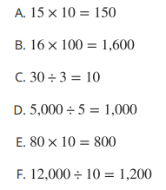
Ten Times as Many
Activity #1
1. Here is a diagram that represents two quantities, A and B. What are some possible values of A and B?
2. Select the equations that could be represented by the diagram.
3. Which equations in the list can not be represented by the diagram?
a. Explain why the diagram does not represent these equations.
b. How would you revise the equations so the diagram could represent them?
c. Compare your equations with your partner’s. Make at least two observations about the equations you and your partner wrote.

Slide 56
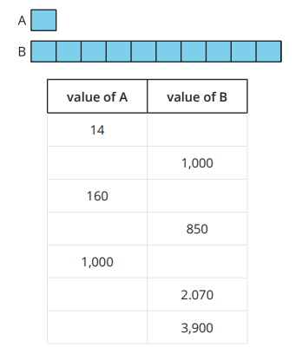
Ten Times as Many
Activity #2
1. Use the diagram to complete the table.
2. Select some values from your table to explain or show:
a. How you found the value of B when the value of A is known.
b. How you found the value of A when the value of B is known.

Slide 57

Lesson Synthesis
Today we used diagrams to represent values that are ten times as much as different values. We noticed some patterns when we analyzed the values.
What are some other statements we can make about this diagram that would always be true?

Slide 58
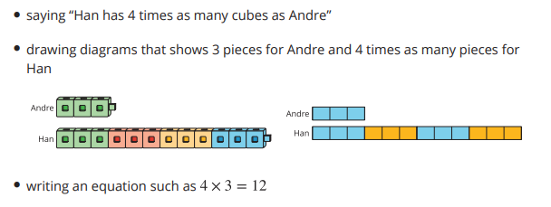
Section Summary
In this section, we learned to use multiplication and the phrase “_____ times as many” or “_____ times as much” for comparing two quantities.
At first, we used cubes and drawings to represent the quantities. For example: Andre has 3 cubes and Han has 12. We compared the number of cubes by:

Slide 59
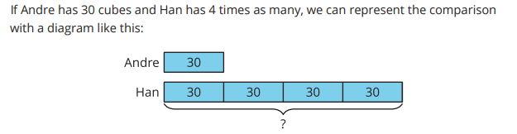
Section Summary
As the numbers got larger, drawing every unit of each quantity became less convenient, so we used simpler diagrams with numbers to represent the size of the quantities.
We ended by comparing quantities in which one quantity is ten times as much as another. We also recalled some patterns in the numbers when we multiplied a number by 10.

Slide 60
Lengths in Meters and Centimeters
7
Let’s explore some lengths that can be measured in meters and centimeters.
4.MD.A.1, 4.MD.A.2

Slide 61
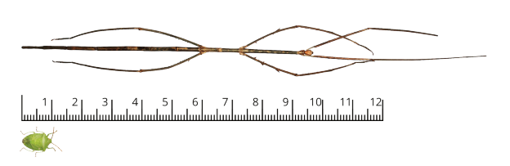
Notice and Wonder:
Big Bug, Little Bug
Warm up
What do you notice?
What do you wonder?

Slide 62
How Long is One Meter?
Activity #1
1. Use the centimeter paper to build a strip that is 100 centimeters long. You will need scissors and tape.
If you do it precisely, your paper strip is 1 meter long.
2. List 5 items in the classroom that you think are about 1 meter long.
Then, use your paper strip to check how close your prediction is to 1 meter.
3. Decide whether each of the following is more than 1 meter, less than 1 meter, or about 1 meter.
a. The stick insect in the warm-up activity
b. The step you make when walking
c. The step you make when running
d. Your arm span
Be prepared to explain how you know.

Slide 63
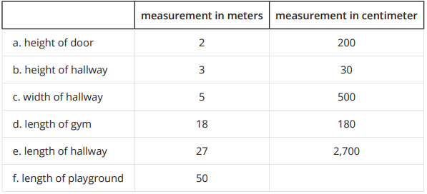
In and Around the School
Activity #2
Priya took some measurements in meters and recorded them in the table, but she made some errors when converting them to centimeters. She also left out one measurement.
1. Find and correct Priya’s conversion errors. Be prepared to explain how you know.
2. Find the length of the playground in centimeters.

Slide 64
Lesson Synthesis
Today we took a close look at the relationship between centimeters and meters.
Write one sentence to describe the relationship between the two units. Be as specific and precise as you can in your word choice.
Share your sentence with your partner and listen to theirs. If you disagree with something they wrote, bring up your disagreement

Slide 65
Lengths in Meters and Kilometers
8
Let’s explore longer measurements in meters and kilometers.
4.MD.A.1, 4.MD.A.2

Slide 66
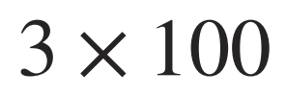
Number Talk: A Number Times Hundreds and Thousands
Warm up
Find the value of each expression mentally.

Slide 67
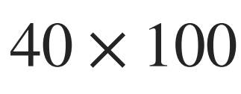
Number Talk: A Number Times Hundreds and Thousands
Warm up
Find the value of each expression mentally.

Slide 68
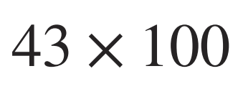
Number Talk: A Number Times Hundreds and Thousands
Warm up
Find the value of each expression mentally.

Slide 69
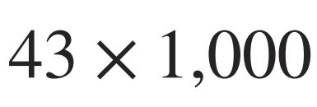
Number Talk: A Number Times Hundreds and Thousands
Warm up
Find the value of each expression mentally.

Slide 70
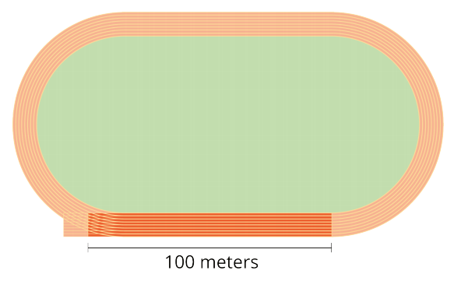
How Long is One Kilometer?
Activity #1
There are 1,000 meters in 1 kilometer.
1. The darkly shaded section of the track is 100 meters.
How many 100-meter races does it take to travel 1 kilometer?
2. Your teacher will give you images of something with a length or height measured in meters.
About how many of the items given to you are needed to make 1 kilometer? Explain or show how you know.
3. Work with your group to write a number in the blank so that each statement is true.
a. One kilometer is the length of (about, exactly) __________ soccer fields.
b. One kilometer is the length of (about, exactly) __________ Statues of Liberty.
c. One kilometer is the length of (about, exactly) __________ Olympic-size swimming pools.
d. One kilometer is the length of (about, exactly) __________ basketball courts.
4. Estimate where you might end up if you travel 1 kilometer from your school’s front door

Slide 71
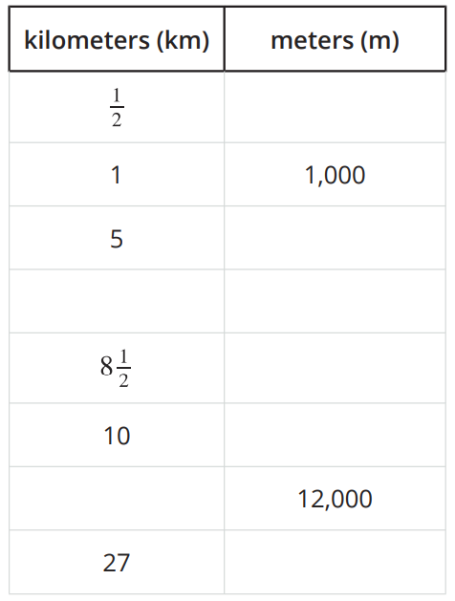
Activity #2
Meters and Kilometers
1. Complete the table with the missing lengths in meters or kilometers.
2. Andre says 100 meters is longer than 10 kilometers. Do you agree or disagree? Explain your reasoning.
3. Which is greater?
a. 2,000 meters or 3 kilometers
b. 500 meters or 1 kilometer
c. 14 kilometers or 14,000 meters
d. 8 kilometers or 80,000 meters

Slide 72
Lesson Synthesis
Today we learned about the relationship between meters and kilometers.
Because 1 kilometer is 1,000 times as long as 1 meter, the number of meters is 1,000 times the measurement in kilometers.
Did you agree with Andre that 100 meters is longer than 10 kilometers? How did you know whether what he said was true?

Slide 73
Grams and Kilograms, Liters and Milliliters
9
Let’s describe the relationship between the digits in multi-digit numbers.
4.MD.A.1, 4.MD.A.2

Slide 74
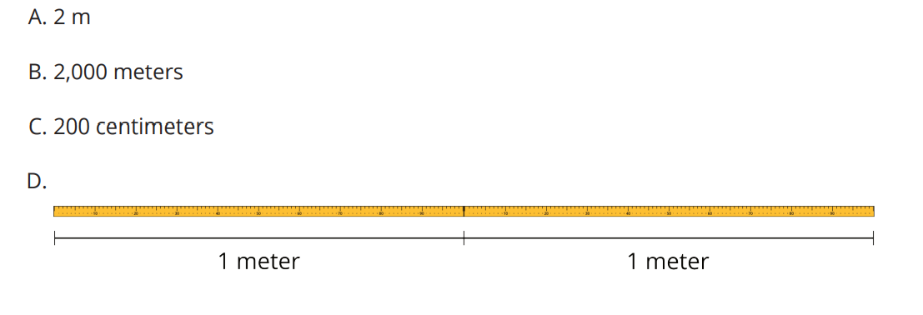
Which One Doesn’t Belong: Meter, Meter on the Page
Warm up
Which one doesn’t belong?

Slide 75

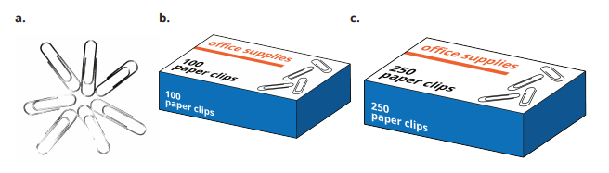
Activity #1
A Whole Lot of Paper Clips
One paper clip weighs 1 gram.
1. How many grams are the paper clips in each image?

Slide 76
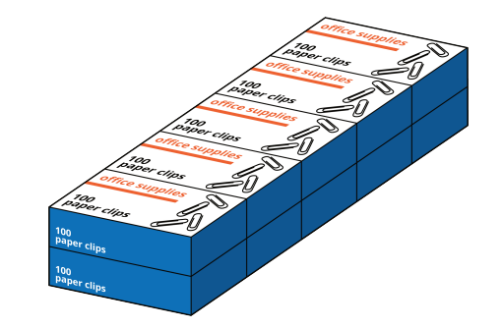
Activity #1
A Whole Lot of Paper Clips
One paper clip weighs 1 gram.
2. The paper clips in this image weigh 1 kilogram.
What is the relationship between kilograms and grams?

Slide 77
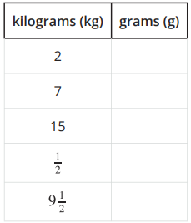
Activity #1
A Whole Lot of Paper Clips
One paper clip weighs 1 gram.
3. Complete the table with the missing amounts in grams.
4. Which weighs more?
a. 8 kilograms or 8 boxes with 100 paper clips in each box
b. 1,250 paper clips or 1 kilogram
c. 500 grams or 2 boxes of 250 paper clips in each box
d. ½ kilogram or 400 paper clips

Slide 78
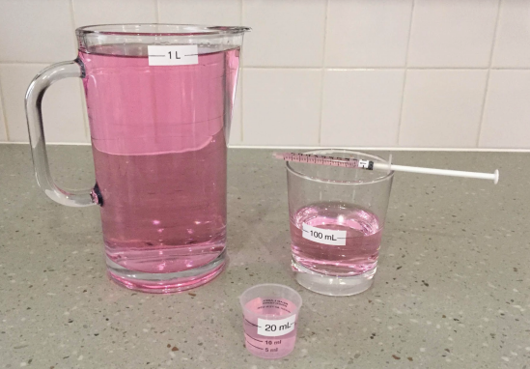
Activity #2
Liters and Milliliters
1.
a. Estimate: How many times do we fill the 100-milliliter glass to get 1 liter of liquid? (Assume that each time the liquid is filled to the 100-milliliter line.)
b. Follow your teacher’s instructions to check your estimate.
c. Write a sentence to describe the relationship between milliliters and liters.

Slide 79
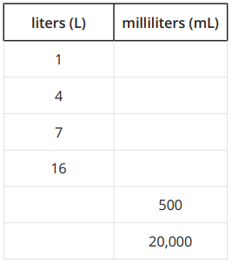
Activity #2
Liters and Milliliters
2. How many times do we fill each of these containers to get 1 liter?
a. A 1-milliliter medicine dropper
b. A 250-milliliter measuring cup
c. A 20-milliliter dosage cup
3. Complete the table with the missing amounts in liters or milliliters.

Slide 80
Lesson Synthesis
Today we learned about a pair of units for measuring weight—kilograms and grams—and the other for measuring the amount of liquids—liters and milliliters.
Which weighs more: 5 kilograms or 500 grams?
How are the two pairs of units alike?
Which holds more: a 2-liter bottle, or a 20,000-milliliter bottle?

Slide 81
Solving Measurement Problems in Standard Units
10
Let’s solve some measurement problems that involve meters and liters.
4.MD.A.2, 4.OA.A.2, 4.OA.A.3

Slide 82
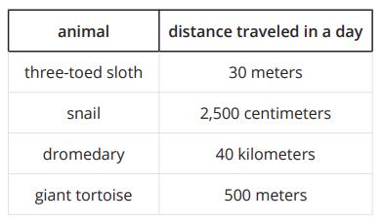
Notice and Wonder:
Distances Traveled
Warm up
What do you notice?
What do you wonder?

Slide 83
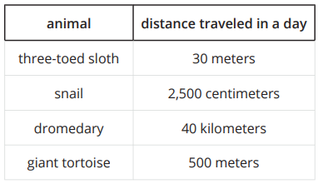
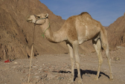
Activity #1
Long Hikes, Short Hikes
Here are estimates of the farthest distances that some animals would move in one day.
1. Put the animals and their travel distances in order, from the shortest to the longest. Explain or show your reasoning.
2. Do you agree with each statement? Explain your reasoning.
a. A giant tortoise can move 2 times as far as a snail can move in a day.
b. A dromedary can move 80 times as far as a giant tortoise can move in a day.

Slide 84


Big Bottles, Little Bottles
Activity #2
Here are six water bottle sizes and four clues about the amount of water they each hold.
One bottle holds 350 mL.
A bottle in size B holds 5 times as much water as a bottle that holds 1 L.
The largest bottle holds 20 times the amount of water in the smallest bottle.
A 1,500 mL bottle holds 3 times as much water as a bottle in size E.
Use the clues to find out the amount of water, in mL, that each bottle size holds. Be prepared to explain or show your reasoning.

Slide 85
Lesson Synthesis
Today we solved some problems that involved comparing and ordering measurements in different units. Let’s reflect on the process of solving those problems. Take a few quiet minutes to think about these reflection questions and write down your responses.
Which parts of the problem solving process did you enjoy or find interesting?
What math did you do to find out which animal traveled the farthest, to see if a statement was true, and to figure out the sizes of water bottles?
Which parts of the problem solving process were challenging or were new to you?

Slide 86
Measurements in Pounds and Ounces
11
Let’s explore how heavy things are in pounds and ounces.
4.MD.A.1, 4.MD.A.2

Slide 87

Notice and Wonder:
A Recipe
Warm up
What do you notice?
What do you wonder?

Slide 88

Activity #1
Pounds and Ounces
Your teacher will show images of some packaged food items.
1. Use the information on the images to find out how pounds (lbs) and ounces (oz) are related.
a. Write a sentence to describe the relationship between the two units.
b. Use two pieces of information to show that your conclusion is right
2. Complete this table with amounts in ounces.

Slide 89

Activity #2
Party Prep
1. A family is cooking for a party and needs to buy some ingredients for a main dish:
5 pounds of rice
½ pound of almonds
2 pounds 8 ounces of pinto beans
How many ounces of each ingredient does the family need to buy? Show your reasoning.
2. To make the dessert, they need 6 pounds of flour. If they already have 40 ounces of flour in the pantry, how many more ounces of flour do they need to buy?

Slide 90
Lesson Synthesis
Today we learned about the relationship between pounds and ounces and solved some problems that involve those measurements.
How is the relationship between pounds and ounces like that between kilograms and grams?
When you weigh yourself, the scale likely gives your weight in pounds. If the scale is set to measure in ounces, will the number be larger or smaller? How much larger or smaller? Why is that?
How is it different from the relationship between kilograms and grams?

Slide 91
Time in Hours, Minutes, and Seconds
12
Let’s look at different ways to measure time.
4.MD.A.1, 4.MD.A.2

Slide 92

What Do You Know about One Hour?
Warm up

Slide 93


Activity #1
Mai’s School Day
The table shows how Mai usually spends her waking hours on a school day.
1. Complete the table to show how many minutes Mai spends on each activity. Be prepared to explain or show your reasoning.
2. How many hours is Mai’s school day? How many minutes is that? Explain or show how you know.
3. How many minutes does Mai sleep on a school night? Explain your reasoning.

Slide 94


Activity #2
Precious Minutes and Seconds
Diego would set a timer to make sure that some things are not done for too long or too short an amount of time.
1. Complete the table with the number of seconds for each activity. Be prepared to explain your reasoning.
2. Diego noticed that on a television channel, commercial breaks are often between 1 ½ and 2 ½ minutes long each. How long are they in seconds? Explain or show your reasoning.
3. Diego’s workout starts with 4 minutes of warm-up and stretching, followed by 100 seconds of jumping jacks.
If he works out for 10 minutes exactly, how many more seconds are left in his workout?

Slide 95


Lesson Synthesis
Today we used hours, minutes, and seconds to express lengths of time. We converted hours to minutes and then minutes to seconds.
How can we use the information in the tables to help us find the number of seconds in 1 hour?
If someone claims that the missing numbers in the first table are the same as the ones in the second table, would you agree? Why or why not?
How many seconds are in 1 hour?

Slide 96
Solving Measurement Problems Involving Whole Numbers and Fractions
13
Let’s solve some multi-step measurement problems.
4.MD.A.2, 4.OA.A.3

Slide 97

True or False: Some Number Times a Fraction
Warm up
Decide whether each equation is true or false. Be prepared to explain your reasoning

Slide 98

True or False: Some Number Times a Fraction
Warm up
Decide whether each equation is true or false. Be prepared to explain your reasoning

Slide 99

True or False: Some Number Times a Fraction
Warm up
Decide whether each equation is true or false. Be prepared to explain your reasoning

Slide 100

True or False: Some Number Times a Fraction
Warm up
Decide whether each equation is true or false. Be prepared to explain your reasoning

Slide 101


Activity #1
Info Gap: Noah’s School Day (Part 1)

Slide 102

Activity #2
Info Gap: Noah’s School Day (Part 2)
Your teacher will give you either a problem card or a data card. Do not show or read your card to your partner.

Slide 103


Activity #3
Shopping List
Here are six ingredients that a shopper bought and some clues about each quantity. The items are listed in order of weight, from least to greatest.
The heaviest item weighs 4 times the weight of tofu.
One ingredient weighs pound.
The item that weighs 10 pounds is 10 times the weight of shrimp.
The carrots are 3 times as heavy as the shrimp.
The carrots are 2 times as heavy as the tapioca flour.
Brown rice weighs 20 times as much as the weight of noodles.
Use the clues to find out the weight of each ingredient in both pounds and ounces.

Slide 104
Lesson Synthesis
Today we solved measurement problems in which not all of the necessary information was readily available
What did you find interesting? What did you find challenging?
How was that experience different from other problem-solving experiences you had so far?
To solve the problems you needed to convert units of time. Did you find it just as easy to convert from hours to minutes as it is to convert from minutes to hours? Did you use different strategies depending on the problems

Slide 105
Section Summary
In this section, we learned about various units for measuring length, distance, weight, capacity, and time. We saw how different units that measure the same property are related.
Here are the relationships that we saw:
One meter (m) is 100 times as long as 1 centimeter (cm).
One kilometer (km) is 1,000 times as long as 1 meter (m).
One kilogram (kg) is 1,000 times as long as 1 gram (g).
One liter (L) is 1,000 times as much as 1 milliliter (mL).
One pound (lb) is 16 times as heavy as 1 ounce (oz).
One hour is 60 times as long as 1 minute.
One minute is 60 times as long as 1 second.

Slide 106
Section Summary
When given a measurement in one unit, we can find the value in another unit by reasoning and writing equations. For example, to express 5 kilograms in grams, we can write 5 x 1,000 = 5,000 . To express 4 pounds in ounces, we can write 4 x 16 = 64 .
Throughout the section, we used these relationships to convert measurements from one unit to another, to compare and order measurements, and to solve problems in different situations.

Slide 107
Measure in Fractions of an Inch
Adaptation
Lesson 3
Let’s measure the length of objects around the room
3.MD.B.4

Slide 108


What do you know about ___?
Warm up
What do you know about….

Slide 109
Measure Around the Room
Activity #1
Use the ruler your teacher gives you to measure the length of objects in the room.
Be prepared to discuss your reasoning.
Object | Length (inches)

Slide 110
Partition Inches into Halves
Activity #2
1. Work with your partner to partition one ruler from the previous activity to show halves of an inch.
2. Use the ruler marked with halves of an inch to measure some lengths around the room.
Object | Length (inches)

Slide 111
Lesson Synthesis
Today we used a ruler to measure length in inches.
How is a ruler like a number line?

Slide 112
Measuring in Halves or Fourths of an Inch
Adaptation
Lesson 4
Let’s measure length in halves or quarters of an inch.
3.MD.B.4

Slide 113

Estimation Exploration:
Measure in Inches
Warm up
What is the length of the paper clip?
Record an estimate that is:
Too low | About right | Too high

Slide 114

Partition Inches into Fourths
Activity #
1. With your partner, partition one of your rulers from the previous lesson to show fourths of an inch.
2. Take turns with your partner using this ruler to measure the length of 4 objects around the room.
Object | Length (inches)

Slide 115
Halves or Quarters of an Inch
Activity #
With your partner, measure some objects around the room. For each object, use your ruler that is marked with half inches or your ruler marked with quarter inches. Practice saying each measurement with your partner.
Object | Length (inches)

Slide 116



Lesson Synthesis
Which ruler would you use if we want to measure and get a length that is as close as possible to the actual length of the object?

Slide 117
Measure Lengths and Generate Data
14
Let’s collect data on colored pencils and organize them on a line plot.
4.MD.B.4

Slide 118

Notice and Wonder:
Which Ruler?
Warm up
What do you notice?
What do you wonder?

Slide 119


Measure to the Nearest ¼ Inch
Activity #1
Use the same set of colored pencils that you used earlier for this activity
1. Work with your group to measure each colored pencil to the nearest ¼ inch.
Check one another’s measurements. Record each measurement in the table.
2. How was measuring to the nearest ¼ inch different from measuring to the nearest ⅛ inch?
3. Create a line plot to represent your new data.

Slide 120

Measure to the Nearest ¼ Inch
Activity #1
Use the same set of colored pencils that you used earlier for this activity
4. Which pencil length is the most common when measured to the nearest inch?
5. What additional questions you could ask about your line plot data? Write 3 new questions.

Slide 121
Lesson Synthesis
Today we measured pencils to the nearest ¼ and ⅛ inch.
What is challenging about measuring to the nearest ⅛ inch?
How did your data and line plots change when you measured colored pencils to the nearest inch?”
Why do you think we measure to the nearest ⅛ inch?

Slide 122
Organize and Analyze Data on Line Plots
15
Let’s organize data on line plots and analyze the data.
4.MD.B.4, 4.NF.B.3, 4.NF.B.4

Slide 123

Estimation Exploration:
A Giant Pencil
Warm up
About how long is the pencil?
Record an estimate that is:
Too low | About right | Too high

Slide 124



Activity #1
Colored-Pencil Measurements
1. Andre’s class measured the length of some colored pencils to the nearest ¼ inch.
The data are shown here:
a. Plot the colored-pencil data on the line plot.
b. Which colored-pencil length is the most common in the data set?
c. Write 2 new questions that could be answered using the line plot data.

Slide 125

Activity #1
Colored-Pencil Measurements
2. Next, Andre’s class measured their colored pencils to the nearest ⅛ inch.
The data are shown here:
a. Plot the colored-pencil data on the line plot.
b. Which colored-pencil length is the most common in the data set?
c. Why did some colored pencil lengths change on this line plot?
d. What is the difference between the length of the longest colored pencil and the shortest colored pencil? Show your reasoning.

Slide 126


Activity #2
Compare Colored-Pencil Data
1. Use each group’s data to answer these questions:
a. Which colored-pencil length occurs the most?
Kiran’s group: Clare’s group:
b. What is the difference between the longest and the shortest pencil lengths? Show your reasoning.
Kiran’s group: Clare’s group:
2. Create a line plot that shows both Kiran’s and Clare’s groups’ data.

Slide 127
Lesson Synthesis
Today we organized data on line plots and answered questions about the data.
The data we saw involved lengths measured to the nearest fourths and eighths. Why might we measure to the nearest ⅛ inch instead of to the nearest ¼ ?
What strategies did you use to create a line plot for both Kiran’s and Clare’s groups’ data?

Slide 128
Use Measurement Data to Solve Problems
16
Let’s solve problems involving measurement data on line plots.
4.MD.B.4

Slide 129

Number Talk:
Multiply a Fraction by a Whole Number
Warm up
Find the value of each product mentally.

Slide 130

Number Talk:
Multiply a Fraction by a Whole Number
Warm up
Find the value of each product mentally.

Slide 131

Number Talk:
Multiply a Fraction by a Whole Number
Warm up
Find the value of each product mentally.

Slide 132

Number Talk:
Multiply a Fraction by a Whole Number
Warm up
Find the value of each product mentally.

Slide 133



Activity #1
Growing Plants
Students in Mai’s class are planting and measuring plants as they grow.
The table represents plant growth data from Mai’s group.
1. Here is a line plot of the class data, but it doesn’t yet include the data from Mai’s group. Complete the line plot with her group’s data.
2. Use the completed line plot to answer the questions.
a. How much did the plant that grew the most grow?
b. How much did the plant that grew the least grow?
c. What is the difference between the growths of those plants?

Slide 134
Activity #1
Growing Plants
Students in Mai’s class are planting and measuring plants as they grow.
The table represents plant growth data from Mai’s group.
2. Use the completed line plot to answer the questions.
d. How many plants grew more than 1 ¾ inches? Explain your reasoning.
e. Mai made an error in measuring her plant. Her measurement is off by ⅝ of an inch. What could be the actual growth of her plant? Show your reasoning.

Slide 135



Activity #2
Watering Plants
Ten students recorded the amount of water they gave their plant in one week. They use a table and a line plot to organize their data.
1. Some data is missing from the line plot. Use the data in the table to complete the line plot.
2. How much water do Han, Kiran, and Tyler give their plants altogether in one week?
3. Do Diego and Jada’s plants get more or less than 5 cups of water each week? Explain your reasoning.
4. Clare made a mistake and recorded ½ cup more than the actual amount she gave her plant.
a. How much did Clare really give her plant?
b. Does Clare’s mistake affect the line plot? Explain your reasoning.

Slide 136
Lesson Synthesis
Today we used our understanding of fraction equivalence to plot and analyze data on line plots. We also answered questions about line plot data using what we know about adding and subtracting fractions.
What information does a line plot give us about a set of data?
What information does the line plot not show?
How do line plots help to organize measurement data?
How did you use your understanding of fractions to analyze and solve problems involving line plots?

Slide 137

Section Summary
In this section, we studied measurement data and displayed the data on line plots.
We learned that a length can be measured to the nearest inch, ½ inch, ¼ inch, ⅛ inch, and so on. When we measure to smaller fractions of a unit, our measurements are more precise.
For instance, when measured to the nearest ¼ inch, the length of this crayon is about 2 2/4 inches. When measured to the nearest ⅛ , its length is 2 ⅜ inches.

Slide 138

Section Summary
We then organized measurement data on line plots like this:
Line plots can help us make sense of the data and solve problems. In this example, we can see that most colored pencils in the data are shorter than 4 inches. We can also find the difference between the longest and shortest pencils.
Because the measurements have different denominators, we used fraction equivalence and the relationships between halves, fourths, and eighths to plot the data and solve problems.

Slide 139
Problem Solving: Mass and Capacity Measurements
17
Let’s solve problems about weight and capacity.
4.MD.A.1, 4.MD.A.2, 4.NBT.B, 4.OA.A.2

Slide 140

Number Talk:
Lots of Thousands
Warm up
Find the value of each sum or difference mentally.

Slide 141

Number Talk:
Lots of Thousands
Warm up
Find the value of each sum or difference mentally.

Slide 142

Number Talk:
Lots of Thousands
Warm up
Find the value of each sum or difference mentally.

Slide 143

Number Talk:
Lots of Thousands
Warm up
Find the value of each sum or difference mentally.

Slide 144



Activity #1
Milk and Mango Lassi
1. Here are three true statements about this jug of milk.
This jug contains 1 gallon of milk.
This jug contains 4 quarts of milk.
This jug contains 16 cups of milk.
Complete each statement so that it is true:
a. One gallon is _____ times as much as 1 quart.
b. One gallon is _____ times as much as 1 cup.
c. One quart is _____ times as much as 1 cup.
2. For a potluck party, Priya and three other relatives are bringing mango lassi. Here’s how much lassi each guest has prepared.
a. Who prepared the most mango lassi? Explain your reasoning.
b. How many cups of lassi did all the guests bring?
c. Complete this sentence: Priya’s grandma made _____ times as much lassi as Priya’s cousin. Show how you know.

Slide 145


Activity #2
Clay for Art Class
At a craft store, clay is sold in packs of different sizes: 1 pound, 24 ounces, 3 pounds, and 5 pounds. An art teacher needs 120 ounces of clay for her class.
1. Would she have enough clay if she bought each of the following combinations? Explain or show your reasoning.
2. Decide if each statement is true or false. Be prepared to explain or show your reasoning.
a. A 3-pound pack weighs 2 times as much as a 24-ounce pack.
b. If we combine a 1-pound pack, a 3-pound pack, and a 5-pound pack, we’d have 6 times as much clay as what’s in a 24-ounce pack.

Slide 146


Lesson Synthesis
Today we solved problems by converting one unit to another unit—first from gallons to quarts or cups (or the other way around) and then from pounds to ounces (or the other way around). By converting some measurements, we were able to make comparisons, find total amounts, and more.
If someone claimed that 3 quarts is greater than 2 gallons because 3 is greater than 2, how would you explain that this is not true? What correction would you offer?
If someone claimed that 24 ounces is 8 times as much as 3 pounds, would you agree? Why or why not?

Slide 147
Problem Solving: Length Measurements
18
Let’s solve problems about distances and lengths.
4.MD.A.2, 4.OA.A.2

Slide 148

Which One Doesn’t Belong: Measurements
Warm up
Which one doesn’t belong?

Slide 149


Activity #1
Frisbee Throws
Six students were throwing frisbees on field day. Here is some information about each person’s first throw.
Elena’s frisbee went 3 times as far as Clare’s did.
Andre’s frisbee went 4 times as far as Tyler’s did.
1. Complete the table with Elena and Tyler’s distances. Show your reasoning.
2. Who are the top three throwers for that first round? Find out by listing the students and their distances in feet and in order, from longest to shortest.

Slide 150


Activity #2
Stone Towers
While on an outing, a group of friends had a stone-stacking contest to see who can build the tallest stone tower.
Andre’s stone tower is 3 times as tall as Diego’s, but Diego didn’t build the shortest tower.
The tallest tower is 4 feet and 2 inches tall and belongs to Tyler.
One person built a tower that is 39 inches tall.
Tyler’s tower is 5 times as tall as the shortest tower.
1. How tall is each person’s stone tower? Be prepared to explain or show your reasoning.
2. Elena came along and built a tower that is 5 times as tall as Diego’s tower. Is Elena’s tower more than 6 feet? Show your reasoning.

Slide 151
Lesson Synthesis
How did you decide whether Elena’s tower is greater than 6 feet? Did you convert the 6 feet into inches, convert Diego’s tower into feet, or another way?
One clue says that Tyler’s tower is 5 times as tall as the shortest tower. We know that Tyler’s tower is 4 feet 2 inches. Is it easier to find the height of the shortest tower using 4 feet 2 inches or using 50 inches? Why?

Slide 152
Comparing Perimeters of Rectangles
19
Let’s solve problems about rectangles of different sizes.
4.MD.A.2, 4.MD.A.3, 4.OA.A.2

Slide 153

Number Talk:
Two and Four Times a Fraction
Warm up
Find the value of each expression mentally.

Slide 154

Number Talk:
Two and Four Times a Fraction
Warm up
Find the value of each expression mentally.

Slide 155

Number Talk:
Two and Four Times a Fraction
Warm up
Find the value of each expression mentally.

Slide 156

Number Talk:
Two and Four Times a Fraction
Warm up
Find the value of each expression mentally.

Slide 157


Activity #1
Pipe-Cleaner Perimeters
1. How many different rectangles can be made using the entire length of one 12-inch pipe cleaner?
a. Record as many pairs of side lengths as you can think of. Be prepared to explain your reasoning.
b. Which pair represent the side lengths of a square?

Slide 158
Activity #1
Pipe-Cleaner Perimeters
3. Two 12-inch pipe cleaners are joined (with no overlaps) to make a longer stick and then used to build a square.
a. What is the side length of this square? What is its perimeter?
b. How do the side length and perimeter of this square compare to those of the first square?
2. Your teacher will assign a pair of side lengths to you. Use a pipe cleaner to build a rectangle with those side lengths.
What is the perimeter of your rectangle?

Slide 159

Activity #1
Pipe-Cleaner Perimeters
4. Several pipe cleaners are joined (with no overlaps) to build a square with a perimeter of 60 inches.
a. How many pipe cleaners are used? Explain or show how you know.
b. What is the side length of the square?
c. How do the side length and perimeter compare to those of the first square?

Slide 160

Activity #2
Gridded Rectangles
1. Draw the following rectangles on centimeter grid paper. Label each rectangle. Record the side lengths and the perimeter of each.
Rectangle A has a perimeter of 16 cm.
Rectangle B has side lengths that are 3 times the side lengths of rectangle A.
Rectangle C has side lengths that are ½ of the side lengths of B.
2. Rectangle D has a perimeter of 96 centimeters.
The perimeter of D is:
__________ times the perimeter of A
__________ times the perimeter of B
__________ times the perimeter of C

Slide 161
Lesson Synthesis
What do you notice about the relationships between rectangles A, B, and C in these tables and drawings?
How did you find the perimeter for rectangle B and C?
How did you figure out how the perimeter for D compares to those of A, B, and C?

Slide 162
Problem Solving: Perimeters
20
Let’s solve some other problems about the perimeter of various shapes.
4.MD.A.2, 4.MD.A.3, 4.OA.A.2

Slide 163

True or False: Fractions and Whole Numbers
Warm up
Decide whether each equation is true or false. Be prepared to explain your reasoning

Slide 164

True or False: Fractions and Whole Numbers
Warm up
Decide whether each equation is true or false. Be prepared to explain your reasoning

Slide 165

True or False: Fractions and Whole Numbers
Warm up
Decide whether each equation is true or false. Be prepared to explain your reasoning

Slide 166

True or False: Fractions and Whole Numbers
Warm up
Decide whether each equation is true or false. Be prepared to explain your reasoning

Slide 167

Activity #1
Along the Walls in Tiny Steps
A rectangular room has a perimeter of 39 feet and a length of 10 ½ feet.
1. What is the width of the room in feet? Show your reasoning.
2. An ant walked along two walls of the room, always in a straight line. It started in one corner and ended up in a corner opposite of where it started. How many inches did it travel? Show your reasoning.

Slide 168
Activity #2
Missing Measurements
Your teacher has posted six quadrilaterals around the room.
Each one has a missing side length or a missing perimeter.
1. Choose two diagrams—one with a missing length and another with a missing perimeter.
Find the missing values. Show your reasoning and remember to include the units
2. Discuss your responses with your group until everyone agrees on the missing measurements for all six figures.
3. Answer one of the following questions. Explain or show your reasoning.
a. The perimeter of B is how many times the perimeter of D?
b. The perimeter of one figure is 1,000 times that of another figure. Which are the two figures?
c. The perimeter of F is how many times the perimeter of B?

Slide 169
Lesson Synthesis
How did you find a figure with a perimeter 1,000 times that of another figure?
How did you know that the perimeter of B is 2 times that of D?
How did you know that the perimeter of F is 9 times that of B

Slide 170

Section Summary
In this section, we solved problems and puzzles by converting units of measurement—gallons, quarts, cups, pounds, ounces, yards, feet, and inches—and by comparing measurements in different units. We saw that the problems could be solved in different ways.
For example, if Priya threw a frisbee 16 yards and this is 4 times as far as the distance Jada threw in feet, how far did Jada throw the frisbee?
In the last two lessons, we solved multiplication and comparison problems that involve the perimeter of rectangles and some other quadrilaterals.

Slide 171
Two Truths and a Lie
21
Let’s compare facts about animals.
4.MD.A.1, 4.OA.A.2

Slide 172

Notice and Wonder:
Animal Facts
Warm up
What do you notice?
What do you wonder?

Slide 173

Activity #1
Two Truths and a Lie
Your teacher will give you a fact sheet about some animals or ask you to perform some research
1. Choose two animals that you would like to compare.
2. Use the information from your teacher or your research to write two true comparison statements and one false comparison statement about these animals.
a. Write one statement on the front side of an index card.
b. On the back side of the card, write whether the statement is true or false.

Slide 174
Activity #2
Gallery Walk: Two Truths and a Lie
Your teacher will give you directions for posting your statements from the first activity.
1. Read at least 5 statements that are not yours and decide if they are true.
Find at least one statement that is false. Write down the statement here. Be prepared to explain or show how you know.
If a statement you read is unclear, use a sticky note to leave a comment or question for the writer.
2. Collect your cards and any notes that your classmates might have left for you.
Think about how to make revisions to make your statements stronger and clearer.
Record your revised statements here.

Slide 175
Lesson Synthesis
Today we wrote some true or false statements and figured out if others’ statements were true or false.
How was the experience of creating true and false statements in today’s activity different from other experiences
What was interesting? What was challenging about this experience?

