Slide 1

Decimal Fractions and Large Numbers
Grade 4: Unit 4
Standards addressed: 4.NF.C.5, 4.NF.C.6, 4.NF.C.7, 4.NBT.A.1, 4.NBT.A.2, 4.NBT.A.2, 4.NBT.A.3, 4.NBT.A.2, 4.NBT.A.3, 4.NBT.B.4, 4.NF.B.3.c
These slides have been created by Britnee Wright- Southeast Arkansas Education Cooperative and are not official IM materials. Images and language are taken from IM Grade 4 Unit 4 by Illustrative Mathematics.
Copyright 2020 by Illustrative Mathematics. All Rights Reserved, adapted and shared with permission.

Slide 2

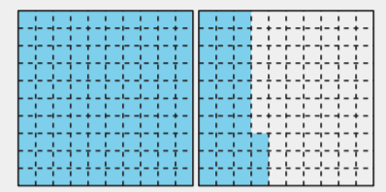
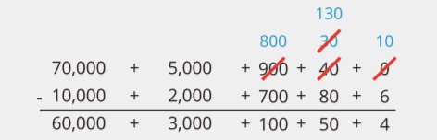
Unit 4 Progression Overview
Decimal Fractions and Large Numbers
Section A
Lessons 1-5
4.NF.C.5, 4.NF.C.6, 4.NF.C.7
Section B
Lessons 6-11
4.NBT.A.1, 4.NBT.A.2
Section C
Lessons 12-17
4.NBT.A.2, 4.NBT.A.3
Section D
Lessons 18-23
4.NBT.A.2, 4.NBT.A.3, 4.NBT.B.4, 4.NF.B.3.c
Represent, compare, and order decimals to the hundredths by reasoning about their size.
Write tenths and hundredths in decimal notation.
Read, represent, and describe the relative magnitude of multi-digit whole numbers up to 1 million.
Recognize that in a multi-digit whole number, the value of a digit in one place represents ten times what it represents in the place to its right
Compare, order and round multi-digit whole numbers within 1 million.
Add and subtract multi-digit whole numbers using the standard algorithm.

Slide 3



Unit 4 Quick Links
L1
L2
L3
L4
L5
L6
L7
L8
L9
L10
L11
Adapt 1
Adapt 2
L12
L13
L14
L15
L16
L17
Adapt 3
Adapt 4
L18
L19
L20
L21
L22
L23

Slide 4
Introduction to Rounding
Adaptation
Lesson 1
Let’s learn about rounding
3.NBT.A.1

Slide 5
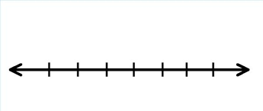
What Do You Know About _____?
Warm up
What do you know about the number line?

Slide 6

What is Close To?
Activity #1
1. What is an amount that is close to the amount the student is describing, but not exactly that amount? You can use the number line to show your reasoning.
a. Noah is wrapping gifts and says he needs about 100 feet of ribbon for all the gifts.
b. Mai says about 35 people came to her last soccer game.
c. Priya has about 75 stuffed animals in her bedroom.
2. Why don’t we need an exact amount in these situations?
3. What is a situation in which you’d want to make sure you got the exact amount?

Slide 7
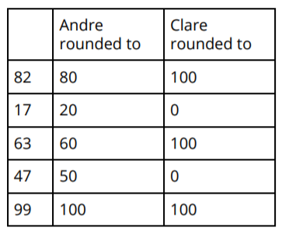
What Am I Rounding To?
Activity #2
What do you notice?
What do you wonder?

Slide 8

What Am I Rounding To?
Activity #2
Did Diego round to the nearest multiple of 10 or the nearest multiple of 100?
Explain your reasoning.
1. Diego says the number marked on this number line rounds to 100.

Slide 9

What Am I Rounding To?
Activity #2
Did Diego round to the nearest multiple of 10 or the nearest multiple of 100?
Explain your reasoning.
2. Diego says the number marked on this number line rounds to 0.

Slide 10

What Am I Rounding To?
Activity #2
Did Diego round to the nearest multiple of 10 or the nearest multiple of 100?
Explain your reasoning.
3. Diego says the number marked on this number line rounds to 70.

Slide 11

Lesson Synthesis
How would you describe rounding to a friend?
How do you know whether you are rounding to the nearest multiple of 10 or the nearest multiple of 100?

Slide 12
Round to the Nearest Ten or Hundred within 1,000
Adaptation
Lesson 2
Let’s round numbers to the nearest multiple of 10 and 100.
3.NBT.A.1

Slide 13
Choral Count: Tens and Hundreds
Warm up
“Count by 10, starting at 0.”
“Count by 100, starting at 0.”

Slide 14

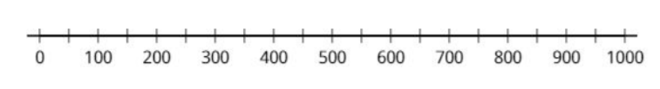
Round to the Nearest Ten or Hundred
Activity #1
1. Plot 3, 5, and 18 on the number line. Then round each number to the nearest multiple of 10.
2. Plot 90, 528, and 891 on the number line. Then round each number to the nearest multiple of 100.

Slide 15
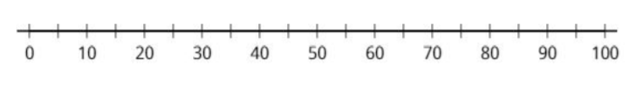
Round to the Nearest Ten or Hundred
Activity #1
3. Round each number to the nearest multiple of 10. You can use the number line.
a. 14
b. 68
c. 25

Slide 16

Round to the Nearest Ten or Hundred
Activity #1
4. Round each number to the nearest multiple of 100. You can use the number line.
a. 110
b. 872
c. 250

Slide 17
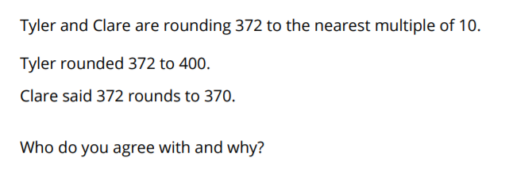
Where Am I Rounding To?
Activity #2

Slide 18
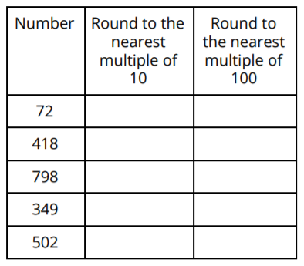
What Am I Rounding To?
Activity #2
Complete the table. Be prepared to explain your reasoning

Slide 19
Lesson Synthesis
Today we rounded numbers to the nearest multiple of 10 and 100. We also learned what to do when a number is halfway between two multiples of 10.
If you were going to round 75 to the nearest 10, what number would it round to?
How could you use how you rounded 75 to the nearest ten to round 175 to the nearest 10?

Slide 20
Decimal Notation
1
Let’s learn about decimals.
4.NF.C.6

Slide 21
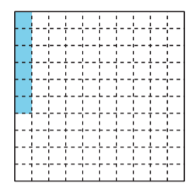
Shaded Grid
Warm up
What do you notice?
What do you wonder?

Slide 22

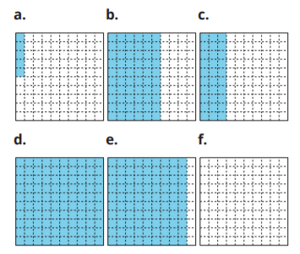
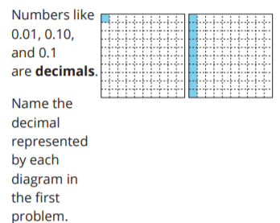
Shady Fractions
Activity #1
1. What fraction does the shaded part of each diagram represent? For the last square, shade in some parts and name the fraction it represents.
2. The first diagram here represents 0.01 or “1 hundredth.” The second diagram represents 0.10 or “10 hundredths.” It also represents 0.1 or "1 tenth."

Slide 23
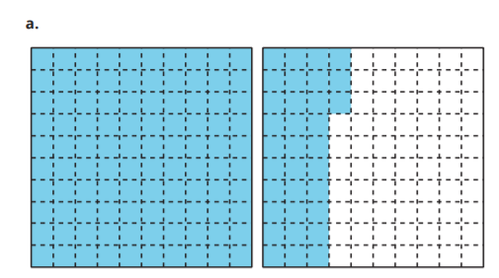
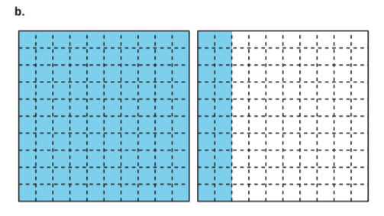
Shady Fractions
Activity #1
3. What fraction do the shaded parts of each diagram represent? What decimal do they represent?

Slide 24
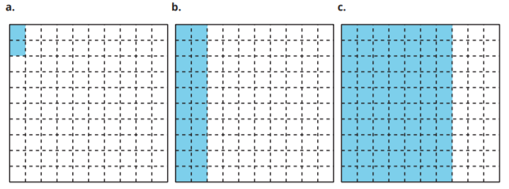
Ways to Express a Number
Activity #2
1. Write a fraction and a decimal that the shaded part of each diagram could represent. Then, write each amount in words.

Slide 25
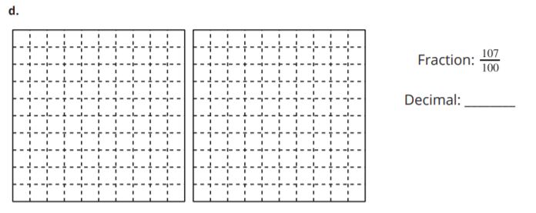
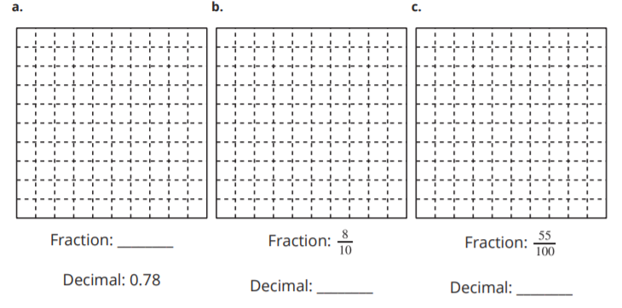
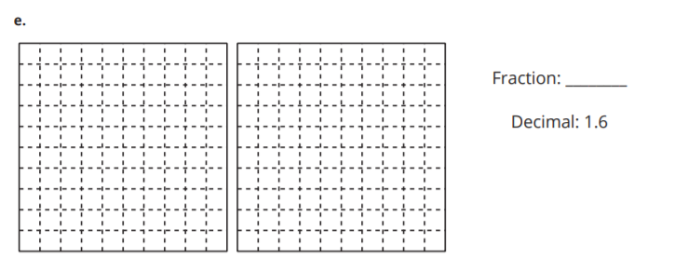
Ways to Express a Number
Activity #2
2. Shade each diagram to represent each given fraction or decimal.

Slide 26
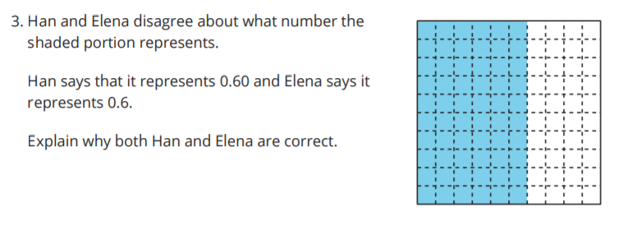
Ways to Express a Number
Activity #2

Slide 27

Lesson Synthesis
Today we learned that a fraction can be written in decimal form, regardless of whether it is less or greater than 1.
In 0.6, what does the 6 represent?” (Six tenths) “In 0.60, what does the 60 represent?
In both numbers, what does the 0 to the left of the decimal point represent?
How do we say these numbers in words?
Why can we use the same diagram to represent 0.6 and 0.60?

Slide 28
Equivalent Decimals
2
Let’s think about equivalent decimals.
4.NF.C.6, 4.NF.C.7

Slide 29

True or False: Equivalent Fractions
Warm up
Decide whether each statement is true or false. Be prepared to explain your reasoning.

Slide 30

True or False: Equivalent Fractions
Warm up
Decide whether each statement is true or false. Be prepared to explain your reasoning.

Slide 31

True or False: Equivalent Fractions
Warm up
Decide whether each statement is true or false. Be prepared to explain your reasoning.

Slide 32

True or False: Equivalent Fractions
Warm up
Decide whether each statement is true or false. Be prepared to explain your reasoning.

Slide 33
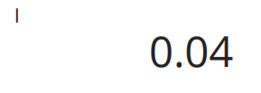
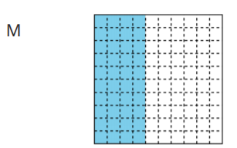
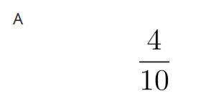
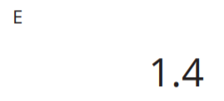
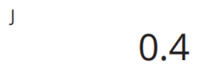
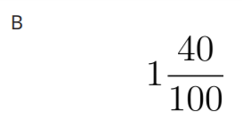
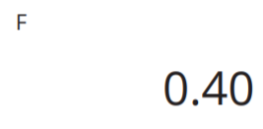
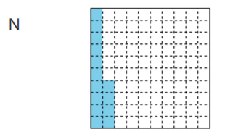
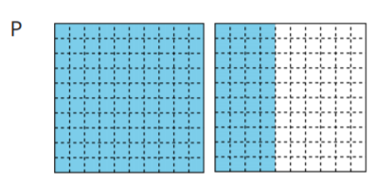
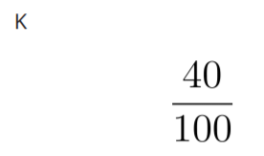
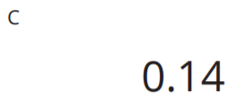
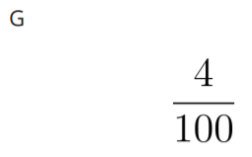
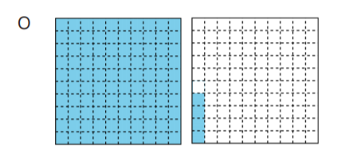
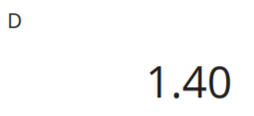
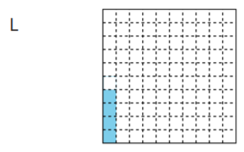
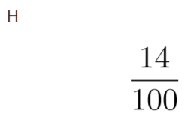
Card Sort: Diagrams of Fractions and Decimals
Activity #1
Your teacher will give you a set of cards. Each large square on the cards represents 1.
1. Sort the cards into groups so that the representations in each group have the same value. Record your sorting decisions. Be prepared to explain your reasoning.
Notes:
Match each fraction with a diagram that represents it. Two of the fractions are not represented. Create a representation for each of them.

Slide 34
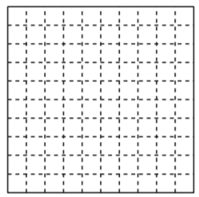
Card Sort: Diagrams of Fractions and Decimals
Activity #1
Your teacher will give you a set of cards. Each large square on the cards represents 1.
2. One of the diagrams has no matching fraction or decimal. What fraction and decimal does it represent?
3. Are 0.20 and 0.2 equivalent? Use fractions and a diagram to explain your reasoning.
Notes:
Match each fraction with a diagram that represents it. Two of the fractions are not represented. Create a representation for each of them.

Slide 35
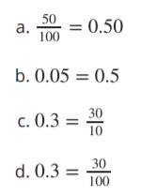
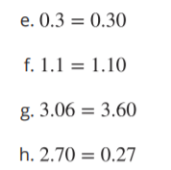
True or Not True?
Activity #2
1. Decide whether each statement is true or false. For each statement that is false, replace one of the numbers to make it true. (The numbers on the two sides of the equal sign should not be identical.)

Slide 36

True or Not True?
Activity #2
2. Jada says that if we locate the numbers 0.05, 0.5, and 0.50 on the number line, we would end up with only two points. Do you agree? Explain or show your reasoning.

Slide 37
Lesson Synthesis
Today we looked at different ways to represent decimals that are equivalent. We used square grids, number lines, and fractions to show that two decimals can represent the same value.”
Suppose a classmate is absent today. How would you convince them that 0.3 and 0.30 are equivalent? Write down at least two different ways.

Slide 38
Decimals on Number Lines
3
Let’s compare some decimals.
4.NF.C.7

Slide 39
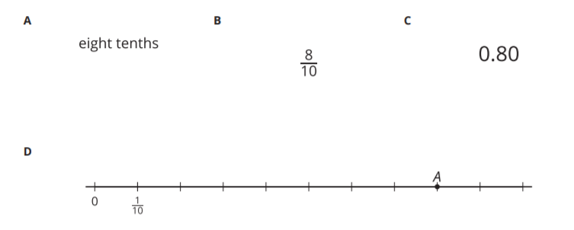
Which One Doesn’t Belong: Decimals and Fractions
Warm up

Slide 40


Points on Number Lines
Activity #1
1. Label each tick mark on the number line.
2. Here are eight decimals.
0.10, 0.40, 0.80, 1.10, 0.15, 0.45, 0.75, 1.05
a. Locate them on the number line and label the points.
b. Explain how the number line can help us see which decimal is the least and which is the greatest. What are those decimals?
3. Locate these decimals on the number line and label the points.
0.24 , 0.96, 0.61, 1.12, 0.08
4. Use two decimals in this activity to complete each comparison statement so that it is true.
a. ________ is greater than _______.
b. ________ is less than _______.
c. ________ is the greatest number.

Slide 41

Decimals Compared
Activity #2
1. Here is a number line with two points on it
a. Name the decimal located at point A.
b. Is the decimal at point A less than or greater than 0.50? Show or explain your reasoning.
c. Is the decimal at point B greater or less than 0.06? Explain your reasoning.
d. Estimate the decimal at point B.

Slide 42
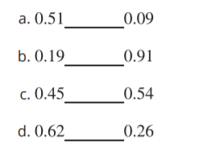
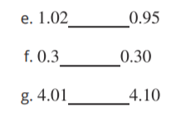
Decimals Compared
Activity #2
2. Compare the numbers using <,> , or = . Can you think of a way to make comparisons without using a number line? Be prepared to explain your reasoning.

Slide 43
Lesson Synthesis
Today we compared decimals in tenths and hundredths.
What strategies did you use when completing the comparison statements in the last activity?
How might we compare decimals without using a number line?
How can we use a number line to help us make comparisons?

Slide 44
Compare and Order Decimals
4
Let’s put some decimals in order.
4.NF.C.7

Slide 45
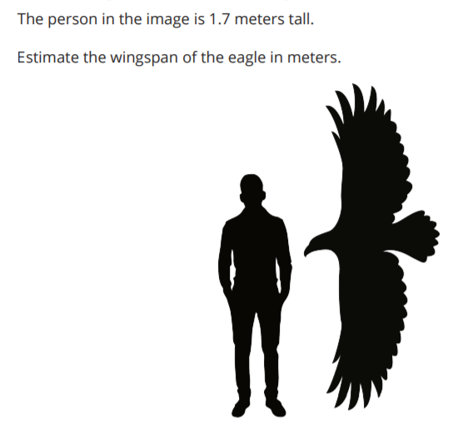
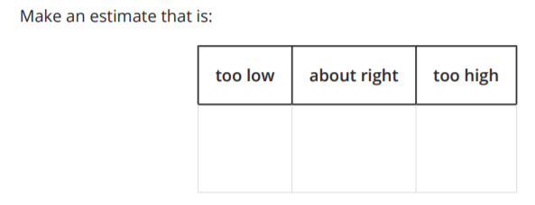
Estimation Exploration
Warm up

Slide 46
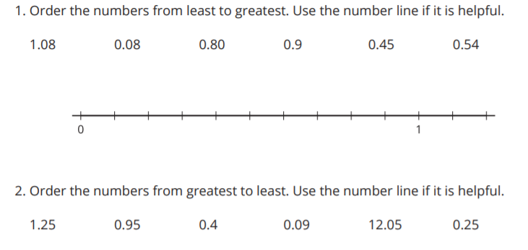
All in Order
Activity #1

Slide 47
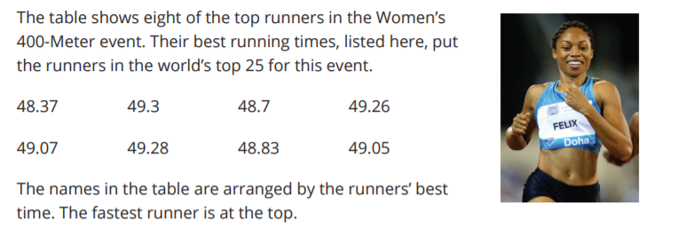
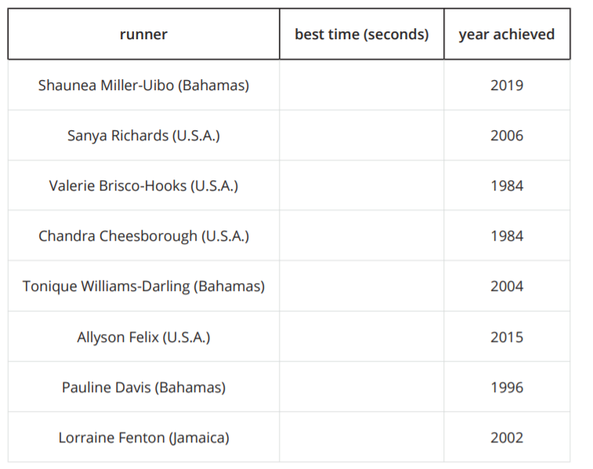
400-Meter Dash in a Flash
Activity #2
1. Put the times in order, from least to greatest, to match the times with the runners.
2. How many seconds did it take Sanya Richards to run 400 meters?
3. What is Allyson Felix’s best time?

Slide 48
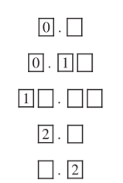
Today we compared decimals and put them in order by their size.
Lesson Synthesis
Are there numbers that we can’t compare?
Are there numbers that we can compare, even though they are all missing digits?
What makes it possible for us to compare some decimals but not others?

Slide 49
Compare and Order Decimals and Fractions
5
Let’s put fractions and decimals in order.
4.NF.C.5, 4.NF.C.6, 4.NF.C.7

Slide 50

Number Talk: Sums of Fractions
Warm up
Find the value of each sum mentally.

Slide 51

Number Talk: Sums of Fractions
Warm up
Find the value of each sum mentally.

Slide 52

Number Talk: Sums of Fractions
Warm up
Find the value of each sum mentally.

Slide 53

Number Talk: Sums of Fractions
Warm up
Find the value of each sum mentally.

Slide 54



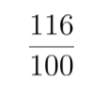






Order Once, Order Twice
Activity #1
Your teacher will give you a set of cards with a decimal or a fraction on it.
1. Work with your group to order the cards from least to greatest. Record your ordered numbers.
Set A
Set B

Slide 55
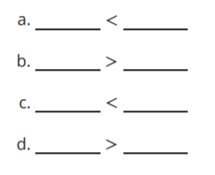
Order Once, Order Twice
Activity #1
2. Find a group whose cards are different than yours. Combine your cards with theirs. Order the combined set from least to greatest. Record your sorted numbers.
3. Use the numbers from your sorted set and <, >, or = symbols to create true comparison statements:

Slide 56
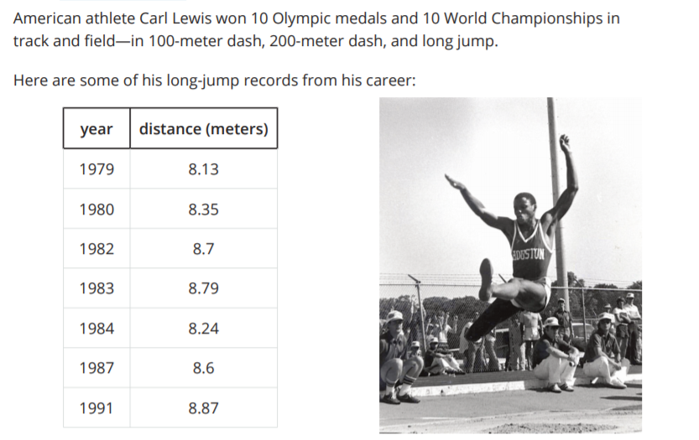
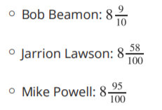
Long Jumps
Activity #2
1. On this list, which distance is his shortest jump? Which is his best (longest) jump?
2. Here are the top distances (in meters) of three other American long jumpers:
Compare their records to Carl Lewis’s best jump. Order the distances from greatest to least.

Slide 57
Lesson Synthesis
Today we compared tenths and hundredths written both in fraction notation and decimal notation.
How did you compare Carl Lewis’s best jump with those of the other jumpers and put the numbers in order?

Slide 58

Section Summary
In this section, we learned to express tenths and hundredths as decimals, locate them on a number line, and compare them.
We learned that the decimal form for the fraction 1/10 is 0.1, and that this number is also read "1 tenth." The decimal form for 1/100 is 0.01 and is read "1 hundredth."
Here are some more examples of tenths and hundredths in their decimal form:

Slide 59

Section Summary
Just like fractions, decimals can be located on a number line. Doing so can help us compare them.
For instance, 0.24 is the decimal form for 24/100 , which is between 20/100 and 30/100 (or between 2/10 and 3/10) on the number line.
We can see that 0.24 is greater than 0.08 and less than 0.61.

Slide 60
How Much is 10,000?
6
Let’s represent 10,000.
4.NBT.A.1

Slide 61

What do you know about?
Warm up
What do you know about 1,000?

Slide 62
Build Numbers
Activity #1
Your teacher will give you four cards, each with a single-digit number on it.
1. Use two cards to make a two-digit number. Name it and build the number with base-ten blocks.
2. Use a third card to make a three-digit number. Name it and build it with base-ten blocks.
3. Use a fourth card to make a four-digit number. Name it and build it. If you don’t have enough blocks, describe what you would need to build the number.
4. Your teacher will give you one more digit card. Use the last card from your teacher to make a five-digit number. Make the card the first digit. Name it and build it. If you don’t have enough blocks, describe what blocks you would need to build the number.

Slide 63



What is 10,000?
Activity #2
Your teacher will give you a set of 10-by-10 grids.
1. Use the grids to represent each of the following numbers. Then, describe or draw a sketch of your representation here.

Slide 64


What is 10,000?
Activity #2
Your teacher will give you a set of 10-by-10 grids.
2. How many 10-by-10 grids would you need to represent each of the following numbers? Explain or draw a sketch to show your reasoning.

Slide 65
What is 10,000?
Activity #2
Your teacher will give you a set of 10-by-10 grids.
3. Draw a sketch to represent 10,000 using 10-by-10 grids. Be sure to clearly label each group of 1,000 in the sketch.

Slide 66
Lesson Synthesis
Today we generated multi-digit numbers, we used blocks and a drawing to represent each multi-digit number, and we used groups of hundreds to build 10,000.
In first grade, we learned that 10 ones are in each unit of ten. In second grade, we learned that 10 tens are in each unit of one hundred. If we count 10 units of a hundred, we have 1,000, which is a new unit.
What do you think the next unit will be after ten thousands?
If we were going to represent a number like 13,000, how might we do this?
Where in this class chart do you see ten of something making a new unit?
Ten groups of 10,000 makes a new unit, 100,000. We will learn about this unit in future lessons.

Slide 67
Numbers Within 100,000
7
Let’s read, write, and represent multi-digit numbers.
4.NBT.A.2

Slide 68
Choral Count by 1,000
Warm up
Count by 1,000, starting at 3,400.

Slide 69


Counting and Writing Numbers
Activity #1
Record each count in the given spaces.
5. Complete each statement:

Slide 70

Many Thousands
Activity #2
1. Complete the table to show how many thousands are in each number.
In the last row, write your own five-digit number. Together with a partner, name each number in words. (Leave the last column blank for now.)

Slide 71
Many Thousands
Activity #2
2. In the top (header) row of the last column, write “number of ten thousands”.
Complete the table to show how many ten-thousands are in each number.

Slide 72

Many Thousands
Activity #2

Slide 73

Lesson Synthesis
Today we practiced counting numbers within 100,000. We identified groups of 1,000 and groups of 10,000 in numbers
How can we tell the number of thousands in a number?
How do we determine the number of ten-thousands in a number?

Slide 74
Beyond 100,000
8
Let’s read, write, and represent numbers beyond 100,000.
4.NBT.A.1, 4.NBT.A.2

Slide 75

Warm up
How Many Do You See?
How many do you see?
How do you see them?

Slide 76

Activity #1
Lin’s Strategy
1. Use base-ten blocks or draw a base-ten diagram to represent 15,710.
What is the value of each block if the value of the small cube is 10?
a. Small cube: 10
b. Long rectangular block: __________
c. Large square block: __________
d. Large cube: __________
2. Lin is using blocks like these to represent 15,710. She decided to change the value of the small cube to represent 10.

Slide 77
Lin’s Strategy
Activity #1
3. Use Lin’s strategy to represent 15,710.
5. Using her strategy, which base-ten blocks would be used to represent 100,000?
4. Use Lin’s strategy to represent each number.
a. 23,000
b. 58,100
c. 69,470

Slide 78

What Number is Represented?
Activity #2
1. A small cube represents 1. What value do the blocks represent?
2. A small cube is now worth 10. What is the new value that the blocks represent?
3. Write two statements comparing the numbers in the previous problems.

Slide 79

Building Hundred Thousands
Activity #3
1. To represent large numbers, Lin changed the value of the small cube to 10. She used the following blocks to represent her first number.
a. What number did Lin represent? Show or explain your reasoning.
b. Write an equation to represent the value of the blocks.

Slide 80

Building Hundred Thousands
Activity #3
2. She used more blocks to represent another number.
a. What number did Lin represent? Show or explain your reasoning.
b. Write an equation to represent the value of the blocks.

Slide 81

Lesson Synthesis
Today we wrote multi-digit numbers using expanded form. Explain expanded form to a partner.
What equation could we write to show 10 groups of 10,000 are equivalent to 100,000?
How many groups of 10,000 make 100,000?
How would we write 115,000 numbers using expanded form?
How many hundred thousands are in this number?

Slide 82
Same Digit,
Different Value
9
Let’s describe the relationship between the digits in multi-digit numbers.
4.NBT.A.1, 4.NBT.A.2

Slide 83
True or False:
Expanded Expressions
Warm up
Decide whether each statement is true or false. Be prepared to explain your reasoning.

Slide 84
True or False:
Expanded Expressions
Warm up
Decide whether each statement is true or false. Be prepared to explain your reasoning.

Slide 85
True or False:
Expanded Expressions
Warm up
Decide whether each statement is true or false. Be prepared to explain your reasoning.

Slide 86









Activity #1
Card Sort: Large Numbers
Your teacher will give you and your partner a set of cards with multi-digit numbers on them.
1. Sort the cards in a way that makes sense to you. Be prepared to explain your reasoning.
2. Join with another group and explain how you sorted your cards.

Slide 87
Activity #1
Card Sort: Large Numbers
3. Write each number in expanded form.
a. 4,620
b. 46,200
c. 462,000
4. Write the value of the 4 in each number.
5. Compare the value of the 4 in two of the numbers. Write two statements to describe what you notice about the values.
6. How is the value of the 2 in 46,200 related to the value of the 2 in 462,000?

Slide 88

Expand Large Numbers
Activity #2
1. Express each number in standard form, expanded form, and word form.
2. Choose two numbers from the table to make this statement true:
The 3 in _______________ is ten times the value of the 3 in _______________.
3. Explain why you chose those numbers.
4. Find two classmates who chose different numbers than you did. Record their numbers. Take turns sharing your completed statements and explaining your reasoning.
The 3 in _______________ is ten times the value of the 3 in _______________.
The 3 in _______________ is ten times the value of the 3 in _______________.

Slide 89
Lesson Synthesis
Today we described the relationship between the same digit in different places in multi-digit numbers.
What equation could we write to show how many groups of 80,000 there are in 800,000?
Share with a neighbor something you learned about the relationship between digits from today’s lesson

Slide 90
Ten Times As Much
10
Let's write equations to show the relationship between the digits in multi digit numbers.
4.NBT.A.1, 4.NBT.A.2

Slide 91

Notice and Wonder: Related Numbers
Warm up
What do you notice?
What do you wonder?

Slide 92

Alike but Not the Same
Activity #1
1. Complete the table with the value of the 8 in each number.
2. Describe the relationship between the value of the 8 in each number.
3. Write a multiplication or division equation to represent the relationship between the values of the 8 in two different numbers in the table.

Slide 93

More and More Money
Activity #2
Diego’s class is counting collections of play money during a math class. There are four types of bills: tens, hundreds, thousands, and ten-thousands.
Diego found 9 of each type of bill. He organized each type into a stack, creating four stacks.
1. How much money is in each stack of bills?
a. 9 tens
b. 9 hundreds
c. 9 thousands
d. 9 ten-thousands
2. Describe the relationship between the values of each stack of bills.

Slide 94
More and More Money
Activity #2
Diego’s class is counting collections of play money during a math class. There are four types of bills: tens, hundreds, thousands, and ten-thousands.
Diego found 9 of each type of bill. He organized each type into a stack, creating four stacks.
3. How is the value of the stack of thousands related to the value of the stack of ten-thousands? Write an equation for that relationship.
4. Clare had 21 bills of each type. How much money is in each stack of bills Clare has?
a. 21 tens
b. 21 hundreds
c. 21 thousands
d. 21 ten-thousands

Slide 95
More and More Money
Activity #2
Diego’s class is counting collections of play money during a math class. There are four types of bills: tens, hundreds, thousands, and ten-thousands.
Diego found 9 of each type of bill. He organized each type into a stack, creating four stacks.
5. What is the value of the 2 in each stack of bills?
6. How is the value of the 2 in the stack of thousands related to the value of 2 in the stack of ten-thousands? Write an equation for that relationship.

Slide 96

Lesson Synthesis
Today we wrote multiplication and division equations to represent the relationship between the digits in different places in multi-digit numbers
Can you write a new equation that correctly describes the relationship between the digit 2 in two of the stacks?
Which of these equations represent the relationship between the digit 2 in the stacks of hundreds, thousands, and ten-thousands?

Slide 97
Large Numbers on a Number Line
11
Let’s locate multi-digit numbers on a number line.
4.NBT.A.1, 4.NBT.A.2

Slide 98


Estimation Exploration:
What Number Could This Be?
Warm up

Slide 99


Activity #1
Locate Large Numbers
1. Locate and label each number on the number line.
2. Locate and label each number on the number line.
3. What do you notice about the location of these numbers on the number lines? Make two observations and discuss them with your partner.

Slide 100



Activity #2
So Many Numbers, So Little Line
1. Decide where your assigned number will fall on this number line. Explain your reasoning.
2. Work with your group to label the tick marks and agree on where each of the numbers should be placed.

Slide 101

Lesson Synthesis
Today we located and analyzed sets of large numbers on a number line. In each set, each number was 10 times as much as the number before it. Let’s look at the number lines from the first activity.
What is the relationship between the values of the labels on each number line?
How might we use multiplication equations to show the relationship between each point on the number line?

Slide 102
Section Summary
In this section, we worked with numbers to the hundred-thousands.
First, we used base-ten blocks, 10-by-10 grids, and base-ten diagrams to name, write, and represent multi-digit numbers within 1,000,000. We wrote the numbers in expanded form so that we can see the value of each digit. For instance:
Next, we learned that the value of a digit in a multi-digit number is ten times the value of the same digit in the place to its right. For example:
Both 14,800 and 148,000 have 4 in them.
The 4 in 14,800 is in the thousands place. Its value is 4,000.
The 4 in 148,000 is in the ten-thousands place. Its value is 40,000.
The value of the 4 in 148,000 is ten times the value of the 4 in 14,800.

Slide 103

Section Summary
We used both multiplication and division equations to represent this relationship.
Finally, we analyzed the “ten times” relationships by locating numbers on number lines.

Slide 104
Use Strategies and Algorithms to Add within 1,000
Adaptation
Lesson 3
Let’s consider when to use algorithms and when to use strategies to add.
3.NBT.A.2

Slide 105

Number Talk: Little More, Little Less
Warm up
Find the value of each difference mentally.

Slide 106

Number Talk: Little More, Little Less
Warm up
Find the value of each difference mentally.

Slide 107

Number Talk: Little More, Little Less
Warm up
Find the value of each difference mentally.

Slide 108

Number Talk: Little More, Little Less
Warm up
Find the value of each difference mentally.

Slide 109

Just Ones
Activity #1
1. How is the newly composed ten and hundred recorded differently in each example?

Slide 110
Just Ones
Activity #1
2. Try the second way of recording to add these numbers:
a. 602 + 179
b. 493 + 161
c. 438 + 364
d. 329 + 381

Slide 111
How Would You Add?
Activity #2
Use a strategy or algorithm of your choice to find the value of each sum. Show your thinking. Organize it so it can be followed by others.
1. 199 + 348
2. 264 + 359
3. 203 + 75
4. 316 + 198
5. 399 + 499

Slide 112
Lesson Synthesis
Today we saw how we can use strategies or algorithms to add.
After hearing what other students chose to use, what are your thoughts about choosing when to use a strategy or an algorithm?

Slide 113
Use Strategies and Algorithms to Subtract within 1,000
Adaptation
Lesson 4
Let’s consider when to use algorithms and when to use strategies to subtract.
3.NBT.A.2

Slide 114

Number Talk
Warm up
Find the value of each difference mentally.

Slide 115

Number Talk
Warm up
Find the value of each difference mentally.

Slide 116

Number Talk
Warm up
Find the value of each difference mentally.

Slide 117

Number Talk
Warm up
Find the value of each difference mentally.

Slide 118
How Would You Subtract?
Activity #1
Use a strategy or algorithm of your choice to find the value of each difference. Show your thinking. Organize it so it can be followed by others.
1. 451 - 329
2. 382 - 190
3. 924 - 285
4. 600 - 478
5. 505 - 417

Slide 119

Greatest Difference, Smallest Difference
Activity #2
1. Decide with your partner whether you will try to make the greatest difference or least difference. 2. Take turns spinning and recording a digit in the hundreds, tens, or ones place. Continue until your numbers are complete.
3. Find the difference.
4. Compare your values.
5. Write a comparison using >, <, or =.
6. Play again.

Slide 120
Lesson Synthesis
Today we saw how we can use strategies or algorithms to subtract.
How did you decide when to use a strategy and when to use an algorithm?

Slide 121
Compare Multi-digit Numbers
12
Let’s compare some multi-digit numbers.
4.NBT.A.2

Slide 122

Which One Doesn’t Belong:
Friendly Numbers
Warm up

Slide 123



Activity #1
Which is Greater?
1. Use the cards for 2, 7, and 8 to make two different three-digit numbers. Use < or > to compare them.
2. Now include the digit 1 to make two different four-digit numbers. Compare the numbers.
Your teacher will give you a set of cards, each with a single digit, 0–9.

Slide 124



Activity #1
Which is Greater?
3. Shuffle the cards. Repeat what you did earlier with new cards.
a. Four-digit numbers
b. Five-digit numbers
c. Six-digit numbers
Your teacher will give you a set of cards, each with a single digit, 0–9.

Slide 125
Activity #1
Which is Greater?
Your teacher will give you a set of cards, each with a single digit, 0–9.
4. For each pair you compared, how did you decide which number is greater?

Slide 126

Activity #2
Incomplete Numbers

Slide 127


Activity #2
Incomplete Numbers
2. Here are some pairs of numbers. The numbers in each pair are missing the same digit. Can you tell which number is greater? Be prepared to explain your reasoning.

Slide 128

Activity #3
Is It Possible?
1. Each of the following pairs of numbers is missing the same digit but in different places.
Your teacher will assign a digit to you. Use it as the missing digit and decide if each comparison statement is true.

Slide 129

Activity #3
Is It Possible?

Slide 130

Activity #3
Is It Possible?

Slide 131
Lesson Synthesis
Today we compared many large numbers. At first, all the digits of the numbers being compared were known. Later in the lesson, one digit of each number was missing, but in many cases we were still able to make comparisons without too much trouble.
Suppose a classmate says that we can’t compare 380,_51 and 384,_89 because a digit is missing from each. How might you convince them that it can be done? Write down what you might say to that classmate.

Slide 132
Order Multi-digit Numbers
13
Let’s put some multi-digit numbers in order.
4.NBT.A.2

Slide 133
True or False: Decomposed Numbers
Warm up
Decide whether each equation is true or false. Be prepared to explain your reasoning

Slide 134
True or False: Decomposed Numbers
Warm up
Decide whether each equation is true or false. Be prepared to explain your reasoning

Slide 135
True or False: Decomposed Numbers
Warm up
Decide whether each equation is true or false. Be prepared to explain your reasoning

Slide 136
True or False: Decomposed Numbers
Warm up
Decide whether each equation is true or false. Be prepared to explain your reasoning

Slide 137



Activity #1
Ways to Compare
1. Tyler compares multi-digit numbers by looking at the first digit from the left.
He says, “The greater the first digit, the greater the number. If the first digit is the same, then we compare the second digit.”
In each of these pairs of numbers, is the number with the greater first digit also the greater number?
2. Does Tyler's strategy work for comparing any pair of numbers? Is it reliable? Explain your reasoning.
3. How would you compare multi-digit numbers? Describe your strategy for comparing 54,000 and 587,000.
4. Use your strategy to order these numbers from least to greatest.

Slide 138


Activity #2
Video Game Scores
Mai and her friends had a video game tournament one weekend. Here are the scores at the end of the tournament:
1. Rank the scores from highest to lowest. Who is in first place?
2. Andre’s score was accidentally deleted but everyone agreed that he is in second place. Could Andre’s score be a six-digit number?
Describe what Andre’s score could be and give a couple of examples.

Slide 139
Lesson Synthesis
Today we compared and ordered numbers within 1,000,000.
Write down two multi-digit numbers that show that it is possible to tell which number is greater by comparing the first or leftmost digits. Then, share the numbers with your partner.
Is it true that whole numbers with more digits are always greater than one with fewer digits? Why or why not? Can you give an example?
Write down two other multi-digit numbers that show that we can’t rely on the first or leftmost digits to tell us which number is greater. Share them with your partner.

Slide 140
Multiples of 1,000, 10,000 and 100,000
14
Let’s explore multiples of 1,000, 10,000, and 100,000 and how other numbers relate to them.
4.NBT.A.2, 4.NBT.A.3

Slide 141
Choral Count:
Multiples of 1,000, 10,000, and 100,000
Warm up
Count by 1,000, starting at 85,000.
Count by 10,000, starting at 80,000.
Count by 100,000, starting at 0.

Slide 142

Activity #1
On Which Line Do They Belong?
Your teacher will assign a set of numbers to you.
1. Several number lines are posted around the room. Work with your group to decide on which number line each number should go.
Then, estimate the location of the number on that line, put a dot sticker to mark it, and label it with the number.
2. Look at the number line that represents 0 to 100,000 and has two points on it.
a. Name two multiples of 10,000 that are closest to each point.
b. Of the two multiples of 10,000 you named, which one is the nearest to each point?

Slide 143


Activity #2
Closer to Some Multiple
Use the number line that represents the numbers between 100,000 and 200,000 for this activity.
1. Name the multiple of 10,000 that is the nearest to each number. (Leave the last column blank for now.)
2. Here is the number line with 215,300 shown on it. Which multiple of 100,000 is the nearest to 215,300?
3. Label the last column in the table “nearest multiple of 100,000.” Then, name the nearest multiple of 100,000 for each number in the table.

Slide 144
Lesson Synthesis
Today we learned to identify multiples of 10,000, and 100,000 that are close to a number. Write a 6- digit number.
Which two multiples of 10,000 are closest to your number? Of the two, which one is the nearest?
Trade your number and its nearest multiples of 10,000 and 100,000 with those of your partner’s.
Which two multiples of 100,000 are closest to your number? Which one is the nearest?
Do you agree that the multiples of 10,000 and 100,000 that they wrote are indeed the nearest ones? Can you tell how they arrived at those multiples?

Slide 145
The Nearest Multiples of 1,000, 10,000, and 100,000
15
Let’s find multiples of 1 thousand, 10 thousand, and 100 thousand that are the nearest to a number.
4.NBT.A.3

Slide 146


Estimation Exploration:
What Could It Be?
Warm up

Slide 147

Activity #1
Closer to This or That?
1. Answer each question. Use the number lines if they are helpful.

Slide 148

Activity #1
Closer to This or That?
2. For 816:
The nearest multiple of 1,000 is 1,000.
The nearest multiple of 100 is 800.
The nearest multiple of 10 is 820.
Complete the table with the nearest multiple of 10, 100, 1,000, 10,000, and 100,000 for each number.

Slide 149

Activity #2
Closer to Which Number?
1. Answer each question. Label and use the number lines if they are helpful.

Slide 150

Activity #2
Closer to Which Number?
1. Answer each question. Label and use the number lines if they are helpful.

Slide 151

Activity #2
Closer to Which Number?
1. Answer each question. Label and use the number lines if they are helpful.

Slide 152

Activity #2
Closer to Which Number?
2. For the number 425,193:

Slide 153


Activity #3
What’s the Nearest Multiple?
1. For the number 136,850, Han can name the nearest multiple of 100,000, 10,000, and 1,000. He is stuck when trying to name the nearest multiple of 100.
a. In the table, write the nearest multiples that Han knows how to name. Use number lines if they are helpful.
b. What might it be tricky to name the nearest multiple of 100 for 136,850? What do you think it is?

Slide 154

Activity #3
What’s the Nearest Multiple?
2. Name the nearest multiples of 100,000, 10,000, 1,000, and 100 for each number.

Slide 155
Lesson Synthesis
Today we learned to find the nearest multiple of 1,000, 10,000, and 100,000 for some large numbers. Let’s revisit the strategies we used.
What about the nearest multiples of 10,000 and 1,000?
Does the number 318,500 have the same nearest multiples of 1,000, 10,000, and 100,000 as 318,495? Why or why not?
How would you go about finding the nearest multiple of 100,000 for a number like 318,495?” Consider providing some sentence frames: “First, I would. . . Next, I would . . . Then, I would . . .

Slide 156
Round Numbers
Within a Million
16
Let’s round some large numbers.
4.NBT.A.3

Slide 157
Number Talk: Missing Numbers
Warm up
Find each missing number mentally.

Slide 158
Number Talk: Missing Numbers
Warm up
Find each missing number mentally.

Slide 159
Number Talk: Missing Numbers
Warm up
Find each missing number mentally.

Slide 160
Number Talk: Missing Numbers
Warm up
Find each missing number mentally.

Slide 161

Activity #1
Round to What?
Noah says that 489,231 can be rounded to 500,000.
Priya says that it can be rounded to 490,000.
1. Estimate the location of 489,231 on the number line. Then, use your number line to help explain why both Noah and Priya are correct.
2. Describe all the numbers that would round to 500,000 if we were rounding to the nearest 100,000?
3. Describe all the numbers that would round to 490,000 if we were rounding to the nearest 10,000.
4. Name two other numbers that can also be rounded to both 500,000 and 490,000.

Slide 162

Activity #2
Some Numbers to Round
Your teacher will show you six numbers.
Choose at least three numbers and round each to the nearest 100,000, 10,000, and 1,000.
Record your work in the table. Use a number line if it is helpful

Slide 163

Activity #3
Rounded Populations
The table shows the estimated populations of two cities in the United States, based on surveys in 2018.
Here are three other cities and their estimated populations:
Charlotte, NC: 872,498
Jacksonville, FL: 903,889
Virginia Beach, VA: 450,189
1. Match each of the three cities with the rounded populations in the table.
2. The table shows three ways of rounding large numbers.
a. If we wish to get a rough idea of how many people are in these cities, which ways of rounding seem appropriate?
b. If we wish to compare the populations or put them in order by size, which ways of rounding are more helpful? Less helpful?

Slide 164

Lesson Synthesis
Why does 370,130 have the same rounded number when rounded to the nearest 10,000 and 1,000?
Why does 4,896 round to 0?
What do you notice? What do you wonder?
Why does 985,411 round to 1,000,000 instead of a six-digit number in the hundred-thousands?

Slide 165
What Do Rounded Numbers Tell Us?
17
Let’s round large numbers to learn about situations and solve problems.
4.NBT.A.3

Slide 166

Notice and Wonder: Plane Altitudes
Warm up
What do you notice?
What do you wonder?

Slide 167


Activity #1
Apart in the Air
The table shows the altitude of ten planes. (Altitude is the vertical distance from sea level.)
1. Which planes are flying at about 30,000 feet? Show or explain your reasoning.
2. For safety, planes flying over the same area need to stay at least 1,000 feet apart in altitude.
Mai said that one way to tell if planes are too close to one another is to round its altitude to the nearest thousand. Do you agree that this is a reliable strategy?
In the last column, round each altitude to the nearest thousand. Use the rounded values to explain why or why not.

Slide 168

Activity #2
Safe or Unsafe?
Use the altitude data table from earlier for the following problems.
1. Look at the column showing exact altitudes.
a. Find two or more numbers that are within 1,000 feet of one another. Mark them with a circle or a color.
b. Find another set of numbers that are within 1,000 feet of one another. Mark them with a square or a different color.
c. Based on what you just did, which planes are too close to one another?
2. Repeat what you just did with the rounded numbers in the last column. If we look there, which planes are too close to one another?
3. Which set of altitude data should air traffic controllers use to keep airplanes safe while in the air? Explain your reasoning.
4. Are there better ways to round these altitudes, or should we not round at all? Explain or show your reasoning.

Slide 169

Activity #3
No-Phone Zone?
In some countries, cell phone use is allowed on a flight only when the plane is at a certain altitude, usually around 40,000 feet.
Here are six planes and their altitudes.
Jada says the passengers in all planes except for plane F can use their phones.
Elena says only those in B and D can do so.
Do you agree with either of them? Explain your reasoning.

Slide 170
Lesson Synthesis
Today we used rounding to make sense of situations and solve problems. We saw that in real-life situations, different ways of rounding may lead us to different conclusions, and some ways of rounding may be more useful than others.
We learned that rounding to the nearest 1,000 was not the best idea for determining if planes are a safe distance apart. When might it be helpful to round numbers like these altitudes, then?
In what situations have you rounded multi-digit numbers to make it easier to do or understand something? Could you give some examples of how you might round the numbers?

Slide 171
Section Summary
In this section, we learned to compare, order, and round numbers up to six digits.
We started by using what we know about place value to compare large whole numbers. For instance, we know that 45,892 is less than 407,892 because:
The number 45,892 has five digits and the 4, which is in the place with the largest value, means 4 ten-thousand.
The number 407,892 has six digits and the 4 means 4 hundred-thousand.
Next, we found multiples of 1,000, 10,000, and 100,000 that are closest to given large numbers—at first with the help of number lines, and later without. For example, for 407,892, we know that:
408,000 is the nearest multiple of 1,000
410,000 is the nearest multiple of 10,000
400,000 is the nearest multiple of 100,000
Finally, we used what we know about finding nearest multiples to round large numbers to the nearest thousand, ten-thousand, and hundred-thousand.

Slide 172
Add and Subtract Within 100,000
18
Let’s find sums and differences of large numbers.
4.NBT.B.4

Slide 173

Estimation Exploration:
What’s the Difference?
Warm up

Slide 174

Activity #1
Weekly Steps
A teacher uses an app on her cell phone to track her physical activity. Here is the data on the number of steps over five school days.
For each question, show your reasoning.
1. On which two days did she take the most steps? Over those two days, how many steps did she take altogether?
2. What is the difference in the number of steps she took on her most active day and on her least active day?
3. Between Wednesday and Thursday, her activity level dropped. How many fewer steps did she take on Thursday compared to Wednesday?

Slide 175



Activity #2
Steps During the Weekend
The teacher also keeps track of the number of steps she took during the weekend. The data from Saturday and Sunday of that same week are shown.
Here are two methods to compute the total number of steps she took over the weekend
1. Analyze the methods. Discuss with your partner:
What is happening in each method?
How are they alike? How are they different?
2. Use both methods to find the difference between the number of steps the teacher took on Saturday and on Sunday.
3. During another week, the teacher took 26,815 steps during the weekdays and 11,403 steps during the weekend. Use both methods to find the total number of steps she took that week.

Slide 176

Lesson Synthesis
How is finding the value of 43,975 + 2,140 different from finding the value of 975 + 140 ?
How is finding the value of 43,975 + 2,140 like finding the value of 975 + 140?
If we were to find the value of 43,975 + 2,140 using the standard algorithm, do we align the first digit of each number? Why or why not?
In the tens place of both addition problems, the 7 and 4 add to 11. Do we write 11 in the tens place of the sum? If not, why not?
How do we find the first sum, 975 + 140 ?

Slide 177
Compose and Decompose to Add and Subtract
19
Let’s compose and decompose groups of ten to add and subtract.
4.NBT.B.4, 4.NF.B.3.c

Slide 178

Number Talk: Subtract Fractions
Warm up
Find each missing number mentally.

Slide 179

Number Talk: Subtract Fractions
Warm up
Find each missing number mentally.

Slide 180

Number Talk: Subtract Fractions
Warm up
Find each missing number mentally.

Slide 181

Number Talk: Subtract Fractions
Warm up
Find each missing number mentally.

Slide 182

Activity #1
Find and Check Sums
1. Find the value of each sum.

Slide 183

Activity #1
Find and Check Sums
3. Each computation shown has at least one error. Find the errors and show the correct calculation.
2. Use the expanded form of both 8,299 and 1,111 to check the value you found for the last sum.

Slide 184




Activity #2
Priya’s Family Heirlooms
Priya’s mom wore an heirloom bracelet at her wedding in 1996. The bracelet was made in 1947.
Priya subtracted to find out how old the bracelet was when her parents were married.
Priya learned that her grandmother had also worn the bracelets at her wedding 24 years earlier.
Priya subtracted to find out when her grandparents were married.
1. Are both calculations correct? Why does one calculation have some numbers crossed out and some new numbers, but the other one does not? Explain your reasoning.
2. Priya’s grandmother wore an heirloom necklace and earring set that was 63 years old when she was married in 1972.
a. If Priya uses the standard algorithm to subtract 1972-63 will she need to decompose a unit? Explain your reasoning.
b. Use the standard algorithm to subtract 1972-63 and find the year the necklace was made.

Slide 185

Activity #2
Priya’s Family Heirlooms
Priya’s mom wore an heirloom bracelet at her wedding in 1996. The bracelet was made in 1947.
Priya subtracted to find out how old the bracelet was when her parents were married.
Priya learned that her grandmother had also worn the bracelets at her wedding 24 years earlier.
Priya subtracted to find out when her grandparents were married.
3. Create a subtraction problem that would not require decomposing a unit to subtract. Then solve the problem.

Slide 186

Lesson Synthesis
When we look at an addition problem, how do we know when we will need to compose a new unit?
When we look at a problem, how do we know if we will need to decompose a unit?

Slide 187
Add and Subtract Within 1,000,000
20
Let’s compose or decompose more than one unit to add and subtract large numbers.
4.NBT.B.4

Slide 188


Notice and Wonder:
Subtracting Tens of Thousands
Warm up
What do you notice?
What do you notice?

Slide 189


Activity #1
Add and Subtract Large Numbers
1. Use the standard algorithm to find the value of each sum and each difference.
If you get stuck, try writing the numbers in expanded form.

Slide 190

Activity #1
Add and Subtract Large Numbers
2. Find the missing number that would make each computation true.

Slide 191

Activity #2
Spot Errors
1. Kiran is trying to find the sum of 204,500 and 695. He isn’t sure how to set up the calculation so he wrote down two ideas. Which way is correct? Explain why the other one is incorrect.
.

Slide 192

Activity #2
Spot Errors
2. Lin made some errors when subtracting 4,325 from 61,870. Identify as many errors as you can find. Then, show the correct way to subtract.
.

Slide 193

Lesson Synthesis
Only problem A can be done. Problem B cannot be completed because the 8s in the second number are greater than most digits in the first number.
Problem A doesn’t require any regrouping.
Problem B requires regrouping in four places.
The result of the subtraction in A is in the 100,000s.
The result of the subtraction in B is also in the 100,000s

Slide 194
Zeros and The Standard Algorithm
21
Let’s learn how to subtract from numbers with multiple zeros.
4.NBT.A.2, 4.NBT.B.4

Slide 195

Which One Doesn’t Belong:
Numbers with 0, 2, and 5
Warm up

Slide 196


Activity #1
What If There is Nothing to Decompose?
Here are some numbers you saw earlier.
Each number has at least one 0. From each number, 1,436 is being subtracted.

Slide 197

Activity #1
What If There is Nothing to Decompose?
Here are some numbers you saw earlier.
Each number has at least one 0. From each number, 1,436 is being subtracted.

Slide 198

Activity #2
What is Your Age?
Jada recorded the birth year of each maternal grandparent for a family history project.
.
As of this year, what is the age of each family member? Show your reasoning. Use the standard algorithm at least once.

Slide 199

Lesson Synthesis
How are the problems alike?
How are they different?
A friend is unsure how to solve problem B. Explain to a partner how you would use the standard algorithm to solve the problem.

Slide 200
Solve Problems Involving Large Numbers
22
Let’s solve problems involving sums and differences of large numbers.
4.NBT.B.4

Slide 201

True or False: Sums and Differences
Warm up
Decide whether each equation is true or false. Be prepared to explain your reasoning

Slide 202

True or False: Sums and Differences
Warm up
Decide whether each equation is true or false. Be prepared to explain your reasoning

Slide 203

True or False: Sums and Differences
Warm up
Decide whether each equation is true or false. Be prepared to explain your reasoning

Slide 204

True or False: Sums and Differences
Warm up
Decide whether each equation is true or false. Be prepared to explain your reasoning

Slide 205
Activity #1
The Fundraiser
A school’s track teams raised $41,560 from fundraisers and concession sales.
In the fall, the teams paid $3,180 for uniforms, $1,425 in entry fees for track meets, and $18,790 in travel costs.
In the spring, the teams paid $10,475 in equipment replacement, $1,160 for competition expenses, and $912 for awards and trophies.
1. Was the amount collected enough to cover all the payments? Show how you know.
2. If the amount collected was enough, how much money did the track teams have left after paying all the expenses? If it was not enough, how much did the track teams overspend? Show how you know.

Slide 206

Activity #2
The Least and the Greatest of Them All

Slide 207
Lesson Synthesis
In this lesson, you added and subtracted lots of large numbers to solve problems. Suppose we’re working with these large numbers.
What are some ways to estimate the sum or difference of a bunch of numbers without performing detailed calculations?
How might we find two numbers that give the greatest sum or greatest difference without trying to find the sum and difference of every pair of numbers?

Slide 208
Section Summary
In this section, we used our understanding of place value and expanded form to add and subtract large numbers using the standard algorithm.
We learned how to use the algorithm to keep track of addition of digits that results in a number greater than 9. Whenever we have 10 in a unit, we make a new unit and record the new unit at the top of the column of numbers in the next place to the left.
We also learned that when we subtract numbers it may be necessary to decompose tens, hundreds, thousands or ten-thousands before subtracting.
Finally, we learned that if the digit we are subtracting is a zero, we may need to decompose one unit of the digit in the next place to the left. Sometimes, it is necessary to look two or more places to the left to find a unit to decompose.

Slide 209
Bees are Buzzing
23
Let’s investigate insect populations.
4.NBT.A.3, 4.NBT.B.4

Slide 210

Estimation Exploration: Bees
Warm up

Slide 211

Activity #1
Termites, Ants, and Bees
Here is some information about insects:
Termites
Size of a colony: 100–1,000,000
A queen lives for 30–50 years.
There are 3,000–3,500 species of termites.
The length of a termite is 4 to 15 millimeters.
In some species, the mature queen may produce around 40,000 eggs a day. Odorous House
Ants
Size of colony: up to 100,000
A queen lives for 300–1,800 days.
The length of an ant is 1.5–3.2 millimeters.
Foraging ants travel up to 700 feet from their nests.
There are 12,000–22,000 possible species.
Honey Bees
Size of a hive: 10,000–60,000
There are around 500 drones in a hive.
A queen can lay about 1,500–2,000 eggs each day.
A hive produces 7–40 liters of honey in a season.
The length of a bee is 10–20 millimeters.
1. Here are some numbers that could represent some facts about termites, house ants, and honey bees. What might each number represent?

Slide 212
Activity #1
Termites, Ants, and Bees
Here is some information about insects:
Termites
Size of a colony: 100–1,000,000
A queen lives for 30–50 years.
There are 3,000–3,500 species of termites.
The length of a termite is 4 to 15 millimeters.
In some species, the mature queen may produce around 40,000 eggs a day. Odorous House
Ants
Size of colony: up to 100,000
A queen lives for 300–1,800 days.
The length of an ant is 1.5–3.2 millimeters.
Foraging ants travel up to 700 feet from their nests.
There are 12,000–22,000 possible species.
Honey Bees
Size of a hive: 10,000–60,000
There are around 500 drones in a hive.
A queen can lay about 1,500–2,000 eggs each day.
A hive produces 7–40 liters of honey in a season.
The length of a bee is 10–20 millimeters.
2. Add another number to the list. What about the insects might this number represent?
3. Discuss your answers with your partner. Be prepared to show or explain your reasoning.

Slide 213

Activity #2
Bee Population
1. Complete the missing information in the table.
2. Discuss your responses with your partner. Be prepared to show or explain your reasoning.
An entomologist records the number of bees in his beehive over the course of several months.
She records:
the number of bees at the beginning of the month
how many bees left (and didn’t return) during a month
how many new bees were added to the hive during the month
Unfortunately, some of the entries in the table are missing.

Slide 214
Lesson Synthesis
Today we explored how the population of bees can change over time.
What did you learn today about the mathematics an entomologist might use as part of their work?

