Slide 1

Fraction Operations
Grade 4: Unit 3
Standards addressed: 4.NF.B.4, 4.NF.B.4.a, 4.NF.B.4.b, 4.NF.B.4.c, 4.NF.B.3, 4.NF.B.3.a, 4.NF.B.3.b, 4.NF.B.3.c, 4.NF.B.3.d, 4.NF.B.4.c, 4.NF.A.1, 4.NF.A.2, 4.NF.B.3.c, 4.NF.B.3.d, 4.NF.B.4, 4.NF.B.4.c, 4.NF.C.5
These slides have been created by Britnee Wright- Southeast Arkansas Education Cooperative and are not official IM materials. Images and language are taken from IM Grade 5, Unit 3 by Illustrative Mathematics.
Copyright 2020 by Illustrative Mathematics. All Rights Reserved, adapted and shared with permission.

Slide 2


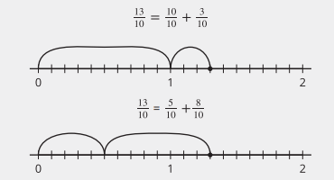
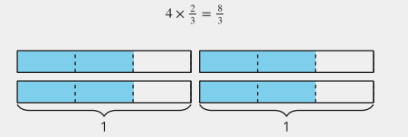
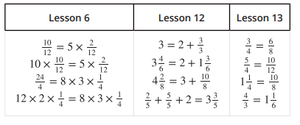
Unit 3 Progression Overview
Fraction Operations
Section A
Lessons 1-6
4.NF.B.4, 4.NF.B.4.a, 4.NF.B.4.b, 4.NF.B.4.c
Section B
Lessons 7-12
4.NF.B.3,, 4.NF.B.4.c
Section B
Lessons 13-18
4.NF.A.1, 4.NF.A.2, 4.NF.B.3., 4.NF.B.4, 4.NF.C.5
Recognize that
Represent and explain that a fraction is a multiple of , namely .
Represent and solve problems involving multiplication of a fraction by a whole number.
Represent and solve problems that involve the addition and subtraction of fractions and mixed numbers.
Use various strategies to add and subtract fractions and mixed numbers with like denominators.
Reason about equivalence to add tenths and hundredths.
Reason about equivalence to solve problems involving addition and subtraction of fractions and mixed numbers.

Slide 3



Unit 3 Quick Links
Adapt 1
L1
L2
L3
L4
L5
L6
L7
L8
L9
L10
L11
L12
L13
L14
L15
L16
L17
L18

Slide 4
Build Fractions from Unit Fractions
Adaptation
Lesson 1
Let’s name parts of a whole.
4.NF.B.3, 4.NF.B.4, 4.NF.C.5, 4.NF.A.1, 4.NF.A.2

Slide 5
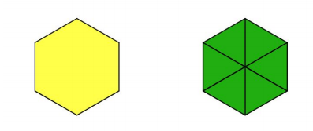
Notice and Wonder:
Two Hexagons
Warm up
What do you notice?
What do you wonder?

Slide 6

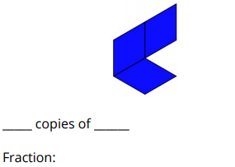
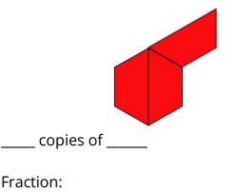
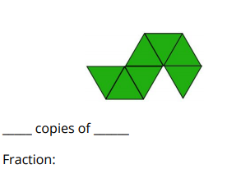
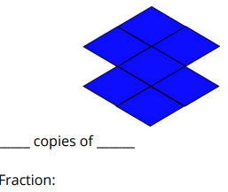
Pattern Block Fraction Puzzles
Activity #1
1. Here are some shapes built from pattern blocks. What fraction does each composite shape represent?
2. Build a shape using only copies of ½ , copies of ⅓ , or copies of ⅙ .
Challenge your partner to figure out what fraction you built. (The hexagon is still 1 whole.)

Slide 7
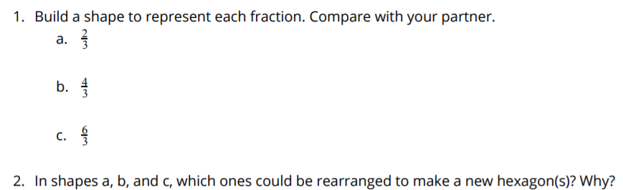

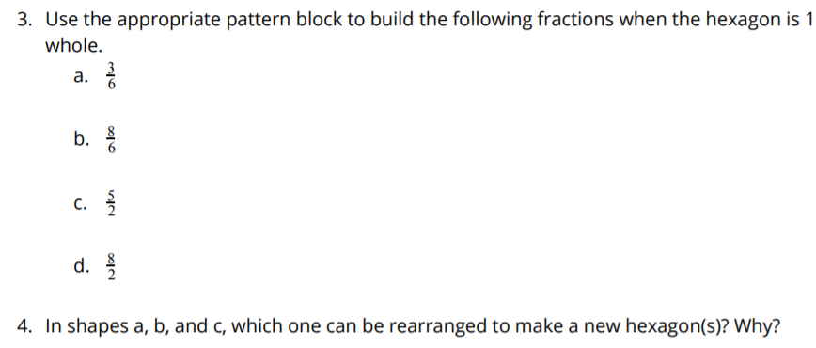
Build Shapes From Units
Activity #2

Slide 8
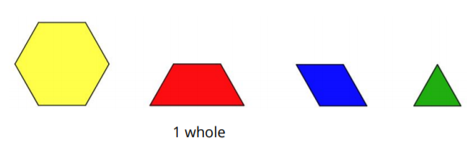
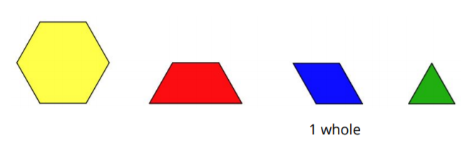
Change the Whole (Optional)
Activity #3
1. The red trapezoid is 1 whole.
Label the other blocks with the correct fraction.
Be prepared to explain your reasoning.
2. The blue rhombus is 1 whole.
Label the other blocks with the correct fraction.
Be prepared to explain your reasoning.

Slide 9



Lesson Synthesis
Based on our activities today, what do we know is the same about these two fractions? What is different?
If the hexagon represents 1 whole, could we build a whole hexagon with the following fractions.

Slide 10
Representing Equal Groups of Unit Fractions
1
Let’s identify equal groups of fractions.
4.NF.B.4.a

Slide 11

How Many Do You See: Oranges
Warm up
How many do you see?
How do you see them?

Slide 12



Equal Groups of Fractions
Activity #1
1. Lin and Andre brought fruit to share with their class.
Draw a diagram to represent each situation.
2. Describe the groups you see and how you see them.
3. Which parts of each diagram are the same?
4. Which parts of the diagram are different?
5. What expressions could you write to represent the oranges each situation?

Slide 13



Equal Groups of Fractions
Activity #1
6. Draw a diagram to represent the amount of fruit in each situation.
Clare brought 3 bags with 6 strawberries in each.
Diego put ½ apple into each of 8 bags.
Noah had 7 bags with ⅓ banana in each.
Priya packed ⅛ of a watermelon into 5 different bags.

Slide 14
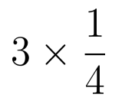
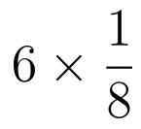



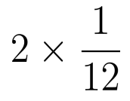

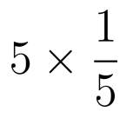
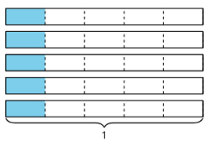

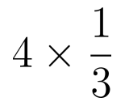
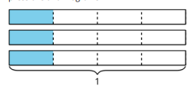
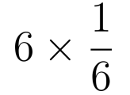
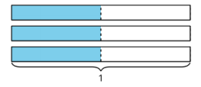

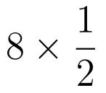
Card Sort: Expressions and Diagrams
Activity #2
Your teacher will give you a set of cards with expressions and diagrams.
1. Match each expression with a diagram that represents the same quantity.
2. Record each expression without a match and draw a diagram that matches it.

Slide 15
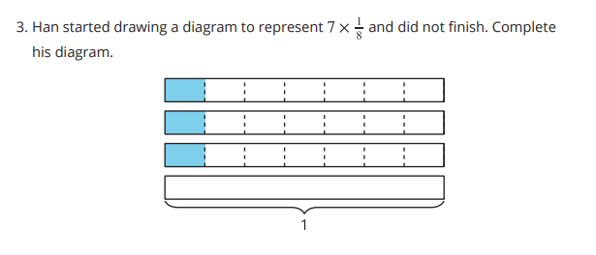
Card Sort: Expressions and Diagrams
Activity #2

Slide 16
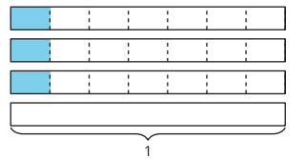
Lesson Synthesis
Today we matched diagrams for multiplication expressions and drew diagrams of equal-group situations.
What was missing from Han’s diagram? How do you know?
If the expression was for 7 groups of ⅓ instead of ⅛ how would Han’s diagram change?

Slide 17
Name That Expression
2
Let’s write multiplication expressions from diagrams and situations.
4.NF.B.4, 4.NF.B.4.a

Slide 18

Choral Count:
Warm up

Slide 19
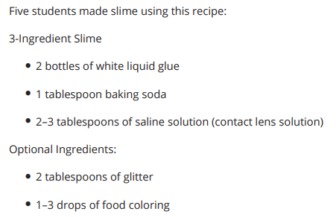
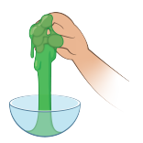
Writing Expressions
Activity #1
Here are four questions and four diagrams. Write an expression to answer each question and identify a matching diagram.
1. Each of the 5 students got ¼ pound of slime. How much slime did the students make?
2. Each person added ⅓ teaspoon of food coloring to their slime. How much food coloring did the students use?
3. Next, each person added ½ tablespoon of glitter to their slime. How much glitter did the students use?
4. The students didn’t think the slime was enough, so they made more. This time, each person got ⅛ pound of the newly made slime. How much slime did they make the second time?
Notes:
Match each fraction with a diagram that represents it. Two of the fractions are not represented. Create a representation for each of them.

Slide 20
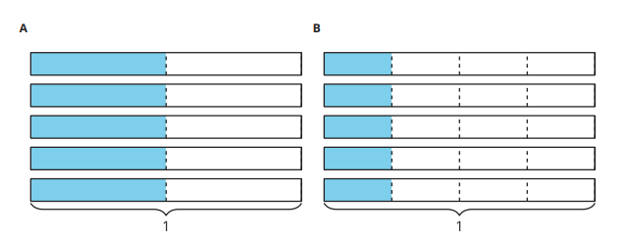
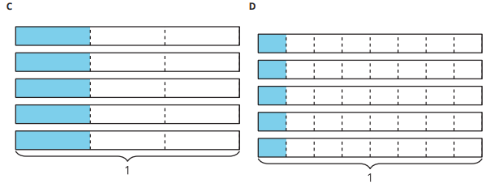
Writing Expressions
Activity #1
Here are four questions and four diagrams. Write an expression to answer each question and identify a matching diagram.
1. Each of the 5 students got ¼ pound of slime. How much slime did the students make?
2. Each person added ⅓ teaspoon of food coloring to their slime. How much food coloring did the students use?
3. Next, each person added ½ tablespoon of glitter to their slime. How much glitter did the students use?
4. The students didn’t think the slime was enough, so they made more. This time, each person got ⅛ pound of the newly made slime. How much slime did they make the second time?
Notes:
Match each fraction with a diagram that represents it. Two of the fractions are not represented. Create a representation for each of them.

Slide 21
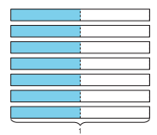
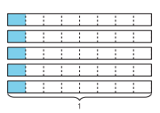
Complete the Story
Activity #2
1. Use numbers to complete each problem so it matches the diagram.
Write an expression to represent the quantity in each problem.
a. Jada made 7 cups of red slime. She added _____ tablespoon of blue food coloring to each cup to make purple slime. How much food coloring did she use?
b. _____ students each had _____ cup of slime. They combined their slime to make a large slime ball. How many cups of slime is that ball?

Slide 22
Complete the Story
Activity #2
2. A batch of slime takes ¼ hour to make. How many hours would it take to make 8 batches of slime? Draw a diagram and write an expression to match the problem.
3. Clare gave _____ friends a slime ball. Each slime ball weighed _____ pounds. How much slime did Clare give away? Use a whole number and a unit fraction to complete the problem. Draw a diagram and write an expression to answer the question.

Slide 23
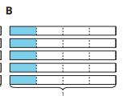

Lesson Synthesis
Today we wrote expressions to represent diagrams and problems.

Slide 24
Multiplication Patterns
3
Let’s look at patterns in multiplication of a fraction by a whole number.
4.NF.B.4, 4.NF.B.4.a, 4.NF.B.4.c

Slide 25
Choral Count:
Warm up

Slide 26
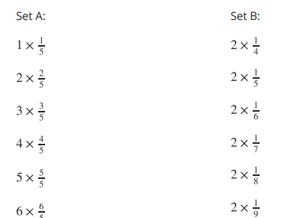
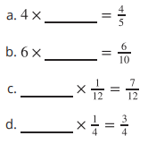
Describe the Pattern
Activity #1
1. Find the value of each expression. Use a diagram if it is helpful.
2. Describe the patterns you notice in the values of the expressions in Sets A and B.
3. Complete each equation to make it true.

Slide 27

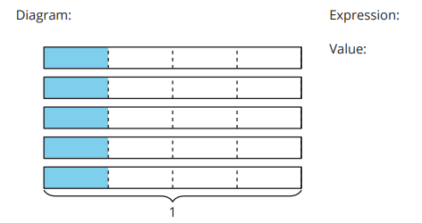

Activity #2
Diagram, Expression, and Value
1.
a. Write a multiplication expression that represents the shaded parts of the diagram. Then, find the value of the expression.
b. Draw a diagram that the expression 6 x ⅓ could represent. Then, find the value of the expression.
c. Draw a diagram and write an expression that gives the value 7/2.

Slide 28

Activity #2
Diagram, Expression, and Value
2. In your group of 4, complete the following steps. After each step, pass your paper to your right.
Step 1: Choose a fraction. Write it down.
Step 2: Write the fraction you received as a multiplication expression using a whole number and a unit fraction.
Step 3: Find the value of the expression you received.
Step 4: Draw a diagram to represent the expression.
Step 5: Discuss what’s on each paper and make revisions if needed.

Slide 29



Today we looked at multiplication expressions in two different ways. In the first activity, the number of groups changed while the unit fraction stayed the same like this:
Then we looked at a situation in which the unit fraction changed and the number of groups stayed the same, like this:
In both cases, we discussed how we could write any fraction as a product of a whole number and unit fraction. Tell a partner about how we could write as a product of a whole number and a fraction.
Lesson Synthesis

Slide 30
Groups with More Things
4
Let’s multiply any fraction by a whole number.
4.NF.B.4, 4.NF.B.4.a, 4.NF.B.4.b, 4.NF.B.4.c

Slide 31
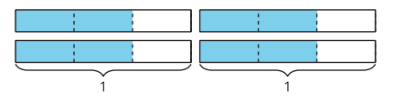
Notice and Wonder: Thirds
Warm up
What do you notice?
What do you wonder?

Slide 32
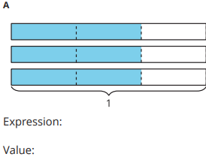
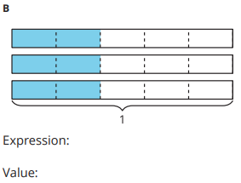
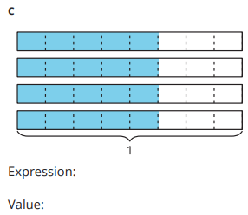
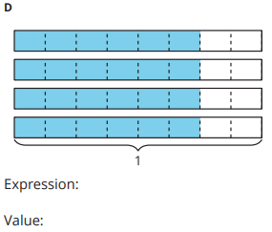
Diagrams for Groups of Many Fractions
Activity #1
1. Write a multiplication expression to represent the shaded parts of each diagram. Then, find the value of the expression.
2. What do you notice about the numbers in the multiplication expression and in the value in each case?

Slide 33
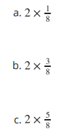
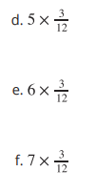
Diagrams for Groups of Many Fractions
Activity #1
3. Use the pattern to find the value of each expression. Explain your reasoning.
Draw a diagram if it is helpful.

Slide 34
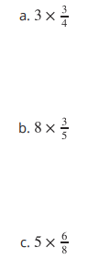
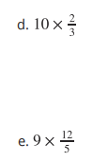
Mai’s Big Discovery
Activity #2
1. Evaluate each expression. Use a diagram if it is helpful.
2. Mai said she can multiply any fraction by a whole number by multiplying the whole number by the numerator and keeping the denominator. Do you agree with Mai? Explain your reasoning.

Slide 35

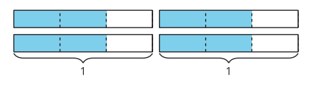
Lesson Synthesis
Today we multiplied fractions by whole numbers. Mai said she can multiply any fraction by a whole number by multiplying the whole number by the numerator and keeping the denominator.
Let’s discuss Mai’s reasoning using the expression and the diagram below from today’s warm-up, "
Why can we multiply 4 x 2 to get the numerator of the product
Why is the denominator of the product the same as the fraction in the expression?

Slide 36
Relate Multiplication Expressions
5
Let's write multiplication expressions in different ways.
4.NF.B.4.a, 4.NF.B.4.b, 4.NF.B.4.c

Slide 37
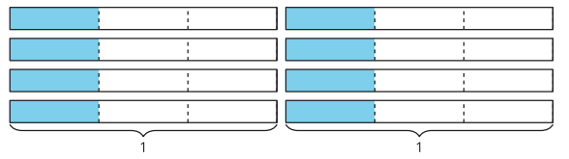
How Many Do You See?
Warm up
How many thirds do you see? How do you see them?

Slide 38
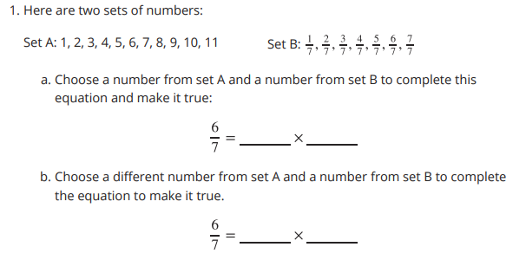
Complete the Equations
Activity #1

Slide 39
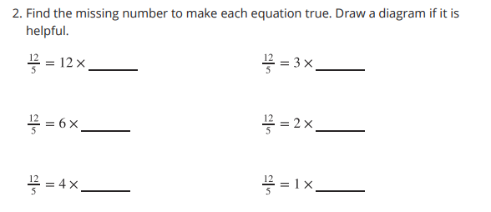
Complete the Equations
Activity #1

Slide 40
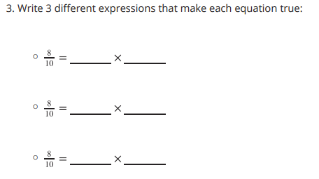
Complete the Equations
Activity #1

Slide 41

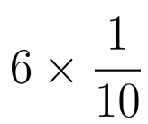
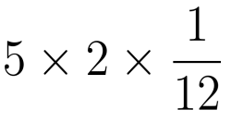






Card Sort: Equivalent Expressions
Activity #2
Your teacher will give you and your partner a set of cards that show expressions. Match each card to one of the following fractions. Record your matches.

Slide 42

Card Sort: Equivalent Expressions
Activity #2
Complete each equation to make it true. Draw diagrams if you find them useful.

Slide 43

Lesson Synthesis
Today we looked at different expressions to represent the same fraction.
Talk with your neighbor to explain how the first equation is related to the second equation, and how that one is related to the third equation

Slide 44
Batches of
Banana Bread
6
Let’s multiply to solve problems.
4.NF.B.4, 4.NF.B.4.a, 4.NF.B.4.b

Slide 45

True or False:
Two and Three Factors
Warm up
Decide whether each statement is true or false. Be prepared to explain your reasoning.

Slide 46

True or False:
Two and Three Factors
Warm up
Decide whether each statement is true or false. Be prepared to explain your reasoning.

Slide 47

True or False:
Two and Three Factors
Warm up
Decide whether each statement is true or false. Be prepared to explain your reasoning.

Slide 48

True or False:
Two and Three Factors
Warm up
Decide whether each statement is true or false. Be prepared to explain your reasoning.

Slide 49


Banana Bread Recipe
Activity #1
A bakery is making banana bread. Here is the recipe for 1 batch.
Ingredients:
1 banana
⅔ cup butter
3/2 teaspoons baking soda
⅝ cup sugar
2 large eggs
5/2 cups of all-purpose flour (sifted separately)
1. The bakery makes 2 batches of banana bread on Monday. Complete the table to show how much of each ingredient is used.

Slide 50
Banana Bread Recipe
Activity #1
A bakery is making banana bread. Here is the recipe for 1 batch.
Ingredients:
1 banana
⅔ cup butter
3/2 teaspoons baking soda
⅝ cup sugar
2 large eggs
5/2 cups of all-purpose flour (sifted separately)
2. On Tuesday, the bakery needs 8/3 cups of butter to make enough banana bread for the day. How many batches were made? Explain or show your reasoning.

Slide 51

Banana Bread Recipe
Activity #1
A bakery is making banana bread. Here is the recipe for 1 batch.
Ingredients:
1 banana
⅔ cup butter
3/2 teaspoons baking soda
⅝ cup sugar
2 large eggs
5/2 cups of all-purpose flour (sifted separately)
3. Complete the table for each ingredient based on the number of batches made on Tuesday.

Slide 52










Multiple Expressions
Activity #2
Here are five descriptions of situations and five expressions.
In each situation, each loaf of banana bread is cut into 10 equal slices, so 1 slice is 1/10 of a loaf.
Each expression represents loaves of banana bread purchased over a period of time.
*Match each description to an expression that represents it

Slide 53


Lesson Synthesis
Today we matched expressions to different situations that they represent. We learned that several expressions can represent the same situation.
Did you notice something about the answers to the problems?
Who can explain how each expression matches the problem
Why do you think they are all the same?

Slide 54

Section Summary
In this section, we learned about multiplying a fraction by a whole number.
In the beginning, we used diagrams and multiplication expressions to represent equal-size groups where the size of each group is a whole number. For instance, we thought of “6 baskets with 4 balls in each” as 6 equal groups of 4, or 6 x 4 .
Later, we used diagrams and expressions to represent equal groups with a fractional amount in each group, such as "6 bags with ½ an apple in each bag" or 6 groups of ½ .
We analyzed patterns and noticed that when we multiply a fraction and a whole number, the whole number is multiplied only by the numerator of the fraction and the denominator stays the same. For example:

Slide 55
Section Summary
We also learned that:
Every fraction can be written as a product of a whole number and a unit fraction.
  For example, 5/4 can be written as 5 x ¼ .
A fraction whose denominator is not 1 can be expressed with different multiplication expressions that are equivalent.
  For example, 8/3 can be expressed as:
    8 x ⅓ , 4 x 2 x ⅓ , 4 x ⅔ , and 2 x 4/3

Slide 56
Fractions as Sums
7
Let’s write fractions as sums.
4.NF.B.3, 4.NF.B.3.b

Slide 57
Choral Count:
Three-Fourths at a Time
Warm up
Count by ¾ , starting at 0

Slide 58

Barley Soup
Activity #1
Lin is learning to make barley soup using a family recipe. Here are some ingredients in the recipe:
¾ cup of barley
5/4 cups of chopped celery
6/4 cups of chopped carrots
1 cup of chopped onions
2 ¼ cups of vegetable broth
1. Lin has only one measuring cup that measures ¼ cup. Show how Lin could use the cup to measure the right amount of each ingredient.
Barley:
Celery:
Carrots:
Onions:
Vegetable broth:

Slide 59
Barley Soup
Activity #1
Lin is learning to make barley soup using a family recipe. Here are some ingredients in the recipe:
¾ cup of barley
5/4 cups of chopped celery
6/4 cups of chopped carrots
1 cup of chopped onions
2 ¼ cups of vegetable broth
2. Lin later found a ¾ -cup measuring cup. Show how she could use the cups to measure the right amount of each ingredient.
Barley:
Celery:
Carrots:
Onions:
Vegetable broth:

Slide 60



Sums in Fifths and Thirds
Activity #2
1. Use different combinations of fifths to make a sum of 9/5.
2. Write different ways to use thirds to make a sum of 4/3.
How many can you think of? Write an equation for each combination.

Slide 61


Lesson Synthesis
In earlier lessons, we saw that a fraction whose numerator is greater than 1 can be written as products. Let’s take 4/3, for example.
We can write:
Today, we saw that a fraction whose numerator is greater than 1 can also be seen as sums.
Compare these two ways of thinking about fractions. How are they alike?
How are they different

Slide 62
Addition of Fractions
8
Let’s explore sums of fractions on a number line.
4.NF.B.3.a, 4.NF.B.3.b

Slide 63

Warm up
Notice and Wonder:
A Fraction on a Number Line
What do you notice?
What do you wonder?

Slide 64


Activity #1
Sum of Jumps
1. Noah draws number lines with a series of “jumps” to show different ways to use sixths to make a sum of 8/6 . He writes 8/6 = 4/6 + 4/6 for the first diagram.
a. Write an equation for each of the other two diagrams.
b. For the following diagram,
Noah writes: 8/6 = 6/6 + 2/6 and 8/6 = 1 + 2/6. Which equation is correct? Explain your reasoning.

Slide 65

Activity #1
Sum of Jumps
2.
a. Draw "jumps" on the number lines to show two ways to use thirds to make a sum of 7/3 .
Then, represent each combination of jumps as an equation.
b. Write 7/3 as a sum of a whole number and a fraction.

Slide 66


What is the Sum?
Activity #2
1. Use a number line to represent each addition expression and to find the sum.
2. Priya says the sum of 1 ⅖ and ⅘ is 1 6/5 . Kiran says the sum is 11/5 . Tyler says it is 2 ⅕ . Do you agree with any of them? Explain or show your reasoning. Use one or more number lines if you find them helpful.

Slide 67

Make Two Jumps
Activity #3
Here are four number lines,
each with a point on it.
For each number line, label the point. This is your target. Make two forward jumps to get from 0 to the target.
Pick a card from the set given to you. Use the fraction on it for your first jump. Draw the jump and label it with the fraction.
From there, draw the second jump to reach the target. What fraction do you need to add? Label the jump with the fraction.
Write an equation to represent the sum of your two fractions.

Slide 68
Lesson Synthesis
Today, we used number lines to decompose fractions into sums of smaller fractions or sums of a whole number and a fraction. We also learn that a fraction greater than 1 can be written as a mixed number.
Let’s look at some sums you found in the second activity: ⅞ ,10/8 , and 20/8 . Which ones can be written as mixed numbers and why?
How would you explain to a classmate who is absent today what a mixed number is? What examples would you give to help them understand it
What mixed number is equivalent to each of those fractions? How do you know?

Slide 69
Differences of Fractions
9
Let’s explore differences of fractions on a number line.
4.NF.B.3.a, 4.NF.B.3.c

Slide 70

What Do You Know About:
Warm up

Slide 71


Activity #1
Differences of Jumps
1. To subtract different fractions from 11/6, Noah draws “jumps” on number lines.
a. The first diagram shows how he finds .
What is the difference (the result of the subtraction)?
b. Write an equation and find the difference for each of Noah’s diagrams.

Slide 72



Activity #1
Differences of Jumps
2. Here is another diagram Noah draws:
Which equations could the diagram represent? Explain your reasoning.
3. Use a number line to show how to find each difference.

Slide 73






What’s the Difference?
Activity #2
Use a number line to represent each subtraction expression and to find the difference.

Slide 74

Make Two Jumps, Subtraction Edition
Activity #3
Here are four number lines, each with a point on it.
For each number line, label the point. This is your target. Then, make two jumps to get from 0 to the target.
Pick a card from the set given to you. Use the fraction on it for your first jump. Draw the jump and label it with the fraction.
From there, draw the second jump to reach the target. What fraction do you need to subtract? Label the jump with the fraction.
Write an equation to represent the difference of your two fractions.

Slide 75



Lesson Synthesis
Today we learned to subtract a fraction from a fraction and a whole number from a fraction. We used a number line to help us.
How might we find the value of:
How might we find the value of:
How might we find the value of:

Slide 76
The Numbers in Subtraction
10
Let’s find out how to subtract fractions from whole numbers.
4.NF.B.3.c, 4.NF.B.3.d, 4.NF.B.4.c

Slide 77

Number Talk: Groups of Twelfths
Warm up
Find the value of each expression mentally.

Slide 78

Number Talk: Groups of Twelfths
Warm up
Find the value of each expression mentally.

Slide 79

Number Talk: Groups of Twelfths
Warm up
Find the value of each expression mentally.

Slide 80

Number Talk: Groups of Twelfths
Warm up
Find the value of each expression mentally.

Slide 81



Activity #1
What’s Left?
2. A second pitcher contains 4 cups of water.
How many cups will be left in that pitcher if we pour each of the following amounts from the full amount? Explain or show your reasoning. Use diagrams or equations, if they are helpful.
1. A pitcher contains 3 cups of watermelon juice.
How many cups will be left in the pitcher if we pour each of the following amounts from the full amount?

Slide 82









Card Sort: Twelfths
Activity #2
1. Sort the cards from your teacher into two groups. Record your sorted expressions. Be prepared to explain why the cards in each group belong together.

Slide 83

Card Sort: Twelfths
Activity #2
2. Find each difference. Show your reasoning.

Slide 84

Lesson Synthesis
Today we learned that we can subtract a fraction from a whole number by either rewriting the whole number as a fraction, or by decomposing the whole number.
Are there any other words or phrases that are important to include on our display?

Slide 85
Subtract Fractions Flexibly
11
Let’s find all kinds of differences.
4.NF.B.3.c, 4.NF.B.3.d

Slide 86

Which One Doesn’t Belong:
Fractional Values
Warm up

Slide 87


Activity #1
Friendship Bracelets
Clare, Elena, and Tyler are making macramé friendship bracelets. They’d like their bracelets to be inches long. For each question, explain or show your reasoning.
1. Clare started her bracelet first and has only ⅞ inch left until she finishes it. How long is her bracelet so far?
2. So far, Elena’s bracelet is 5 ⅛ inches long and Andre’s is 3 ⅝ inches long. How many more inches do they each need to reach 9 4/8 inches?
3. How much longer is Elena’s bracelet than Andre’s at the moment?

Slide 88

Activity #2
Multiple Ways to Subtract
Here are four expressions that you may have written about the friendship bracelets.
1. Here is one way to find the value of the first expression. Analyze the calculation. Talk to your partner about why is written as different sums.

Slide 89



Activity #2
Multiple Ways to Subtract
2. Here are some unfinished calculations. Complete them to find each difference

Slide 90
Lesson Synthesis
When might it be helpful or necessary to decompose a whole number into a sum in order to subtract a fraction?

Slide 91
Sums and Differences of Fractions
12
Let’s look at some problems that can be solved by adding and subtracting fractions.
4.NF.B.3.c, 4.NF.B.3.d

Slide 92

True or False: A Mix of Equations
Warm up
Decide whether each equation is true or false. Be prepared to explain your reasoning

Slide 93

True or False: A Mix of Equations
Warm up
Decide whether each equation is true or false. Be prepared to explain your reasoning

Slide 94

True or False: A Mix of Equations
Warm up
Decide whether each equation is true or false. Be prepared to explain your reasoning

Slide 95

True or False: A Mix of Equations
Warm up
Decide whether each equation is true or false. Be prepared to explain your reasoning

Slide 96

Activity #1
Shoe Sizes
Here is a chart that shows “big kids” shoe sizes and the insole lengths in inches.
For each question, explain or show your reasoning.
Priya’s shoe size went from 2 to 4 in the past year. How much did her feet grow in inches?
Mai’s shoe size is 2.5 and her older cousin’s shoe size is 5. What is the difference in their foot length in inches?
3. The insole length of Tyler’s shoes increased ⅜ inch in the past year. What was his shoe size a year ago and what is it now?

Slide 97

Activity #1
Shoe Sizes
4. Collect some shoe-size data.
Record your shoe size and those of at least 3 classmates. Use the given chart in the first problem to find out the length of each shoe size in inches
b. Identify the largest and smallest shoe sizes in your data set. Find the difference in lengths, in inches, of those two sizes.
c. Write a new question about shoe sizes that can be answered by adding or subtracting the insole lengths.

Slide 98


Activity #2
Make It True
Find the missing number that would make each equation true. Show your reasoning.

Slide 99

Activity #3
To Decompose or Not to Decompose
1. Here are some addition and subtraction expressions. Sort them into two groups based on whether you think it would be helpful to decompose a number to find the value of the expression. Be prepared to explain your reasoning.
Not necessary or not helpful to decompose any number:
Necessary or helpful to decompose one or more numbers:

Slide 100
Activity #3
To Decompose or Not to Decompose
2. Choose at least one expression from each group and find their values. Show your reasoning.

Slide 101
Section Summary
In this section, we learned to add and subtract fractions with the same denominator, using number lines to help with our reasoning.
In the beginning, we saw that a fraction can be decomposed into a sum of other fractions. For example: 6/10 can be decomposed into 4/10 + 2/10.
If the fraction is greater than 1, it can be decomposed into a whole number and a fraction. For instance: 17/10 can be decomposed into 10/10 + 7/10 . Because 10/10 is equivalent to 1, we can write , 1 + 7/10 or 1 7/10, which we call a mixed number.
Later, we learned to add and subtract all kinds of fractions by writing equivalent fractions and decomposing numbers into sums.

Slide 102
An Assortment of Fractions
13
Let’s find the heights of some stacked objects with different fractional heights.
4.NF.A.1, 4.NF.A.2, 4.NF.B.3.d

Slide 103

True or False: Are They Equal?
Warm up
Decide whether each equation is true or false. Be prepared to explain your reasoning

Slide 104

True or False: Are They Equal?
Warm up
Decide whether each equation is true or false. Be prepared to explain your reasoning

Slide 105

True or False: Are They Equal?
Warm up
Decide whether each equation is true or false. Be prepared to explain your reasoning

Slide 106

True or False: Are They Equal?
Warm up
Decide whether each equation is true or false. Be prepared to explain your reasoning

Slide 107


Activity #1
All the Way to the Top
Priya, Kiran, and Lin are using large playing bricks to make towers. Here are the heights of their towers so far:
For each question, show your reasoning.
1. How much taller is Lin’s tower compared to: a. Priya’s tower?
b. Kiran’s tower?
2. They are playing in a room that is 109 inches tall. Priya says that If they combine their towers to make a super tall one, it would be too tall for the room and they’ll have to remove one brick.
Do you agree with Priya? Explain your reasoning

Slide 108

Activity #2
Stacks of Blocks
Andre is building a tower out of foam blocks. The blocks come in three different thicknesses: ½ foot, ⅓ foot, and ⅙ foot.
1. Andre stacks one block of each size. Will that stack be more than 1 foot tall? Explain or show how you know.
2. Can Andre use only the ⅙ -foot and ⅓ -foot blocks to make a stack that is 1 ½ feet tall? If you think so, show one or more ways. If not, explain why not.
3. Can Andre use only the ⅙ -foot and ½ -foot blocks to make a stack that is 1 ⅓ feet tall? If so, show one or more ways. If not, explain why not.

Slide 109
Lesson Synthesis
Today we solved problems where we had to combine halves, fourths, and eights, or removed one of those fractions from another. We also combined halves, thirds, and sixths
Suppose a classmate who is absent today says that it is not possible to find the combined length of ½ inch and ⅜ inch (or to find the difference between the two lengths) because the fractions have different-size parts. How would you convince them that it can be done?
In upcoming lessons, we’ll use some of the strategies we used today to combine tenths and hundredths.

Slide 110
Tenths and Hundredths, Together
14
Let’s add some tenths and hundredths.
4.NF.C.5

Slide 111


Estimation Exploration:
An Ant on a Noodle
Warm up
A foam noodle is 100 centimeters or 1 meter long. An ant is walking from one end of the noodle toward the other end.
Estimate the distance of the ant from its starting point, in centimeters. Make an estimate that is:

Slide 112


Activity #1
Tenths and Hundredths
1. Complete the table with equivalent fractions in tenths or hundredths. In the last row, write a new pair of equivalent fractions.
2. Here are some pairs of sums of fractions. For each pair, decide which sum is greater. Show your reasoning.

Slide 113


Activity #2
Walk, Stop, and Sip
Noah walks 2/10 kilometer (km), stops for a drink of water, 5/100 walks kilometer, and stops for another sip.
The diagram that you didn’t choose represents Jada’s walk. Write an equation to represent:
a. the total distance Jada has walked
b. the total distance Noah has walked
Find the value of each of the following sums. Show your reasoning. Use number lines if you find them helpful.

Slide 114

Lesson Synthesis
Today we learned to find the sum of tenths and hundredths. We used what we know about equivalent fractions and what we know about adding fractions with the same denominator.
How would you interpret this work? What is happening in each part
Suppose we’re adding and . Here’s one way to record our thinking for finding the sum
Is there another way to find the sum?
Are the two results the same?

Slide 115
Sums of Tenths and Hundredths
15
Let’s add larger tenths and hundredths.
4.NF.C.5

Slide 116

Which One Doesn’t Belong:
Tenths and Hundredths
Warm up

Slide 117
Activity #1
Card Sort:
Less Than, Equal to, or Greater Than 1?
1. Sort the cards from your teacher based on whether the value of the expression is less than 1, equal to 1, or greater than 1. When done, make a quick note of which expressions you have in each group.
2. Visit the sorted collection of another group. Did they sort the cards the same way? Select 1–2 cards that you have a question about or whose placement you disagree with. Leave a note for the group members to discuss.
3. Return to your collection. Discuss any notes that are left for your group, or revise your sorting decision based on what you learned from another group. Record the expressions here.
less than
1 equal to 1
greater than 1

Slide 118




Activity #2
What’s Missing?
1. Each equation is missing a fraction in hundredths. Find the missing fraction to make the equation true.
2. Each equation is missing a fraction in tenths. Find the missing fraction to make the equation true.

Slide 119

Activity #3
Fraction Action (Tenths, Hundredths)
Play Fraction Action with 2 players:
Shuffle the cards from your teacher. Place the cards in a stack, face down.
Each player turns 2 cards over and adds the fractions on the cards.
Compare the sums. The player with the greater sum wins that round and keeps all four cards.
If the sums are equivalent, each player turns one more card over and adds the value to their sum.
The player with the greater new sum keeps all cards.
The player with the most cards wins the game.
Play Fraction Action with 3 or 4 players:
The player with the greatest sum of fractions wins the round.
If 2 or more players have the greatest sum, those players turn two more cards over and find their sum. The player with the greatest sum keeps all the cards.

Slide 120
Lesson Synthesis
Today we practice finding sums of fractions and finding missing fractions that would make addition equations true.
What strategies did you find helpful when adding tenths and hundredths and writing true equations with both tenths and hundredths?
Was there an error that you made or something that was missed multiple times? What was it? Why might it be an easy error to make or an easy thing to miss?

Slide 121
Lots of Fractions to Add
16
Let’s add tenths and hundredths again, more than two at a time.
4.NF.B.4.c, 4.NF.C.5

Slide 122
Number Talk: A Bunch of Numbers
Warm up
Find the value of each expression mentally.

Slide 123
Number Talk: A Bunch of Numbers
Warm up
Find the value of each expression mentally.

Slide 124
Number Talk: A Bunch of Numbers
Warm up
Find the value of each expression mentally.

Slide 125
Number Talk: A Bunch of Numbers
Warm up
Find the value of each expression mentally.

Slide 126


Activity #1
Stacking Centavos and Pesos
Diego and Lin each have a small collection of Mexican coins. The table shows the thickness of different coins in centimeters (cm) and how many of each Diego and Lin have.
1. If Diego and Lin each stack their centavo coins, whose stack would be taller? Show your reasoning.
2. If they each stack their peso coins, whose stack would be taller? Show your reasoning.
3. If they each stack all their coins, whose stack would be taller? Show your reasoning.
4. If they combine their coins to make a single stack, would it be more than 2 centimeters tall? Show your reasoning.

Slide 127


Activity #2
More Than Two Fractions
Find the value of at least 3 of the expressions. Show your reasoning.

Slide 128
Lesson Synthesis
Today we used what we know about equivalent fractions and addition of fractions, including mixed numbers, to solve problems.
In what ways has your ability to add fractions improved? What might still be challenging?
Did you find yourself making the same kind of error multiple times? What was the error and why might you be making it?

Slide 129
Flexible with Fractions
17
Let’s solve all kinds of problems involving fractions.
4.NF.B.3.c, 4.NF.B.3.d, 4.NF.B.4, 4.NF.C.5

Slide 130

Notice and Wonder: Sticky Notes
Warm up
What do you notice?
What do you wonder?

Slide 131

Activity #1
Sticky-Note Designs
Is the folder tall enough and wide enough for his designs? If so, which design(s) would fit?
Show your reasoning.

Slide 132
Activity #2
Find a Match
Your teacher will give you one card with an expression on it.
1. Find the value of the expression.
2. Find a classmate whose card also has the same value. Prove to each other that you’re a match.
3. Work with your partner to find at least two features that your expressions share (other than the fact that they have the same value.)
4. Write one more expression that has the same value but uses a different operation.

Slide 133



Activity #3
Hiking Trails
1. Jada and Noah hike the orange trail from point F to point E, make one full loop on the red trail back to point E, and then hike from E back to F.
How many miles do they hike? Show your reasoning
2. Here are two expressions that represent some hiking situations and can help to answer two questions. What question might each expression help to answer? Write the question and the answer.
3. Use the distances on the map to write a new question and find its answer. Then, trade questions with a partner and answer one another's question.
Jada and Noah’s class are hiking at a park. Here is a map of the trails. The length of each trail is shown.

Slide 134
Lesson Synthesis
Today we used what we know about equivalent fractions and addition of fractions, including mixed numbers, to solve problems.
What were some important things you learned about solving problems with fractions?
What were some helpful ways to prevent making common errors?
What were some helpful ways to get started?
How did you know if your answers make sense?

Slide 135

Section Summary
In this section, we learned more ways to add fractions and to solve problems that involve adding, subtracting, and multiplying fractions.
We started by adding tenths and hundredths, using what we know about equivalent fractions. For example, to find the sum of 4/10 and 30/100, we can:
Next, we learned that If there are more than two fractions to add, it may help to rearrange or group them. For instance: 6/100 + 2/10 + 74/100 can be rearranged as 6/100 + 74/100 + 2/10 . Then, the hundredths can be added first, giving 80/100 + 2/10. We can then use equivalent fractions in tenths or in hundredths to find the sum.
Finally, we used multiplication, addition, and subtraction to solve problems about lengths, weights, distances, and more.

Slide 136
Sticky Notes
18
Let’s make a sticky note design.
4.NF.B.3.d, 4.NF.B.4

Slide 137

Which One Doesn’t Belong:
Sticky Notes
Warm up

Slide 138

Activity #1
Estimation Exploration: Sticky Notes
1. How many sticky notes will fit across the top or the side of the page? Record an estimate that is: too low about right too high
2. What information do you need to help you make a better estimate?
3. With the new information you have now, make a better estimate. Show or explain your reasoning.
4. Write an expression that represents your estimate that shows how many sticky notes fit across or on the side of the paper.

Slide 139
Activity #2
Design Your Initial
Design your initial with sticky notes.
1. Plan your design and determine the number of sticky notes that you need.
2. Write at least two equations that show your design will fit on a piece of paper.
3. Take turns sharing your design with your partner.
4. Get the supplies and make your design.

Slide 140
Lesson Synthesis
Today we made sticky note designs.
What was the most challenging part of your experience today? What would you do differently to make it less challenging?
What was the easiest part of your experience today? How would you make it more challenging

