Slide 1

Fraction Equivalence and Comparison
Grade 4: Unit 2
Standards addressed: 4.NF.A.1, 4.NF.A.2
These slides have been created by Britnee Wright- Southeast Arkansas Education Cooperative and are not official IM materials. Images and language are taken from IM Grade 5, Unit 2 by Illustrative Mathematics.
Copyright 2020 by Illustrative Mathematics. All Rights Reserved, adapted and shared with permission.

Slide 2

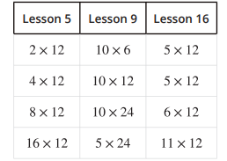
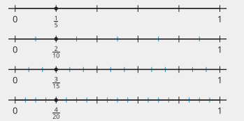

Unit 2 Progression Overview
Fraction Equivalence and Comparison
Section A
Lessons 1-6
Section B
Lessons 7-11
Section B
Lessons 12-17
Make sense of fractions with denominators 2, 3, 4, 5, 6, 8, 10, and 12 through physical representations and diagrams.
Reason about the location of fractions on the number line.
Generate equivalent fractions with the following denominators: 2, 3, 4, 5, 6, 8, 10, 12, and 100.
Use visual representations to reason about fraction equivalence, including using benchmarks such as 1/2 and 1.
Use visual representations or a numerical process to reason about fraction comparison.

Slide 3



Unit 2 Quick Links
Adapt 1
Adapt 2
Adapt 3
Adapt 4
Adapt 5
Adapt 6
Adapt 7
Adapt 8
L1
L2
L3
L4
L5
L6
L7
L8
L9
L10
L11
L12
L13
L14
L15
L16
L17

Slide 4
Name the Parts
Adaptation
Lesson 1
Let’s name parts of a whole.
3.G.A.2

Slide 5
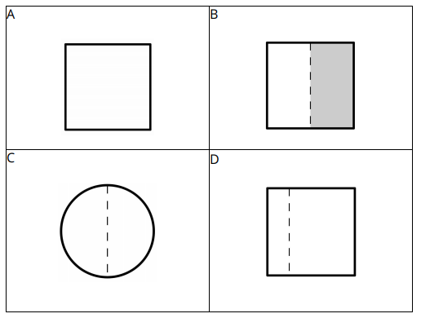
Which One Doesn’t Belong?
Warm up

Slide 6
Partition Problems
Activity #1
Solve each problem. Draw a diagram to show your thinking
A space on a table is shared equally for 3 activities. How much of the table is used for each activity?
Two students want to share one piece of tape so each student gets the same amount. How much of the piece of tape will each student get?
Some classes are sharing a basketball court for P.E. If 4 classes share the court equally how much of the court does each class get to use?

Slide 7
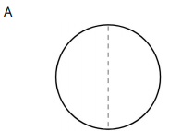
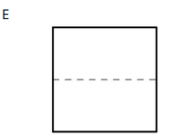
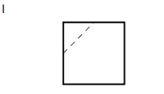
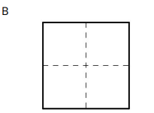
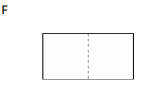
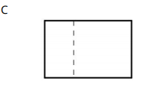
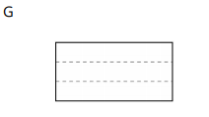
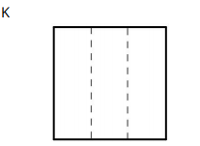
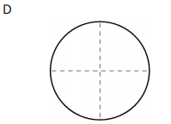
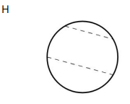
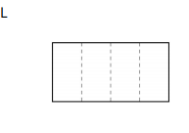
Partition Sort
Activity #2
Sort the shapes in any way that makes sense to you. Be ready to explain your reasoning

Slide 8
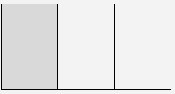

Let’s Put it All Together
Lesson Synthesis
“Today we learned is the number you use when you partition a whole into equal parts and describe 3 1 one of them.”
How do the 1 and the 3 connect with the diagram?

Slide 9
Unit Fractions
Adaptation
Lesson 2
Let’s learn about unit fractions
3.G.1.2, 3.NF.A.1

Slide 10
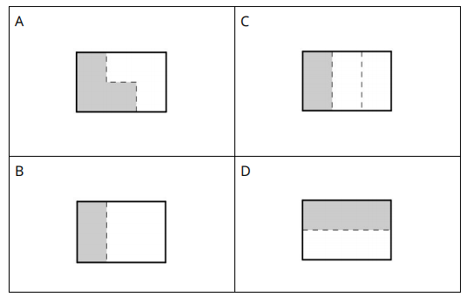
Which One Doesn’t Belong?
Warm up

Slide 11
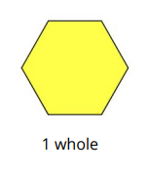
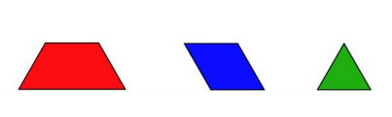
Fractions with Pattern Blocks
Activity #1
The yellow hexagon is 1 whole.
What number represents each other block?
Be prepared to explain your reasoning.

Slide 12
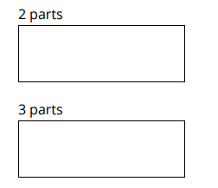
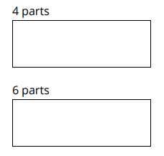
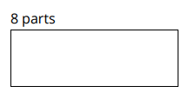
Partitions
Activity #2
Partition each rectangle into 2, 3, 4, 6, or 8 equal parts.
Then label the size of each part with the correct fraction.

Slide 13
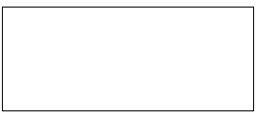
Partition, Shade, Trade
Activity #3
1. Partition the rectangle into equal-sized parts. Shade one of the parts.
2. Trade rectangles with a partner. If the whole rectangle is 1, what number represents the shaded part? Explain your reasoning.

Slide 14


Let’s Put it All Together
Lesson Synthesis
“Today we wrote fractions to show the size of each part when we partitioned a shape into 6 equal parts and 8 equal parts”
How are they different?
How are these fractions the same as other fractions you’ve already written?

Slide 15
Non-unit Fractions
Adaptation
Lesson 3
Let’s learn about non-unit fractions
3.NF.A.1

Slide 16
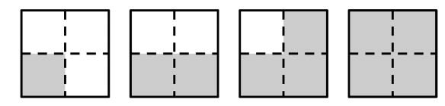
Notice and Wonder: More Than One Part
Warm up
What do you notice?
What do you wonder?

Slide 17
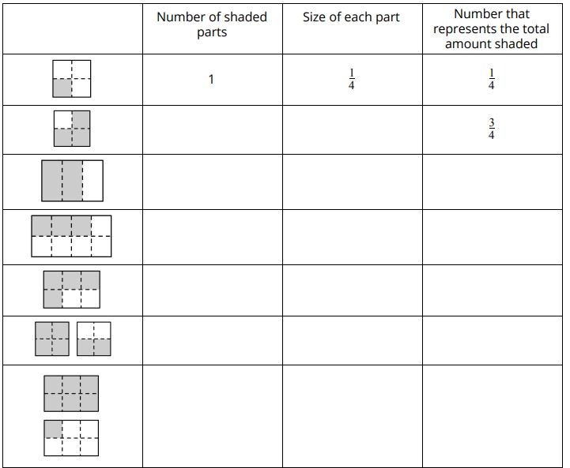
Write Fractions
Activity #1
You learned how to represent the shaded amount in the first diagram with the number ¼ .
Use the diagrams in the table to figure out the information that’s missing.
Be prepared to explain your reasoning.

Slide 18
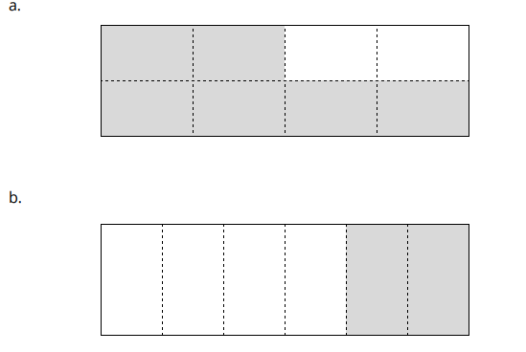
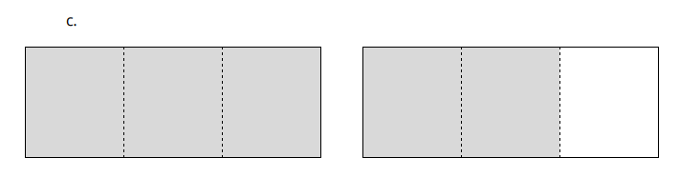
Identify and Shade Fractions
Activity #2
Part 1:
1. What fraction is shaded? Explain your reasoning.

Slide 19
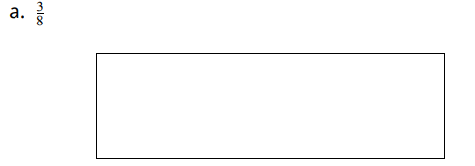
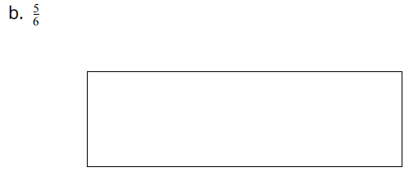
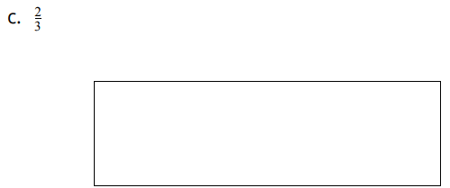
Identify and Shade Fractions
Activity #2
Part 2:
2. Partition and shade each diagram to represent each fraction.

Slide 20


Let’s Put it All Together
Lesson Synthesis
Look at the fraction . What does each part of the number tell us?
How did you see unit fractions helping us build new fractions today?
“Today we learned how to build more fractions, like ⅝ , from fractions we already knew, like ⅛ . We call fractions, like , with a one in the top part, unit fractions.

Slide 21
Unit Fractions on a Number Line
Adaptation
Lesson 4
Let’s represent unit fractions on a number line.
3.NF.A.1, 3.NF.A.2.A

Slide 22
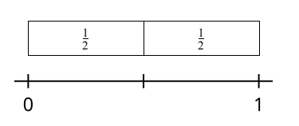
Notice and Wonder: Strips and Number Lines
Warm up
What do you notice?
What do you wonder?

Slide 23


Thinking about on the Number Line
Activity #1
Andre is labeling his number line and says ½ can be labeled like this:
Clare is labeling her number line and says ½ can be labeled like this:
How could each student’s labeling make sense?

Slide 24
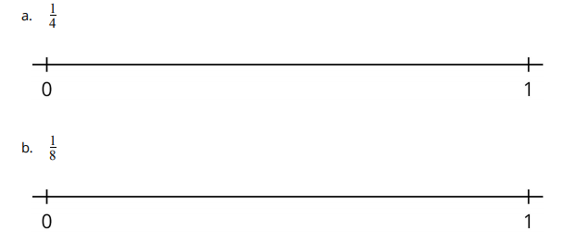
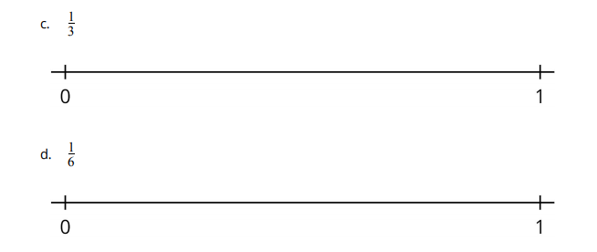
Unit Fractions on a Number Line
Activity #2
1. Partition each number line so that you can locate and label each fraction
2. How is seeing the parts of a partitioned number line the same as seeing the parts of a partitioned rectangle? How is it different?

Slide 25

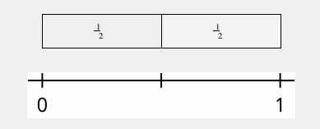
Let’s Put it All Together
Lesson Synthesis
“Today we started to use what we know about fractions to put fractions on number lines.”
How could we use this length to locate and label the number on this number line?
What connections did you notice between fraction strips and number lines during the lesson?

Slide 26
Locate Unit Fractions and 1 on the Number Line
Adaptation
Lesson 5
Let’s locate unit fractions and 1 on the number line
3.NF.A.2.A

Slide 27
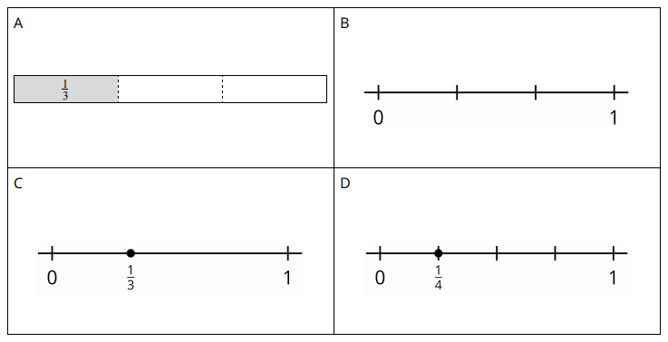
Which one doesn’t belong?
Warm up

Slide 28

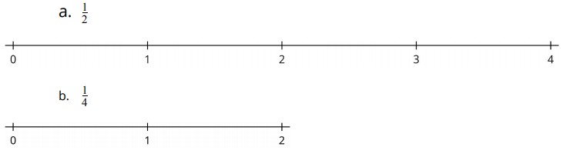
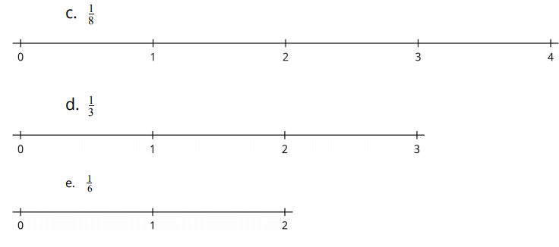
Partition a Number Line
Activity #1
1. Elena says the number line is partitioned into fourths. Do you agree or disagree? Explain your reasoning.
2. Partition each number line. Locate and label each fraction.

Slide 29
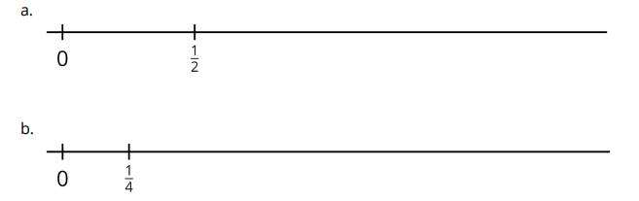
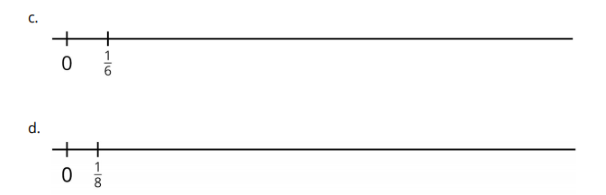
Locate 1 on the Number Line
Activity #2
1. Locate and label 1 on each number line. Be prepared to explain your reasoning.
2. How could you locate 2 on the number lines in the previous problem?

Slide 30

Let’s Put it All Together
Lesson Synthesis
“Today we used our knowledge of unit fractions and the number line to locate unit fractions on the number line and used unit fractions to help us find 1 on the number line. We have seen unit fractions represented several ways now”
What is particularly helpful for you to remember when you are locating unit fractions on the number line?
How are these representations the same? How are they different?

Slide 31
Non-Unit Fractions on the Number Line
Adaptation
Lesson 6
Let’s locate fractions on the number line.
3.NF.A.2.B

Slide 32
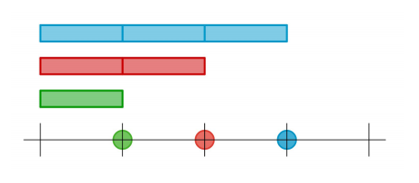
Notice and Wonder: Strips and Dots
Warm up
What do you notice?
What do you wonder?

Slide 33
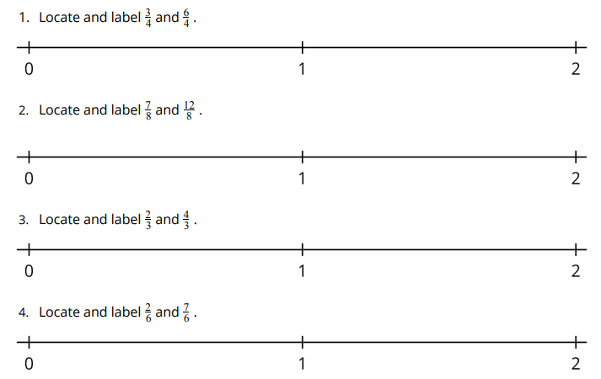
Fractions on the Number Line
Activity #1
5. How did you partition the number line when you were locating the numbers ⅞ and 12/8 and ? Explain your reasoning.
6. What is the same and what is different about the first number and the second number you located in each problem?

Slide 34
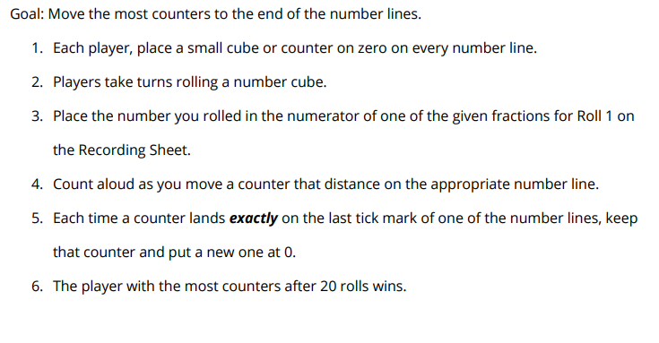
Many Fractions on Many Number Lines
Activity #2

Slide 35
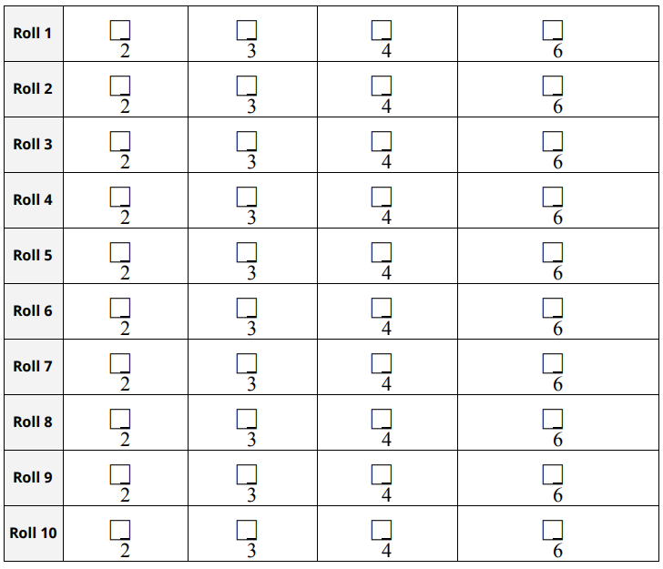
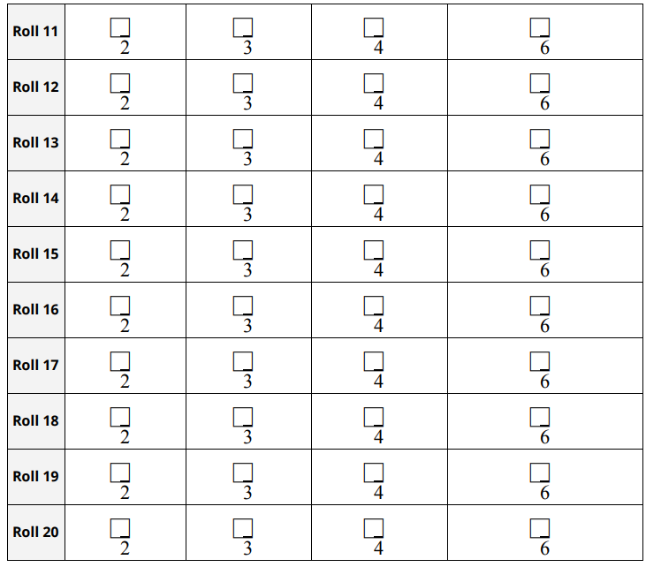
Many Fractions on Many Number Lines
Activity #2

Slide 36
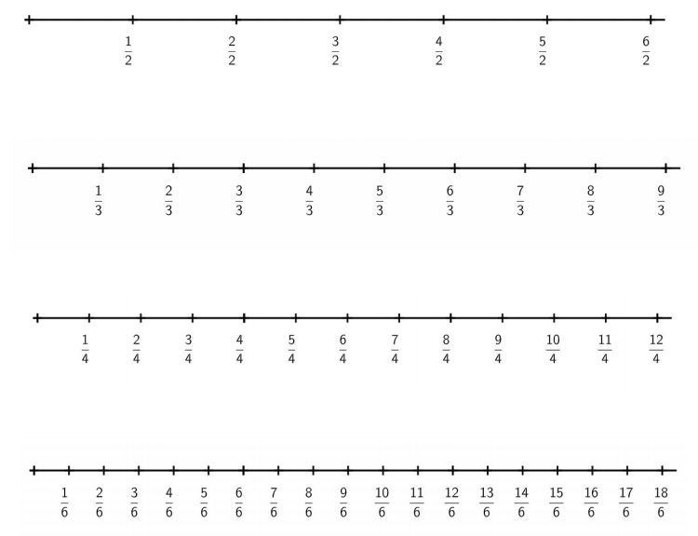
Many Fractions on Many Number Lines
Activity #2

Slide 37

Secret Fraction
Activity #3
1. Partition the number line in any way you’d like in equal size parts. Locate and mark, but don’t label, a fraction of your choice.
2. Trade number lines with a partner.
a. How did your partner partition their number line? Explain your reasoning.
b. What number did your partner mark on their number line? Explain your reasoning

Slide 38
Let’s Put it All Together
Lesson Synthesis
“Today we located more fractions on the number line.”
What questions do you have about locating fractions on the number line?
What strategies do you have for locating fractions on the number line?

Slide 39
Equivalent Fractions
Adaptation
Lesson 7
Let’s learn about equivalent fractions
3.NF.A.2

Slide 40
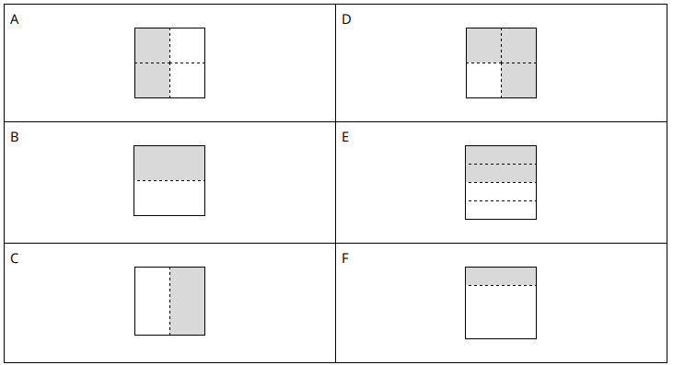
Is it ½ ?
Activity #1
Which figures have ½ of the shape shaded? Be prepared to share your reasoning

Slide 41
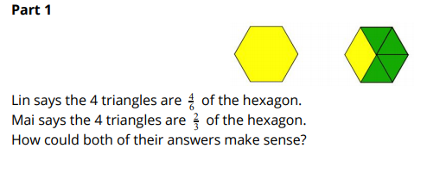
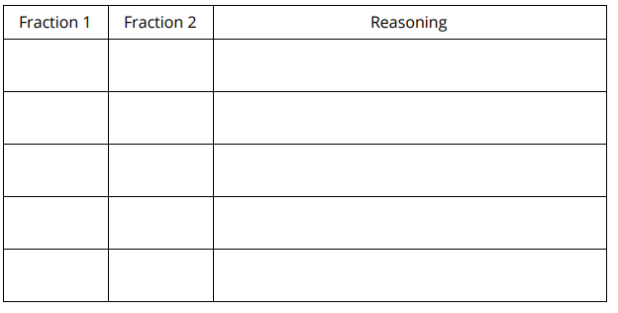
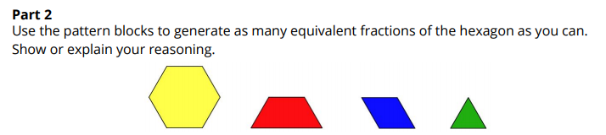
Pattern Block Equivalence
Activity #2

Slide 42
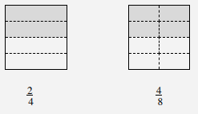
Let’s Put it All Together
Lesson Synthesis
If you were given two fractions, how would you decide if they are equivalent?
How do we know that these fractions are equivalent?

Slide 43
Generate Equivalent Fractions
Adaptation
Lesson 8
Let’s generate equivalent fractions
3.NF.A.3, 3.NF.A.3.A, 3.NF.A.3.B

Slide 44
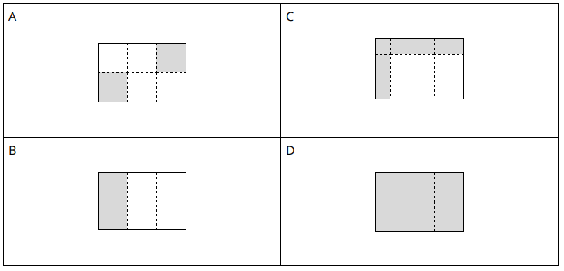
Which one doesn’t belong?
Warm up

Slide 45

How Many Names?
Activity #1
What fraction of each rectangle is shaded? Name the fraction in as many ways as you can. Be prepared to share your reasoning.

Slide 46

Find Equivalent Fractions
Activity #2
1. Use your fraction strips to find as many equivalent fractions as you can that are equivalent to:
½
⅔
6/6
3/4
2. Explain how you knew the fractions were equivalent.

Slide 47

Let’s Put it All Together
Lesson Synthesis
“Today, we recognized fractions that were equivalent and you generated fractions that were equivalent.”
How would you use fractions and the equal sign to record the shaded amounts are equivalent?
What were some strategies you used to recognize and generate equivalent fractions?

Slide 48
Representations of Fractions (Part 1)
1
Let’s name some fractions and represent them visually.
OA.B.4

Slide 49

What do you know about:
Warm up
What different ways can we represent ½ ?

Slide 50

Fraction Strips
Activity #1
Use the strips to represent halves, fourths, and eighths. Use one strip for each fraction and label the fractional parts.
What do you notice about the number of pieces or the size of the pieces?
Make at least two observations

Slide 51

Fraction Strips
Activity #1
What do you notice?
The denominator, the number at the bottom of a fraction, tells us the number of equal-size parts in 1 whole.
The numerator, the number at the top of a fraction, refers to how many of those parts are being described.

Slide 52

Fractions, Represented
Activity #2
1. If the entire diagram represents 1, what fraction does each shaded part represent?

Slide 53

Fractions, Represented
Activity #2
2. Here are four other blank diagrams. Each diagram represents 1. Partition each diagram and shade one part so that the shaded part represents the given fraction.
3. Suppose you are creating a representation of 1/20 using the same tape diagram. Would the shaded part be larger or smaller than the shaded part in the diagram of 1/10?
Explain how you know.
How did you know how to partition the diagrams in the second question?
What relationships do you see between the fractions in this activity?

Slide 54
Let’s Put it All Together
Lesson Synthesis
What did you notice about the size of a fraction as the denominator gets larger?
What does the fraction ⅕ tell us?
In general, what does the denominator in a fraction represent?
What relationships did we see between the fractions that we studied today?

Slide 55
Representations of Fractions (Part 2)
2
Let’s name some other fractions and represent them with diagrams.
4.NF.A.1

Slide 56

Which One Doesn’t Belong: All Cut Up
Warm up
What does the shaded part in D represent?
Is each shaded part one-third of the shape as well?
Why is the shaded part not one-third of the square in C?

Slide 57






Matching: A Diagram for Each Fraction
Activity #1
Notes:
Match each fraction with a diagram that represents it. Two of the fractions are not represented. Create a representation for each of them.

Slide 58




Matching: A Diagram for Each Fraction
Activity #1
A
L
What does it mean that the diagrams representing the same amount shaded but the fractions they represent have different numbers?
B
H
Notes:
Match each fraction with a diagram that represents it. Two of the fractions are not represented. Create a representation for each of them.

Slide 59


Diagrams for Some Other Fractions
Activity #2
1. What fraction does each shaded part represent?
2. Here are four fractions and four blank diagrams. Partition each diagram and shade one part so that the shaded part represents the fraction.
How did you know how many parts to partition each diagram and how many parts to shade?

Slide 60
Let’s Put it All Together
Lesson Synthesis
Did you notice anything interesting about the last two diagrams you created and the fractions they represent?

Slide 61
Fractions with the Same Denominator or Numerator
3
Let’s compare fractions with the same numerator or the same denominator
4.NF.A.2

Slide 62

Row After Row
Warm up
What do you notice?
What do you wonder?

Slide 63


Fractions with the Same Denominator
Activity #1
1. This diagram shows a set of fraction strips. Label each rectangle with the fraction it represents.
2. Circle the greater fraction in each of the following pairs. If helpful, use the diagram of fraction strips.
3. What pattern do you notice about the circled fractions? How can you explain the pattern?
4. Which one is greater: 7/3 or 10/3 ? Explain your reasoning.

Slide 64

Activity #2
Fractions with the Same Numerator
1. Circle the greater fraction in each of the following pairs. If helpful, use the diagram of fraction strips
2. What pattern do you notice about the circled fractions? How can you explain the pattern?
3. Which one is greater: 70/100 or 70/20? Explain your reasoning.
4. Tyler is comparing 4/10 and 4/6 . He says, “Ten is greater than 6, so 4/10 is greater than 4/6.” Explain why Tyler’s conclusion is incorrect.

Slide 65
Let’s Put it All Together
Lesson Synthesis
“Today we looked at fractions with the same denominator and those with the same numerator.”
What might have Tyler misunderstood? What would you say to help clear it up for him?
Based on your work today, how would you complete these sentence starters?
“If two fractions have the same denominator, I can tell which one is greater by . . . “
“If two fractions have the same numerator, I can tell which one is greater by . . .”

Slide 66
Fractions of the Same Size, Fractions of Related Sizes
4
Let’s find some fractions that are the same size
4.NF.A.1

Slide 67

Notice and Wonder: A Fraction Strip and a Number Line
Warm up
What do you notice?
What do you wonder?

Slide 68

Same Size, Different Numbers
Activity #1
1. Create a strip that shows tenths. Label the parts. How did you partition the strip?
2. Create a strip that shows twelfths. Label the parts. How did you partition the strip?
3. Jada says, “I noticed that one part of ½ is the same size as two parts of ¼ and three parts of ⅙ . So ½ 2/4 , 3/6 and must be equivalent. Find a fraction that is equivalent to each of the following fractions. Be prepared to explain your reasoning.
⅙
2/10
3/3
Here’s a labeled diagram of fraction strips, with two rows added for tenths and twelfths.

Slide 69

Fractions on Number Lines
Activity #2

Slide 70



Fractions on Number Lines
Activity #2

Slide 71
Let’s Put it All Together
Lesson Synthesis
How did you know where to put a point to locate a fraction?
How did you know which number line to choose?

Slide 72

Let’s Put it All Together
Lesson Synthesis
How is it different?
How is representing a fraction like 6/10 on a number line like representing it on a fraction strip?

Slide 73
Fractions on Number Lines
5
Let’s investigate equivalent fractions on a number line.
4.NF.A.1

Slide 74

Number Talk
Warm up
Find the value of each product mentally.

Slide 75

Number Talk
Warm up
Find the value of each product mentally.

Slide 76

Number Talk
Warm up
Find the value of each product mentally.

Slide 77

Number Talk
Warm up
Find the value of each product mentally.

Slide 78


All Lined Up
Activity #1

Slide 79



All Lined Up
Activity #1
2. Label the point on each number line with a fraction it describes. Be prepared to explain your reasoning.

Slide 80


How Far to Run?
Activity #2

Slide 81


How Far to Run?
Activity #2

Slide 82


Let’s Put it All Together
Lesson Synthesis
Where on the number lines do we see equivalent fractions?
Where in the diagram of fraction strips do we see equivalent fractions?
Suppose you’d like to help someone see that ⅕ is equivalent to 10/50 . Would you use a number line or a fraction strip? Why?

Slide 83
Greater Than or Less Than 1? Greater Than or Less Than ½ ?
6
Let’s find out the size of fractions compared to ½ and to 1.
4.NF.A.2

Slide 84

Notice and Wonder: A Point on a Number Line
Warm up
What do you notice?
What do you wonder?

Slide 85


Greater Than or Less Than 1?
Activity #1
For each diagram:
a. Name a fraction the point describes.
b. Is that fraction greater than or less than 1?
c. How far is it from 1?

Slide 86




Card Sort: Where Do They Belong?
Activity #2

Slide 87


Greater Than or Less Than ½ ?
Activity #3
For each diagram:
a. Name a fraction the point describes.
b. Is that fraction greater than or less than ½ ?
c. How far is it from ½ ?

Slide 88

Let’s Put it All Together
Lesson Synthesis
1/2
Take a few quiet minutes to think about how you would explain your strategy. Then, share your explanation with a partner
Suppose a classmate is absent today, and you are asked to explain how you would figure out the fraction that the point describes and how far away it is from ½ .

Slide 89
Equivalent Fractions
7
Let’s find some equivalent fractions
4.NF.A.1

Slide 90

True or False: Equivalence
Warm up
Is it true?
Is it false?
How do you know?

Slide 91

True or False: Equivalence
Warm up
Is it true?
Is it false?
How do you know?

Slide 92

True or False: Equivalence
Warm up
Is it true?
Is it false?
How do you know?

Slide 93

True or False: Equivalence
Warm up
Is it true?
Is it false?
How do you know?

Slide 94


Two or More Fractions
Activity #1
1. Each diagram represents 1. Write two or more fractions to represent the shaded part of each diagram. Be prepared to explain your reasoning
2. Write two or more fractions to describe the point on each number line. Be prepared to explain your reasoning.
3. Place a new point on a tick mark on the number line in part c or d. Then, write two fractions to describe that point.

Slide 95

Equivalent for Sure?
Activity #2

Slide 96
Let’s Put it All Together
Lesson Synthesis
As you study others’ work, pay attention to how the reasoning is alike and how it is different.
Take a few minutes to walk around and look at the work of at least 4 classmates. Make sure to look at the work by both partners, A and B
What is the same about the diagrams, words, or explanations that you saw? What is different?

Slide 97
Equivalent Fractions on the Number Line
8
Let’s use number lines to reason about equivalent fractions.
4.NF.A.1

Slide 98

Warm up
Estimation Exploration:
A Shaded Portion

Slide 99


Activity #1
Handy Number Lines
Andre used number lines to find fractions that are equivalent to . He drew this number line:
Then, he drew three more lines and wrote a fraction for the point on each line:
1. How did Andre use the number lines to find fractions equivalent to ? Explain your thinking to a partner.
2. How can number lines be used to show whether the following fractions are equivalent?
8/10 and ⅘
14/20 and ⅘
3. Find three fractions that are equivalent to 6/5. Explain or show how Andre’s number lines can help.

Slide 100


Can It Be Done?
Activity #2

Slide 101
Let’s Put it All Together
Lesson Synthesis
There were times in the lesson when some of you chose not to use the number lines to find equivalent fractions or to tell if two fractions were equivalent. Why might that be?
How can number lines help us find equivalent fractions for, say,1/10 ?

Slide 102
Explanations for Equivalence
9
Let’s talk about how we know that two fractions are or are not equivalent
4.NF.A.1

Slide 103
Number Talk
Warm up
Find the value of each product mentally.

Slide 104
Number Talk
Warm up
Find the value of each product mentally.

Slide 105
Number Talk
Warm up
Find the value of each product mentally.

Slide 106


Activity #1
Pointed Discussion
Tyler, Jada, and Noah are representing 70/100 on a number line.
Tyler said, “Oh, no! We’ll need to partition the line into 100 equal parts and count 70 parts just to mark one point!”
Jada said, “What if we mark 7/10 instead? We could partition the line into just 10 parts and count 7 parts.”
Noah said, “What if we partition the line into 5 parts and mark 3/5 ?”

Slide 107




How Do You Know?
Activity #2

Slide 108
Let’s Put it All Together
Lesson Synthesis
How did you know that ¼ and 5/20 are equivalent but 20/100 is not equivalent to them?

Slide 109
Reason about Equivalence Numerically (Part 1)
10
Let’s look at a way to find equivalent fractions without using diagrams.
4.NF.A.1

Slide 110

Notice and Wonder: Four Equations
Warm up
What do you notice?
What do you wonder?

Slide 111



Activity #1
Another Way, Elena’s Way
Elena thought of another way to find equivalent fractions. She wrote:

Slide 112


Equivalence Hunting
Activity #2
Look at Elena’s strategy from an earlier activity.

Slide 113

Let’s Put it All Together
Lesson Synthesis
Suppose a classmate was absent today. They later saw some examples of how to find equivalent fractions for ⅓ using this strategy, but they don’t fully follow the examples.
What would you say to help your classmate understand what is happening in the equations? How would you explain the multiplication by 4 or by 6?

Slide 114
Reason about Equivalence Numerically (Part 2)
11
Let’s find equivalent fractions by working with numerators and denominators.
4.NF.A.1

Slide 115

Which One Doesn’t Belong:
Four Representations
Warm up

Slide 116


Activity #1
The Other Way Around

Slide 117


Activity #1
The Other Way Around

Slide 118


How Would You Find Them?
Activity #2
Find at least two fractions that are equivalent to each fraction. Show your reasoning.

Slide 119

Card Sort: Fractions Galore
Activity #3
Your teacher will give you a set of cards. Find as many sets of equivalent fractions as you can. Be prepared to explain or show your reasoning.

Slide 120
Let’s Put it All Together
Lesson Synthesis
How did you decide whether to use multiplication or division to write an equivalent fraction?

Slide 121
Ways to Compare Fractions (Part 1)
12
Let’s compare some fractions.
4.NF.A.2

Slide 122

Estimation Exploration:
What’s That Point?
Warm up

Slide 123

Activity #1
The Greatest of Them All
Here are 25 fractions in a table.
For each question, be prepared to explain your reasoning.
1. Identify the greatest fraction in each column (A, B, C, D, and E).
2. Identify the greatest fraction in each row (1, 2, 3, 4, and 5).
3. Which fraction is the greatest fraction in the entire table?

Slide 124

Activity #1
Relative to ½ and 1
Here is the same table you saw earlier
1. Which fractions are less than ½ ?
Circle each one of them.
Then, complete this sentence: I know a fraction is less than when . . .
2. Which are greater than ½ but less than 1?
Circle each of them with a pencil of a different color (or draw a triangle around each one).
Then, complete this sentence: I know a fraction is greater than but less than 1 when . . .
3. Circle the remaining fractions with a pencil of a third color (or draw a square around each one). How would you describe the size of these fractions?

Slide 125

Activity #1
Relative to ½ and 1
Here is the same table you saw earlier
4. Next to the table, create a legend or key to show what each color (or each shape) represents.
5. Here are some pairs of fractions from the table. In each pair, which fraction is greater?

Slide 126
Let’s Put it All Together
Lesson Synthesis
How did you compare fractions in which neither the numerator nor the denominator are the same?
How did the color coding (or comparison to ½ or 1) help?

Slide 127
Ways to Compare Fractions (Part 2)
13
Let’s compare fractions by writing an equivalent fraction.
4.NF.A.2

Slide 128

Notice and Wonder: Pairs of Numbers
Warm up
What do you notice?
What do you wonder?

Slide 129



Activity #1
Pairs to Compare
Here are some pairs of fractions sorted into three groups. Circle the greater fraction in each pair. Explain or show your reasoning.

Slide 130



Activity #2
New Pairs to Compare
1. Decide whether each statement is true or false. Be prepared to show how you know.
2. Compare each pair of fractions.
Use the symbols <, =, and > to make each statement true

Slide 131

Let’s Put it All Together
Lesson Synthesis
Find an example of a pair of fractions in today’s activity that are easier (or easiest) to compare by:

Slide 132
Fraction Comparison Problems
14
Let’s solve different kinds of fraction comparison problems
4.NF.A.2

Slide 133

Which One Doesn’t Belong:
Fractions Here and There
Warm up

Slide 134






Activity #1
Mystery Fractions
Six friends are each given a list of 5 fractions. They each chose one fraction quietly and wrote clues about their choice. Use their clues to identify the fractions they chose.

Slide 135




Activity #2
Distances on Foot

Slide 136
Let’s Put it All Together
Lesson Synthesis
What about the diagrams, explanations, or calculations that you saw is alike? What about them is different?

Slide 137
Ways to Compare Fractions (Part 3)
15
Let’s compare fractions by writing equivalent fractions with the same denominator.
4.NF.A.2

Slide 138
What Do You Know about 15 and 30?
Warm up

Slide 139



Activity #1
Tricky Fractions?

Slide 140


Activity #2
Use a Common Denominator, or Not

Slide 141
Compare and Order Fractions
16
Let’s put some fractions in order.
4.NF.A.2

Slide 142

Number Talk: Multiples of 6 and 12
Warm up
Find the value of each expression mentally.

Slide 143



Activity #1
Fraction Action!

Slide 144


Activity #2
Fractions in Order
Put each set of fractions in order, from least to greatest. Be prepared to explain your reasoning.

Slide 145
Let’s Put it All Together
Lesson Synthesis
What are some things about writing, representing, or comparing fractions that you didn’t know at the beginning of the unit but you know quite well now? Think of at least two specific things

Slide 146
Paper Clip Games
17
Let’s create a game about locating and comparing fractions on the number line.
4.NF.A.2

Slide 147

Lots of Paper Clips
Warm up
What do you notice?
What do you wonder?

Slide 148

Activity #1
Paper Clip Tossing Game

Slide 149


Activity #2
A New Game with New Rules
Invent your own game.

Slide 150

Activity #3
Field Test

Slide 151
Let’s Put it All Together
Lesson Synthesis
What are some things about writing, representing, or comparing fractions that you didn’t know at the beginning of the unit but you know quite well now? Think of at least two specific things

