Slide 1

Factors and Multiples
Grade 4: Unit 1
Standards addressed: OA.B.4
These slides have been created by Plainville Community Schools and are not official IM materials. Images and language are taken from IM Grade 4, Unit 1 by Illustrative Mathematics.
Copyright 2020 by Illustrative Mathematics. All Rights Reserved, adapted and shared with permission.

Slide 2
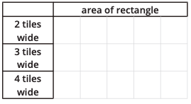
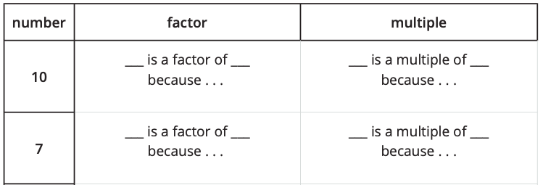
Unit 1 Progression Overview
Factors and Multiples
Section A
Lessons 1-4
Section B
Lessons 5-8
Throughout the Unit
Determine if a number is prime or composite.
Explain what it means to be a factor or a multiple of a whole number.
Relate the side lengths and area of a rectangle to factors and multiples.
Apply multiplication fluency within 100 and the relationship between multiplication and division to find factor pairs and multiples.
Build upon multiplication and division fluency from grade 3 and prepare for the work of the unit with deepening understanding of factors and multiples.

Slide 3

Unit 1 Quick Links
Adapt 1
Adapt 2
Adapt 3
Adapt 4
L1
L2
L3
L4
L5
L6
L7
L8

Slide 4
Area of Rectangles
Adaptation
Lesson 1
Let’s find the area of more rectangles.
3.MD.C.6

Slide 5
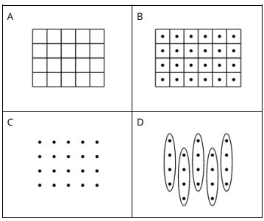
Which One Doesn’t Belong?
Warm up
How did you determine the total number for each image?

Slide 6
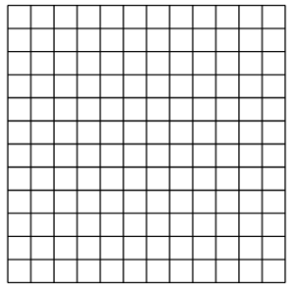
What Did I Create?
Activity #1
1. Can you and your partner draw the same rectangle without looking at each other’s drawings?
Partner A: Draw a rectangle on one of the grids provided. Describe it to your partner without telling them the total number of squares.
Partner B: Draw the rectangle your partner describes to you.
2. Place your two rectangles next to each other.
Discuss: What is the same? What is different?
3. Switch roles and repeat.
What language did you use that was most helpful for you to draw the same rectangle they drew?

Slide 7
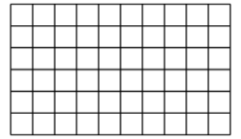

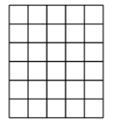
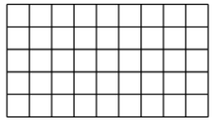
Find the Area
Activity #2
Find the area of each rectangle. Include the units in your answer. Explain or show your reasoning.
3.
1.
2.
4.
Did your strategy change from rectangle to rectangle?

Slide 8

Let’s Put it All Together
Lesson Synthesis
How do you see equal groups in these representations?
How is area different from an array?

Slide 9
Today, we learned that area is the amount of space covered by a shape. Then we learned that we could find the area of two-dimensional shapes by counting how many squares cover the shape. We also revisited arrays today during our warm-up.
Tomorrow, we will be connecting multiplication expressions to area.

Slide 10
Represent Products
as Areas
Adaptation
Lesson 2
Let’s connect multiplication expressions to area.
3.MD.C.7.b

Slide 11
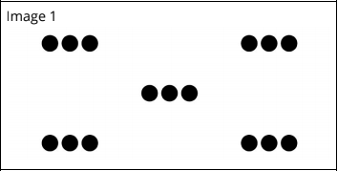
How Many Do You See?
Warm up
How many do you see? How do you see them?

Slide 12
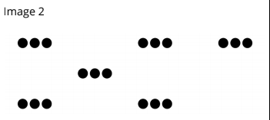
How Many Do You See?
Warm up
How many do you see? How do you see them?

Slide 13
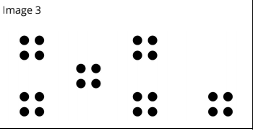
How Many Do You See?
Warm up
How many do you see? How do you see them?
How did the first image help you find the number of dots in the second image?
How did the first and second images help you find the number of dots in the third image?

Slide 14

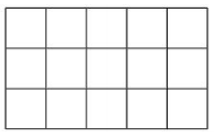
Match Expressions and Areas
Activity #1
What is one way you could describe this rectangle?
Match each expression to one of the rectangles posted around the room.
Be ready to explain your reasoning.
How do you see each factor in the rectangle?
How do you see the product in the rectangle?
Why does multiplication give the same number as counting one by one?

Slide 15
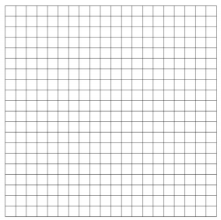
Create from Expressions
Activity #2
The numbers in each expression represent the number of rows (or columns) in a rectangle and how many squares are in each row (or column).
One the grid, draw each rectangle, label with the numbers, and find its areas.
3 x 4
4 x 6
6 x 3
7 x 4
3 x 2
How does the area of this rectangle match the expression?
Did anyone draw a different rectangle?
How can there be two rectangles that match the same expression?

Slide 16
Let’s Put it All Together
Lesson Synthesis
2
7
How are rectangular areas similar to other ways to show multiplication? How are they different?
How could you figure out the total number of squares in this rectangle?

Slide 17
Today, we connected multiplication expressions to area.
Tomorrow, we will be determining the area of a rectangle using what we know about multiplication.

Slide 18
Area of Rectangles Without a Grid
Adaptation
Lesson 3
Let’s solve area problems without a grid.
3.MD.C.7.b

Slide 19
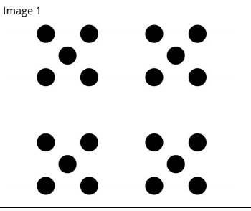
How Many Do You See?
Warm up
How many do you see? How do you see them?

Slide 20
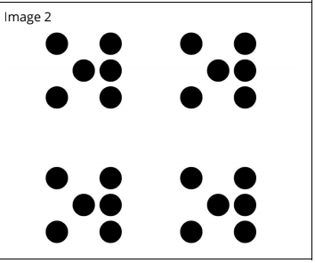
How Many Do You See?
Warm up
How many do you see? How do you see them?

Slide 21
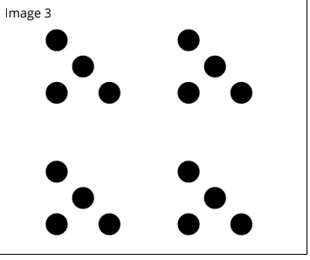
How Many Do You See?
Warm up
How many do you see? How do you see them?
What numbers were easy to see in the images?
How did the first image help you find the number of dots in the next two images?

Slide 22
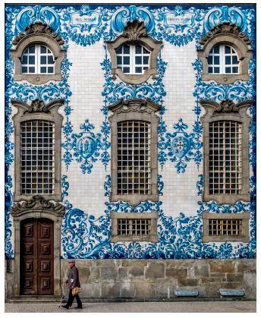
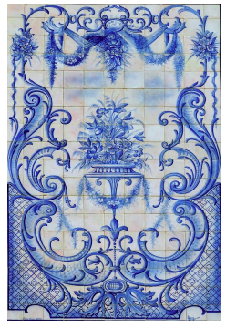
Partially Tiled
Activity #1
What do you notice? What do you wonder?

Slide 23
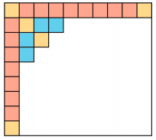
Partially Tiled
Activity #1
After learning about azulejos in Portugal, Elena is making her own tile artwork. This rectangle shows the project Elena is tiling.
Each tile has a side length of 1 inch.
1. How many tiles will it take to tile the whole rectangle? Explain or show your reasoning.
How did you know how many tiles would be in each row or column?
How did you find the total number of tiles needed?

Slide 24
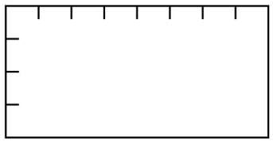
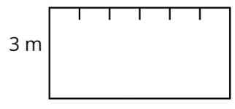
No More Squares
Activity #2
1. The rectangle is marked off in meters. What
is the area of the rectangle in square meters?
2. This rectangle is marked off in meter lengths along the top and labeled with the length in meters on the left side. What is the area of this rectangle in square meters?
How can creating the grid from the tick marks help us see the missing groups?
Did you have to fill in the grid lines to find the area of these rectangles?

Slide 25
Let’s Put it All Together
Lesson Synthesis
What did you need to think about to find the area of rectangles where only some of the squares were visible or none of the squares were visible?
What do you need to know to find the area of any rectangle?

Slide 26
Today we found the area of rectangles where the squares weren’t visible.
Tomorrow, we will be calculating the area of ungridded figures made of rectangles using multiplication and addition.

Slide 27
​Find the Area of Figures
Adaptation
Lesson 4
Let’s find the area of figures.
​3.MD.C.7.d

Slide 28
Number Talk
Warm up
109 + 4

Slide 29
Number Talk
Warm up
109 + 14

Slide 30
Number Talk
Warm up
209 + 34

Slide 31
Number Talk
Warm up
219 + 34
What did you notice about how the first two expression are related? What about how the last two expressions are related?

Slide 32
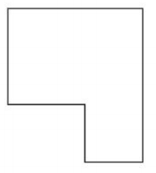
Bye-Bye Squares
Activity #1
What do you notice? What do you wonder?

Slide 33
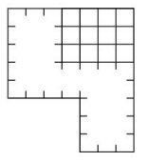
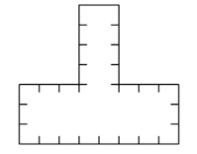
Bye-Bye Squares
Activity #1
Find the area of each figure. Explain or show your reasoning.
1. 2.
What was your strategy for finding the area of the second figure?
What helps you find the area of figures like these where the shape is not fully covered with squares?

Slide 34
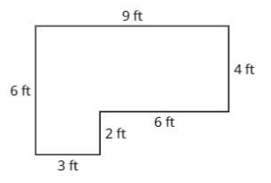
How Many Pavers Do We Need?
Activity #2
Noah wants to use square pavers that are 1 square foot each to create a small patio in the community garden.
1. How many 1 square foot pavers will Noah need
to cover the whole patio?
2. What is the area of the patio? Explain or show
your reasoning.
How did you figure out how many pavers Noah would need?
How does each expression represent a way of finding the area of the figure?

Slide 35
Let’s Put it All Together
Lesson Synthesis
What did you need to think about when finding the area of a figure with just side length measurements?

Slide 36
Today, we found the area of figures even if they were not fully gridded with squares.

Slide 37
Multiples of a Number Lesson
1
Let’s build some rectangles..
OA.B.4

Slide 38
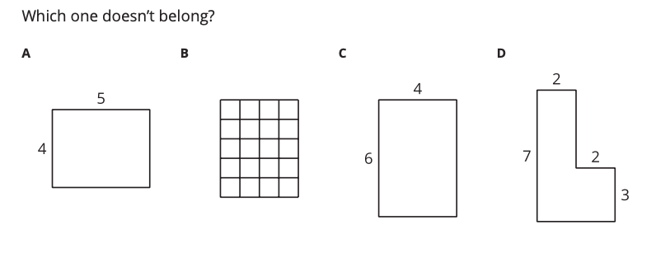
Which One Doesn’t Belong?
Warm up
How could we determine the area of each figure?

Slide 39
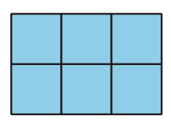
Build Rectangles and Find Area
Activity #1
Build 5 different rectangles with the given width. Record the area of each rectangle in the table.

Slide 40
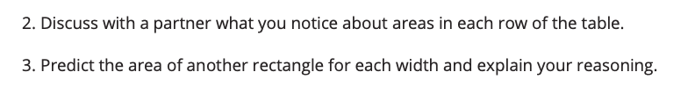
Build Rectangles and Find Area
Activity #1
For rectangles that were 2 tiles wide, how can we tell if our area predictions are true without building each rectangle?
How can we check our predictions for rectangles that are 3 or 4 tiles wide?

Slide 41
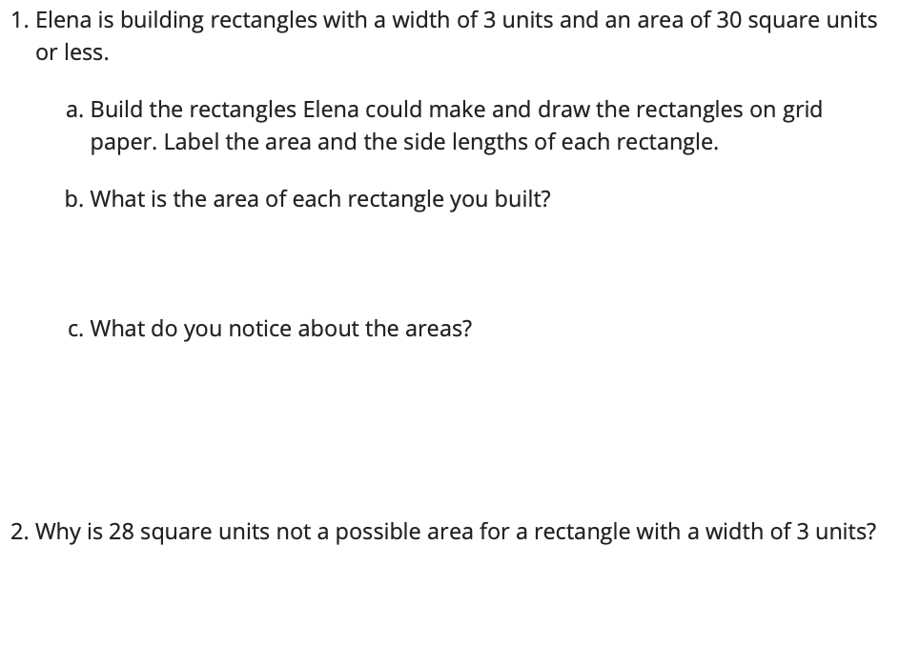
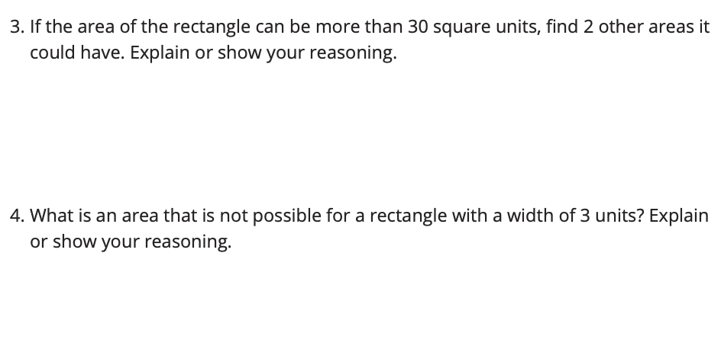
What Areas Can You Build?
Activity #2
What did you notice about each of the areas your found?
A multiple of a number is the result of multiplying a number by a whole number.

Slide 42
Let’s Put it All Together
Lesson Synthesis
What is a number that would not be a multiple of 4? How do you know?
How would you decide whether 28 is a multiple of 4?

Slide 43
Today, we built rectangles and learned about multiples. You found the area of rectangles when given a side length.
Next, let’s keep learning about area by using factor pairs.

Slide 44
Factor Pairs
2
Let’s learn about factor pairs.
OA.B.4

Slide 45
Number Talk
Warm up
2 X 7

Slide 46
Number Talk
Warm up
4 X 7

Slide 47
Number Talk
Warm up
3 X 7

Slide 48
Number Talk
Warm up
7 X 7
How did the first three expressions help you find 7 x 7?

Slide 49
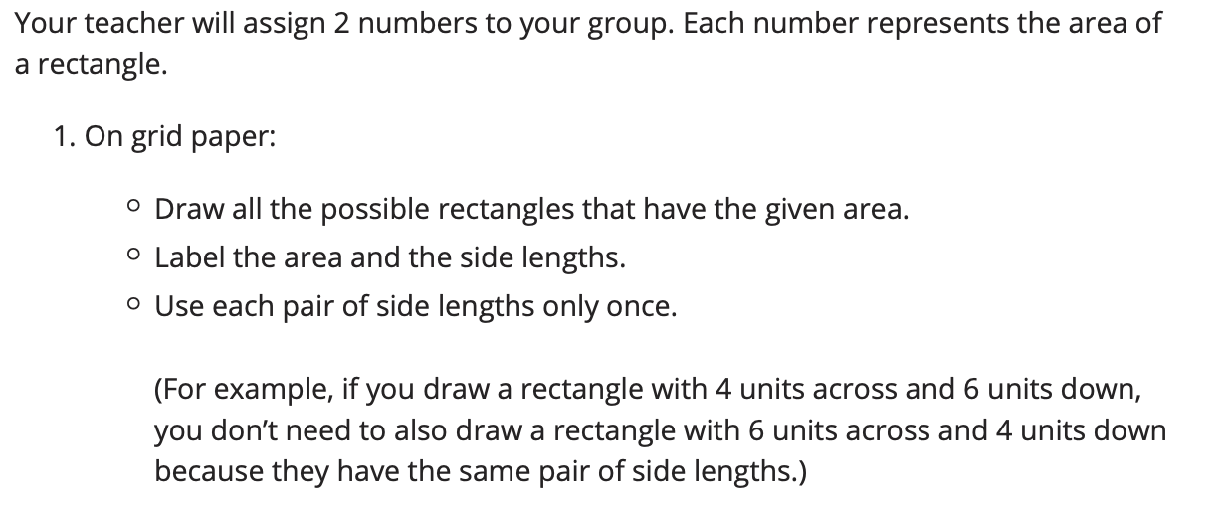
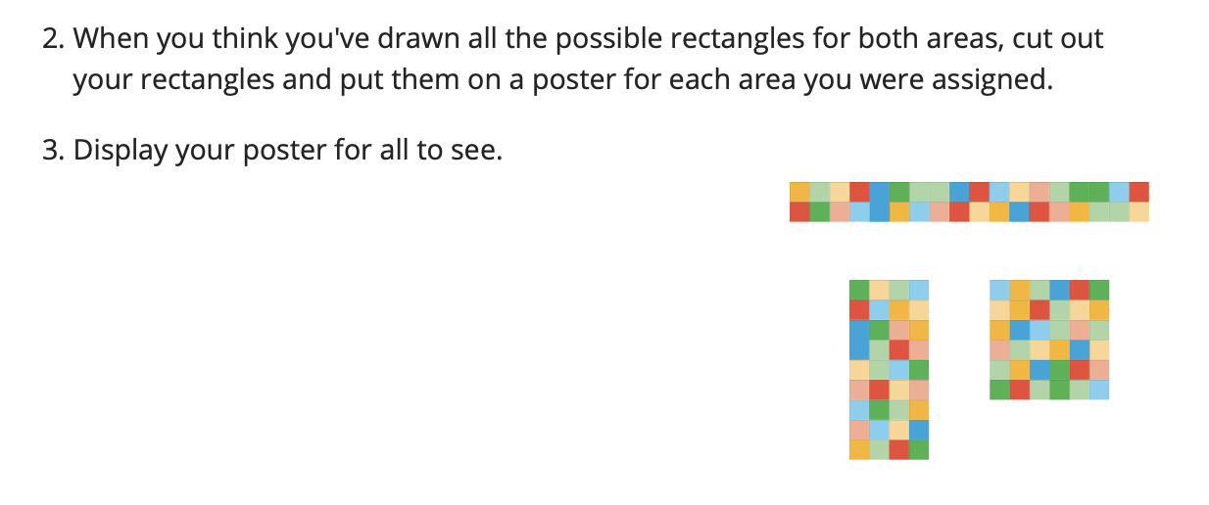
How Many Rectangles?
Activity #1
Group A: 11, 27
Group B: 25, 5
Group C: 16, 8
Group D: 9, 18
Group E: 24, 12
Group F: 14, 28
Group G: 15, 30
Group H: 19, 20

Slide 50
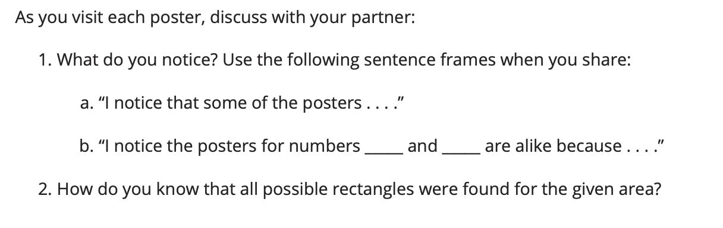
How Many Rectangles Gallery Walk
Activity #1

Slide 51
Let’s Put it All Together
Lesson Synthesis
Today we learned that a factor pair of a whole number is a pair of whole numbers that multiply to result in that number. For example, 5 and 4 are a factor pair of 20.
How do we know if we found all the factor pairs of 24?
What are the factor pairs of 24?
Can you use the same strategies to find all the factor pairs of 45?

Slide 52
Today, we learned about factor pairs of whole numbers.
Next, let’s learn about prime and composite using rectangles.

Slide 53
Prime and Composite Numbers
3
Let’s identify prime and composite numbers..
OA.B.4

Slide 54
Choral Count
Warm up
Let’s skip count by 2, starting at 0.
Let’s skip count by 5, starting at 0.
How many 2s did it take to get to 10? How many 5s did it take to get to 10?
If the count continues, what other numbers would you see that are multiples of both 2 and 5?

Slide 55
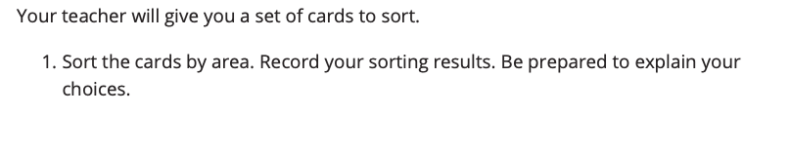
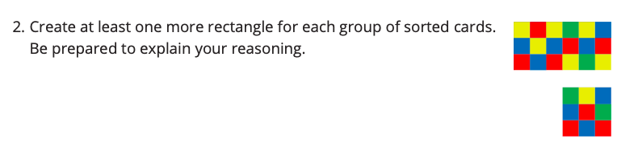
Card Sort: Area
Activity #1
Why were you able to create more rectangle for some but not others?

Slide 56
Card Sort: Area
Activity #1
Only one rectangle can be made for the area of 7. Numbers like this are called prime numbers. Prime numbers have only one factor pair: 1 and itself.
Numbers like 15 that have more than one factor pair are called composite numbers.
What other composite numbers did you work with? How do you know they are composite?

Slide 57
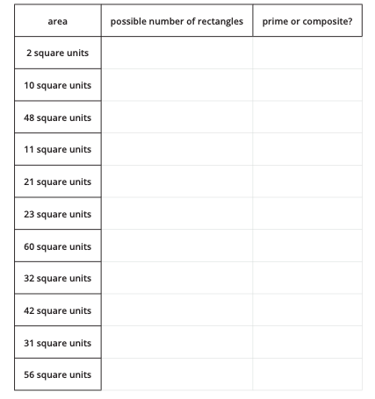
Prime or Composite?
Activity #2
The table shows different areas. How many rectangles can be made for each area?
Complete the table and be prepared to explain or show your reasoning.
Rectangles with the same pair of side lengths should be counted only once. For example, if you count a rectangle with 4 units across and 6 units down, you don’t need to also count a rectangle with 6 units across and 4 units down.
How does the number of factor pairs relate to the number of rectangles?

Slide 58
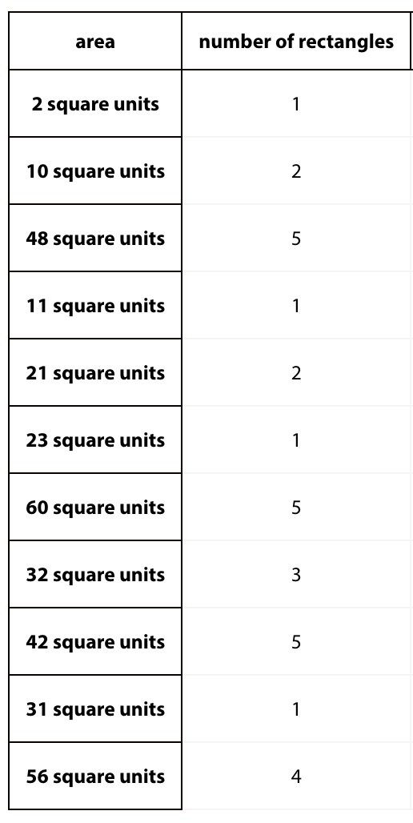
Prime or Composite?
Activity #2
What are all of the prime numbers in our list? How do we know they are prime?
What do you notice about the prime numbers?
What is the smallest prime number in the set? Is it the smallest prime number?

Slide 59
Prime or Composite?
Activity #2
What are the slide lengths of a rectangle with an area of 1 square unit?
1 square unit
Since 1 only has 1 factor, it doesn't have have any factor pairs so its neither prime or composite.

Slide 60
Prime or Composite?
Activity #2
What are all of the composite numbers in our set? How do we know they aren’t prime?

Slide 61
Let’s Put it All Together
Lesson Synthesis
How does finding all the rectangles with a certain area tell us if the value of the area is prime or composite?
What questions do you still have about these types of numbers?

Slide 62
Today, we learned about prime and composite numbers.
Next, let’s learn about contexts that involve multiples.

Slide 63
Multiplication Practice Center Day
(optional)
4
Let’s practice multiplication.
OA.C.7

Slide 64
Number Talk
Warm up
10 X 6

Slide 65
Number Talk
Warm up
3 X 6

Slide 66
Number Talk
Warm up
13 X 6

Slide 67
Number Talk
Warm up
12 X 4
How can knowing the value of the first two expressions help you find the value of the third expression?

Slide 68
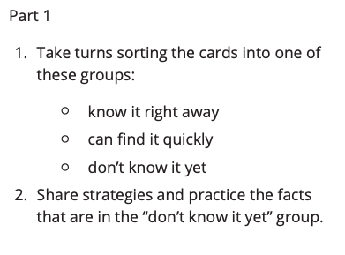
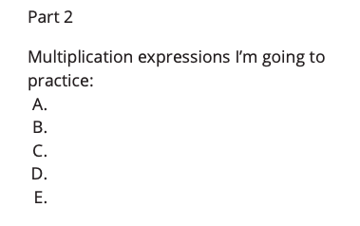
Card Sort Multiplication
Activity #1
What are some useful strategies for finding products you didn’t know yet?

Slide 69
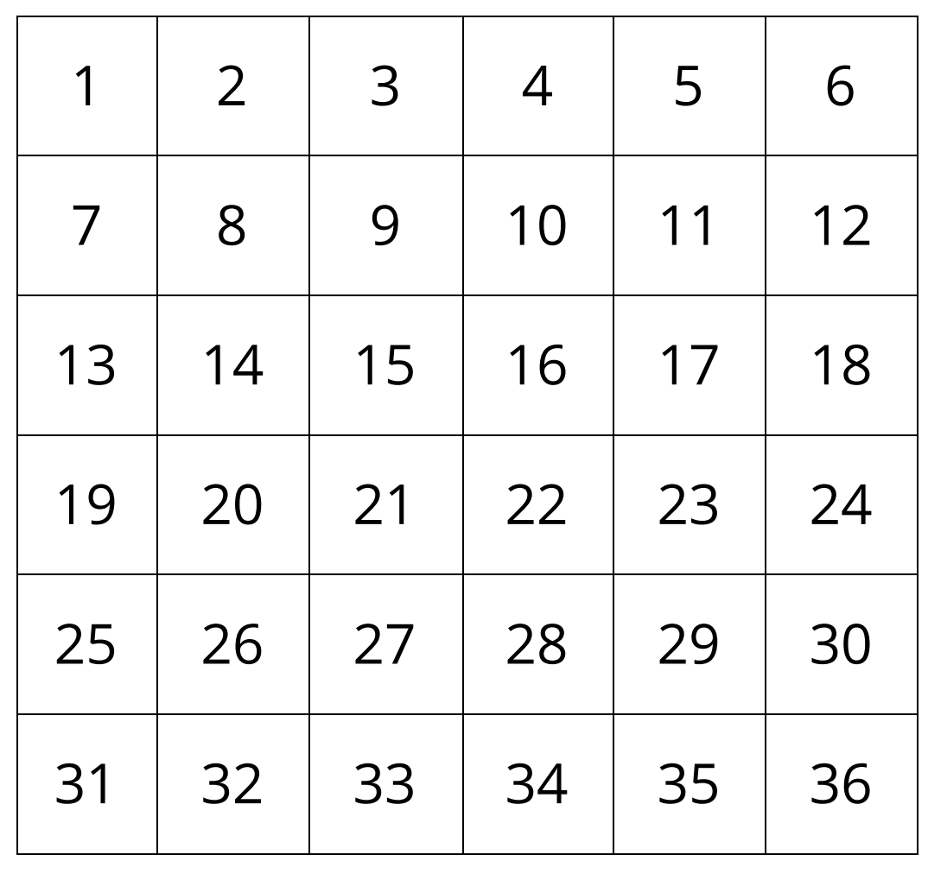
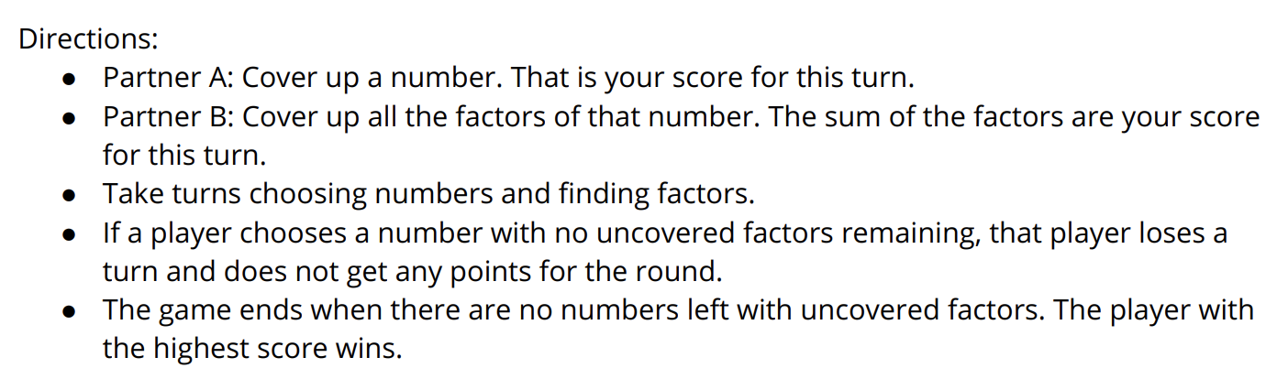
Introduce Find the Number, Factors
Activity #2
What strategies were helpful for the game?

Slide 70
Let’s Put it All Together
Lesson Synthesis
What is a strategy you remember from grade 3, or a new strategy you learned today?

Slide 71
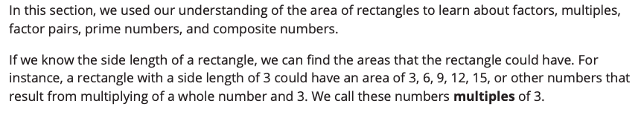
Section Summary

Slide 72
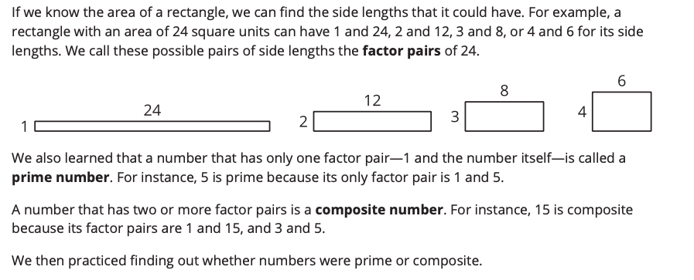

Slide 73
More Multiples
5
Let’s solve problems that involve factors and multiples.
OA.A.3, OA.B.4

Slide 74
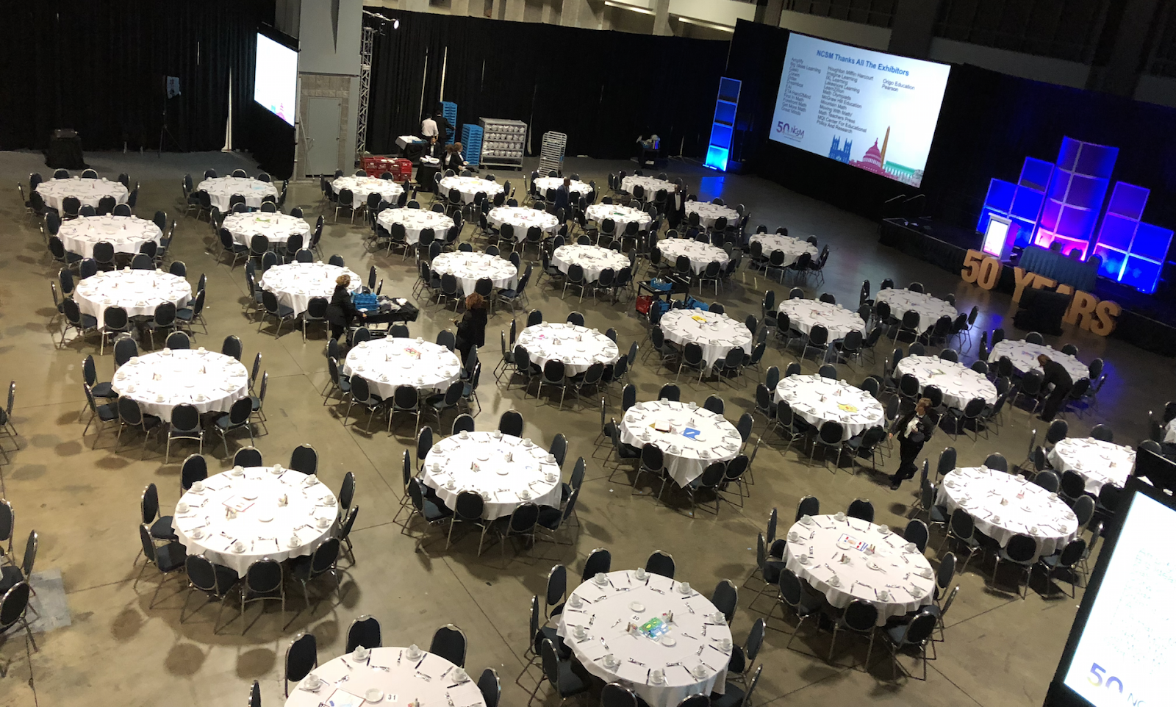
Estimation Exploration
Warm up
About how many chairs are in the room?
Record an estimate that is:
too low | about right | too high
What part of the picture did you use to make your estimate?
Which estimates would have been unreasonable?

Slide 75

Choosing the Right Seat
Activity #1
Students are preparing for a party. The school has tables where 6 people can sit and tables where 8 people can sit.
The students can only choose one type of table and they want to avoid having empty seats.

Slide 76
Choosing the Right Seat
Activity #1
Jada’s class has 18 students. Which tables would you choose for Jada’s class? Explain or show your reasoning.
Noah’s class has 30 students. Which tables would you choose for Noah’s class? Explain or show your reasoning.
Which tables would you choose for Noah’s and Jada’s classes together? Can you find more than one option? Explain or show your reasoning.
If you also want places for Noah’s teacher and Jada’s teacher to sit, which tables would you choose? Explain or show your reasoning.

Slide 77
Choosing the Right Seat
Activity #1
Can Noah’s class fit exactly in tables for 6? How do you know?
Can Noah’s class fit exactly in tables for 8? How do you know?
How do multiplication facts or the idea of multiples help us think about this problem?
For the problem with both classes and the teachers, could they all fit at tables of 6? Why or why not?
Could they all fit at tables of 8? Why or why not?

Slide 78
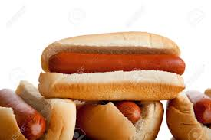
Hot Dogs and Buns
Activity #2
Each package of hot dogs has 10 hot dogs. Each package of hot dog buns has 8 buns.
What questions could you ask about the situation?

Slide 79
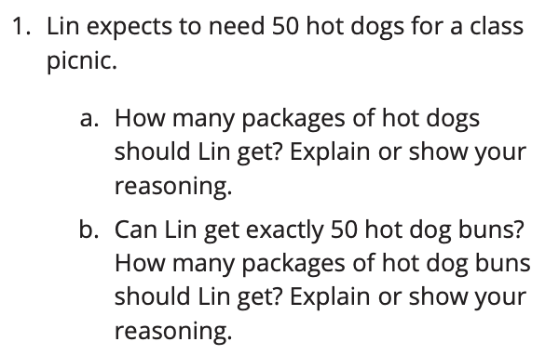
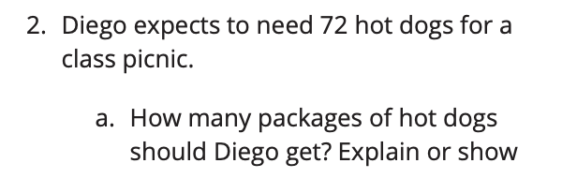
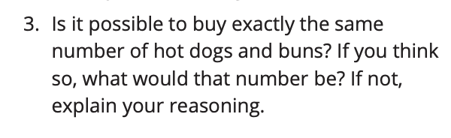
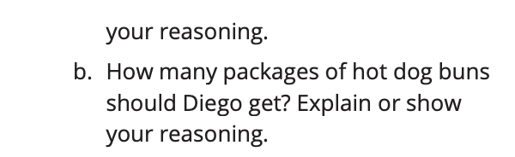
Hot Dogs and Buns
Activity #2
Each package of hot dogs has 10 hot dogs. Each package of hot dog buns has 8 buns.
Why are there different answer to #2?
Is it possible to buy exactly the same number of hot dogs and buns? If so, how many of each?
Why is it possible to buy the same number of hot dogs and buns when the packaging is different?

Slide 80
Let’s Put it All Together
Lesson Synthesis
What does it feel like when someone points out a mistake or disagrees with you?
Is making a mistake part of math class and doing math together?
What might it look like or sound like to challenge each other’s ideas without hurting feelings?

Slide 81
Today, we looked at multiples of different numbers to solve problems. You used what you know about skip counting and factors.
Next, let’s learn about factors and multiples of whole numbers.

Slide 82
The Locker Problem
6
Let’s figure out what’s happening in a game about lockers.
OA.B.4

Slide 83
Choral Count
Warm up
Let’s skip count by 2s, starting at 0.
Let’s skip count by 4s, starting at 0.
How can I get the number in the second list from the corresponding numbers in the first list?
How can I get the number in the first list from the corresponding numbers in the second list?

Slide 84
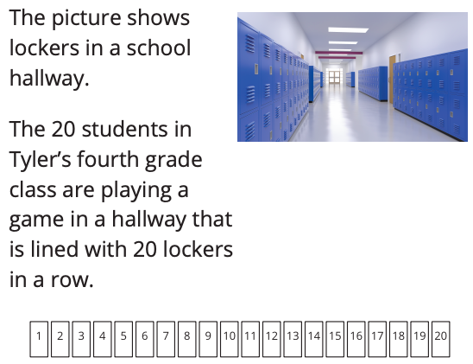
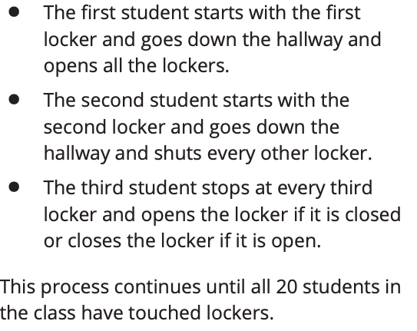

Questionable Lockers
Activity #1

Slide 85


Questionable Lockers
Activity #1
In the next activity, you will answer questions about the game. You may use your representation or one shared by a classmate to help you think about the problems.

Slide 86

An Open and Shut Case
Activity #2

Slide 87




An Open and Shut Case
Activity #2

Slide 88
Let’s Put it All Together
Lesson Synthesis
Which numbers have an odd number of factors? What do those numbers have in common?
How do today’s problems relate to what we have been studying?
Which numbers get touched exactly 2 students?

Slide 89
Today, we looked at a game with opening and closing lockers and used what we know about factor pairs.
Next, let’s learn about factors and multiples of numbers 1 - 100.

Slide 90
Find Factors and Multiples
7
Let’s find factors and multiples of whole numbers from 1-100.
OA.B.4

Slide 91
Number Talk
Warm up
12 ÷ 3

Slide 92
Number Talk
Warm up
30 ÷ 3

Slide 93
Number Talk
Warm up
60 ÷ 3

Slide 94
Number Talk
Warm up
72 ÷ 3
How does knowing the first and the third quotients help you find the last quotient?

Slide 95


Factor and Multiple Statements
Activity #1
What was your favorite statement you came up with? Why was it your favorite?
What did you and your partner notice and wonder about this activity?

Slide 96


Introduce Find the Number, Factor and Multiples
Activity #2
What was your strategy for choosing numbers as you played the game?

Slide 97

Let’s Put it All Together
Lesson Synthesis
With your partner, take turns using each number 1, 2, 5, and 10 to answer the prompts.

Slide 98
Today, we used terms factors and multiples to describe numbers within 100.
Next, let’s use what we know about the area of rectangles and factor pairs to make art.

Slide 99
Mondrian’s Art
(optional)
8
Let’s make art with rectangles.
OA.B.4

Slide 100


Warm up
Notice and Wonder
What do you notice? What do you wonder?
How do you think this art connect with what we have been studying? Why are we looking at art in math class?

Slide 101

Activity #1
My Mondrian Outline
Compare your work with a partner. What is alike or different about your outlines?
How can you determine if any of the rectangles have the same area?

Slide 102


Analyse the Rectangles
Activity #2

Slide 103
Gallery Walk
Activity #2
You will now walk around and look at the art the class has made.
As you do so, consider questions that you might ask the artists about their design.
Choose at least one piece of artwork and write a question about it on a sticky note.
What was the most challenging part of creating the artwork?
What connections do you see between the mathematics and art we experienced today?

Slide 104

Section Summary

