Slide 1

Geometry and Time
Grade 1: Unit 7
Standards addressed: 1.G.A.1, 1.G.A.2, 1.MD.C.4, 1.NBT.C.4, 1.OA.C.6, 1.G.A.3, 1.NBT.C.5, 1.MD.B.3, 1.NBT.A.1, 1.OA.D.7
These slides have been created by Britnee Wright- Southeast Arkansas Education Cooperative and are not official IM materials. Images and language are taken from IM Grade 1, Unit 7 by Illustrative Mathematics.
Copyright 2020 by Illustrative Mathematics. All Rights Reserved, adapted and shared with permission.

Slide 2
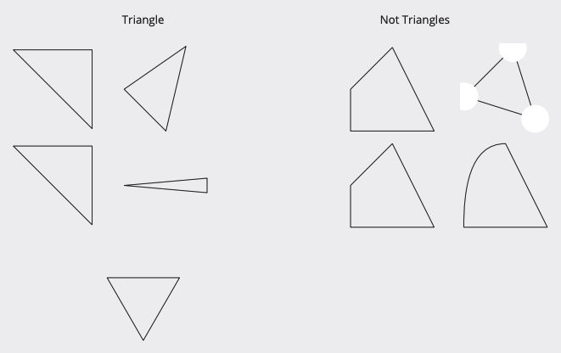
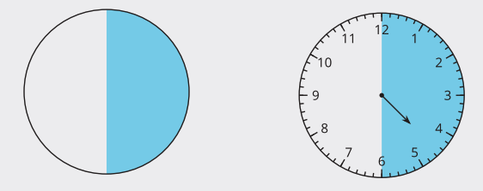
Unit 7 Progression Overview
Geometry and Time
Section A
Lessons 1-8
1.G.A.1, 1.G.A.2, 1.MD.C.4, 1.NBT.C.4, 1.OA.C.6
Section B
Lessons 9-12
1.G.A.2, 1.G.A.3, 1.NBT.C.5, 1.OA.C.6
Section C
Lessons 13-17
1.G.A.2, 1.MD.B.3, 1.NBT.A.1, 1.NBT.C.4, 1.OA.D.7
Build and draw shapes to possess defining attributes.
Put two- and three-dimensional shapes together to form larger shapes.
Partition circles and rectangles into two and four equal pieces, describe the pieces with words (halves, fourths, and quarters).
Students connect the language of “o’clock” and “half past” to clock faces and written times.

Slide 3



Unit 7 Quick Links
L1
L2
L3
L4
L5
L6
L7
L8
L9
L10
L11
L12
L13
L14
L15
L16
L17

Slide 4
Shapes That are Solid
1
Let’s sort and describe solid shapes.
1.G.A, 1.G.A.2

Slide 5
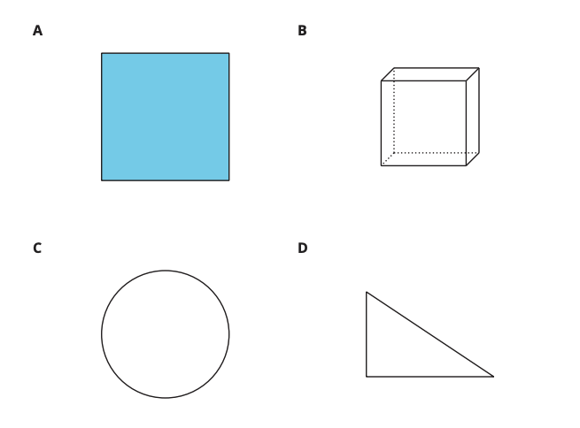
Which One Doesn’t Belong: Shapes
Warm up
Which one doesn’t belong?

Slide 6
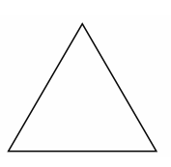

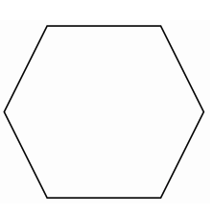

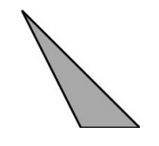
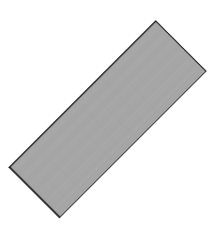
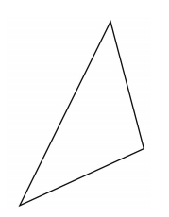
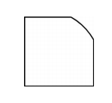
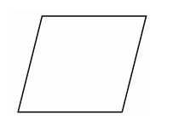
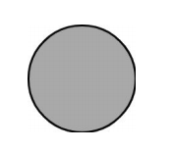


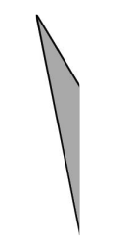
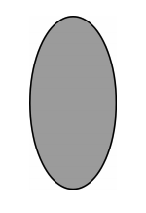
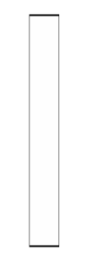
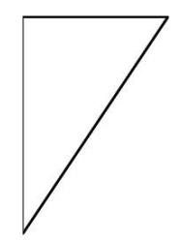
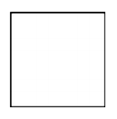
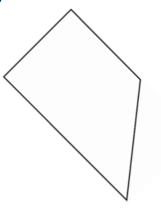
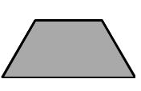
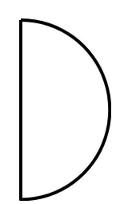
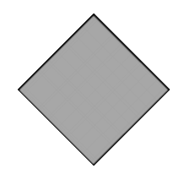

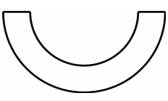
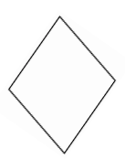
Card Sort: Solid Shapes
Activity #1
1. Sort some of your shapes. Represent your sort.

Slide 7
Card Sort: Solid Shapes
Activity #1
2. Sort some of your shapes in a different way. Represent your sort.

Slide 8
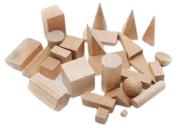
Describe and Find Shapes
Activity #2
We’re going to play a game with our shapes.
Pick a bag.
Each partner feels the shape in the bag without looking at it and thinks about which shape it is.
Each partner tells which shape they think it is and why.
Look in the bag to check.
Pick a different bag.

Slide 9


Lesson
Synthesis
Find one way that these solid shapes are the same and one way that they are different.

Slide 10
Build Shapes from
Other Shapes
2
Let’s use geoblocks to build new shapes.
1.G.A.2

Slide 11
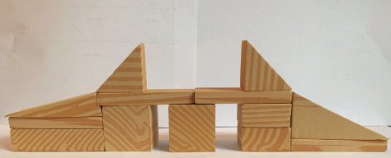
Notice and Wonder:
A Geoblock Bridge
Warm up
What do you notice?
What do you wonder?

Slide 12
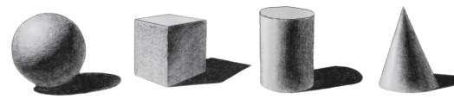
Build With Geoblocks
Activity #1
What are the names of these solid shapes?

Slide 13
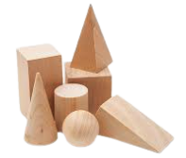
Build With Geoblocks
Activity #1
Use the geoblocks to build any shape you want.
Be sure you can describe your new shape.
Show the shape you built to your group.
Describe what you made and what blocks you used.

Slide 14
Use Geoblocks to Make Other Geoblocks
Activity #2
Choose a geoblock.
Try to find smaller blocks you can use to build that geoblock.

Slide 15
Lesson
Synthesis
What do you notice about this shape?
What shapes do you see that were made from other solid shapes?
Notes:
Display a student’s work from the first activity.

Slide 16
Shapes that are Flat
3
Let’s sort flat shapes and create a data display to represent our sort.
1.G.A, 1.MD.C.4

Slide 17
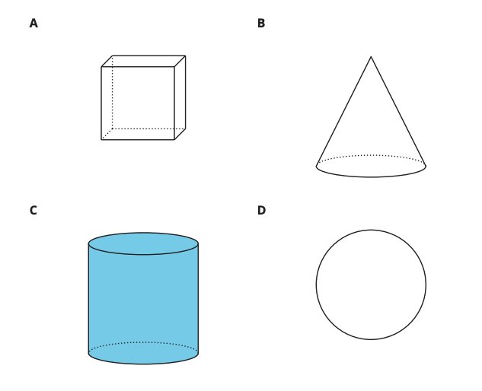
Which One Doesn’t Belong:
All the Shapes
Warm up
Which one doesn’t belong?

Slide 18
Card Sort: Flat Shapes
Activity #1
With your partner, sort your shape cards into groups.
Give each group a category.
  A category is a label that tells how objects in a group are alike.
  Explain each category you made. Then sort the cards in a different way.

Slide 19
Show How You Sorted
Activity #2
Earlier in the year, we created data representations.
What are some things you remember about creating data representations?
Create a representation that shows one of the ways you sorted your shape cards.
You will visit three different data representations. As you visit each poster, write two statements about the data.

Slide 20
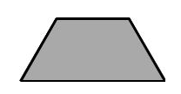
Lesson Synthesis
How might you describe this shape?
How might you describe this shape?

Slide 21
Draw Flat Shapes
4
Let’s describe and draw shapes.
1.G.A, 1.G.A.1

Slide 22
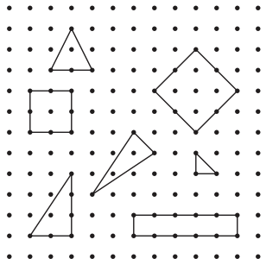
Notice and Wonder:
Dot Paper
Warm up
What do you notice?
What do you wonder?

Slide 23
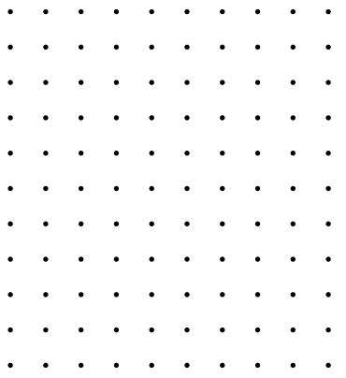
Draw Shapes on Dot Paper
Activity #1
Pick a shape card.
Each partner draws the shape on dot paper.
Take turns describing the shape you drew.

Slide 24
Center:
Introduce Guess My Shape, Draw
Activity #1
Partner A picks a card without showing it to their partner, and describes the shape.
Partner B draws the shape.
Partner A looks at the shape and gives more information, if needed.
Partner B revises their shape.
Partner A shows the shape card and both partners discuss how the shapes are the same and different.

Slide 25
Lesson Synthesis
Are there any other words or phrases that are important to include on our chart?

Slide 26
Some Triangles,
All Triangles
5
Let’s explore what makes a shape a triangle.
1.G.A.1

Slide 27
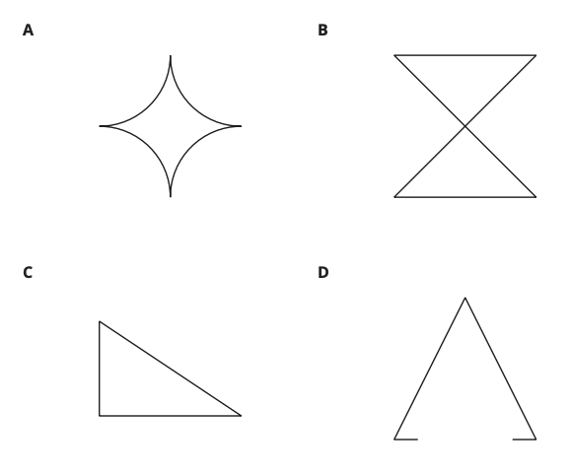
Which One Doesn’t Belong:
Shapes
Warm up
Which one doesn’t belong?

Slide 28
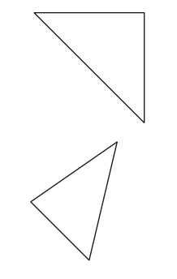
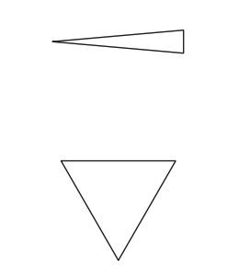
Triangles and “Not Triangles”
Activity #1
1. These are triangles.
What is the same about all these triangles?

Slide 29
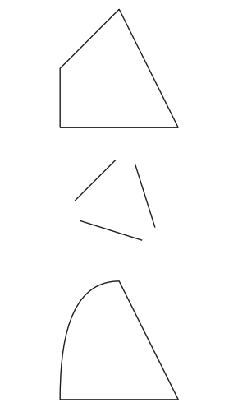
Triangles and “Not Triangles”
Activity #1
2. These are not triangles.
What is the same about all these triangles?

Slide 30

Draw Triangles
Activity #2
1. Draw 3 different triangles.
2. Draw 3 different shapes that are not triangles.

Slide 31
Lesson Synthesis
Draw a triangle that you think no one else will draw.
What makes this shape a triangle?
Who thinks they have a triangle that no one else drew?
Check the triangle you drew to be sure it has three straight sides, three corners, and is closed.

Slide 32
Rectangles and Squares
6
Let’s explore what makes a shape a rectangle or a square.
1.G.A.1, 1.NBT.C.4

Slide 33

Number Talk: Some Sums
Warm up
Find the value of each expression mentally.
Notes:
Optional Warm UP Activity

Slide 34
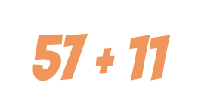
Number Talk: Some Sums
Warm up
Find the value of each expression mentally.
Notes:
Optional Warm UP Activity

Slide 35

Number Talk: Some Sums
Warm up
Find the value of each expression mentally.
Notes:
Optional Warm UP Activity

Slide 36

Number Talk: Some Sums
Warm up
Find the value of each expression mentally.
Notes:
Optional Warm UP Activity

Slide 37
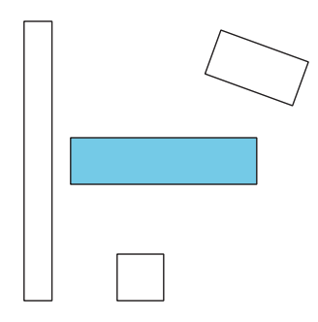
Squares and Rectangles
Activity #1
1. These are rectangles.
What do you notice about them?

Slide 38
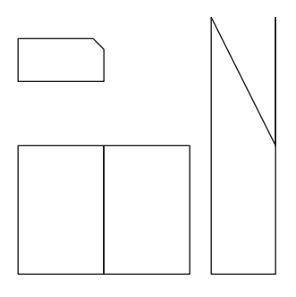
Squares and Rectangles
Activity #1
2. These are not rectangles.
What makes these shapes different from the rectangles?

Slide 39
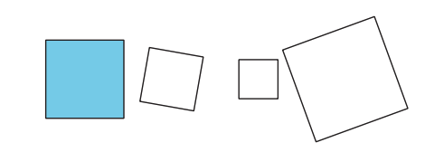
Squares and Rectangles
Activity #1
3. These are squares.
What do you notice about them?

Slide 40
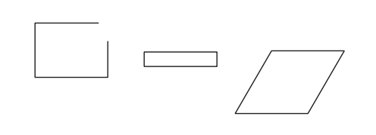
Squares and Rectangles
Activity #1
4. These are not squares.
What makes these shapes different from the squares?

Slide 41
Draw Rectangles and Squares
Activity #2
1. Draw 5 rectangles.
How do you know these are rectangles?
2. Draw 3 shapes that are not rectangles.
How do you know these are not rectangles?

Slide 42
Draw Rectangles and Squares
Activity #2
3. Draw 5 squares.
How do you know these are squares?
4. Draw 3 shapes that are not squares.
How do you know these are not squares?

Slide 43
Lesson Synthesis
Today we learned about squares and rectangles.
What is true about all rectangles?
What is true about some rectangles, but not all rectangles?

Slide 44
Put Together
Flat Shapes
7
Let’s build a new shape from smaller shapes.
1.G.A.2

Slide 45
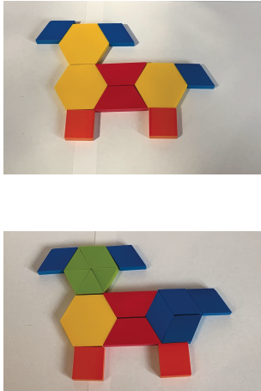
Notice and Wonder:
Dogs
Warm up
What do you notice?
What do you wonder?

Slide 46
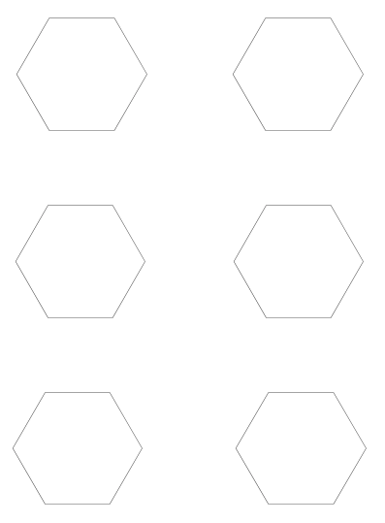
Build with Pattern Blocks
Activity #1
1. Fill in the hexagon in different ways using the pattern blocks. Record how you filled in the shape using drawings, numbers, or words.
Use the pattern blocks to fill the outline in different ways.
Each time, record how you filled in the shape with pictures, numbers, or words.

Slide 47
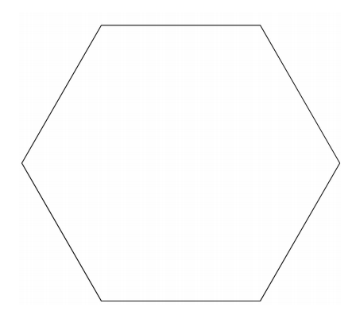
Build with Pattern Blocks
Activity #1
2. Fill in the hexagon in different ways using the pattern blocks. Record how you filled in the shape using drawings, numbers, or words.
Use the pattern blocks to fill the outline in different ways.
Each time, record how you filled in the shape with pictures, numbers, or words.

Slide 48
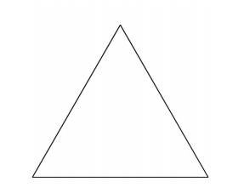
Build with Pattern Blocks
Activity #1
3. Fill in the triangle in different ways using the pattern blocks. Record how you filled in the shape using drawings, numbers, or words.
Use the pattern blocks to fill the outline in different ways.
Each time, record how you filled in the shape with pictures, numbers, or words.

Slide 49
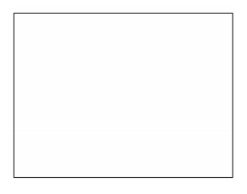
Build with Pattern Blocks
Activity #1
4. Fill in the rectangle in different ways using the pattern blocks. Record how you filled in the shape using drawings, numbers, or words.
Use the pattern blocks to fill the outline in different ways.
Each time, record how you filled in the shape with pictures, numbers, or words.

Slide 50
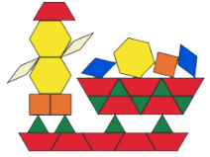
Shape Pictures
Activity #2
Use the pattern blocks to build a new shape.
Your new shape can be whatever you want.
  It can be an object, an animal, or a thing.
After you build your shape, trace it and count the number of pattern blocks you used.
Then build the same shape using different blocks, trace your shape, and count the blocks.

Slide 51
Lesson Synthesis
The most important thing to remember about shapes is…
Let’s reflect on the work we did in this section with shapes. First you will think on your own. Then you will share your ideas with a partner

Slide 52
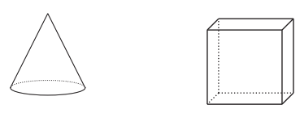

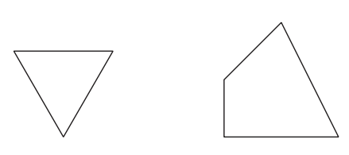
Lesson Synthesis
Lesson 7 Summary
We learned about solid shapes.
We learned about flat shapes.
We described and named shapes.
This shape is a triangle because it has 3 straight sides. It is pointy.

Slide 53
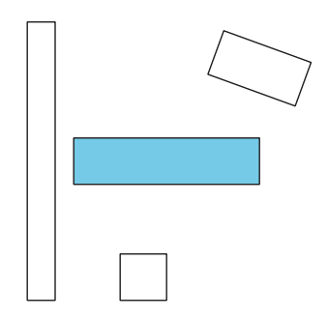
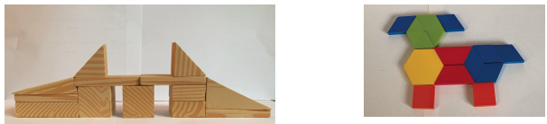
Lesson Synthesis
Lesson 7 Summary
These shapes are all rectangles because they have 4 sides and 4 square corners.
We built larger shapes from smaller shapes.

Slide 54
Center Day 1
8
Let’s describe and draw geometric shapes.
1.G.A.1, 1.OA.C.6

Slide 55
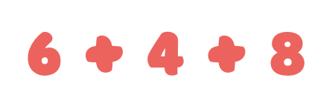
Number Talk: Add 3 Numbers
Warm up
Find the value of each expression mentally.
Notes:
Optional Warm UP Activity

Slide 56

Number Talk: Add 3 Numbers
Warm up
Find the value of each expression mentally.
Notes:
Optional Warm UP Activity

Slide 57

Number Talk: Add 3 Numbers
Warm up
Find the value of each expression mentally.
Notes:
Optional Warm UP Activity

Slide 58

Number Talk: Add 3 Numbers
Warm up
Find the value of each expression mentally.
Notes:
Optional Warm UP Activity

Slide 59
Center: Introduce Guess My Shape, Shape Flash
Activity #1
We are going to do an activity in which we draw the shapes we see.
Draw the shape that you saw.
I’m going to flash the image again and you can revise your drawing, if needed.
Share drawings.
Who can explain how they saw the image?
You will continue this activity with your partner, taking turns flashing the shape card.

Slide 60



Centers: Choice Time
Activity #2
Guess My Shape: Draw
Guess My Shape:
Shape Flash
Counting Collections

Slide 61
Lesson Synthesis
How did you and your partner work together during centers?
What went well?
What can we continue to work on?

Slide 62
Equal Pieces
9
Let’s split shapes into equal sized pieces.
1.G.A, 1.G.A.3

Slide 63

Which One Doesn’t Belong:
Pieces of Shapes
Warm up
Which one doesn’t belong?

Slide 64

Build a Circle
Activity #1
Put your pieces together.
What shape did you make?
Find three other people that have the same-sized piece as you and find a place to sit.
Put your pieces together. What shape did you make?
Do each of you have an equal piece of the circle? How do you know?

Slide 65

Build a Circle
Activity #1
Which of these shows equal pieces that make a circle?
Why don’t the other pieces make a circle?

Slide 66

Fold into Equal Pieces
Activity #2
Cut out one circle and one square.
Fold each shape so that there are 2 equal pieces.
Be ready to explain how you know your shape has 2 equal pieces.

Slide 67
Fold into Equal Pieces
Activity #2
2.
Cut out one circle and one square.
Fold each shape so that there are 4 equal pieces.
Be ready to explain how you know your shape has 2 equal pieces.

Slide 68

Halves or Fourths
Activity #3
Here are some shapes split into pieces.
What do you notice?
Based on what you observed, what do you think split into halves means? What do you think split into fourths means?

Slide 69


Halves or Fourths
Activity #3
Part 2
1. Split each shape into halves.
2. Split each shape into fourths.

Slide 70


Halves or Fourths
Activity #3
Part 2
3. Split each shape into fourths.
4. Split each shape into halves.

Slide 71

Halves or Fourths
Activity #3
Part 2
5. Split each shape into halves.
6. Split each shape into fourths.

Slide 72


Lesson Synthesis
Tyler says each of these circles are split into quarters. Do you agree? Why or why not?

Slide 73
One of the Pieces
10
Let’s describe equal pieces of shapes.
1.G.A.3

Slide 74
Which One Doesn’t Belong:
Split Shapes
Warm up
Which one doesn’t belong?

Slide 75


Color a Piece
Activity #1
1. Split the square into halves.
Color in one of the halves.
How much of the square is colored in?
2. Split the circle into fourths.
Color in one of the fourths.
How much of the circle is colored in?

Slide 76
















Card Sort: Shaded Pieces
Activity #2
1. Sort your cards. Then explain how you sorted them.

Slide 77

Card Sort: Shaded Pieces
Activity #2
2. Sort your cards in the following way.
Write the letter of each card in the space for it’s category.

Slide 78

Card Sort: Shaded Pieces
Activity #2
2. Sort your cards in the following way.
Write the letter of each card in the space for it’s category.

Slide 79



Describe Equal Pieces
Activity #3
Label each shape with at least one phrase from the lists.

Slide 80


Describe Equal Pieces
Activity #3
Label each shape with at least one phrase from the lists.

Slide 81


Describe Equal Pieces
Activity #3
Label each shape with at least one phrase from the lists.

Slide 82

Describe Equal Pieces
Activity #3
Label each shape with at least one phrase from the lists.

Slide 83


Lesson Synthesis
How are the shapes the same? How are they different?

Slide 84
A Bigger Piece
11
Let’s compare the size of halves and fourths.
1.G.A.3, 1.NBT.C.5

Slide 85
Choral Count: 10 More, 10 Less
Warm up
What do you
notice?
What patterns do you see?
Count by 10, starting at 6.
Stop counting and recording at 116.
Count back by 10 starting at 116.
Stop counting and recording at 6.

Slide 86

Which is Bigger?
Activity #1
Each partner cuts out their circle.
Decide who will cut into halves and who will cut into fourths.
Fold your circle into halves or fourths then cut it.
Compare your pieces with your partner.
What do you notice?
Be ready to explain your thinking so that others can understand.

Slide 87

Which is Bigger?
Activity #1
2.
Repeat with your squares.
Compare your pieces with your partner.
What do you notice?
Be ready to explain your thinking so that others can understand.
3. Write 2 things you notice about your pieces.

Slide 88


Priya and Han Share Roti
Activity #2
Who do you agree with?
Show your thinking using drawings, numbers or words.
Use the circle if it helps you.

Slide 89
Lesson Synthesis
What did you learn about splitting shapes into equal pieces?

Slide 90



Lesson Synthesis
Lesson 11 Summary
We learned that circles and rectangles can be split into two equal pieces which are called halves and four equal pieces which are called quarters or fourths.
A half of the square is shaded. The whole rectangle is shaded.
A fourth or a quarter of the circle is shaded.

Slide 91
Center Day 2
12
Let’s partition shapes into 2 or 4 pieces.
1.G.A.2, 1.G.A.3, 1.OA.C.6

Slide 92

How Many Do You See:
2 or 3 Addends
Warm up
How many do you see?
How do you see them?

Slide 93

How Many Do You See:
2 or 3 Addends
Warm up
How many do you see?
How do you see them?

Slide 94

How Many Do You See:
2 or 3 Addends
Warm up
How many do you see?
How do you see them?

Slide 95


Introduce Split the Shapes
Activity #1
We are going to learn two different ways to play the center called Split the Shapes. Then you can choose which way you want to play.
Stage 1:
Spin and split your shape.
Compare your shapes.
If you made equal parts, name the parts using halves or fourths.
Stage 2:
Spin and split your shapes two different ways.
Compare your shapes.
Name the parts using half of, fourth of, or quarter of.

Slide 96

Centers: Choice Time
Activity #2
Guess My Shape: Draw
Guess My Shape:
Shape Flash
Split the Shapes

Slide 97
Lesson Synthesis
Describe a time during centers today when you learned something by listening carefully to your partner or someone in your class.

Slide 98
It’s Time to Learn
About Clocks
13
Let’s tell and write times from a clock.
1.MD.B.3

Slide 99

Notice and Wonder: Clocks
Warm up
What do you notice?
What do you wonder?

Slide 100

Card Sort: Clocks
Activity #1
What do you notice?
What do you wonder?

Slide 101
























Card Sort: Clocks
Activity #1
Cut out the cards and organize them in a way that makes sense to you.
Explain how you sorted or organized your cards with your partner.

Slide 102

Connect Clocks to Written Times
Activity #2
These clocks both show the same time.
What time do they show?
How do you know?

Slide 103

Our School Day
Activity #3
Both of these clocks show the same time.
What do you notice?
The clock has two hands or arrows. We saw the hour hand pointing to different times.
The long hand is the minute hand.
When it points to 12, we say it is 8 o’clock.

Slide 104

Our School Day
Activity #3
This list shows a schedule, but not all of the clocks are filled in.
With your partner, make each clock show the time each activity happens.”

Slide 105

Our School Day
Activity #3
This list shows a schedule, but not all of the clocks are filled in.
With your partner, make each clock show the time each activity happens.”

Slide 106

Our School Day
Activity #3
This list shows a schedule, but not all of the clocks are filled in.
With your partner, make each clock show the time each activity happens.”

Slide 107

Our School Day
Activity #3
This list shows a schedule, but not all of the clocks are filled in.
With your partner, make each clock show the time each activity happens.”

Slide 108

Our School Day
Activity #3
This list shows a schedule, but not all of the clocks are filled in.
With your partner, make each clock show the time each activity happens.”

Slide 109

Our School Day
Activity #3
This list shows a schedule, but not all of the clocks are filled in.
With your partner, make each clock show the time each activity happens.”

Slide 110

Our School Day
Activity #3
This list shows a schedule, but not all of the clocks are filled in.
With your partner, make each clock show the time each activity happens.”

Slide 111

Our School Day
Activity #3
This list shows a schedule, but not all of the clocks are filled in.
With your partner, make each clock show the time each activity happens.”

Slide 112

Our School Day
Activity #3
This list shows a schedule, but not all of the clocks are filled in.
With your partner, make each clock show the time each activity happens.”

Slide 113

Lesson Synthesis
How should I draw the minute hand?
What time does this show?
How can we write the time?

Slide 114
Half of the Clock
14
Let’s compare half of a circle with half of an hour.
1.MD.B.3, 1.NBT.C.4

Slide 115

Number Talk: Work with 30
Warm up
Find the value of each expression mentally.
Notes:
Optional Warm UP Activity

Slide 116

Number Talk: Work with 30
Warm up
Find the value of each expression mentally.
Notes:
Optional Warm UP Activity

Slide 117

Number Talk: Work with 30
Warm up
Find the value of each expression mentally.
Notes:
Optional Warm UP Activity

Slide 118

Number Talk: Work with 30
Warm up
Find the value of each expression mentally.
Notes:
Optional Warm UP Activity

Slide 119

Put Times in Order
Activity #1
What do you notice?
What do you wonder?

Slide 120
Put Times in Order
Activity #1
Cut out your new cards and put them in order with the cards you already have.
Be ready to explain why you organized them the way you did.

Slide 121

Half Past What?
Activity #2
What time is shown on each clock?
If the time is half past, color the clock red.
If the time is o’clock, color the clock blue.
Write the time in words using half past or o’clock.

Slide 122

Half Past What?
Activity #2
What time is shown on each clock?
If the time is half past, color the clock red.
If the time is o’clock, color the clock blue.
Write the time in words using half past or o’clock.

Slide 123

Half Past What?
Activity #2
What time is shown on each clock?
If the time is half past, color the clock red.
If the time is o’clock, color the clock blue.
Write the time in words using half past or o’clock.

Slide 124

Half Past What?
Activity #2
What time is shown on each clock?
If the time is half past, color the clock red.
If the time is o’clock, color the clock blue.
Write the time in words using half past or o’clock.

Slide 125

Half Past What?
Activity #2
What time is shown on each clock?
If the time is half past, color the clock red.
If the time is o’clock, color the clock blue.
Write the time in words using half past or o’clock.

Slide 126

Half Past What?
Activity #2
What time is shown on each clock?
If the time is half past, color the clock red.
If the time is o’clock, color the clock blue.
Write the time in words using half past or o’clock.

Slide 127

Half Past What?
Activity #2
What do you notice?
What do you wonder?

Slide 128


Lesson Synthesis
We’ve looked at clocks that show times in hours and half-hours.
What is the same about these clocks? What is different?

Slide 129
Write Times
15
Let’s write times in hours and half hours.
1.MD.B.3, 1.NBT.A.1, 1.OA.D.7

Slide 130

True or False: Close To 30
Warm up
Decide if each statement is true or false.
Be prepared to explain your reasoning.
Notes:
Optional Warm UP Activity

Slide 131

True or False: Close To 30
Warm up
Decide if each statement is true or false.
Be prepared to explain your reasoning.
Notes:
Optional Warm UP Activity

Slide 132

True or False: Close To 30
Warm up
Decide if each statement is true or false.
Be prepared to explain your reasoning.
Notes:
Optional Warm UP Activity

Slide 133

Count the Minutes
Activity #1
Start at 12.
Count the minutes around the clock until you get to half the clock.
Circle where you stop.

Slide 134

Count the Minutes
Activity #1
Which hand tells the hours and which tells the minutes?
We can write the time as 2:30 because it is 30 minutes past 2 or half past 2. Write 2:30.

Slide 135

Count the Minutes
Activity #1
How would we write the time?
For these two clocks, how could you describe where the hour hand is

Slide 136


All the Time in the World
Activity #2
1. For each clock, write the time.

Slide 137


All the Time in the World
Activity #2
1. For each clock, write the time.

Slide 138

All the Time in the World
Activity #2
1. For each clock, write the time.

Slide 139


All the Time in the World
Activity #2
2. For each clock, draw the minute hand and write the time.

Slide 140


All the Time in the World
Activity #2
2. For each clock, draw the minute hand and write the time.

Slide 141

All the Time in the World
Activity #2
2. For each clock, draw the minute hand and write the time.

Slide 142

All the Time in the World
Activity #2
3. This clock only has a minute hand.
What time could it be?
Draw an hour hand and write the time.

Slide 143

Lesson Synthesis
Which clock shows 3:30? How do you know?

Slide 144
Hard Times
16
Let’s show time in hours and half-hours.
1.MD.B.3, 1.NBT.C.4

Slide 145

Number Talk:
Tens and Ones
Warm up
Find the value of each expression mentally.
Notes:
Optional Warm UP Activity

Slide 146

Number Talk:
Tens and Ones
Warm up
Find the value of each expression mentally.
Notes:
Optional Warm UP Activity

Slide 147

Number Talk:
Tens and Ones
Warm up
Find the value of each expression mentally.
Notes:
Optional Warm UP Activity

Slide 148

Number Talk:
Tens and Ones
Warm up
Find the value of each expression mentally.
Notes:
Optional Warm UP Activity

Slide 149
What’s the Time?
Activity #1
From your pile of cards, take out 12:00, 12:30, 6:00, 6:30.
What do these clocks have in common? How are they the same and different?
What time does each clock show? How do you know?
You are going to play a game with your partner using all your cards. Hold up a clock card for your partner and cover up the written time. Your partner reads the time and you check what they say with the time on the card. Then switch roles.

Slide 150

What’s the Time, Again?
Activity #2
Diego says this clock shows 6:00.
Priya says the clock shows 12:30.
Who do you agree with? Why?
Explain your thinking.

Slide 151

What’s the Time, Again?
Activity #2
Why do you think Priya got mixed up? What could you say to help her revise her thinking?
On the blank clock, draw hands to show 12:30.

Slide 152


Sunday Schedule
Activity #3
Fill in the blanks to show your ideal Sunday schedule.

Slide 153
Lesson Synthesis
In this unit, we studied shapes, split shapes into equal parts, and learned to tell time. What did you like best in this unit? Why?

Slide 154


Lesson Synthesis
Lesson 16 Summary
We learned how to tell time to the hour and half hour. We learned when the minute hand points to the 12, the hour hand points to a number. We say “___ o’clock.”
We learned when the minute hand has gone half way around the clock and points to the 6, the hour hand points between 2 numbers. We say “half past ___.”

Slide 155

Lesson Synthesis
Lesson 16 Summary
We learned how to write time.

Slide 156
Center Day 3
17
Let’s tell time in hours and half hours.
1.G.A.2, 1.MD.B.3

Slide 157

Which One Doesn’t Belong:
Clocks
Warm up
Which one doesn’t belong?

Slide 158
Introduce What Time Is It?
Activity #1
You and your partner are going to take turns showing a card with the written time covered.
If your partner says the correct time, they get to keep the card and add it to their pile.
If your partner does not say the correct time, you keep it in your pile.
At the end, the partner with the most cards wins.

Slide 159



Centers: Choice Time
Activity #2
Get to 95
Measuring Length
Split the Shapes

Slide 160
Lesson Synthesis
How did you and your partner work together during centers? What went well? What can we continue to work on?”

