Slide 1

Measuring Length
Grade 1: Unit 6
Standards addressed: 1.MD.A.1, 1.NBT.C.4, 1.OA.C.6, 1.MD.A.2, 1.NBT.A.1, 1.MD.C.4, 1.OA.A.1, 1.OA.A.2, 1.OA.B.4, 1.OA.D.7
These slides have been created by Britnee Wright- Southeast Arkansas Education Cooperative and are not official IM materials. Images and language are taken from IM Grade 1, Unit 6 by Illustrative Mathematics.
Copyright 2020 by Illustrative Mathematics. All Rights Reserved, adapted and shared with permission.

Slide 2
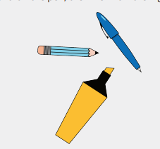


Unit 6 Progression Overview
Measuring Length
Section A
Lessons 1-4
1.MD.A.1, 1.NBT.C.4, 1.OA.C.6
Section B
Lessons 5-10
1.MD.A.2, 1.NBT.A.1, 1.NBT.C.4, 1.OA.C.6
Section C
Lessons 11-17
1.MD.A.2, 1.MD.C.4, 1.NBT.A.1, 1.NBT.C.4, 1.OA.A.1, 1.OA.A.2, 1.OA.B.4,
1.OA.C.6, 1.OA.D.7
Measure lengths indirectly.
Count groups of up to 120 objects and write a number to represent them.
Lay standard units end-to-end with no gaps or overlaps and count the units to determine length.
Solve addition and subtraction story problems with unknowns in all positions.

Slide 3



Unit 6 Quick Links
L1
L2
L3
L4
L5
L6
L7
L8
L9
L10
L11
L12
L13
L14
L15
L16
L17

Slide 4
Compare Lengths
1
Let’s compare and order objects by length.
1.MD.A.1

Slide 5
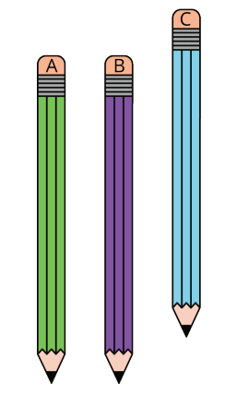
Notice and Wonder: Pencils
Warm up
What do you notice?
What do you wonder?

Slide 6
Is it Longer or Shorter?
Activity #1
Write down your answers:
1. Choose an object that you could write with and find the tower of 3 connecting cubes.
Which is longer?
Draw the 2 objects to show which is longer.
2. Choose a different object and find the tower of 8 connecting cubes.
Which is shorter?
Draw the 2 objects to show which is shorter.
Share your thinking with your partner:
Choose 2 objects and compare their lengths.
Choose 2 different objects and compare their lengths.

Slide 7
Is it Longer or Shorter?
Activity #1
Write down your answers:
3. Find an object from the collection that is shorter than your foot.
Fill in the blank:
The __________ is shorter than my foot.
4. Find an object from the collection that is longer than your pointer finger.
Fill in the blank.
The _____ is longer than my pointer finger.
Share your thinking with your partner:
Choose 2 objects and compare their lengths.
Choose 2 different objects and compare their lengths.

Slide 8
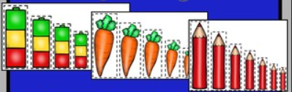
Ordering Objects
Activity #2
1.
Pick 3 objects.
With your partner, put the objects in order from shortest to longest.
Trace or draw your objects.
2.
Pick 3 new objects.
With your partner, put them in order from longest to shortest.
Write the names of the objects in order from longest to shortest.

Slide 9

Lesson
Synthesis
If we pulled 6 objects from our collection, what could we do to order them by length? What if we pulled 100 objects?

Slide 10
Indirectly Compare Objects
2
Let’s use a third object to find longer and shorter objects.
1.MD.A.1, 1.NBT.C.4

Slide 11

Number Talk: Adding within 100
Warm up
Find the value of each expression mentally.
Notes:
Optional Warm UP Activity

Slide 12

Number Talk: Adding within 100
Warm up
Find the value of each expression mentally.
Notes:
Optional Warm UP Activity

Slide 13
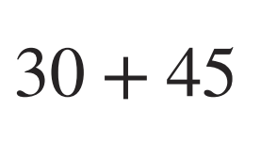
Number Talk: Adding within 100
Warm up
Find the value of each expression mentally.
Notes:
Optional Warm UP Activity

Slide 14
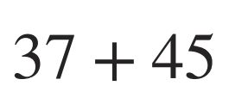
Number Talk: Adding within 100
Warm up
Find the value of each expression mentally.
Notes:
Optional Warm UP Activity

Slide 15
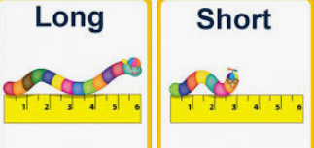
Which is Longer? Which is Shorter?
Activity #1
Find 2 objects in the bucket that are longer and 2 objects that are shorter than the unsharpened pencil.
Write a sentence that compares each object to the pencil.
Example: The bulletin board is longer than the pencil

Slide 16
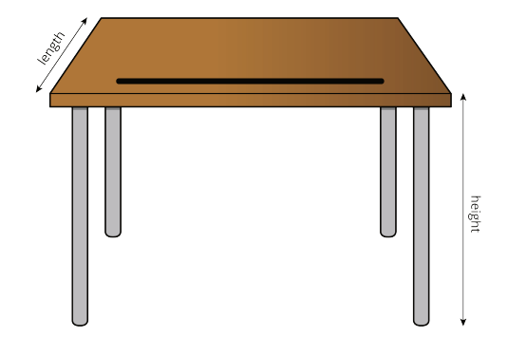
Measure Your Desk
Activity #2
Compare the length and height of your desk using the string.
Use a drawing or words to explain how you know which is longer.

Slide 17
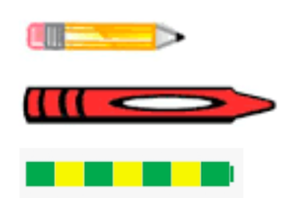
Lesson
Synthesis
Jada says that the crayon is shorter than the tower. Do you agree? Why or why not?
What other statements could we say about the objects?

Slide 18
Choose Objects to Indirectly Compare Length
3
Let’s compare the length of objects that can’t be moved.
1.MD.A.1

Slide 19
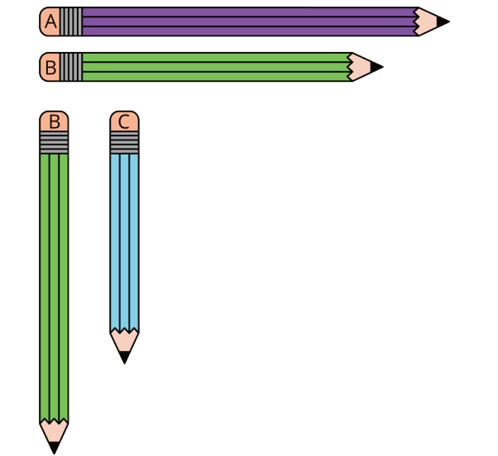
Notice and Wonder: More Pencils
Warm up
What do you notice?
What do you wonder?

Slide 20
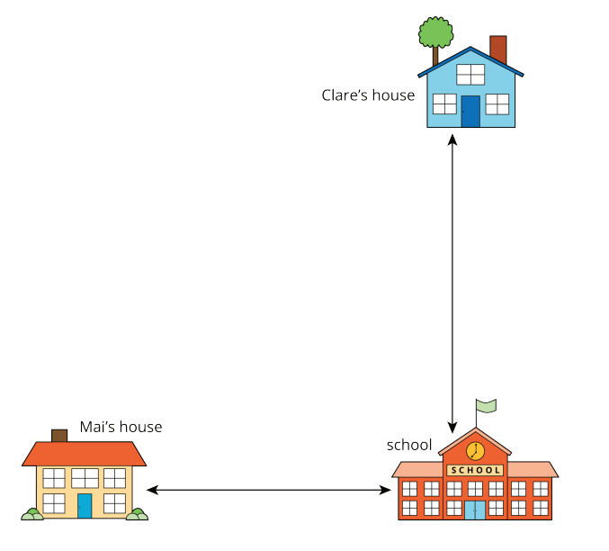
Mai and Clare Walk to School
Activity #1
Who has a shorter walk to school, Clare or Mai?
How do you know?
Be ready to explain your thinking so that others can understand.

Slide 21


Will It Fit?
Activity #2
1. Will the teacher’s desk fit through the door?
2. Will a student desk fit through the door?
3. Which is longer, the bookshelf or the rug?
4. Which is longer, the file cabinet or the bookshelf?
5. Which is shorter, the bookshelf, or the teacher’s desk?
6. Will the teacher’s desk fit next to the bookshelf?
Show your thinking using drawings, numbers, or words.

Slide 22
Lesson Synthesis
What was your strategy for picking an object to help you compare in both activities?

Slide 23
Center Day 1
4
Let’s practice adding and subtracting.
1.MD.A.1, 1.NBT.C.4, 1.OA.C.6

Slide 24
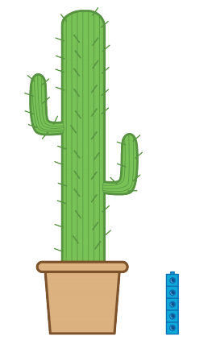
Act It Out: Trucks
Warm up
Record an estimate that is:
How long is the cactus?
Too low | About right | Too high
Notes:
Optional Warm UP Activity

Slide 25
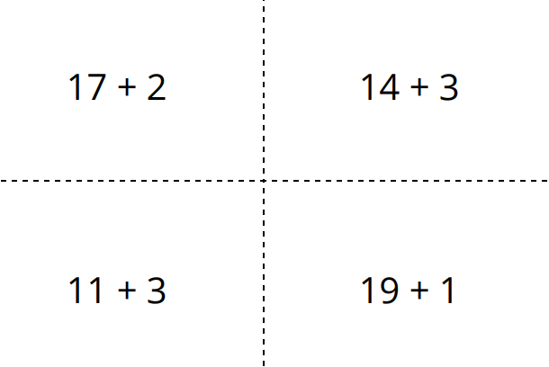
Introduce Compare, Stage 3
Activity #1
Directions:
Both partners flip over a card
The partner whose card has the greater value takes both cards
The game is over when each partner runs out of cards to flip over.
The partner with the most cards wins.

Slide 26



Centers Choice Time
Activity #1
Compare
How Close?
Get to 95

Slide 27
Lesson Synthesis
How did you and your partner work together during centers? What went well? What can we continue to work on?

Slide 28
Measure with Connecting Cubes
5
Let’s use connecting cubes to measure length.
1.MD.A.2

Slide 29
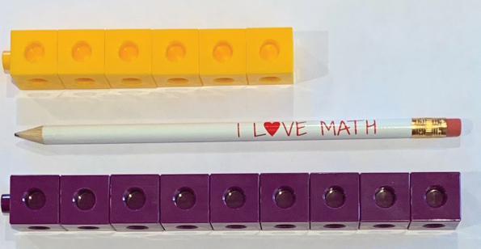
Notice and Wonder: Measure a Pencil
Warm up
What do you notice?
What do you wonder?

Slide 30
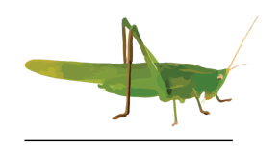
Lengths of Creepy, Crawly Things
Activity #1
Use connecting cubes to build a tower that is the same length as each creepy, crawly thing
1. The grasshopper is the same length as a tower of ___________ connecting cubes.

Slide 31
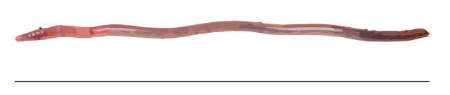
Lengths of Creepy, Crawly Things
Activity #1
Use connecting cubes to build a tower that is the same length as each creepy, crawly thing
2. The earthworm is the same length as a tower of ___________ connecting cubes.

Slide 32
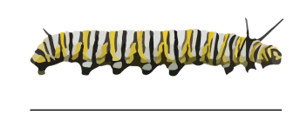
Lengths of Creepy, Crawly Things
Activity #1
Use connecting cubes to build a tower that is the same length as each creepy, crawly thing
3. The caterpillar is the same length as a tower of ___________ connecting cubes.

Slide 33

Lengths of Creepy, Crawly Things
Activity #1
Use connecting cubes to build a tower that is the same length as each creepy, crawly thing
4. The dragonfly is the same length as a tower of ___________ connecting cubes.

Slide 34
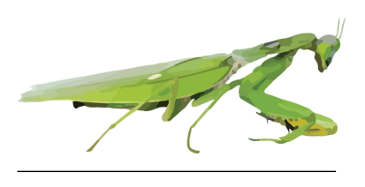
Lengths of Creepy, Crawly Things
Activity #1
Use connecting cubes to build a tower that is the same length as each creepy, crawly thing
5. The praying mantis is the same length as a tower of ___________ connecting cubes.

Slide 35
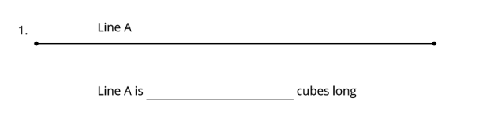
Measure Lines
Activity #2
Use connecting cubes to measure the length of each line
1. First, find the length of each line on your own.
2. Then compare your thinking with your partner.
*If you and your partner don’t agree on the length, work together to come to an agreement.
3. Write the length of the line in each statement.

Slide 36
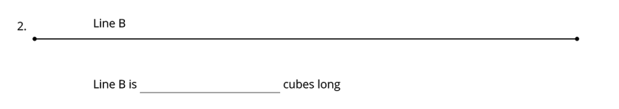
Measure Lines
Activity #2
Use connecting cubes to measure the length of each line
1. First, find the length of each line on your own.
2. Then compare your thinking with your partner.
*If you and your partner don’t agree on the length, work together to come to an agreement.
3. Write the length of the line in each statement.

Slide 37
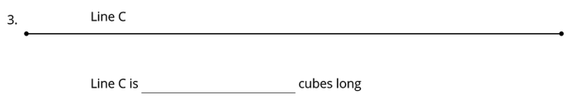
Measure Lines
Activity #2
Use connecting cubes to measure the length of each line
1. First, find the length of each line on your own.
2. Then compare your thinking with your partner.
*If you and your partner don’t agree on the length, work together to come to an agreement.
3. Write the length of the line in each statement.

Slide 38
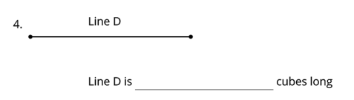
Measure Lines
Activity #2
Use connecting cubes to measure the length of each line
1. First, find the length of each line on your own.
2. Then compare your thinking with your partner.
*If you and your partner don’t agree on the length, work together to come to an agreement.
3. Write the length of the line in each statement.

Slide 39
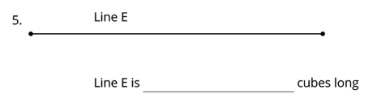
Measure Lines
Activity #2
Use connecting cubes to measure the length of each line
1. First, find the length of each line on your own.
2. Then compare your thinking with your partner.
*If you and your partner don’t agree on the length, work together to come to an agreement.
3. Write the length of the line in each statement.

Slide 40
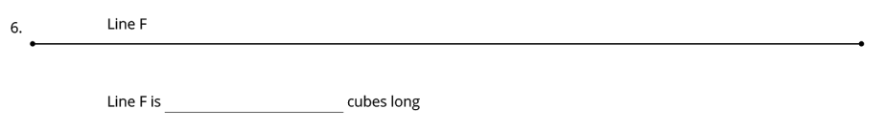
Measure Lines
Activity #2
Use connecting cubes to measure the length of each line
1. First, find the length of each line on your own.
2. Then compare your thinking with your partner.
*If you and your partner don’t agree on the length, work together to come to an agreement.
3. Write the length of the line in each statement.

Slide 41
Lesson Synthesis
How do you know?
What is the length of the pencil?

Slide 42
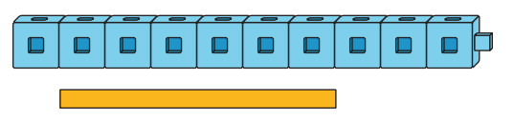
Lesson Synthesis
Even if there are extra units, you only count the units that start and end with the object being measured.
What is the length of the pencil? How do you know?

Slide 43
Measure with Paper Clips
6
Let’s measure length with new tools.
1.MD.A.2, 1.NBT.C.4

Slide 44

Number Talk: Use Tens to Add
Warm up
Find the value of each expression mentally.
Notes:
Optional Warm UP Activity

Slide 45
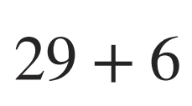
Number Talk: Use Tens to Add
Warm up
Find the value of each expression mentally.
Notes:
Optional Warm UP Activity

Slide 46

Number Talk: Use Tens to Add
Warm up
Find the value of each expression mentally.
Notes:
Optional Warm UP Activity

Slide 47

Number Talk: Use Tens to Add
Warm up
Find the value of each expression mentally.
Notes:
Optional Warm UP Activity

Slide 48

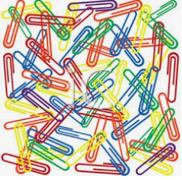
Measure with Paper Clips
Activity #1
We have been measuring length with connecting cubes. Now we are going to use a different unit.
Measure this line using paper clips.
When each partner has measured, compare your thinking with your partner

Slide 49
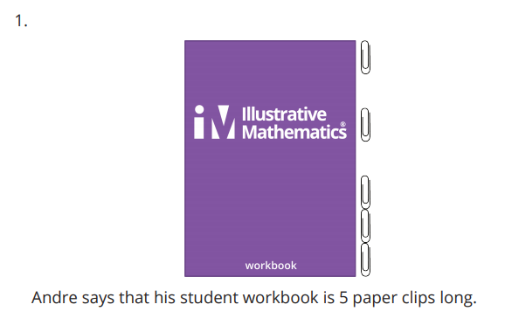
Measure with Paper Clips
Activity #2
Do you agree or disagree with each student.
Explain why you agree or disagree.

Slide 50
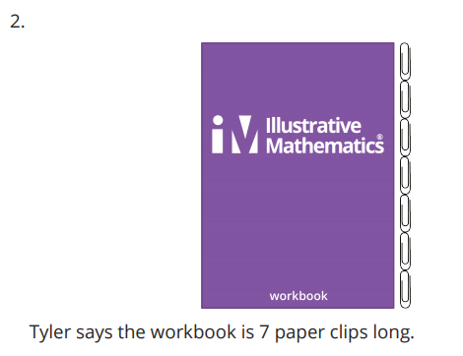
Measure with Paper Clips
Activity #2
Do you agree or disagree with each student.
Explain why you agree or disagree.

Slide 51
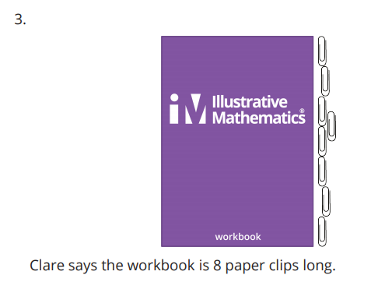
Measure with Paper Clips
Activity #2
Do you agree or disagree with each student.
Explain why you agree or disagree.

Slide 52
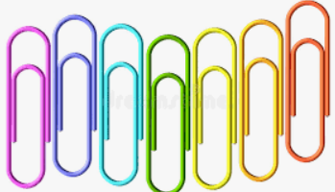
Measure Lengths of Lines
Activity #3
Use paper clips to measure each line.
1. The length of Line A is____ paper clips.
2. The length of Line B is ____ paper clips.
3. The length of Line C is ____ paper clips.
4. The length of Line D is ____ paper clips.
5. The length of Line E is ____ paper clips.
6. The length of Line F is ____ paper clips.

Slide 53
Lesson Synthesis
Today we learned more about how to measure length using paper clips.
What advice would you give to someone who has never measured before?

Slide 54
Measure Length with Different Units
7
Let’s measure the same object using different units.
1.MD.A.2

Slide 55
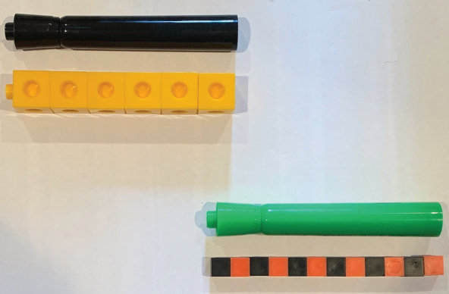
Notice and Wonder:
Large Cubes and Small Cubes
Warm up
What do you notice?
What do you wonder?

Slide 56
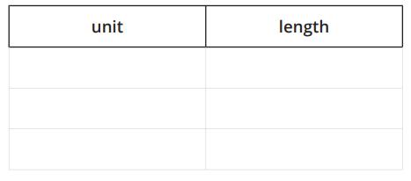
Measure With Different Length Units
Activity #1
Choose 3 different measurement units.
Choose the 3 units you will use:
connecting cubes
small cubes
small paper clips
large paper clips
Measure the line with each unit you chose and fill in the table.

Slide 57
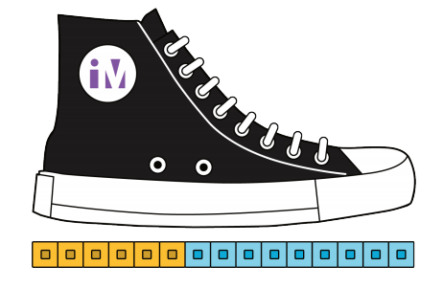
Measure the Teacher’s Shoe
Activity #2
1. Andre measured his teacher’s shoe and said it was 15 connecting cubes long.
Is his measurement accurate? Why or why not?

Slide 58
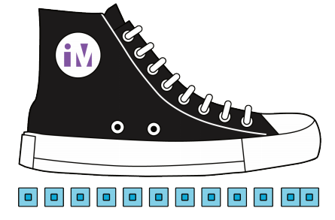
Measure the Teacher’s Shoe
Activity #2
2. Jada measured her teacher’s shoe and said it was 12 connecting cubes long.
Is her measurement accurate? Why or why not?

Slide 59
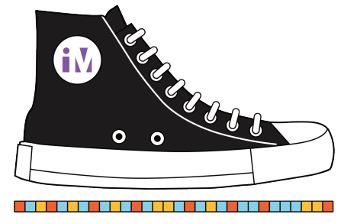
Measure the Teacher’s Shoe
Activity #2
3. Clare measured her teacher’s shoe and said it was 30 cubes long.
Is her measurement accurate? Why or why not?

Slide 60
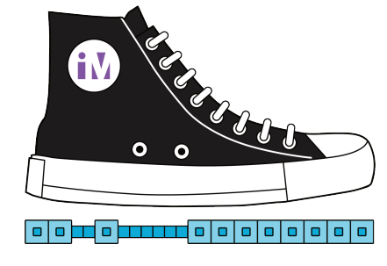
Measure the Teacher’s Shoe
Activity #2
4. Kiran measured his teacher’s shoe and said it was 19 cubes long.
Is his measurement accurate? Why or why not?

Slide 61
Lesson Synthesis
This piece of tape shows how tall I am. Would you rather use connecting cubes, paper clips or small cubes to find out my length. Why?

Slide 62
Groups Up to 110
8
Let’s measure lengths that are longer than 100 cubes.
1.MD.A.2, 1.NBT.A.1

Slide 63

Choral Count: Above 100
Warm up
What do you
notice?
Let’s count from 80 to 110.
Stop counting and recording at 110.
What patterns do you see?

Slide 64


Long Lengths with Small Cubes
Activity #1
Today we are going to measure one of your group members’ height.
Each group will have base-ten cubes and string.
Cut a piece of string that is the same length as their height.
Measure the length of the string using cubes.
  Represent the measurement using drawings, numbers, or words.

Slide 65
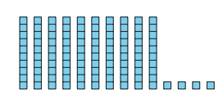
Representations of Large Numbers
Activity #2
This is how many cubes it took to measure Jada’s height.
What do you notice about this representation?

Slide 66
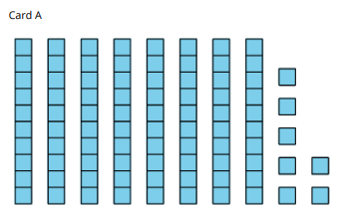



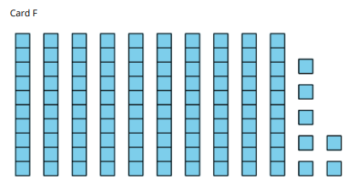

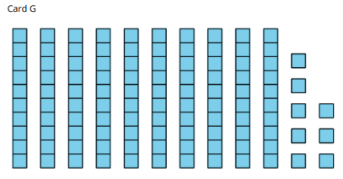
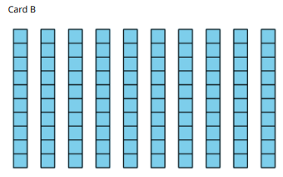

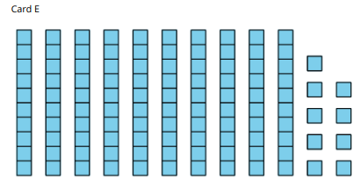


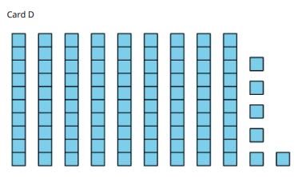
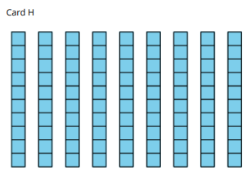
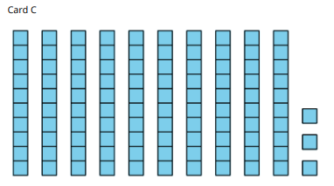

Representations of Large Numbers
Activity #2
Match each picture to the number that represents it.

Slide 67
Lesson Synthesis
Today we learned that after measuring a long length with cubes, you can group the cubes to make determining the length easier.
Let’s count the towers together by tens. When we count 10 tens, we get 100.
How many cubes are there?

Slide 68
Write Numbers to 120
9
Let’s count, write, and read numbers up to 120.
1.MD.A.2, 1.NBT.A.1

Slide 69

Choral Count: Numbers Up to 120
Warm up
What do you
notice?
Count by 1, starting at 90.
Stop counting and recording at 120
What patterns do you see?

Slide 70
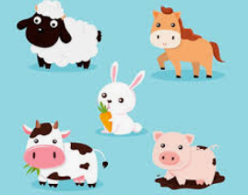
Measure Animal Lengths
Activity #1
Around the classroom are pieces of tape that show the lengths of different animals.
Each group will measure one animal and determine how to count the cubes.
Show your thinking using drawings, numbers, and words.

Slide 71
Write Numbers to Represent Animal Lengths
Activity #2
Create a poster to show how you counted the cubes you used to measure the length of the animal in the measuring animals activity.
Do not write the number of units long your animal is on your poster.
Complete a gallery walk with your group.
As you look at each poster, use the representation to determine the length of the animal.
  Write the number of cubes that represents its length in your book.

Slide 72
Lesson Synthesis
How would you explain writing numbers from 100 to 120 to a friend?
Let’s count by ones. Start at 100.

Slide 73
Center Day 2
10
Let’s measure the length of objects.
1.MD.A.2, 1.NBT.C.4, 1.OA.C.6

Slide 74
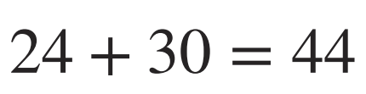
True or False: Adding within 100
Warm up
Is each statement true or false?
Notes:
Optional Warm UP Activity

Slide 75

True or False: Adding within 100
Warm up
Is each statement true or false?
Notes:
Optional Warm UP Activity

Slide 76

True or False: Adding within 100
Warm up
Is each statement true or false?
Notes:
Optional Warm UP Activity

Slide 77
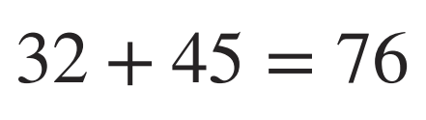
True or False: Adding within 100
Warm up
Is each statement true or false?
Notes:
Optional Warm UP Activity

Slide 78
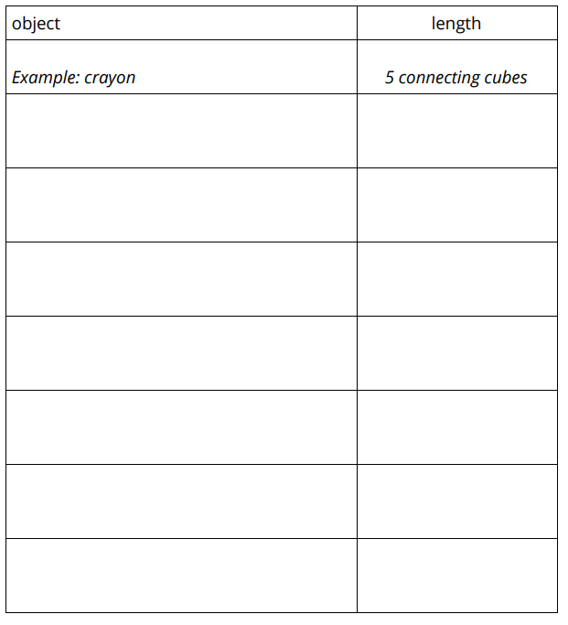
Introduce Measure Length, Stage 1
Activity #1
Directions:
Choose an object to measure.
Choose your length measuring tool.
Measure and record the length.

Slide 79



Centers: Choice Time
Activity #2
Get to 95
Compare
How Close?

Slide 80
Lesson Synthesis
What went well? What can we continue to work on?
How did you and your partner work together during centers?

Slide 81
How Long Are Our Shoes?
11
Let’s solve story problems about measurement.
1.MD.A.2, 1.MD.C.4, 1.NBT.C.4, 1.OA.A.1, 1.OA.A.2, 1.OA.B.4, 1.OA.C.6

Slide 82
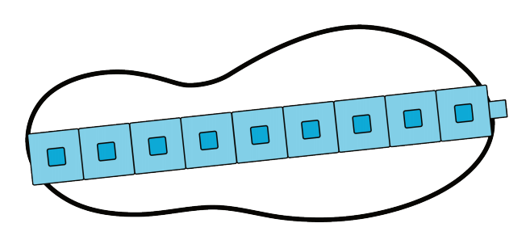
Notice and Wonder:
Length of a Shoe
Warm up
What do you notice?
What do you wonder?

Slide 83


The Length of Our Shoes
Activity #1
Trace your shoe.
My shoe is _________ connecting cubes long.
My partner’s shoe is _________ connecting cubes long.
The lengths of my other group members’ shoes are _________ connecting cubes and _________ connecting cubes long

Slide 84

The Length of Our Shoes
Activity #1
Solve these problems about the length of your group’s shoes.
Show your thinking using drawings, numbers, words, or equations.
1. What is the total length of your shoe and your partner’s shoe?
2. Whose shoe is longer, yours or your partner’s?
How much longer?
3. Your teacher’s shoe is 12 connecting cubes long.
Whose shoe is shorter, your teacher’s shoe or your shoe?
How much shorter?
4. How many connecting cubes long are the shoes of the students in your group altogether?

Slide 85
Measurement Story Problems
Activity #2
Solve these problems about the length of your group’s shoes.
Show your thinking using drawings, numbers, words, or equations.
1.
Clare’s shoe is 11 cubes long.
Han’s shoe is 8 cubes long.
How many cubes long are Clare’s and Han’s shoes together?
2.
Kiran’s pencil is 9 paper clips long.
Elena’s pencil is 6 paper clips long. Noah’s pencil is 5 paper clips long.
What is the total length of their pencils in paper clips?

Slide 86
Measurement Story Problems
Activity #2
Solve these problems about the length of your group’s shoes.
Show your thinking using drawings, numbers, words, or equations.
3.
Kiran’s reading book is 8 cubes long.
His math workbook is 17 cubes long.
How many cubes longer is the math book than the reading book?
4.
Elena made a tower of 7 cubes. Kiran added his tower to Elena’s. Now the tower is 12 cubes long.
How long was Kiran’s tower?

Slide 87

Lesson Synthesis
When solving story problems about measurement, you can write an equation to represent your thinking
How many cubes longer is his math book than his reading book?

Slide 88

Lesson Synthesis
When solving story problems about measurement, you can write an equation to represent your thinking
What do the numbers in these equation represent?

Slide 89
Compare Measurements
12
Let’s solve story problems in which we compare lengths.
1.OA.A.1, 1.OA.B.4, 1.OA.C.6

Slide 90

Notice and Wonder:
Friendship Bracelets
Warm up
What do you notice?
What do you wonder?

Slide 91
Kiran’s Friendship Bracelets
Activity #1
Priya and Han are comparing the lengths of their friendship bracelets.
Han’s bracelet is 14 cubes long.
The length of Priya’s bracelet is 4 cubes fewer than Han’s bracelet.
How long is Priya’s bracelet?
Show your thinking using drawings, numbers, or words.

Slide 92

One Representation, Different Story Problems
Activity #2
What do you notice?
What do you wonder?

Slide 93

One Representation, Different Story Problems
Activity #2
Discuss with your partner how the drawing shows each problem
1.
Diego’s bracelet is 12 cubes long. Mai’s bracelet is 5 cubes long.
How much longer is Diego’s bracelet than Mai’s bracelet?
2.
Diego’s bracelet is 7 cubes longer than Mai’s bracelet.
Mai’s bracelet is 5 cubes long.
How long is Diego’s bracelet?

Slide 94
One Representation, Different Story Problems
Activity #2
Discuss with your partner how the drawing shows each problem
3.
Mai’s bracelet is 7 cubes fewer than Diego’s.
Diego’s bracelet is 12 cubes long.
How long is Mai’s bracelet?

Slide 95

Lesson Synthesis
Solve the story problem. Be ready to explain how you solved it in a way that others can understand.

Slide 96
Problems About Taking From
13
Let’s solve a new type of story problem.
1.OA.A.1, 1.OA.C.6

Slide 97

Number Talk:
Add 2 Two-digit Numbers
Warm up
Find the value of each expression mentally.
Notes:
Optional Warm UP Activity

Slide 98

Number Talk:
Add 2 Two-digit Numbers
Warm up
Find the value of each expression mentally.
Notes:
Optional Warm UP Activity

Slide 99

Number Talk:
Add 2 Two-digit Numbers
Warm up
Find the value of each expression mentally.
Notes:
Optional Warm UP Activity

Slide 100

Number Talk:
Add 2 Two-digit Numbers
Warm up
Find the value of each expression mentally.
Notes:
Optional Warm UP Activity

Slide 101

Elena’s Beads
Activity #1
Elena bought a bag of beads to make bracelets.
She takes out 9 beads to make a bracelet.
There are 11 beads left in the bag.
What question can you ask about the story?

Slide 102
Elena’s Beads
Activity #1
Elena bought a bag of beads to make bracelets.
She takes out 9 beads to make a bracelet.
There are 11 beads left in the bag.
How many beads were in the bag when Elena bought it?
Solve the story problem.
Show your thinking using drawings, numbers, and words.

Slide 103






Stories About Beaded Bracelets
Activity #2
Match each story problem to the equation that represents it.
Be ready to explain how you know each equation matches the story problem in a way that others will understand.

Slide 104

Lesson Synthesis
How does this drawing represent each problem?

Slide 105
Which Equation Matches?
14
Let’s think about story problems and equations.
1.OA.A.1, 1.OA.B.4, 1.OA.C.6, 1.OA.D.7

Slide 106

Which One Doesn’t Belong: Equations
Warm up
Which one doesn’t belong?
Notes:
Optional Warm UP Activity

Slide 107






Sort Story Problems
Activity #1
Sort the story problems by whether they are addition or subtraction.
Be ready to explain how you know so that others can understand.

Slide 108


Stories and Equations
Activity #2
For each problem, circle the 2 equations that match the story.
You can use objects or drawings to represent the problem, if it helps you.

Slide 109


Stories and Equations
Activity #2
For each problem, circle the 2 equations that match the story.
You can use objects or drawings to represent the problem, if it helps you.

Slide 110


Stories and Equations
Activity #2
For each problem, circle the 2 equations that match the story.
You can use objects or drawings to represent the problem, if it helps you.

Slide 111

Lesson Synthesis
Which equation would you use to solve this problem? Why?

Slide 112
Which Equation Matches?
15
Let’s solve story problems and write equations.
1.NBT.A.1, 1.OA.A.1, 1.OA.C.6

Slide 113

Estimation Exploration:
Paper Cranes
Warm up
How many cranes are there in the image?
Record an estimate that is:
Too low | About right | Too high
Notes:
Optional Warm UP Activity

Slide 114



Story Problems about Origami
Activity #1
Show your thinking using drawings, numbers, or words.

Slide 115



Story Problems about Origami
Activity #1
Show your thinking using drawings, numbers, or words.

Slide 116

Story Problem Gallery Walk
Activity #2
Write an equation to represent each story problem.

Slide 117
Lesson Synthesis
In this section you practiced solving different types of story problems. What did you learn? What do you still need to practice?

Slide 118

Lesson Synthesis
Lesson 15 Summary
We solved different types of problems and represented our thinking using drawings and equations.
Diego’s bracelet is 7 cubes longer than Mai’s bracelet.
Mai’s bracelet is 5 cubes long.
How long is Diego’s bracelet?

Slide 119

Lesson Synthesis
Lesson 15 Summary
Kiran gave 5 of his cranes to his brother. Now, we has 10 left.
How many cranes did Kiran start with?

Slide 120
Center Day 3
16
Let’s practice counting and measuring
1.MD.A.2, 1.NBT.A.1, 1.NBT.C.4

Slide 121

Number Talk:
Adding 20 and 1
Warm up
Find the value of each expression mentally.
Notes:
Optional Warm UP Activity

Slide 122

Number Talk:
Adding 20 and 1
Warm up
Find the value of each expression mentally.
Notes:
Optional Warm UP Activity

Slide 123

Number Talk:
Adding 20 and 1
Warm up
Find the value of each expression mentally.
Notes:
Optional Warm UP Activity

Slide 124

Number Talk:
Adding 20 and 1
Warm up
Find the value of each expression mentally.
Notes:
Optional Warm UP Activity

Slide 125

Revisit Write Numbers
Activity #1
Directions:
Player A: Spin the number spinner.
Player B: Spin the direction spinner to see whether to count forward or backward by 1.
Both players: record the starting number and then fill in the column of numbers.
Switch roles and repeat

Slide 126



Centers: Choice Time
Activity #1
Write Numbers
Counting Collections
Measuring Length

Slide 127
Lesson Synthesis
How did you and your partner work together during centers? What went well? What can we continue to work on?

Slide 128
Puppies and Tulips
17
Let’s make origami puppies and tulips and tell and solve story problems using the words “more” and “fewer”.
1.OA.A.1, 1.OA.C.6

Slide 129

How Many Do You See:
Puppies and Tulips
Warm up
How many do you see?
How do you see them?

Slide 130

Puppy and Tulip Stories
Activity #1
1. For each paper you fold, decide if it is a puppy or a tulip:
a. Total:______
b. Tulips: _____
c. Puppies: _______

Slide 131
Puppy and Tulip Stories
Activity #1
2. Complete the two sentences that apply to your story.
a.
There are ______ fewer puppies than tulips.
There are _____ tulips.
How many puppies are there?
b.
There are ______ fewer tulips than puppies.
There are _____ tulips.
How many puppies are there?

Slide 132
Puppy and Tulip Stories
Activity #1
2. Complete the two sentences that apply to your story.
c.
There are ______ more tulips than puppies.
There are ______ tulips.
How many puppies are there?
d.
There are _____ more puppies than tulips.
There are _____ tulips.
How many puppies are there?

Slide 133

Act it Out
Activity #2

Slide 134

Lesson Synthesis
Today, we made origami puppies and tulips to help us learn more about how to write and solve comparison problems
What equations can we write to represent this situation?
Explain to your partner how both of these equations represent the situation.

