Slide 1

Adding
within 100
Grade 1: Unit 5
Standards addressed: 1.NBT.A.1, 1.NBT.C.4, 1.OA.A.1, 1.OA.C.6, 1.OA.D.8, 1.NBT.B, 1.NBT.C.5, 1.NBT.C.6,
These slides have been created by Britnee Wright- Southeast Arkansas Education Cooperative and are not official IM materials. Images and language are taken from IM Grade 1, Unit 5 by Illustrative Mathematics.
Copyright 2020 by Illustrative Mathematics. All Rights Reserved, adapted and shared with permission.

Slide 2
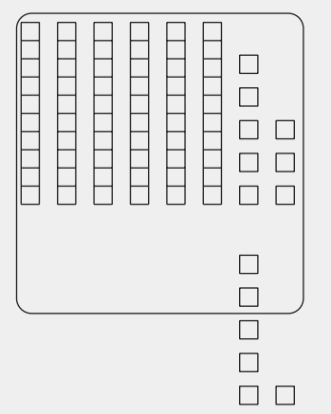
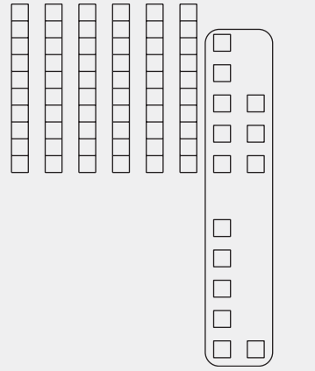
Unit 5 Progression Overview
Adding within 100
Section A
Lessons 1-4
1.NBT.A.1, 1.NBT.C.4, 1.OA.A.1, 1.OA.C.6, 1.OA.D.8
Section B
Lessons 5-8
1.NBT.C.4, 1.OA.C.6, 1.OA.D.8
Section C
Lessons 9-14
1.NBT.A.1, 1.NBT.B, 1.NBT.C.4, 1.NBT.C.5, 1.NBT.C.6, 1.OA.A.1, 1.OA.C.6, 1.OA.D.8
Add within 100 without composing a ten.
Use equations to represent addition strategies
Add a one-digit and a two-digit number within 100 with composing a ten.
Use equations to represent addition strategies.
Add 2 two-digit numbers within 100, with composing a ten.
Use equations to represent addition strategies.

Slide 3



Unit 5 Quick Links
L1
L2
L3
L4
L5
L6
L7
L8
L9
L10
L11
L12
L13
L14

Slide 4
Add Tens or Ones
1
Let’s add tens or ones to two-digit numbers.
1.NBT.C.4

Slide 5
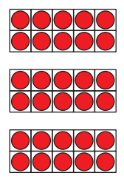
How Many Do You See: 10-Frames
Warm up
How many do you see?
How do you see them?

Slide 6
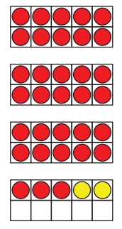
How Many Do You See: 10-Frames
Warm up
How many do you see?
How do you see them?

Slide 7
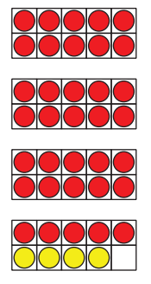
How Many Do You See: 10-Frames
Warm up
How many do you see?
How do you see them?

Slide 8
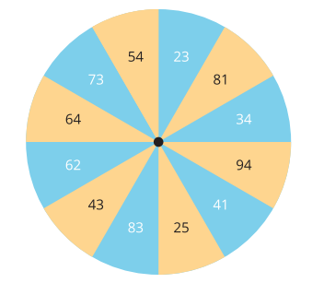
1.1: What Did I Add?
Activity #1
Partner A: Spin to get a starting number.
Partner B: Pick a number card without showing your partner. Choose whether to add that many ones or tens to your starting number.
Partner 2: Tell your partner the sum. Don’t go over 99!
Partner 1: Tell your partner what number you think they added and explain your thinking.
Switch roles and repeat. •

Slide 9
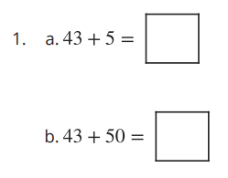
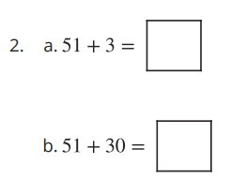
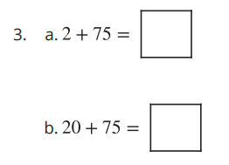
1.2: Add Tens or Ones
Activity #2
Find the value that makes each equation true.

Slide 10



1.2: Add Tens or Ones
Activity #2
Find the value that makes each equation true.
Show your thinking using drawings, numbers or words.

Slide 11

1.3: Mai and Andre Share Their Thinking
Activity #3
Mai and Andre are sharing their answers for the sum
5 + 34
Andre says the sum is 84.
Mai says the sum is 39.
Who do you agree with? Why?
Show your thinking with drawings, numbers, or words.

Slide 12


Lesson
Synthesis
How would you explain to Andre how he can determine whether to add tens or ones?

Slide 13
How Did You Add?
2
Let’s add numbers and find matching equations.
1.NBT.A.1, 1.NBT.C.4

Slide 14

Choral Count: Count Back From 70
Warm up
What do you
notice?
Count backward 1, starting at 70
Stop counting and recording at 20
What patterns do you see?

Slide 15

Find the Sum
Activity #1
Find the sum of: 23 + 45
Show your thinking using drawings, numbers or words.

Slide 16
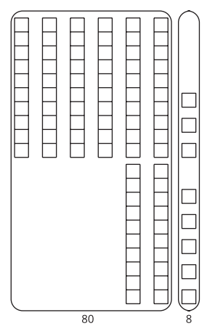
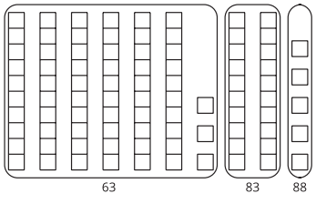
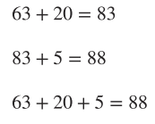
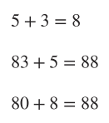
Elena and Andre Represent 63 + 25
Activity #1
1. Here are two drawings students made for
63 + 25 .
Elena's work
2. Which equations go with which drawings?
Be ready to explain how you know so that others can understand.
Andre’s work

Slide 17
Lesson
Synthesis
15 + 34 = ?
How could we use Elena’s method to find the sum? How could we use Andre’s method?
What equations could represent the methods you described?

Slide 18
Add It, Explain It
3
Let’s add numbers and write equations to show our work.
1.NBT.C.4, 1.OA.C.6, 1.OA.D.8

Slide 19
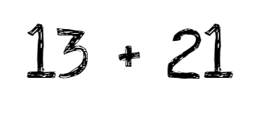
Number Talk: 13
Warm up
Find the value of each expression mentally.
Notes:
Optional Warm UP Activity

Slide 20
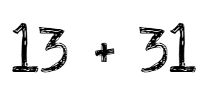
Number Talk: 13
Warm up
Find the value of each expression mentally.
Notes:
Optional Warm UP Activity

Slide 21
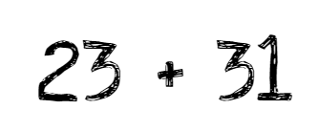
Number Talk: 13
Warm up
Find the value of each expression mentally.
Notes:
Optional Warm UP Activity

Slide 22
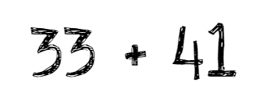
Number Talk: 13
Warm up
Find the value of each expression mentally.
Notes:
Optional Warm UP Activity

Slide 23
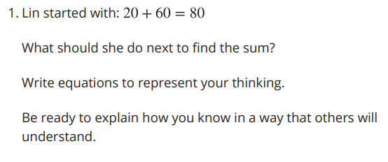
Lin and Han Add
Activity #1

Slide 24
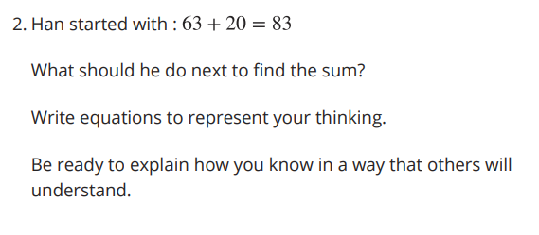
Lin and Han Add
Activity #1

Slide 25
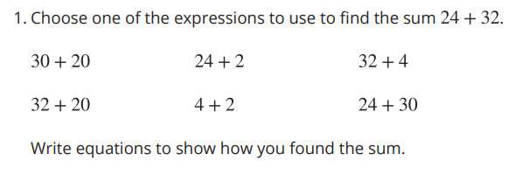
Show With Equations
Activity #2

Slide 26
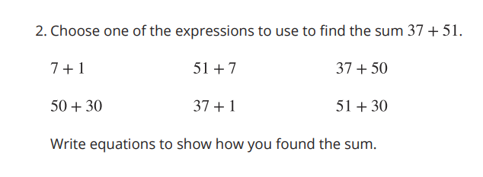
Show With Equations
Activity #2

Slide 27
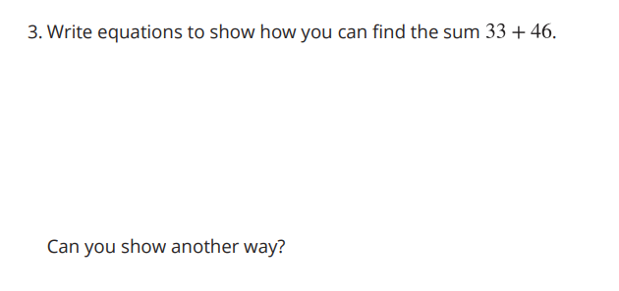
Show With Equations
Activity #2

Slide 28

Lesson Synthesis
How do the equations help you understand how your classmates added?
Why are there so many different ways to add?

Slide 29
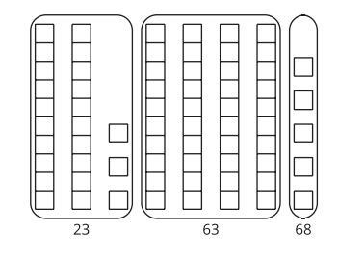
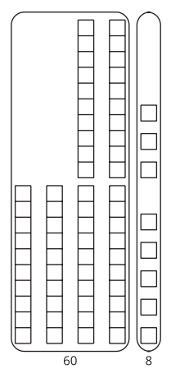
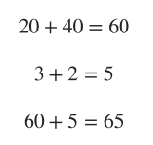

Lesson 3 Summary
We added numbers within 100. We learned different methods to add and recorded our thinking with equations.

Slide 30
Center Day 1
4
Let’s add and subtract tens.
1.NBT.C.4, 1.NBT.C.5, 1.NBT.C.6

Slide 31
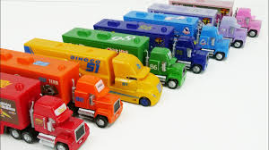
Act It Out: Trucks
Warm up
Kiran and Priya each have some toy trucks.
Kiran has 15 toy trucks.
Priya has 18 toy trucks.
Notes:
Optional Warm UP Activity

Slide 32
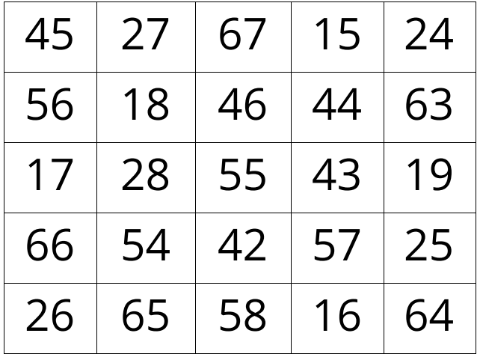
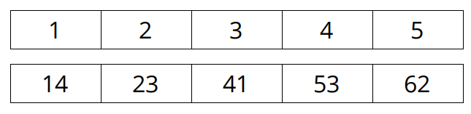
Introduce 5 in a Row
Activity #1
We are going to play a game where the goal is to get 5 squares in a row.
Directions:
● Player 1 puts a paper clip on the 2 numbers you will add.
● Player 1 puts a counter on the sum.
● Player 2 moves 1 of the paper clips, adds the numbers, and puts a counter on the sum.
● Continue taking turns until someone gets 5 in a row

Slide 33
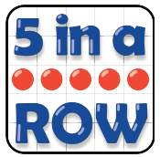
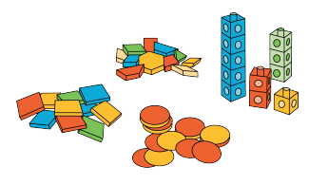
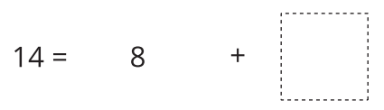
Centers: Choice Time
Activity #1
Counting
Collections
Number
Puzzles
5 in a Row

Slide 34
Lesson Synthesis
How did you and your partner work together during centers? What went well? What can we continue to work on?

Slide 35
Compose a Ten
5
Let’s add two-digit and one-digit numbers.
1.NBT.C.4

Slide 36
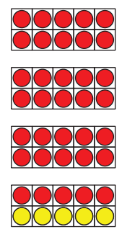
How Many Do You See: Many 10-frames
Warm up
How many do you see?
How do you see them?

Slide 37
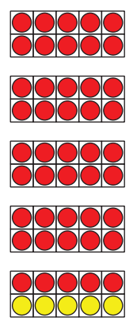
How Many Do You See: Many 10-frames
Warm up
How many do you see?
How do you see them?

Slide 38
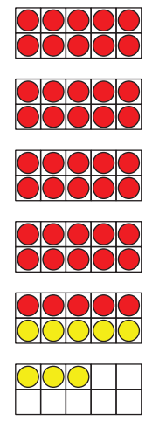
How Many Do You See: Many 10-frames
Warm up
How many do you see?
How do you see them?

Slide 39

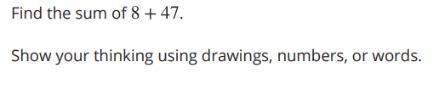
Choose a Way to Add
Activity #1

Slide 40
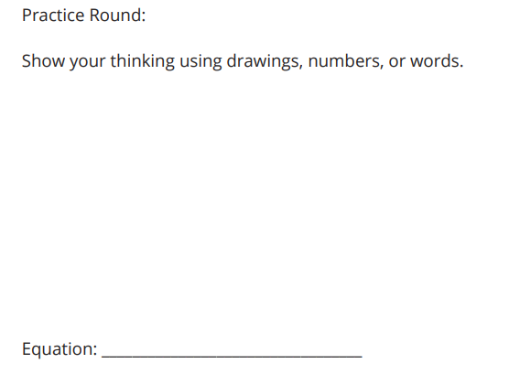
Add ‘Em Up Partner
Activity #2
“You will find a partner and find the sum of your two numbers. In your group, one student should have a one-digit number and the other should have a two-digit number. Let's do one round together.”
Find the sum.
Show your thinking using drawings, numbers, or words.
Then write an equation that shows the sum you found.
Now we will play 2 more rounds.

Slide 41
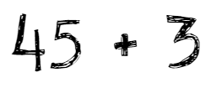
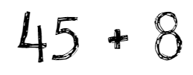
Lesson Synthesis
Sometimes when adding two-digit and one-digit numbers we compose a ten, and sometimes we don’t.
What do you notice about these expressions?

Slide 42
Compose a Ten and Make Sense of Equations
6
Let’s add one-digit and two-digit numbers and make sense of equations.
1.NBT.C.4, 1.OA.C.6

Slide 43
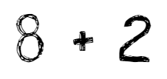
Number Talk: Add Within 20
Warm up
Find the value of each expression mentally.
Notes:
Optional Warm UP Activity

Slide 44
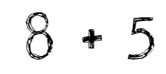
Number Talk: Add Within 20
Warm up
Find the value of each expression mentally.
Notes:
Optional Warm UP Activity

Slide 45
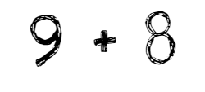
Number Talk: Add Within 20
Warm up
Find the value of each expression mentally.
Notes:
Optional Warm UP Activity

Slide 46
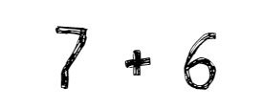
Number Talk: Add Within 20
Warm up
Find the value of each expression mentally.
Notes:
Optional Warm UP Activity

Slide 47
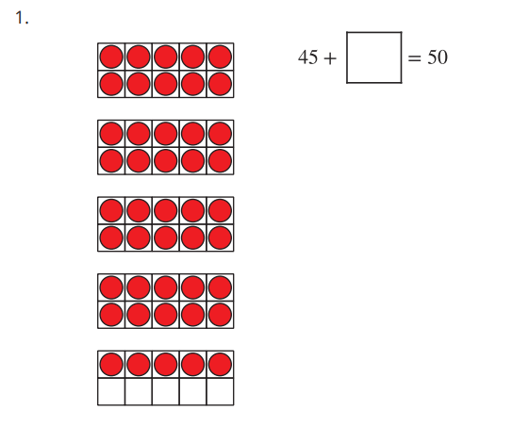
How Many to the Next Ten?
Activity #1
Find the value that makes each equation true.
Be ready to explain your thinking in a way that makes sense to others.

Slide 48
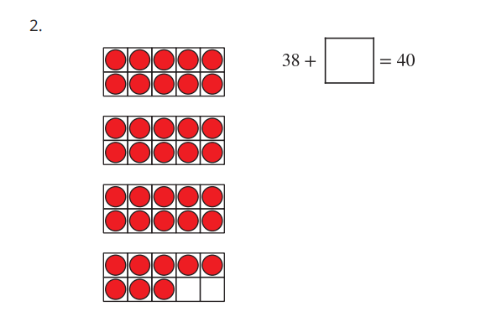
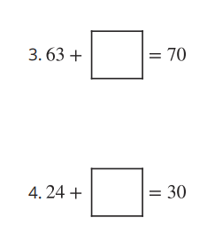
How Many to the Next Ten?
Activity #1
Find the value that makes each equation true.
Be ready to explain your thinking in a way that makes sense to others.

Slide 49
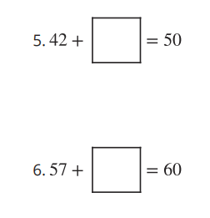
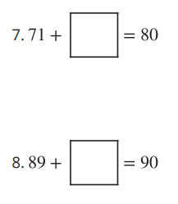

How Many to the Next Ten?
Activity #1
Find the value that makes each equation true.
Be ready to explain your thinking in a way that makes sense to others.

Slide 50
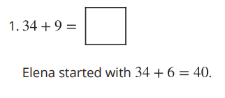

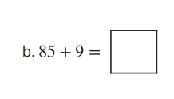
Elena Adds 34 + 9
Activity #2
2. Solve each equation using Elena’s method.
Show your thinking using drawings, numbers, or words

Slide 51
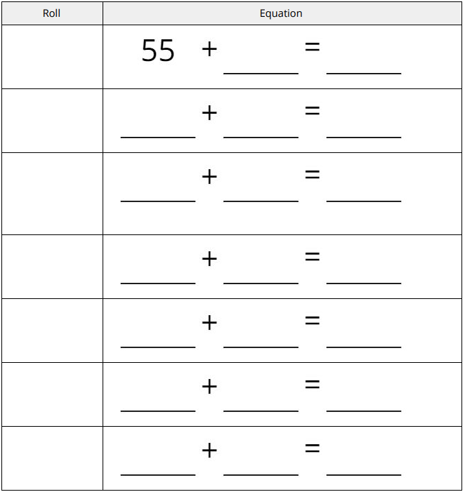
Introduce Get to 95
Activity #3
We are going to play a new game called Get to 95.
Let’s play a round together. First, mix up your number cards.
Directions:
● Start at 55.
● Pick a number card.
● Add it to your starting number.
● Write an equation.
● The sum becomes the starting number in the next equation.

Slide 52
Lesson Synthesis
Choose one of your favorite equations from the game. Explain to a partner how you found the sum. You may use connecting cubes or 10-frames and counters to help you explain your strategy.
“I heard you say…….”
We are going to practice restating what our partner tells us. Use the sentence ‘I heard you say . . .’ to restate their thinking.

Slide 53
Does it Make a
New Ten?
7
Let’s add one-digit to two-digit numbers and write equations.
1.NBT.C.4

Slide 54

Which One Doesn’t Belong: Expressions
Warm up

Slide 55



A Ten or Not a Ten?
Activity #1
Does the expression make a new ten?
If it makes a new ten, circle “Yes.” If it doesn’t make a new ten, circle “No.”
1. Does the expression make a new ten?
Explain how you know:
Find the sum.
Write equations to show how you found the sum.
2. Does the expression make a new ten?
Explain how you know:
Find the sum.
Write equations to show how you found the sum.

Slide 56


A Ten or Not a Ten?
Activity #1
Does the expression make a new ten?
If it makes a new ten, circle “Yes.” If it doesn’t make a new ten, circle “No.”
3. Does the expression make a new ten?
Explain how you know:
Find the sum.
Write equations to show how you found the sum.
4. Does the expression make a new ten?
Explain how you know:
Find the sum.
Write equations to show how you found the sum.

Slide 57


Missing Numbers
Activity #2
Lin’s brother spilled water on her math work again!
Figure out what number Lin wrote before it got smudged
1. Lin wrote a one-digit number with which you will make a new ten when you find the sum.
What could Lin’s number be?
Write equations to show your thinking.
2. Lin wrote a one-digit number with which you will not make a new ten when you find the sum.
What could Lin’s number be?
Write equations to show your thinking.

Slide 58


Missing Numbers
Activity #2
Lin’s brother spilled water on her math work again!
Figure out what number Lin wrote before it got smudged
3. Lin wrote a two-digit number with which you will make a new ten when you find the sum.
What could Lin’s number be?
Write equations to show your thinking.
4. Lin wrote a two-digit number with which you will not make a new ten when you find the sum.
What could Lin’s number be?
Write equations to show your thinking.

Slide 59

Missing Numbers
Activity #2

Slide 60
Lesson Synthesis
How do you know whether or not you will make a new ten when you are finding a sum?

Slide 61


Lesson 7 Summary
We added one-digit numbers and two-digit numbers and composed a new ten.

Slide 62
Center Day 2
8
Let’s add within 100.
1.NBT.C.4, 1.OA.C.6, 1.OA.D.8

Slide 63

Number Talk: Add Within 100
Warm up
Find the value of each expression mentally.
Notes:
Optional Warm UP Activity

Slide 64

Number Talk: Add Within 100
Warm up
Find the value of each expression mentally.
Notes:
Optional Warm UP Activity

Slide 65

Number Talk: Add Within 100
Warm up
Find the value of each expression mentally.
Notes:
Optional Warm UP Activity

Slide 66

Number Talk: Add Within 100
Warm up
Find the value of each expression mentally.
Notes:
Optional Warm UP Activity

Slide 67

Centers: Choice Time
Activity #2
Number
Puzzles
Get to 95
5 in a Row

Slide 68
Lesson Synthesis
How did you and your partner work together during centers?
What went well? What can you continue to work on?

Slide 69
Compose a Ten to Add 2 Two-digit Numbers
9
Let’s add two-digit numbers.
1.NBT.C.4

Slide 70

Number Talk: Compose A Ten
Warm up
Find the value of each expression mentally.
Notes:
Optional Warm UP Activity

Slide 71

Number Talk: Compose A Ten
Warm up
Find the value of each expression mentally.
Notes:
Optional Warm UP Activity

Slide 72

Number Talk: Compose A Ten
Warm up
Find the value of each expression mentally.
Notes:
Optional Warm UP Activity

Slide 73

Number Talk: Compose A Ten
Warm up
Find the value of each expression mentally.
Notes:
Optional Warm UP Activity

Slide 74


17 + 36
Activity #1

Slide 75


Grab and Add
Activity #2

Slide 76

Grab and Add
Activity #2

Slide 77

Grab and Add
Activity #2

Slide 78

Grab and Add
Activity #2

Slide 79


Lesson Synthesis
How are these the same and how are they different?
In the past you found sums like 56 + 13 . In this lesson you found sums like 56 + 19 .

Slide 80
Tens and Tens,
Ones and Ones
10
Let’s add two-digit numbers.
1.NBT.C.4

Slide 81

How Many Do You See:
Tens and Ones
Warm up
How many do you see?
How do you see them?

Slide 82

How Many Do You See:
Tens and Ones
Warm up
How many do you see?
How do you see them?

Slide 83

How Many Do You See:
Tens and Ones
Warm up
How many do you see?
How do you see them?

Slide 84

Priya‘s Work
Activity #1
Find the sum:
37 + 26
Priya’s work
How did Priya find the sum?

Slide 85


Finish the Work
Activity #2
1. Each expression shows a first step to find the sum.
Finish the work to find the sum.
Show your thinking using drawings, numbers, or words.

Slide 86


Finish the Work
Activity #2
2. Find the sum.
Show your thinking using drawings, numbers, or words.

Slide 87
Lesson Synthesis
We can use equations to show different ways to find the sum. You can add the tens first or the ones first.

Slide 88
What’s the Equation?
11
Let’s add two-digit numbers and make sense of equations.
1.NBT.C.4, 1.OA.A.1

Slide 89

Act It Out: Lightning Bugs
Warm up
Mai has 13 lightning bugs in a jar.
Some lightning bugs fly away.
Mai has 7 lightning bugs left in the jar.
How many lightning bugs flew away?

Slide 90

Add Two-digit Numbers in Different Ways
Activity #1
Three students found the sum of 37 +25 .
With your partner, explain how each student found the sum.
Be ready to explain your thinking in a way that others will understand.

Slide 91


23 + 68
Activity #2

Slide 92
Lesson Synthesis
How do the different equations match how you found the sum?

Slide 93
Add it Up
12
Let’s add two-digit numbers and write equations.
1.NBT.C.4

Slide 94

Number Talk: Make a Ten
Warm up
Find the value of each expression mentally.
Notes:
Optional Warm UP Activity

Slide 95

Number Talk: Make a Ten
Warm up
Find the value of each expression mentally.
Notes:
Optional Warm UP Activity

Slide 96

Number Talk: Make a Ten
Warm up
Find the value of each expression mentally.
Notes:
Optional Warm UP Activity

Slide 97

Number Talk: Make a Ten
Warm up
Find the value of each expression mentally.
Notes:
Optional Warm UP Activity

Slide 98


Add Two-digit Numbers Within 100
Activity #1
Find the sum using any method that you want.
Show your thinking using drawings, numbers, or words.
Write equations to represent your thinking.

Slide 99
Reason About Addition
Activity #2
makes the smallest possible number. Expression:____________________
makes the largest possible number. Expression:____________________
does not make a new ten. Expression:____________________
makes a new ten and some ones. Expression:____________________
makes a new ten with no more ones. Expression:____________________
Be ready to explain how you know in a way that others will be able to understand.
37 22 18 56 41
Choose 2 numbers from above and write an addition expression where the sum:

Slide 100

Reason About Addition
Activity #2
If you have time:
Choose 2 numbers from above and write an addition equation where the sum is closest to 95.
How do you know your sum is closest to 95?

Slide 101
Lesson Synthesis
During this unit you learned how to add within 100. What are some things that you learned?
What are you most proud of learning? What do you still need to work on?

Slide 102



Lesson 12 Summary
We learned to add any 2 two-digit numbers within 100.
We added tens and tens and ones and ones
We broke apart an addend to make a new ten.

Slide 103
Center Day 3
13
Let’s work in centers.
1.NBT.A.1, 1.NBT.C.4, 1.NBT.C.6, 1.OA.C.6

Slide 104

Choral Count: Count Back from 100
Warm up
What do you
notice?
Count backwards by 1, starting at 100.
Stop counting and recording at 70.
What patterns do you see?

Slide 105

Introduce How Close, Close to 100
Activity #1
We are going to play a new stage of the game “How Close?
Directions:
1. Take 7 cards.
2. Use 4 cards to make 2 two-digit numbers.
3. Write an equation to show the sum of the numbers you made.
4. Compare sums with your partner, whoever is closer to 100 wins.

Slide 106


Centers: Choice Time
Activity #1
How Close?
Number
Puzzles
Get to 95

Slide 107
Lesson Synthesis
What are some strategies you used for adding two numbers?

Slide 108
Food Drive
14
Let’s add 2-digit numbers.
1.NBT.B, 1.NBT.C.4, 1.NBT.C.5, 1.NBT.C.6

Slide 109

Estimation Exploration:
Food Drive
Warm up
How many cans did the first graders collect for the food drive?
Record an estimate that is:
Too low | About right | Too high

Slide 110

Cans for the Food Drive
Activity #1
Partner A:
Write an equation to represent your thinking.
1. How many cans did Lin and Priya collect altogether?
2. How many cans did Han and Tyler collect altogether?
3. How many cans did all four students collect altogether?

Slide 111
Cans for the Food Drive
Activity #1
Partner B:
Write an equation to represent your thinking.
1. How many cans did Tyler and Priya collect altogether?
2. How many cans did Lin and Han collect altogether?
3. How many cans did all four students collect altogether?

Slide 112

Boxes of Cans
Activity #2
How can the boxes be packed so that they each hold 35 to 65 cans?
Try to find as many different ways as you can.
Write an equation to represent your thinking.
If you have time:
Can any box have cans from 3 grade levels?
What is the least amount of boxes the school can pack to
send to the Food Bank?

Slide 113
Lesson Synthesis
Today we represented and solved real world problems about a food drive and packing cans in boxes to take to the Food Bank.
What methods did you use to determine which grade level’s cans could be packed together in the boxes?
Which grade levels could not have their cans packed together? How do you know?

