Slide 1

Numbers to 99
Grade 1: Unit 4
Standards addressed: 1.NBT.A.1, 1.NBT.B.2, 1.NBT.C.4, 1.NBT.C.5, 1.NBT.C.6, 1.OA.C.6, 1.OA.D.8, 1.NBT.B, 1.NBT.B.3, 1.NBT.C.4, 1.NBT.C.5, 1.NBT.C.6, 1, 1.NBT.A.1,
These slides have been created by Britnee Wright- Southeast Arkansas Education Cooperative and are not official IM materials. Images and language are taken from IM Grade 1, Unit 4 by Illustrative Mathematics.
Copyright 2020 by Illustrative Mathematics. All Rights Reserved, adapted and shared with permission.

Slide 2
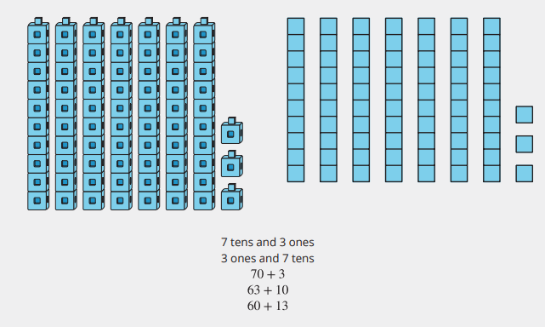
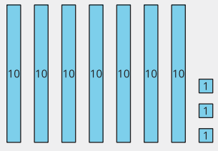
Unit 4 Progression Overview
Numbers to 99
Section A
Lessons 1-5
1.NBT.A., 1.NBT.B. 1,1.NBT.C., 1.OA.C.6, 1.OA.D.8
Section B
Lessons 6-13
1.NBT.A., 1.NBT.B, 1.NBT.C.,1.OA.C.6
Section C
Lessons 14-18
1.NBT.B.3, 1.NBT.C.,
Section D
Lessons 19-23
1.NBT.A., 1.NBT.B, 1.NBT.C.,
Add and subtract multiples of 10.
Represent the base-ten structure of multiples of 10 up to 90 using pictures, words and symbols.
Add and subtract multiples of 10.
Represent the base-ten structure of numbers up to 99 using pictures, numbers and words.
Understand that the two digits of a two-digit number represent amounts of tens and ones.
Compare two two-digit numbers based on the values of the tens and ones digits, recording the results of comparisons with the symbols >, =, and <.
Breaking apart two-digit numbers using different amounts of tens and ones.

Slide 3



Unit 4 Quick Links
L1
L2
L3
L4
L5
L6
L7
L8
L9
L10
L11
L12
L13
L14
L15
L16
L17
L18
L19
L20
L21
L22
L23

Slide 4
Counting Collections
1
Let’s count objects
1.NBT.A.1, 1.NBT.B.2, 1.NBT.B.2.c, 1.NBT.C.6

Slide 5
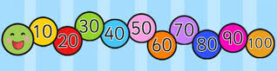
Choral Count: Multiples of 10
Warm up
Count by 10, starting at 30
Stop at 100
Count back down to 30

Slide 6
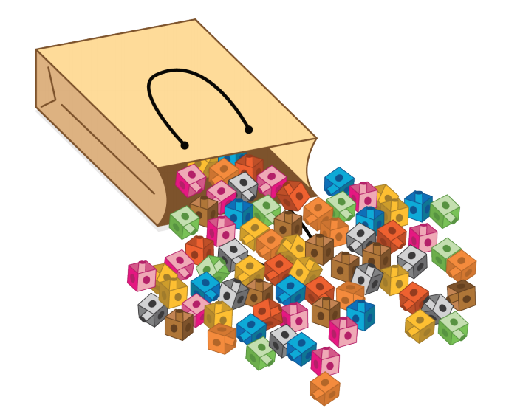
Counting Collections
Activity #1
You and your partner will get a bag of objects. Your job is to figure out how many are in the bag.
Work with your partner to count the collection. Each partner will show on paper how many there are and how you counted them

Slide 7
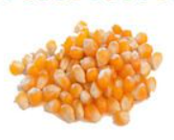
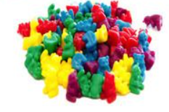
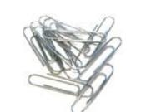
Count More Than One Collection
Activity #2
Work with your partner to count the collection. Each partner will show on paper how many there are and show how you counted them.
Switch bags with another group. Work with your partner to count the collection. Each partner will show on paper how many there are and show how you counted them.

Slide 8

Lesson
Synthesis
What can you and your partner improve for next time?
What did you learn from your partner today?
What went well when you worked with your partner today?”

Slide 9
It’s a Match!
2
Let’s learn how to show 10.
1.NBT.A.1, 1.NBT.B.2, 1.NBT.B.2.c

Slide 10
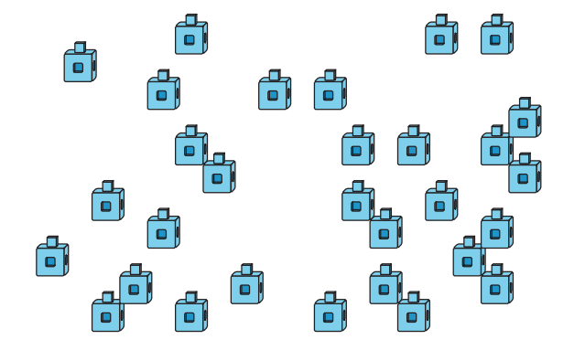
Estimation Exploration:
Cubes and Towers
Warm up
Round 1
How many cubes?
Record an estimate that is:
Too low | About right | Too high

Slide 11
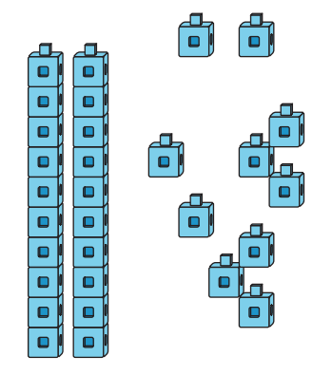
Estimation Exploration:
Cubes and Towers
Warm up
Round 2
How many cubes?
Record an estimate that is:
Too low | About right | Too high

Slide 12
Representations of Tens
Activity #1
Today you will be playing a game in which you try to find cards that match
To play this game, each of you will get one card.
Find the other two students who have cards with the same value.
Each time you compare cards with another student, discuss whether or not your cards have the same value and how you know.

Slide 13
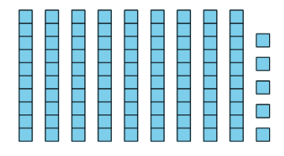
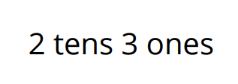

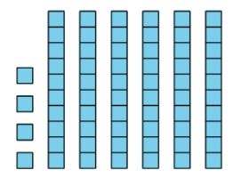


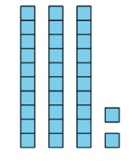
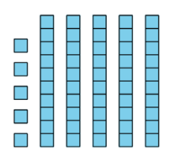




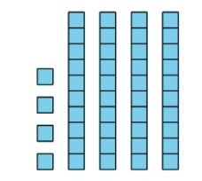
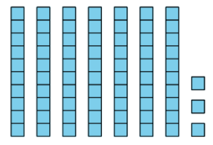


Representations of Tens
Activity #1

Slide 14








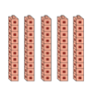
Number Match
Activity #2
Match each picture to the number and words that show the same amount.
7 tens
5 tens
30 thirty
50 fifty
1 tens
4 tens
20 twenty
60 sixty
8 tens
3 tens
10 ten
80 eighty
9 tens
2 tens
40 forty
70 seventy
90 ninety
6 tens

Slide 15
Lesson
Synthesis
Today we thought about how to count things that are arranged in groups of 10 and looked at the numbers that represent them.
30 thirty
3 tens
How many cubes are there?
How many tens are there?
What do you notice about the towers of 10 and the number that represents them?

Slide 16
Addition and Subtraction with Multiples of 10
3
Let’s add and subtract tens.
1.NBT.A.1, 1.NBT.B.2, 1.NBT.C.5, 1.NBT.C.6

Slide 17

How Many Do You See: Multiples of 10
Warm up
How many do you see?
How do you see them?

Slide 18

How Many Do You See: Multiples of 10
Warm up
How many do you see?
How do you see them?

Slide 19
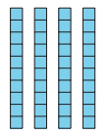
How Many Do You See: Multiples of 10
Warm up
How many do you see?
How do you see them?

Slide 20

Introduce Bingo, Add or Subtract 10
Activity #1
Today we’re going to learn a new way to play a bingo. In this game, you and your partner will take turns flipping over cards and decide whether to add or subtract 10. The first partner to get 5 in a row wins.
I am going to flip one card over. Now I will decide if I want to add 10 to the number or subtract 10 from the number. I am going to choose to add 10. What is the sum? How do you know?
Now, I put a counter on the sum on my bingo board. Now it’s my partner’s turn.
Take turns flipping one card over, choosing to add or subtract 10 to from the number, and placing your counter on the bingo board to cover that number.

Slide 21




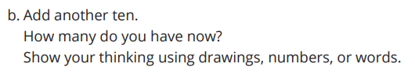




How Many Tens Now?
Activity #2
Determine whether each equation is true or false.
Be ready to explain your reasoning in a way that others can understand.

Slide 22
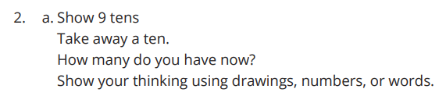




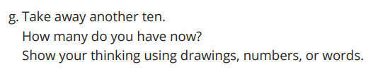
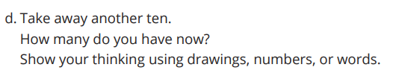

How Many Tens Now?
Activity #2
Determine whether each equation is true or false.
Be ready to explain your reasoning in a way that others can understand.

Slide 23
Lesson Synthesis
What happens when you add or subtract 10 from a number?

Slide 24
More Addition and Subtraction with Multiples of 10
4
Let’s add and subtract tens.
1.NBT.C.4, 1.NBT.C.5, 1.NBT.C.6

Slide 25
Number Talk: Plus or Minus 10
Warm up
Find the value of each expression mentally.
Notes:
Optional Warm UP Activity

Slide 26
Number Talk: Plus or Minus 10
Warm up
Find the value of each expression mentally.
Notes:
Optional Warm UP Activity

Slide 27
Number Talk: Plus or Minus 10
Warm up
Find the value of each expression mentally.
Notes:
Optional Warm UP Activity

Slide 28
Number Talk: Plus or Minus 10
Warm up
Find the value of each expression mentally.
Notes:
Optional Warm UP Activity

Slide 29
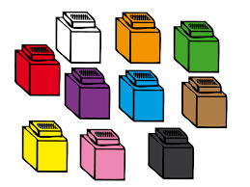
How Many Are in the Bag?
Activity #1
1. Jada is counting collections of cubes.
In Bag A there are 30 cubes.
In Bag B there are 2 towers of 10.
How many cubes are in the two bags altogether?
Show your thinking using drawings, numbers, or words.
2. Tyler is counting a collection of cubes. In Bag C there are 7 towers of 10.
He takes 40 cubes out of the bag.
How many cubes does he have left in the bag?
Show your thinking using drawings, numbers, or words

Slide 30
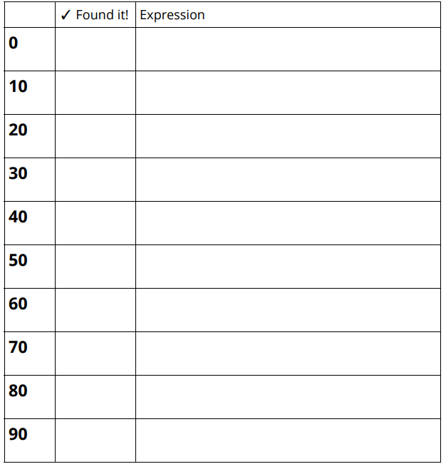

Introduce Make The Number,
Add or Subtract Tens
Activity #2
We’ve played this game before. Describe the game to your partner.
This game is different because it has cards with different representations of ten.

Slide 31
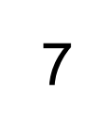

Lesson Synthesis
Han said that if they have these cards, they can think about addition and subtraction facts they know to find the sum or difference. What does Han mean?

Slide 32
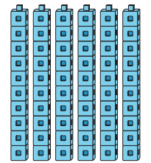

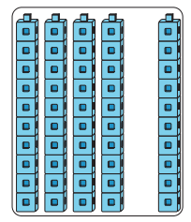
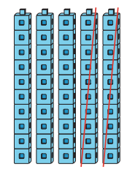
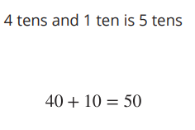
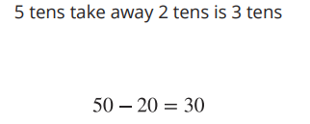
Lesson 4 Summary
We learned that 10 ones make a unit called a ten.
We learned how to show tens in different ways.
You learned how to add and subtract tens from other tens.

Slide 33
Center Day 1
5
Let’s add and subtract
1.NBT.B.2, 1.NBT.C.4, 1.NBT.C.5, 1.NBT.C.6, 1.OA.C.6, 1.OA.D.8

Slide 34
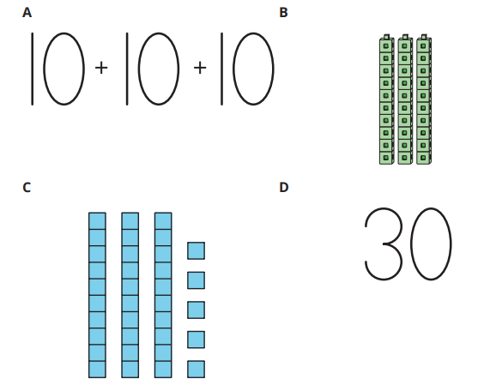
Which One Doesn’t Belong: Tens
Warm up

Slide 35
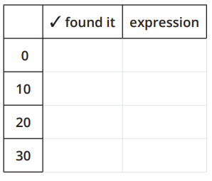

Centers Choice Time: Add and Subtract within 20
Activity #1
Bingo, Stage 6
Make the Number, Stage 6

Slide 36
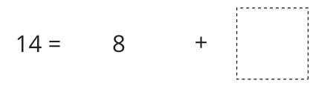
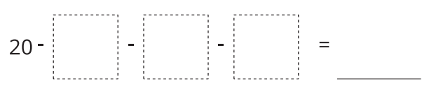
Centers Choice Time: Plus or Minus 10
Activity #2
Number Puzzles, Stage 2
How Close?, Stage 3

Slide 37
Lesson Synthesis
How did you and your partner work together during centers? What went well? What can we continue to work on?

Slide 38
More Counting Collections
6
Let’s organize and count collections.
1.NBT.A.1, 1.NBT.B, 1.NBT.B.2, 1.NBT.B.2.a, 1.NBT.B.2.c

Slide 39
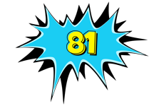
Choral Count: Count to 81
Warm up
Count by 1, starting at 50.
Stop at 81
What patterns do you see?

Slide 40
Count a Collection
Activity #1
You and your partner will get a bag or objects. Your job is to figure out how many are in the bag.
Work with your partner to count the collection. Each partner will show on paper how many there are and show how you counted them.

Slide 41
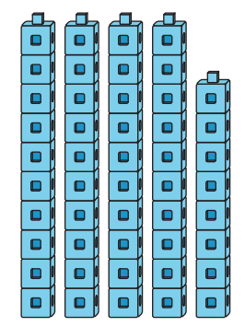
Noah Counts a Collection
Activity #2
He counts and says there are 5 tens or 50 cubes.
Do you agree or disagree?
Explain how you know:
Noah organized his collection using connecting cubes.

Slide 42


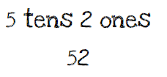
Lesson Synthesis
Today we learned that a collection can be made up of tens and ones. Knowing how many tens and how many ones can help us determine how many are in a collection.
Here is a representation from one of our counting collections. How many tens are there?
How many ones are there?
How can knowing that this representation has 5 tens 2 ones help us read the number?

Slide 43
Numbers With Tens and Ones
7
Let’s learn more about tens and ones.
1.NBT.A.1, 1.NBT.B.2, 1.NBT.B.2.b, 1.NBT.B.2.c

Slide 44

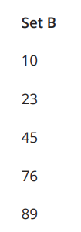
Notice and Wonder:
One- and Two-Digit Numbers
Warm up
What do you notice?
What do you wonder?

Slide 45
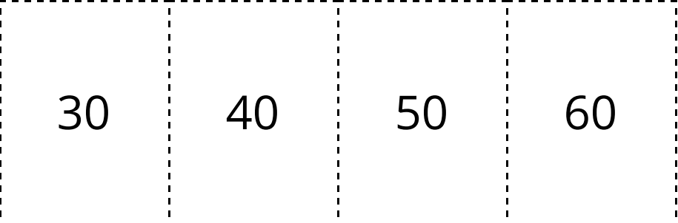
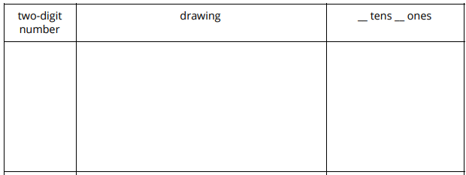
7.1: Make It: Tens and Ones
Activity #1
Partner 1 draws 2 number cards and uses them to make a two-digit number.
Each partner says the number.
Partner 2 builds the number using cubes.
Partner 1 checks to see if they agree.
Each partner makes a drawing of the number.
Switch roles and repeat.

Slide 46
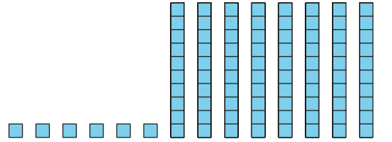
Who Do You Agree With?
Activity #2
Clare says that this shows 68 (sixty-eight)
Diego says that this shows 86 (eighty-six).
Who do you agree with? Explain how you know:

Slide 47

Lesson Synthesis
This is a two-digit number. This sticky note is covering one of the digits in the number. What number could this be? How do you know?

Slide 48
Different Representations of Tens and Ones
8
Let’s think about how two-digit numbers can be represented.
1.NBT.A.1, 1.NBT.B.2, 1.NBT.B.2.a, 1.NBT.B.2.b

Slide 49
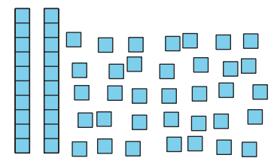
Estimation Exploration:
How Many Squares?
Warm up
1. How many cubes do you see?
Record an estimate that is:
Too low | About right | Too high

Slide 50
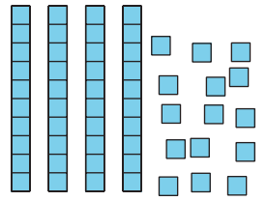
Estimation Exploration:
How Many Squares?
Warm up
2. How many cubes do you see?
Record an estimate that is:
Too low | About right | Too high

Slide 51
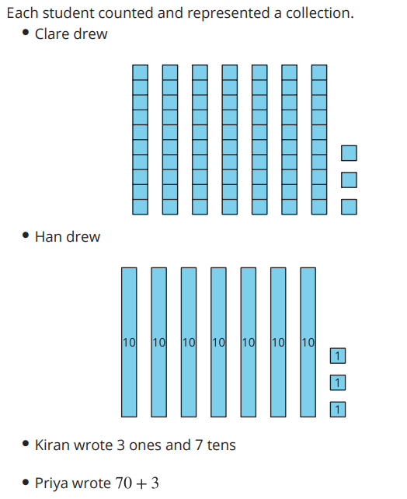
A Counting Collection Represented
Activity #1
Did the students count the same collection?
How do you know?
Show your thinking using drawings, numbers, or words.

Slide 52
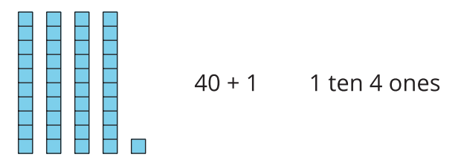
Base-Ten Representation Concentration
Activity #2
Players take turns.
On your turn: Flip over 2 cards.
If they match, keep them.
If they don’t match, turn them back over.
Play until all of the cards are matched.

Slide 53

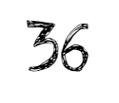

Lesson Synthesis
Today we thought about different ways to represent numbers.
What number does this represent?
How can we represent this number?

Slide 54
Show Me Your Number
9
Let’s show numbers in different ways.
1.NBT.A.1, 1.NBT.B.2, 1.NBT.B.2.b

Slide 55
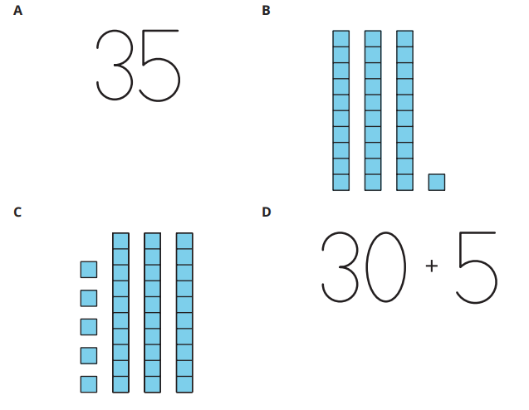
Which One Doesn’t Belong: Tens and Ones
Warm up

Slide 56
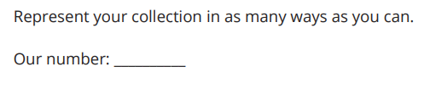
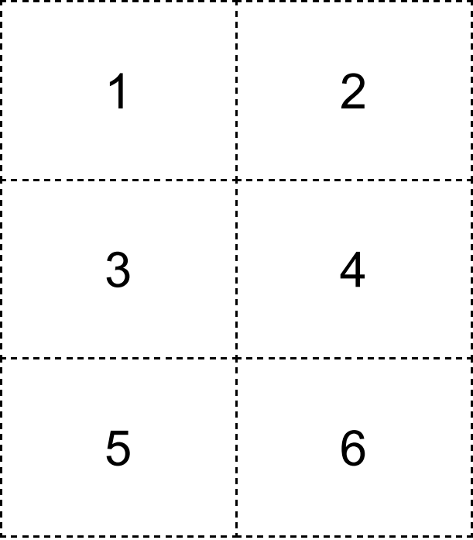
Create a Counting Collection
Activity #1
Use your number cards to make a number and write the number in the blank.
Work with your partner to create a collection of cubes that represents the number you wrote.
Then each partner will represent the collection in as many ways as they can in your workbook.

Slide 57
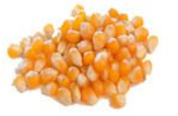



Represent Collections In Many Ways
Activity #2
Represent each collection in as many ways as you can.
Visit at least 4 collections.

Slide 58

Lesson Synthesis
How is this representation the same and different from the others?
What are all the ways I can represent this collection?
There is a different way that we can represent this collection.

Slide 59
Write Two-digit Numbers
10
Let’s write two-digit numbers.
1.NBT.A.1, 1.NBT.B.2

Slide 60

Notice and Wonder:
Same Digit, Different Place
Warm up
What do you notice?
What do you wonder?

Slide 61
Count and Make a New Ten
Activity #1
Today we are going to choral count, but instead of just saying and writing the numbers, you will add cubes to the collection I have here.
Together we will count by 1, starting at 60.

Slide 62


Introduce Write Numbers,
Numbers to 99 by 1
Activity #2
For this activity you and your partner will practice writing numbers. First, one partner will take 2 number cards and make a two-digit number.
Let’s say the number I made out loud
Each partner writes the number in the top box of a column. Each partner independently fills in the column with the numbers you say when you count forward by ones. Give me a signal when you are done.
Once both partners have written all the numbers, compare your numbers. Say them out loud together. Did you both write them the same way?

Slide 63

Write Numbers to Match Base-Ten Representations
Activity #3
Write the number that matches each representation.

Slide 64

Write Numbers to Match Base-Ten Representations
Activity #3
Write the number that matches each representation.

Slide 65

Write Numbers to Match Base-Ten Representations
Activity #3
Write the number that matches each representation.

Slide 66

Write Numbers to Match Base-Ten Representations
Activity #3
Write the number that matches each representation.

Slide 67

Write Numbers to Match Base-Ten Representations
Activity #3
Write the number that matches each representation.

Slide 68

Lesson Synthesis
Clare counted a collection of seventy-two objects. This is the number she wrote. Give a thumbs up if you agree and a thumbs down if you disagree
What advice do you have for Clare about writing numbers that have tens and ones?

Slide 69
Add Tens to Two-digit Numbers
11
Let’s add tens to two-digit numbers.
1.NBT.B.2, 1.NBT.C.4, 1.NBT.C.5

Slide 70

True or False: Tens and Ones
Warm up
Decide whether each statement is true or false.
Be prepared to explain your reasoning.

Slide 71

True or False: Teen Numbers
Warm up
Decide whether each statement is true or false.
Be prepared to explain your reasoning.

Slide 72

True or False: Teen Numbers
Warm up
Decide whether each statement is true or false.
Be prepared to explain your reasoning.

Slide 73





Add Two-digit Numbers and Tens
Activity #1
Find the value that makes each equation true
Show your thinking using drawings, numbers, or words.

Slide 74

The Missing Digit
Activity #2

Slide 75

The Missing Digit
Activity #2

Slide 76
Lesson Synthesis
What would you tell a friend to help them quickly add tens to a two-digit number?

Slide 77


Lesson 11 Summary
We learned that two-digit numbers are made up of tens and ones.
We represented two-digit numbers in many different ways.
We added tens to two-digit numbers to tens.
We mentally added and subtracted 10 from two-digit numbers.

Slide 78
Mentally Add and Subtract Tens
12
Let’s add and subtract tens in our heads.
1.NBT.B.3, 1.NBT.C.5, 1.OA.C.6

Slide 79

Number Talk: Add and Subtract 10
Warm up
Find the value of each expression mentally.
Notes:
Optional Warm UP Activity

Slide 80

Number Talk: Add and Subtract 10
Warm up
Find the value of each expression mentally.
Notes:
Optional Warm UP Activity

Slide 81

Number Talk: Add and Subtract 10
Warm up
Find the value of each expression mentally.
Notes:
Optional Warm UP Activity

Slide 82

Number Talk: Add and Subtract 10
Warm up
Find the value of each expression mentally.
Notes:
Optional Warm UP Activity

Slide 83





Add and Subtract 10
Activity #1
Part 1: Find the value that makes each equation true. Then tell what you notice.

Slide 84


Add and Subtract 10
Activity #1
Part 2: Find the value that makes each equation true. After each set of equations, tell what pattern you notice.

Slide 85

Add and Subtract 10
Activity #1
Part 2: Find the value that makes each equation true. After each set of equations, tell what pattern you notice.

Slide 86


Lesson Synthesis
What statements can you make about these two numbers?
What statements can you make about these two numbers

Slide 87
Center Day 2
13
Let’s work in centers.
1.NBT.A.1, 1.NBT.C.4, 1.NBT.C.6, 1.OA.C.6

Slide 88

Number Talk: Add and Subtract 10
Warm up
Find the value of each expression mentally.
Notes:
Optional Warm UP Activity

Slide 89

Number Talk: Add and Subtract 10
Warm up
Find the value of each expression mentally.
Notes:
Optional Warm UP Activity

Slide 90

Number Talk: Add and Subtract 10
Warm up
Find the value of each expression mentally.
Notes:
Optional Warm UP Activity

Slide 91

Number Talk: Add and Subtract 10
Warm up
Find the value of each expression mentally.
Notes:
Optional Warm UP Activity

Slide 92


Introduce Write Numbers,
Numbers to 99 by 1 and 10
Activity #1
We are going to play Write Numbers again, but this time you are going to write the numbers for counting forward or backwards by 1 or 10. First, Partner A will take 2 number cards and make a two-digit number.
Let’s say the number I made out loud. Each partner writes the number in the top box of a column.
Partner A also spins the spinner to know which direction to count and what numbers to count by.
It shows count forward by 10.
Each partner independently fills in the column with the numbers you say when you count forward by 10.
Once both partners have written all the numbers, compare your numbers. Say them out loud together.

Slide 93


Centers Choice Time
Activity #2
Counting Collections
Make the Number

Slide 94
Lesson Synthesis
How did you and your partner work together during centers? What went well? What can we continue to work on?

Slide 95
Let’s Compare
14
Let’s compare numbers.
1.NBT.B.3, 1.NBT.C.5

Slide 96
Choral Count: Plus 10
Warm up
Count by 10, starting at 3
Stop at 93
Count back by 10

Slide 97


Which is Greater?
Activity #1
Each partner spins a spinner.
Each partner represents the number any way they choose.
Compare with your partner.
Which number is more?

Slide 98

Noah Compares Numbers
Activity #2

Slide 99


Lesson Synthesis
Which is greater? How do you know?
Which is less? How do you know?

Slide 100
Greater Than,
Less Than
15
Let’s use symbols to compare numbers.
1.NBT.B.3, 1.NBT.C.5

Slide 101

Number Talk: Add or Subtract 10
Warm up
Find the value of each expression mentally.
Notes:
Optional Warm UP Activity

Slide 102

Number Talk: Add or Subtract 10
Warm up
Find the value of each expression mentally.
Notes:
Optional Warm UP Activity

Slide 103

Number Talk: Add or Subtract 10
Warm up
Find the value of each expression mentally.
Notes:
Optional Warm UP Activity

Slide 104

Number Talk: Add or Subtract 10
Warm up
Find the value of each expression mentally.
Notes:
Optional Warm UP Activity

Slide 105

Which is Greater, Which is Less?
Activity #1
Circle the statement that is true in each pair.
Be ready to explain how you know so that others can understand.

Slide 106

Which is Greater, Which is Less?
Activity #1
Circle the statement that is true in each pair.
Be ready to explain how you know so that others can understand.

Slide 107

Which is Greater, Which is Less?
Activity #1
Circle the statement that is true in each pair.
Be ready to explain how you know so that others can understand.

Slide 108



True or False Comparisons
Activity #2
Determine whether each statement is true or false.
Be ready to explain how you know so that others can understand.
If you have time, rewrite each false statement to make it true.

Slide 109


Lesson Synthesis
Use the words ‘greater than’ to compare the numbers.
How might I write this using the greater than symbol?
Use the words ‘greater than’ to compare the numbers.
How might I write this using the greater than symbol?

Slide 110
Use Symbols to Compare
16
Let’s use symbols to compare numbers.
1.NBT.B.3

Slide 111

Notice and Wonder: 49 and 45
Warm up
What do you notice?
What do you wonder?

Slide 112


Introduce Make the Greatest Number, Two-digit Numbers
Activity #1

Slide 113

Make the Statement True
Activity #2
Part 1: Compare the numbers. Write <, >, or = in each blank. Then read the comparison statement.

Slide 114

Make the Statement True
Activity #2
Part 2: Fill in each box with a number to make each statement true.

Slide 115


Lesson Synthesis
Fill in a digit to make this true.
How did you know what the digit could be?

Slide 116
Compare and Order Numbers
17
Let’s compare and order numbers.
1.NBT.B.3

Slide 117

Which One Doesn’t Belong: Comparison Statements
Warm up

Slide 118




Compare and Order Quantities
Activity #1

Slide 119

Order Numbers
Activity #2

Slide 120

Order Numbers
Activity #2

Slide 121
Lesson Synthesis
In this section, we compared and ordered two-digit numbers. What are some things that can help us order numbers?

Slide 122



Lesson 17 Summary
We compared numbers using the number of tens and ones.
17 has 1 ten and 35 has 3 tens so 17 is less than 35.
We learned there are symbols that mean greater than, less than, or equal to.

Slide 123
Center Day 3
18
Let’s work in centers.
1.NBT.B.3, 1.NBT.C.4, 1.NBT.C.5, 1.NBT.C.6

Slide 124

Number Talk: Start with 32
Warm up
Find the value of each expression mentally.
Notes:
Optional Warm UP Activity

Slide 125

Number Talk: Start with 32
Warm up
Find the value of each expression mentally.
Notes:
Optional Warm UP Activity

Slide 126

Number Talk: Start with 32
Warm up
Find the value of each expression mentally.
Notes:
Optional Warm UP Activity

Slide 127

Number Talk: Start with 32
Warm up
Find the value of each expression mentally.
Notes:
Optional Warm UP Activity

Slide 128
Centers Choice Time: Plus or Minus 10
Activity #1
Bingo, Stage 6
Make the Number, Stage 6

Slide 129

Centers Choice Time
Activity #2
Counting Collections
Write Numbers

Slide 130
Lesson Synthesis
How did you and your partner work together during centers? What went well? What can we continue to work on?

Slide 131
Break Apart Two-digit Numbers
19
Let’s break apart two-digit numbers in different ways.
1.NBT.B.2

Slide 132

Which One Doesn’t Belong:
Different Ways to Represent a Number
Warm up

Slide 133

Show 65 Using Tens and Ones
Activity #1

Slide 134


Show 37 in Different Ways
Activity #2

Slide 135

Lesson Synthesis
What other expressions can we write to the other ways you broke 37 apart?

Slide 136
Break Apart Two-Digit Numbers in Different Ways
20
Let’s put together and break apart two-digit numbers in different ways.
1.NBT.B.2, 1.NBT.B.2.b

Slide 137

Estimation Exploration:
Tens and Ones
Warm up
1. How many cubes do you see?
Record an estimate that is:
Too low | About right | Too high

Slide 138

Estimation Exploration:
Tens and Ones
Warm up
2. How many cubes do you see?
Record an estimate that is:
Too low | About right | Too high

Slide 139


All The Ways to Make 94
Activity #1

Slide 140





Number Riddles
Activity #2
Show your thinking using drawings, numbers, or words.

Slide 141



Find the value that makes this equation true.
Be ready to explain how you know
Lesson Synthesis
What is the same about each of these problems?

Slide 142
Compare Two-Digit Numbers Broken Apart in Different Ways
21
Let’s compare numbers.
1.NBT.B.2, 1.NBT.B.3, 1.NBT.C.4

Slide 143

Number Talk: Addition Within 20
Warm up
Find the value of each expression mentally.
Notes:
Optional Warm UP Activity

Slide 144

Number Talk: Addition Within 20
Warm up
Find the value of each expression mentally.
Notes:
Optional Warm UP Activity

Slide 145

Number Talk: Addition Within 20
Warm up
Find the value of each expression mentally.
Notes:
Optional Warm UP Activity

Slide 146

Number Talk: Addition Within 20
Warm up
Find the value of each expression mentally.
Notes:
Optional Warm UP Activity

Slide 147

Elena and Kiran Compare Collections
Activity #1

Slide 148

Base-Ten Representation Compare
Activity #2
Part 1:
What do you notice?

Slide 149

Base-Ten Representation Compare
Activity #2
Part 2:
Circle the representation that shows more.
Write a number to match each representation.
Then write a comparison statement using <,>, or =

Slide 150

Base-Ten Representation Compare
Activity #2
Part 2:
Circle the representation that shows more.
Write a number to match each representation.
Then write a comparison statement using <,>, or =

Slide 151

Base-Ten Representation Compare
Activity #2
Part 2:
Circle the representation that shows more.
Write a number to match each representation.
Then write a comparison statement using <,>, or =

Slide 152

Base-Ten Representation Compare
Activity #2
Part 2:
Circle the representation that shows more.
Write a number to match each representation.
Then write a comparison statement using <,>, or =

Slide 153

Base-Ten Representation Compare
Activity #2
Part 2:
Circle the representation that shows more.
Write a number to match each representation.
Then write a comparison statement using <,>, or =

Slide 154

Base-Ten Representation Compare
Activity #2
Part 2:
Circle the representation that shows more.
Write a number to match each representation.
Then write a comparison statement using <,>, or =

Slide 155
Lesson Synthesis
What are 2 important ideas to remember about two-digit numbers?

Slide 156


Lesson 21 Summary
We learned that two-digit numbers can be broken into tens and ones in different ways.
We learned that you can compare representations of two-digit numbers broken into tens and ones in different ways and write comparison statements.

Slide 157
Center Day 4
22
Let’s play games about tens and ones.
1.NBT.A.1, 1.NBT.B.2, 1.NBT.B.3, 1.NBT.C.4, 1.NBT.C.6

Slide 158

True or False: Tens and Ones
Warm up
Decide whether each statement is true or false.
Be prepared to explain your reasoning.

Slide 159

True or False: Tens and Ones
Warm up
Decide whether each statement is true or false.
Be prepared to explain your reasoning.

Slide 160

True or False: Tens and Ones
Warm up
Decide whether each statement is true or false.
Be prepared to explain your reasoning.

Slide 161
Introduce Make the Greatest Number, Two-digit Numbers
Activity #1
Notes:
Pick your favorite equation. Show how you found the difference using drawings, words, or numbers.

Slide 162



Introduce Make the Greatest Number, Two-digit Numbers
Activity #2
Write Numbers
Bingo
Make the Number

Slide 163
Lesson Synthesis
How did you and your partner work together during centers? What went well? What can we continue to work on?

Slide 164
Two-Digit Numbers in Our World
23
Let’s look at groups and estimate how many objects are in a group.
1.NBT.A.1, 1.NBT.B.2, 1.NBT.B.3, 1.NBT.C.5

Slide 165

Estimation Exploration: Beans
Warm up
How many beans are there?
Record an estimate that is:
Too low | About right | Too high

Slide 166

Count the Beans
Activity #1
Notes:
Pick your favorite equation. Show how you found the difference using drawings, words, or numbers.

Slide 167

Count the Beans
Activity #1
Notes:
Pick your favorite equation. Show how you found the difference using drawings, words, or numbers.

Slide 168

Count the Beans
Activity #1
Notes:
Pick your favorite equation. Show how you found the difference using drawings, words, or numbers.

Slide 169




Quantities Card Sort
Activity #2
Notes:
Pick your favorite equation. Show how you found the difference using drawings, words, or numbers.

Slide 170
Lesson Synthesis
Today we made estimates and counted groups of objects.
How did you use your understanding of tens and ones in two-digit numbers to help you with your work?

