Slide 1

Adding and Subtracting Within 20
Grade 1: Unit 3
Standards addressed: 1.OA.A, 1.OA.B., 1.OA.C., 1.OA.D, NBT.A, 1.NBT.B.,
These slides have been created by Britnee Wright- Southeast Arkansas Education Cooperative and are not official IM materials. Images and language are taken from IM Grade 5, Unit 3 by Illustrative Mathematics.
Copyright 2020 by Illustrative Mathematics. All Rights Reserved, adapted and shared with permission.

Slide 2
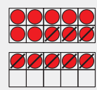
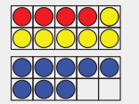

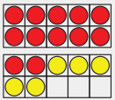
Unit 3 Progression Overview
Adding and Subtracting Within 20
Section A
Lessons 1-7
1.OA.A, 1.OA.B.,, 1.OA.C., 1.OA.D.7, 1.OA.D.
Section B
Lessons 8-14
1.NBT.A, 1.NBT.B., 1.OA.A, 1.OA.B, 1.OA.C, 1.OA.D
Section C
Lessons 15-21
1.OA.A., 1.OA.B., 1.OA.C., 1.OA.D.
Section D
Lessons 15-21
1.NBT.A., 1.OA.A., 1.OA.B., 1.OA.C., 1.OA.D
Build toward fluency with adding and subtracting within 10
Add and subtract one-digit numbers from teen numbers.
Find the value of an addition expression where one addend is 10 or a subtraction expression where the difference is 10.
Understand 10 ones as a ten and the numbers 11 to 19 as a ten and some ones.
Add within 20, including 3 addends.
Subtract within 20.

Slide 3



Unit 3 Quick Links
Adapt 1
Adapt 2
Adapt 3
Adapt 4
Adapt
5
L1
L2
L3
L4
L5
L6
L7
L8
L9
L10
L11
L12
L13
L14
L15
L16
L17
L18
L23
L24
L25
L26
L27
L19
L20
L21
L22
L28

Slide 4
Composing and Decomposing with Fingers
Adaptation
Lesson 1
Let’s make 10 with our fingers
: K.CC.A.3

Slide 5

What Do You Know About:
Warm up
Notes:
Optional Warm UP Activity

Slide 6
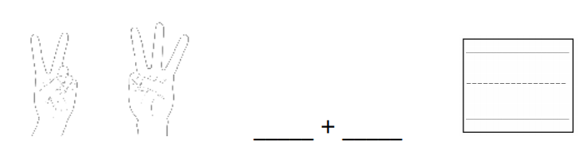
Fingers and Expressions
Activity #1

Slide 7
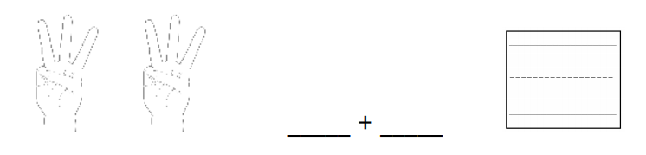
Fingers and Expressions
Activity #1

Slide 8
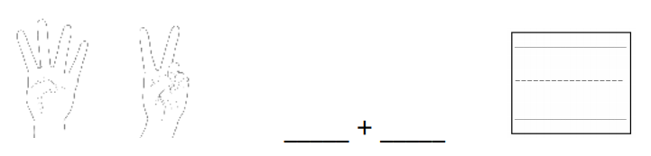
Fingers and Expressions
Activity #1

Slide 9
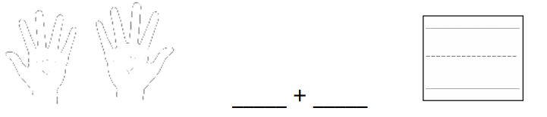
Fingers and Expressions
Activity #1

Slide 10
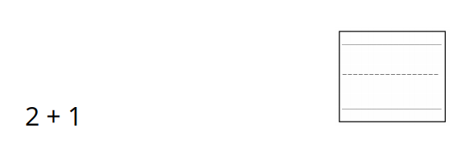
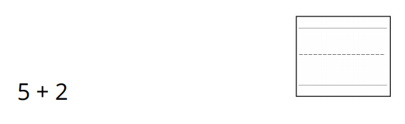
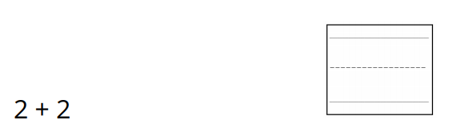
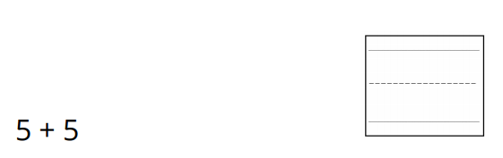
Fingers and Expressions
Activity #1

Slide 11
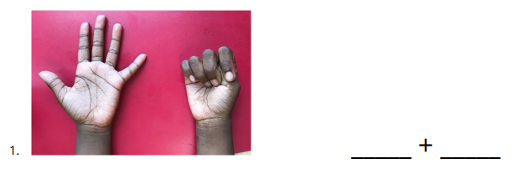
10 Fingers
Activity #2

Slide 12
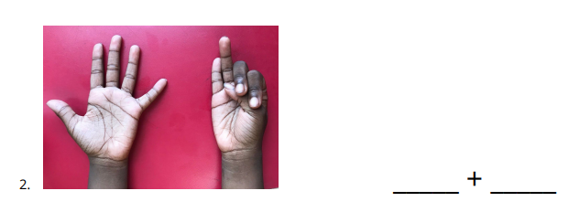
10 Fingers
Activity #2

Slide 13
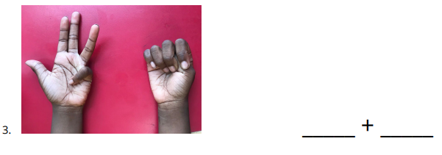
10 Fingers
Activity #2

Slide 14
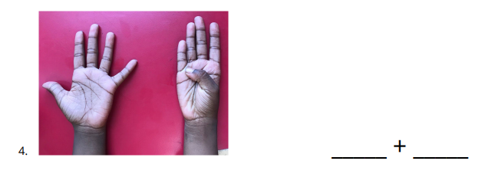
10 Fingers
Activity #2

Slide 15
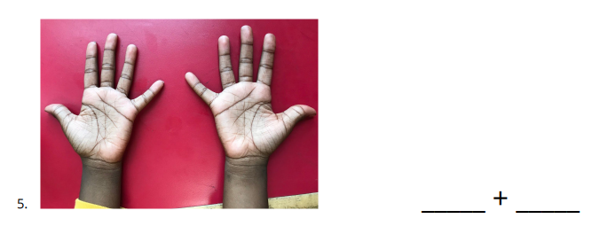
10 Fingers
Activity #2

Slide 16


Lesson Synthesis
How can you use fingers to show this equation
Where do you see the 8 on the hands?
Where do you see the 10 on the hands?

Slide 17
How Many Are Missing?
Adaptation
Lesson 2
I can find the partner for a number to make 10
: K.OA.A.3, K.OA.A.4

Slide 18
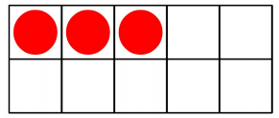
How Many Do You See? 10-frames
Warm up
Notes:
Optional Warm UP Activity

Slide 19
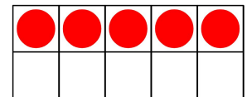
How Many Do You See? 10-frames
Warm up
Notes:
Optional Warm UP Activity

Slide 20
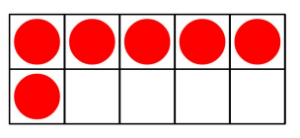
How Many Do You See? 10-frames
Warm up
Notes:
Optional Warm UP Activity

Slide 21
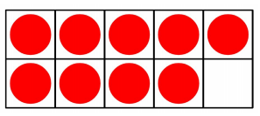
How Many Do You See? 10-frames
Warm up
Notes:
Optional Warm UP Activity

Slide 22
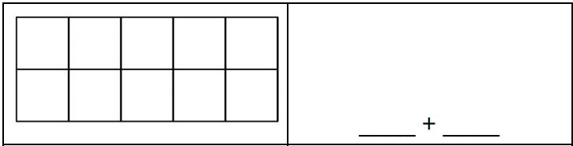
Shake, Spill, and Arrange with 10
Activity #1
Shake and spill all 10 counters. Arrange your counters in the 10-frame.
Use your red and yellow crayons to show what the counters look like in the 10-frame.
Fill in an expression to represent the red and yellow counters.
Take turns playing until you fill in all the expressions.

Slide 23
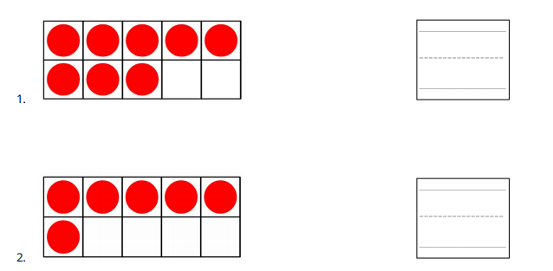
How Many to Get 10?
Activity #2

Slide 24
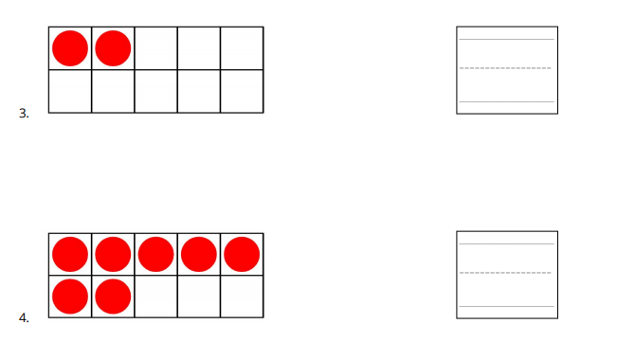
How Many to Get 10?
Activity #2

Slide 25
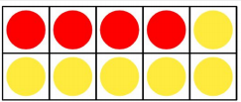

Lesson Synthesis
Jada spilled 10 counters. Here are the red counters Jada got when she was playing Shake and Spill.
There are 4 red counters and 6 yellow counters and 10 counters total. I can also write 4 + 6 = 10
How many yellow counters did Jada get? How do you know?

Slide 26
10 Ones and
Some More Ones
Adaptation
Lesson 3
Let’s use 10 to make larger numbers.
K.NBT.A.1, K.CC.B.5, K.CC.A.3

Slide 27
Choral Count: Half at a Time
Warm up
Group 1:
Count as a group from 1 until you tell them to stop.
Group 2:
Count on where the first group leaves off.
What number always comes after 10?
Notes:
Optional Warm UP Activity

Slide 28
Putting Together Numbers 11-19
Activity #1
Walk around and find a partner.
  If you have a 10-frame on your card, find a partner who does not have a 10-frame on their card.
  If you do not have a 10-frame on your card, find a partner who does have a 10-frame
Tell your partner how many dots you have on your card. Then work together to figure out how many dots you both have altogether.
Switch cards and find a new partner.

Slide 29

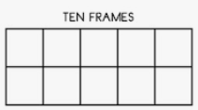
Making Number Cards
Activity #2
Make each number. You can cut out the 10-frames and the dots to help you make each number.
When you’re finished, trace each number.

Slide 30
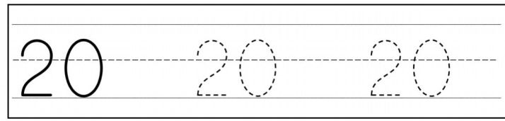
Writing Number 20
Activity #3
Practice writing the number 20.

Slide 31


Lesson Synthesis
Elena says there are 11 dots. Clare says there are 10 dots and 1 dot. What do you think?
Which two images can we put together to make 12? How do you know?

Slide 32
Composing with a
Full 10-frame
Adaptation
Lesson 4
Let’s make numbers using a full 10-frame
K.NBT.A.1, K.CC.A.2

Slide 33
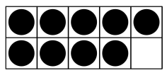
How Many Do You See: Teen Numbers on a 10-Frame
Warm up
How many do you see?
How do you see them?
Notes:
Optional Warm UP Activity

Slide 34
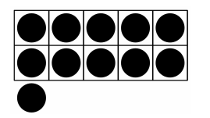
How Many Do You See: Teen Numbers on a 10-Frame
Warm up
How many do you see?
How do you see them?
Notes:
Optional Warm UP Activity

Slide 35
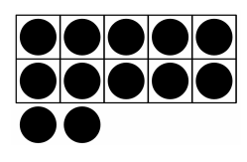
How Many Do You See: Teen Numbers on a 10-Frame
Warm up
How many do you see?
How do you see them?
Notes:
Optional Warm UP Activity

Slide 36
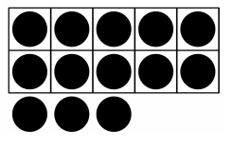
How Many Do You See: Teen Numbers on a 10-Frame
Warm up
How many do you see?
How do you see them?
Notes:
Optional Warm UP Activity

Slide 37
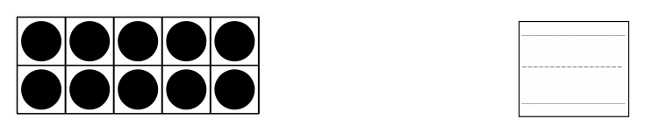
Adding More Counters
Activity #1
Flip over 1 card.
Add that many dots to your 10-frame.
Write a number to show how many dots there are now.
Work with your partner to finish the rest of the problems.
Notes:
Give each group of students a set of Cards 1–9. Give students access to two-color counters.

Slide 38
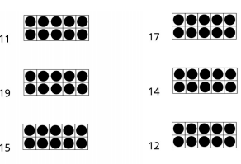
Finish the Representation
Activity #2
Draw more dots to finish the representation of each number.

Slide 39


Lesson Synthesis
How many dots are there? How do you know?
How many dots are there? How do you know?
We don’t need to touch and count each dot. We know that when the 10-frame is full, there are 10 dots.

Slide 40
Expressions and Numbers
Adaptation
Lesson 5
Let’s look at expressions for numbers 11–19.
: K.NBT.A.1, K.OA.A.1

Slide 41
Number Talk: 3 + ___
Warm up
Add

Slide 42
Number Talk: 3 + ___
Warm up
Add

Slide 43
Number Talk: 3 + ___
Warm up
Add

Slide 44
Number Talk: 3 + ___
Warm up
Add

Slide 45
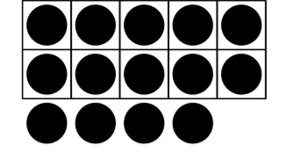
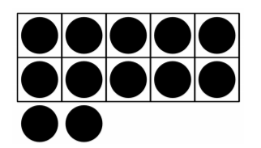




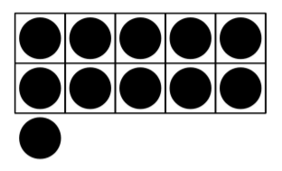
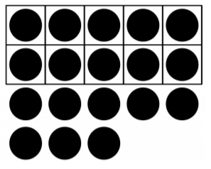


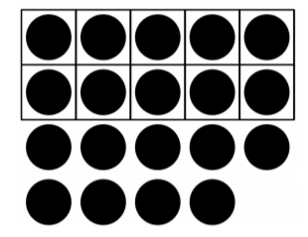
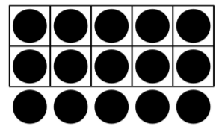
Expressions and 10-frames
Activity #1
Match each expression to the image it represents

Slide 46
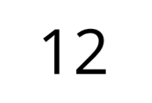
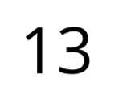
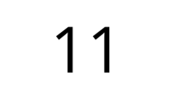
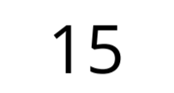
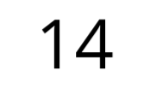
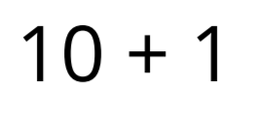
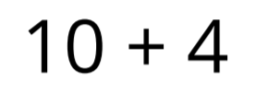
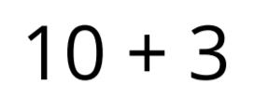
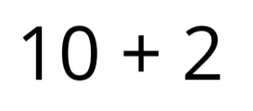
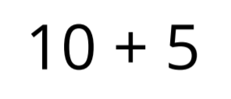
Organizing Expressions and Numbers
Activity #2
Work with your group to organize the cards in a way that makes sense to you.

Slide 47

Lesson Synthesis
Andre says that there are 12 dots. Clare says that there are 10 + 2 dots.
What do you think?

Slide 48
What I Know About Sums Within 10
1
Let’s see which sums within 10 we know.
1.OA.C.6

Slide 49
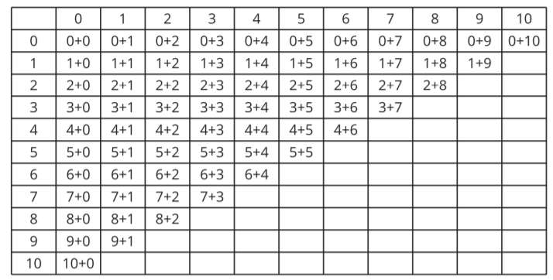
The Addition Table
Warm up
What do you notice?
What do you wonder?

Slide 50
My Favorite Sum
Activity #1
Pick your favorite sum.
Write the equation:
Show why it is your favorite using drawings, numbers, or words.

Slide 51
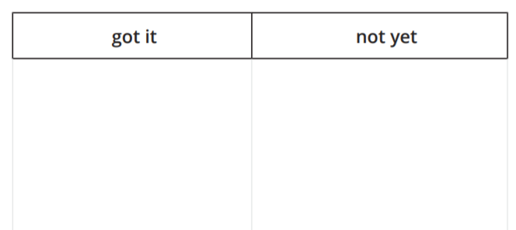
Sums I’ve Got
Activity #2
1. Place your cards in a pile face down.
2. Flip the card and say the expression.
3. If you can say the sum quickly, place it under “got it”.
4. If it takes you some time to find the sum, place it under “not yet.

Slide 52

Lesson
Synthesis
Some students have ‘got’ . What is a strategy you can use to help a friend who doesn’t know the sum yet?

Slide 53
Relate Counting to Addition
2
Let’s add within 10.
1.OA.A.1, 1.OA.B.3, 1.OA.C.5, 1.OA.C.6, 1.OA.D.8

Slide 54
Number Talk: 2 or 3 More
Warm up
Find the sum mentally.

Slide 55
Number Talk: 2 or 3 More
Warm up
Find the sum mentally.

Slide 56
Number Talk: 2 or 3 More
Warm up
Find the sum mentally.

Slide 57
Number Talk: 2 or 3 More
Warm up
Find the sum mentally.

Slide 58

Shake and Spill Story Problems
Activity #1
1. Priya is playing Shake and Spill. She spills 7 red counters and 2 yellow counters.
How many counters did she spill in all? Show your thinking using drawings, numbers, or words.
Equation:
2. Tyler spills 5 red counters and 3 yellow counters. How many counters did he spill in all? Show your thinking using drawings, numbers, or words.
Equation:

Slide 59
Shake and Spill Story Problems
Activity #1
3. Clare spills 2 red counters and 8 yellow counters.
How many counters did she spill in all?
Show your thinking using drawings, numbers, or words.
Equation:
4. Han spills 3 red counters and 6 yellow counters.
How many counters did he spill in all?
Show your thinking using drawings, numbers, or words.
Equation:

Slide 60

4 + 5 = ______
Activity #2
How can both methods be correct?
Be ready to explain your thinking.

Slide 61


Practice Addition within 10
Activity #3
Find the sum.

Slide 62
Lesson
Synthesis
Mai is practicing her sums to 10. She has in her “got it” pile and in her “not yet” pile. What would you tell Mai?
Look through your 'not yet' cards. If you just know the sum, move it to your 'got it’ pile. If you still need practice with a sum, keep it in your ‘not yet’ pile

Slide 63
Equivalent Expressions
3
Let’s think about how expressions can be equal.
1.OA.B.3, 1.OA.C.5, 1.OA.C.6, 1.OA.D.7

Slide 64

How Many Do You See: Sums within 10
Warm up
How many do you see?
How do you see them?

Slide 65

How Many Do You See: Sums within 10
Warm up
How many do you see?
How do you see them?

Slide 66

How Many Do You See: Sums within 10
Warm up
How many do you see?
How do you see them?

Slide 67

Sort Addition Expressions
Activity #1
Sort your addition expressions that have the same sum.
Work with your partner. Make sure that each partner has a chance to find the sum of the card before you place it with its sum. If you and your partner disagree, work together to find the sum. Then when you are finished, keep your sums sorted.

Slide 68





Equations with Equivalent Expressions
Activity #2
Determine whether each equation is true or false.
Be ready to explain your reasoning in a way that others can understand.

Slide 69

Lesson Synthesis
What would you tell someone who said this equation was true because 6 + 3 = 9 ?

Slide 70
Sums of 10
4
Let’s find all the ways to make 10.
1.OA.B.3, 1.OA.C.6, 1.OA.D.7, 1.OA.D.8

Slide 71

True or False:
Equivalent Expressions
Warm up
Is it true?
Is it false?
How do you know?
Notes:
Optional Warm UP Activity

Slide 72

True or False:
Equivalent Expressions
Warm up
Is it true?
Is it false?
How do you know?
Notes:
Optional Warm UP Activity

Slide 73

True or False:
Equivalent Expressions
Warm up
Is it true?
Is it false?
How do you know?
Notes:
Optional Warm UP Activity

Slide 74
Shake and Spill: 10 Counters
Activity #1
Today you will play Shake and Spill with 10 counters.
When you write the equation to represent your counters, make sure it shows how many red counters and how many yellow counters you got.

Slide 75

All The Ways To Make 10
Activity #2
1. Show all the ways to make 10.
2. How do you know that you have found all of the ways? Be ready to explain your thinking in a way that others will understand.

Slide 76



Lesson Synthesis
What is the value that makes this equation true? How do you know

Slide 77
More About Addition and Subtraction
5
Let’s subtract within 10.
1.OA.B.4, 1.OA.C.5, 1.OA.C.6

Slide 78

Number Talk: Missing Addend Within 10
Warm up
Find the value that makes each equation true.

Slide 79

Number Talk: Missing Addend Within 10
Warm up
Find the value that makes each equation true.

Slide 80

Number Talk: Missing Addend Within 10
Warm up
Find the value that makes each equation true.

Slide 81

Number Talk: Missing Addend Within 10
Warm up
Find the value that makes each equation true.

Slide 82



Different Ways to Find the Difference
Activity #1
Mai, Diego, and Noah found all the ways to make 10. Now, they are finding the difference for 10 - 6:

Slide 83


Subtraction Number Strings
Activity #2
Find the differences for each expression in the subtraction string, then explain what you notice.
2.
What do you notice?
Why do you think this happens?
Be ready to explain your thinking in a way that others will understand.

Slide 84

Subtraction Number Strings
Activity #2
Find the differences for each expression in the subtraction string, then explain what you notice.
2.
What do you notice?
Why do you think this happens?
Be ready to explain your thinking in a way that others will understand.

Slide 85


Some Subtraction Problems
Activity #3
Find the difference.

Slide 86
When solving subtraction problems you can use what you know about addition. To find the difference in a problem like 9 - 5 =_, you can think about the sums of 9.
I know that 5 + 4 = 9 , so 9 - 5 = 4 .
Lesson Synthesis
We say that 4, 5, and 9 are related. We can write both addition and subtraction equations.
What are the addition and subtraction equations we can write with 4, 5, and 9?

Slide 87
Story Problems
within 10
6
Let’s solve story problems.
1.OA.A.1, 1.OA.C.5, 1.OA.C.6

Slide 88

Notice and Wonder:
A Numberless Word Problem
Warm up
What do you notice?
What do you wonder?

Slide 89

5 Practices:
A Shake and Spill Story Problem
Activity #1

Slide 90



Shake and Spill Story Problems
Activity #2

Slide 91



Shake and Spill Story Problems
Activity #2

Slide 92
Lesson Synthesis
What did you learn about adding and subtracting within 10? Give an example to support your thinking

Slide 93





Lesson 6 Summary
We practiced adding within 10. We found the sum by counting on.
We learned that we can be add in any order. 4 + 3 is the same amount as 3 + 4.
We learned that when expressions have the same value, you can show that with an equal sign.
We saw that there are patterns within equivalent expressions.

Slide 94

Center Day 1 (Optional)
7
Let’s play games to practice adding.
1.OA.C.6

Slide 95


Choral Counting: Beyond 20
Warm up
Count by 1, starting at 20.

Slide 96

Introduce Find the Pair
Activity #1
We are going to learn a new game where we find pairs of numbers that make 10.

Slide 97


Centers Choice Time: Adding Within 10
Activity #2
Number Puzzles
Capturing Squares

Slide 98
Today we learned a new game that we can play during center time.
Lesson Synthesis
How did you and your partner work together during centers? What went well? What can we continue to work on?

Slide 99
Introduce Ten as a Unit
8
Let's explore teen numbers.
1.NBT.B.2.a, 1.NBT.B.2.b, 1.OA.C.6

Slide 100

Which One Doesn’t Belong: Groups of 10
Warm up

Slide 101

Counting Collections:
Teen Numbers
Activity #1
You and your partner will get a bag and your job is to figure out how many cubes are in the bag.
Work with your partner to count the collection. Each partner will show on paper how many there are and show how you counted them.

Slide 102


Building Teen Numbers
Activity #2

Slide 103

Lesson Synthesis
We can also say that 14 is 10 and 4. We can write the equation 10 + 4 = 14.
If I have a collection with a ten and 6 ones, how many are in my collection? What equation represents this?
We can say 14 is a ten and four ones. How does this representation show a ten and 4 ones?
If I have 19 in my collection, what equation can I write? What does each number stand for?

Slide 104
Addition With a Ten
9
Let's use a ten to make teen numbers.
1.NBT.B.2, 1.NBT.B.2.a, 1.OA.B.3

Slide 105

Notice and Wonder: Two Teen Numbers
Warm up
What do you notice?
What do you wonder?

Slide 106

Make It: Teen Numbers and 10-Frames
Activity #1

Slide 107






Equations With a Ten
Activity #2
Find the missing value so that each equation is true. Show your thinking using drawings, numbers, or words.

Slide 108

Lesson Synthesis
How do these equations help you understand teen numbers?
What equations can you write to represent this number?

Slide 109
Addition and Subtraction with a Ten
10
Let’s use a ten to help us add and subtract.
1.NBT.B.2, 1.OA.A.1, 1.OA.B.3, 1.OA.C.6, 1.OA.D.8

Slide 110

Number Talk: A Ten and Some Ones
Warm up
Find the value of each expression mentally

Slide 111

Number Talk: A Ten and Some Ones
Warm up
Find the value of each expression mentally

Slide 112

Number Talk: A Ten and Some Ones
Warm up
Find the value of each expression mentally

Slide 113

Number Talk: A Ten and Some Ones
Warm up
Find the value of each expression mentally

Slide 114



Story Problems With a Ten
Activity #1

Slide 115

Related Equations
Activity #2

Slide 116





Related Equations
Activity #2

Slide 117



Lesson Synthesis
How can using addition help you find the value that makes this equation true?
How can using subtraction help you find the value that makes this equation true?

Slide 118
Add to a Teen Number
11
Let’s add teen numbers and single-digit numbers.
1.OA.A.1, 1.OA.C.6, 1.OA.D.7

Slide 119
True or False: Teen Numbers
Warm up
Decide whether each statement is true or false.
Be prepared to explain your reasoning.

Slide 120
True or False: Teen Numbers
Warm up
Decide whether each statement is true or false.
Be prepared to explain your reasoning.

Slide 121
True or False: Teen Numbers
Warm up
Decide whether each statement is true or false.
Be prepared to explain your reasoning.

Slide 122



Mancala
Activity #1

Slide 123







Write Equations:
Adding on to Teen Numbers
Activity #2
Find the missing value so that each equation is true.
Show your thinking using drawings, numbers, or words

Slide 124


Lesson Synthesis
What are different ways to find the value that makes the equation true?

Slide 125
Subtract From a Teen Number
12
Let’s subtract and add within 20.
1.NBT.A.1, 1.OA.A.1, 1.OA.C.6

Slide 126


Choral Count: By Ten
Warm up
Count by 10, starting at 2.

Slide 127

Noah’s Collection
Activity #1
Noah likes to collect game pieces.
He has 19 game pieces arranged like this in his bin:
He takes out 8 game pieces to play with.
How many game pieces are left in the bin?
Show your thinking using drawings, numbers, or words.
Write an equation to represent the problem.

Slide 128


Addition and Subtraction Equations
with Teen Number
Activity #2
Find the value that makes the equation true.
Be ready to explain or show your thinking in a way that others can understand.

Slide 129

Lesson Synthesis
Which method would you recommend to a friend? Why?

Slide 130
More Story Problems
with Teen Numbers
13
Let’s solve story problems.
1.OA.A.1, 1.OA.C.6

Slide 131

Notice and Wonder: Cincos
Warm up
What do you notice?
What do you wonder?

Slide 132





Playing Cincos
Activity #1

Slide 133




Solve Story Problems and Compare Strategies
Activity #2

Slide 134

Lesson Synthesis
What question was the second equation answering?
What do you notice about the two equations? What do you wonder?
What do you notice about the two equations? What do you wonder?
Why is the box in different places?

Slide 135




Section Summary
We learned that 10 ones make a ten.
We learned that all teen numbers can be represented as a ten and some ones.
We used that understanding to find missing values in addition and subtraction equations.

Slide 136
Center Day 2 (Optional)
14
Let’s play games to practice adding and subtracting.
1.OA.B.3, 1.OA.C.6

Slide 137
True or False: Addition Within 10
Warm up
Is it true?
Is it false?
How do you know?

Slide 138
True or False: Addition Within 10
Warm up
Is it true?
Is it false?
How do you know?

Slide 139
True or False: Addition Within 10
Warm up
Is it true?
Is it false?
How do you know?

Slide 140

Centers: Introduce Compare, Addition and Subtraction Expressions
Activity #1
In the new center activity, you and your partner will compare addition and subtraction expressions.
You will each flip over a card and whoever has the greater value takes both cards.
The game is over when a partner runs out of cards to flip over.
The partner with the most cards wins.
5 - 3 = 2
4 - 3 = 1

Slide 141




Centers Choice Time:
Adding Within 10
Activity #2
Find the Pair
Capturing Squares
Compare, Addition and Subtraction Expressions

Slide 142
Lesson Synthesis
Today we learned a new game that we can play during center time.
How did you and your partner work together during centers?
What went well? What can we continue to work on?

Slide 143
Solve Story Problems with 3 Addends
15
Let’s solve story problems with 3 addends.
1.OA.A.2, 1.OA.B.3, 1.OA.C.5, 1.OA.C.6

Slide 144

How Many Do You See: 10-Frames
Warm up
How many do
you see?
How do you
see them?

Slide 145

How Many Do You See: 10-Frames
Warm up
How many do
you see?
How do you
see them?

Slide 146

How Many Do You See: 10-Frames
Warm up
How many do
you see?
How do you
see them?

Slide 147


5 Practices: Elena’s Balloons
Activity #1

Slide 148






More Problems with 3 Addends
Activity #2

Slide 149
Lesson Synthesis
We have learned that when you add numbers, it doesn’t matter which order you add them—you still get the same sum. Today we saw that when adding 3 numbers it can be helpful to look for pairs of numbers that make a ten.
Think of an equation with 3 addends in which 2 of the numbers add to 10.
What is the sum? How do you know?

Slide 150
Three Addend Equations
16
Let’s find the sum with 3 addends.
1.OA.A.2, 1.OA.B.3, 1.OA.C.5, 1.OA.C.6, 1.OA.D.7

Slide 151

Number Talk: Related Expressions
Warm up
Find the value of each expression mentally

Slide 152

Number Talk: Related Expressions
Warm up
Find the value of each expression mentally

Slide 153

Number Talk: Related Expressions
Warm up
Find the value of each expression mentally

Slide 154

Number Talk: Related Expressions
Warm up
Find the value of each expression mentally

Slide 155

Match Expressions
Activity #1
Draw a line to match each expression to one that has the same sum.

Slide 156





Is the Equation True?
Activity #2
Determine whether each equation is true or false.
Be ready to explain your reasoning in a way that others can understand.
Notes:
If you have time: 1. Make any false equations true. 2. Write 1 equation that is true and 1 that is false. Switch with your partner.

Slide 157


Write 10 + n Expressions
Activity #3
Write the related 10 + _ expression and find the sum.
Notes:
If you have time, write as many expressions as you can with 3 addends that are equal to 10 + 5

Slide 158

Lesson Synthesis
Did anyone determine whether it is true or false without adding all the numbers?
Is this equation true or false? How do you know?

Slide 159
Make 10 to Add
17
Let’s make a ten to help us add.
1.OA.A.1, 1.OA.C.5, 1.OA.C.6

Slide 160

How Many Do You See:
Double 10-Frames
Warm up
How many do
you see?
How do you
see them?

Slide 161

How Many Do You See:
Double 10-Frames
Warm up
How many do
you see?
How do you
see them?

Slide 162

How Many Do You See:
Double 10-Frames
Warm up
How many do
you see?
How do you
see them?

Slide 163


The 9 Plus Game
Activity #1

Slide 164




Clare’s Cars
Activity #1

Slide 165

Lesson Synthesis
Today, we saw that making a ten can help us add numbers within 20.
How can I write 1 equation to show that these two expressions are equivalent?
If I add 7, how could we record the sum with an equation?

Slide 166
Patterns in Addition
18
Let’s look for and use patterns to help us add within 20.
1.OA.A.1, 1.OA.B.3, 1.OA.C.5, 1.OA.C.6

Slide 167

How Many Do You See:
More Double 10-Frames
Warm up
How many do you see?
How do you see them?

Slide 168

How Many Do You See:
More Double 10-Frames
Warm up
How many do you see?
How do you see them?

Slide 169

How Many Do You See:
More Double 10-Frames
Warm up
How many do you see?
How do you see them?

Slide 170

Expression Match
Activity #1

Slide 171
Compare and Connect:
Gallery Walk
Activity #2
What do you notice about the expressions?

Slide 172

Lesson Synthesis
Is this equation true or false? How do you know?

Slide 173
Methods for Addition Within 20
19
Let’s add within 20
1.OA.A.1

Slide 174

Number Talk: Related Addends
Warm up
Find the value of each expression mentally

Slide 175

Number Talk: Related Addends
Warm up
Find the value of each expression mentally

Slide 176

Number Talk: Related Addends
Warm up
Find the value of each expression mentally

Slide 177

Number Talk: Related Addends
Warm up
Find the value of each expression mentally

Slide 178

Lin, Han, and Kiran Add
Activity #1
Explain how each student’s method works.
Share your thinking using objects, drawings, numbers, or words.

Slide 179


How Did You Add?
Activity #2

Slide 180
Lesson Synthesis
Today, we found sums within 20 and thought about how we can use what we know to find sums.
Pick one of those ways and explain to your partner what the student did

Slide 181
Story Problems With 3 Addends
20
Let’s solve story problems.
1.OA.A.1, 1.OA.A.2, 1.OA.C.5, 1.OA.C.6

Slide 182

Number Talk: Using 10 + n
Warm up
Find the value of each expression mentally

Slide 183

Number Talk: Using 10 + n
Warm up
Find the value of each expression mentally

Slide 184

Number Talk: Using 10 + n
Warm up
Find the value of each expression mentally

Slide 185

Number Talk: Using 10 + n
Warm up
Find the value of each expression mentally

Slide 186

A Story Problem with 3 Addends
Activity #1
Jada is having a barbeque with her family. Her mom bought 8 hot dogs, 7 hamburgers, and 5 veggie burgers.
How many hotdogs, hamburgers, and veggie burgers did Jada’s mom buy in all?
Show your thinking using drawings, numbers, or words.

Slide 187






More Story Problems
Activity #2

Slide 188
In this section, we worked on different ways to add within 20.
Lesson Synthesis
What are you most proud of? What do you still need to practice?

Slide 189

How Many Do You See: Ten-Frames
Warm up
How many do you see?
How do you see them?

Slide 190

How Many Do You See: Ten-Frames
Warm up
How many do you see?
How do you see them?

Slide 191

How Many Do You See: Ten-Frames
Warm up
How many do you see?
How do you see them?

Slide 192

How Many Do You See: Ten-Frames
Warm up
How many do you see?
How do you see them?

Slide 193





Let’s Write Story Problems (Part 1)
Activity #1

Slide 194




Let’s Write Story Problems (Part 2)
Activity #2

Slide 195
Lesson Synthesis
Which equations represent this story problem?
What is an equation with an unknown value that represents this story problem?

Slide 196


Section Summary
We saw that making a ten could help when we add 3 numbers together.
We saw that making a ten could also help when we add 2 numbers together.

Slide 197
Center Day 3 (Optional)
21
Let’s play games where we add and subtract.
1.OA.C.5, 1.OA.C.6

Slide 198

What Do You Know About?
Warm up

Slide 199

Introduce How Close?, Close to 20
Activity #1
For each round, both partners need 7 cards. Use 2 or 3 cards to add to get as close to 20 as you can.
Explain to your partner how you know you are close to 20.
Keep the cards that you don’t use. These cards can be played in the next round.
Pick 2 or 3 new cards so that you have 7 cards

Slide 200

Introduce Bingo, Add 7, 8 or 9
Activity #2
We are going to play Bingo again.
This time, you will pick a number card and then decide whether to add 7, 8 or 9 to that number.
Then I get to put a counter on the sum and then my partner gets a turn.

Slide 201
Today we learned two new games we can play during center time
Lesson Synthesis
How did you and your partner work together during centers? What went well? What can we continue to work on?

Slide 202
Subtracting from
Teen Numbers
22
Let’s subtract from teen numbers
1.OA.C.5, 1.OA.C.6

Slide 203

Number Talk: Subtraction Problems
Warm up
Find the value of each expression mentally

Slide 204

Number Talk: Subtraction Problems
Warm up
Find the value of each expression mentally

Slide 205

Number Talk: Subtraction Problems
Warm up
Find the value of each expression mentally

Slide 206

Number Talk: Subtraction Problems
Warm up
Find the value of each expression mentally

Slide 207

Subtraction Methods
Activity #1

Slide 208


Number Card Subtraction
Activity #2
Notes:
Pick your favorite equation. Show how you found the difference using drawings, words, or numbers.

Slide 209


Lesson Synthesis
How can you find the difference?

Slide 210
Use a Ten to Find the Difference
23
Let’s use 10 to help us subtract.
1.OA.C.5, 1.OA.C.6, 1.OA.D.8

Slide 211

Number Talk: Subtraction
Warm up
Find the value of each expression mentally

Slide 212

Number Talk: Subtraction
Warm up
Find the value of each expression mentally

Slide 213

Number Talk: Subtraction
Warm up
Find the value of each expression mentally

Slide 214

Number Talk: Subtraction
Warm up
Find the value of each expression mentally

Slide 215


Number Card Subtraction with 10-Frames
Activity #1
Notes:
Pick your favorite equation. Show how you found the difference using drawings, words, or numbers.

Slide 216


Diego and Andre Find the Difference
Activity #2
Notes:
Pick your favorite equation. Show how you found the difference using drawings, words, or numbers.

Slide 217

Diego and Andre Find the Difference
Activity #2
Notes:
Pick your favorite equation. Show how you found the difference using drawings, words, or numbers.

Slide 218

Lesson Synthesis
Today you learned how a ten can help you subtract from teen numbers.
How can we use a ten to help us solve?

Slide 219
Relate Counting to Addition and Subtraction
24
Let’s subtract by counting up or taking away.
1.NBT.A.1, 1.OA.B.4, 1.OA.C.5, 1.OA.C.6, 1.OA.D.7, 1.OA.D.8

Slide 220

Choral Count: Backward
Warm up
Count backwards by 1, starting at 50.

Slide 221



Different Ways to Subtract
Activity #1

Slide 222


Different Ways to Subtract
Activity #1

Slide 223






Find the Value That Makes Equations True
Activity #2
Find the value that makes each equation true.
Be sure you can explain your thinking in a way that others will understand.
Notes:
Pick your favorite equation. Show how you found the difference using drawings, words, or numbers.

Slide 224




Find the Value That Makes Equations True
Activity #2
Find the value that makes each equation true.
Be sure you can explain your thinking in a way that others will understand.
Notes:
Pick your favorite equation. Show how you found the difference using drawings, words, or numbers.

Slide 225
Lesson Synthesis
You have now tried 3 different ways to subtract.
Which one do you like best? Why

Slide 226
How Do You Want
to Subtract?
25
Let’s use subtraction methods that work for the numbers in a problem.
1.NBT.A.1, 1.OA.A.1, 1.OA.C.5, 1.OA.C.6

Slide 227
Choral Count
Warm up
Count by 1, starting at 50.

Slide 228





Choose Your Own Subtraction Method
Activity #1
Show your thinking using drawings, numbers, or words.

Slide 229






Solve Story Problems
Activity #2
Notes:
Pick your favorite equation. Show how you found the difference using drawings, words, or numbers.

Slide 230
Lesson Synthesis
Today, you used different methods you’ve learned to find differences and solve story problems. Talk to your partner about the most important thing to remember about doing subtraction problems.
The most important thing to remember when doing problems like we did today is…

Slide 231
What’s the Story?
26
Let’s solve story problems.
1.OA.A.1, 1.OA.B.3, 1.OA.C.5, 1.OA.C.6

Slide 232

Number Talk: Subtraction
Warm up
Find the value of each expression mentally

Slide 233

Number Talk: Subtraction
Warm up
Find the value of each expression mentally

Slide 234

Number Talk: Subtraction
Warm up
Find the value of each expression mentally

Slide 235

Number Talk: Subtraction
Warm up
Find the value of each expression mentally

Slide 236



Solve Related Story Problems
Activity #1

Slide 237


More Story Problems
Activity #2
Show your thinking using drawings, words or numbers.
Equation: _________________________________
Notes:
Pick your favorite equation. Show how you found the difference using drawings, words, or numbers.

Slide 238
Lesson Synthesis
Today we solved word problems together using different methods.
What were some of the methods you used?

Slide 239
Center Day 4 (Optional)
27
Let’s play games to practice subtracting and making equations.
1.OA.C.6, 1.OA.D.8

Slide 240

Number Talk: Subtraction
Warm up
Find the value of each expression mentally

Slide 241

Number Talk: Subtraction
Warm up
Find the value of each expression mentally

Slide 242

Number Talk: Subtraction
Warm up
Find the value of each expression mentally

Slide 243

Number Talk: Subtraction
Warm up
Find the value of each expression mentally

Slide 244
Introduce How Close?, Close to 0
Activity #1
You are going to play another stage of How Close? In this version, the goal is to get as close to 0 as possible. You can choose to subtract two or three numbers from 20.
During each round, both partners need 4 cards. Choose 2 or 3 of those cards to subtract from 20.
After each partner records their choice and the difference, explain to your partner why you chose the number you did.
Keep the cards that you don’t use. These cards can be played in the next round.
Pick new cards so that you have 4 cards.
Choose the round where you got closest to 0 and make a representation of one of your subtraction equations.

Slide 245

Centers: Introduce Number Puzzles, Up to 20
Activity #2
We are going to play a new version of the Number Puzzles Center. This time, you will work with numbers up to 20.
Take out all of the 10s from your deck. You will use the cards 0-9 to fill in the number puzzle page.
You will only use each card once.
Then you will compare with your partner.
Notes:
Pick your favorite equation. Show how you found the difference using drawings, words, or numbers.

Slide 246
Lesson Synthesis
Today we learned two new games that we can play during center time.
What strategies did you use to subtract numbers?

Slide 247
Around the Room (Optional)
28
Let’s write addition and subtraction story problems.
1.OA.A.1, 1.OA.A.2, 1.OA.B.3, 1.OA.C.5

Slide 248

Notice and Wonder:
5 in the Classroom
Warm up
What do you notice?
What do you wonder?

Slide 249

Writing Classroom Story Problems
Activity #1
1.
Addition story problem:
Solve the story problem.
Show your thinking using drawings, numbers, or words.
Equation
2.
Subtraction story problem:
Solve the story problem.
Show your thinking using drawings, numbers, or words.
Equation

Slide 250
Centers: Introduce Number Puzzles, Up to 20
Activity #2
Let’s solve our classmates’ story problems.
1.
Solve the story problem using drawings, numbers, or words.
Equation:
2.
Solve the story problem using drawings, numbers, or words.
Equation:
3.
Solve the story problem using drawings, numbers, or words.
Equation:
4.
Solve the story problem using drawings, numbers, or words.
Equation:

Slide 251
Lesson Synthesis
Today, we wrote and solved story problems involving addition and subtraction.
What was the most challenging part of writing or solving the story problems today?

