Slide 1

Addition and Subtraction Story Problems
Grade 1: Unit 2
Standards addressed: 1.OA.A.1, 1.OA.C.6, 1.OA.D.7, 1.OA.B.3,1. MD.C.4, 1.OA.C.5
These slides have been created by Britnee Wright- Southeast Arkansas Education Cooperative and are not official IM materials. Images and language are taken from IM Grade 5, Unit 2 by Illustrative Mathematics.
Copyright 2020 by Illustrative Mathematics. All Rights Reserved, adapted and shared with permission.

Slide 2
Unit 2 Progression Overview
Addition & Subtraction Story Problems
Section A
Lessons 1-5
1.OA.A.1, 1.OA.C.6, 1.OA.D.7
Section B
Lessons 6-10
1.OA.A.1, 1.OA.B.3, 1.OA.C.6, 1.OA.D.7
Section C
Lessons 11 - 15
1.MD.C.4, 1.OA.A.1, 1.OA.C.5, 1.OA.C.6, 1.OA.D.7
Solve Add To/Take From, Result Unknown and Add To, Change Unknown problems.
Understand the meaning of the equal sign.
Solve Put Together/Take Apart problems with unknowns in all positions.
Write equations to represent problems.
Relate addition and subtraction.
Solve Compare, Difference Unknown problems.

Slide 3



Unit 2 Quick Links
Adapt 1
Adapt 2
Adapt 3
Adapt 4
Adapt
5
L1
L2
L3
L4
L5
L6
L7
L8
L9
L10
L11
L12
L13
L14
L15
L16
L17
L18
L19
L20
L21
L22

Slide 4
Organized Drawings of Story Problems
Adaptation
Lesson 1
Let’s organize our drawings.
K.OA.A.2

Slide 5

How Many Do You See?
Warm up
How many dots do you see?
How do you see them?
Notes:
Optional Warm UP Activity

Slide 6

How Many Do You See?
Warm up
How many dots do you see?
How do you see them?

Slide 7

How Many Do You See?
Warm up
How many dots do you see?
How do you see them?

Slide 8

How Many Do You See?
Warm up
How many dots do you see?
How do you see them?

Slide 9
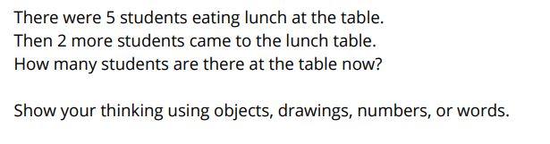
Lunch in the Cafeteria
Activity #1

Slide 10
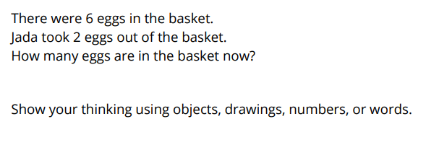
A Basket of Eggs
Activity #2

Slide 11
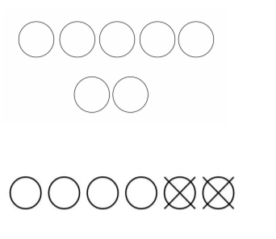
Narrative: Comparing Representations
Activity #3
We just solved two different problems and had drawings that looked like these?
Why did we cross out items on one of the representations, but not the other?

Slide 12


Lesson Synthesis
How are the images the same?
How are the images different?

Slide 13
Comparing Addition and Subtraction Story Problems
Adaptation
Lesson 2
Let’s compare addition and subtraction.
K.OA.A.1, K.OA.A.2

Slide 14

How Many Do You See?
Warm up
How many dots do you see?
How do you see them?
Notes:
Optional Warm UP Activity

Slide 15

How Many Do You See?
Warm up
How many dots do you see?
How do you see them?

Slide 16

How Many Do You See?
Warm up
How many dots do you see?
How do you see them?

Slide 17
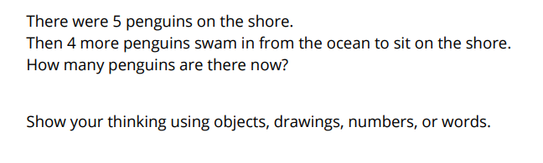
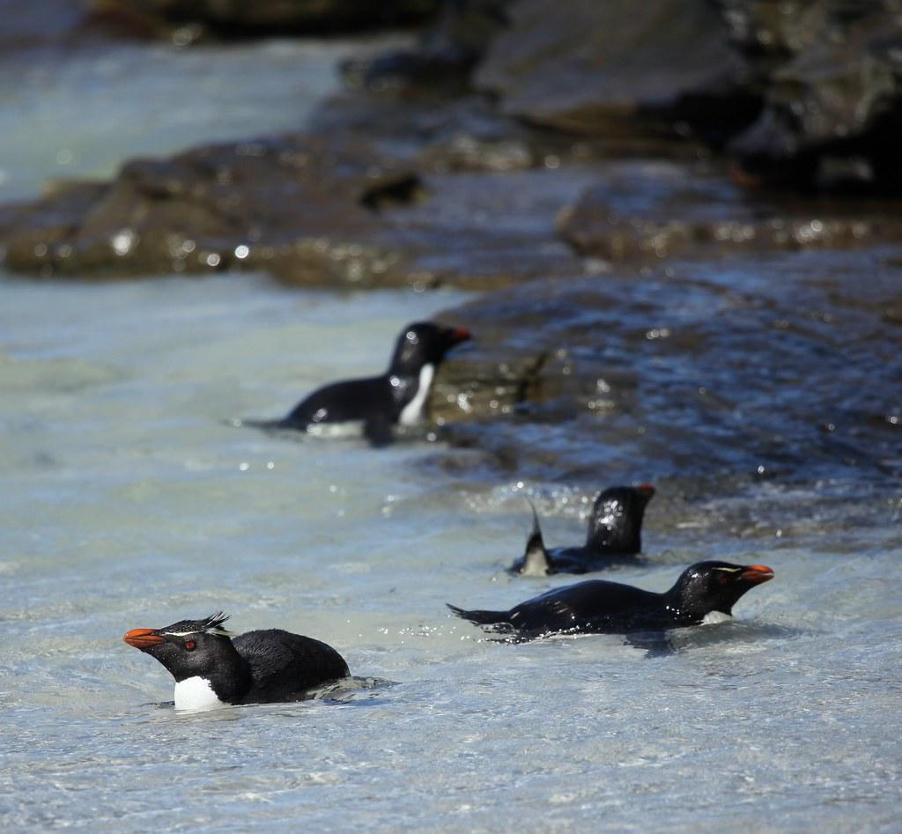
Penguins Swimming Ashore
Activity #1

Slide 18
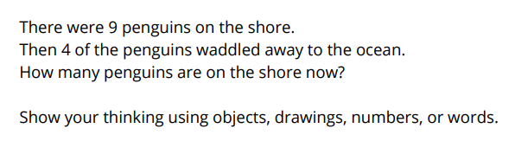
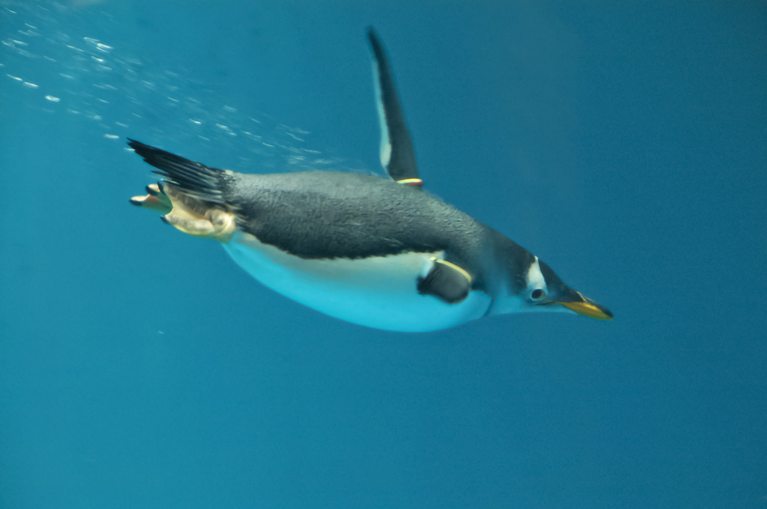
Penguins Out For a Swim
Activity #2

Slide 19

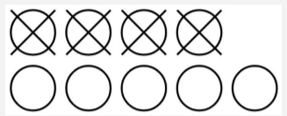
Lesson Synthesis
How are the images the same?
How are they different?
How are the stories the same?
How are the stories different?

Slide 20
Acting Out and solving Story Problems
Adaptation
Lesson 3
Let’s act out and solve story problems.
K.CC.B

Slide 21
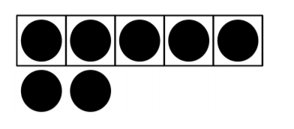
How Many Do You See?
Warm up
How many dots do you see?
How do you see them?
Notes:
Optional Warm UP Activity

Slide 22
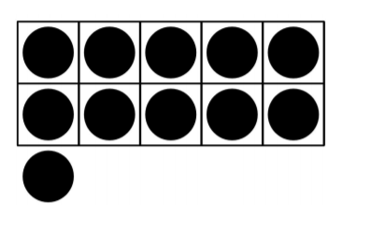
How Many Do You See?
Warm up
How many dots do you see?
How do you see them?

Slide 23
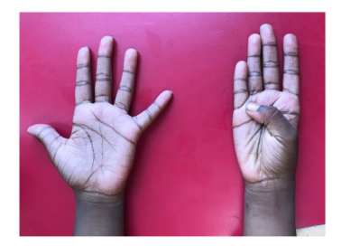
How Many Do You See?
Warm up
How many dots do you see?
How do you see them?

Slide 24

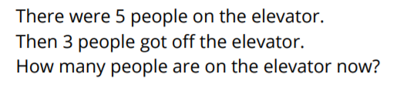
Stepping Out
Activity #1

Slide 25
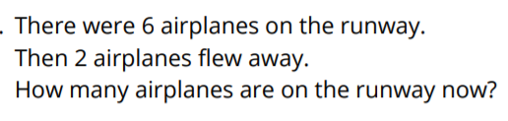
Solving Story Problems
Activity #2

Slide 26

Lesson Synthesis
There are 4 giraffes and 3 elephants drinking at the pool. How many animals are drinking?
How does the diagram represent the story?
How does the diagram help answer the question?

Slide 27
Creating Math Stories
Adaptation
Lesson 4
Let’s tell math stories.
K.OA.A.1, K.OA.A.2

Slide 28

True or False: Addition Equations
Warm up
Is it true?
Is it false?
How do you know?
Notes:
Optional Warm UP Activity

Slide 29

True or False: Addition Equations
Warm up
Is it true?
Is it false?
How do you know?
Notes:
Optional Warm UP Activity

Slide 30

True or False: Addition Equations
Warm up
Is it true?
Is it false?
How do you know?
Notes:
Optional Warm UP Activity

Slide 31

True or False: Addition Equations
Warm up
Is it true?
Is it false?
How do you know?
Notes:
Optional Warm UP Activity

Slide 32

Exercise Time
Activity #1

Slide 33
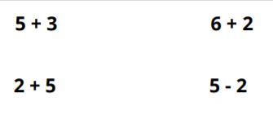
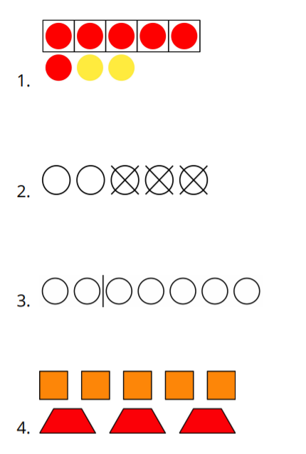

Which Expression?
Activity #2
Write an expression that represents each picture.

Slide 34
Lesson Synthesis
There were 6 students eating lunch. Then 2 more students came to join them. How many students are at lunch now?
How are the two stories the same?
How are they different?
There are 6 cats and 2 dogs in the park. How many animals are in the park altogether?

Slide 35
Counting to Add and Subtract
Adaptation
Lesson 5
Let’s solve story problems.
K.OA.A.2

Slide 36
Choral Counting
Warm up
Count by 1, starting at 10.
Notes:
Optional Warm UP Activity

Slide 37
Choral Counting
Warm up
Count by 1, starting at 20.
Notes:
Optional Warm UP Activity

Slide 38
Choral Counting
Warm up
Count by 1 backwards, starting at 20.
Notes:
Optional Warm UP Activity

Slide 39
Choral Counting
Warm up
Count to 40 starting at 10.
Notes:
Optional Warm UP Activity

Slide 40
Choral Counting
Warm up
What patterns do you see?
Notes:
Optional Warm UP Activity

Slide 41
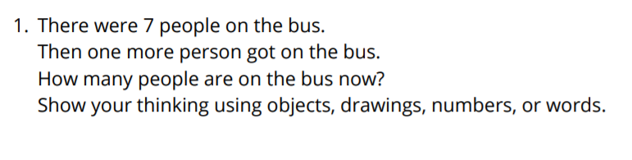

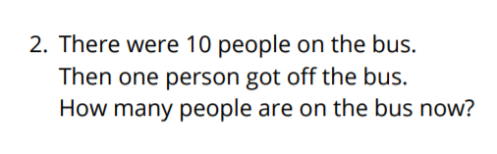
Riding the Bus
Activity #1

Slide 42
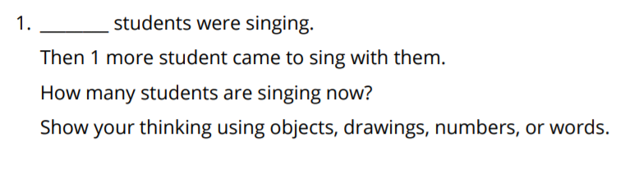


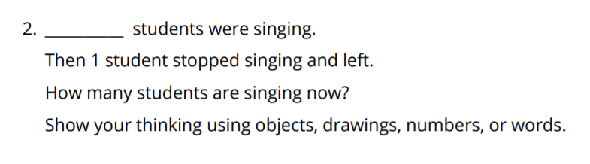
Singing Students
Activity #2

Slide 43
Lesson Synthesis
Today we told stories about one more person joining a group and one more person leaving a group.
When you take away 1 from a number, which number do you get?
When you take away 1 from a number, which number do you get?

Slide 44
Story Problems (Part 1)
1
Let’s make sense of and solve story problems.
1.OA.A.1, 1.OA.C.6, 1.OA.D.7

Slide 45

Number Talk: Adding 1 More
Warm up
Find the value of each expression mentally

Slide 46

Number Talk: Adding 1 More
Warm up
Find the value of each expression mentally

Slide 47

Number Talk: Adding 1 More
Warm up
Find the value of each expression mentally

Slide 48

Number Talk: Adding 1 More
Warm up
Find the value of each expression mentally

Slide 49
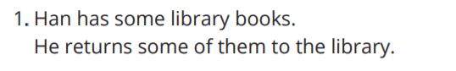

Library Books
Activity #1
What do you notice?
What do you wonder?

Slide 50
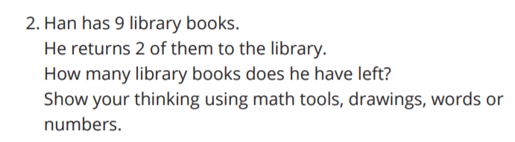
Library Books
Activity #1

Slide 51
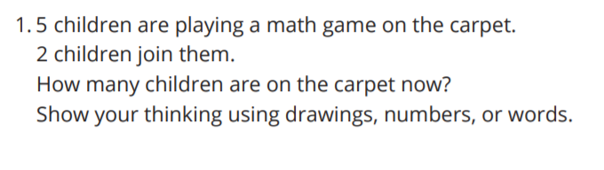

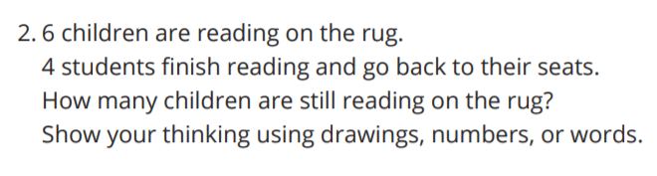

Story Problems about School
Activity #2

Slide 52
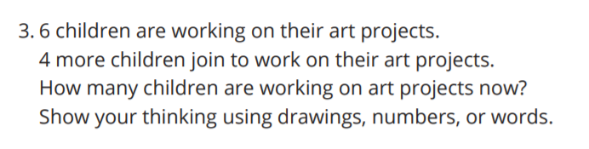

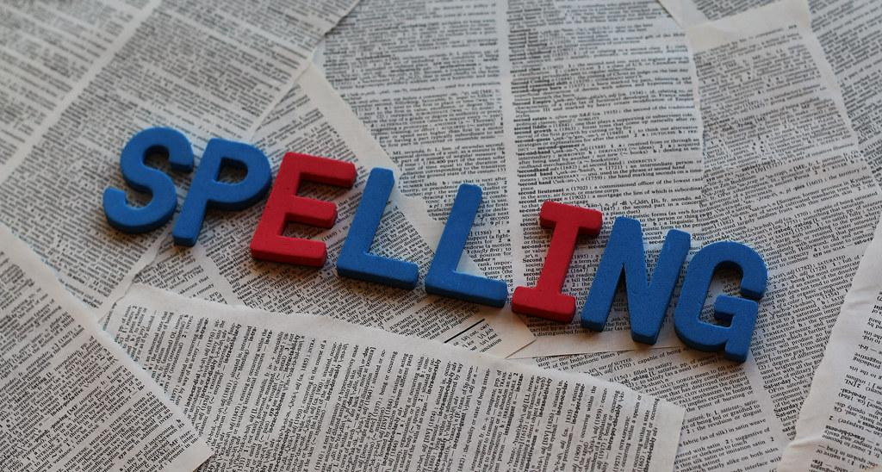
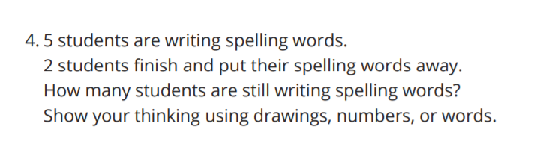
Story Problems about School
Activity #2

Slide 53

Lesson
Synthesis
For problem 1 we wrote the expression 5 + 2. We can write an equation that shows the answer by writing “ ”. The equation tells us that 5 plus 2 is the same amount as 7.
What does the 7 represent?
When we write an equation, we can draw a box around the number that shows the answer to the question.
That means the equation would be written as

Slide 54
Story Problems (Part 2)
2
Let’s solve story problems and write equations.
1.OA.A.1

Slide 55

Notice and Wonder: Children Sliding
Warm up
What do you notice?
What do you wonder?

Slide 56

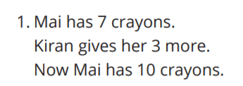
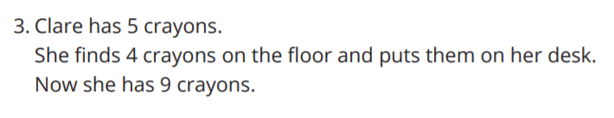
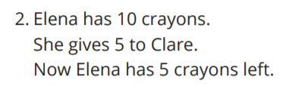
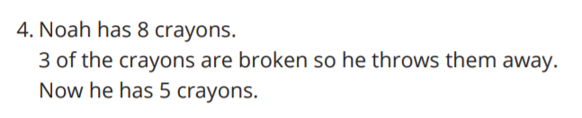
Writing Equations to Match Story Problems
Activity #1

Slide 57
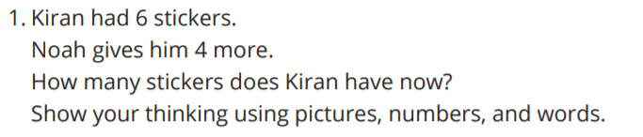

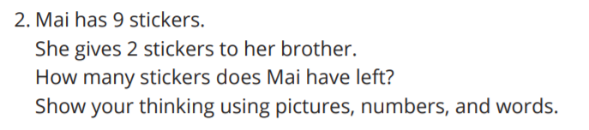
Solve Story Problems and Write Equations
Activity #2

Slide 58

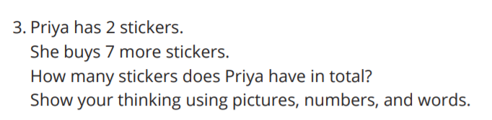
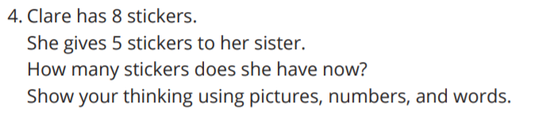
Solve Story Problems and Write Equations
Activity #2

Slide 59

Lesson
Synthesis
What do you notice?
What do you wonder?
How does this story problem connect to the equation:

Slide 60
A Change is Coming (Part 1)
3
Let’s write equations to match story problems.
1.OA.A.1

Slide 61
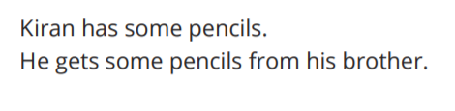

Notice and Wonder: Kiran’s Pencils
Warm up
What do you notice?
What do you wonder?

Slide 62
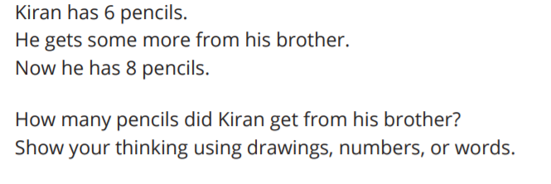
Kiran’s Pencils
Activity #1

Slide 63
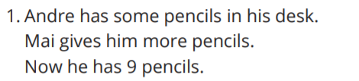

Lin Represents a Story Problem
Activity #2
What do you notice?
What do you wonder?

Slide 64

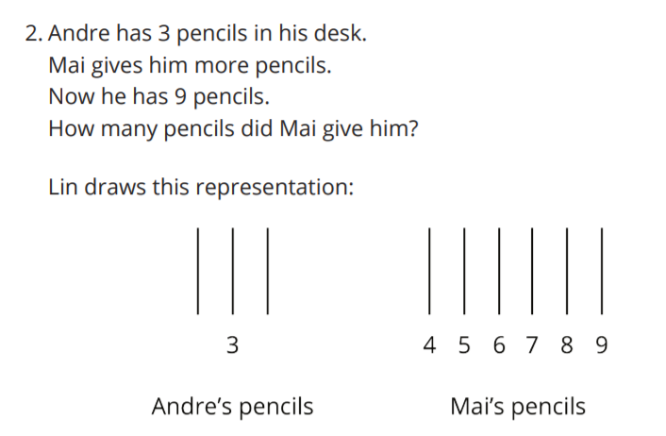
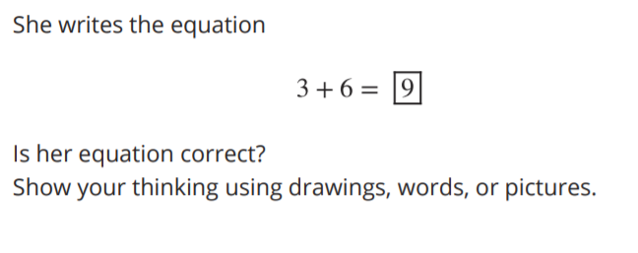
Lin Represents a Story Problem
Activity #2

Slide 65

Lesson Synthesis
How are these equations the same?
How are they different?

Slide 66
A Change is Coming (Part 2)
4
Let’s solve story problems and write equations to match.
1.OA.A.1, 1.OA.D.7

Slide 67

True or False: Equations with 10
Warm up
Is it true?
Is it false?
How do you know?
Notes:
Optional Warm UP Activity

Slide 68

True or False: Equations with 10
Warm up
Is it true?
Is it false?
How do you know?
Notes:
Optional Warm UP Activity

Slide 69

True or False: Equations with 10
Warm up
Is it true?
Is it false?
How do you know?
Notes:
Optional Warm UP Activity

Slide 70
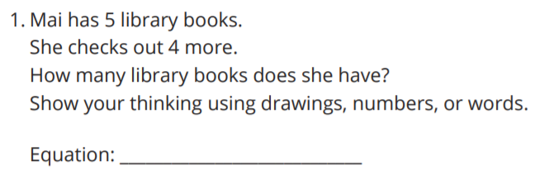

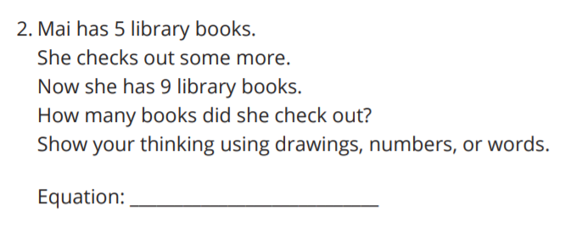
Story Problem Posters
Activity #1

Slide 71
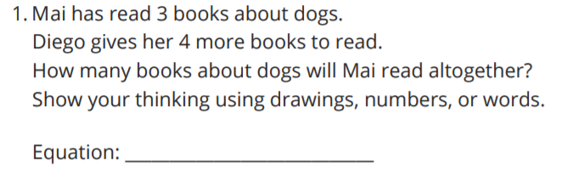


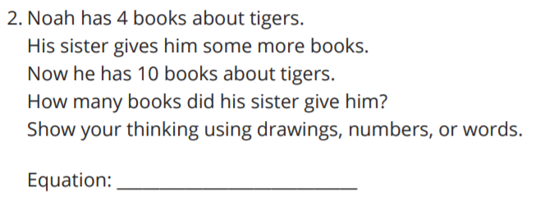
Story Problems about Books
Activity #2

Slide 72
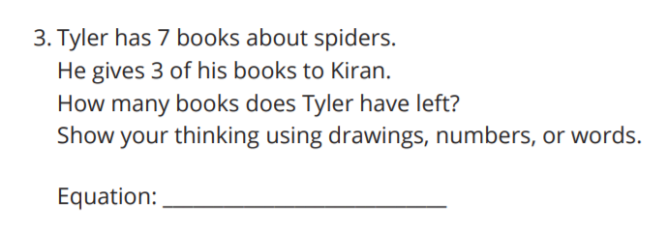

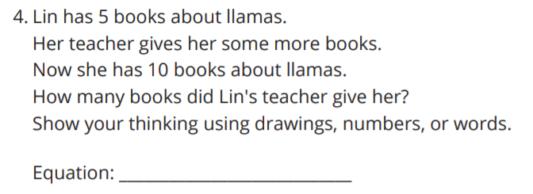

Story Problems about Books
Activity #2

Slide 73

Lesson Synthesis
How does this story problem connect to the equation?
What do you notice? What do you wonder?

Slide 74
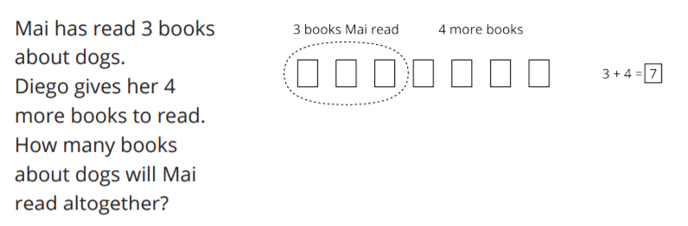
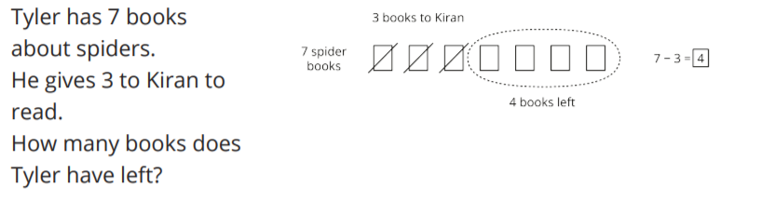
Lesson 4 Summary
We solved story problems and represented them with objects, drawings, words, and equations.
Addition Problems
Subtraction Problems

Slide 75
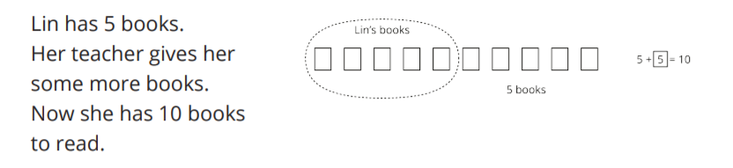
Lesson 4 Summary
We solved story problems where the change was unknown:
We learned that the equal sign means “the same amount as” and “equals”.

Slide 76

Center Day
5
Let’s play games to practice adding and subtracting.
1.OA.A.1, 1.OA.C.6

Slide 77

Notice and Wonder: Math Picture
Warm up
What do you notice?
What do you wonder?

Slide 78
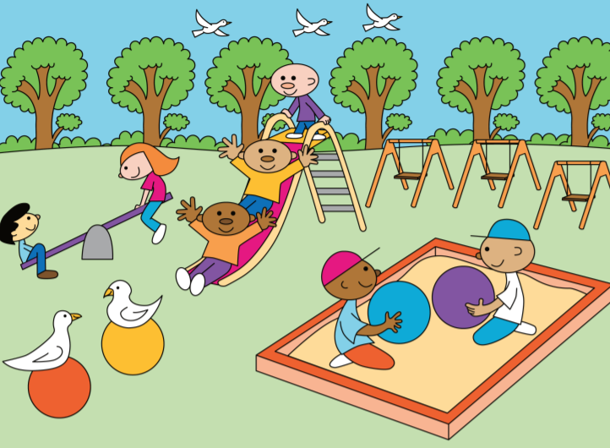
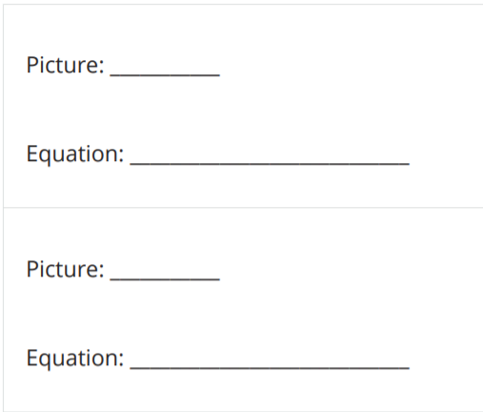
Centers: Introduce Math Stories, Add and Subtract
Activity #1

Slide 79


Centers: Choice Time: Add or Subtract within 10
Activity #2
Choose a center.
Bingo: Add or Subtract 1 or 2
Make the Number: Add or Subtract within 10

Slide 80
Today we chose activities to work on and worked with a partner during center time.
Lesson Synthesis
What went well? What can we continue to work on?
How did you and your partner work together during centers?

Slide 81
Story Problems about Pets
6
Let’s write equations to match story problems.
1.OA.A.1

Slide 82


Notice and Wonder: Kiran’s Fish
Warm up
What do you notice?
What do you wonder?

Slide 83



Three Reads: Kiran’s Fish
Activity #1

Slide 84



Tyler and Clare’s Pets
Activity #2

Slide 85

Lesson Synthesis
What does the 4 stand for in the story problem?
What does the 2 stand for in the story problem?
What does the 6 stand for in the story problem?

Slide 86
Shake and Spill
7
Let’s think about breaking numbers apart and putting them back together.
1.OA.A.1, 1.OA.C.6, 1.OA.D.7

Slide 87

How Many Do You See: Two-color Counters
Warm up
How many dots do you see?
How do you see them?

Slide 88

How Many Do You See: Two-color Counters
Warm up
How many dots do you see?
How do you see them?

Slide 89

How Many Do You See: Two-color Counters
Warm up
How many dots do you see?
How do you see them?

Slide 90




Introduce Shake and Spill, Represent
Activity #1

Slide 91


Introduce Shake and Spill, Represent
Activity #1

Slide 92

Shake and Spill Story Problems
Activity #2

Slide 93

Shake and Spill Story Problems
Activity #2

Slide 94




Are you ready for more?
Activity #2

Slide 95

For one round of Shake and Spill a student wrote these equations
Lesson Synthesis
How are they the same? How are they different?
How does each equation represent the game?

Slide 96
Shake, Spill, and Cover
8
Let’s solve a new kind of story problem.
1.OA.A.1, 1.OA.C.6

Slide 97

Number Talk: Changing Addends
Warm up
Find the value of each expression mentally

Slide 98

Number Talk: Changing Addends
Warm up
Find the value of each expression mentally

Slide 99

Number Talk: Changing Addends
Warm up
Find the value of each expression mentally

Slide 100

Number Talk: Changing Addends
Warm up
Find the value of each expression mentally

Slide 101



Introduce Shake, Spill, and Cover
Activity #1

Slide 102


Introduce Shake, Spill, and Cover
Activity #1

Slide 103


Shake, Spill, and Cover Problems
Activity #2

Slide 104


Shake, Spill, and Cover Problems
Activity #2

Slide 105

Lesson Synthesis
Find the value that makes the equation true? Show how you know
How does this equation relate back to a round of Shake, Spill, and Cover?
When we know one of the addends in an equation, we can find the other by thinking about it how many more equals the total.

Slide 106
Comparing Story Problems
9
Let’s solve story problems and write equations.
1.OA.A.1, 1.OA.B.3, 1.OA.D.7

Slide 107

Number Talk: Addition and Subtraction Expressions
Warm up
Find the value of each expression mentally

Slide 108

Number Talk: Addition and Subtraction Expressions
Warm up
Find the value of each expression mentally

Slide 109

Number Talk: Addition and Subtraction Expressions
Warm up
Find the value of each expression mentally

Slide 110

Number Talk: Addition and Subtraction Expressions
Warm up
Find the value of each expression mentally

Slide 111




Solve and Represent Story Problems
Activity #1

Slide 112

Solve and Represent Story Problems
Activity #1

Slide 113
Gallery Walk: Compare Story Problems
Activity #2
As you look at your classmate’s work, think about the questions and be prepared to share your answers.
What is the same about the story problems and representations?
What is different about the story problems and representations?
Explain how the equation matches the story problem.

Slide 114

Lesson Synthesis
Could this equation represent the problem? Why or why not?

Slide 115




Section Summary
In this section, we solved story problems.
We solved story problems where the total was unknown.
We solved story problems where both parts were unknown.

Slide 116



Section Summary
We solved problems where the second part was unknown. We learned you can add or subtract to solve these problems.
We learned that the total can come before or after the equal sign.
We learned that numbers can be added in any order.

Slide 117
Center Day 2
10
Let’s play games to practice adding and subtracting.
1.OA.A.1, 1.OA.C.6

Slide 118

Number Talk: Subtraction Methods
Warm up
Find the value of each expression mentally

Slide 119

Number Talk: Subtraction Methods
Warm up
Find the value of each expression mentally

Slide 120

Number Talk: Subtraction Methods
Warm up
Find the value of each expression mentally

Slide 121

Number Talk: Subtraction Methods
Warm up
Find the value of each expression mentally

Slide 122


Introduce What’s Behind My Back, Up to 10 Cubes
Activity #1

Slide 123



Choice Time
Activity #2
Math Stories Shake and Spill What's Behind My Back

Slide 124
Today we chose activities to work on and worked with a partner during center time.
Lesson Synthesis
How did you and your partner work together during centers? What went well? What can we continue to work on?

Slide 125
Make Them The Same
11
Let’s solve story problems.
1.OA.A.1

Slide 126

Notice and Wonder: Cube Towers
Warm up
What do you notice?
What do you wonder?

Slide 127

Cube Towers
Activity #1
How can Diego and Jada make their towers have the same number of cubes? Show your thinking using objects, drawings, numbers, or words.

Slide 128

Cube Towers
Activity #1
How can Diego and Jada make their towers have the same number of cubes? Show your thinking using objects, drawings, numbers, or words.

Slide 129

Cube Towers
Activity #1
How can Diego and Jada make their towers have the same number of cubes? Show your thinking using objects, drawings, numbers, or words.

Slide 130




Solving Cube Tower Problems
Activity #2

Slide 131



Are you ready for more:
Activity #2

Slide 132
You can make the towers the same by adding more cubes to the smaller tower or taking cubes from the larger tower.
Lesson Synthesis
How does adding more cubes relate to addition?

Slide 133
At the Step Show
12
Let’s solve story problems.
1.OA.A.1, 1.OA.C.5

Slide 134

Notice and Wonder: Step Show
Warm up
What do you notice?
What do you wonder?

Slide 135

At the Step Show
Activity #1

Slide 136



Solving Comparison Problems
Activity #2

Slide 137

Solving Comparison Problems
Activity #2

Slide 138
Today we solved a new kind of story problem. How were these problems the same as ones you solved in the past?
Lesson Synthesis
How are they different?

Slide 139
Compare Favorite Meal Data
13
Let’s compare data.
1.MD.C.4, 1.OA.A.1

Slide 140

Notice and Wonder: More and Fewer
Warm up
What do you notice?
What do you wonder?

Slide 141



Compare Data (Part 1)
Activity #1
A group of students was asked, “What is your favorite meal?” Their responses are shown in this chart.

Slide 142


Compare Data (Part 1)
Activity #1
A group of students was asked, “What is your favorite meal?” Their responses are shown in this chart.

Slide 143

Compare Data (Part 1)
Activity #1
A group of students was asked, “What is your favorite meal?” Their responses are shown in this chart.

Slide 144

Are you ready for more:
Activity #1

Slide 145


Compare Data (Part 2)
Activity #2
A group of students was asked, “What is your favorite meal?” Their responses are shown in this chart.

Slide 146

Compare Data (Part 2)
Activity #2
A group of students was asked, “What is your favorite meal?” Their responses are shown in this chart.

Slide 147

Compare Data (Part 2)
Activity #2
A group of students was asked, “What is your favorite meal?” Their responses are shown in this chart.

Slide 148

Compare Data (Part 2)
Activity #2
A group of students was asked, “What is your favorite meal?” Their responses are shown in this chart.

Slide 149
Lesson Synthesis
What equations can we write to represent the problem?
Which number represents the difference?

Slide 150
Compare with Addition and Subtraction
14
Let’s solve story problems and match them to addition and subtraction equations.
1.OA.A.1, 1.OA.C.5, 1.OA.D.7

Slide 151

True or False: Equal Sign
Warm up
Is it true?
Is it false?
How do you know?

Slide 152

True or False: Equal Sign
Warm up
Is it true?
Is it false?
How do you know?

Slide 153

True or False: Equal Sign
Warm up
Is it true?
Is it false?
How do you know?

Slide 154



Is It Addition or Subtraction?
Activity #1

Slide 155



Which Equation?
Activity #2

Slide 156



Which Equation?
Activity #2

Slide 157



Which Equation?
Activity #2

Slide 158

Lesson Synthesis
Why does the position of the boxed number change?
What does each number represent?

Slide 159
Story Problems About Students
15
Let’s solve story problems and write an equation to match each one.
1.OA.A.1, 1.OA.C.6

Slide 160

Which One Doesn’t Belong: Equations
Warm up

Slide 161

What Questions Can We Ask?
Activity #1
What mathematical questions can you ask about this image?

Slide 162



Solving Story Problems About Students
Activity #2

Slide 163

Solving Story Problems About Students
Activity #2

Slide 164

Solving Story Problems About Students
Activity #2

Slide 165



Solving Story Problems About Students
Activity #2

Slide 166

Lesson Synthesis
Tell a story about the equations.

Slide 167

Section Summary
We answered questions about “how many more” and “how many fewer” in story problems.
We wrote equations and put a box around the answer the the question.

Slide 168
Center Day 3 (Optional)
16
Let’s play games to practice adding and subtracting.
1.OA.A.1, 1.OA.C.6

Slide 169

Number Talk: Subtraction
Warm up
Find the value of each expression mentally

Slide 170

Number Talk: Subtraction Methods
Warm up
Find the value of each expression mentally

Slide 171

Number Talk: Subtraction Methods
Warm up
Find the value of each expression mentally

Slide 172

Number Talk: Subtraction Methods
Warm up
Find the value of each expression mentally

Slide 173
Choice Time
Activity #2
Math Stories Shake and Spill What's Behind My Back

Slide 174
Today we chose activities to work on and worked with a partner during center time
Lesson Synthesis
“How did you and your partner work together during centers? What went well? What can we continue to work on?

Slide 175
Sort Story Problems
17
Let’s solve story problems and write equations.
1.OA.A.1, 1.OA.C.6, 1.OA.D.7

Slide 176

Which One Doesn’t Belong: Equations
Warm up

Slide 177

Comparing Recess Stories
Activity #1

Slide 178

Comparing Recess Stories
Activity #1

Slide 179
Solve a Recess Story Problem
Activity #2
Read your problem with your partner. Then solve the problem on your own. Show your thinking with drawings, numbers, or words. Write an equation to represent the story problem.
Work with your group to agree on the answer to the story problem and make a display of your work. If you showed your thinking in different ways, include them all on the poster

Slide 180


Lesson Synthesis
How do each of these equations represent the problem?

Slide 181
Introduce Equations with Unknowns
18
Let’s make sense of equations with boxes.
1.OA.A.1, 1.OA.D.8

Slide 182

Interpreting Equations with Unknowns
Warm up
What do you notice?
What do you wonder?

Slide 183




Which Equation?
Activity #1

Slide 184
Lesson Synthesis
Today, we saw that for some story problems, there are addition and subtraction equations that can represent the problem.
Which kind of equation do you prefer to write? Why?

Slide 185
Story Problems and Equations
19
Let’s write more than 1 equation to match story problems
1.OA.A.1

Slide 186

Which One Doesn’t Belong: More Equations
Warm up

Slide 187


Write More Than 1 Equation
Activity #1

Slide 188

Write More Than 1 Equation
Activity #1

Slide 189

Write More Than 1 Equation
Activity #1

Slide 190

Write More Than 1 Equation
Activity #1

Slide 191





Questionless Word Problems
Activity #2

Slide 192



Questionless Word Problems
Activity #2

Slide 193

Lesson Synthesis
How is the first equation the same as the second equation? How is it different?

Slide 194
What’s the Story?
20
Let’s write story problems to match equations.
1.OA.A.1, 1.OA.C.6

Slide 195

How Many Do You See: Ten-Frames
Warm up
How many do you see?
How do you see them?

Slide 196

How Many Do You See: Ten-Frames
Warm up
How many do you see?
How do you see them?

Slide 197

How Many Do You See: Ten-Frames
Warm up
How many do you see?
How do you see them?

Slide 198

How Many Do You See: Ten-Frames
Warm up
How many do you see?
How do you see them?

Slide 199





Let’s Write Story Problems (Part 1)
Activity #1

Slide 200




Let’s Write Story Problems (Part 2)
Activity #2

Slide 201
Lesson Synthesis
Which equations represent this story problem?
What is an equation with an unknown value that represents this story problem?

Slide 202




Section Summary
We learned about equations where a number is missing and related them to story problems.
We thought about how addition and subtraction are related by solving story problems.

Slide 203
Center Day 4 (Optional)
21
Let’s play games to practice adding and subtracting.
1.OA.C.6, 1.OA.D.8

Slide 204

Number Talk: Missing Values
Warm up
Find the value of each expression mentally

Slide 205

Number Talk: Subtraction Methods
Warm up
Find the value of each expression mentally

Slide 206

Number Talk: Subtraction Methods
Warm up
Find the value of each expression mentally

Slide 207

Number Talk: Subtraction Methods
Warm up
Find the value of each expression mentally

Slide 208


Centers: Introduce Capture Squares, Add Within 10
Activity #2

Slide 209
Today we learned two new games that we can play during center time.
Lesson Synthesis
How did you and your partner work together during centers? What went well? What can we continue to work on?

Slide 210
Story Problems and Equations
22
Let’s write our own equations.
1.OA.A, 1.OA.B.4

Slide 211

Notice and Wonder: Equations
Warm up
What do you notice?
What do you wonder?

Slide 212


Revisit Data
Activity #1

Slide 213


Questions and Answers
Activity #2

Slide 214
Lesson Synthesis
Today we used the equations we’ve been studying to investigate our survey results again. That is an important thing that mathematicians and scientists do. When they learn new tools for investigating, they often go back to something they studied in the past to try to learn more from it.
What new thing did you learn from this data that you had not realized the first time?

