Slide 1

Adding, Subtracting & Working with Data
Grade 1: Unit 1
Standards addressed: MD.C.4, OA.A.1, OA.C.5, OA.C.6
These slides have been created by Plainville Community Schools and are not official IM materials. Images and language are taken from IM Grade 1, Unit 1 by Illustrative Mathematics.
Copyright 2020 by Illustrative Mathematics. All Rights Reserved, adapted and shared with permission.

Slide 2
Unit 1 Progression Overview
Adding, Subtracting & Working with Data
Section A
Lessons 1-6
OA.C.5, .OA.C.6
Section B
Lessons 7-10
MD.C.4
Section C
Lessons 11 - 15
MD.C.4, OA.C.6
Build toward fluency by adding and subtracting within 10, in a way that makes sense to them.
Organize and represent data.
Interpret data representations to ask and answer questions.

Slide 3

Unit 1 Quick Links
Adapt 1
L1
L2
L3
L4
L5
L6
Adapt 2
L7
L8
L9
L10
Adapt 3
Adapt 4
L11
L12
L13
L14
L15

Slide 4
Addition and Subtraction Expressions within 5
Adaptation
Lesson 1
Let’s add and subtract within 5
K.OA.A.5, K.OA.A.2

Slide 5
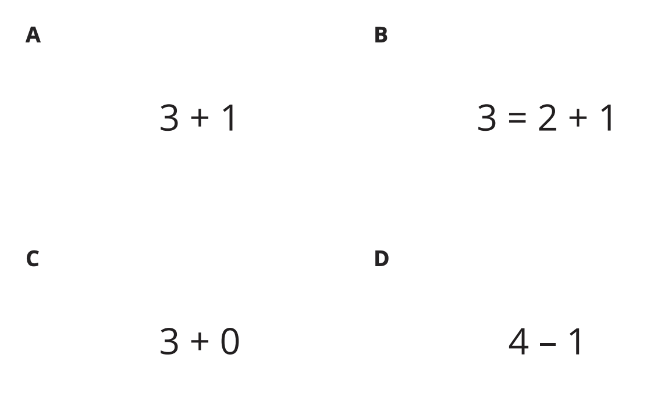
Which One Doesn’t Belong?
Warm up

Slide 6
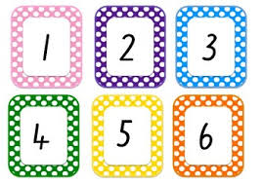
Four Corners: Totals and Differences
Activity #1
Find the value of the expression on your card. Go to the corner that is labeled with the value of the expression.
Find a partner in your corner. Show them your card and tell them how you found the value of your expression.
Walk back to the center of the room. Trade your card with a partner. Repeat.
3-1
Noah saw this expression and went to the corner labelled 4. Was he correct? How do you know?
Why do you think he went to the corner labelled 4?

Slide 7
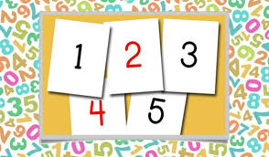
Compare Expressions
Activity #2
You and your partner will both flip over a card. Look at both expressions.
If your expression shows the number that is more, say ‘Me!’ and then explain to your partner how you know. If both expressions show the same number, say ‘Same!’
2 + 0
4 + 1
Which expression shows a number that is more?
4 - 2
2 + 0
Tell your partner about these expressions using ‘less’ or ‘the same number as.’

Slide 8
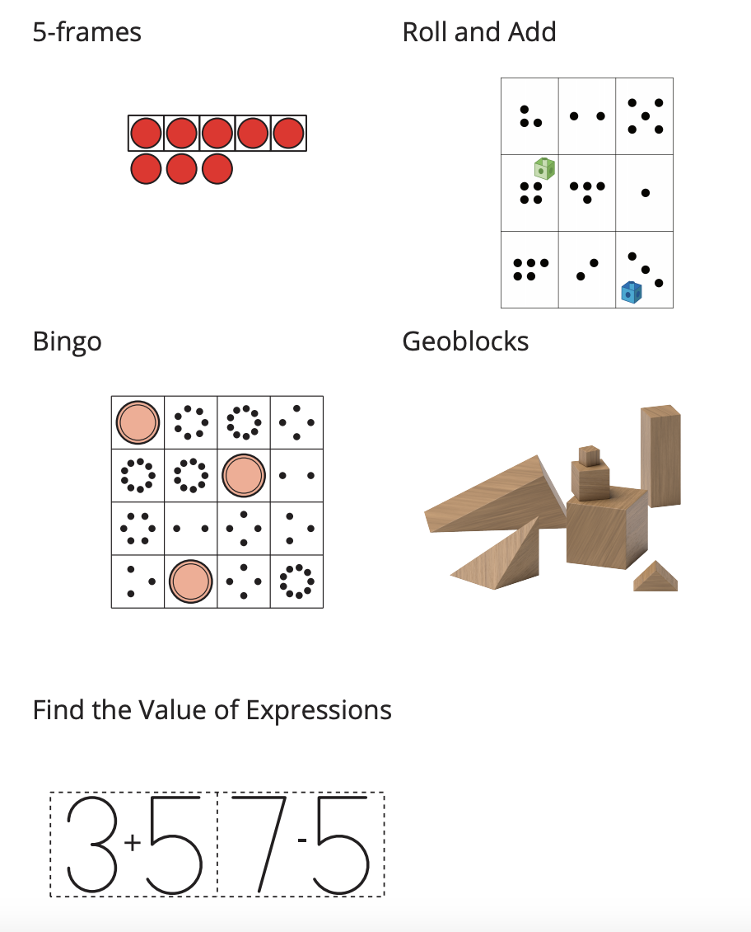
Center Choice Time
Activity #3
Tell your partner about a time when you used a math tool to help you during centers. How did the tool help you?

Slide 9

Today we found the value of expressions and compared expressions.
I’m going to say and write a number or expression. Your job is to work together to get into groups of
the correct number. If you can’t find a group, stand in the middle of the carpet. If you need another
person in your group, find someone in the middle of the carpet.
Lesson Synthesis

Slide 10
Count and Add
1
Let’s count objects.
OA.C.6

Slide 11

What Do You Know About Math?
Warm up

Slide 12
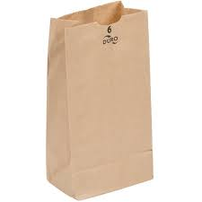
Revisit Counting Collections, Up to 20
Activity #1
How many objects are in your collection? Can you prove it? Can you draw a picture to show how you counted?.
How did you keep track of the objects as you counted?

Slide 13
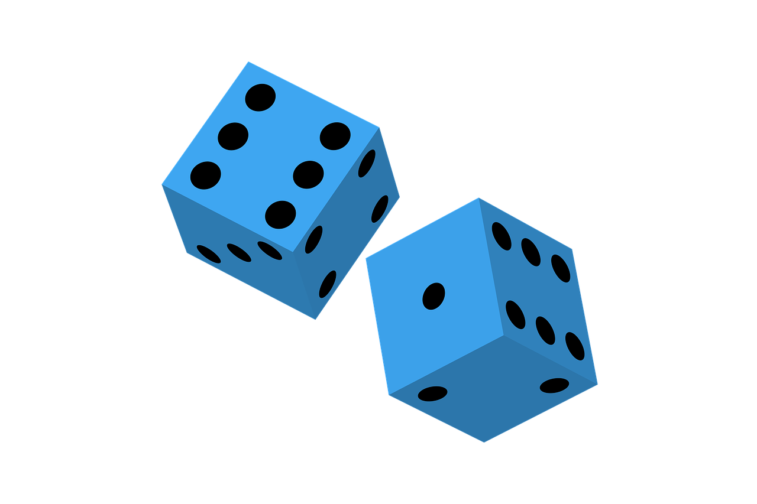
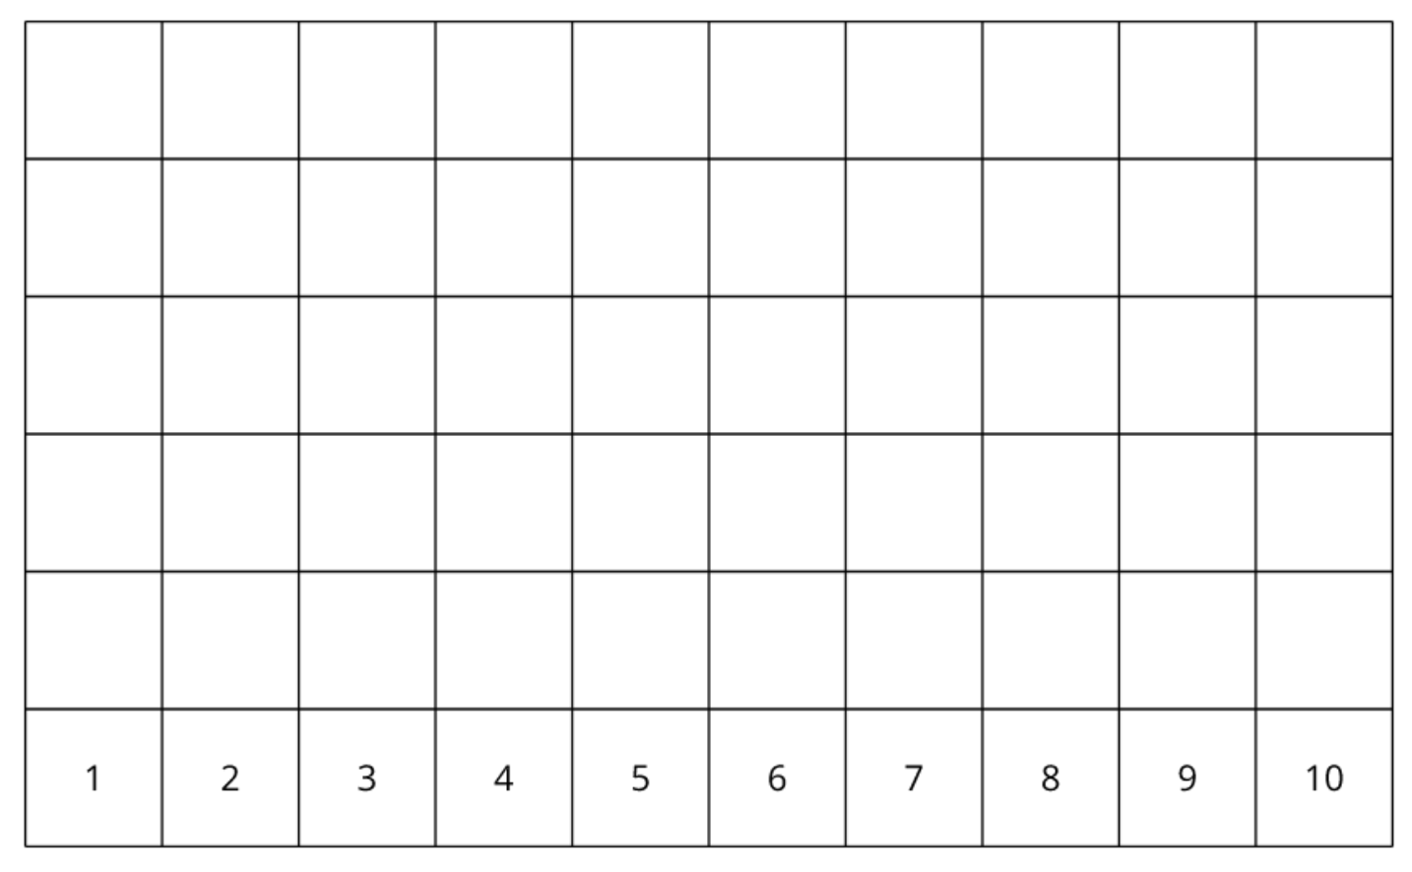
Introduce Number Race, Add to 10
Activity #2
Take turns with your partner. During each turn, roll the dot cubes, find the total number of dots, and show your partner how you know. When you agree, record the total above the number on the game board. If the total is more than 10, roll the cubes again.”

Slide 14




Introduce Number Race, Add to 10
Activity #2

Slide 15
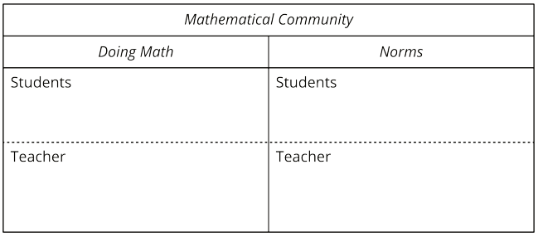
Today we counted math tools and played a math game. We are going to make a chart of what you do and what I do in our mathematical community.
Lesson
Synthesis
What does it look like and sound like to do math together?

Slide 16
Explore Expressions and Sums
2
Let’s write addition expressions and find the sums of two numbers.
OA.C.5, OA.C.6

Slide 17
Choral Count
Warm up
Count by 1, starting at 0.
Does anyone want to add an observation on why that pattern is happening here?
Do you agree or disagree? Why?

Slide 18
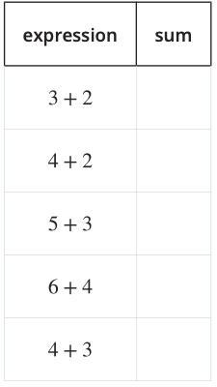
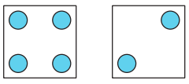
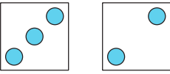
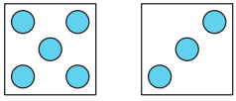
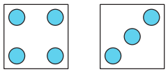
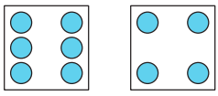
Matching Dot Cards and Expressions
Activity #1

Slide 19
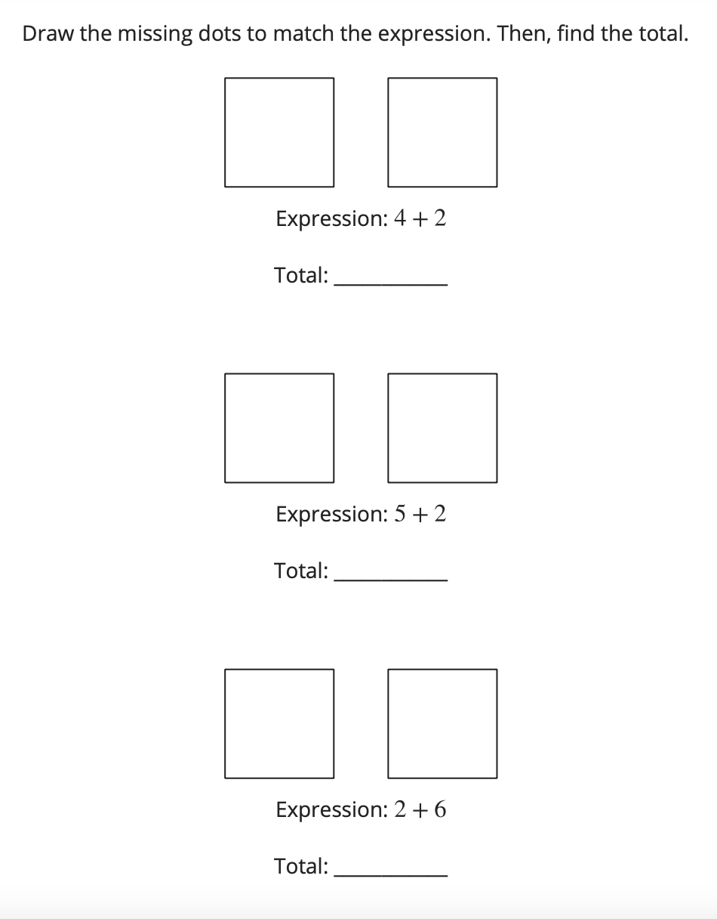
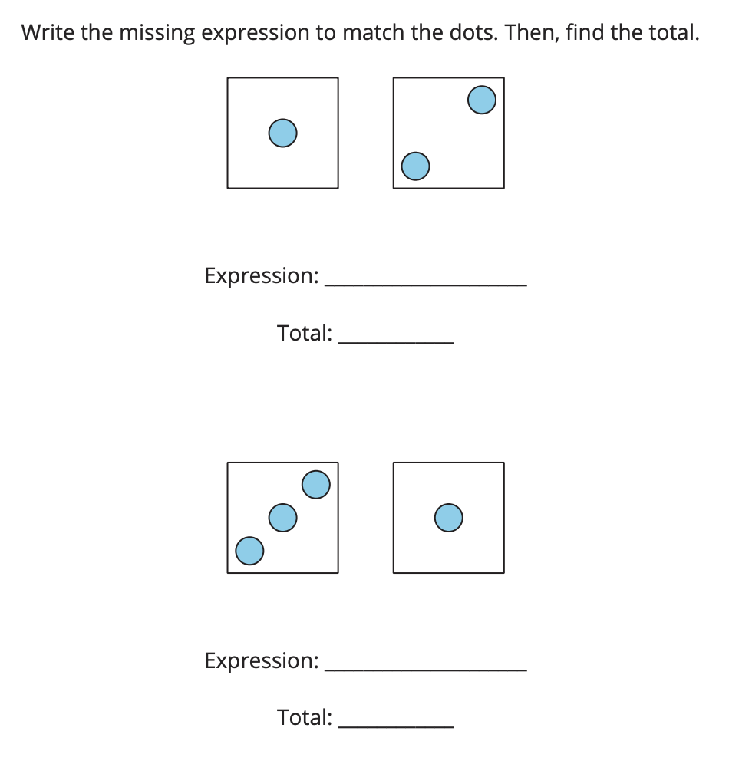
Matching Dot Cards and Expressions
Activity #1
Continued
How did you know which expression matched each set of dots?

Slide 20
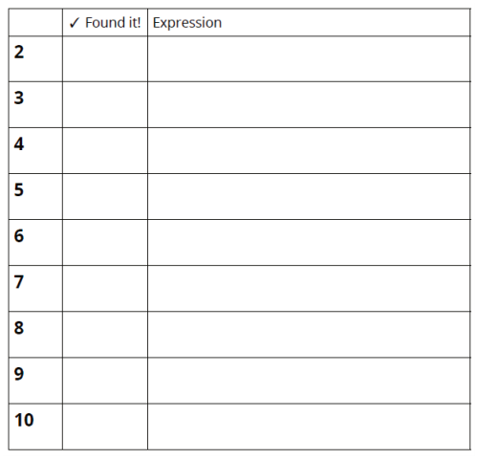
Introduce Check It Off; Add within 10
Activity #2
First we take out all of the cards greater than five. We will not use those cards in this game.
Now I am going to pick two number cards and find the sum of the numbers. The sum is the total when adding two or more numbers.
Now I check off the sum. What addition expression represents the sum of the numbers?
I record the expression on my recording sheet next to the sum. Now it’s my partner’s turn.

Slide 21
Introduce Check It Off; Add within 10
Activity #2
4
3
How can we find the sum of these two numbers?
What addition expression can we write to represent the sum of these numbers?

Slide 22
Today we wrote addition expressions and found the sum. Let’s revisit our mathematical community chart and add to “doing math”.
Lesson
Synthesis

Slide 23
Add 1 or 2
3
Let’s add 1 or 2.
OA.C.5, OA.C.6

Slide 24

How Many Do You See?
Warm up

Slide 25

How Many Do You See?
Warm up

Slide 26

How Many Do You See?
Warm up

Slide 27

How Many Do You See?
Warm up
How do you know how many dots there are in all?

Slide 28
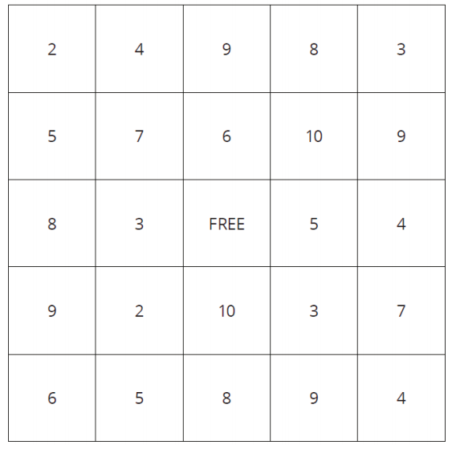
Introduce 5 in a Row: Addition and Subtraction; Add 1 or 2
Activity #1
First we need to remove any card with the number 10 on it. We will not use these cards in this game.
Now I’m going to flip over a card and decide if I want to add 1 or 2 to the number.
I got a _____ and I’m going to choose to add 2 to my number. What is the sum?
Now I put a counter on the sum on the game board. Then it is my partner’s turn.

Slide 29
Introduce 5 in a Row: Addition and Subtraction; Add 1 or 2
Activity #1
This is my game board. I just drew the number 6. Should I add 1 or 2 to the number 6? Why?

Slide 30
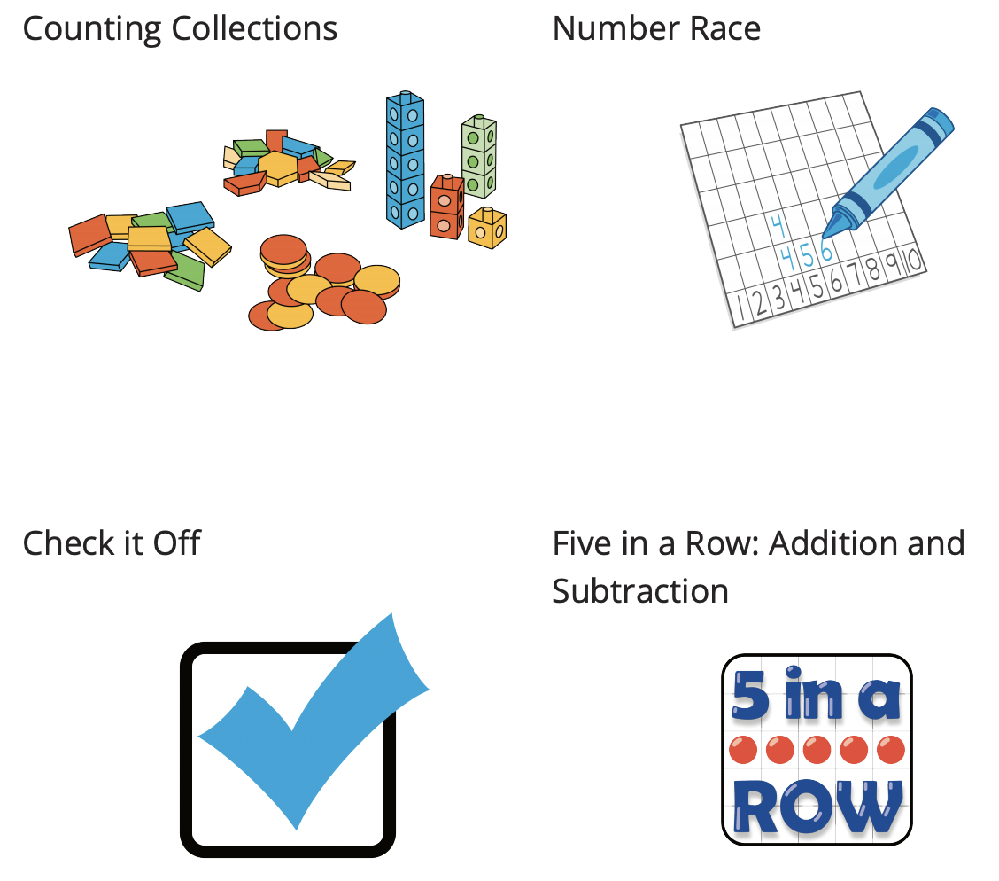
Center Choice Time
Activity #3
How did you and your partner work well together during centers today?

Slide 31
Today we added 1 or 2 more. Let’s take a look at our mathematical community poster.
Lesson Synthesis
Is there anything else we should add?
Which of these did you do today? How did they help you?

Slide 32
More Work with 1 and 2
4
Let’s subtract 1 or 2.
OA.C.5, OA.C.6

Slide 33
Number Talk
Warm up
6 + 1

Slide 34
Number Talk
Warm up
6 + 2

Slide 35
Number Talk
Warm up
8 + 1

Slide 36
Number Talk
Warm up
8 + 2

Slide 37
Number Talk
Synthesis
8 + 1
8 + 2
How are problems 3 and 4 the same? How are they different?

Slide 38
Introduce 5 in a Row: Addition and Subtraction; Subtract 1 or 2
Activity #1
We are going to learn a new way to play 5 in a Row.

Slide 39
Introduce 5 in a Row: Addition and Subtraction; Subtract 1 or 2
Activity #1
Now I’m going to flip over a card and decide if I want to subtract 1 or 2 to the number.
I got a _____ and I’m going to choose to subtract 1 to my number. What is the difference?
Now I put a counter on the difference on the game board. Then it is my partner’s turn.

Slide 40
Introduce 5 in a Row: Addition and Subtraction; Subtract 1 or 2
Activity #1
I have the number 8 and I want to subtract 2. How can I do it?

Slide 41
Center Choice Time
Activity #3
What was your favorite part of center time today? Why was it your favorite?

Slide 42
Today we subtracted 1 or 2. Let’s take a look at our mathematical community poster.
Lesson Synthesis

Slide 43
Explore Addition and Subtraction
5
Let’s add and subtract.
OA.C.5, OA.C.6

Slide 44
Number Talk
Warm up
6 - 1

Slide 45
Number Talk
Warm up
6 - 2

Slide 46
Number Talk
Warm up
8 - 1

Slide 47
Number Talk
Warm up
8 - 2
How are problems 3 and 4 the same? How are they different?

Slide 48
Introduce Check It Off; Subtract within 10
Activity #1
We are going to learn a new way to play Check it Off. This time, instead of adding to find each number on the recording sheet, you will subtract.
Now I find the difference between the two numbers. The difference is the result when one number is subtracted from another. What is the difference between these two numbers? How do you know?
After you check off the number, write a subtraction expression to show the difference.
Continue taking turns with your partner. The person who checks off the most numbers wins.”

Slide 49
Introduce Check It Off; Subtract within 10
Activity #2
7
3
How can we find the difference of these two numbers?
What subtraction expression can we write to represent the difference of these numbers?

Slide 50
Center Choice Time
Activity #3
What is something you have gotten better at from playing these games?

Slide 51
Today we worked on subtracting. Let’s take a look at our mathematical community poster. We are going to make a list of norms for how we do math together.
Lesson Synthesis

Slide 52
Center Day 1
6
Let’s play games to practice adding and subtracting.
OA.C.5, OA.C.6

Slide 53
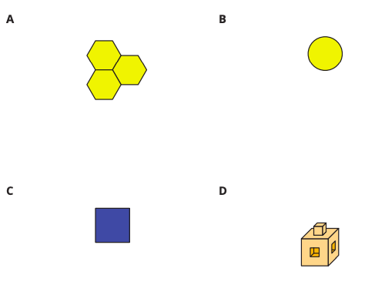
Which One Doesn’t Belong?
Warm up

Slide 54
Revist Find the Pair; Make 10
Activity #1
Each person gets five cards to start.
When it is your turn, you ask your partner for a number that makes 10 when added to a number on one of your cards.
If your partner has the number you asked for, they give you the card. Then you put those two cards down and fill in the equation showing the numbers that make 10.
If your partner doesn’t have the number you asked for, pick up one card from the pile.
Continue playing until one player runs out of cards. The player with the most pairs wins.

Slide 55
Revist Find the Pair; Make 10
Activity #1
3
This is my last card. How can I figure out what number to ask my partner for?

Slide 56
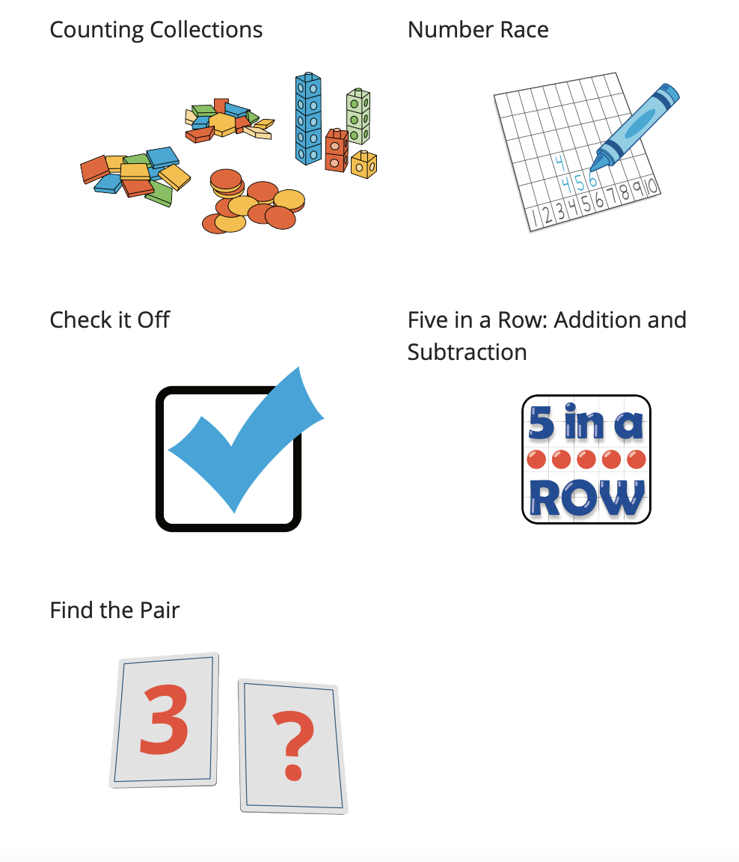
Centers: Choice Time
Activity #2
We have been playing a lot of games to help us build fluency with addition and subtraction within 10.
How can you continue working on addition and subtraction at home?

Slide 57
Today, we worked in centers to practice adding and subtracting. Let’s look at our math community poster.
Lesson Synthesis
What norms were we mindful of as we did math today?

Slide 58
Sort and Count Objects
Adaptation
Lesson 2
Let’s sort objects in different ways.
K.CC.B.5, K.MD.B.3

Slide 59
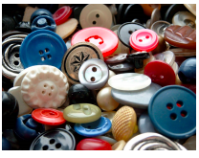
Notice and Wonder
Warm up

Slide 60
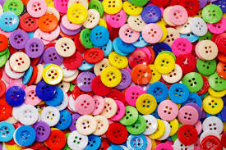
Sorting by Shape
Activity #1
Sort the buttons by shape.
Show how many buttons are in each category.

Slide 61
Sorting in Different Ways
Activity #2
1. Represent the number of buttons in
each category.
How many buttons do you have altogether?
2. Represent the number of buttons in
each category.
How many buttons do you have altogether?

Slide 62
Today we sorted buttons in different ways. Tell your partner something you learned about sorting,
counting, or representing a set of objects.
Lesson Synthesis

Slide 63
Sort Math Tools
7
Let’s sort objects and describe how many.
MD.C.4

Slide 64
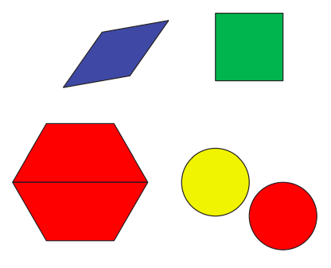
Notice and Wonder
Warm up
What do you notice? What do you wonder?
How are the shapes alike? How are they different?

Slide 65



Sorting Objects
Activity #1
Sort your math tools.
Use the tables if they are helpful.
Are there any words or phrases that are important to include on our display?

Slide 66


How Did They Sort?
Activity #1
Now you’re going to walk around to other tables to look at how other students sorted their tools.
How did they sort their math tools?
How many objects are in each category?
What are some different ways you saw the math tools sorted?

Slide 67
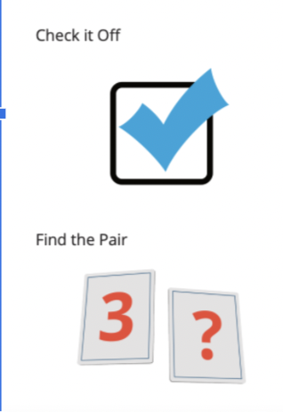
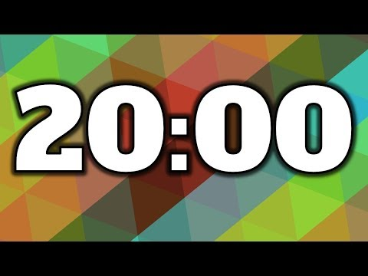
Centers: Choice Time
Activity #2
How was the center activity you chose helpful for your today?

Slide 68
Today, we sorted groups of objects and described our sorts. Let’s look at the words we collected today during your discussions.
Lesson Synthesis
Are there any words or phrases that are important to include on our display?

Slide 69
Count and Sort Shape Cards
8
Let’s sort shapes and show how many.
MD.C.4

Slide 70
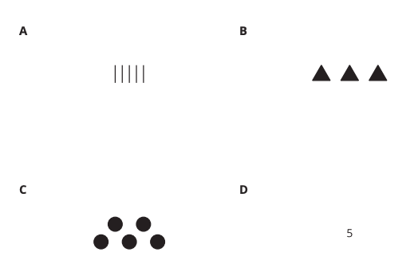
Which One Doesn’t Belong?
Warm up
Which representation is easiest for you to see how many? Why?

Slide 71
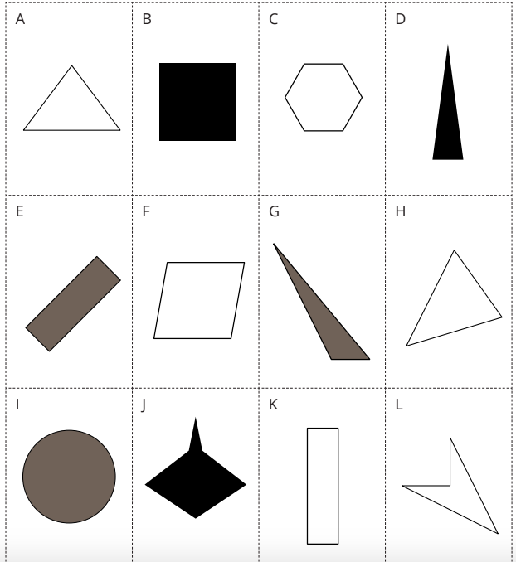
Sort Shape Cards
Activity #1
How did this group sort their shapes? How many shapes are in each category?

Slide 72
Show How You Sorted
Activity #2
Show how you sorted the shape cards.
Be sure that someone else who looks at your paper can see how many shapes are in each category.
Complete the sentences:
The first category has ______ shapes.
The second category has ______ shapes.
The third category has _______ shapes.
There are ______ shapes all together.

Slide 73
Shape Sort: Gallery Walk
Activity #3
With your partner, look at each representation. Discuss
How each group sorted their shapes?
How many shapes are in each category? How do you know?
How did this group sort their shapes? How many are in each category? How do you know?

Slide 74
Today we saw different ways to show our sorts and talked about how we can make sure they are easy for others to understand.
Lesson Synthesis
Tell your partner one thing you would change to make your representation easier for others to understand.

Slide 75
What’s Your Favorite ________?
9
Let’s collect, organize and show data.
1.MD.C.4, 1.OA.C.5

Slide 76
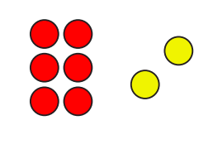
How Many Do You See?
Warm up
How many do you see? How do you see them?

Slide 77
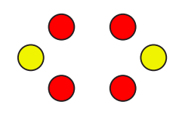
How Many Do You See?
Warm up
How many do you see? How do you see them?

Slide 78
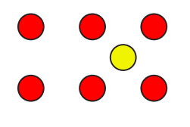
How Many Do You See?
Warm up
How many do you see? How do you see them?
Did you see the same number in a different way?

Slide 79
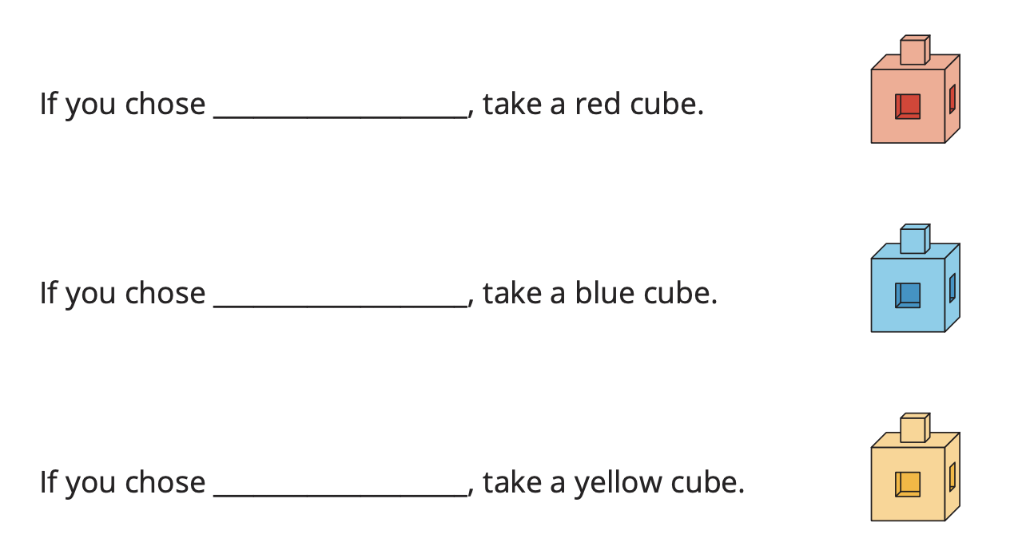
A Class Survey
Activity #1
Today we are going to take a survey. A survey is a way to collect information about a group of people's answers to the same question. The information we collect about the things or people in the group is called data.
Let’s take a survey and collect data about our favorite _____.
What do you notice about the data we collected?
What could we do to organize the data?
How does organizing the cubes help us show the data from our class survey?

Slide 80
Show Our Class Data
Activity #2
Show the survey data about our class’s favorite __________ data on paper.

Slide 81
Different Ways to Show the Data
Activity #3
“With your partner, find a group of 2 that represented the data in a different way than you. One person from each group switches papers with a partner from the other group. With your partner, talk about what you notice is the same about each representation and what you notice is different.”
What’s the same about these representations? What is different?

Slide 82
Today we say that there are different ways to show our data on paper.
Lesson Synthesis
What are some things you should remember when doing this?

Slide 83
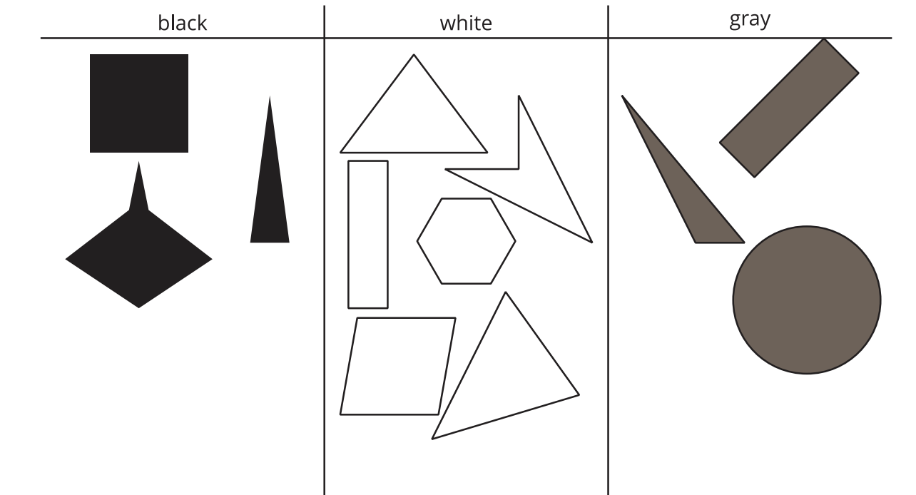
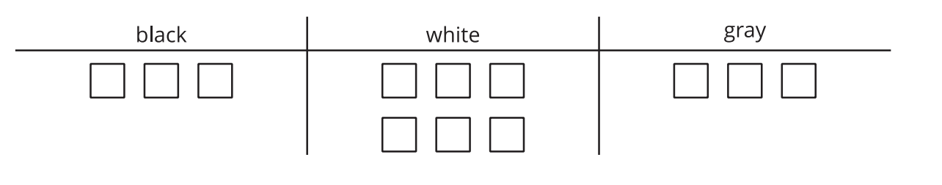
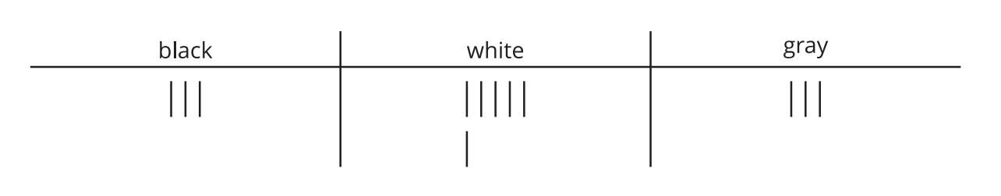
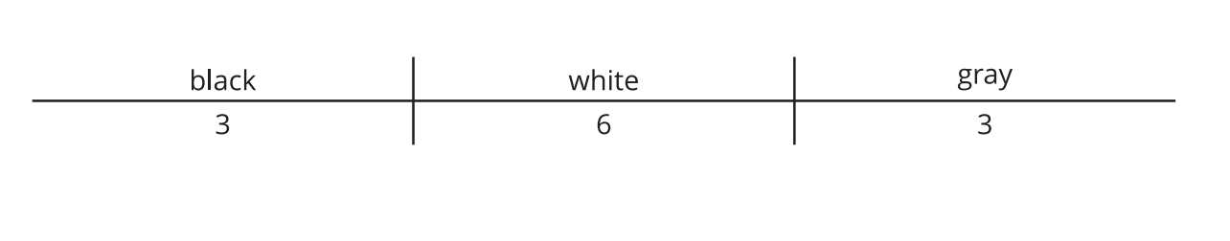
Section Summary
In this section, we sorted objects and shapes.
We showed our sorts on paper in different ways.

Slide 84
Center Day
10
Let’s add and subtract.
NBT.A.1

Slide 85
Choral Count
Warm up
Count by 10, starting at 0.
How is counting by 10, like counting by 1?

Slide 86

Revisit What’s Behind My Back; 10 Cubes
Activity #1
We are going to play a game you learned in kindergarten called What’s Behind My Back. Let’s play the first round together to make sure we all remember how to play.
Each group will start with a tower of ten cubes. Then one partner will break the tower into two parts and hide one of the parts behind their back.
The other partner will write an equation leaving a blank box for the missing number.
Then they will figure out how many cubes are hidden behind their partner’s back. You may use 10-frames and two-color counters if they are helpful. How many cubes are behind my back?
When you agree on how many are hiding, you can complete the equation.
How did you determine how many cubes were behind your partner’s back?

Slide 87
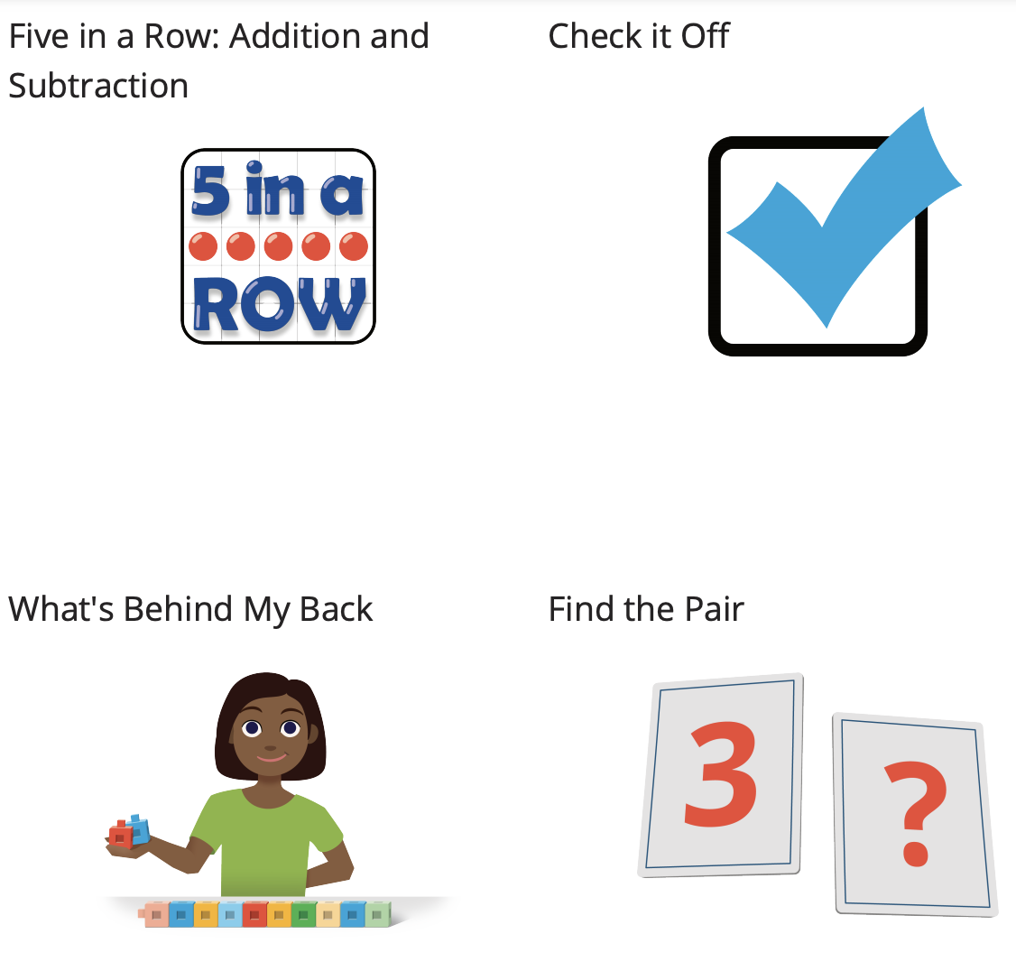
Choice Time
Activity #2
How do you know that the center you chose was a good choice?

Slide 88
Today we practiced adding and subtracting within 10. What’s one thing you enjoyed about this work?
Lesson Synthesis

Slide 89
Solving Story Problems
Adaptation
Lesson 3
Let’s solve take from, result unknown, put together, and total unknown story problems within 10.
K.OA.A.2

Slide 90

All the Books
Activity #2
Elena has 5 books and Han has 4 books.
How many books do Elena and Han have together?
Show your thinking using objects, drawings,
numbers, or words.

Slide 91
Today, we solved story problems.
Lesson Synthesis
1. Noah has 10 crayons.
He gives 4 of his crayons to Jada.
How many crayons does Noah have now?
2. Elena has 5 books and Han has 4 books.
How many books do Elena and Han have together?

Slide 92
Comparing Representations
Adaptation
Lesson 4
Let’s create and compare organized representations of story problems.
K.OA.A.2

Slide 93
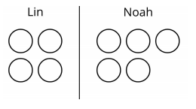
Notice and Wonder
Warm up

Slide 94
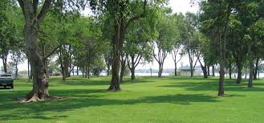
Waiting in the Park
Activity #1
At the park, there are 7 people waiting in line at the water fountain and 3 people waiting in line at the bathroom.
How many people are waiting in line?
Show your thinking using objects, drawings,
numbers, or words.

Slide 95
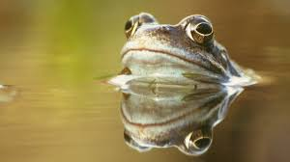
Frogs in the Pond
Activity #2
There are 5 frogs swimming in the pond.
Then 3 more frogs come to swim in the pond.
How many frogs are in the pond now?
Show your thinking using objects, drawings,
numbers, or words.

Slide 96

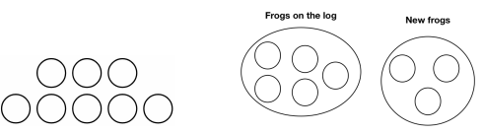
Here is a drawing we saw that represents the frogs in the pond.
Here are two more drawings that represent the frogs in the pond.
Lesson Synthesis
How are they the same?
How are they different?
Do each of the drawings show what happened in the story?

Slide 97
Class Pet Survey
11
Let’s see what the data tells us.
MD.C.4

Slide 98
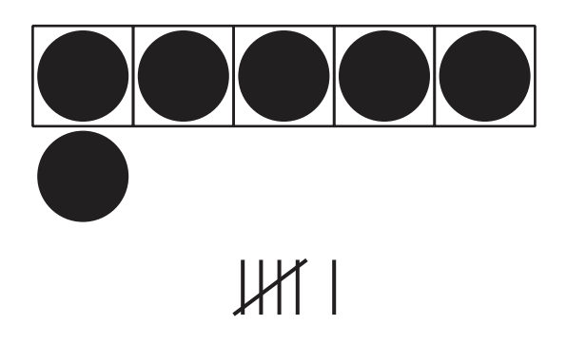
Notice & Wonder
Warm up
What do you notice? What do you wonder?
These lines are called tally marks. We know there are 5 tally marks when we see the diagonal line through the other lines. We are going to see data represented in tally marks.
Where do you see a group of 5 in each image?

Slide 99
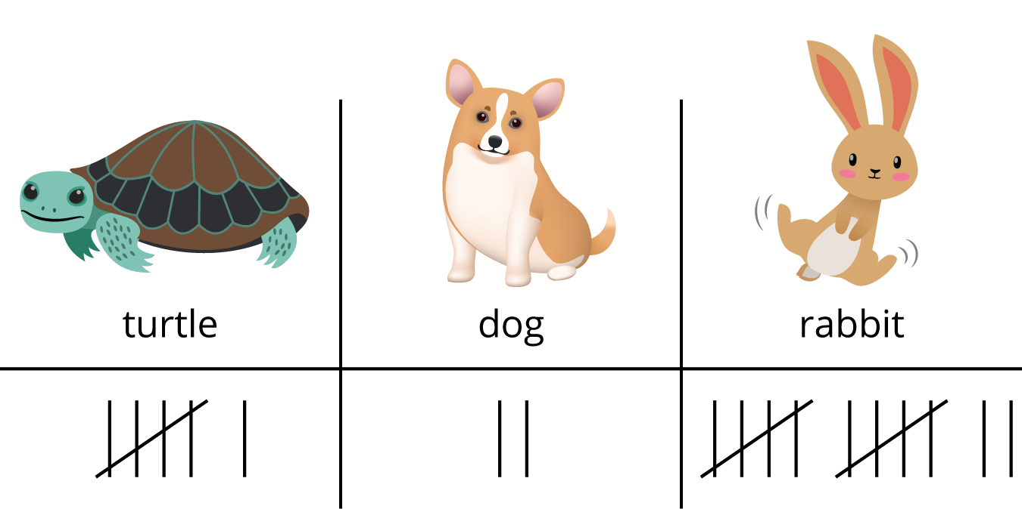
Jada’s Class Pet Survey
Activity #1
Jada took a survey of her classmates and asked, “Which animal would make the best class pet?

Slide 100
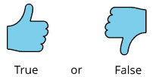
Jada’s Survey About Class Pets
Activity #1
Decide whether each statement is true or false. Be ready to explain why.
1.) There are 12 votes for rabbit.
3.) 14 students voted for turtle or rabbit.
2.) There are 18 votes all together.
4.) 8 students voted for dog or turtle

Slide 101
Jada’s Survey About Class Pets
Activity #1
Decide whether each statement is true or false. Be ready to explain why.
2.) There are 18 votes all together.
Is this statement true or false? How do you know?
How can you revise this statement to make it true?

Slide 102
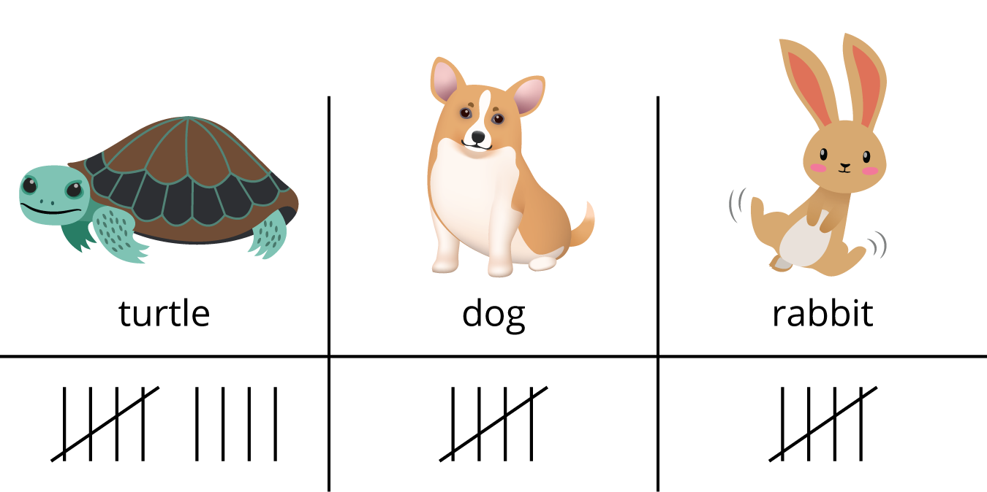
Interpret Data About Class Pets
Activity #2
Tyler asked the same survey question to his classmates.
He showed their responses.
Write 3 things that you learned about Tyler’s survey data from the representation.

Slide 103
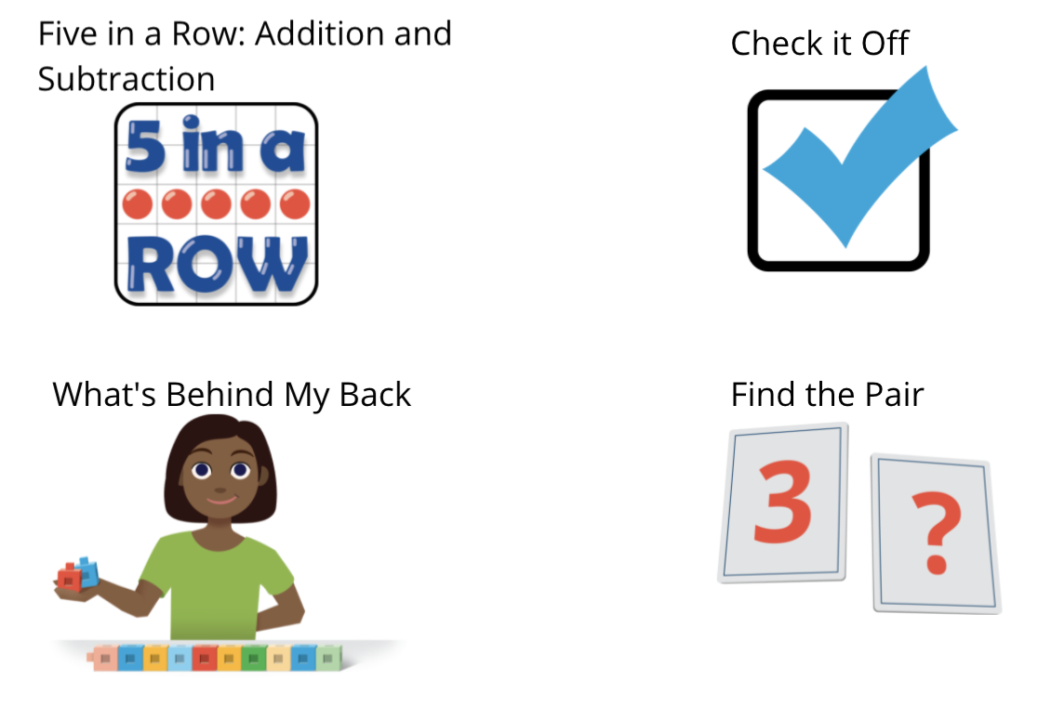
Centers: Choice Time
Activity #2
How has working on these center activities helped you build fluency with addition and subtraction?

Slide 104
Today we made statements based on survey data.
Lesson Synthesis
Can we make a statement about how many students think a fish would make the best class pet?
If so, what would the statement be? If not, why not?

Slide 105
How Many?
12
Let’s ask questions about data.
MD.A.4

Slide 106
Choral Count
Warm up
Count by 1 starting at 30.
How is starting at 30 like staring at 0?

Slide 107
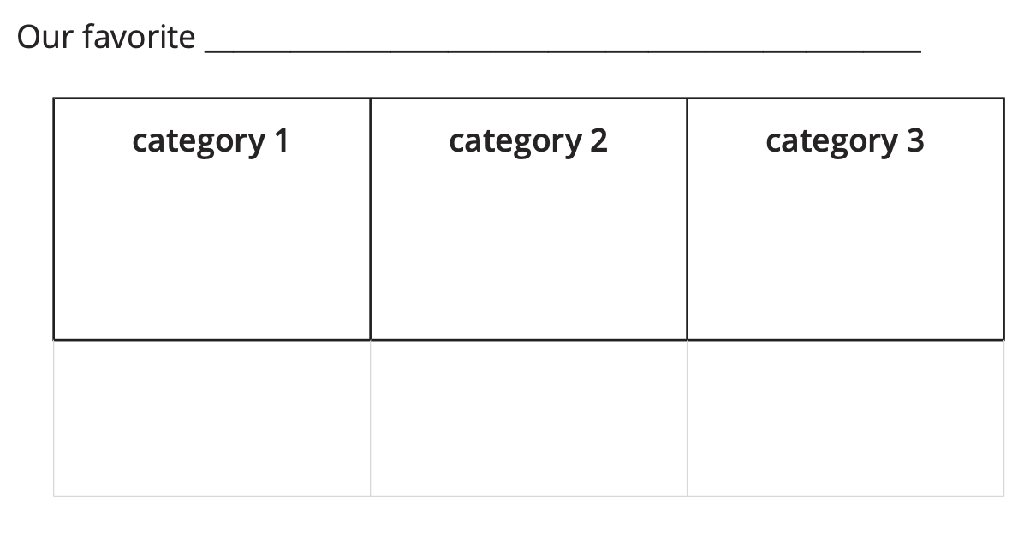
Data Represented with Tally Marks
Activity #1
How many students chose category 1? _____
How many students chose category 2?_____
How many students chose category 3? _____
How many students chose category 1 or category 2? _____
How many students took this survey? _____
How did you know how many student chose category 1?
How did you figure out how many students took the survey?

Slide 108
Data Represented with Numbers
Activity #2
How many students chose category 1? _____
How many students chose category 2?_____
How many students chose category 3? _____
How many students chose category 1 or category 2? _____
How many students took this survey? _____
How did you know how many student chose category 1?
How did you figure out how many students took the survey?

Slide 109
Today we answered questions about data represented with tally marks and numbers.
Lesson Synthesis
Which representation do you prefer? Why?

Slide 110
Questions About Data
13
Let’s ask and answer questions about data.
1.MD.A.4, 1.OA.C.6

Slide 111
Number Talk
7 + 1
Warm up

Slide 112
Number Talk
7 + 2
Warm up

Slide 113
Number Talk
9 - 1
Warm up

Slide 114
Number Talk
9 - 2
Warm up
How can we add or subtract 1 or 2 quickly?

Slide 115
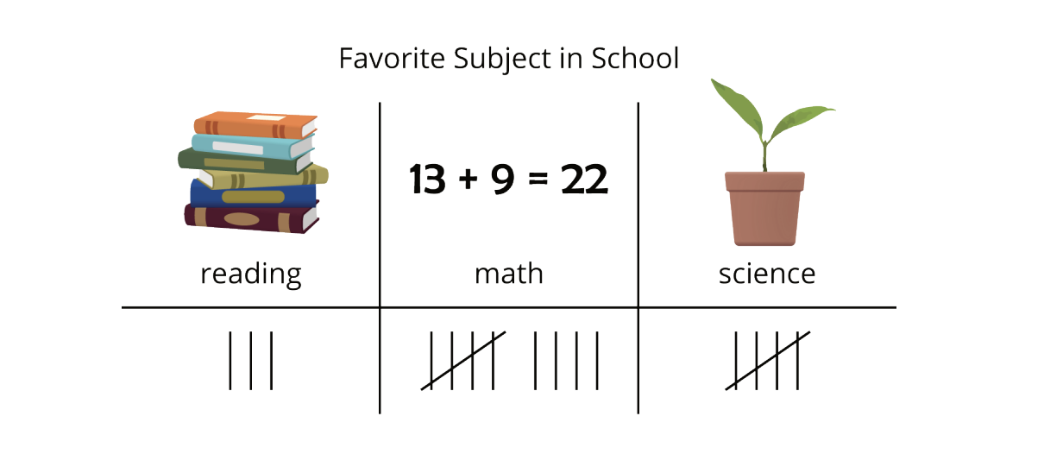
Can You Answer It?
Activity #1
Elena asked her classmates, “What is your favorite subject in school?” She showed their responses below.

Slide 116
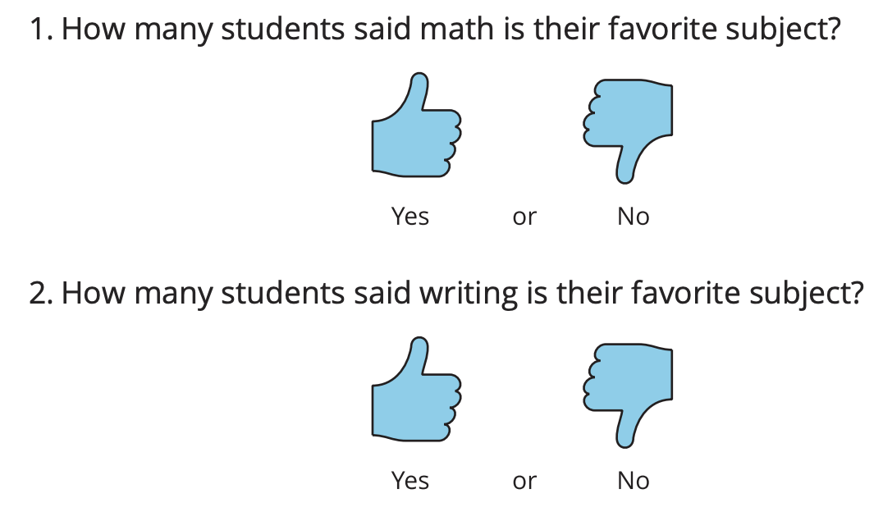
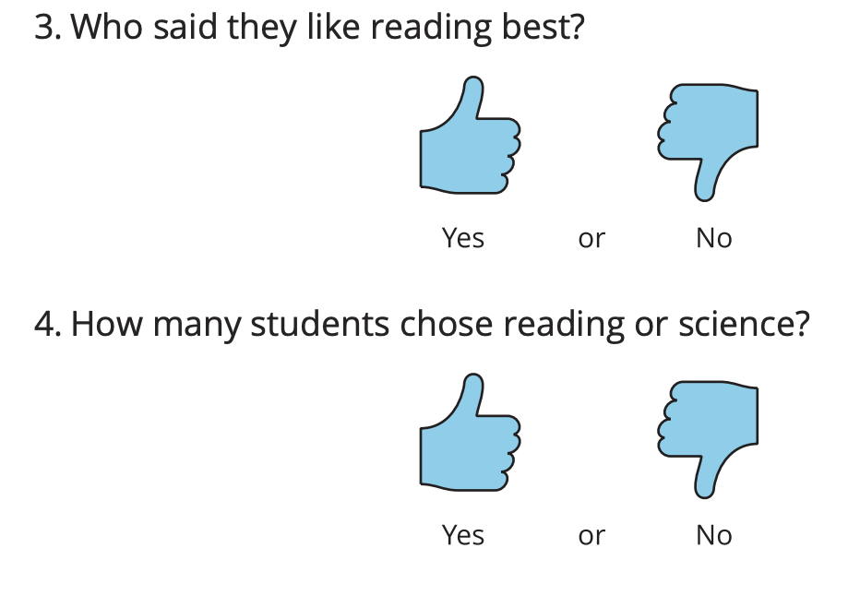
Can You Answer It?
Activity #1
Han wrote questions about Elena's data. Decide whether each question can be answered using the data representation. Be ready to explain why.
What question did you find cannot be answered? Why can’t it be answered?
How can we change the question so that it can be answered using this representation?

Slide 117

Ask Questions
Activity #2
Group A
Group B

Slide 118
Answer Questions
Activity #3
Now you will take turns asking and answering questions about your data.
The person who goes first shows their data representation to their partner and asks a question about the data. Their partner answers the question and explains how they found the answer.
Repeat with another question, then switch roles.
If your partner asks you a question that can’t be answered using the data representation, explain why it can’t be answered.
Why do we have two different answers to the questions?

Slide 119
Today we asked questions about our data.
Lesson Synthesis
What do you need to think about when asking questions, to be sure they can be answered using your data representation?

Slide 120


Section Summary
In this section, we looked at different ways to show data. You can show data using tally marks
You can show data using numbers.
We asked and answered questions about data.
How many students want a turtle as a class pet? (6)
How many students want a dog or a rabbit as a class pet? (14)
How many students took the survey? (20)

Slide 121
Center Day
14
Let’s work with data and practice adding and
subtracting.
1.OA.C.5, 1.OA.C.6

Slide 122
Number Talk
Warm up
4 + 2

Slide 123
Number Talk
Warm up
7 - 2

Slide 124
Number Talk
Warm up
9 - 2

Slide 125
Number Talk
Warm up
8 + 2
How can we add or subtract 1 or 2 quickly?

Slide 126

Centers: Introducing Sort and Display, Any Way
Activity #1
Directions:
1. Sort the objects into 2 or 3 categories.
2. Show how you sorted the objects on paper.
3. Ask your partner 2 questions about your representation.
What questions can we ask about this sort that can be answered by this representation?

Slide 127

Centers Choice Time
Activity #2
What is one thing you learned or got better at by working on the activity you chose?

Slide 128
Today we chose activities to work on and worked with a partner during center time.
Lesson Synthesis
What went well? What can we continue to work on?

Slide 129
Animals in the Jungle
15
Let’s make a survey and collect and show
data.
1.MD.C.4, 1.OA.A.1

Slide 130

Notice and Wonder
Warm up
What do you notice? What do you wonder?

Slide 131

Collect Survey Data
Activity #1
Let’s survey our classmates.
1. Circle one question:
a. Which animal would you like to meet in real life?
b. If you could spend one day as an animal, which one would you choose?
c. Which animal would you like to spend vacation with?
d. Which animal would you like to talk to?
2. Animal choices: ______________________
______________________
______________________
3. Collect and record 10 responses.

Slide 132

Asking Our Own Questions
Activity #2
Let’s come up with questions about our data and answer them.
What questions were interesting to answer? What was interesting about them?
What was the hardest/easiest question your partner asked? Why was it hard/easy to answer?

Slide 133

Share Data
Activity #3
Let’s make posters to share what we learned from our surveys.
What is one thing you learned from the other pair’s survey?
How does their poster help us see that?

Slide 134
Today we made our own surveys and came up with mathematical questions we could ask and answer about our data.
Lesson Synthesis

