Slide 1
Choose a Scale
Materials needed: pencil
Notes:
The purpose of this lesson is for students to consider the advantages and disadvantages of various bar graph scales

Slide 2
Let’s...
choose a scale for our bar graph
Notes:
Tell students they will have an opportunity to revise their math community ideas at the end of this lesson, so as they work today they should think about actions that may be missing from the current list..
Provide 1 sticky note per student.

Slide 3
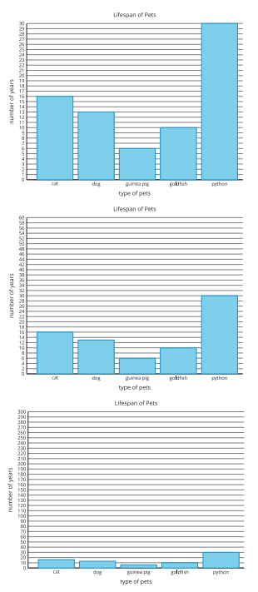
Warm Up: Notice and Wonder
What do you notice? What do you wonder?
Notes:
Groups of 2 Display the image.
“What do you notice? What do you wonder?”
1 minute: quiet think time
“Discuss your thinking with your partner.”
1 minute: partner discussion
Share and record responses.

Slide 4
Warm-Up Synthesis
What is the difference between these three graphs?

Slide 5
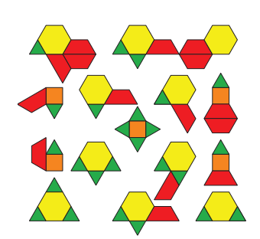
Activity 1: Represent Pattern Blocks
So far, we have made scaled graphs to represent survey data.
We can also make graphs to represent other things.
Take a minute to consider these pattern blocks and think about how you could represent them in a scaled graph.
Notes:
Groups of 2 Display the image
“Now answer the questions about organizing and representing the pattern blocks in a bar graph with your partner. Be prepared to justify your choice of scale.” 12 minutes: partner work Monitor for students who used each of the scales to create their bar graph.

Slide 6
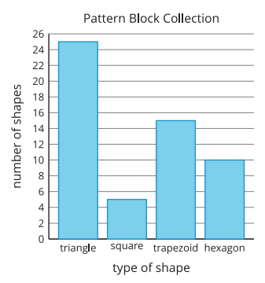
Activity Synthesis
What scale did you use for your bar graph?
Why did you choose that scale?
Notes:
Advancing Student Thinking
If many students are using a scale of 2, discuss the efficiency of different scales in the activity synthesis

Slide 7
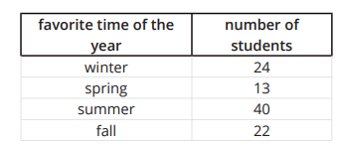
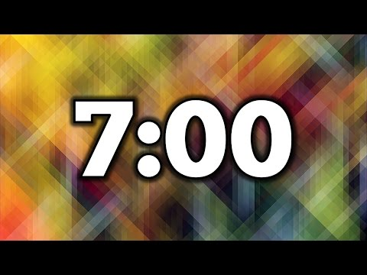
Activity 2: More Practice Creating a Scaled Bar Graph
Represent the data shown in the table in a scaled bar graph.
Think about a scale that makes sense of the number of students
Notes:
5–7 minutes: independent work time “Share your graphs with your smallgroup. Discuss the scales you chose to use.” 2–3 minutes: small-group discussion

Slide 8
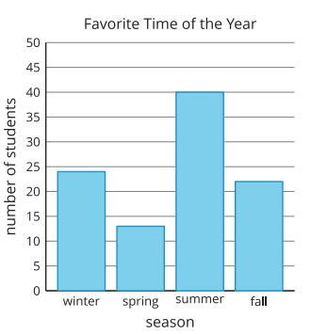
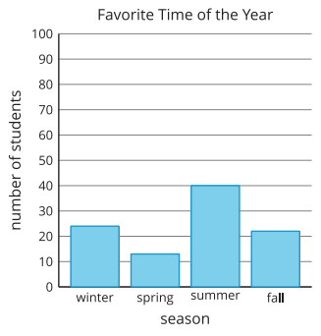
Activity Synthesis
How did the scale you chose for your graph affect how your graph looked in the end?”
Notes:
Advancing Student Thinking
If students cannot decide on or create a scale, provide them with grids that show different scales and have them choose one to use to create their graph.

Slide 9
Lesson Synthesis
What did you learn today that will help you make decisions about how to create scaled graphs in the future?

