Slide 1
Create Scaled Picture Graphs
Materials needed: pencil
Notes:
The purpose of this lesson is for students to create a scaled picture graph to represent categorical data.

Slide 2
Let’s...
make a scaled picture graph
Notes:
Tell students they will have an opportunity to revise their math community ideas at the end of this lesson, so as they work today they should think about actions that may be missing from the current list..
Provide 1 sticky note per student.

Slide 3
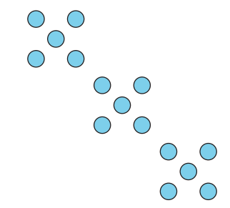

Warm-up: How many do you see?
How many do you see?
How do you see them?
Notes:
10 minutes
Display the image. “Discuss your thinking with your partner.” 1 minute: partner discussion Record responses. Repeat for each image.

Slide 4
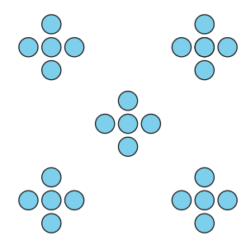
Warm-up: How many do you see?
How many do you see?
How do you see them?
Notes:
10 minutes
Display the image. “Discuss your thinking with your partner.” 1 minute: partner discussion Record responses. Repeat for each image.

Slide 5
Warm-Up Synthesis
What pattern did you see first and how did this help you figure out the total?
Did anyone see the dots the same way but would explain it differently?

Slide 6

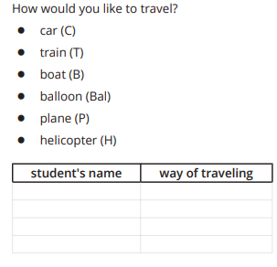

Activity 1: Ways to Travel
Today you will survey your classmates.
You will start with your group and then we will collect the group data as a class.
10 minutes: students record classmate responses
Notes:
Groups of 4

Slide 7

Activity Synthesis
What's helpful about having this data in the form of a list? What's not helpful?

Slide 8

Activity 2: Create a Scaled Picture Graph
How can we represent our survey data in a picture graph without having to draw a picture for each student in our class?
Represent the way you would like to travel data that you collected in your own scaled picture graph where each picture represents 2 students.
Notes:
Groups of 2
Circulate as students work: Encourage them to include a title, category labels, and key. Pay attention to how students are grouping by 2. Support students with questions they may have (especially around representing odd number amounts). “Compare your graph with your partner.”
2 minutes: partner discussion Monitor for a graph that is missing a title, labels, or a key to share during the activity synthesis.

Slide 9
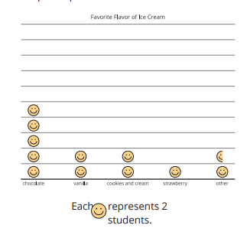
Activity Synthesis
How does this graph clearly represent the survey data from our class?
What can we add to the graph to make it more clear?
How can we represent the number of students who picked a way of travel when it was an odd number?
What questions do you have about creating a scaled picture graph?
Notes:
Advancing Student Thinking
If students choose symbols that are time-consuming to draw, encourage them to consider symbols that are more efficient to draw.

Slide 10


Lesson Synthesis
What if 2 more students chose to travel by balloon? How could we represent that on this graph?
What if 1 more student chose to travel by car? How could we represent that on this graph?
Notes:
Display a scaled picture graph from today’s lesson

