Slide 1

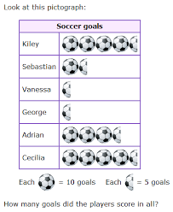
Scaled Picture Graphs
Materials needed: pencil
Notes:
The purpose of this lesson is for students to read and answer questions about scaled picture graphs.

Slide 2
Let’s...
explore scaled picture graphs.
Notes:
Tell students they will have an opportunity to revise their math community ideas at the end of this lesson, so as they work today they should think about actions that may be missing from the current list..
Provide 1 sticky note per student.

Slide 3

Warm Up: Number Talk: Addition
Find the value of each expression mentally
Quiet think time..
Notes:
Launch:
Display one expression.
“Give me a signal when you have an answer and can explain how you got it.”
1 minute: quiet think time
Activity
Record answers and strategy.
Keep problems and work displayed.
Repeat with each expression.

Slide 4
Warm-Up Synthesis
How was place value helpful as you added these numbers?
How can we restate _______’s reasoning in a different way?
Did anyone approach the problem in a different way?

Slide 5
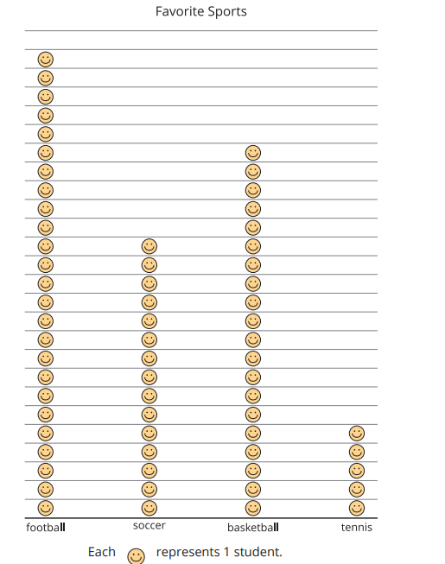
Activity 1: So Many Responses
What do you notice?
What do you wonder?
How many students are represented in the graph?
Notes:
1 minute: quiet think time “Discuss your thinking with your partner.” 1 minute: partner discussion Share and record responses.
“Work with your partner to find how many students are represented in the graph.” 3–5 minutes: partner work time Monitor for students who group the smiley faces by 2, 5, or 10 to make them easier to count. Have students who grouped the smiley faces share their strategies for how they found the total number of students represented in the graph.
If no students use this strategy ask, “How could grouping the pictures in the graph make them easier to count?” (We could circle tens so we could count by ten. It would be easier to keep track of your count than by counting by ones.)

Slide 6
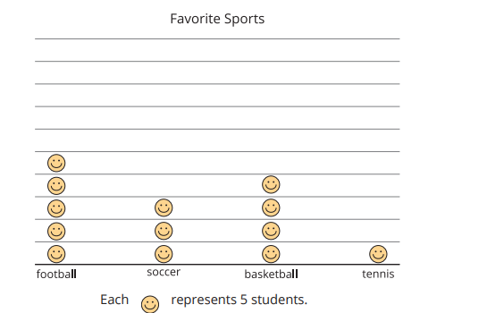
Activity 1: So Many Responses
How could we count the total number of students in this graph?
Notes:
1 minute: quiet think time “Discuss your thinking with your partner.” 1 minute: partner discussion Share and record responses.
“Work with your partner to find how many students are represented in the graph.” 3–5 minutes: partner work time Monitor for students who group the smiley faces by 2, 5, or 10 to make them easier to count. Have students who grouped the smiley faces share their strategies for how they found the total number of students represented in the graph.
If no students use this strategy ask, “How could grouping the pictures in the graph make them easier to count?” (We could circle tens so we could count by ten. It would be easier to keep track of your count than by counting by ones.)

Slide 7
Activity Synthesis
In a graph where there’s a lot of data we can adjust the scale so each picture represents more than 1 object.
When each picture represents something other than 1, we say that it’s a scaled picture graph.
The key shows how many students each picture represents. In this graph each smiley face represents 5 students

Slide 8
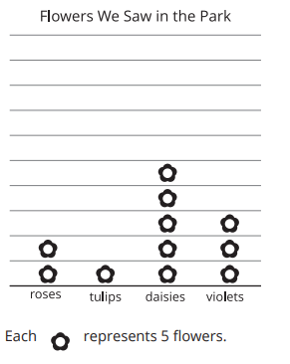

Activity 2: Questions about Scaled Picture Graphs
What are some strategies you could use to read the graphs?
Now, we’re going to answer some questions about the scaled picture graphs. You will also have a chance to write your own question that can be asked based on each graph.
Notes:
15 minutes for the whole activity
Groups of 2 Display the graphs for all to see.

Slide 9

Activity Synthesis
How did you use the scale to answer the questions?
How did you know your question could be answered with the graph?
What questions cannot be answered by this graph?

Slide 10
Lesson Synthesis
Why would we make a scaled picture graph?
How is reading scaled picture graphs different from reading graphs that have a scale of 1?
Notes:
Have students answer the questions and share their reasoning

