Slide 1


More Data
Materials needed: pencil, sticky notes

Slide 2
Let’s...
Let’s create graphs and answer questions.
Notes:
Tell students they will have an opportunity to revise their math community ideas at the end of this lesson, so as they work today they should think about actions that may be missing from the current list..
Provide 1 sticky note per student.

Slide 3
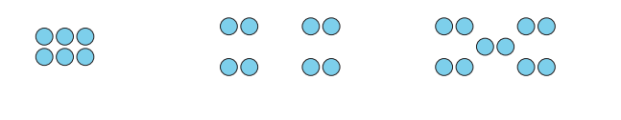

Warm-up: How many do you see?
How many do you see?
How do you see them?
Notes:
10 minutes
Display the image. “Discuss your thinking with your partner.” 1 minute: partner discussion Record responses. Repeat for each image.

Slide 4
Warm-up: How many do you see?
How many do you see?
How do you see them?
Notes:
10 minutes
Display the image. “Discuss your thinking with your partner.” 1 minute: partner discussion Record responses. Repeat for each image.

Slide 5
Warm-up: How many do you see?
How many do you see?
How do you see them?
Notes:
10 minutes
Display the image. “Discuss your thinking with your partner.” 1 minute: partner discussion Record responses. Repeat for each image.

Slide 6
Warm-Up Synthesis
How many more dots were in the third image than in the second image?
What equation matches your thinking?

Slide 7

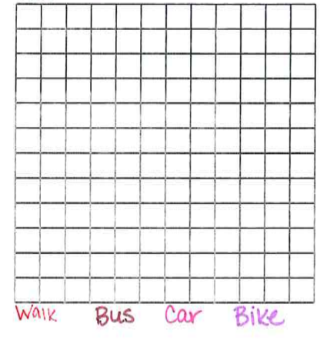
Activity 1: How we Get home
Represent the data shown in the class picture graph in a bar graph with your partner.
Make sure to include the parts of the graph that will help someone else read it.
Notes:
15 minutes for the whole activity
Give each student a small sticky note. Have each student draw a smiley face on their sticky note. “Put your smiley face on the graph based on how you get home from school.” “What needs to be added to the class picture graph to communicate the data clearly?” Facilitate addition of title and key to class picture graph.
5-7 minutes of partner time for creating the bar graph.

Slide 8
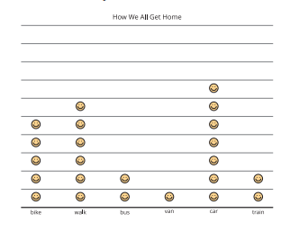
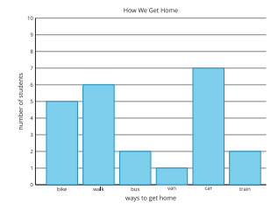
Activity Synthesis
How are our picture graph and bar graph alike?
How are our picture graph and bar graph different?

Slide 9

Activity 2: Questions About a Bar Graph
Now you’re going to use your bar graph to decide if statements are true or false.
Notes:
15 minutes for the whole activity
1–2 minutes: independent work time 3–5 minutes: partner discussion
As students work, decide which categories will go in the question stems for Part 2. Consider providing these sentence stems if students need support explaining their reasoning: “I knew the statement was false because...” “I knew the statement was true because…” “How did you know if each statement was true or false?”
If students have trouble using the data in the bar graph to create or solve problems, ask them to refer back to the categories of data presented in the graph as they create problems and to the data in each category as they solve problems.

Slide 10
Activity 2: Questions About a Bar Graph
How many more students _____ than ____?
How many more students _____ or _____ than _____?
Notes:
***Teacher needs to fill in the blanks before you post for the class.
1–2 minutes: independent work time 3–5 minutes: partner discussion
As students work, decide which categories will go in the question stems for Part 2. Consider providing these sentence stems if students need support explaining their reasoning: “I knew the statement was false because...” “I knew the statement was true because…” “How did you know if each statement was true or false?”

Slide 11

Activity Synthesis
Do you have any lingering questions about how to answer these questions from the bar graph?
What equation matches your thinking?

Slide 12
Lesson Synthesis
How many more students __________ than ____________?
How many fewer students ___________ than_______________?
How many more students __________ or _________ than ___________?
Notes:
Have students answer the questions and share their reasoning

