Slide 1
Collecting and Representing Data
Materials Needed: chart paper, scissors, glue, markers, stickers and tape
Notes:
The mathematical purpose of this lesson is to build on students’ previous understandings and experiences with organizing and representing data.

Slide 2
Let’s organize data and share with others.

Slide 3
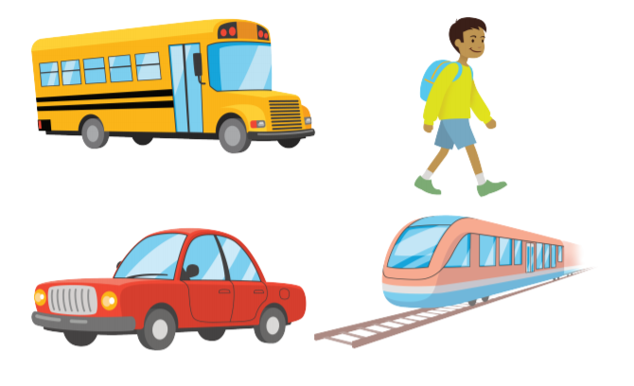

Warm Up: Notice and Wonder: Let’s Get There
What do you notice? What do you wonder?
Quiet think time..
Notes:
Launch:
Groups of 2
Display image
Activity:
1 minute: quiet think time
1 minute: partner discussion
Share and record responses

Slide 4



Warm Up Synthesis
We are going to keep thinking about these ways of getting around in our first activity today.

Slide 5
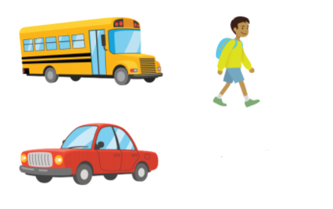
Activity 1: How Do We Get to School?
How We Got to School Today.
Choose the picture that shows how you got to school today.
Write your name on the picture.
Notes:
You could add a peardeck slide
They will place their picture on chart paper, unless you want to create a peardeck.

Slide 6
Activity 1 Synthesis
How could we find out how many students in our class took the bus to school today?
What other questions could we ask about how we got to school today based on our chart?

Slide 7

Activity 2: Visual Representations of Data Activity 2
Organize and represent the data we collected in a visual display.
Data is information about the things or people in a group.
Think about how you can represent the data in a way that will make sense to other people.”
Notes:
Glue, Markers, Scissors, Stickers, Tape
8 minutes: independent work time Monitor for a student who used pictures to display during the syntheses. Monitor for students who used tally marks or other symbols to display during the syntheses. 5 minutes: gallery walk

Slide 8
Activity 2 Synthesis
What is the same and what is different between these representations?
What suggestions do you have for another student to make their representation more clear?
Notes:
Advancing Student Thinking
Some students may include detailed drawings to represent the data. Ask them if they can think of ways to represent the data that do not take as much time.

Slide 9
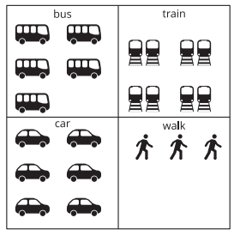

Lesson Synthesis
Today, we saw that there are different ways to represent data in an organized way.
How does the number of students who took the bus show up in each representation?
What makes a data display organized and clear to read?

