Slide 1
Add Within 50
Materials Needed: connecting cubes
Notes:
The purpose of this lesson is for students to add and subtract within 20 in a way that makes sense to them.

Slide 2
Let’s add within 50.

Slide 3

Warm Up: Adding a One-Digit Number and a Two-Digit Number
Find the value of each expression mentally.
Quiet think time..
Notes:
Launch:
Display one expression.
“Give me a signal when you have an answer and can explain how you got it.”
1 minute: quiet think time
Activity:
Record answers and strategy.
Keep problems and work displayed.
Repeat with each expression.

Slide 4
Warm Up Synthesis
How does making 10 help in finding the sum with larger numbers?
Notes:
If needed, use connecting cubes to represent students’ thinking.

Slide 5
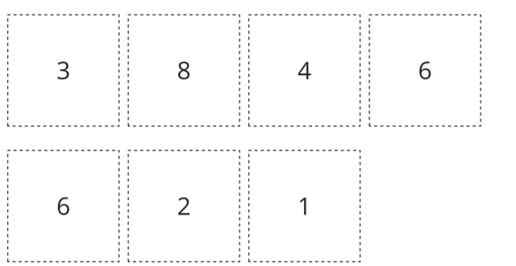
Activity 1: How Close? Close to 50
We start with 7 cards again. Think about what cards you would choose to make 2 two-digit numbers that have a sum close to 50.
Notes:
Launch:
Groups of 2 Give one set of digit cards to each group.
“Today we are going to play another game of How Close. This time we will play Close to 50.”
Activity:
10 minutes: partner work time Share responses. “After you make your two-digit numbers, you will write an equation showing the sum.” Demonstrate writing an equation on the recording sheet. “Now, we see whose sum is closer to 50.Talk to your partner about how you could figure it out.” (You can count up or back from 50 and see whose number is closer) 30 seconds: quiet think time 1 minute: partner discussion “Then you will replace the cards you used and play again.

Slide 6

Activity 1: How Close? Close to 50
Take 7 cards.
Use 4 cards to make 2 two-digit numbers.
Write an equation to show the sum of the numbers you made
Compare sums with your partner. Whoever is closer to 50, wins.
Notes:
10 minutes: partner work time

Slide 7
Activity 1 Synthesis
Diego made the number 38. What number could Diego make next to get close to 50?
Notes:
Advancing Student Thinking
If students are not yet able to make 2 numbers that get close to 50, encourage them to choose 2 cards, make a 2 digit number and represent the number with cubes. Then determine how many more cubes they need to get to 50 and choose the 2 cards that will get closest to that number.

Slide 8


Activity 2: Adding within 50
Now we are going to add larger numbers. Think about how you can show your thinking so others can understand
Think about how you can show your thinking so others can understand
Notes:
Launch
Groups of 2 Give students access to connecting cubes in towers of 10 and singles

Slide 9
Activity 2 Synthesis
Share your thinking on the below problem.
How did thinking about a ten help them find their answer?

