Slide 1
Add Within 20
Materials Needed: connecting cubes
Notes:
The purpose of this lesson is for students to add and subtract within 20 in a way that makes sense to them.

Slide 2
Let’s add and subtract within 20.

Slide 3

Warm Up: Making 10
Find the value of each expression mentally.
Quiet think time..
Notes:
Launch:
Display one expression.
“Give me a signal when you have an answer and can explain how you got it.”
1 minute: quiet think time
Activity:
Record answers and strategy.
Keep problems and work displayed.
Repeat with each expression.

Slide 4

Warm Up Synthesis
How does making 10 help in finding the sum?
Notes:
If needed, use connecting cubes to represent students’ thinking.

Slide 5
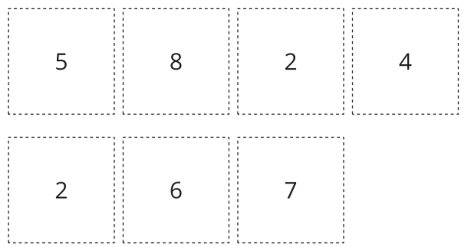
Activity 1: How Close? Close to 20
Look at the 7 cards. Think about which 3 cards you would choose to add together to get close to 20.
Notes:
Launch:
Groups of 2 Give each group a set of cards. Have them remove the number 10 cards. Display the digit cards at the top of the student page.
We are going to play a game called How Close: Close to 20. Let’s play 1 round together.”
Activity:
10 minutes: partner work time Monitor for students who try to make 10 and then add the greatest number possible to it. Montor for students who add the 2 greatest numbers and then look for the other number needed to make 20. Share responses. “After you choose your 3 cards, you will write an equation showing the sum.” Demonstrate writing an equation to show the sum of the 3 cards that get closest to 20. “When you have your equation written,compare it with your partner’s to see who found a sum closer to 20.” “Then you will replace the cards you used and play again.”

Slide 6

Activity 1: How Close? Close to 20
Take 7 cards.
Choose 3 numbers.
Write an equation to show the sum of the 3 numbers.
Compare sums with your partner.
Whoever is closer to 20 wins.
Notes:
10 minutes: partner work time

Slide 7

Activity 1 Synthesis
What strategies did you use to find a sum close to 20?
Notes:
Advancing Student Thinking
If students begin by choosing 3 numbers, encourage them to find the sum of 2 numbers first and think about how many more they need to make 20. If students make each number with cubes and count all the cubes, ask how they could organize their cubes so they wouldn’t have to count them all. Encourage organizing the cubes in groups of 10.

Slide 8
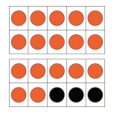

Activity 2: Adding and Subtracting within 20
Now we are going to add and subtract within 20.
Think about how you can show your thinking so others can understand
Notes:
Launch
Groups of 2
Give students access to connecting cubes.
You have time to work independently before sharing your thinking with a partner.

Slide 9
Activity 2 Synthesis
Share your thinking on the below problem.
How did thinking about a ten help them find their answer?
Notes:
Display 9 cubes
Monitor for students who talk about making a 10 and knowing there is one more 10. Share responses.
Advancing Student Thinking
If students are not yet making 10 to help add and subtract, encourage the use of connecting cubes in towers of 10 and singles.

