Slide 1
Moving up to 20
Materials Needed: connecting cubes
Notes:
The purpose of this lesson is for students to find the missing value in equations within 20

Slide 2
Let’s find the missing value in equations to 20.

Slide 3

Warm Up: Number Talk
Find the value of each expression mentally.
Quiet think time..
Notes:
Launch:
Display one expression.
“Give me a signal when you have an answer and can explain how you got it.”
1 minute: quiet think time
Activity:
Record answers and strategy.
Keep problems and work displayed.
Repeat with each expression.

Slide 4

Warm Up Synthesis
How did thinking about addiction help you subtract?
Notes:
If needed, use connecting cubes to represent students’ thinking.

Slide 5
Activity 1: What’s Behind My Back: 20 Cubes
We are going to play What’s Behind My Back, this time with 20 cubes.
How did you figure out how many connecting cubes were behind your partner’s back last time?
This time when you play, you are going to record an addition equation with a blank to represent the missing cubes, before you figure out how many are behind your partner’s back.
Notes:
Launch:
Groups of 2
Give each group of 2 students 20 connecting cubes and a blackline master recording sheet.
Show students 2 towers of 10 cubes. Put the tower behind your back. Break off 8 cubes, and display the rest of the tower. What equation should we record?”

Slide 6

Activity 1: What’s Behind My Back: 20 Cubes
Build a tower of 10 cubes
Partner A, put the tower behind your back and break off some of the cubes.
Show your partner one part of the tower.
Partner B, record an addition equation with a blank to represent the cubes
Partner A, ask your partner, “How many are behind my back? How do you know?”
Check your answers.
Switch roles.
Notes:
10 minutes: partner work time

Slide 7
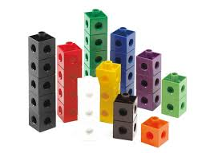
Activity 1 Synthesis
What’s an addition equation I can write to represent the problem?
Tell your partner how you can figure out how many cubes are missing.
Notes:
Display 9 cubes
Monitor for students who talk about making a 10 and knowing there is one more 10. Share responses.
Advancing Student Thinking
If students have difficulty figuring out what is missing, give students an extra set of 20 cubes so that the partner who is guessing can use cubes to represent the problem.

Slide 8
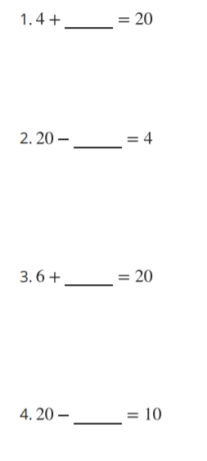
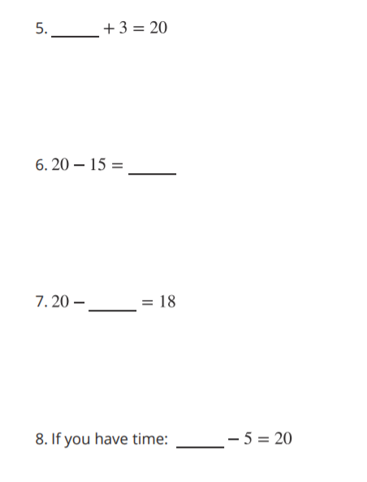
Activity 2: Find the Value to Make the Equation True
Write the value that makes the equation true.
Show your thinking using drawings, numbers, or words.
Notes:
Launch
Groups of 2, different than the previous activity
“You are going to find the value in equations that make them true. Switch books with someone who you didn’t play What’s Behind My Back with. Fill in the values to make their equations true. Be prepared to share with your partner how you found the missing value.”
3 minutes: independent work time
“Share your work with your partner.

Slide 9
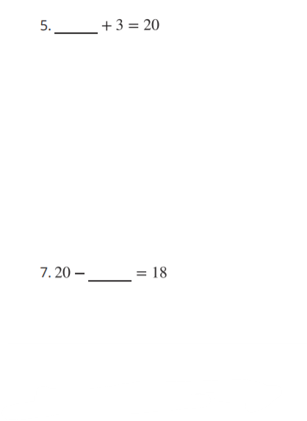
Activity 2 Synthesis
Share your thinking on questions 5 and 7.
How did thinking about a ten help them find their answer?
Notes:
Display 9 cubes
Monitor for students who talk about making a 10 and knowing there is one more 10. Share responses.
Advancing Student Thinking
If students have difficulty figuring out what is missing, give students an extra set of 20 cubes so that the partner who is guessing can use cubes to represent the problem.

