Slide 1
Add and Subtract within 10
Materials needed:

Slide 2
Let’s...
Add and Subtract within 10.

Slide 3


Warm-up: What Do you know about math?
“What do you know about math?”
Tell your partner
Quiet think time

Slide 4
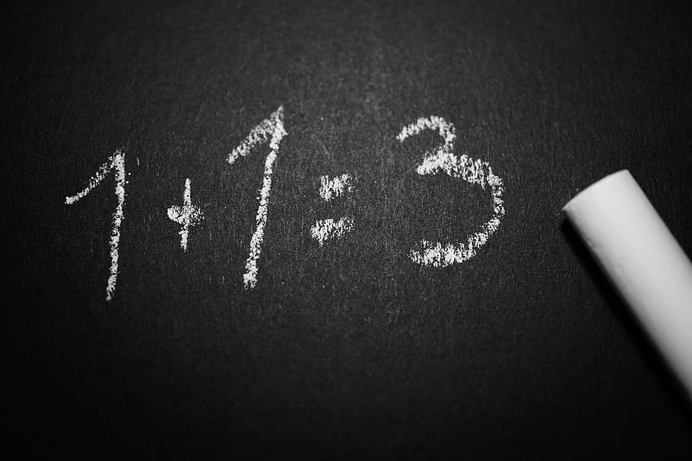
Warm-Up Synthesis
“Today, you will get to do math in different ways.”

Slide 5
Activity 1 Check it Off: Add or Subtract to 10
“We are going to play Check it Off: Add or Subtract 10. The goal is to be the 1st person to write an expression for each number.”

Slide 6
“I’m going to pick two cards. I have to decide when I want to add or subtract. I don’t want a value that is greater than 10, so I will need to decide if I should add or subtract.”
I drew a 10 and a 7. . . . so I am going to subtract.
10-7
What’s the value of the difference?

Slide 7
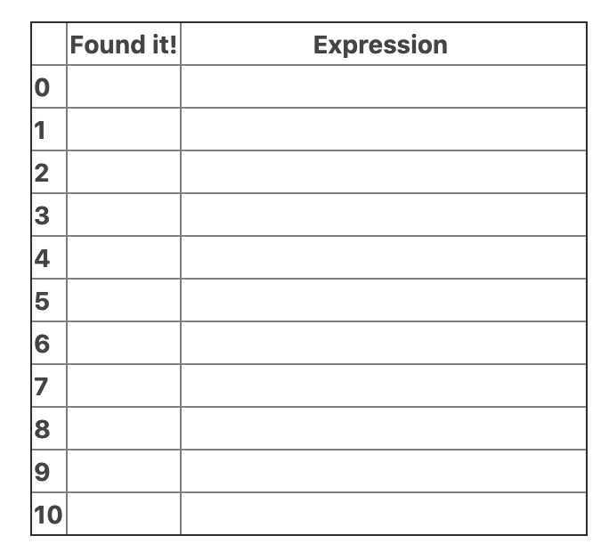
Pick 2 cards and find the value of the sum or difference.
Check off the number you found and write the expression.
The person who checks off the most numbers wins.

Slide 8

“If you run out of cards before someone checks off all the numbers, shuffle them and start again.”
3...
2...
1...
Play!!!

Slide 9
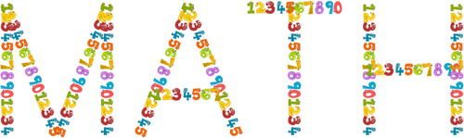
Activity Synthesis
Did you write any expressions that matched the same value? What number was it? What were the expressions?
Were there any values that you and your partner did not find? What are some expressions that could match these numbers?

Slide 10
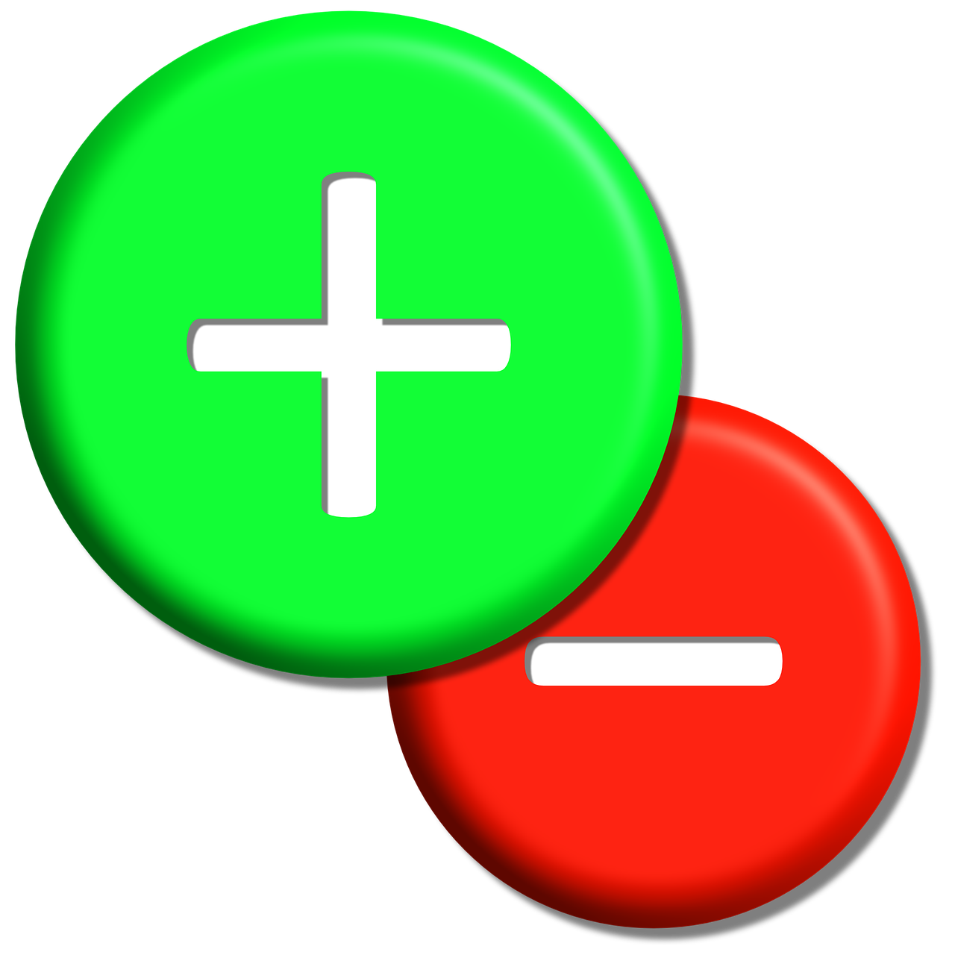
Activity 2
What’s the Value?

Slide 11
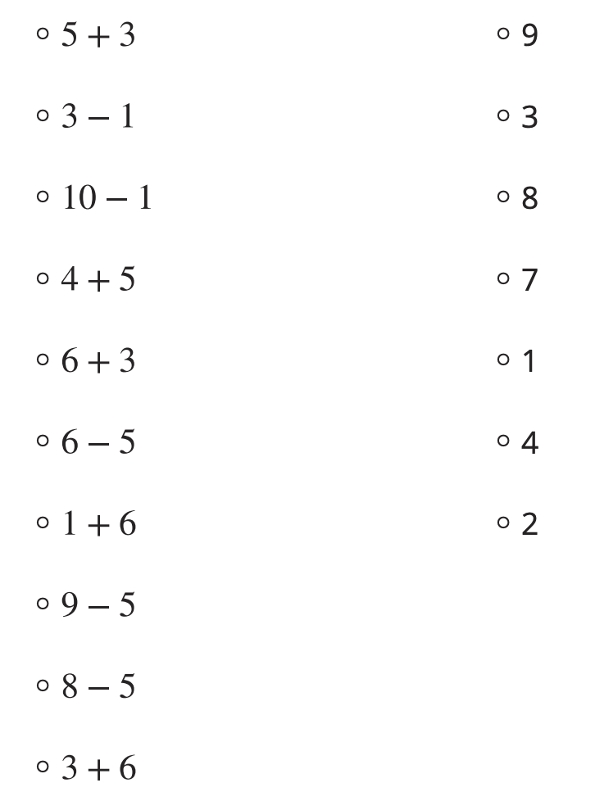
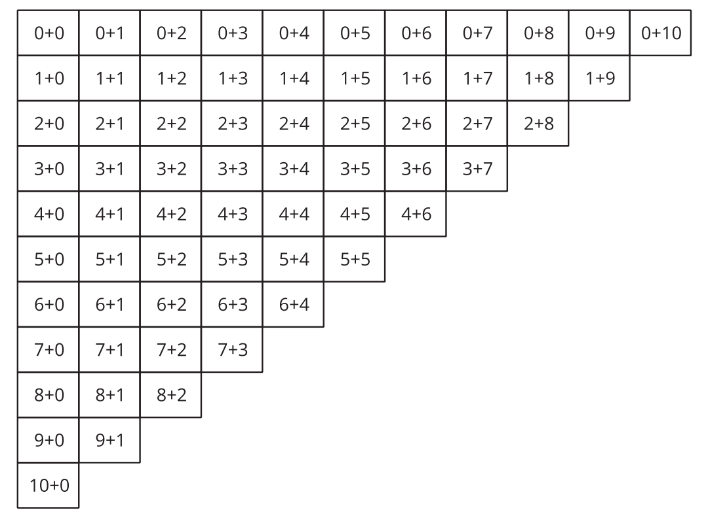
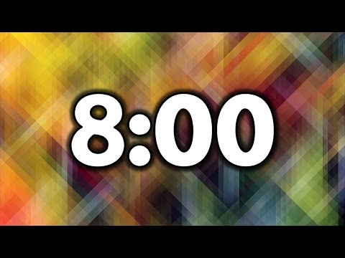
Match each expression to the value of the sum or difference.
3. What patterns do you see in the numbers in the expressions that have a value of 10?
2. Circle all the addition expressions that have a value of 10.
Quiet independent work time

Slide 12

Activity Synthesis
What patterns do you see in the numbers in the expressions that have a value of 10?

Slide 13
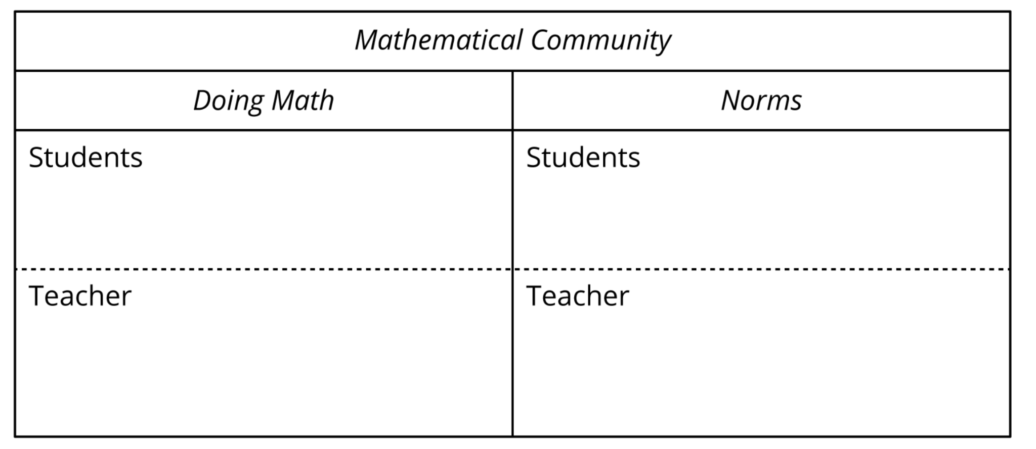
Lesson Synthesis
“Today, we played a math game and added and subtracted within 10. We are going to make a chart to describe what you do and what I do in our math community.”

