Slide 1
Center Day 1
Materials needed: Two-color counters, number cards 0-10, 10-frames, connecting cubes, pattern blocks, and mathematical community poster

Slide 2

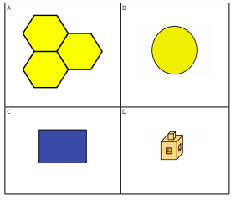
Warm Up
Which One Doesn’t Belong: MathTools
Pick one that doesn’t belong. Be ready to share why it doesn’t belong.
Discuss your thinking with your partner.

Slide 3
Warm Up: Synthesis
Let’s find at least one reason why each doesn’t belong?

Slide 4
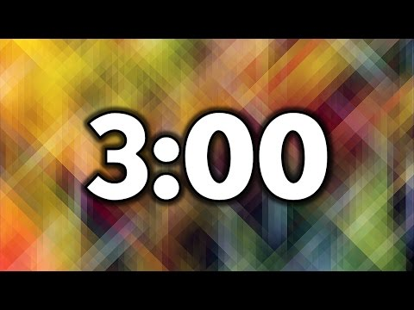
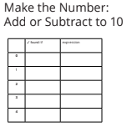
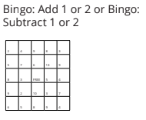
Activity 1 Centers:
Choice Time: Addition and Subtraction
Today you will work in center activities to practice adding and subtracting.
Open up your math workbook and turn to page 24.
Think about what you would like to do first today.

Slide 5
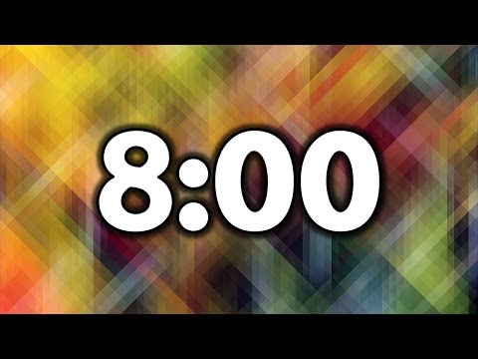
Activity 1: Center Work Time
You may choose which center you would like to work at first
Then, once the timer goes off choose what you would like to work with next

Slide 6

Activity 1 Synthesis
How do you know that the center you chose was a good choice?
Let’s share with a partner.

Slide 7
Activity 2
Centers: Choice Time: Math Tools
You are going to pick which center activity you want to work on. You can choose to work with connecting cubes or pattern blocks. There are some
cards you can choose to work with as you explore the tools.
Think about what you would like to work with first.

Slide 8

Activity 2 Synthesis
What patterns did you notice?

Slide 9
Lesson Synthesis
Math Community!
Which of these did you do today?
How did they help you in the class?
Is there anything else we could add to the poster?

