Slide 1
Exploring Addition and Subtraction
Materials needed: Number cards 0-10, two-color counters, 10-frames, mathematical community poster

Slide 2



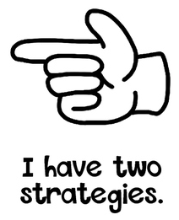

Warm Up Number Talk: Subtract 1 or 2
Give me a signal when you have an
answer and can explain how you got it.
6-1
6 -2
8 -1
8 -2

Slide 3
Warm Up: Synthesis
How are problems 3 and 4 the same?
How are they different?

Slide 4
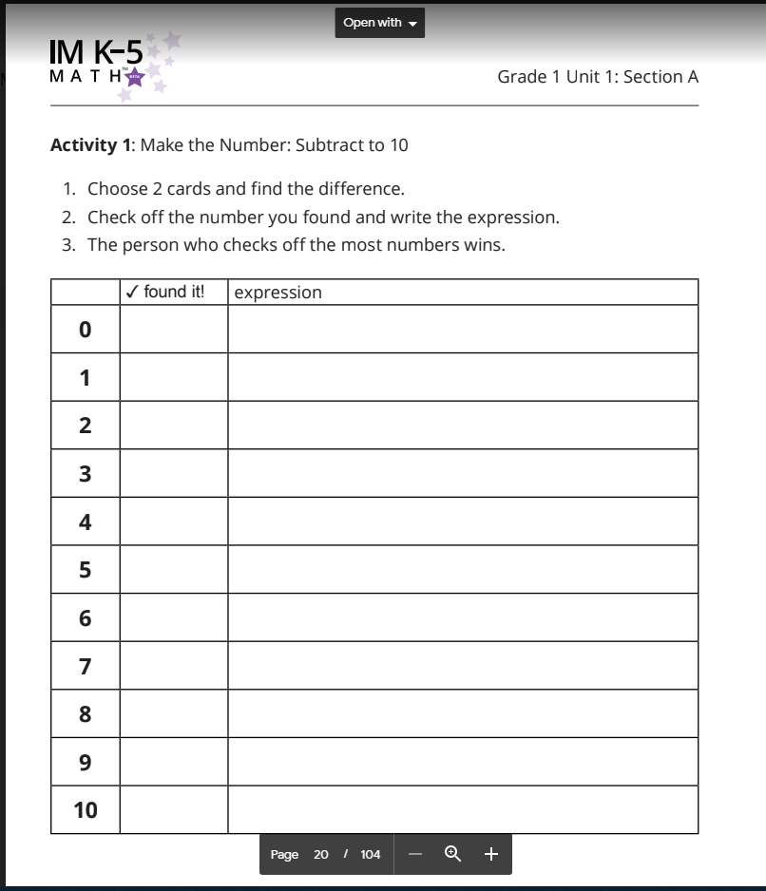
Activity 1:
Make the Number: Subtract to 10
Choose 2 cards and find the difference.
Check off the number you found and write the expression
The person who checks off the most number wins.

Slide 5

Activity 1 Continued: Partner Work Time
We are going to play Make the Number again. In this version we subtract, but first I need to make one pile with numbers 6-10 and one pile with numbers 0-5.
I am going to turn over a card from the bigger number pile. I got (9). Then I will turn over a card from the second pile. I got (3). This is the number I will subtract. The subtraction expression I need to find is the difference of (9-3).
What is the difference?
How do you know?
I record the expression I made on my recording sheet next to the difference and check off the difference. Now it is my partner’s turn.
Take turns picking cards, making a subtraction expression, finding the difference, and showing your partner how you know.
The person who checked off the most numbers when you run out of cards, wins.

Slide 6
Activity 1 Synthesis
Which numbers were you not able to get? Why do you think that is?

Slide 7
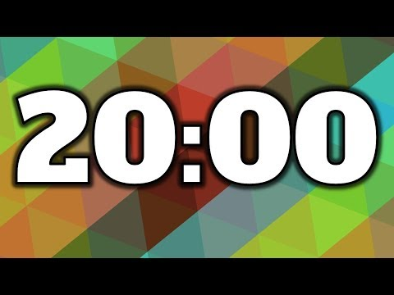
Activity 2: Make the number:Add or Subtract to 10
Choose 2 cards and find the sum or
Difference.
Check off the number you found and write the expression.
The person who checks off the most numbers wins.
We are going to play the same game, but this time, you pick the top 2 cards and decide whether to add or subtract.

Slide 8

Activity 2 Synthesis
What numbers could have been an addition or subtraction expression?

Slide 9

Lesson Synthesis
Math Community!
We are going to make a list of norms for how we do math together. One example of a norm is ‘Listen as others share their ideas.’
What are other norms that we should set for our class?

