Slide 1
More Work with 1 and 2
Materials needed: Number cards 0-10, two-color counters, 10-frames, mathematical community poster

Slide 2


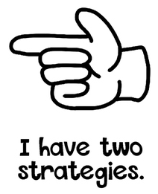

Let’s Learn Our Hand Signals for a Number Talk...

Slide 3

Warm Up Number Talk: Add 1 or 2
Give me a signal when you have an
answer and can explain how you got it.
6 + 1
6 + 2
8 + 1
8 + 2

Slide 4
Warm Up: Synthesis
How are problems 3 and 4 the same?
How are they different?

Slide 5

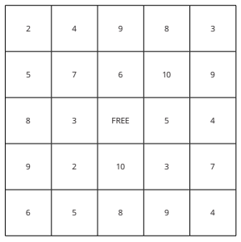
Activity 1 Bingo: Subtract 1 or 2
We are going to play bingo again, but this time instead of adding, we will subtract 1 or 2.
Like in the last lesson, each partner takes turns. One partner flips a card. They subtract 1 or 2 from the number and place their counter on the number
on the bingo board.
When one partner has 5 counters on the board across, up, down, or diagonally, they win.

Slide 6
Activity 1 Continued: Partner Work Time
How did you find the difference?
How did you decide whether to subtract 1 or 2?

Slide 7
Activity 1 Synthesis
How are these strategies the same?
How are they different?

Slide 8
Activity 2: Add or Subtract 1 or 2
Expression
Sum or Difference
Find the sum or difference for each expression.
5 + 1
5 + 2
7 – 1
7 – 2
8 + 1
8 – 1
6 + 2
6 – 2
7 + 1
7 + 2
10 – 1
10 – 2
Share your answers with your partner. If you
disagree, each partner shares their thinking.
Then work together to find the correct
answer.

Slide 9

Activity 2 Synthesis
What patterns did you notice?

Slide 10

Lesson Synthesis
Math Community!
Which of these did you do today?
How did they help you in the class?
Is there anything else we could add to the poster?

