Slide 1
One or Two More!
Materials needed:

Slide 2
Let’s explore adding 1 or 2.

Slide 3
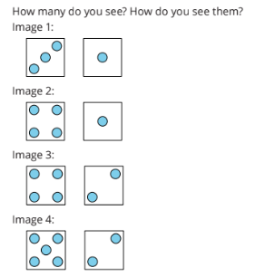

Warm Up: How Many Do You See: More Dots on Cubes
“How many dots do you see? How do you see them?
“Discuss your thinking with your partner.”

Slide 4
Warm Up: Synthesis
How did you know how many dots there are in all?
Did anyone see the dots in the same way but would explain it differently?

Slide 5
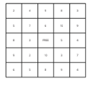
Activity 1 Bingo: Add 1 or 2
I am going to flip one card over.
Now I will decide if I want to add 1 or 2 to the number.
I am going to choose to add 1.
What is my sum? How do you know?
Now, I put my counter on the sum on my bingo board. Now it’s my partners turn.

Slide 6

Activity 1 Continued: Partner Work Time
Now it’s your turn!
Take turns flipping one card over.
Choose adding 1 or 2 to the number
Place your counter on the bingo board

Slide 7
Activity 1 Synthesis
How are these methods the same?
How are these methods different?

Slide 8

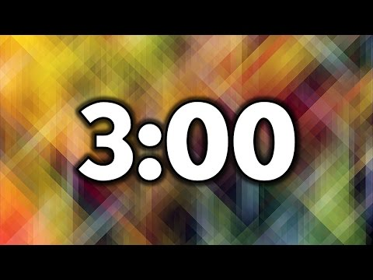
Activity 2: Add it up
Find the sum of each expression- Independent Work Time
Share your answers with your partner.
If you disagree, each partner shares their thinking.
Then work together to find the correct answer.

Slide 9
Activity 2 Synthesis
What do you notice about the sums of all of the expressions?
Did you notice any other patterns when you were solving?

Slide 10
Lesson Synthesis
Let’s look at our Math community poster under “Doing Math”
Which of these did you do today?
How did they help you in class?
Is there anything else we should add to the poster?

